Slide 1


INVESTIGATION OF SIS MULTILAYER FILMS AT HZB
D. Tikhonov, O. Kugeler, S. Keckert, J. Knobloch, E. Chyhyrynets, S. Leith, M. Vogel, C. Pira
9th International Workshop on Thin Films and New Ideas for Pushing the Limits of RF Superconductivity
Presenter
Dmitry Tikhonov
Early stage researcher
Helmholtz-Zentrum Berlin
dmitry.tikhonov@helmholtz-berlin.de
+49-30-8062-12922
EASITrain – European Advanced Superconductivity Innovation and Training. This Marie Sklodowska-Curie Action (MSCA) Innovative Training Networks (ITN) has received funding from the European Union’s H2020 Framework Programme under Grant Agreement no. 764879

Slide 2
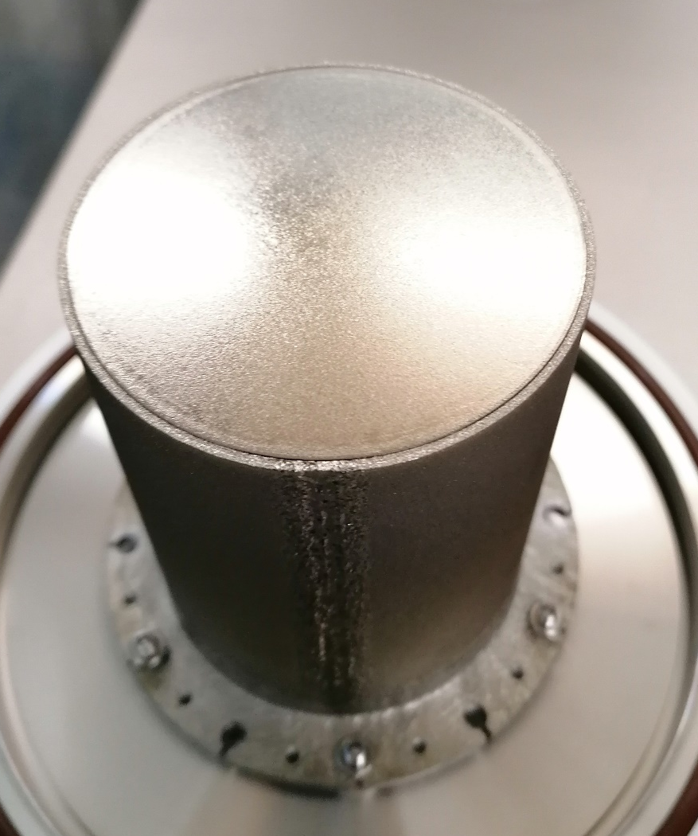
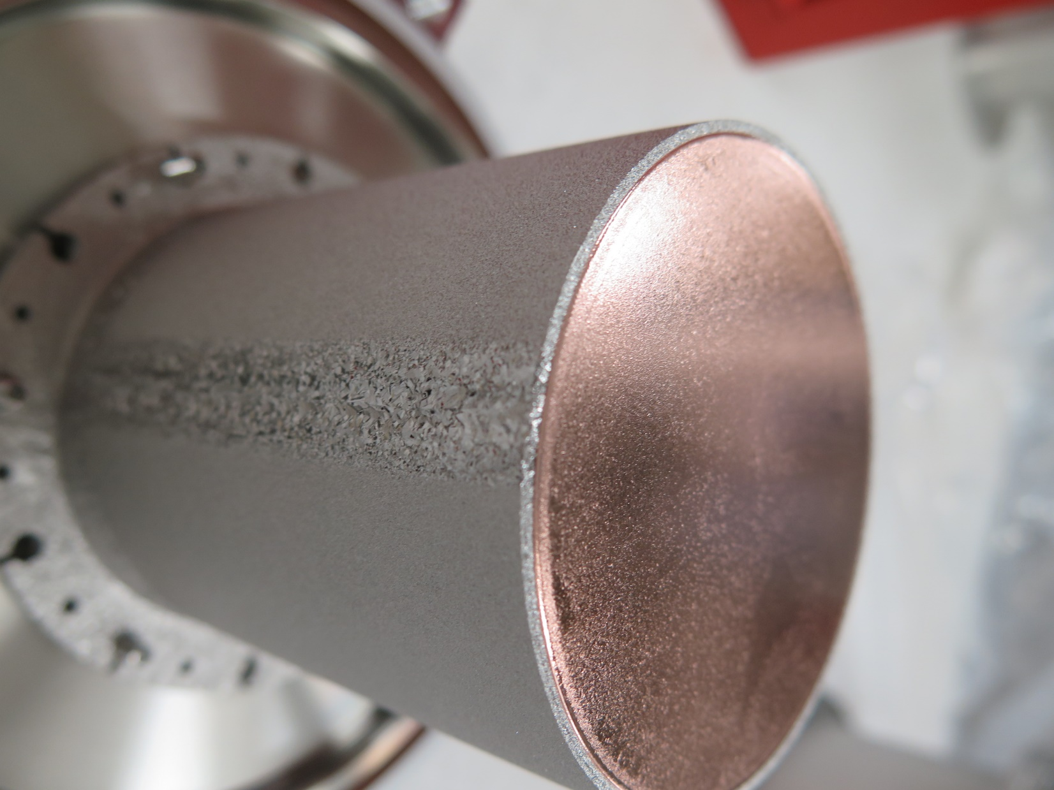
Temperature behaviour of the samples
 | SIS films tested | Structure | Base test? | Produced by
J-Lab SIS [1] | NbTiN – AlN – Nb(bulk) | 75nm – 15 nm – bulk Nb | Yes | J-lab
ARIES 1st SIS | NbN – AlN – Nb(film)/Cu | 197nm – 35 nm – 3 µm Nb | Yes | Siegen
ARIES 2nd SIS | NbN – AlN – Nb(film)/Cu | 180nm – 8 nm – 4 µm Nb | No | Siegen
ARIES 3ed SIS | NbN – AlN – Nb(film)/Cu | 180nm – 24 nm – 4 µm Nb | No | Siegen
4 Multilayer samples tested at HZB
Samples 2 & 3 coated with HiPIMS, substrate is polished by INFN
The manufacture of the QPR samples received funding from the European Union’s Horizon 2020 Research and Innovation programme under Grant Agreement No 730871
Substrate and the coated sample
[1] S. Keckert, Rf characterization of an s-i-s’ multilayer sample, Proceedings of SRF2019, Dresden, Germany, THFUA1

Slide 3
Coating parameters
 | SIS films tested | Structure | Base test? | Produced by
ARIES 1st SIS | NbN – AlN – Nb(film)/Cu | 200nm – 35 nm – 3 µm Nb | Yes | Siegen
Lab | Process
INFN-LNL | EP 40 min
Siegen | 650 deg C annealing
Siegen | 1st layer: Sample coated for 40 mins with DCMS Nb layer and HiPIMS interlayer
HZB | QPR test, Rinsed with UP water (18 MOhm), inserted into the QPR, cooldown, tested
HZB | Dismounted from the QPR and disassembled in the local clean area. Stored with room air in the container.
Siegen | Bake out overnight with temperature set at 650 deg C.
Siegen | 2nd and 3^{ed} layers: AlN: DCMS process 600mPa dep pressure, 100% N₂ process gas 1rpm rotation speed 5 mins coating @ 7 nm/min dep rate = 35 180°C substr. Temp NbN: DCMS process 1400mPa deposition pressure, Ar + 8% N₂ (48sccm) 1rpm rotation speed 29 min coating @ 6.81 nm/min dep rate = 200 nm 290°C substr. Temp

Slide 4
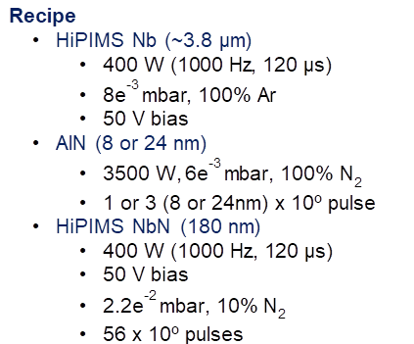
Coating parameters
 | SIS films tested | Structure | Base test? | Produced by
ARIES 2nd SIS | NbN – AlN – Nb(film)/Cu | 180nm – 8 nm – 4 µm Nb | No | Siegen
ARIES 3ed SIS | NbN – AlN – Nb(film)/Cu | 180nm – 24 nm – 4 µm Nb | No | Siegen
INFN | EP
USi | ARIES 2nd SIS, Coated in one run: 1. HiPIMS Nb (4mu) 2. AlN (8nm) 3. HiPIMS NbN (180nm)
HZB | QPR test, Cleanroom inspection, rinsing with u.p. water (>18 MOhm), drying 48h in ISO 5 Clean room.
INFN | Stripping
INFN | Fast EP, No black dots, pitting (obviously not removed)
INFN | Passivation, HPR, packaging.
USi | ARIES 3ed SIS, Coated in one run: 1. HiPIMS Nb (4mu) 2. AlN (23/24nm) 3. HiPIMS NbN (180nm)

Slide 5
Temperature behaviour of the samples
 | SIS films tested | Structure | Base test? | Produced by
J-Lab SIS | NbTiN – AlN – Nb(bulk) | 75nm – 15 nm – bulk Nb | Yes | J-lab
ARIES 1st SIS | NbN – AlN – Nb(film)/Cu | 197nm – 35 nm – 3 µm Nb | Yes | Siegen
ARIES 2nd SIS | NbN – AlN – Nb(film)/Cu | 180nm – 8 nm – 4 µm Nb | No | Siegen
ARIES 3ed SIS | NbN – AlN – Nb(film)/Cu | 180nm – 24 nm – 4 µm Nb | No | Siegen
Non-monotonic temperature dependence is observed at different temperatures
On 1st ARIES sample the effect is lower, but still resolvable
Measurement results for Q1 ~ 415 MHz

Slide 6
Temperature behaviour of the samples
 | SIS films tested | Structure | Base test? | Produced by
J-Lab SIS | NbTiN – AlN – Nb(bulk) | 75nm – 15 nm – bulk Nb | Yes | J-lab
ARIES 1st SIS | NbN – AlN – Nb(film)/Cu | 197nm – 35 nm – 3 µm Nb | Yes | Siegen
ARIES 2nd SIS | NbN – AlN – Nb(film)/Cu | 180nm – 8 nm – 4 µm Nb | No | Siegen
ARIES 3ed SIS | NbN – AlN – Nb(film)/Cu | 180nm – 24 nm – 4 µm Nb | No | Siegen
Non-monotonic temperature dependence is observed at different temperatures
On 2nd sample the effect is lower, but still resolvable
Sample with 8 nm insulator was produced to try to shift the peak, nothing observed
Measurement results for Q1 ~ 415 MHz

Slide 7
Temperature behaviour of the samples
 | SIS films tested | Structure | Base test? | Produced by
J-Lab SIS | NbTiN – AlN – Nb(bulk) | 75nm – 15 nm – bulk Nb | Yes | J-lab
ARIES 1st SIS | NbN – AlN – Nb(film)/Cu | 197nm – 35 nm – 3 µm Nb | Yes | Siegen
ARIES 2nd SIS | NbN – AlN – Nb(film)/Cu | 180nm – 8 nm – 4 µm Nb | No | Siegen
ARIES 3ed SIS | NbN – AlN – Nb(film)/Cu | 180nm – 24 nm – 4 µm Nb | No | Siegen
Measurement results for Q1 ~ 415 MHz
Non-monotonic temperature dependence is observed at different temperatures
On 2nd sample the effect is lower, but still resolvable
Sample with 8 nm insulator was produced to try to shift the peak, nothing observed
Another coating also shows no result

Slide 8
Temperature behaviour of: ARIES 1st sis
 | SIS films tested | Structure | Base test? | Produced by
ARIES 1st SIS | NbN – AlN – Nb(film)/Cu | 197nm – 35 nm – 3 µm Nb | Yes | Siegen
High residual resistance
Non-monotonic dependence is observed at low field
At higher field it changes to a monotonic “plateau”

Slide 9
Temperature behaviour of: ARIES 1st sis
 | SIS films tested | Structure | Base test? | Produced by
ARIES 1st SIS | NbN – AlN – Nb(film)/Cu | 200nm – 35 nm – 3 µm Nb | Yes | Siegen
3d reconstruction of Rs at Q1 ~415 MHz

Slide 10
Temperature behaviour of: ARIES 1st sis
 | SIS films tested | Structure | Base test? | Produced by
J-Lab SIS | NbTiN – AlN – Nb(bulk) | 75nm – 15 nm – bulk Nb | Yes | J-lab
ARIES 1st SIS | NbN – AlN – Nb(film)/Cu | 197nm – 35 nm – 3 µm Nb | Yes | Siegen
Measurement results for: Q1 ~ 415 MHz and Q2 ~850 MHz, B 10 mT
At 415 MHz Rres is increased also ‘BCS’ is bigger for SIS structure then baseline
Nothing is observed for 2nd mode Q2 ~850 MHz

Slide 11
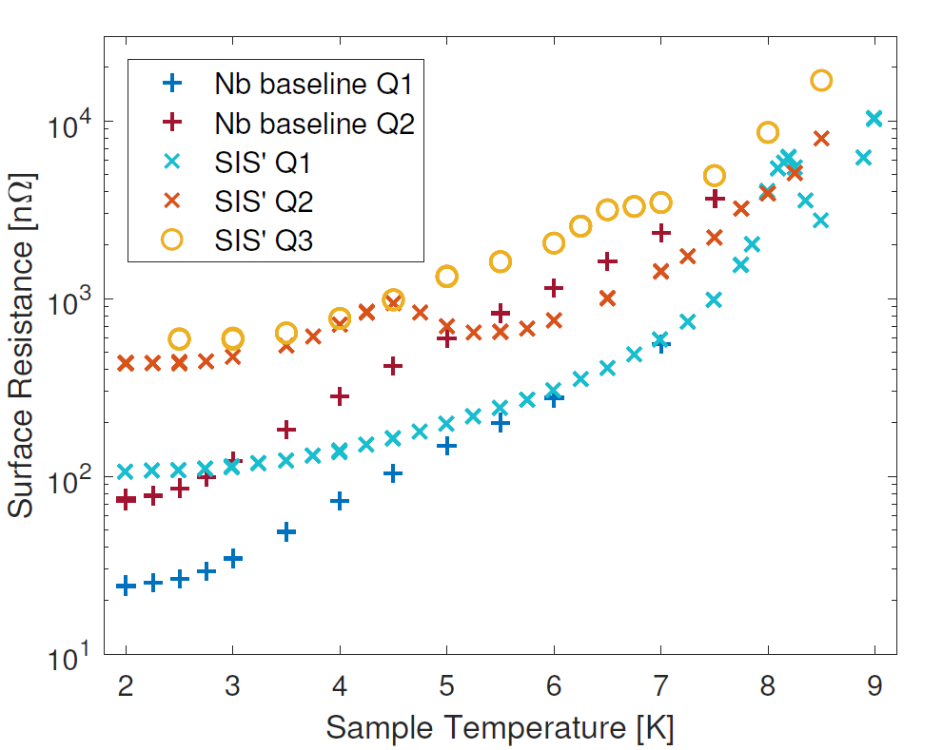
Temperature behaviour of: ARIES 1st sis
 | SIS films tested | Structure | Base test? | Produced by
J-Lab SIS | NbTiN – AlN – Nb(bulk) | 75nm – 15 nm – bulk Nb | Yes | J-lab
ARIES 1st SIS | NbN – AlN – Nb(film)/Cu | 197nm – 35 nm – 3 µm Nb | Yes | Siegen
Measurement results for: Q1 ~ 415 MHz and Q2 ~850 MHz, B 10 mT
At 415 MHz Rres is increased also ‘BCS’ is bigger for SIS structure then baseline
Nothing is observed for 2nd mode Q2 ~850 MHz
For J-lab SIS the peak shifted for second mode
[1] S. Keckert, Rf characterization of an s-i-s’ multilayer sample, Proceedings of SRF2019, Dresden, Germany, THFUA1

Slide 12
Temperature behaviour of: ARIES 1st sis
 | SIS films tested | Structure | Base test? | Produced by
ARIES 1st SIS | NbN – AlN – Nb(film)/Cu | 197nm – 35 nm – 3 µm Nb | Yes | Siegen
Interesting results are obtained after 2nd Cooldown of same sample:
Measurement results for Q1 ~ 415 MHz
Pre-conditions
Warmup after 1st test Sample was stored in the cavity under nitrogen/air Test break: 4 month
Peak has shifted
After a shift observed, a VTS thermocycle (>25K) was done to check is peaks are due to trapped flux
Disclaimer: lines added for visual effect, and not a fit; errorbars coming from the thermal behavior of He system/cavity/heater, and come from statistical average

Slide 13
Temperature behaviour of the best samples
 | SIS films tested | Structure | Base test? | Produced by
ARIES 2nd SIS | NbN – AlN – Nb(film)/Cu | 180nm – 8 nm – 4 µm Nb | No | Siegen
ARIES 3ed SIS | NbN – AlN – Nb(film)/Cu | 180nm – 24 nm – 4 µm Nb | No | Siegen
Measurement results for Q1 ~ 415 MHz
Temperature dependent part (BCS) is growing slower then bulk Nb
Sample | Rres
ARIES 2nd SIS | ~45 nOhm
ARIES 3ed SIS | ~127 nOhm
Bulk Nb | ~23 nOhm

Slide 14
Temperature behaviour of the best samples
 | SIS films tested | Structure | Base test? | Produced by
ARIES 2nd SIS | NbN – AlN – Nb(film)/Cu | 180nm – 8 nm – 4 µm Nb | No | Siegen
ARIES 3ed SIS | NbN – AlN – Nb(film)/Cu | 180nm – 24 nm – 4 µm Nb | No | Siegen
Measurement results for Q1 ~ 415 MHz
Temperature dependent part (BCS) is growing slower then bulk Nb, here the data for subtracted ~residual resistance
Sample | Rres
ARIES 2nd SIS | ~45 nOhm
ARIES 3ed SIS | ~127 nOhm
Bulk Nb | ~23 nOhm

Slide 15
Temperature behaviour of the best samples
 | SIS films tested | Structure | Base test? | Produced by
ARIES 2nd SIS | NbN – AlN – Nb(film)/Cu | 180nm – 8 nm – 4 µm Nb | No | Siegen
ARIES 3ed SIS | NbN – AlN – Nb(film)/Cu | 180nm – 24 nm – 4 µm Nb | No | Siegen
Measurement results for Q1 ~ 415 MHz
On the ARIES 2nd SIS we observed quieted low Field dependant Rs growth, comparable to bulk Nb!
On the other hand max field (quench of the film) is stiel low, and there is a room for improvement
Sample | Bmax (2.5K)
ARIES 2nd SIS | 32 mT
ARIES 3ed SIS | 26 mT

Slide 16
Field limit of SIS
 | SIS films tested | Structure | Base test? | Produced by
ARIES 3ed SIS | NbN – AlN – Nb(film)/Cu | 180nm – 24 nm – 4 µm Nb | No | Siegen
Max field converging to >9K

Slide 17
Concl.?
Unusual temperature behavior due to thermal properties of insulator? (exclude?)
Unusual temperature behavior due to Flux trapping
Due to the Film defects (no baseline tests)?
Unusual temperature behavior: No persistence, reproducible dependence
Results: good temp and field dependence, comparable for bulk Nb, except Max field and Residual resistance

Slide 18
THANK YOU!
Conf logo
Presenter
Dmitry Tikhonov
Early stage researcher
Helmholtz-Zentrum Berlin
dmitry.tikhonov@helmholtz-berlin.de
+49-30-8062-12922
D. Tikhonov, Authors
EASITrain – European Advanced Superconductivity Innovation and Training. This Marie Sklodowska-Curie Action (MSCA) Innovative Training Networks (ITN) has received funding from the European Union’s H2020 Framework Programme under Grant Agreement no. 764879

Slide 19
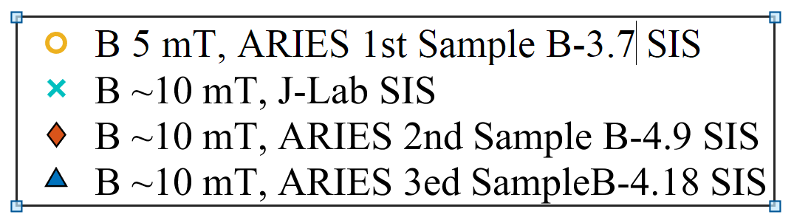
Notes

Slide 20
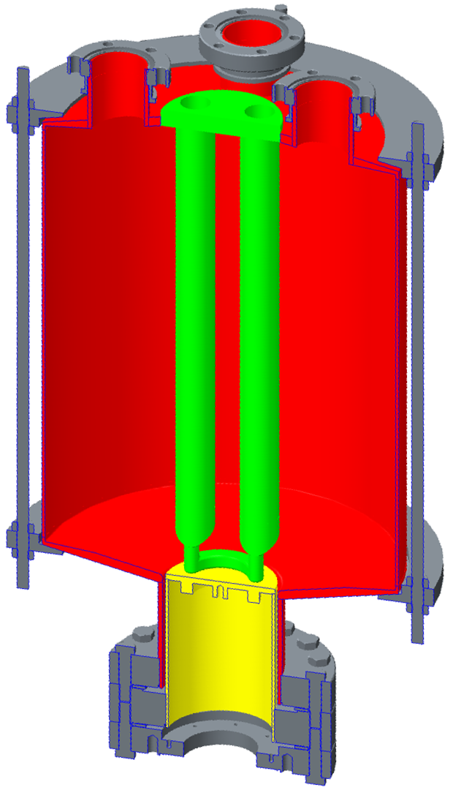
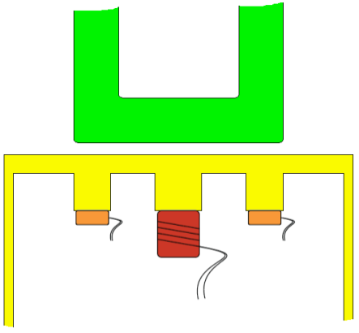
The Quadrupole resonator (QPR)
He
Pumping and
Coupler ports
Cavity (Nb)
Brief overview:
Calorimetric measurement: Surface resistance is calculated from dissipated power
Operating frequencies 414, 847, 1285 MHz
B_{max} on sample up to 120 mT
T on sample from 2 to 20 K
Resolution (limits) < 1 nΩ
Measurements of Magnetic field penetration depth and critical field
4 hollow
rods (Nb)
Pole shoes
Gap ≈ 0.5 mm
Vacuum
~1E-9 mBar
Sample
Coaxial gap
Calorimetry chamber
Vacuum exp. up to
~1E-6 mBar
T-Sensor
Heater

