Slide 1
Using HiPIMS for V3Si Superconducting Thin Films
Presented by
F. Lockwood Estrin
Other authors
J. W. Bradley, A. Hannah, E. Sieler and R. Valizadeh

Slide 2
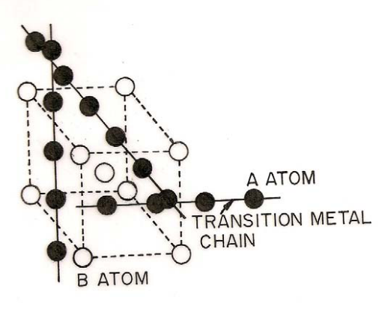


A-15 Superconductors
Nb is the standard for superconductor RF cavities accelerator applications. It is used in both bulk and thin films form. However it has flaws: Low T_{c}, lower operation temperatures, contamination by oxides.
Therefore there has been a push to find new superconductors for use in SCR Cavities.
No pure superconductors are viable and many alloy superconductors have short mean free paths and therefore high BCS-surface resistances.
A-15 Superconductors are one of the few viable candidate materials.
R.G. Sharma, “A Review on A-15 Superconductors
for RF Cavity” International Workshop on:
Thin Films and New Ideas for Pushing the
Limits of RF Superconductivity,
INFN Italy, 2006
1

Slide 3
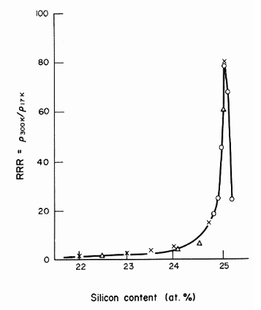
V₃Si
V₃Si was the first A-15 Superconductor to be discovered (1954)
T_{C} = 17.1 ºK
Low normal resistivity ρ_{n} = 4 μΩ cm
H_{c1} = 0.072 T and H_{c2} = 24.5 T
At 25 % concentration V₃Si can have a RRR of around 80.
One of the biggest problems with V₃Si is stoichiometric. The Si content can vary from 10% to 30 %. However, the peak performance only occurs at 25 % concentration.
V. Palmieri, “New Materials for Superconducting Cavities,” Proc. SRF 2001, no. 6, pp. 162–169, 2001
2

Slide 4
Previous attempts to create V₃Si
The Stoichiometry of V₃Si is very dependent on temperature at which the sample is deposited. Ideally samples should be deposited at 800 ºC.
Previous sputtering has used the dual target (two targets facing each other) method, or reactive sputtering (Si gas with a V target).
Unfortunately at this temperature was considered too high for copper substrates. To avoid this, sapphire substrates are post annealing at 800 ºC to re-crystallise the film.
Conclusions
Unable to reach 800 ºC Deposition temp.
Low measured RRR
Difficulty finding proper substate
Thermal diffusion was chosen as the future path
3
Notes:
None are volitial or corrosive

Slide 5
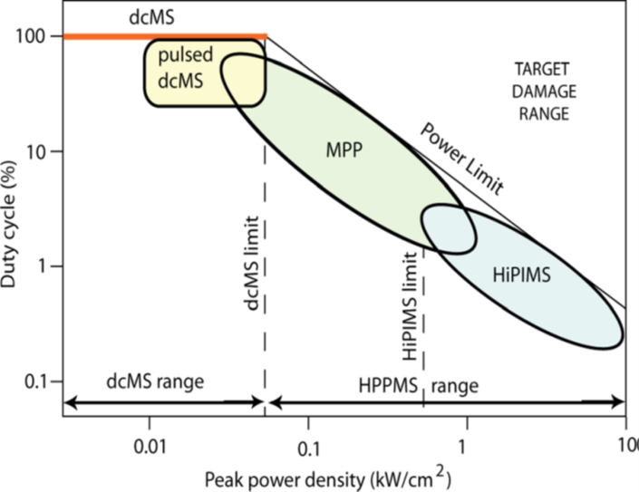
HiPIMS
HiPIMS e.g. high power impulse magnetron sputtering
HiPIMS is a method of magnetron sputtering where the power is applied as a set of discreet high energy pulses at a low duty cycle. Normally around 1% duty cycle but powers of around 1-10 kW.
This high power leads to high levels of ionised sputter flux (up to 80%) reaching the substrate.
This can be used to ion bombard the substrate, a process which can re-crystallise films at a lower temperature than would be required.
J. T. Gudmundsson, et al, “High power impulse magnetron sputtering discharge,” Journal of Vacuum Science & TechnologyA: Vacuum, Surfaces, and Films, 30, (2012), 030801
4
Notes:
Show peak

Slide 6
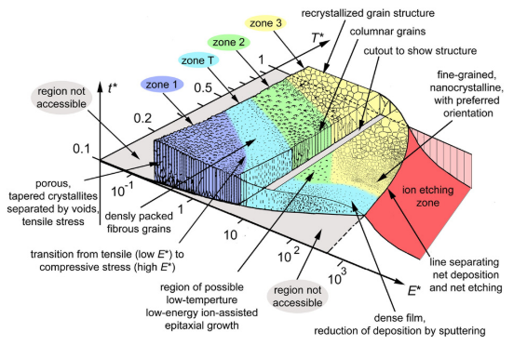
HiPIMS and Ion bombardment
The highly ionised high density HiPIMS discharge is very complicated. Effects like self-sputtering, spokes and rarefaction will effect sputter flux ionisation, composition and energy.
Ion bombardment leads to breaking of the existing crystal structure and ion implantation. This can produce the same effects as increased heating and lead to an increase in film stress.
Ion energy, ion to neutral ratio, and target to gas ratios all have a major effect on the film and can be controlled to some degree by the biasing and HiPIMS pulse.
Sample biasing, synchronised biasing and Bi-polar HiPIMS are all capable of ion bombardment
A. Anders, “A structure zone diagram including plasma-based deposition and ion etching” Thin Solid Films 518 (2010) 4087–4090
5
Notes:
Show peak

Slide 7
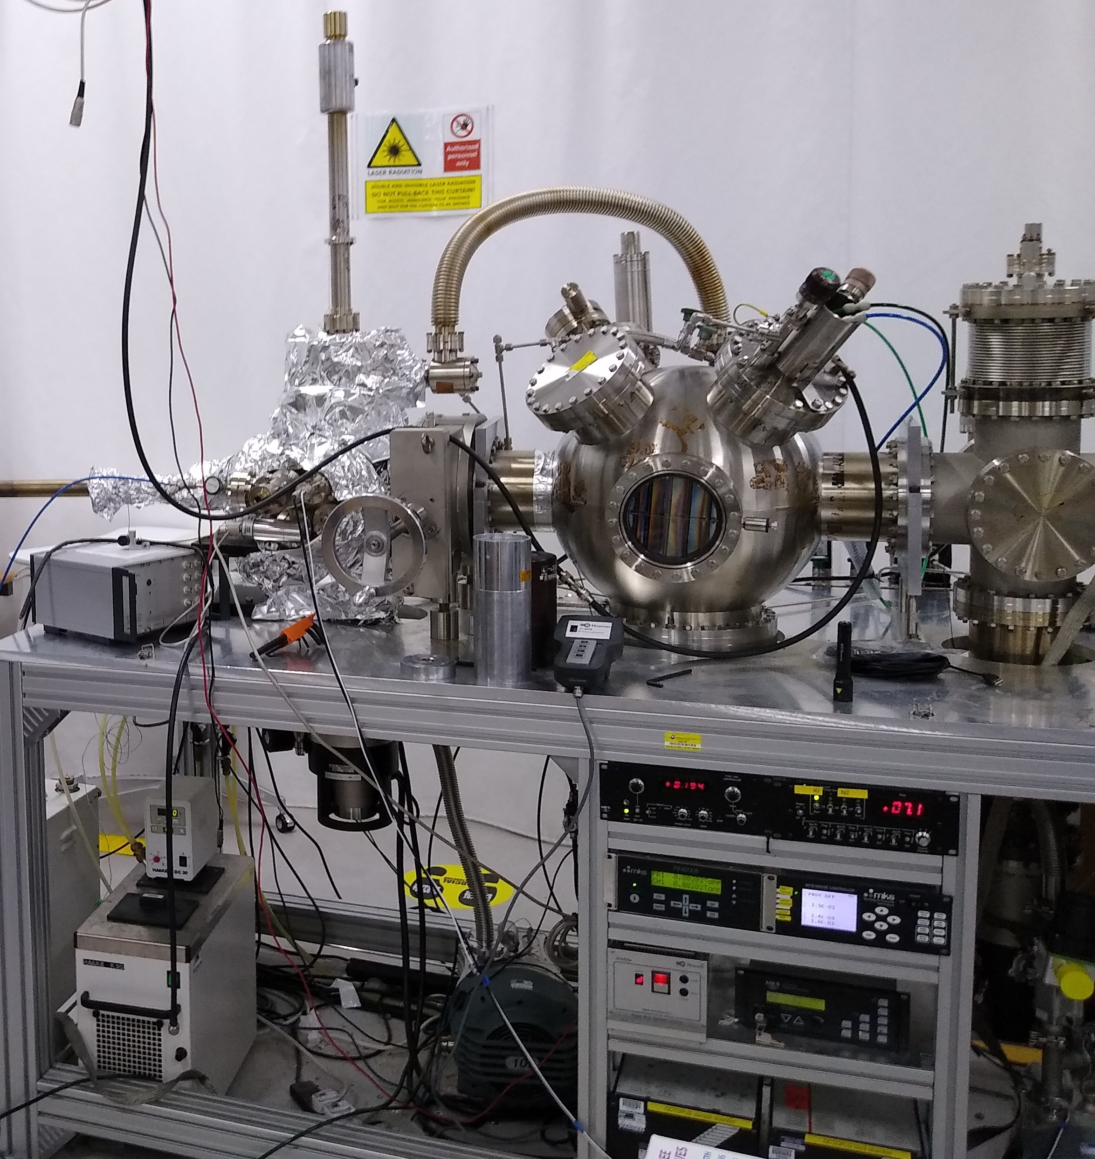
Octopus System’s setup
STCF Octopus
Heated samples at Temperature for room temp to 650 ºC
Single V₃Si Target
Sample biasing or grounding
Background pressure <1x10⁻⁸ mBar
Operating pressure 1.5 - 5 mTorr
Substrates of Copper, Sapphire and Ta.
All of which a potential substrates or multi-layer components.
Power supplies:
Starfire HiPIMS supply
Advanced energy pulsed DC supply
Ionautics HiPIMS supply
Liverpool Homemade HiPIMS Supply
6

Slide 8
Deposition conditions
Date | Supply | Chamber | Temperture | Pressure | Bias | Conditions | Power | Substraite
06/07/2020 | Pulsed DC | Octopus | 650 C | 1.5 mTorr | eathed | 1.1 us 350 kHz pulse | 299 W | Cu, Sapphire, Ta
08/07/2020 | Pulsed DC | Octopus | 550 C | 1.5 mTorr | eathed | 1.1 us 350 kHz pulse | 300 W | Cu, Sapphire, Ta
09/07/2020 | Pulsed DC | Octopus | room temp | 2 mTorr | earthed | 1.1 us 350 kHz pulse | 300 W | Cu, Sapphire, Ta
24/07/2020 | Starfire | Octopus | 550 C | 4.5 mTorr | earthed | 150 Hz 100 us pulse length | ~300 W | Cu, Sapphire, Ta
28/07/2020 | Starfire | Octopus | 650 C | 1.95 mtorr | earthed | 150 Hz 100 us pulse length | ~300 W | Cu, Sapphire, Ta
29/07/2020 | Starfire | Octopus | room temp | 1.93 mTorr | earthed | 150 Hz 100 us pulse length | ~300 W | Cu, Sapphire, Ta
13/08/2020 | Starfire | Octopus | 550 C | 1.93 mTorr | 150 V | 150 Hz 100 us pulse length | ~300 W | Cu, Sapphire, Ta
21/08/2020 | Starfire | Octopus | 550 C | 1.9 mTorr | 50 V | 150 Hz 100 us pulse length | ~300 W | Cu, Sapphire, Ta
28/08/2020 | Starfire | Octopus | 650 C | 1.9 mTorr | 150 V | 150 Hz 100 us pulse length | ~300 W | Cu, Sapphire, Ta
02/09/2020 | Ionautics | Octopus | 650 C | 1.94 mTorr | Earthed | 150 Hz 100 us pulse length | ~300 W | Cu, Sapphire, Ta
08/09/2020 | Liverpool Home-made | Octopus | 550 C | 1.94 mTorr | Earthed | 150 Hz 100 us pulse length | ~300 W | Cu, Sapphire, Ta
11/10/2020 | Ionautics | Octopus | 550 C | 1.91 mTorr | Earthed | 150 Hz 100 us pulse length | ~300 W | Cu, Sapphire, Ta
All 2 hour deposition
7

Slide 9
SEM and EDX
An ion milled cross section was subject to SEM to measure thickness.
All samples were deposited on Sapphire using Pulsed DC: 650 ºC is 490 nm, 550 ºC is 550 nm and room temperature is 710 nm.
Given that all the deposition conditions are the same for all samples, this indicates that higher temperature samples are more dense.
This is in line with expectations.
EDX shown on the next slide is typical for all three samples
650 ºC Pulsed DC
Room Temp. Pulsed DC
8
Notes:
Further deification via HiPIMS

Slide 10
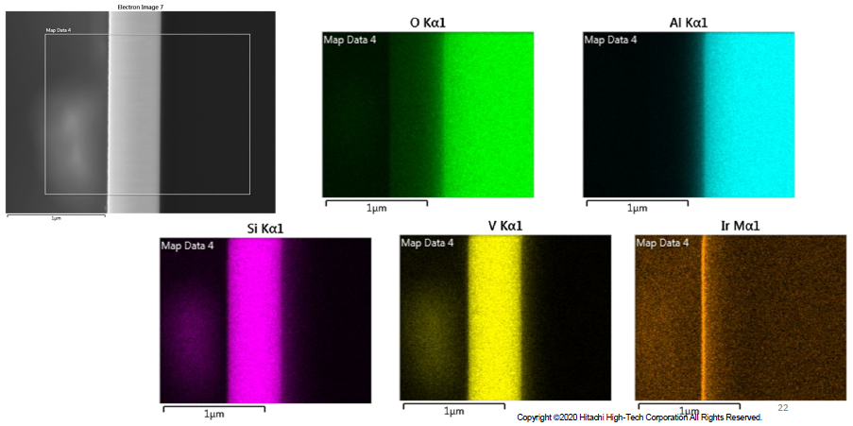
SEM and EDX
9
Notes:
Further densify

Slide 11
Results of Critical temperature measurement
10
Notes:
Bc of this we thought there was a copper contamination

Slide 12
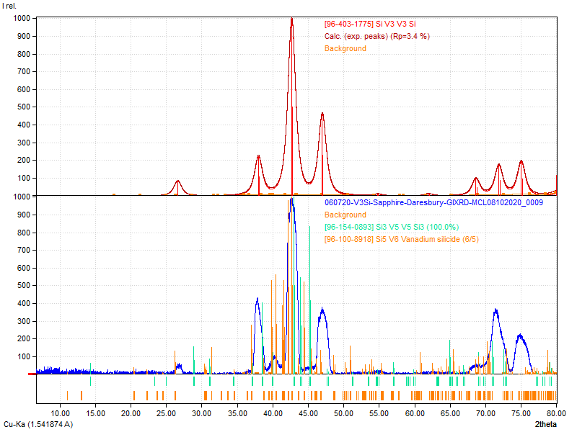
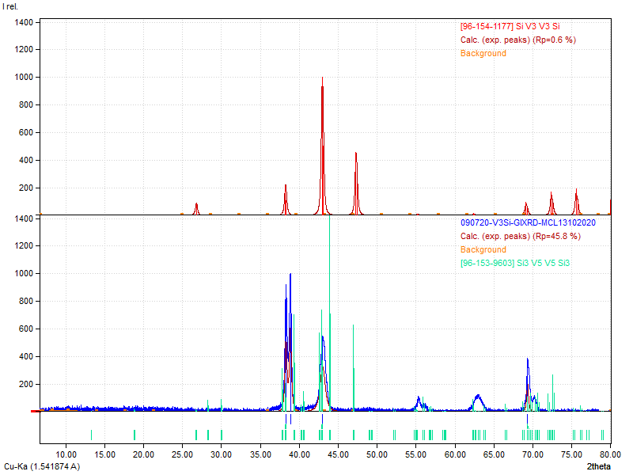
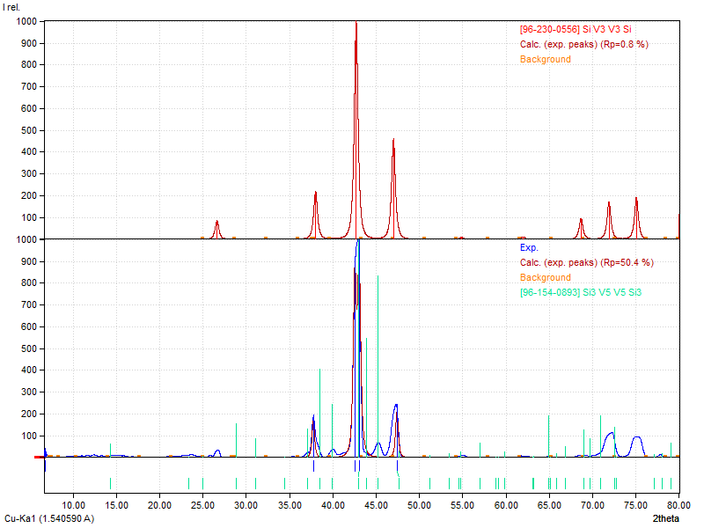
XRD results for DC
Sapphire, 650 ºC, Pulsed DC
Sapphire, Room Temperature, Pulsed DC
Sapphire, 550 ºC, Pulsed DC
11
Notes:
Need to put in peaks
no peaks on copper
Mixture of phase

Slide 13
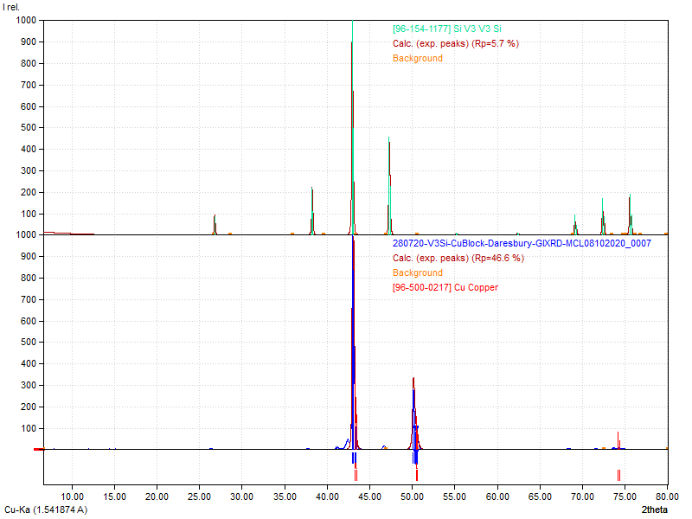
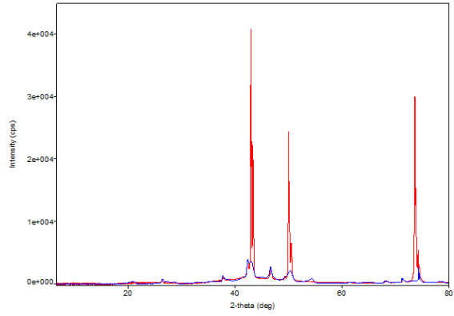
XRD HiPIMS
The XRD of the 650ºC, DC sample showed the V₃Si (2 1 1) and (3 2 0) crystal structure was dominant.
For the other two DC samples structures V₃Si (2 1 1) was present with other structures like V₅ Si₃ (2 0 2) and (2 1 1), as well as unknown elements.
The HiPIMS XRD shows peak close to those predicted for V₃Si, alongside strong copper line. Indicating there the V₃Si films are very thin.
This is inline with the lower HiPIMS deposition rate.
Cu substrate, Starfire HiPIMS, 650 ºC, No bias
Cu substrate, Starfire HiPIMS, 650 ºC, No bias.
Plotted with the DC results
12
Notes:
Include orientation

Slide 14
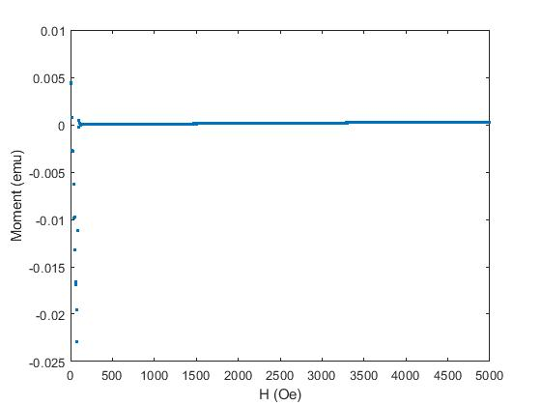
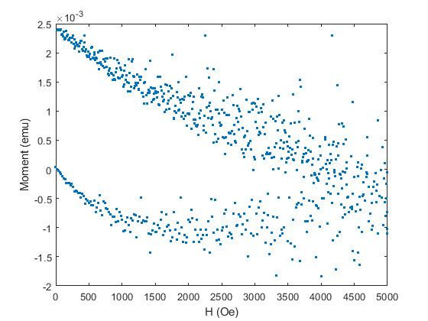
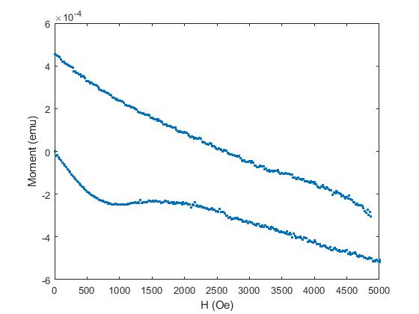

Results of VSM
Vibrating Sample Magnetometer (VSM) is used to measure the critical field of the deposited samples at 4.2 ºK.
Results show that there is almost no superconductivity in the DC sputtered sample deposited on Ta substrate at room temperature.
H_{C1} and H_{C2} can be found for both Cu substrate, Starfire HiPIMS, 550 ºC, No bias and sapphire substrate, Starfire HiPIMS, 650 ºC.
H_{C1} for the Cu sample is around 10 mT and around 25-50 mT for the sapphire sample.
H_{C2} for the Cu sample is around 300 mT
However, the sapphire sample moment never returns to 0 therefore H_{C2} is above the maximum 0.5 T.
Ta substrate, pulsed DC, room-temperature, no bias
Cu substrate, Starfire HiPIMS, 550 ºC, No bias
Sapphire substrate, Starfire HiPIMS, 650 ºC, No bias
13
Notes:
V3si has an expected 24.5 T Hc2
Resitivity is 4 ucm

Slide 15
Deposition conditions
Date | Supply | Chamber | Temperture | Pressure | Bias | Conditions | Power | Substraite
06/07/2020 | Pulsed DC | Octopus | 650 C | 1.5 mTorr | eathed | 1.1 us 350 kHz pulse | 299 W | Cu, Sapphire, Ta
08/07/2020 | Pulsed DC | Octopus | 550 C | 1.5 mTorr | eathed | 1.1 us 350 kHz pulse | 300 W | Cu, Sapphire, Ta
09/07/2020 | Pulsed DC | Octopus | room temp | 2 mTorr | earthed | 1.1 us 350 kHz pulse | 300 W | Cu, Sapphire, Ta
24/07/2020 | Starfire | Octopus | 550 C | 4.5 mTorr | earthed | 150 Hz 100 us pulse length | ~300 W | Cu, Sapphire, Ta
28/07/2020 | Starfire | Octopus | 650 C | 1.95 mtorr | earthed | 150 Hz 100 us pulse length | ~300 W | Cu, Sapphire, Ta
29/07/2020 | Starfire | Octopus | room temp | 1.93 mTorr | earthed | 150 Hz 100 us pulse length | ~300 W | Cu, Sapphire, Ta
13/08/2020 | Starfire | Octopus | 550 C | 1.93 mTorr | 150 V | 150 Hz 100 us pulse length | ~300 W | Cu, Sapphire, Ta
21/08/2020 | Starfire | Octopus | 550 C | 1.9 mTorr | 50 V | 150 Hz 100 us pulse length | ~300 W | Cu, Sapphire, Ta
28/08/2020 | Starfire | Octopus | 650 C | 1.9 mTorr | 150 V | 150 Hz 100 us pulse length | ~300 W | Cu, Sapphire, Ta
02/09/2020 | Ionautics | Octopus | 650 C | 1.94 mTorr | Earthed | 150 Hz 100 us pulse length | ~300 W | Cu, Sapphire, Ta
08/09/2020 | Liverpool Home-made | Octopus | 550 C | 1.94 mTorr | Earthed | 150 Hz 100 us pulse length | ~300 W | Cu, Sapphire, Ta
11/10/2020 | Ionautics | Octopus | 550 C | 1.91 mTorr | Earthed | 150 Hz 100 us pulse length | ~300 W | Cu, Sapphire, Ta
All 2 hour deposition
14

Slide 16
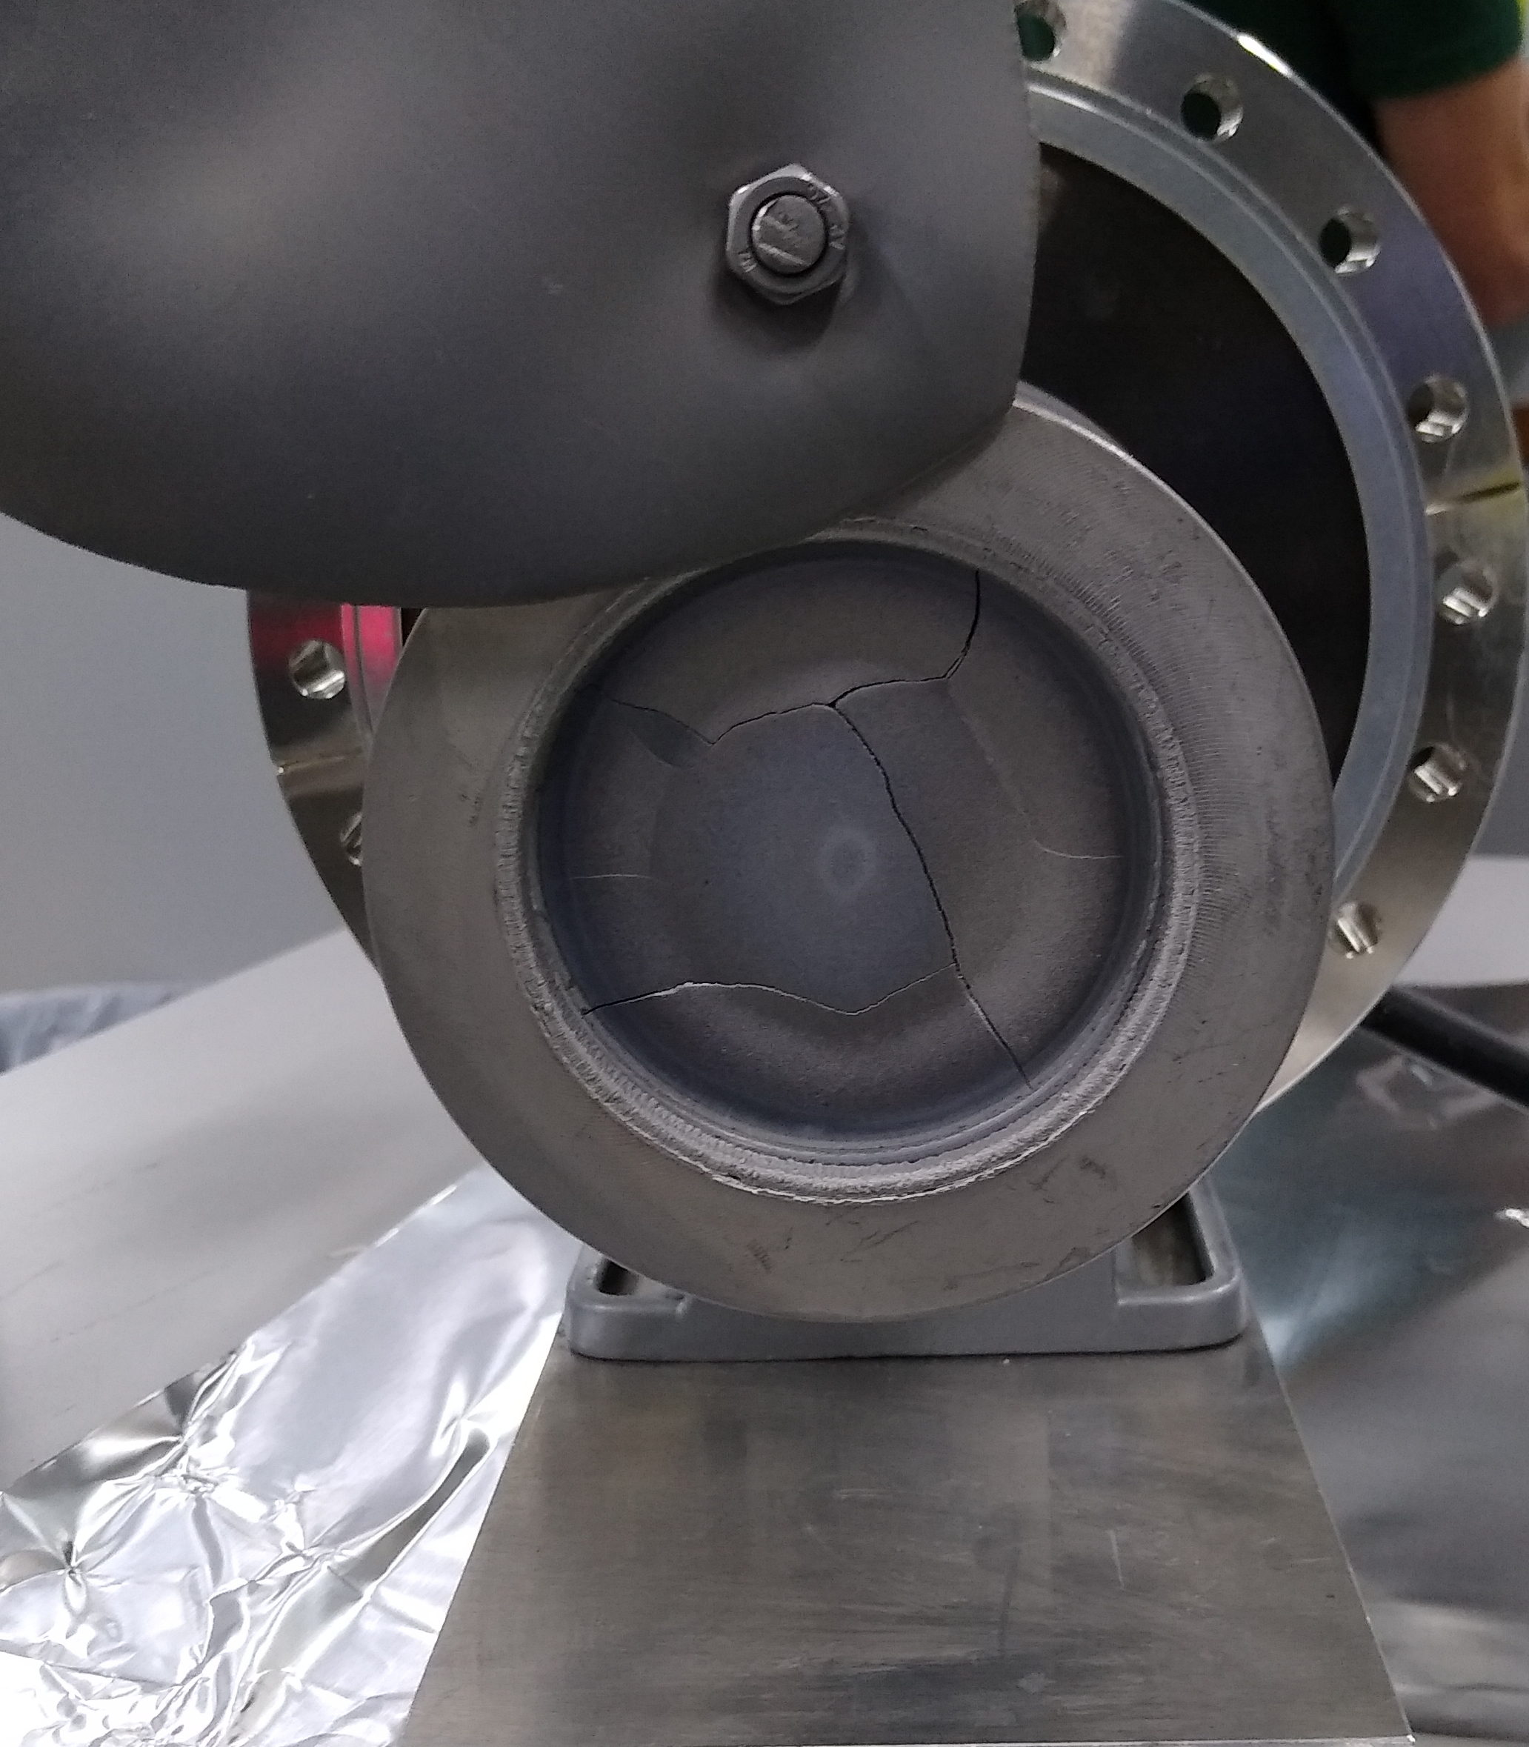
Difficulties
V₃Si Targets are very brittle
we have had difficulty with cracking.
The backing plate is copper and as no copper was detected in the samples it seems effect on the films was minimal.
The DC samples indicate that the deposition temperatures were not sufficient. Higher temperatures are required for good T_{c}.
V₃Si Target
15

Slide 17
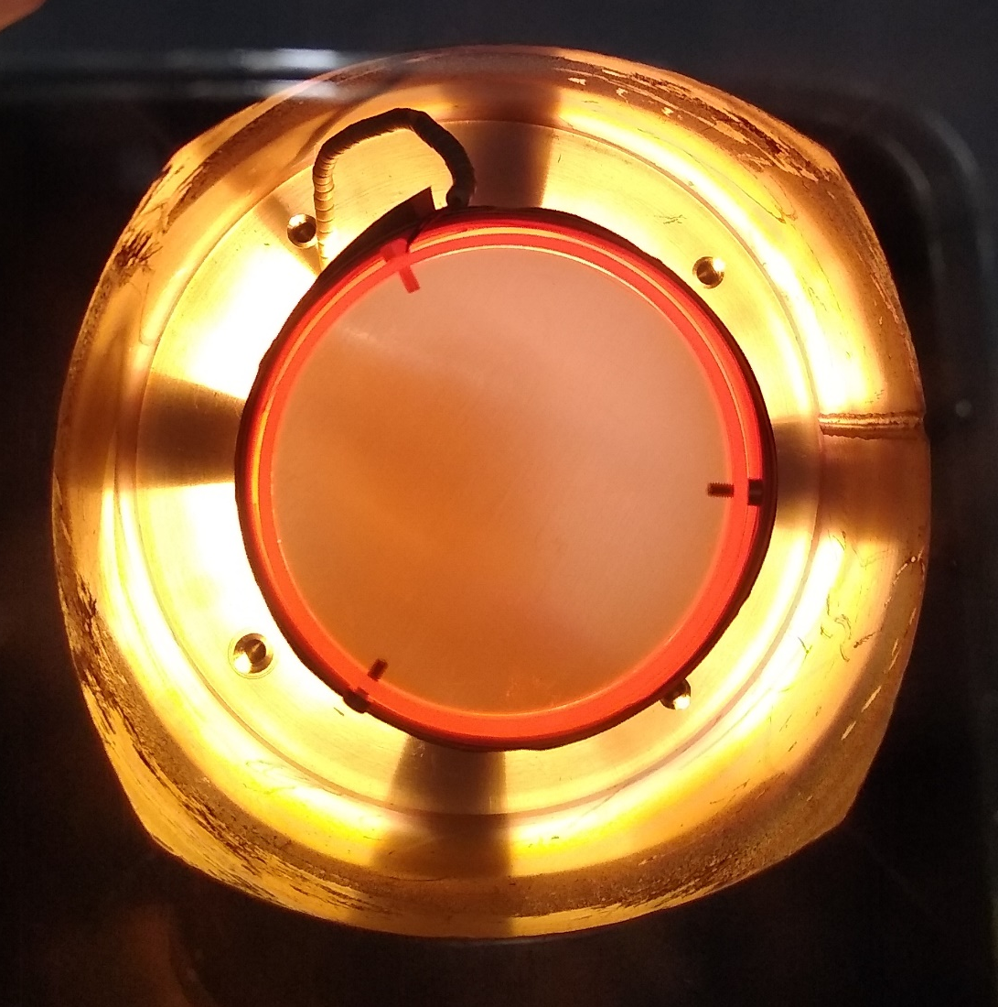
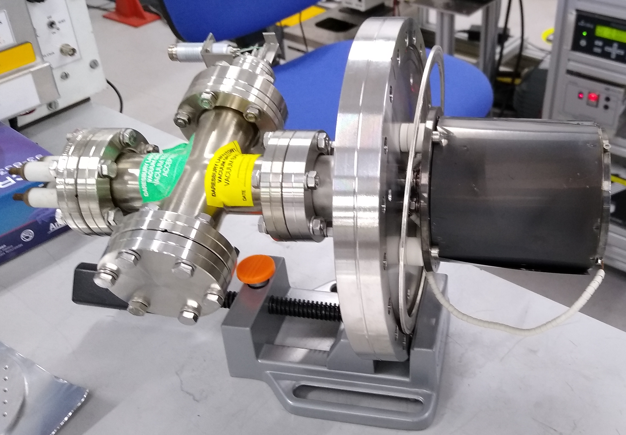
New Heater
After a full set of HiPIMS films were sputtered a new heater was designed and designed to reach higher temperatures.
This new heater is already producing new samples.
There is still an issue with target cracking. However the experience with the previous test indicates this is not a massive problem.
16

Slide 18
Results and future work
We have shown it is possible to produce superconducting V₃Si films in our system.
DC sputtered samples with a T_{c} of up to 10 ºK have been produced.
XRD of DC deposited V₃Si shows broad peak.
XRD of HiPIMS samples shows signs of copper substrate.
VSM also indicates that the HiPIMS samples are super conducting with a good critical field.
Theory indicates that the highest quality samples should be deposited at high heat, with biasing. Such samples have been produced and await analysis.
There is problem with target cracking however the effect seems minimal
Future work will revolve around analysis of all sputtered films and the use of the heater to create V₃si films at higher temperatures.
17
Notes:
Deposit on Ta
Bia-layer of Ta

