Slide 1
DC magnetic field penetration results for Nb thin films with superconducting radiofrequency applications
Daniel Turner
Lancaster University
Daresbury Laboratory
daniel.turner@cockcroft.ac.uk
Notes:
Working title

Slide 2
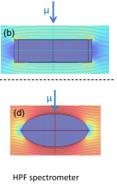
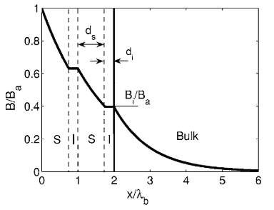
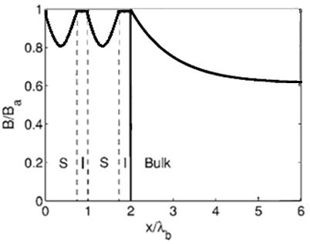
Motivation
Commercial magnetometry
  Field is applied over the whole sample.
  Non-ellipsoidal/spherical samples will experience edge effects by field enhancement.
  Both Vibrating sample magnetometry (VSM) measure the total superconducting volume of the sample.
  Any normal component of the applied field will penetrate through the sample at a lower field.
  The applied field will penetrate through the insulating layers when using multilayer structures such that the screening effect will not be observed.
  If the thin film is comparable to that of the London penetration depth, λ_{L}, H_{c1} is different when the field is applied from both sides of a sample.
Junginger, T., et al. (2018). Physical Review Accelerators and Beams, 21(3), 32002.
Schematic
Gurevich. A , (2006) Appl. Phys. Lett. 88, 012511
Notes:
Should I cite the paper which says less than 0.05 degrees for a thin film in a parallel field?
Tobis paper https://doi.org/10.1103/PhysRevAccelBeams.21.032002 - Junginger, T., Abidi, S. H., Maffett, R. D., Buck, T., Dehn, M. H., Gheidi, S., Kiefl, R., Kolb, P., Storey, D., Thoeng, E., Wasserman, W., & Laxdal, R. E. (2018). Field of first magnetic flux entry and pinning strength of superconductors for rf application measured with muon spin rotation. Physical Review Accelerators and Beams, 21(3), 32002.

Slide 3
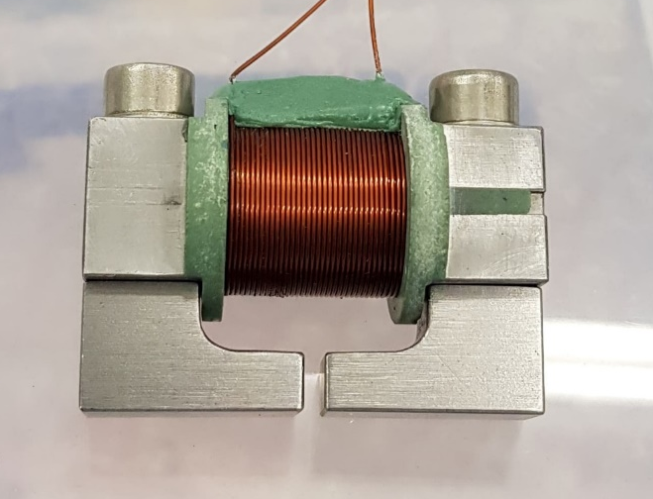
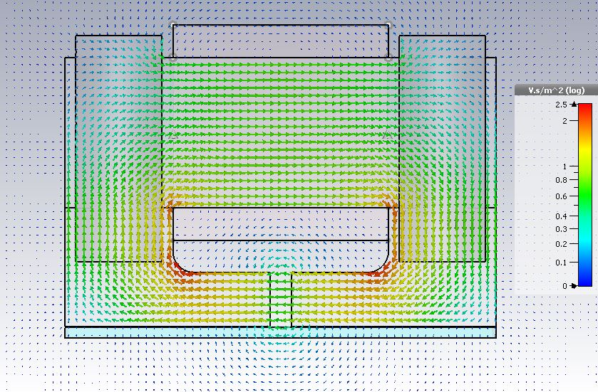
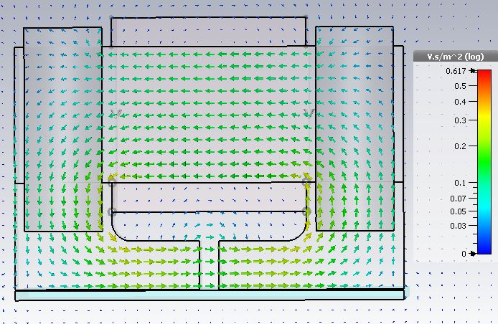
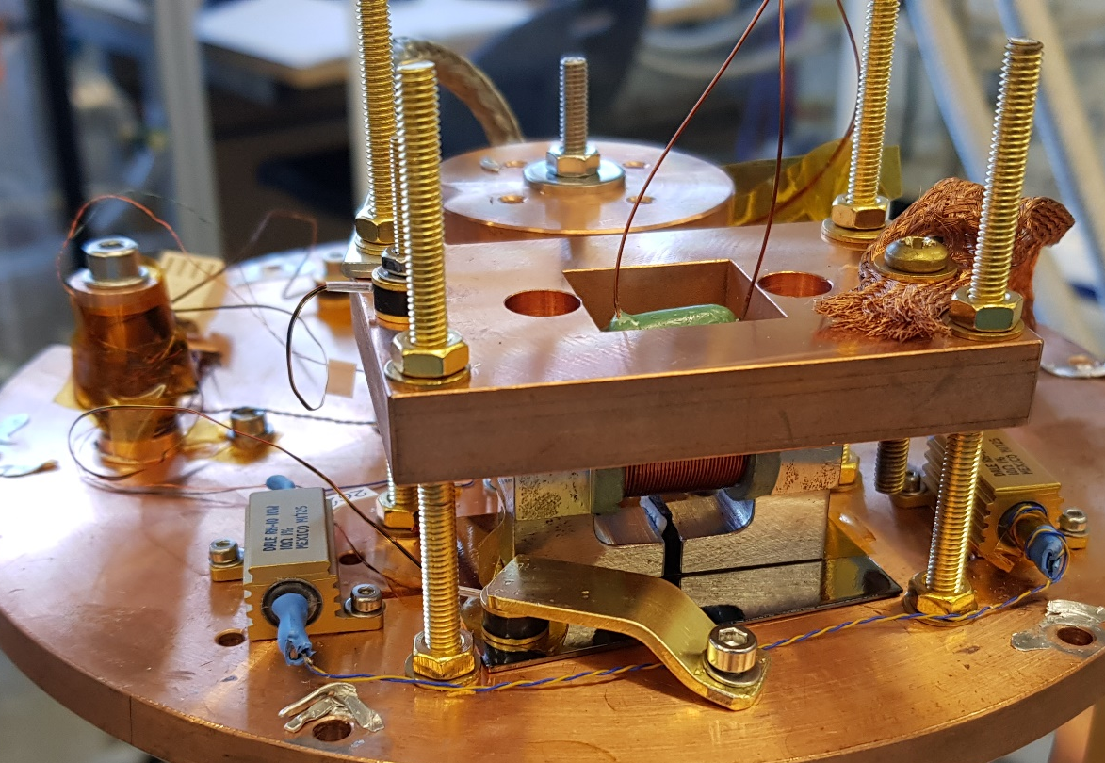
Field penetration experiment at Daresbury
DC magnetic field parallel to the surface applied from one side, similar to SRF cavity. Detection once field has penetrated through the sample.
  Easy alignment
  Field local to the sample surface
  Avoid edge effects.
  Allows the possibility of sample scanning.
40 mm
2mm
HP1
HP2
Applied and penetrated field measured by Hall probe sensors
Sample
Thermometer
Kapton
Sample
3

Slide 4
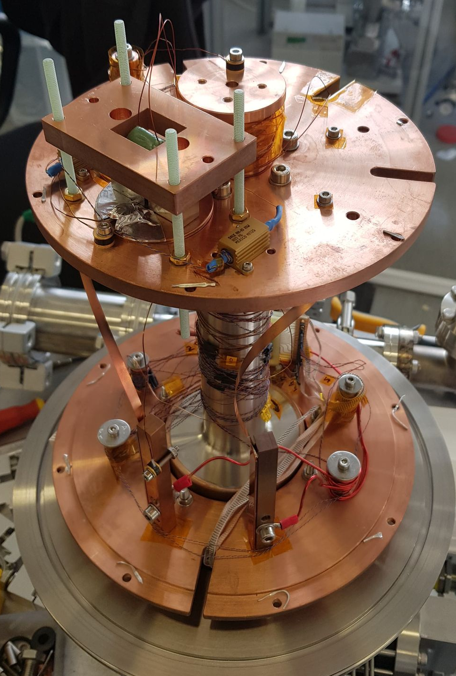
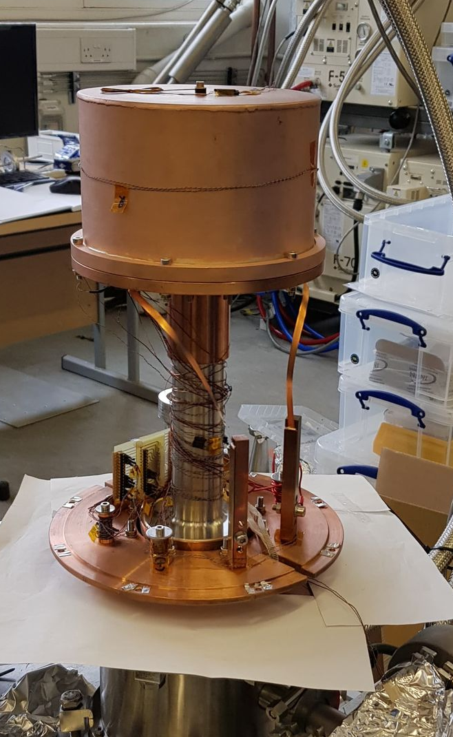
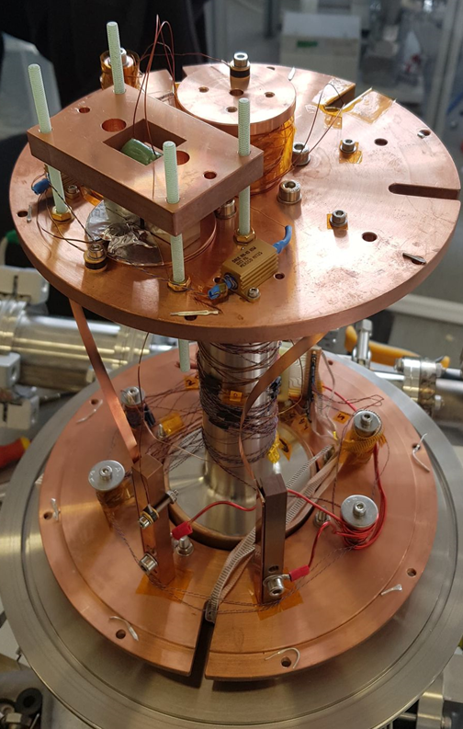
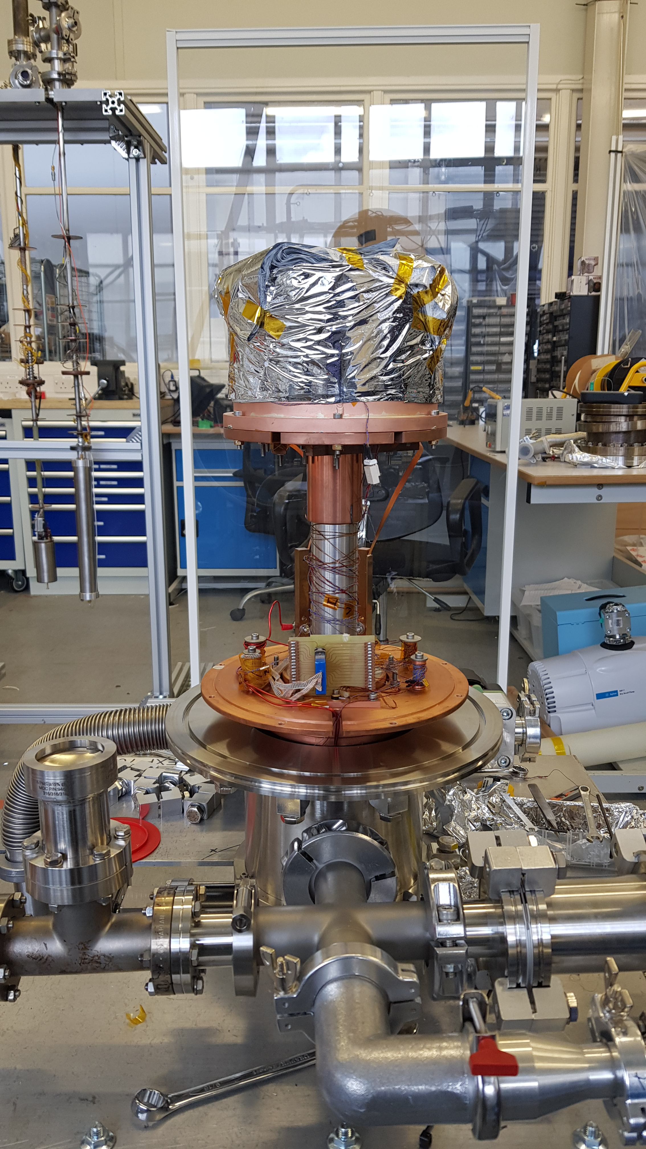
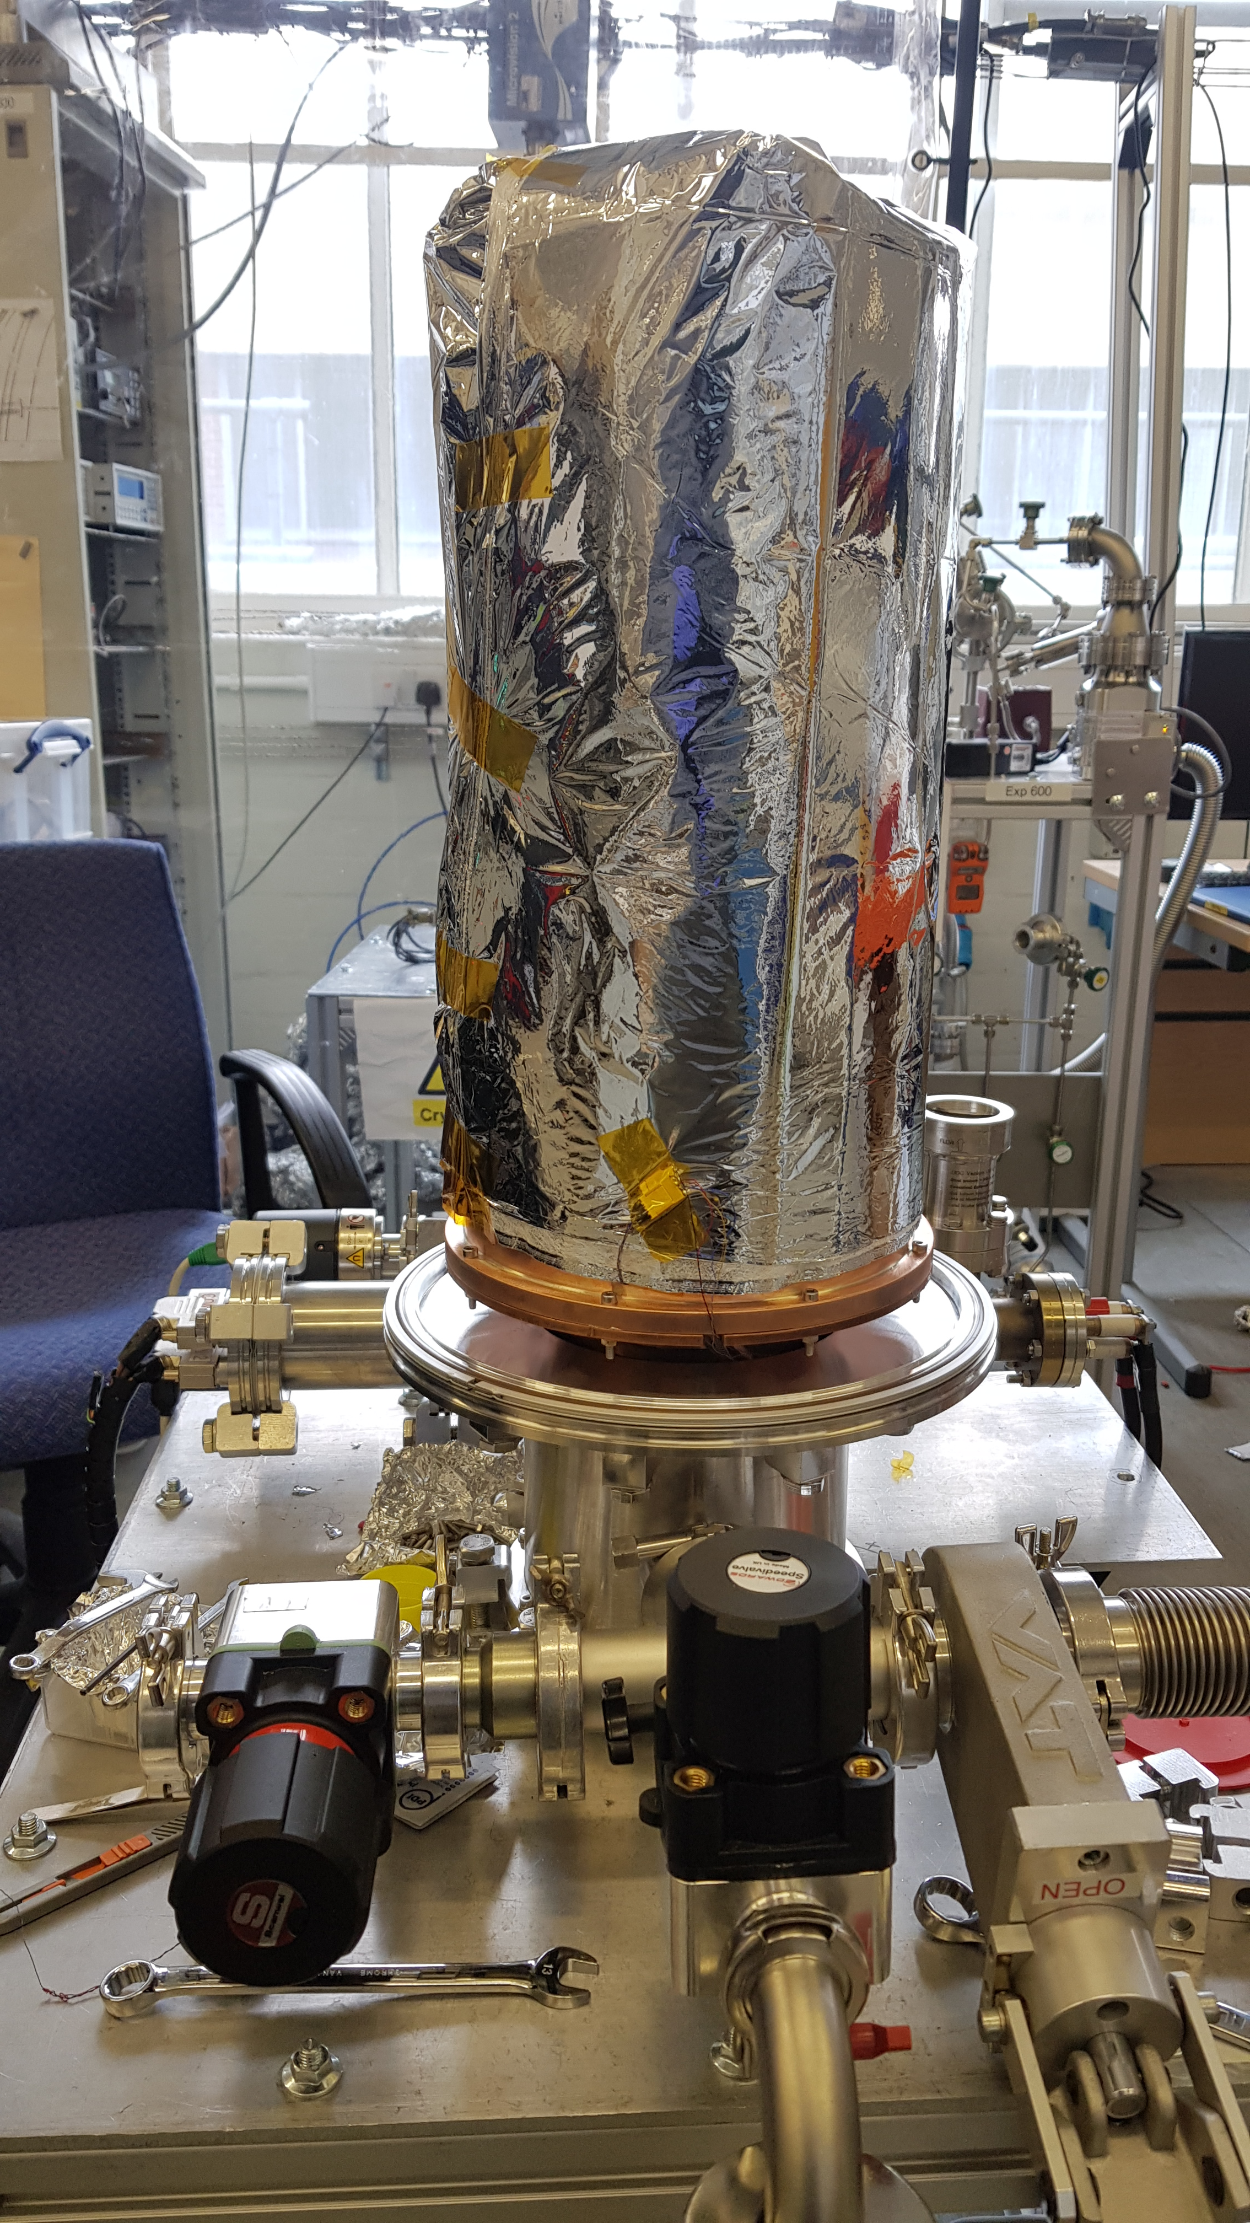
Facility
Sample stage is mounted directly onto the cold head, with 2 thermal radiation shields to reduce the heat load.
Minimum temperature of the sample is 2.6 K.
Turn around:
  2 Hours to change sample – Open, close and pump down.
  4 Hours to cool down
  1 day testing – depending on amount of temperature set points.
  8-12 hours warm up.
4
Notes:
Take pictures of each stage with the MLI on the shields and then replace these
Mention min T, How long to change sample, How long to pump down, how long to run test – Fully auto

Slide 5
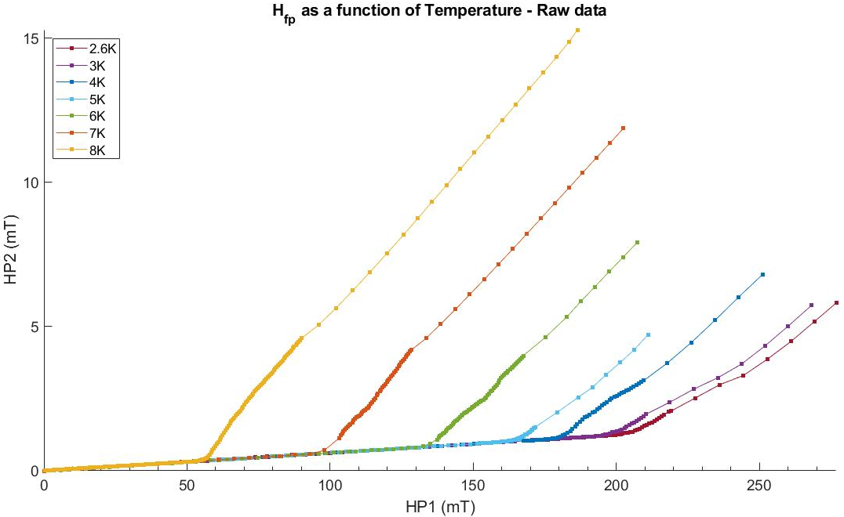
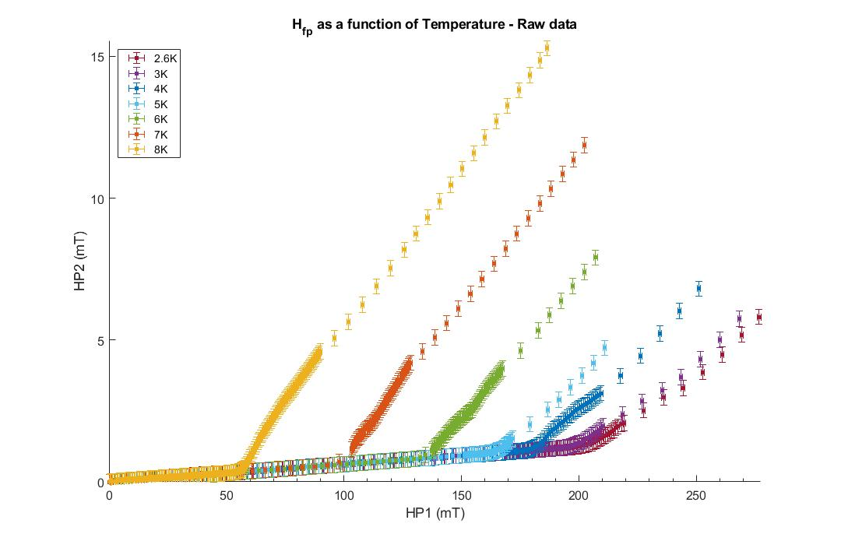
Raw data
The applied field (HP1) is increased, and the penetrated field (HP2) increases linearly with an initially small slope. This linear increase is determined to be leakage around the sample.
Field of full flux penetration (H_{fp}) occurs when there is a sharp linear increase in HP2.
HP1
HP2
Notes:
Mention that it is determined to be leakage as the linear increase changes when the sample changes position

Slide 6
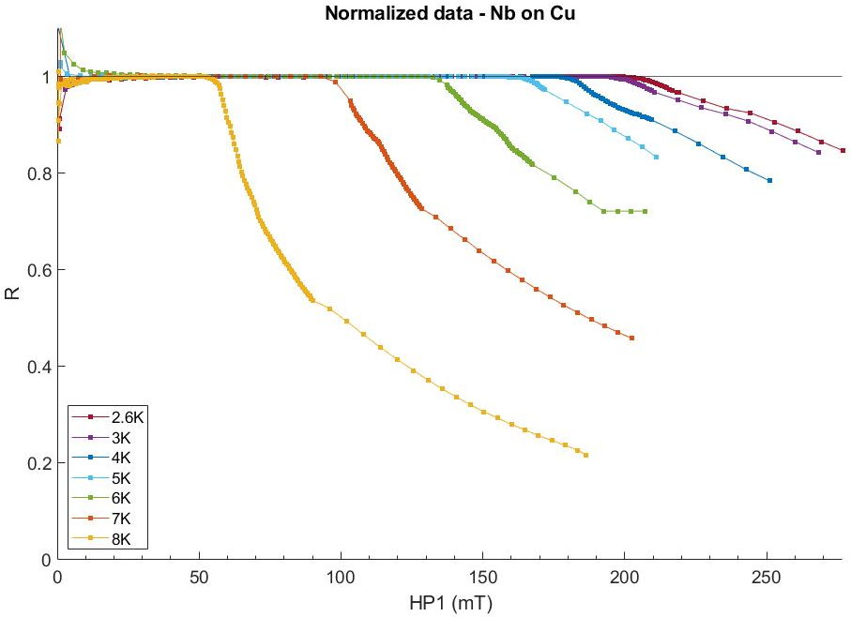
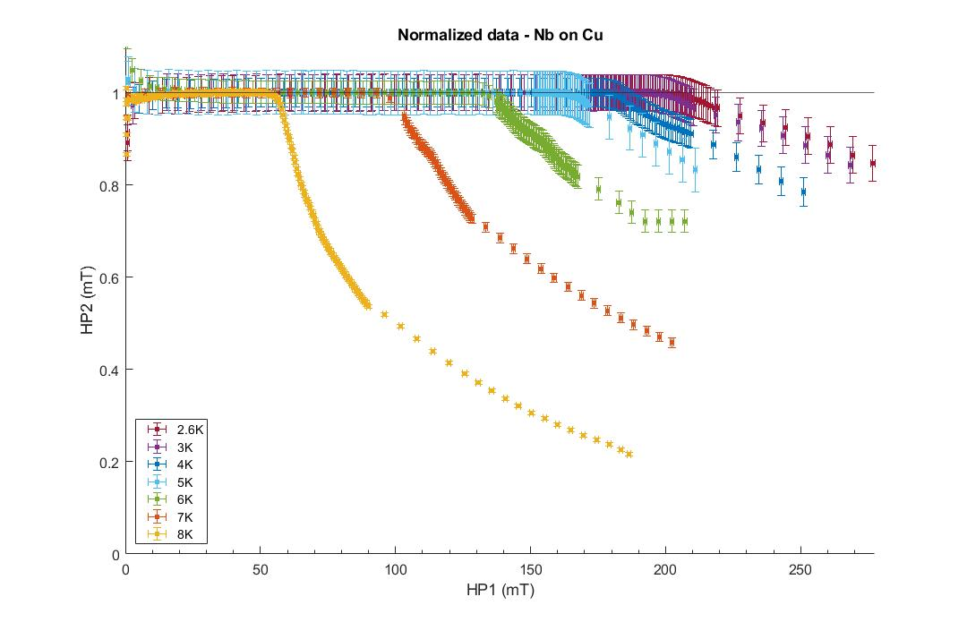
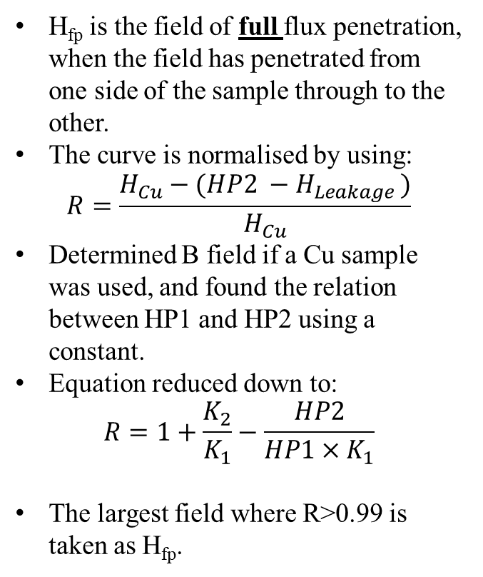
Determining H_{fp}
H_{fp} is the field of full flux penetration, when the field has penetrated from one side of the sample through to the other.
The curve is normalised by using:
$$R=\frac{H_{Cu}−(HP2 −H_{Leakage })}{H_{Cu}}$$
Determined B field if a Cu sample was used, and found the relation between HP1 and HP2 using a constant.
Equation reduced down to:
$$R=1+\frac{K_{2}}{K_{1}}−\frac{HP2}{HP1×K_{1}}$$
The largest field where R>0.99 is taken as H_{fp}.

Slide 7
Effect of Cu substrate polishing on Nb Thin films
7

Slide 8
Substrate treatment
Nb samples have been deposited on Cu at INFN, Siegen and STFC. As part of the ARIES collaboration.
The superconducting substrates have undergone various treatments such as SUBU from both INFN and CERN, tumbling, EP and EP+SUBU.
  SUBU CERN: 40 minutes polishing by SUBU5.
  SUBU INFN: 30 minutes polishing, followed by pre-rinsing, rinsing, drying with N2, followed by another 35 minutes polish before further rinsing and drying.
  Tumbling: in a solution composed by alumina, rinsing, followed by further tumbling using coconut powders as media.
  EP: In a solution composed by Phosphoric Acid (H3PO3 85%) and Buthanol (C4H10O 99%) in a ratio 3:2, at room temperature, without bath agitation.
  EP+SUBU: Electropolishing followed by 5 minutes of SUBU from INFN. (Note, not 2 runs here)
Each of these samples have been tested to determine the effect of each treatment.
Laser polishing: Occurs on the surface of the Nb once already deposited.
SUBU5: sulfamic acid (H3NO3S, 5 g/l), hydrogen peroxide (H2O2, 5% vol), n-butanol (5% vol) and ammonium citrate (1 g/l) at 72°C (70-75°C) with bath agitation, 5 samples in a 10L beaker

Slide 9
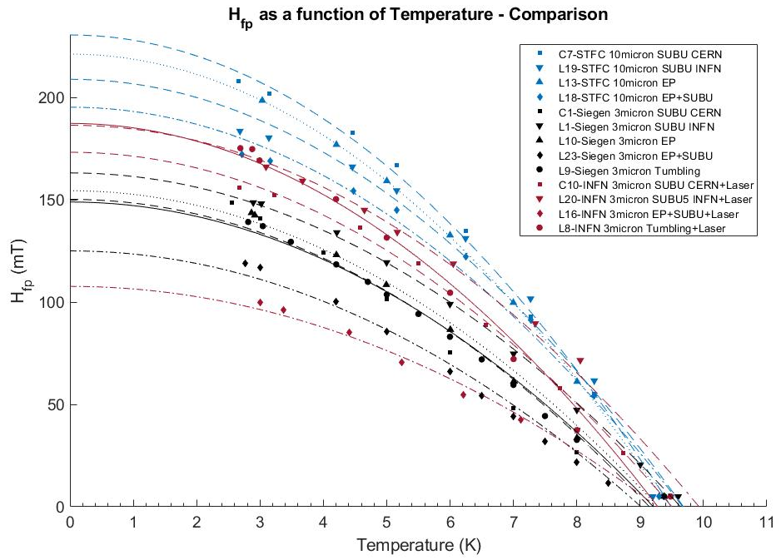




Field of full flux penetration as a function of temperature

Slide 10
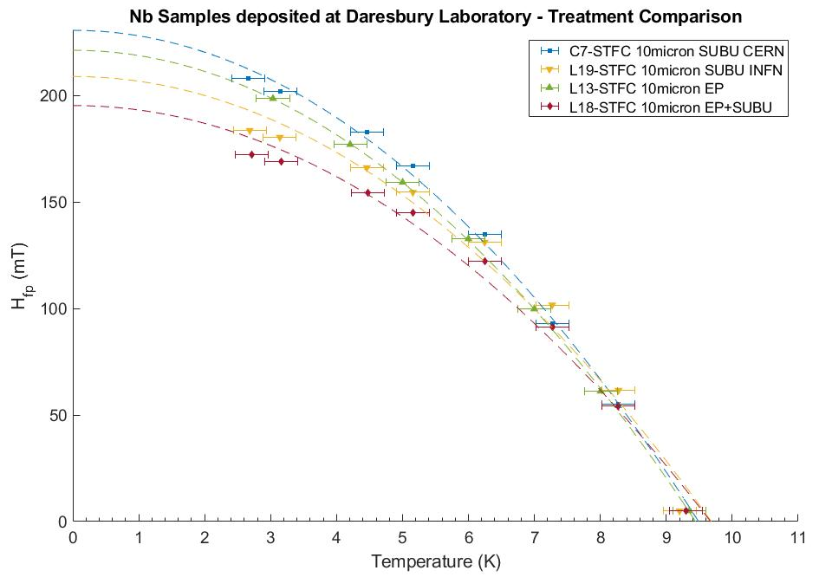

Slide 11
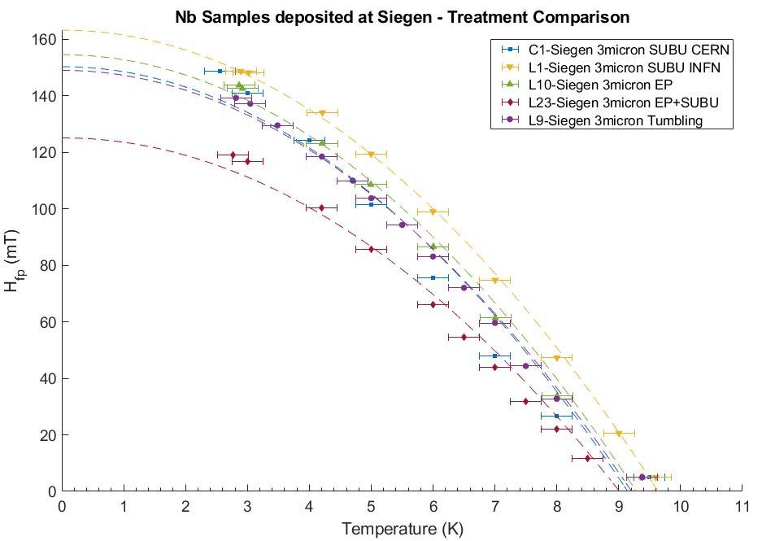

Slide 12
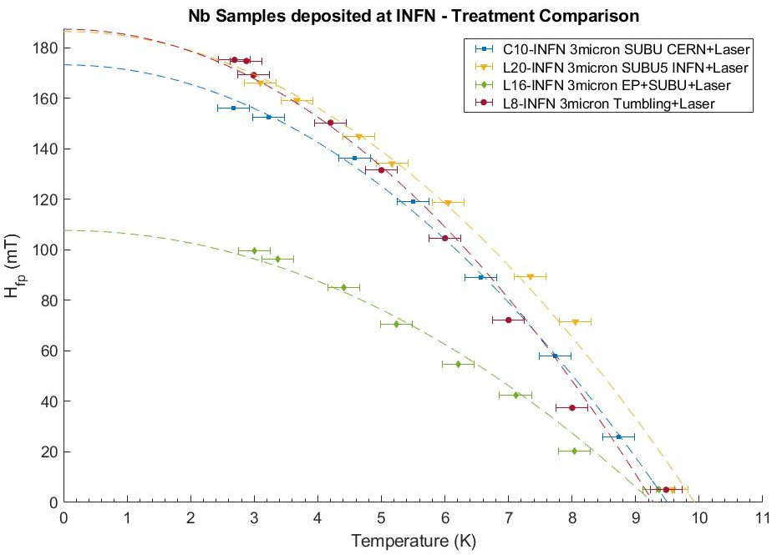
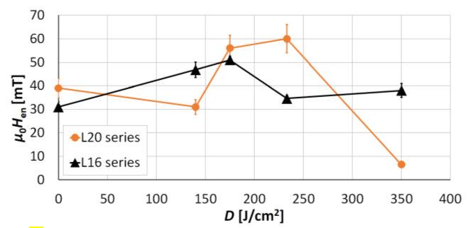
Nb samples post laser polishing
Improvement of Mechanical and Magnetic Properties of Nb/Cu Structure by Laser Radiation for SRF Applications - Arturs Medvids
Tuesday 16th March

Slide 13
Best surface treatment determined by H_{fp}
Highest H_{fp}
Lowest H_{fp}
STFC | Siegen . | INFN with laser treatment
SUBU CERN | SUBU INFN | SUBU INFN
EP | EP
SUBU INFN | SUBU CERN | Tumbling
 | Tumbling | SUBU CERN
EP + SUBU | EP + SUBU | EP + SUBU
Notes:
All of these have been taken using Hfp(0). It can be seen in the next slide that this is not the case at 4.2 K when compared with VSM. Should I compare at 4.2 K here instead?
EP+SUBU is the worst for each institution.

Slide 14
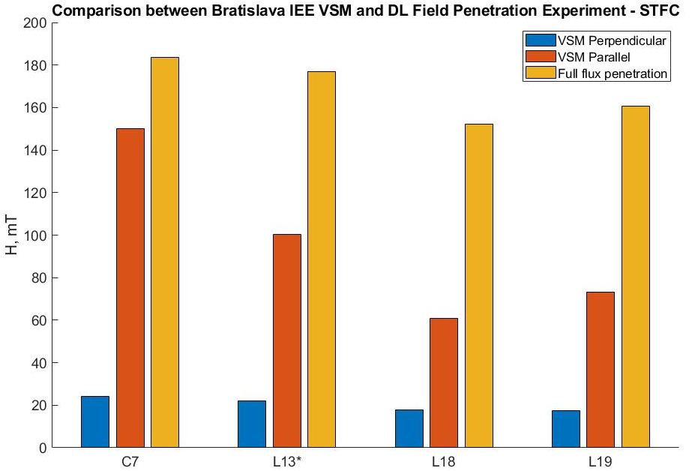

STFC
IEE
STFC
C7 | SUBU CERN
L13 | EP
L18 | EP + SUBU
L19 | SUBU
VSM results courtesy of Eugen Seiler and Rastislav Ries (IEE)
* Measured in the field penetration facility at 4.2 K and not a calculated value
Notes:
Bratislava IEE
Put data in ascending/descending order

Slide 15
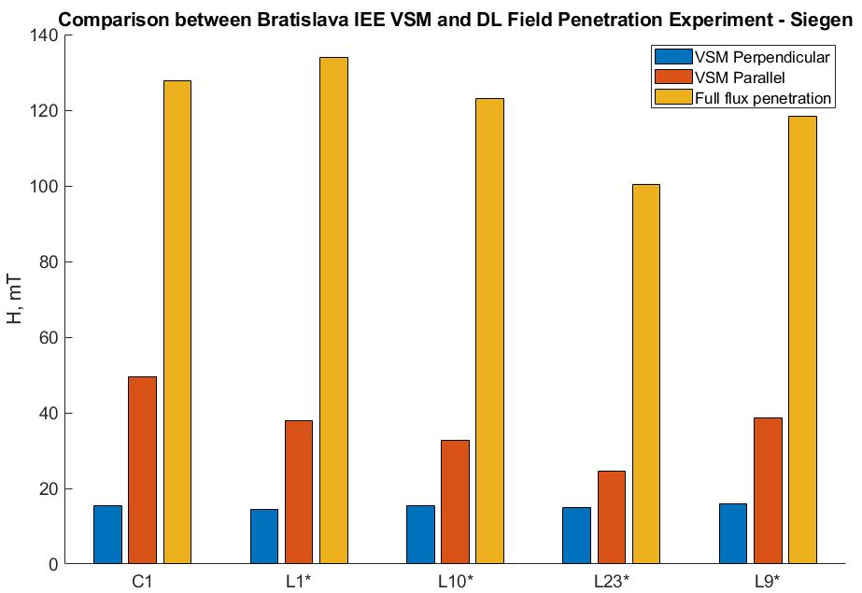
Siegen
IEE
STFC
VSM results courtesy of Eugen Seiler and Rastislav Ries (IEE)
C1 | SUBU CERN
L1 | SUBU INFN
L9 | Tumbling
L10 | EP
L23 | EP + SUBU
* Measured in the field penetration facility at 4.2 K and not a calculated value

Slide 16
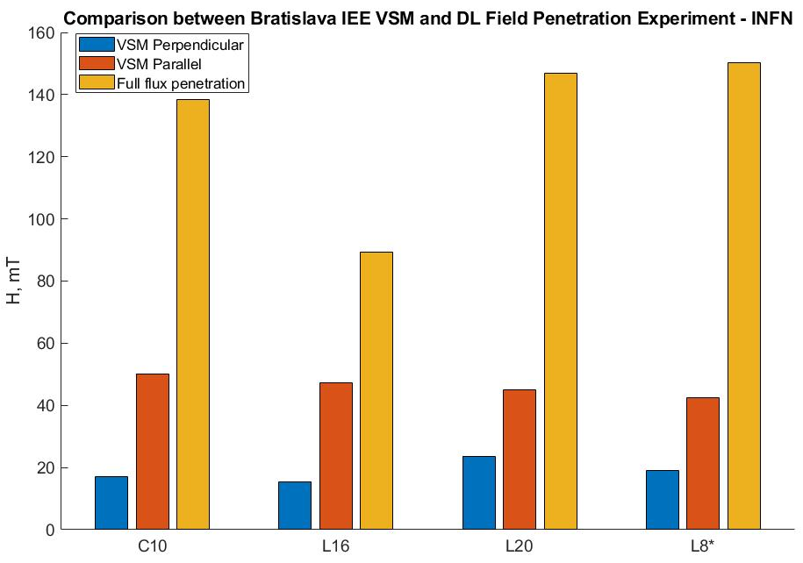
IEE
STFC
VSM results courtesy of Eugen Seiler and Rastislav Ries (IEE)
C10 | SUBU5 CERN + Laser
L8 | Tumbling + Laser
L16 | EP + SUBU5 + Laser
L20 | SUBU5 INFN + Laser
L21 | EP + Laser
* Measured in the field penetration facility at 4.2 K and not a calculated value
Notes:
Increasing H_{fp} for each sample, but not increasing H_{ll}

Slide 17
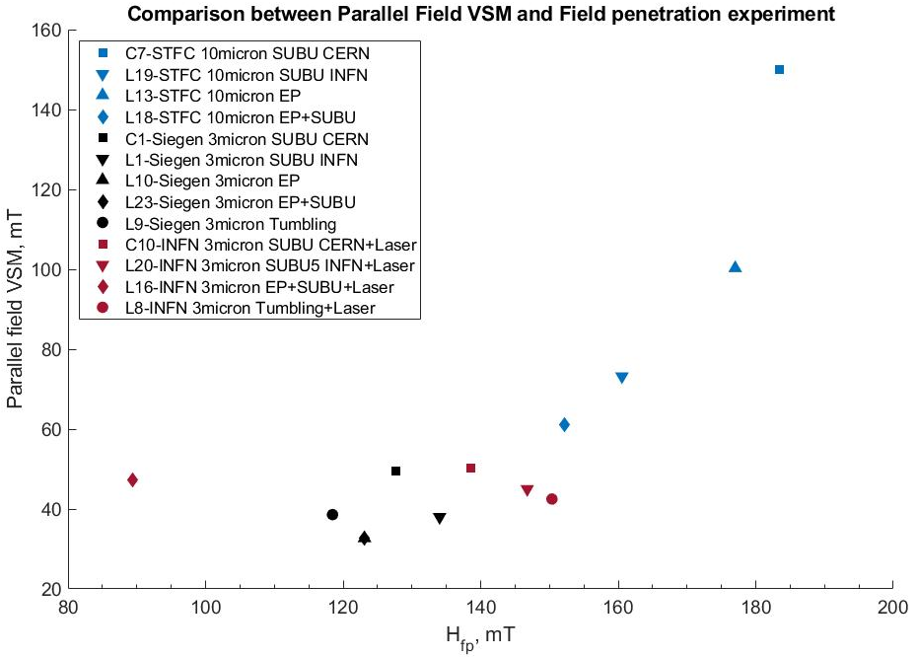
Notes:
Not a strong correlation between H_{FPE} and H_{ll} with a big jump in VSM for EP and SUBU CERN from STFC
Make laser treated samples full color

Slide 18
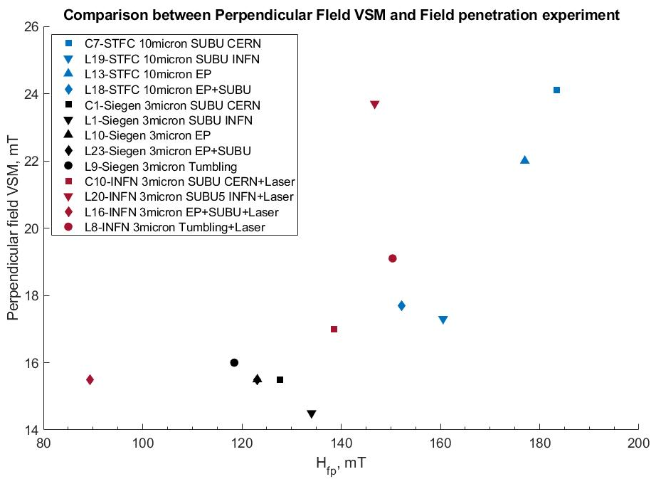
Notes:
Some kind of correlation with H_{perp} and H_{fp}

Slide 19
Conclusion and future plans
A cryogen free system has been designed, built and tested at Daresbury Laboratory
  Applies a local DC field, from one side to the other
  T_{min} = 2.6 K, controlled by heaters.
  B_{max} ~ 612 mT at I = 8 A
Multiple Nb samples have been tested, deposited at various institutes undergoing various treatments.
  Results show that there is some difference of H_{fp} between VSM and the field penetration facility.
  SUBU5 and EP seem to yield the highest H_{fp}.
  EP + SUBU seems to yield the lowest H_{fp}.
  Laser polished Nb with various intensities will also be tested.
Sample size
  Maximum: 53 mm ×53 mm
  Min: 35 mm×35 mm tested, reducing sample size to ensure results still reliable.
The new penetration facility demonstrated that it can be a new powerful instrument for characterising superconducting thin films.
Future plans:
  H_{fp} of Nb films as a function of film thickness
  SIS structures – Test thin films shielding substrate
Looking for multilayers structures please email!
daniel.turner@cockcroft.ac.uk
Notes:
Should I mention that the system is now fully automated?

Slide 20
Acknowledgements
• CERN: A. Sublet
• IEE: E. Seiler, R. Ries
• INFN: C. Pira, E. Chyhyrynets
• RTU: A. Medvids, P. Onufrievs
• Siegen University: M. Vogel, S. Leith
• STFC/CI: O. Malyshev, R. Valizadeh, G. Burt, K. Dumbell, J. T. G. Wilson, J Conlon, L. Smith,
F. Lockwood Estrin, F. Walk, N. Pattalwar, S. Pattalwar, A May
University of Victoria: T. Junginger
This research has been supported by European Commission’s ARIES collaboration H2020 Research and Innovation Programme under Grant Agreement no. 730871
Thank you for your attention

Slide 21
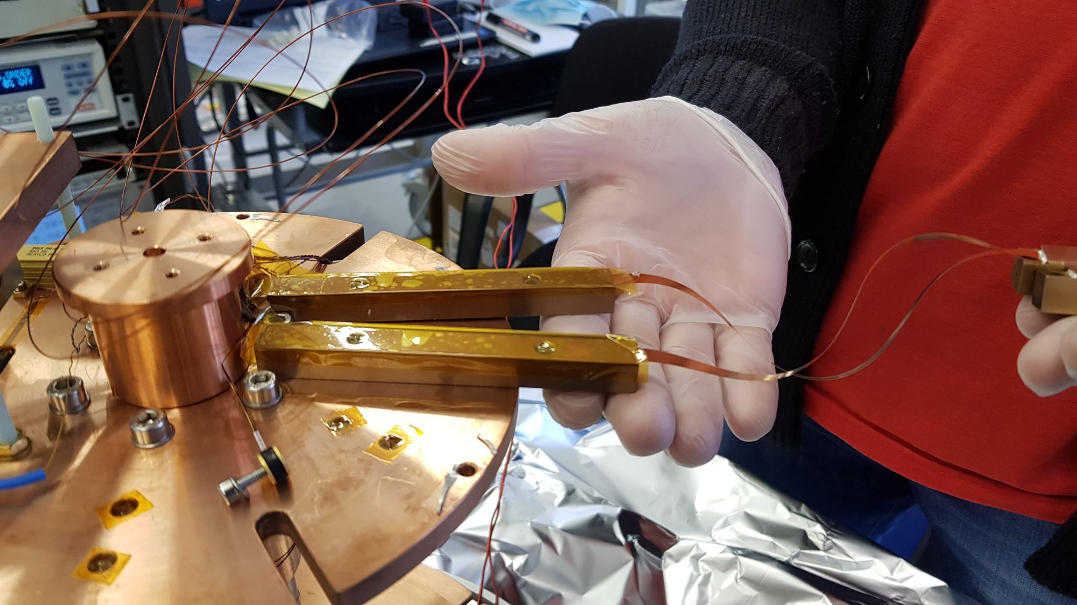
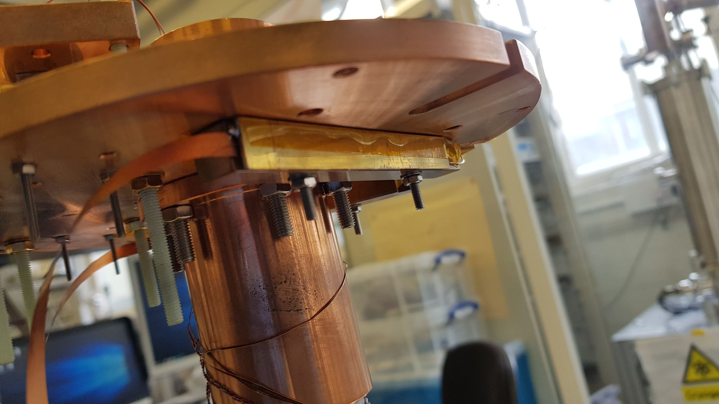
Superconducting joins

Slide 22
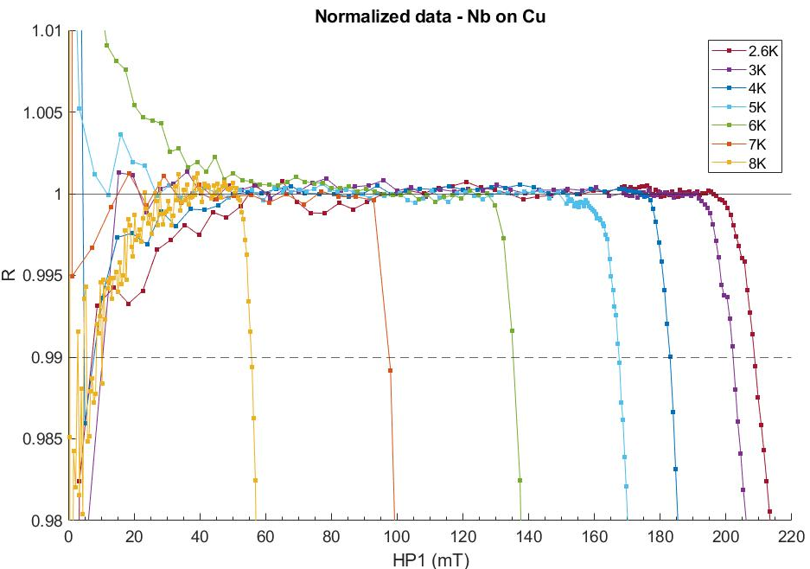
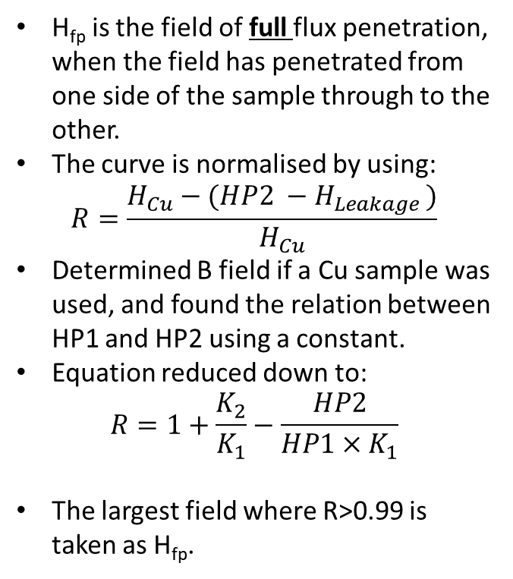
Determining H_{fp}
H_{fp} is the field of full flux penetration, when the field has penetrated from one side of the sample through to the other.
The curve is normalised by using:
$$R=\frac{H_{Cu}−(HP2 −H_{Leakage })}{H_{Cu}}$$
Determined B field if a Cu sample was used, and found the relation between HP1 and HP2 using a constant.
Equation reduced down to:
$$R=1+\frac{K_{2}}{K_{1}}−\frac{HP2}{HP1×K_{1}}$$
The largest field where R>0.99 is taken as H_{fp}.
Notes:
These errors must be wrong, seem way to high for temperatures below 6K., must of done something wrong Need to figure out what I am doing wrong in the code, they seem reasonable for higher Temps.

