Slide 1
Status of the ALPI Upgrade for the SPES facility
A.Tsymbaliuk; E. Munaron; D. Bortolato; E. Chyhyrynets; F. Stivanello; C. Pira; G. Keppel
Instituto Nazionale di Fisica Nucleare Laboratori Nazionali di Legnaro (INFN – LNL)
University of Ferrara

Slide 2
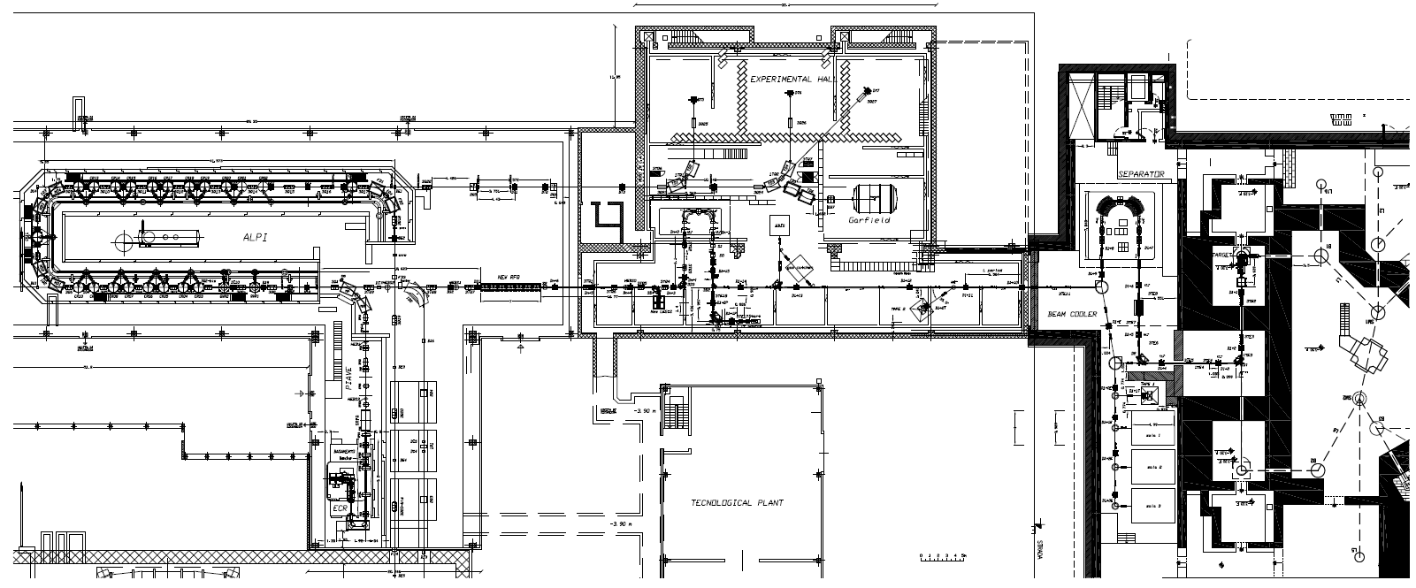
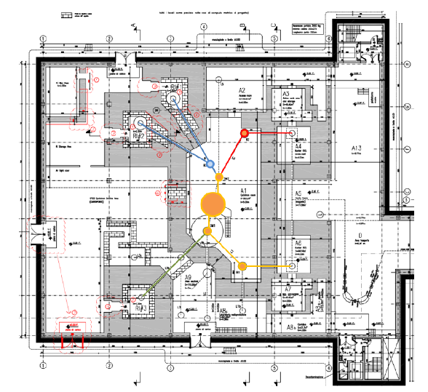
SPES facility in LNL-INFN
Selective Production of Exotic Species (the SPES Facility):
Second generation ISOL facility for nuclear physics:
production and re-acceleration with ALPI linac of exotic beams
Research and production radioisotopes for nuclear medicine:
LARAMED and ISOLPHARM Projects;
Accelerator-based neutron source (proton and neutron facility for applied physics).
Cyclotron
ISOL RIBs+ Post-Acc.
Nuclear Medicine
Nuclear Applications
ALPI SC_linac
RFQ
HRMS
ISOL1
CB - MRMS
1+ area
cyclotron
ISOL2
TFSRF-2021 15-18 March Andrii.Tsymbaliuk@lnl.infn.it

Slide 3
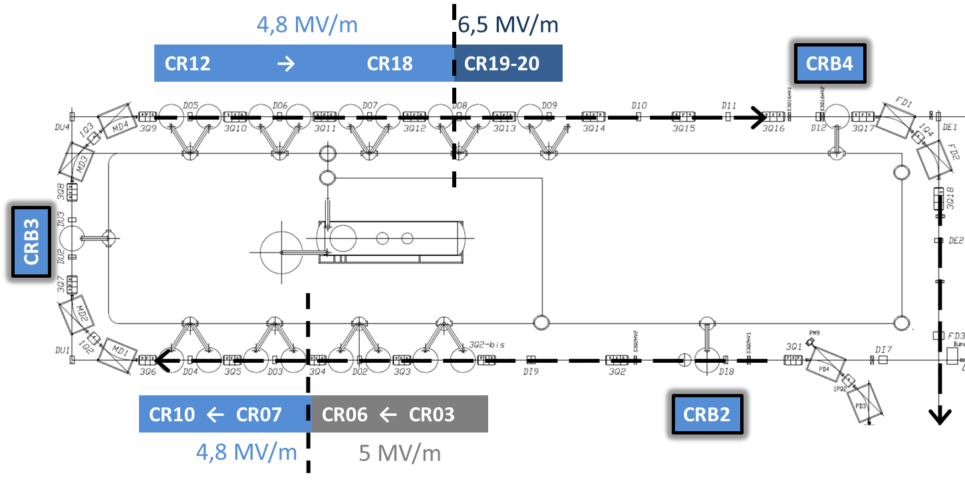
Project of ALPI upgrade for SPES facility
Additional 8 cavities
Re-positioned low β cavities
Upgrade advantages: higher energy (+2 cryostats, 8 cavities), higher transmission, increased reliability.
TFSRF-2021 15-18 March Andrii.Tsymbaliuk@lnl.infn.it
3

Slide 4
Beam Energies with full SPES Upgrade for Piave-Tandem-ALPI
TFSRF-2021 15-18 March Andrii.Tsymbaliuk@lnl.infn.it

Slide 5
History of the ALPI Upgrade
TFSRF-2021 15-18 March Andrii.Tsymbaliuk@lnl.infn.it
5

Slide 6
Cryostat measurement of previously sputtered medium-β QWR
TFSRF-2021 15-18 March Andrii.Tsymbaliuk@lnl.infn.it
6

Slide 7
Sputtering parameters definition
TFSRF-2021 15-18 March Andrii.Tsymbaliuk@lnl.infn.it
7

Slide 8
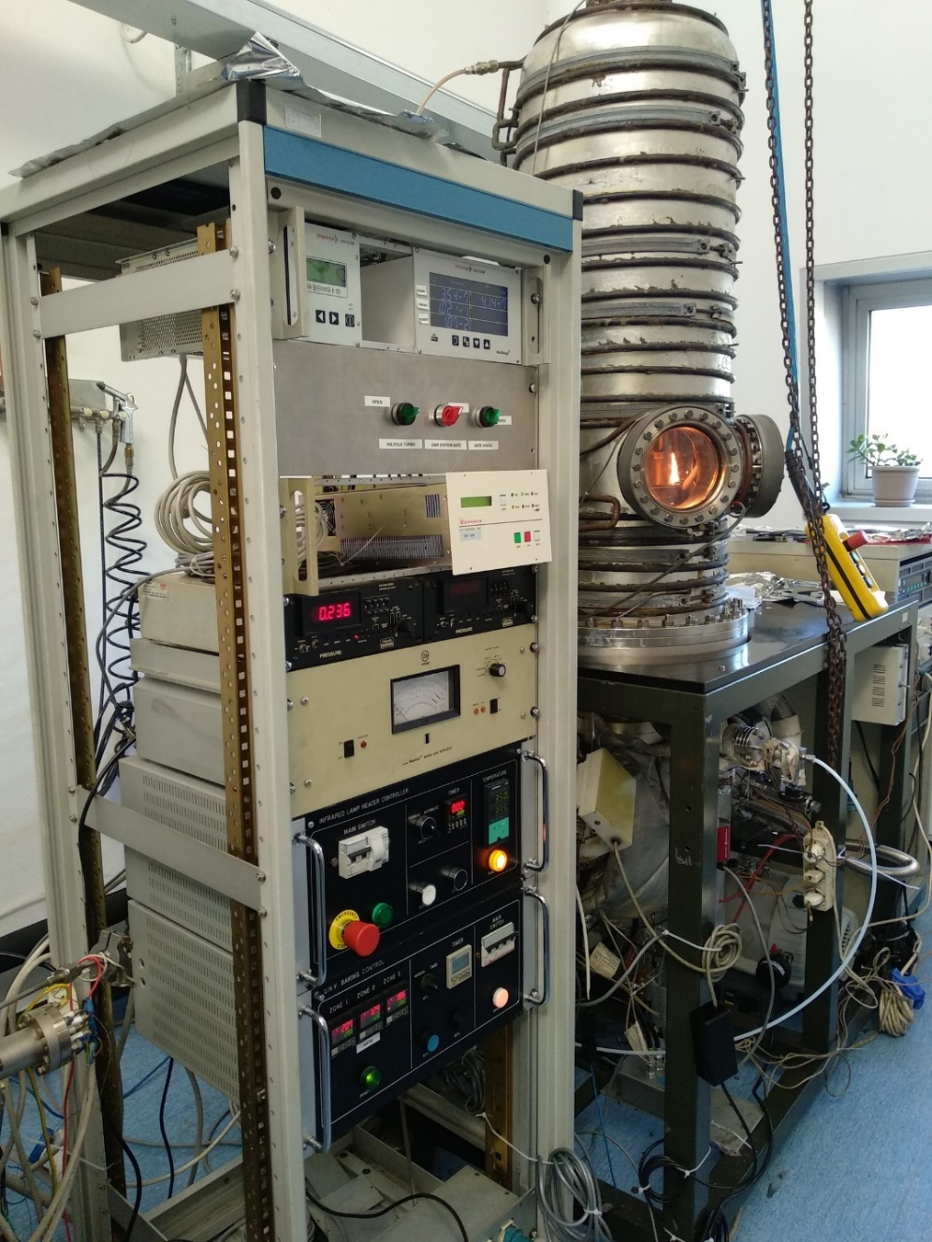
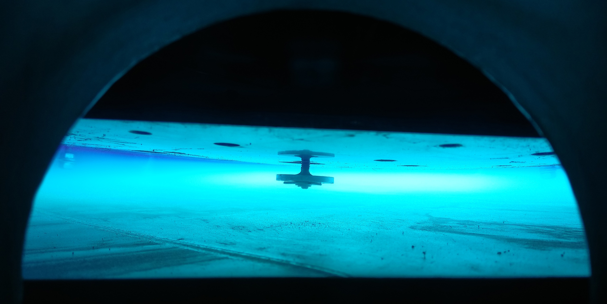
Process of research activity
Refurbishing and modification of the QWR sputtering system.
More then 15 tests were done in order to find best sputtering parameters for QWR deposition process.
Refurbishing and modification of the cryostat for low temperature measurements.
Definition of the best sputtering parameters with cleaned quartz for the QWR plates was done.
More then 5 high-β QWRs were deposited from 2019.
More then 12 low temperature measurements of medium-β and high-β QWRs were done.
TFSRF-2021 15-18 March Andrii.Tsymbaliuk@lnl.infn.it

Slide 9
Parameters of the test measurements for QWR deposition
Parameters of different sputtering tests
Parameters | # 6 | # 7 | # 8 | # 9 | # 10 | # 11 | # 12 | # 13 | # 14 | # 15
Pre sputtering baking
Chamber temp. [°C] | - | 120 – 150 | 120 – 200
Cavity temp. [°C] | - | 300 – 400 | 350
Time [hours] | - | 51 | 63 | 48 | 72 | 48 | 88 | 72 | 48 | 72
 | - |  |  |  |  |  | 3 | 1,3 | 1,6 | 4,6
Sputtering parameters
Full time [min] | 60 | 165 |  |  | 150 | 160 | 165 |  | 260 | 240
Series | 4 x 15 | 11 x 15 |  |  | 10 x 15 | 11 x 15 |  |  | 17 x 15 | 16 x 15
Pressure [mbar] | 0,1 - 0,21
Bias voltage [V] | -130
Cavity temp. [°C] | 25 | 300
Cathode current [A] | 3 | 3 | 3 | 3,5 | 4 | 3,25 | 3,25 | 3,25 | 2 | 3,25
TFSRF-2021 15-18 March Andrii.Tsymbaliuk@lnl.infn.it
9

Slide 10
Scheme of the system for high-β QWR deposition
QWR resonator
(130 V)
Nb cathode
(-700V)
Grounded grids
Vacuum chamber
grounded
Biased cathode
(130 V)
TFSRF-2021 15-18 March Andrii.Tsymbaliuk@lnl.infn.it
10

Slide 11
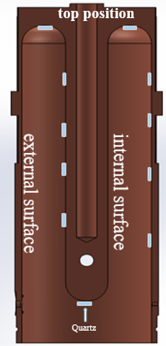
Results of the tests sputtering
– Deposition rate vs sputtering current
TFSRF-2021 15-18 March Andrii.Tsymbaliuk@lnl.infn.it
11

Slide 12
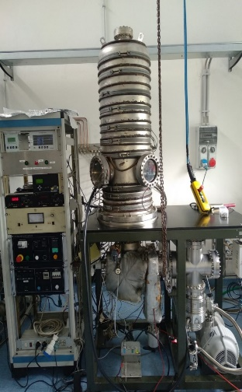
Experimentally defined optimal parameters
Baking process
Parameter
Temperature (zone 1) [°C] | 200
Temperature (zone 2) [°C] | 120
Temperature (zone 3) [°C] | 200
Cavity temperature [°C] | 350 – 400
Baking time [hours] | 48
Sputtering process
Parameter
Sputtering pressure [mbar] | 0,1
Cycle time [min] | 15
Number of cycles | 20
Total time [min] | 300
Cathode current [A] | 3.25
Bias voltage [V] | -130
Temperature of the cavity before sputtering [°C] | 300
TFSRF-2021 15-18 March Andrii.Tsymbaliuk@lnl.infn.it
12

Slide 13
Nb/Cu high-β QWR cavity production
TFSRF-2021 15-18 March Andrii.Tsymbaliuk@lnl.infn.it
13
13

Slide 14
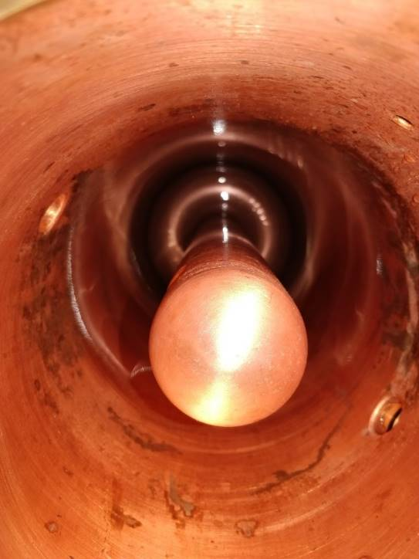
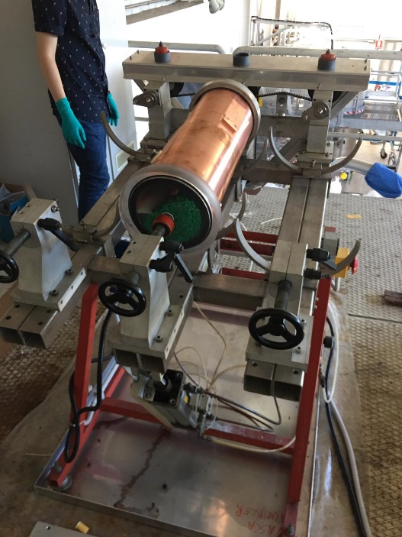
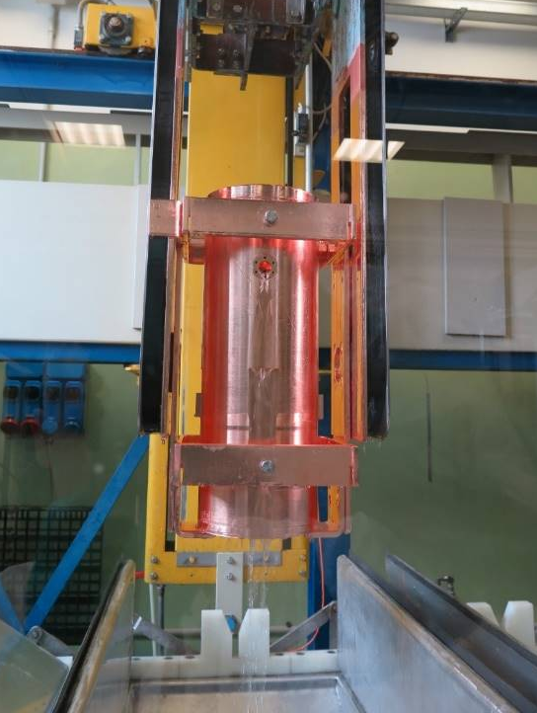
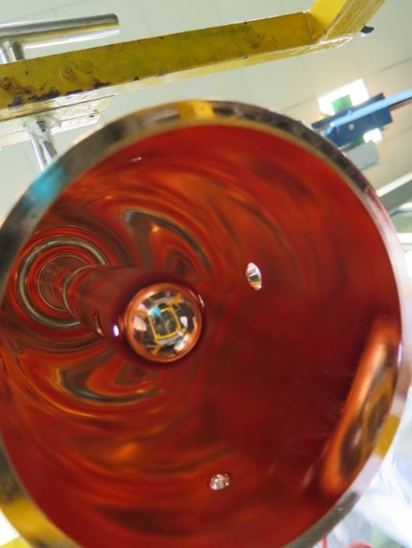
Nb/Cu QWR preparation
№ | Process | Parameters
1 | Tumbling | Abrasive form: Green finishing pyramids; time 12 hours
2 | Ultrasound cleaning
3 | Electro polishing | Solution: H3PO4 : Butanol 3:2 v.r.; Volume: 90 l; Time: 2,5 hours.
4 | High Pressure Rinsing | Solution: water
5 | SUBU 5 | Solution: Sulfamic acid 5 g/l , Ammonium citrate - 1 g/l, Butanol - 50 ml/l , H₂O₂ - 50 ml/l; Time: 4 min.
6 | Rinsing
7 | Passivation | Solution: Sulfamic acid 10 g/l; Time: 5 min.
8 | Rinsing | 5 times
9 | Ultrasound cleaning | 10 min.
10 | Rinsing | 5 min.
11 | High Pressure Rinsing, ethanol rinsing, nitrogen drying, packaging
TFSRF-2021 15-18 March Andrii.Tsymbaliuk@lnl.infn.it
14
14

Slide 15
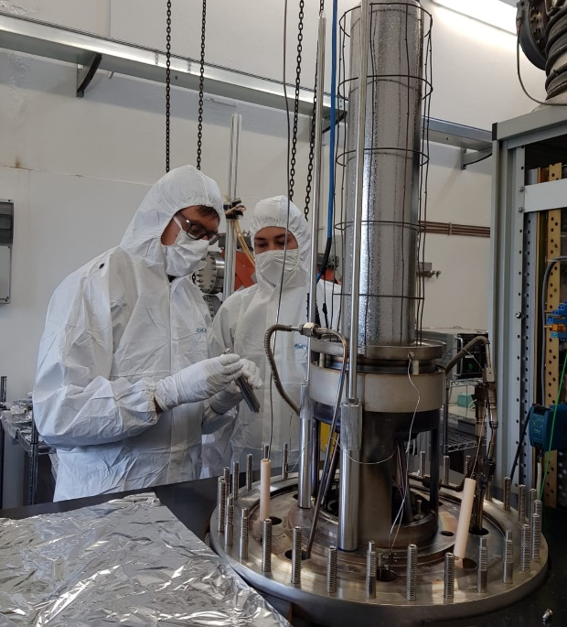
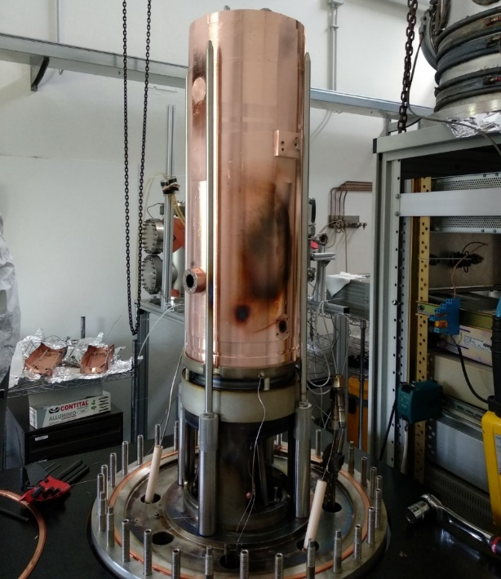
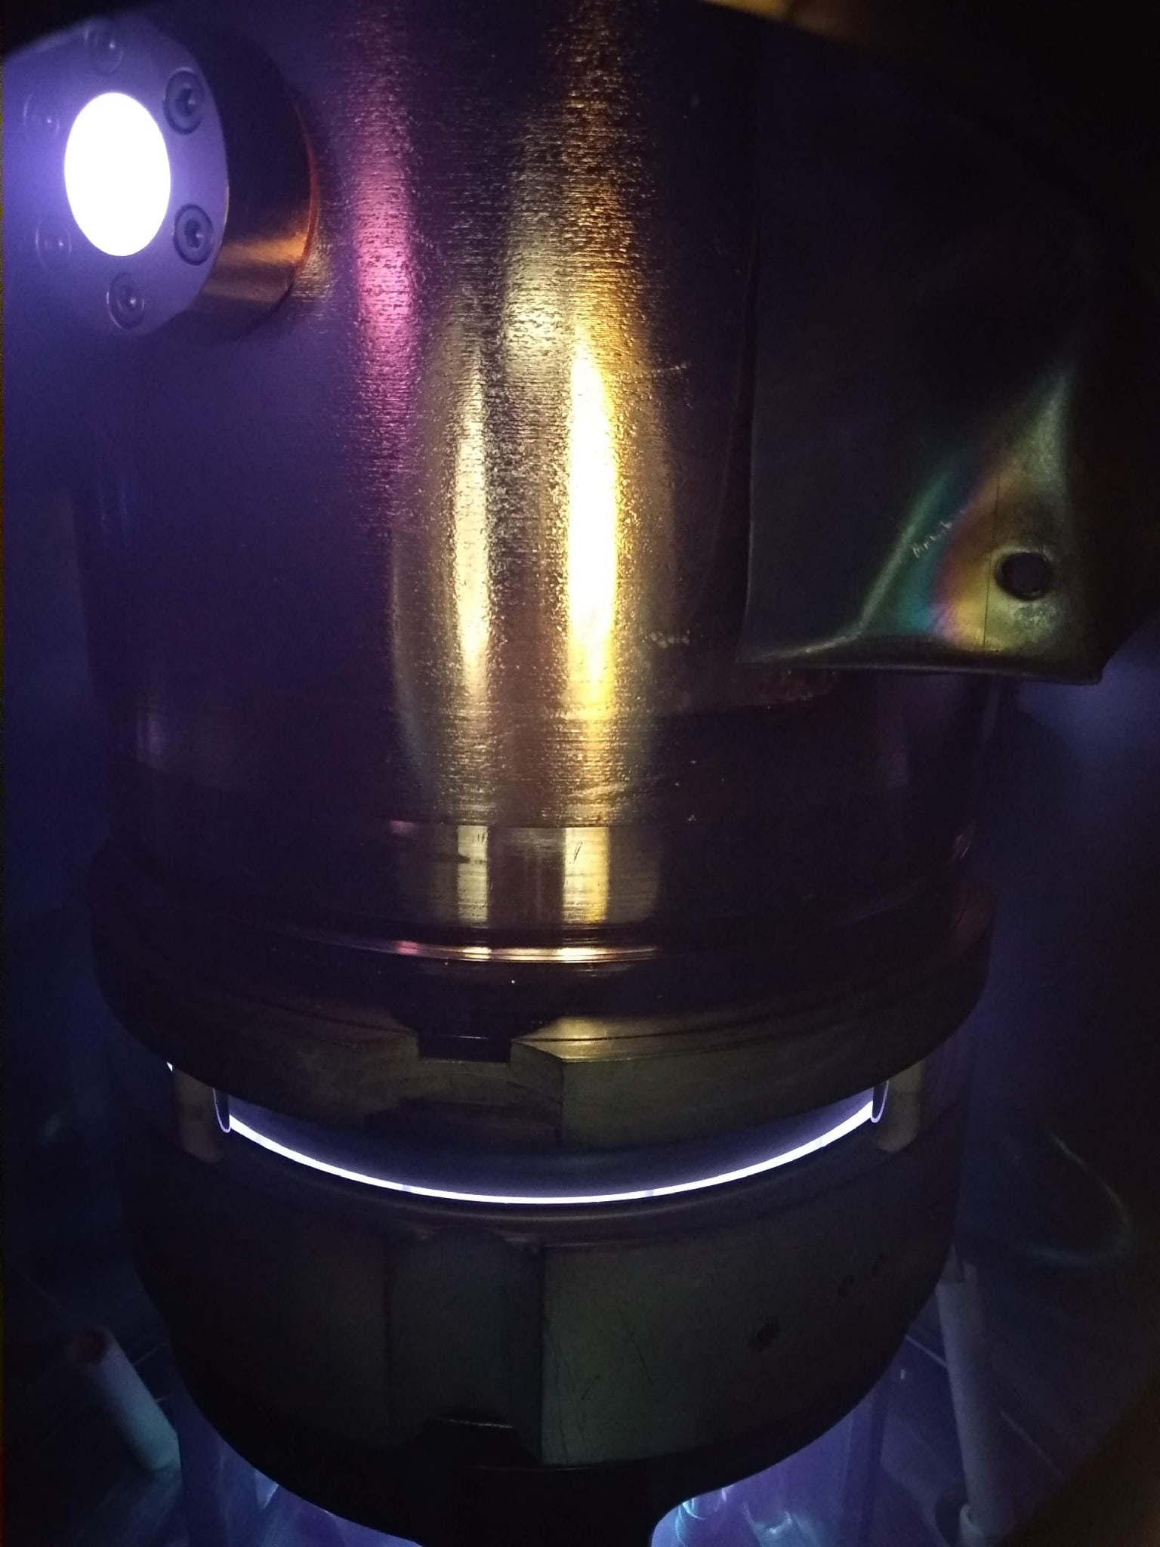
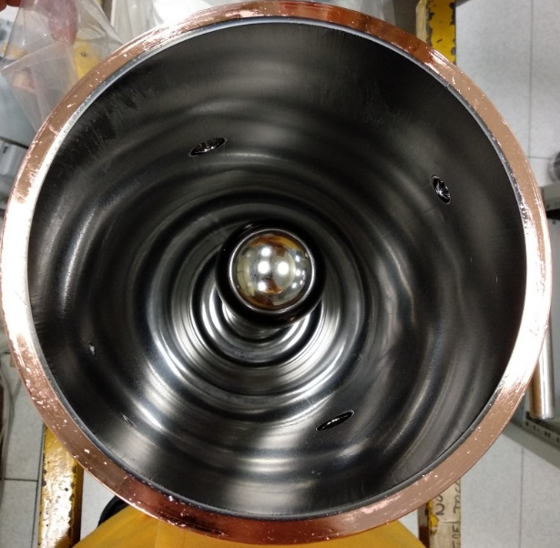
Nb/Cu QWR sputtering
Baking process
Parameter
Temperature (zone 1) [°C] | 220
Temperature (zone 2) [°C] | 120
Temperature (zone 3) [°C] | 220
Cavity temperature [°C] | 400
Baking time [hours] | 48 - 96
Sputtering process
Parameter
Sputtering pressure [mbar] | 0,1
Cycle time [min] | 15
Number of cycles | 20
Total time [min] | 300
Pause between depositions [min] | 150
Cathode current [A] | 3.25
Bias voltage [V] | -130
Temperature of the cavity before sputtering [°C] | 300
TFSRF-2021 15-18 March Andrii.Tsymbaliuk@lnl.infn.it
15
15

Slide 16
Results of Nb/Cu high-β QWR cryostat measurements
TFSRF-2021 15-18 March Andrii.Tsymbaliuk@lnl.infn.it
16

Slide 17
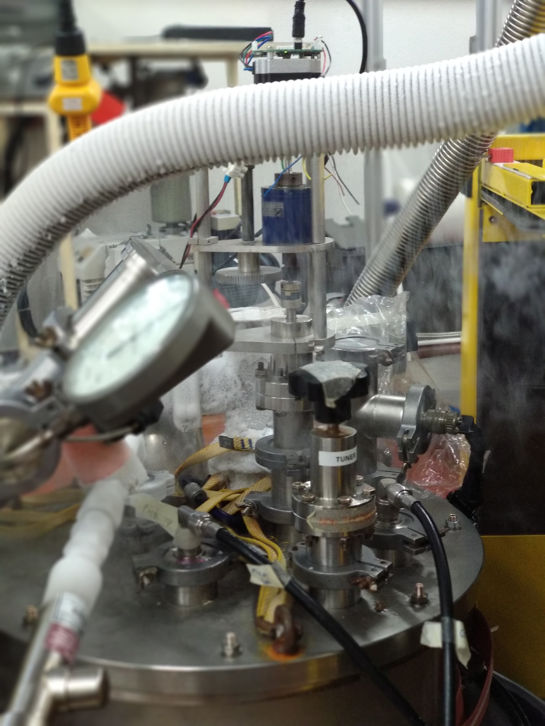
Preparation methodology of Nb/Cu QWR for cryostat measurement
№ | Process | Parameters
1 | Pumping of the system.
2 | Liquid Nitrogen transfer in the external shield.
3 | Cavity baking. | 350 K; 48 – 120 h.
4 | “Hot conditioning”. | 1 – 70 W; 24 – 48 h.
5 | Liquid Nitrogen cooling down of the cavity. | From 350 K to 100 K.
6 | Liquid Helium cooling down of the cavity. | From 100 K to 4,2 K.
7 | “Cold conditioning”. | P(He) = 5,0E-5 mbar.
8 | Cryostat measurements
TFSRF-2021 15-18 March Andrii.Tsymbaliuk@lnl.infn.it
17
Notes:
1)
2)
3)

Slide 18
Nb/Cu QWR cryostat measurement results
Target
Measurement goal
Power | Eacc | Q
7 W | >4,5 MV/m | >1,0E8
TFSRF-2021 15-18 March Andrii.Tsymbaliuk@lnl.infn.it
18
18

Slide 19
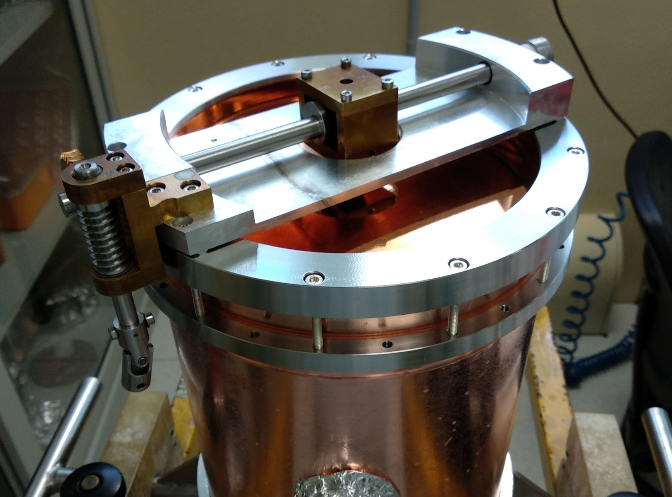
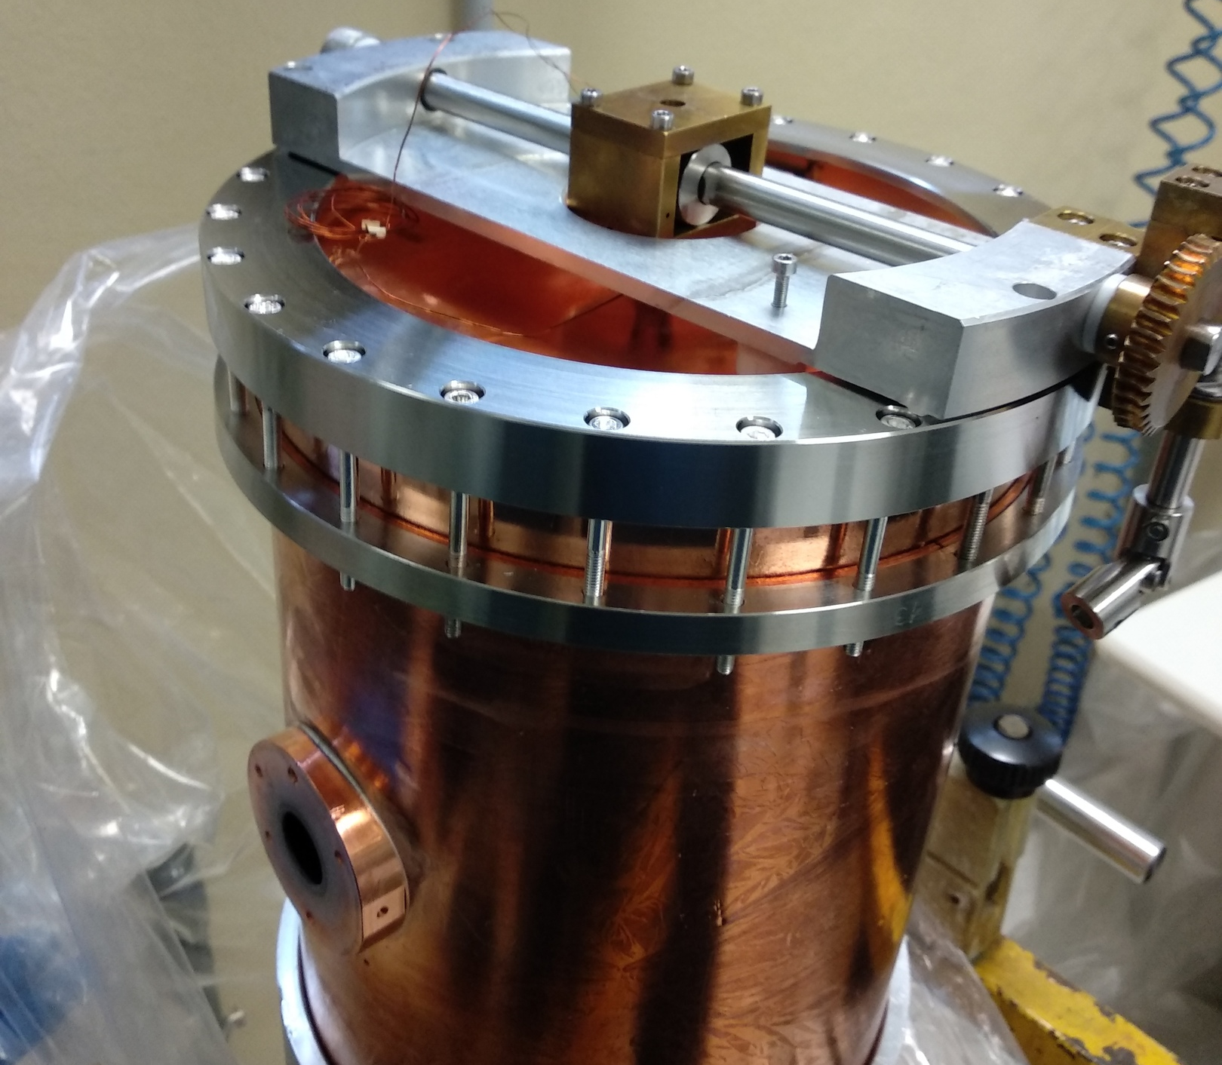
Nb/Cu QWR cryostat measurement results
Cavity number | Q[0] | Eacc, [MV/m] | Q (at 7W) | ΔT (plate – cavity)
DD cavity | 2,07E+9 | 6,6 | 4,2E+8 | 0,96
HB 5 | 7,6E+8 | 5,5 | 2,8E+8 | 1,66
HB 8 | 1,5E+8 | 3,8 | 1,4E+8 | 2
HB 7 | 3,2E+8 | 3,7 | 1,8E+8 | 2,8
HB 6 | 7,6E+7 | 2,6 | 6,7E+7 | 3,2
TFSRF-2021 15-18 March Andrii.Tsymbaliuk@lnl.infn.it
19
19

Slide 20
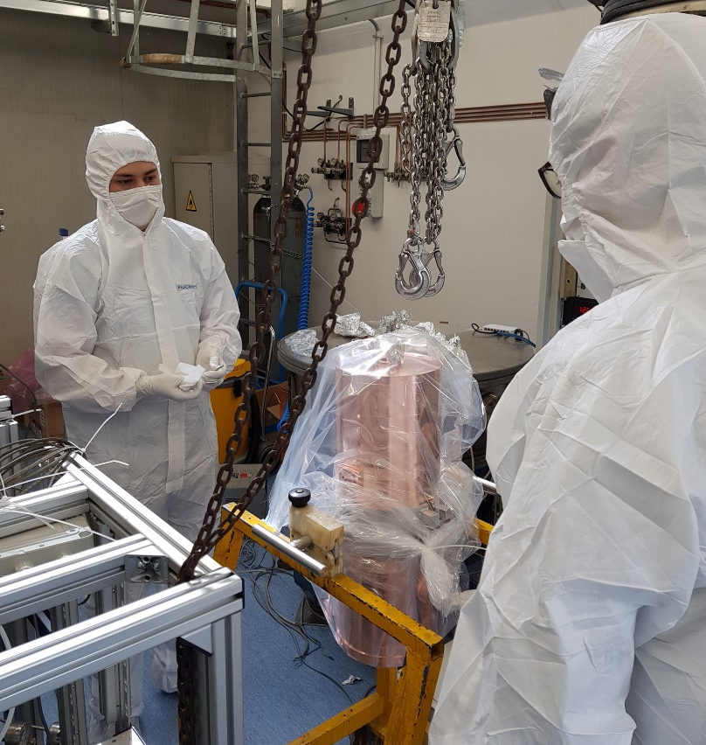
Current status of the ALPI Upgrade
Conclusions
Sputtering and measurement vacuum systems for QWR production were refurbished and modified;
QWR sputtering technology was updated for production of Nb/Cu high-β QWR cavities;
Several Nb/Cu QWR cavities were produced;
2 Nb/Cu QWR cavities are ready for use;
The best performance of the produced QWR:
Q[0] = 2,07E+9; Q[7W] = 4,2E+8 E[acc] = 6,6 MV/m)
TFSRF-2021 15-18 March Andrii.Tsymbaliuk@lnl.infn.it
20
20

Slide 21
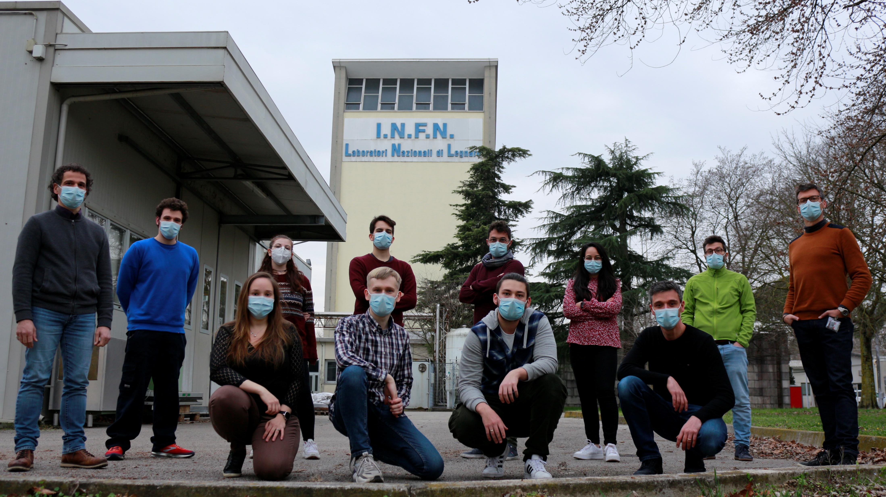
Thank you for attention!
Special thanks to my research team: Giorgio Keppel, Enrico Munaron, Damiano Bortolato, Fabrizio Stivanello, Eduard Chyhyrynets and Cristian Pira.
TFSRF-2021 15-18 March Andrii.Tsymbaliuk@lnl.infn.it
21
21

