Slide 1


Improvement of Nb thin film on Cu substrate by Nd:YAG laser radiation
Arturs Medvids¹, Pavels Onufrijevs¹, Reza Valizadeh², Oleg Malyshev², Cristian Pira³, Alban Sublet⁴, Rastislav Ries⁵, Eugen Seiler⁵
¹ Riga Technical University, P. Valdena 3/7, Riga, LV-1048, Latvia
² STFC Daresburt Laboratory, WA4 4AD Warrington, UK
³ LNL/INFN, 35020 Legnaro PD, Italy
⁴ CERN, 1211 Genève, Switzerland
⁵ Institute of Electrical Engineering SAS, Dubravska cesta 9, 841 04 Bratislava, Slovakia
16.03.2021.

Slide 2

OUTLINE
I. Introduction
    1. Motivation;
    2. The Aim of the Work.
II. Experimental Part and Discussion
  Investigation of the grain size of Nb in Nb/Cu structure before and after the irradiation by Nd:YAG laser;
  Investigation of Nb layer adhesion to Cu substrate before and after the irradiation by Nd:YAG laser;
  Investigation of Nb/Cu structure magnetic properties before and after the irradiation by Nd:YAG laser.
  In experiments on Nb/Cu structure: AFM, optical microscope, CSM Micro-Combi Tester with conical diamond indenter (Rockwell), SEM and DC magnetic field till B^{max}_{z}=0.35 mT were used.
III. Conclusions

Slide 3
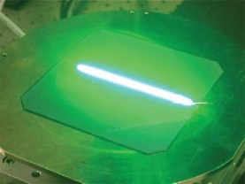
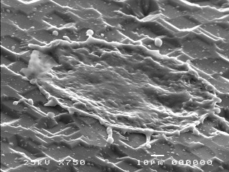
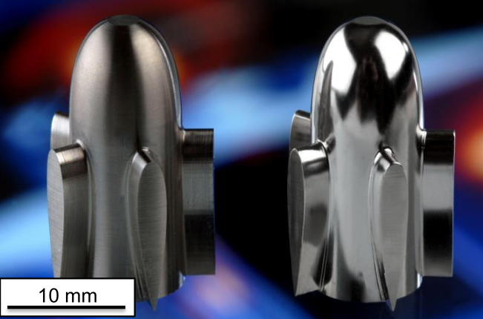
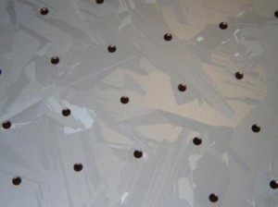
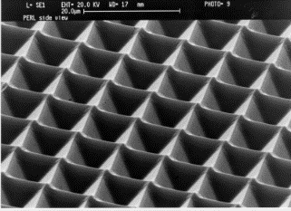
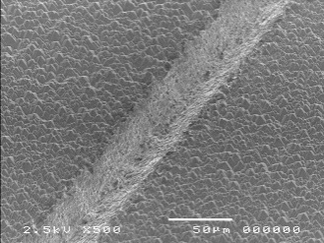
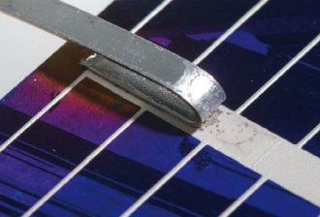
INTRODUCTION
Increase of application of laser radiation in different processes of metals, semiconductors, polymers is explained by flexibility, simplicity and cheapness of laser technology.
Laser-fired contacts
Laser pollishing
Laser doping
Laser drilling
Laser damage-less ablation for formation of front contact
Laser texturing
Laser edge isolation
http://www.solarnovus.com/the-laser-at-50-playing-a-vital-role-in-the-solar-industry_N1021.html
http://www.pveducation.org/pvcdrom/design/surface-texturing
http://www.innolas-solutions.de/mwt-ewt-via-drilling/
http://www.oxfordlasers.com/laser-micromachining/applications/photovoltaic-cell-production-and-rd/
http://www.ilt.fraunhofer.de/en/publication-and-press/brochures/brochure_Lasers_in_Photovoltaics.html
Energy Procedia 8 (2011) 614–619
Laser soldering and welding

Slide 4
The Aim of the Work
The aim of the study is to develop laser technology for application in RF cavity.
Increase the grain size of Nb on Cu substrate;
Increase adhesion of Nb layer to Cu substrate;
Increase the magnetic field of first flux entry B_{en}.

Slide 5
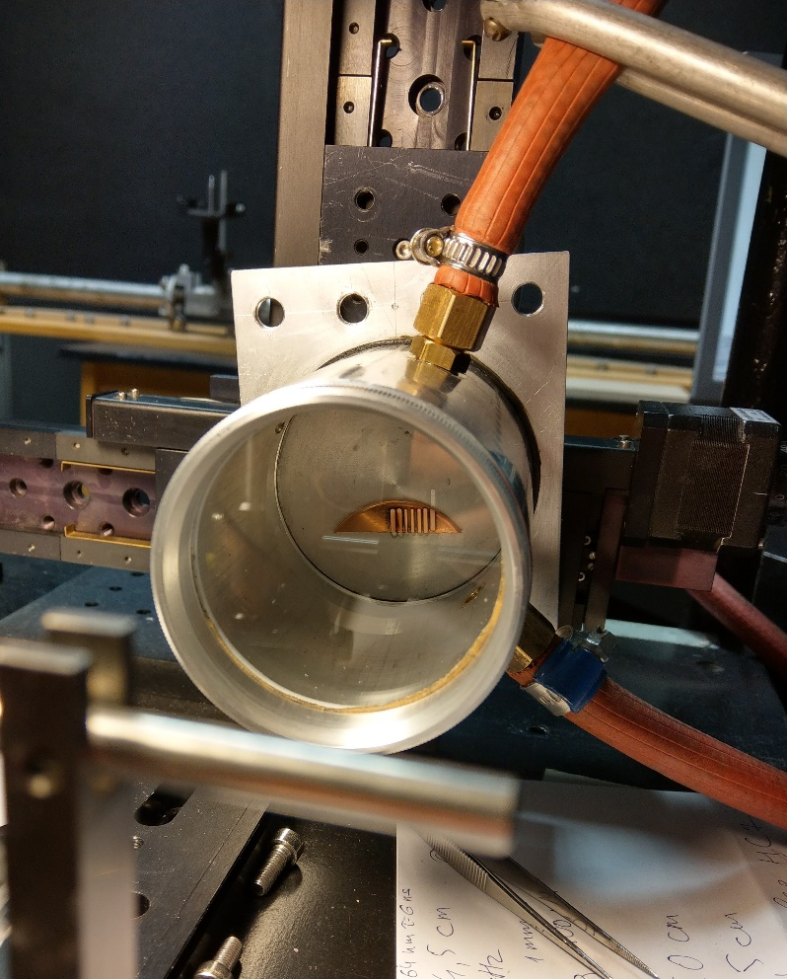
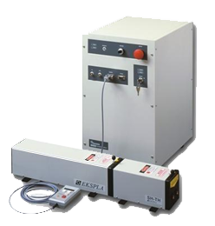
Experiment 1. Nb/Cu structure polishing
Fig.1.Chamber with inert gas Argon for laser cleaning and polishing of Cu and Nb/Cu structure. Nd:YAG laser “EKSPLA”.
The samples Nr.22/3/16; 4/5/16; 1/7/16 from (STFC); C10 (CERN) and L8, L16, L20, L21 (INFN) were irradiated by pulsed Nd:YAG laser (λ= 1.064 µm, τ =6 ns and intensity up to 200 MW/cm²) in scanning mode with step 5µm in Ar atmosphere.

Slide 6


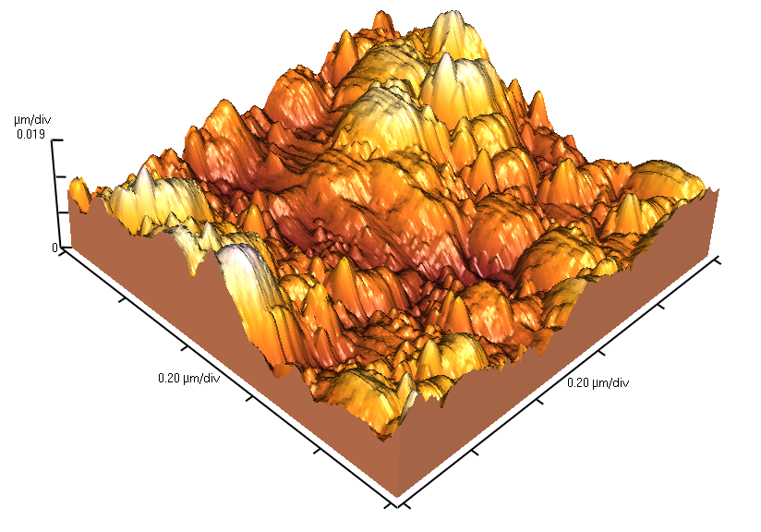
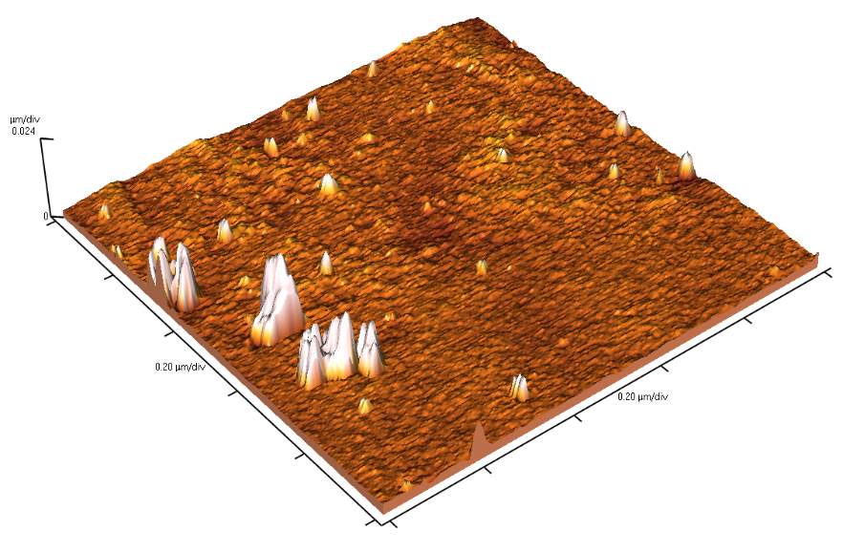
Influence of Laser Radiation on Surface Roughness of Nb/Cu Structure
Experiment 1.
Nb films were deposited by HiPIMS (magnetron sputtering) (STFC) with pulse width of 100 µs, repetition rate of 200 Hz, average plasma current of 600 mA, peak current of 40 A and a krypton pressure of 500 mTorr.
Sample Nr. 1/7/16– 500 ˚C deposition temperature with 0V DC substrate bias (grounded) for 240 mins onto copper substrate which was pre-annealed to 700˚C for 12 hours prior to deposition.
Sample Nr. 22/3/16 - 500 ˚C deposition temperature with -80 V DC substrate bias deposited for 240 mins onto as received copper substrate
Sample Nr. 4/5/16 - 700 ˚C deposition temperature with -80 V DC substrate bias deposited for 480 mins onto as received copper substrate.
The sample was irradiated by Nd:YAG laser (λ= 1.064 µm, τ =6 ns and intensity I=200.0 MW/cm²) in scanning mode with step 5µm in Ar atmosphere.
a)
b)
Fig.2. 3D AFM images of Nb/Cu sample (1/7/16) : non-irradiated (a) and irradiated by Nd:YAG at intensity I=200.0 MW/cm² (b). The Nb surface roughness Ra of the non-irradiated is 7.6 nm; for laser irradiated it is 0.5 nm.

Slide 7
a) b)
d)
Fig.3. SEM images of Nb/Cu sample Nr.22/3/16 before irradiation (a) and after irradiation by Nd:YAG laser with
Intensities: I₁ = 140 MW/cm² (b); I₃ = 253 MW/cm² (d).

Slide 8
Sample deposition at INFN
Samples C10 (CERN), L8, L16, L20, and L21 (INFN) have been coated with a 3 µm thick Nb film. The below listed procedure and deposition parameters have been applied:
Chamber evacuation and baking at 650 °C for more than 40 hours.
Target conditioning for 5 minutes.
Subsequent deposition without interruption of the process for 20 min.
Cooldown for more than 15 hours.
Rinsing the pieces in ethanol and dry with nitrogen.
Sample Nr. | Methods
C10 | SUBU5 (CERN)
L20 | SUBU5 (INFN)
L21 | EP
L16 | EP+SUBU5
L8 | Tumbling

Slide 9
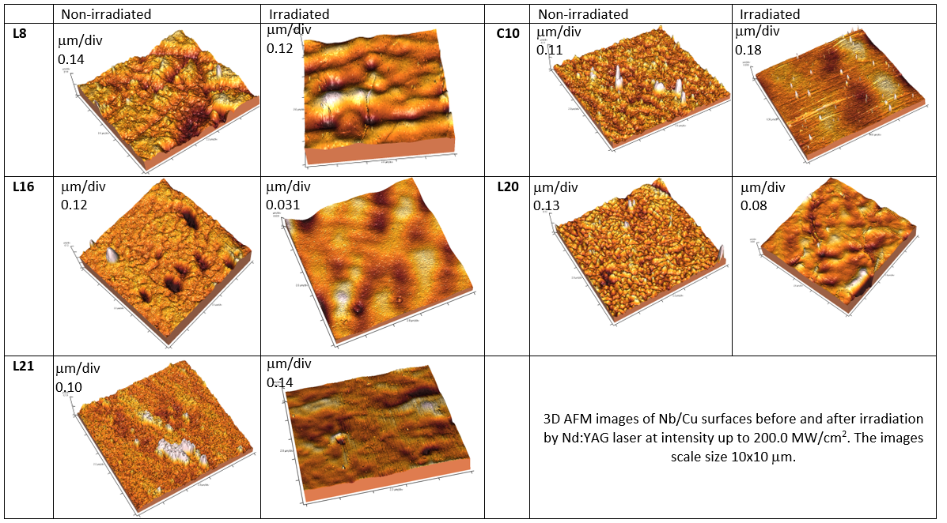
Fig. 4. 3D AFM images of Nb/Cu structures.

Slide 10
Roughness
The roughness was measured with a VEECO CP II Scanning Probe Microscope
Table 1 Roughness comparison between the five coated samples
Sample | Ra by AFM non-irradiated | Ra by AFM Irradiated by Laser
SUBU5 CERN (C10) | 9 nm | 1 nm
SUBU5 INFN (L20) | 9 nm | 7 nm
EP (L21) | 12 nm | 5 nm
EP+SUBU5 (L16) | 13 nm | 3 nm
Tumbling (L8) | 25 nm | 13 nm

Slide 11
L21
Non-irradiated
Irradiated by Nd:YAG laser
Lens mode: Field-Free
Lens mode: Immersion
Fig.5. SEM images of L21 sample before and after irradiation by pulsed Nd:YAG laser (λ= 1.064 µm, τ =6 ns and intensity up to I=200 MW/cm²).
For the sample longitudinal pinholes fully disappeared.

Slide 12
L8
Non-irradiated
Irradiated by Nd:YAG laser
Lens mode: Field-Free
Lens mode: Immersion
Fig.6. SEM images of the sample L8 the surface is characterized by chaotically distributed scratches with length up to10 μm, which disappear after irradiation by the laser.

Slide 13
Fig. 7: XRD of Niobium on Copper substrate (sample
22/3/16) before and after irradiation by Nd:YAG laser.
The program EVA (DIFFRAC plus BASIC Evaluation Package, Bruker AXS)

Slide 14
ARIES samples, before and after Laser-irradiation at RTU
deposited at INFN Legnaro
Magnetization measurements in Perpendicular applied field, planar samples ~2x2 mm²
4.22 K | Field of 1st entry of mag. flux, 2% criterion |  | Δ/Ben, % | Field of maximum mag. moment | Field of maximum mag. moment |  | Δ/Bp, % | Cu Surface prep.
Sample: | Original | after-Laser |  | Original | Original | after-Laser
 | Ben [Oe] | Ben [Oe] |  | Bp [Oe] | Bp [Oe] | Bp [Oe]
L8 | 180 | 191 | 6 | 465 | 465 | 465 | 0 | Tumbling
C10 | 120 | 170 | 30 | 315 | 315 | 352 | 11 | CERN subu
L16 | 140 | 155 | 10 | 320 | 320 | 322 | 1 | EP+SUBU
L20 | 200 | 237 | 16 | 825 | 825 | 787 | 5 | SUBU
L21 | 180 | 188 | 4 | 445 | 445 | 437 | 2 | EP
Table 2. The flux entry field B_{en} (left), determined applying the 2% relative difference criterion, and the field of maximum magnetic moment B_{p} (right) before and after irradiation by laser depending on Cu surface preparation methods at 4.22 K.

Slide 15
Fig. 8. The first magnetic flux entry field Hen vs. the laser dose for sample L16.

Slide 16
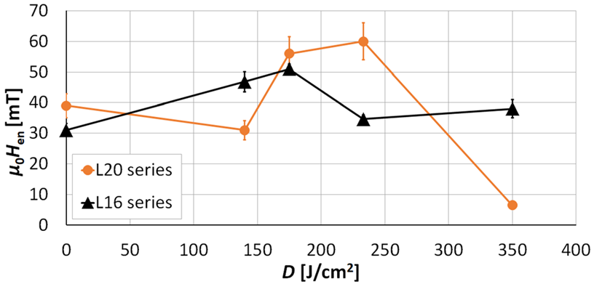
Magnetic flux penetration into the superconducting Nb films deposited on Cu substrate
Fig. 9. The first magnetic flux entry field H_{en} vs. the laser dose for samples: L16 (triangles) and L20 (circles).

Slide 17
Influence of Laser Radiation on Adhesion of Nb layer to Cu Substrate
Experiment 2.
Nb films were deposited by magnetron sputtering (HiPIMS) on Cu substrate.
The variable deposition parameters:
Sample Nr.22/3/16 (STFC) - 500 ˚C deposition temperature with -80 V DC substrate bias deposited for 240 mins onto as received copper substrate
Sample Nr.4/5/16 (STFC) - 700 ˚C deposition temperature with -80 V DC substrate bias deposited for 480 mins onto as received copper substrate
The samples were irradiated by Nd:YAG laser (λ= 1.064 µm, τ =6 ns and intensity I=200.0 MW/cm²) in scanning mode with step 5µm in Ar atmosphere. Four samples were irradiated with different doses: D1=1.4x10²⁰ phot/cm²; D2=2.2x10²⁰ phot/cm²; D3=4.4x10²⁰ phot/cm²; D4=44.0x10²⁰ phot/cm².
Delamination was investigated by scratching method (CSM Micro-Combi Tester) using conical diamond indenter (Rockwell). Scratch force on the indenter was gradually increased from 10 mN to 3.0 N.

Slide 18
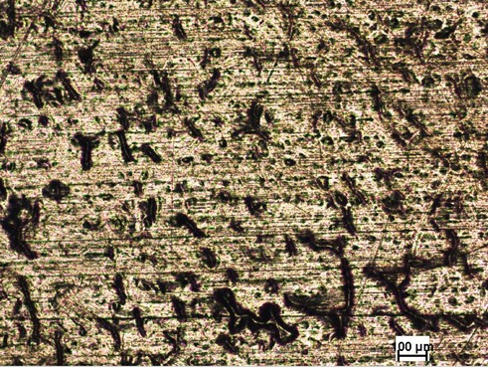
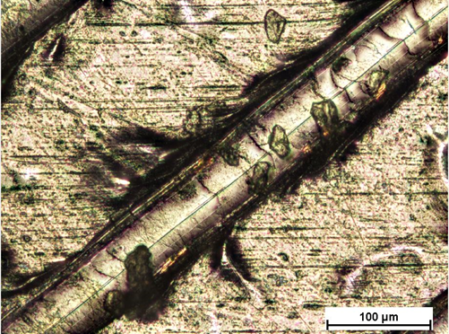
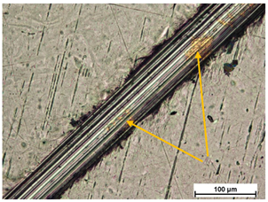
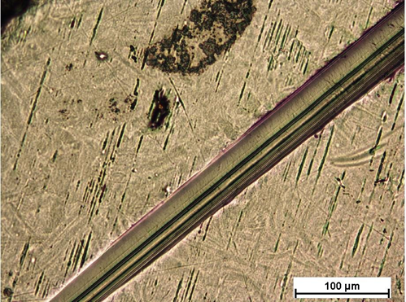
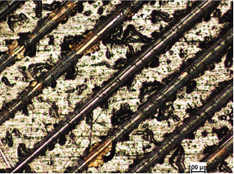
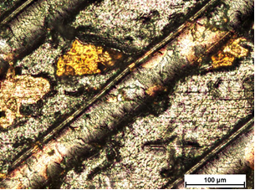
Influence of Laser Radiation on Adhesion of Nb layer to Cu Substrate
Fig.9. Optical microscope images of Nb/Cu structure sample Nr.4/5/16: (a) before irradiation and (b) after irradiation by laser with D2.
Fig.10. Optical microscope images of Nb/Cu structure sample Nr.22/3/16: (a) before irradiation and (b) after irradiation by laser with D4.
The laser irradiation not only affects the adhesion of coating, but also increases its hardness.
Fig11. Optical microscope images of Nb/Cu structure sample Nr.4/5/16 after scratch: (a) before irradiation and (b) after irradiation by laser with D4.

Slide 19
Influence of Laser Radiation on Adhesion of Nb/Cu Structure
Fig.12. Critical force for the coating delamination.
Sample 22/3/16.
It was found that the critical delamination force for sample Nr.22/3/16 increased with the laser dose and for dose D4 is maximal 36% as compared with non-irradiated area. The hardness of the structure was increased after laser irradiation.

Slide 20
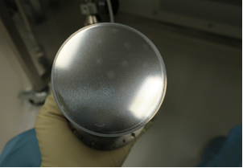
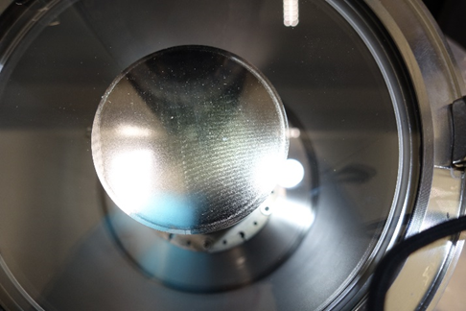
QPR sample
Fig.5. QPR sample before (a) and after irradiation (b) by Nd:YAG laser at intensity I=75MW/cm².

Slide 21
Conclusions
The critical delamination force for irradiated Nb/Cu structure increased with the laser dose by maximally 36%. The results can be explained by the diffusion of Nb into Cu substrate.
Laser irradiation of Nb/Cu structure leads to a decrease of surface roughness Ra from 8 nm till 1 nm.
The size of Nb crystals is increased from 25 nm to 31nm at the intensity of Nd:YAG laser radiation 230 MW/cm².
The laser irradiation of Nb/Cu structure increased the field of first flux entry by up to 65% compared to a non-irradiated sample.
The first magnetic flux entry field H_{en} as function of the laser irradiation dose is no monotonous with maximum about 200 J/cm².

Slide 22

The authors would like to acknowledge the support provided by European Union’s ARIES collaboration H2020 Research and Innovation Programme under Grant Agreement no. 730871.
Thank you for your attention!

