Slide 1



Investigation of Local Nonlinear Microwave Response of Nb₃Sn and Nb-on-Cu in the Superconducting State
Chung-Yang Wang, Bakhrom Oripov, Steven Anlage
Quantum Materials Center, Department of Physics, University of Maryland
Thin Film SRF workshop 2021

Slide 2
Outline
Motivation: SRF (Superconducting Radio Frequency) physics and local measurement
Measurement method and nonlinear response
Result for Nb₃Sn (sample from Cornell)
Result for Nb-on-Cu (sample from CERN)
Summary and future work

Slide 3
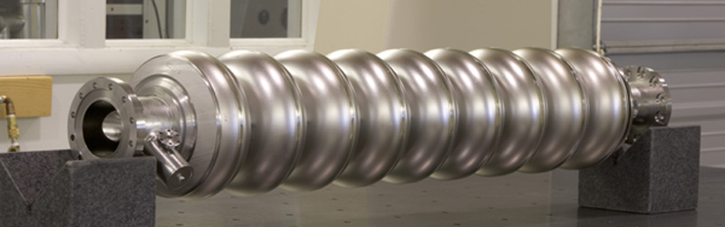
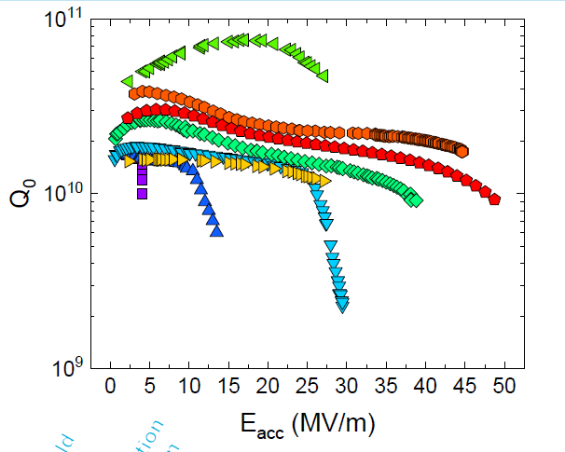
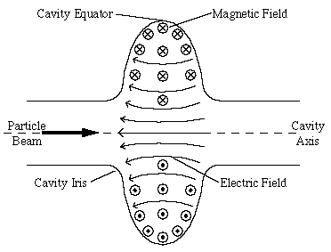
Superconducting Radio Frequency Cavity
https://www-bd.fnal.gov/srf/about_NML.html
1.3 GHz
https://www.classe.cornell.edu/rsrc/Home/Research/SRF/SrfCavitiesAPrimerOne/SRFBas1.GIF
SRF2019 (Anna Grassellino)

Slide 4
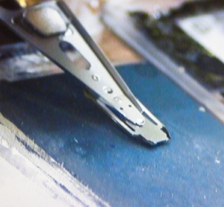
Near-field microwave microscope
Use a near-field microwave microscope to study defects and their relation to cavity performance.
B_{rf}
near SRF cavity operating frequency
Input: (f, P_{input})
Response: (f, P_{f}), (2f, P_{2f}), (3f, P_{3f}), etc.
sample
B_{rf}
J_{surf}

Slide 5
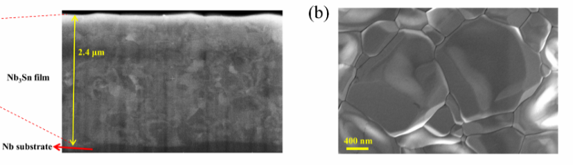
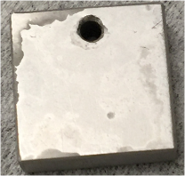
Nb₃Sn film information (Sn-plating converted Nb₃Sn )
Surface SEM
Grain size: 100 nm – 2 um
Cross-section
Size: 1 cm *1cm
Substrate thickness: 3 mm

Slide 6
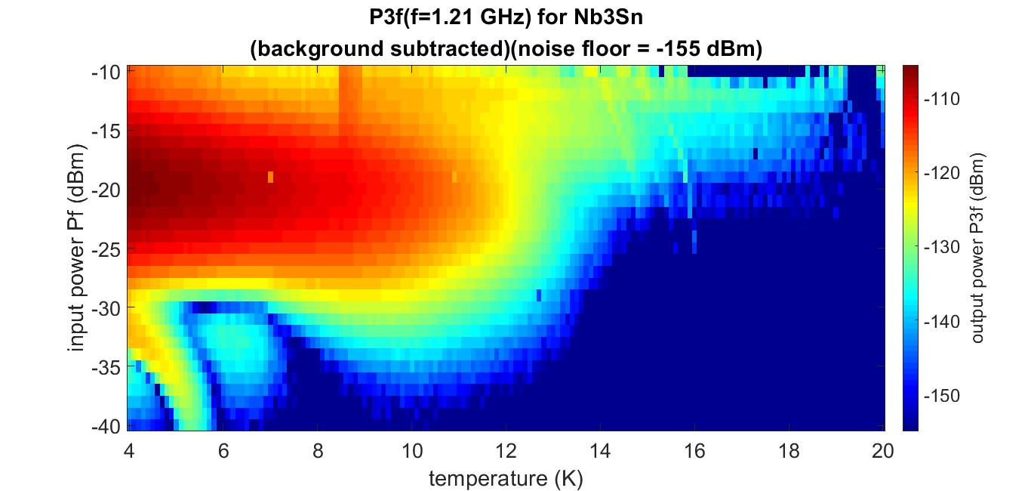
Fixed-point measurement for Nb₃Sn (T_{c} around 18.3 K)
B
normal state
SC
T
superconducting transition-induced nonlinearity
↓
around phase boundary

Slide 7
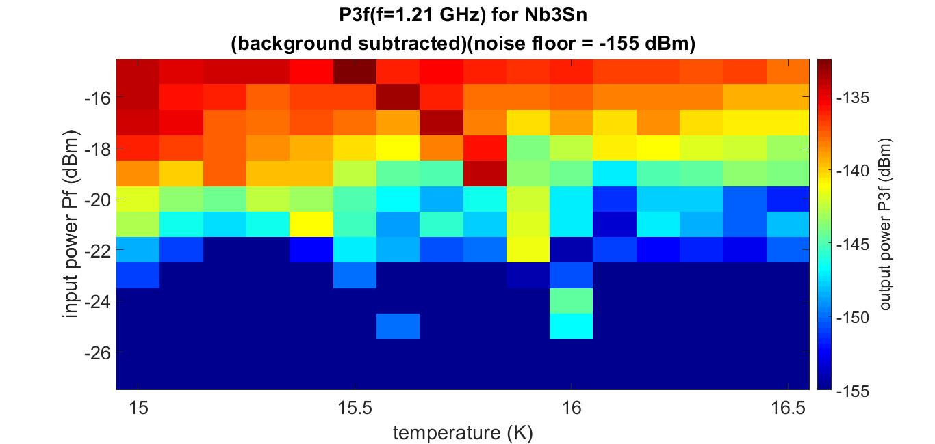
Fixed-point measurement for Nb₃Sn (T_{c} around 18.3 K)

Slide 8
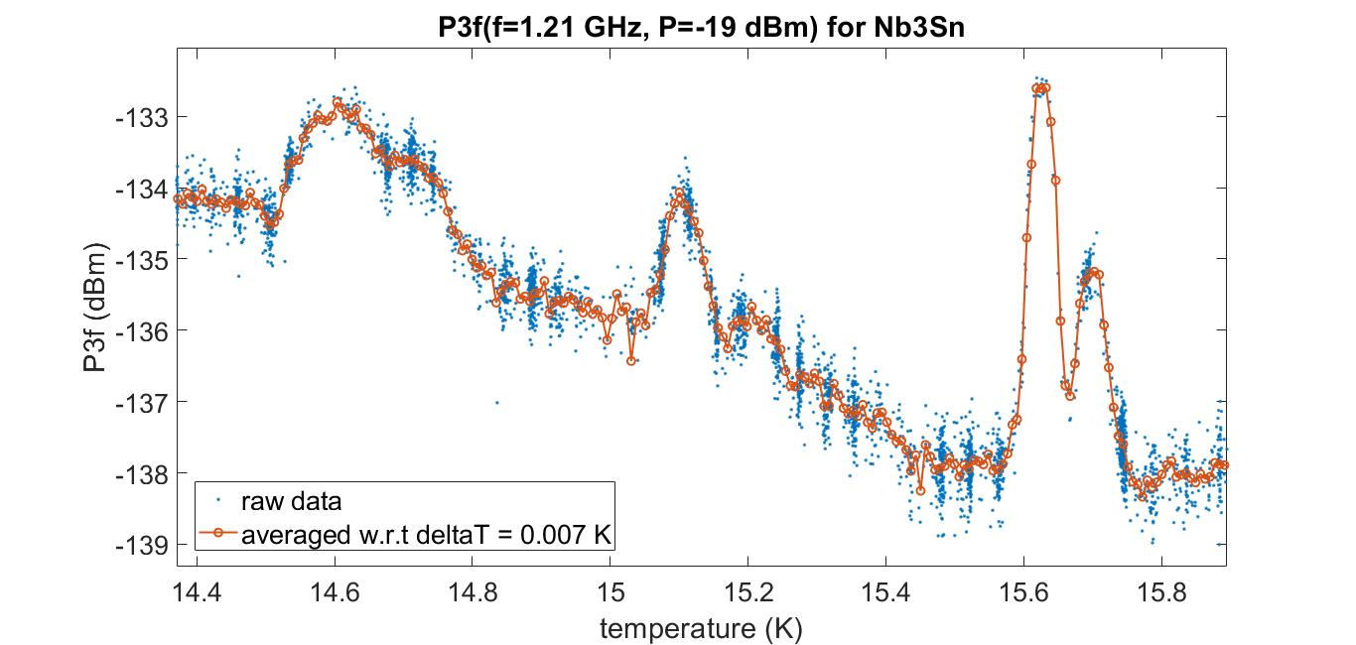




Temperature scan
$$T=14.5 K\sim 14.8 K$$
$$T=15.62 K$$
$$T=15.1 K$$
$$T=15.7 K$$

Slide 9
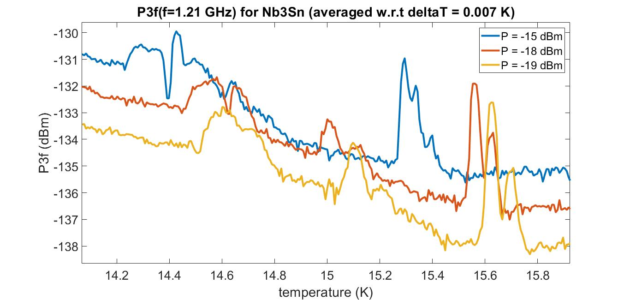
Temperature scan for various input powers
strong power
↓
weak power

Slide 10
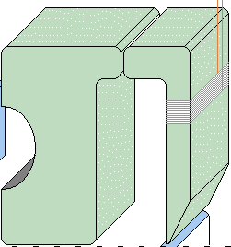
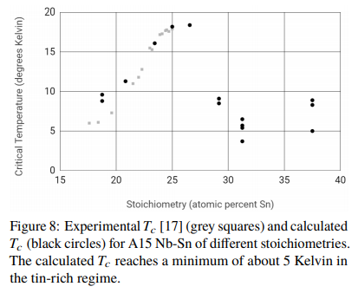
Sources of 3rd harmonic response
Likely harmonic generation from vortex semi-loop
Evidence of several Sn-deficient/Sn-rich Nb₃Sn phases
magnetic writer head
sample
arXiv:1912.07576

Slide 11
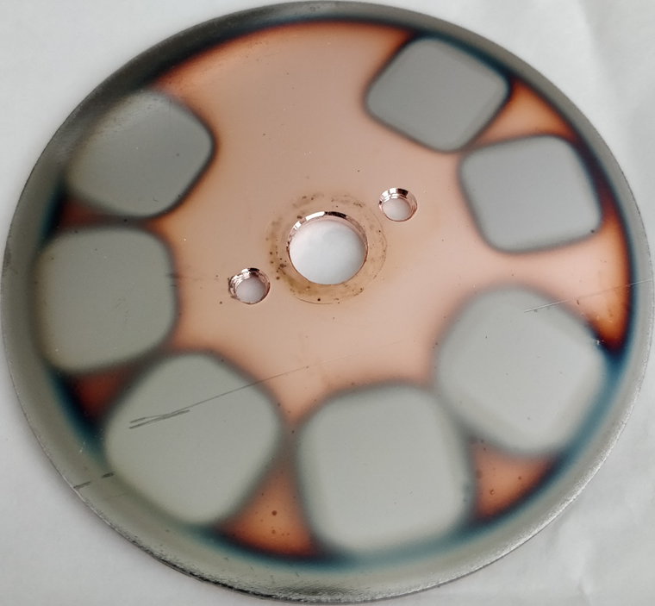
Nb-on-Cu film information
sample 3
sample 2
DCMS – No bias
3.50±0.08 µm
HiPIMS – No bias
1.5±0.1 µm
HiPIMS -125V bias
1.25±0.03 µm
sample 1
HiPIMS -25V bias
1.20±0.05 µm
HiPIMS -100V bias
1.17±0.04 µm
HiPIMS -50V bias
1.24±0.04 µm
HiPIMS -75V bias
1.15±0.04 µm

Slide 12
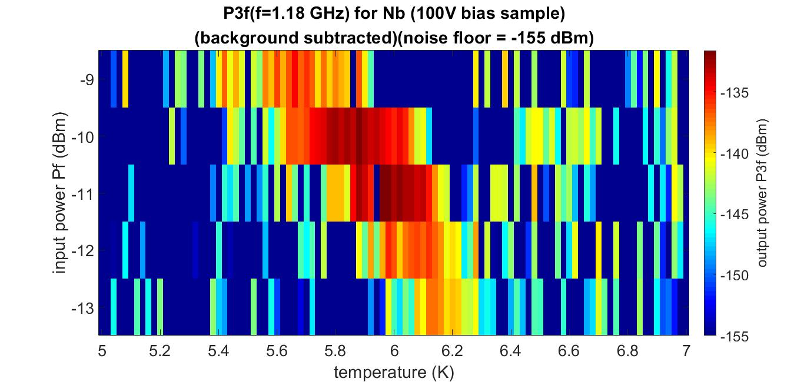
First Nb-on-Cu sample (100 V bias sample)

Slide 13
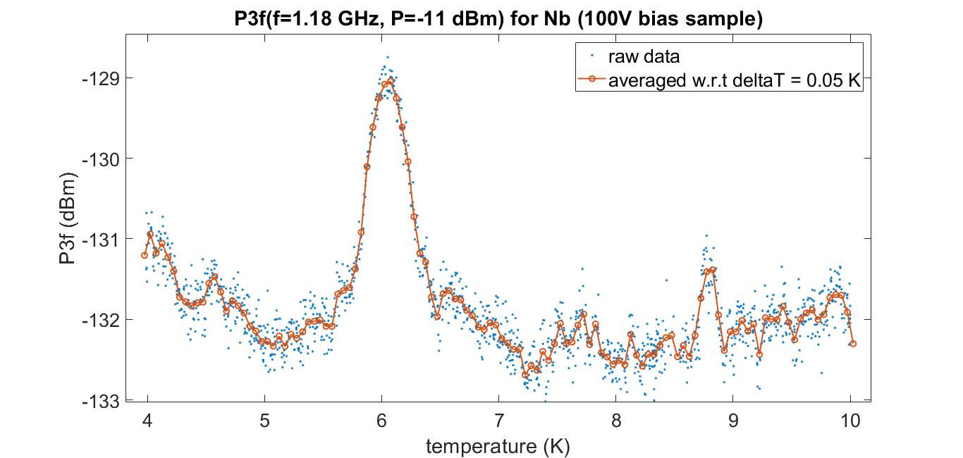
Temperature scan

Slide 14
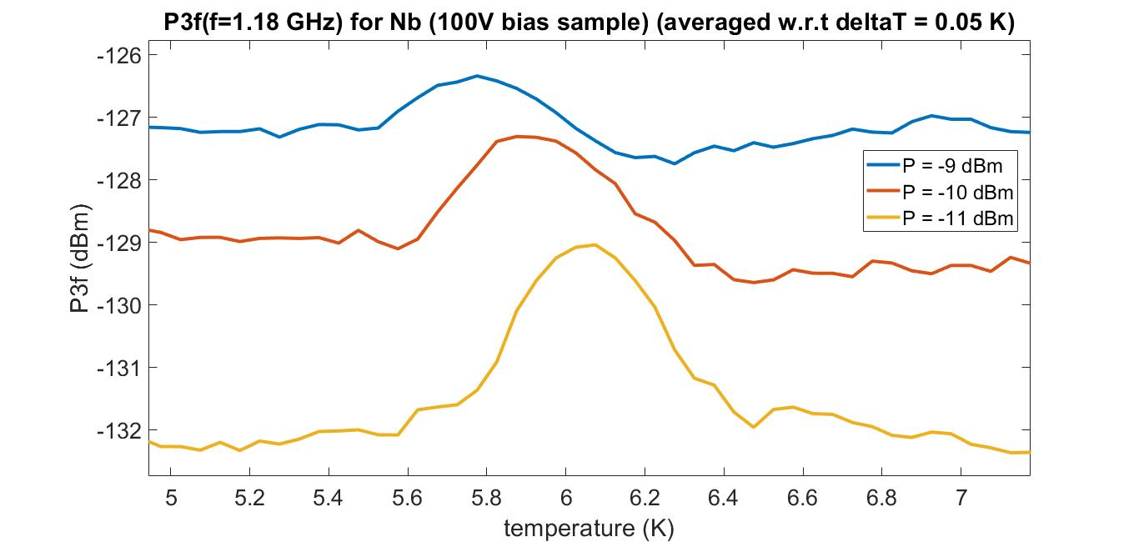
Temperature scan for various input powers
strong power
↓
weak power

Slide 15
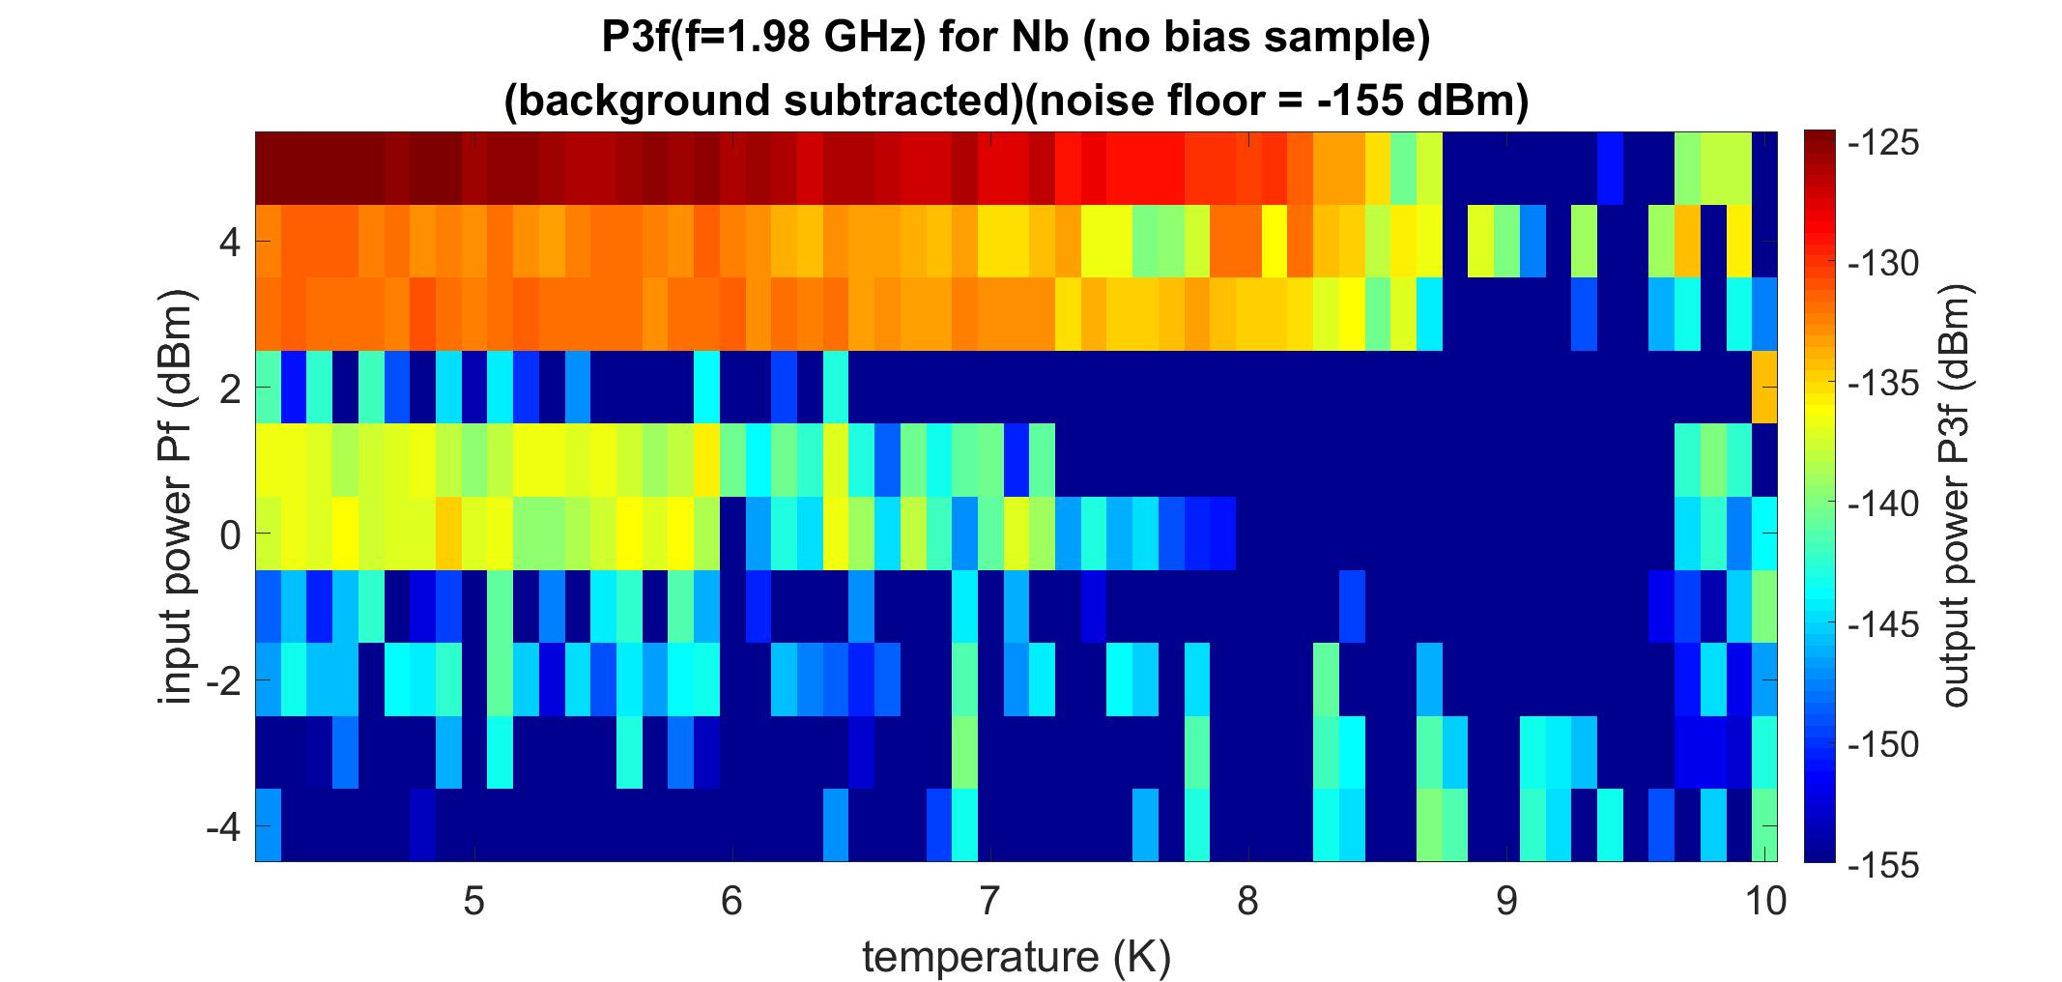
Second Nb-on-Cu sample (no bias sample)

Slide 16
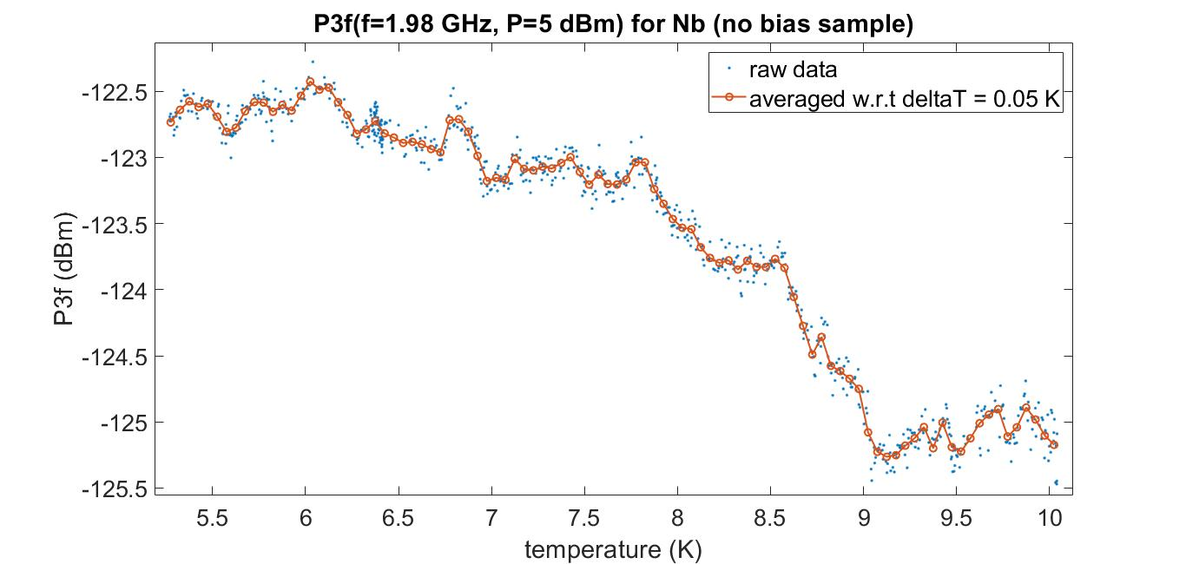
Temperature scan
low temperature nonlinearity up to 9 K
↓
likely to be intrinsic response of Nb

Slide 17
Comparison among Nb-on-Cu samples
sample 3
sample 2
DCMS – No bias
3.50±0.08 µm
HiPIMS – No bias
1.5±0.1 µm
find no nontrivial signal
intrinsic signal from Nb
sample 1
HiPIMS -100V bias
1.17±0.04 µm
superconducting transition around 6.1 K (oxide of Nb?)

Slide 18
Conclusion
Demonstration of magnetic microwave microscope as a RF characterization
Reveal possible existences of lower-T_{c} superconducting transition
Future work:
AFM-based microwave microscope
shielded microwave
probe

Slide 19
Acknowledgement
Nb₃Sn sample (Cornell): Matthias Liepe, Zeming Sun, Thomas Oseroff
Nb-on-Cu sample (CERN): Guillaume Rosaz
This work is funded by US DOE / HEP through grant # DE-SC0017931 and the Maryland QMC.
Special thanks to Seagate Corp. and Western Digital Corp. for providing magnetic probes for us.

Slide 20
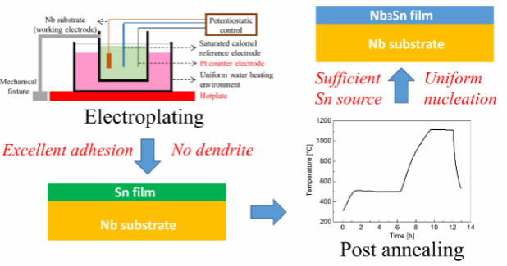
Sample fabrication for Nb₃Sn
Sn-plating converted Nb₃Sn (not vapor diffusion approach)

Slide 21
Coating parameters for Nb-on-Cu
Parameter | HiPIMS | DCMS
Average Power (kW) | 1.3kW | 1.3kW
Discharge Voltage (V) | -660 | -377
Current (A) (peak for HiPIMS) | 160 | 3.4
Gas | Kr | Kr
Pressure (mbar) | 2.3.10⁻³ | 2.3.10⁻³
Temperature (˚C) | 150 | 150
Coating duration (min) | 60 | 60

