Slide 1
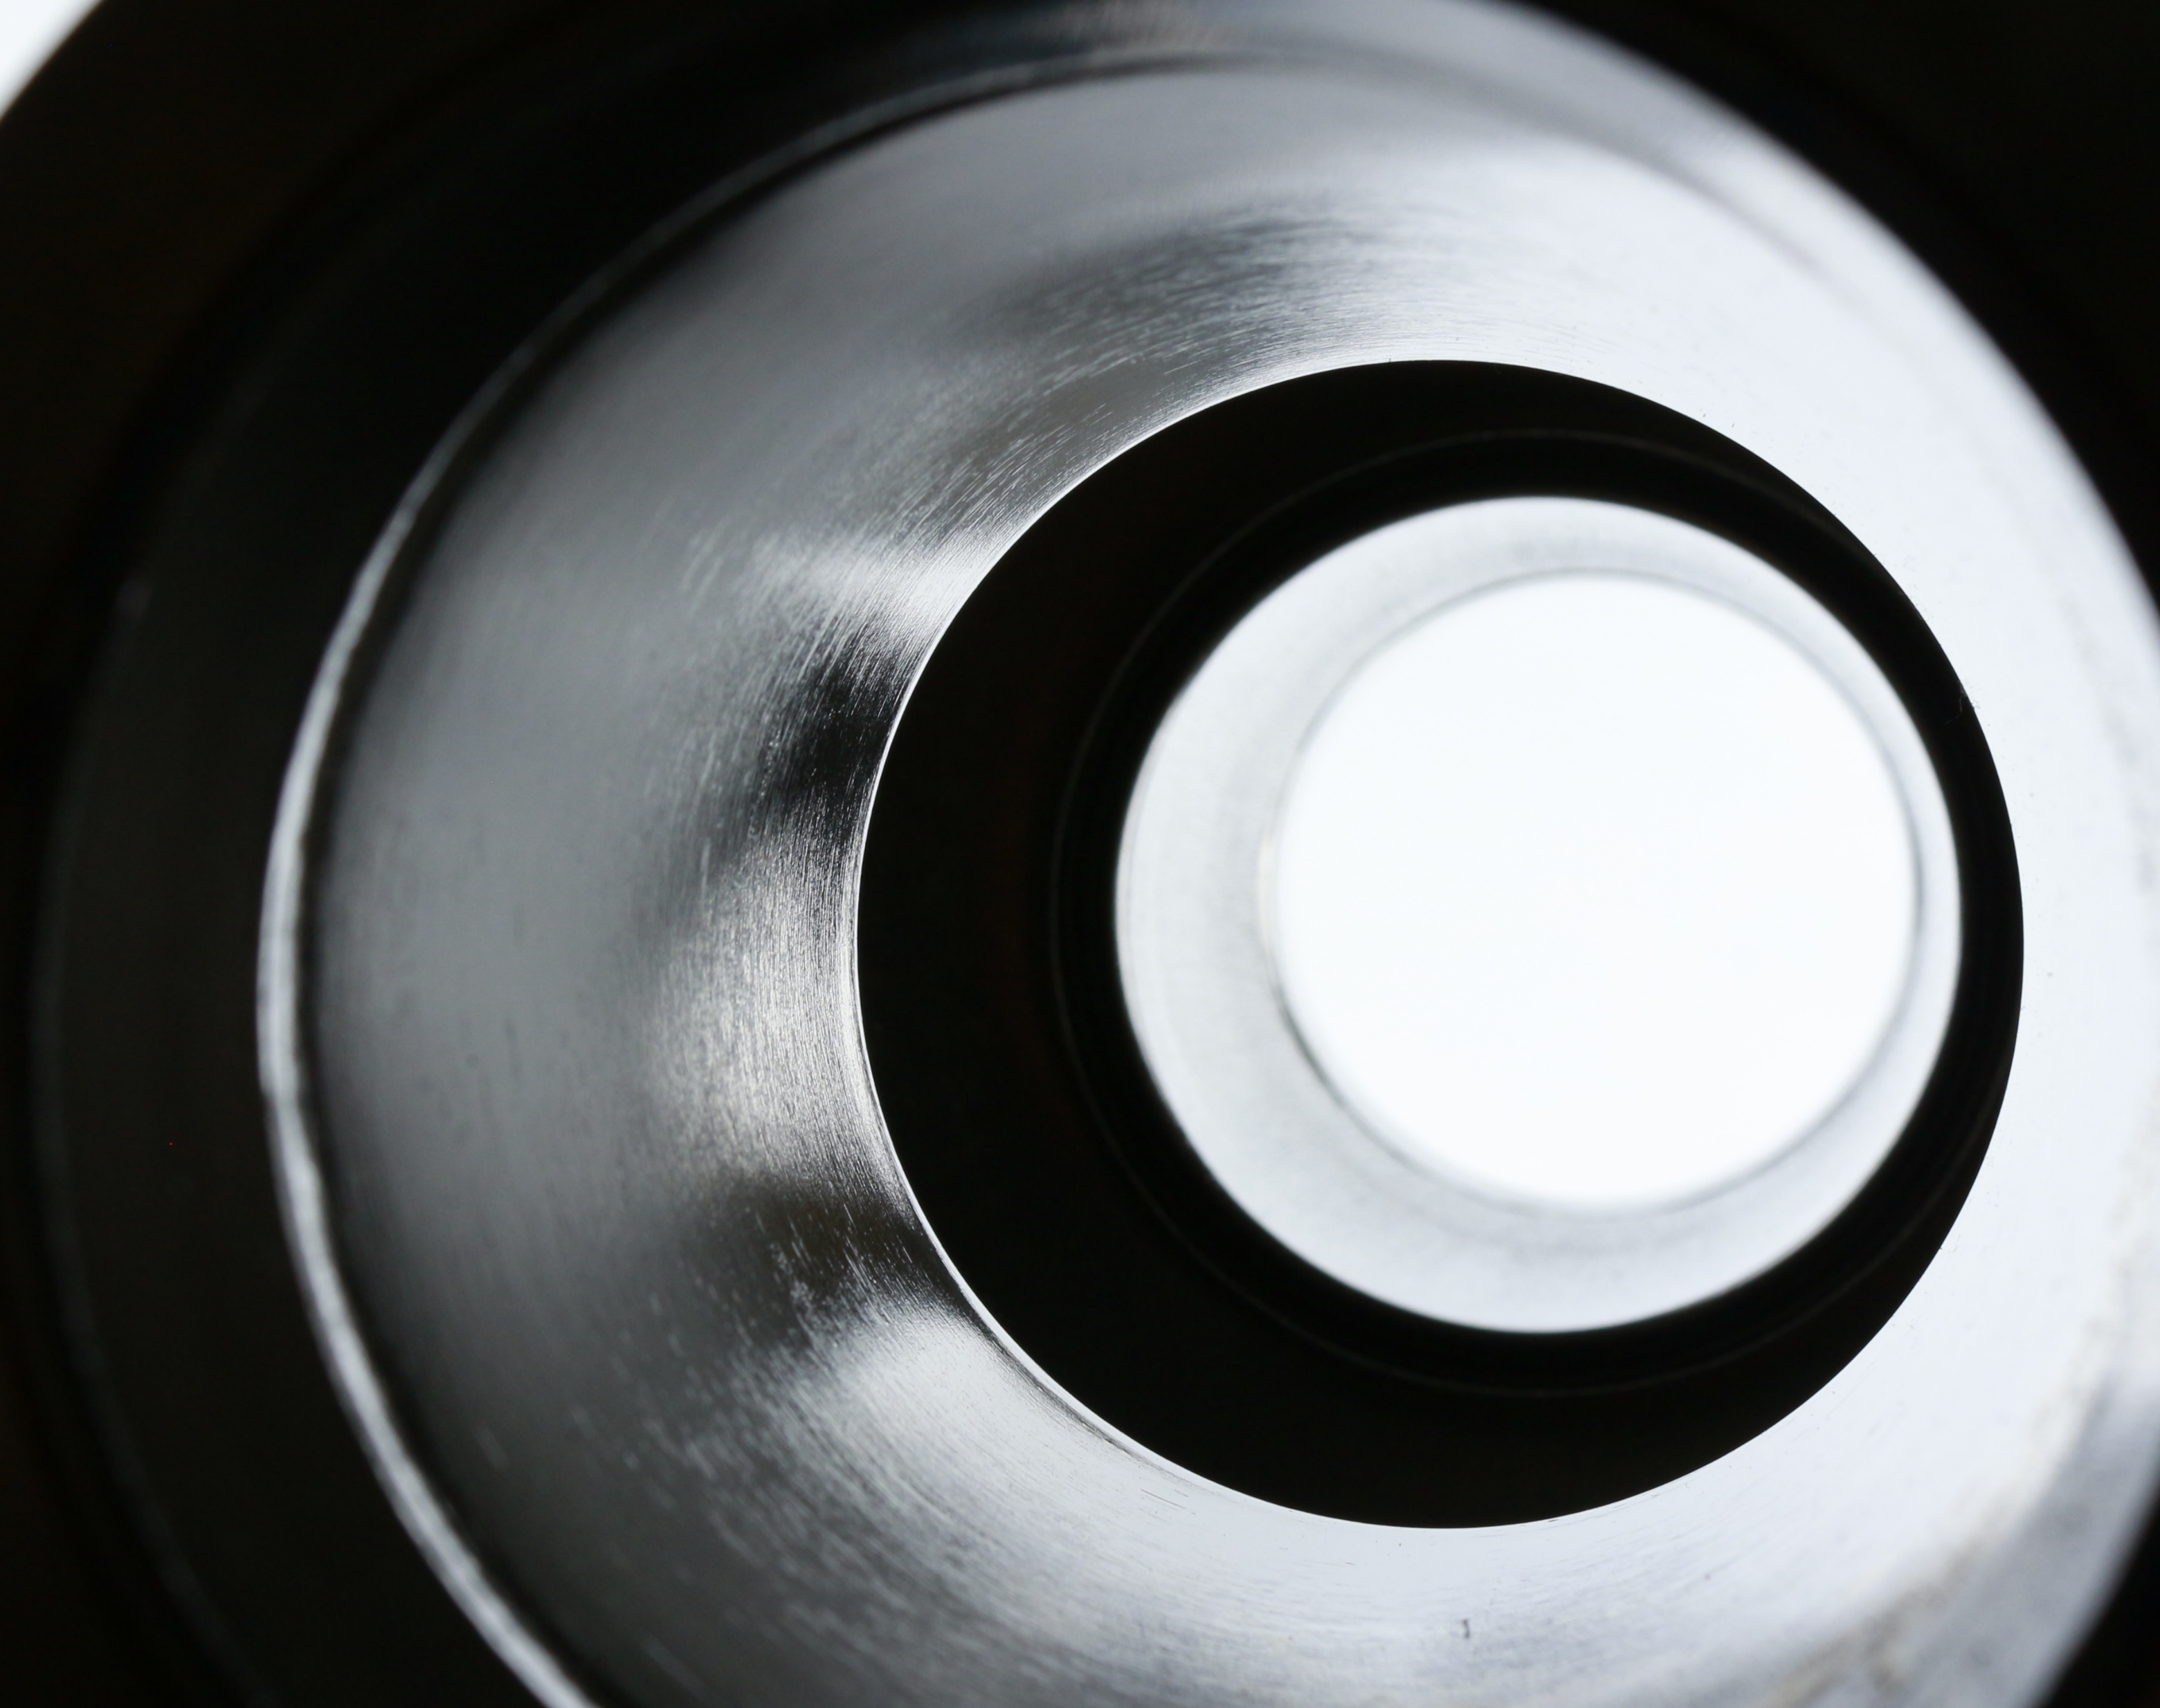
Plasma Electrolytic Polishing as a promising treatment replacement of electropolishing in the Cu and Nb substrate preparation for SRF
The 9th International Workshop on "Thin films applied to Superconducting RF: Pushing the limits of RF Superconductivity"
15-18 March 2021
Eduard Chyhyrynets
Work supported by the INFN CSNV experiment TEFEN

Slide 2
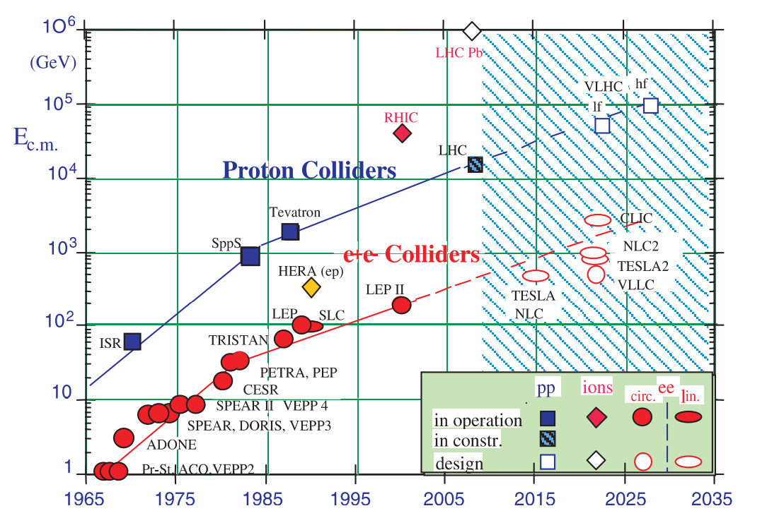
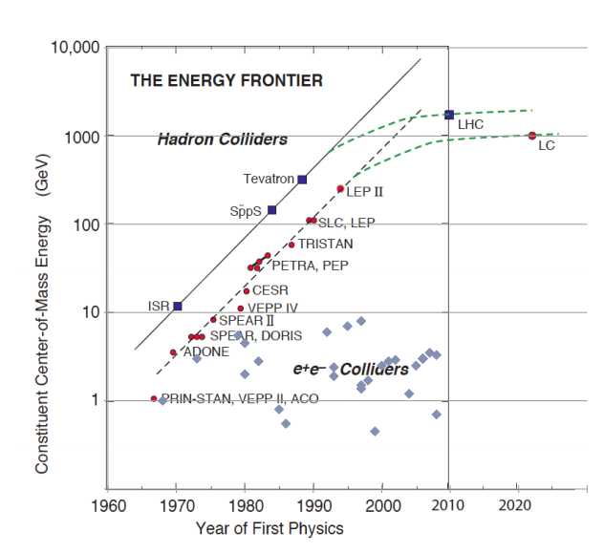
Motivation
S. Tazzari and M. Ferrario, ‘Trends in high energy particle accelerators’, Rep. Prog. Phys., vol. 66, no. 6, pp. 1045–1094, Jun. 2003, doi: 10.1088/0034-4885/66/6/204.
Current and Future Developments in Accelerator Facilities, 2010 IOP Meeting Immediate source: http://www.hep.ucl.ac.uk/iop2010/talks/14.pdf

Slide 3
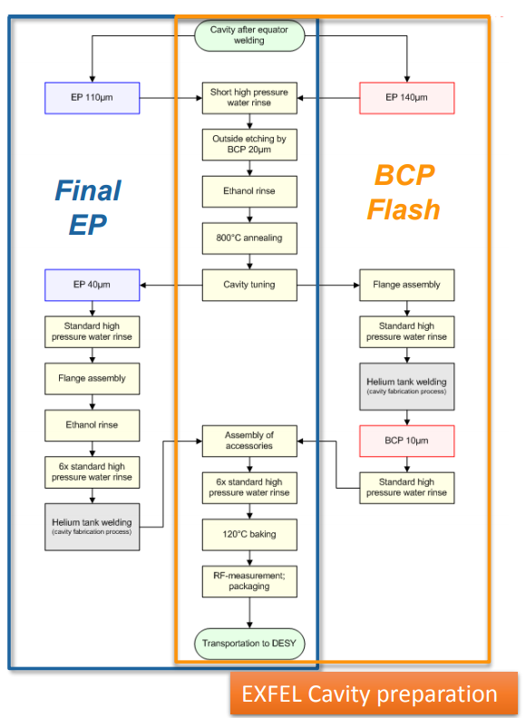
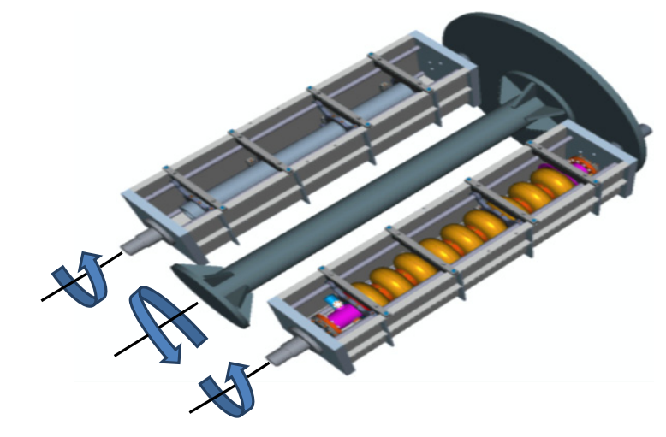
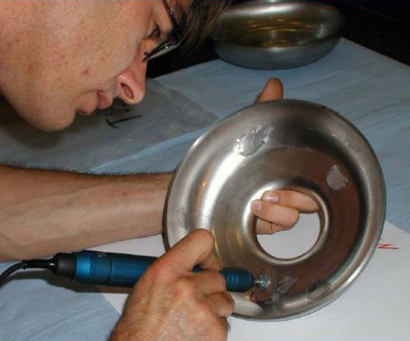
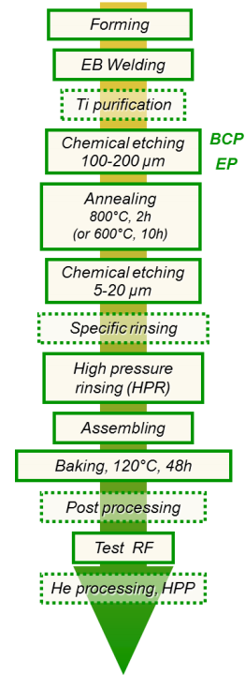
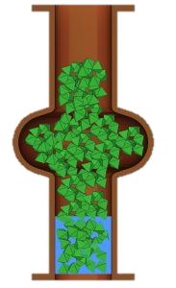
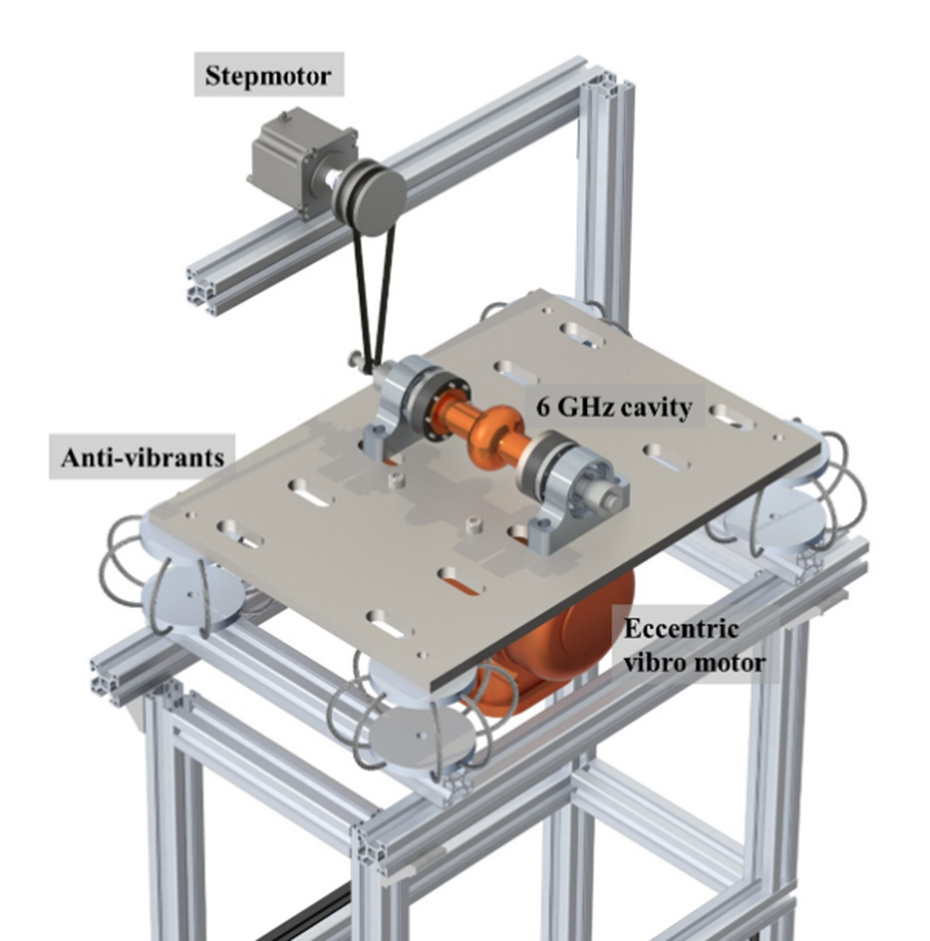
Motivation
C A Cooper and L.D. Cooley 2013 Supercond. Sci. Technol. 26 015011
Daniele Sertore Cavities fabrication¶ EASISchool 3 2020
Claire Antoine Materials and surface aspects in the development of SRF Niobium cavities 2012
Daniele Sertore Cavities fabrication¶ EASISchool 3 2020
Gianluigi Ciovati SURFACE PREPARATION 2015

Slide 4
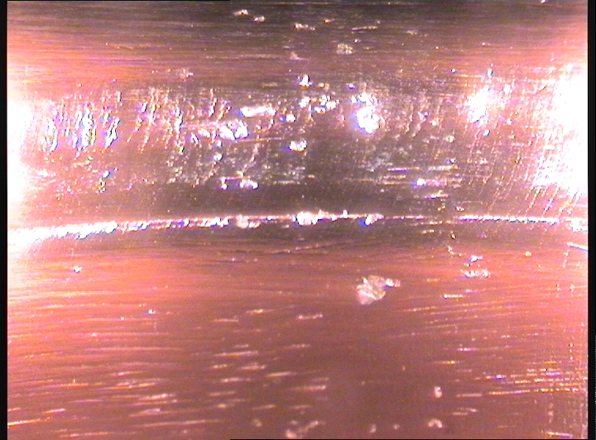
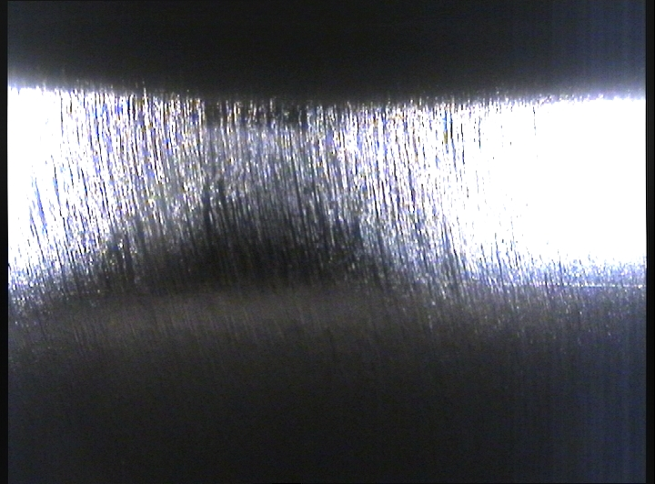
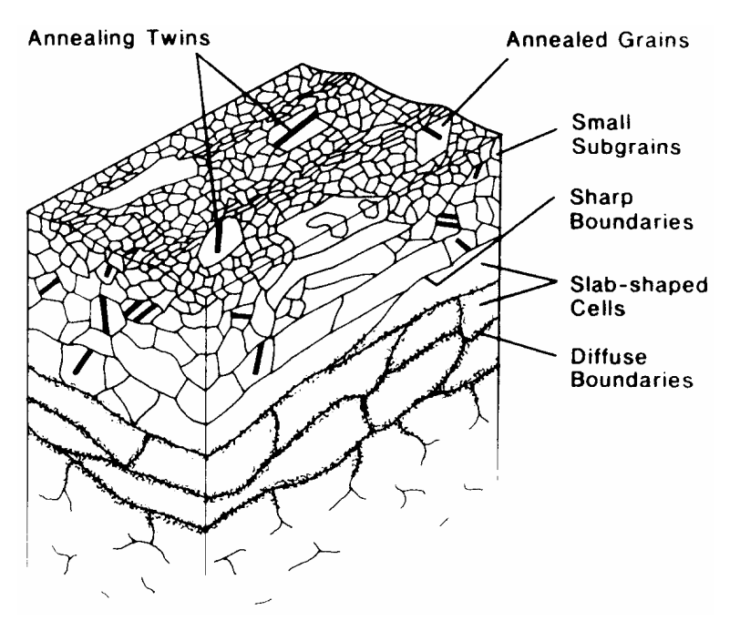
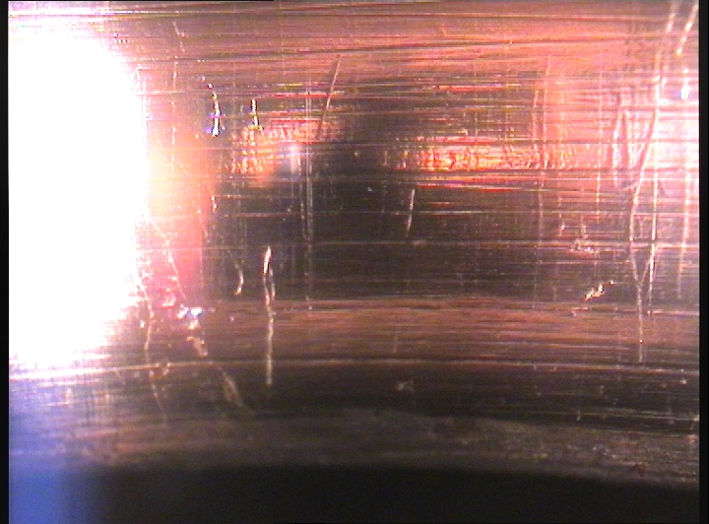
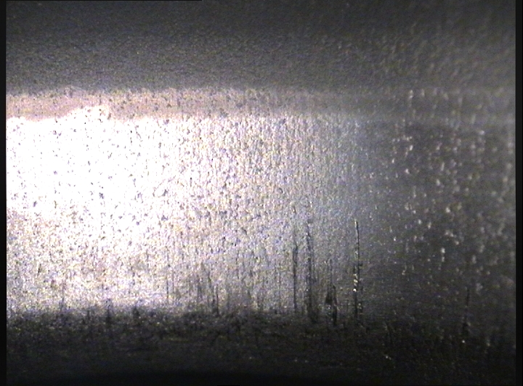
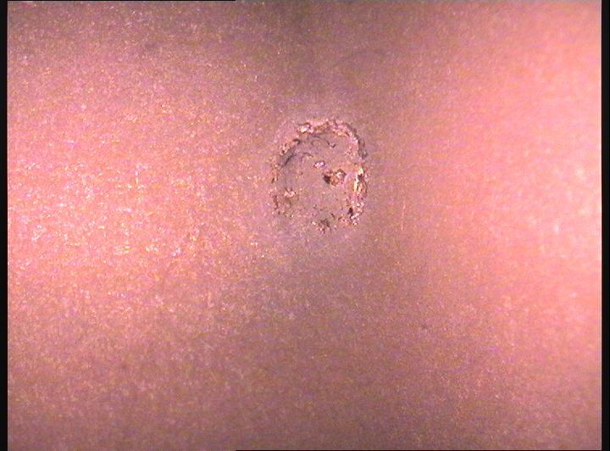
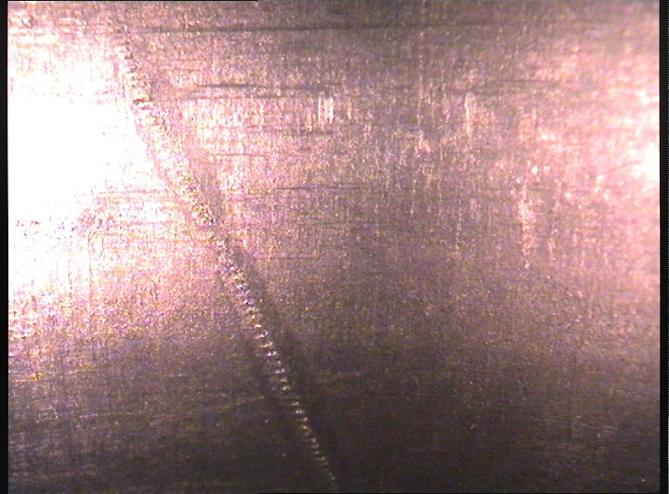
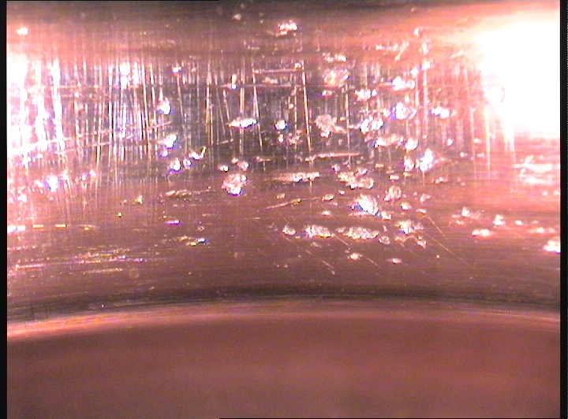
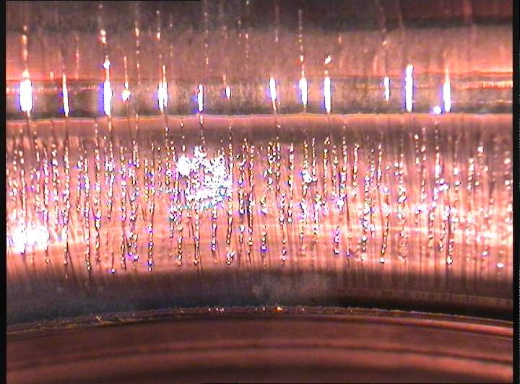
Motivation
Upper layer 0,1-1 μm
Defect layer 1-100 μm
Deformed layer 100-200 μm
Defect-free Bulk
D.M. Turley, L.E. Samuels Metallography +, 275 (1981) and Turley and Samuels; J Iron and Steel Inst, 186 (1957) 211.
Collier, David, and Rod Schuster. “Superpolishing Deep-UV Optics.” Photonics Spectra, February 2005.

Slide 5
Content
PEP state of art.
Comparison with EP.
Potential benefits and prospects for SRF.
Trials and optimization.
Proof of concept: Polishing of Cu and Nb.

Slide 6
Historical overview
Plasma Electrolytic Process
The possibility of electrolysis using an electrical discharge was shown by Gubkin 1 in 1887, J. Gubkin, Ann. Physik 32 [III]
1887
This technology was developed for surface treatments in previous Soviet Union. Many literatures were published in Russian language by Russian and Ukrainian scientists (from 1930s - 1992).
1930
This technology was systematically reviewed and started to draw attention by the Western world researchers until the end of the 20st century (Yerokhin et al. 1999).
2000
Recently technology is being adapting in the various industries and studied in the research institution of Belarus, Bulgaria, Germany, China, Netherland, Russia, Slovakia, USA, Japan, Ukraine and others.
2021

Slide 7
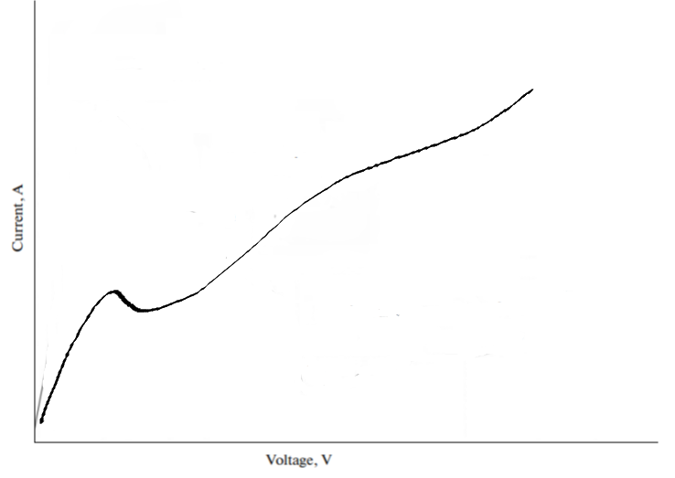
State of art
Conventional electrolysis 0-60 V
v
Current, A
0
Voltage, V
60 V

Slide 8
State of art
Plasma electrolytic processing 200-500 V
Active gas production
v
Current, A
Spark ignition
Arcing regime
Continuous plasma ignition
0
60 V
200 V
Voltage, V
500 V
60 V

Slide 9
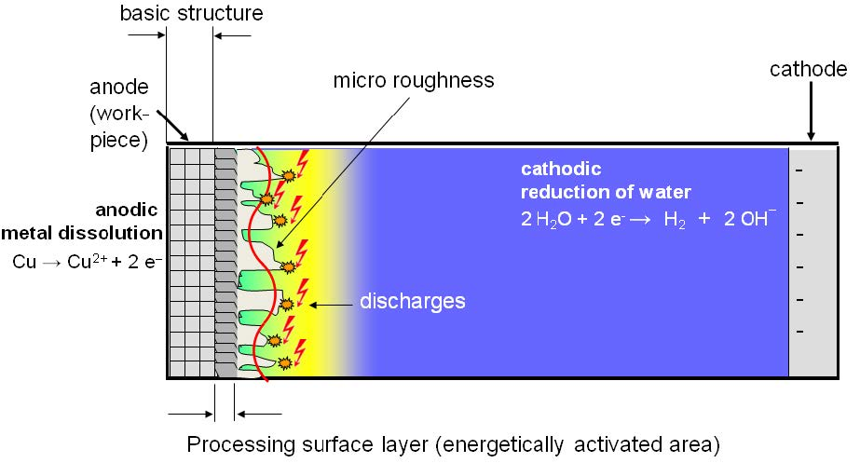
State of art
PEP parameters
Parameters | Values
Voltage range , U | 200-360 V
Current density, i | 0,15-0,5 A/cm²
Bath temp. , T_{b} | 40-95 °C
Time, τ | 1-10 min
Conductivity, δ | 40-300 mS/cm
I. Danilov, M. et. al, ‘Process Understanding of Plasma Electrolytic Polishing through Multiphysics Simulation and Inline Metrology’, Micromachines, vol. 10, no. 3, p. 214, Mar. 2019, doi: 10.3390/mi10030214.
Vana, D et. al, V. Surface Properties of the Stainless Steel X10 CrNi 18/10 after Application of Plasma Polishing in Electrolyte. Int. J. Mod. Eng. Res. 2013, 3, 788–792.

Slide 10
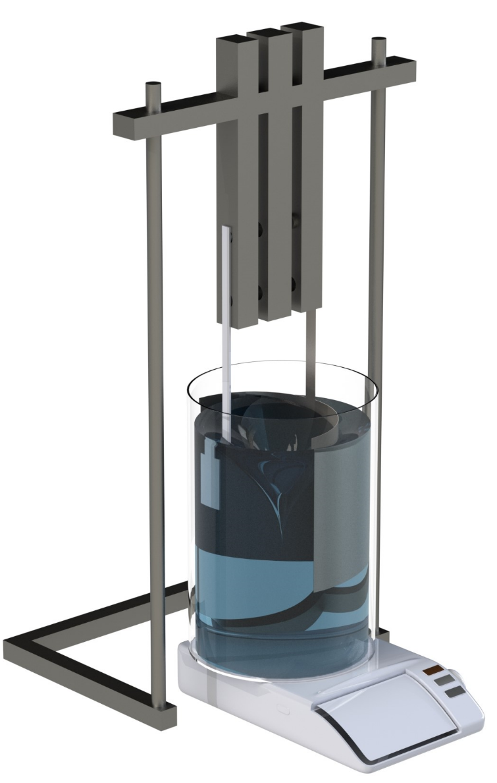
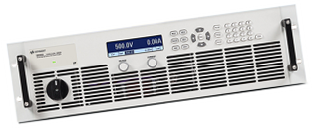
State of art: equipment
Chemical stand with connections to the power supply
High voltage,
High current PSU
Anode/sample
Cathode (s.s.)
Beaker with solution
Magnetic stirrer & heater
Inner surface polishing design
M. Cornelsen, C. Deutsch, and H. Seitz, ‘Electrolytic Plasma Polishing of Pipe Inner Surfaces’, Metals, vol. 8, no. 1, p. 12, Dec. 2017, doi: 10.3390/met8010012.
LNL system

Slide 11
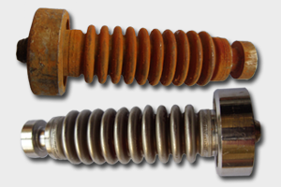
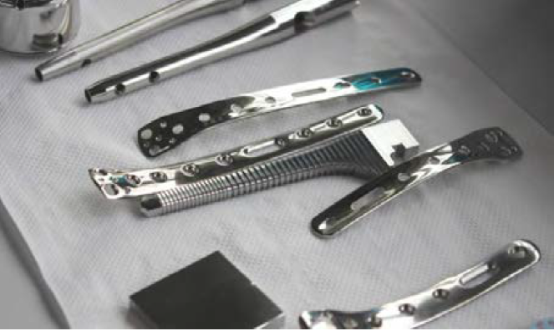
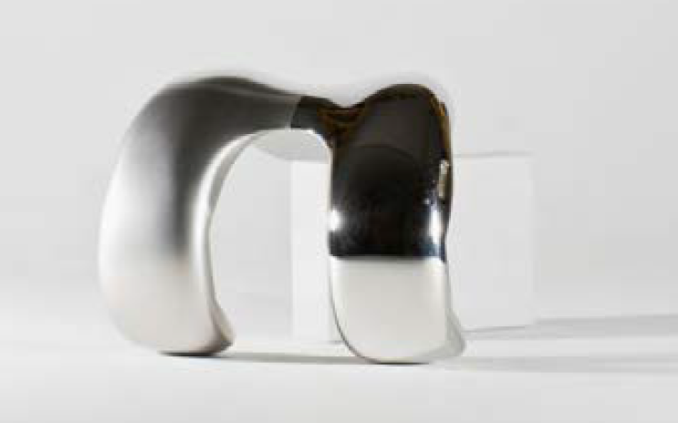
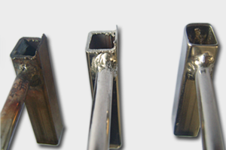
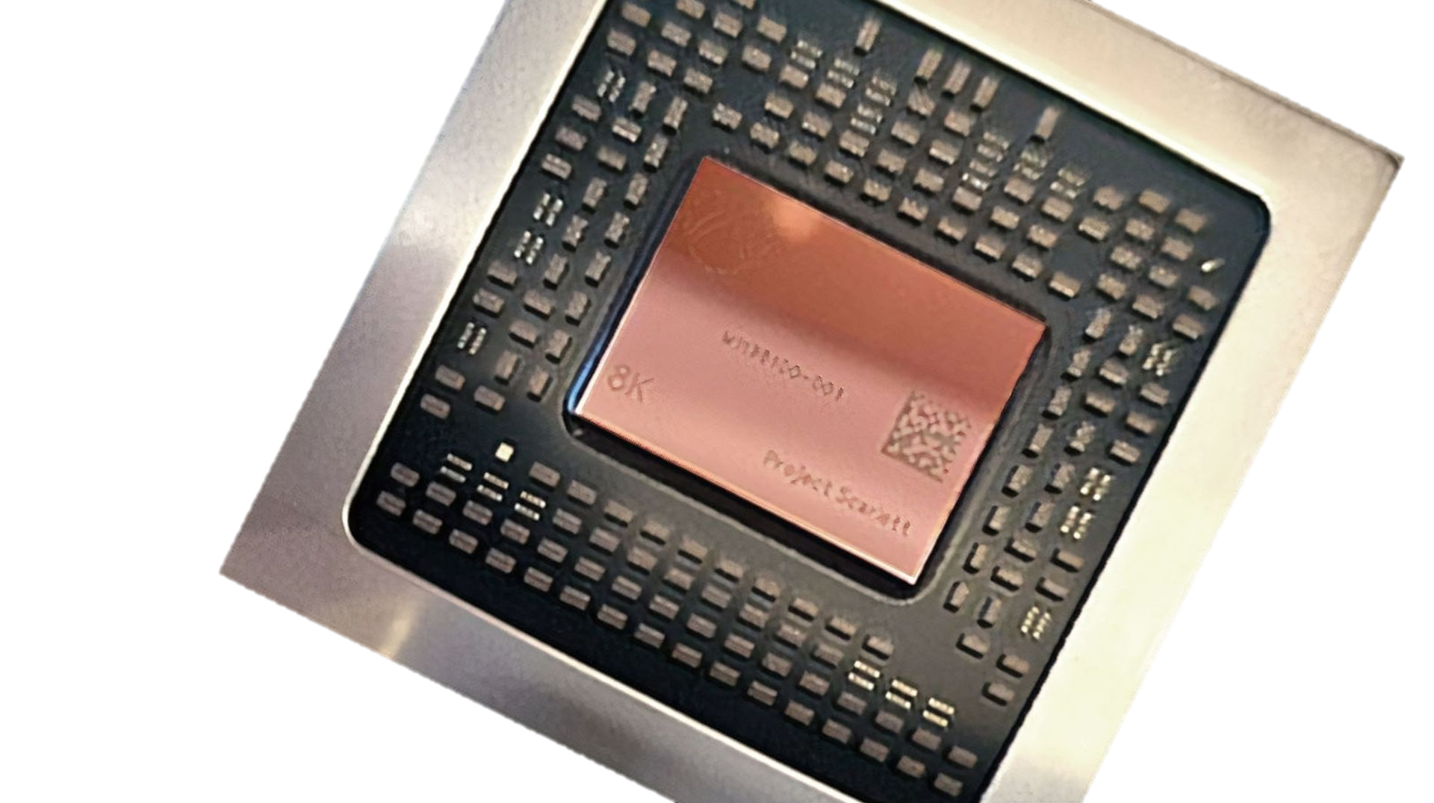
Applications
Semiconductor processing Alloy and multi-metal polishing
Dental implants polishing
Final polishing
Metal surface cleaning
quick surface decontamination (from 30 seconds)
removal of various contaminations (paints, oils, scales, rust/oxides, abrasive impurities) Blunting and deburring
quick removal of burrs with length up to 3 mm
Preparation for coating
cleaning and defatting
etching
surface activation
effective removal of defective coatings for repeated coating
significant improvement of surface wettability

Slide 12
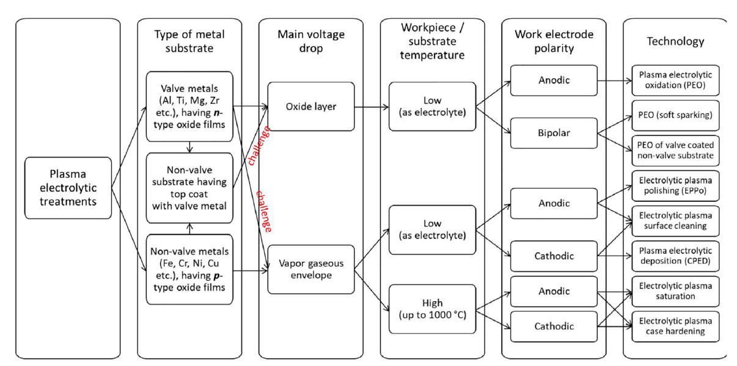
Applications
Commonly polished, available recipes
Various stainless steel alloys
Brass, Bronze Cr, Ni, Co, Mo, W, Zn alloys.
Not well studied, challenging applications
Nb, V, and alloys
Cu and its alloys
Ti and its alloys
E.V. Parfenov, V.R. Mukaeva, R.G. Farrakhov, Plasma electrolytic treatments for advanced surface finishing technologies, Mater. Technol. Des. 1 (1) (2019) 34–41 http://journal.ugatu.ac.ru/index.php/mtd/article/view/1843/1911 .

Slide 13
Applications
Commonly polished, available recipes
Stainless steel alloys
Brass, Bronze Cr, Ni, Co, Mo, W, Zn alloys.
Not well studied, challenging applications
Nb, V, and alloys
Cu and its alloys
Ti and its alloys

Slide 14
Comparison EP vs PEP
Parameters |  | Conventional EP | Plasma Electrolytic Polishing
Pre-treatment |  | Requires (in some cases mechanical) cleaning | Not required
Roughness |  | 0,2 μm | Achievable up to 0,01 μm
Cathode |  | Should follow the shape of the piece | Shape isn’t important
Electrolytes | Metals | Harsh electrolytes, concentrated acids | Greener, diluted water based salts (1-10%)
 | Copper | H₃PO₄(85%):Butanol = 3:2
 | Niobium | H₂SO₄(95-98%):HF(49%)=9:1 | Salts
Time to remove 100 μm |  | 3 h – 7 h | 15-30 min
Voltage |  | 2-60 V | 260-360 V
Temperature |  | Ambient | > 65 ֯C
Current density |  | 0,01-0,04 A/cm² | 0,2-0,6 A/cm²

Slide 15
Advantages and disadvantages
Economical (time & materials)
Ecological (non harsh electrolytes)
Quality (better roughness limits)
Pre-treatment is not required step
Possible substitution of some mechanical treatments
Security requirements
Higher price of PSU.
Holes, pits, caves are hard to treat (like EP).
Higher temperature requirements.

Slide 16
Potential benefits and prospects for SRF
Avoid of mechanical pre-treatment of cavities.
Chemical polishing decrease from 1 day to 1 hr time.
Less harmful, concentrated, expensive wastes. Greener way to treat the substrates.
Less (to prove) of Hydrogen in the Niobium. No H₂SO₄ – no sulfur residuals.
H S

Slide 17
Risk assessment comparison
BCP 1:1:2
EP Nb 1:9
PEP Nb

Slide 18
Risk assessment comparison
BCP 1:1:2
EP Nb 1:9
PEP Nb
Quantity of chemicals (w. %)
79 %
93 %
~5%

Slide 19
Risk assessment comparison
BCP 1:1:2
EP Nb 1:9
PEP Nb
Quantity of chemicals (w. %)
79 %
93 %
~5%
Acids, harsh chemicals
3 Acids: HF:HNO₃:H₃PO₄
2 Acids: HF:H₂SO₄
No acids! Only salt(s)

Slide 20
Risk assessment comparison
BCP 1:1:2
EP Nb 1:9
PEP Nb
Quantity of chemicals (w. %)
79 %
93 %
~5%
Acids, harsh chemicals
3 Acids: HF:HNO₃:H₃PO₄
2 Acids: HF:H₂SO₄
No acids! Only salt(s)
RISK * TIME = More RISK, Time to remove 200 μm
~4 h
~8-11 h
~1 h

Slide 21
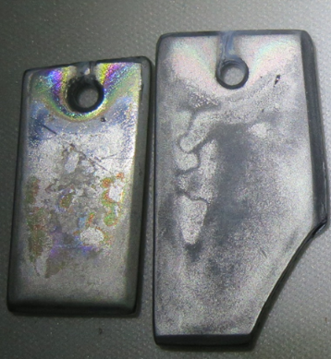
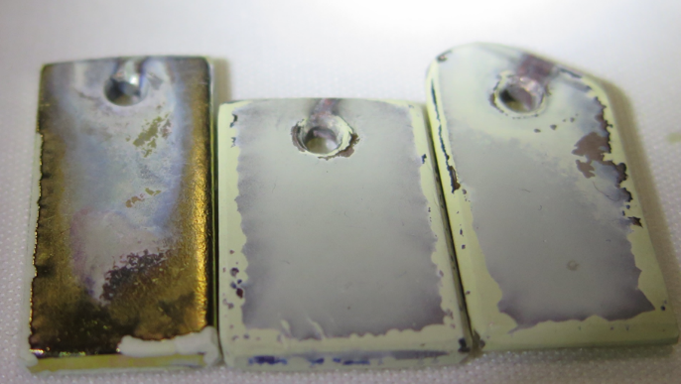
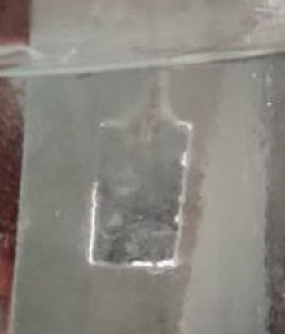
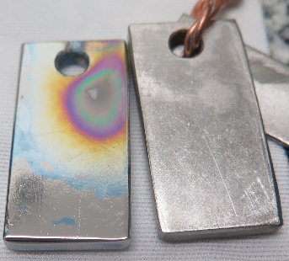
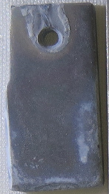
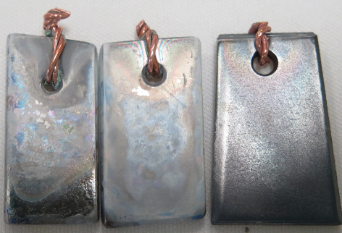
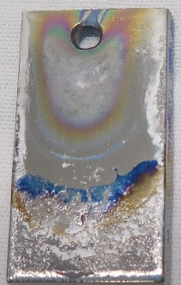
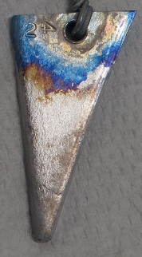
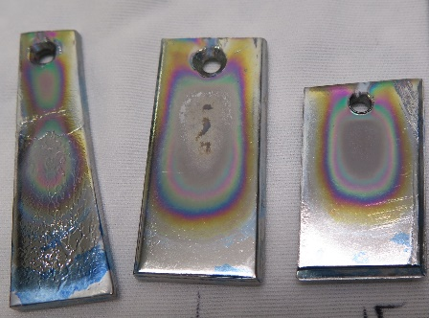
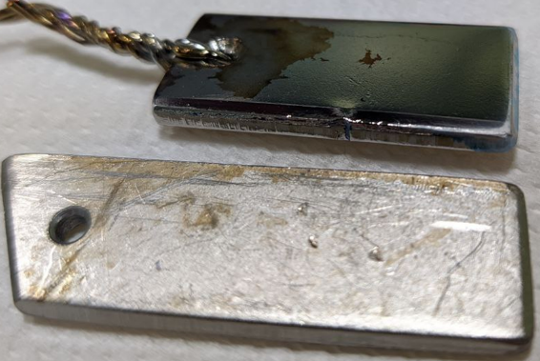
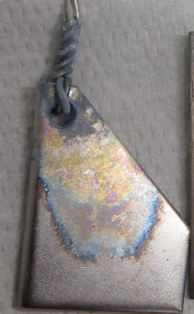
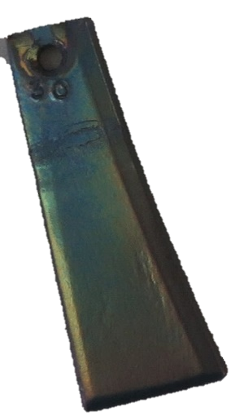
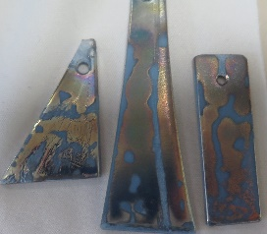
Trials and optimization
Around 10 different compounds were tried and their mixtures.
Study of the bath temperature.
Cathode shape study.
Salts production.
Conductivity study.

Slide 22
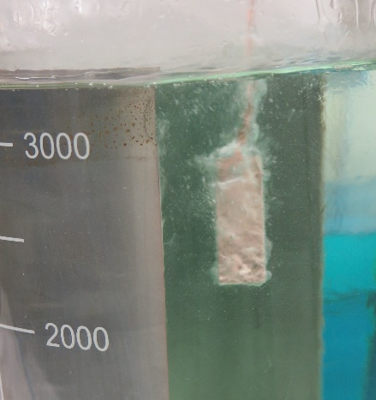
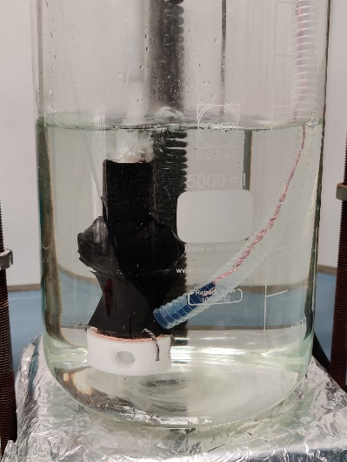
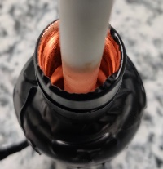
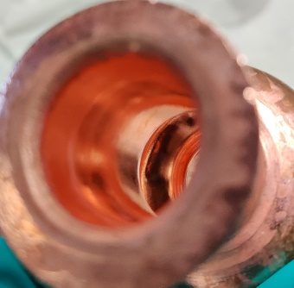
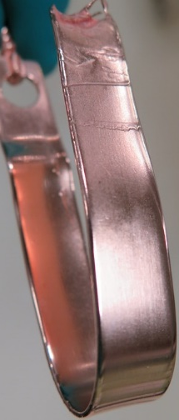
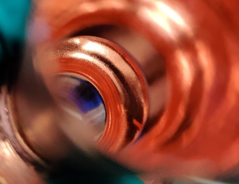
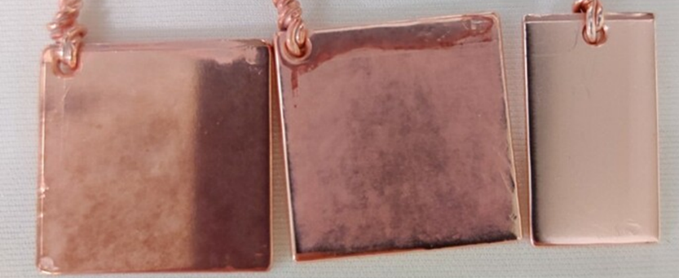
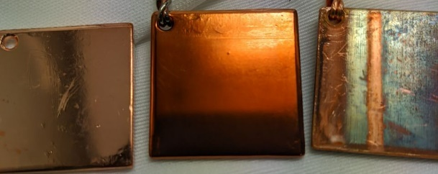
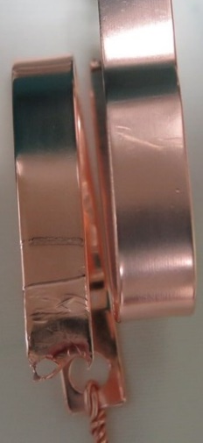
Trials and optimization
Around 15 different compounds were tried.
Study on the bath temperature.
Voltage range.
Conductivity study.

Slide 23
Proof of concept: Nb
Comparison BCP, EP and PEP
Process / parameters | BCP (1:1:2) | EP (1:9) | PEP
Solution composition | HF:HNO₃:H₃PO₄ | HF:H₂SO₄ | 1-5 % of Salt
Voltage | - | 18 V | 300 V
Current density | - | 0,025 A/cm² | 0,4-0,6 A/cm²
Power draw | - | 0,45 W/cm² | ~150 W/cm²

Slide 24
Proof of concept: Nb
Comparison BCP, EP and PEP
Process / parameters | BCP (1:1:2) | EP (1:9) | PEP
Solution composition | HF:HNO₃:H₃PO₄ | HF:H₂SO₄ | 1-5 % of Salt
Voltage | - | 18 V | 300 V
Current density | - | 0,025 A/cm² | 0,4-0,6 A/cm²
Power draw | - | 0,45 W/cm² | ~150 W/cm²
Removing rate | 1 µm/min (15 ̊C) * | 0.3 µm/min (30 ̊C) * | 3.5 µm/min (78 ̊C)
Faster then BCP by 3,5 x Faster then EP by 11,6 x

Slide 25
Proof of concept: Nb
Comparison BCP, EP and PEP
Process / parameters | BCP (1:1:2) | EP (1:9) | PEP
Solution composition | HF:HNO₃:H₃PO₄ | HF:H₂SO₄ | 1-5 % of Salt
Voltage | - | 18 V | 300 V
Current density | - | 0,025 A/cm² | 0,4-0,6 A/cm²
Power draw | - | 0,45 W/cm² | ~150 W/cm²
Removing rate | 1 µm/min (15 ̊C) * | 0.3 µm/min (30 ̊C) * | 3.5 µm/min (78 ̊C)
Time of treatment | 5 min | 20min | 2 min
To remove similar values = 6-7 µm

Slide 26
Proof of concept: Nb
Comparison BCP, EP and PEP
Process / parameters | BCP (1:1:2) | EP (1:9) | PEP
Solution composition | HF:HNO₃:H₃PO₄ | HF:H₂SO₄ | 1-5 % of Salt
Voltage | - | 18 V | 300 V
Current density | - | 0,025 A/cm² | 0,4-0,6 A/cm²
Power draw | - | 0,45 W/cm² | ~150 W/cm²
Removing rate | 1 µm/min (15 ̊C) * | 0.3 µm/min (30 ̊C) * | 3.5 µm/min (78 ̊C)
Time of treatment | 5 min | 20min | 2 min
Removed | 6 µm | 6,5 µm | 7 µm
Roughness evaluated with a Veeco Dektat 8 Profilometer

Slide 27
Proof of concept: Nb
Comparison BCP, EP and PEP
Initial
BCP 5 min 6 µm
EP 20min 6,5 µm
PEP 2 min 7 µm
PEP 2 min 7 µm
Ra 548±62 nm Ra 440±17 nm Ra 390±23 nm Ra 251±31 nm
Rq 557±142 nm Rq 481±92 nm Rq 327±71 nm Rq 267±29 nm

Slide 28
Proof of concept: Nb
Comparison BCP, EP and PEP
Initial
BCP
EP
PEP

Slide 29
Proof of concept: Nb
Comparison BCP, EP and PEP
Initial
BCP 5 min; 6 µm
EP 20 min; 6,5 µm
PEP 2 min; 7µm
Initial
BCP
EP
PEP

Slide 30
Proof of concept: Nb
Initial 100x
Initial 500x
Initial 1000x
PEP 100x; 2 min
PEP 500x; 2 min
PEP 1000x; 2 min

Slide 31
Proof of concept: Cu
Comparison SUBU5, EP and PEP
Process / parameters | SUBU5 | EP (3:2) | PEP
Solution | Sulfamic acid 5 g/l; NH₄-citrate 1 g/l Butanol 50 ml/l; H₂O₂ 50 ml/l; | 85 % H₃PO₄ : n-Butanol | Diluted salts
Voltage | - | 2-6 V | 300 V
Current density | - | 0,01 – 0,03 A/cm² | 0,35-0,45 A/cm²
Power draw | - | 0,12 W/cm² | 135 W/cm²

Slide 32
Proof of concept: Cu
Comparison SUBU5, EP and PEP
Process / parameters | SUBU5 | EP (3:2) | PEP
Solution | Sulfamic acid 5 g/l; NH₄-citrate 1 g/l Butanol 50 ml/l; H₂O₂ 50 ml/l; | 85 % H₃PO₄ : n-Butanol | Diluted salts
Voltage | - | 2-6 V | 300 V
Current density | - | 0,01 – 0,03 A/cm² | 0,35-0,45 A/cm²
Power draw | - | 0,12 W/cm² | 135 W/cm²
Removing rate | 1,5 (70±2 ̊C) μm/min * | 0,15-0,5 (25 ̊C) μm/min | 3-6 (72-80 ̊C) μm/min
Faster then SUBU5 by ~ 3 x Faster then EP by ~10 x

Slide 33
Proof of concept: Cu
Comparison SUBU5, EP and PEP
Process / parameters | SUBU5 | EP (3:2) | PEP
Solution | Sulfamic acid 5 g/l; NH₄-citrate 1 g/l Butanol 50 ml/l; H₂O₂ 50 ml/l; | 85 % H₃PO₄ : n-Butanol | Diluted salts
Voltage | - | 2-6 V | 300 V
Current density | - | 0,01 – 0,03 A/cm² | 0,35-0,45 A/cm²
Power draw | - | 0,12 W/cm² | 135 W/cm²
Removing rate | 1,5 (70±2 ̊C) μm/min | 0,15-0,5 (25 ̊C) μm/min | 3-6 (72-80 ̊C) μm/min
Time of treatment | 5 min | 30 min | 2 min
To remove similar values = 7,5-8 µm

Slide 34
Proof of concept: Cu
Comparison SUBU5, EP and PEP
Process / parameters | SUBU5 | EP (3:2) | PEP
Solution | Sulfamic acid 5 g/l; NH₄-citrate 1 g/l Butanol 50 ml/l; H₂O₂ 50 ml/l; | 85 % H₃PO₄ : n-Butanol | Diluted salts
Voltage | - | 2-6 V | 300 V
Current density | - | 0,01 – 0,03 A/cm² | 0,35-0,45 A/cm²
Power draw | - | 0,12 W/cm² | 135 W/cm²
Removing rate | 1,5 (70±2 ̊C) μm/min | 0,15-0,5 (25 ̊C) μm/min | 3-6 (72-80 ̊C) μm/min
Time of treatment | 5 min | 30 min | 2 min
Removed | 7,5 μm | 8 μm | 8 μm
Roughness evaluated with a Veeco Dektat 8 Profilometer

Slide 35
Proof of concept: Cu
Comparison SUBU5, EP and PEP
SUBU 5 min 7,5 μm
EP 30min 8 μm
PEP 2 min 8 μm
Initial ! Rough surface !
Ra 490±19 nm Ra 113±21 nm Ra 98±9 nm Ra 72±12 nm
Rq 562±84 nm Rq 331±126 nm Rq 152±41 nm Rq 93±19 nm

Slide 36
Proof of concept: Cu
Comparison of SUBU, EP and PEP
Initial
SUBU 5 min 7,5 μm
EP 30 min
8 μm
PEP 2 min 8 μm

Slide 37
Proof of concept: Cu
Comparison of SUBU, EP and PEP
Initial
SUBU 5 min; 7,5 μm
EP 30 min; 8 μm
PEP 2 min; 8 μm
Initial
SUBU
EP
PEP

Slide 38
Proof of concept: Cu
150x Initial
600x Initial
2400x Initial
75x PEP 5 min
600x PEP 5 min
2400x PEP 5 min

Slide 39
Conclusions
Two recipes of PEP were developed and studied to polish Nb and Cu.
Similar or better surface can be achieved with PEP comparing to EP.
Proved higher performance, and ecological benefits.
Hydrogen disease – to evaluate.

Slide 40
Future work
Further optimization and look out of recipes for PEP of Nb and Cu.
Design and implementation of PEP polishing of inner surfaces of 6 & 1.3 GHz cavities.
Website https://surfacetreatments.it
https://chyhyrynets.com Thanks to Cristian Pira, Fabrizio Stivanello, Vanessa Garcia, Roberta Caforio, Matteo Zanierato
Material Science and Technology Service for Nuclear Physics crew

Slide 41
State of art
A. L. Yerokhin, X. Nie, A. Leyland, A. Matthews, and S. J. Dowey, ‘Plasma electrolysis for surface engineering’, Surface and Coatings Technology, vol. 122, no. 2–3, pp. 73–93, Dec. 1999, doi: 10.1016/S0257-8972(99)00441-7.

Slide 42
Nb chemistry
Electrochemistry
BCP
A: 2Nb + 5H₂O = Nb₂O₅ + 10H⁺ + 10e
2Nb + 5NO₃⁻ = Nb₂O₅ + 5NO₂ + 5e
C: 2 H⁺= H₂ + 2e⁻
6 Nb + 10 HNO₃ = 3 Nb₂O₅ + 10 NO↑ + 5 H₂O
Nb₂O₅ + 10 HF = 2 NbF₅ + 5 H₂O
Nb₂O₅ + 6HF ⇒ H₂NbOF_{5 (soluble)}
NbO₂F ∙ ½H₂O _{(insoluble)} + 1.5H₂O
NbO₂F ∙ ½ H₂O + 4HF ⇒ H₂NbOF₅ + 1.5H₂O
Nb₂O₅ + HF = H₂NbOF₅(aq) + HNbF₆(aq)+ NbF₅(aq)+ H₆NbO₂F₇(aq)+ H₂NbF₇(aq) +H₂O

