Slide 1

Main highlights ARIES WP15 team collaboration on Thin Film for Superconducting RF (TF-SRF)
Oleg Malyshev
ARIES WP15 coordinator
on behalf of the WP15 team
9th International Workshop on Thin Film and New Ideas for pushing the Limits of RF Superconductivity , 15-18 March 2021

Slide 2
What is ARIES project?
ARIES is a Horizon 2020 Integrating Activity, co-funded by the European Commission
  Accelerator started 01/05/2017
  Research and end date 31/04/2021
  Innovation for
  European
  Science and Society
Three components of ARIES:
  Network (NA), Transnational Access (TNA), Joint research activities (JRA) in 18 WPs
    JRA – only four WPs, where
      WP15: Thin films for superconducting cavities

Slide 3
WP15 Description
The aim of this work package is to intensify systematic studies and development of the coating technology of superconducting materials to enable the superconducting coated RF cavities with Q(E) characteristics better than for the bulk ones.
The main emphasis is on a systematic study of correlation between
  substrate surface preparation,
  deposition parameters for:
    superconducting material Nb, NbN, Nb₃Sn, NbTiN and SIS
    deposited on Cu substrate,
  film structure, morphology, chemistry, phase,
  AC and DC superconductivity parameters:
    such as T_{c}, H_{c}, H_{fp}, H_{sh}, RRR
  and, finally, the behaviour at RF conditions with the test cavities at CERN, HZB and STFC.

Slide 4
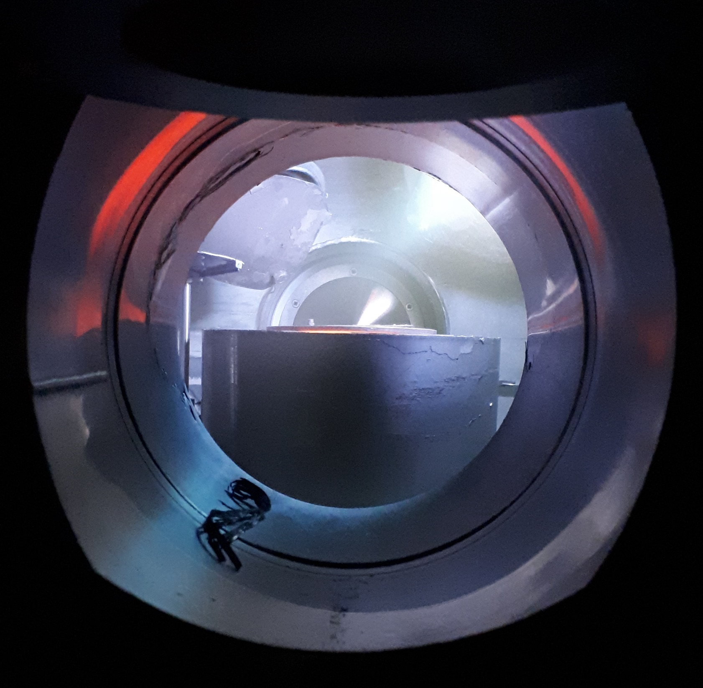
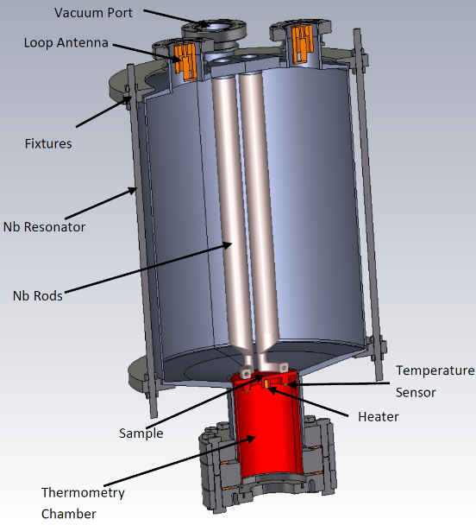
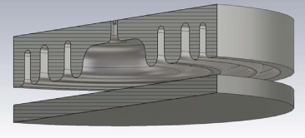
Work distribution for WP15 Tasks
The main emphasis is on a systematic study of correlation between
TASK 15.2
Thin film deposition
PVD: DC, pulsed, HIPIMS…
Film characterisation
SEM, FIB, AFM,
Real cavity measurement
Cavity deposition
(PE)CVD, (PE)ALD
XPS, XRD, RBS, TEM…
Superconducting RF properties evaluation
Superconducting properties measurement
RRR, H_{c}, H_{fp}, H_{sh}, …
QPR at CERN
QPR at HZF
HW cavity at ASTeC
Nb, NbN, Nb₃Sn, MgB₂, etc.
Surface preparation
Cleaning, etching,
Polishing, passivating
DC magnetic susceptibility,
Field penetration
TASK 15.3
Film deposition
TASK 15.4
SEM image of a NbN thin film
QPR
DC magnetisation
Test cavity

Slide 5









WP15 Partners
 | Participants | Leading | Participating
1 | CEA (Saclay, France) |  | Task 4
2 | CERN (Geneva, Switzerland) |  | All tasks
3 | IEE-SAS (Bratislava, Slovakia) |  | Tasks 4
4 | LNL/INFN (Legnaro, Italy) | Task 2 | Tasks 1, 2 and 3
5 | Helmholtz-Zentrum Berlin (Berlin, Germany) | Task 4 | Tasks 1 and 4
6 | RTU (Riga, Latvia) |  | Task 2 and 3
7 | University Siegen, (Siegen, Germany) |  | Tasks 3
8 | ASTeC/STFC (Daresbury, UK) | WP and Tasks 3 | All tasks
9 | Lancaster University (Lancaster, UK) |  | Task 4

Slide 6
Superconducting Thin Film Development

Slide 7
Objectives
  Thin film development on small samples (53 mm × 53 mm)
    Copper substrate polishing
      with EP, SUBU5, EP + SUBU5, Tumbling (INFN)
      with SUBU5 (CERN)
      with laser (RTU)
    Nb (STFC, Siegen, INFN)
      Laser treatment of the film (RTU)
    NbN, Nb₃Sn, NbTiN and SIS deposition (STFC, Siegen)
    Film characterisation (STFC, Siegen, INFN, RTU)
    DC and AC superconductivity evaluation
    measurements (CEA, IEE, STFC)
Task 15.2
Task 15.3
Task 15.4

Slide 8
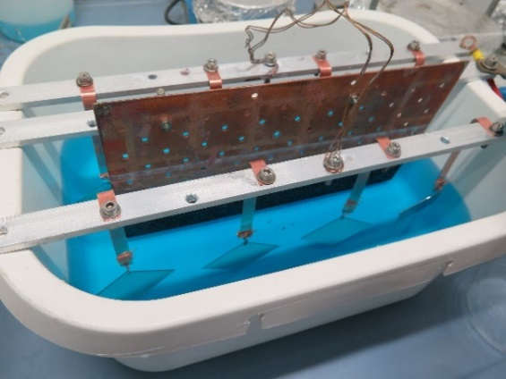
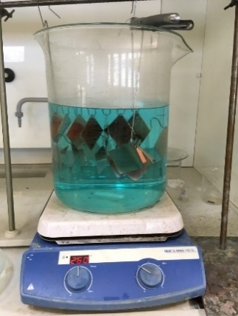
Task 15.2. Substrate surface preparation
50 planar copper samples with 4 different procedures:
  50 samples with a size of 53mm x 53 mm were cut at CERN from the same copper sheet
    25 samples were treated at CERN with
      SUBU solution
    25 samples were treated at INFN with
      SUBU solution,
      Electropolishing (EP),
      SUBU+EP,
      Tumbling
Based on results from 1st and 2nd year SUBU and EP were selected as most promising polishing procedures for the following WP15 work
Most resent results were obtained in 4th Year
SUBU and Electropolishing treatments
Courtesy of E. Chyhyrynets and C. Pira (INFN)
More details on 18th March:
Dan Turner, “DC magnetic field penetration results for Nb thin films with superconducting radiofrequency applications”

Slide 9
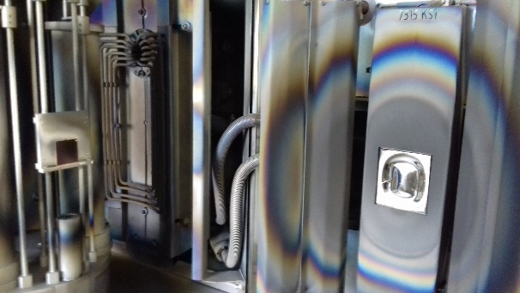
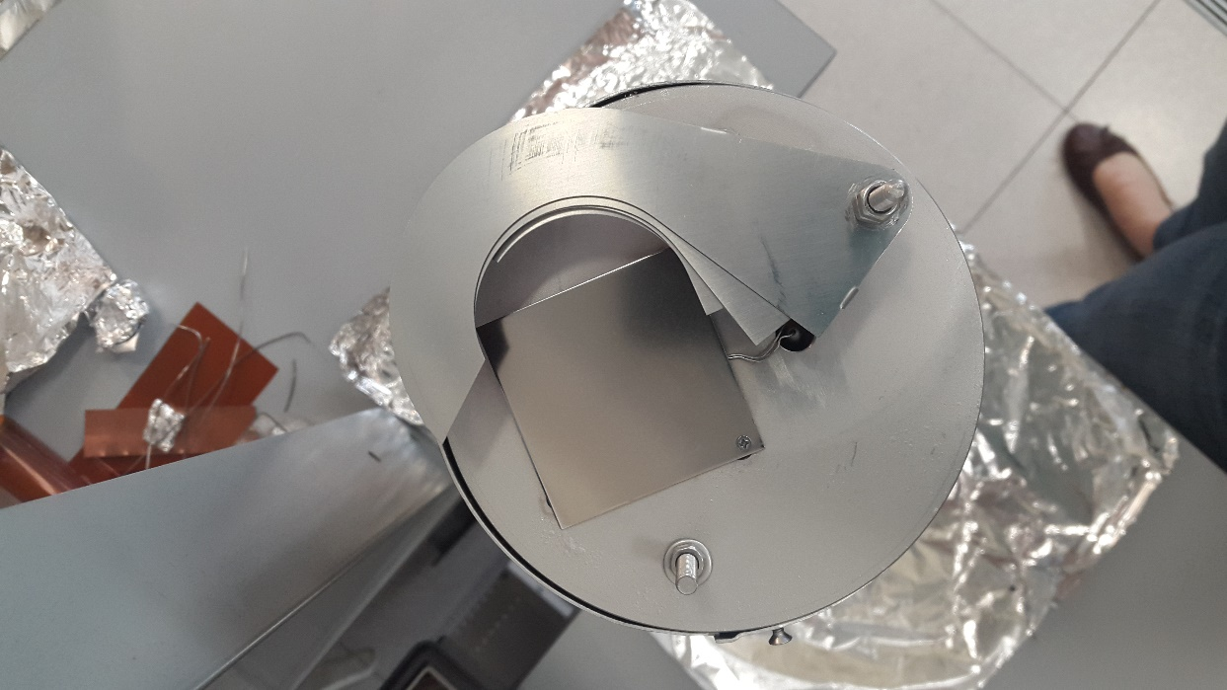
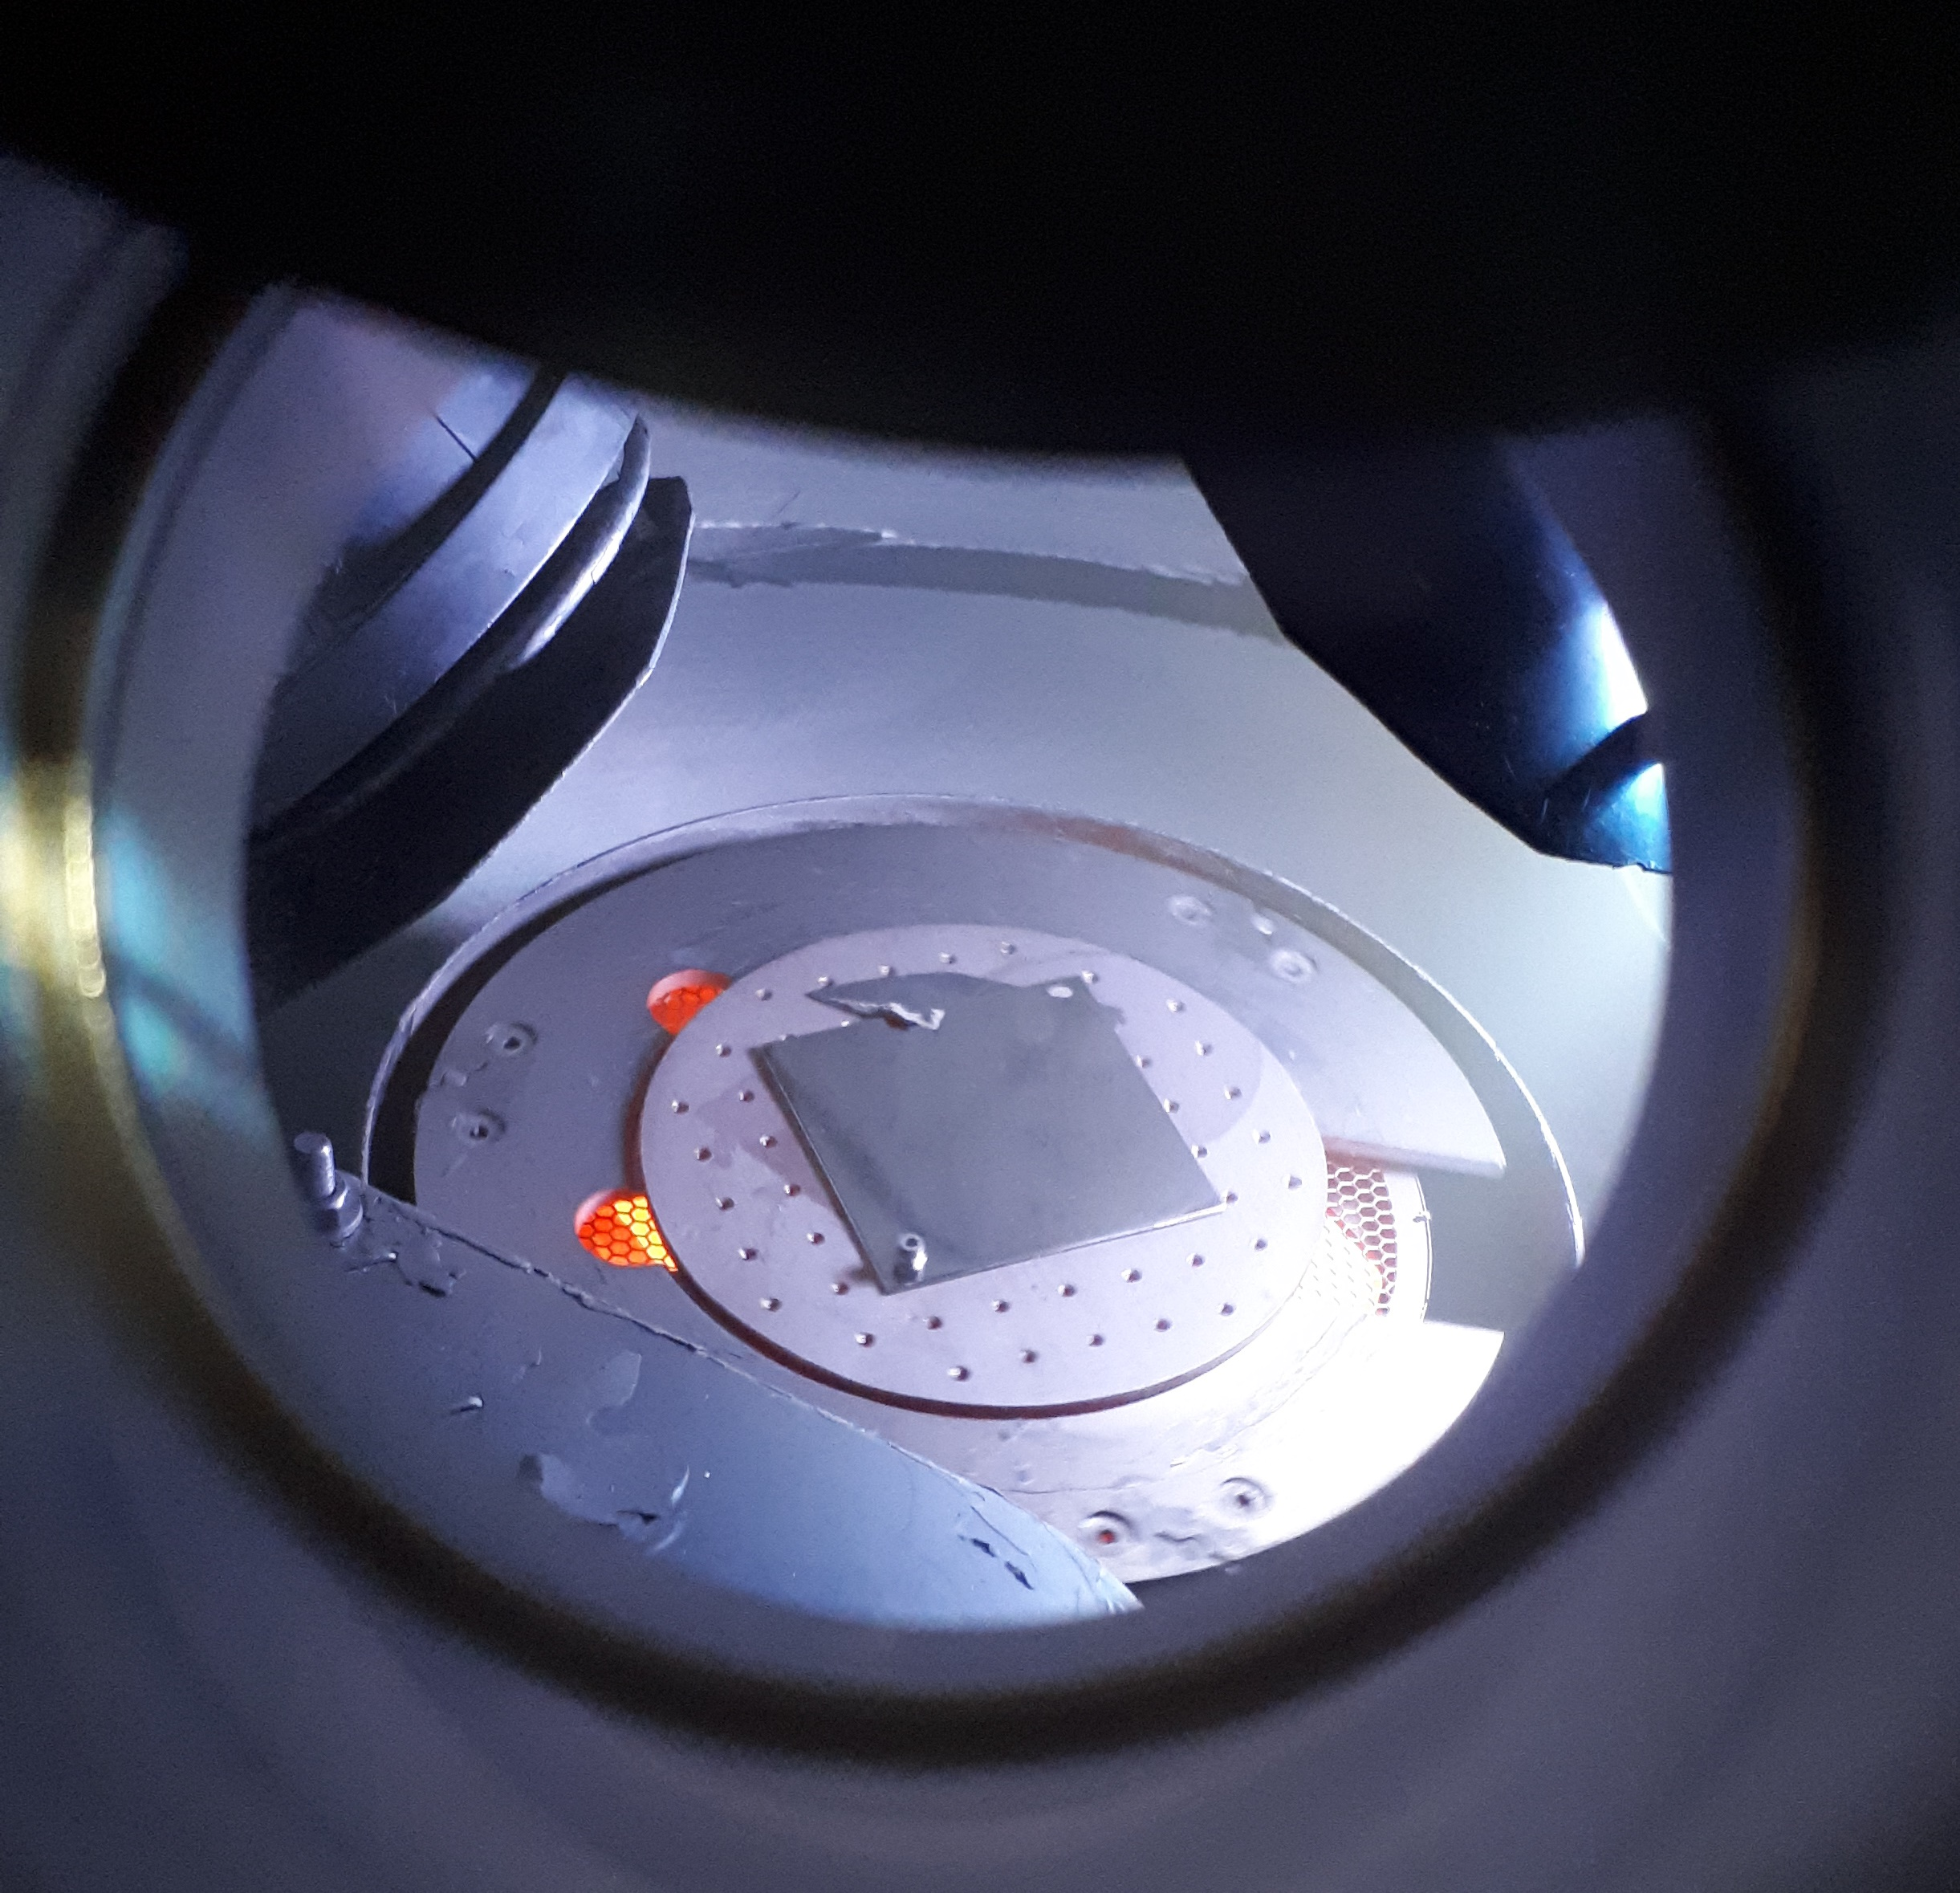
Task 15.3. Thin film deposition
Thin film deposition facilities are key facilities for the project
Quality of Nb films deposited in Year 1 and 2 at INFN, Siegen and STFC is comparable
Year 3 and 4: the main focus is on producing and testing the films different from Nb: NbN, Nb₃Sn, NbTiN, as well as SIS structures
Deposition at facilities at different institutes:
University Siegen LNL/INFN ASTeC/STFC
A sample and a Nb target in deposition facility at University Siegen.
Courtesy of M. Vogel (Siegen)
A sample and sutter assembly for the Nb deposition at LNL/INFN
Courtesy of C. Pira (INFN)
A sample during the Nb deposition at ASTeC/STFC
Courtesy of R. Valizadeh (STFC)

Slide 10
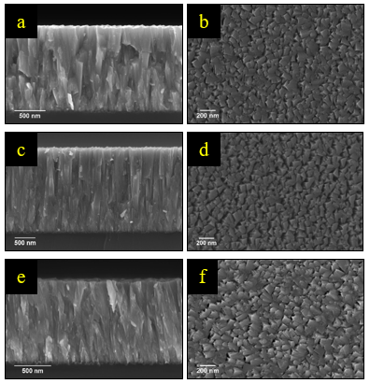
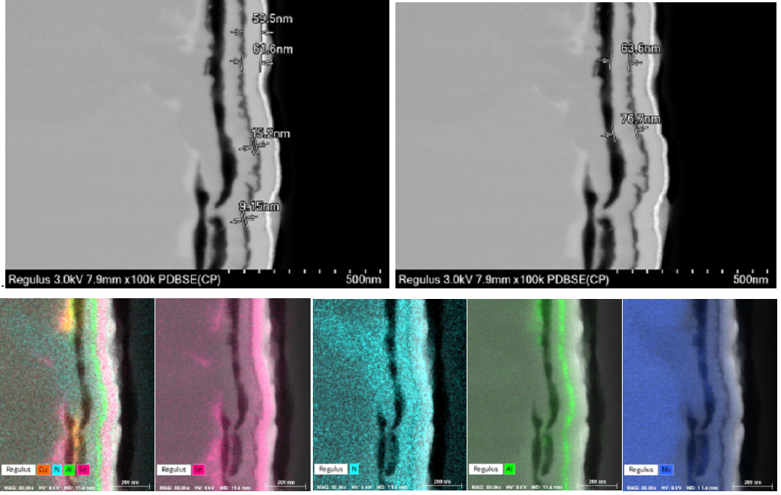
Task 15.3. Thin film characterisation
At STFC At University Siegen
.
High resolution SEM of ion milled X-section of SIS multilayer structure (Nb/AlN/Nb3Sn) deposited on Ta.
(b) EDX chemical mapping of the X-section.
Cross sectional SEM images of NbN
Courtesy of R. Valizadeh (STFC)
Courtesy of M. Vogel (Siegen)

Slide 11
Task 15.3. Thin film development
The results will be reported in 6 talks at this workshop:
  on 16th March:
    Cristian Pira (INFN/LNL), “Nb₃Sn films via liquid tin diffusion for SRF application”
    Felix Walk (STFC/CI), “Bipolar HiPIMS: Correlating plasma parameters to thin film properties”
  on 17th March:
    Francis Lockwood Estrin (STFC/CI), “Using HiPIMS for V₃Si Superconducting Thin Films Nearly all”
    Reza Valizadeh (STFC/CI), “Synthesis of Alternative Superconducting Film to Nb for SRF Cavity”
    Stewart Leith (Siegen Uni), “The Development of HiPIMS Multilayer SIS film coatings on Copper for SRF Applications”
    Özdem Sezgin (Siegen Uni), “NbN Thin Film-Based Multilayer (S-(I)-S) Structures for SRF Cavities”

Slide 12
Task 15.3. Laser treatment Nb films at RTU
Aims:
  Increase the grain size of Nb;
  Increase the adhesion of Nb layer to Cu substrate (annealing the defects by laser radiation);
  Improve superconducting properties.
(a) (b ) (c) (d) (e)
SEM images of Nb/Cu structure before irradiation (a) and after irradiation by Nd:YAG laser with I₁ = 140 MW/cm² (b); I₂ = 170 MW/cm² (c); I₃ = 253 MW/cm² (d); I₄ = 320 MW/cm² (e).
Courtesy to Arturs Medvids, Pavels Onufrijevs and Jevgenijs Kaupuzs (RTU)
Main results for Nb film irradiated by laser:
The sizes of Nb crystals can be increased
Defects between grains (pinholes) can be eliminated
Superconducting properties are changing
More details on 16th March:
Arturs Medvids, “Improvement of Mechanical and Magnetic Properties of Nb/Cu Structure by Laser Radiation for SRF Applications”

Slide 13
Task 15.4. DC Superconductivity evaluation at IEE
PPMS (Physical Property Measurement System)
Virgin DC magnetisation curve: B_{en}(~B_{c1 perp}), [B_{p}, B_{c2}]
Nb/Cu Siegen Uni
Nb/Cu STFC
Courtesy of Eugen Seiler and Rastislav Ries (IEE)
L16 (Nb/Cu)
Laser treated at RTU

Slide 14
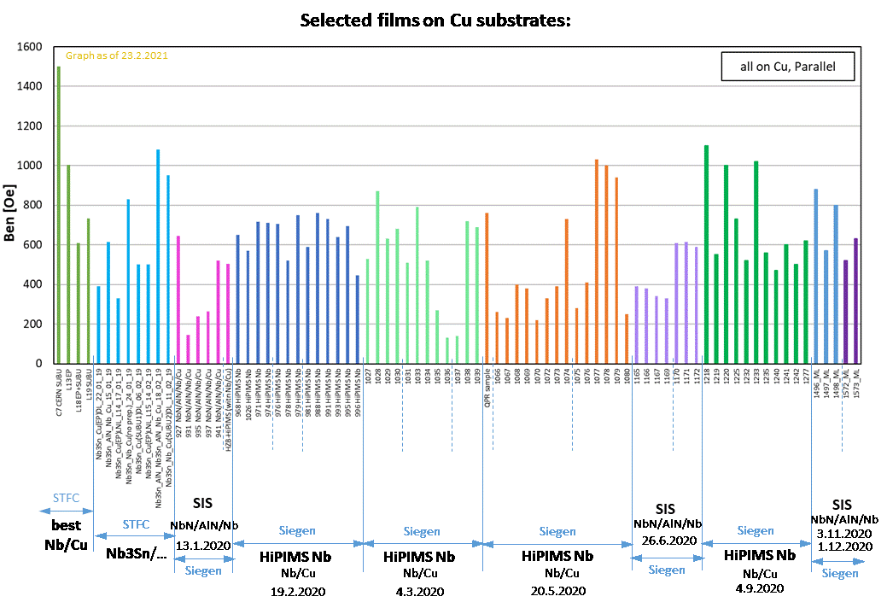
Task 15.4. DC Superconductivity evaluation at IEE
Courtesy of Eugen Seiler and Rastislav Ries (IEE)
Notes:
This graph shows some results on first entry fields for various samples produced by ARIES partners.
Although, at this workshop there will be no talk from this partner, their results will be shown at almost every talk from the ARIES partners.

Slide 15
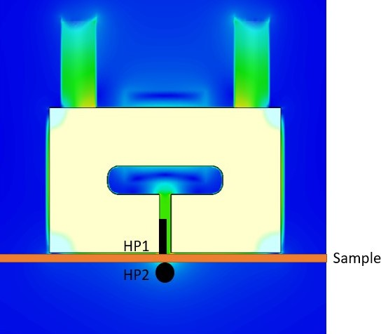
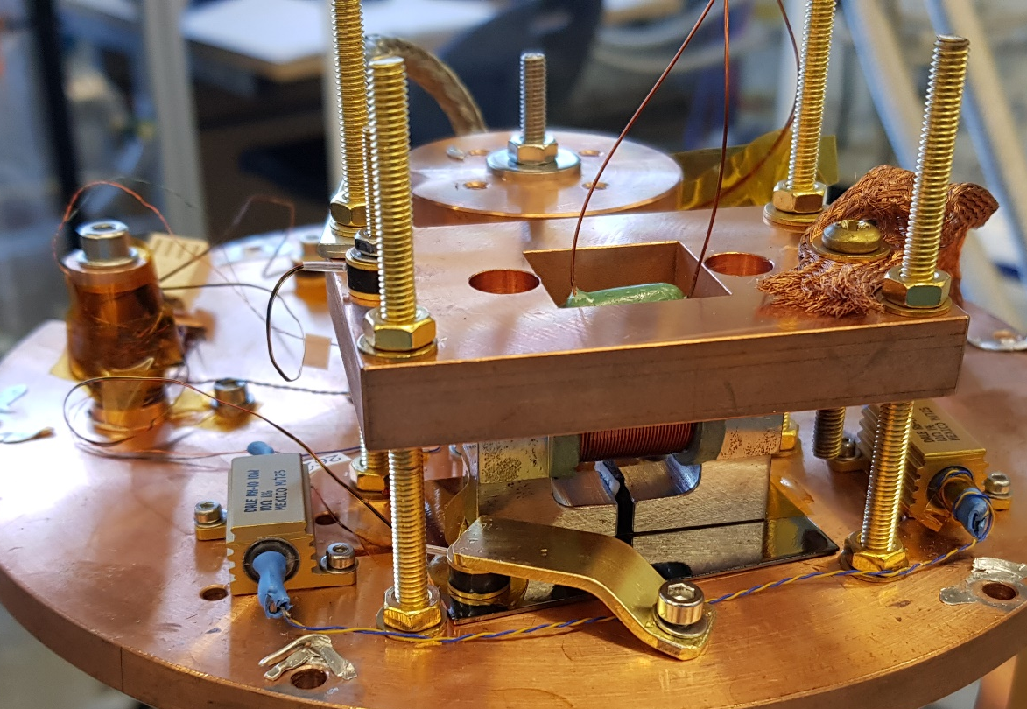
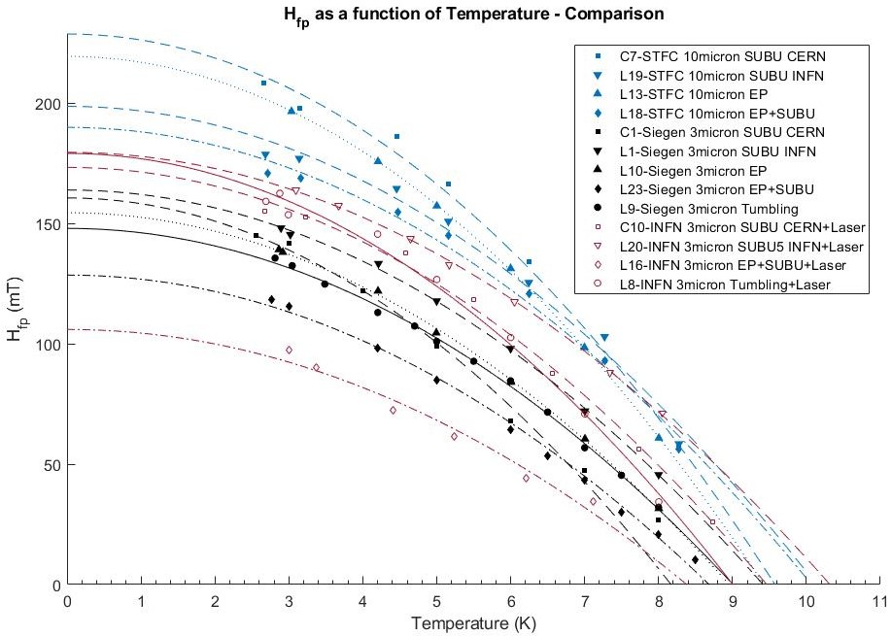
Task 15.4: AC/DC Superconductivity evaluation at STFC
Magnetic field penetration facility for the planar samples
  DC magnetic field parallel to the surface
  Magnetic field applied from one side of the sample (similar to an SRF cavity)
  Field local to the sample surface
    Avoid edge effect.
    Allow possibility of sample scanning.
  Applied and penetrated field measured by Hall probe sensors
Courtesy of D. Turner (LancU/STFC)
More details on 18th March:
Dan Turner, “DC magnetic field penetration results for Nb thin films with superconducting radiofrequency applications”

Slide 16
QPR samples for SRF test

Slide 17
Objectives
  The main objective is
  testing the deposited thin films
  at the RF conditions,
  this includes:
    Sample manufacturing (HZB)
    Cases for sample transfer (HZB)
    Sample polishing with EP and SUBU (INFN)
    Nb film deposition (STFC, Siegen, INFN)
      Laser treatment (RTU)
    SIS deposition (STFC, Siegen)
    SRF testing of QPR samples (HZB, CERN)
Task 15.4
Task 15.2
Task 15.3
Task 15.4

Slide 18
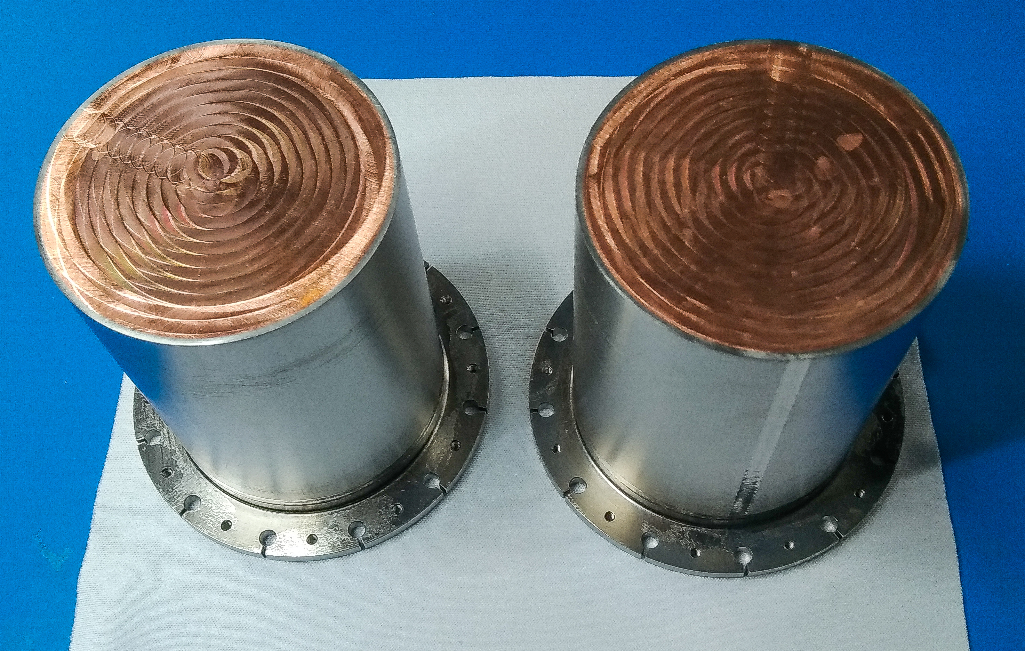
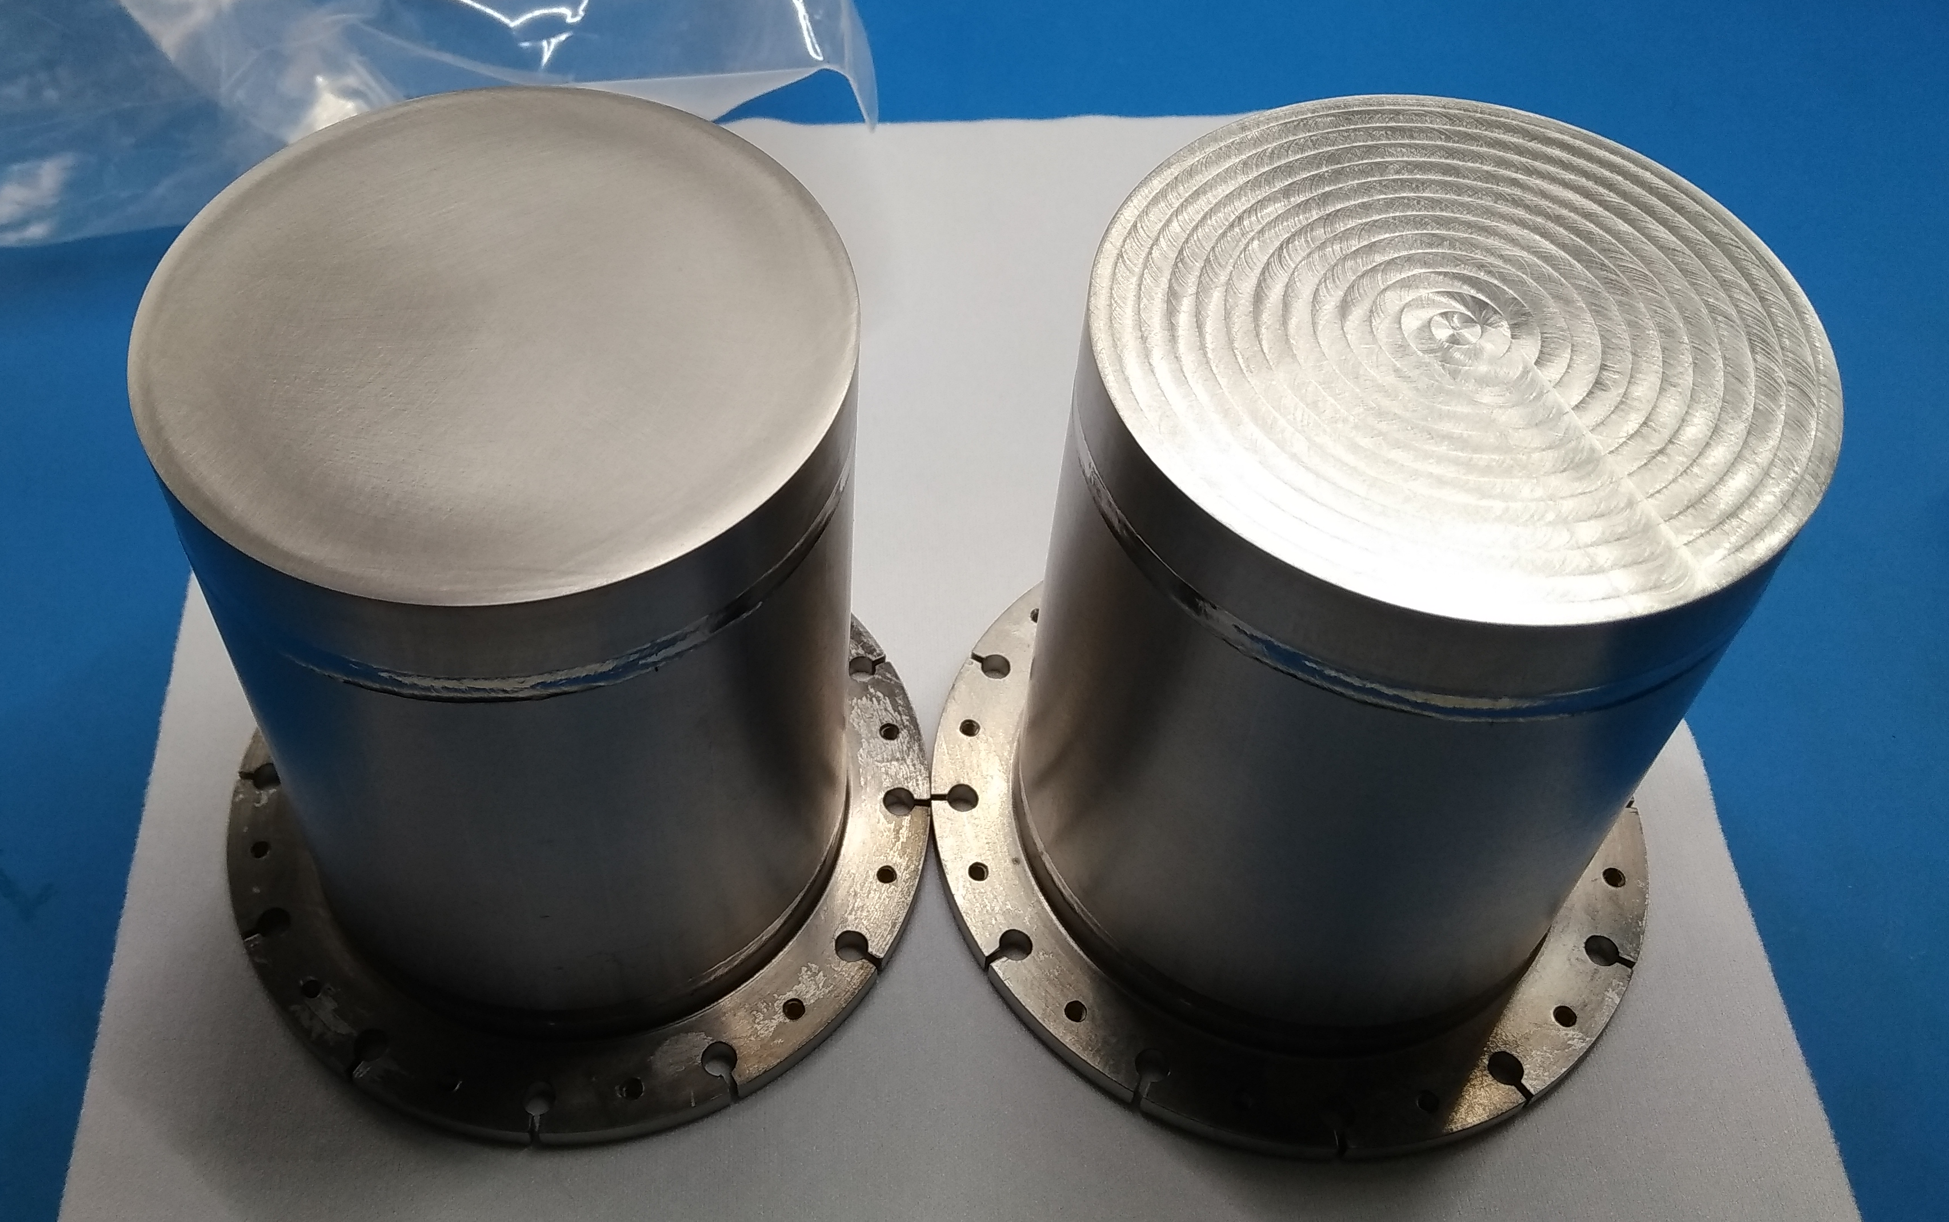
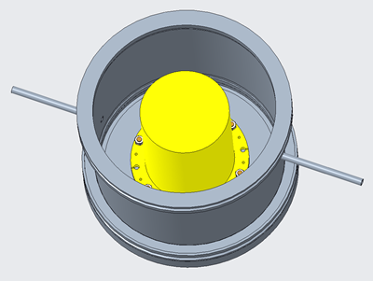
QPR samples
QPR samples were designed at HZB, manufacured at Research Instruments and delivered in Year 2 (2018):
  5 OFHC/Nb samples
  5 Nb samples
A dedicated chamber for transporting the QPR samples under clean room conditions in vacuum or arbitrary atmospheres has been designed and manufactured:
  It consists of ISO-KF160 standard pieces,
  equipped with suitable fixtures for the samples,
  and an evacuation/vent
  manifold.
Cu-Nb samples at HZB after production
Nb samples at HZB after production
Sample transport chamber
Courtesy of Oliver Kugeler (HZB)

Slide 19




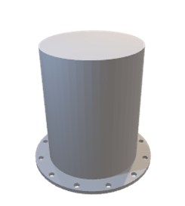
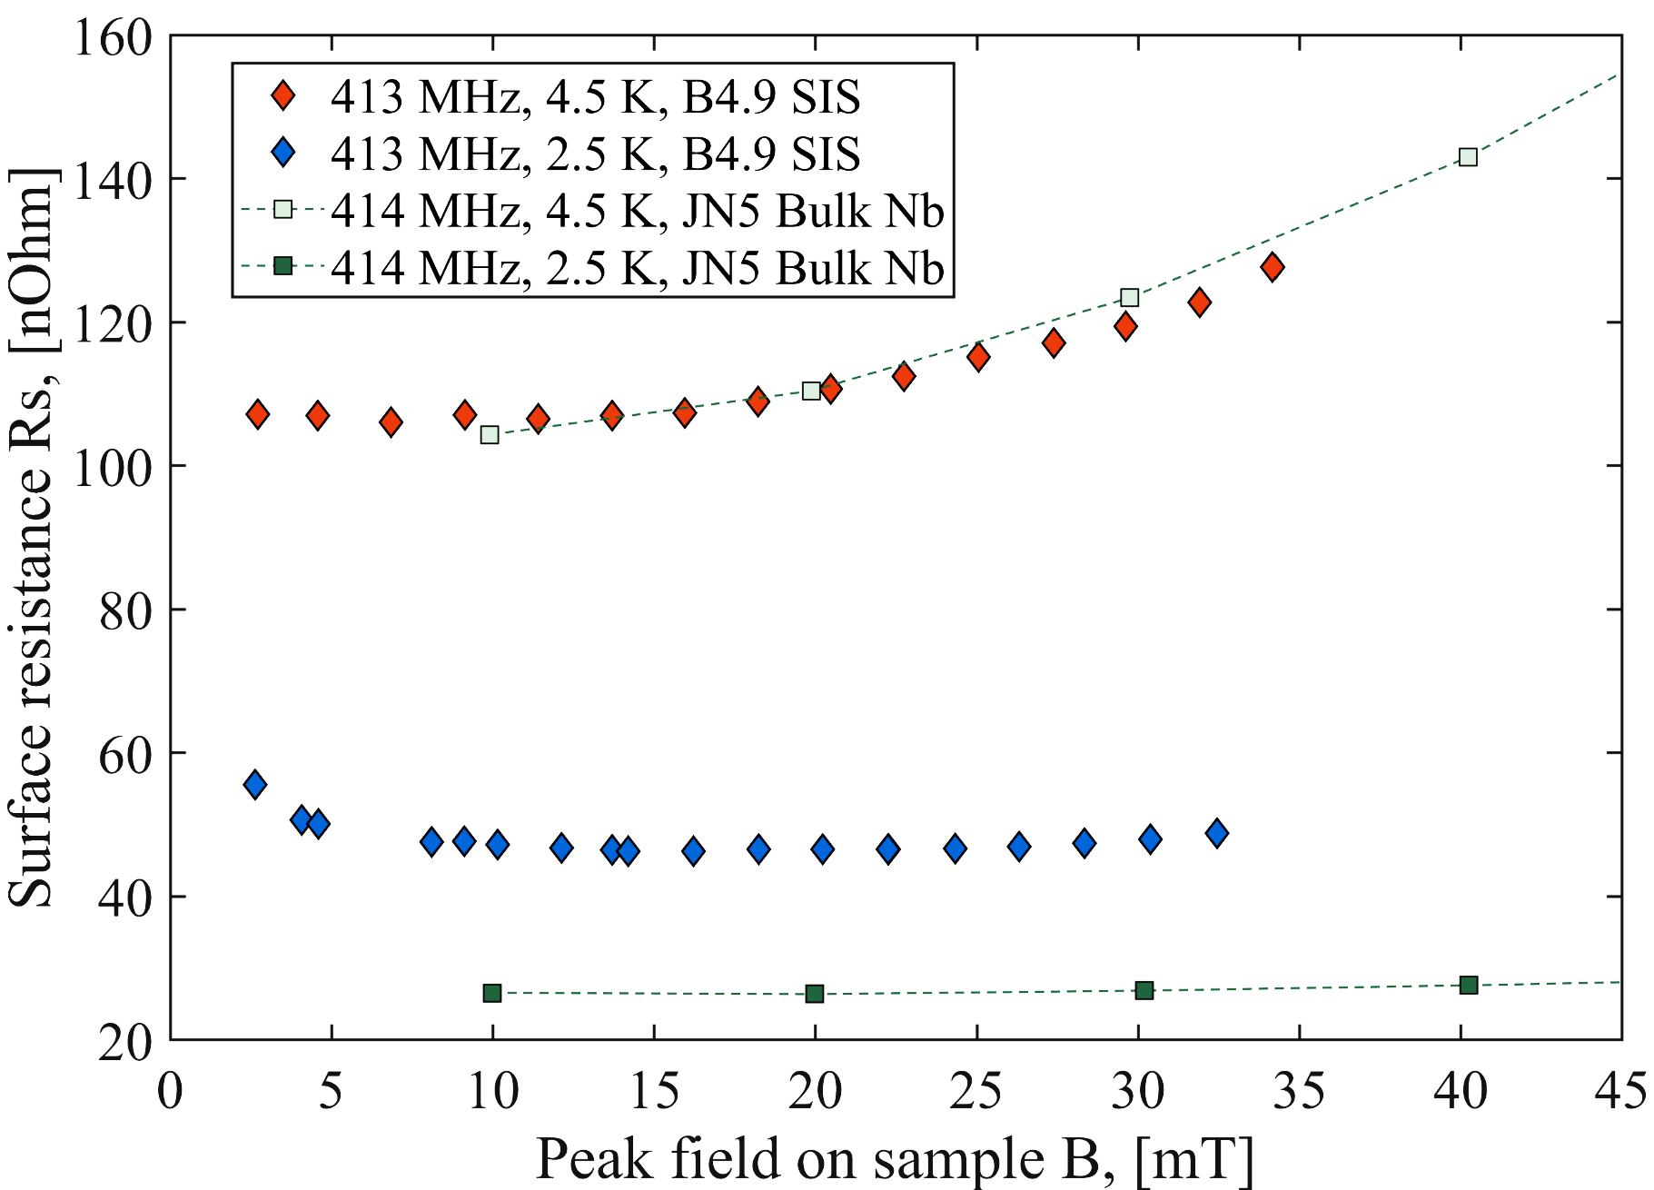
Workflow of the QPR Experiment
GOAL: Evaluate the effect of planar substrate Cu polishing on RF performance of QPR
Nb, NbN and SIS by HiPIMS
Nb, Nb3SN, SIS by DCMS or HiPIMS
Lathe
machining
Chemical
or
Electrochemical
Polishing
Nb thick film by DCMS
MECHANICAL
MACHINING
POLISHING
COATING
RF TEST
Courtesy of C. Pira (INFN) and E. Chyhyrynets

Slide 20
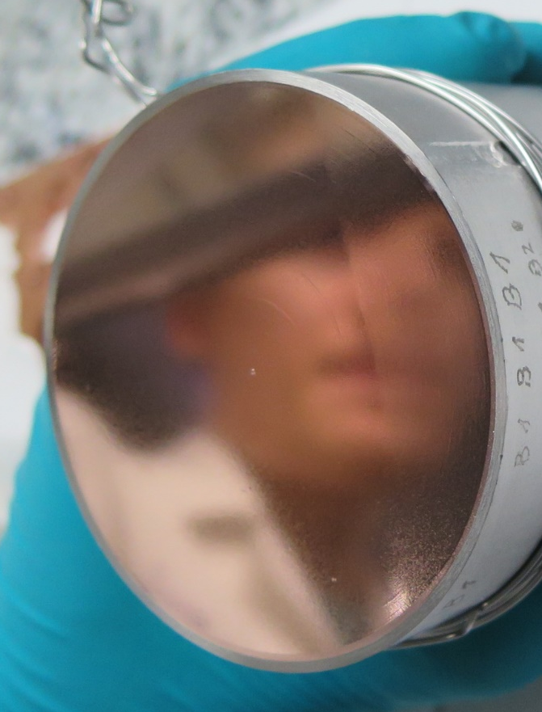
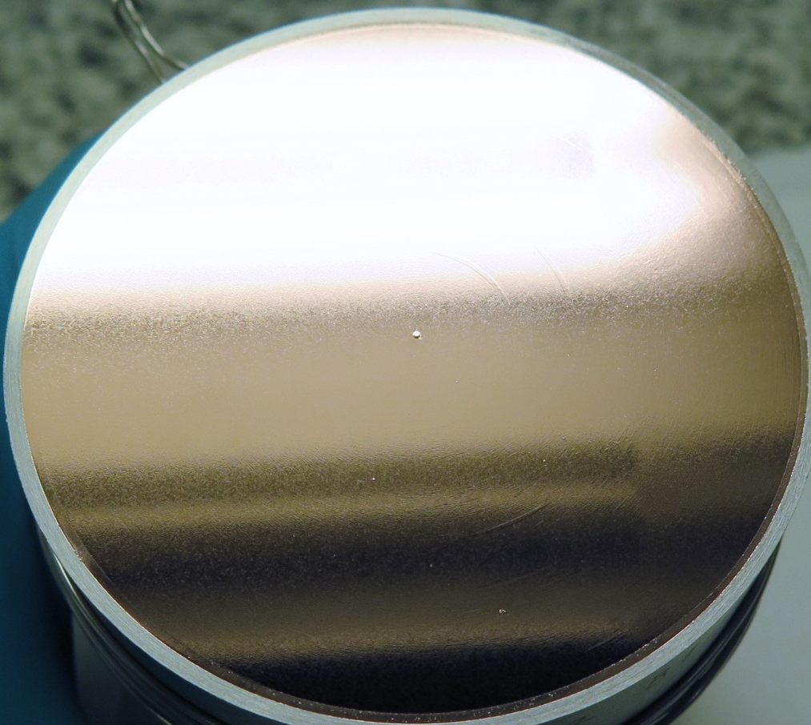
QPR substrate polishing at INFN
SUBU5 (Chemical Polishing) -> 3 samples:
  Sulfamic acid – 5 g/l, (NH₄)₃Cit – 1 g/l, H₂O₂ – 50 ml/l, Butanol – 50 ml/l,
  T = 73 °C
  Average removal thickens: δ = ~6 μm
Passivation (5 min):
  Sulfamic acid – 20 g/l,
EP (ElectroPolishing):
  Phosphoric acid 85% - 3 v.r., N-Butanol 98% - 2 v.r.,
  Temperature 40 °C
  Average removal thickens: δ = ~15 μm
Passivation:
  Sulfamic acid – 20 g/l,
Courtesy of
Eduard Chyhyrynets (INFN)

Slide 21
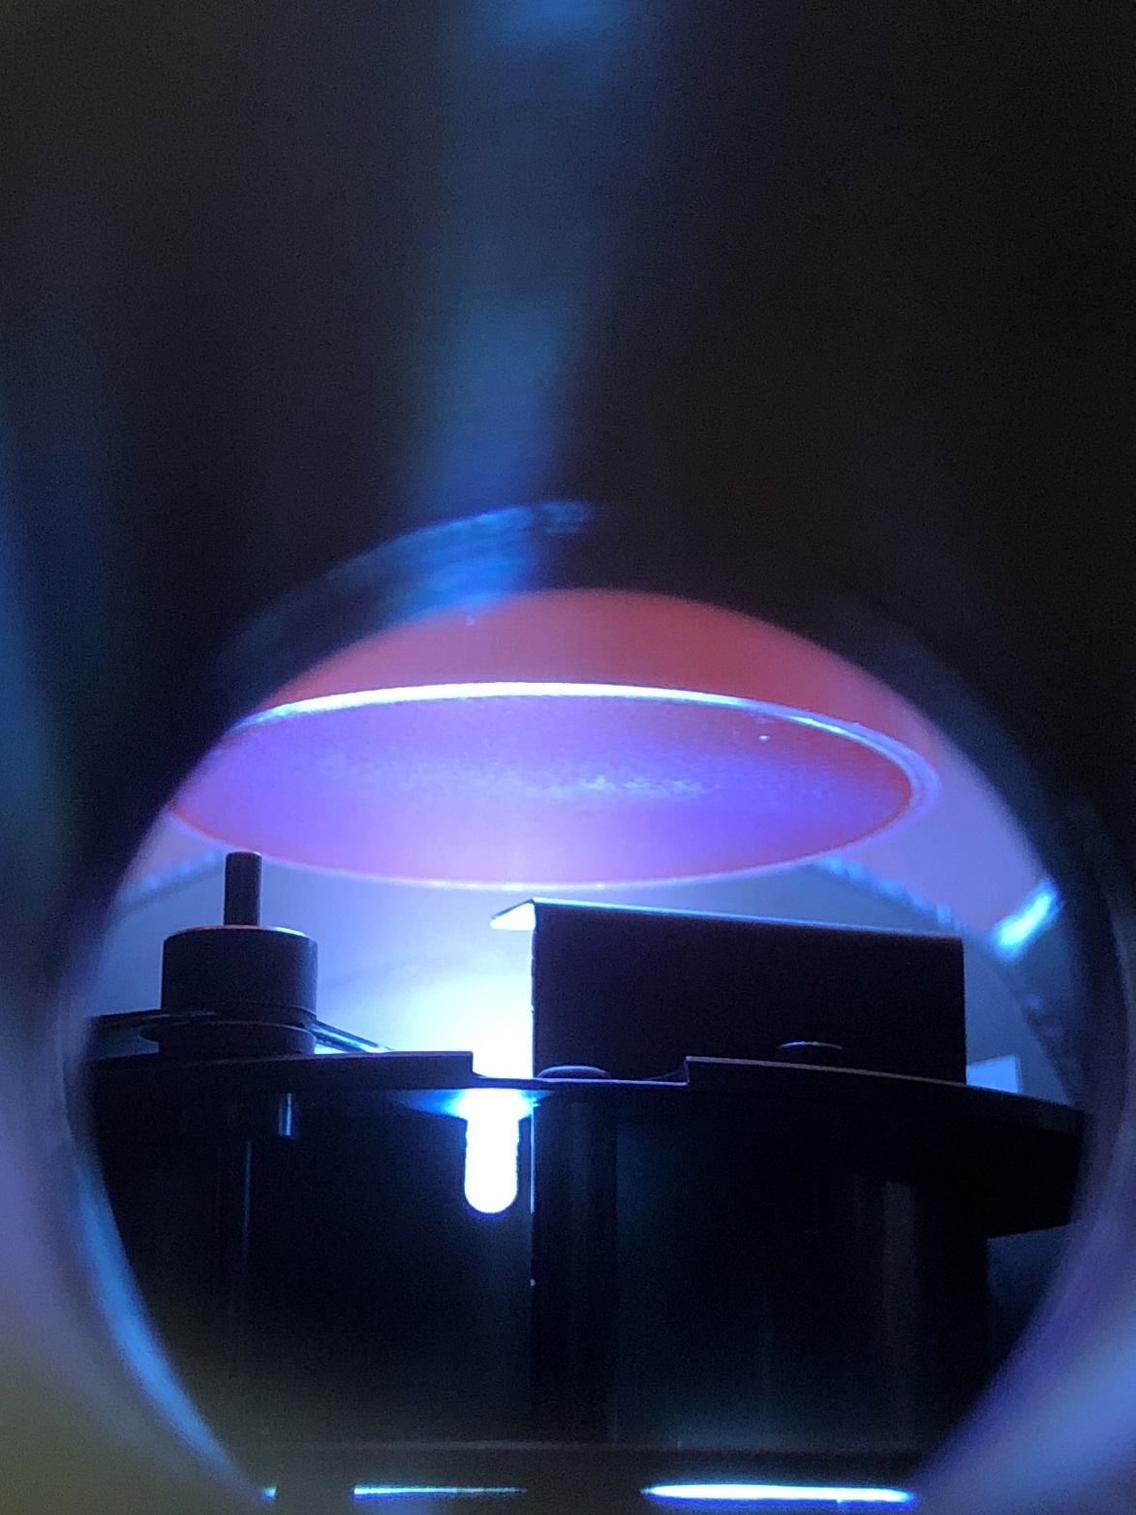
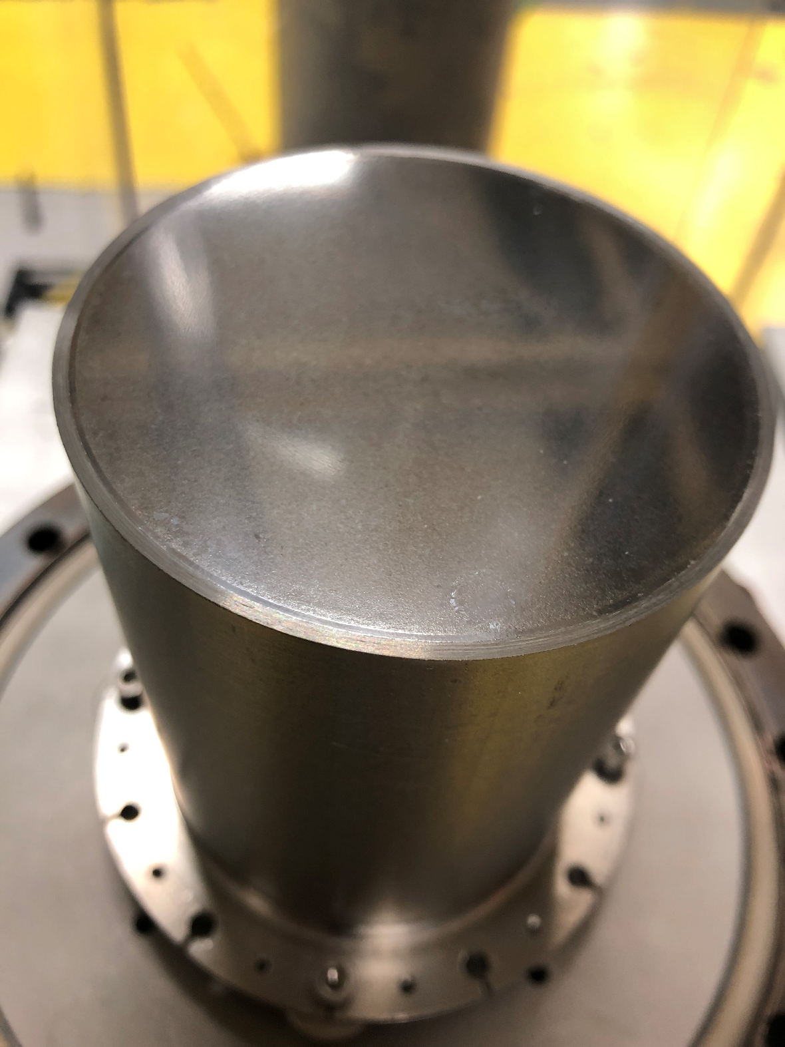
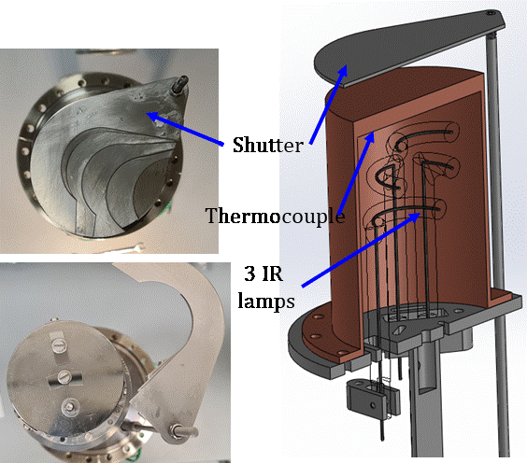
QPR deposition
A QPR sample inside the deposition chamber at Siegen Uni.
Courtesy of M. Vogel
A QPR sample (a) inside the deposition chamber and (b) after Nb film deposition at STFC/ASTeC.
Courtesy of R. Valizadeh (STFC)
Seven QPR samples deposited with Nb at CERN, INFN, Siegen and STFC
  One QPR- laser treated
Three QPR samples with SIS at Siegen and STFC
A QPR sample deposition facility at INFN/LNL.
Courtesy of C. Pira

Slide 22





Task 15.4: RF Superconductivity evaluation with QPR
Samp
B-1 | SUBU | 3 µm Nb film | Cutting, Stripping, EP | 3 µm Nb film | Laser treatment | Field Penetration
B-2 | SUBU | 2 µm Nb film | RF test | Recoat.: 7.3 µm Nb | RF test | RF test | Stripping, SUBU, Nb
B-3 | EP | 3 µm Nb film | RF test | SIS: 3 µm Nb/30 nm AlN/100 nm NbN | RF test | Stripping, SUBU | TBD
B-4 | EP | 3 µm Nb film | RF test | Stripping, EP | SIS | RF test | Stripping, EP
B-5 | SUBU | 3 µm Nb film | RF test | Laser treatment | RF test | Stripping, SUBU | SIS
 | DONE |  | FAILED
 | IN PROCESS |  | LASER
Courtesy of D. Tikhonov (HZB)

Slide 23
QPR testing at HZB
R_{s}(B) at 415 MHz and T = 4.5 K
R_{s}(B) at 415 MHz and T = 4.5 K and 2.5 K
Courtesy of D. Tikhonov (HZB)
More details on 18th March:
Dmitry Tikhonov, “Investigation of SIS multilayer films at HZB”

Slide 24
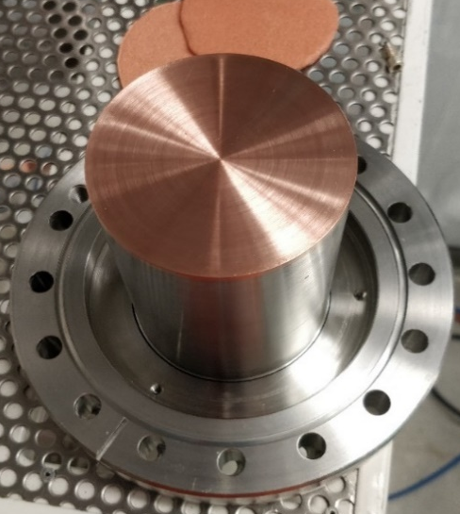
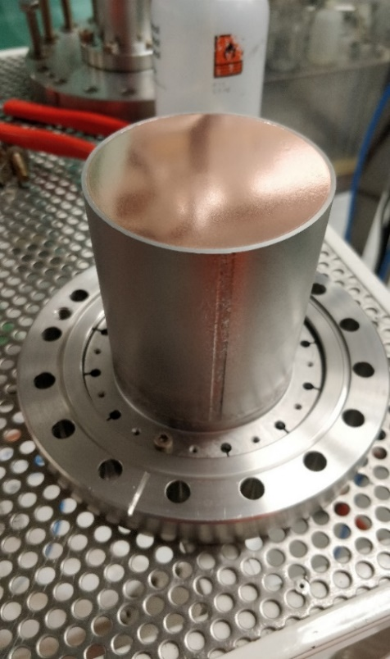
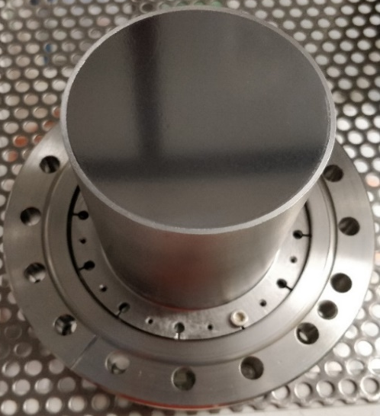
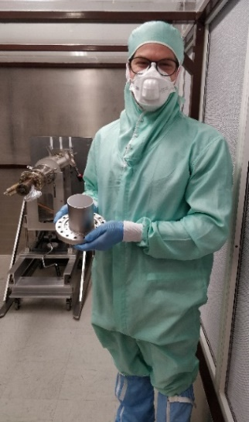
QPR testing at CERN
Main purposes
  To develop a QPR sample substrate that could be used at both CERN and HZB facilities
  To compare the results of the same sample measured at both facilities
Work in progress
QPR sample holder
QPR sample mounted
After coating
A happy ESR ☺
Courtesy of L. Vega Cid (CERN)

Slide 25
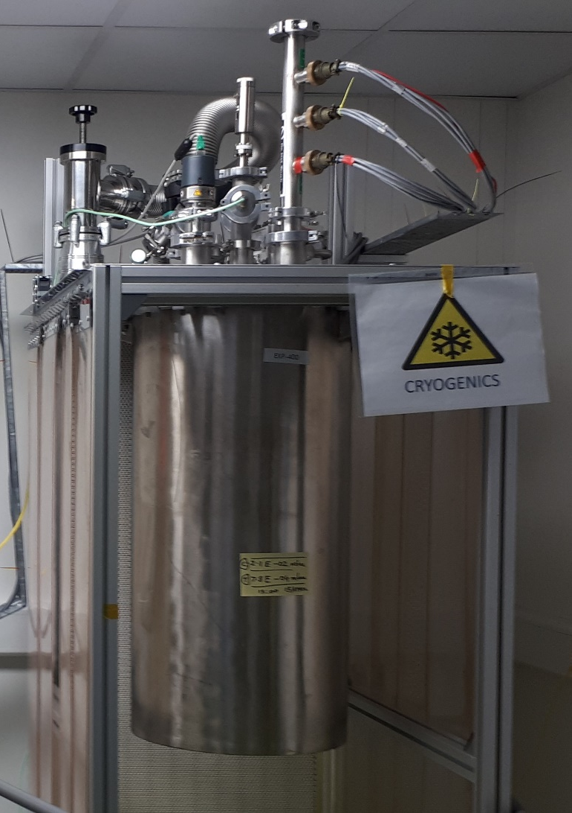
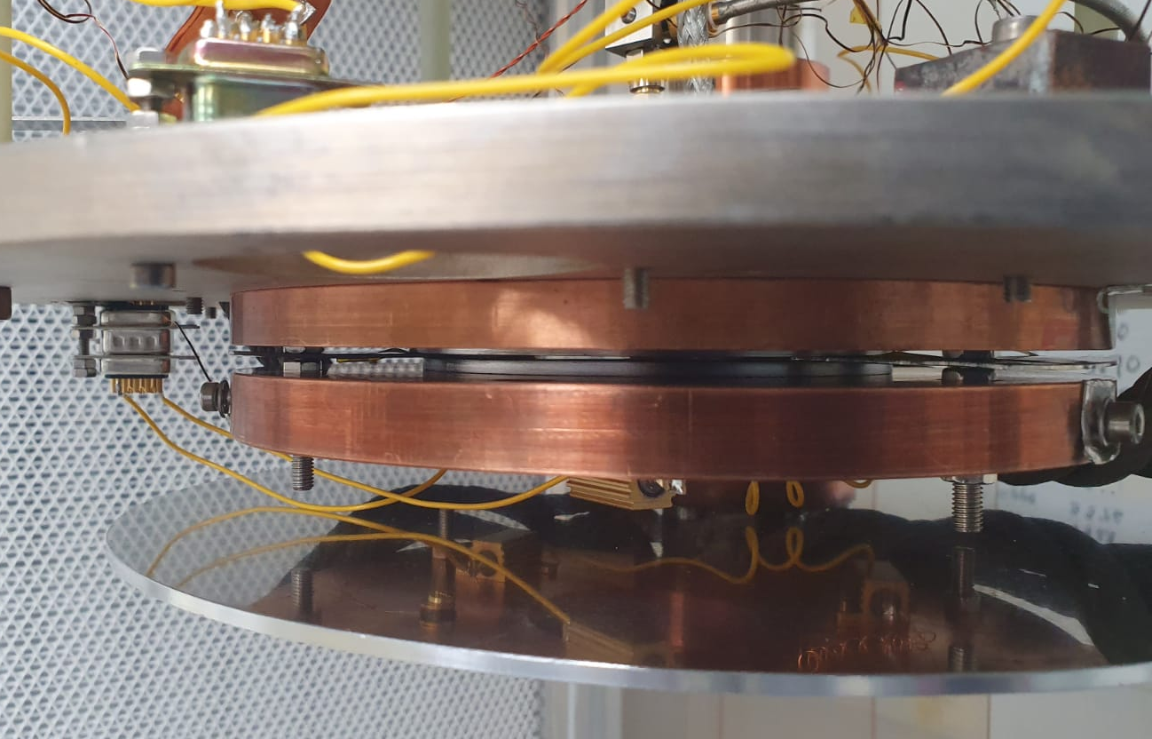
Task 15.4: RF Superconductivity evaluation (STFC)
At STFC a radiofrequency (RF) cavity and cryostat dedicated to the measurement of superconducting coatings at 7.8 GHz has been updated to operation with a closed-cycle refrigerator.
Low power measurements with an emphasis on fast turn-around time (~2 days for each sample).
A cooldown demonstrated
  T_{cavity} = 4.1 K and T_{sample} = 3.8 K.
RF testing with a bulk Nb sample is in progress
Pill-box cavity in a new facility with a closed-cycle refrigerator in STFC
Cavity Plate
Sample
Sample Plate
More details on 18th March:
Dan Seal, “A low power test facility for SRF thin film testing with high sample throughput rate”

Slide 26
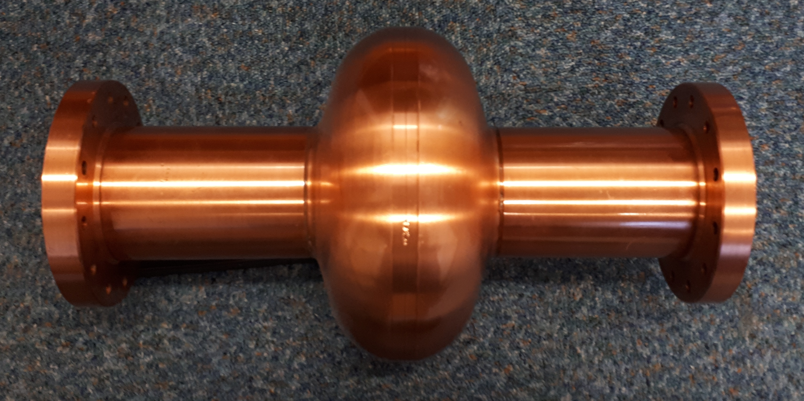
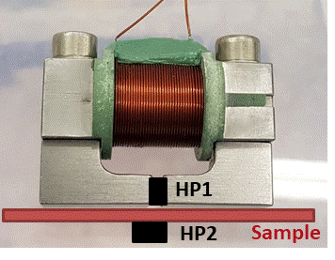
Future: I.FAST WP9: Innovative superconducting cavities (01/05/2021-30/04/2025)
Thin film deposition
PVD: DC, pulsed, HIPIMS…
Film characterisation
SEM, FIB, AFM,
Real cavity measurement
Cavity deposition
(PE)CVD, (PE)ALD
XPS, XRD, RBS, TEM…
Superconducting RF properties evaluation
Superconducting properties measurement
RRR, H_{c}, H_{fp}, H_{sh}, …
QPR at CERN
QPR at HZF
HW cavity at ASTeC
Nb, NbN, Nb₃Sn, MgB₂, SIS, etc.
Surface preparation
Cleaning, etching,
Polishing, passivating
DC magnetic susceptibility,
Field penetration
Nb film laser treatment
The main emphasis is on applying the result of ARIES to RF cavity deposition and testing
1.3 GHz cavity for STF deposition
Film deposition
SEM image of a NbN thin film
QPR
DC magnetisation
Test cavity

Slide 27
Conclusions
Five polishing techniques for Cu have been tested with Nb films
  SUBU5 and EP demonstrate best results
Development of superconducting films on small samples:
  NbN, Nb₃Sn, NbTiN films as well as SIS structures deposited and characterised,
  Small sample evaluation on SC properties with VSM and MFPF;
Evaluation of Nb films at the RF conditions:
  New QPR design, sample transport case,
  QRR sample polishing developed and applied to the samples at INFN
  Deposition of 10 QPR samples at INFN, Siegen and STFC
    with Nb and SIS: Nb/AlN/NbN and Nb/AlN/Nb₃Sn,
  Comparative testing of QPR facilities at CERN and HZB with the samples produced by WP15 team;
Developing of new technologies for TF SRF:
  Laser treatment of Cu substrate and Nb films,
  Magnetic field penetration facility (MFPF);
Collaborating, involving new partners, enhancing a capability of every partner, frequent discussions, joint publications.

Slide 28
ARIES WP15 team:
CERN:
  A. Sublet, L. Vega Cid, G. Rosaz, P. Vidal, W. Venturini, G. Vandoni and M. Taborelli
IEE:
  E. Seiler, R. Ries and F. Gömöry
INFN
  V. Palmieri, C. Pira, E. Chyhyrynets, F. Stivanello, O. Azzolini and G. Keppel
HZB:
  O. Kugeler, S. Keckert, J. Köszegi and D. Tikhonov
CEA:
  C. Antoine
RTU
  A. Medvids, P. Onufrievs and A. Katashev
Siegen University
  M. Vogel, S. Leith and Ö. Sezgin
STFC/CI:
  O. Malyshev, R. Valizadeh, F. Lockwood Estrin, F. Walk, D. Turner, D. Seal, T. Sean, F. Goudket and G. Burt
This research has been supported by European Commission’s ARIES collaboration H2020 Research and Innovation Programme under Grant Agreement no. 730871.

Slide 29
Thanks for your attention

