Slide 1


ALD-Based NbTiN studies for SIS R&D
Isabel González Díaz-Palacio¹, Marc Wenskat², Wolfgang Hillert², Robert H. Blick¹, Robert Zierold¹
Institute of Nanostructure and Solid State Physics & Center for Hybrid Nanostructures, Universität Hamburg
Institute of Experimental Physics, Universität Hamburg
9th International Workshop on Thin Films and New Ideas for Pushing the Limits of RF Superconductivity
15th-18th March 2021

Slide 2
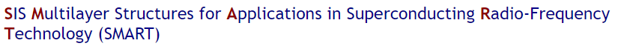
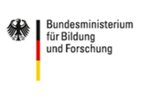

The Project SMART
06.2019-06.2022
SIS Coatings R&D
ALD
PVD
Computational EM
QPRs
Isabel González Díaz-Palacio, 9th International Workshop on Thin Films

Slide 3
Work tasks
PEALD
Superconductor: NbTiN
Insulator: AlN
Thin film deposition
Process optimization
Film characterization
Transport properties
Structural properties (analysis on-going)
Isabel González Díaz-Palacio, 9th International Workshop on Thin Films

Slide 4
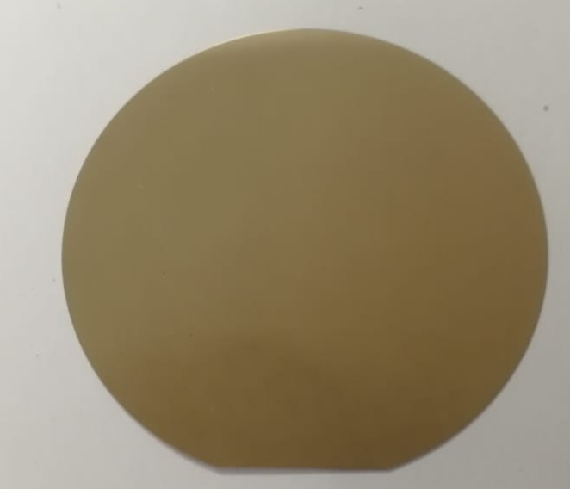
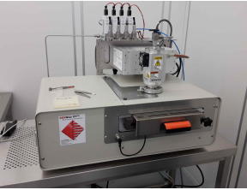
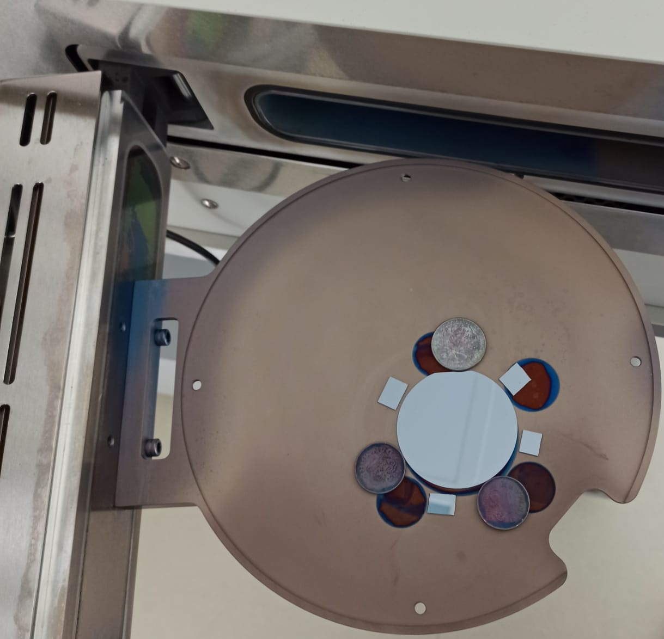
On-going NbTiN R&D
Plasma Enhanced ALD Setup
Samples after deposition
ALD allows for uniform coatings of complex geometries – limited by the reactor
AlN and NbTiN deposited on Si wafer
Isabel González Díaz-Palacio, 9th International Workshop on Thin Films

Slide 5
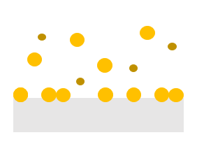
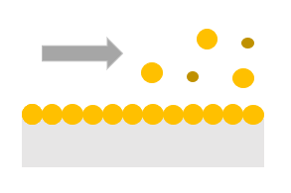
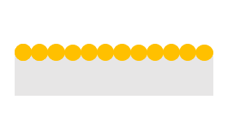
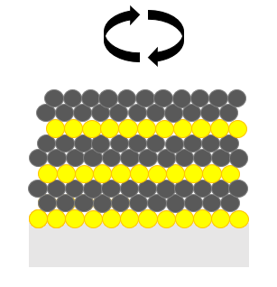
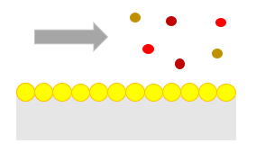
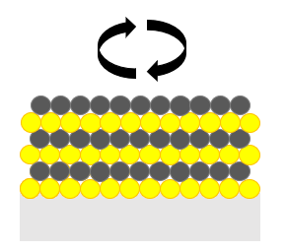
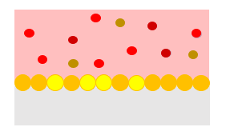
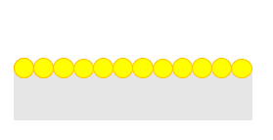
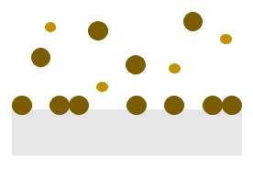
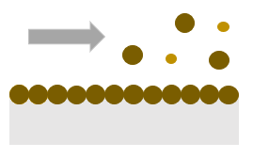
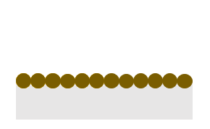
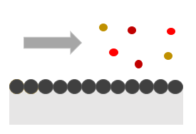
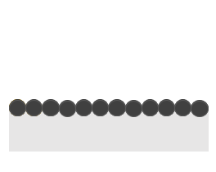
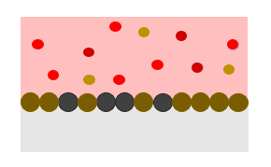
Supercycle ALD Approach for Nb_{x}Ti_{1-x}N
TiN cycle
NbN cycle
X2
TDMAT
TBTDEN
By-product
H₂ / N₂
TiN
NbN
Isabel González Díaz-Palacio, 9th International Workshop on Thin Films

Slide 6
Tuning the superconducting properties by varying ratio of NbN to TiN
EDX Composition Analysis
Isabel González Díaz-Palacio, 9th International Workshop on Thin Films
Notes:
Bilder

Slide 7
Process Optimization
TiN deposition parameters
NbN deposition parameters
Deposition Temperature (°C) | TDMAT pulse (ms) | Plasma Power (W) | Plasma Time (s) | H2 (sccm) | N2 (sccm) | TBTDEN pulse (ms) | Plasma Power (W) | Plasma Time (s) | H2 (sccm) | N2 (sccm)
250 | 500 | 300 | 60 | 45 | 20 | 1000 | 300 | 60 | 45 | 20
250 | 500 | 300 | 60 | 45 | 20 | 500 | 300 | 60 | 45 | 20
250 | 500 | 300 | 60 | 45 | 20 | 500 | 300 | 30 | 45 | 20
250 | 500 | 300 | 60 | 45 | 20 | 500 | 300 | 90 | 45 | 20
250 | 500 | 300 | 60 | 45 | 20 | 500 | 300 | 120 | 45 | 20
250 | 500 | 300 | 60 | 45 | 20 | 500 | 300 | 90 | 45 | 5
250 | 500 | 300 | 60 | 45 | 20 | 500 | 300 | 90 | 45 | 9
250 | 500 | 300 | 60 | 45 | 20 | 500 | 300 | 90 | 45 | 12
250 | 500 | 300 | 60 | 45 | 20 | 500 | 300 | 90 | 45 | 20
NbTiN Tc= 7.8 K
Isabel González Díaz-Palacio, 9th International Workshop on Thin Films

Slide 8
Rapid Thermal Annealing
Influence of temperature and time of the annealing process in the transport properties of the Nb0.66Ti0.33N films
Ar H₂
Ar H₂
Isabel González Díaz-Palacio, 9th International Workshop on Thin Films

Slide 9
Rapid Thermal Annealing
Influence of the gas atmosphere in the transport properties of the Nb0.66Ti0.33N films
Different annealing atmospheres :
Studies varying the N2/H2 mixture are being made
Ar/H2 mixture (95% of Ar and 5% of H2)
N2
N2/H2 mixture (85% of N2 and 15% of H2)
After the first RTA, a 2nd thermal treatment (without vacuum break) in pure N₂ atmosphere has been performed at 1000°C. The results showed that Tc has been increased.
The best result is Tc= 13,93 K ; ρ = 132 μΩ·cm
Isabel González Díaz-Palacio, 9th International Workshop on Thin Films

Slide 10
Effect of RTA in samples with different ratios of NbN to TiN
Influence of RTA at 1000°C in pure H₂ for 50 minutes in the transport properties of samples with different ratios of NbN to TiN
Isabel González Díaz-Palacio, 9th International Workshop on Thin Films

Slide 11
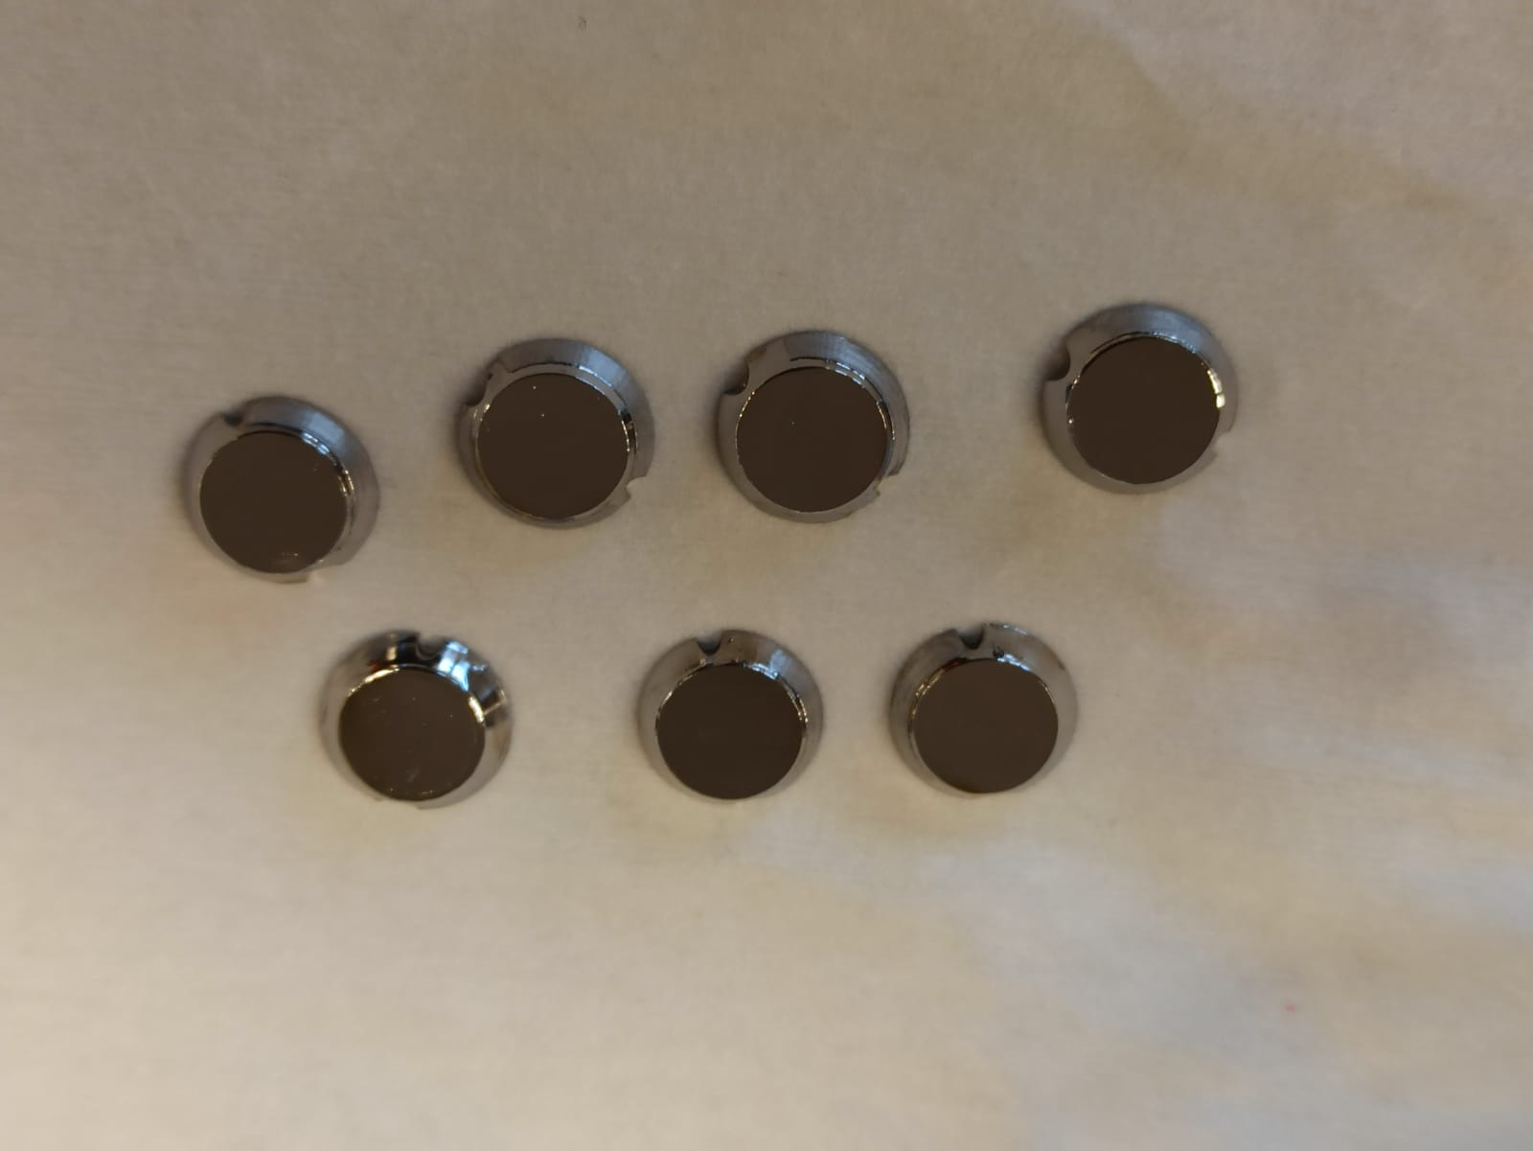
Conclusions and Persperctives
I have synthesized AlN and superconducting NbTiN alloys by PEALD and the deposition process has been optimized
Transport properties of NbTiN alloys have been studied for different compositions
Post-annealing is mandatory to improve the deposited NbTiN films
Deposition on Nb already treated (EP + 800 ºC baking for 3h)
Structural analysis are on-going at DESY NanoLab
  ( EBSD, XRD and XRR)
DC magnetic field penetration study is on-going at LancU/STFC
Analysis of H₂ concentration using EMGA is scheduled at DESY
Isabel González Díaz-Palacio, 9th International Workshop on Thin Films

Slide 12
THANK YOU FOR
YOUR ATTENTION!
Feel free to contact via: igonzale@physnet.uni-hamburg.de
Isabel González Díaz-Palacio, 9th International Workshop on Thin Films

