Slide 1


Nonlinear RF losses of a trapped vortex in different pinning landscapes under strong RF field in a superconducting film
W.P. Manula Pathirana
Alex Gurevich
Old Dominion University
Department of Physics and Center for Accelerator Science
Norfolk VA 23529, USA
Supported by NSF under Grants No. PHY 1632749 and PHY 1734075,
and by DOE under Grant No. DE-SC0010081.
15th March 2021

Slide 2
Outline
We report extensive numerical simulations of the nonlinear dynamics and losses of a trapped elastic vortex under strong RF field.
We took into account:
  Vortex line tension,
  Vortex mass,
  Bardeen-Stephen, and Larkin-Ovchinnikov (LO) viscous drag coefficients,
  Different distribution of pinning centers.
At low field, the surface resistance can increase linearly with H
We show that the LO decrease of viscous drag coefficient with vortex velocity results in a vortex residual resistance R_{i}(H) which decreases with H at higher fields and frequencies.
The Joule overheating can mask the LO decrease of R_{i}(H).
Opportunities to investigate extreme nonlinear dynamics of vortices. Heating is much weaker than in pulse flux flow measurements.

Slide 3
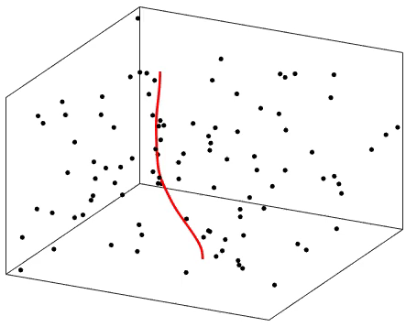
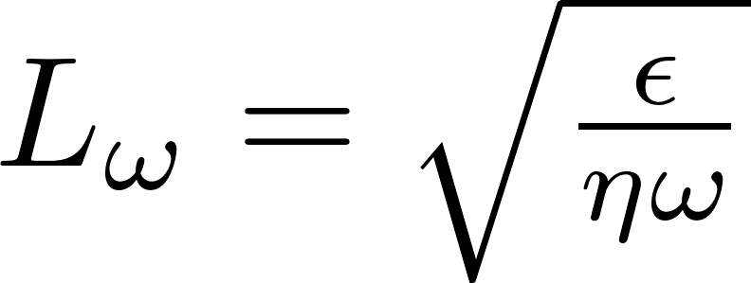
Goals
H(t)
We want to understand the behavior of field-dependent residual resistance R_{i}(H) as functions of:
RF field amplitude
Frequency
Volume density of pinning centers
Strength and statistical distributions of pinning centers
The effect of LO velocity dependence of viscous drag coefficient
Effect of Joule overheating at high vortex velocities
y(x,t)
z(x,t)
L_{ω}
Decay length of oscillating bending disturbance along the vortex line
Nb₃Sn
L⍵ can be much greater than λ.

Slide 4
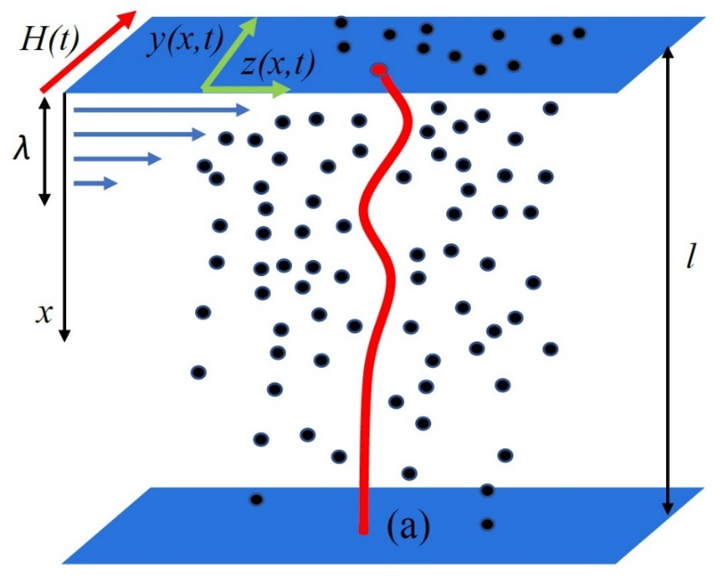
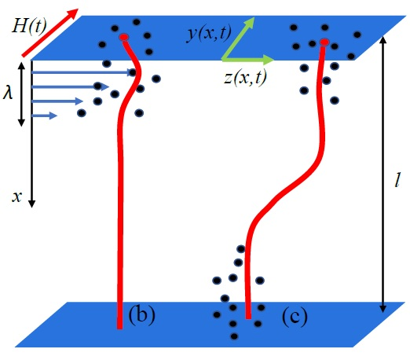
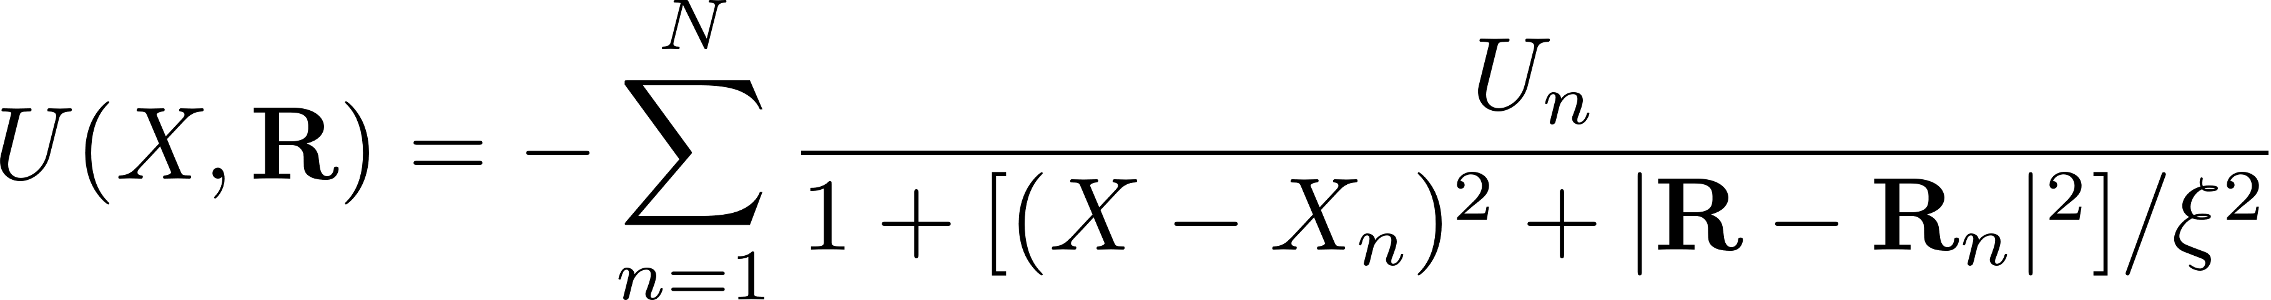
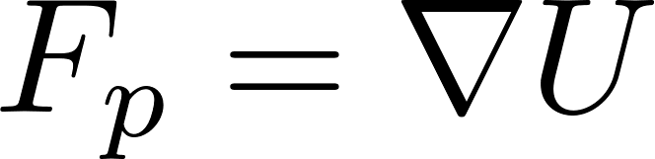
Pinning Configurations
Bulk pinning
Surface pinning
Cluster pinning
pinning potential
pinning force
U_{n}- Gain in the condensation energy in the vortex core at the pin.

Slide 5
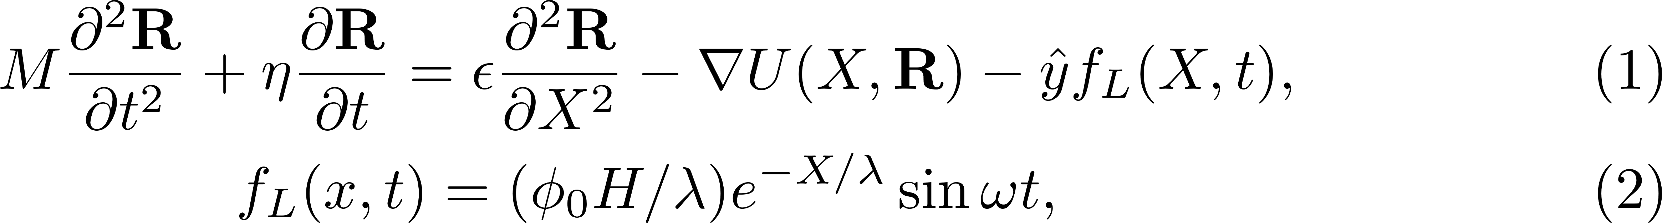
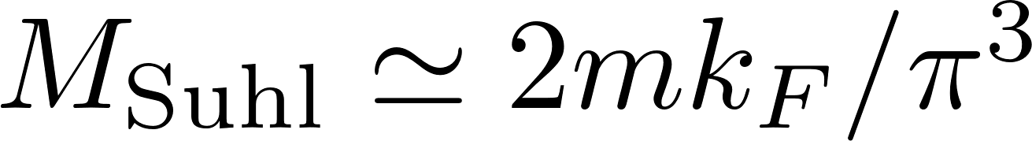
Balance of different forces
M-vortex mass, η(v)-nonlinear viscosity, ε-vortex line energy
The effective vortex mass mostly results from the kinetic energy of quasiparticles in the normal core, For Nb, M_{Suhl}~7 x 10⁻²² kg/m
Line tension arises from change in vortex line energy
κ=λ/ξ is the Ginzburg-Landau parameter
H. Suhl, Phy. Rev. Lett., vol. 14, no. 7, p. 226, 1965.

Slide 6
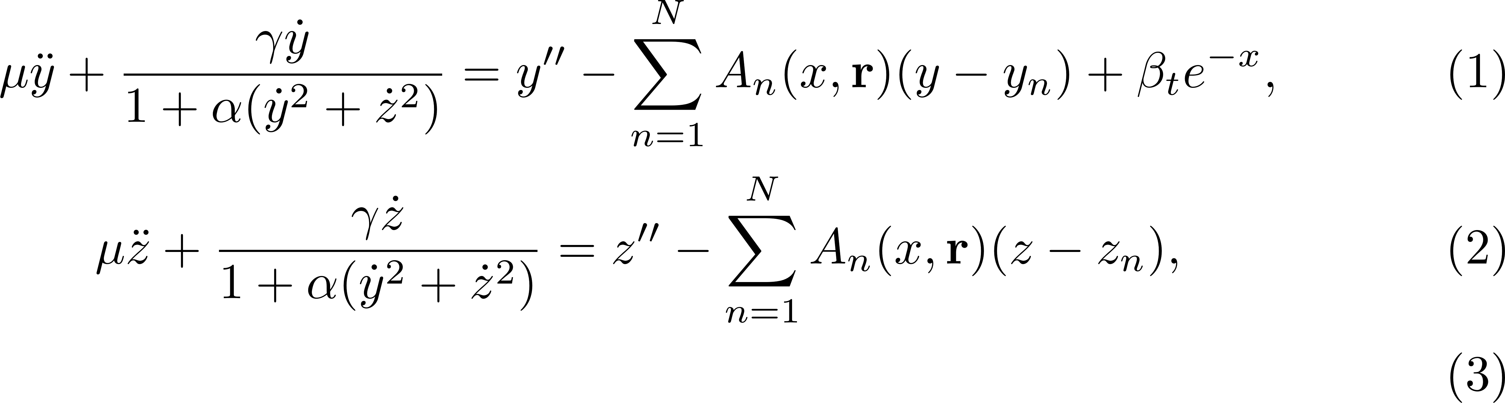
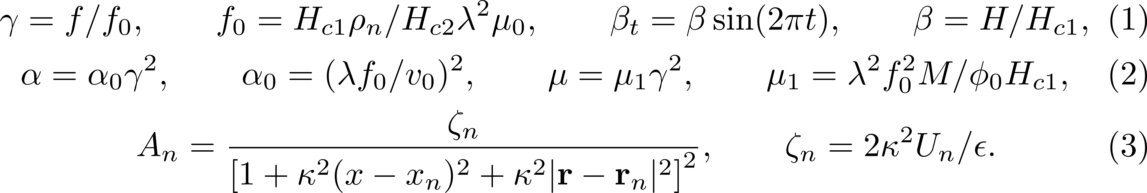
Dimensionless equations for numerical simulations
γ α frequency
ζ_{n} α pinning strength
β α RF field amplitude
α₀ α 1/(LO critical velocity)^2

Slide 7
Bardeen-Stephen viscous drag force
E
J
F_{L}
This model assumes superconductor is local and has a finite normal core with size ξ.
Finite electric field E proportional to v generate energy dissipation.
Viscous drag
Bardeen-Stephen viscous drag coefficient
At strong currents
Quasiparticles in the core are accelerated by E and diffuse away from the core.
Size of the core decreases as the velocity v increases.

Slide 8
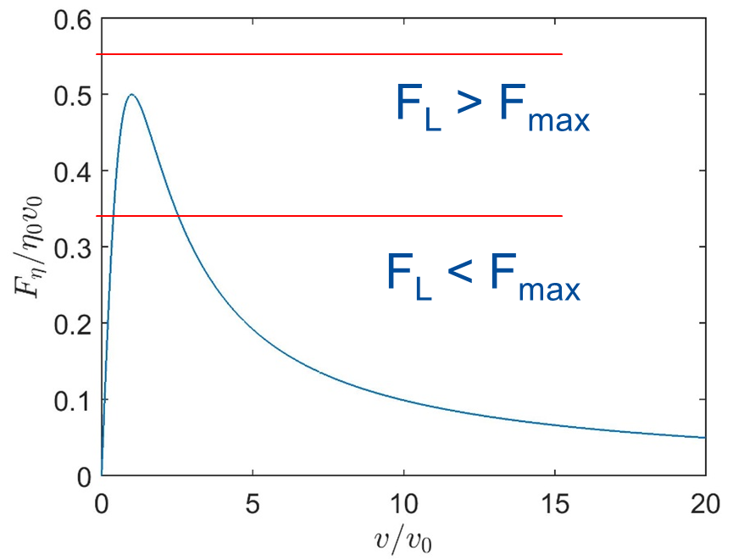
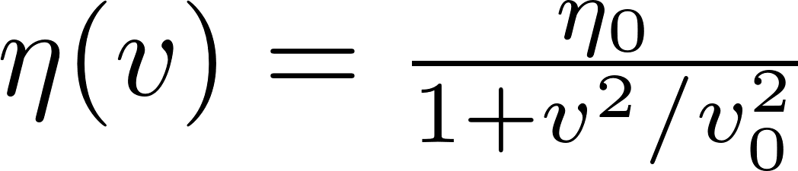
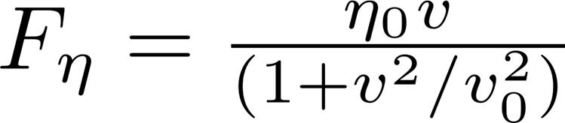
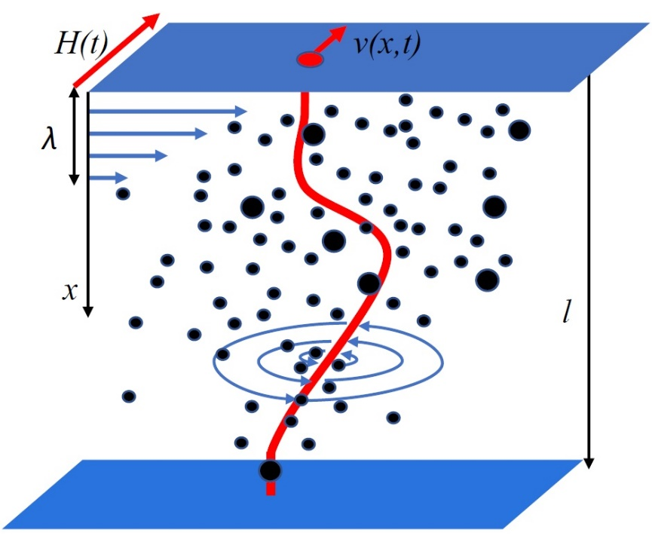
Larkin – Ovchinnikov (LO) instability
LO vortex drag force
Velocity depend vortex drag:
Jumps of straight vortices at F_{L}>F_{max} =η₀v₀/2
The LO instability has been observed in many materials.
(G. Grimaldi et al., PRB,92, 024513 (2015). M.Kunchur, PRL,87, 177001 (2001), A. I. Bezuglyj et al. PRB, 99, 174518 (2019).
LO unstable
v>v₀
For Nb v₀ ~ 0.1 km/s – 1km/s near T_{c} and decreases as T decreases
LO stable
What happens to the vortex if its fast tip is LO-unstable while the rest of the vortex is LO-stable?
A. I. Larkin and Yu. N. Ovchinnikov, Sov. Phys.–JETP 41, 960 (1975)

Slide 9
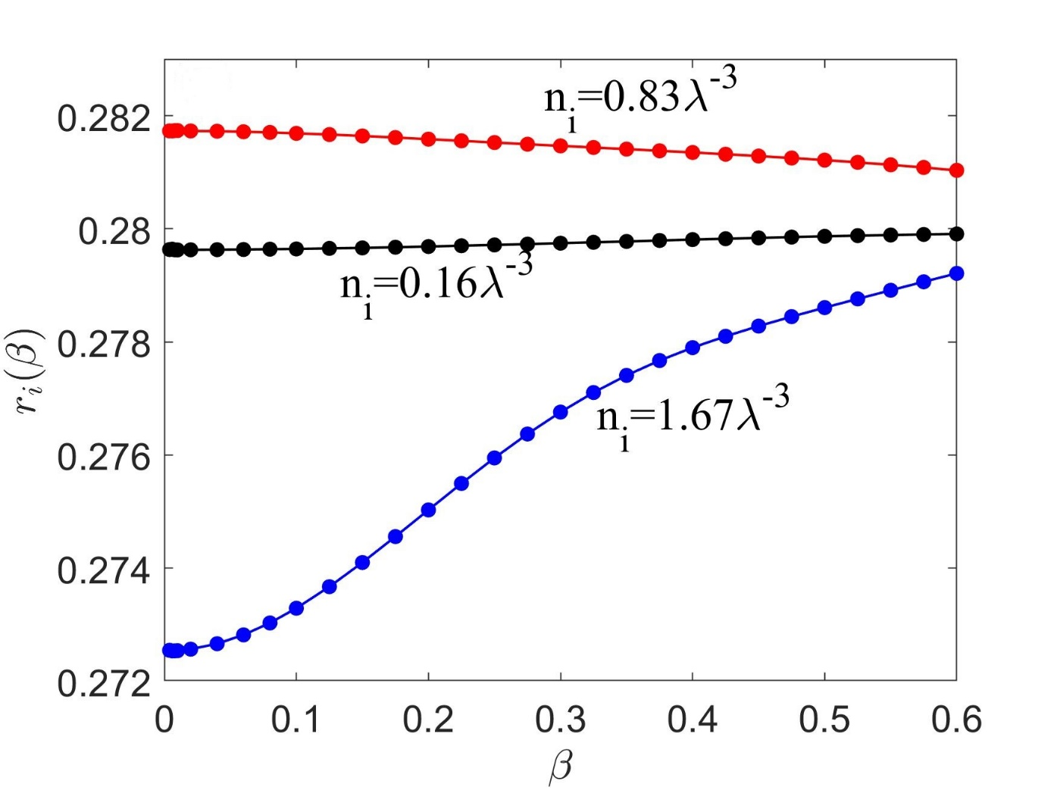
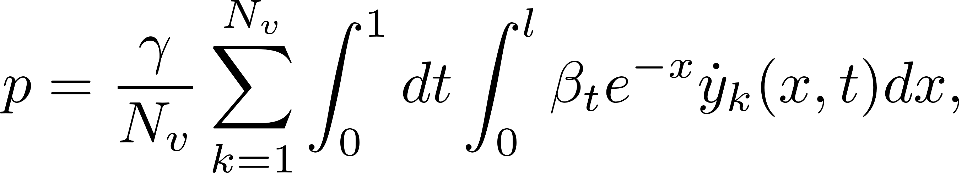
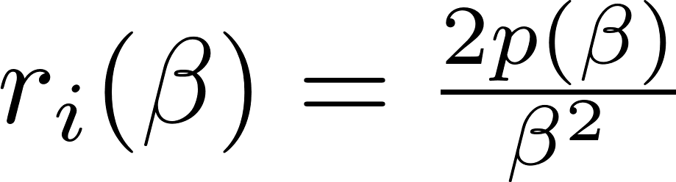
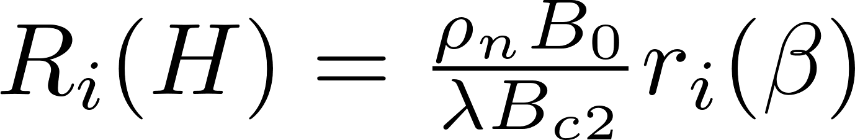
Effect of pinning density on R_{i}(H)
Using the solution for R(x,y,z,t) power p was calculated
N_{v}- Number of vortices
~0.2-3 GHz
Surface resistance R_{i}(H)
Bulk pinning
B₀-Field due to trapped flux
r_{i}(β) at n_{i}=0.16λ⁻³ < r_{i}(β) at n_{i}=0.83λ⁻³
Bardeen-Stephen limit

Slide 10
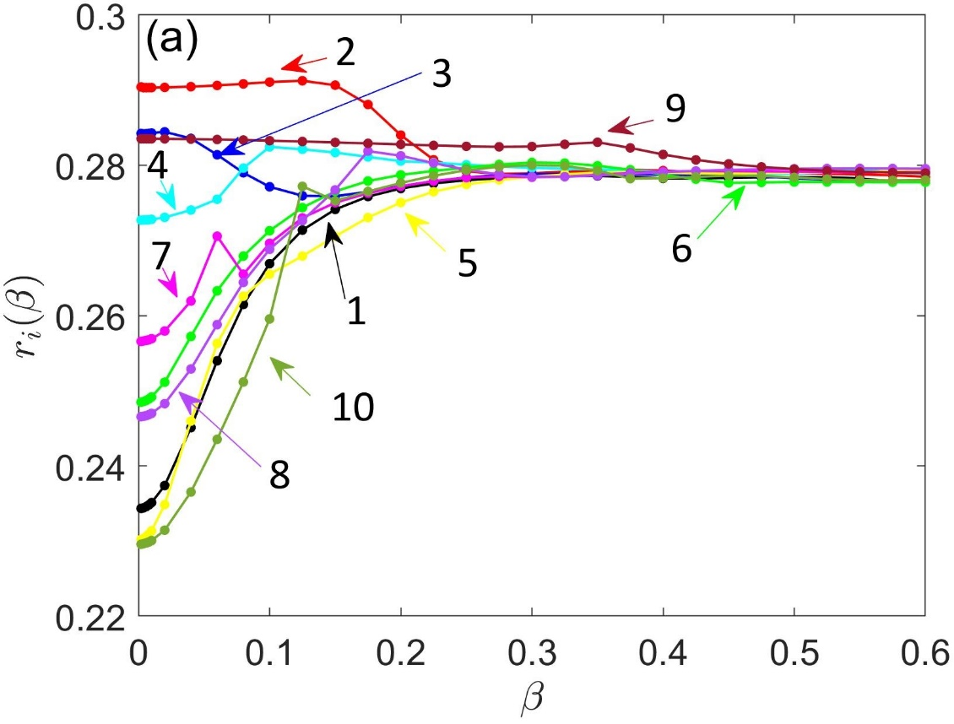
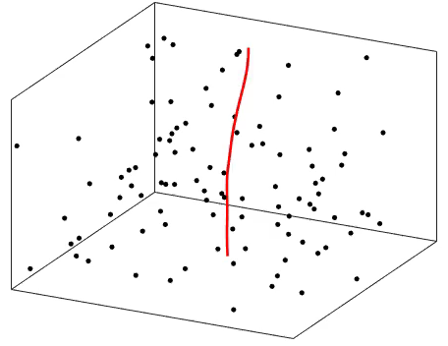
Effect of pinning fluctuations on R_{i}(H)
Bulk pinning
different statistical distributions of pins with same pin density
Depinning of the vortex between clusters
f ~0.2-3 GHz
Strong fluctuations in R_{i}(H) at the small field under different statistical realizations of the pinning potentials are observed.

Slide 11
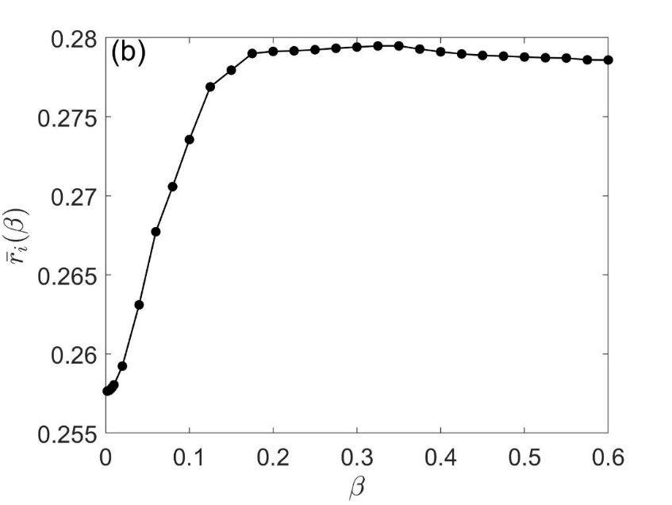
Global surface resistance
viscous-dominated
hysteretic losses
f ~0.2-3 GHz
Bulk pinning
The low-field R_{i}(H) averaged over statistical realizations of random pinning potentials exhibits a nearly linear increase with H.
Qualitative behavior of R_{i}(H) is the same for surface and cluster pinning

Slide 12
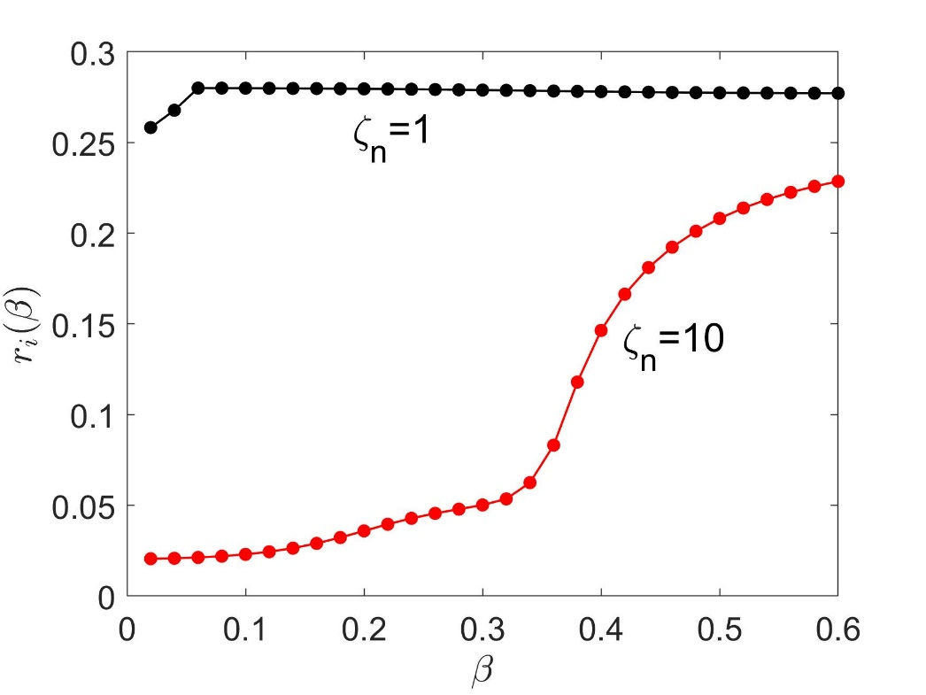
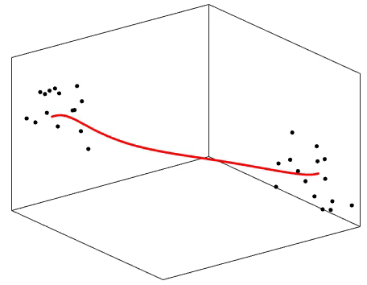
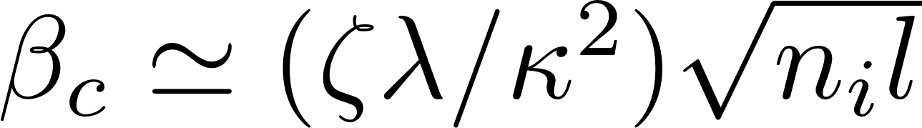
Effect of pinning Strength on R_{i}(H)
Cluster pinning
r_{i}(β) calculated at γ=0.04, κ=10, l=10λ
The temporal escape of the vortex tip
The temporal escape of the vortex tip occurs at
  β_{c} ~ 0.35 at ζ_{n}=10
  β_{c} ~ 0.03 at ζ_{n}=1
Larkin-Overchinnikov theory of collective pinning :
β_{c} is the depinning field

Slide 13
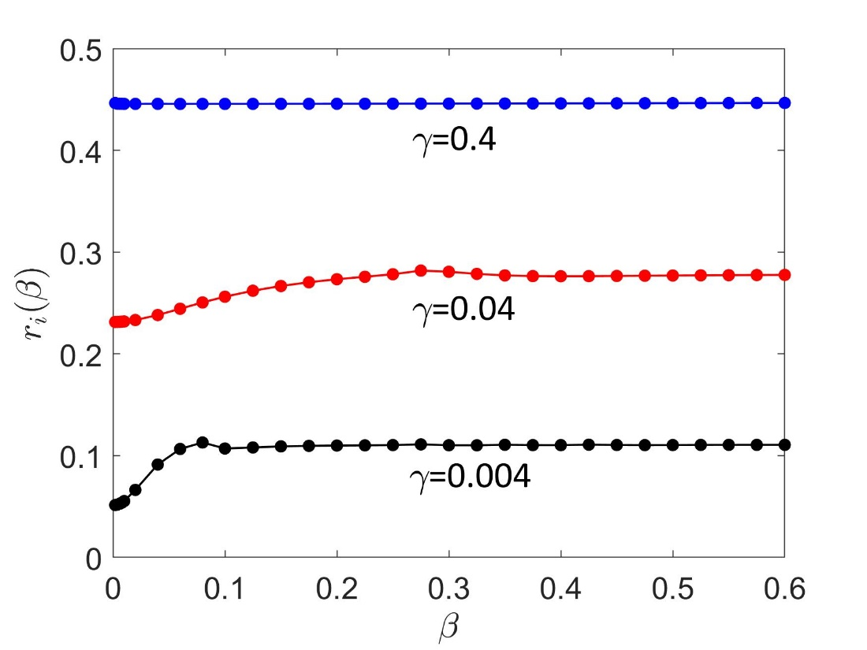
Effect of frequency on the field dependence of R_{i}(H)
r_{i}(β) calculated at κ=10, ζ_{n}=1 (Bulk pinning)
As frequency decreases a linear field dependence of R_{i}(H) develops at small field.
Qualitative behavior is similar for surface and cluster pinning

Slide 14
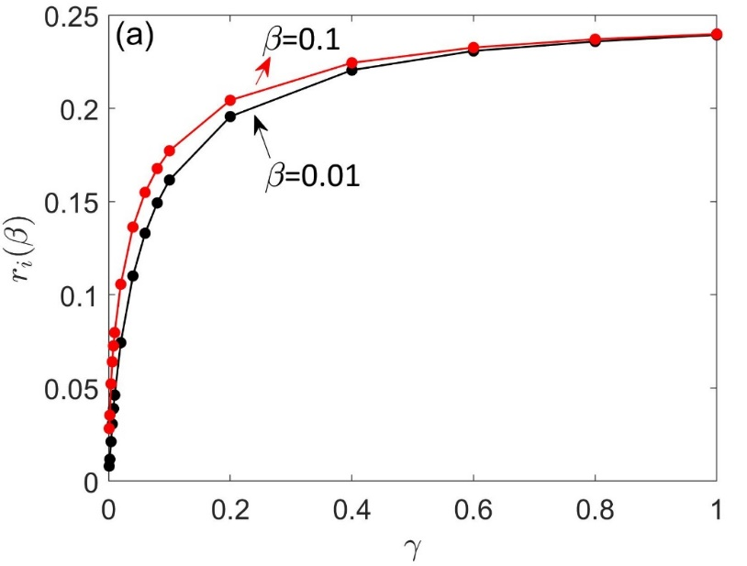
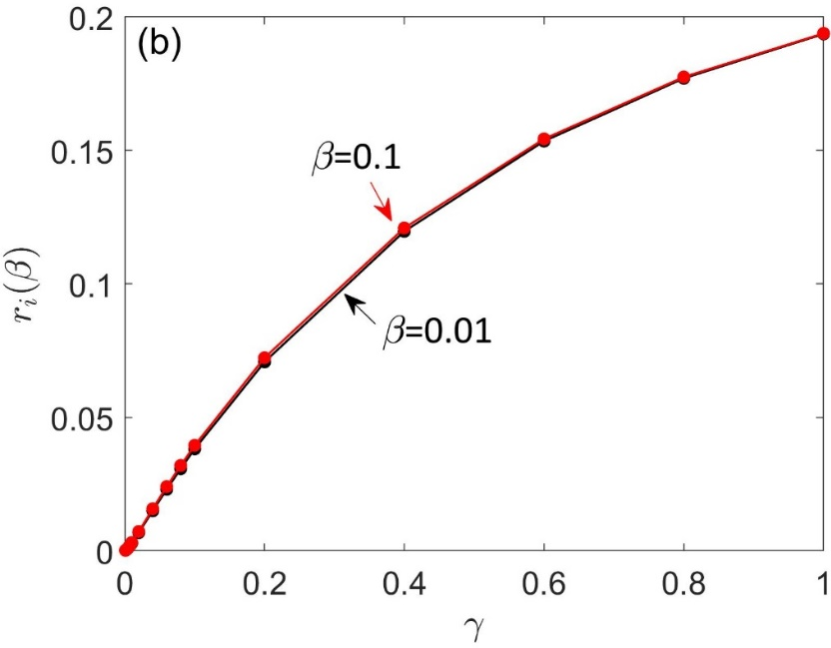
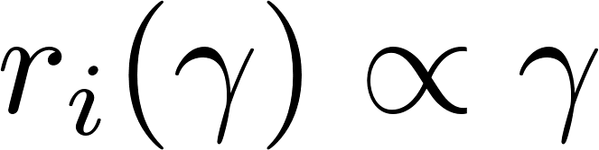
Frequency dependence of R_{i}(f)
ζ_{n}=20
ζ_{n}=1
viscous-dominated
Finite length effect
Pinning-dominated
γ=0.04, l/λ=20, κ=10 n_{i}=0.0625λ⁻³
(Bulk pinning)

Slide 15
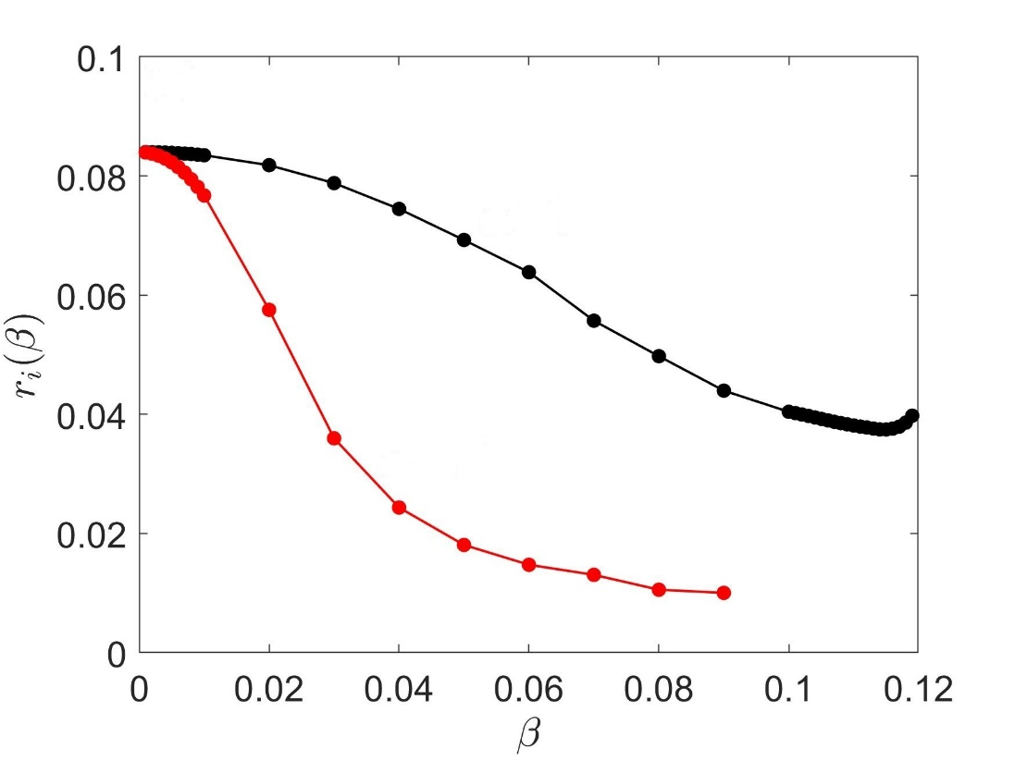
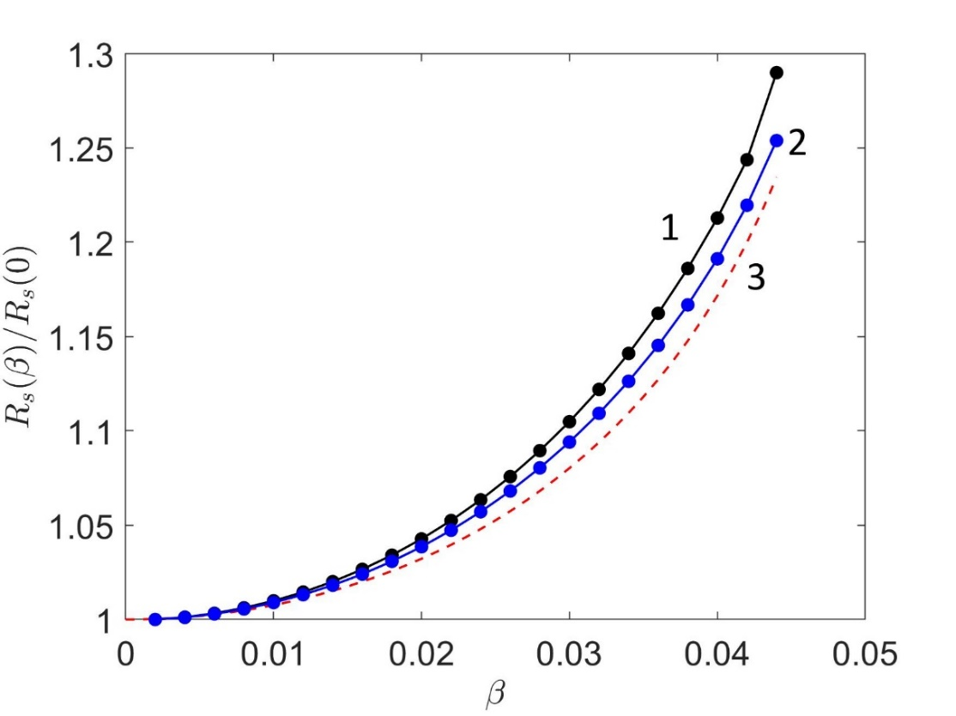
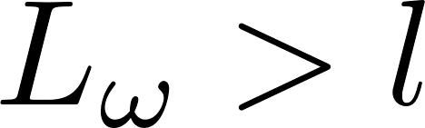
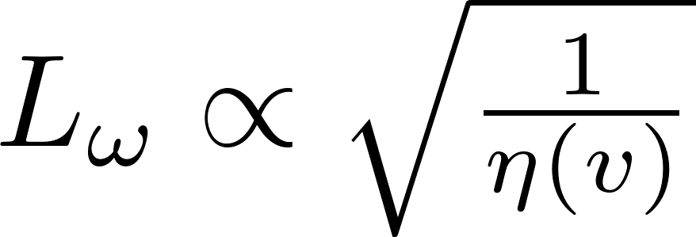
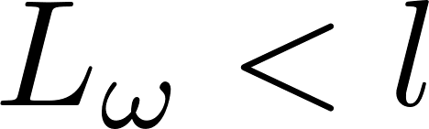
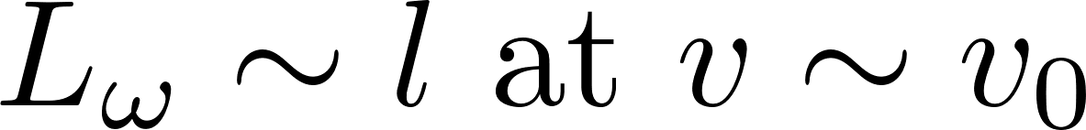
R_{i}(H) for the LO drag at strong RF fields
Weak pinning
Strong pinning
ζ_{n}=0.8
ζ_{n}=0.08,
ζ_{n}=0.04
α₀=10⁴
α₀=10⁴
α₀=10⁵
γ=0.01, κ=2, l=10λ (f~ 0.2-3 GHz)
Weak pinning
Strong pinning
Vortex moves as a stick
Vortex line tension and pinning suppress the LO instability at v~v₀
LO instability at v~v₀

Slide 16
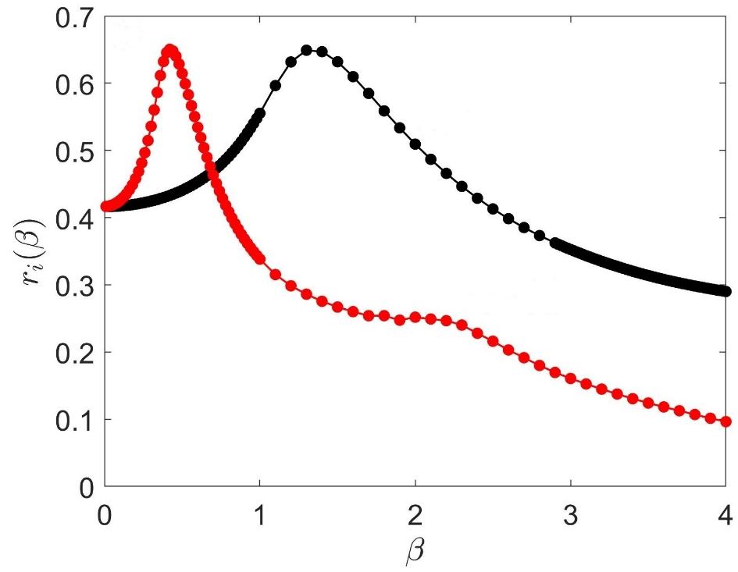
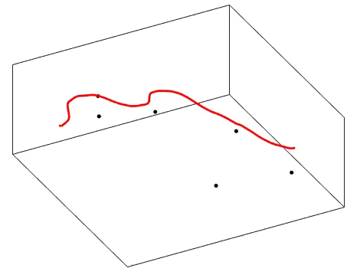
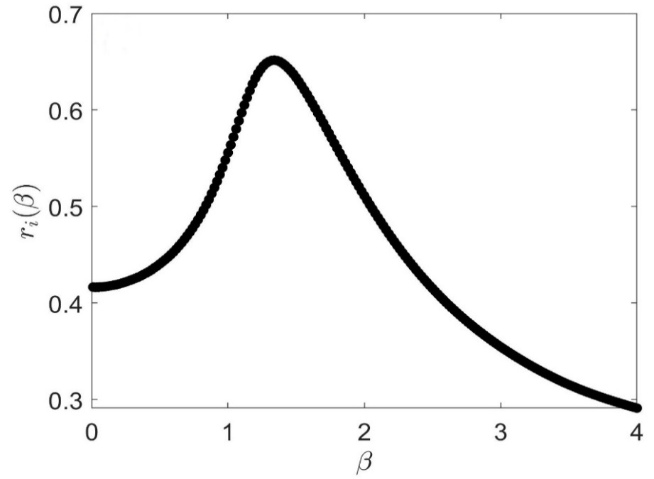
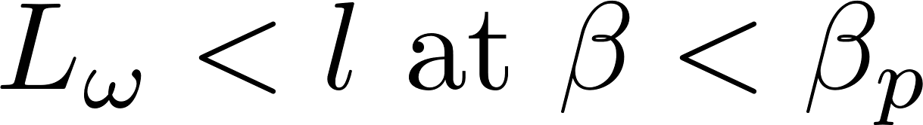
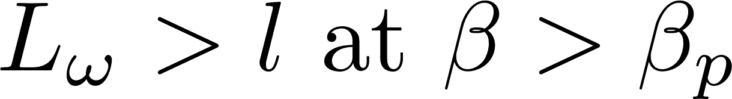
R_{i}(H) at strong RF fields at high frequencies
β=3,α₀=10,ζ_{n}=0.8
ζ_{n}=0.8
α₀=1
α₀=10
β_{p}
Strong pinning
ζ_{n}=0.08
Pins in the vicinity of the vortex are shown to clarify the vortex behavior.
α₀=1
Transition from a nearly harmonic oscillations to highly anharmonic oscillations at β=β_{p}. Elastic skin depth L_{ω} increases with β
α₀ α 1/v₀^2
Weak pinning
γ=1, κ=2, l=10λ (f ~ 10-50 GHz)

Slide 17
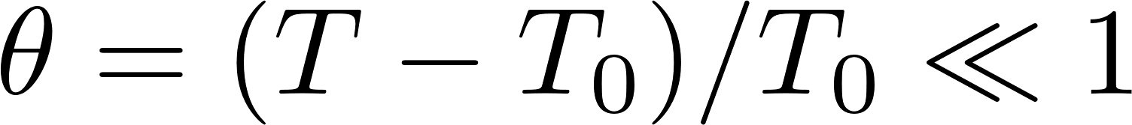
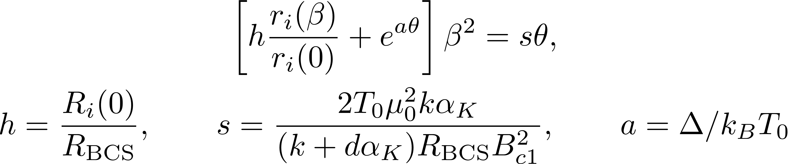
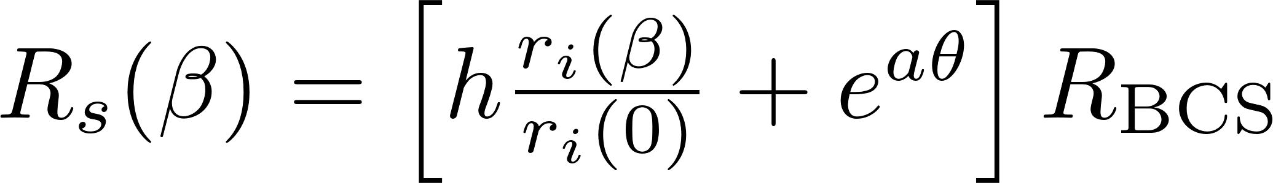
RF overheating
At high vortex velocities, the Joule overheating can mask the LO decrease of R_{s}(H).
Thermal feedback for trapped vortices and linear BCS*:
α_{k}-Kapitza
k-thermal conductivity
d-thickness
(At Weak overheating)
α Trapped flux density
h ~ 0.1-10, s ~ 43 and a ~ 11 (For moderately dirty Nb with κ=2 at T₀=1.6 K and f ~ 1.5 GHz.
*A. Gurevich, Rev. Accel. Sci. Technol. 5,119 (2012).

Slide 18
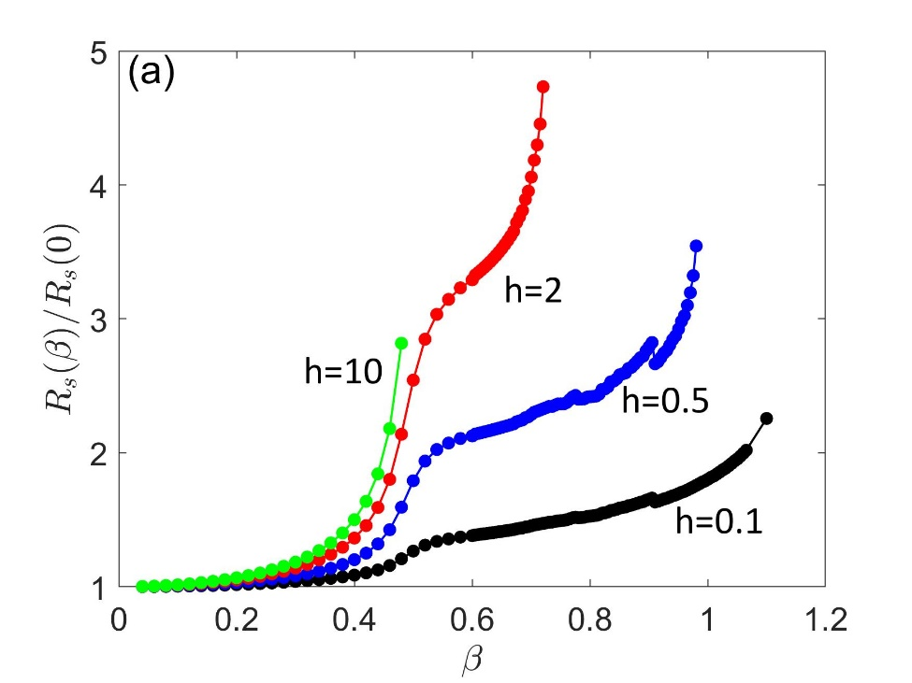
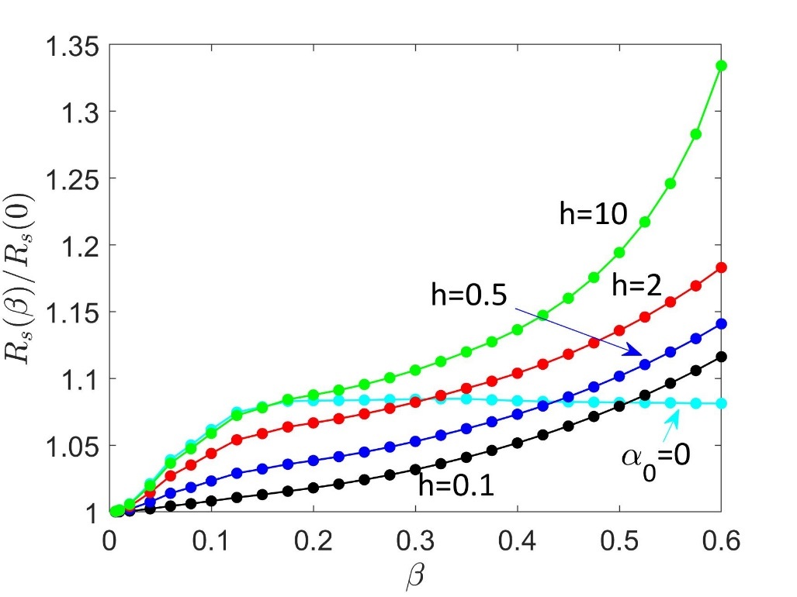
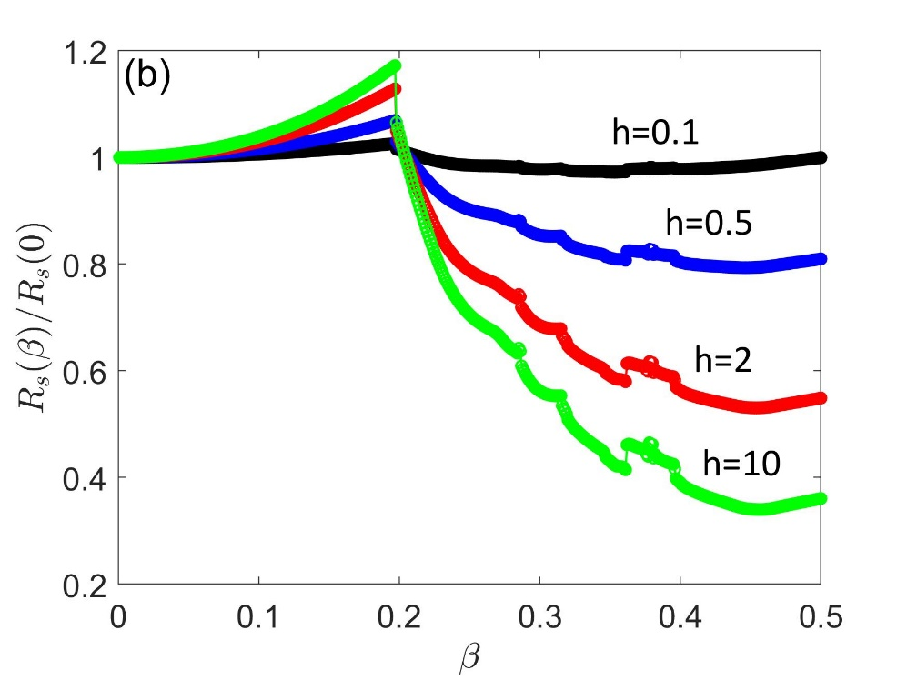
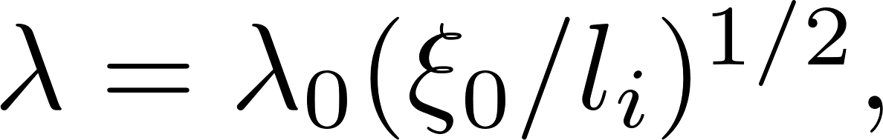
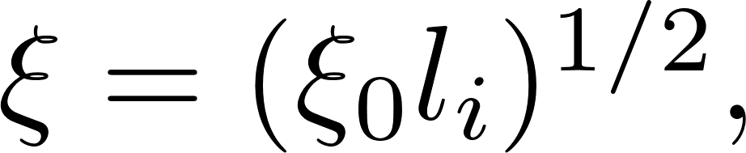
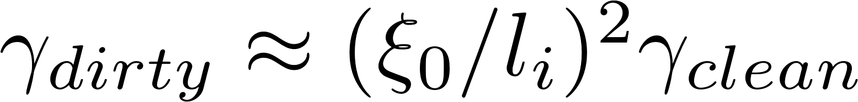
RF overheating
LO limit
γ=0.4
γ=0.04
Bardeen-Stephen limit
Dirty Nb/High frequency
(f ~3-10 GHz)
(f ~0.5-3 GHz)
LO limit
Clean Nb/Low frequency
(f ~0.5-3 GHz)
γ=0.04

Slide 19
Summary
Field dependent R_{i}(H) strongly depends on pinning density, strength and their statistical distributions at small fields.
The low-field global surface resistance averaged over statistical realizations of a random pinning potential can exhibits a nearly linear increase with H and level off at higher fields.
R_{i}(H) at strong RF field becomes a nonmonotonic function of H which decreases with H at higher frequencies due to the LO decrease of η(v). This can contribute to the negative Q(H) slope in SRF cavities.
Overheating can mask the descending field dependence of R_{i}(H) as frequency increases.
Measurements of R_{i} (H) due to trapped vortices offer opportunities to investigate an extreme nonlinear dynamics of vortices driven by strong Meissner current densities at T<<T_{c}

