Slide 1

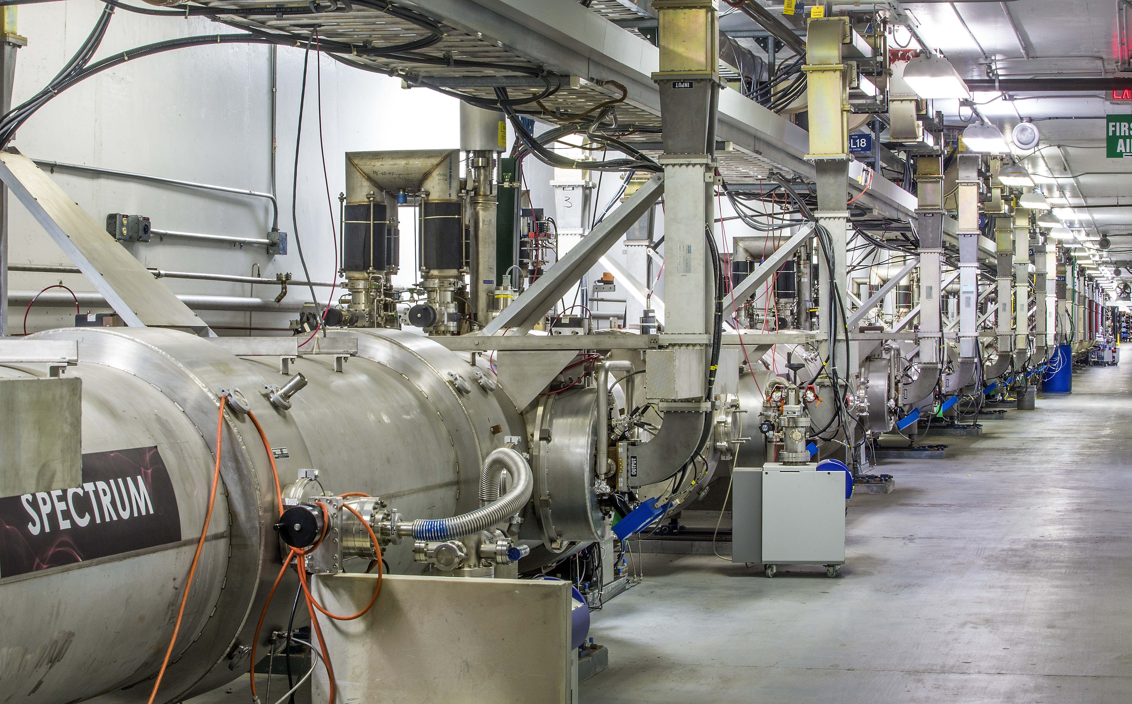
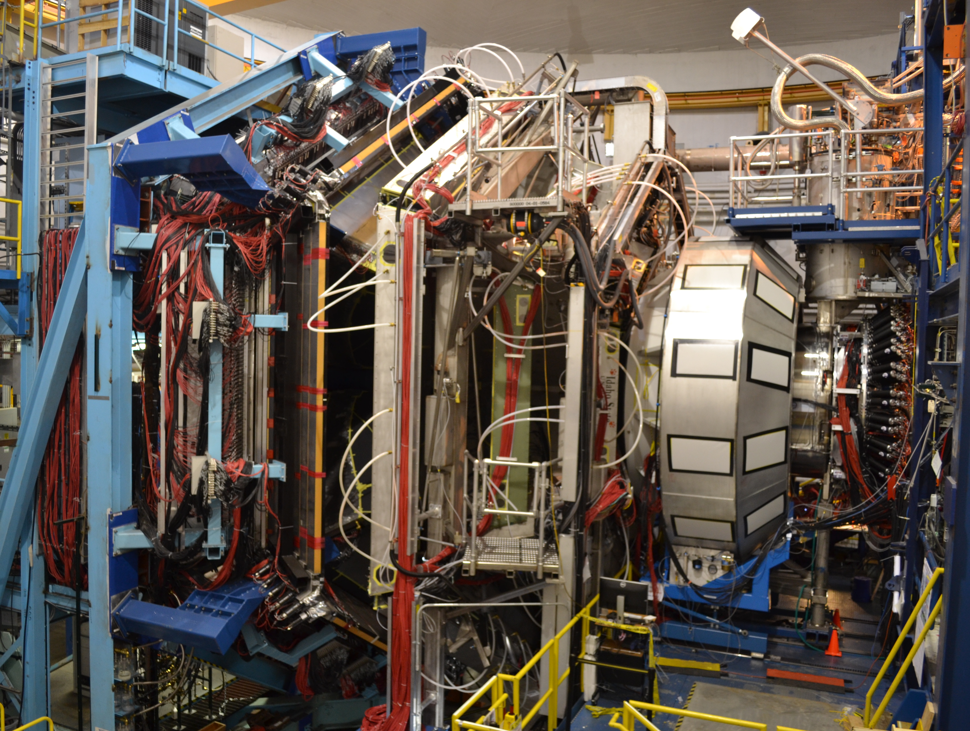
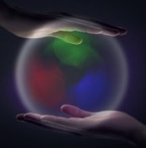
Hall B Run Group A (RG-A) (Pol. e on Unpol. H)
11 GeV Polarized Electrons on Unpolarized Liquid Hydrogen Target to Study Proton Structure, 3D Imaging, and Gluonic Excitations with CLAS12
Latifa Elouadrhiri
For RG-A and the CLAS collaboration
Jefferson Lab PAC 48
September 18, 2020

Slide 2
outline
RG-A Science Program
New information with scientific importance since the original proposal - Some highlights
The Experiment
Data Analysis and required beam time
Summary

Slide 3
RG- A Science Program
The CLAS12 RG-A experiments were designed to perform complementary measurements to study proton structure for both the ground and excited states, 3D imaging, and gluonic excitations with the core mission to understand the manner in which the constituents of protons are held together by the strong force and the emergence of the dominant part of hadron mass.
RG-A is composed of 13 experiments driven by an international collaboration grouped in 5 categories:
  Deep Exclusive Processes (E12-06-119, E12-06-108 and E12-12-00): Study of Generalized Parton Distributions (GPDs), (2 +1) D imaging of the proton and the study of its gravitational and mechanical structure.
  Deep inclusive & SIDIS (E12-06-112, E12-06-112A and E12-06-112B):Study of the Transverse Momentum Dependence (TMDs) and the of 3D structure in momentum space.
  Nucleon structure (E12-09-003, E12-06-108A, E12-06-108B): Study of the nucleon resonance structure at photon virtualities from 2.0 to 12 GeV²
  Quasi photo-production (E12-12-001 and E12-12-001A): Study of J/ψ Photoproduction, LHCb Pentaquarks and Timelike Compton Scattering.
  MesonX program (E12-11-005 and E12-11-005A): Study of meson spectroscopy in search of hybrid mesons

Slide 4

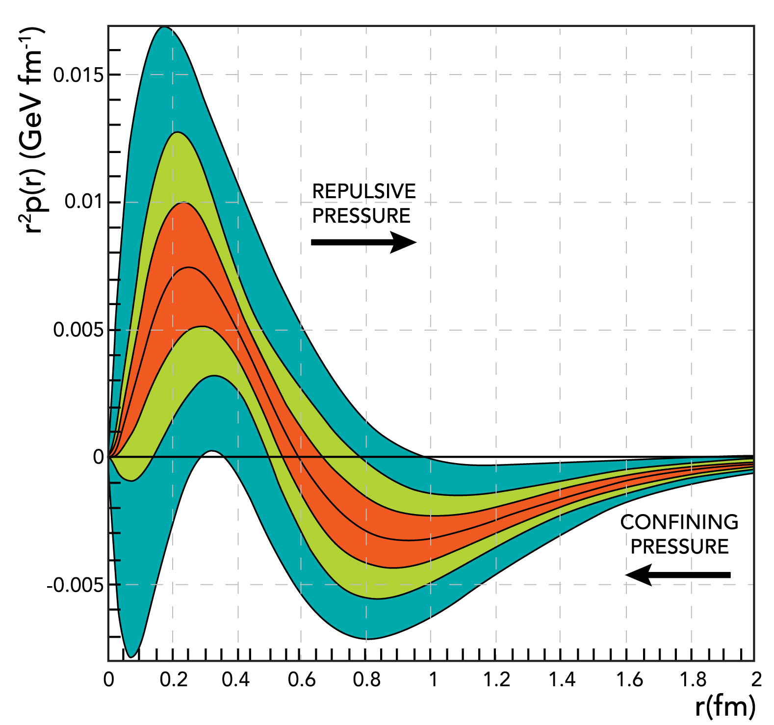
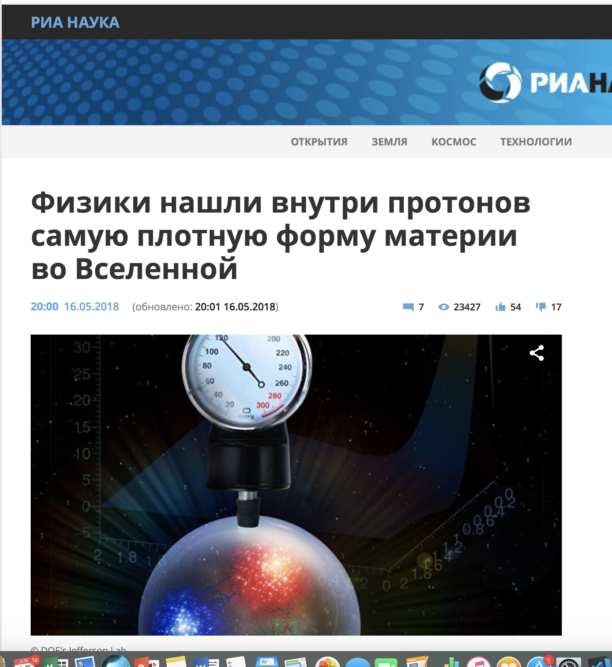
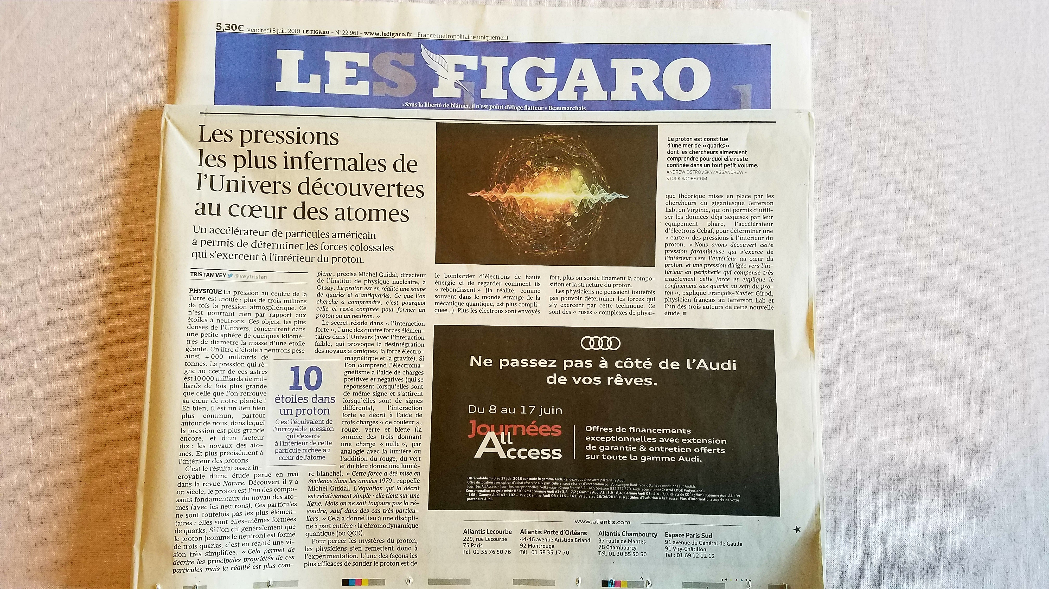
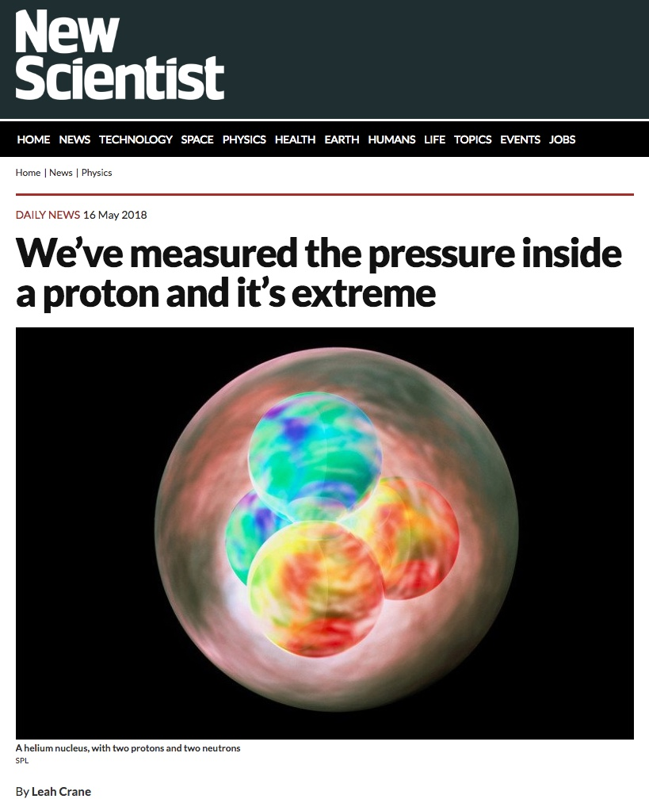
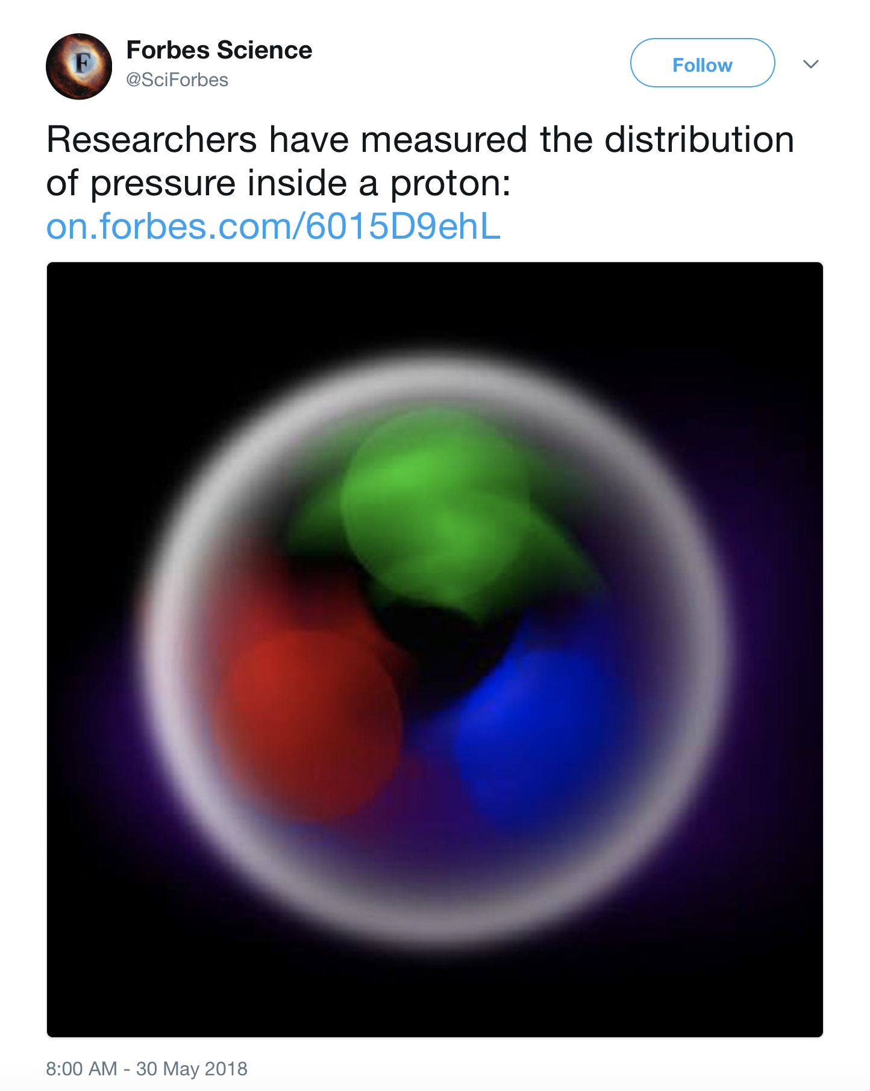
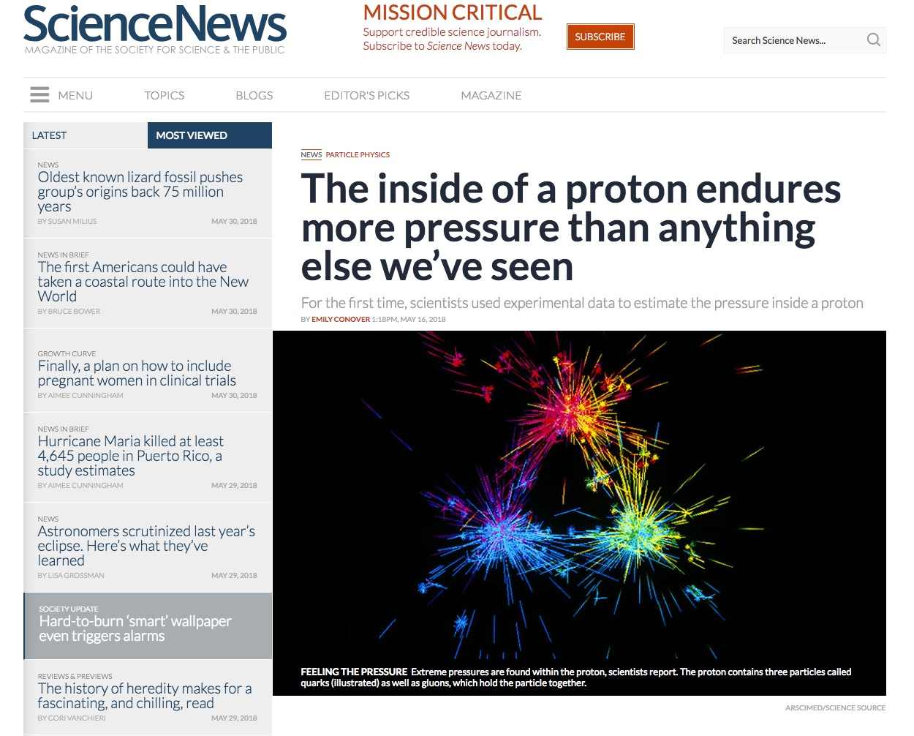

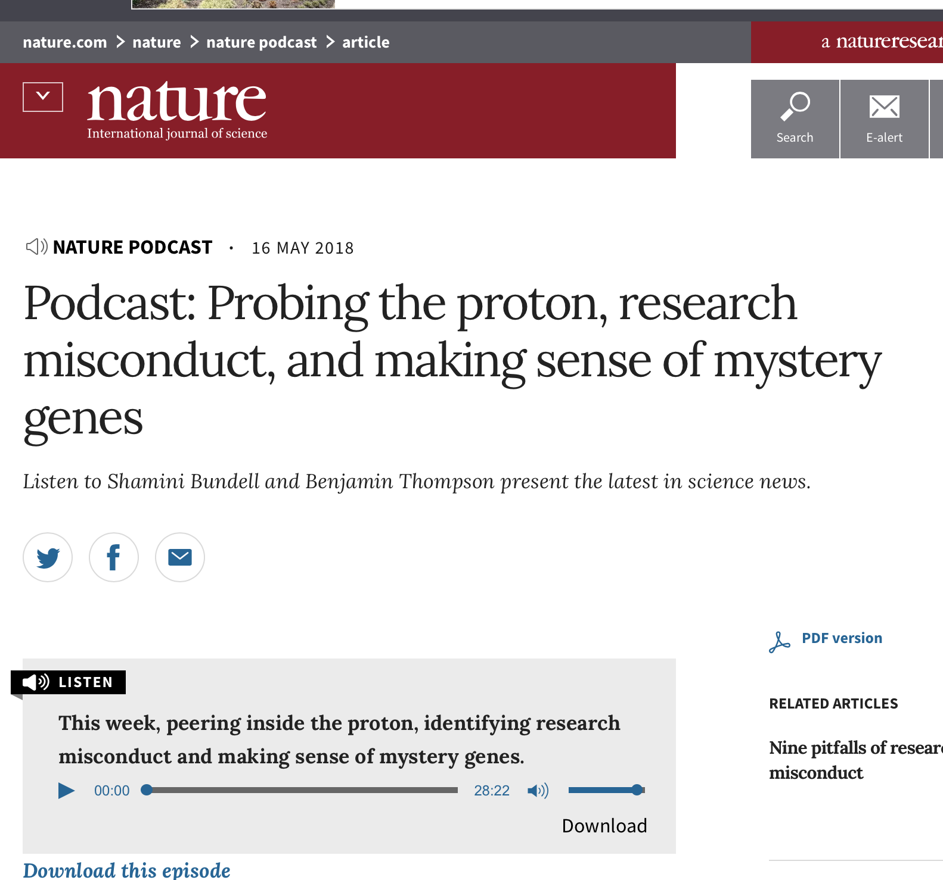
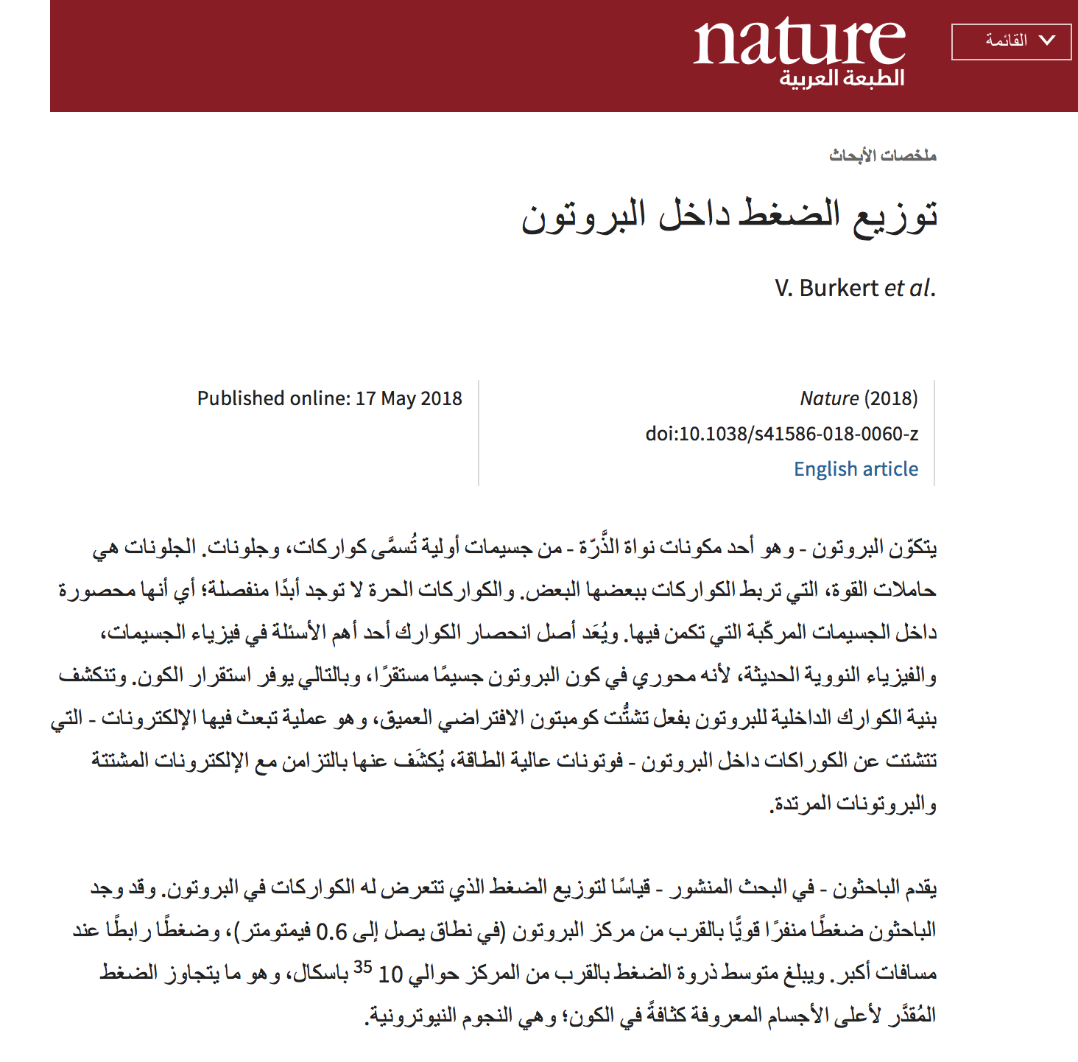
The pressure distribution inside the proton
New information with scientific importance - highlights
Repulsive pressure at
r < 0.6 fm <p> 10³⁵ Pa
Confining pressure at
r > 0.6 fm
Nature 557 (2018) no.7705, 396-399
V. Burkert, L. Elouadrhiri, F.X. Girod
In the News
4
This work opens up a new area of research on the fundamental gravitational properties of protons, neutrons and nuclei, which can provide access to their physical radii, the internal shear forces acting on the quarks and their pressure distributions.
Projected CLAS12 data

Slide 5
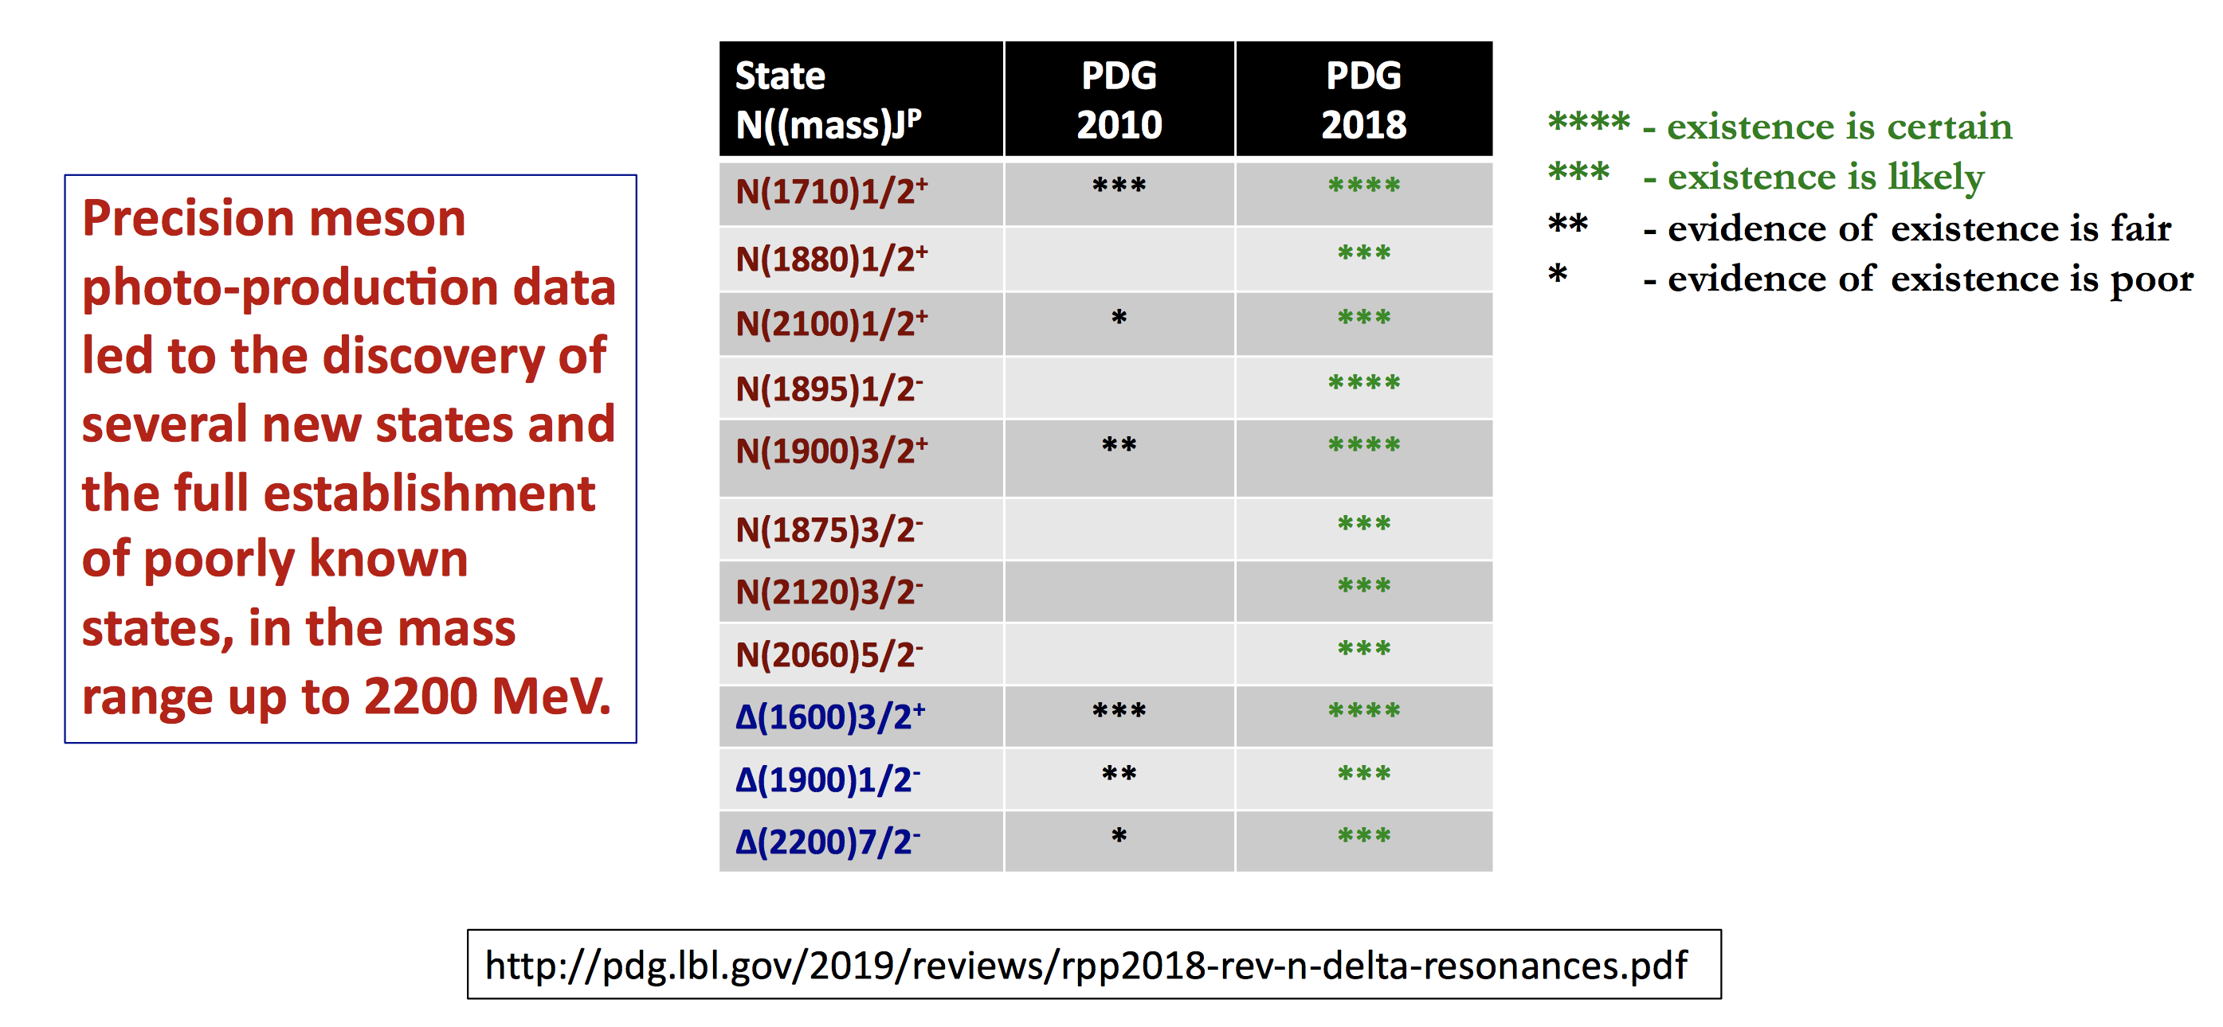
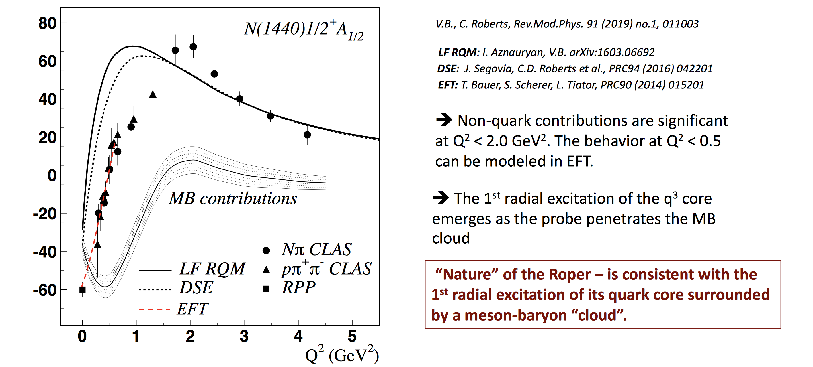
The quest for Missing Resonances
New information with scientific importance - highlights
CLAS12 Will allow the extension of this program to high Q²

Slide 6
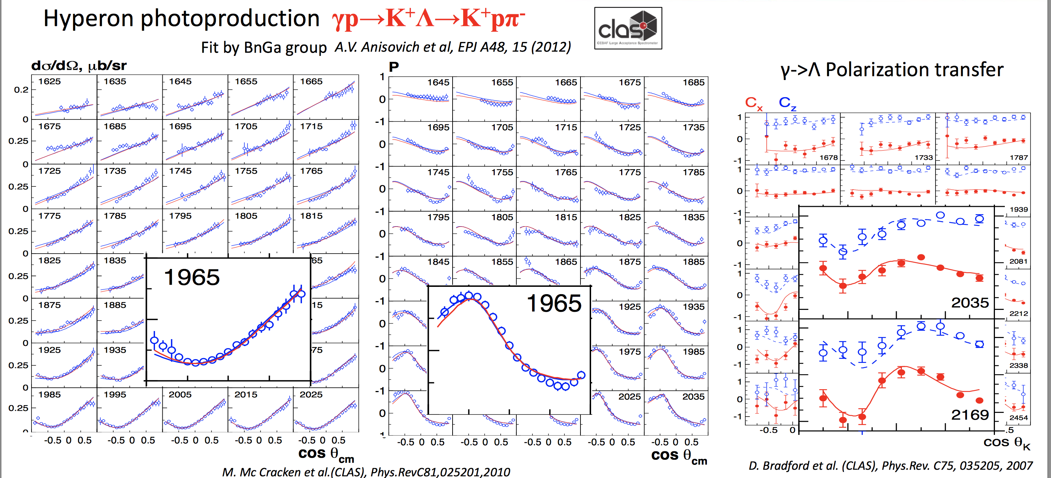
New information with scientific importance - highlights

Slide 7
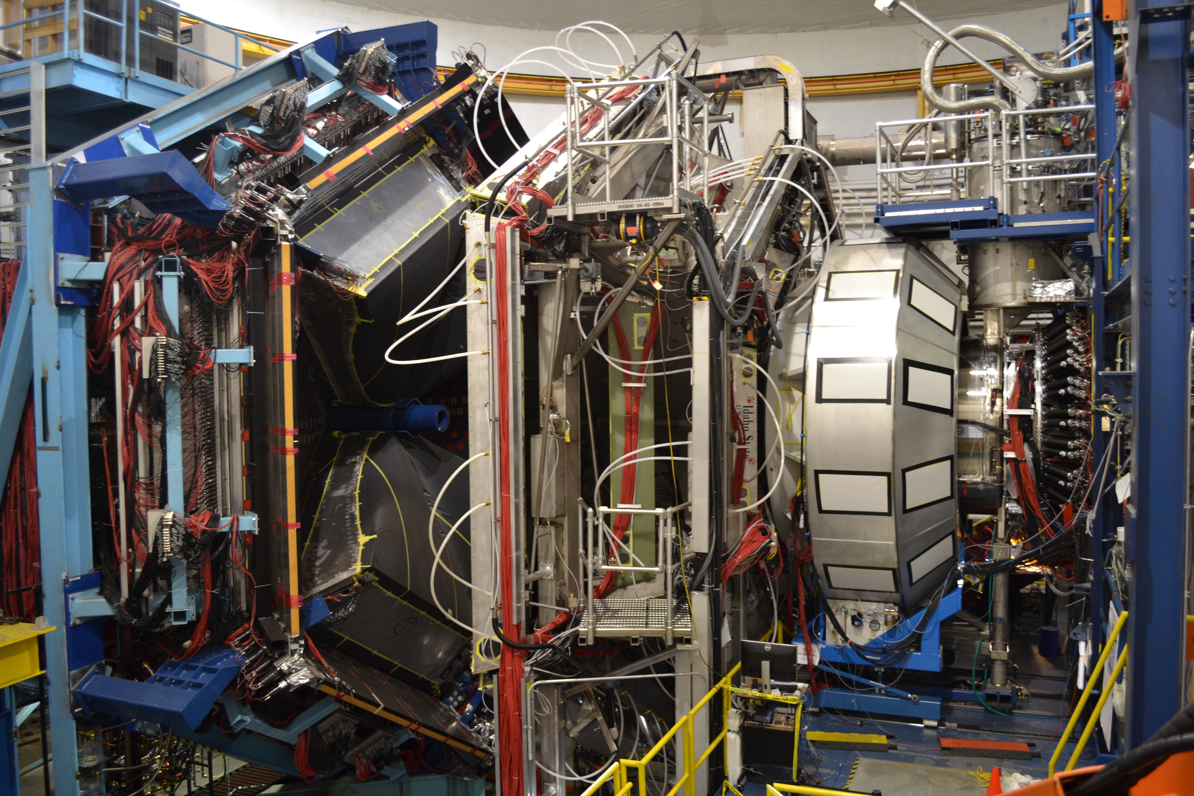
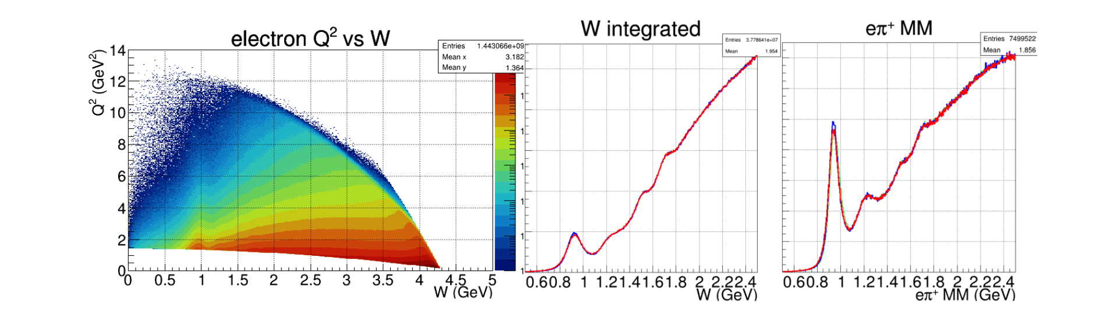
RG-A Experiment
CLAS12
RG-A has acquired data in three separate running periods, spring 2018 (126 mC), fall 2018 (99 mC), and spring 2019 (60 mC), with the collected charge amounting to roughly half of the full approved RG-A beam time. So far, the fall 2018 data set has been calibrated and processed for data analysis.
To fully realize the goals of the RG-A science program, the full statistics of the approved beam time is required.
Published in: Nucl.Instrum.Meth.A 959 (2020) 163419

Slide 8
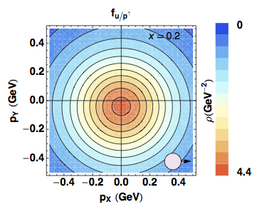
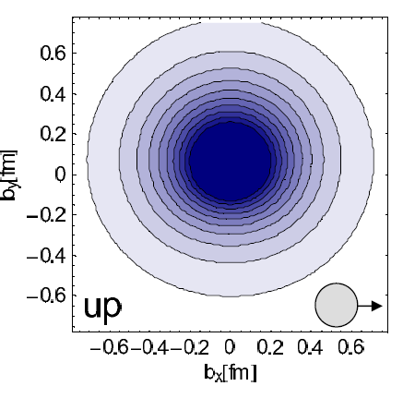
Quantum phase-space distributions of quarks
W_{p}^{q}(x,k_{T},r) “Mother” Wigner distributions
Probability to find a quark q in a nucleon P with a certain polarization in a position r & momentum k
d³r
d²k_{T}
[Wigner (1932)]
[Belitsky, Ji, Yuan (04)]
[Lorce’, BP (11)]
QM
QFT (Breit frame)
QFT (light cone)
TMD PDFs: f_{p}^{u}(x,k_{T}),…
GPDs: H_{p}^{u}(x,ξ,t), …
Semi-inclusive measurements
Momentum transfer to quark
Direct info about momentum distribution
Exclusive Measurements
Momentum transfer to target
Direct info about spatial distribution
d²k_{T}
ξ=0,t=0
PDFs f_{p}^{u}(x),…
Contalbrigo M.
8

Slide 9
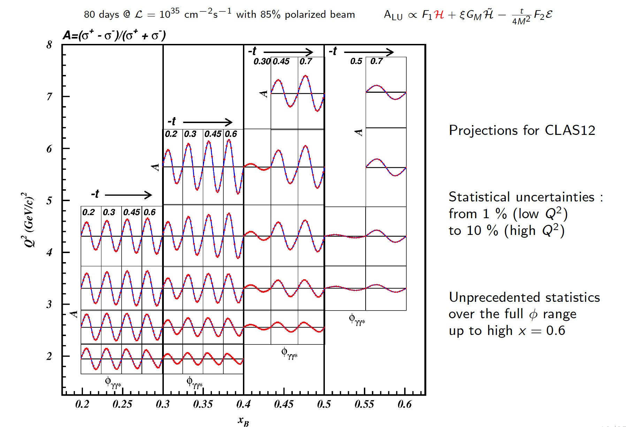
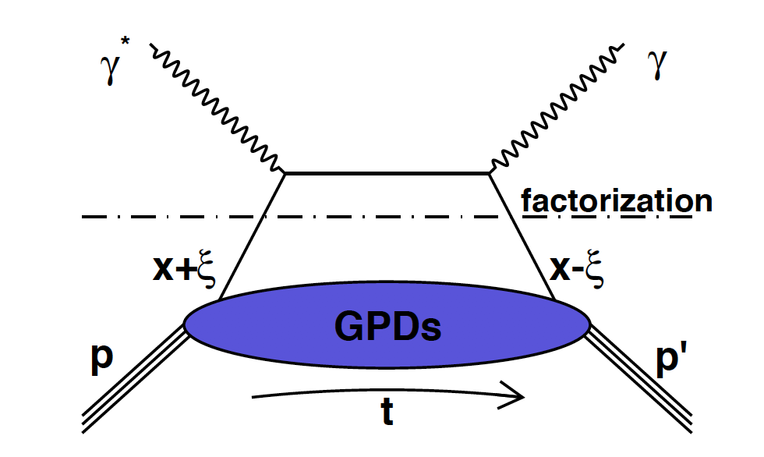
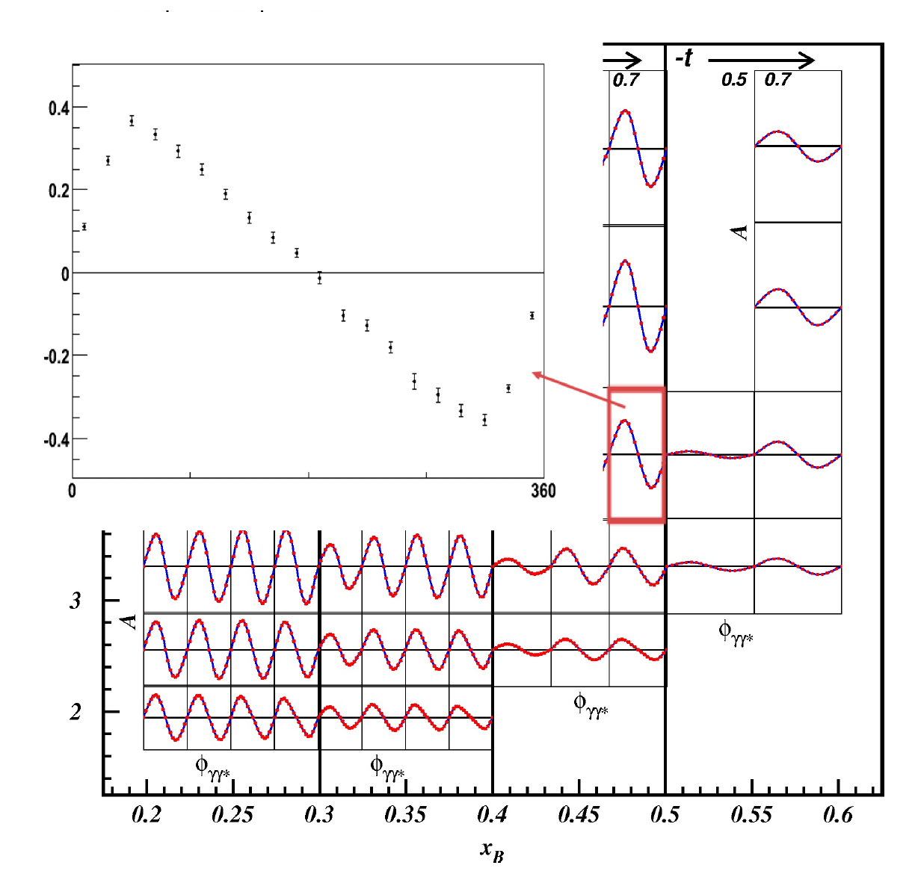
DVCS Experiment

Slide 10
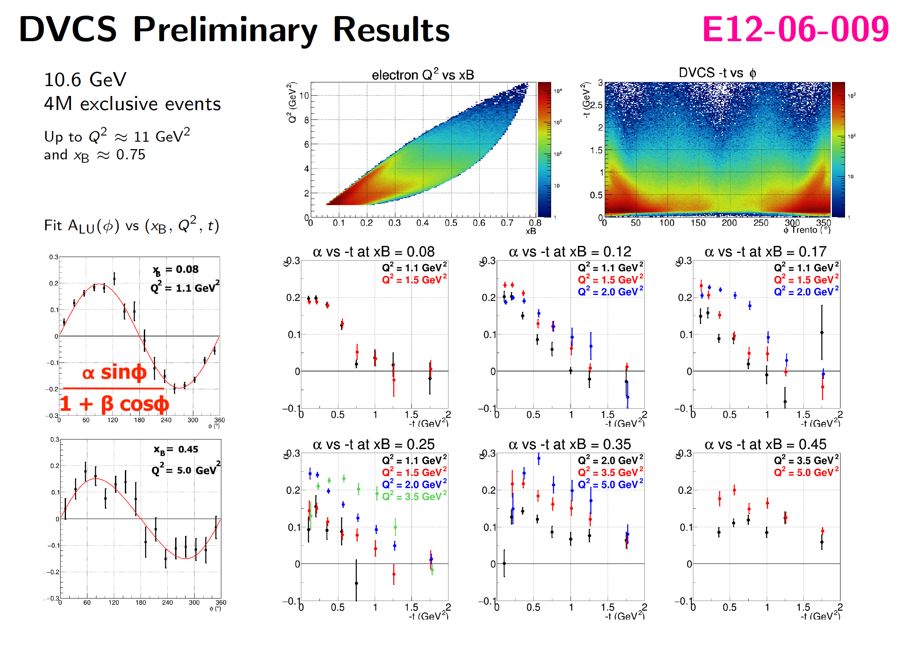
DVCS– Preliminary Results

Slide 11
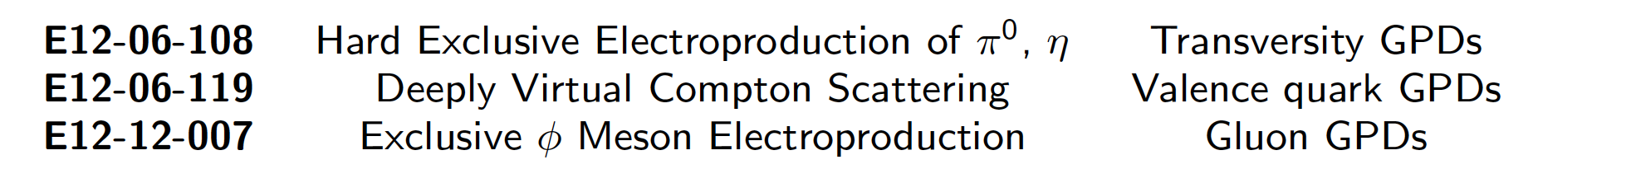
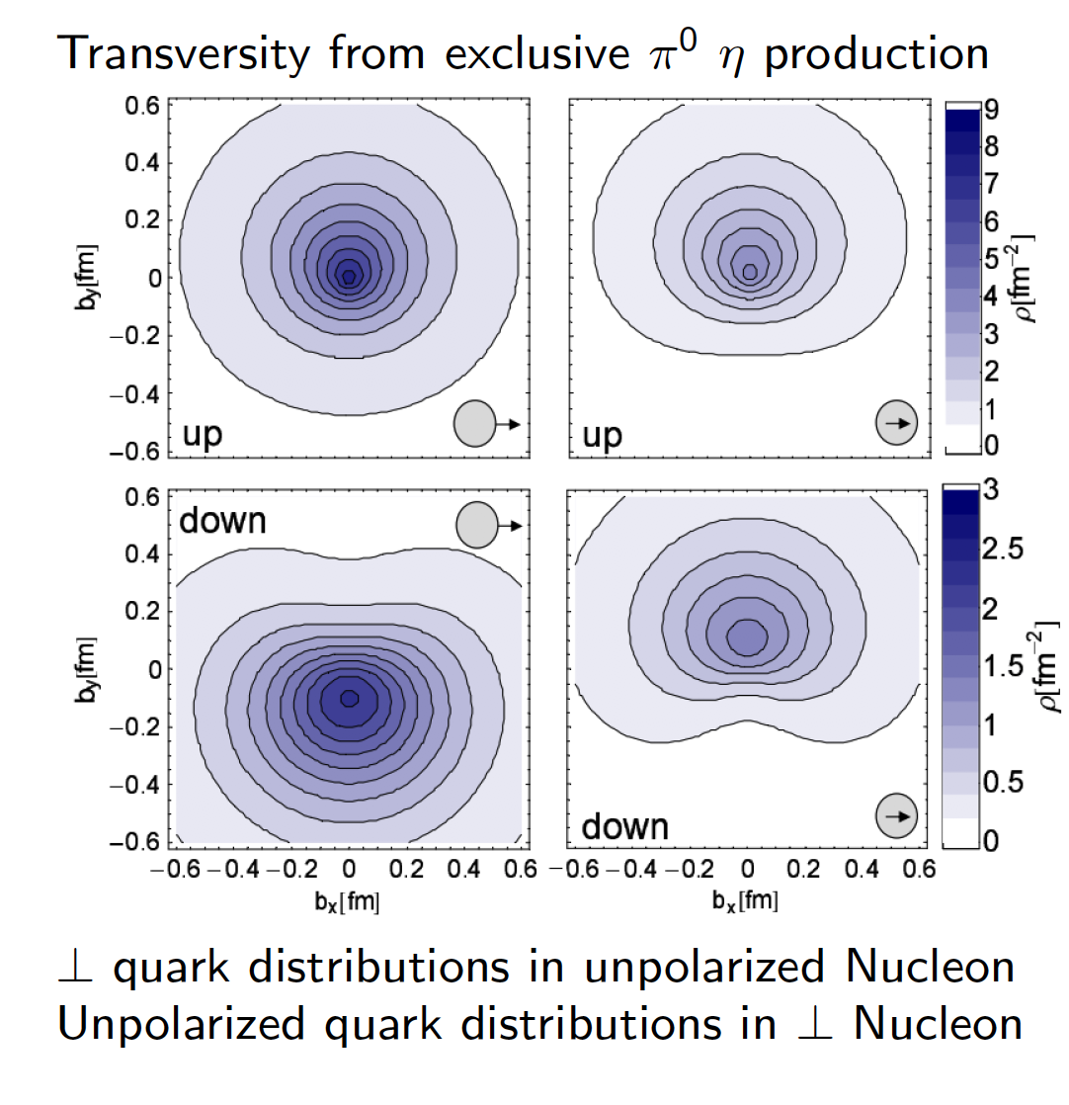
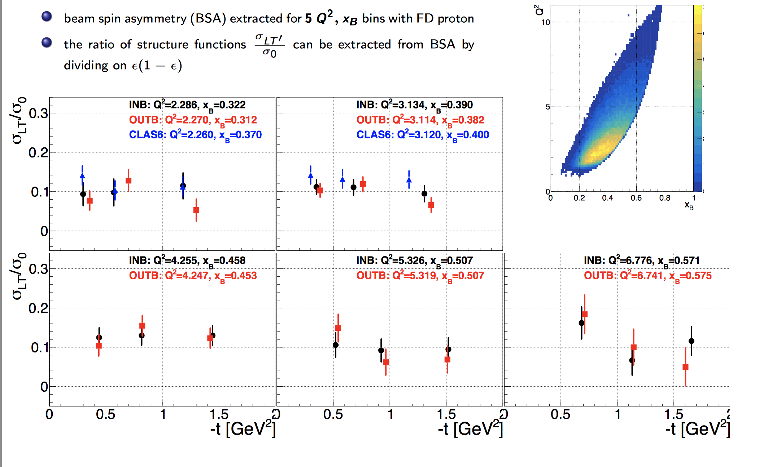

Slide 12
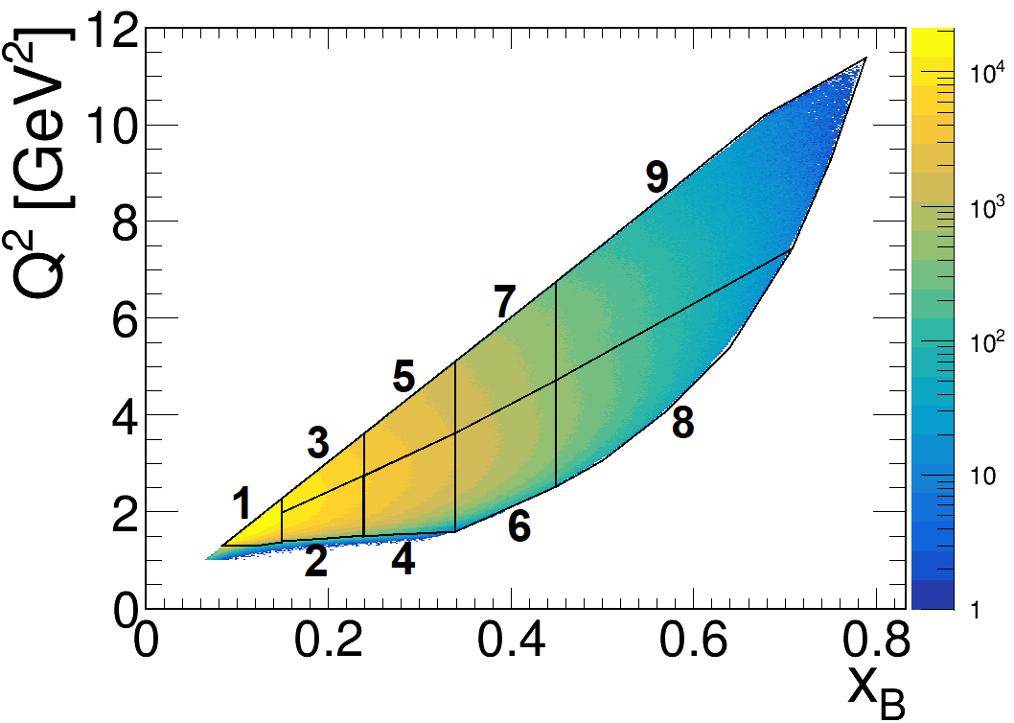
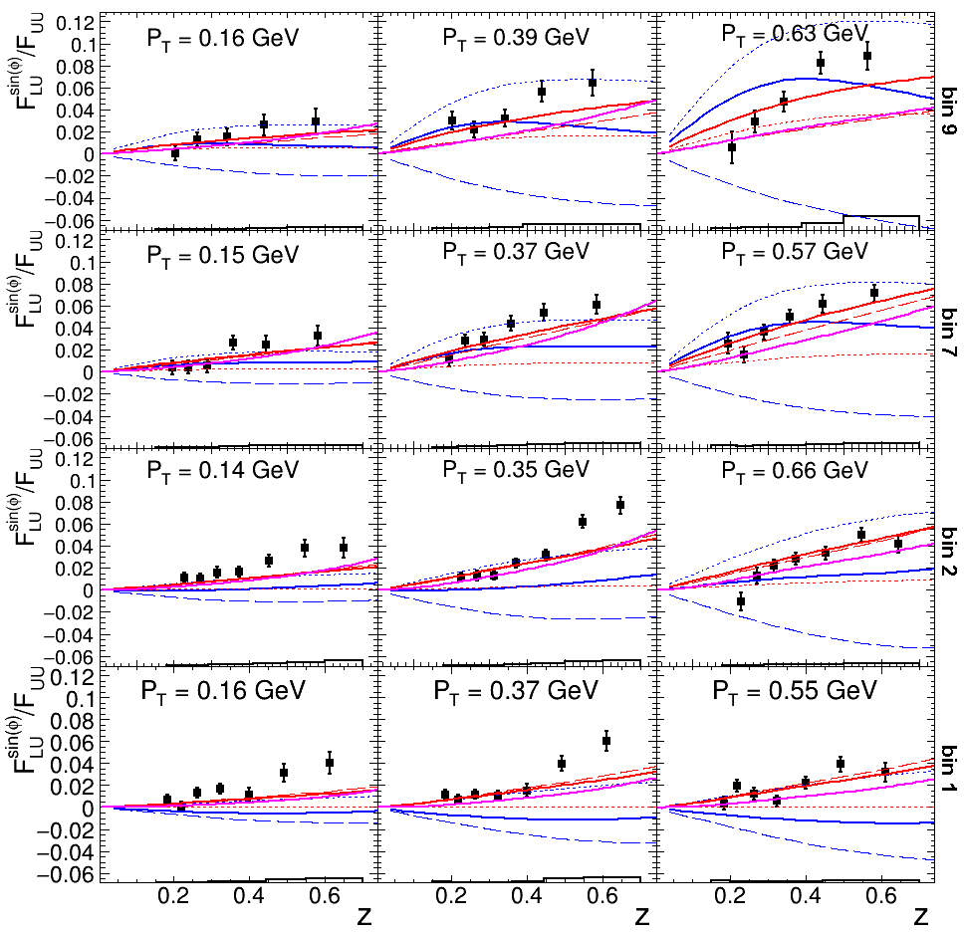
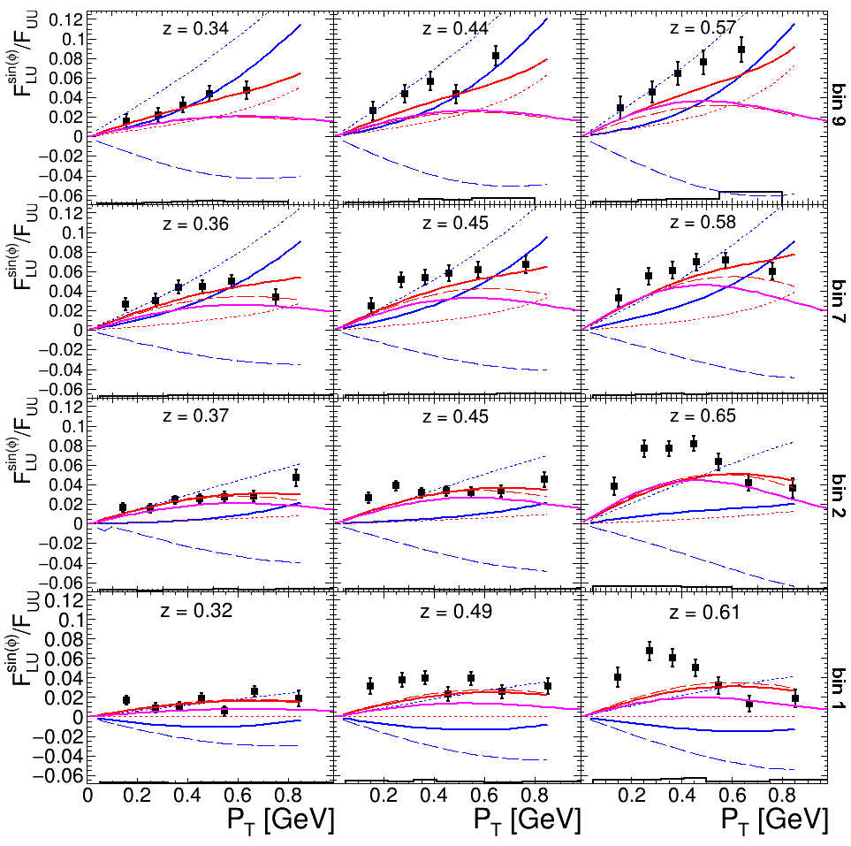
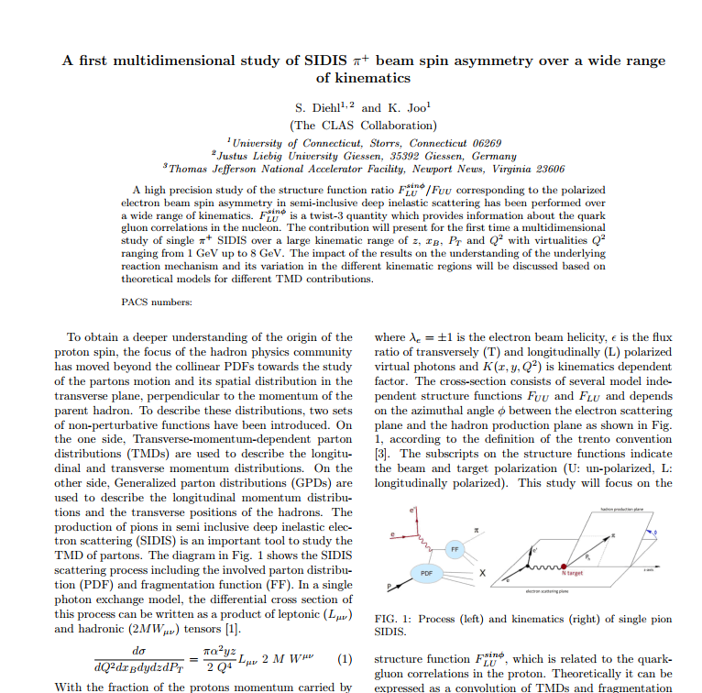
A first multidimensional high precision study of SIDIS π⁺ beam single
spin asymmetry over a wide range of kinematics
SIDIS can probe the transverse momentum dependent parton structure
Previous experiments: Mostly only one dimensional studies
CLAS12: First fully differential study
High precision CLAS12 data can help to distinguish between
reaction models and to improve global fits of TMDs and FFs
CLAS12 First Publication in Preparation

Slide 13
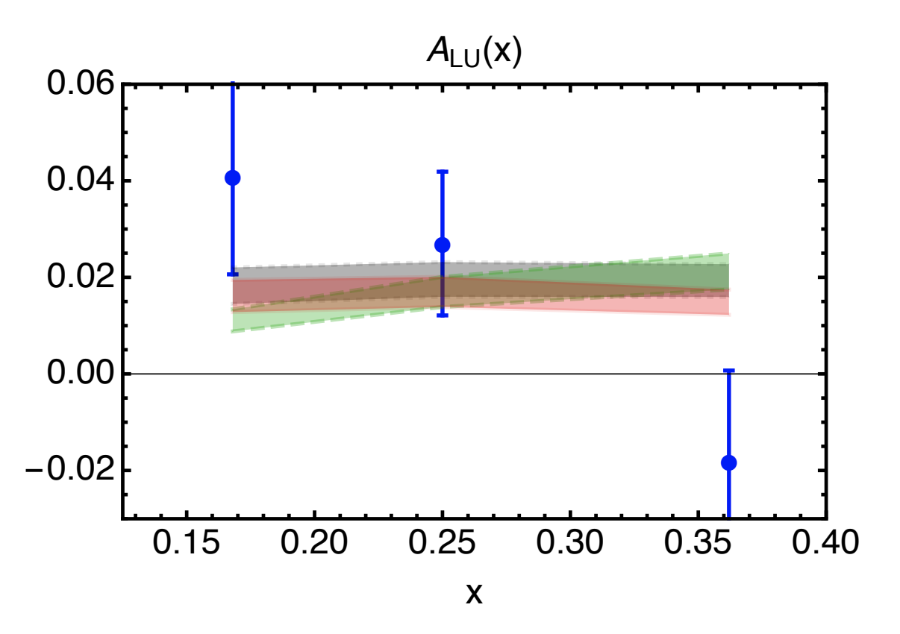
Measurements of Dihadron Beam-spin Asymmetries
Intent to publish a PRL paper with RGA dipion beam spin asymmetries.
Physics quantities of interest:
  A_{LU} sin(ϕ_{R}) modulation: allowing the first significant access in a collinear framework to the twist-3 PDF e(x), which gives insight into largely unexplored quark-gluon correlations.
  A_{LU} sin(ϕ_{H}-ϕ_{R}) modulation: first measurement sensitive to the DiFF G₁⊥, which describes the helicity dependent fragmentation of a dihadron pair.
CLAS12 Preliminary
Preliminary
CLAS6 Preliminary
CLAS12 Preliminary
R. Jakob, P. J. Mulders and J. Rodrigues, Nucl. Phys. A 626 (1997)
R. L. Jaffe and X. D. Ji, Nucl. Phys. B 375 (1992)
B. Pasquini and S. Rodini, Phys. Lett. B 788 (2019)
Luo, Xuan and Sun, Hao and Xie, Yi-Ling, Phys. Rev. D 101 (2020)
(asymmetry for CLAS12 kinematics via personal correspondence)
The PDF e(x) can be extracted point by point from this asymmetry.
A sign change is observed around the ρ mass.

Slide 14
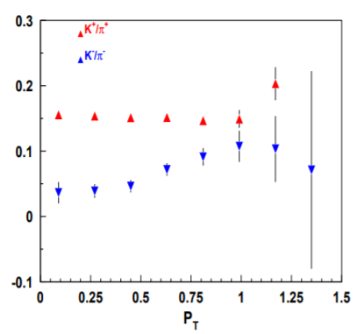
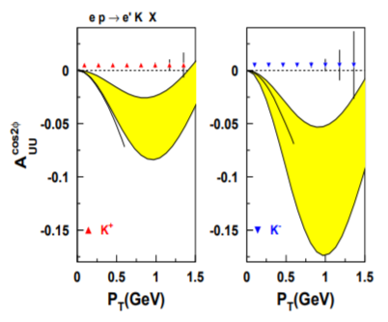

Measurements of Boer-Mulders effect for Kaons
Boer-Mulders structure function, F_{UU}^{cosφ} , provides access to Boer-Mulders distribution and Collins fragmentation function, which are under intensive studies worldwide, including SIDIS and DY experiments
F_{UU}∞h₁┴ H₁┴
Significantly smaller fraction of Kaons, K- in particular, require more statistics for studies of Boer-Mulders effects on proton for Kaons

Slide 15
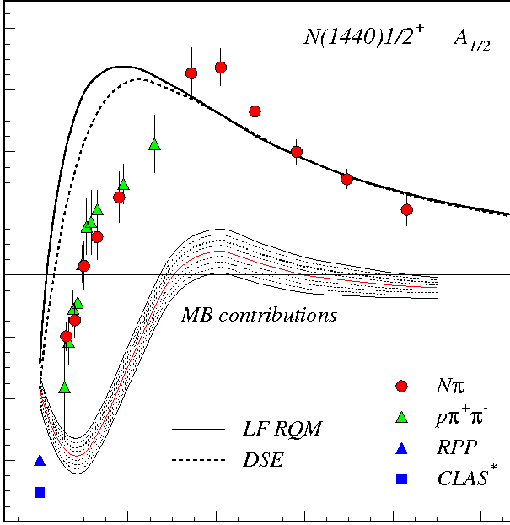
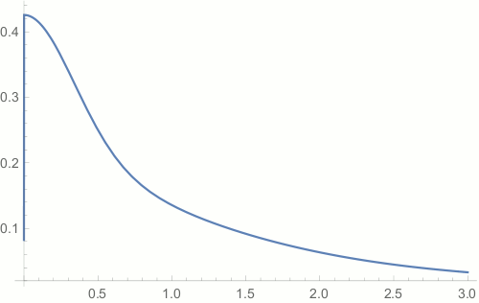
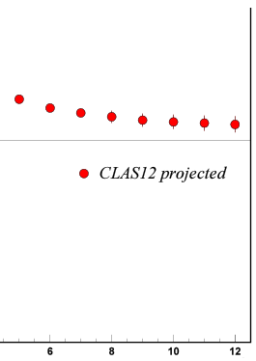
Hadron Structure Experiments (E12-09-003, E12-06-108A)
N* electroexcitation studies with CLAS12 will address the critical open questions:
How is >98% of hadron mass generated and how is it related to Dynamical Chiral Symmetry Breaking?
What is the behavior of QCD's running coupling at infrared momenta?
Mapping out the quark mass function from CLAS12 data on the γ_{v}pN* electrocouplings of spin-isospin flip, radial, and orbital excited nucleon resonances for Q²:[5:12] GeV² will allow us to explore how the dominant part of hadron mass is generated in the transition from the strong QCD to pQCD regimes
Chart the QCD running coupling from the results on the electrocouplings of orbital excited resonances
//
80
60
40
20
0
-20
-40
-60
-80
N(1440)1/2⁺
mass composition
<2% Higgs mechanism
>98% non-perturbative
strong interaction
CLAS12
range
A_{1/2} (GeV^{-1/2}) *1000
Dressed Quark Mass, GeV
confinement (approaching
constituent quark mass)
MB contributions
CLAS12 projected
approaching bare Higgs quark mass and pQCD regime
//
0 1 2 3 4 5 6 8 10 12
Quark Momentum, GeV
Q² (GeV²)
CLAS results vs. theory expectations with running quark mass
V.D. Burkert, C.D. Roberts, Rev. Mod. Phys. 91, 011003 (2019)
D.S. Carman, K. Joo, V.I. Mokeev, FBS 61, 29 (2020)

Slide 16
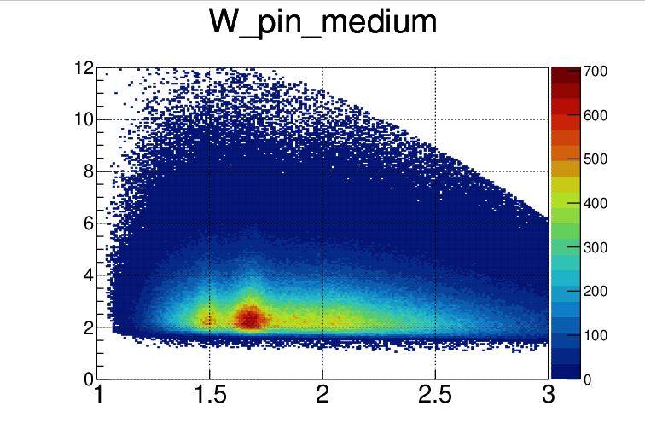
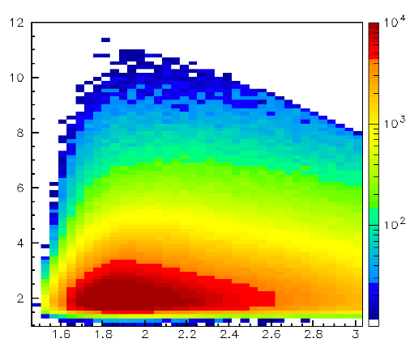
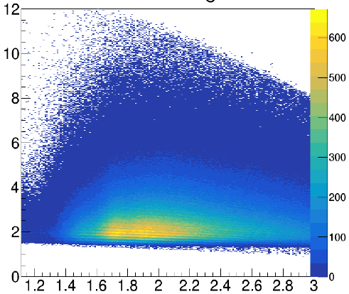
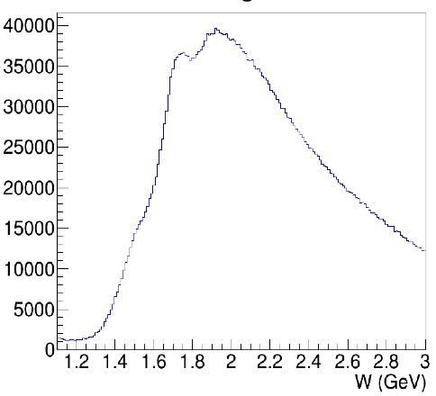
N* Electroexcitation to high Q² with CLAS12
Expected outcome: The first results on the γ_{v}pN* electrocouplings of most N* states from data in the range W < 3.0 GeV and Q² > 5.0 GeV² for exclusive reaction channels: πN, ππN, KY, K*Y, KY*
kinematic coverage for RG-A data @ 10.6 GeV
π⁺n
K⁺Y
π⁺π⁻p
π⁺π⁻p
Q² (GeV²)
Q² (GeV²)
Q² (GeV²)
resonances?
3rd
resonance
regions
2nd
W (GeV)
W (GeV)
W (GeV)
W (GeV)
Expected events per Q²/W bin for full RG-A dataset
π⁺n |  |  | K⁺Λ & K⁺Σ⁰ |  |  |  |  | π⁺π⁻p
Q² [GeV²] | W [GeV] 1.5-1.55 | W [GeV] 1.7-1.75 | Q² [GeV²] | W_{Λ} [GeV] 1.7-1.75 | W_{Σ} [GeV] 1.7-1.75 | W_{Λ} [GeV] 1.9-1.95 | W_{Σ} [GeV] 1.9-1.95 | Q² [GeV²] | W [GeV] 1.7-1.75 | W [GeV] 1.9-1.95
 |  |  | 1.4-2.2 | 63417 | 6012 | 66564 | 33170
 |  |  | 2.2-3.0 | 72144 | 5364 | 77443 | 28720
5.2-5.8 | 15272 | 4175 | 3.0-4.0 | 52358 | 3945 | 51991 | 18936 | 5.2-5.8 | 2813 | 2808
5.8-6.5 | 10737 | 2637 | 4.0-5.0 | 24833 | 3103 | 26690 | 5925 | 5.8-6.5 | 1822 | 1969
6.5-7.2 | 7367 | 1684 | 5.0-6.0 | 11203 | 1598 | 11160 | 2642 | 6.5-7.2 | 1159 | 1294
7.2-8.1 | 4567 | 1290 | 6.0-7.0 | 5566 | 648 | 6300 | 943 | 7.2-8.1 | 661 | 924
8.1-9.1 | 2742 | 540 | 7.0-8.0 | 2606 | 338 | 3276 | 633 | 8.1-9.1 | 364 | 414
9.1-10.5 | 1453 | 194 | 8.0-9.0 | 1440 | 244 | 936 | 86 | 9.1-10.5 | 118 | 179
Collecting the remainder of the approved RG-A beam time will give a factor of two more statistics
This will extend the Q² range of the γ_{v}pN* electrocouplings to 8-10 GeV² for each of these channels – the data collected so far will limit us to 6-8 GeV²

Slide 17
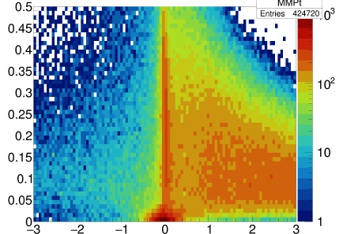
E12-12-001 – Time-like Compton Scattering and J/ψ photoproduction
Exclusivity cuts for untagged photoproduction
Lepton pair photoproduction using untagged electron scattering with exclusive final state (kinematics of the missing $e^{′}$ constrained to $Q^{2}\sim 0$)
$$ep→e^{+}e^{−}p^{′}(e^{′})$$
$$p_{x}^{⊥}/p_{x}$$
The analysis framework is ready, validated using the 60% of the available data to analyze
Since the approval of the original proposal:
new additions to the Hall-B program, RG proposals for J/ψ production on deuterium and hydrogen, search for LHCb pentaquarks
proposals in Hall-C to search for LHCb pentaquarks and Time-like Compton scattering (TCS) with the transversely polarized target (C2)
The first results from Gluex on J/ψ photoproduction, 461 events. No evidence for LHCb pentaquarks, upper limits on branching ratios have been evaluated. The Hall-C experiment is expected to release their results soon.
There have been several publications on the phenomenology of TCS, next-to-leading order corrections, new observables.
A renewed interest in near-threshold J/ψ production - J/ψ-N scattering length, QCD trace anomaly in proton mass decomposition.
E12-12-001(A) will complement Gluex and Hall-C experiments in J/ψ production and will be the first to publish experimental results on TCS.
$${MM}^{2}\left(e^{+}e^{−}p^{′}\right), GeV2$$
$$ω(782)$$
$$φ(1020)$$
$$ρ(770)$$
TCS region
$$J/ψ(3097)$$
$M_{e^{+}e^{−} }$ (GeV)

Slide 18
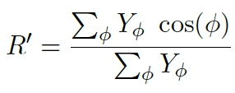
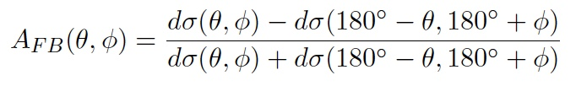
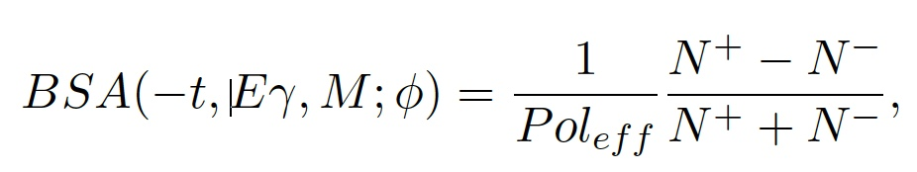
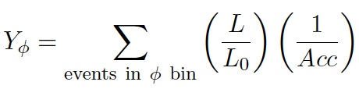
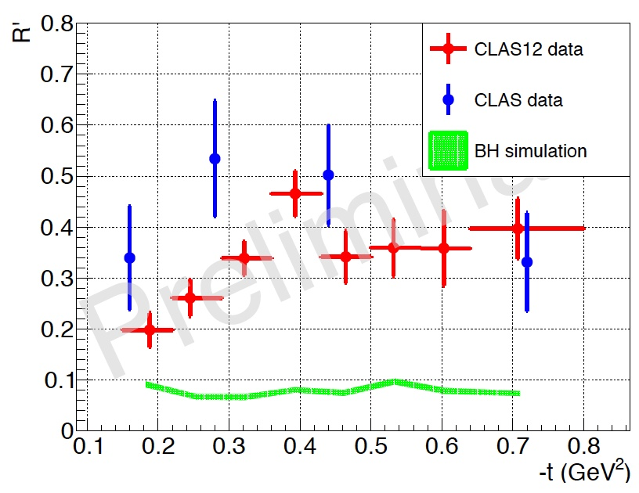
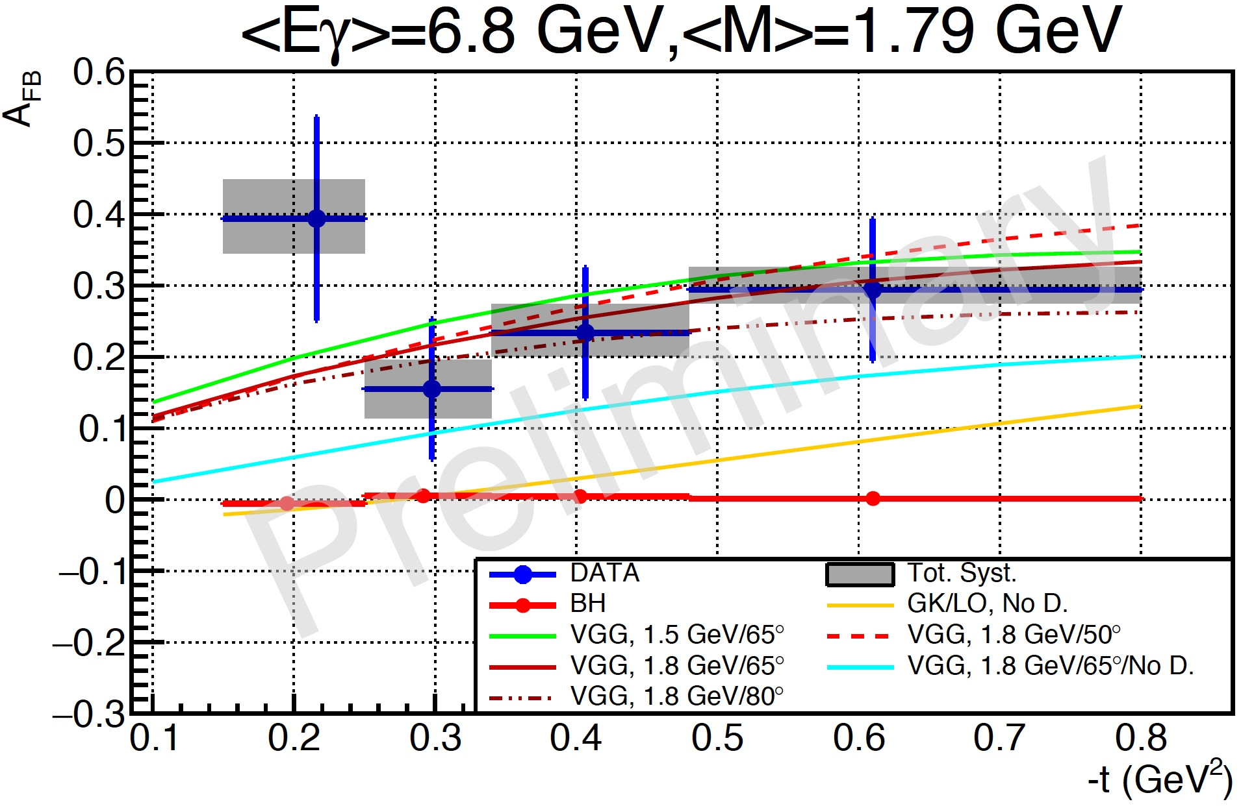
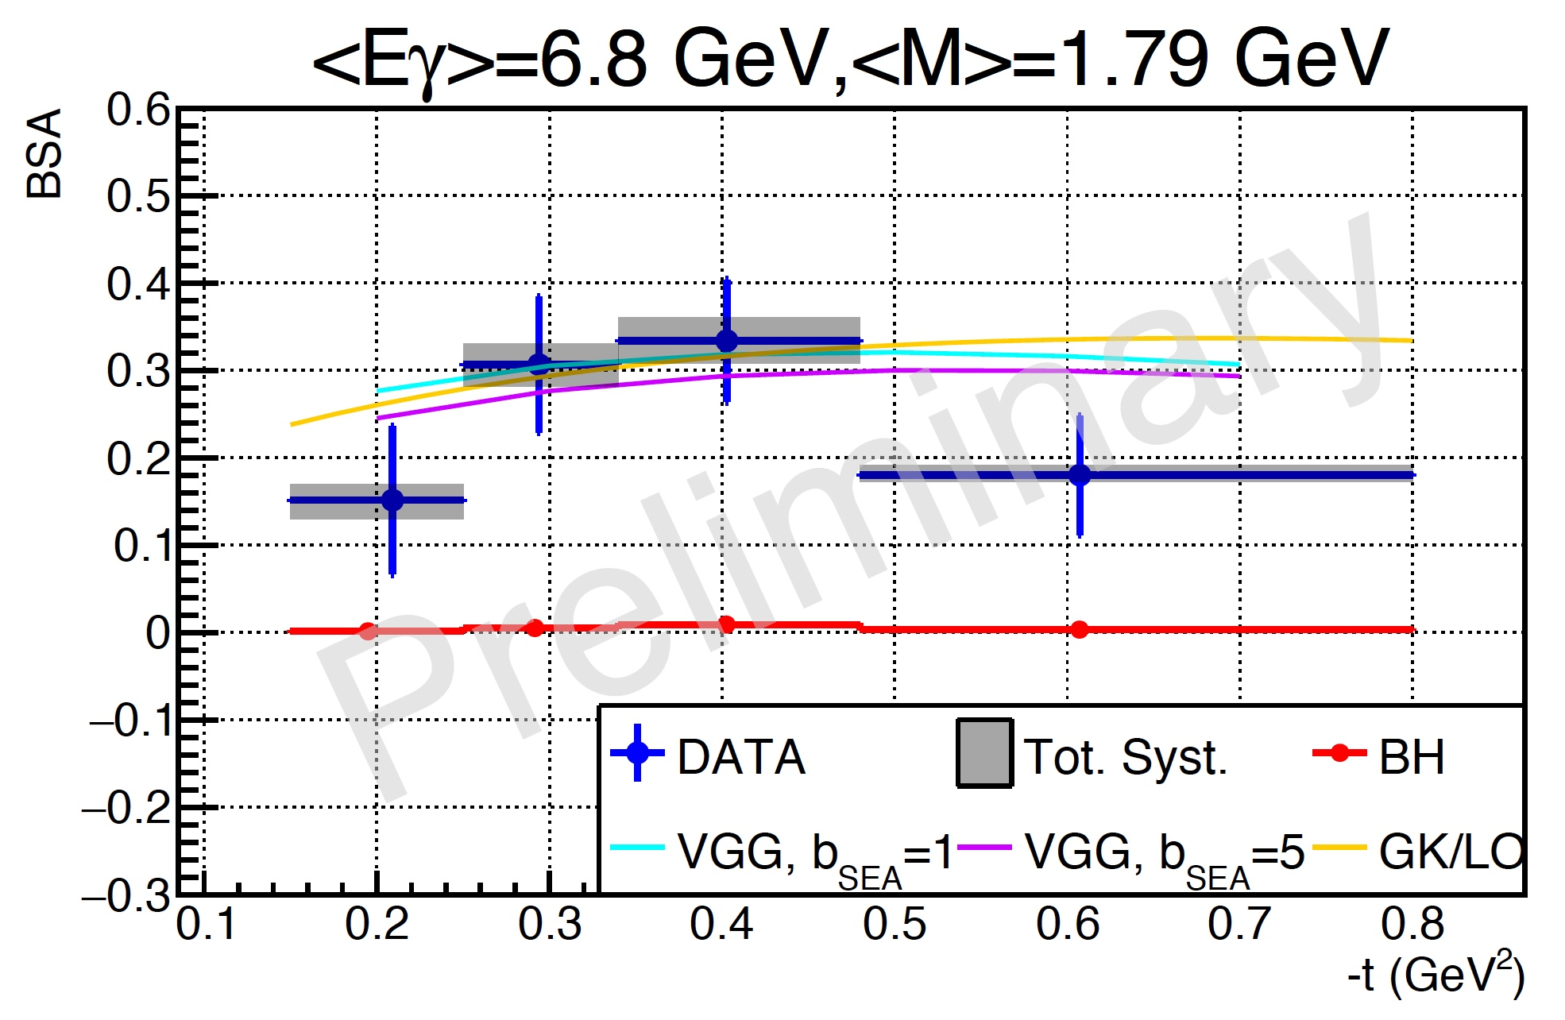
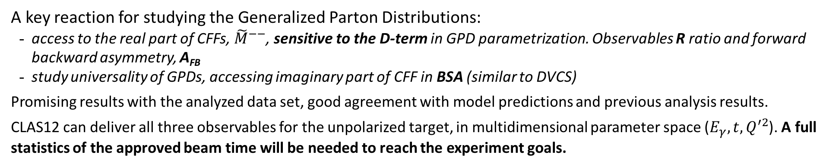
Time-like Compton Scattering
A key reaction for studying the Generalized Parton Distributions:
access to the real part of CFFs, ${\tilde{M}}^{−−}$, sensitive to the D-term in GPD parametrization. Observables R ratio and forward backward asymmetry, A_{FB}
study universality of GPDs, accessing imaginary part of CFF in BSA (similar to DVCS)
Promising results with the analyzed data set, good agreement with model predictions and previous analysis results.
CLAS12 can deliver all three observables for the unpolarized target, in multidimensional parameter space ($E_{γ}, t,Q^{′2}$). A full statistics of the approved beam time will be needed to reach the experiment goals.

Slide 19
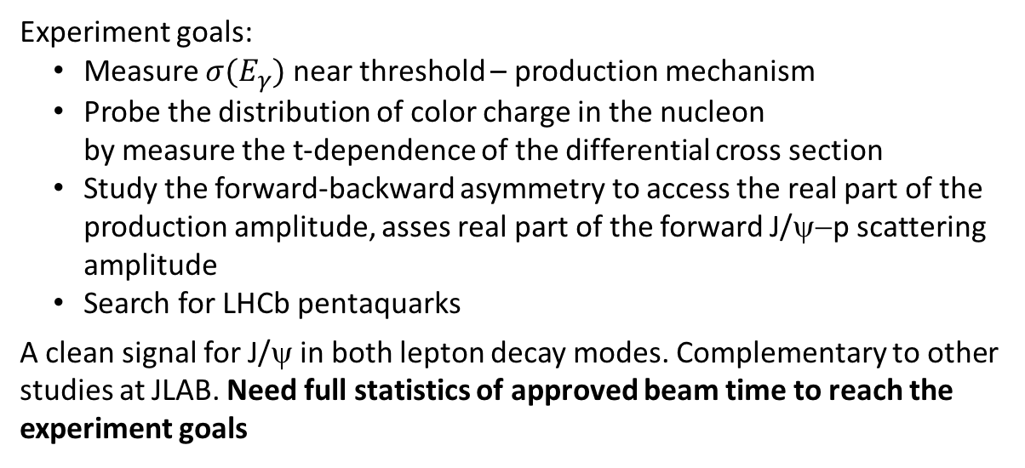
J/ψ photoproduction
J/ψ yield = 218 +/- 21
Mass = 3.081 +/- 0.005 GeV
Sigma = 54 +/- 9 MeV
Experiment goals:
Measure $σ(E_{γ})$ near threshold – production mechanism
Probe the distribution of color charge in the nucleon
by measure the t-dependence of the differential cross section
Study the forward-backward asymmetry to access the real part of the production amplitude, asses real part of the forward J/ψ−p scattering amplitude
Search for LHCb pentaquarks
A clean signal for J/ψ in both lepton decay modes. Complementary to other studies at JLAB. Need full statistics of approved beam time to reach the experiment goals
$M_{e^{+}e^{−} }$ (GeV)
$M_{e^{+}e^{−} }$ (GeV)
$${}_{}E$$
$−t (GeV2$)
$$E_{γ} (GeV)$$
$$E_{γ} (GeV)$$
$M_{μ^{+}μ^{−} }$ (GeV)

Slide 20
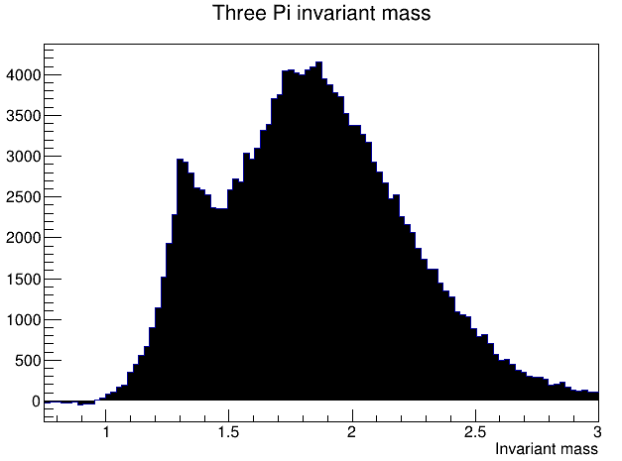


MesonEx and Very Strange
Motivations
World-wide effort to understand the meson spectrum (COMPASS, LHCb, BES-III, BELLE, …)
Extensive scientific program at JLab to understand the role of gluonic excitations in the spectroscopy of light mesons
Hall-B is using of a combination of low-Q2 electron scattering (equivalent to an high intensity photon beam) and the CLAS12 detector (4π acceptance, excellent Pid, high resolution) to measure exclusive final states and perform a full Partial Wave Analysis on mesonic and baryonic systems
MesonEx (E-11-005): Study of meson spectrum in the 1-3 GeV mass range to identify gluons excitation of mesons (hybrids) and other quark configurations beyond the CQM
Very Strange (E-12-008): Serach for mission excited hyperon states
Unique opportunity to extend baryon photo production to the complementary electroproduction with the same data set
Assessment
I) MesonEx example: Search for exotic π₁ (1600) in e p → e’ n π+ π+ π-
M(3π)
M(3π)
Results for inbending fall 2018 e- data
CLAS12 acceptance low for 2π⁻
Extra data required for a₂(1230) region
M(π⁺₁π⁻)
M(π⁺₂π⁻)
Low cross sections in interesting mass region 1.5-2.5 GeV/c², containing several interesting resonances including π₁
Other final states with kaons have lower cross section but still accessible with CLAS12

Slide 21


MesonEx and Very Strange
Assessment
II) Very Strange example: Strange and very strange hyperons
MissingMass(e’ K⁺ X) [GeV]
MissingMass(e’ K⁺ K⁺) [GeV]
Results for inbending fall 2018 e- data
Clearly see hyperon resonances
Cascade electroproduction easily accessible and any results are new
Electroproduction (Q^2 dependence) provides with new and complementary information on these states
Σ⁰(1189)
Σ*
Λ*(1520)
Λ⁰(1110)
Ξ⁻(1320)
Future plans
Good performance of the CLAS12-FT to provide low Q2 electroproduction data
Clear benefit by collecting the remaining 50% of approved statistics
MesonEx: PWA requires high statistics to pin down the tiny signal (~1%) of exotic mesons
Very Strange: high statistics is needed to study excited cascades and Ω⁻ that require detection of final states with many particles(kaons)

Slide 22
Summary
The RG-A science program is broad and rich and addresses several of the most fundamental questions in hadronic physics.
We have also designed and optimized a smart trigger to run successfully all 13 experiments simultaneously! The data processing and analysis of the 50% of RG-A data that is already on tape is in an advanced stage and preparation of the first publications is underway.
We request the approval of the 60 remaining days to fully realize the goals of the RG-A science program, the full statistics is required to allow:
  significant extension in Q² promised by the CLAS12 &12-GeV upgrade
  muti-dimentional analysis for the 3D imaging program & hadron struture
  Science requiring kaon identification (across the RG-A Program)
  PWA analysis from meson and baryon spectroscopy
  potential for science discovery!

