Slide 1
Hall B - Run Group K
Color Confinement and Strong QCD
PAC48 – Jeopardy Defense
E12-16-010 A Search for Hybrid Baryons in Hall B with CLAS12
A. D’Angelo, V.D. Burkert, D.S. Carman, V. Mokeev, E. Golovach, R. Gothe
E12-16-010A Nucleon Resonance Structure Studies Via Exclusive KY Electroproduction at 6.6 GeV and 8.8 GeV
D.S. Carman, V. Mokeev, R. Gothe
E12-16-010B Deeply Virtual Compton Scattering with CLAS12 at 6.6 GeV and 8.8 GeV
L. Elouadrhiri, F.X. Girod
Approved:
50 PAC days at 8.8 GeV
50 PAC days at 6.6 GeV
Data Taken (Dec 2018):
6 PAC days at 7.5 GeV
6 PAC days at 6.5 GeV

Slide 2
Questions to Address
Is there any new information that would affect the scientific importance or impact of the Experiment since it was originally proposed?
Latest developments in the field
What is the status of the analysis of the collected data ? What are the projected results for the full approved statistics?
Physics impact of the respective data sets
Should the remaining beam time allocation and experiment grade be reconsidered?
A⁻ to A grade upgrade scientific rating
Request for the remaining 88 PAC approved days

Slide 3
Physics Program Highlights
The N* spectrum: what is the role of glue?
Search for new baryon states → hybrid states
E12-16-010
How does the role of the active degrees of freedom in the nucleon spectrum evolve with distance scale?
Probe underlying N* d.o.f. and their emergence from QCD from the Q² evolution of the resonance electrocouplings
E12-16-010A
How is color confinement realized in the force and pressure distributions resulting in stable nucleons?
Study GPDs and their moments from DVCS
E12-16-010B

Slide 4
Evidence for New N* in KY
State N(mass)J^{P} | PDG pre 2010 | PDG 2020 | KΛ | KΣ | Nγ | Nπ
N(1710)1/2⁺ | *** | **** | ** | * | **** | ****
N(1880)1/2⁺ |  | *** | ** | * | ** | *
N(2100)1/2⁺ | * | *** | * |  | ** | ***
N(1895)1/2⁻ |  | **** | ** | ** | **** | *
N(1900)3/2⁺ | ** | **** | ** | ** | **** | **
N(1875)3/2⁻ |  | *** | * | * | ** | **
N(2120)3/2⁻ |  | *** | ** | * | *** | **
N(2060)5/2⁻ |  | *** | * | * | *** | **
Δ(1600)3/2⁺ | *** | **** |  |  | **** | ***
Δ(1900)1/2⁻ | ** | *** |  | ** | *** | ***
Δ(2200)7/2⁻ | * | *** |  | ** | ** | ***
Study these states in electroproduction and extend to higher masses
Notes:
This slides shows a summary of the results in this analysis. The green column shows the rating by the PDG. The two columns show the importance of the strangeness channel in this results.

Slide 5
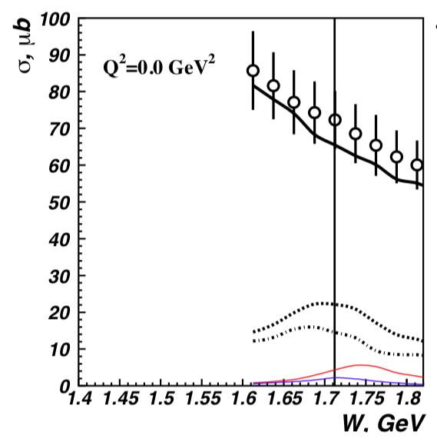
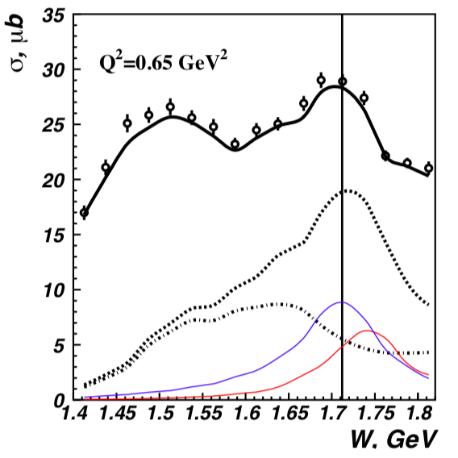
π⁺π⁻p CLAS data - Newly Discovered N’(1720)3/2⁺
π⁺π⁻p photoproduction
π⁺π⁻p electroproduction
V.I. Mokeev et al., Phys. Lett. B 805, 135457 (2020)
N(1720)3/2⁺
Resonant part
N’(1720)3/2⁺
N’(1720)3/2⁺
Resonant part w/o
N’(1720)3/2⁺,
& N(1720)3/2⁺
N(1720)3/2⁺
Evidence of a new N’(1720)3/2⁺ resonance from the combined analysis of CLAS photo- and electroproduction of the π⁺π⁻p channel
First result on Q² evolution of new resonance electrocoupling

Slide 6
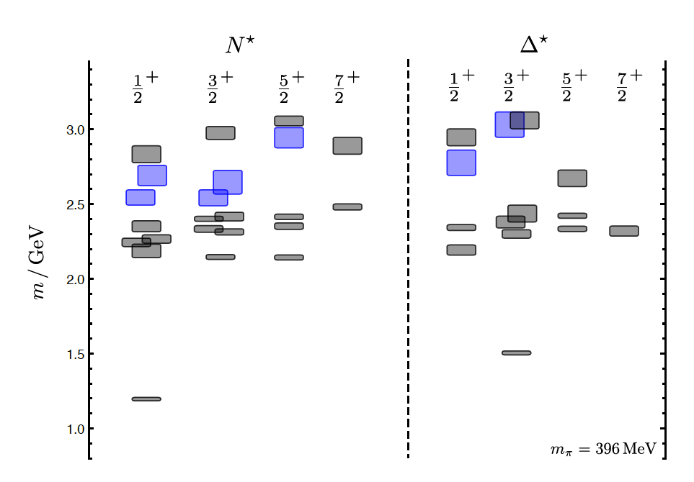
Hybrid Baryons in LQCD
Hybrid hadrons with dominant gluonic contributions are predicted to exist by QCD
J.J. Dudek and R.G. Edwards, PRD85, 054016 (2012)
LQCD
regular states
clustered
in mass
hybrid states
1.3 GeV
The nucleon mass is shifted ~300 MeV to higher masses
N
Hybrid states have same J^{P} values as qqq baryons. How to identify them?
Overpopulation of N 1/2⁺ and N 3/2⁺ bands
A_{1/2} (A_{3/2}) and S_{1/2} show different Q² evolutions than for the regular baryons

Slide 7
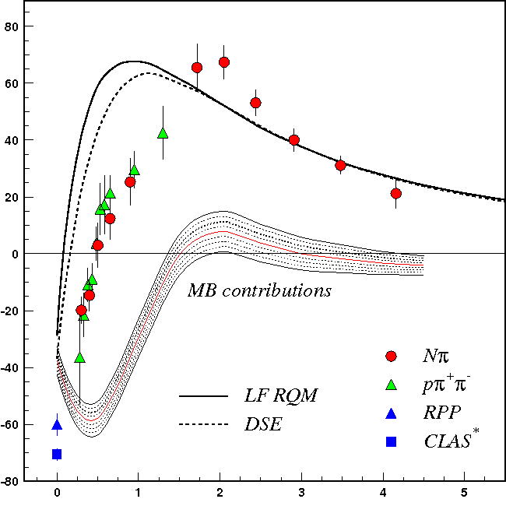
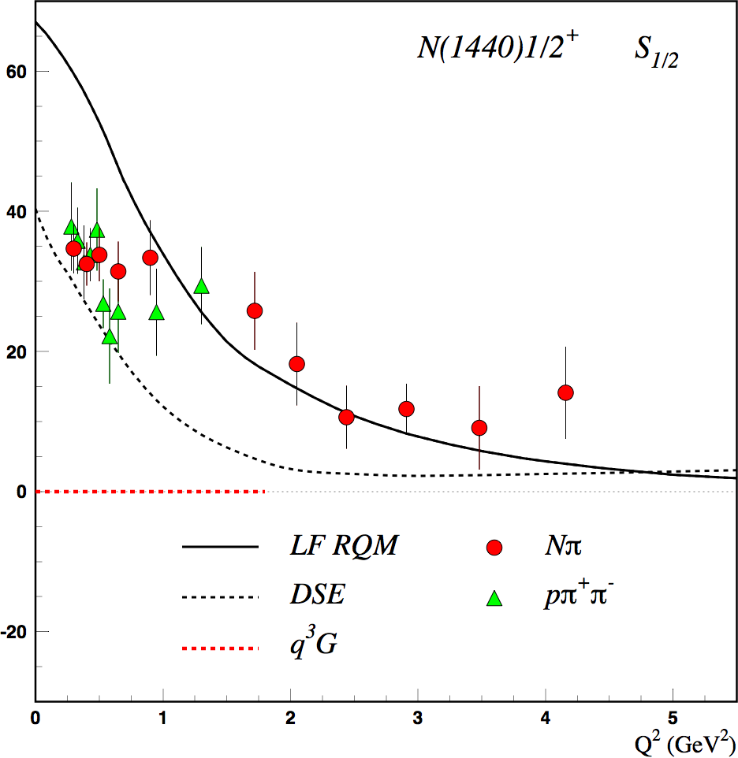
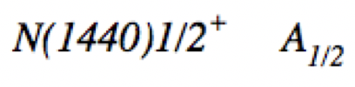


Dissecting N* Structure & Hybrid Signatures
Precise CLAS results on electrocouplings clarified nature of the Roper
q³
q³
q³g
q³g
q³
q³G: Z. P. Li, V.D. Burkert, and Z.J. Li, Phys. Rev. D 46, 70 (1992)
A_{1/2} and S_{1/2} amplitudes at high Q² indicate 1st radial q³ excitation
Complex interplay between inner 3q core & external meson-baryon cloud
For hybrid “Roper”, A_{1/2}(Q²) drops off faster with Q² and S_{1/2}(Q²) ~ 0

Slide 8
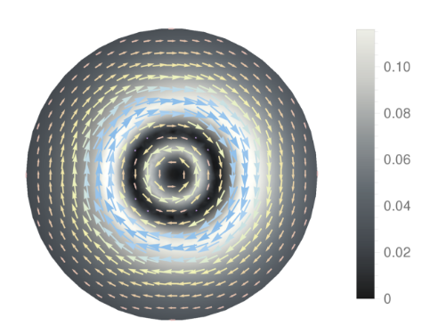
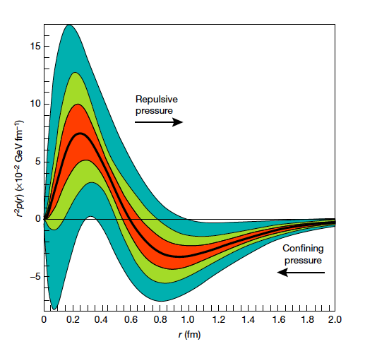
Accessing Shear Forces & Parton Pressure
M.V. Polyakov and P. Schweitzer, Int. Mod. J. Phys. A 33, 26 1830025 (2018)
Nucleon matrix element of EMT contains:
M₂(t) : Mass distribution inside the nucleon
J (t) : Angular momentum distribution
d₁(t) : Pressure distribution
∫dx x [H(x,ξ,t) + E(x,ξ,t)] = 2 J(t)
Shear forces inside the nucleon
∫dx x H(x,ξ,t) = M₂(t) + 4/5 ξ² d₁(t)
New since PAC44!
Measuring these form factors, we learn about confinement forces
43 Web of Science citations
87 Inspire citations
Parton pressure inside the nucleon
V.D. Burkert, L. Elouadrhiri, & F.X. Girod, Nature, 557 396 (2018)
Notes:
The nucleon matrix element of the energy-momentum tensor is known to contain 3 form factors. They describe ….. and can only be measured directly in elastic graviton-nucleon scattering. However, these form factors appear as moments of the unpolarized GPDs as shown here. The quark angular momentum in the nucleon is given by the 2nd moment of the sum of GPD H and E. The mass and pressure distribution of the quarks are given by the 2nd moment of H where the pressure is probed by parameter xi.

Slide 9
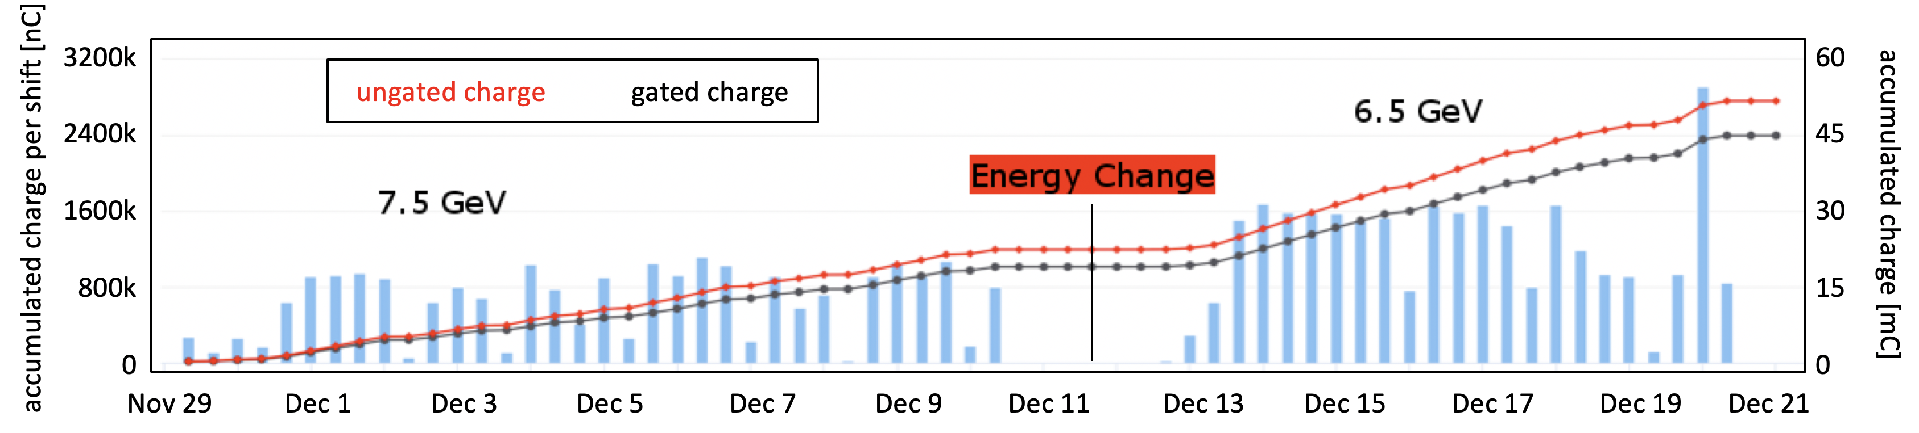
Run Group K Production
CHARGE
FT OFF
Q~45mC = 7% of
Expected 648mC
Opportunistic Run
RUN CONDITIONS – FALL 2018
Torus Current | 100% (3375 A) - negative outbending
Solenoid | -100 %
FT | ON @ 7.5 GeV -> OFF @ 6.5 GeV
Beam/Target | Polarized electrons, unpolarized LH₂ target
Luminosity | ~ 5 10 ³⁴ cm⁻²s⁻¹ @ 7.5 GeV 10 ³⁵ cm⁻²s⁻¹ @ 6.5 GeV FULL LUMINOSITY
12 PAC
days
EVENTS
15.6 G

Slide 10
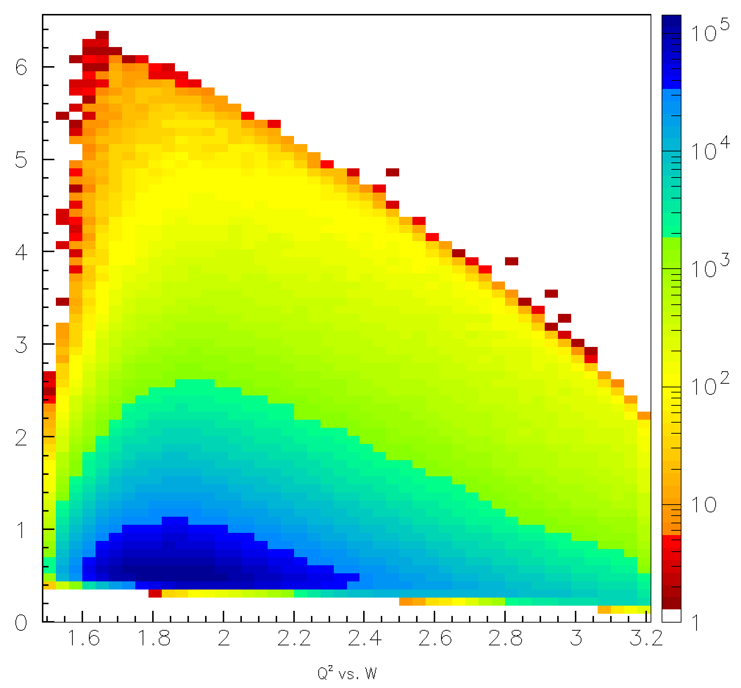
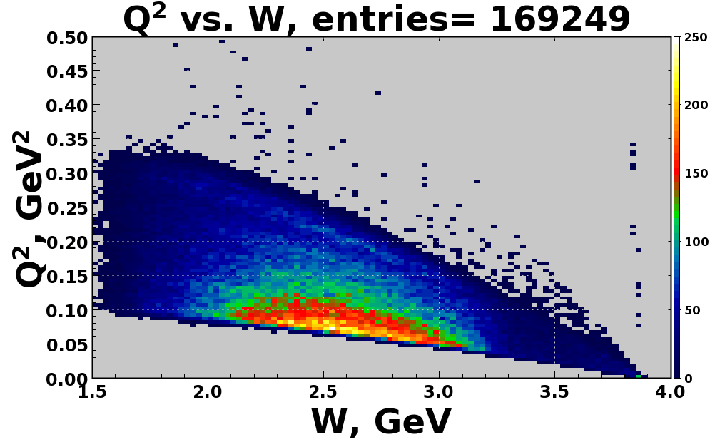
RG-K Kinematic Coverage
Q² vs. W
Q²>1 GeV²:
Evolution of active degrees of freedom in the N* structure
E_{e} =7.5 GeV
KY
Q² (GeV²)
e’ in the FD
Q²<1 GeV²:
search for:
hybrid baryon signature
meson-baryon contributions to the N* structure
0.4 GeV²≤Q² ≤ 5 GeV²
0.05 GeV²≤Q² ≤ 0.25 GeV²
e’ in the FT
Reactions of interest for the N*/hybrid program:
ep epπ⁺π⁻
ep eK⁺Y

Slide 11
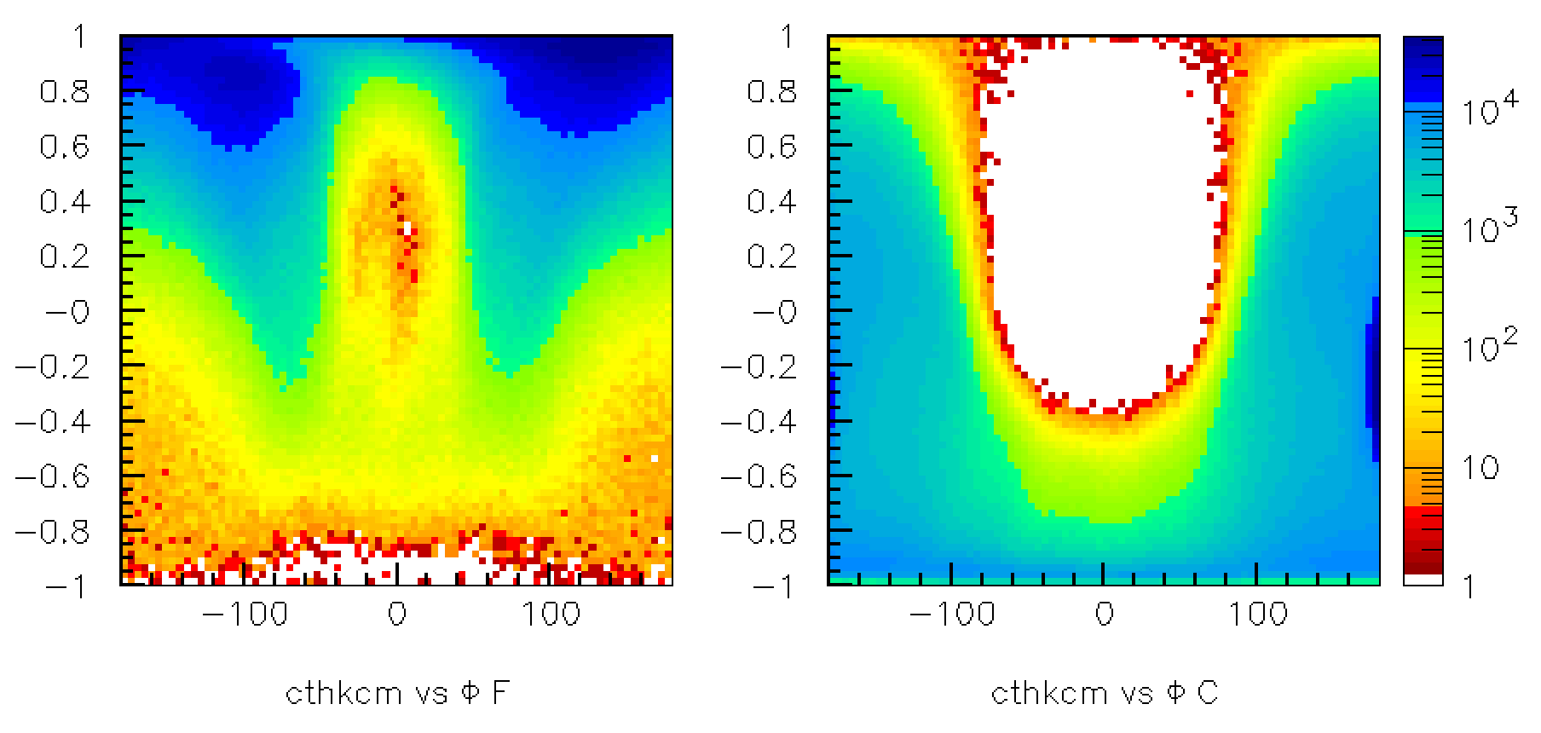
K⁺Y Analysis Status/Plans
K⁺ forward
K⁺ central
cos θ_{K}^{cm}
Φ [deg]
Φ [deg]
Analysis objectives: (RG-K datasets at both 6.6 and 8.8 GeV)
  Extract the separated structure functions σ_{T} + εσ_{L}, σ_{TT}, σ_{LT}, σ_{LT’} in bins of Q², W, cos θ_{K}^{cm}, Φ
  Extract the recoil and beam-recoil hyperon polarization in bins of Q², W, cos θ_{K}^{cm}
To extract the resonance electrocouplings to access the N* structure information, development of a suitable KY reaction model is essential (work in progress by several phenomenology/theory groups)
Work in conjunction with RG-A KY analysis

Slide 12
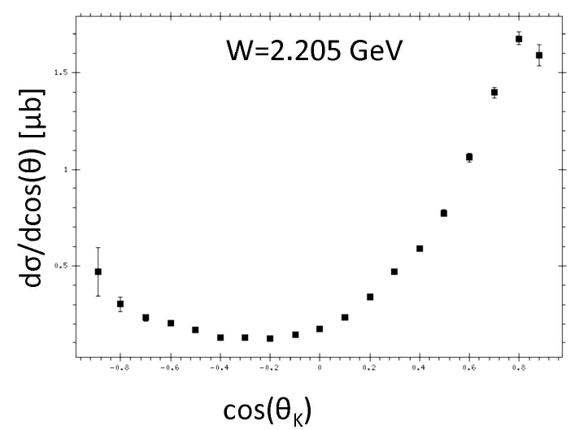
Hybrid Baryons Statistics and Binning Requirements
Samples of γp→K⁺Λ cross section used in BnGa analysis that discovered new baryon states in the W range 1.85 – 2.2 GeV
Statistical precision ranges from 2% - 7%
γp→K⁺Λ
Similar statistics needed to:
Separate structure functions in φ
Find new excited baryon states
Map Q² dependence of amplitudes
Total KΛ data in 50+50 days: 40 x10⁶ events
Number of bins: 80x10³
<N> = 540 evts/bin
σ_{N}/N = 4.3%
 | Range | Bin | #bins
W (GeV) | 1.8-2.8 | 0.04 | 20
cos θ* | -1 to +1 | 0.1 | 20
φ [º] | 0 - 360 | 18 | 20
Q²(GeV²) | 0.05 - 2 | 0.02/0.1 | 5/15

Slide 13
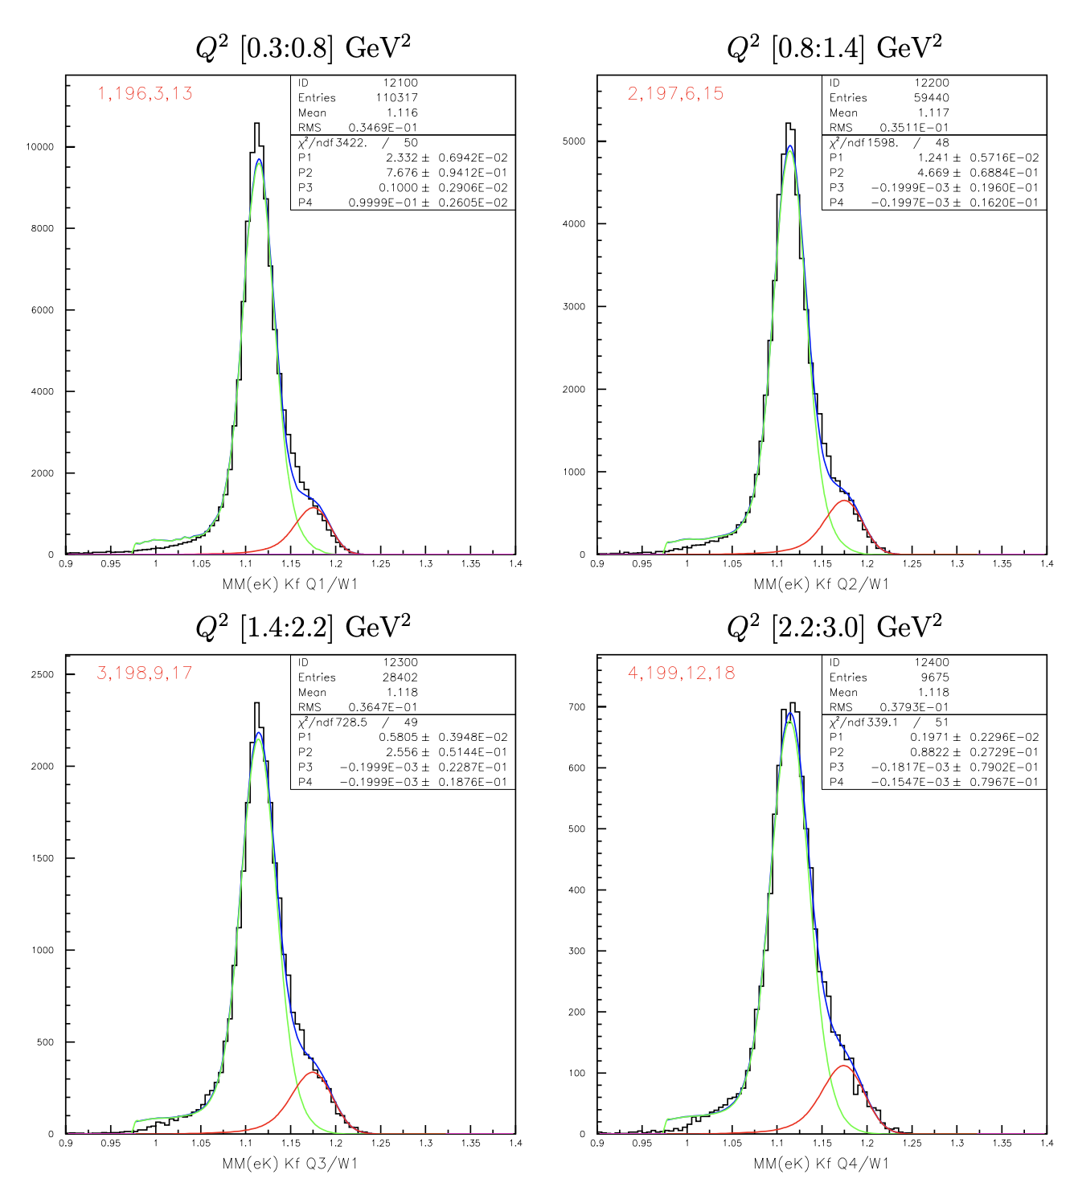
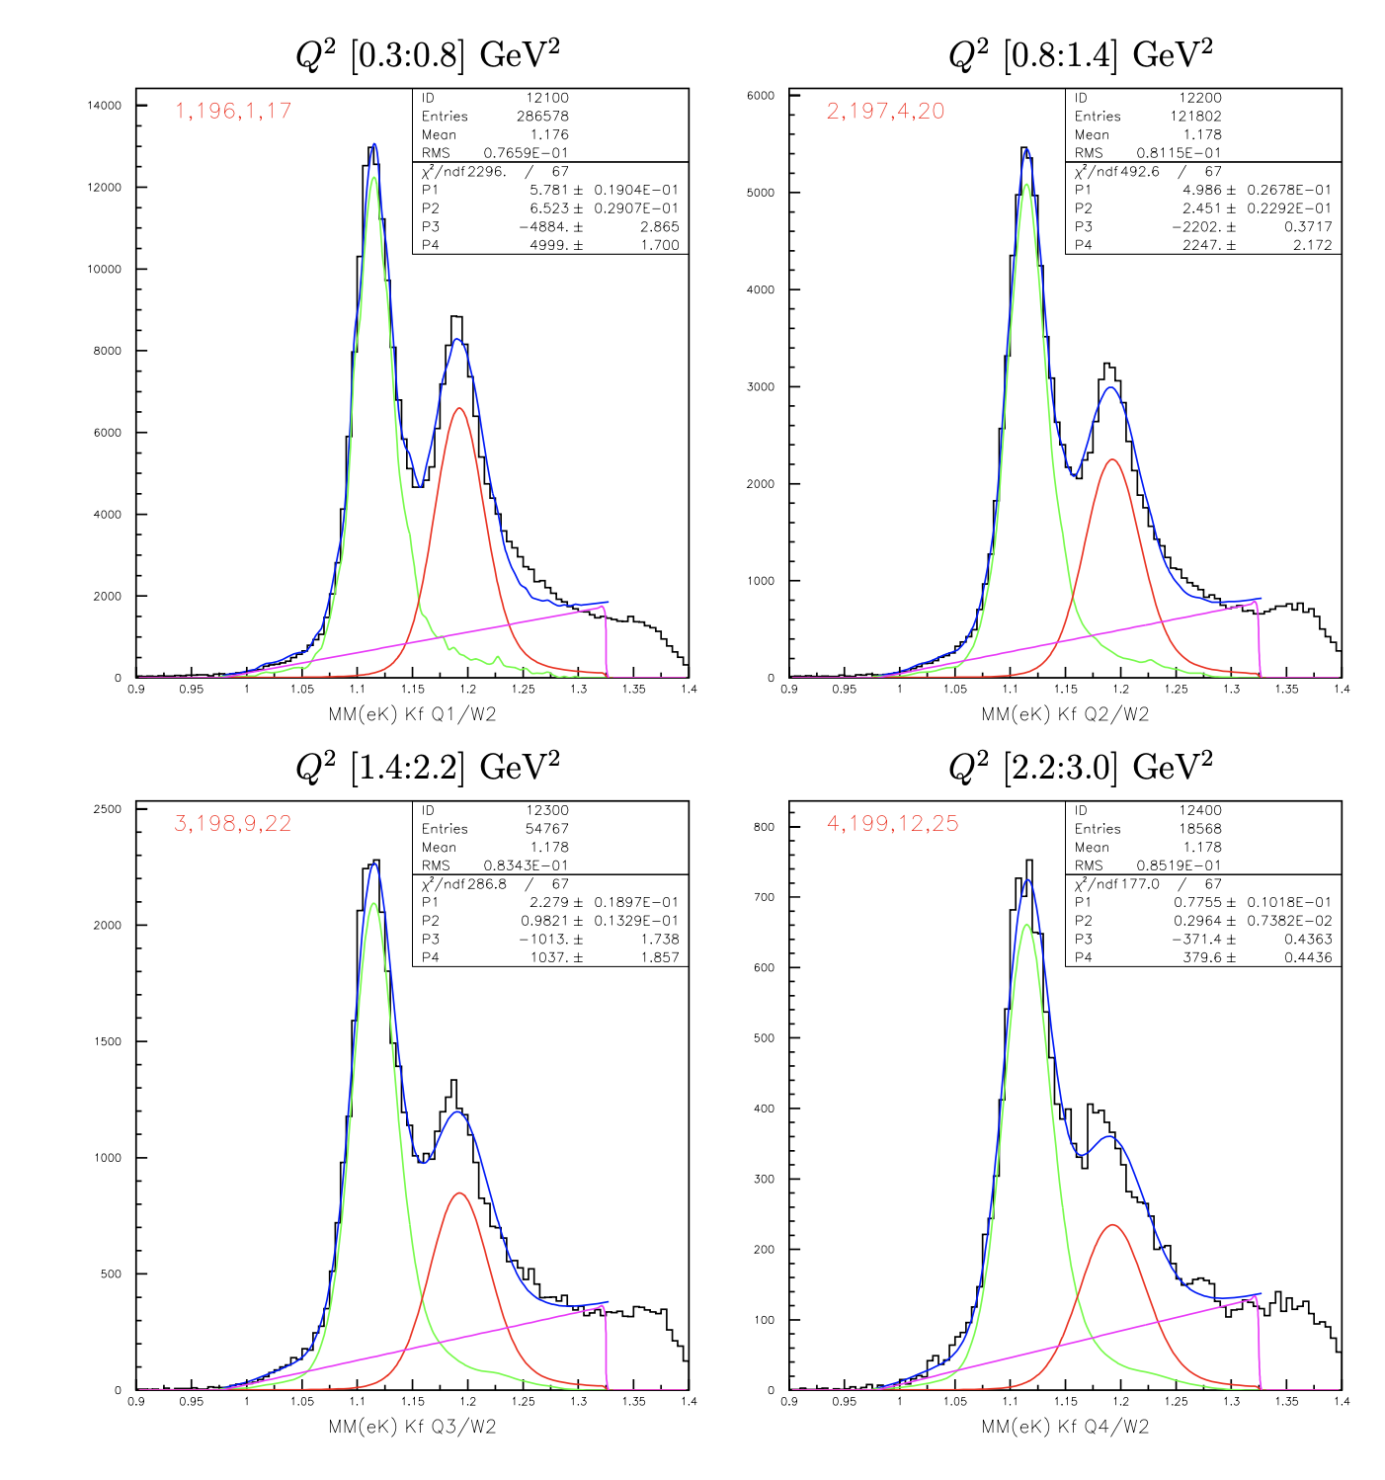
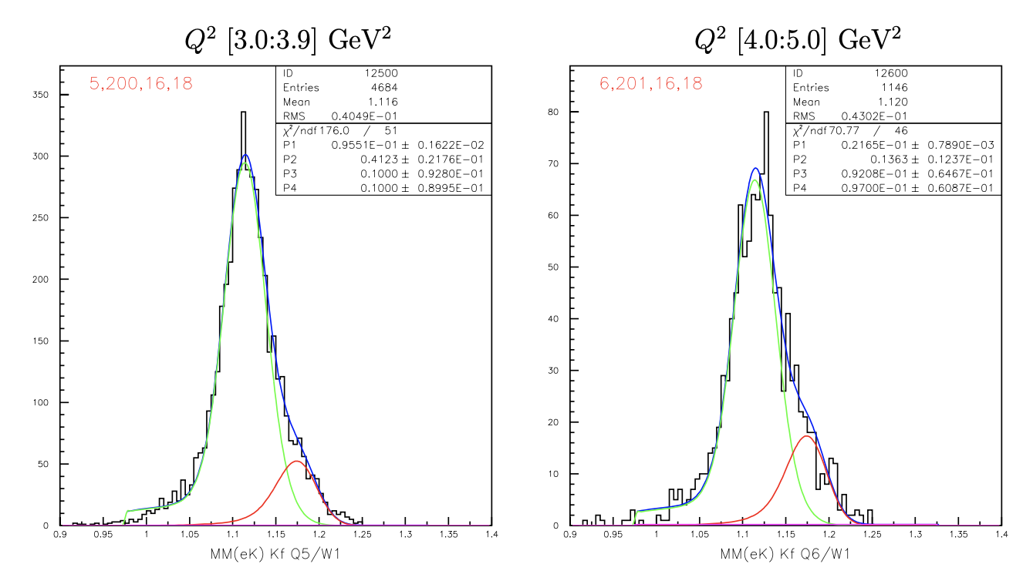
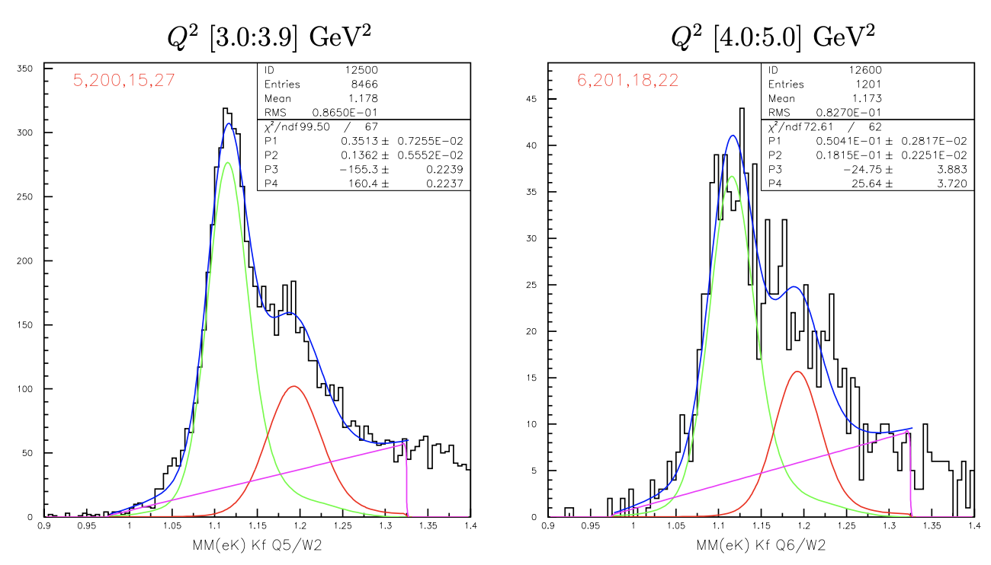
K⁺Y Yield Extraction Fits
W = 1.725 GeV
7.5 GeV
W = 1.925 GeV
MM(e’K⁺) [GeV]
MM(e’K⁺) [GeV]
Fit MM(e’K⁺) with MC K⁺Y templates convoluted with Gaussian + bck to minimize χ²

Slide 14
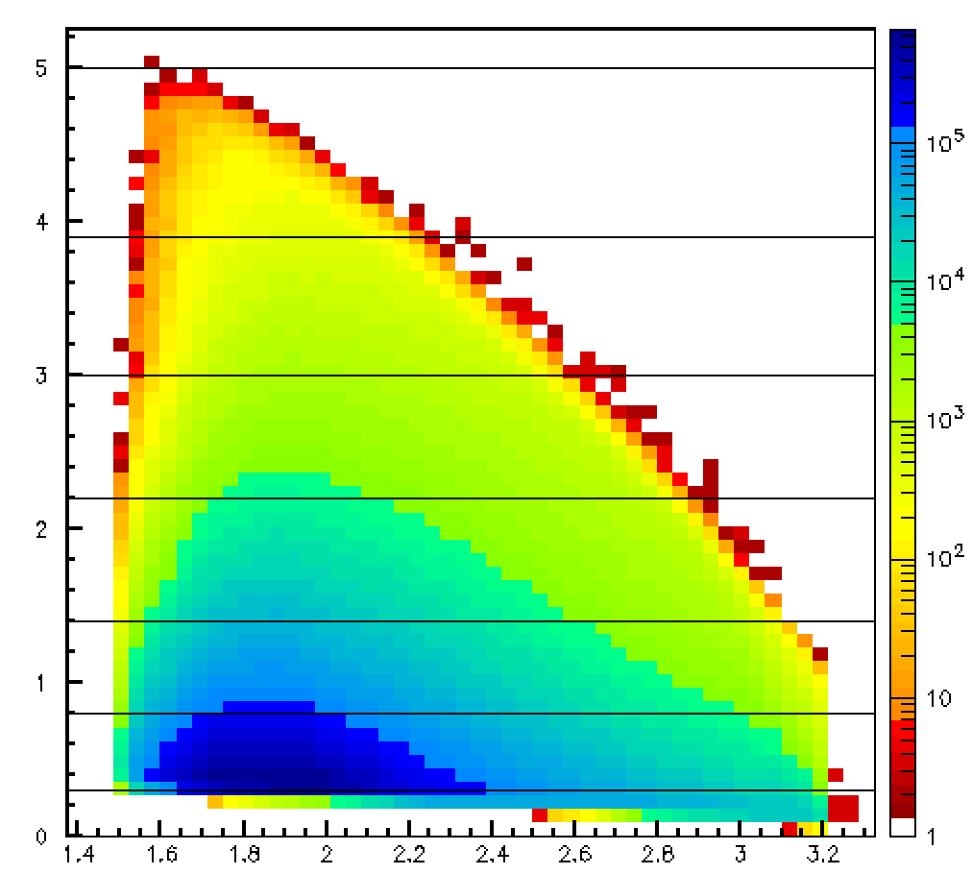
K⁺Y Yield Estimates
Estimate for full 6.5 RG-K dataset (analyzed stat. x10)
Kinematic phase space for RG-K @ 6.5 GeV
Q² GeV² | W GeV | RG-K K⁺Λ Yield | RG-K K⁺Σ⁰ Yield | CLAS e1f K⁺Λ Yield | CLAS e1f K⁺Σ⁰ Yield
0.3 – 0.8 | 1.7 - 1.75 | 967810 | 123250 | - | -
0.8 – 1.4 |  | 514170 | 74980 | - | -
1.4 - 2.2 |  | 240520 | 41050 | 10092 | 1032
2.2 – 3.0 |  | 81630 | 14170 | 7808 | 810
3.0 – 3.9 |  | 39550 | 6620 | 3925 | 450
4.0 – 5.0 |  | 8970 | 2190 | - | -
0.3 – 0.8 | 1.9 – 1.95 | 1241070 | 824020 | - | -
0.8 – 1.4 |  | 536520 | 309710 | - | -
1.4 - 2.2 |  | 245160 | 124080 | 11365 | 3843
2.2 – 3.0 |  | 83430 | 37440 | 7954 | 2537
3.0 – 3.9 |  | 37790 | 17190 | 3466 | 1122
4.0 – 5.0 |  | 5420 | 2290 | - | -
Q² [GeV²]
e’ in the FD
CLAS e1f data
W [GeV]
 | Total Yield
K⁺Λ | 35618500
K⁺Σ⁰ | 17702300
Full statistics for RG-K will allow for:
KY electroproduction measurements up to Q² = 3 GeV² with statistics comparable to photoproduction

Slide 15
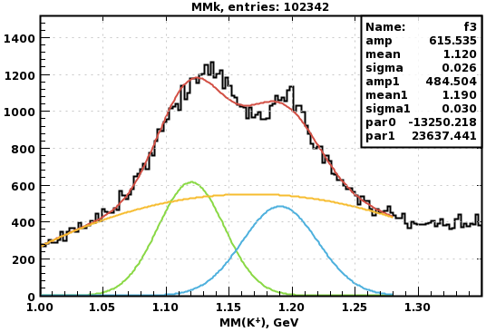
K⁺Y Yield at Low Q² - Electron Detected in FT
Estimate for full 7.5 RG-K dataset (analyzed stat. x10)
Q² GeV² | W GeV | RG-K K⁺Λ Yield | RG-K K⁺Σ⁰ Yield
0.05– 0.25 | 1.6 – 3 | 361250 | 196250
W (GeV) | RG-K K⁺Λ Yield | RG-K K⁺Σ⁰ Yield
thresh. – 2.0 | 75580 | 7830
2.0 – 2.5 | 198130 | 95410
2.5 – 3.2 | 101670 | 78360
Fully exclusive kinematics
CLAS12 momentum correction implementation will allow for analysis via e’K⁺ final state to maximize statistics
Full statistics for RG-K will allow for:
KY electroproduction measurements down to Q² = 0.05 GeV²

Slide 16
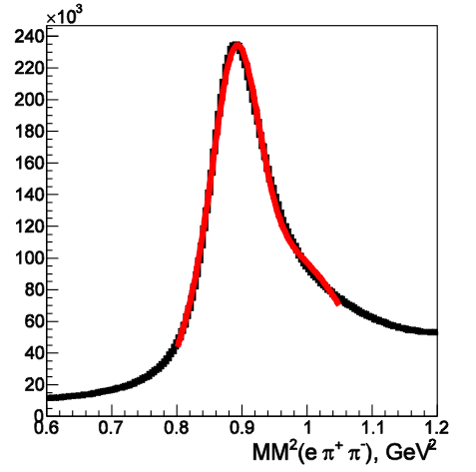
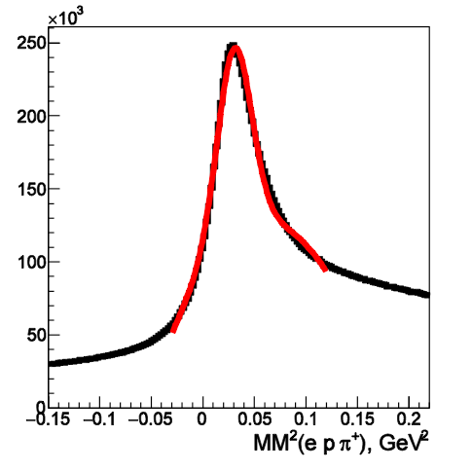
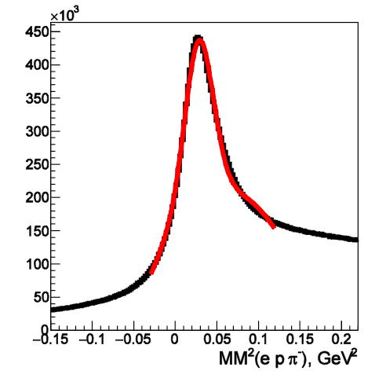
π⁺π⁻p Yield Estimates
Q² GeV² | e p π⁻ | e p π⁺
0.15-0.25 | 1080k | 800k
0.25-0.35 | 1550k | 940k
0.35-0.45 | 1100k | 660k
0.45-0.55 | 870k | 570k
0.55-0.65 | 660k | 480k
0.65-0.75 | 640k | 370k
0.75-0.85 | 450k | 270k
0.85-0.95 | 340k | 260k
0.95-1.05 | 360k | 210k
1.05-1.15 | 250k | 180k
1.15-1.25 | 250k | 170k
1.25-1.35 | 210k | 170k
1.35-1.45 | 150k | 100k
1.45-1.55 | 130k | 90k
Total | 7940k | 5270k
RG-K @ 6.5 GeV
2.2<W<2.5 GeV
Full statistics for RG-K will allow:
to obtain π⁺π⁻p electroproduction cross section within Q²-bins of 0.1 GeV² size

Slide 17
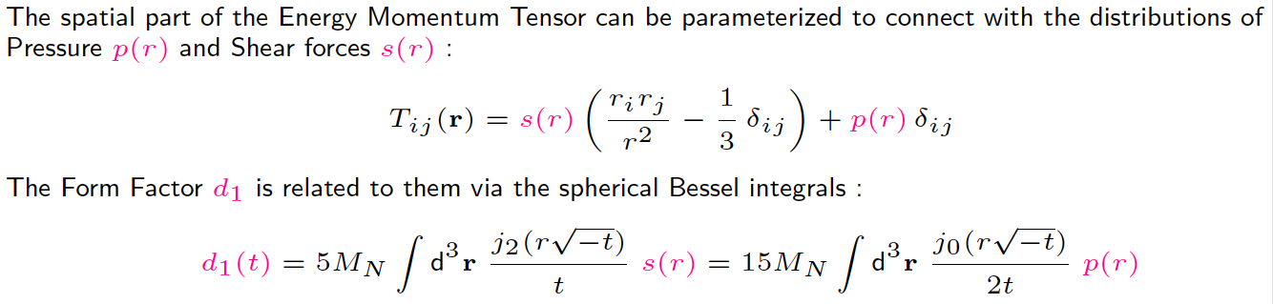
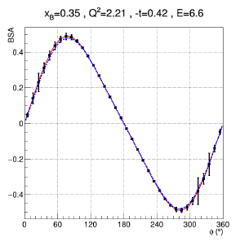

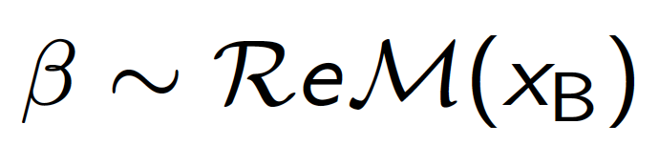
RG-K DVCS Physics
Dispersion relation relates
α and β to d₁(t)
α sin φ
1 + β cos φ

Slide 18
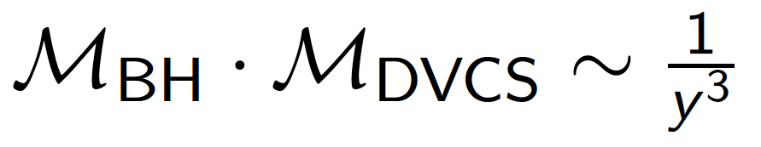
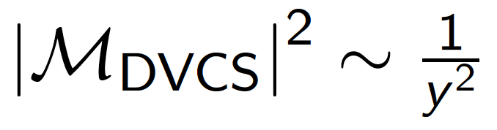
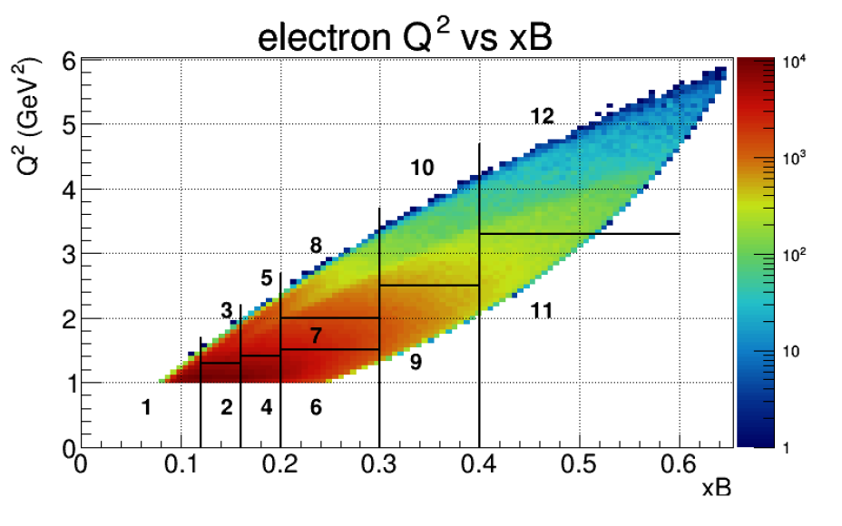
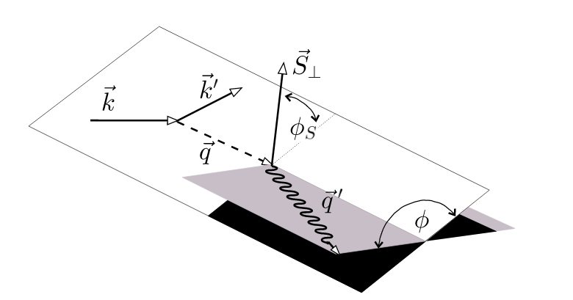
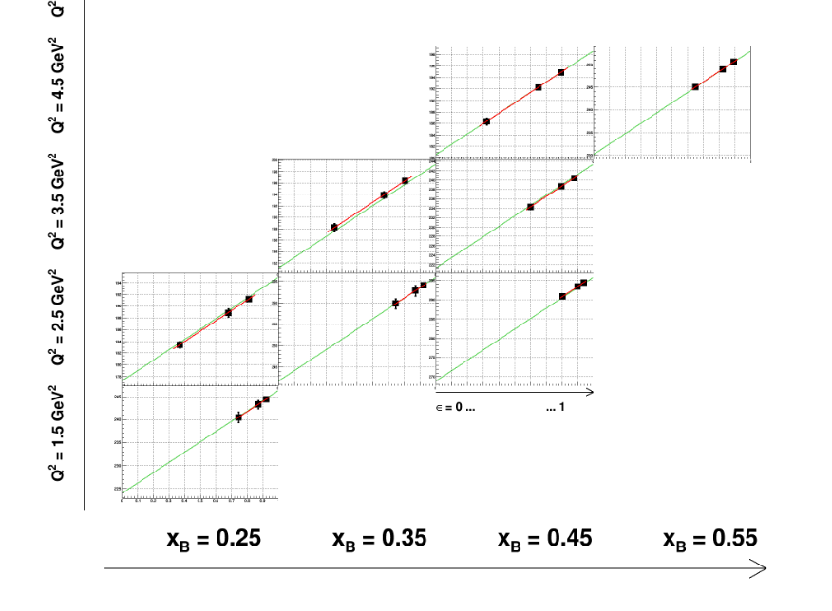

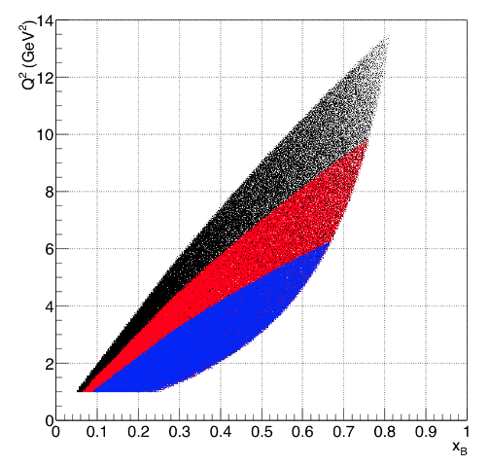
RG-K DVCS Analysis Strategy
Need two beam energies, in addition to RGA 10.6 GeV
to separate the interference from
6.5&7.5
11 GeV
BSA(Q², x_{B,} t)
8.8 GeV
6.6 GeV
Different beam energies are needed for Rosenbluth separation

Slide 19
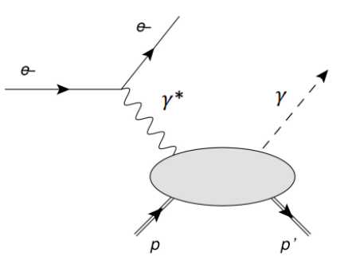
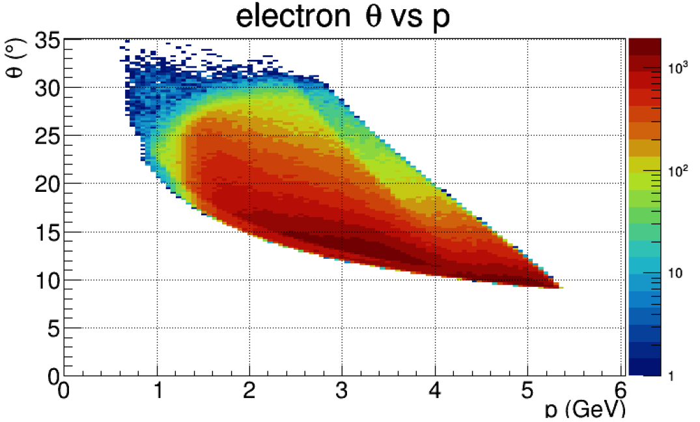
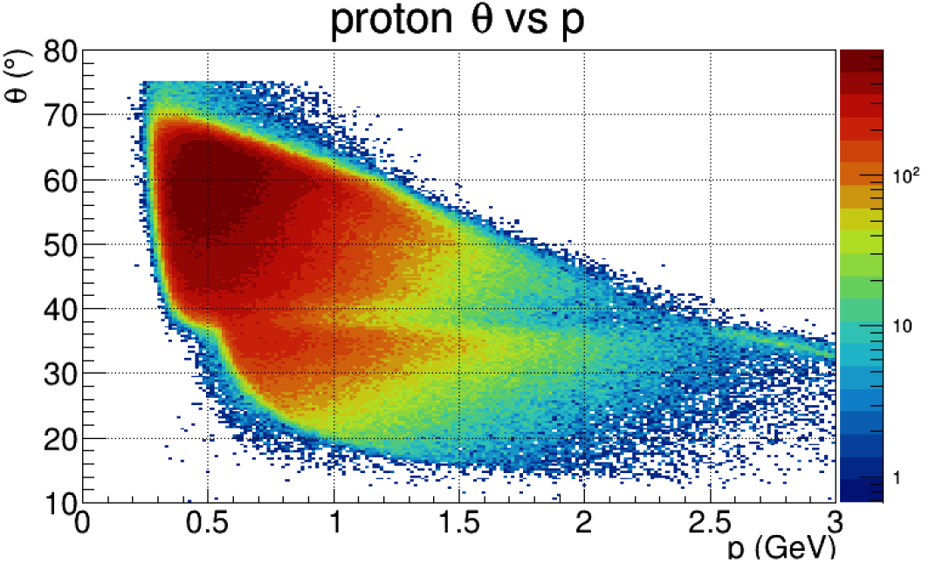
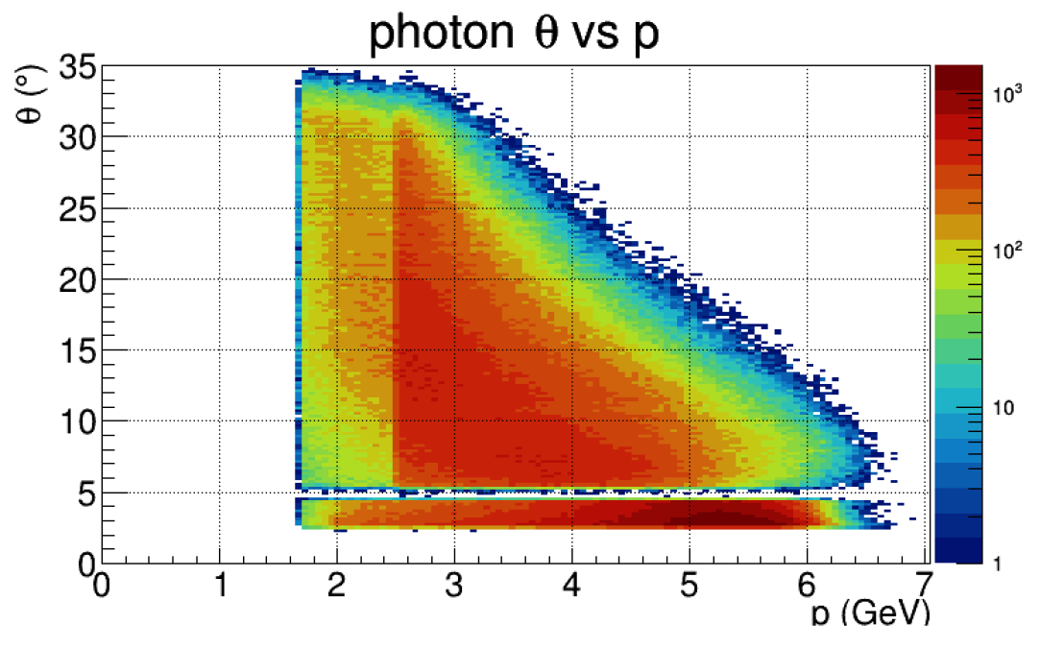
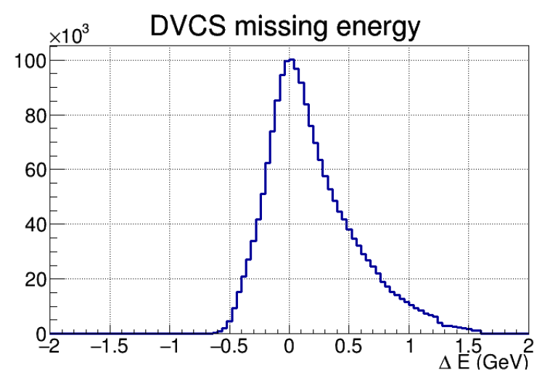
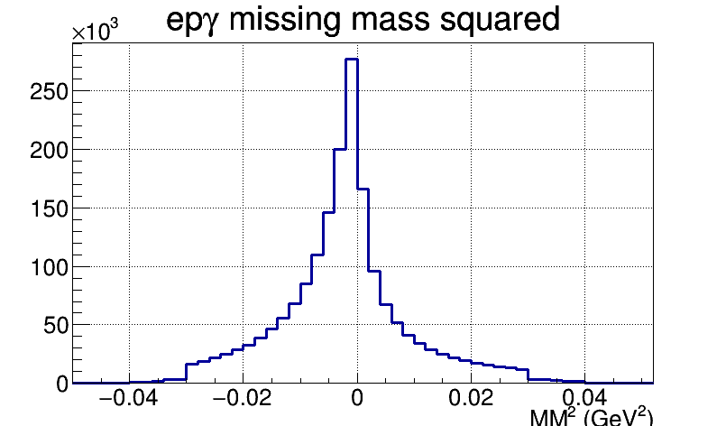
RG-K DVCS Kinematics and Statistics
6.5 GeV and 7.5 GeV
Q² > 1 GeV² W > 2 GeV
e⁻ in the FD
p
CD
85%
FD
15%
p (GeV)
p (GeV)
All final particles are detected: e’ γ p
γ
FD
Ex
FT
Available statistics ~ 1.8 M events Full projected statistics ~ 20 M events

Slide 20
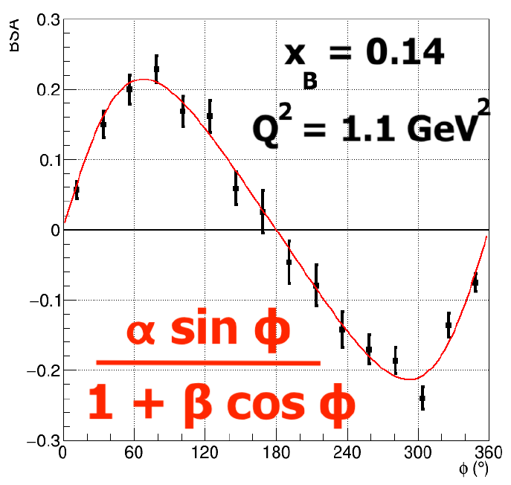
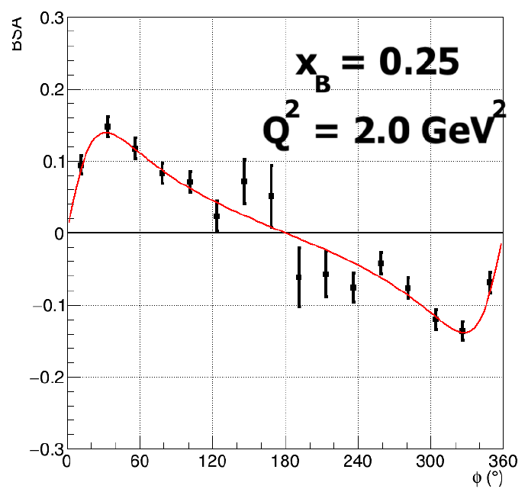
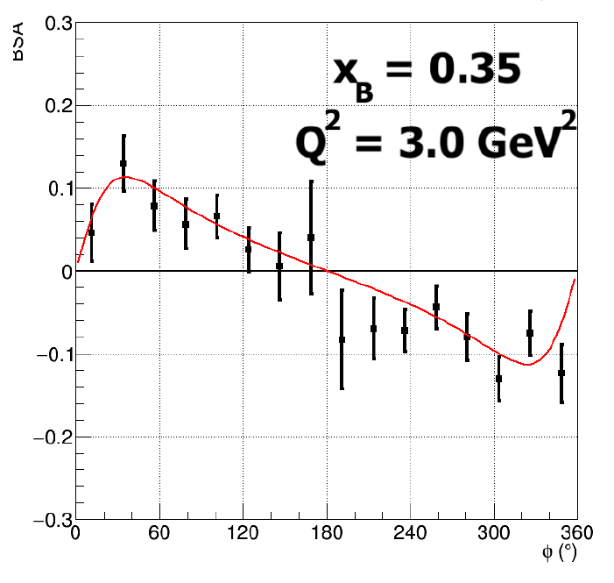
RG-K DVCS BSA Preliminary Results
Proposed statistical accuracy
Appropriate matching with RGA statistics is essential
Large kinematical coverage is crucial to minimize systematic uncertainties
50 PAC days + 50 PAC days
6.6 GeV 8.8 GeV

Slide 21
Summary
Expected results from the RG-K data will address several fundamental open problems in hadron physics:
  - search for new states of baryon matter with glue as a structural component
  - insight into the emergence of the deconfined meson-baryon cloud from the confined core of three constituent quarks
  - shed light on the nature of the nucleon stability through the balance between the explosive/implosive parton pressure and shear forces
We have demonstrated the physics impact of the respective data sets:
  - high statistics for the K⁺Y and π⁺π⁻p channels allows for the determination of the Q² evolution of the resonance electrocouplings within Q² bins of the smallest sizes ever achieved
  detailed information on the Q²-dependence of the resonance electrocouplings is of particular importance both for hybrid baryon identification and for the exploration of the relevant degrees of freedom in baryon structure
  data at different beam energies are of particular importance to isolate the interference term between the BH and DVCS amplitudes for gaining insight into energy-momentum tensor of QCD and the gravitation properties of the nucleon
We ask for A⁻ to A scientific rating increase for RG-K and remaining 88 PAC days:
The RG-K data is essential to clarify the active degrees of freedom of baryons and to get insight into the confinement mechanism of light quarks

Slide 22
Back-up Slides

Slide 23
Hybrid Baryons: Baryons with Glue as Structural Component
Hybrid hadrons with dominant gluonic contributions are predicted to exist by QCD
Experimentally:
Hybrid mesons |qqg> states may have exotic quantum numbers J^{PC} not possible for |qq> configurations GlueX, MesonEx, COMPASS, PANDA ….
Hybrid baryons |qqqg> have the same quantum numbers J^{P} as regular |qqq> baryons ⇒ identification requires to explore Q²-evolution of their electrocouplings with CLAS12
Theoretical predictions:
        MIT bag model - T. Barnes and F. Close, Phys. Lett. 123B, 89 (1983)
        QCD Sum Rule - L. Kisslinger and Z. Li, Phys. Rev. D 51, R5986 (1995)
        Flux Tube model - S. Capstick and P. R. Page, Phys. Rev. C 66, 065204 (2002)
        LQCD - J.J. Dudek and R.G. Edwards, Phys. Rev. D 85, 054016 (2012)
        LFQM and AdS /QCD - S. Brodsky et al., Int. J. Mod. Phys. E (in press) (2020)
Notes:
… One of the experimental tool we employ is the study of the N* spectrum as a reflection of the underlying degrees of freedom, some of which are shown by these cartoons representing constituent quarks in a bag, held together by gluon strings that my also get excited and generate hybrid baryons, quarks model with di-quark clustering, and states generated dynamically by meson-baryon interaction. These configuration result in variations of the excitation spectrum which we study with hadron or electromagnetic beams. The second line of research is to measure the strength of resonance excitations versus the space-time resolution of the probe to see how the strength of the effective degrees of freedom change with the distance scale. Beyond these mostly experimental aspects, there has been significant progress in the theory sector , e.g. predictions from LQCD of the spectrum, the Dyson-Schwinger equations of QCD, holographic QCD, and others.

Slide 24
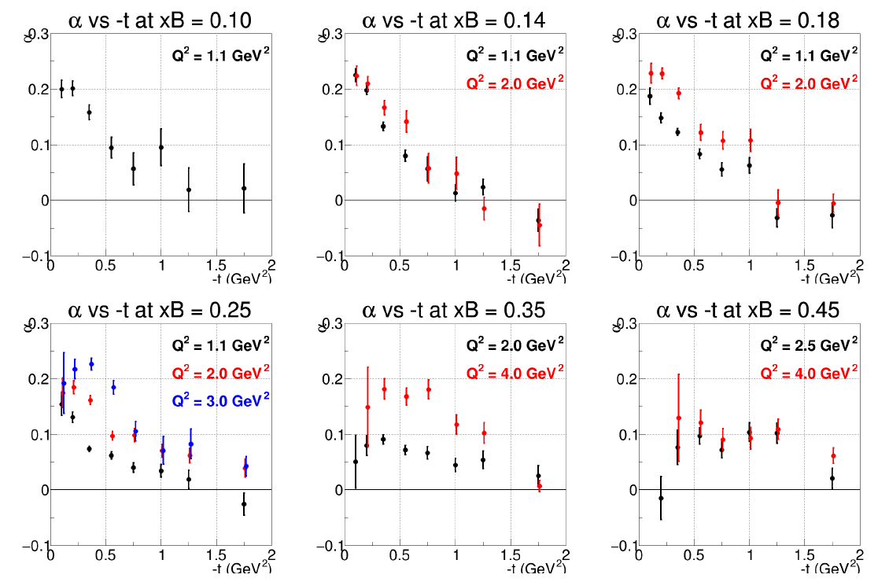
RG-K DVCS Preliminary Results
Flattening of the α(t) slope
evolution of transverse nucleon size with x

