Slide 1
CLAS12 Run Group C
Jeopardy Review PAC 48
September 25, 2020
Sebastian Kuhn, Old Dominion University
for the Run Group and the CLAS collaboration
Notes:
Image from PANDA

Slide 2
Overview
Science goals of RG-C
  Inclusive DIS (double spin asymmetries)
  Semi-inclusive DIS
  TMDs
  DVCS
Status of Polarized Target and Beamline
  Target Design
  Present status
  Completion Plan
Run Plan
2 of 20

Slide 3
RG C Goals:
Measure inclusive spin structure functions (A₁, g₁) of the proton and deuteron
Combine with flavor tagging (π±, K±) to extract Δq in the valence and moderate-x sea regions, constrain ΔG
Provide anchor for PDF fits, study higher twist and duality, and test fundamental sum rules
Measure spin- and transverse momentum-dependent (TMD) PDFs (SIDIS)
Measure target single and beam/target double spin asymmetries in proton and neutron DVCS
3 of 20

Slide 4
Approved Experiments in RG C
Proposal ID | Title | Contact Person | PAC Rating | Awarded Days
E12-06-109 | Longitudinal Spin Structure of the Nucleon | Kuhn | A | 80
E12-06-109A | DVCS on the neutron with polarized deuterium target | Niccolai | RG addition | (60)
E12-06-119(b) | DVCS on longitudinally polarized proton target | Sabatie | A | 120
E12-07-107 | Spin-Orbit Correlations with longitudinally polarized target | Avakian | A- | 103
E12-09-007(b) | Study of partonic distributions using SIDIS K production | Hafidi | A- | 80
E12-09-009 | Spin-Orbit correlations in K production with polarized targets | Avakian | B+ | 103
E12-09-007A | Studies of Dihadron Electroproduction in DIS with Longitudinally Polarized Hydrogen and Deuterium Targets | Dilks | RG addition | (185)
(PAC48)
4 of 20
Total number of approved beam (PAC) days: 185 (120 p, 60 d, 5 auxiliary)

Slide 5
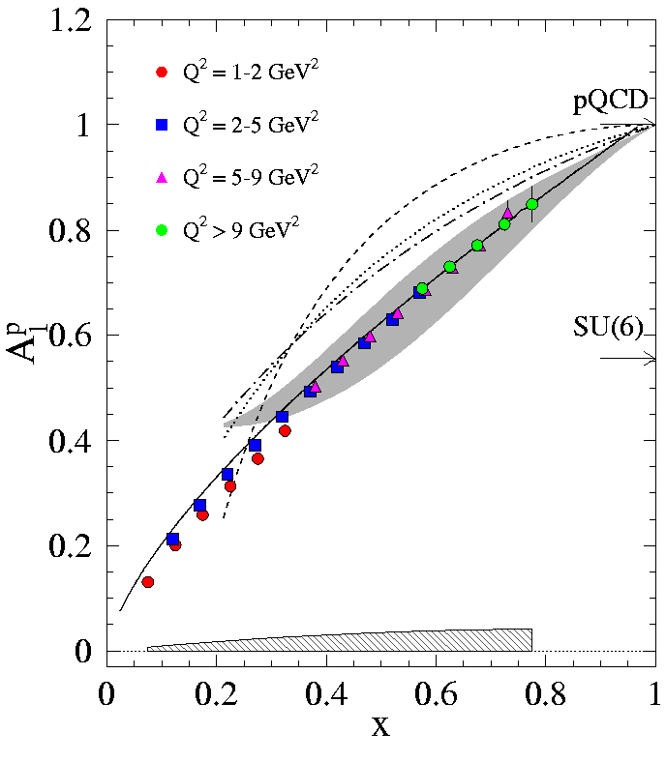
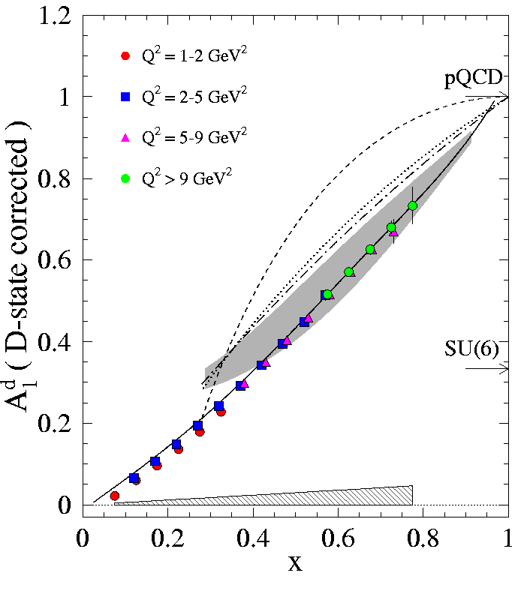
Predicted Data from CLAS12 - DIS
Proton
W > 2; Q² > 1
Deuteron
5 of 20
Notes:
Example of statistics achievable with specified running conditions. Emphasize large Q2 coverage – together with 6 GeV data (EG4/EG1/EG1-EG1dvcs) and high-Q2 data from SLAC and COMPASS/SMC, will provide enough precision to separate HT and DGLAP evolution and put new bounds on Delta-G at moderate to high x, as well as pol. PDFs. (Deuteron important!)

Slide 6
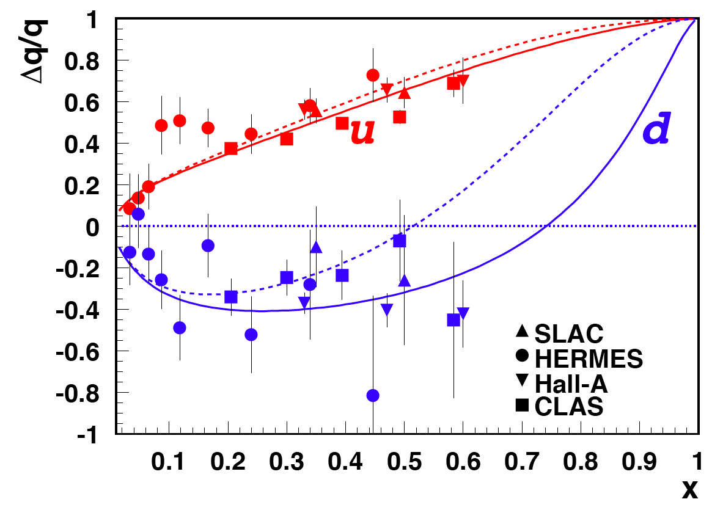
Example: Δd/d
Up-to-date estimate for 1st run of RGC
Inclusive and semi-inclusive data
6 of 20
Notes:
From the TAC report: “The expected data are highly anticipated, and will provide valuable inputs into global QCD analyses of PDFs, TMDs and GPDs, such as those being undertaken in 1-D and 3-D studies by the JAM Collaboration at JLab and other global analysis efforts worldwide.“

Slide 7
Recent theoretical predictions
Ji, Yuan and Zhao: arXiv2009.01291 [hep-ph] 2 Sep 2020
Full Data set will significantly constrain valence + sea quark and gluon PDF fits, higher twist effects and sum rules
7 of 20
Notes:
indicate continuing high interest.

Slide 8

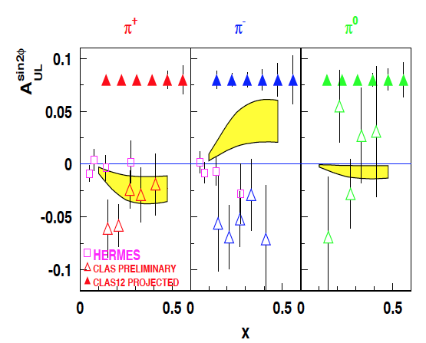
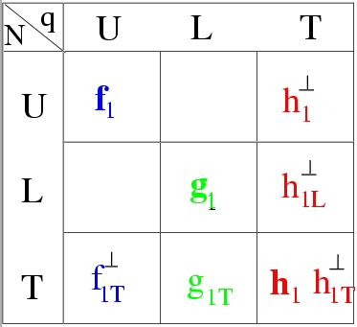
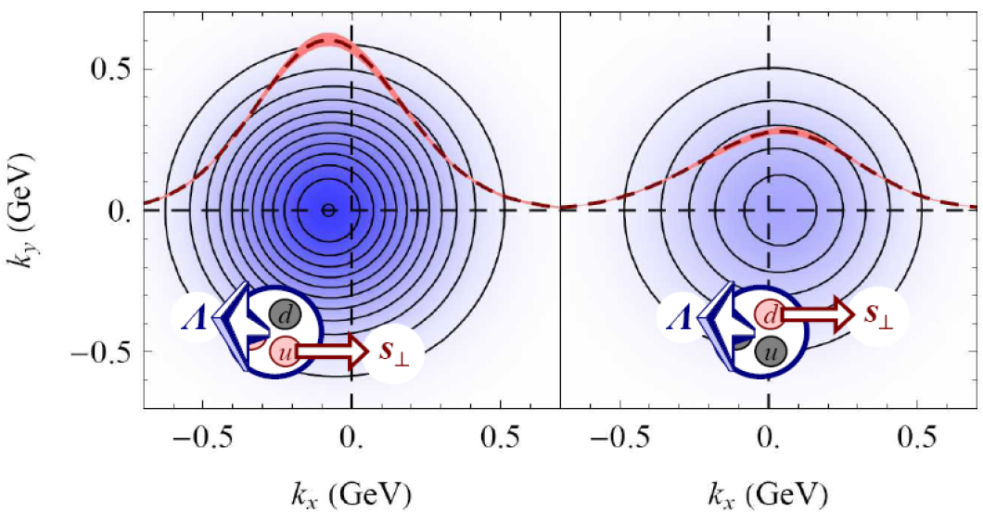
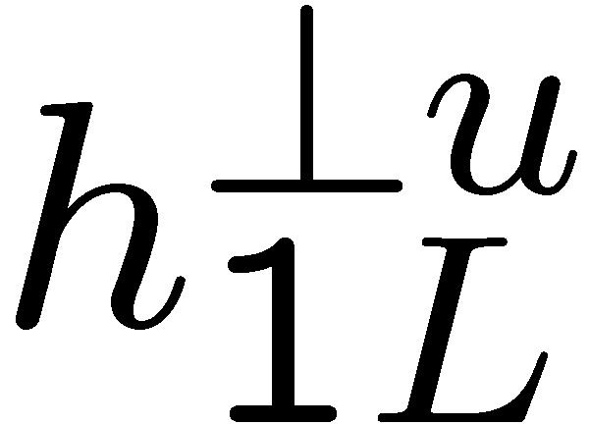
TMDs: Kotzinian-Mulders Asymmetries
A.V. Efremov, K. Goeke and P. Schweitzer, Czech. J. Phys. 55 (2005) A189, hep-ph/0412420.
B.Musch arXiv:0907.2381
Worm gear TMDs are unique (no analog in GPDs)
8 of 20

Slide 9
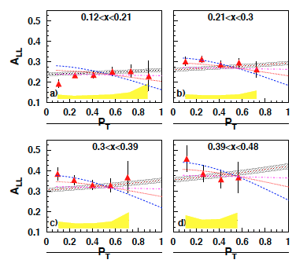
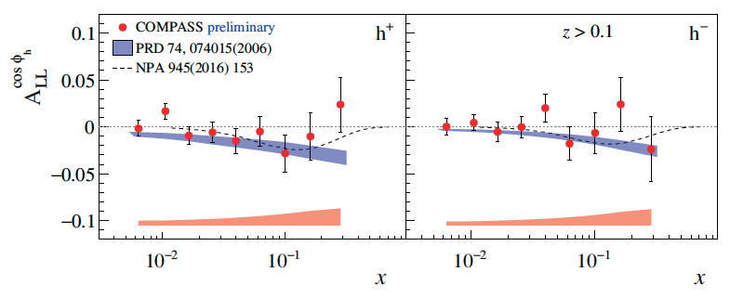
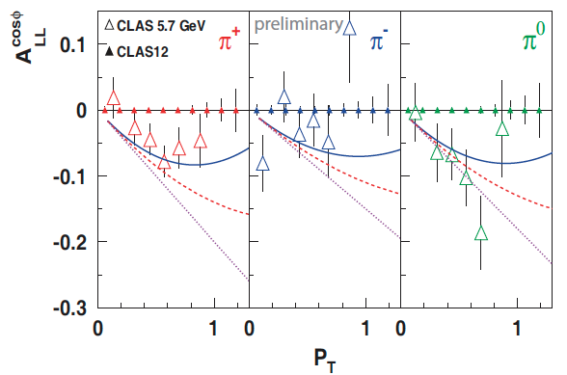
1D SIDIS: A_{LL}-P_{T} and φ-dependences
Kinematical dependences of A_{LL} should be properly integrated to provide input for 1D SIDIS studies
Measurements A_{LL} P_{T} and φ-dependence is crucial also for 1D SIDIS
π⁰ from EG1-DVCS
arXiv:1709.10054
EG1b
9 of 20

Slide 10
DVCS on proton and neutron with polarized target
DVCS allows access to 4 complex GPDs-related quantities: Compton Form Factors CFF(ξ,t)
CFF
GPD
GPD
CFF
GPD
GPD
Unpolarized beam, longitudinal target:
~
Proton
Neutron
~
~
Im{H_{p}, H_{p}}
Δσ_{UL} ~ sinφIm{F₁H+ξ(F₁+F₂)(H + x_{B}/2E) –ξkF₂ E+…}
Im{H_{n}, E_{n}}
Polarized beam, longitudinal target:
~
~
Re{H_{p}, H_{p}}
ξ= x_{B}/(2-x_{B})
k=-t/4M²
Δσ_{LL} ~ (A+Bcosφ)Re{F₁H+ξ(F₁+F₂)(H + x_{B}/2E)…}
Re{H_{n}, E_{n}}
Proton and neutron GPDs (and CFFs) are linear combinations of quark GPDs
A combined analysis of DVCS observables for proton and neutron targets is necessary to perform the flavor separation of the CFFs
10 of 20

Slide 11
Projected DVCS results: target-spin asymmetry
2
L = 10³⁵cm⁻²s⁻¹ (pol. n: 1.5. 10³⁴cm⁻²s⁻¹), 50 days , P_{t} = 0.4
-t
1.2
TSA ~ 0.2
Count rates computed with nDVCS+BH
event generator
+ CLAS12 acceptance from FastMC
+ CND efficiency from GEANT4 simulation
Asymmetries computed with VGG model
0
1
0
First time measurement
-1
• 4 bins in Q²
• 4 bins in −t
• 4 bins in x_{B}
• 12 bins in φ
(Same as E12-11-003)
11 of 20

Slide 12
Projections for CFF flavor separation (ImH, ImE)
Fit using all the projected pDVCS asymmetries of the CLAS12 program
Nucleon CFFs
Fit using the projected nDVCS asymmetries of E12-06-109a and E12-11-003
Quark CFFs
σ(pDVCS) ≈
10σ(nDVCS)
Neutron eff = 10%
Double beam
time for proton
12 of 20
Notes:
Im(H) and Im(E) for the n REQUIRE pol. target

Slide 13
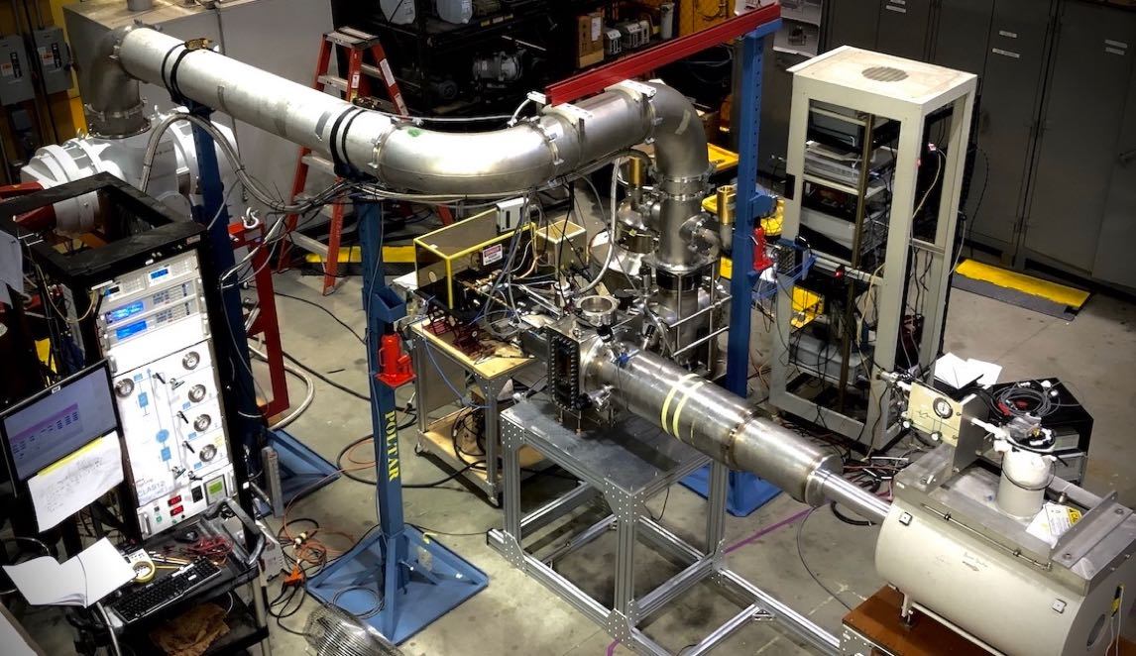




Longitudinally Polarized Target for CLAS12
The target is > 90% complete and has been successfully tested at JLab on three occasions.
Additional cool-down tests are scheduled for 2020 and 2021. Full “dress rehearsal” September 2021 in the EEL. Ready for installation immediately after Summer Run 2021 (RG-M) ends.
Pumping System
Microwaves
NMR
Slow Controls + EPICS
5 T Solenoid (FROST)
1K Refrigerator
13 of 20
Notes:
mention MRI

Slide 14
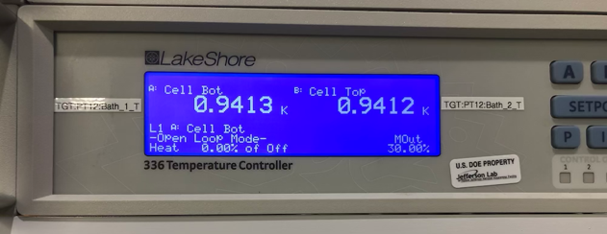
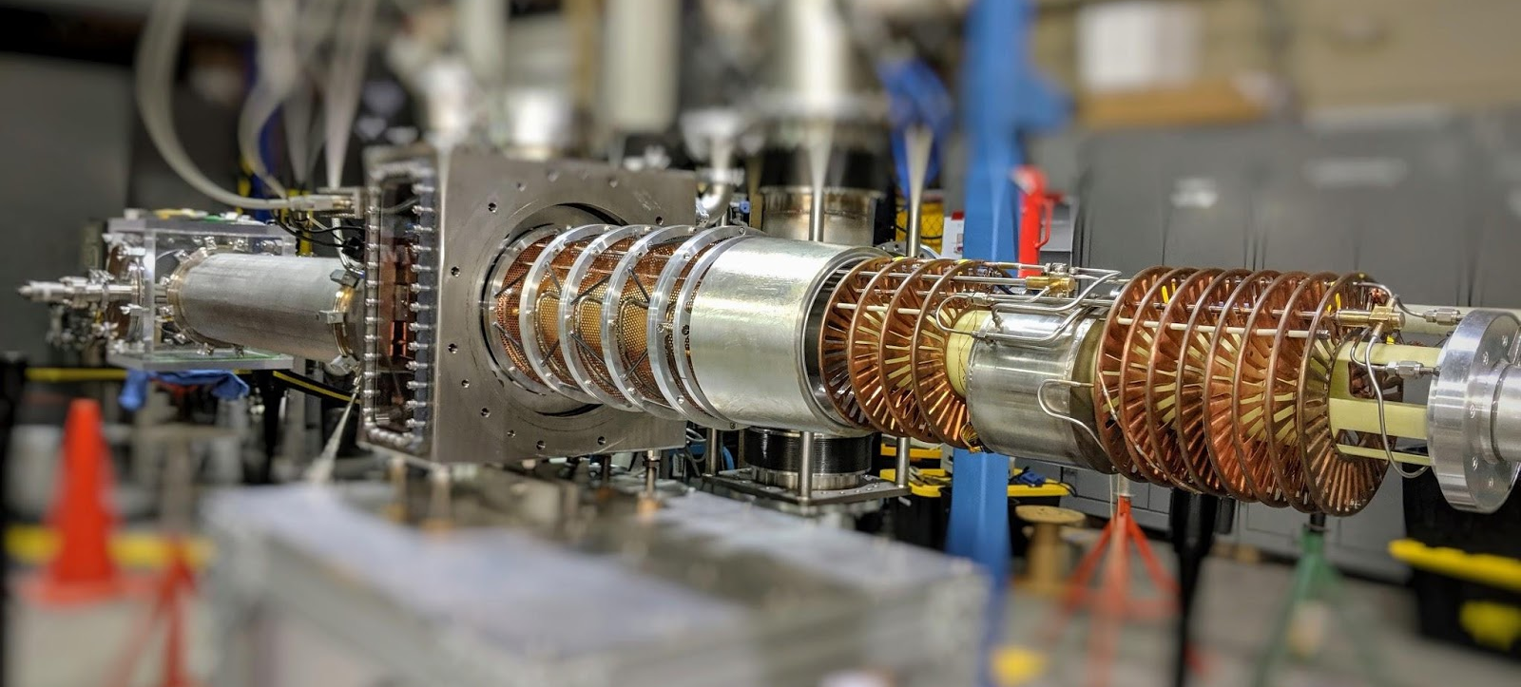
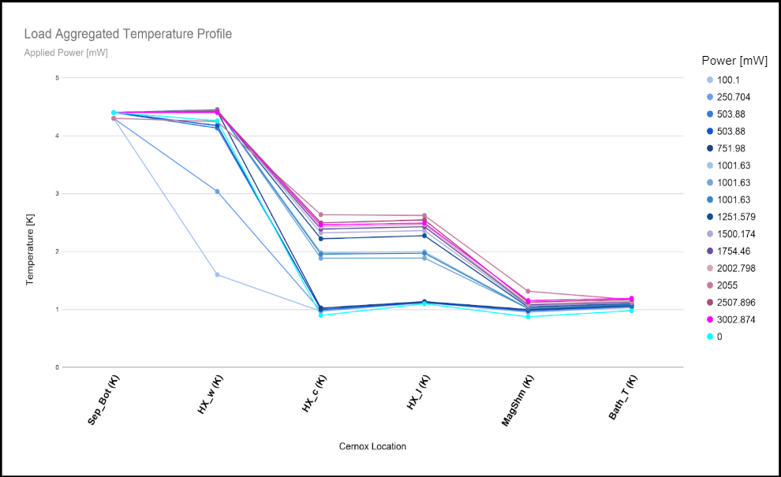
Longitudinally Polarized Target for CLAS12
Horizontal 1 K refrigerator: constructed and tested.
Meets or exceeds all design parameters.
  Stable & reproducible operation;
  Base temperature below 1 K;
  Cooling power of 0.6 W at 1.0 K, 1 W at 1.1 K
  Max. helium consumption < 5 liters/hr
14 of 20

Slide 15
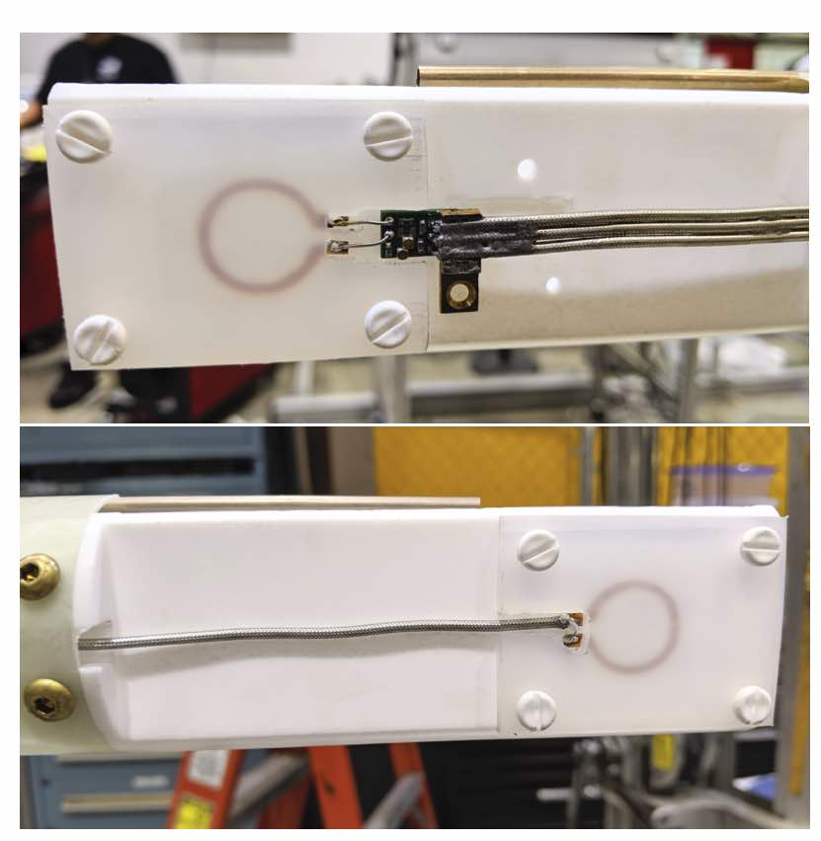
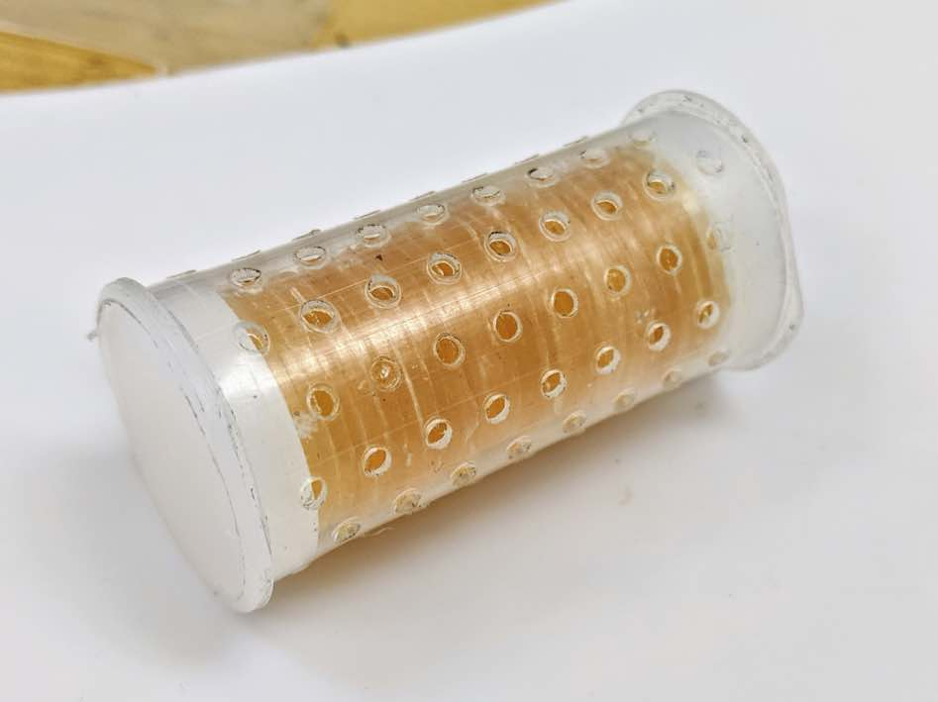
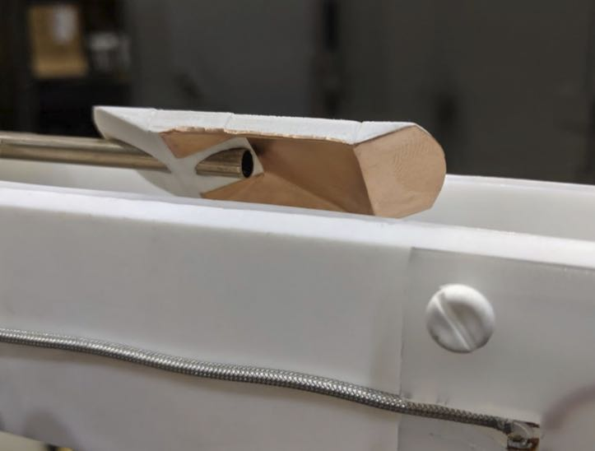
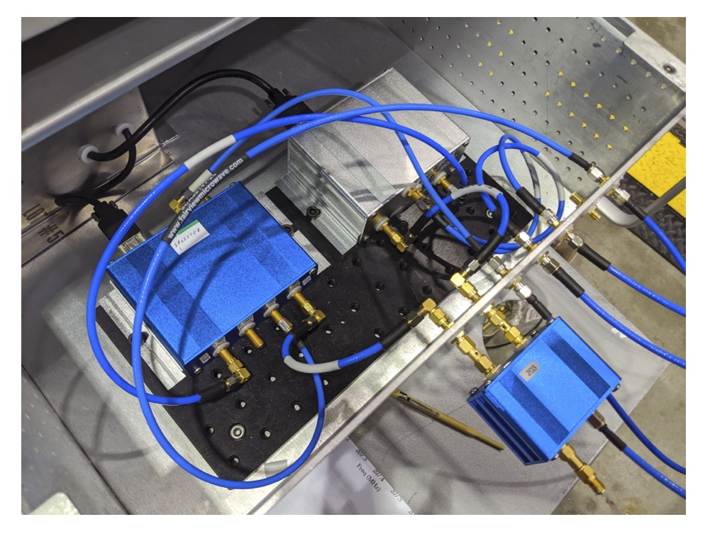
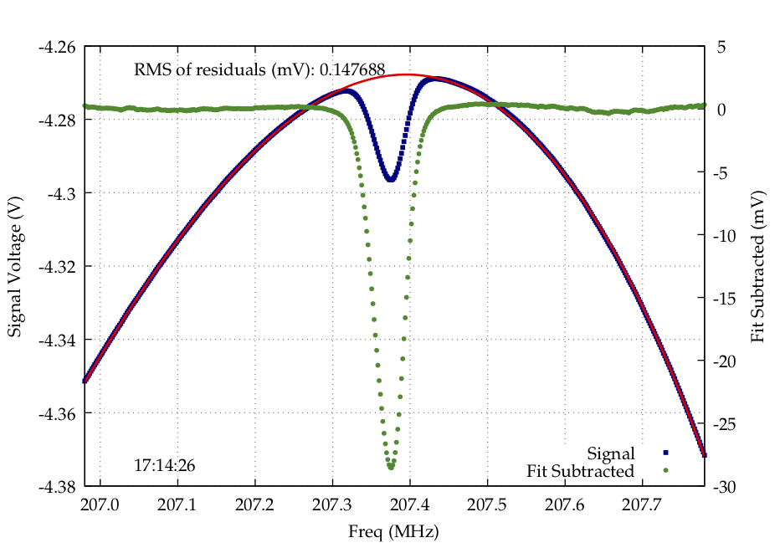
Longitudinally Polarized Target for CLAS12
Polarizations are measured using prototypes of a new NMR Q-meter developed by the JLab Target and Fast Electronics Groups
  Meets or exceeds performance of the 40-yr old Liverpool Q-meter
  Has remote-control capabilities not present on Liverpool version
  Modular for easy repair, modification, and upgrading
  R&D will continue on new version with faster, higher-resolution ADCs
  All-digital version is under design
We have dynamically polarized ⌀2 x 4 cm² samples of 5-min. epoxy doped with TEMPO radical
(chosen for convenience) ➔ 30%-40%
Switch to butanol and NH3 for upcoming tests
15 of 20

Slide 16
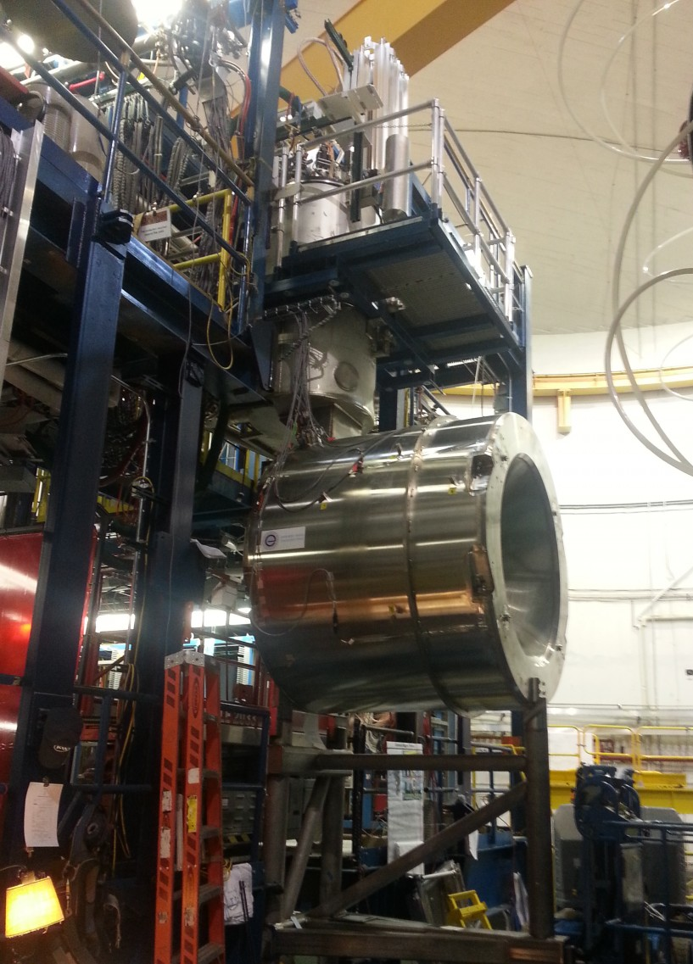
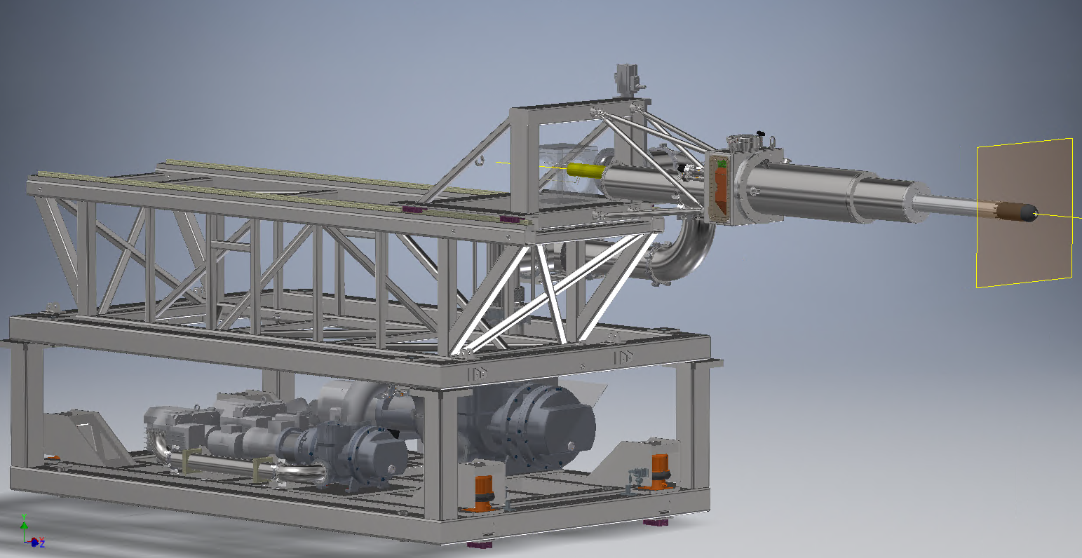
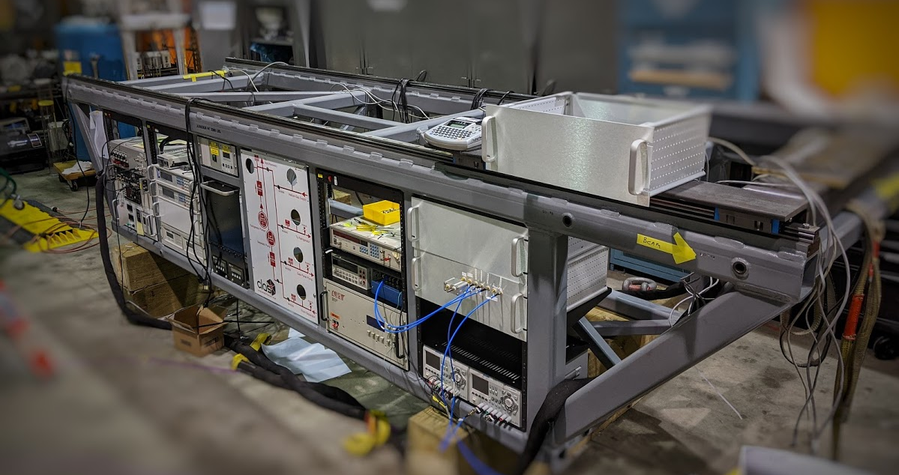
Longitudinally Polarized Target for CLAS12
The CLAS12 5 T solenoid will be used to polarize the target
  Field uniformity is ok for protons – should be improved to optimize the deuteron polarization
  Superconducting shim coils will be installed inside the the 1 K cryostat
  Demonstrated the efficacy of this approach
Support & adjustment frame
(on rails)
Electronics Cart
Pump Cart
(on rails)
Target insertion cart for CLAS12: ~75% complete.
  Fast, easy insertion and removal of target cryostat
  Six-axis adjustment
16 of 20

Slide 17
Target Completion Schedule
Remaining work summarized into five categories.
Accomplished in stages and tested during three cool-downs in Target Lab.
Final, “dress rehearsal” run will demonstrate readiness for installation in Hall B.
Insertion Cart for Hall B
  Wire/cable electronics cart (15) ^{*)}
  Fabricate vibration-isolated platform for vacuum pumps (40)
  Survey and align refrigerator to cart fiducials (3)
NOVEMBER ’20:
1 K fridge on insertion cart, vac. pumps to the side
Improved motion mechanism for He-II bath
Python-based NMR software
DNP of butanol + d-butanol
2. 1 K Refrigerator
  Replace prototype bath and target cells w/ beam-ready versions (30)
  Prototype bath motion mechanism replaced w/ final version (30)
  Fabricate thin-wall vacuum chamber extension (20)
FEBRUARY ‘21:
Production Q-meter + μ-wave/NMR carrier
Ready-for-beam bath and target cells
Superconducting shim coils installed
3. Microwaves and NMR
  Replace prototype μ-wave + NMR carrier w/ beam-ready versions (60)
  Python-based NMR software Q-meter (20)
  Fabricate production version of JLab Q-meter (x3) (15)
MAY ‘21:
Vibration-isolated pumps on cart
DNP of ammonia + d-ammonia
4. Dynamic Polarization
  DNP w/ “real” target materials like butanol & ammonia (Material is in hand)
  DNP w/ deuterated counterparts
SEPTEMBER ‘21:
Dress rehearsal in EEL
Thin-wall vacuum extension
5. Shim Coils
  Wind and install internal, superconducting shim coils (40)
^{*)} numbers = FTE days. TOTAL: 273 FTE days for 3 target group experts and 2 students
10/21/2021

Slide 18
Proposed Run Plan
We assume RG C will be scheduled for a half year run in 2022 (e.g., Winter/Spring 2022), with 6 months (26 weeks) of data taking. That corresponds to 182 calendar days or 91 PAC days, which is just under ½ of the approved total beam time
Complete approved experiments not requiring the FT
Come back at a later time to run 94 additional PAC days with the FT for DVCS (requires optimizing the best tradeoff between raster size, luminosity, and target length)
18 of 20

Slide 19
Run Conditions
> 10.5 GeV electron beam (4 days at 2.2 GeV for commissioning and calibration), beam polarization > 0.85
p and d (ammonia and deuterated ammonia) targets polarized (via DNP) along or opposite to the beam direction
Standard CLAS12 Forward Tracker including 2 (or more) sectors of LTCC and 2 sectors of RICH; NO FT for part 1 but for part 2
Standard CLAS12 Central Detector with all components (SVT, BMT, FMT^{*)}, CTOF, CND); no BAND
New Møller shield (detailed design exists and has been verified by extensive GEMC simulations), upgraded beam line with 2 cm diameter raster
Standard e⁻ inclusive trigger with ”roads”; data rate and data storage similar to previous run groups (e.g., RG-B)
19 of 20
^{*)} Successfully modified by Saclay and re-commissioned during RG-F.
Notes:
All of these have been demonstrated or are in hand. 2nd RICH expected end of 2021.

Slide 20
Summary
RG-C combines several highly rated experiments that will make crucial contributions to the core 12 GeV program at Jefferson Lab.
The physics goals of RG-C are aligned with the NSAC 2015 Long Range Plan and continue to enjoy high interest in the community, with a steady stream of new publications.
The longitudinally polarized target is nearing completion (tremendous investment by Lab and collaborators, including NSF MRI).
RG-C passed ERR and submitted beam time request in 2019. Hall B Task Force has been appointed.
Ready to begin running by the end of 2021
We request re-approval of the entire Run Group (185 PAC days).
20 of 20

Slide 21
Backup Slides

Slide 22
Improvement in PDF uncertainties from INCLUSIVE RG-C data
Relative uncertainties on polarized PDFs with various data sets (Courtesy N. Sato)
Notes:
Includes both statistics and estimated systematic uncertainties

Slide 23
JAM 2017
J. J. Ethier, N. Sato, W. Melnitchouk
Phys. Rev. Lett. 119, 132001 (2017), arXiv:1705.05889 [hep-ph]
Notes:
Future plan: Include RHIC and Tevatron data (W, jets,…)

Slide 24
PDFs from SEMI-inclusive RG-C data
Only K⁻ production on D is uniquely sensitive to Δs (Δu and Δd largely cancel)
Notes:
Note: Existing data are of course pitiful; this is just to illustrate how HIGH statistics data on the d can have a very big impact.

Slide 25
EPJA 53 (2017) 8, 171
Example for the power of using combined fits of polarized target and polarized beam DVCS data on the extraction of Compton Form factors (from 6 GeV data taken with CLAS).
Red filled circles = combined analysis with 8 free parameters
Red open squares = unpolarized target data only
Black filled squares = restricted fits with only 4 free parameters.
red triangles = data from Hall A (unpolarized target)
Notes:
Stars = VGG prediction; curves = fits to the various data sets. NOTE: this is for p; for n, ImH and ImE cannot be extracted at all from BSSA alone.

Slide 26
Combined analysis of E12-06-109a and E12-11-003
ImH_{n}
Extraction of neutron CFFs using M. Guidal’s fitting code. Fit of TSA, DSA (E12-06-109a) and BSA
(E12-11-003)
7 CFFs as free fit parameters
ImE = 0
~

Slide 27
Combined analysis of E12-06-109a and E12-11-003
ImE_{n}
Extraction of neutron CFFs using M. Guidal’s fitting code. Fit of TSA, DSA (E12-06-109a) and BSA
(E12-11-003)
7 CFFs as free fit parameters
ImE = 0
~

Slide 28
Sensitivity to CFFs of DVCS spin observables
Twist 2
approximation
(-t<<Q²)
(ξ= x_{B}/(2-x_{B}) k=-t/4M²)
Proton Neutron
Polarized beam, unpolarized target:
~
Im{H_{p}, H_{p}, E_{p}}
~
s^{I}_{1,unp} ~ sinφ Im{F₁H + ξ(F₁+F₂)H -kF₂E}
~
Im{H_{n}, H_{n}, E_{n}}
Unpolarized beam, longitudinal target:
~
~
~
Im{H_{p}, H_{p}}
s^{I}_{1,UL} ~ sinφIm{F₁H+ξ(F₁+F₂)(H + x_{B}/2E) –ξkF₂ E+…}
Im{H_{n}, E_{n}}
~
Polarized beam, longitudinal target:
Re{H_{p}, H_{p}}
~
c^{I}₁,_{LP} ~ (A+Bcosφ)Re{F₁H+ξ(F₁+F₂)(H + x_{B}/2E)…}
Re{H_{n}, E_{n}}
Unpolarized beam, transverse target:
Im{H_{p}, E_{p}}
Δσ_{UT} ~ cosφsin(φ_{s}−φ)Im{k(F₂H – F₁E) +… }
Im{H_{n}}
Notes:
At leading twist, the sinfi term of the single-spin asymmetries and the cosphi/numerator term of the DSA are proportional to the interference of DVCS and BH, and are linear combinations of CFFs and electromagnetic form factors. The coefficients of the combinations change for each observable, making each observable sensitive to a specific combination of CFFs.
nDVCS complements pDVCS for the different sensitivity to GPDs of the various observables.

Slide 29
Møller Shield

