Slide 1
Infrastructure: cooling, signal and power cables, detector safety system, existing ITS2/3 like control system etc.
Detector packages – how collider tracking detectors go together.
Grounding plan – essential ingredient for system (detector and support) design
Services – examples from existing similar detector systems ALICE-ITS (in and adjacent to the detector)
Services – what can we expect for an EIC tracking detector?
Additional infrastructure – grounding, cooling, detector safety interlocks, environmental monitoring.
Way forward

Slide 2
Si Tracker Detector Packages
Modern Si tracking detectors are highly integrated objects and are installed as packages. The internal services are already installed and brought out to patch panels and the sensors already tested and characterized. These packages are self-supported mechanical objects.
As such, the integration into the overall detector can be described as an exercise in supporting and locating internally calibrated packages into the overall detector envelopes.
This is an engineering problem that has generally been solved for cylindrical detector volumes in similar ways at STAR, ALICE, ATLAS, etc.
The patch panels for detector package services are usually located in accessible space so that the detector package can be cabled and tested as part of the overall detector assembly process.
Detector packages are usually split so that they can be installed with the beam pipe in place.

Slide 3
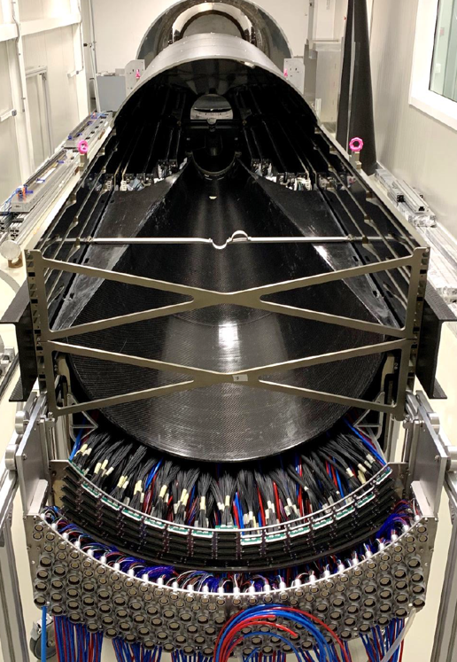
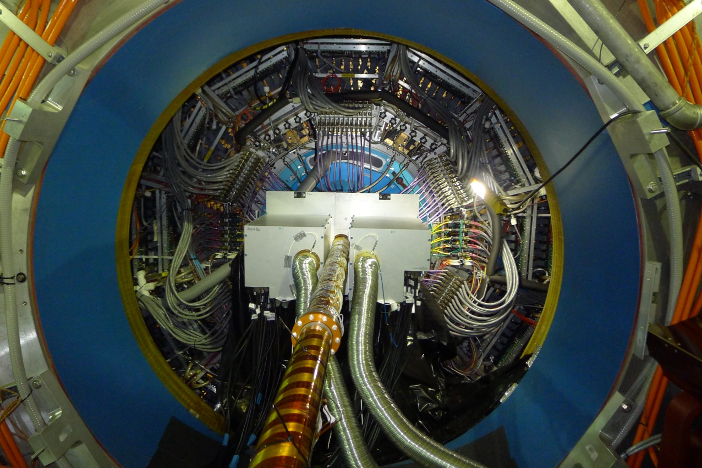
Detector Packages
ALICE ITS
Patch panels for IL (not installed)
Air cooling
STAR PXL detector
Patch panels for signal, power
Patch panels for signal, power and water cooling

Slide 4
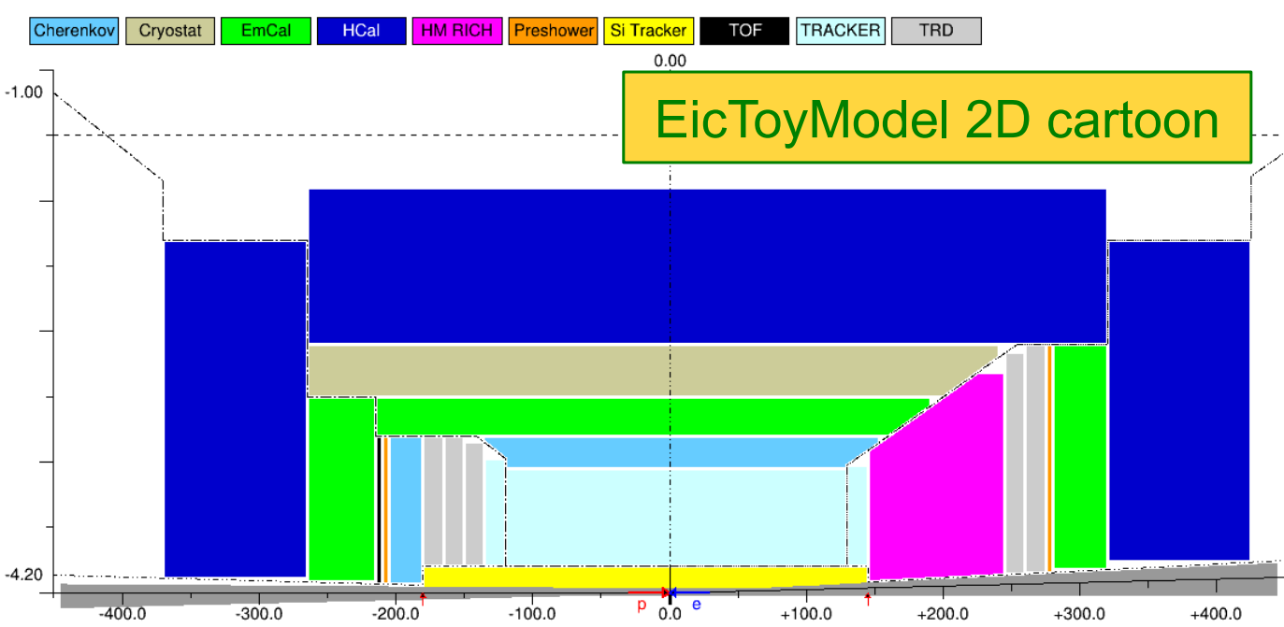
EIC Services routing
Alexander Kiselev
General Routing of services. Internal routing of detector package services are up to the detector designer.
Patch panel cables to outside of detector.

Slide 5
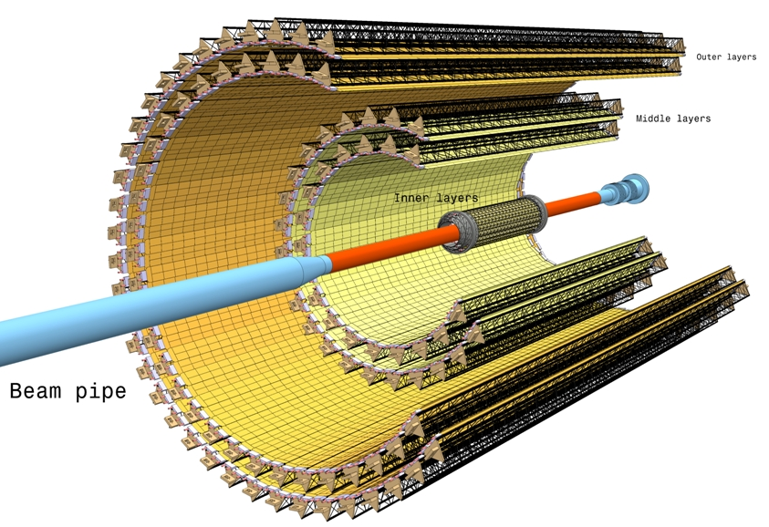
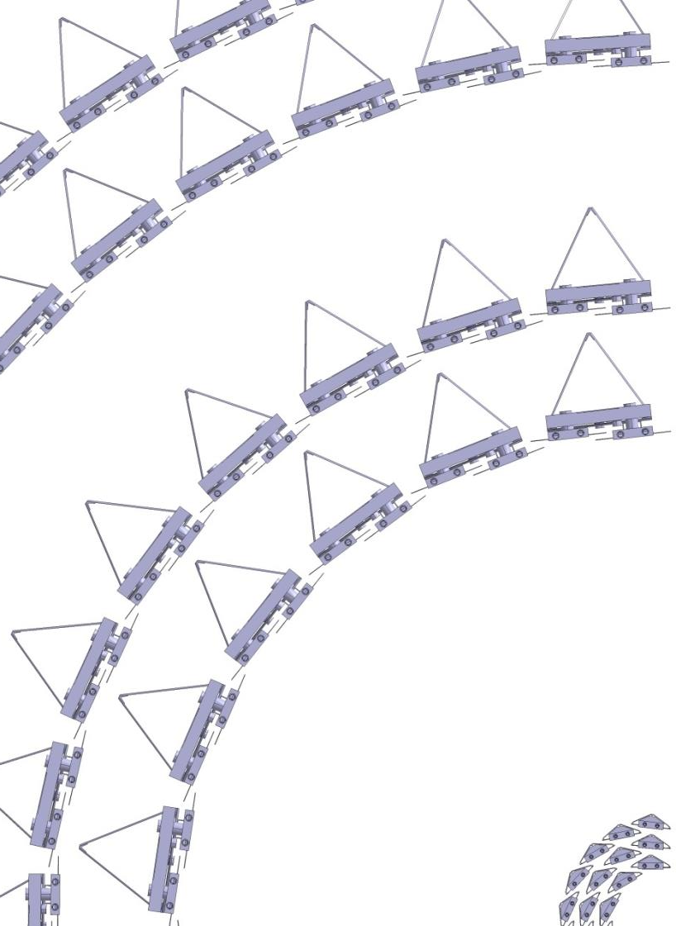
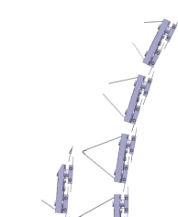
ALICE ITS Upgrade geometry
90 Outer Layer staves, 2 layers X/X0 ~1%
54 Middle Layer staves, 2 layers X/X0 ~1%
48 Inner Layer staves, 3 layers X/X0 ~0.3%
~10 m^2 surface area

Slide 6
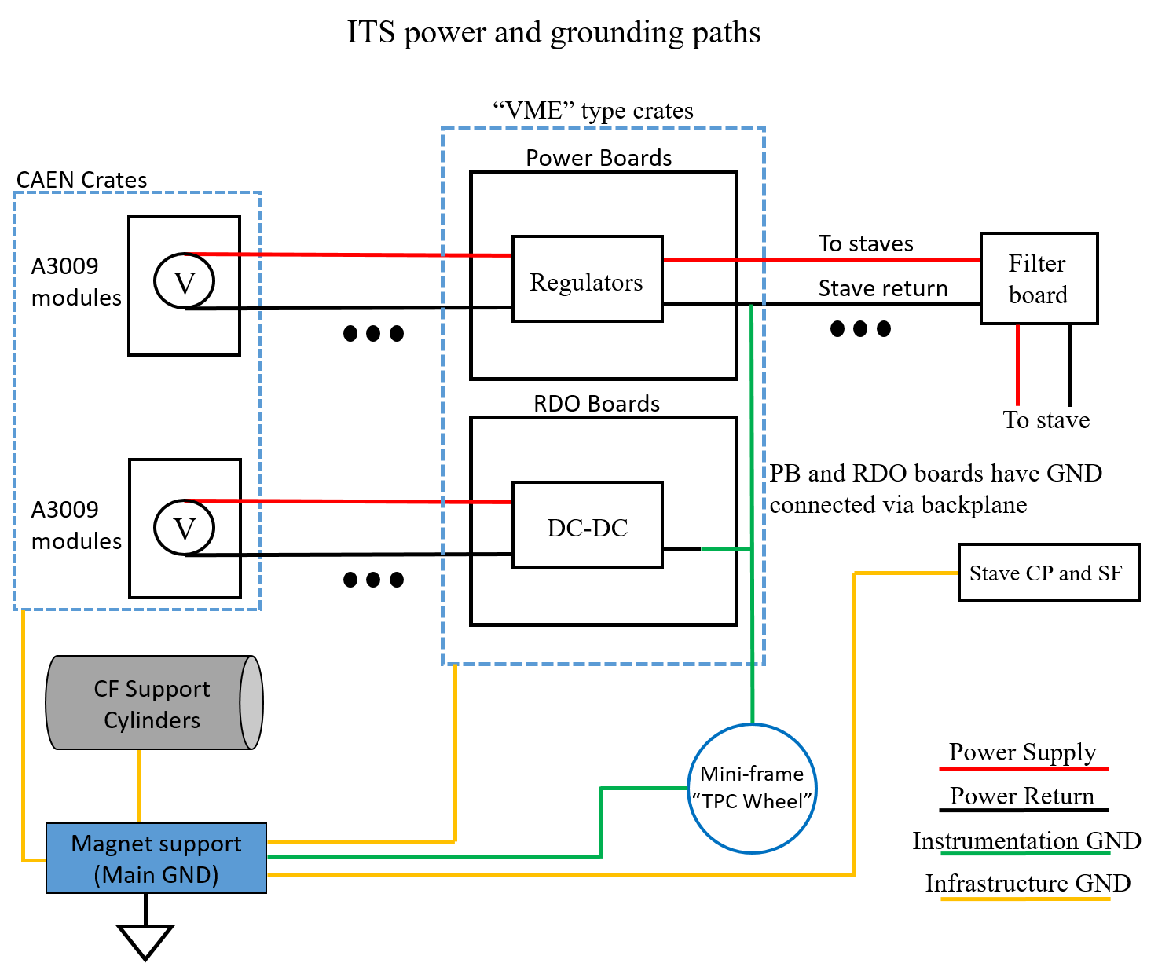
Grounding Plan
A grounding plan is essential for detector design.
Must be in place and detectors and support structures designed to comply with “star” type grounding arrangement.
Infrastructure and Instrumentation grounds must be kept isolated until joined at overall detector ground.
Carbon fiber support structures designed with electrically attached grounding points.

Slide 7
ALICE ITS Services Architecture
Power, RDO and Control
Detector (100k rad)
CANBUS
RDO
unit
data, config, control
Half-stave
monitor, control
Power bus
Power
Bias bus
power,
bias
bias
Power and
Bias Supply
Board
BOB
Filter
Board
Mini-frame
racks
(10k rad)
BOB
PP
PP1
PP0
CAEN
Main
Power
Power, sense
CAEN
bias
supply
bias, sense
Cavern Racks (low rad)
Counting Room (no rad)
10 year radiation estimates
Notes:
Subdivided by Rad areas – all components in these areas need to be tested to estimate + safety factor of ~>2

Slide 8
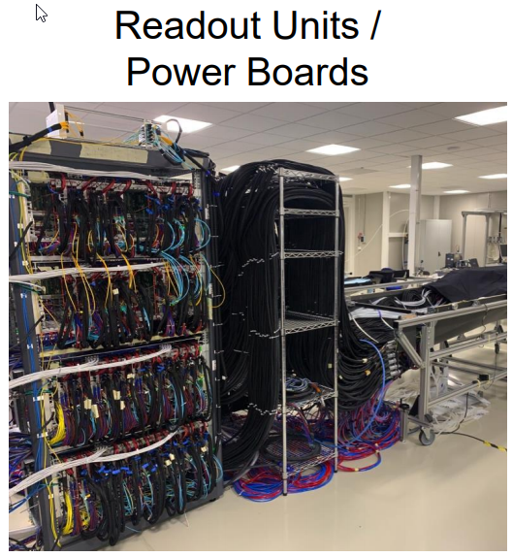
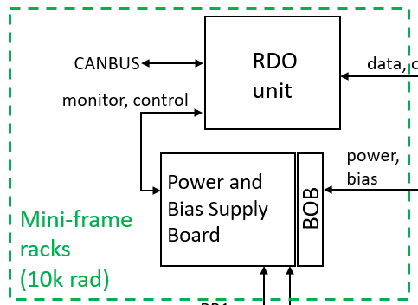
ALICE ITS Services Architecture
One of Four total racks shown
~200 each of RDO and power boards.
Additional slow controls boards and fiber break out boards.

Slide 9
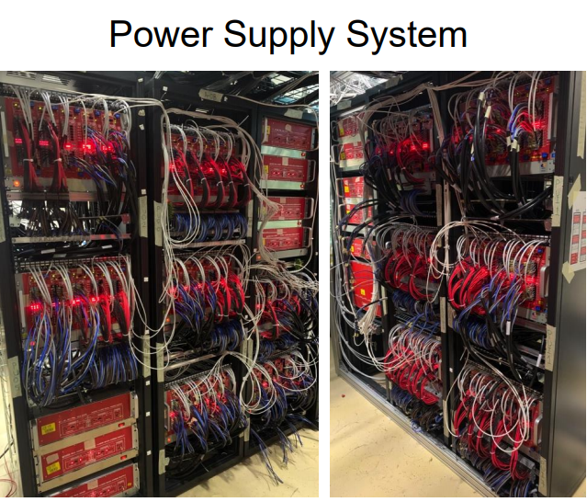
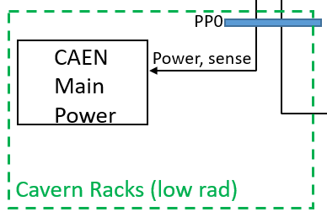
ALICE ITS Services Architecture
See Alberto’s talk for the cabling between the Main CAEN power supplies and the power boards (5 Tons)

Slide 10
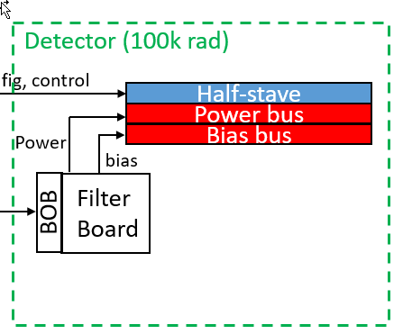
ALICE ITS Services Architecture
Broken down in detail in next slide

Slide 11
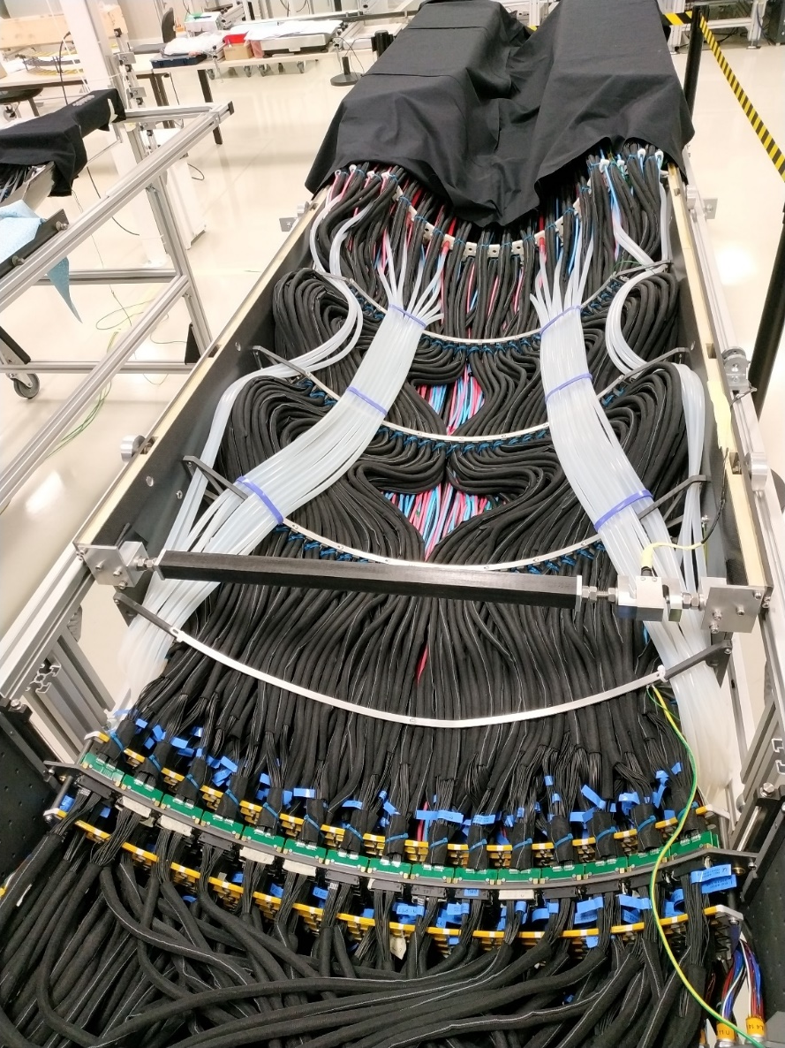
Services
ALICE ITS Half-barrel
ALICE ITS2 Upgrade example (half barrel outer layers)
27 x ~1 m ML staves, 45 x ~1.5 m OL staves in 4 layers
~5 m^2 of silicon surface area
846 modules of 14 sensors/module. Power is delivered to each module independently. (see Nikki’s talk for stave component breakdown)
4 X 18 AWG power/return wires bundled per module = 3384 power/return wires
378 x 22 AWG bias lines
288 supply/return water connections (total number of water supply/return lines depend on the number of parallel cooling circuits)
288 Samtec firefly signal cables (note that the control/configuration interface is included in the Samtec firefly connection.
+ infrastructure (PT100 temperature sensors, infrastructure ground wires, environmental monitoring wires, etc.)

Slide 12
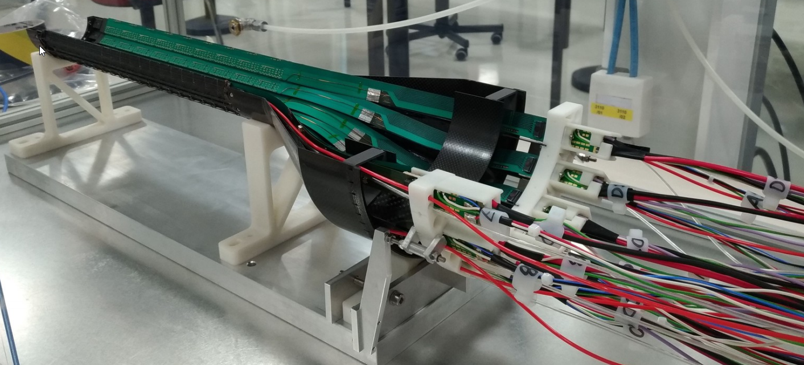
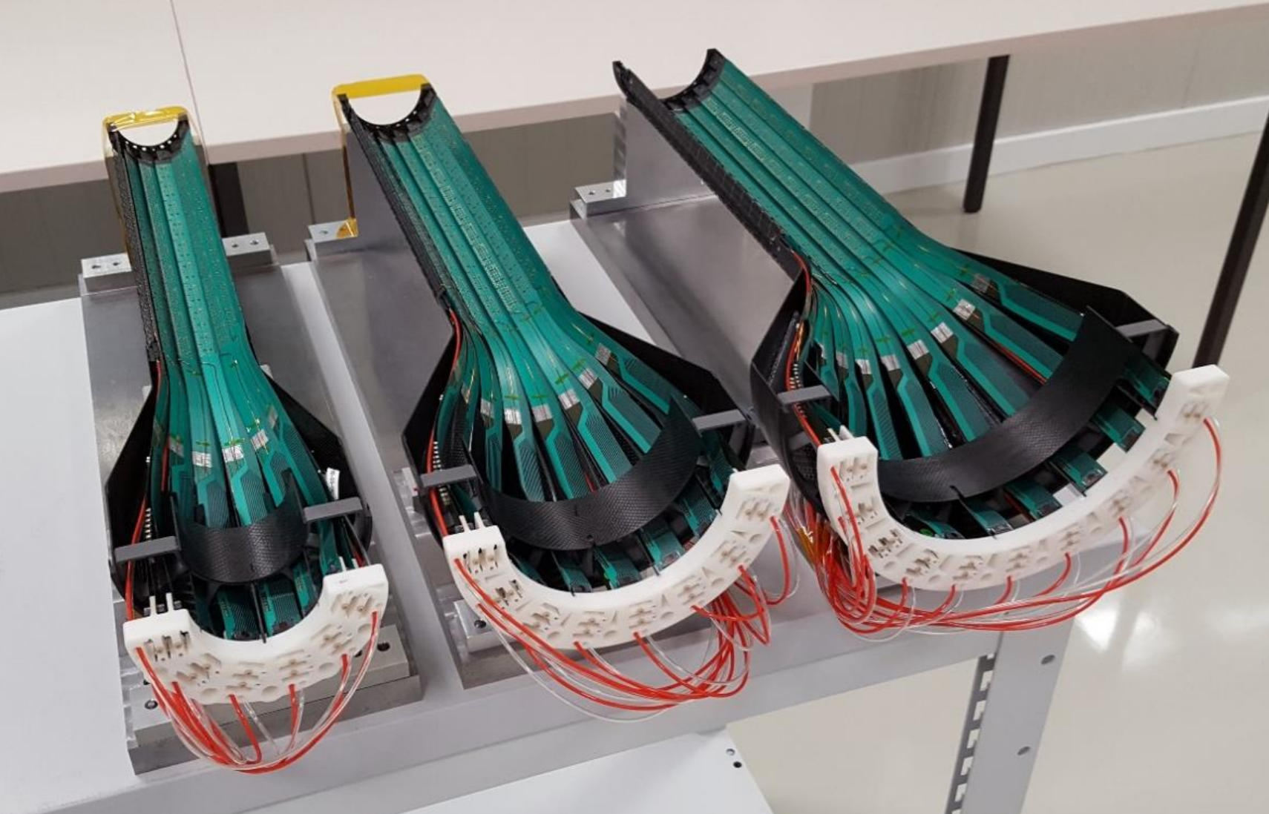
Services
ALICE ITS inner barrels have their own services cone and support
54 staves – 9 sensors per stave – in 3 layers
4 x 18 AWG power/return lines per stave => 216 x 18 AWG power wires
1 x 22 AWG bias line per stave => 54 x 22 AWG bias wires
2 x supply/return cooling line per stave => up to 108 cooling lines (depends on modularity of cooling manifolds)
1 x Samtec firefly signal cable per stave => 54 Samtec firefly signal cables.
This material will be in the tracking acceptance for outer layer discs

Slide 13
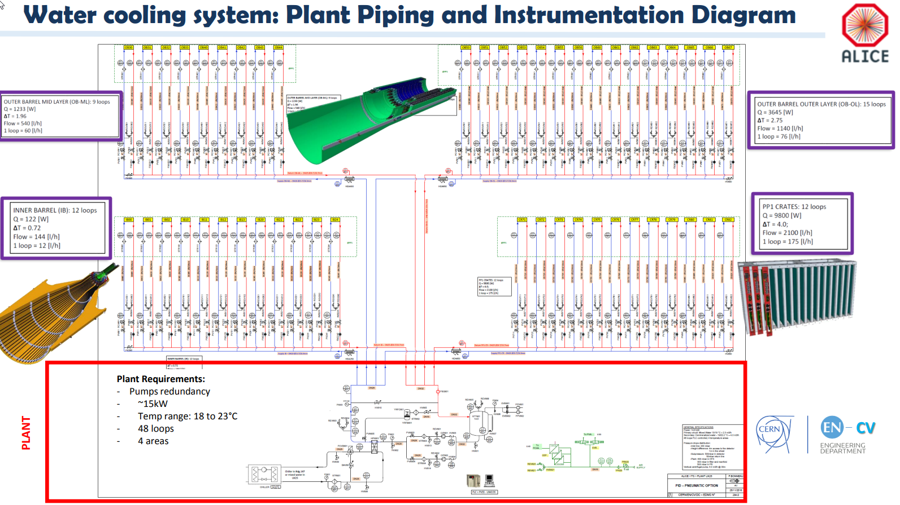
ALICE ITS Services Architecture
Notes:
Supplies the cooling for the RDO boards and power boards as well

Slide 14
ALICE ITS Services Architecture
Sub-atmospheric cooling plant
Sensors operate at room temperature.
Power dissipation of ALPIDE sensors is ~40 mW/cm^2.
Flow rates are relatively low.

Slide 15
Services – what can we expect for EIC tracking Si?
We can use ITS as a baseline for services estimates
The expected surface area of an EIC tracking detector is similar to the ALICE ITS at ~10 m^2.
The largest component by far that will need to be routed inside the main EIC detector will be power and data cabling (see Alberto’s talk for other possible powering options).
The data cabling will likely remain similar of similar footprint. Targeted R&D can possibly improve this.
If we use water cooling, we can likely reduce the number and size of cooling lines since a new sensor power dissipation will likely be less.
Using what we know of the service needs for the existing ITS we can project and estimate what would be needed for a detector composed of similar ALPIDE like sensors.
We can then scale to what might be needed for a tracking detector based on new technology (such as ITS3 like sensors with half of the power dissipation) and using aluminum conductors for power/return wiring to reduce overall radiation length.
This exercise has been done for the volume and radiation length of the expected services to be used in the simulation efforts for the yellow report effort.

Slide 16
Services – what can we expect for EIC tracking Si?
stave
Volume and radiation length estimates for ITS3 like sensor based EIC tracking detector
 | Stave X/X0 | Stave transition (per 100 cm^2 of Si surface) | Services (per 100 cm^2 of Si surface) | Patch panel (per 100 cm^2 of Si surface)
ITS3 like vertexing | ~0.1% | 6.66 cm^3 of material with X/X0 of 0.031 per traversed cm | 2.96 cm^2 cross section with X/X0 of 0.002 per traversed cm | 4.32 cm x 1cm x 1 cm with 0.03423 X/X0 per traversed cm
ITS3 like barrel (up to 1.5m length) | 0.55 % | 4.286 cm^3 of material with X/X0 of 0.0306 per traversed cm | 1.905 cm^2 cross section with X/X0 of 0.002 per traversed cm | 2.778cm x 1cm x 1 cm with 0.03423 X/X0 per traversed cm
ITS3 like disc (up to 60 cm diameter) | 0.24% | 6.66 cm^3 of material with X/X0 of 0.031 per traversed cm | 2.96 cm^2 cross section with X/X0 of 0.002 per traversed cm | 4.321 cm x 1cm x 1 cm with 0.03423 X/X0 per traversed cm
Stave
transition
services
Patch panel
https://indico.bnl.gov/event/7449/contributions/36038/attachments/27241/41529/2020_03_20_EIC_Si_services_parametrization_for_sim.pptx
https://indico.bnl.gov/event/8231/contributions/37955/attachments/28329/43586/2020_05_15_EIC_Si_material_projections.pptx

Slide 17
Additional infrastructure
Detector Safety System:
Interlocked PT100 temperature sensors on the output tubes of the stave cooling water for each stave.
Environmental Monitoring system
Temperature
Humidity
Leak detection (if not using sub-atmospheric cooling pressure)
Grounding
Infrastructure (detector support structures, services supports, etc.) must be grounded.
Isolation between instrumentation grounds and other ground.
Inner detector temperature and humidity stabilization
The inner detector area needs to be controlled usually with conditioned air. This is particularly important with an outer TPC. This system needs to be integrated into the design
All of these (and usually more) will need to be integrated into the detector packages and some into the places between detector packages.
The loads for these in EIC will likely be very similar to the ALICE ITS.

Slide 18
Way Forward
The proposed EIC detector design is a quite compact detector with a lot of silicon tracking surface area.
The services routing areas are somewhat limited.
As the full detector simulations develop, we can begin to understand the effects of the mass of the services on the physics performance, this will likely instigate targeted R&D into reducing these services.
The service loads for the power supply/return of the tracking detector are likely to be similar in scale to the ALICE ITS if we use the same architecture. It is worth using directed R&D to explore DC-DC converters or serial powering to reduce this load (see Alberto’s talk)
Similarly, the service loads for the data/configuration cabling could possibly be reduced by using targeted R&D on fiber optic systems.
The environmental monitoring, interlocks, grounding arrangements, etc. could be improved, but likely only moderately.
Cooling lines could be removed if we could used a forced air cooling system. This is feasible for a ~20 mW/cm^2 dissipation. But this requires ducting and space and generates it’s own set of issues. Options for air cooling should be considered.

Slide 19
Backup

Slide 20
