Slide 1
EIC Science – Project Status and Plans
Elke Aschenauer and Rolf Ent
Co-Associate Directors for the Experimental Program
Silicon Vertex and Tracking Detectors Workshop
September 2-4, 2020

Slide 2
Electron-Ion Collider Project
Performance and Scope
  Full-energy, full-luminosity accelerator (NSAC and NAS recommended)
  One interaction region with allowance for a second
  One detector
Schedule
  Completion in ~10-15 years
Cost
  CD-0 approved with a range of $1.6B-$2.6B

Slide 3
Reference Funding Profile
Includes one Interaction Region and one detector (but already assuming $100M in-kind contributions)
  CD-1: March 2021
  CD-2: September 2022
  CD-3: September 2023
  CD-4a: September 2030
  CD-4: June 2032
  Staged CD-4
    Operations Start - CD-4a
    Install full RF Power - CD-4
  $100M from New York State toward infrastructure
Note: this $100M has nothing to do with the $100M in-kind above!!!

Slide 4
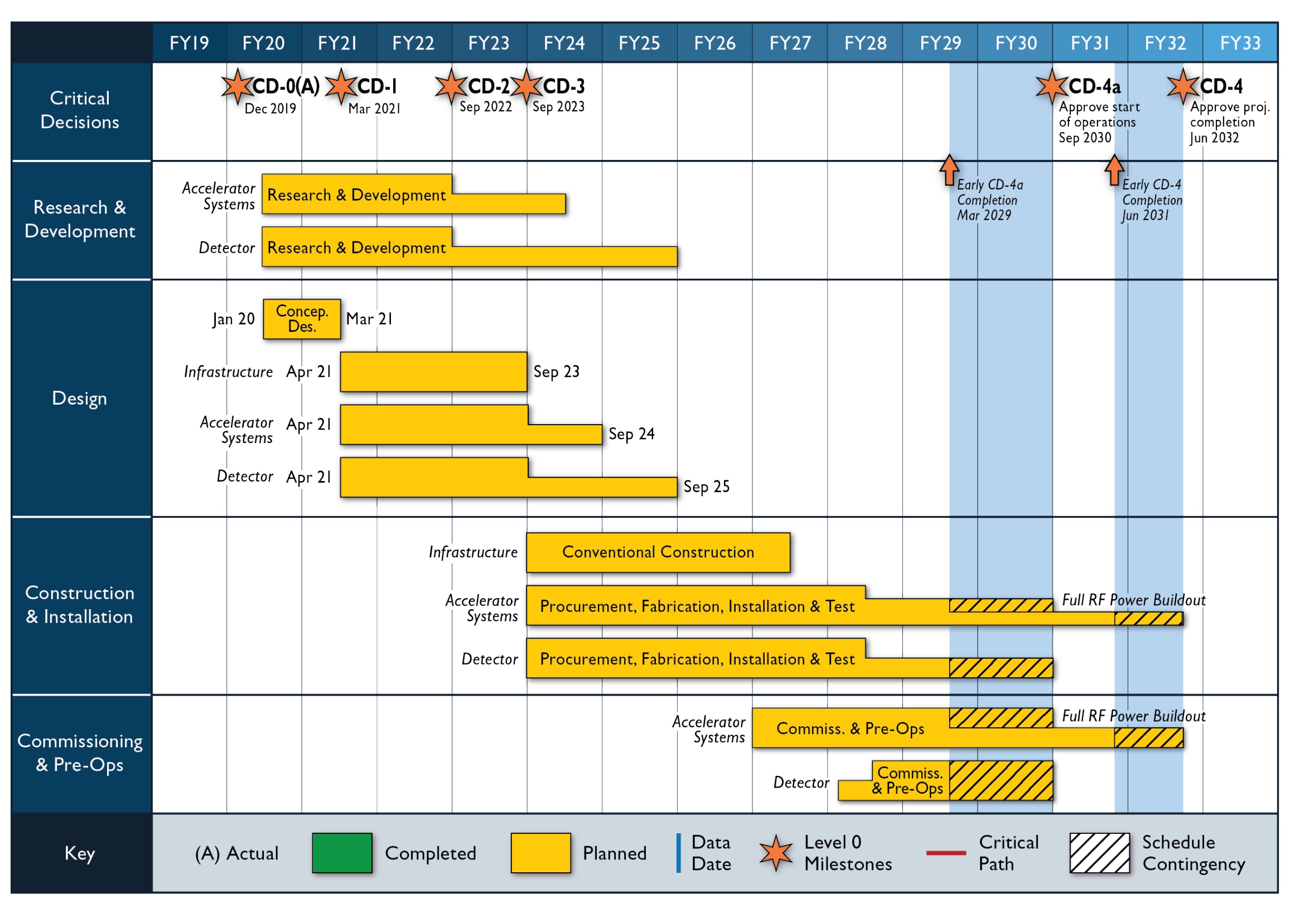
Reference Schedule

Slide 5

Detector Location Assumption
Two assumed detectors and Interaction Regions – IP6 and IP8
Assumption: IP6 is “default” EIC detector location (as IP8 has sPHENIX).
Existing IP6 and IP8 Hall, doors, and situation are different which can lead to complications to use or reuse equipment.
Hadron Storage Ring
Electron Storage Ring
Electron Injector Synchrotron
Possible on-energy Hadron
injector ring
Hadron injector complex

Slide 6
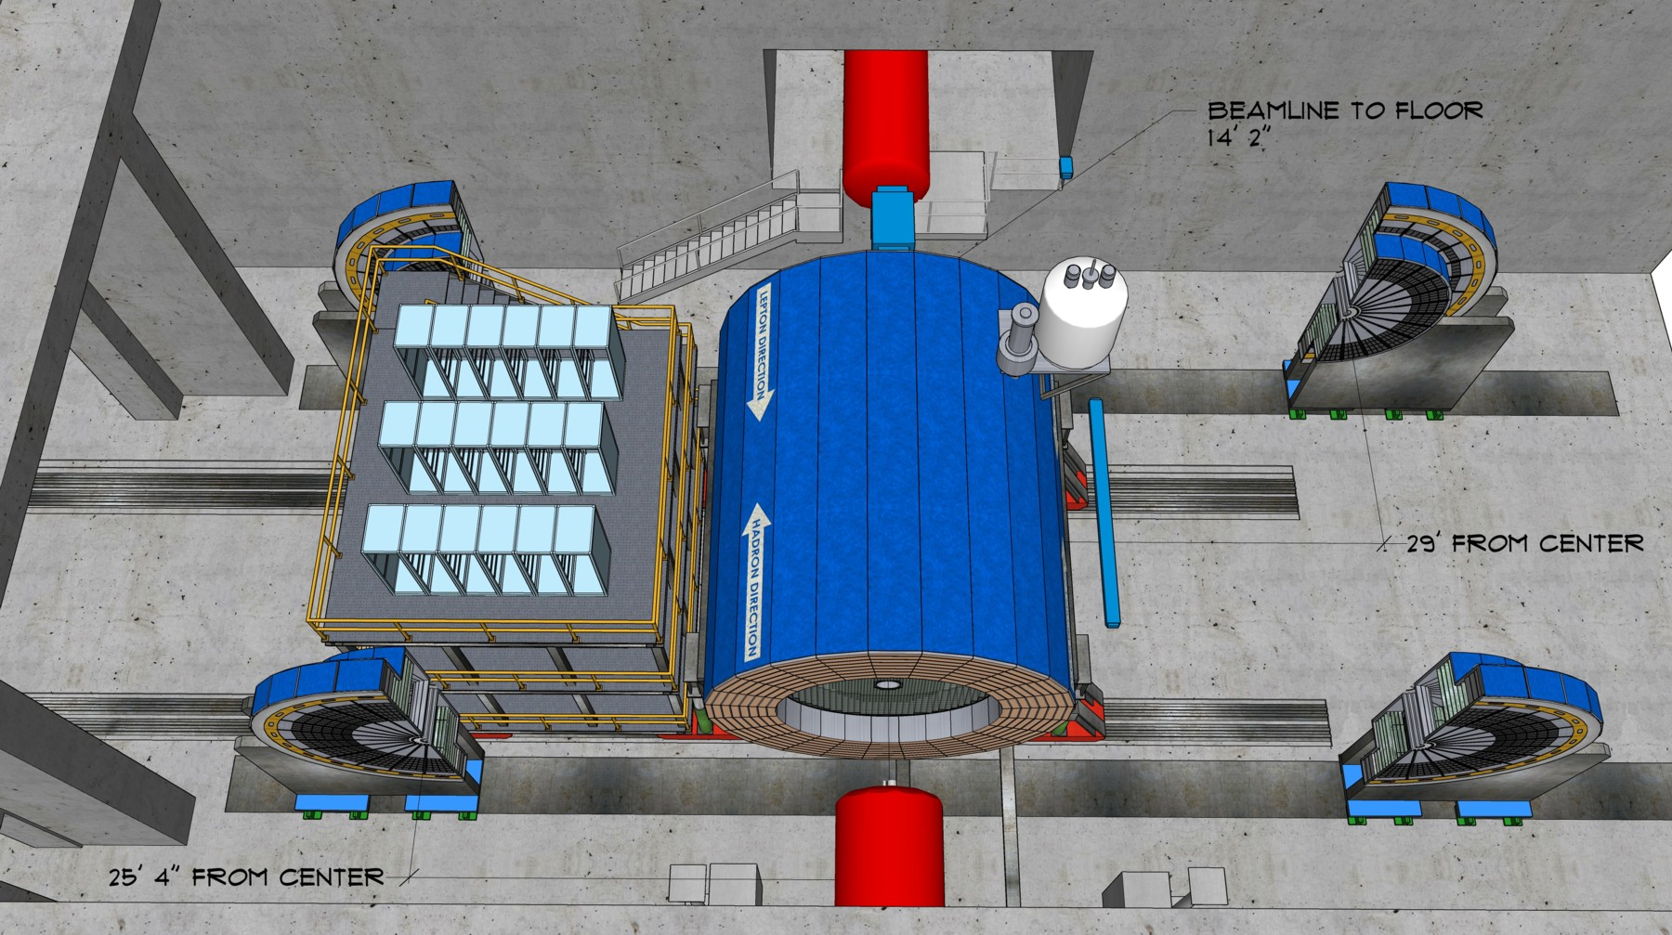
Highly integrated detector system
Total size detector: ~75m
1.Central detector: ~10m
2.Backward electron detection: ~35m
3.Forward hadron spectrometer: ~40m

Slide 7
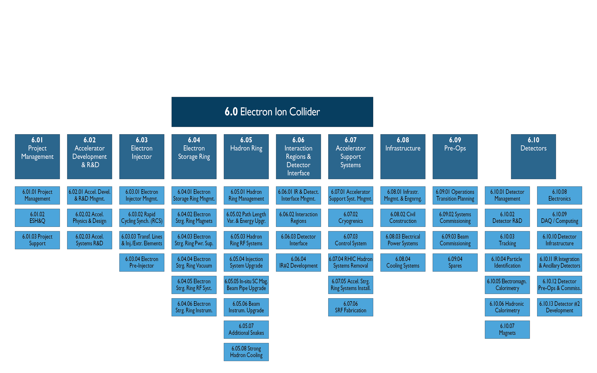
Within EIC Project: 6.10 Detectors

Slide 8
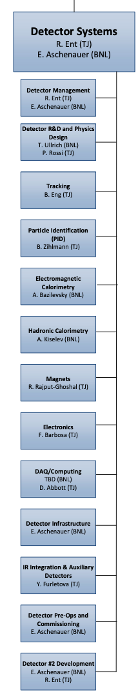
Joint responsibility
Co-associate directors for Experimental Program: Rolf Ent (JLab) and Elke Aschenauer (BNL)
  6.10 Detectors
  6.10.01 Detector Management
  6.10.13 Detector #2 Development
Some scope has both a BNL and JLab person
  6.10.02 Detector R&D Thomas Ullrich (BNL) & Patrizia Rossi (JLab)
  6.10.09 DAQ/Computing David Abbott (JLab) & TBD (BNL)
Some scope has a BNL person
  6.10.05 EM Calorimetry Alexander Basilevsky (BNL)
  6.10.06 Hadronic Calorimetry Alexander Kiselev (BNL)
  6.10.10 Detector Infrastructure Elke Aschenauer (BNL)*
  6.10.12 Detector Pre-Ops Elke Aschenauer (BNL)*
Some scope has a JLab person
  6.10.03 Tracking Brian Eng (JLab)
  6.10.04 Particle Identification Beni Zihlmann (JLab)
  6.10.07 Magnets Renuka Rajput-Ghoshal (JLab)
  6.10.08 Electronics Fernando Barbosa (JLab)
We also heavily utilize Walt Akers (JLab) who is a Systems Engineer

Slide 9
EIC Detector Other Project Cost Activities
Tasks – Joint BNL and JLab efforts, working in sync with EIC User Group-driven Yellow Report activity through the sub-working groups
  Conceptual design of experimental solenoid
  Engineering concept for the full detector (incl. installation, maintenance)
  Interaction region (background, detector integration, vacuum)
  Evaluation of ASIC, PCB and FPGA needs
  Resource evaluation of the computing needs for a fully streaming DAQ
Task Owners – Elke Aschenauer (BNL) and Rolf Ent (JLab)

Slide 10
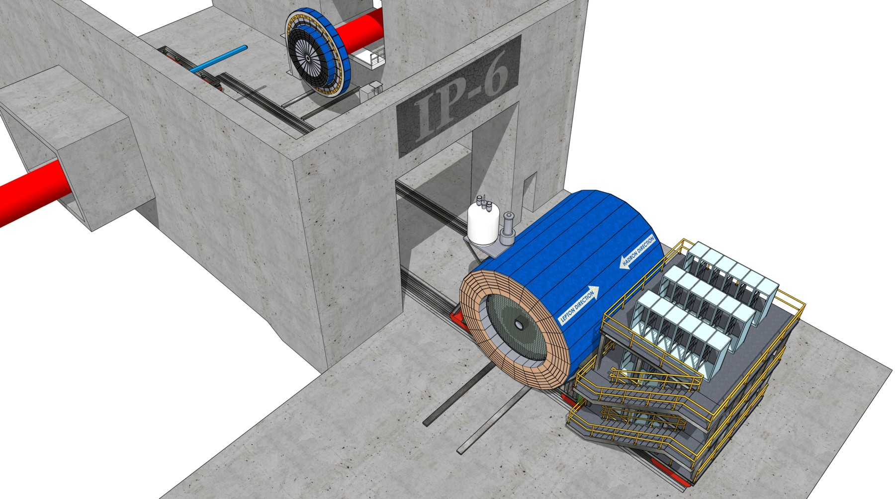
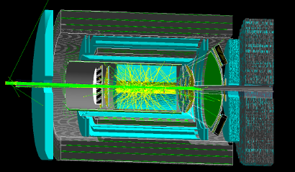
Engineering concept for the full detector (incl. installation, maintenance)
This task has been valuable to see “what fits through the door”, where to put the cryo distribution can, where the electronics platform, and showed that maintenance can really only be done outside the Hall.
We look at both IP6 and IP8 for this.
Interaction region (background, detector integration, vacuum)
(left) GEANT simulations of the synchrotron photon background.
Similar, GEANT beam gas interaction background, MOLFLOW static vacuum, FLUKA radiation damage and overall signal data rate calculations are done.

Slide 11
Conceptual Design Report
Note: At CD-1 we need a plausible scenario reference design for any general-purpose detector (= one full detector to do the NSAC/NAS Report science)
CDR planning for experimental equipment in full swing
Have assembled editorial board (mix of BNL staff, JLab staff, and users – taking strong advantage of existing info and ongoing Yellow Report activities)]
All members of this assembled editorial board are asked for specific sections that need updating in the text assembled from existing pre-CDRs, the EIC detector handbook, ongoing Yellow Report + Other Project Cost activities, etc.
Also 3 readers: Tom Ludlam, Klaus Dehmelt, Thia Keppel

Slide 12
Conceptual Design Report – Section 2
Rolf
Elke
O. Evdokimov,
C. Munoz Camacho,
R. Seidl,
Th. Ullrich,

Slide 13
Conceptual Design Report – section 8
Rolf
Elke
Yulia Furletova,
Jin Huang,
Latifa Elouadhriri
Silvia Dalla Torre,
Tanja Horn,
Alex Jentsch
Fernando Barbosa
Kai Chen
Andrea Bressan
Dave Gaskell
Bill Schmidke
Yulia Furletova
Walt Akers
Alexander Kiselev

Slide 14

Expression of Interest Timeline
(non-binding) Expressions of Interest (EoI) to get guidance on detector scope
Introduce concept and timeline for Call for Expressions of Interest March 2020
(introduce notion for Expressions of Interest for contribution to EIC
detectors in plenary talks at 1stYellow Report (remote) meeting at Temple)
Discussion Call for EoI for potential cooperation to EIC Detectors
initial discussion session at Remote EICUGM April 23 2020
final discussion at 2nd Yellow Report meeting at Pavia May 20 2020
Call for EoI for potential cooperation to EIC Detectors May 31 2020
(issue call after folding in feedback of EICUG)
Deadline EoI for potential cooperation to EIC Detectors November 1 2020
Status report at 4th (final) Yellow Report meeting at UCB/LBL November 19-21 2020
(also discussion session at 4th Yellow Report meeting
on 2nd IR ideas based on YR and Accelerator Task Force status)
Evaluate EoI and inform Call for Detector Proposal(s) February 2021
(complete after assumed January 2021 Yellow Report
completion, EoI can give guidance on detector scope)
https://www.bnl.gov/EIC/EOI.php

Slide 15
Detector Advisory Committee (DAC)
International Committee assembled
  Committee composition: geographically (USA: 5, Europe: 4, Asia: 1 Canada: 1, South America: 1) and gender diverse (5 females, 7 males)
Ex-officio: Chair and Vice-chair of EICUG Steering Committee
Ex-officio: Chair and coordinator of generic EIC detector R&D program
First meeting is planned for early October 2020 September 28 + 29, 2020. The goal for that initial meeting is to bring the DAC up to speed and prepare them for upcoming charges, e.g., related to input on the evaluation of the EoI.
Name | Institution | Expertise
Ed Kinney (chair) | UC-Boulder | EIC Science, general
Ewa Rondio | Warsaw | EIC Science, general
Werner Riegler | CERN | Integration
Greg Rakness | FNAL | Integration
Peter Krizan | U Ljubljana | Particle Identification
Ana Amelia Machado | Unicamp/Campinas State U. | Particle Identification, Sensors
Heidi Schellman | Oregon State | Computing
Brigitte Vachon | McGill | Electronics
Glenn Young | BNL | Calorimetry
Etiennette Auffray | CERN | Calorimetry
Andrew White | U. Texas Arlington | Tracking
Chi Yang | SDU China | Tracking

Slide 16
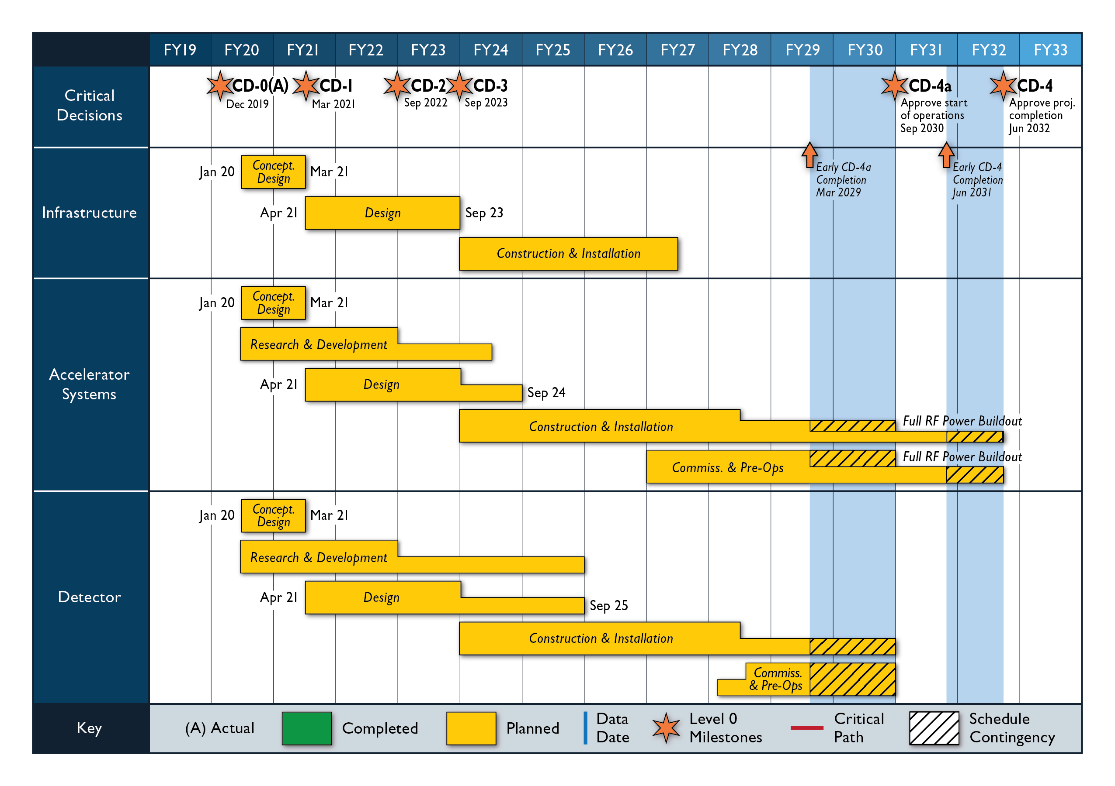
Timeline beyond Expression of Interest
March 2021:
Issue Call for Detector
Proposals
September 2021:
Deadline for Proposals
December 2021:
Selection of Detector(s)
Evaluation Committee:
Project management team
Lab management
Members of the User Group
Advise from DAC

Slide 17
Outlook/Summary
The EIC is capable of supporting a science program that includes two detectors and two interaction regions.
  The EIC is progressing rapidly in the US, we have dates (January 26-28, 2021) for a possible CD-1 review by the Office of Project Assessment, with an earlier OPA Status Review September 9-11, 2020.
  The call for expression of interest is a crucial step to get guidance on the EIC detector scope.
  The EIC Project needs to assume a scenario at this stage to keep us on track towards a CD-1 review, with manageable risk.
  A presumed 70%-30% split of US and in-kind or international commitments for the first detector is a starting value as the level of international and non-DOE interest has not yet been fully assessed.
  Ultimately, the EIC community will be very influential in determining the trajectory of both detectors (and Interaction Regions).
DOE/BNL/TJNAF interests in advancing the EIC are aligned and facilitated by weekly project meetings organized by DOE ONP
Prospects for significant international and domestic partners are being considered in planning the project – the EIC is a US-based project but to give the international community a sense of ownership is crucial – working on a governance structure.
Possible contributions to EIC accelerator scope not in EoI but welcome!

Slide 18


Slide 19
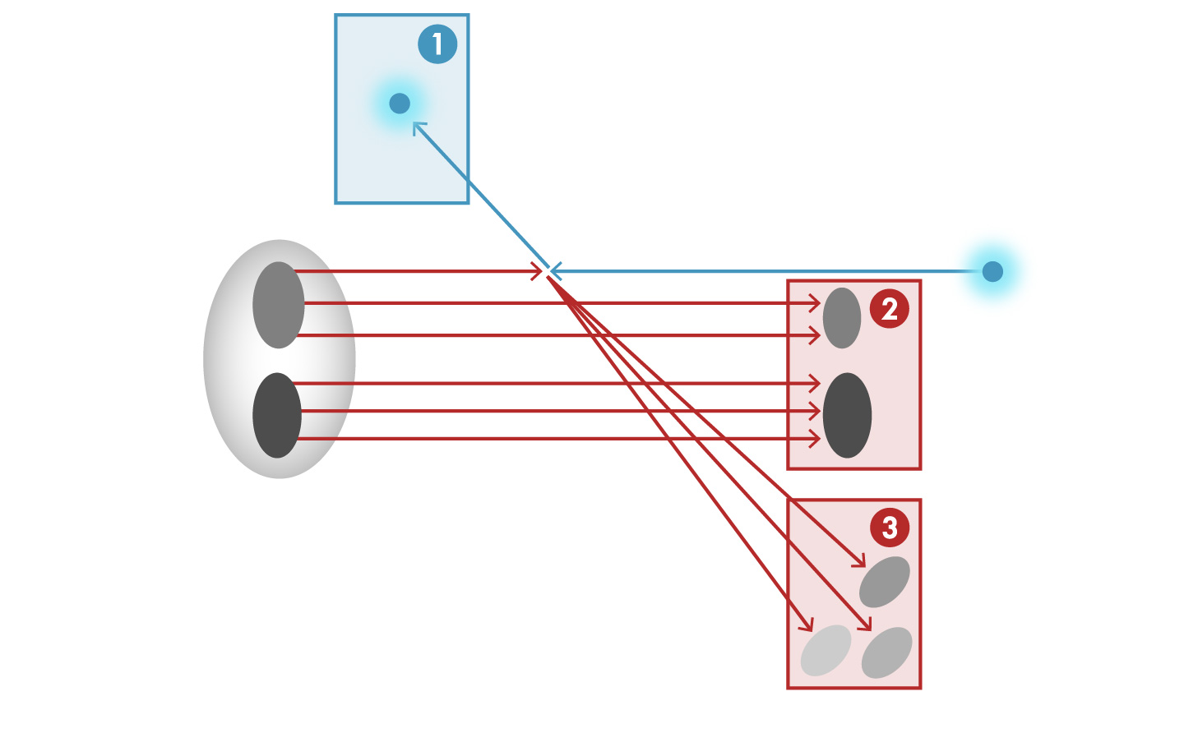


Detector Challenge of the EIC
e’, $ν$
Aim of EIC is 3D nucleon and nuclear structure beyond the longitudinal description.
This makes the requirements for the machine and detector different from all previous colliders.
e
$γ,$Z,W
p/A
q
p remnant
“Statistics”=Luminosity × Acceptance
EIC Physics demands ~100% acceptance for all final state particles (including particles associated with initial ion)
e’
e
p/A
Ion remnant is particularly challenging
not a usual concern at colliders
at EIC integrated from the start with a highly integrated (and complex) detector and interaction region scheme.
Scattered electron
Particle associated with initial Ion
Particle associated with struck quark (or associated gluon)

Slide 20
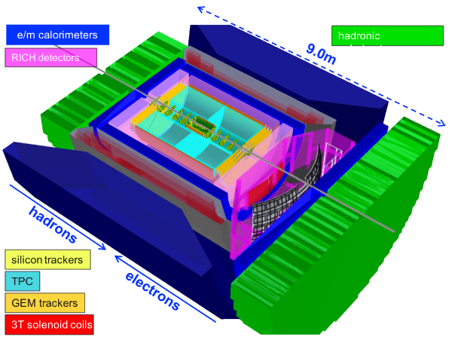
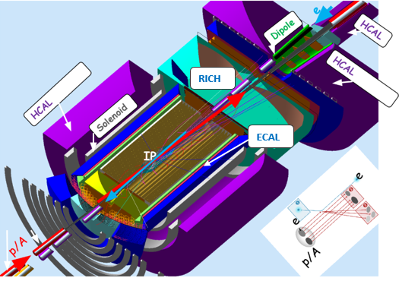
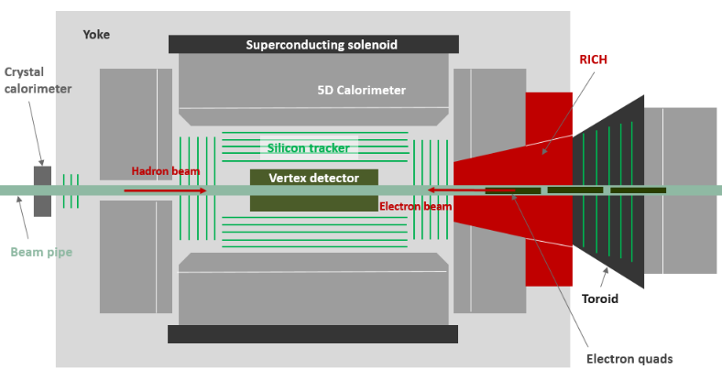
EIC Experimental Equipment Requirements
Any general purpose EIC Detector is complex
Overall detector requirements:
Large rapidity (-4 < η < 4) coverage; and far beyond in especially far-forward detector regions
High precision low mass tracking
  small (μ-vertex) and large radius (gaseous-based) tracking
Electromagnetic and Hadronic Calorimetry
  equal coverage of tracking and EM-calorimetry
High performance PID to separate π, K, p on track level
  also need good e/π separation for electron-scattering
Large acceptance for diffraction, tagging, neutrons from nuclear breakup: critical for physics program
  Many ancillary detector integrated in the beam line: low-Q² tagger, Roman Pots, Zero-Degree Calorimeter, ….
High control of systematics
  luminosity monitors, electron & hadron Polarimetry
Brookhaven concept: BEAST
Jefferson lab concept
Argonne concept: TOPSiDE
Integration into Interaction Region is critical

Slide 21
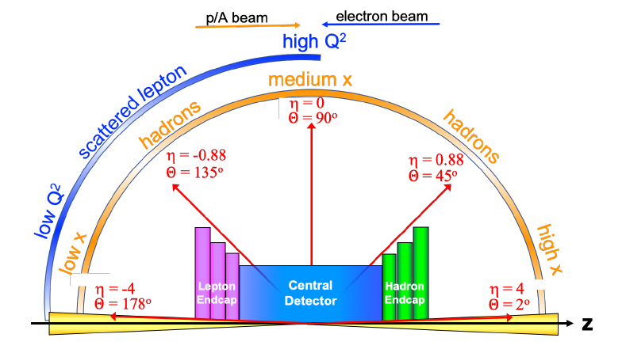
Detector Nomenclature
p: 41 GeV, 100 to 275 GeV
e: 5 GeV to 18 GeV
Large rapidity (-4 < η < 4) coverage
  → Detect from 2º to 178º…
… and far beyond
Many detectors
in backward +
forward region
low Q² scattered electrons
Bethe-Heitler photons
for luminosity
Main detector = Barrel + Lepton Endcap + Hadron Endcap
particles from nuclear
breakup, i.e. neutrons
scattered protons and ions
from diffractive reactions
Endcaps critical because of
asymmetric beam energies

Slide 22
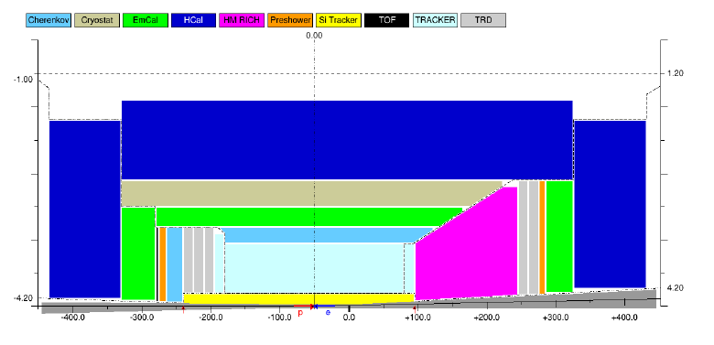
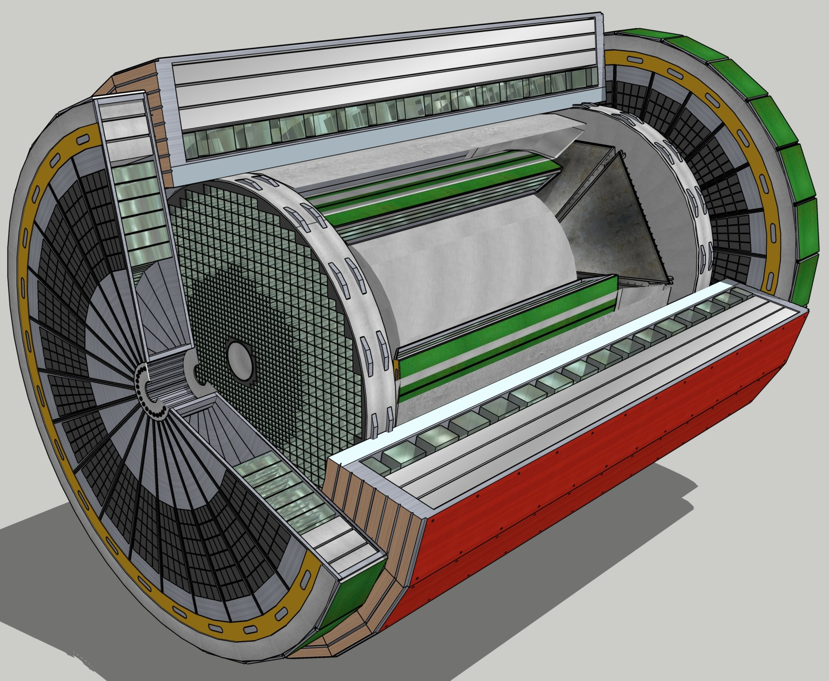
Reference General-Purpose EIC Detector
2D sketch of an EIC detector layout, horizontal cross cut. Only one half of the detector is shown, with the other half being mirror-symmetric in this view, up to the crossing angle. Beam pipe is indicated in gray.

Slide 23
Detector planning
The DOE-NP supported EIC Project includes one detector and one Interaction Region in the reference costing. Reference cost is the BNL estimate prepared for the DOE CD-0 Independent Cost Review (ICR).
    See various talks at the 1st Yellow Report Workshop at Temple University (https://indico.bnl.gov/event/7449/timetable/#20200319)
Comprehensive general-purpose detector: rough costs (US project accounting) = ~$300M
This assumed in-kind contributions (non-DOE or reused equipment) of order $100M
Costs for one Interaction Region included in accelerator scope (US accounting) = ~$200M
(Conversion of direct costs to US project accounting is a bit more than a factor of two)
The EIC is capable of supporting a science program that includes two detectors and two interaction regions.
  See the Yellow Report Initiative as spearheaded by the EIC User Group (http://www.eicug.org/web/content/yellow-report-initiative)
The purpose of the Yellow Report Initiative is to advance the state and detail of the documented physics studies (White Paper, INT program proceedings) and detector concepts (Detector and R&D Handbook) in preparation for the realization of the EIC. The effort aims to provide the basis for further development of concepts for experimental equipment best suited for science needs, including complementarity of two detectors towards future Technical Design Reports (TDRs).

