Slide 1
Integration to PID
Physics
Community
Two basic forms of “integration”:
Deliverable measurements PID ⬄ Tracking
Space and material considerations
Detectors
Machine
PID
Tracking
mRICH
TOF
RICH
DIRC

Slide 2
Rey Cruz-Torres
XIN DONG
XUAN LI
SPENCER KLEIN
Håkan WENNLÖF
FRANCOIS-XAVIER GIROD
Many presentations.
Similar themes:
Si as a vertex
All-Silicon
RACHID NOUICER
ASTRID MORREALE

Slide 3
From the PID Viewpoint
Cylindrical defining volume
+/- ~ 1.2 meters
Outer radius:
~20 cm for hybrid
~50 cm for All-silicon
LAURA GONELLA

Slide 4
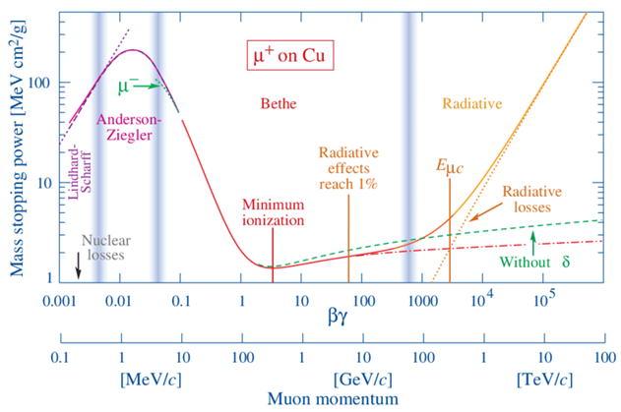
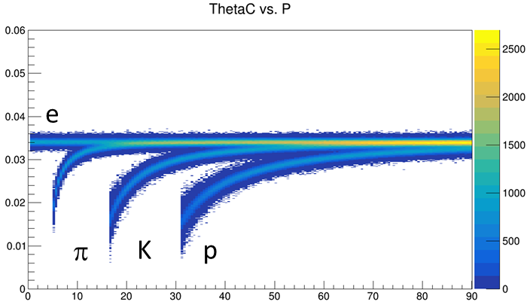
PID ~ Velocity
p = mγβ E = mγ velocity(β) measurement yields mass.
Direct measurement:
Record signal time at multiple locations, calculate v.
“Fast” detector = low transit time spread (most easily achieved at small transit time)
Velocity-dependent interaction(s) with detector:
Specific Ionization (aka $\frac{dE}{dx}$)
Cherenkov Radiation: $\cos{θ_{C}=\frac{1}{nβ}}$
θ_{C} measured wrt track direction.
Thus dependent upon deliverables from tracking
Bremsstrahlung: $P= \frac{q^{2}γ^{4}}{6πε_{0}c}\left({\dot{β}}^{2}+\frac{{\left(\vec{β}∙\dot{\vec{β}}\right)}^{2}}{1−β^{2}}\right)$
Transition Radiation: $I=\frac{Z^{2}e^{2}γω_{p}}{3c}$
eID mechanisms
TOF & $\frac{dE}{dx}$ can be deliverables of tracking system

Slide 5
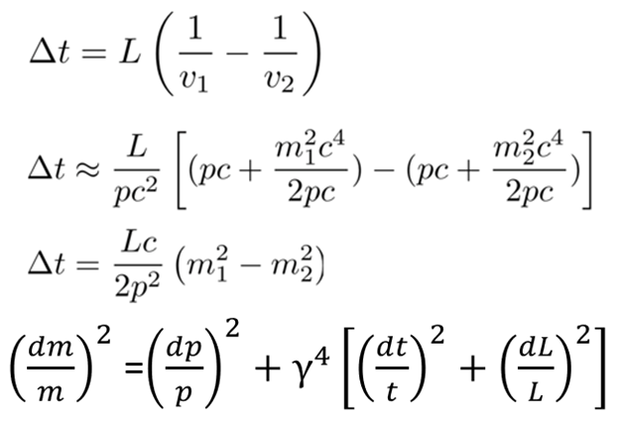
Basic Coupling of Tracking to PID
NOTE: Where PID is excellent, it can contribute to momentum resolution.
$${\left(\frac{dm}{m}\right)}^{2}={\left(γ^{2}\frac{dβ}{β}\right)}^{2}+{\left(\frac{dp}{p}\right)}^{2}$$
NOTE:
N independent TOF measurements, $δ_{t}→\frac{δ_{t1}}{\sqrt{N}}$
Challenges exist to make independent
Common clock
Etc…
Dominant Term
Cherenkov Angle (θ_{C}):
Centroid from n
δθ_{c} from:
N_{photo-electrons}
chromaticity (aka dispersion; n(λ))
pixel size
optical aberration (aka “emission”)
magnetic field
Track Pointing
δp from tracking
Time Of Flight (TOF):
Calculates m² using p, β.
δm from:
δ_{t}
δ_{p}
δ_{L}
$c∙5ps=1.5 mm$
If δ_{t} is tiny, δ_{L} is significant
Dominant
Strongly reliant upon tracking
Weakly reliant upon tracking…discussed in backup slides

Slide 6
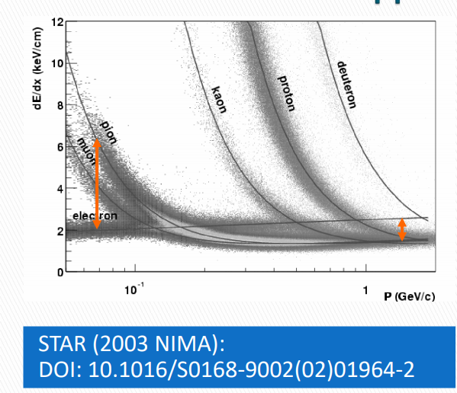
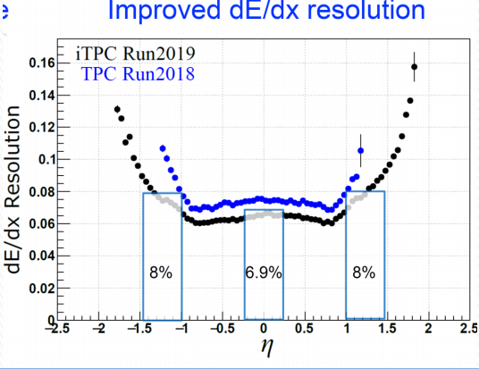
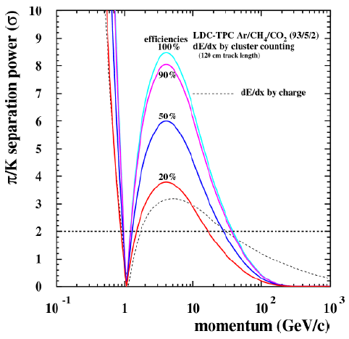
dE/dx w/ hybrid detector
Goal: Achieve dE/dx performance with least gas volume
Specific ionization is a function of β.
PID bands vs momentum.
Crossing ~β = 0.7 (TOF can help)
Limitations from Landau tails:
Primary ionization Statistics = Poisson
Total ionization = Landau
Traditional Approach:
Lots of gas & lots of samples
Forward thinking approaches:
Gas choice to minimize Landau
“Cluster Counting”
Dots = STAR
Boxes = sPHENIX Test Beam

Slide 7
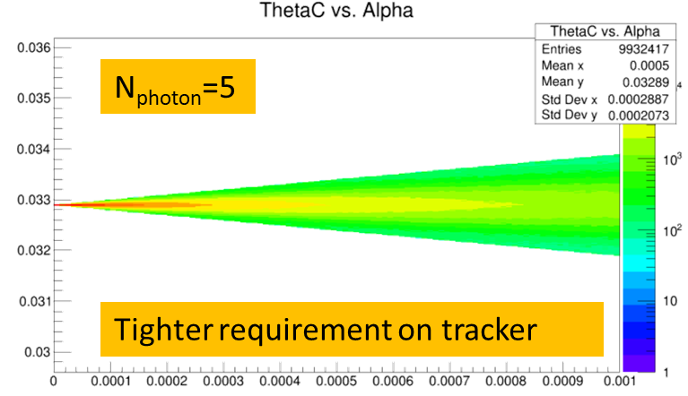
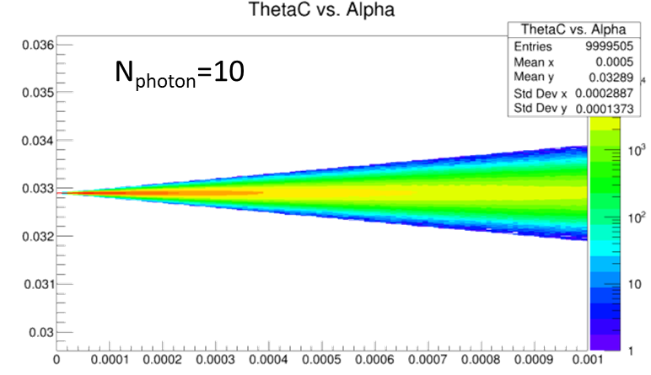
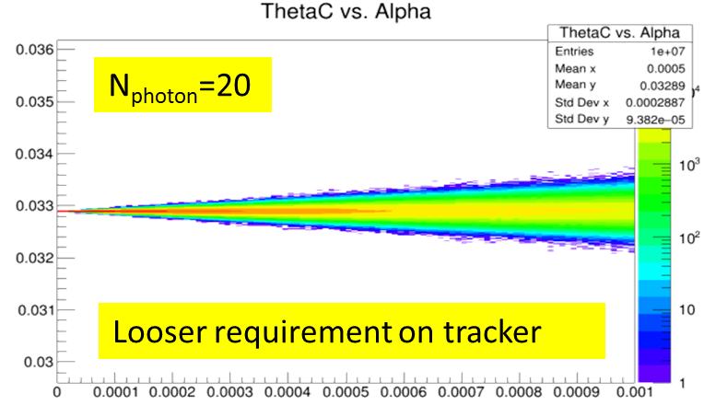
Ring Imaging Cherenkov (RICH) vs. Track Direction
Trivial (just math) Calculation:
Assume photon measured perfectly.
Tracker makes fixed error α.
δθ_{C} depends on both $\frac{\left\langle N_{pe}\right\rangle }{ring}$ and α!
Requirements depend upon performance
Parameterizations:
Wide range of assumptions possible.
Full Monte Carlo
Robust and Reliable results.
We present both parameterizations and full Monte Carlo calculations

Slide 8
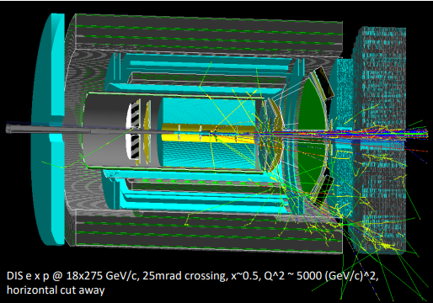
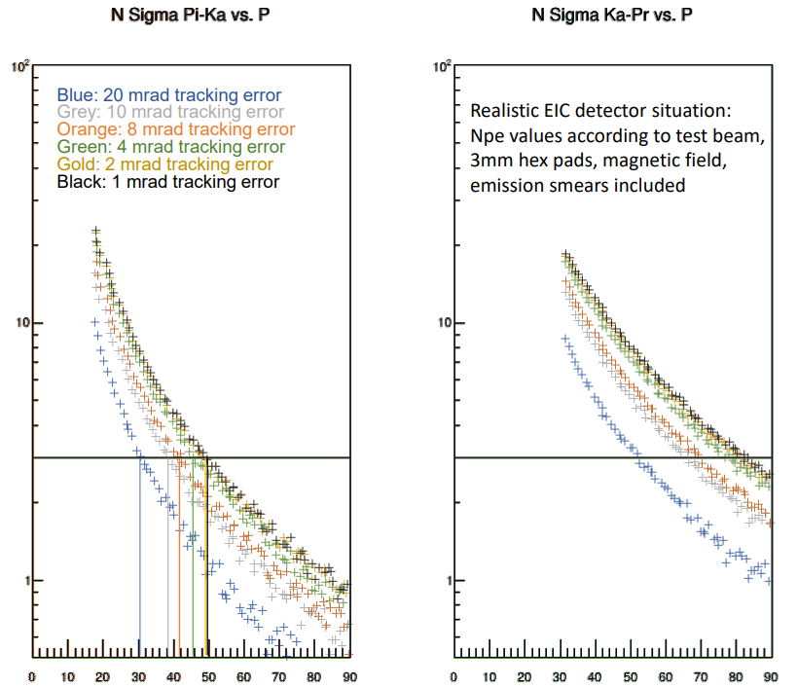
High Momentum GEM RICH
1m of CF₄ radiator at 1.003 bar (slightly overpressure)
CsI Photocathode on top GEM
Mirror in deep UV -> MgF₂ coating
Single Photon Capability ->quintuple GEM stack with APV25-SRS
Particles ~perpendicularly incident on spherical mirror, focused onto a GEM stack directly
hmm
OK
According to the parameterization, tracking is leading error contribution is worse than ~7 mrad, becomes negligible resolution factor around 2 mrad. Between 2 and 7mrad , more detailed investigation is required.
Plot shows viscerally the effect.
More detailed simulation required.
p
p
NOTE: High chromaticity = loose requirement on tracking
Performance from Parameterized Test Beam Data

Slide 9
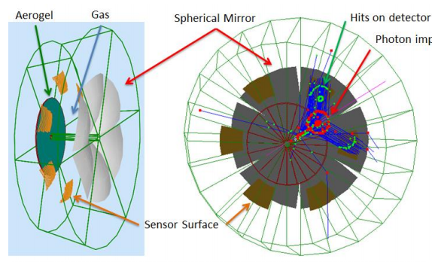
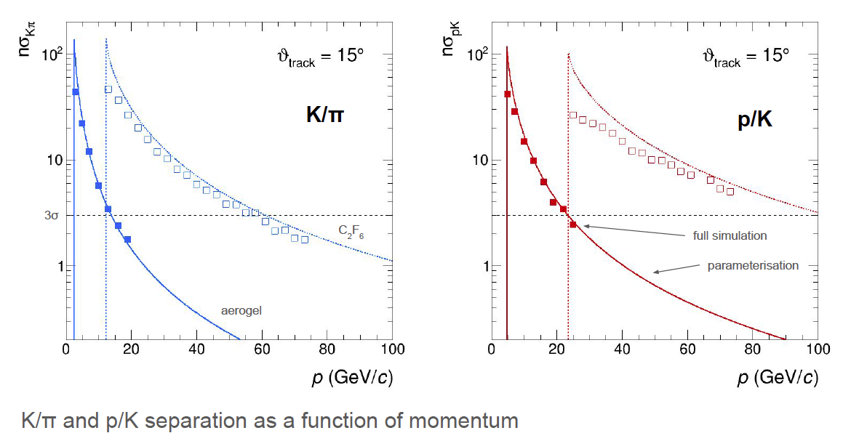
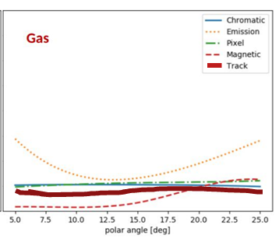
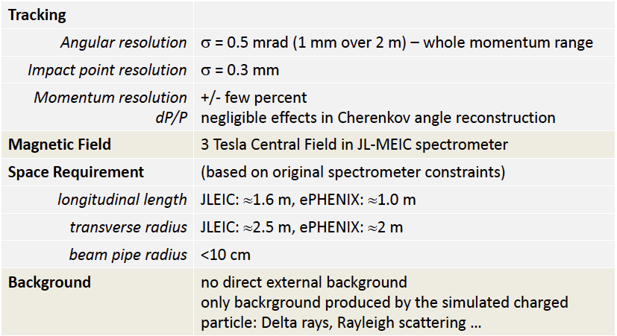
dRICH
Cherenkov radiator
○ Refractive Index
n = 1.02 (aerogel) 1.0008 (C₂F₆)
○ Length of the radiator
L = 4 cm (aerogel) , 160 cm (C₂F₆)
Mirrors
Photon Detector
3 mm pixel size; 200-500 nm MAPMT
Particle Generation
Originate from the vertex
Exquisite detail in simulation.
AI-based optimization.
Uses constant external angular resolution assumption.
Similar external constraint assumed as deduced for separate gas & aerogel RICHes
Tracking maybe tolerates ~2X sim (0.5 – 1.0 mrad)
NOTE: PMTs to the side makes optical aberration (“Emission”) dominant

Slide 10
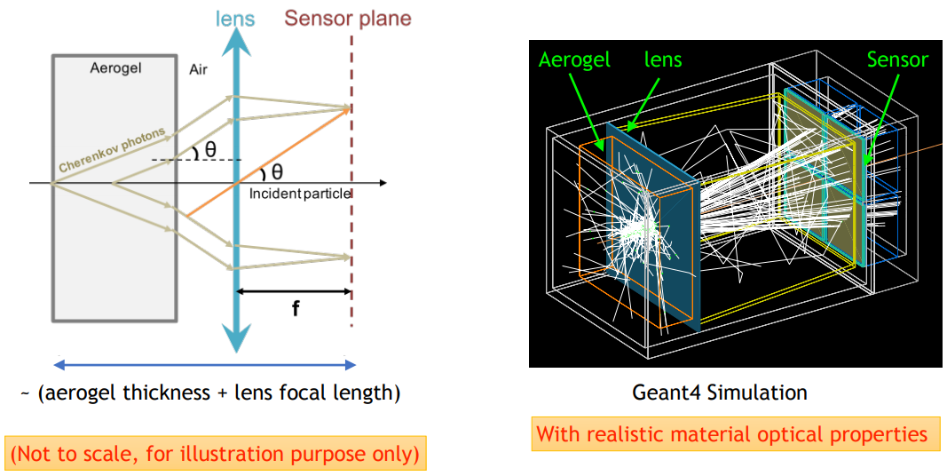
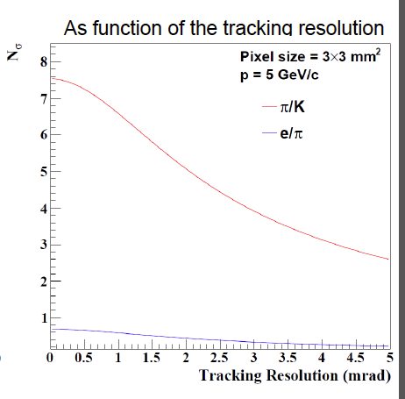
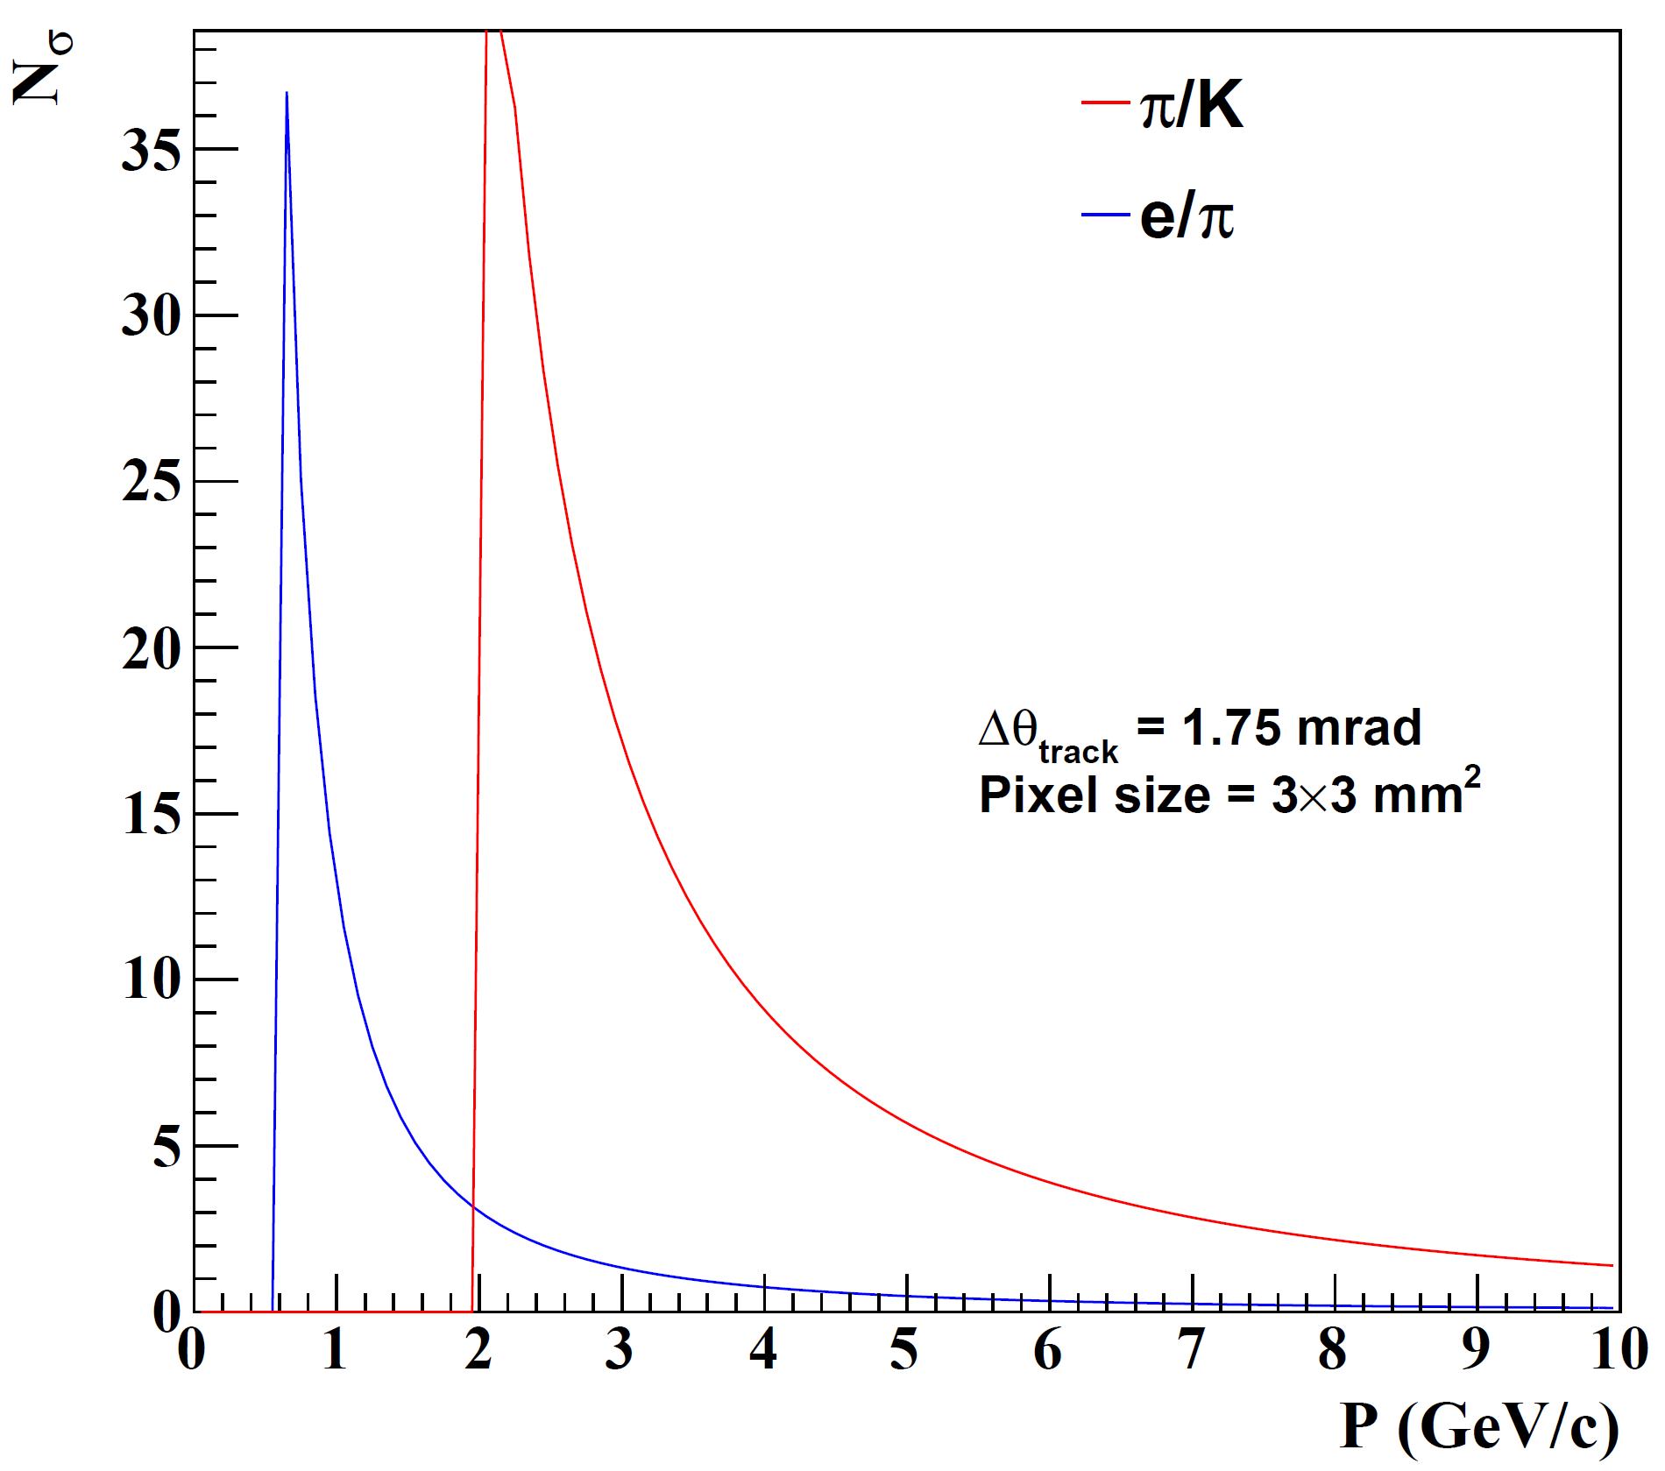
mRICH
Cherenkov radiator
(Aerogel) refractive index, n = 1.03
Length of the radiator, L = 3cm
lens with focal length, 𝑓= 6”
Photon Detector
3 mm pixel size
Tracking influence minor
Tracking influence major
NOTE: Similar performance to aerogel in dRICH

Slide 11
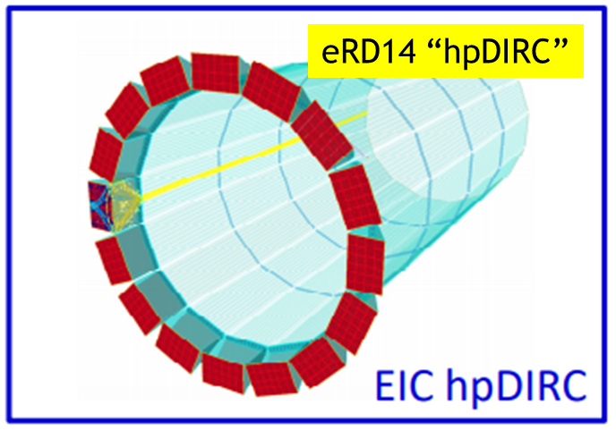
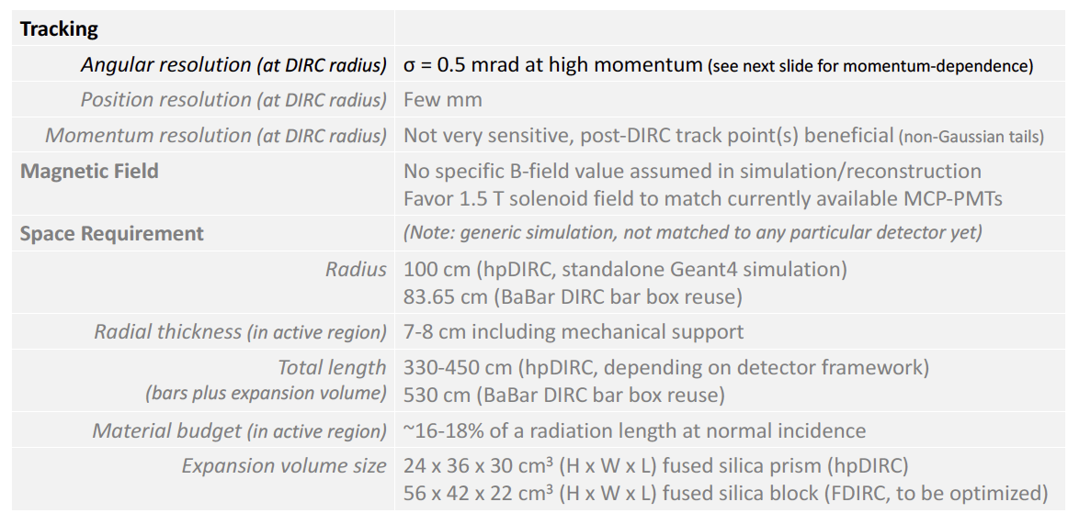
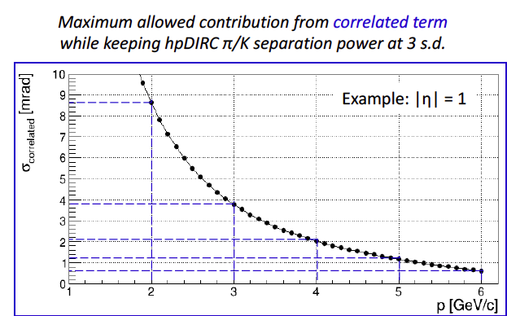
DIRC
Generic reference design: 1m barrel radius, 16 sectors
176 bars: synthetic fused silica,17mm (T) ´ 32mm (W) ´ 4200mm (L)
Photo sensors: MCP-PMTs -3x3mm2 pixels
Ext. Requirements
:
In the absence of multiple scattering σ_{correlated} = σ_{track}.
Secondary tracker (behind DIRC) may be beneficial both at low momentum and at high momentum (possible impact not studied yet).
All non-tracking factors sum to ~0.8 mrad, tracking must not exceed this (~ 0.5 mrad)
11

Slide 12
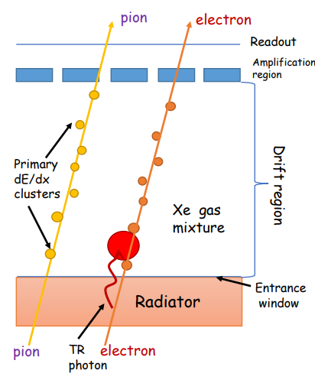
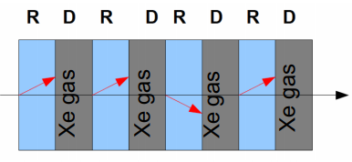
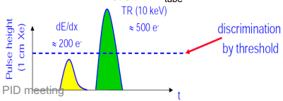
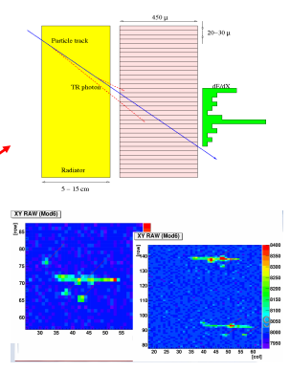
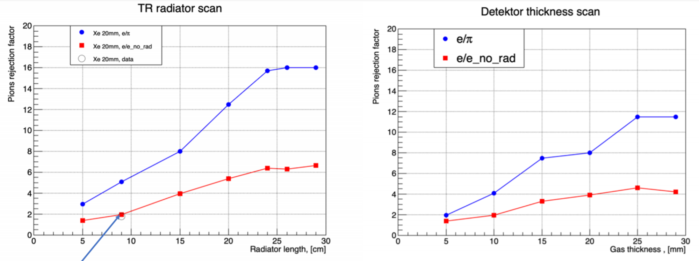
Transition Radiation Detector (TRD)
3: ID TR photons by energy/pos
1: Make TR photons:
Index, n, change
X-ray regime
Film, foam, fleece
2: Layered to get more photons
4: Reject Pions
“Threshold detector” (TR X-rays produced or not)
P_{min} ~ 1 GeV (rejection ~constant at higher momentum)
Balance between X₀ and rejection

Slide 13
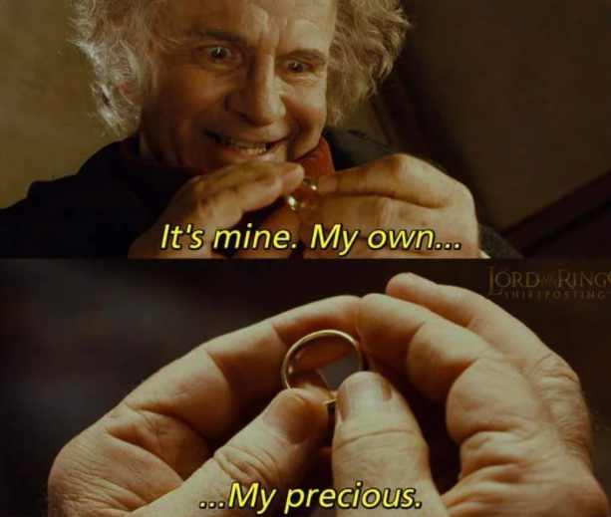
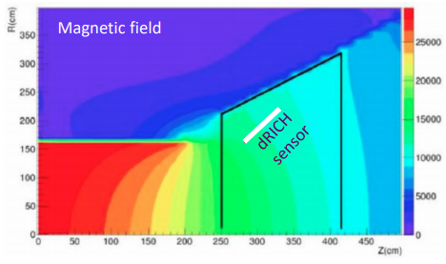
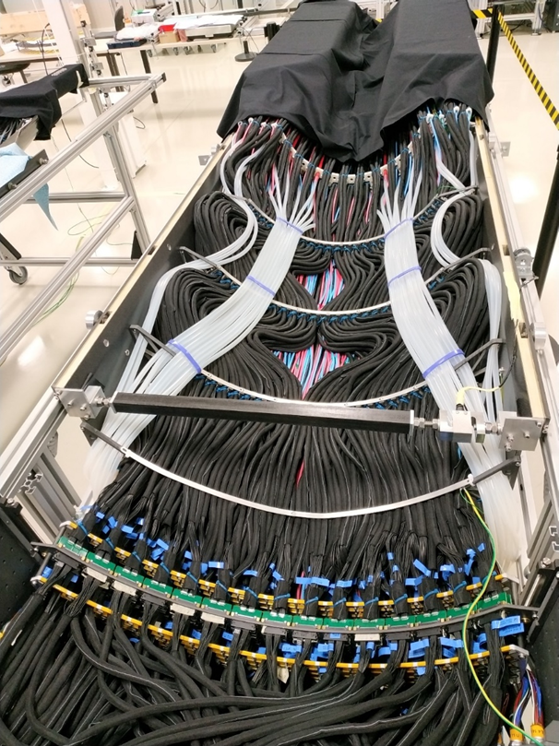
Additional Integration Points
Gas RICH at highest momentum (hadron arm) does not enjoy an over-abundance of Cherenkov photons (love to have lots of Zed).
Angular resolutions required for Cherenkov-based PID detectors must be evaluated WITHIN the radiator:
Services at Zed > 1.2 may scatter particle before hadron arm Cherenkov.
DIRC bars scatter particles on their own (17 mm quartz)
Must evaluate needs of a tracking layer behind Cherenkov devices.
Cherenkov detectors require photo-sensors
Many technologies are sensitive to field strength and orientation.
1 Tesla at the sensor is fine.
Easy to achieve with central field = 1.5 Tesla.
Very challenging but seems doable if central field = 3 Tesla…trade off with optical aberration as you move sensors back.
SiPM sensors operate fine in the field, but radiation damage can lead to high rate of “false photons”
Need to minimize bending of tracks within the RICH.
Zed
Is this less than 1 mrad scattering

Slide 14
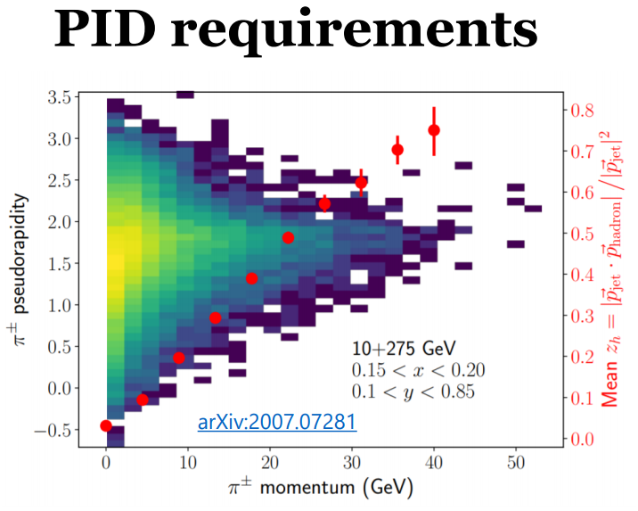
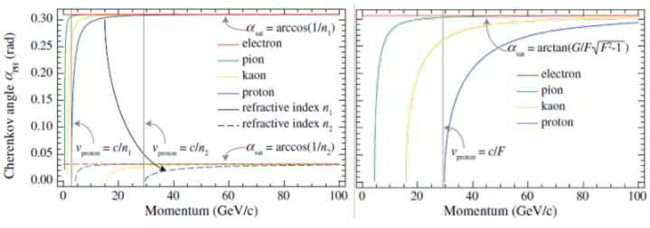
Summary
Cherenkov Pointing:
Parameterizations of gas Cherenkov indicate pointing required at 0.5-1.0 mrad level while inside the radiator.
Calculations of aerogel devices indicate 0.5 -1.0 mrad level.
Calculations of DIRC indicate 0.5 mrad level or better.
TOF:
Path length can influence PID resolution at the best δt.
Non-trivial influence of “material budget distribution”.
Need deeper understanding of this issue.
PID requirements toughening with time:
SIDIS group shown on right. Jets want even more.
PID requirements are not symmetric in eta, driven by 0.8 → 1.0
Is a symmetric barrel optimal at our asymmetric collider?
Old
New
Meta-materials: Game changer,
But we can’t assume these will work:

Slide 15
BACKUP SLIDES

Slide 16
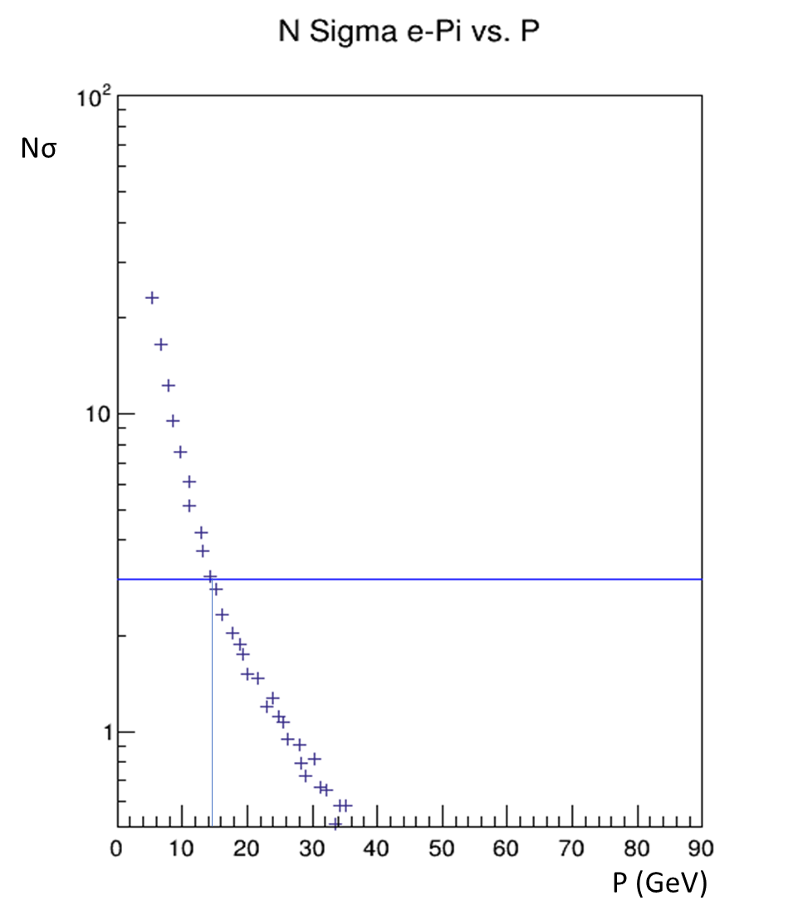
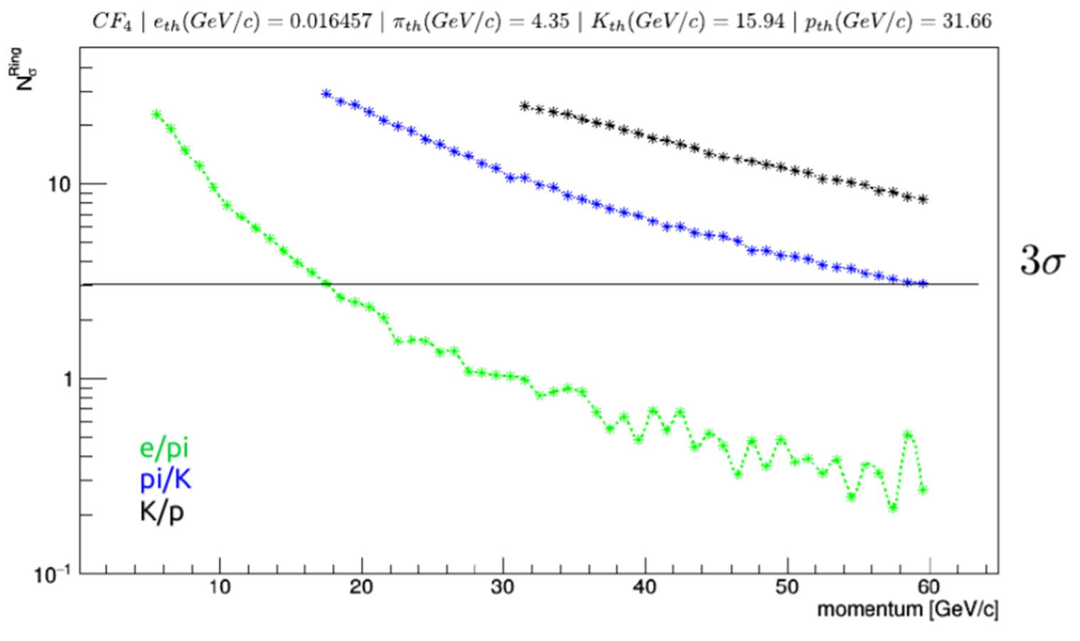
Superb e/π Separation
eRD6 RICH
prototype
eRD14 “dual RICH”
simulation
Focused Gas RICH
Low index gas pushed the e/π out to 15 GeV or beyond.
Compromise parameter is Zed length:
1-1.5 meters in Zed
Under study:
Move Z_{vertex} toward –η exacerbating the space issue.
Notice:
eID needs met w threshold device
Optics maybe unnecessary

Slide 17
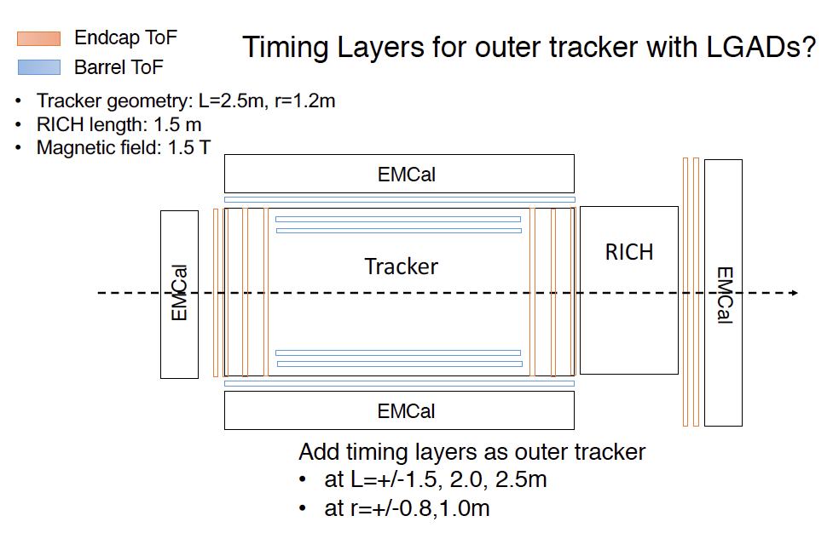
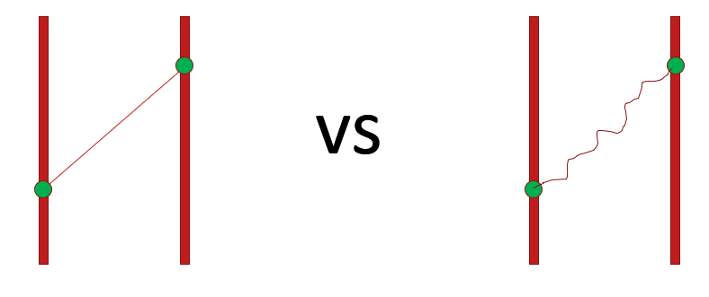
psTOF
Several technologies reviewed, no one chosen yet
AC-LGADs could provide a very good tracking layer (~100 um) + timing (20 ps)
External start time provided by forward detectors could be helpful
Study of Self-timing (Internal) using tracks
TOF needs a measurement of p and L
As δt➝5 ps, requires precision path length L ( c*δt~1.5 mm…tracking must exceed this.)
Multiple scattering might be the biggest worry, need to ensure low material budget and/or enough tracking layers to catch scattering.
Depends partly upon the material that does not provide position measurement:
17

Slide 18
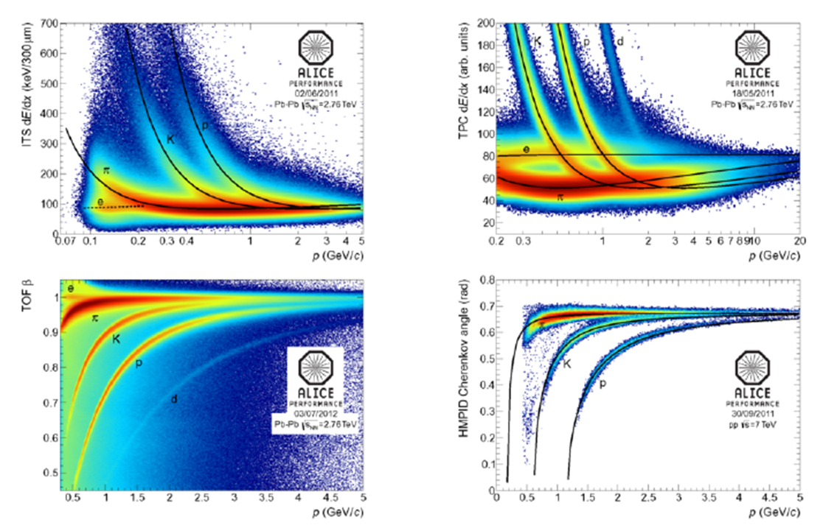

Slide 19
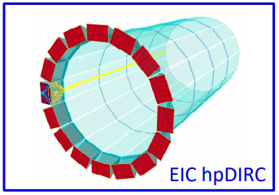
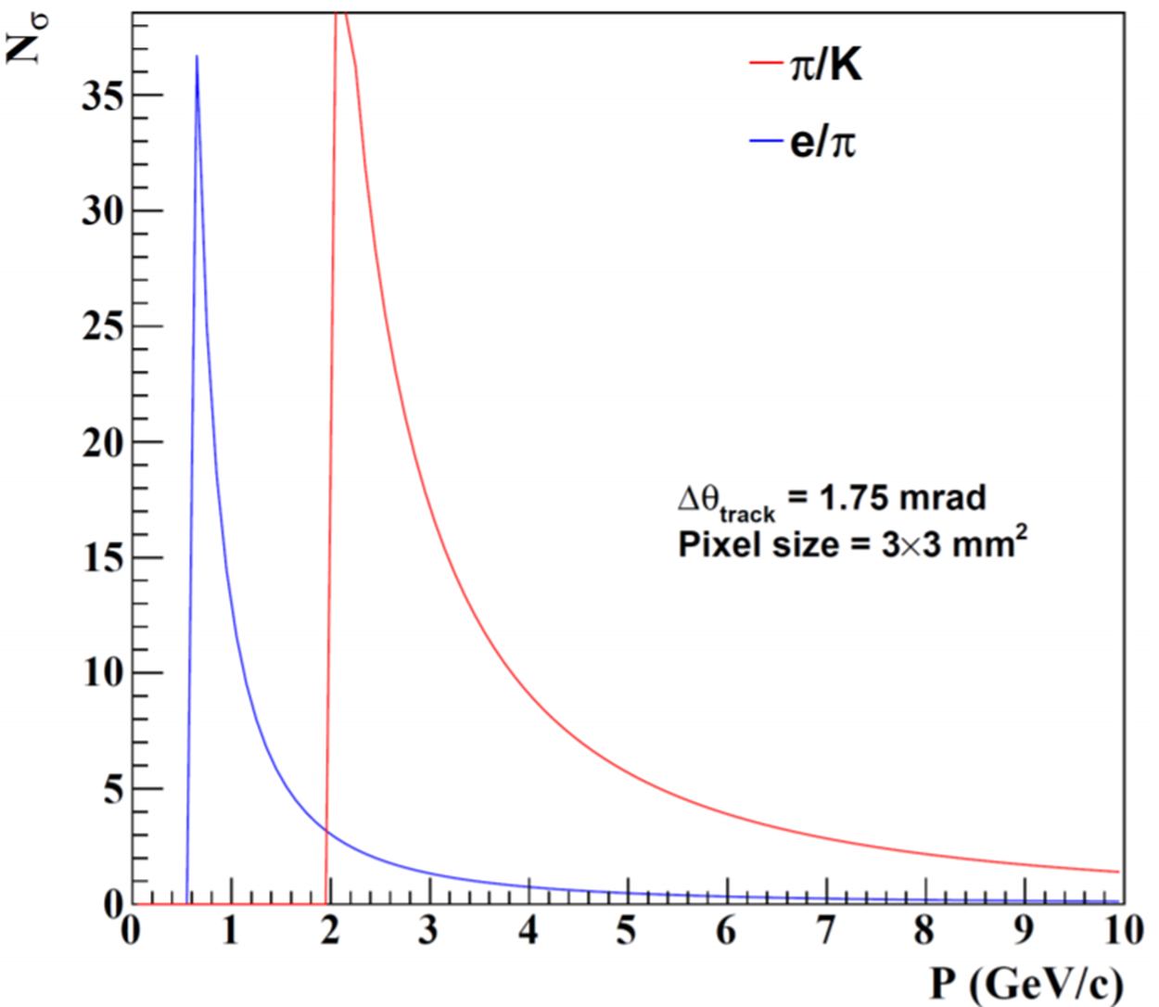
More Compact Cherenkov eID Detectors
Modular RICH:
Fresnel-focused compact RICH
eRD14 “hpDIRC”
Close to 4 GeV.
Effective enough alone?
Complementary detector?
TRD?
dE/dx?
Useful at the lowest momenta.
Performance limited by Mult. Scattering.
Detailed simulations req’d and underway
Expectation:
3-4σ @ 1 GeV
eRD14 “mRICH”

