Slide 1
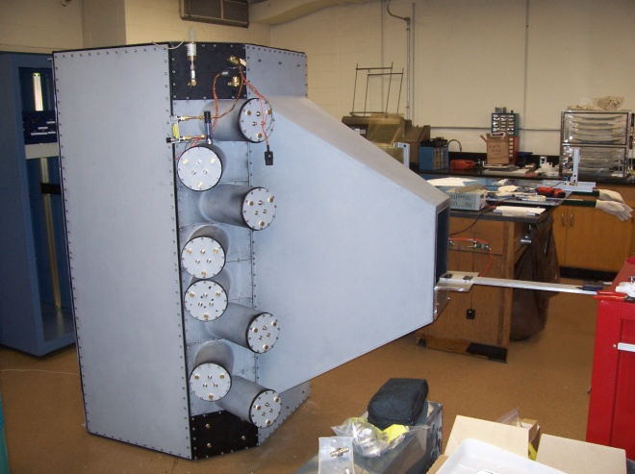
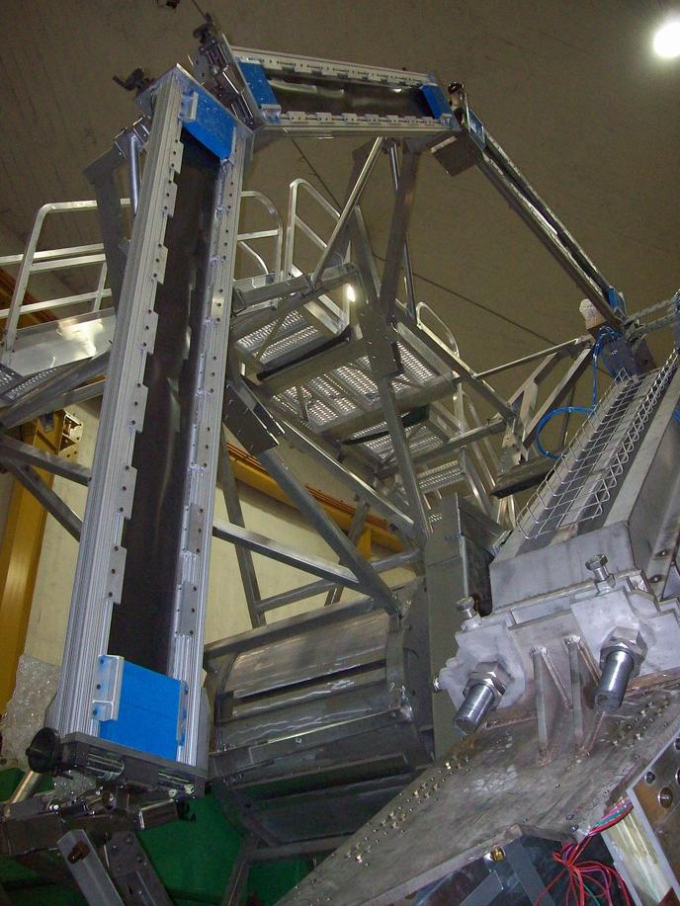

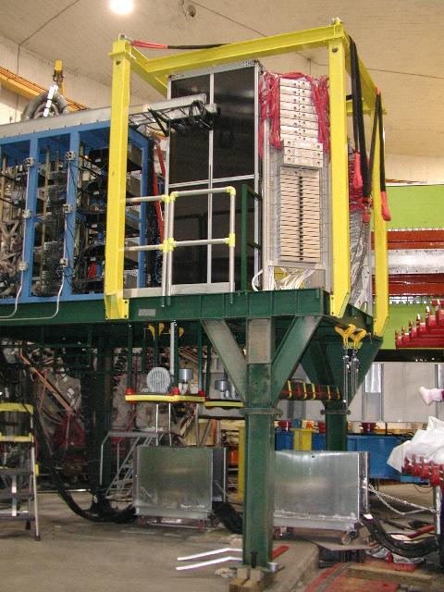
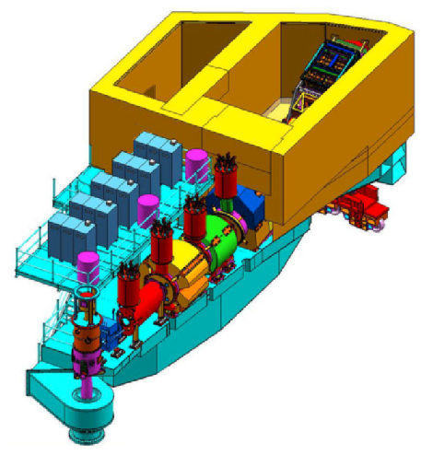
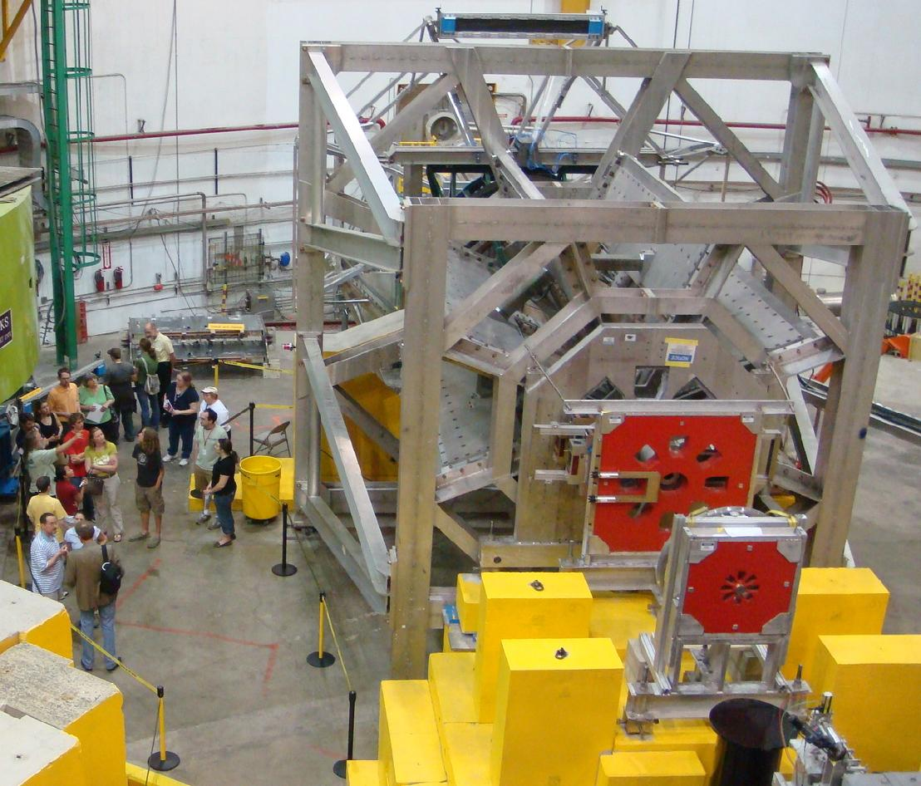
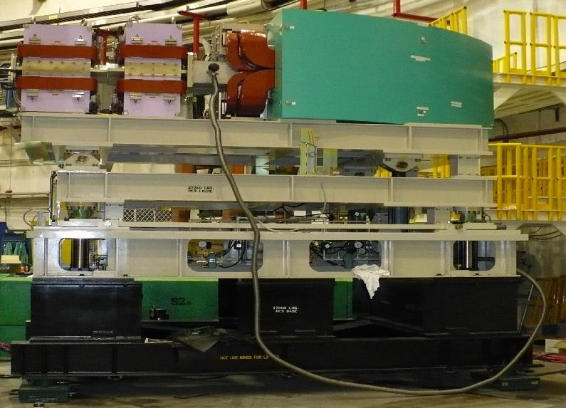
Software Review
June 7, 2012
Stephen Wood, Mark Jones

Slide 2
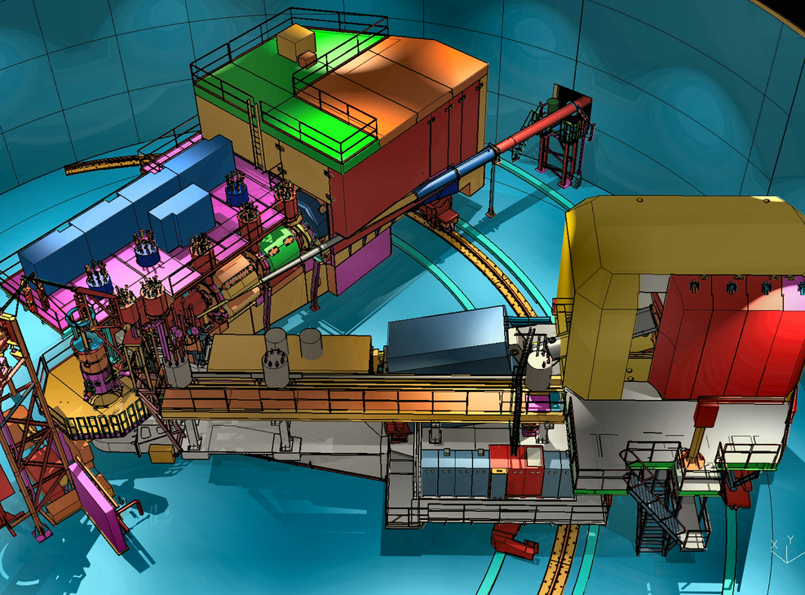
Hall C after 12 GeV Upgrade
Beam Energy: 2 – 11 GeV/c
Super High Momentum Spectrometer (SHMS)
  Horizontal Bender, 3 Quads, Dipole
  P → 11 GeV/c
  dP/P 0.5 – 1.0x10⁻³
  Acceptance: 5msr, 30%
  5.5° < θ < 40°
High Momentum Spectrometer (HMS)
  P → 7.5 GeV/c
  dP/P 0.5 – 1.0x10⁻³
  Acceptance: 6.5msr, 18%
  10.5° < θ < 90°
Minimum opening angle: 17°
Well shielded detector huts
Compton and Moller beam polarimeters
Ideal facility for:
  σ_{L} and σ_{T} separations
  Inclusive & Exclusive reactions
  Small cross sections (neutrino level)
Notes:
The SHMS replaces the 2 GeV/c Short Orbit Spectrometer. SHMS has very different physics goal, but detector package very close to SOS.

Slide 3
12 GeV Hall C Physics
Exclusive reactions and form factors
  Neutron Electric Form Factor
  d(e,e′p)
  Pion Form Factor
  Factorization of exclusive p(e,e′π), p(e,e′K), Kaon FF?
Semi-Inclusive Deep Inelastic Scattering p,d(e, e′π±)
  Quark transverse momentum distributions
  Charge symmetry of parton distributions – u^{p}(x) = d^{n}(x) ?
Nucleon Structure Functions – Inclusive (e,e′)
  Unpolarized structure functions, high x
  Neutron spin-structure functions (polarized 3He)
Nuclear Effects
  Nuclear transparency, A(e,e′p), A(e,e′π)
  EMC effect
  x>1(Short Range Correlations, Superfast quarks)
  ⁴He(e,e’p)
Notes:
Point of this is that we do a wide variety of physics with variable precision and PID requirements

Slide 4
Hall C Commissioning Early Running
Year 1 (2015?) 25 PAC days (50 days of scheduled beam)
  “Commissioning” experiments (parts of 3 experiments)
    A(e,e′p) - Coincidence, minimal PID requirements
    p(e,e′), d(e,e′), A(e,e′) - HMS and SHMS operate
      simultaneously but independently, shakedown PID
Year 2 80-90 PAC days
  p,d(e,e′ π±) – Need to control relative π⁺ vs π⁻ efficiencies at 1% level
  p(e,e ′K⁺) LT separation, small cross sections, good angle/energy determination
Year 3 80-90 PAC days
  Polarized ³He experiments
  Start first experiment with non-”standard” detectors?
Notes:
Commissioning experiments straightforward, good shakedown for experiments that require best performance
Don’t plan to do physics with pipeline mode DAQ, but take some data in pipeline mode to help
Develop future software.

Slide 5
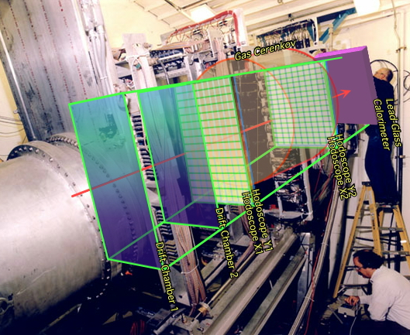
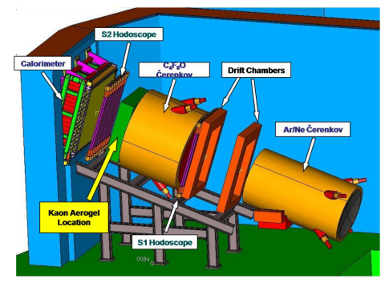
Similar HMS-SHMS detector packages
HMS
SHMS
12 horizontal-drift chamber planes
4 Planes of segmented scintillator (one plane quartz bar in SHMS)
Gas Threshold Cerenkov detectors
Aerogel Cerenkov detector
Lead Glass Shower Counter
Notes:
Logically similar detector packages. Much shared code possible between spectrometers. (In Fortran, was duplicated code)

Slide 6
Hall C 12 GeV DAQ Summary
In Progress Now
“Stage 0” : Testing
  Testbed and production stress testing is well underway.
“Stage 1” : SHMS 'Hybrid' system (Baseline / Fallback plan)
  Legacy electronics + limited FADC readout
  Would support 5kHz trigger rate at < 20% DT
    event sizes on the order of 2 kB (for both HMS + SHMS)
  This remains a viable fallback plan and may be implemented for early systems tests, but we will move to make Stage 2 ready for production data taking.
“Stage 2” : SHMS pipeline-capable (Priority goal for initial beam tests)
  All modern VME + FADC readout, NIM trigger will be developed and maintained
  >10kHz trigger rate with negl. deadtime as single arm; limited by HMS readout in coincidence mode to ~5 kHz with DT < 20%
    Ave. event sizes on order of 4 kB; data rates at 40 MB/s (nominal systems goal; true performance limit should be considerably higher)
      Note: Estimated data rate < 10MB/sec for majority of proposed experiments.
“Stage 3” : Upgrade HMS readout to match SHMS
  All modern VME + FADC readout
  NIM triggers will be maintained on both arms (useful for integration with legacy-based 3rd arms, and to debug any more sophisticated FPGA-based triggers).
Ready: Fall 2013
for sub-system testing
(if needed/desired)
Ready: Fall 2014
Ready: Summer 2015
(or earlier as
funding permits)
Notes:
Make into something clearer, perhaps like Hall A timeline.
Major motivation for Flash ADC’s and High resolution Multihit TDCs is elimination of delay cable.
Intial exepriments will use hardware in legacy (non-pipelined mode), will turn on pipeline and ADC waveform readout as needed by specific experiments.
Future experiments that would use full waveform and pipelining. GeN, (e,e’pi0), EMC (open detectors.)
Not specifically planning coding for these detectors yet.

Slide 7
Hall C 12 GeV DAQ Timeline
Start Detector
Installation
Detectors
Installed
Commissioning
Experiments
Early
Experiments
Large Installation/
3rd Arm Experiments
FY 2013
FY 2014
FY 2015
FY 2016
FY 2017
Stage 0: DAQ Testbed
SHMS Shower Counter
With Flash ADC
Stage 3: Upgrade HMS
electronics to modern VME
Stage 1: FADC in SHMS
with legacy Fastbus
for drift chambers
Utilize pipeline and FADC waveform readout for non-magnetic “3rd” arm detectors:
Neutron polarimeter
π⁰ Detector
Large scintillator TOF array
Stage 2: Modern SHMS
readout with NIM
trigger, but pipeline capable
Notes:
Make into something clearer, perhaps like Hall A timeline.
Major motivation for Flash ADC’s and High resolution Multihit TDCs is elimination of delay cable.
Intial exepriments will use hardware in legacy (non-pipelined mode), will turn on pipeline and ADC waveform readout as needed by specific experiments.
Future experiments that would use full waveform and pipelining. GeN, (e,e’pi0), EMC (open detectors.)
Not specifically planning coding for these detectors yet.

Slide 8
Resource Estimates
Most recent experiment: Qweak (to May 2012) – very different DAQ and Analysis style from future Hall C experiments, but resource needs not to far from future needs:
  1kHZ trigger, 4kb/event, ~50 weeks@60% -> 75TB, 2x10¹⁰ events
  10ms/event, 2 analysis passes, “ntuple”/raw = 4
  CPU time 2x10⁸sec, 3 farm cores
  600TB cooked data, 60TB on live disk
2015:
  5kHZ trigger, 4kb/event ~8 weeks@60% -> 60TB 1.5x10¹⁰ events
  10ms/event, 2 analysis passes, “ntuple”/raw = 2
  CPU time 1.5x10⁸, 5 farm cores
  250TB cooked data, 125TB on live disk (for 2-3 years)
2016+
  10 kHZ trigger, ~30 weeks
  34 farm cores, 1.75PB cooked data/year, 175TB on live disk (for 2-3 years)
Notes:
8

Slide 9
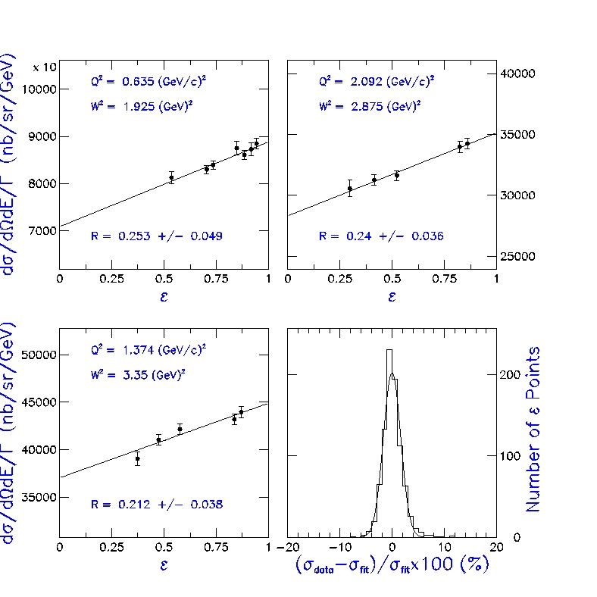
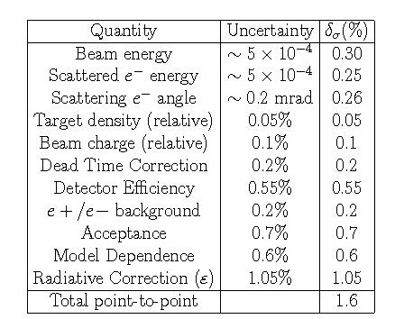
Hall C L/T Separations
Typical and unique Hall C use: σ_{L} - σ_{T} separation
  Measure σ at several ε with fixed Q²
  Control point to point errors to < 2%
  → Control tracking/PID uncertainty to < 1% over wide range of rates
σ < 1.8% - as estimated…
Notes:
In progress

Slide 10
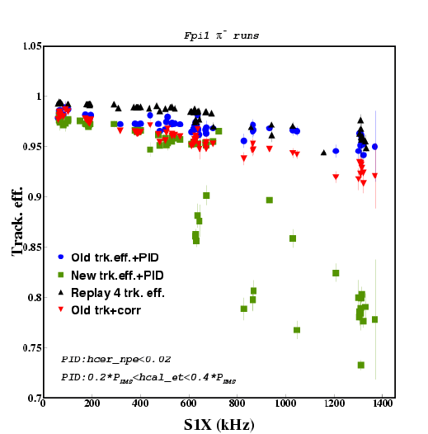
Tracking efficiency
Any new code developments must preserve drift chamber tracking algorithms that work well under high rates (> 1MHz)
Notes:
In progress

Slide 11
Hall C Collaboration Structure
Historically no formal collaboration
  But strong defacto collaboration on
    Detectors, Electronics, DAQ, Software, Experiment Execution…
    Detailed analysis responsibility of individual experiments, but much sharing of analysis techniques/procedures occurs.
  Typically 50-75 physicists/experiment
SHMS-HMS Users group – 12 GeV Era user group
  Started in 2009
  Active elected board of directors
  New software efforts under auspices of user group
Notes:
Core Analysis software always has been in CVS

Slide 12
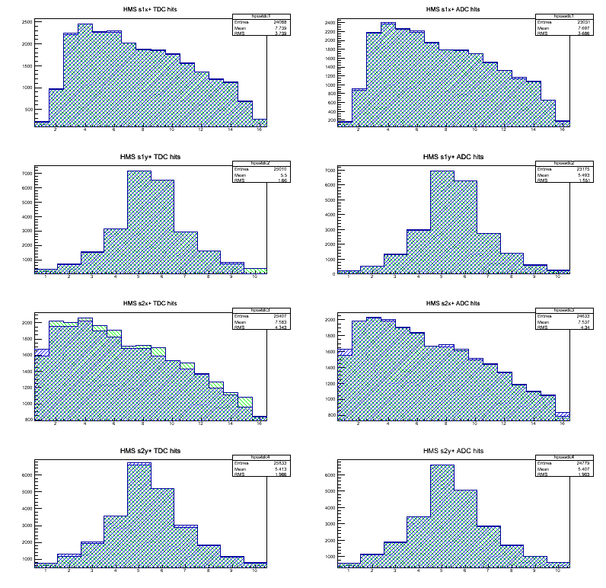
Online Analysis requirements
Detector diagnostics (all channels functioning?)
Tracking (Focal Plane position/angular shapes as expected?)
Rough PID and efficiencies
  (Take correct amount of data for desired statistics)
Preliminary physics spectra
Versatile histogram display tool

Slide 13
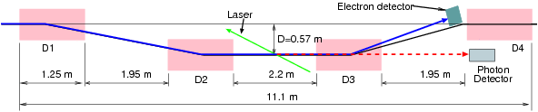
Polarimetry Analysis Software
Hall C has Compton and Moller beamline polarimeters.
Polarimeter DAQ and analysis independent of spectrometers.
Polarimeter analysis software upgrades planned:
Polarimeter analysis fairly simple
Likely use ROOT/C++ analysis
Polarimetry team will follow Hall C analyzer efforts, but will not be constrained to use common framework.

Slide 14
Status of Hall C 6 GeV Analysis Software
Robust Fortran/CERNLIB code, “ENGINE”, for analysis of HMS/SOS coincidence and single arm experiments that has been refined over 15 years of experiments.
Well understood code for calibrating detectors, calculating detector and tracking efficiencies and determining spectrometer optics matrix.
Well tested Monte Carlo simulation code for radiative corrections and spectrometer acceptance.
JLab data mass storage and batch farm well suited to demands of offline analysis.
Software management done with CVS
Sparse documentation

Slide 15
Goals of Hall C 12 GeV Software
Main goal is to have online/offline software ready for start of experiments.
To achieve this goal decided:
  Modify present Fortran/CERNLIB based analysis code
    Include the SHMS
    Update the HMS sections of code. (new DAQ modules)
    Document the code.
  Develop a C++/ROOT based analysis code based on the existing Hall A code.
  Add SHMS to the Hall C MC Simulation Code.
    Finished since needed to plan experiments

Slide 16
Monte Carlo Simulation
For spectrometer experiments, a GEANT based simulation is not needed.
SHMS has been added to the MC, since it is a necessary part of planning for 12 GeV experiments.
    MC code kept in Fortran, since code size is small.
GEANT3/4 simulation used for detector design, calculating hall radiation background and planning experiments using other apparatus than the HMS/SHMS.
GEMC developed by Hall B has been used for detector design

Slide 17
Fortran Analyzer code, ENGINE
Motivation:
Robust code has been refined over 15 years.
Detectors in SHMS similar to HMS. Much of the HMS code can be copied and reused.
Minimal effort given the expertise of staff and users.
Use as a cross check on the C++/Root code
Drawbacks:
    CERNLIB is no longer supported.
    Younger collaborators not familiar with Fortran.

Slide 18
New C++ analysis code
Motivation:
To have a modern object oriented language. Younger collaborators will be more familiar with C++.
To have histogramming and data storage in the ROOT
To have similar style codes in Halls A and C which both use spectrometers so that users can minimize the cross Hall learning curve.
To share code development and documentation with Hall A and to take advantage of ROOT and C++ software developed elsewhere in the world.
Easy to add third arm detector setups. Hall A has had great success with adding BigBite and other third arms during the 6 GeV era.
Drawbacks:
  Limited C++ expertise in Hall C staff
  C++ code used in just completed QWEAK
  Major manpower effort.

Slide 19
Management Structure
Software Manager
Mark Jones
Jefferson Lab
C++/ROOT Analyzer
Gabriel Niculescu, James Madison University
Simulation (SIMC)
David Gaskell
Jefferson Lab
Fortran Analyzer
Ed Brash
CNU
Calibrations
John Arrington, Argonne National Lab
Online histogramming
Pete Markowitz,
Florida International University

Slide 20
Milestones
Present
Set-up Management structure
Monte Carlo simulation is ready
Decided on Git for code management of C++ analyzer
2012
July : Define reference HMS data for testing code
Sep : Documented non-tracking HMS detectors code in Fortran Analyzer
Oct : Make DAQ decoding in C++ Analyzer object-oriented
Oct : Ability to analyzed Hall C data at the raw data level in C++ Analyzer
Dec : Documented the drift chambers and tracking code in Fortran Analyzer
Dec : Verify HMS hodoscope analysis in C++ Analyzer

Slide 21
Milestones (Part 2)
2013
Jun : SHMS code added to Fortran Analyzer.
July : Full analysis of HMS data with C++ Analyzer ready
Sep : C++ Analyzer ready for SHMS calorimeter tests.
Dec : Full analysis of HMS data with C++ Analyzer verified by comparison to Fortran analyzer.
2014
Jan : Scalar and BPM analysis code in C++ analyzer
Feb : Calibration codes ready.
Jul : Analyze cosmic ray data in SHMS with both Analyzers
Sep : First beam, analyze data with both Analyzers

Slide 22
Present and near term work
Documentation of Fortran code and implementation of C++
  JMU faculty and an undergraduate for hodoscopes.
  CNU faculty and an undergraduate for detector ADC thresholds.
  Yerevan research scientist and a graduate student for calorimeters.
  FIU faculty and an undergraduate for aerogels .
  Hampton faculty and postdocs for wire chambers
Hall C staff scientist working on
  Reading Hall C style parameter files
  Reads Hall C style hardware->detector mapping

Slide 23
Summary
Monte Carlo simulation updated for 12 GeV.
Two pronged approach for software development:
  Updated existing Fortran “ENGINE” code to include SHMS
  Develop new C++ code based on the Hall A C++/Root code
Created a management structure and milestones to have online/offline data analysis ready for start of experiments.
More details on present status in afternoon talk

