Slide 1
Software Project for Hall B 12 GeV Upgrade
Status and Plans
Dennis Weygand
CLAS12 Software Project Manager
12 GeV Upgrade Software Review
Jefferson Lab
June 7-8, 2012

Slide 2
Outline
CLAS12 Specifications
Simulations
Tracking
Event Reconstruction
Framework
Calibration and Monitoring
Data Processing
Software Tools and Documentation
Risk Mitigation
Future Plans and Milestones
Summary

Slide 3
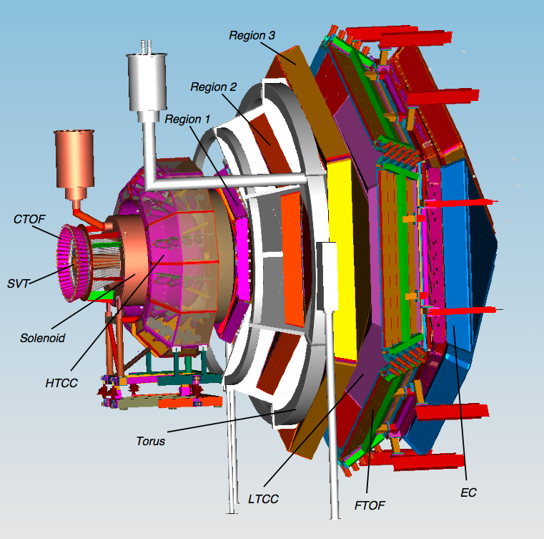
CLAS12 – Design Parameters
Forward Central
Detector Detector
Angular range
Tracks 5⁰ – 40⁰ 35⁰ – 125⁰
Photons 2.5⁰ – 40⁰ ---
Resolution
δp/p (%) < 1 @ 5 GeV/c < 5 @ 1.5 GeV/c
δθ (mr) < 1 < 10 - 20
Δφ (mr) < 3 < 5
Photon detection
Energy (MeV) >150 ---
δθ (mr) 4 @ 1 GeV ---
Neutron detection
N_{eff} < 0.7 (EC+PCAL) under development
Particle ID
e/π Full range ---
π/p < 5 GeV/c < 1.25 GeV/c
π/K < 2.5 GeV/c < 0.65 GeV/c
K/p < 4 GeV/c < 1.0 GeV/c
π⁰→γγ Full range ---
η→γγ Full range ---
L=10³⁵cm⁻²s⁻¹

Slide 4
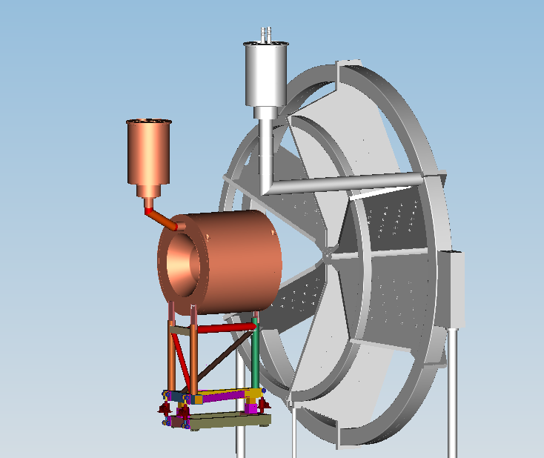
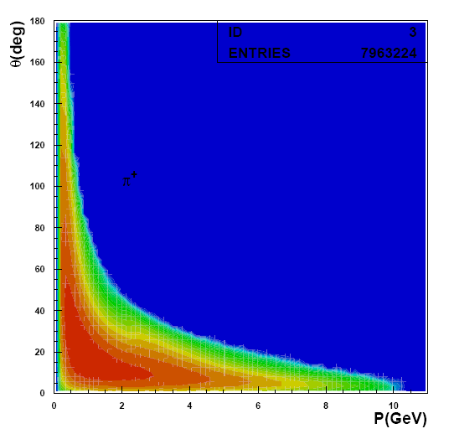
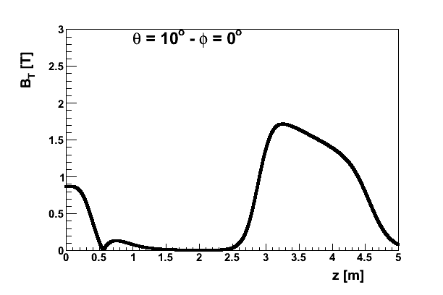
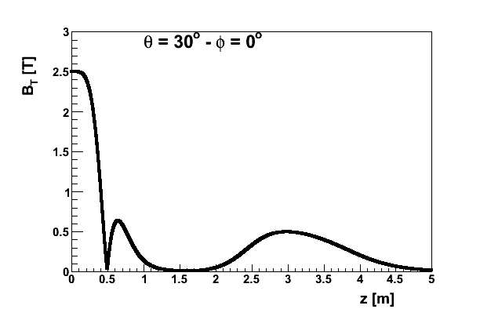
CLAS12 – Solenoid and Torus Magnets
The B-field transverse to the particle trajectory is approximately matched to the average particle momentum.
Notes:
The Torus and Solenoid magnets provide bending power for tracking with sufficient momentum resolution to allow exclusive processes to be identified. At forward angles the Torus field provides large integral Bdl while the solenoid provides tracking at large angles over a limited radial distance.

Slide 5
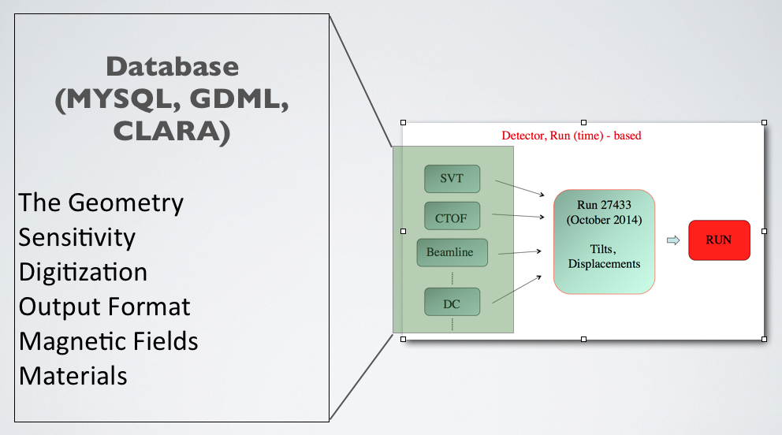
GEant4 Monte-Carlo (GEMC)
Object Oriented Approach
C++ classes, Standard Template Library
Simulation Parameters are External to Software
Geometry, Materials, Parameters, Sensitivity, Fields, Banks
Run-Time decisions on step, Output Format, Parameters Factory, etc
Notes:
GEMC is a software framework that interfaces with the GEANT4 libraries.
It is driven by two design principles:
Number 1: Use Object Oriented design that includes the c++ Standard Template Library.
The geant4 solid, logical physical volumes, magnetic fields, sensitivities, etc are abstracted into general classes that can be built from the database of user choice.
For example, one can use MYSQL, GDML or CLARA to define the geometry.
Number 2: All simulation parameters must stored external to the code, stored in an external database. In other words, there are no hardcoded numbers in gemc.
In fact gemc is agnostic on the detector: choosing what configuration to use is a matter of choosing what database to use, a choice that can be done trivially at run time.

Slide 6
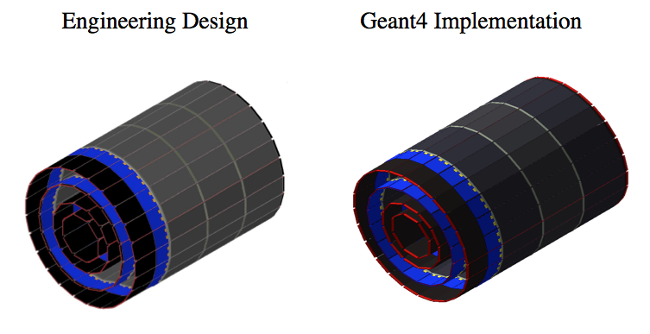
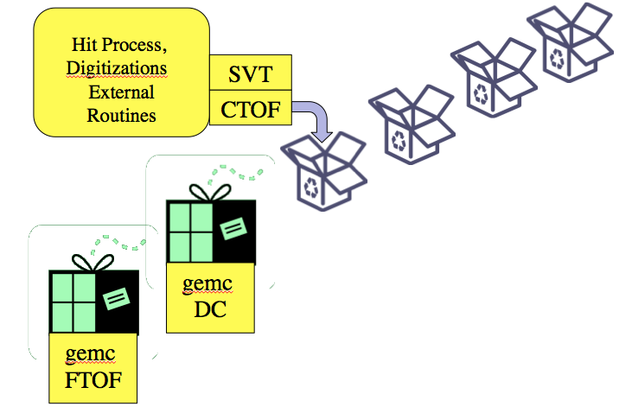
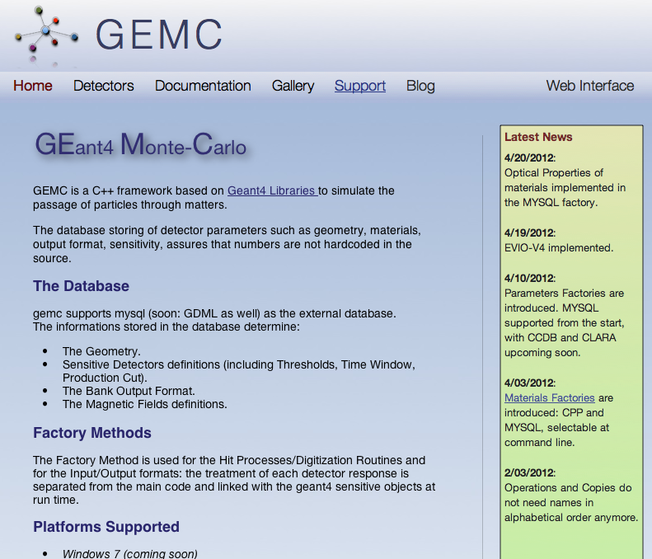
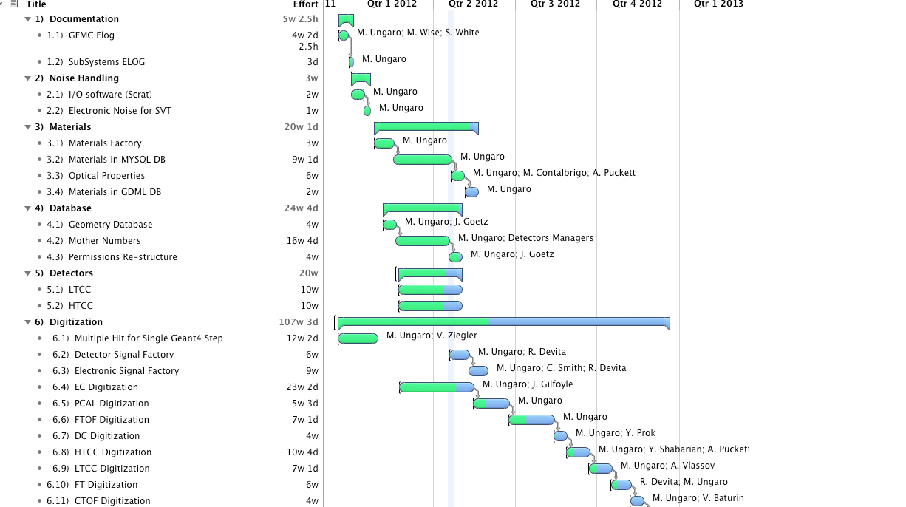
GEMC Features
1) No Hardcoded Numbers
Realistic Geometry
No Recompiling
At run-time: tilt, displacements, step sizes, fields, etc
2) Flexible, Maintainable Code. Cross Platform.
User selection of routines (plugins) at run time
Windows, Mac, Linux
Used in several experiments
3) Documentation
Doxygen
Mantis Bug Report / Feature Request
Timeline, Software Management
gemc.jlab.org, mailing list, blog
Notes:
Documentation:
Gemc uses doxygen; that documentation is generated nightly. Classes and method are defined inline and described in details.
Gemc makes extensive use of Mantis, a web based Bug/Features request system. Bugs are tracked, solutions and debugging are logged, all the conversation is automatically sent by email to the interested parties.
The project timeline uses the Omniplan software. Resources are allocated, projects are assigned with duration time. Milestone are managed.
The software is released on the subversion repository, and it is maintained and tested across several platform. M. Ungaro, the author of the code, supervise all aspects of development and has in place code validation and testing. Some runs every 15 minutes, some daily. For example, if a change is introduced that will not cause compilation error for a particular platform, his pager will alarm!
All of this is kept on the gemc website, that also store howtos, tutorials, quick guides, step by step installation guides. We invite you to visit this website.

Slide 7
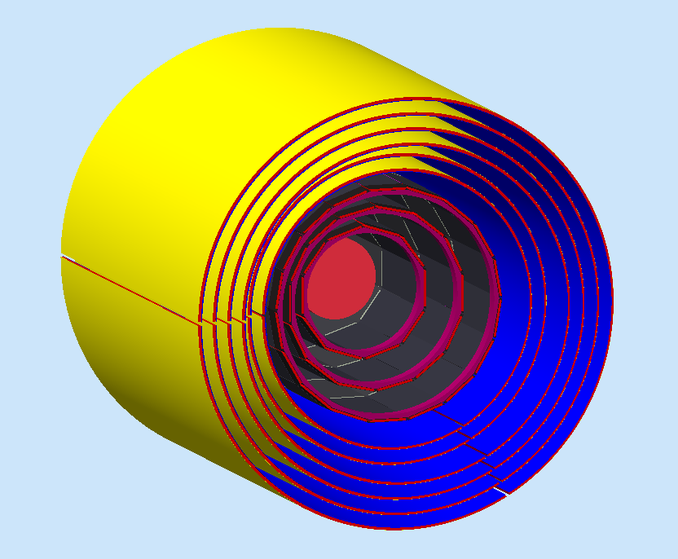
Barrel Tracker
Geometry: Complete
Sensitivity (BST): 3 or 4 regions, 2 layers/reg, 3 modules/lay, 256 variable angle strips /lay. Charge Sharing, Electronic Noise.
Sensitivity (BMT): 3 or 4 regions, 2 layers/reg, 3 tiles/lay, 1000 strips /tiles. Charge Sharing, Lorentz Angle.
Digitization (BST): 3 bit ADC, region/layer/strip #
Digitization (BMT): 12 bit ADC, region/layer/tiles/strip #
Time Window: 132 (BST)/100 (BMT) ns
Resources:
3 BST Regions, 2 SL each
3 BMT Regions, 2 SL each
Sebastien Procureur
Gabriel Charles
Maurizio Ungaro
Amrit Yegneswaran
Yuri Gotra

Slide 8
Sensitivity/Digitization
Detector | Sensitivity | Digitization | Time Window
BST | 3 or 4 regions, 2 layers/reg, 3 modules/lay, 256 variable angle strips /lay. Charge Sharing, Electronic Noise. | 3 bit ADC, region/layer/strip # | 130 ns
BMT/FMT | 3 or 4 regions, 2 layers/reg, 3 tiles/lay, 1000 strips /tiles. Charge Sharing, Lorentz Angle. | 12 bit ADC, region/layer/tile/strip # | 130 ns
CTOF | 58 scintillators , (photo-sensor quantum efficiency, attenuation length, effective velocity*) | Paddle #, (ADC, TDC*) | 4 ns
CND | 3 or 4 layers, 48 scintillators each, photo-sensor quantum efficiency, attenuation length, effective velocity, Birks Effect, paddle resolution | Region, Paddle #, ADC, TDC | 4 ns
HTCC | 12 sectors, 4 layers. Wavelength-dependent PMT quantum efficiency and gas, mirrors refraction indexes. | PMT#, ADC, TDC | 100 ns
DC | 3 regions 2 Superlayers/reg 6 layers/SL. DOCA, drift velocity, cell resolution. | Sector, Region, SL, L, wire #, (ADC, TDC*) | 250, 500 ns
LTCC | 36 elliptical, 36 hyperbolical mirrors, WC*, PMT. (Wavelength-dependent PMT quantum efficiency and gas, mirrors refraction indexes*). Number of photoelectrons and timing. | Sector, PMT# L/R, (ADC, TDC*) | 100 ns
FTOF | 3 panels, 5, 56, 120 paddles. (photo-sensor quantum efficiency, attenuation length, effective velocity*) | Sector, Panel, PMT#, ADC, TDC | 4 ns
PCAL | 15 layers, u,v,w views, 24 scintillators/view , attenuation length, effective velocity, PMT gain, number of photons/charge | Sector, stack, view, strip, ADC, TDC | 200 ns
EC | 39 layers, u, v, w views, 36 scintillators/view, attenuation length, effective velocity, PMT gain, number of photons/charge | Sector, stack, view, strip, ADC, TDC | 200 ns
RICH | Wavelength-dependent PMT quantum efficiency and gas, mirrors refraction indexes. Multi-channel PMT | Multi-channel PMT#, ADC, TDC | 4 ns
FT | Light Yield for PbWO4, APD Quantum Efficiency, gain, noise. | PMT#, ADC, TDC | 132 ns
* In progress

Slide 9
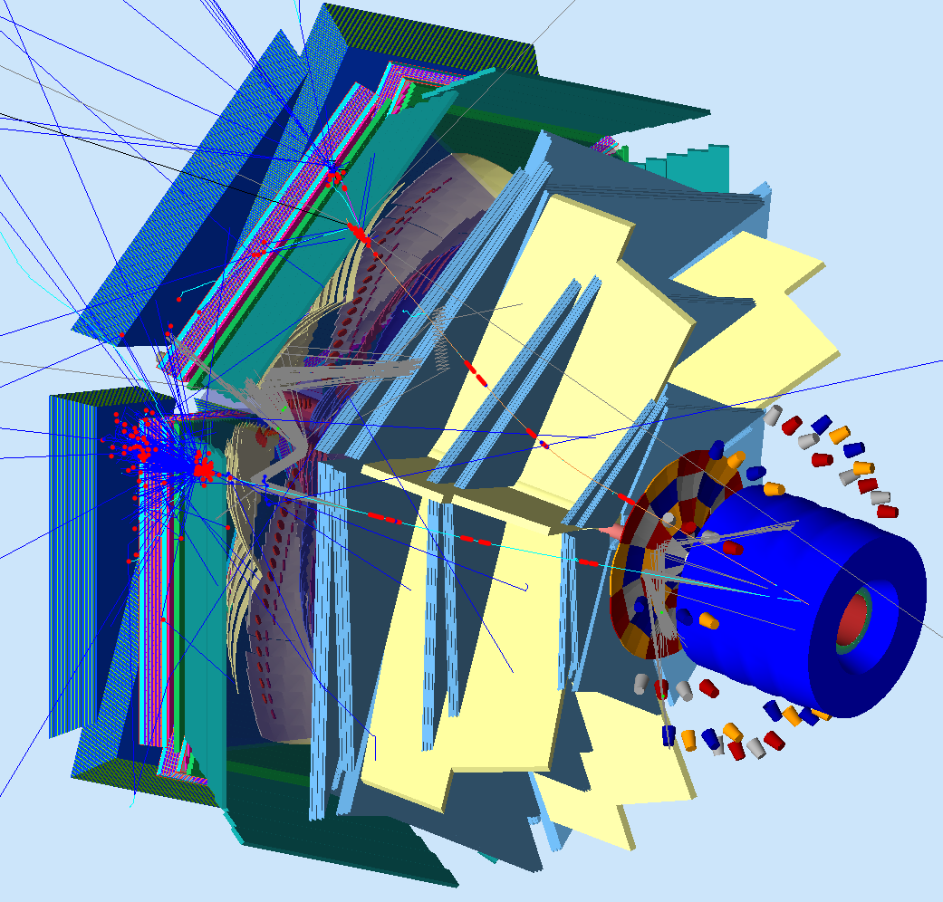
GEant4 Monte-Carlo (GEMC)
Object Oriented Design
  C++ classes, Standard Template Library
Includes the complete CLAS12 base line
Includes all detectors upgrades to CLAS12
In use since 2007 for:
  input for detector design and optimization
  event reconstruction
  high level physics analysis
  beam background
No hardcoded numbers: geometry, digitization from database
PCAL
FTOF
EC
LTCC
DC
Central Detector
BST, BMT, FMT,
CTOF, CND
HTCC

Slide 10
Reconstruction Code
First Generation
  ROOT based tracking code, developed in C
  Modern algorithms commonly used in particles physics
      Hough transform, Kalman filter
  Input: ROOT files from GEMC
  Reconstruction of charged particles and photons
      Central Tracker (Barrel: BST+BMT)
      Forward Tracker (DC+FMT), Very Forward Tracker (VFTM)
      Inner Calorimeter
Second Generation
  Developed in ClaRA framework. Structured Data and Object models
  Rewritten first generation algorithms in Java as services
  Electromagnetic Calorimeter reconstruction services in Java
  Forward Time-of-flight reconstruction services in C++
  HTCC reconstruction services in C++
  PCAL reconstruction services in Java
  Particle identification services in C++
  Input: EVIO files from GEMC
Notes:
First generation: Socrat, developed with GEMC/Root
Then SOT, ‘Clarafication’ of Socrat
Then a variety of event reconstruction services

Slide 11
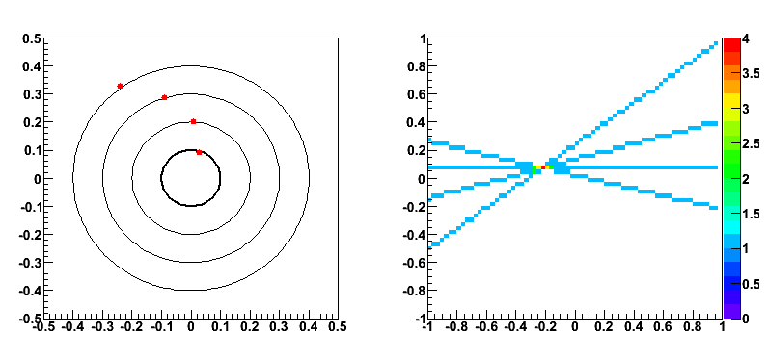
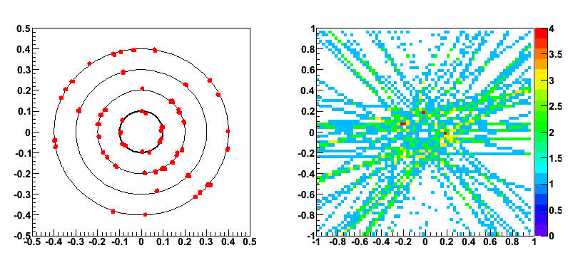
Elements of CLAS12 Track Reconstruction
Pattern Recognition
  Identification of hits consistent with belonging to same trajectory (track)
  Determination of the particle trajectory parameters (e.g. helix) from reconstructed hits
    Hough transform for central tracking,
    Segment finding/linking algorithm for forward tracking
Track Fitting
  Fitting set of hits identified by pattern recognition to expected trajectory
    Kalman Filter
  Knowledge of detector material (i.e. multiple scattering) and detailed magnetic field map incorporated into fit
Illustration with a good track
Same, with high background (3-7 x CLAS12 luminosity)
⟹ only 3 track candidates (including the real track)
Notes:
Hough transform, Kalman filter

Slide 12
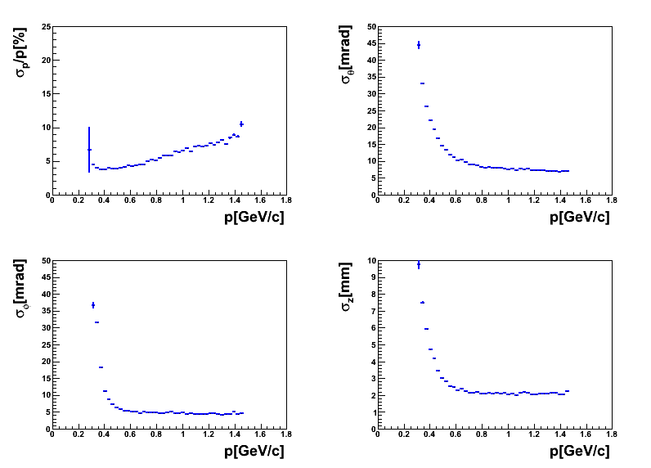
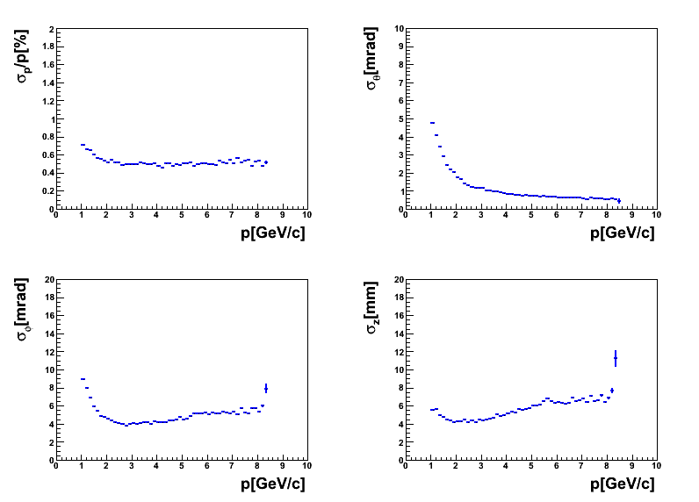
Results – DVCS reconstruction
Reconstruction of the reaction ep→epγ through the whole chain dvcsgen→GEMC→SOCRAT
Resolutions for proton tracks (Central)
Resolutions for electron tracks (Forward)
Notes:
Shows resolutions obtained

Slide 13
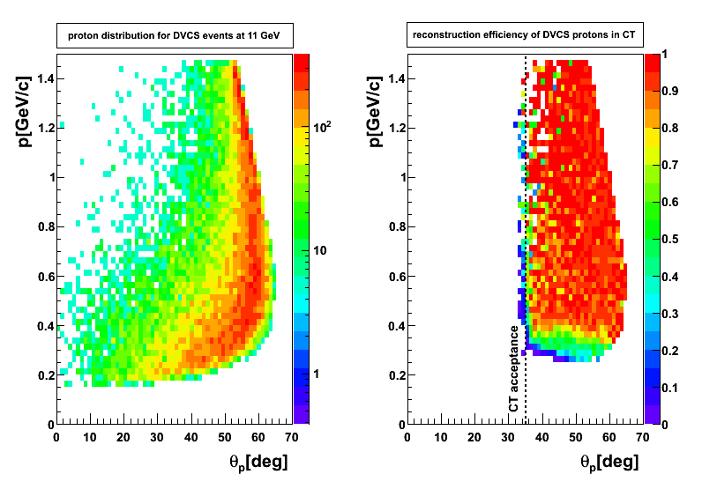
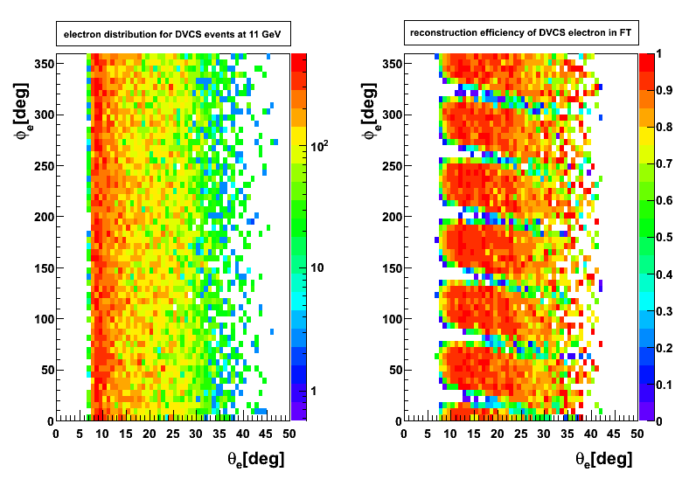
Results – DVCS reconstruction
Reconstruction of the reaction ep→epγ through the whole chain dvcsgen→GEMC→SOCRAT
Efficiency for proton reconstruction
Efficiency for electron reconstruction
Notes:
Show efficiency

Slide 14
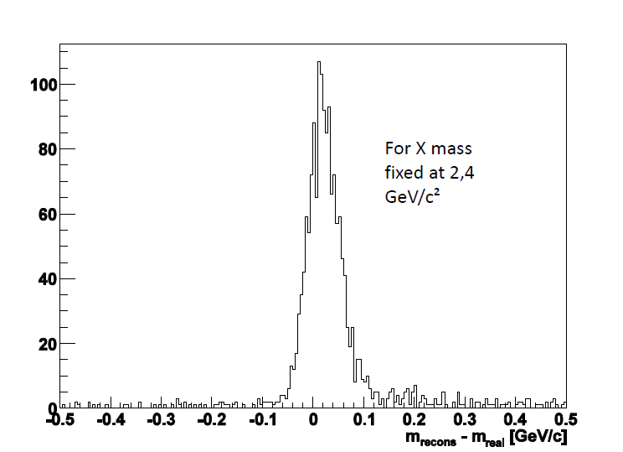
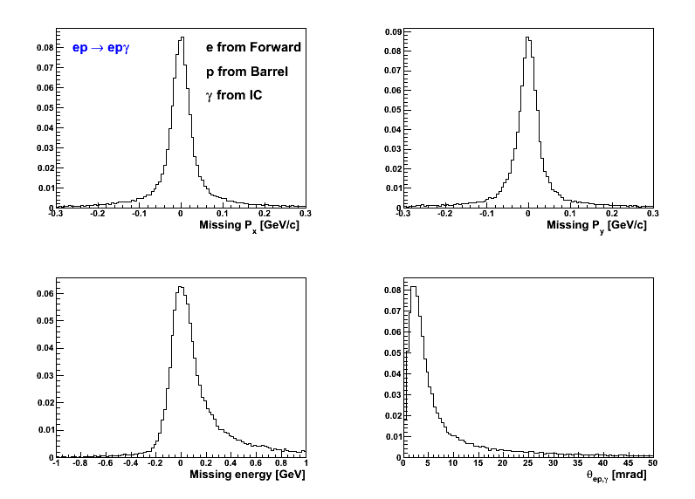
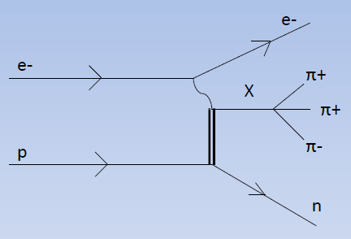
Event Reconstruction - Examples
Reconstruction of the DVCS event
with electron in the Forward tracker
the proton in the Barrel Tracker (SVT+MM)
And the photon in the Inner Calorimeter
Reconstruction of the reaction ep→enX→enπ⁺π+π- with pions in the Forward Tracker and electron in the Very Forward Tracker
(m_{X}=2.4 GeV/c²)
Neutron missing mass

Slide 15
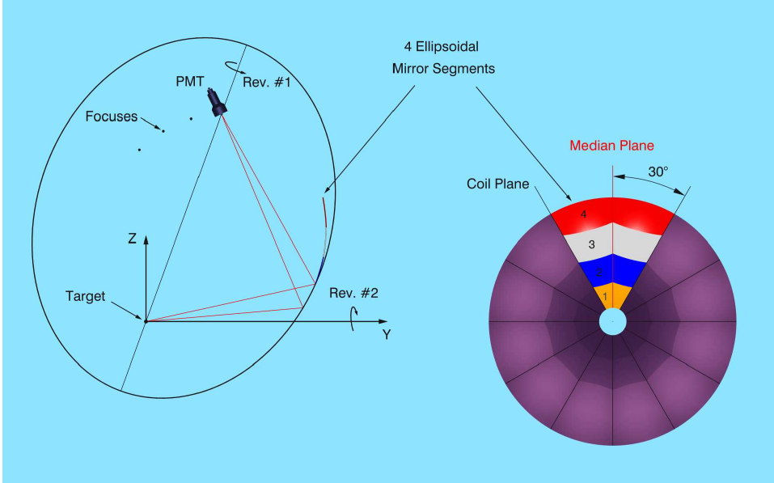
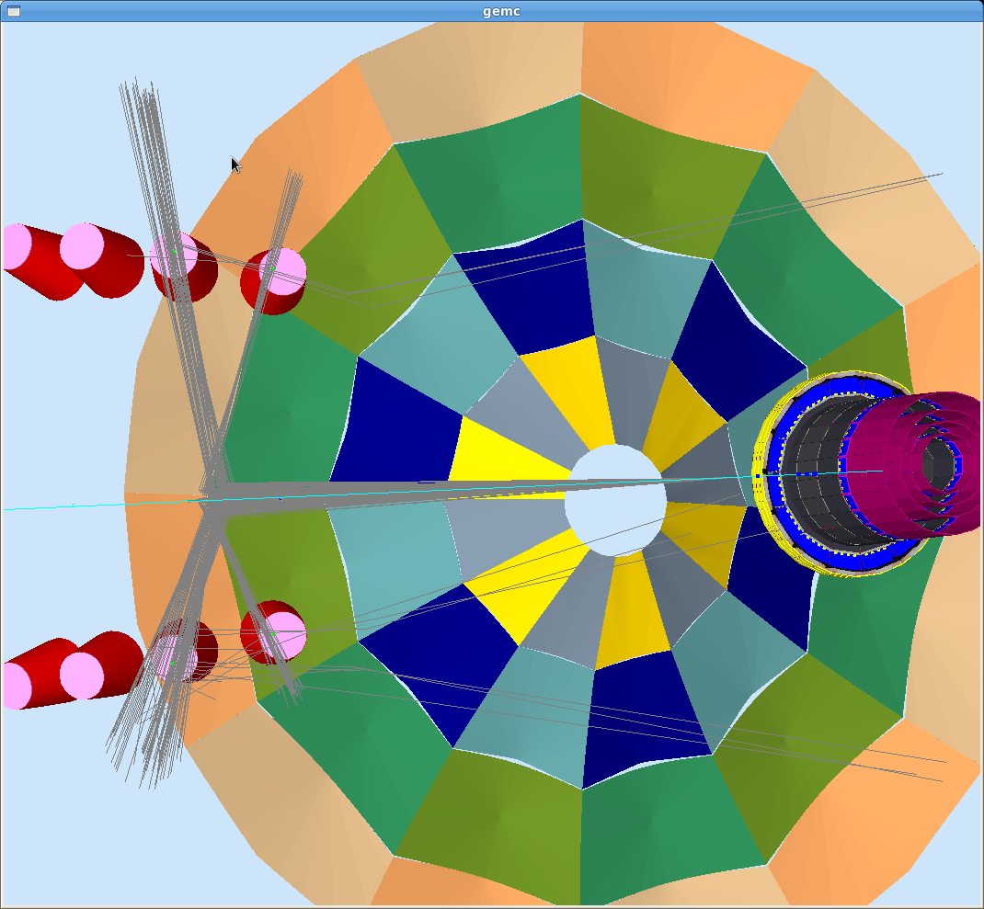
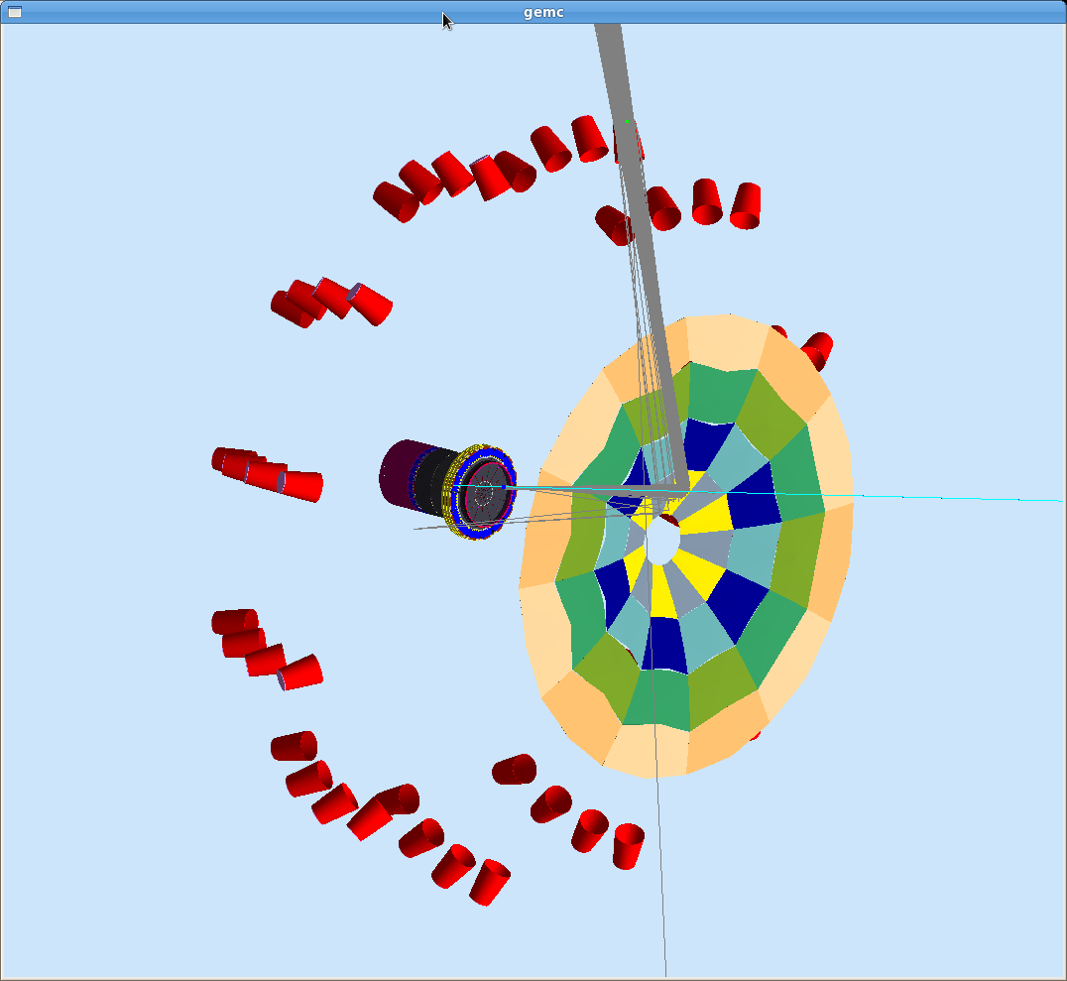
CLAS12 High Threshold Cerenkov

Slide 16
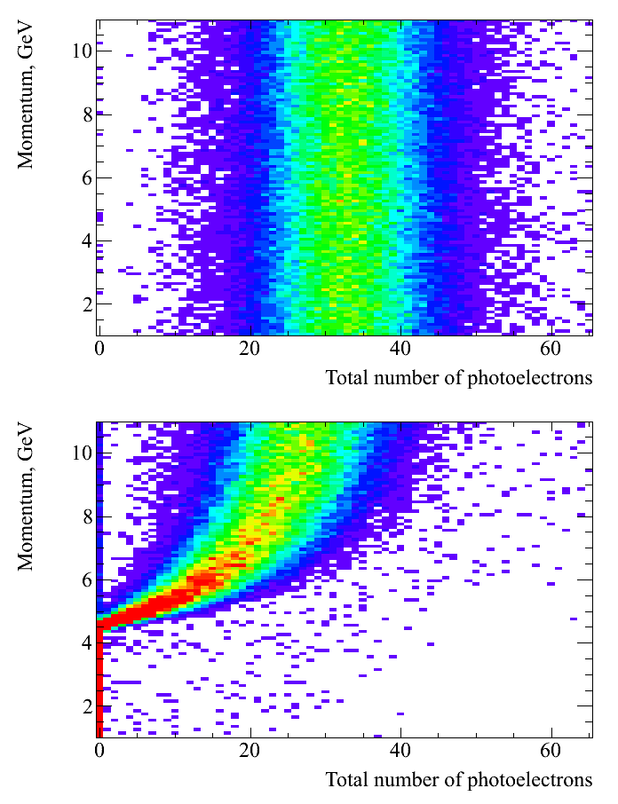
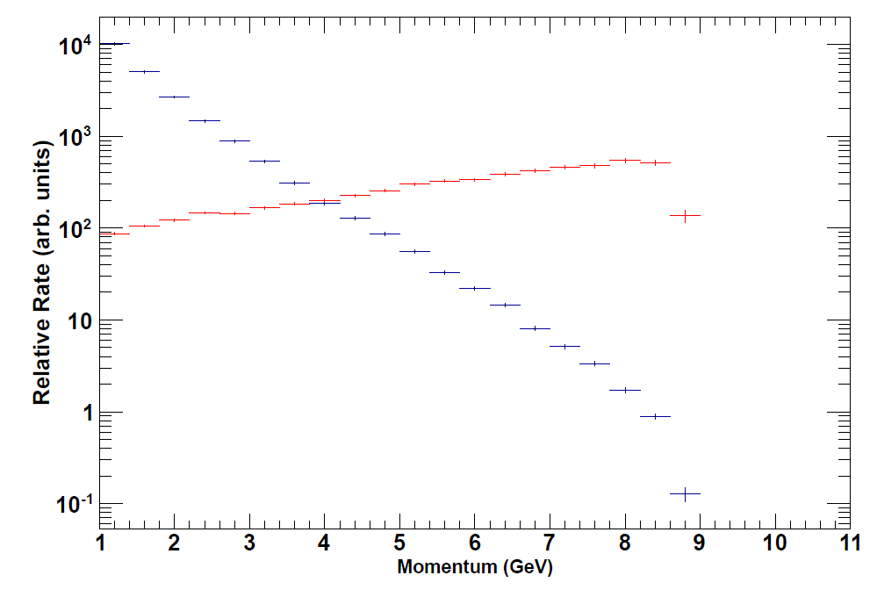
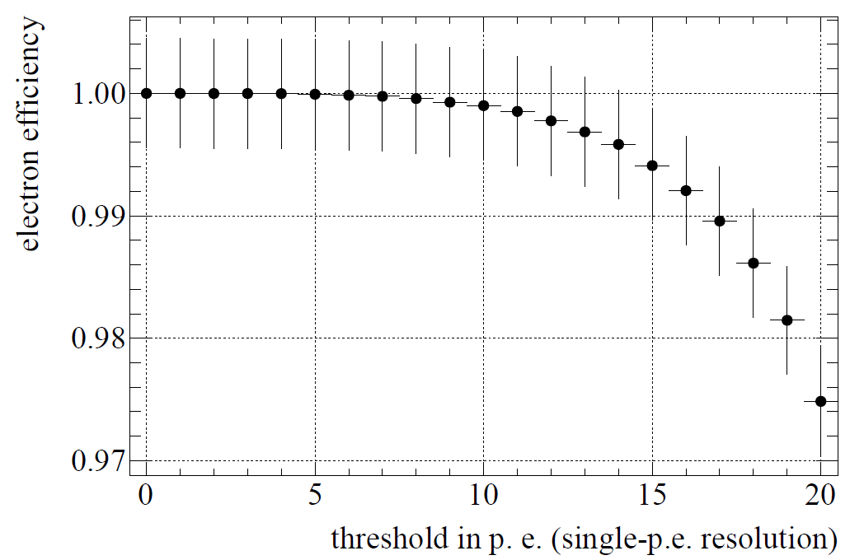
HTCC PID performance
Electrons
Relative rate:
DIS electrons
Inclusive pions
Assuming PMTs + electronics give us single-p.e. resolution, e⁻ efficiency exceeds 99% for threshold up to 16 p.e. !!!
Pions

Slide 17
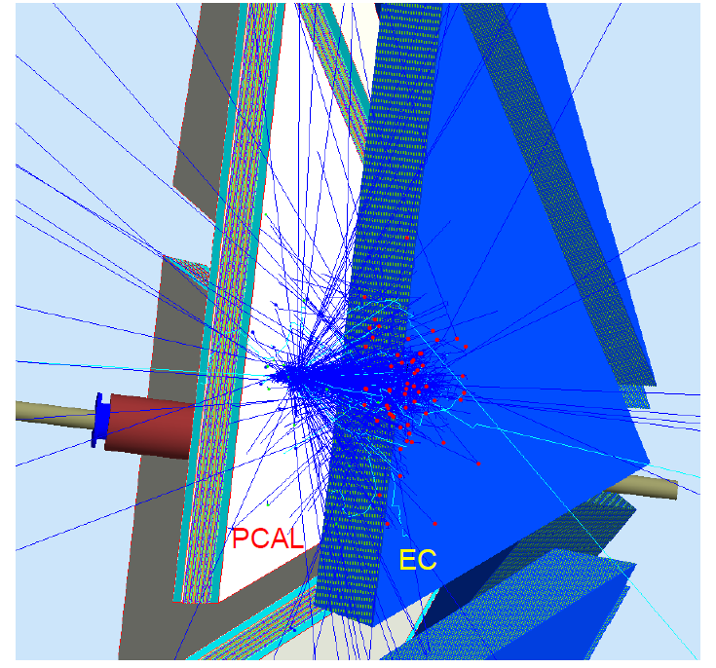
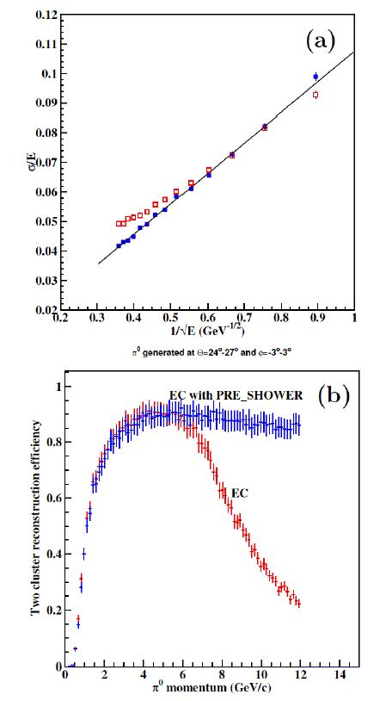
EC + PCAL Simulation and Reconstruction

Slide 18
Clas12 Reconstruction and Analysis Framework
Based on Service Oriented architecture (SOA)
Major components implemented as services
  Multilingual support
    Services can be written in C++, Java and Python
Physics application design/composition based on services
Supports both traditional and cloud computing models
  Single process as well as distributed application design modes
  Centralized batch processing
  Distributed cloud processing
Multi-Threaded
Framework fully functional and mature
Large scale activities have begun for developing physics data processing services
Notes:
SOA Architecture
Encapsulation of physics analysis components in services
Supports batch and cloud computing
Multi-threaded
Mature

Slide 19
Clas12 Physics Data Processing
Database
Geometry, Calibration
and MFM Services
Raw Data
Reconstruction
Services
DST and Tuple
Generation Services
DST
Tuples
Physics Analysis
Services
Simulation
Sim Data
Monitors and Displays

Slide 20
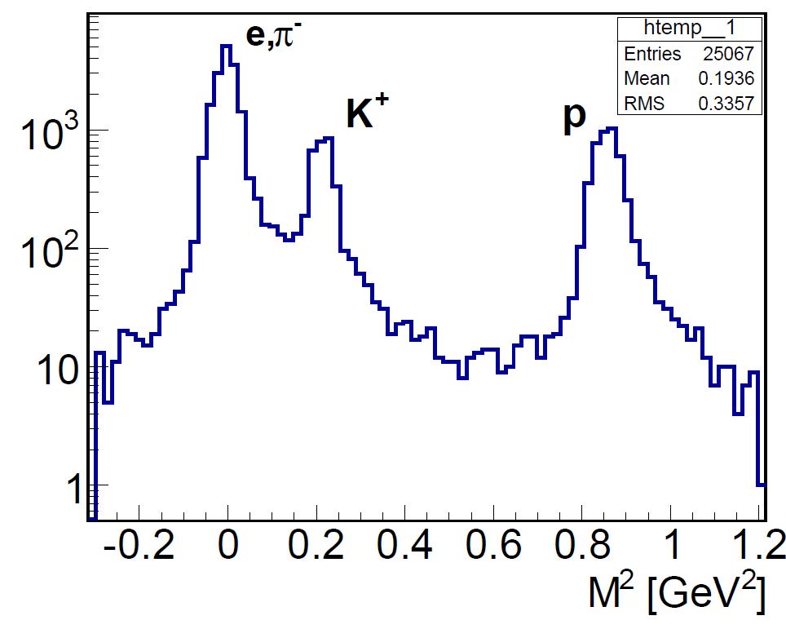
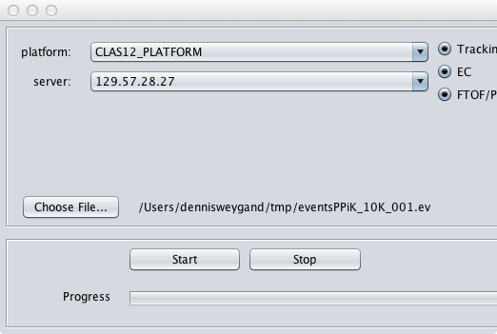
Event Reconstruction
Node 1
Central Tracking
Forward Tracking
EC
Database
Services
BSMTHitFilter
DCClusterFinder
ECStripsCreator
BSMTMergeHits
DCRoadsInClusterFinder
Shared memory
ECHitsFinder
PointHitFinder
DCRegionSegmentFinder
Transient Data Storage. Shared memory
Transient Data Storage. Shared memory
FTOF
ForwardTOFReconstruction
HoughTransform
DCTrackCandidateFinder
Physics Data Processing Application Orchestrator
Permanent Storage
HelixTrackEstimator
FMTHitsToTrackSegment
ParticleIdentification
PID
TrackFitter
ForwardKalmanFilter
JVM
C++ VM
Node n

Slide 21
Calibration
Calibration Strategy
  Beginning of run: internal calibrations (pedestals, spe peaks, etc)
  5% of each run on-line calibration
  Required special calibration runs
Calibration Status
  Calibration suite complete
  PCAL/EC complete
  FTOF/CTOF being developed
  DC will be based on legacy code
Calibration Plan
  Calibration and Commissioning plan for each detector subsystem has been documented, presented, and reviewed by CalCom committee.

Slide 22
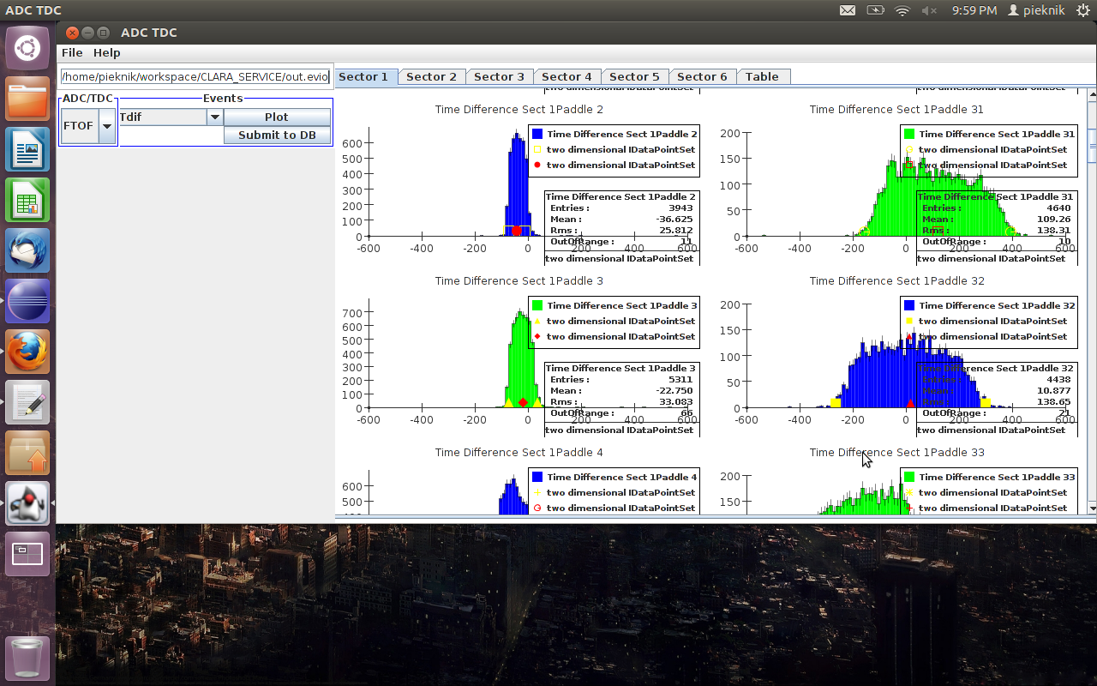
Time-of-Flight Calibration
Program based on CLAS Legacy Algorithms
Program tested on CLAS data

Slide 23
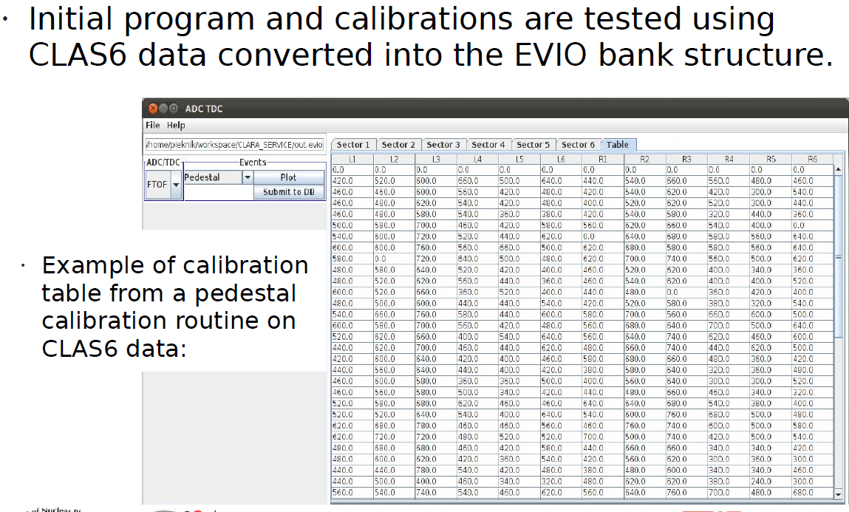
FTOF Calibration

Slide 24
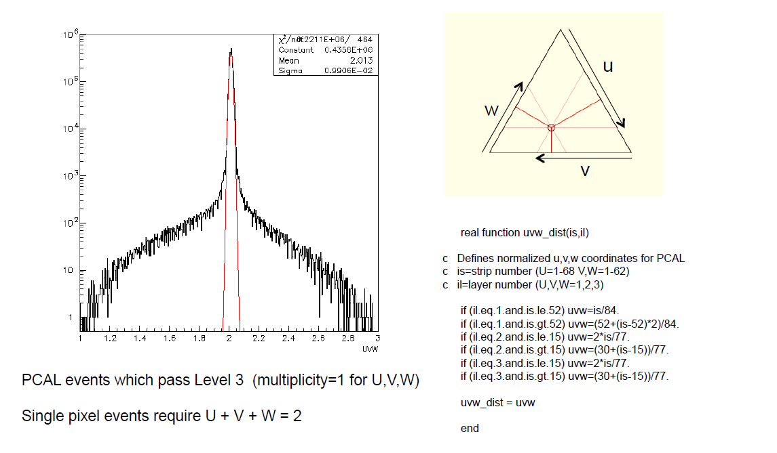
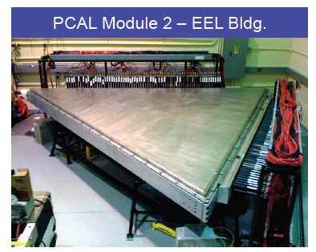
Pre-Shower Calorimeter Cosmic Ray Test
April 2012

Slide 25
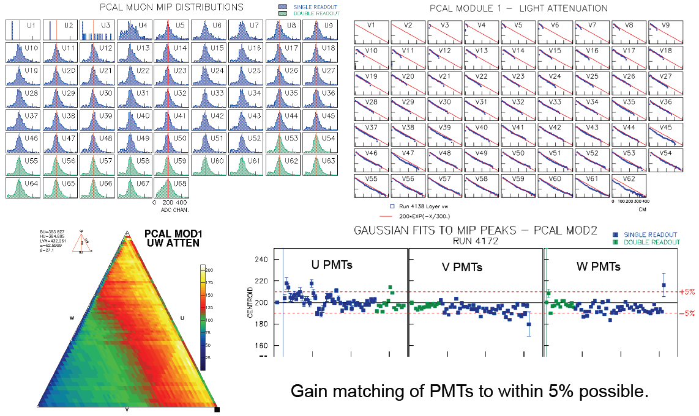
Pre-Shower Calorimeter Cosmic Ray Test

Slide 26
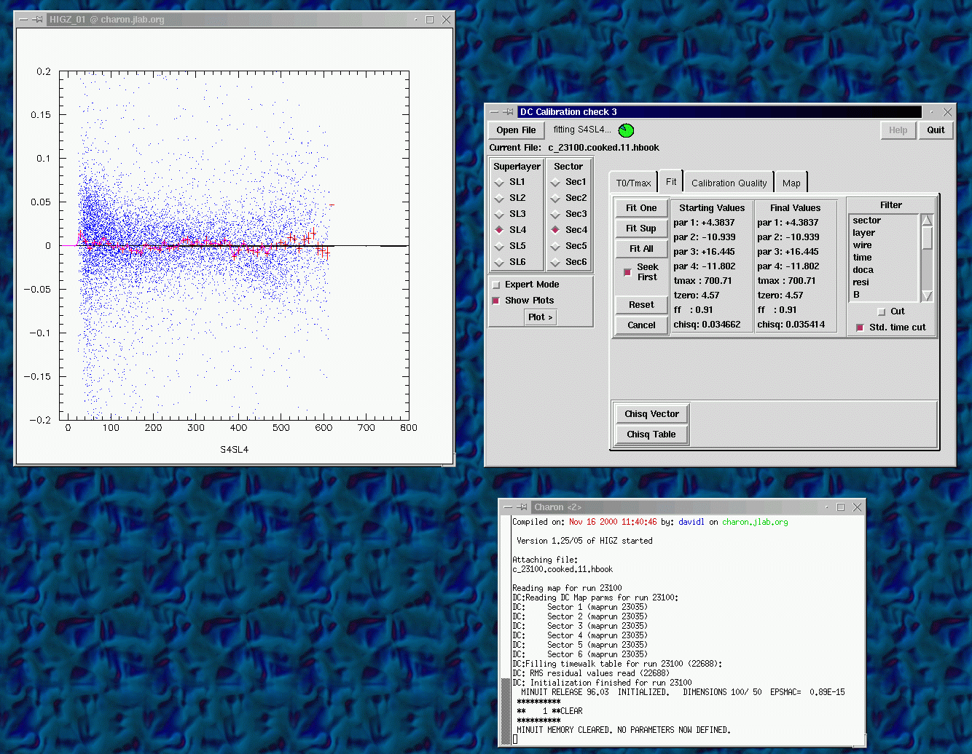
Drift Chamber Calibration

Slide 27
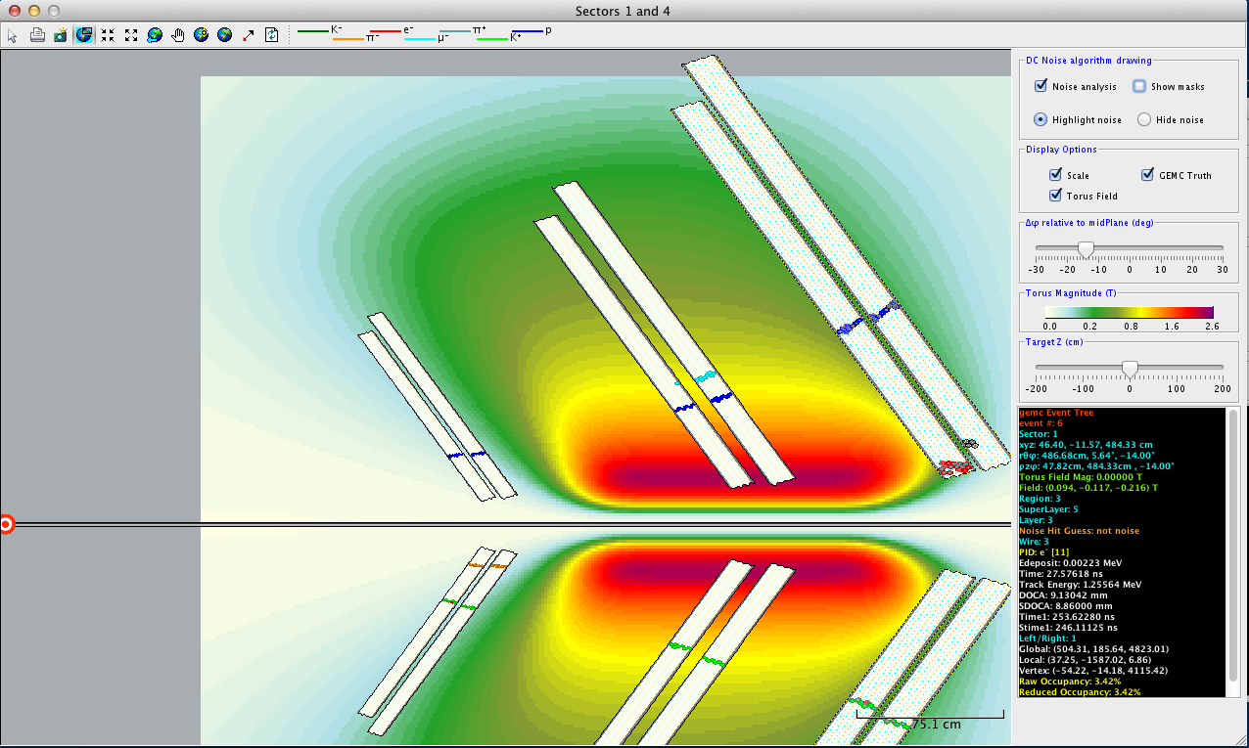
CLAS12 - Event Display
ced (cLAS eVENT dISPLAY) has been operating since 1995. It is used for online detector diagnostics and offline analysis support.
It is being entirely rewritten for the 12 GeV upgrade to leverage modern technology
  A modern object-oriented computer language (JAVA)
  A modern structure– Service Oriented Architecture (SOA)
  With ClaRA as the service container
Christopher Newport University(CNU)
Hall B
Hall D
ced
ded
bCNU
bCNU
jevio (hdfio)
jevio (hdfio)
Goal:
Common features for Hall D and Hall B are developed in bCNU (or migrated to bCNU) with the intent that the ced and ded code bases are <~ ¼ the size of the bCNU code base.
Notes:
primary monitoring tool

Slide 28
Data Processing Plans
For calibration use 5% of the data
Simulate 10X of the real data events
  400msec to generate Monte Carlo event (full background)
Estimated time spent on event reconstruction ~155 msec on a single core.
  ~40 msec currently measured including charge particle tracking, EC, FTOF reconstructions and PID; single track, dual hypothesis
Online reconstruction and calibration
  ~20% data reconstruction for data quality checks
First pass event reconstruction on JLAB compute farm.
DST generation applications at JLAB.
  Large fraction of the DST data will be stored on disks
Transfer DST to the collaborating university farms/clouds for further analysis.

Slide 29
CLAS12 Data Volumes/Core Requirements
Raw : 1.3 PB/year
Reconstructed : 5 PB/year
Simulated : 1.5 PB/year
 | Core | Disk (TB) | Tape (TB/yr)
DAQ | - | - | 1,270
Calibration | 2173 | - | -
Reconstruction | 1,387 | 508 | 5,080
Simulation | 8,139 | 318 | 1,588
Post-Reconstruction | 1,214 | 508 | -
Physics Analysis | 607 | 889 | -
Total | 11,520 | 2,223 | 7,938

Slide 30
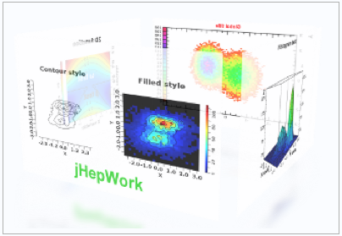
Software Tools
Languages: C++, Java, Python
Jlab Developed Tools
EVIO
CCDB: mysql based calibration and conditions (and geometry) database (Shared with GlueX)
bCNU/jevio Event Display
(Shared with GlueX)
jMath
JToolBox/CToolBox
Code management: Subversion
Code Development:
Standard IDE’s: Eclipse, IntelliJ, Netbeans
HEP/NP Data analysis
Root
CLHEP: C++ tools for HEP
HDF5: NCSA developed data format
jHepWork/freeHep
COLT: Java implementation of CLHEP
JAIDA
NumPy: Python Mathematical tools
SciPy: Python Numerical tools
Geant4: Particle tracking through material

Slide 31
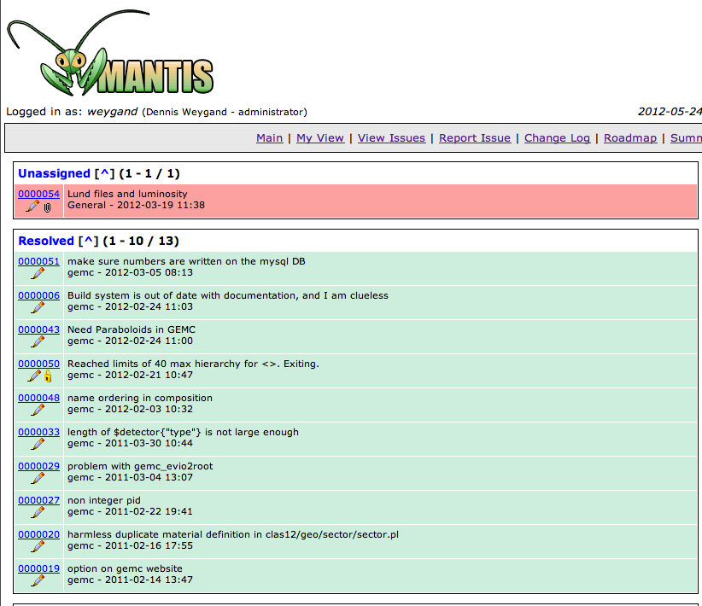
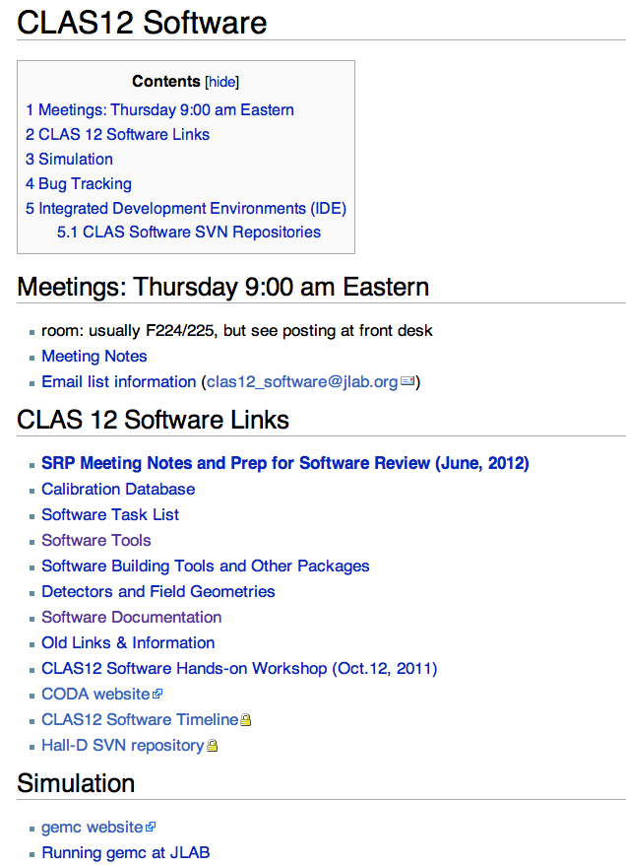
Documentation
Principal Source of Documentation is CLAS wiki
Within the wiki is access to:
Tutorials/HowTos
Javadoc/Doxygen
Access to ancillary websites/wikis
TDR for Software
TDR for Calibration and commissioning
Hands-on Workshops
Bug Tracking/Feature Requests via Mantis

Slide 32
Collaboration wide Utilization and Contribution
Application Users
Users manual
Service Programmers
ClaRA Developers manual
Graphical interface client bundles
Wiki how-to
Workshops and conferences
Application design graphical tool
Service discovery and monitoring tool
Release notes
Svn
JavaDoc, Doxigen
Wiki forums
Bug-tracking tools
ClaRA developers blog
Framework developers
Service deployment and management tools.
Discussion forums
Maintenance and request tracking

Slide 33
Transitioning from Development to Operations
Many test deployments at local and remote desktops and laptops.
ClaRA operational platforms at UR, ODU and JLAB.
Deployment of the ClaRA platform on the batch queue system at the JLAB is in the progress with the help of the IT department.

Slide 34
ClaRA Deployment on the JLAB Batch Farm
Conditions
Database
Calibration
Database
Farm Nod 1
Java Service Container
Service Bus
Run Conditions
Services
Geometry Calibration Services
Service Registration
C++ Service Container
Farm Nod 2
Cloud Control
PDP
Application
Orchestrator
C++ Service Container
Service Control
Java Service Container
Service Bus
Event
Services
ClaRA Cloud Control Node
Clas12 private resource
Permanent
Data Storage
Notes:
Currently working with IT on the details of this deployment

Slide 35
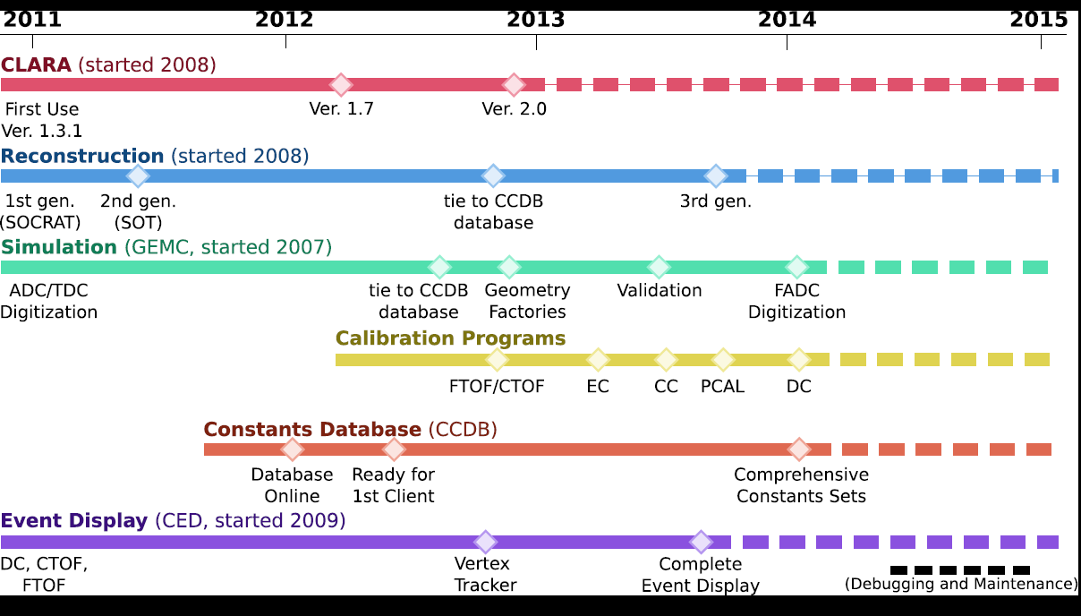
Timeline/Milestones

Slide 36
Risks and Mitigation
Communication latency
  Careful analysis of the criticality of a service, introduce built-in tolerance for variations in network service response times
  Application design taking into account data distribution
Broad author and user pools
  Proper management and administration; strict service canonization rules
Workloads of different clients may introduce “pileups” on a single service
  Service and Cloud governance (e.g. service locking)
Network security
  Client authentication and message encryption
Limited manpower
  Interfaces (C++/Java) provide access to CLAS legacy code

Slide 37
Future Plans
Extend database services to all systems
Optimize Kalman Filter parameters (3rd generation tracking)
Implement calibration suite for all systems
Develop monitoring for all systems
Complete event reconstruction
Explore DST formats
Complete digitization for all systems
Develop standard tests

Slide 38
Summary
The CLAS12 framework is stable and ready for production deployment
Simulation, reconstruction and database services are available
The software project timeline has been developed with the appropriate milestones and tests included
Project management established, risks and mitigations identified, commissioning plan developed and resource needs estimated
User support is achieved through online documentation, mailing lists, and bug tracking software
Use of a wide variety of software tools: developed within JLab, the larger HEP community, and from previous CLAS experience
All essential components of the analysis software (simulation, reconstruction, calibration, and ancillary software) are due to be complete by 12/2013, 18 months prior to physics beam

