Slide 1
Electron Ion Collider Update
Douglas W. Higinbotham

Slide 2
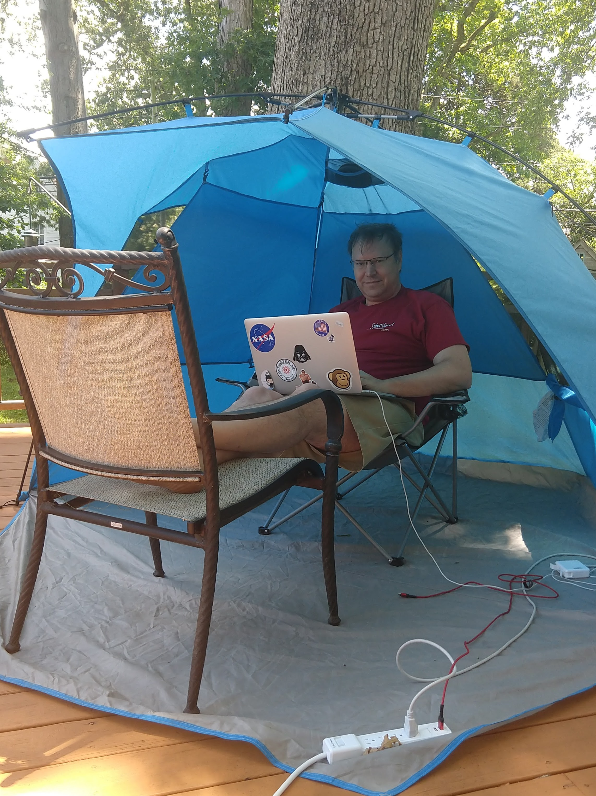
Electron Ion Collider Physics Group @ JLab
Core Group
Douglas Higinbotham (head)
Markus Diefenthaler
Yulia Furletova
Dmitry Romanov
Matrixed to the Group
Volker Burkert (from Hall B)
Christian Weiss (from Theory)
EIC Fellows (funded by Virginia)
2019/20
2 postdocs
1 graduate student
2020/21
3 postdocs
3 graduate students
SULI student working remotely
And MANY JLab users and staff are contributing to the EIC efforts!
working from home during pandemic
Weekly Multi-Divisional Meeting To Discuss Progress In Physics, Theory, Accelerator and Computation Science with a database of talks stored in a DOCDB

Slide 3
October Review of Two Competing EIC Designs
For e-N collisions:
Polarized beams: e, p, d/³He (effective neutron)
e beam 5-10(20) GeV
Luminosity ~ 10³³⁻³⁴ cm⁻²sec⁻¹
100-1000 times HERA
20-100 (140) GeV variable center of mass energy
For e-A collisions:
Wide range in nuclei
Luminosity per nucleon same as e-p
Variable center of mass energy
Key Supporting Documents
EIC White Paper
National Academy of Science Report
JLEIC

Slide 4
Site Selection & Intellectual Ownership of the Physics
CD0 was approved Dec. 19th with an announcement from the DOE department of energy on Jan. 9th https://www.energy.gov/articles/us-department-energy-selects-brookhaven-national-laboratory-host-major-new-nuclear-physics
While we were understandably disappointed, Tim Hallman came to JLab after site selection and encouraged us to continue to develop our intellectual ownership of the physics.
This idea really resonated with many of us and a very positive partnership and commitment to the EIC has continued to grow since site selection
This commitment to the EIC was formalized with the BNL-JLAB Partnership Agreement, signed May 7, 2020.
Informally, this growing partnership can be seen online almost day of the week at our numerous EIC meetings, workshops, and discussions.

Slide 5
EIC User Group Yellow Report Efforts
Major focus of the entire EIC community to ensure the detectors can do the physics in the white paper and the national academy science reports.
Kick-off meeting at MIT in Dec. (in-person) and two online meetings hosted by Temple and Pavia in May (both-remote)
Jefferson Lab User Community Heavily Involved In These Efforts!
http://www.eicug.org/web/content/yellow-report-physics-working-group
http://www.eicug.org/web/content/yellow-report-detector-working-group
Strong involvement by Jefferson Lab staff and users in all subgroups
Bringing our experience from the recent 12GeV upgrade and ongoing detector development efforts to the EIC project
Staff Efforts Continuing Beyond the Yellow Reports
Physics
Exclusive Group
Semi-inclusive Group
Short-Range Correlations Group
Deuteron Working Group
Detector R&D
Helping Refine the case for a 2nd detector & IR (likely a white paper in 2021)
The software working group ties the physics and detector efforts together

Slide 6
EIC Software
Docker Images of Software
For someone who have spent many hours fighting with paths and libraries, Docker images is amazing
Click install and you have an amazing amount of EIC software at your finger tips.
Software coding and development with major role in the Geant4 simulations known as g4e within the ESCalate framework.
Tutorials by the software working group on YouTube: https://www.youtube.com/channel/UCXc9WfDKdlLXoZMGrotkf7w
Introductory Tutorials
Advanced Fast Simulations
Using uproot ( ROOT trees in Python)
Full Detector Simulations in g4e and fun4all
Thank you to Holly for helping with our latest tutorials!!
This modular software could also be used for the SoLID.

Slide 7
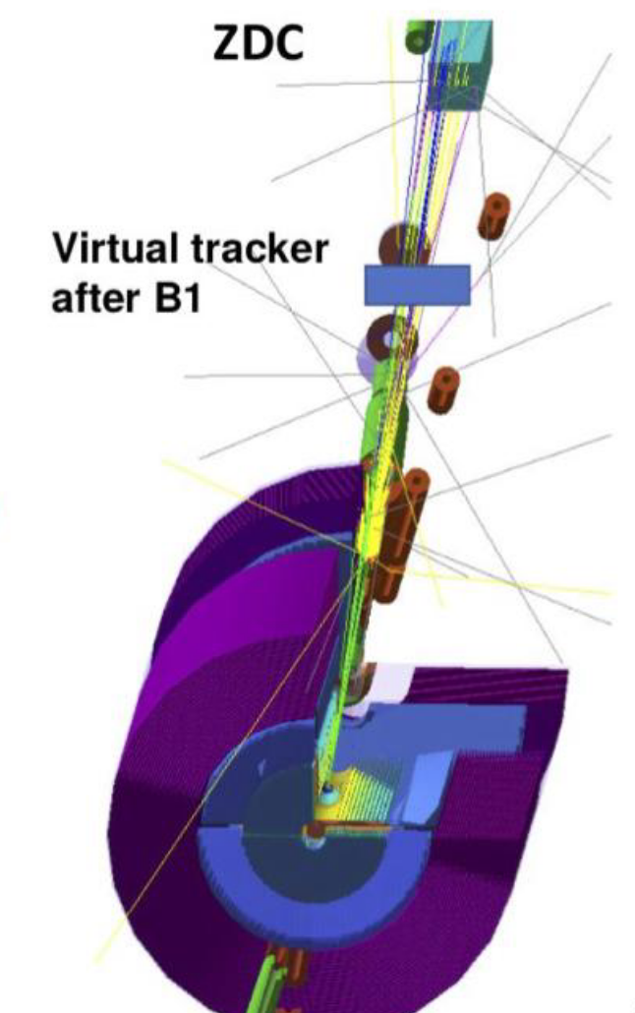
Pion and Kaon Structure Function Measurements at the EIC
Extremely challenging measurements which require particle detection in the far forward region.
This type of measurement was impossible at HERA due to synchrotron radiation and vacuum issues. (being addressed explicitly as part of OPC efforts for the EIC)
In collaboration with our user community using our g4e simulations to optimize detector locations and ensure design is capable of doing the physics.
For pi+/n reaction have found a 60x60 cm² zero degree calorimeter (ZDC) needed with ~1 cm resolution.
For K+/Λ reaction lower energy running is better and tracking after the B1 dipole.
Details at CFNS workshop 2-5 June 2020 https://indico.bnl.gov/event/8315/timetable/

Slide 8
Probing short-range correlations in the deuteron via incoherent diffractive J/ψ production with spectator tagging
Contributing the development of the Benchmark eA Generator for Leptoproduction: BeAGLE
Combining diffractive processes and short-range correlations
Studying the acceptance of the far-forward region of the EIC.
https://arxiv.org/abs/2005.14706 and submitted for publication

Slide 9
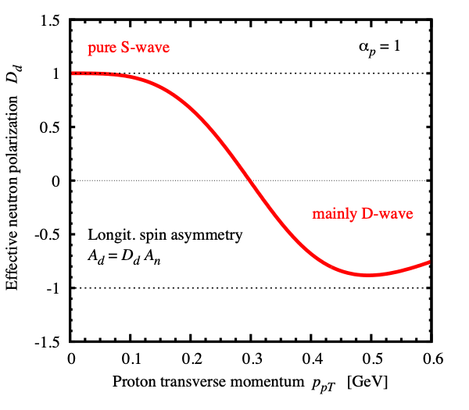
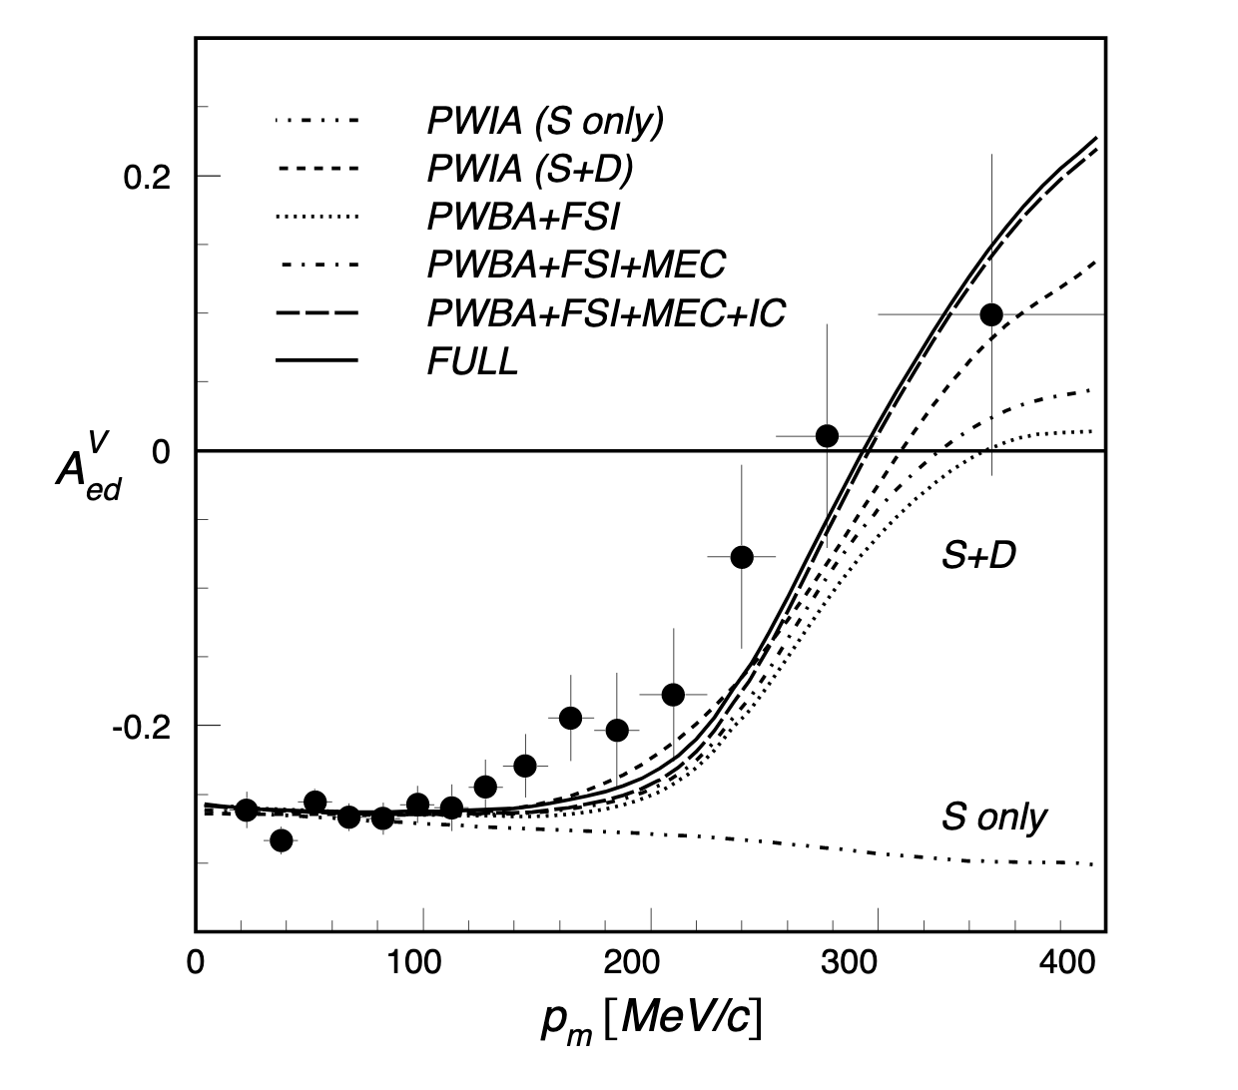
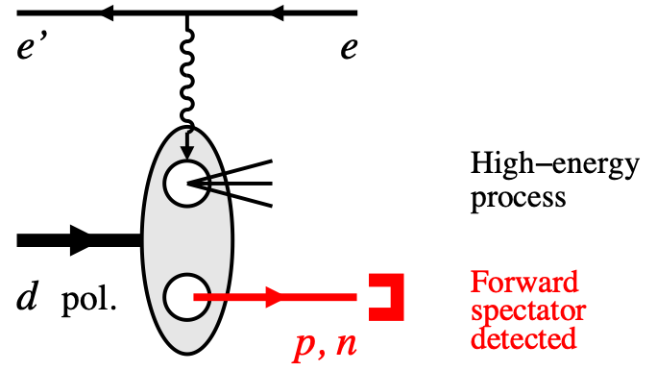
Polarized light ion physics at the EIC
https://doi.org/10.1103/PhysRevLett.88.102302
Developed theory for DIS polarized deuteron and spectator nucleon tagging. Tagging controls nuclear configuration in DIS: nuclear binding, D-wave depolarization. Demonstrated extraction of free neutron spin structure:
W. Cosyn and C. Weiss, Phys. Lett. B 799 (2019) 135035 and arXiv:2006.03033
Results used in EIC simulations: Yellow Report, forward detector design.
Working with accelerator to ensure polarized deuteron will be possible and recently found that at “magic energies” it seems polarized deuteron will be able to be stored within the baseline project. (i.e. without new Siberian Snakes)
Also working on deuteron tensor polarization (Elena L.) and polarized 3He (Dien N.)

Slide 10
2019/20 Jefferson Lab EIC Postdoctoral Fellows
Postdoc Tim Hobbs (SMU) Theory:
detailed studies of the impact of future EIC quark-gluon structure measurements https://doi.org/10.1103/PhysRevD.100.094040 and https://arxiv.org/abs/2001.07862
Charm jets studies to understand vertex requirement for the yellow report: https://arxiv.org/abs/2006.12520
Postdoc Ivica Friscic (MIT) Experimental Nuclear:
streaming readout
polarized SIDIS 3He measurements with CLAS12 & the EIC.
Graduate Student Abdullah Farhat (ODU) Multidisciplinary:
applying machine learning and artificial intelligence on HERA data to develop techniques for the EIC. publication in progress

Slide 11
Electron Ion Collider Center Fellowship Program
19 Completed Applications
8 Postdocs / 11 Graduate Students
6 Women Applied (3 Postdoc and 3 Graduate Students)
2020/21 funding for 3 Postdoc and 3 Graduate Students
Funding provided by the Commonwealth of Virginia via SURA/JSA
Follows are typically expected to spend half their time at Jlab
Members of the Selection Committee
Dr. Douglas Higinbotham (JLab/Head of EIC Center)
Dr. Jianwei Qiu (JLab/Nuclear Theory)
Dr. David Lawrence (JLab/Information Technology)
Prof. Abhay Deshpande (Stony Brook/Head of CFNS)
Dr. Thia Keppel (JLab/Experimental Nuclear Physics)
Dr. Todd Satogata (JLab/Accelerator Physics)

Slide 12
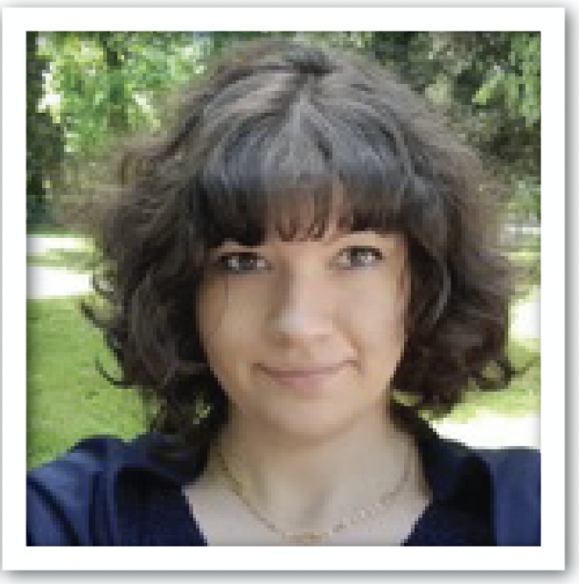
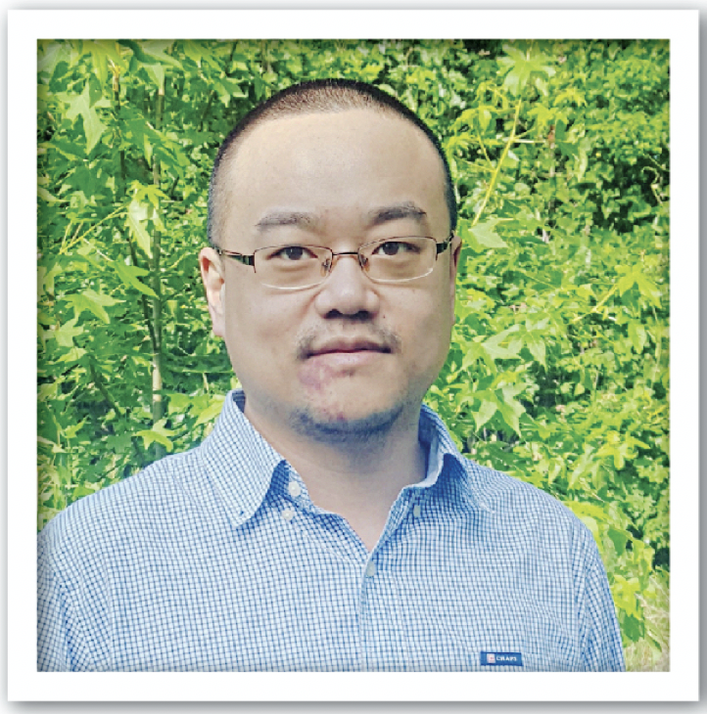
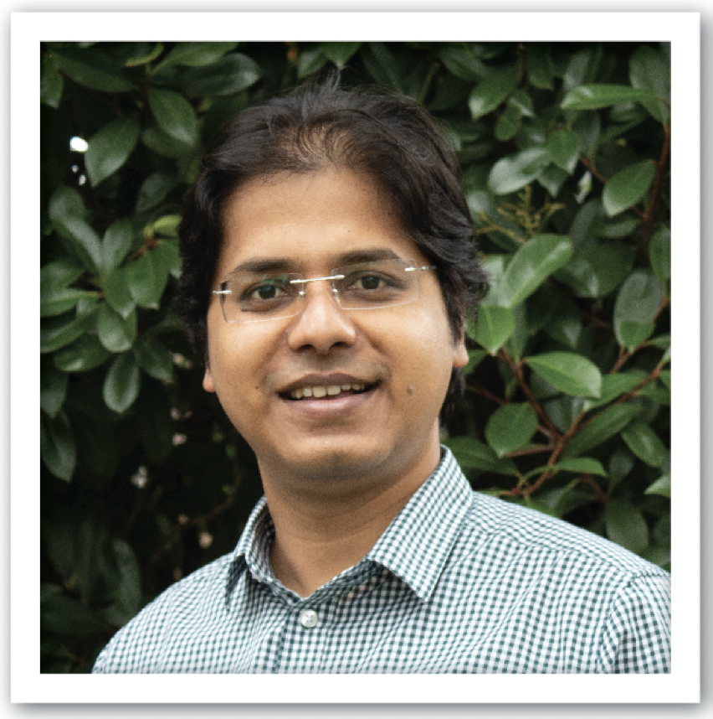
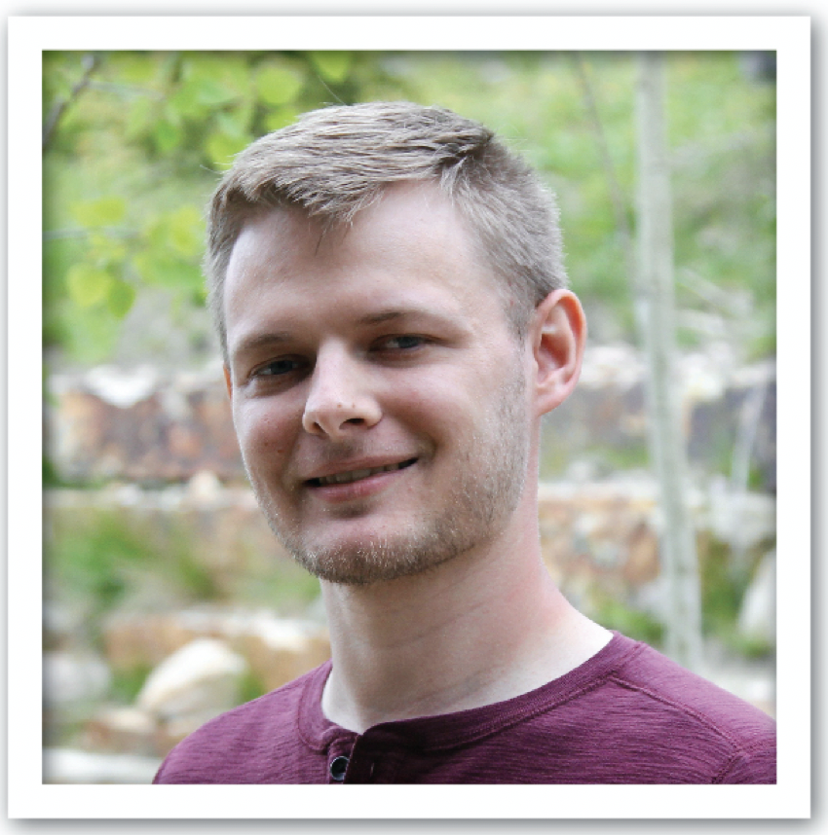
Charlotte Van Hulse
Orsay, France
Study of the detector requirements and optimal
configurations for the study of parton distribution functions and fragmentation functions at the EIC.
Chiara Bissolotti
Pavia, Italy
Theoretical calculations of the integrated
transverse momentum distribution cross sections at next to leading order.
Wenliang (Bill) Li
William & Mary, Virginia
Simulation studies of EIC u-channel exclusive production and contributing to the forward tagging detector requirements and design.
Bhawin Dhital
Old Dominion University, Virginia
Accelerator project to study the two-energy storage ring cooler to improve the luminosity of the EIC.
Jennifer Rittenhouse West
SLAC, California
Theoretical studies of the dynamics of the novel color singlet and studying mechanisms to explain the EMC effect.
Jackson Pybus
MIT, Massachusetts Study of deep inelastic scattering from short-range correlated pairs and determination of the requirements of the far forward detectors.

Slide 13
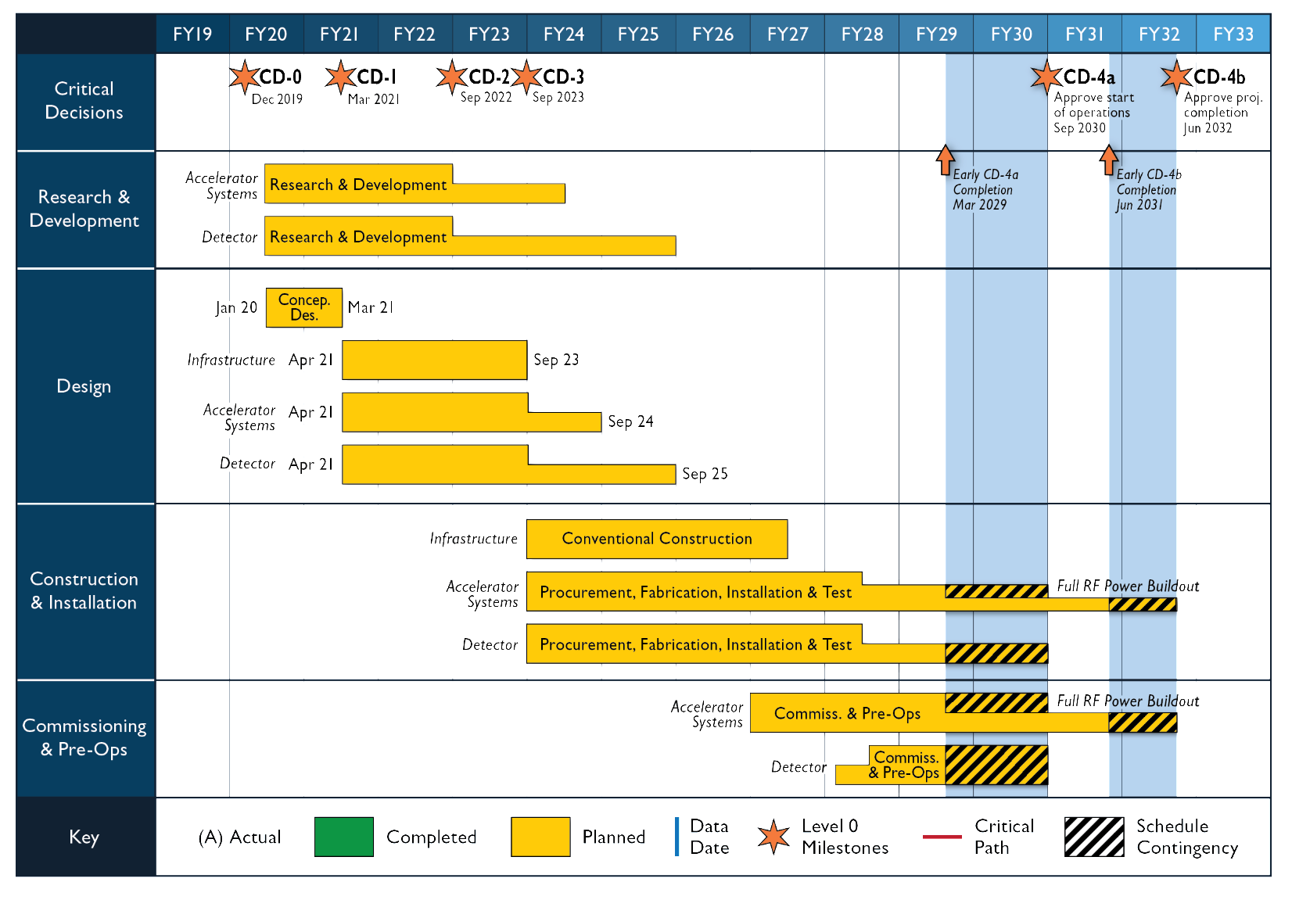
Reference Schedule

Slide 14
Reference Funding Profile
CD-1: March 2021
CD-2: September 2022
CD-3: September 2023
CD-4a: September 2030
CD-4b: June 2032
Staged Luminosity
Operations Start CD-4a
Full RF Power Installed by CD-4b
$100M from New York State toward infrastructure

Slide 15
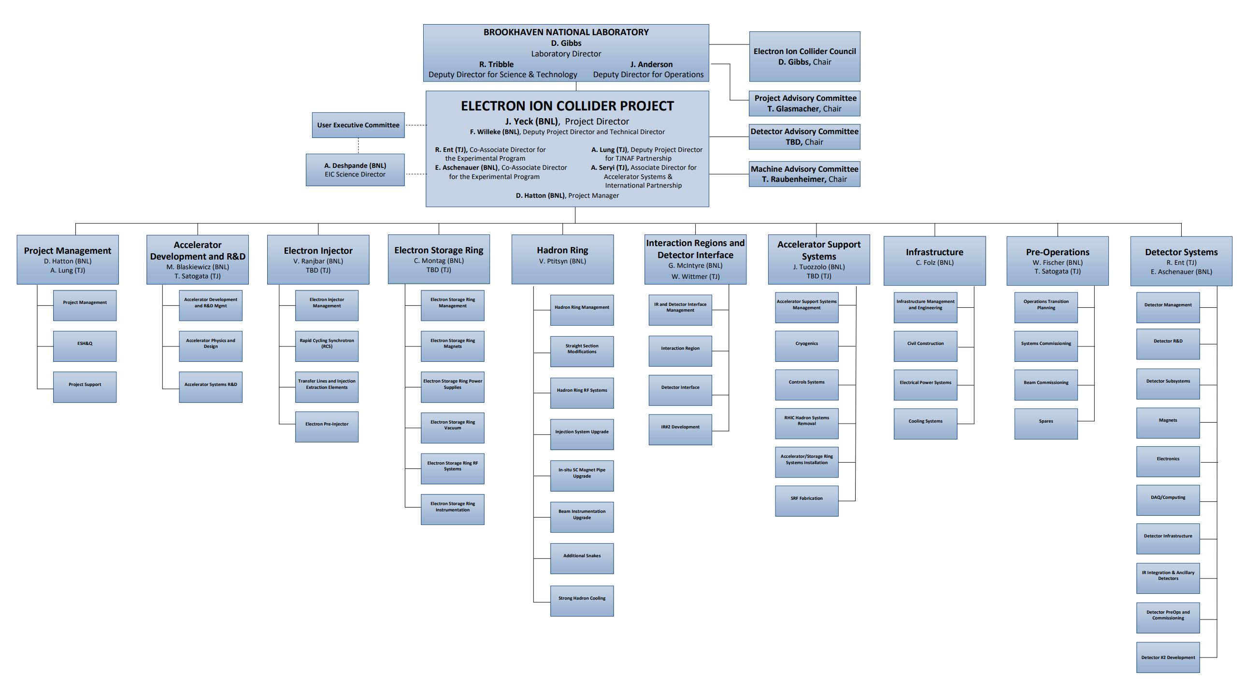
DRAFT EIC Project Org Chart
As shown at Miami EIC user group meeting on 15 July 2020 by Project Manager Jim Yeck

Slide 16
Refining the Science Case For The 2nd Interaction Region
The JLEIC design had a secondary focus making the far forward region act like a spectrometer.
This coupled with a possible focus on lower energies and tagging is making a strong case for a complimentary 2nd detector and IR.
Working with accelerator divisions we have already identified “magic energies” that would likely allow polarized deuterons at both IR’s within the baseline design: 39.3 GeV/nucleon and 118 GeV/nucleon.
Working with CFNS to have a workshop on this topic next year.

Slide 17
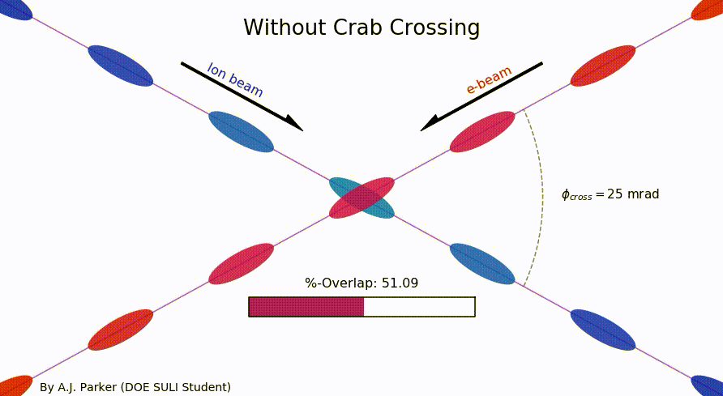
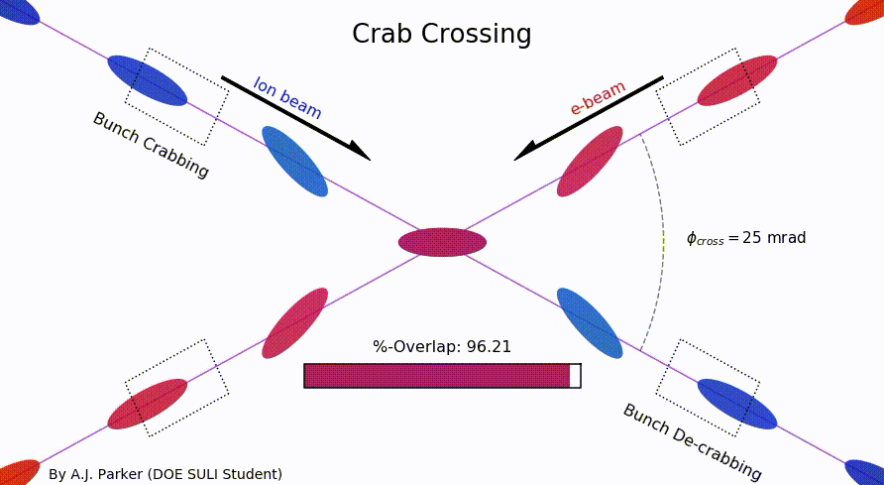
SULI Student Project
As an exercise to learn Python, our summer student Asia Parker (Duquesne University) took a static image of the EIC’s crab crossing and made an animation.
She did this within a couple weeks and now has her first code on github: https://github.com/sherwberry/SULI2020_CrabCrossingAnimation
Asia is now working on improving deuteron form factor parameterizations that are needed for high Q² yellow report studies.
And of course this summer all SULI student work is being done remotely.

Slide 18
Pushing for next generation technologies for the EIC
Steaming Readout
https://www.jlab.org/indico/event/378/ (13-15 May 2020)
Artificial Intelligence for Nuclear Physics
Interdisciplinary and very attractive to our young scientists
Also provides many careers paths outside academia (APS CCPD)
https://arxiv.org/abs/2006.05422
Group photo from the workshop AI for Nuclear Physics held at Jefferson Lab 4-6 March 2020.

Slide 19
Detector Testing Program
Jefferson Lab users have a long history of its users setting up small parasitic detector tests in the experimental halls to ensure successful experiments.
With a focus on detectors for the EIC, the EIC center will coordinate between outside groups and the experimental Halls to facilitate parasitic testing.
Presently Four Parasitic Testing Areas On Site
High Luminosity Tests: Hall A and Hall C
Low Luminosity Tests: Hall B and Hall D
Presently One Area For Dedicated Testing
10 MeV Upgraded Injector Test Facility
Testing will require approval by hall leader and work coordinator as well as appropriate training and safety documentation
More details found at: https://www.eiccenter.org/detector-testing

Slide 20
Summary
Douglas Higinbotham
Physics Division, EIC Center
doug@jlab.org
Jlab has a strong commitment to furthering the science case for the EIC.
Further development the physics of the project and the requirement for the 1st interaction region.
Refining the physics case for a 2nd interaction region.
Very strong involvement of the Jefferson Lab user community in the physics of the EIC and detector development!
EIC

