Slide 1
Polarization Transfer in Wide Angle Charged Pion Photoproduction
John Arrington – Argonne National Lab
Andrew Puckett – University of Connecticut
Arun Tadepalli – Jefferson Lab
Bogdan Wojtsekhowski – Jefferson Lab

Slide 2
The spokespersons
John Arrington
Andrew Puckett
Arun Tadepalli
Bogdan Wojtsekhowski

Slide 3
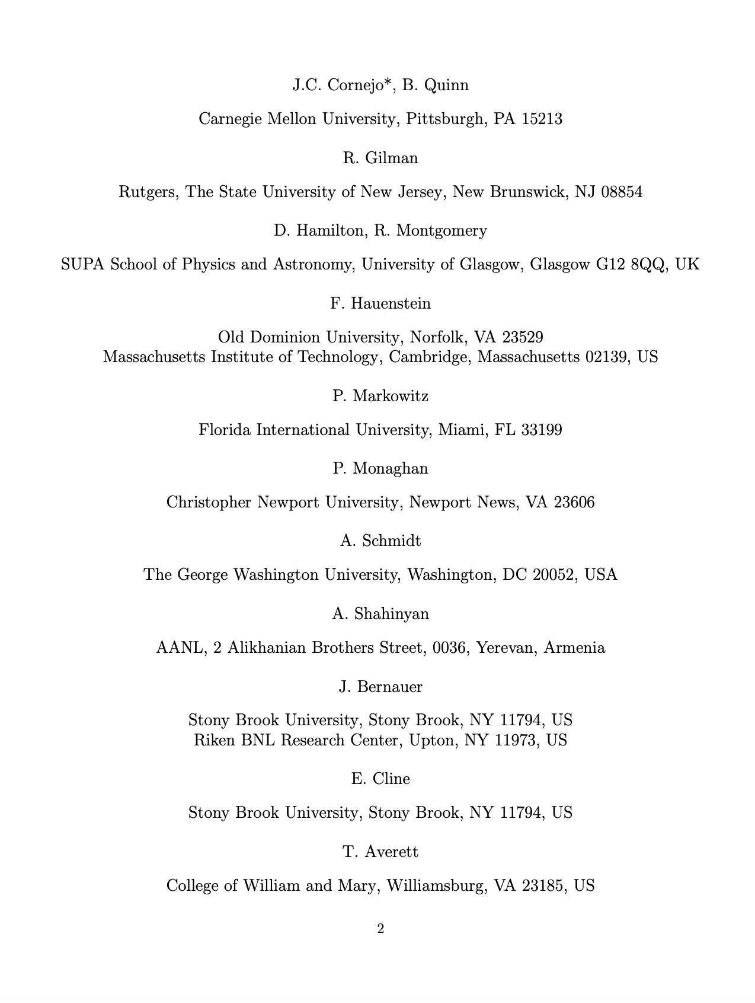
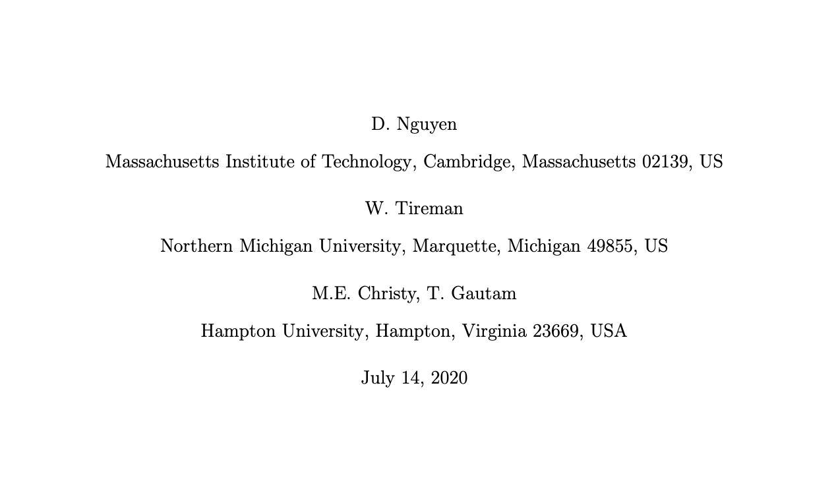
> 60 collaborators!

Slide 4
Contents
Field of Meson Photoproduction
Observed yet unexplained cross sections
Theoretical efforts
Possible solution: Polarization tests of handbag mechanism?
What are we proposing?
Summary

Slide 5
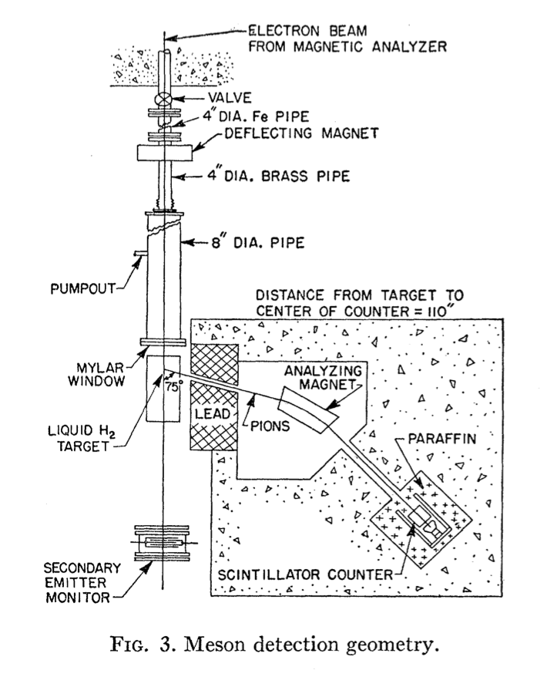
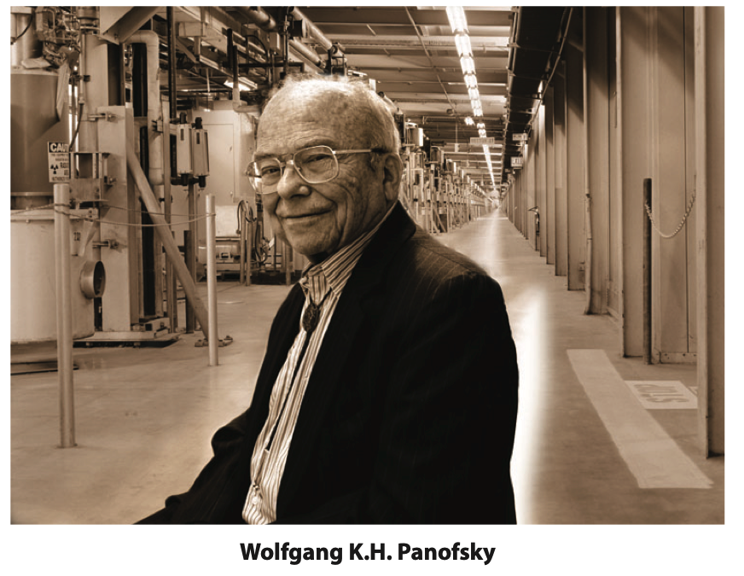
Meson Photo- and Electroproduction
Has been around for quite some time!
Early measurements at Stanford conducted to study the ratio of the pions produced due to electro and photo production

Slide 6
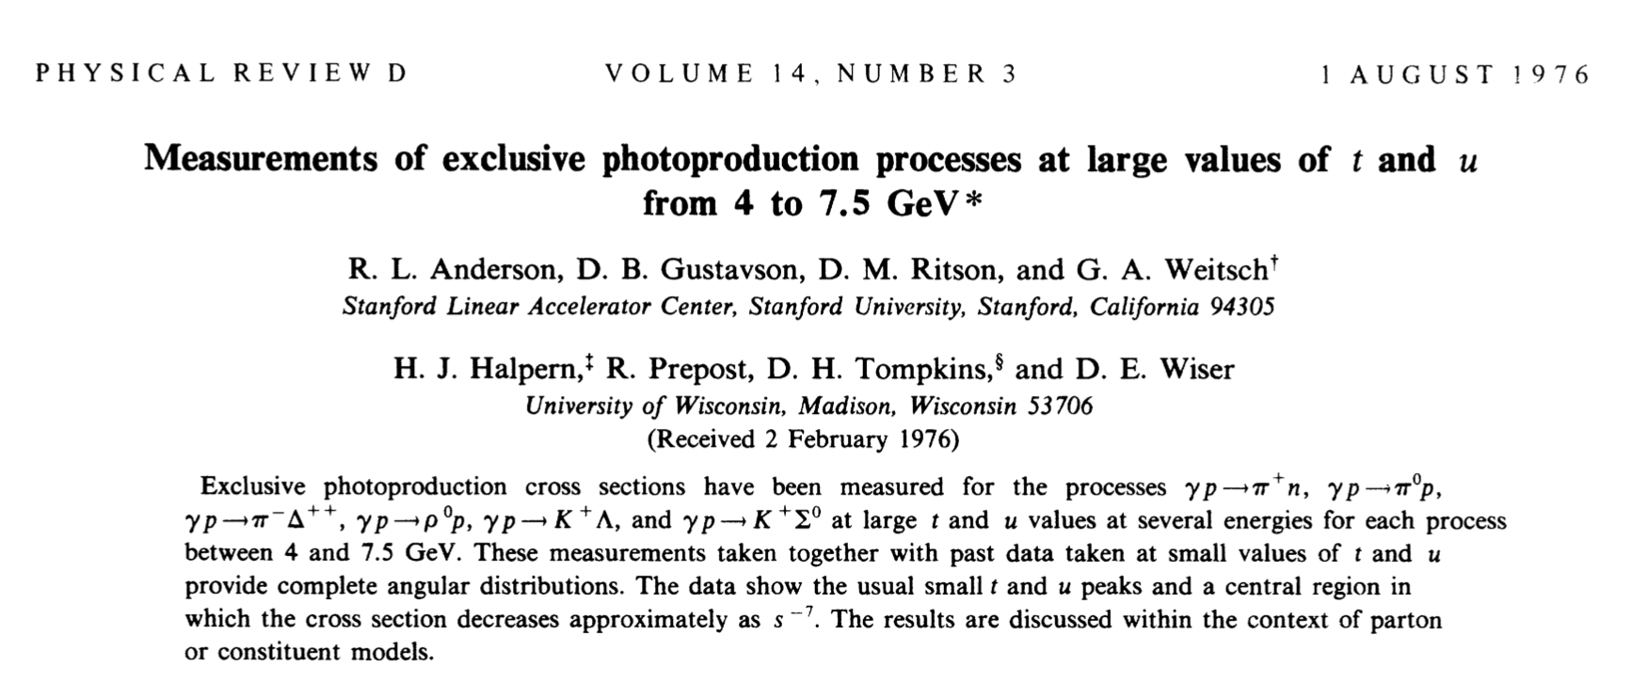
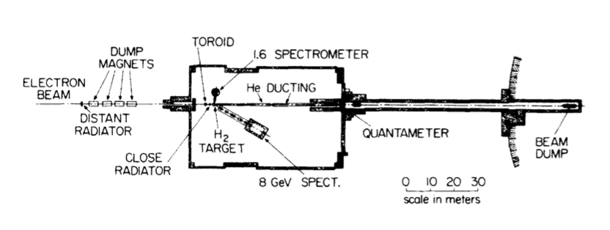
Measurements of exclusive photoproduction
Other measurements of exclusive photoproduction were conducted which revealed intriguing features

Slide 7
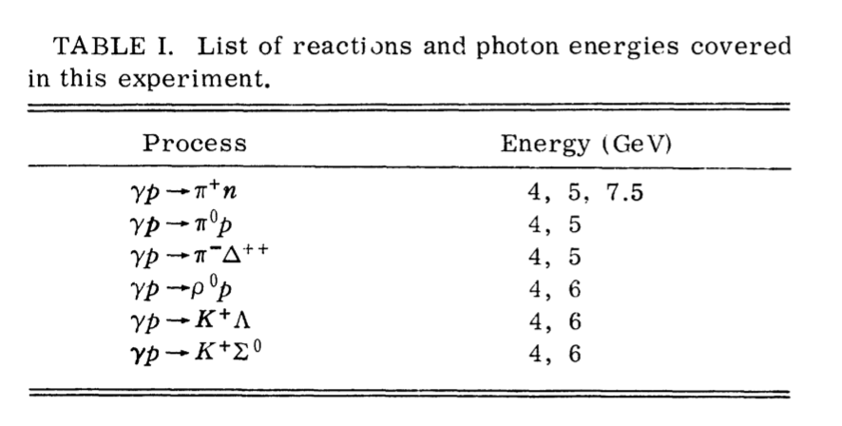
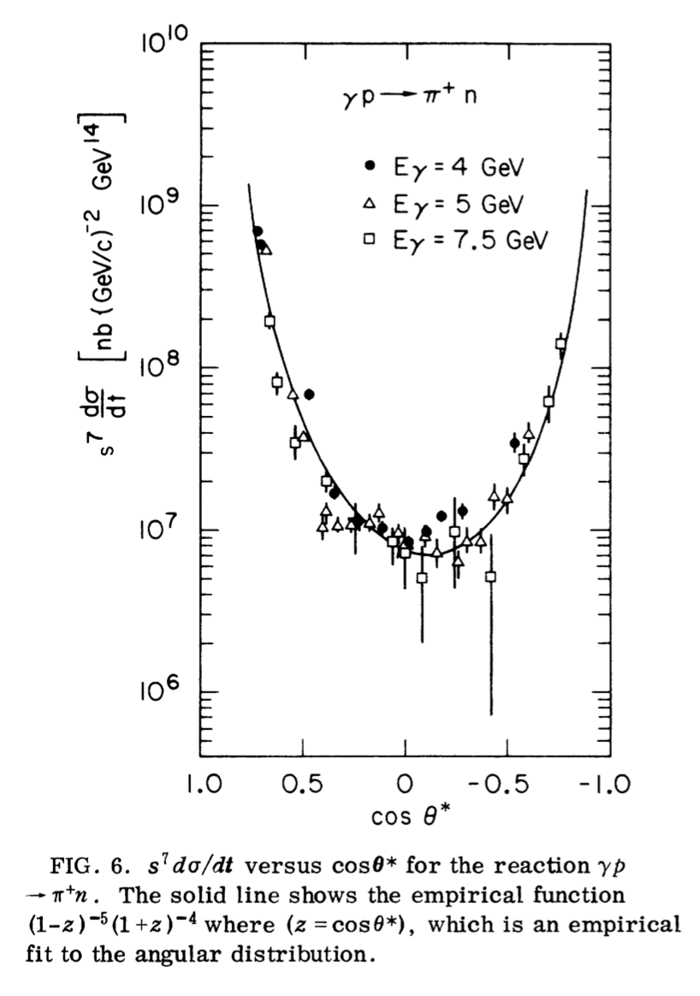
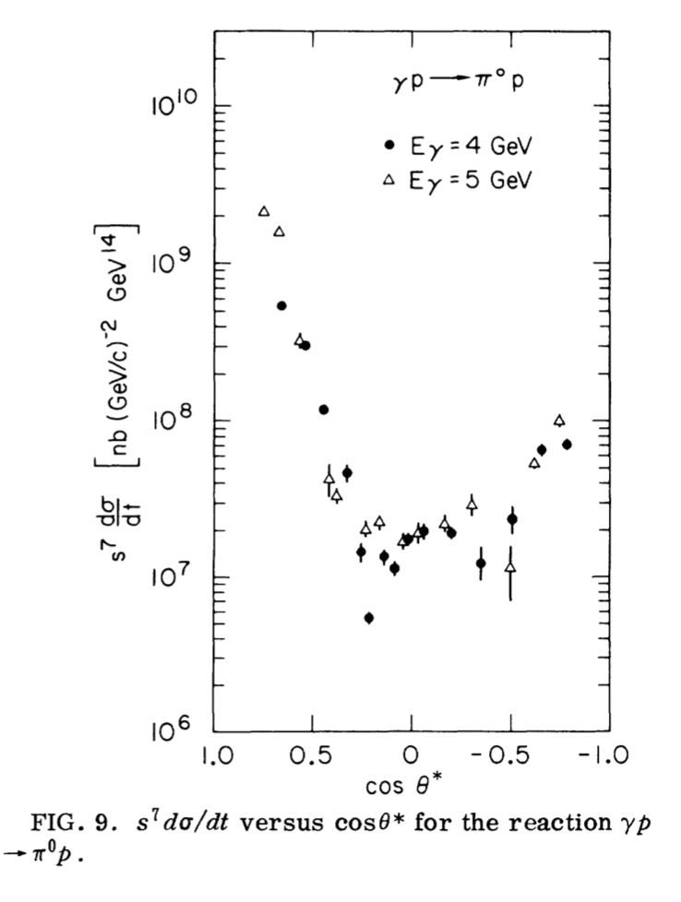
Measurements conducted for a variety of physics processes and particles

Slide 8
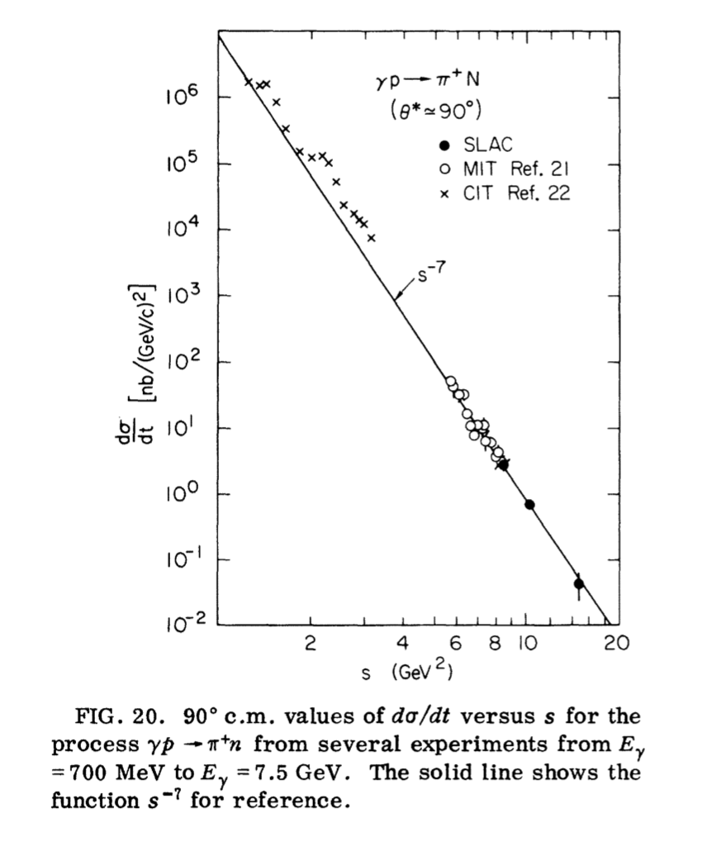
Mechanism of scaling
Continuing interest in the features but the cross sections are still unexplained
Models tried to explain the observed cross sections by considering the number of “active fields” involved in the photoproduction
CCR (Constituent Counting Rules)
HHC (Hadron Helicity Conservation)
pQCD (perturbative QCD)
Handbag approach in the GPD framework (Generalized Parton Distributions)

Slide 9
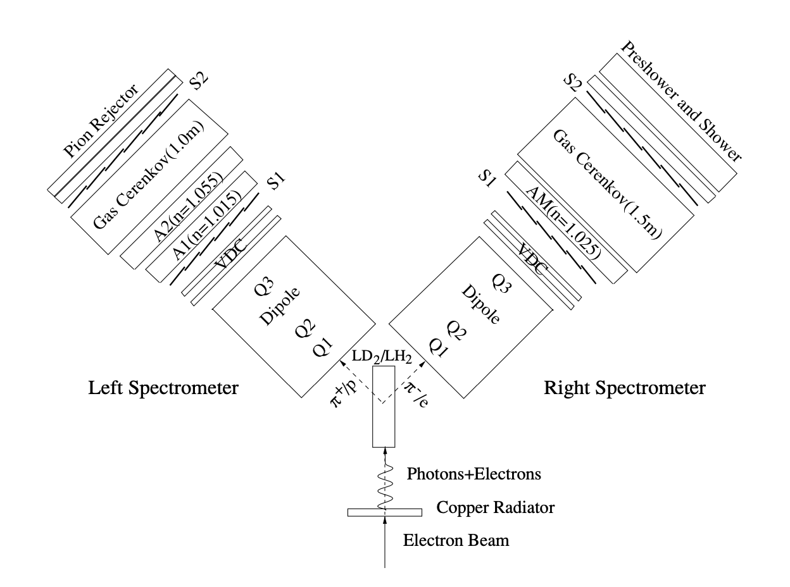
Photoproduction experiments in Hall A
Photoproduction experiments conducted in Hall A using LHRS and RHRS
π⁺ and π⁻ cross sections and their ratios studied for a range of s and t
Many intriguing features that still have continued interest at Jefferson Lab

Slide 10
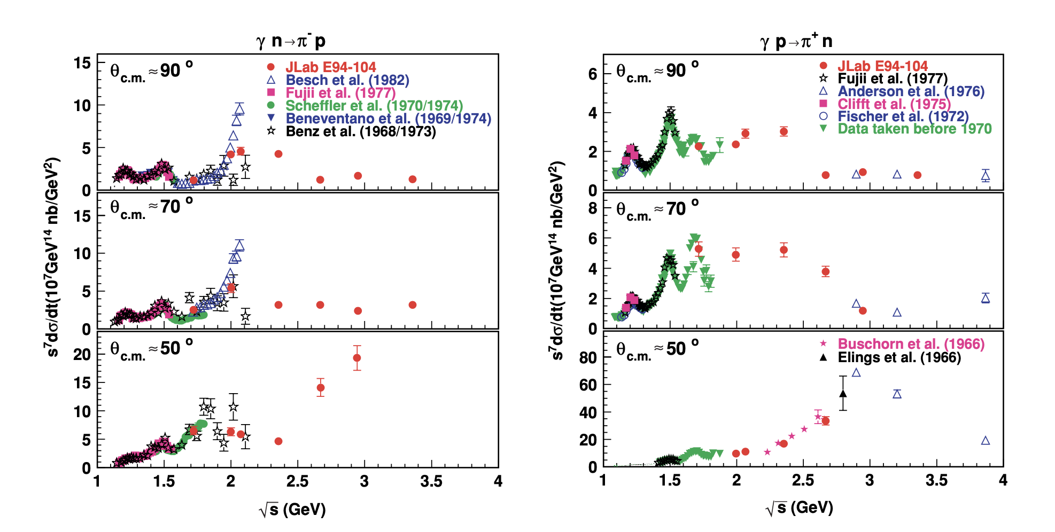
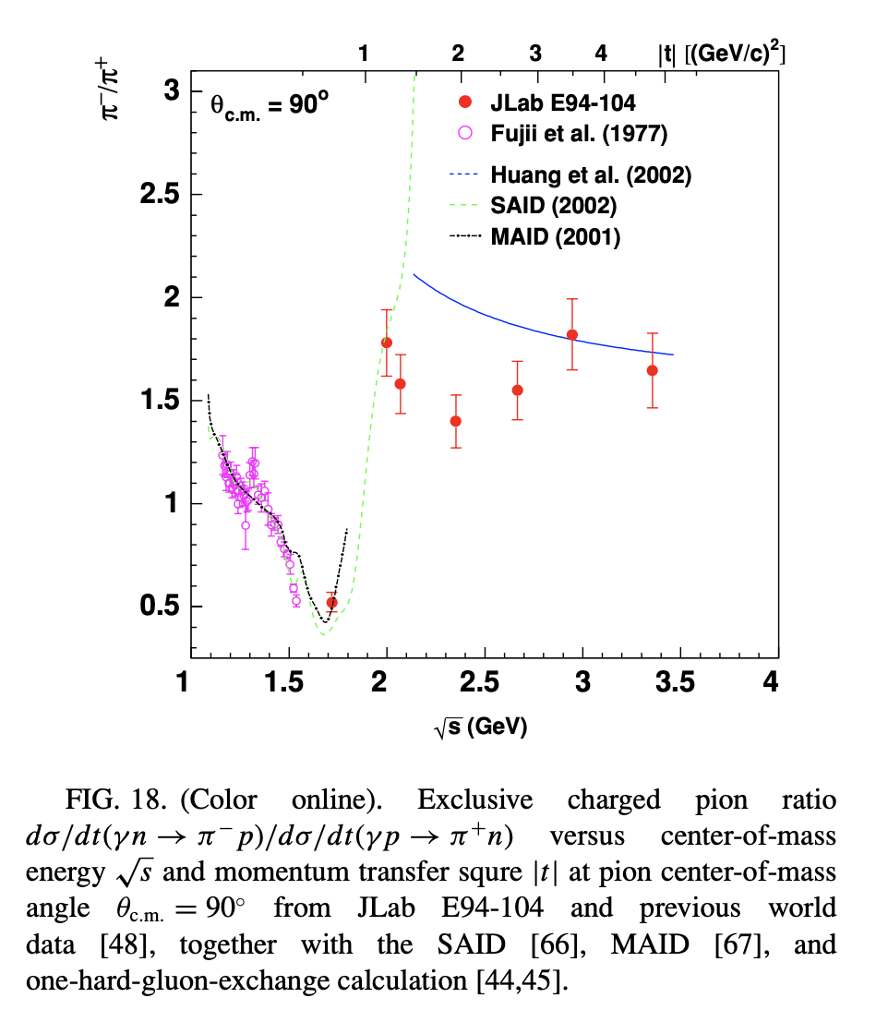
Experiment in Hall A E94-104

Slide 11
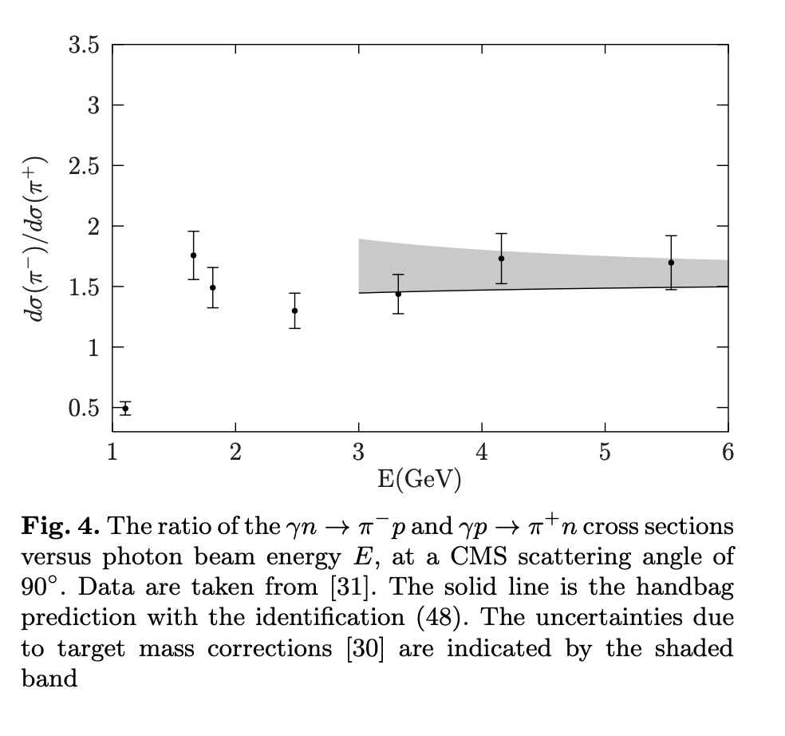
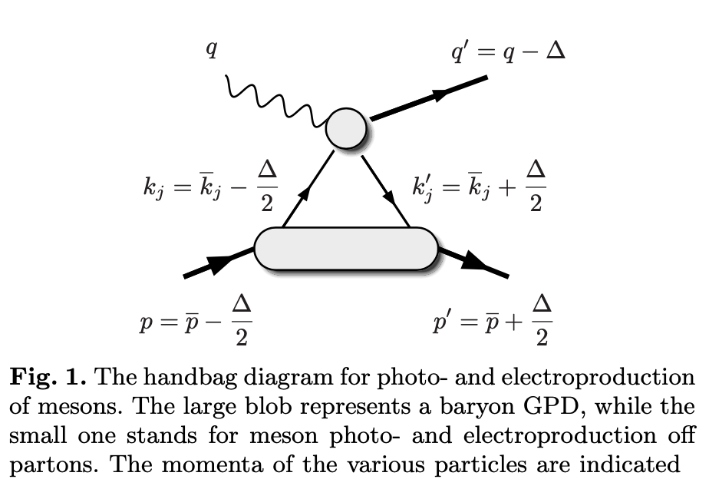
But calculations fall short!

Slide 12
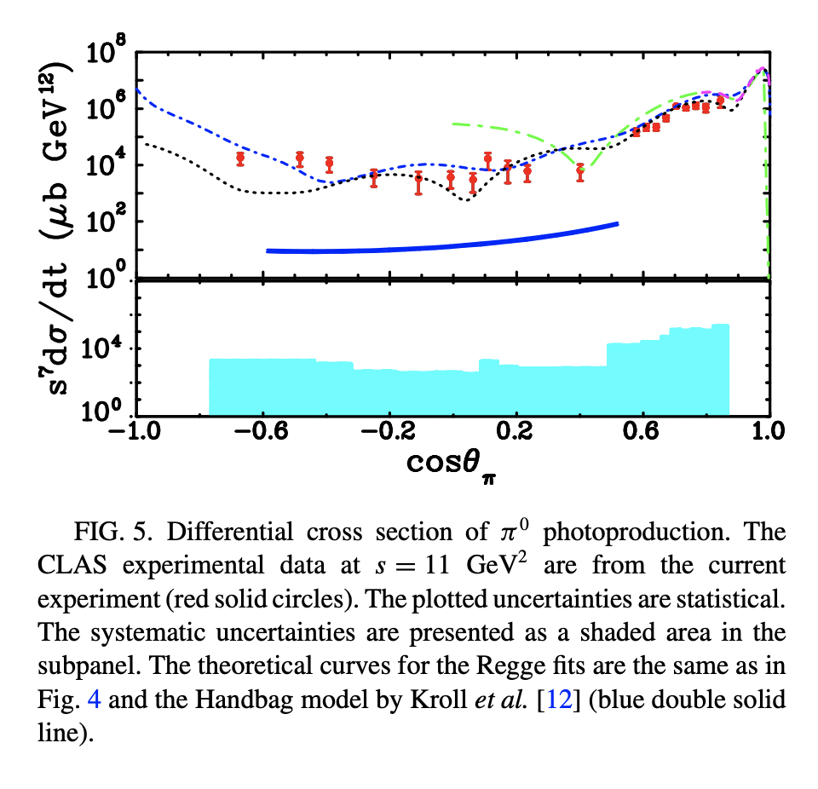
π⁰ photoproduction experiments in Hall B
Calculations using the Handbag approach fall short by more than two orders of magnitude
Missing some crucial information in the amplitude used in calculations
Figuring that out will shed light on the interaction mechanism responsible for these cross sections

Slide 13
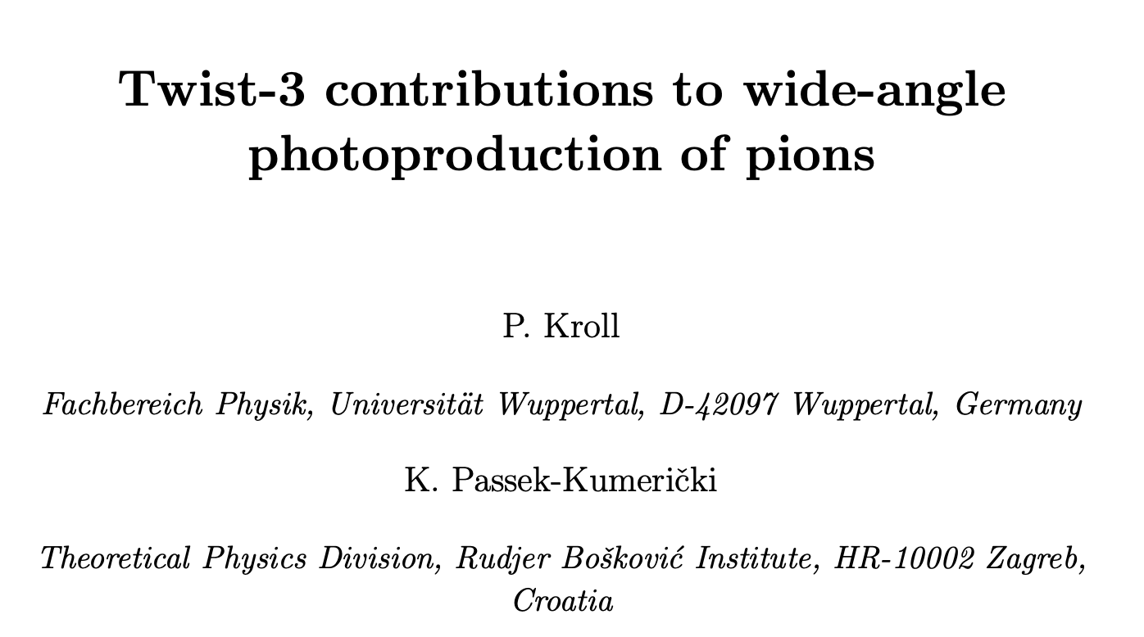
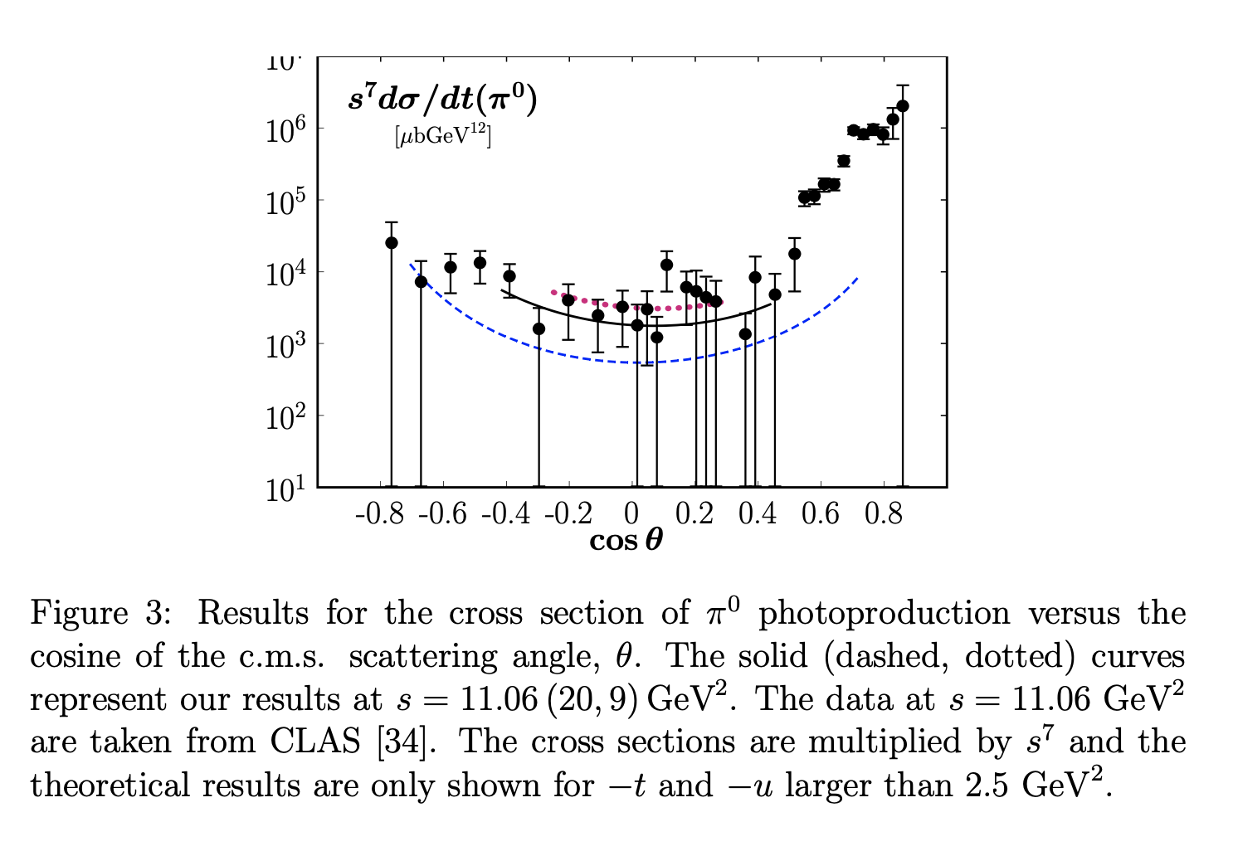
Calculations with higher twists
Calculations with twist 2 and twist 3 contributions performed for π⁰
They are in reasonable agreement (black curve) with CLAS data
Polarization test of the handbag mechanism is necessary and timely

Slide 14
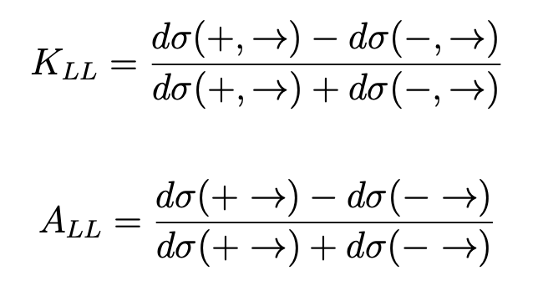
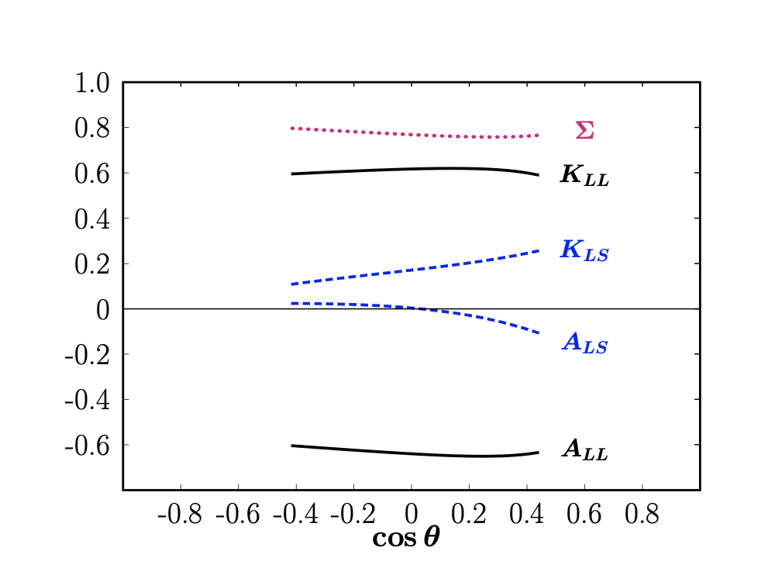
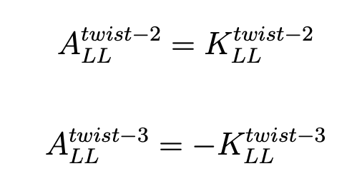
Helicity correlation observables
Helicity correlations A_{LL} and K_{LL} provide tests of the handbag mechanism
Twist 3 contribution dominates twist 2
Predictions made for π⁰ and π⁻

Slide 15
Predictions for π⁻
Measurements have been conducted for WACS for π⁰ which show good agreement with handbag mechanism
Calculations made by Kroll et al for WAPP π⁻ case
Measurement will test the calculations as well as provide constraints for other models
This measurement is fundamental, important and the first of its kind in the wide angle regime!

Slide 16
Experimental setup: same as GEn-RP setup
6.6 GeV electron beam (photons in the range 4.0 – 6.0 GeV)
LD2 target with 6% Cu radiator upstream
BigBite as the pion arm
SBS as the nucleon arm

Slide 17
Mandelstam variables >> λ_{QCD} to test out handbag mechanism

Slide 19
Energy deposition in the preshower and shower
GEn-RP trigger designed to have increased e⁻ efficiency
Threshold cuts have to be applied on at the trigger level to suppress e⁻ and increase pion detection efficiency
Need to demonstrate the feasibility of such a configuration change

Slide 20
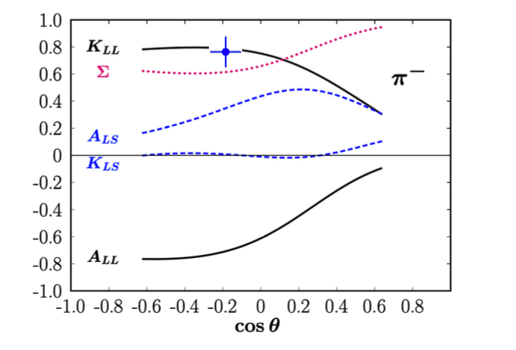
Projected results for K_{LL}
Just 48 hours with 16 hours beam energy change procedure (4.4 to 6.6 GeV)!

Slide 21
Summary
Wide angle pion photoproduction is an interesting and a powerful took to study the interaction mechanism in the wide angle regime
A solution (handbag approach in the framework of GPDs) has been proposed and an independent test of the polarization observables is timely and necessary
Proposal has been submitted to PAC48
With minimal beam time request and experiment configuration change, we can test something fundamental that will contribute to the 3D picture of the nucleon
There is an intention to measure A_{LL} using polHe3 (proposal to a future PAC)!

Slide 22
Thank you!

Slide 23
Single arm and coincidence rates

