Slide 1
BigBite shower and preshower current status
Arun Tadepalli – Jefferson Lab
Bogdan Wojtsekhowski – Jefferson Lab
Eric Fuchey – University of Connecticut
Mark Jones – Jefferson Lab

Slide 2
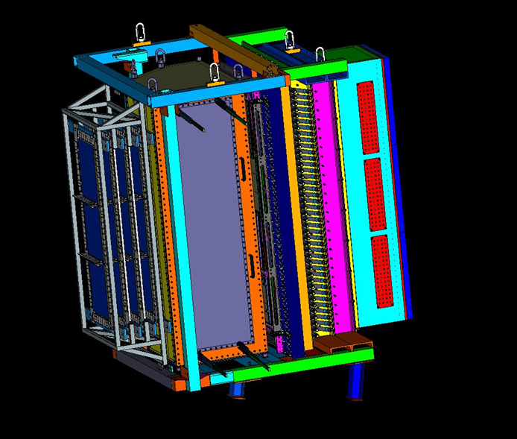
BigBite spectrometer
Major upgrade to 6 GeV version of BigBite
4 GEM chambers
INFN
GRINCH Cerenkov
W&M
1 GEM chamber
UVa
Preshower
Scintillator plane
Glasgow
Shower
Will be the electron arm

Slide 3
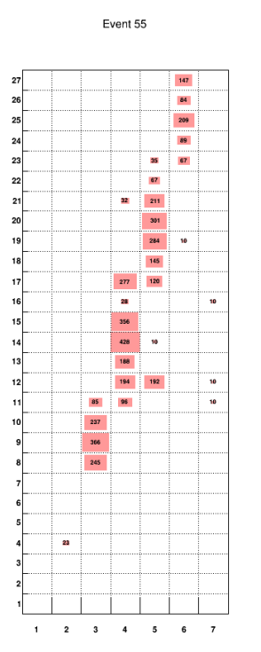
Purpose of shower and preshower
27 layers of blocks
7 blocks per each layer
Shower and preshower will be the trigger for all these experiments
Lot of changes made since the last collaboration meeting
Figure credit: Nandhu

Slide 4
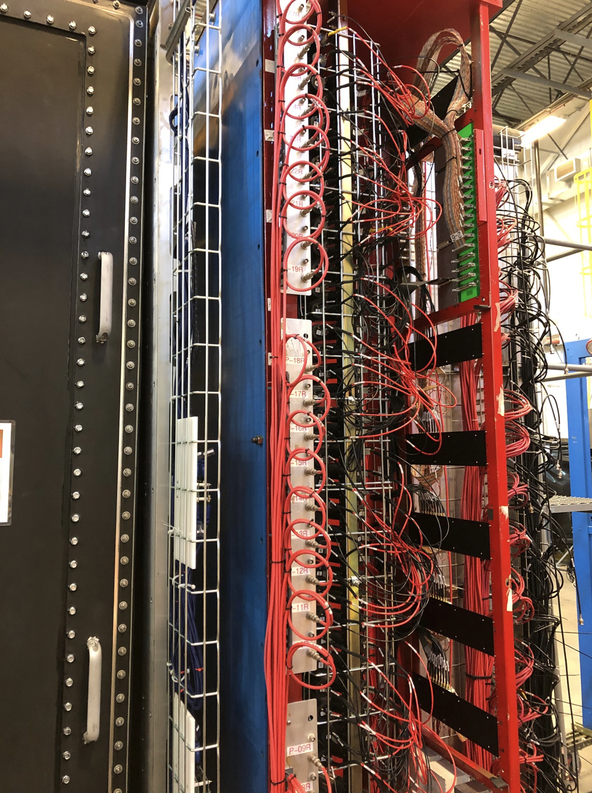
Before de-cabling and disassembling preshower

Slide 5
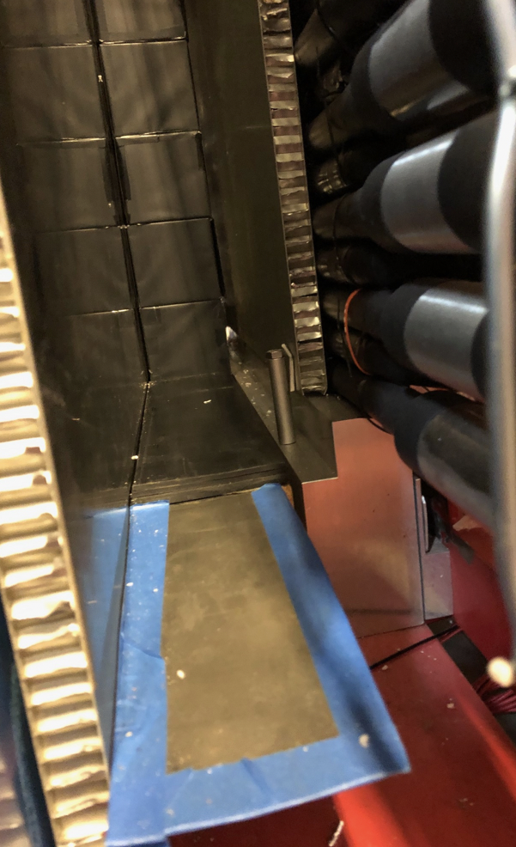
Right side removed
Timing hodoscopes
Honeycomb sheet
Rubber sheets
Mu metal sheet
*left-right convention when looking downstream

Slide 6
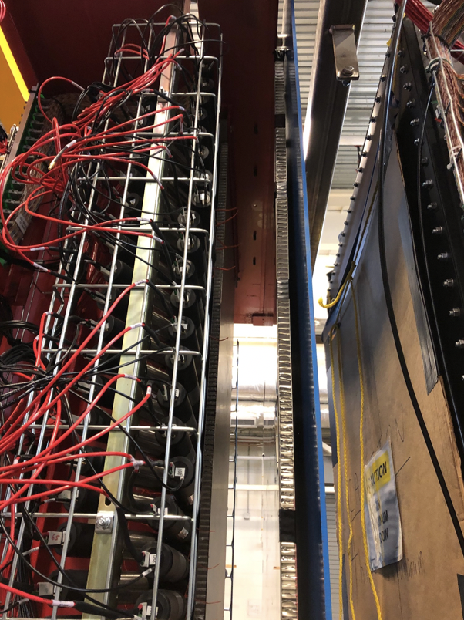
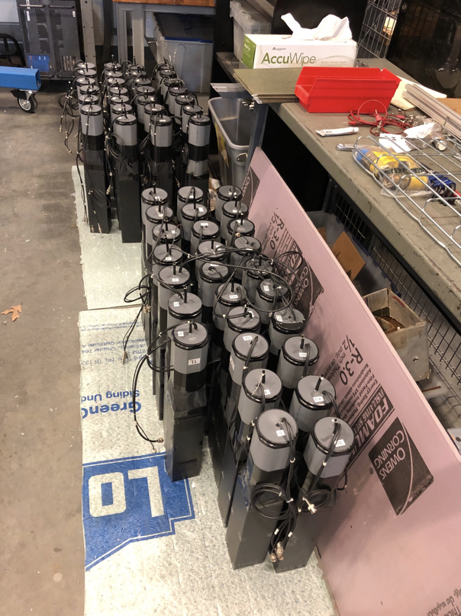
Left side removed

Slide 7
Current status
Blocks were cleaned, tested and painted (the square side that is opposite to the PMT)
Albert has been working on wrapping up the blocks
Needs to be installed and cabling needs to be re-attached
DAQ cables need to be attached
Cosmic commissioning needs to be done

Slide 8
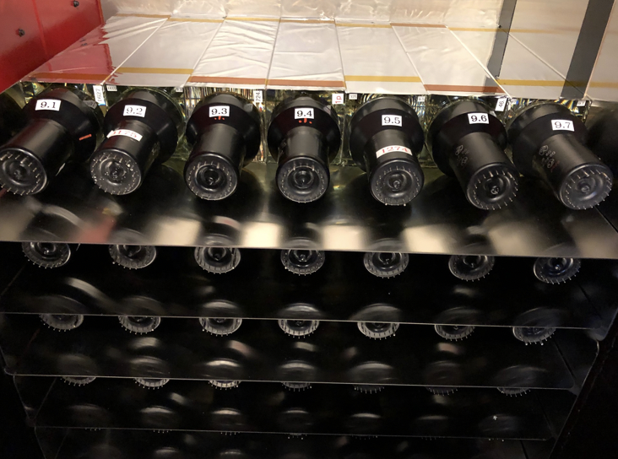
Work on shower
Replaced the inefficient shower blocks with more efficient shower blocks
Installed alternating layers of thick and thin mu-metal sheets in between different layers and on the side
Re-attached the PMT bases

Slide 9
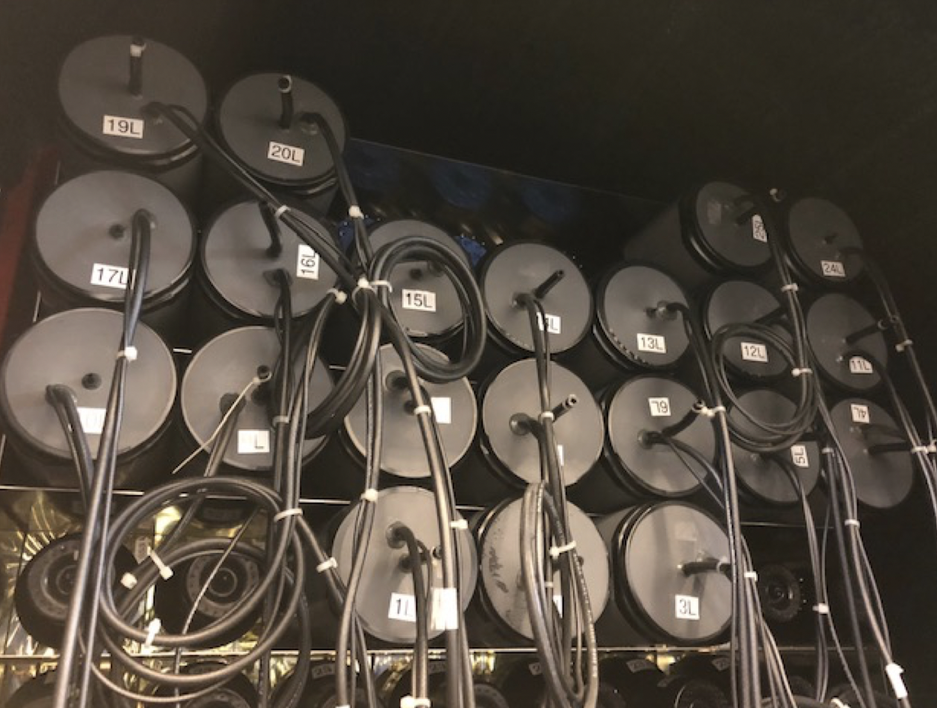
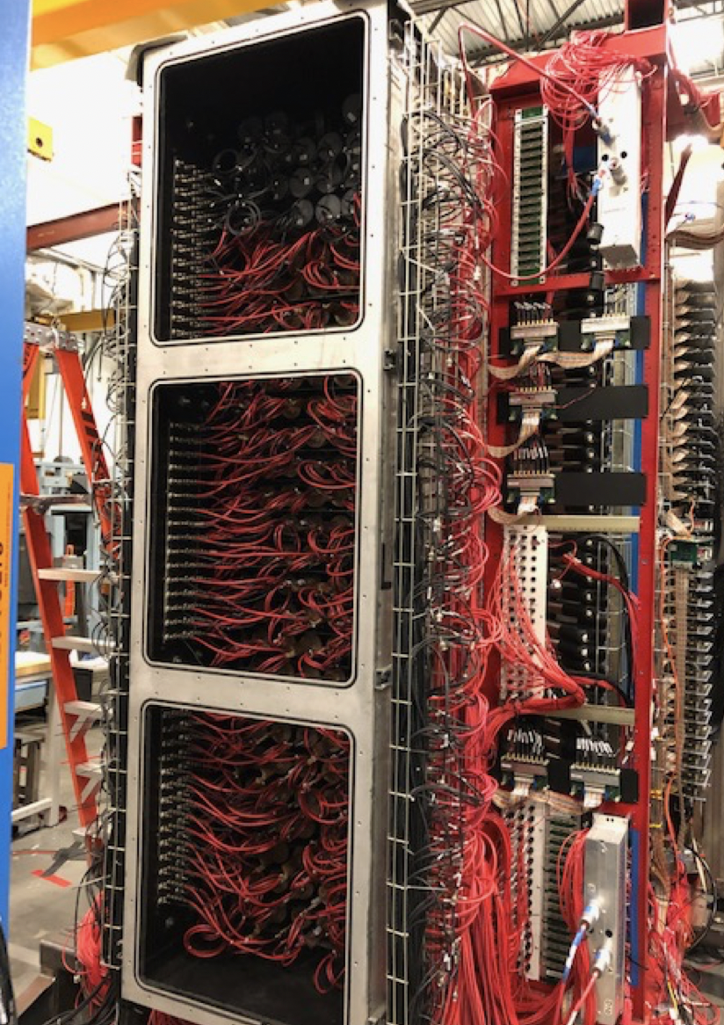
Shower status and plan
Replaced (previously adjusted) top layers of inefficient shower blocks with good preshower blocks
The HV bases for the shower have been installed

Slide 10
Shower status
100 m long BNC cables for shower completed
Next step is to start cabling up the front end shower electronics
Install the cosmic counter on top of the shower

Slide 11
List of remaining tasks - shower
Ask Hall C technicians for help with making whatever cables we need
Attach the cables for the updated trigger logic from the patch panels
Check for any light leaks
Make sure that all the cable connectors are intact
Cosmic counter connected but HV connection need to be labeled and identified in the software
Check if the cables are connected properly
Make sure the current on the HV bases are ok by turning on one layer at a time and observing the base current. Make sure that they are mapped correctly by checking the signals from the DAQ side
Check the shape of the amplitude distribution from each module
Take data at different high voltage settings
Perform gain matching studies for the shower (Mark’s code) and make sure that the 𝛂 value is satisfactory
Make documentation

Slide 12
List of remaining tasks - preshower
Install the magnetic shield items (blue plate, smaller plate and spacers)
Make inlet for gas flow for each preshower block housing
Move preshower blocks from EEL building
Install the preshower modules in place (rubber piece goes at the bottom*)
Install the red u-channel and cable support angle bar
Attach the cables
Steps are identical as mentioned in the previous slide (steps 1 - 11)

Slide 13
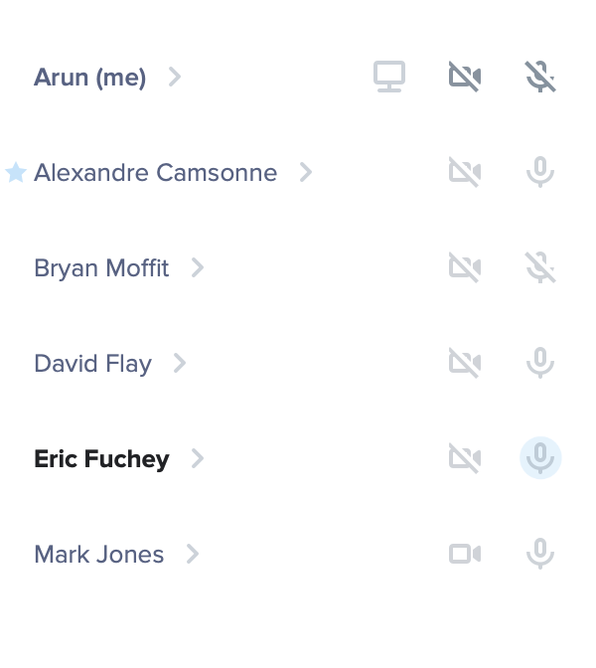
DAQ for shower and preshower
Switch to CODA 3 ( B. Moffit)
Setup TS and TD in VXS crate ( B. Moffit, A. Camsonne, M. Jones)
Setup fast clear for the FASTBUS ADC/TDC
Need to run optical fiber from TD to FASTBUS TI. Fiber carries the readout signal and crate busy signal
Fast clear ECL cable from TS to FASTBUS back plane card
ADC Gate/TDC stop cable from TS to FASTBUS back plane card
Pedestal readout with pulser trigger to test system (E. Fuchey, A. Tadepalli, M Jones)
Cosmic data for shower (E. Fuchey, A. Tadepalli, M Jones)
Use shower sum of two layers as the trigger.
Cosmic data for preshower (E. Fuchey, A. Tadepalli, M Jones)
Use separate scintillator paddles as trigger

Slide 14
Thank you

Slide 15
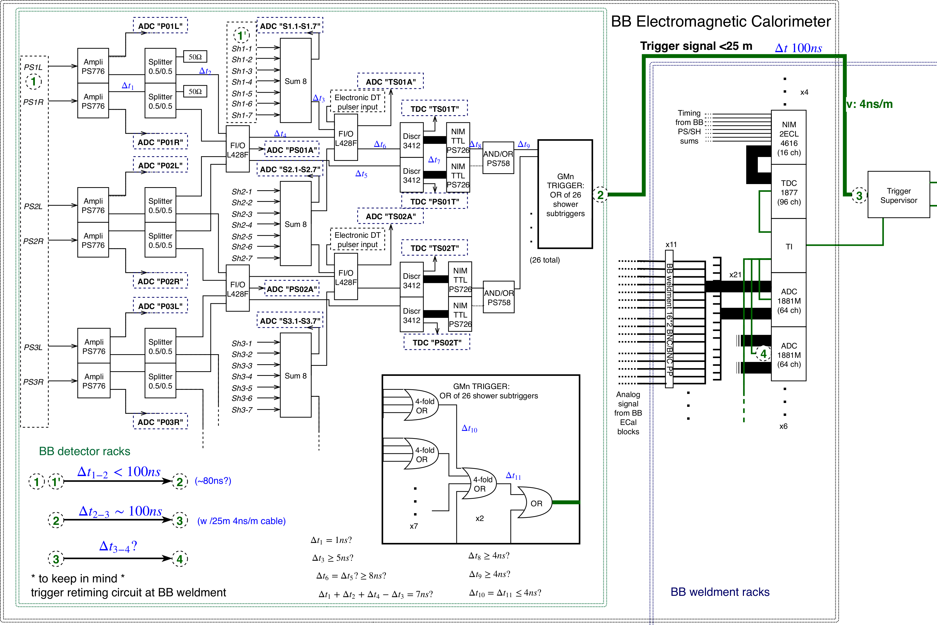
Global scheme: BB Ecal and trigger logic + preliminary timing
#24
#12
NB: #?? in gray corresponds to item number on item liste table
#10
#25
#11
#2
#13
#3
#1
Patch panel somewhere?
#7
#16
#14
#4
#4
#15
(2)
#18
#23
(1)
#5
#19
#17
#9
#6
#20
#8 (1)
#21
#22
#8 (2)
#8 (3)
2018/08/13
15
If Δt₃₋₄ <250 ns (to be measured), we can use 500 ns cables to delay ADC.
Notes:
7/14/20
15
15

