Slide 1
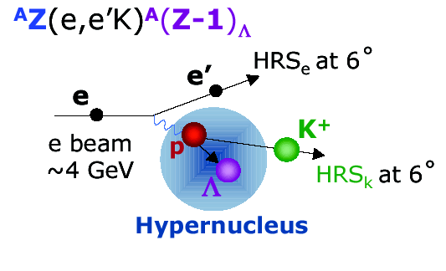
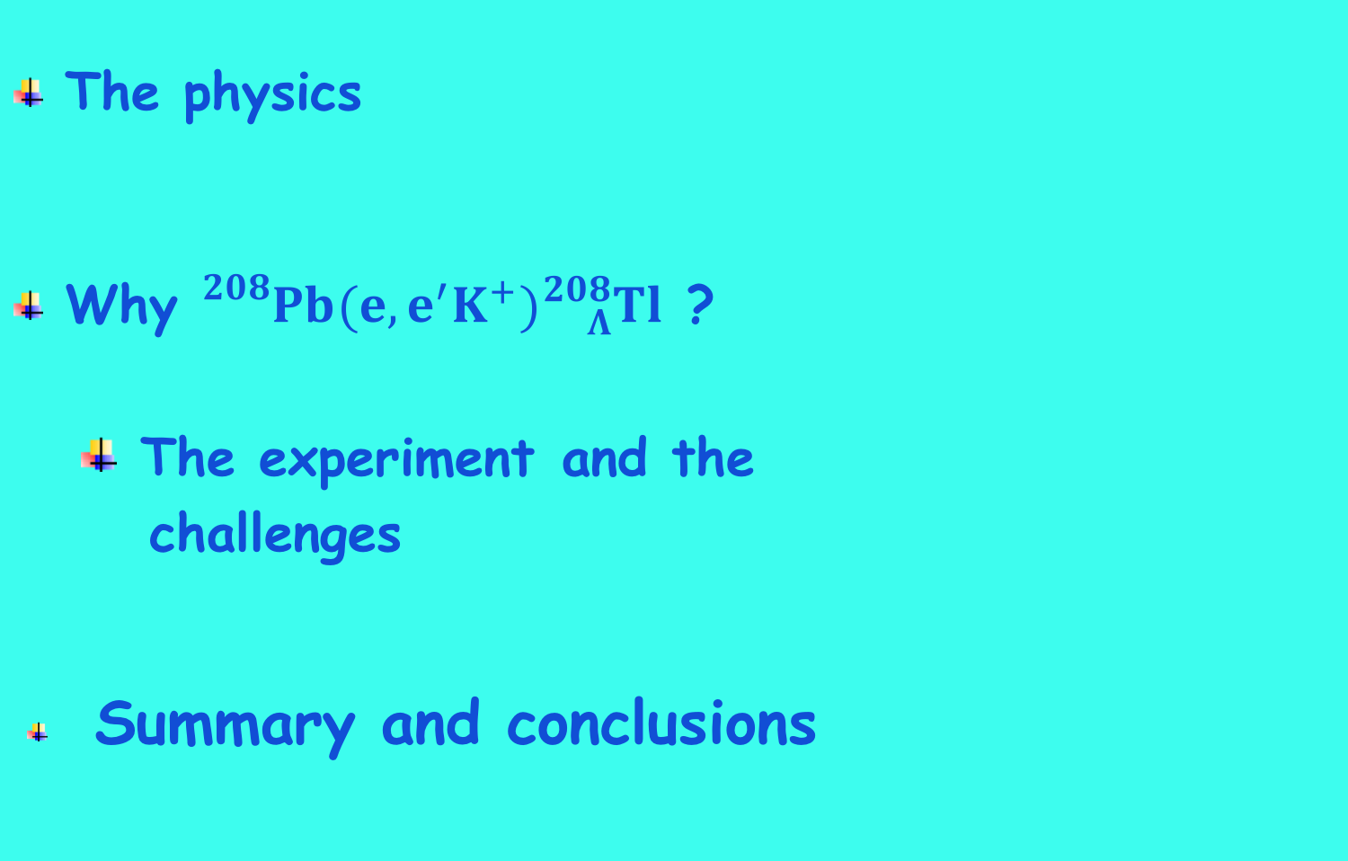

Workshop on ${}_{}^{208}{Pb}(e,e^{′}K^{+}){}_{Λ}^{208}{Tl}$
and neutron stars
F. Garibaldi May 11 - 2020
The physics
Why ${}_{}^{208}{Pb}(e,e^{′}K^{+}){}_{Λ}^{208}{Tl}$ ?
  The experiment and the
  challenges
  Summary and conclusions

Slide 2
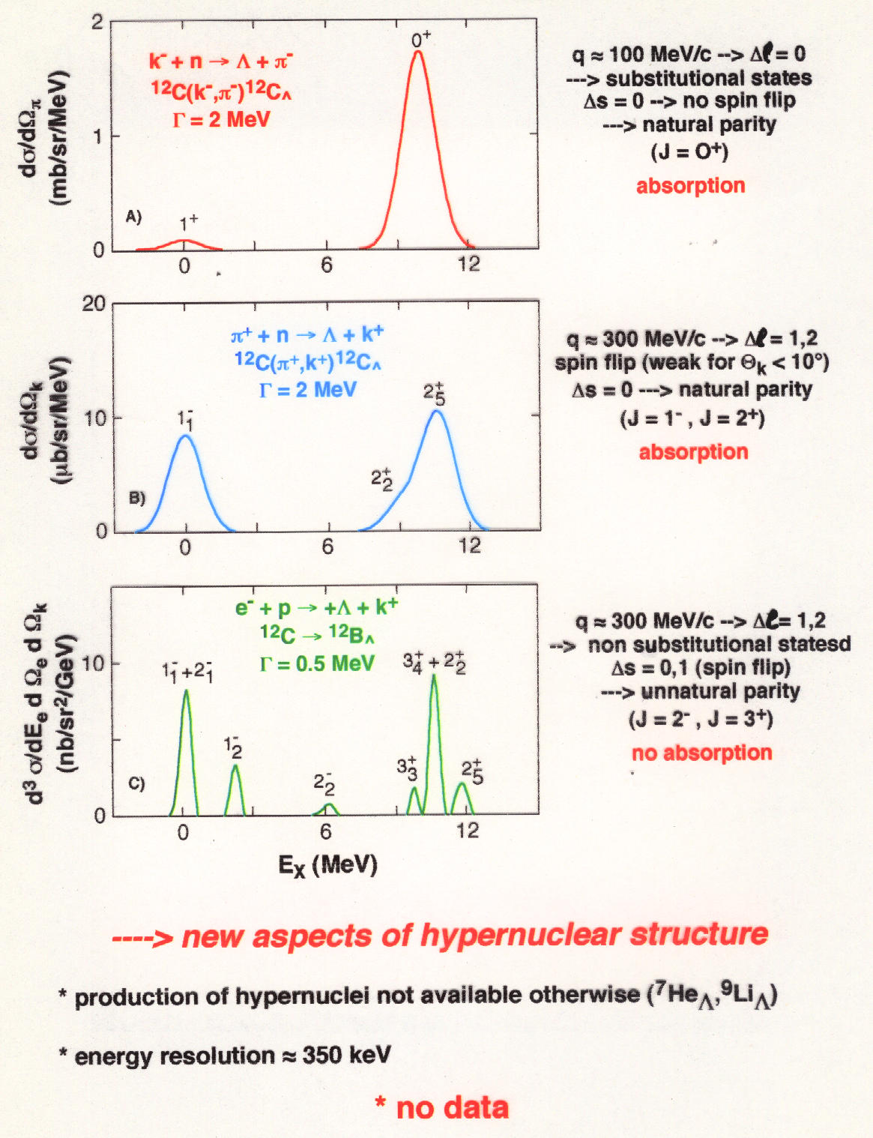
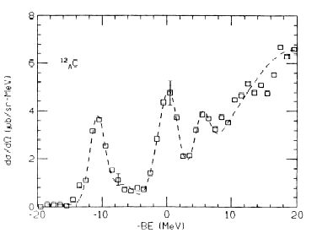
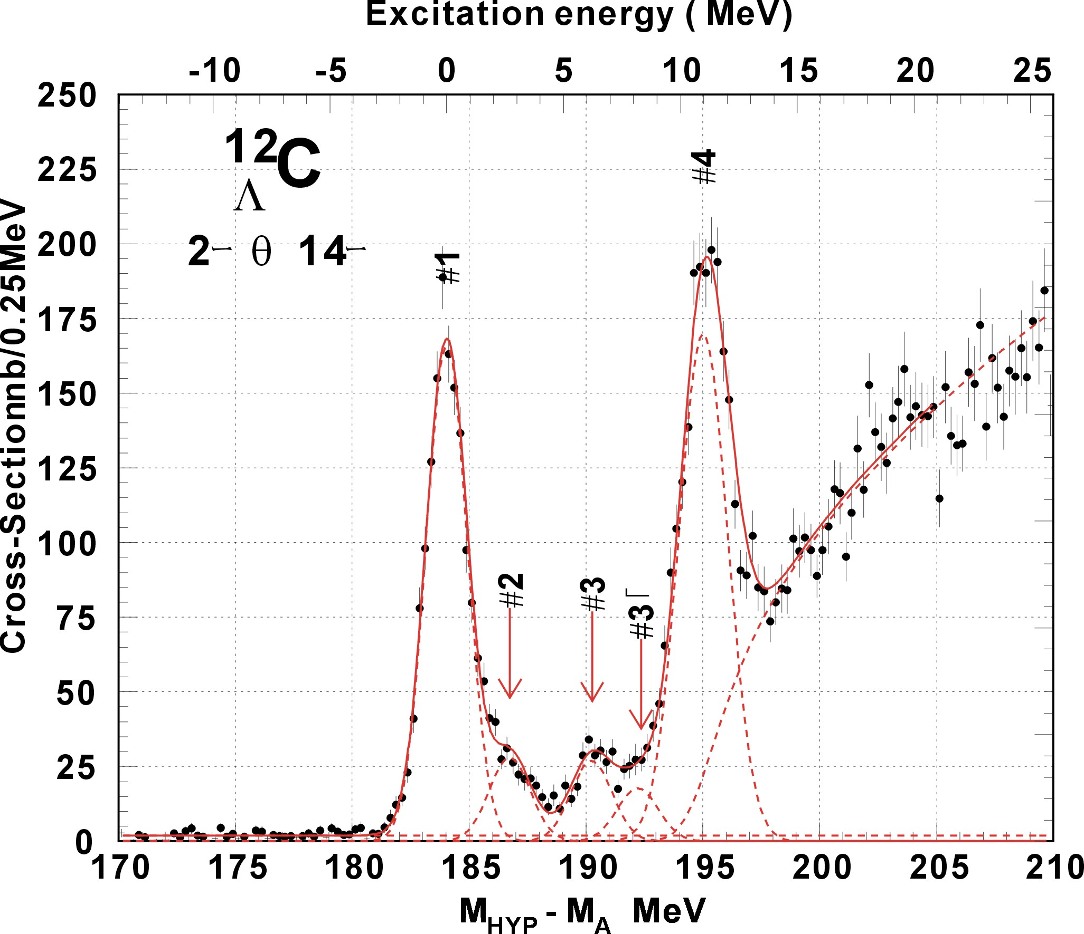
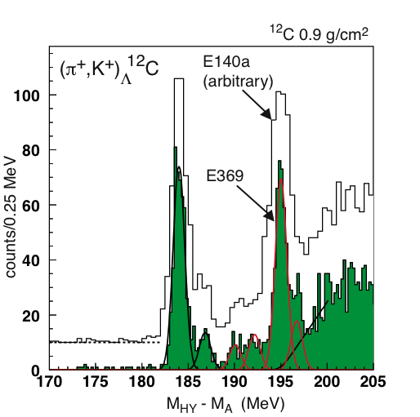
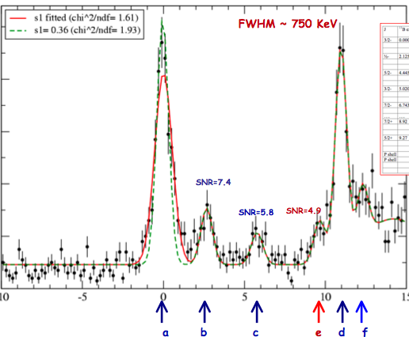
BNL 3 MeV
KEK336 2 MeV
Improving energy resolution
~ 1.5 MeV
and
using electromagnetic probe
635 KeV
635 KeV
new aspects of hyernuclear structure
High resolution, high yield, and systematic study is essential
production of mirror hypernuclei
energy resolution ~ 500 KeV

Slide 3
The hyperon puzzle
They are excellent observatories to test fundamental properties of nuclear matter under extreme conditions and offer interesting interplay between nuclear processes and astrophysical observables
Neutron stars are remnants of the gravitational collapse of massive stars having masses of (1-2 Mo ~ 2 x 10³³ Kg)
Hyperons are expected to appear in their core at ρ ~ (2-3)ρ_{o} when μ_{N} is large enough to make conversion of N to Y energetically favorable
but
The relief of the Fermi pressure due to its appearance → EoS softer → reduction of the mass to values incompatible with observation (~ 2 Mo that requires much stiffer EoS)
Strong softening of the EoS of dense matter due to the appearance of hyperons which leads to maximum masses of compact stars that are not compatible with the observations

Slide 4
The present understanding of the nuclear interactions involving hyperons is far from being complete. The reason is in a combination of an incomplete knowledge of the forces governing the system (in the hypernuclear case both two- and three-body forces), and in the concurrent use of approximated theoretical many-body techniques.
It has been suggested that three body forces could provide additional repulsion making the EOS stiffer enough to help solving the hyperon puzzle.
When additional information on the three-nucleon interaction is inferred from saturation properties of symmetric nuclear matter (Urbana IX force [PUD95]), the resulting PNM EOS turns out to be stiff enough to be compatible with astrophysical observations
Nucleons without 3 body forces
Nucleons with 3 body forces
Λ and N with 3 body forces(ΛNN)
Λ and N without 3 body force
It clearly appears that the inclusion of YNN forces (curve 3) leads to a large increase of the maximum mass, although the resulting value is still below the two solar mass line.

Slide 5
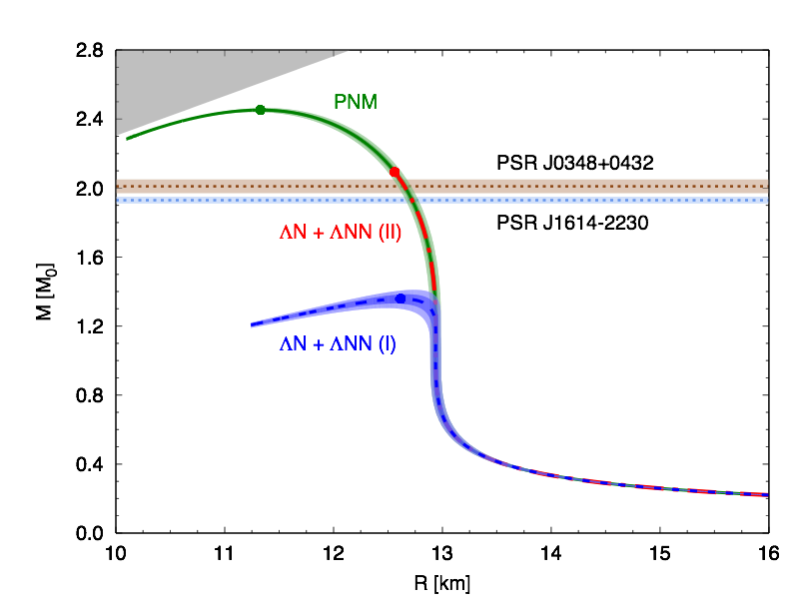
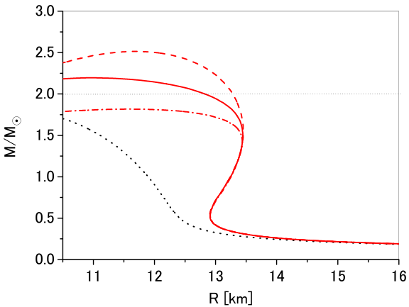
AFDMC: Argonne + Urbana
G-Matrix: ESC08 + MPa
D.Lonardoni et al., Phys. Rev. Lett. 114, 092301 (2015)
Y. Yamamoto et al., Phys. Rev. C 90, 045805 (2014)
The new parametrization of AFDMC (normalization of (π,k) data (shifts of 0,54 MEV)) of Mcarlo calculation brings to the right mass
Important role played by the experiment on ¹⁰_{Λ}Be performed in Hall C by this collaboration: High resolution spectroscopic study of ¹⁰_{Λ}Be T. Gogami et al. (HKS(JLab E05-115) Collaboration) Phys. Rev. C 93, 034314 (2016) – Published 10 March 2016
See also: Gal, Hugenford and Millener, “Strangeness in Nuclear Physics”, Rev of Mod. Phyisics 88
July 2016

Slide 6
The results of AFDMC calculations show that the difference between the Λ binding energies predicted by different models of the three-body ΛNN force, while being still rather small in ⁴⁰Ca, rapidly increases with A
Figure 2-4: Λ separation energies as a function of A^{-2/3}. Predicted results for ⁴⁰_{L}K and ⁴⁸_{L}K are also included
(b) Experimental results for Λ in s, p, d, f and g waves. Red open circles are the AFDMC results obtained including the most recent 2-body plus 3-body hyperon-nucleon phenomenological interaction model (updated from [PED15]).
Experimental B_{Λ} values in s wave and AFDMC calculation results with 2-body ΛN interaction alone, and two different parametrizations of the 3-body YN interaction (updated from [LON14]).
The use of a ²⁰⁸Pb target appears to be uniquely suited to study Λ interactions in a uniform nuclear medium with large neutron excess
Jlab is the only lab where to make this experiment

Slide 7
Hypernuclear spectroscopy is the only method that can measure the absolute binding energy for ground and excited states with an high accuracy (< 100 KeV)
Energy calibration IS important !
We are proposing to extend the experimental study of kaon electroproduction to the ²⁰⁸Pb(e,e’K⁺)²⁰⁸_{Λ}Tl reaction.
It is a complementary (to the ⁴⁰_{Λ}Κ and ⁴⁸_{Λ}Κ experiment that was approved by PAC 45) way to address the same problem (“hyperon puzzle”). In fact E12-15-008 will allow us to extract isospin dependence of the 3-body ΛNN force
Three-body ΛNN forces are known to be strongly A-dependent, making the ²⁰⁸Pb target uniquely suited to study Λ interaction in a uniform nuclear medium with large neutron excess

Slide 8
B. Frois and C.N. Papanicolas, Ann. Rev. Nucl. Part. Sci. 37, 133 (1987)
The measured charge density distribution of ²⁰⁸Pb clearly shows that the region of nearly constant density accounts for a very large fraction (~70 %) of the nuclear volume, thus suggesting that its properties largely reflect those of uniform nuclear matter in the neutron star.The validity of this conjecture has been long established by a comparison between the results of theoretical calculations and the data extracted from the ²⁰⁸Pb(e,e´p)²⁰⁷Tl cross sections measured at NIKHEF in the 1990s

Slide 9
Exploiting K⁺ electroproduction data to constrain the models of hyperon dynamics requires a quantitative understanding of the nucleon sector
A framework has been developed (O.Benhar, P. Bydzowsky, I.Vidana) to carry out calculations of the nuclear (e,e’K⁺) cross section within the formalism of nuclear many-body theory, which has been extensively and successfully employed to study the proton knockout, (e,e’p) reaction. In fact, the clear connection between (e,e’p) and (e,e’K⁺) processes that naturally emerges from the proposed analysis, shows that the missing energy spectra measured in (e,e’p) experiments provide the baseline for a model-independent determination of the hyperon binding energies
Microscopic calculations of the Λ spectral function in a variety of nuclei, ranging from ⁵He to ²⁰⁸Pb, have been recently carried out [ref.Vidana]
The hyperon binding energies are given by the difference between the missing energies measured in (e,e´K⁺) and the proton binding energies obtained from the (e,e´p) cross sections. Hence, (e,e´p) data will provide the baseline needed to extract information on hyperon binding energies

Slide 10
Short-range correlations appear to be the most important mechanism leading to the observed quenching of the spectroscopic factor, while surface and shell effects only play an important role in the vicinity of the Fermi surface.
Deeply bound protons in the ²⁰⁸Pb ground state largely behave as if they were in nuclear matter

Slide 11
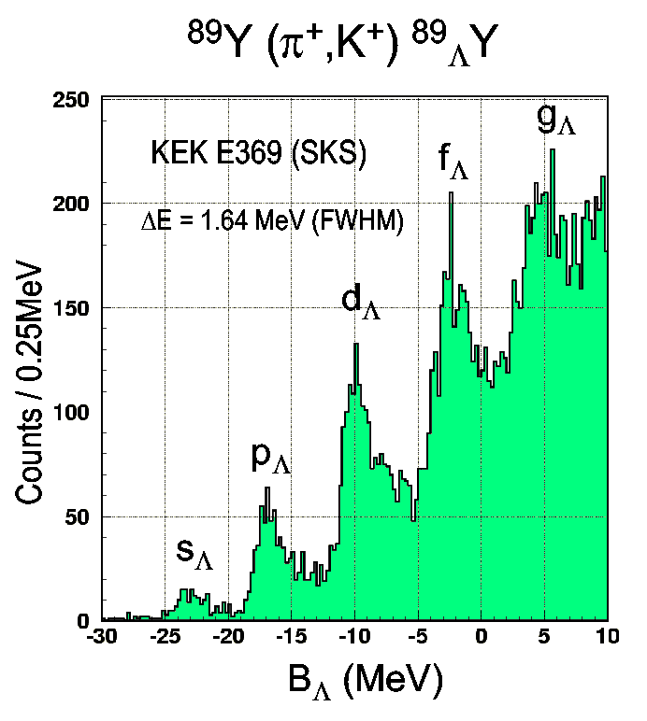
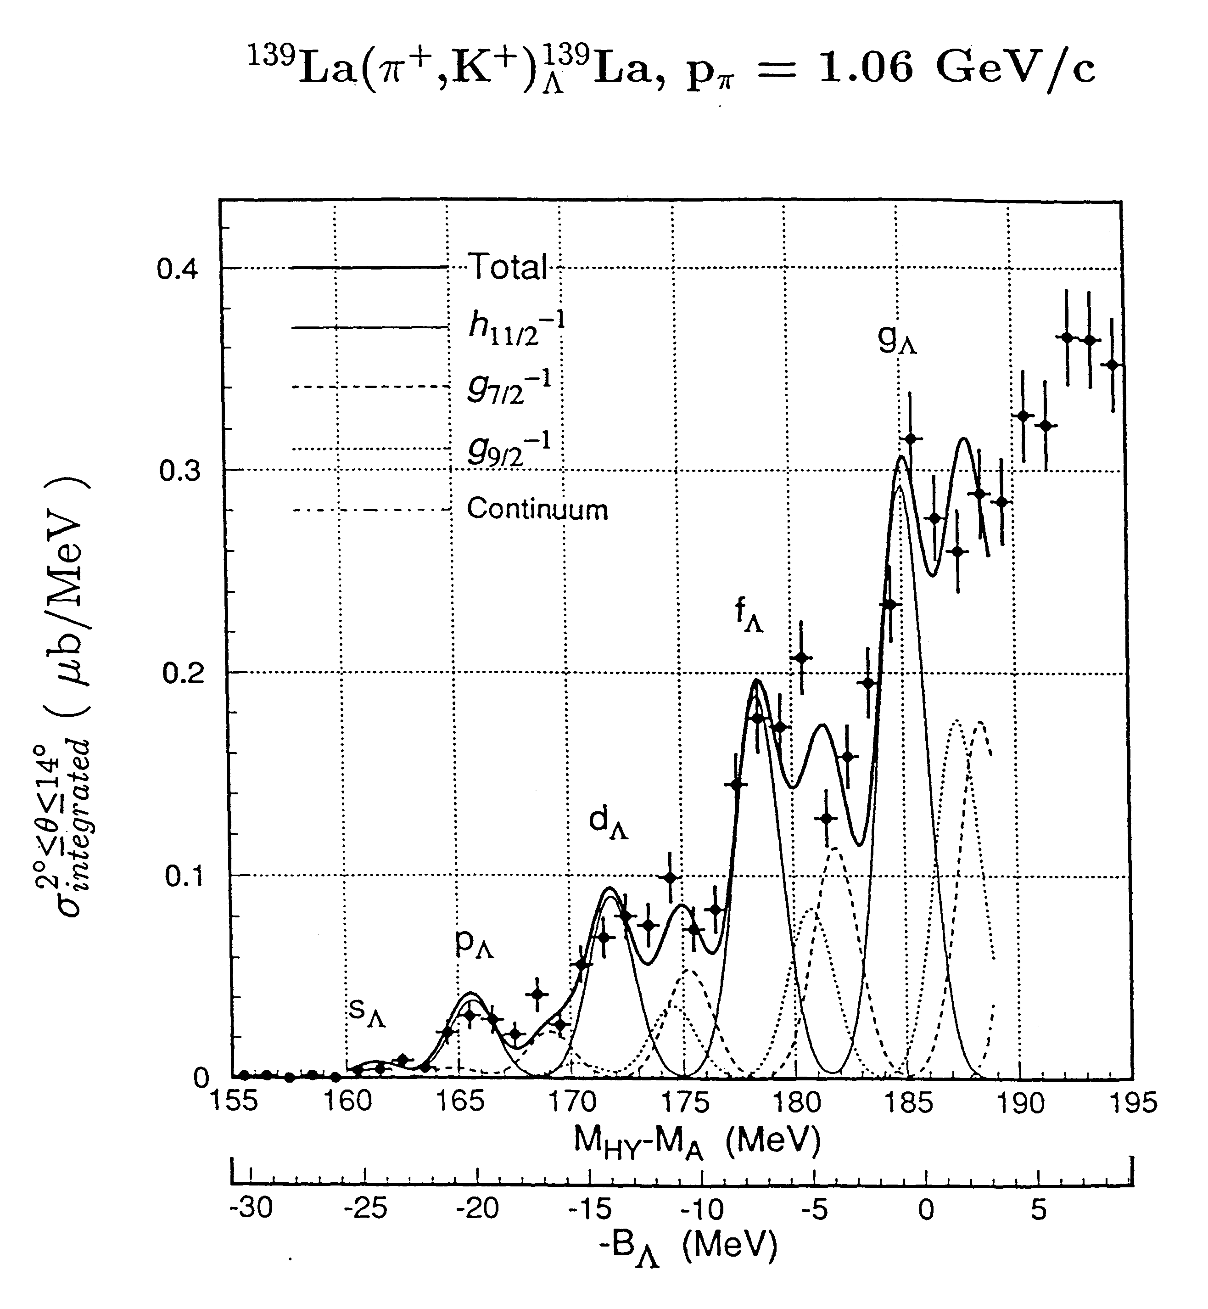
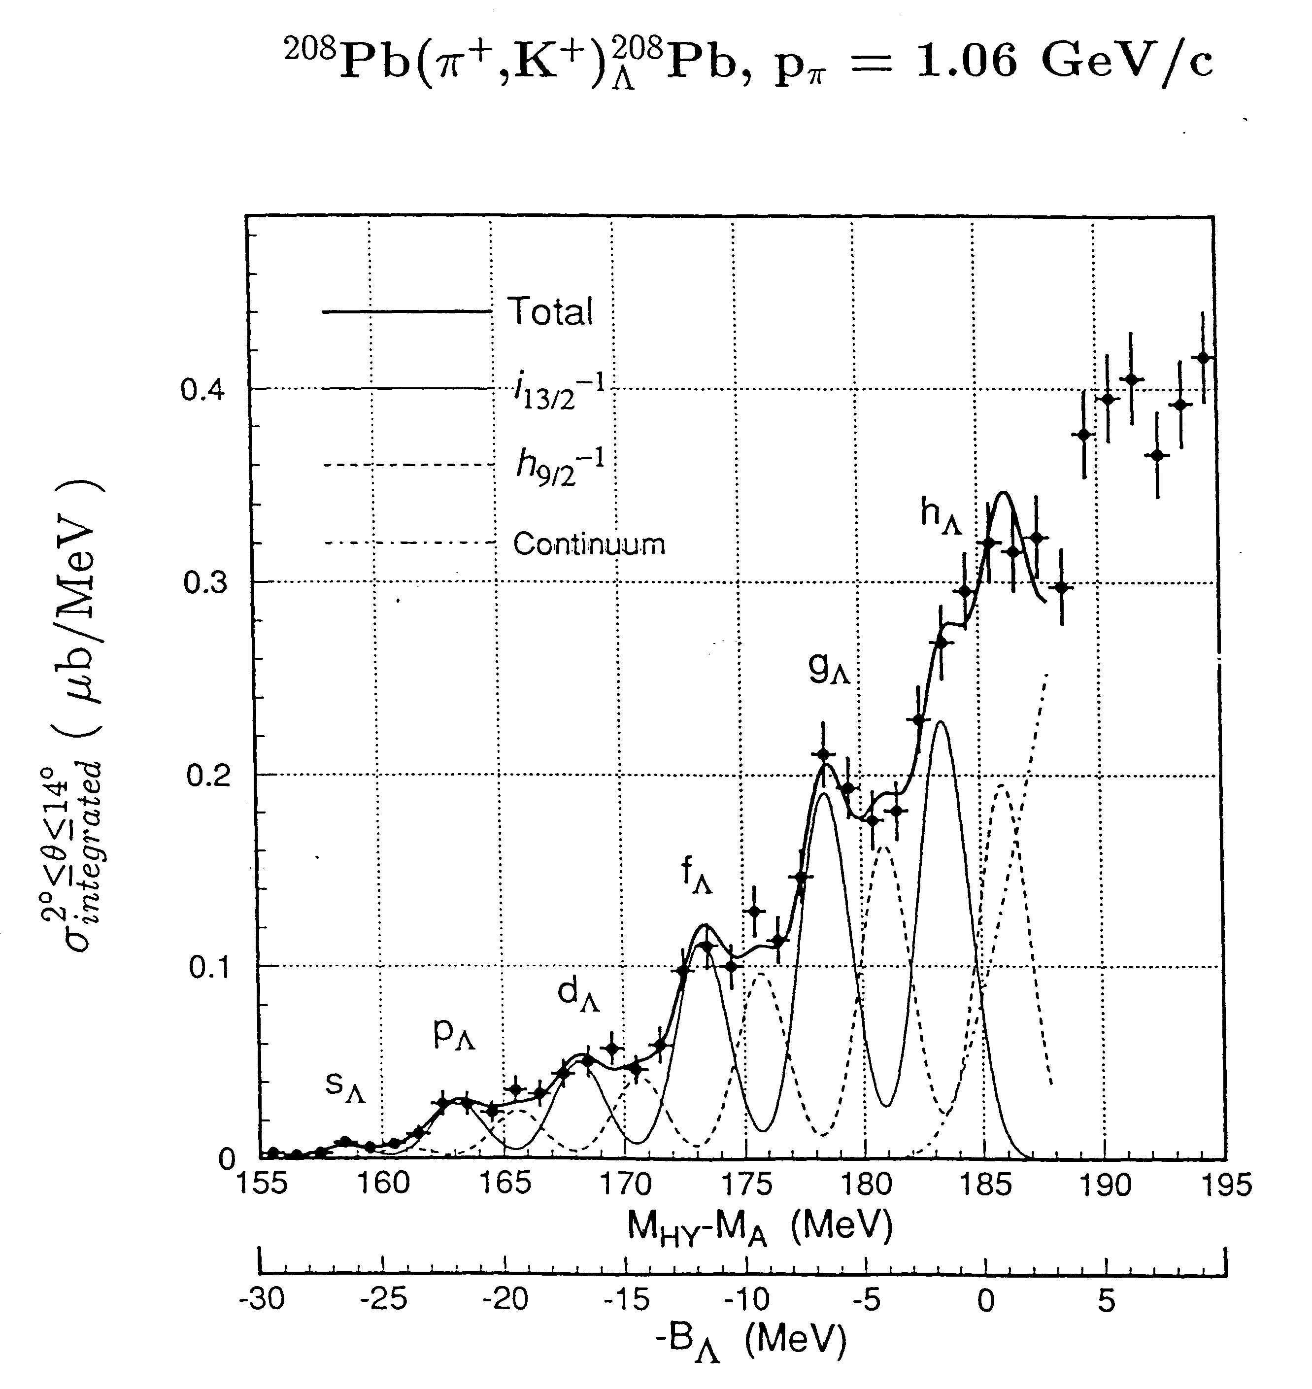
Λ Hyperon in heavy nuclei – ²⁰⁸(e,e’K+)²⁰⁸_{Λ}Ti
✔ Mass spectroscopy to its extreme
✔ (π,k) reaction, levels barely visible (poor energy resolution)
Hasegawa et. al., PRC 53 (1996)1210
Hotchi et al., PRC 64 (2001) 044302
“Up to now these data are the best proof ever of quasi particle motion in a strongly interacting system” (Review paper by Hashimoto and Tamura)
(e,e’K) reaction can do much better
Better energy resolution → Much more precise Λ single particle energies. Complementary to (π,k) reaction

Slide 12
Millener-Motoba calculations
Particle hole calculation, weak-coupling of the Λ hyperon to the hole states of the core (i.e. no residual Λ-N interaction).
One can extract Λ single-particle energies from each of the observed peaks. Each peak does correspond to several levels based on two closely-spaced proton-hole states

Slide 13
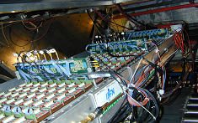
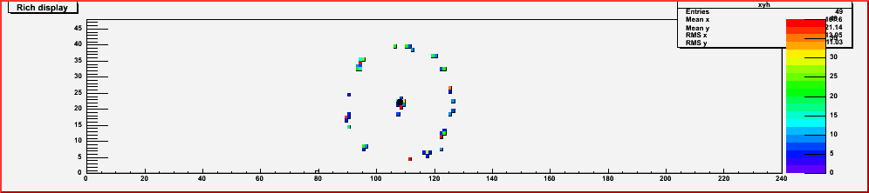
Kaon identification
HKS
We might add theRICH detector
RICH Detector
The RICH detector has been upgraded for the neutron Transversity experiment. Easy calculation show that the new layout would allow us to get an added factor of 10⁶ as π/K rejection factor
3 TOF, 2 water Cherenkov,
three aerogel Cerenkov
pK=1.2 GeV/c)
(π/k rejection ratio: 4.7 x 10⁻⁴)
(T. Gogami et al, NIM (2018) 69-83 )

Slide 14
Background free spectroscopy while maintaining good signal/accidental ratio for the heavy mass region.
The most important feature of the new configuration is the low accidental background.
The new configuration can be considered a significant upgrade of the Hall A experiment and increases its physics yield rate by a factor of five.

Slide 15
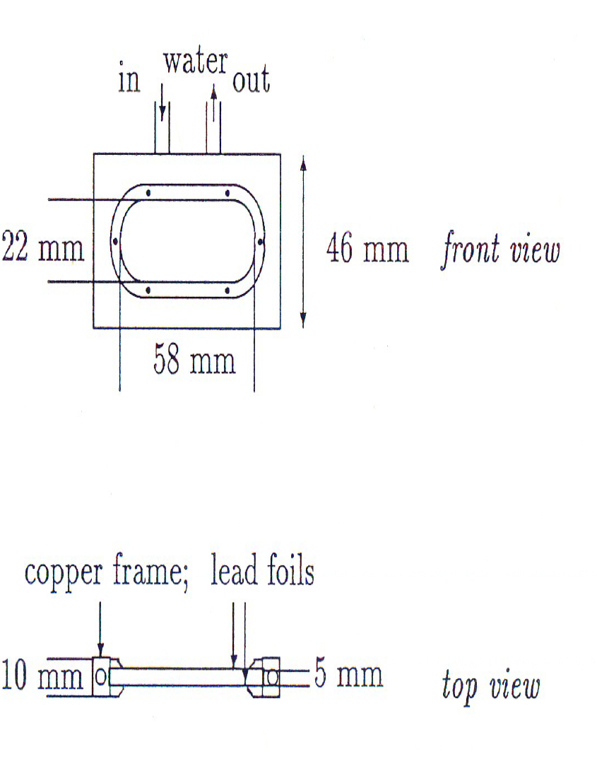
Target
Water - 15º - 60—70 l/h
Heath transfer calculation show that the conduction cooling becomes competitve as compared to increase radiation cooling by rotating the target for thick target

Slide 16
Counting rates and beam time request
Thickness (mg/cm²) | <I> (mA) | (e,e’) (kHz) | (e,K’) (kHz) | (e,p') (kHz) | Accid. (e,e’)(e,k’)DT | Back. (c/h/MeV) | Coinc. | Peak Sig. | peak
100 | 25 | 37 | 0.07 | 16 | 0.01 | 0.10 | 0.06 | 6.3 | s-shell g.s
100 | 25 | 37 | 0.07 | 16 | 0.01 | 0.10 | 0.21 | 20.8 | p-shell g.s
The calculations assume a beam time request of 840 hours (5 weeks).
We used the Sotona and Millener - Motoba calculations.The rate of K⁺ and the rate of background hadrons in HKS as function of Z and A are known and measured. The cross-section is ~ 17 times lower than the same reaction on ¹²C target. We estimated the coincidence counting rate for signal and background, assuming a rate of electrons in HRS to be comparable to the value measured in the E94-107 experiment for the same weighted thickness and beam current. This is confirmed by calculation and test measurement performed in Hall A for APEX experiment

Slide 17
Summary and conclusions
PAC45 approved a proposal on ⁴⁰_{Λ}Κ and ⁴⁸_{Λ}Κ on isospin dependence of ΛNN force to study the “hyperon puzzle”
We submitted to the last PAC a LOI to extend the experimental study of kaon electroproduction to the ²⁰⁸Pb(e,e’K)²⁰⁸_{Λ}Tl reaction to study the hyperon puzzle in a complementary way. The PAC encouraged us to submit a proposal
We show that the connection with proton knockout reactions and the availability of accurate ²⁰⁸Pb(e,e’p)²⁰⁷Tl data may be exploited to achieve a largely model-independent analysis of the measured cross section, based on the well established formalism of nuclear many-body theory
The Λ binding energies obtained from the analysis will provide valuable new information on three-body ΛNN forces, whose contributions are known to be strongly A-dependent
ΛNN could provide additional repulsion making the EOS stiffer enough to help solving the hyperon puzzle. Moreover they rapidly increase with A, making the ²⁰⁸Pb target uniquely suited to study Λ interaction in a uniform nuclear medium with large neutron excess
In conclusion, even if the typical baryon density inside a neutron star is much higher than in a hypernucleus a precise knowledge of the ²⁰⁸Pb level structure can, by constraining the hyperon-nucleon potential, contribute to more reliable predictions regarding the internal structure of neutrons stars, and in particular their maximum mass

