Slide 1
Science Networks
Eli Dart, Network Engineer
ESnet Science Engagement
Lawrence Berkeley National Laboratory
NUG User Facilities SIG
Berkeley, CA
June 24, 2020

Slide 2
Outline
Science Networks – structure and relationship to the rest of the Internet
Key elements of high performance data transfer
Data transfer at HPC facilities
Data portals – past, present, and future

Slide 3
What Is A Science Network?
Moving data between facilities happens via the network
(unless you’re shipping disks…)
What does “via the network” actually mean?
What is “the network” anyway?
Most of us are familiar with the notion of an ISP
Internet access at home (Netflix, etc.)
Data for phones (Facebook, maps, Google, etc.)
This is “the Internet” that most people see
Science networks interconnect scientific sites
HPC facilities
Particle accelerators (LHC, light sources, …)
Data portals
Science networks use the same protocols as the rest of the Internet
They are also connected to the rest of the Internet

Slide 4
The Internet
The Internet is composed of a large number of individual networks
Each is run by some entity for its own reasons
Google
US Department of Defense
Ford Motor Company
US Department of Energy
AT&T
Many many many many many more….
Each network connects to other networks for its own reasons
In general, networks are more valuable when connected to each other
But remember – this connectivity happens for selfish reasons
Not all networks are the same – each exists for its own reasons

Slide 5
Selected networks and their missions
Notes:
Blue-toned networks are science networks

Slide 6
Selected networks and their missions
Notes:
Blue-toned networks are science networks

Slide 7
Notes about different networks
The previous diagram is a drastic simplification
http://www.caida.org/research/topology/as_core_network/2015/
Key points:
All networks exist for a specific reason
Some networks provide connectivity between networks
Some networks primarily serve their own users
Some networks provide services to users who access them via different networks (e.g. Google)
These lines are blurry, but it’s a useful way to think about it
Network mission influences engineering, policy, reliability, etc.
Not all networks are built the same way
Not all networks can support all use models
Science networks have a different traffic profile than commercial networks

Slide 8
Science Networks Are Built For Science
Commodity networks often throttle high-speed flows
What does a multi-gigabit traffic spike mean?
Commodity: another DoS attack - this should be stopped!
R&E: another scientist doing normal things - this is core mission!
Commodity networks often have packet loss
This is bad, as we’ll see in a minute
Common theme: R&E networks are engineered to support science while commodity networks are not
This shouldn’t surprise anyone - high speed science is what we’ve been doing for years

Slide 9
Effective Use Of Science Networks – Science DMZ
Networks are an essential part of data-intensive science
Connect data sources to data analysis
Connect collaborators to each other
Enable machine-consumable interfaces to data and analysis resources (e.g. portals), automation, scale
Performance is critical
Exponential data growth
Constant human factors
Data movement and data analysis must keep up
Effective use of wide area (long-haul) networks by scientists has historically been difficult
© 2014, Energy Sciences Network
Notes:
Human factors – attention span, ability to manage complexity – these are constant
There is a huge amount of promise in data-intensive science. Effective use of networks can help realize those benefits.
The Science DMZ model helps address the difficulties scientists often experience with using networks.

Slide 10
The Central Role of the Network
The very structure of modern science assumes science networks exist: high performance, feature rich, global scope
What is “The Network” anyway?
“The Network” is the set of devices and applications involved in the use of a remote resource
This is not about supercomputer interconnects
This is about data flow from experiment to analysis, between facilities, etc.
User interfaces for “The Network” – portal, data transfer tool, workflow engine
Therefore, servers and applications must also be considered
What is important? Ordered list:
Correctness
Consistency
Performance
© 2014, Energy Sciences Network
Notes:
Networks are key. However, the user interface runs on systems at the edges.
The ordered list of important items is derived from the users of the network:
1) If a tool doesn’t behave correctly, the tool is broken – get another tool
2) If the tool doesn’t behave consistently, I can’t organize my life
3) Among the tools that behave correctly and consistently, choose the tool with the required performance that is easiest to use

Slide 11
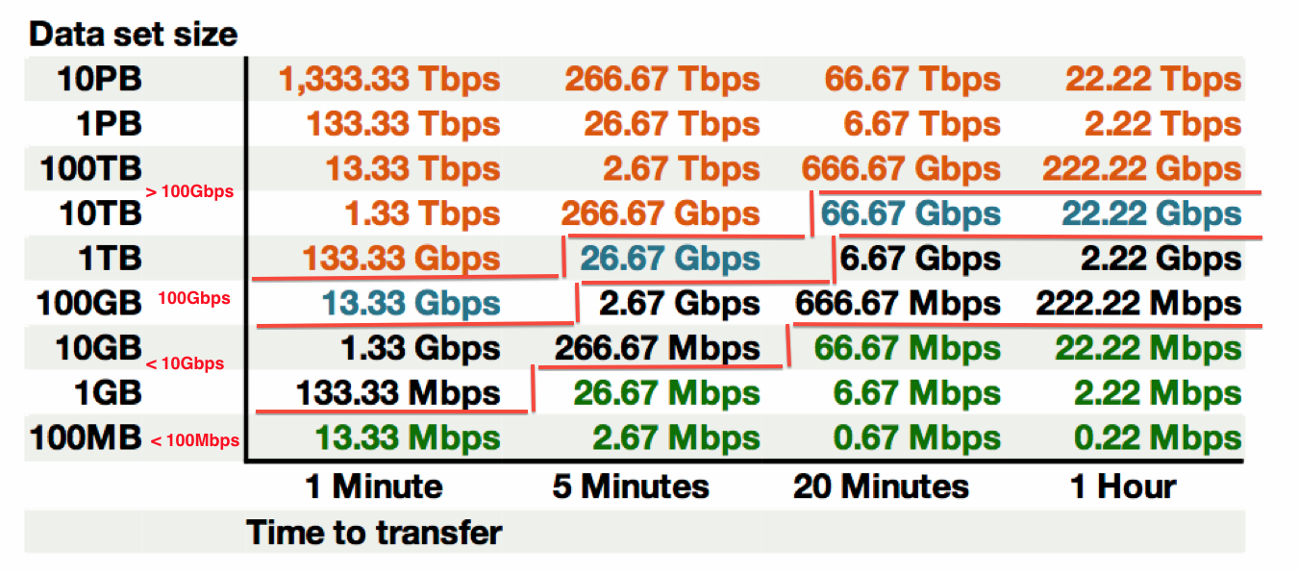
Performance At Different Data Scales
This table available at:
http://fasterdata.es.net/fasterdata-home/requirements-and-expectations/
© 2014, Energy Sciences Network
Notes:
This succinctly describes what the end to end data path must achieve – network, hosts, storage, application
Green: <= 100Mbps Throughput (almost all domestic locations can do this) – less than Fast Ethernet!
Black: 100Mbps to 10Gbps Throughput (most major research institutions can do this, if its running clean)
Blue 10Gbps to 100Gbps Throughput (emerging at major locations)
Orange > 100Gbps Throughput (future for many)
Note: 1TB/hour and 100TB/week fit easily within 10G of throughput

Slide 12
TCP – Ubiquitous and Fragile
Networks provide connectivity between hosts – how do hosts see the network?
From an application’s perspective, the interface to “the other end” is a socket
Communication is between applications – mostly over TCP
TCP – the fragile workhorse
TCP is (for very good reasons) timid – packet loss is interpreted as congestion
Packet loss in conjunction with latency is a performance killer
Like it or not, TCP is used for the vast majority of data transfer applications (more than 95% of ESnet traffic is TCP)
© 2014, Energy Sciences Network
Notes:
The application sees the network as a socket.
The socket interface does not provide path diagnostics or other troubleshooting information.
TCP behaves as it does because of measures taken in the 1980s to fix the congestion collapse of the Internet
TCP makes a promise to the application – TCP will get the data to the other end, or TCP will return an error. TCP makes no promises about performance.

Slide 13
A small amount of packet loss makes a huge difference in TCP performance
Local
(LAN)
With loss, high performance beyond metro distances is essentially impossible
International
Metro Area
Regional
Continental
Measured (TCP Reno)
Measured (HTCP)
Theoretical (TCP Reno)
Measured (no loss)
© 2014, Energy Sciences Network
Notes:
This is an annotated version of the plot from the Science DMZ paper
Beyond your metro area, zero loss is essentially required for high performance
Where are your collaborators? Where are your users?
When global collaboration is the norm, nobody can afford to be a local-only resource

Slide 14
Working With TCP In Practice
Far easier to support TCP than to fix TCP
People have been trying to fix TCP for years – only some success
RFC1323
Buffer autotuning
Like it or not we’re stuck with TCP in the general case
Pragmatically speaking, we must accommodate TCP
Sufficient bandwidth to avoid congestion
Zero packet loss
Verifiable infrastructure
Networks are complex
Must be able to locate problems quickly
Small footprint is a huge win – small number of devices so that problem isolation is tractable
© 2014, Energy Sciences Network
Notes:
Do not underestimate the value of three TCP improvements:
RFC1323 (window scaling)
Kernel autotuning
Improved congestion algorithms
However, loss + latency is still a performance killer.
TCP must be accommodated – this is our job as engineers and architects

Slide 15
Putting A Solution Together
Effective support for TCP-based data transfer
Design for correct, consistent, high-performance operation
Design for ease of troubleshooting
Easy adoption is critical
Large laboratories and universities have extensive IT deployments
Drastic change is prohibitively difficult
Cybersecurity – defensible without compromising performance
Borrow ideas from traditional network security
Traditional DMZ
Separate enclave at network perimeter (“Demilitarized Zone”)
Specific location for external-facing services
Clean separation from internal network
Do the same thing for science – Science DMZ
© 2014, Energy Sciences Network
Notes:
In order to accommodate TCP, we need a pragmatic engineering solution that:
Addresses the needs
Is implementable given financial, policy, and cultural constraints
Can be defended – we cannot ignore security

Slide 16
The Science DMZ Design Pattern
Dedicated Systems for Data Transfer
Network Architecture
Performance Testing & Measurement
perfSONAR
Enables fault isolation
Verify correct operation
Widely deployed in ESnet and other networks, as well as sites and facilities
Data Transfer Node
High performance
Configured specifically for data transfer
Proper tools
Science DMZ
Dedicated network location for high-speed data resources
Appropriate security
Easy to deploy - no need to redesign the whole network
© 2014, Energy Sciences Network
Notes:
The Science DMZ design pattern is a set of composable ideas, including:
The architectural element itself – the Science DMZ enclave
Appropriate security that does not impact performance
Dedicated systems – Data Transfer Nodes
perfSONAR
The elements of the Science DMZ can be combined in a variety of ways depending on the need

Slide 17
Abstract or Prototype Deployment
Add-on to existing network infrastructure
All that is required is a port on the border router
Small footprint, pre-production commitment
Easy to experiment with components and technologies
DTN prototyping
perfSONAR testing
Limited scope makes security policy exceptions easy
Only allow traffic from partners
Add-on to production infrastructure – lower risk
© 2014, Energy Sciences Network

Slide 18
Science DMZ Design Pattern (Abstract)
© 2014, Energy Sciences Network
Notes:
This is an abstract cartoon – nobody’s network looks exactly like this
The diagram has no management LAN, no terminal servers, etc.
However, this is the minimum network diagram that shows the essential Science DMZ components:
Science DMZ enclave
DTN
perfSONAR (in the WAN, at the border, in the Science DMZ)
Security policy controls

Slide 19
Local And Wide Area Data Flows
© 2014, Energy Sciences Network
Notes:
The green data path is susceptible to TCP performance problems stemming from packet loss combined with long distances
The red data path is very low latency – loss matters much less here (though too much loss will still cause problems)
Remember the throughput vs. latency graph

Slide 20
Supercomputer Center Deployment
High-performance networking is assumed in this environment
Data flows between systems, between systems and storage, wide area, etc.
Global filesystem often ties resources together
Portions of this may not run over Ethernet (e.g. IB)
Implications for Data Transfer Nodes
“Science DMZ” may not look like a discrete entity here
By the time you get through interconnecting all the resources, you end up with most of the network in the Science DMZ
This is as it should be – the point is appropriate deployment of tools, configuration, policy control, etc.
Office networks can look like an afterthought, but they aren’t
Deployed with appropriate security controls
Office infrastructure need not be sized for science traffic
© 2014, Energy Sciences Network

Slide 21
Supercomputer Center
© 2014, Energy Sciences Network
Notes:
Applying the Science DMZ design patterns to a supercomputer center
Note global filesystem – avoids double-copy workflow between DTNs and compute resources
DTNs are not part of major computational resource, and so are not entangled with its config
Science DMZ does not look discrete – however, the elements are here
Firewall appropriately placed
Security for major resources and DTNs implemented in network core
PerfSONAR for performance assurance

Slide 22
Supercomputer Center Data Path
© 2014, Energy Sciences Network
Notes:
DTNs are not part of major computational resource, and so are not entangled with its config
They are part of the filesystem – the DTNs are the external interface to the filesystem.

Slide 23
The Petascale DTN Project
Built on top of the Science DMZ model
Effort to improve data transfer performance between the DOE ASCR HPC facilities at ANL, LBNL, and ORNL, and also NCSA.
Multiple current and future science projects need to transfer data between HPC facilities
Performance goal is 15 gigabits per second (equivalent to 1PB/week)
Realize performance goal for routine Globus transfers without special tuning
Reference data set is 4.4TB of cosmology simulation data

Slide 24
DTN Cluster Performance – HPC Facilities

Slide 25
Science Data Portals
Large repositories of scientific data
Climate data
Sky surveys (astronomy, cosmology)
Many others
Data search, browsing, access
Many scientific data portals were designed 15+ years ago
Single-web-server design
Data browse/search, data access, user awareness all in a single system
All the data goes through the portal server
In many cases by design
E.g. embargo before publication (enforce access control)

Slide 26
Legacy Portal Design
Very difficult to improve performance without architectural change
Software components all tangled together
Difficult to put the whole portal in a Science DMZ because of security
Even if you could put it in a DMZ, many components aren’t scalable
What does architectural change mean?
Notes:
Legacy portal model:
Web server with filesystem-level access to data store
CGI, perl/python, database, etc. for portal logic all run on the web server
Evolved in place over 15-ish years
Need to work smarter not harder – re-think the architecture

Slide 27
Architectural Examination of Data Portals
Common data portal functions (most portals have these)
Search/query/discovery
Data download method for data access
GUI for browsing by humans
API for machine access – ideally incorporates search/query + download
Performance pain is primarily in the data handling piece
Rapid increase in data scale eclipsed legacy software stack capabilities
Portal servers often stuck in enterprise network
Can we “disassemble” the portal and put the pieces back together better?
Use Science DMZ as a platform for the data piece
Avoid placing complex software in the Science DMZ
Notes:
Back to data portals now – how can we take the traditional data portal apart and optimize the pieces for scalability and for deployment in a Science DMZ?

Slide 28
Legacy Portal Design
Notes:
So, how do we fix this?
Borrow ideas from commercial Internet - CDNs

Slide 29
Next-Generation Portal Leverages Science DMZ
Notes:
Portal logic still runs in the enterprise network.
However, instead of handing out pointers to data objects stored within the portal server, the portal hands out pointers to data objects stored on the big filesystem and accessible via the DTNs.

Slide 30
Put The Data On Dedicated Infrastructure
We have separated the data handling from the portal logic
Portal is still its normal self, but enhanced
Portal GUI, database, search, etc. all function as they did before
Query returns pointers to data objects in the Science DMZ
Portal is now freed from ties to the data servers (run it on Amazon if you want!)
Data handling is separate, and scalable
High-performance DTNs in the Science DMZ
Scale as much as you need to without modifying the portal software
Notes:
Key point – the portal hands users references to data objects stored elsewhere. Because those data objects are tied to a name (the Globus endpoint in this case, but it could be any tool), the infrastructure behind that name can be scaled as much as it needs to be scaled….all without touching the portal code.
Large-scale computing facilities can now handle the big data objects, and the portal just needs to refer back to the appropriate service running at the computing facility.

Slide 31
Data Portal Implications
Portals hold a lot of valuable data
Observations (sky surveys, satellite data, genomes, etc.)
Many have been in place for years
Most are inadequate to support large-scale analysis
Legacy search/query interfaces
Legacy access protocols/tools
This is in the process of changing
The technology exists to radically improve the utility of data portals
What should the performance expectation be?
HPC facilities can do 1PB/week – if data portals could do this…

Slide 32
NCAR RDA Performance to DOE HPC Facilities
1.5TB data set
1121 files

Slide 33
Summary
Science networks are engineered to support data-intensive science
Related to and connected to the rest of the Internet, but different
Science DMZ model effectively connects data infrastructure to networks
If you need to send your sysadmin to me, feel free
Globus at HPC facilities makes terascale to petascale data transfers possible
Huge opportunity in upgrading data portals to use Science DMZ, DTNs, advanced tools (e.g. Globus)
Make large data repositories available for analysis at HPC facilities

Slide 34
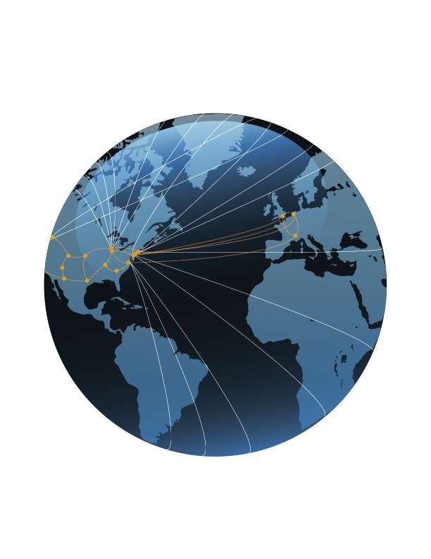
In conclusion – ESnet’s vision:
Scientific progress will be completely unconstrained by the physical location of instruments, people, computational resources, or data.

Slide 35
Links and Lists
ESnet fasterdata knowledge base
http://fasterdata.es.net/
Science DMZ paper
http://www.es.net/assets/pubs_presos/sc13sciDMZ-final.pdf
Science DMZ email list
Send mail to sympa@lists.lbl.gov with subject "subscribe esnet-sciencedmz”
perfSONAR
http://fasterdata.es.net/performance-testing/perfsonar/
http://www.perfsonar.net
Globus
https://www.globus.org/
© 2015, Energy Sciences Network

Slide 36
Thanks!
Eli Dart
Energy Sciences Network (ESnet)
Lawrence Berkeley National Laboratory
http://my.es.net/
http://www.es.net/
http://fasterdata.es.net/

