Slide 1
Hall B - Run Group K
Color Confinement and Strong QCD
Status Update
E12-16-010 A Search for Hybrid Baryons in Hall B with CLAS12
Annalisa D’Angelo
E12-16-010A Nucleon Resonance Structure Studies Via Exclusive KY Electroproduction at 6.6 GeV and 8.8 GeV
Daniel Carman
E12-16-010B Deeply Virtual Compton Scattering with CLAS12 at 6.6 GeV and 8.8 GeV Latifa Elouadrhiri
Approved:
50 PAC days at 8.8 GeV
50 PAC days at 6.6 GeV
Assigned:
6.0 PAC days at 7.5 GeV
3.5 PAC days at 6.5 GeV
Data Taken (Dec 2018):
5.5 PAC days at 7.5 GeV
4.0 PAC days at 6.5 GeV

Slide 2
Main Questions to Address
The N* spectrum: what is the role of glue?
Search for new baryon states
E12-16-010
How do massless quarks acquire mass?
Measure the Q² dependence of electrocoupling amplitudes
E12-16-010A
How is color confinement realized in the force and pressure distributions and stabilize nucleons?
Study GPDs and their moments from DVCS
E12-16-010B

Slide 3
Run Group Proposal (RG K)
“Color Confinement and Strong QCD”
Hybrid Baryons E12-16-010 | Search for hybrid baryons (qqqg) focusing on 0.05 GeV² < Q² < 2.0 GeV² in mass range from 1.8 to 3 GeV in KΛ, Nππ, Nπ (A. D’Angelo, V. Burkert, D.S. Carman, V. Mokeev, E. Golovach, R. Gothe)
KY Electroproduction E12-16-010A | Study N* structure for states that couple to KY through measurements of cross sections and polarization observables that will yield Q² evolution of electrocoupling amplitudes (D.S. Carman, V. Mokeev, R. Gothe)
DVCS E12-16-010B | Access GPDs H, E, H, E using DVCS process ep → epγ and the DVMP process ep → epπ⁰ (L.Elouadrhiri, F.X. Girod)
~ ~
Run Group conditions 100 days approved by PAC44:
E_{b} = 6.6 GeV, 50 days
E_{b} = 8.8 GeV, 50 days
Torus I = -3375 A (negatives outbending) 100%
Solenoid = - 100%
FT ON, MM, RICH
Polarized electrons, unpolarized LH₂ target
L = 1x10³⁵ cm⁻²s⁻¹

Slide 4
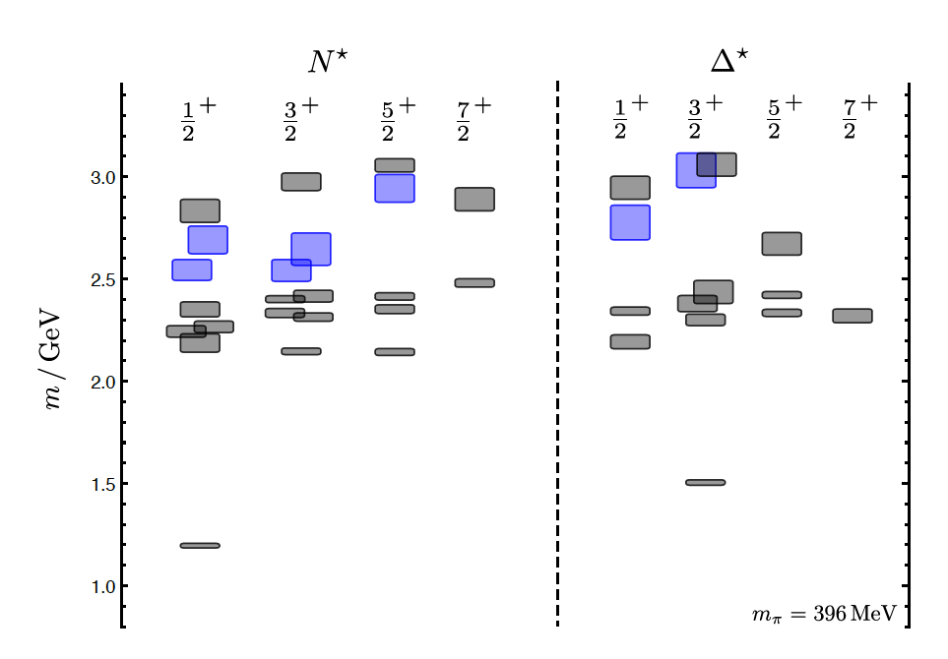
Hybrid Baryons in LQCD
J.J. Dudek and R.G. Edwards, PRD85, 054016 (2012)
LQCD
clustered
in mass
regular states
hybrid states
1.3GeV
The nucleon mass is shifted ~300 MeV to higher masses
N
Hybrid states have same J^{P} values as qqq baryons. How to identify them?
Overpopulation of N 1/2⁺ and N 3/2⁺ states compared to QM projections. ?
A_{1/2} (A_{3/2}) and S_{1/2} show different Q² evolution. Can we do it?

Slide 5
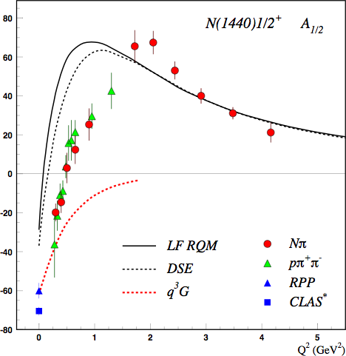
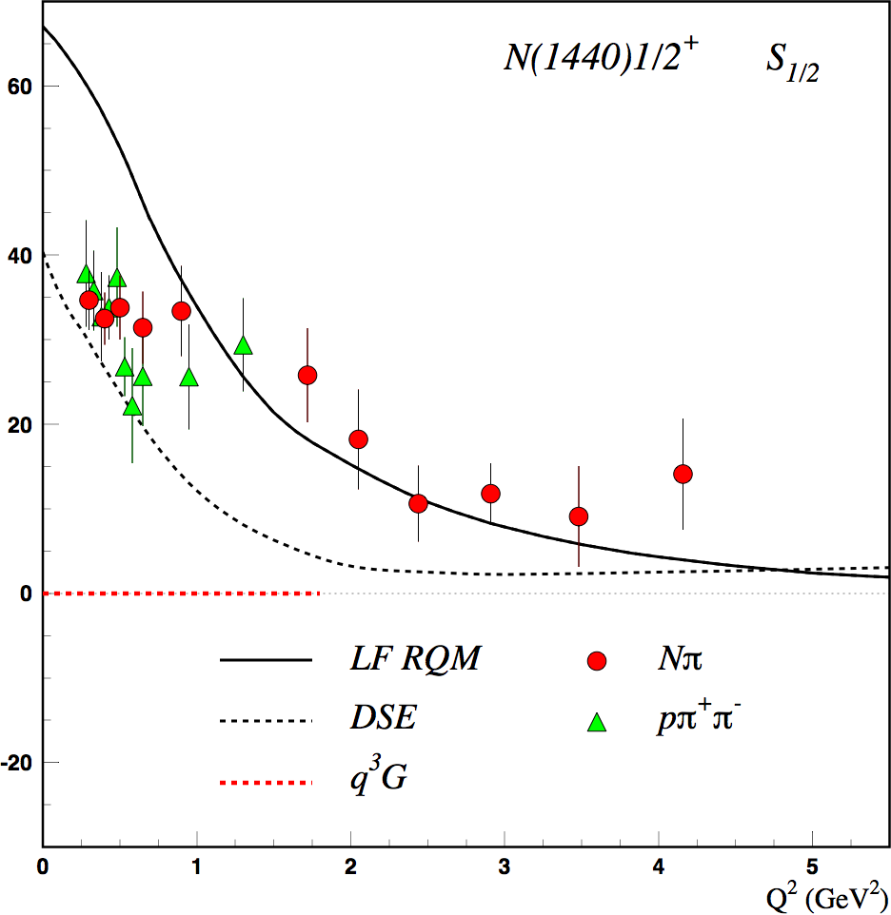
Separating q³g from q³ States?
Precise CLAS results on electrocouplings clarified nature of the Roper
q³
q³
q³g
q³g
q³
A_{1/2} and S_{1/2} amplitudes at high Q² indicate 1st radial q³ excitation
Significant meson-baryon coupling at small Q²
For hybrid “Roper”, A_{1/2}(Q²) drops off faster with Q² and S_{1/2}(Q²) ~ 0.

Slide 6
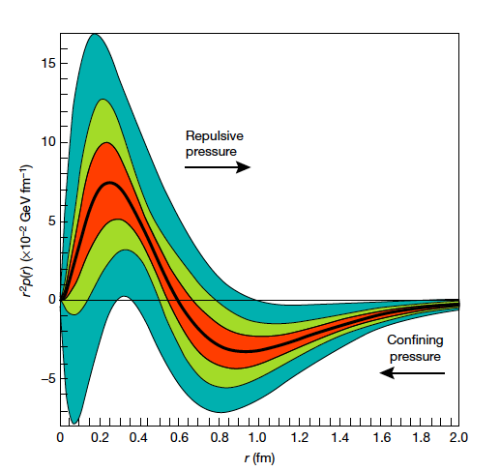

Accessing the Forces & Pressure on Quarks
Nucleon matrix element of EMT contains:
M₂(t) : Mass distribution inside the nucleon
J (t) : Angular momentum distribution
d₁(t) : Shear forces and pressure distribution
Separate M₂(t) and d₁(t) through measurements at small/large ξ.
V. D. Burkert, L. Elouadrhiri & F. X. Girod
Nature, 557 396-399 (2018)
Measuring these form factors, we learn about confinement forces.
Notes:
The nucleon matrix element of the energy-momentum tensor is known to contain 3 form factors. They describe ….. and can only be measured directly in elastic graviton-nucleon scattering. However, these form factors appear as moments of the unpolarized GPDs as shown here. The quark angular momentum in the nucleon is given by the 2nd moment of the sum of GPD H and E. The mass and pressure distribution of the quarks are given by the 2nd moment of H where the pressure is probed by parameter xi.

Slide 7
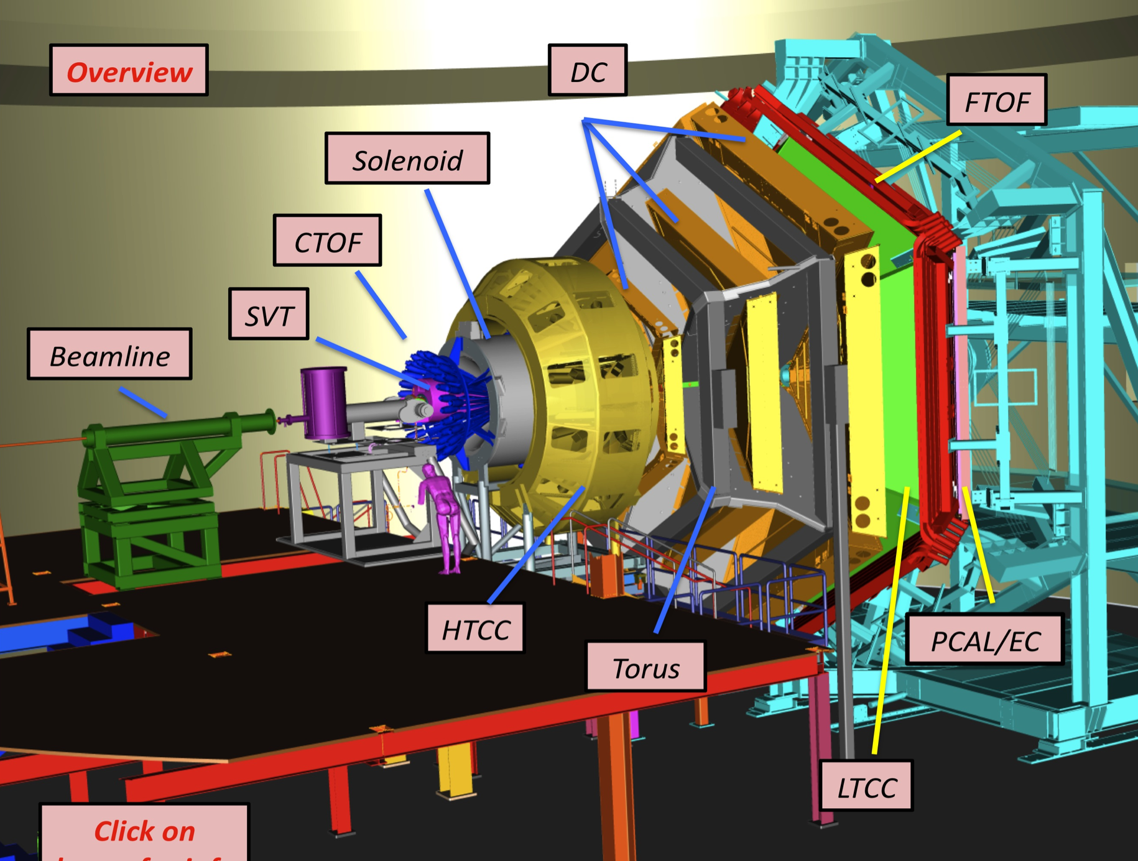
Equipment
CLAS12
Hall B
Forward Detector (FD)
  - TORUS magnet
  HT Cherenkov Counter
  Drift chamber system
  LT Cherenkov Counter
  Forward TOF System
  Pre-shower calorimeter
  E.M. calorimeter
Central Detector (CD)
  SOLENOID magnet
  Silicon Vertex Tracker
  Central Time-of-Flight
Beamline
  Cryo Target
  Moller polarimeter
  - Shielding
  Photon Tagger
Upgrade to the baseline
- Central Neutron Detector
  MicroMegas
  Forward Tagger
  RICH detector
  Polarized target
MM
CND
FT
RICH

Slide 8
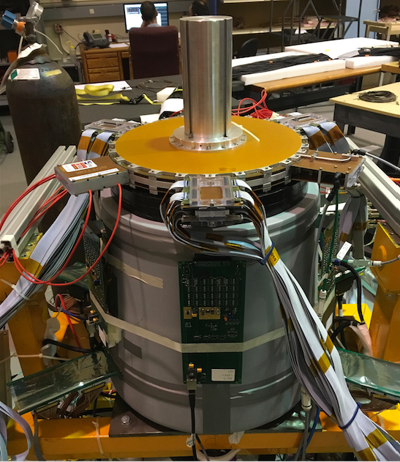
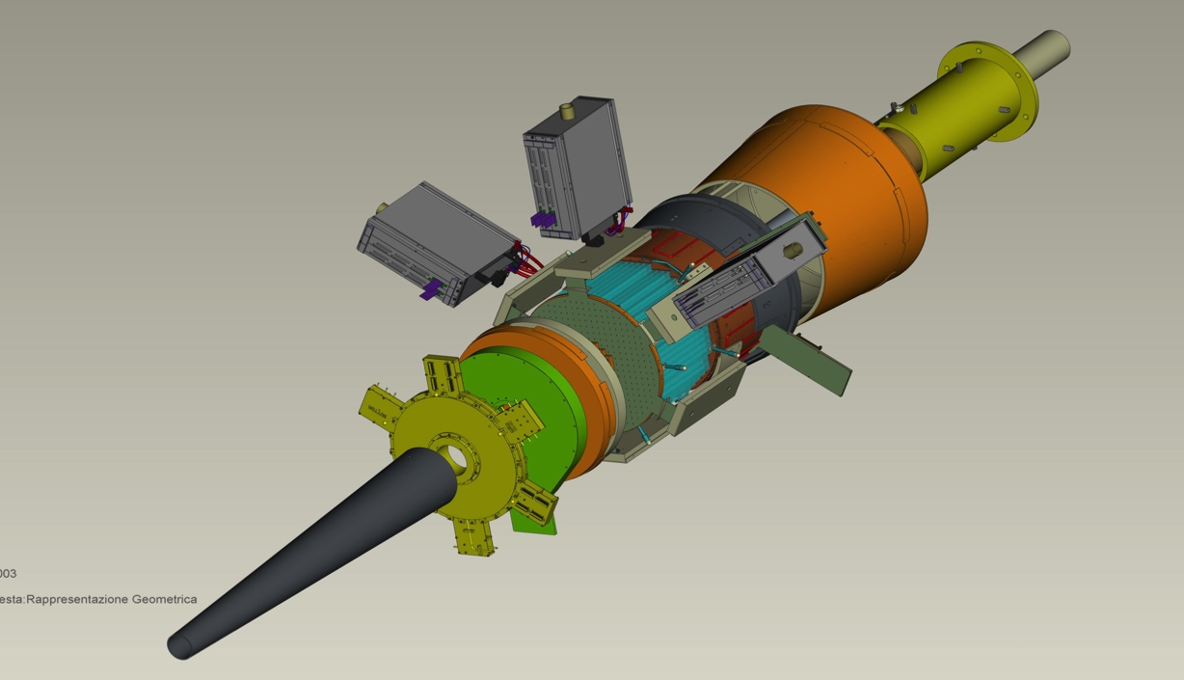
Forward Tagger
CLAS12
Hall B
FT designed to detect electrons and photons at small angles
FT-Cal: calorimeter to measure electron energy/momentum
  FT-Hodo: scintillation hodoscope to veto photons & backsplash
FT-Trk: micro-mega detector to measure electron angles, polarization plane
calorimeter
tracker
hodoscope

Slide 9
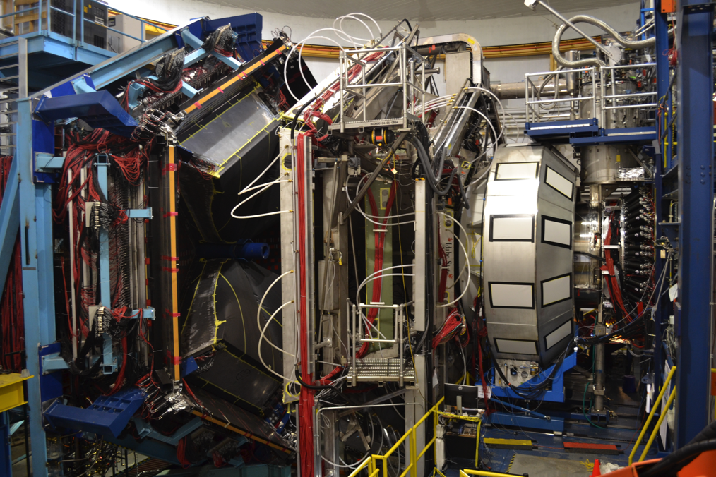
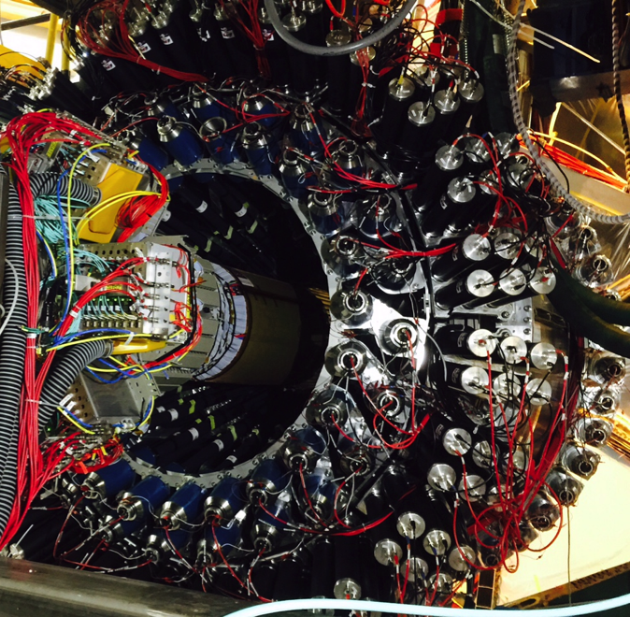
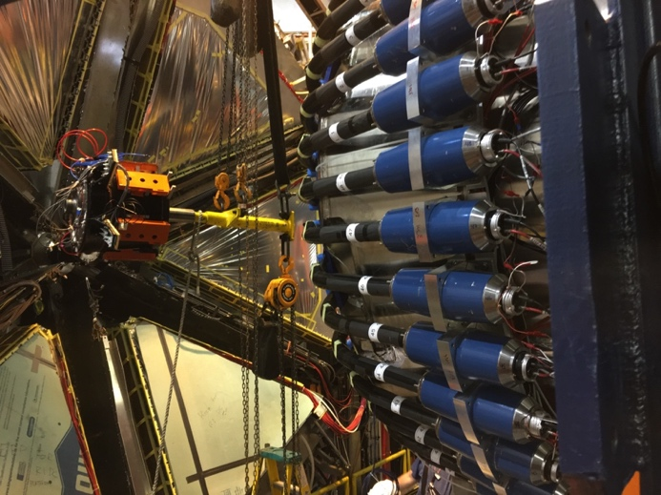
Run Conditions
Torus Current | 100% (3375 A) - negative outbending
Solenoid | -100 %
FT | ON @ 7.5 GeV -> OFF @ 6.5 GeV
MM RICH | ON
FMT | OFF
Beam/Target | Polarized electrons, unpolarized LH₂ target
Luminosity | ~ 5 10 ³⁴ cm⁻²s⁻¹ @ 7.5 GeV 10 ³⁵ cm⁻²s⁻¹ @ 6.5 GeV FULL LUMINOSITY

Slide 10
Run Group K Triggers Configurations E=7.5 GeV
Data rate = 400 MB/sec Maximum electron current = 35 nA
Trigger Number | Physics Definition | Detectors Conditions | Thresholds | pre-scale | Trigger rate
0 | 1 electron in CLAS | (DC x HTTC x ECAL x PCAL) or (DC x HTTC x PCAL) | (PCAL+ECAL)> 300 MeV PCAL>60 MeV ECAL>10 MeV or PCAL> 300 MeV | 1 | 11 KHz
29 (new) | Forward electron 1 forward hadron | FT (1800-6600) x DC x FTOFPCU x PCAL | PCAL>15 MeV | 1 | 8.9 KHz
Total trigger rate = 20.5 KHz @ Lifetime = 93.5%
Data rate = 400 MB/sec Maximum electron current = 45 nA
Trigger Number | Physics Definition | Detectors Conditions | Thresholds | pre-scale | Trigger rate
0 | 1 electron in CLAS | (DC x HTTC x ECAL x PCAL) or (DC x HTTC x PCAL) | (PCAL+ECAL)> 300 MeV PCAL>60 MeV ECAL>10 MeV or PCAL> 300 MeV | 2 | 7 KHz
29 (new) | Forward electron 1 forward hadron | FT (1800-6600) x DC x FTOFPCU x PCAL | PCAL>15 MeV | 1 | 12 KHz
Total trigger rate = 20.5 KHz @ Lifetime = 93.5%

Slide 11
Run Group K Triggers Configurations E=6.5 GeV
FT OFF Full Luminosity
Data rate = 450 MB/sec Maximum electron current = 60 nA
Trigger Number | Physics Definition | Detectors Conditions | Thresholds | pre-scale | Trigger rate
0 | 1 electron in CLAS | (DC x HTTC x ECAL x PCAL) or (DC x HTTC x PCAL) | (PCAL+ECAL)> 300 MeV PCAL>60 MeV ECAL>10 MeV or PCAL> 300 MeV | 1 | 25 KHz
Total trigger rate = 25 KHz @ Lifetime = 91%

Slide 12
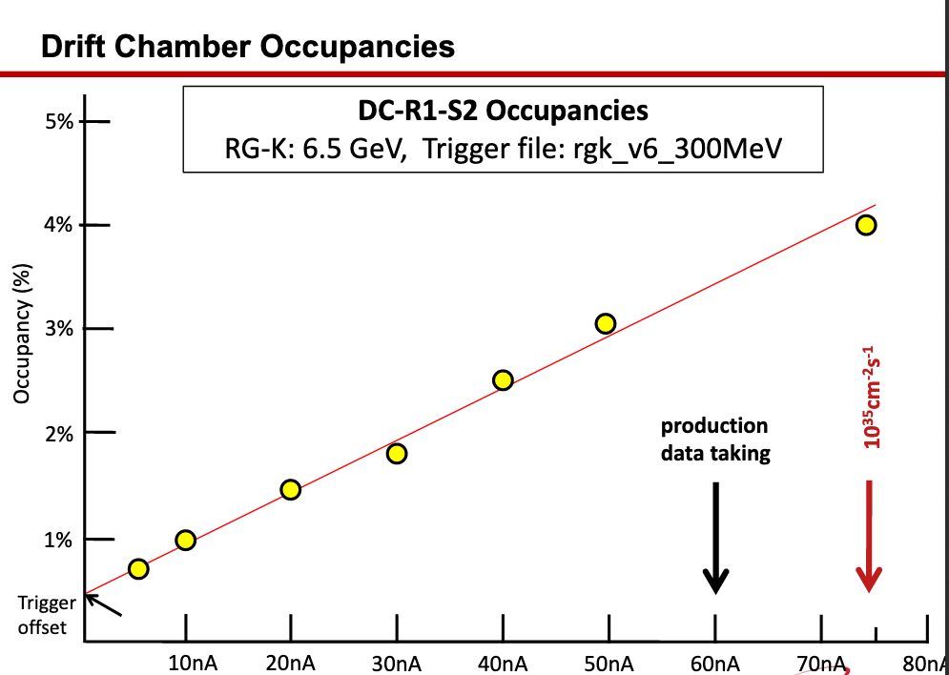
Luminosity scan

Slide 13
Run Group K Production
RG-K
E=7.5GeV
Fall 2018
E=6.5GeV
CHARGE
Machine down
FT-OFF
Q~45mC = 7% of
Expected 648mC
Beam Energy | Beam Current | Target | Trigger | Collected Events
7.5 GeV | 35 nA | LH₂ | e in CLAS e in FT + 1 Fwd Hadron | 3.5 G
7.5 GeV | 45 nA | LH₂ | e in CLAS - prescaled e in FT + 1 Fwd Hadron | 4.3 G
6.5 GeV | 60 nA | LH₂ | e in CLAS | 7.8 G
EVENTS
15.6 G

Slide 14
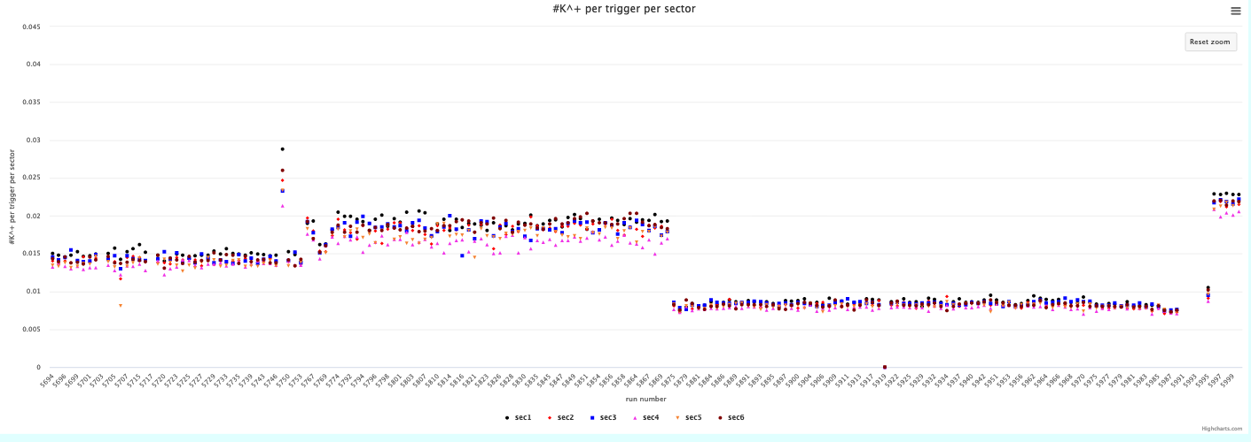
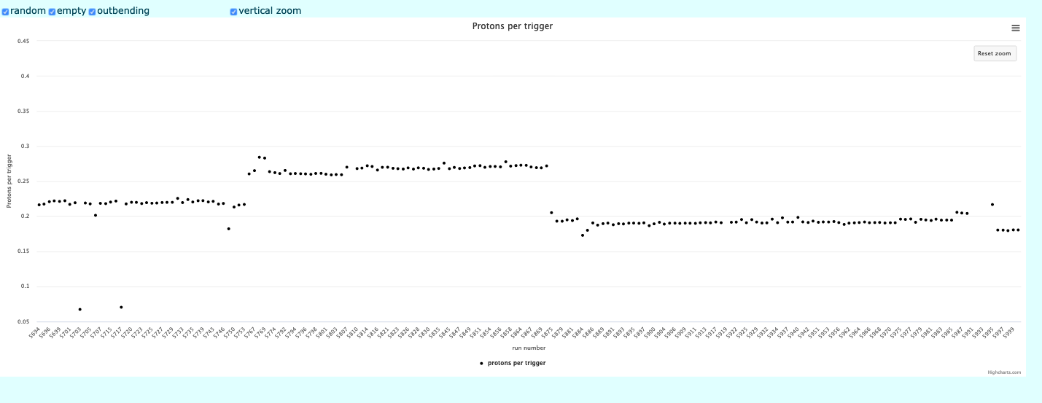
pass0 - RGK data timelines
e- in CLAS
+
FT &1 H
Trigger
e- in CLAS (prescaled)
+
FT &1 H
Trigger
e- in CLAS
Trigger
k⁺ per trigger
(Forward)
RG-k_v2 trigger
RG-k_v4 trigger
RG-k_v6 trigger
7.5 GeV
7.5 GeV
6.5 GeV
protons per trigger
(Central)

Slide 15
RG-K Run 5990 Alignment

Slide 16
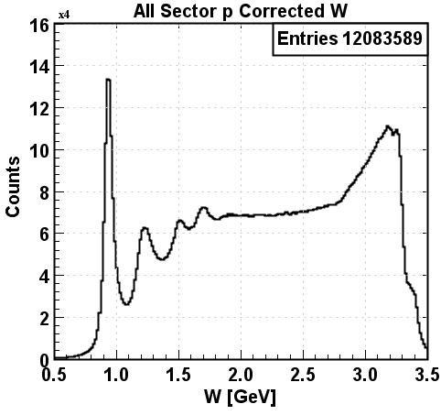
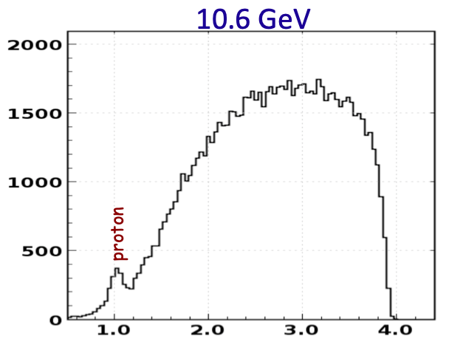
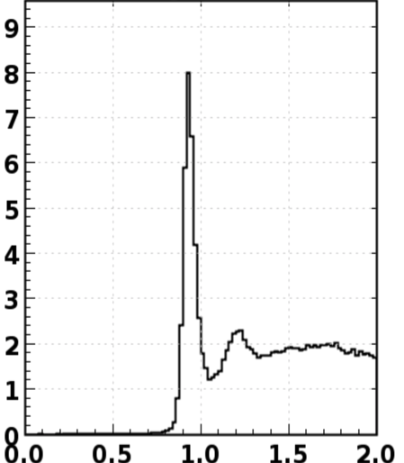
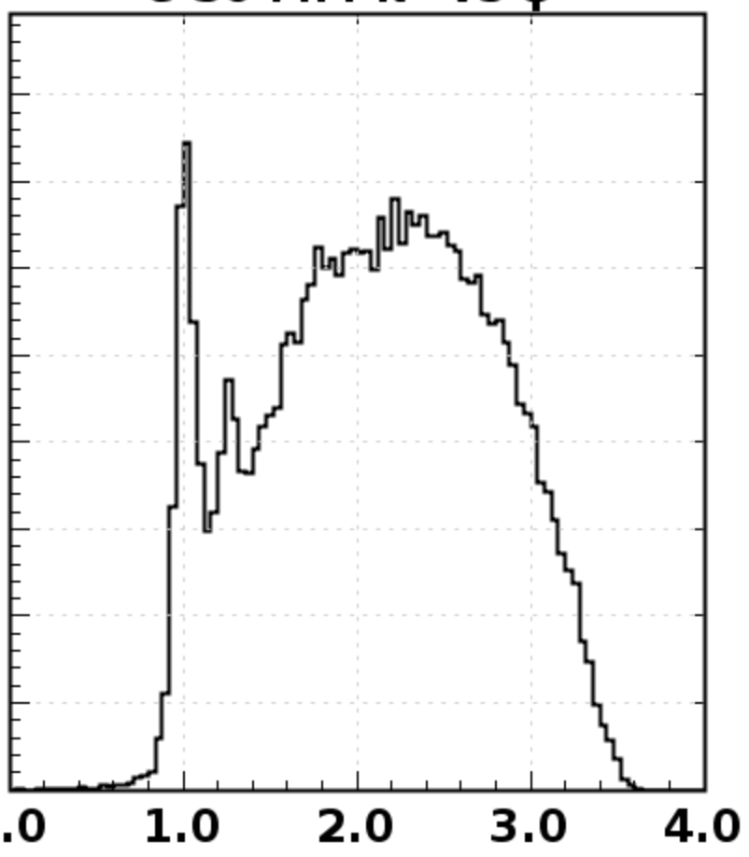
Inclusive and semi-inclusive Electron Scattering
p
6.5 GeV
7.5 GeV
p(e,e’)X
p
p(e,e’)X
p(e,e’)X
Δ⁺(1232)
Δ⁺(1232)
3rd N* Region
3rd N* Region
2nd N* Region
2nd N* Region
p(e,e’π⁺)X
6.5 GeV
7.5 GeV
p(e,e’π⁺)X
p(e,e’π⁺)X
10.6 GeV
3rd N* region
neutron
2nd N*region
Δ⁰(1232)
neutron
Δ⁰(1232)
2nd N* region
3rd N* region
Δ⁰(1232)
neutron
M_{x} (GeV)

Slide 17
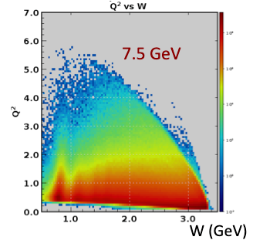
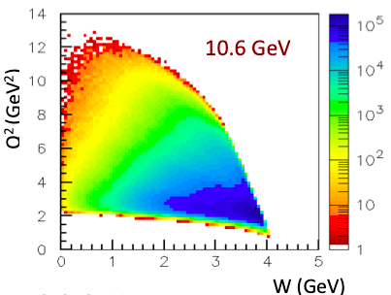
Inclusive and semi-inclusive Electron Scattering
p
6.5 GeV
7.5 GeV
p(e,e’)X
p
p(e,e’)X
p(e,e’)X
Δ⁺(1232)
Δ⁺(1232)
3rd N* Region
3rd N* Region
2nd N* Region
2nd N* Region
p(e,e’π⁺)X
6.5 GeV
7.5 GeV
p(e,e’π⁺)X
p(e,e’π⁺)X
10.6 GeV
3rd N* region
neutron
2nd N*region
Δ⁰(1232)
neutron
Δ⁰(1232)
2nd N* region
3rd N* region
Δ⁰(1232)
neutron
M_{x} (GeV)

Slide 18
Manpower
Run group K experiments benefits of the collaboration with similar experiment of Run group A running at 10 GeV :
E12-06-108A Exclusive N* -> KY Studies with CLAS12 - D.S. Carman
E12-06-119 (a) Deeply Virtual Compton Scattering - F. Sabatie
Same analysis working group of Run Group A will be involved.
Analysis coordinator: Annalisa
Chef: Nick Markov Trains: Will Phelps, Nick Markov Decoding: Andrei Kim Quality: FX Girod
decoding, cooking and trains now via workflows N. Baltzell
Dedicated Post-doc: Lucilla Lanza
Dedicated PhD student: Joshua Artam Tan
RGK Scientists: V. Burkert, D. Carman, A. D'Angelo, M. Defurne, L. Elouadrhiri, F.X. Girod, E. Golovach, A. Golubenko, R. Gothe, K. Hicks, E. Isupov, A. Khanal, L. Lanza, N. Markov, V. Mokeev
The Run Group A Calibration Team is also available.
Leader: Dan Carman
Run 5700 is used to calibrate 7.5 GeV data - Run 5893 used to calibrate 6.5 GeV data
Pass 0 and preparation for Pass1 cooking is being implemented in collaboration with Run Group A team

Slide 19
Preparation for PASS1 – 7.5 GeV
31 runs corresponding to the first Trigger Configuration V2 have been fully reconstructed and skimmed using 6.3.1 catjava relesase
(beam offset not taken into account) .
2,75 G events are available for physics analysis
17,6% of collected data
1,2% of approved runtime
Available Trains
skim1_jpsi_tcs skim7_epiNCND skim10_elec_ft_pip
skim2_ft_pi0 skim8_ep skim11_elect_ft_kaon
skim3_mesonx_vs skim9_ppbar
skim4_inclusive

Slide 20
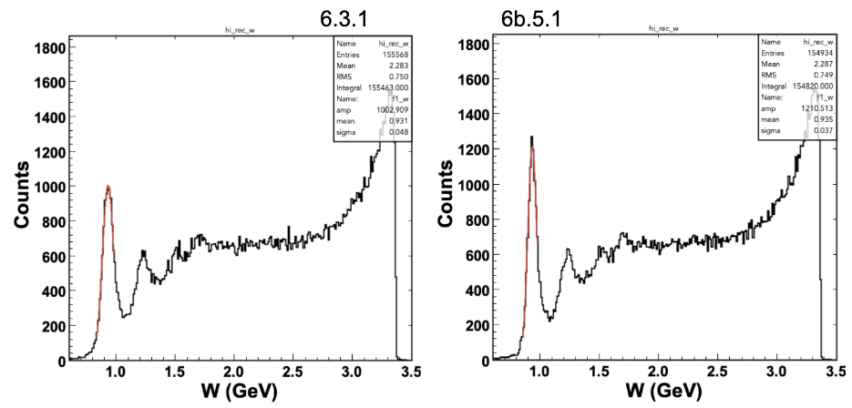
Preparation for PASS1 – 6.5 GeV
σ=37 MeV
σ=48 MeV
Invariant mass spectrum of inclusive electron scattering at 6.5 GeV obtained from 6.3.1 (left) and 6b.5.1 (right) coatjava releases.
The elastic peak resolution is significantly improved from 48 MeV to 37 MeV.

Slide 21
Preparation for PASS1 – 6.5 GeV and 7.5 GeV
10 runs corresponding to7.5 GeV energy Trigger Configuration V2
10 runs corresponding to 6.5 GeV energy Trigger Configuration V6
have been fully reconstructed and skimmed using 6.5.1 coatjava release, including beam offset information
the outputs are now being analyzed to prepare for PAC48 jeopardy
Preparation for the RGK pass1 cooking is following the road opened by the RGA experience

Slide 22
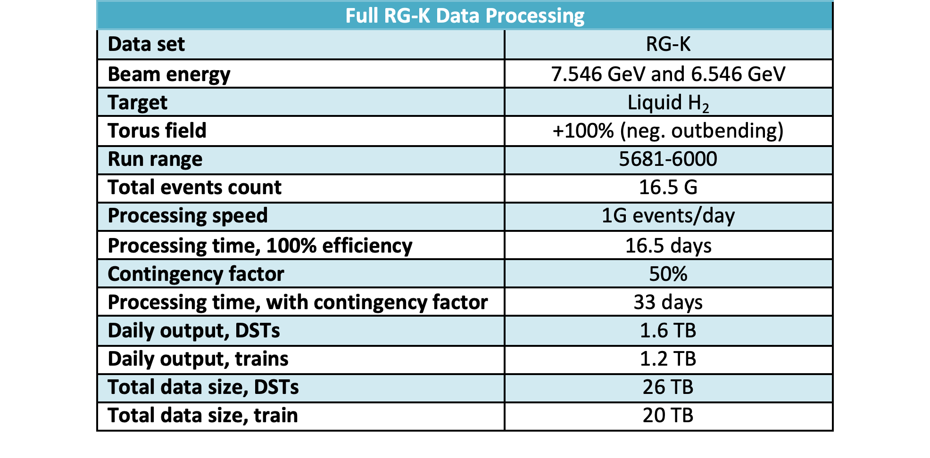
Preparation for PASS1 – 6.5 GeV and 7.5 GeV

Slide 23
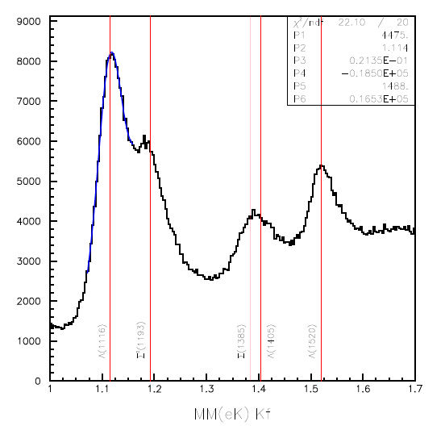
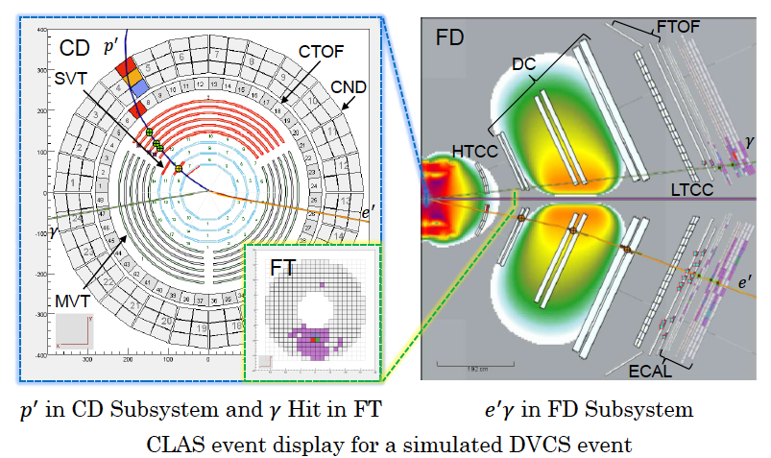
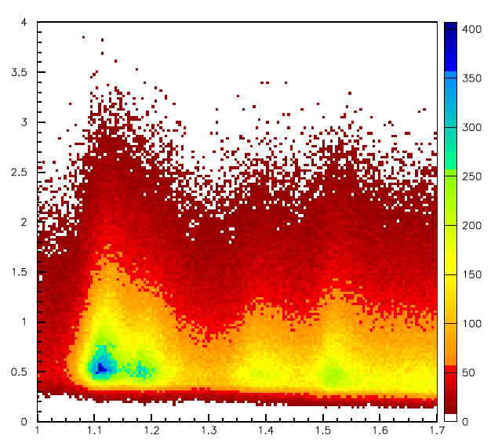
On-going analyses
p(e,e’K⁺)
KY electroproduction:
ep e’K⁺ Y
DVCS: ep e’p’γ
Σ(1193)
Λ(1115)
Λ(1405)
Λ(1520)
Σ(1385)
MM(K⁺)
Q² (GeV²)
Λ(1115)
Σ(1193)
Σ(1385)
Λ(1405)
Λ(1520)
D. Carman
MM(K⁺)

Slide 24
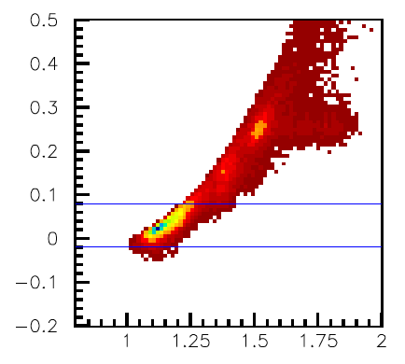
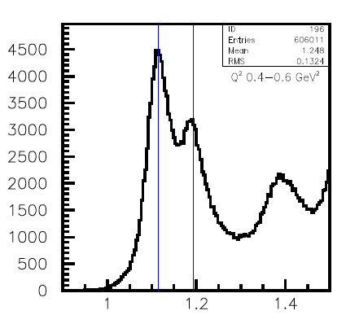
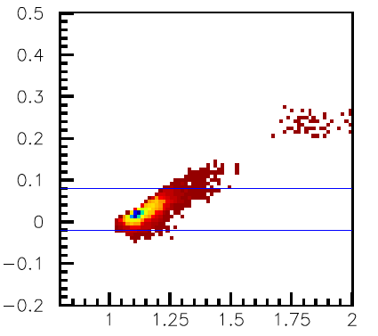
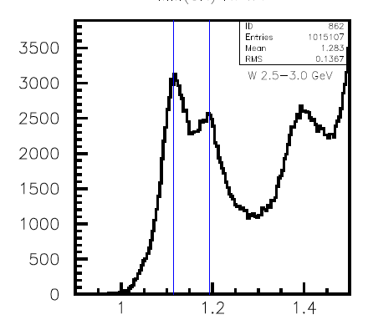
First results: KY electroproduction – e in CLAS
K⁺Λ
MM(K⁺p)
forward p
MM(K⁺p)
central p
D. Carman
MM(K⁺)
MM(K⁺)

Slide 25
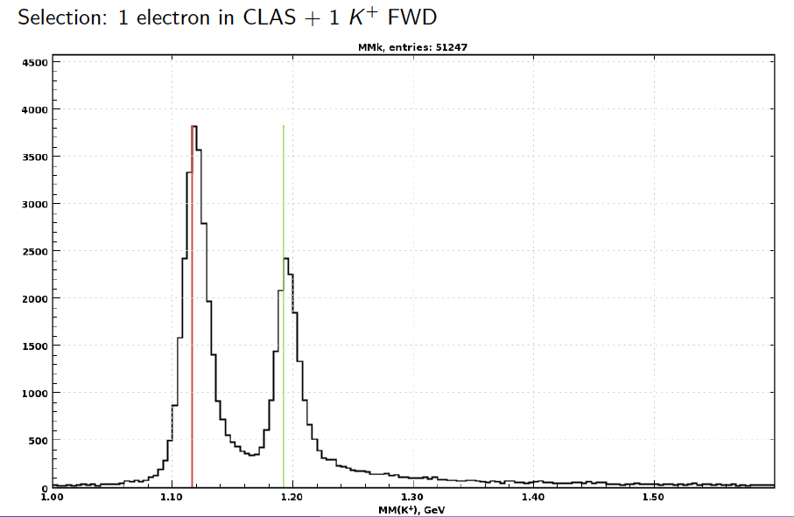
First results: KY electroproduction
electron in CLAS
simulation
data
L. Lanza
D. Carman
Final resolution is expected to improve sensibly

Slide 26
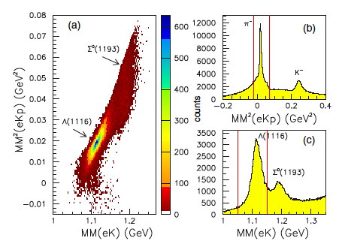
Comparison with published CLAS results
MM(K⁺p)
CLAS
forward p
K⁺Λ
CLAS12
D. Carman
W (1.6-3.5 GeV)
Q² =0.05 – 5 GeV²
W (1.6 - 2.7 GeV)
Q² = 1.9 GeV²
MM(K⁺)

Slide 27
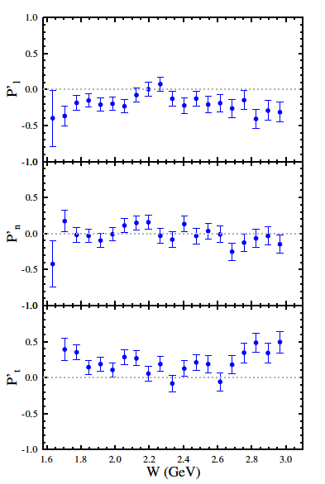
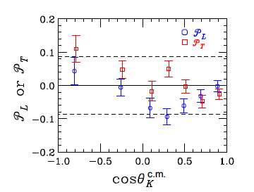
Beam-recoil transferred polarization
CLAS12
KY electroproduction:
ep e’K⁺ Y
CLAS
D. Carman
(no background subtraction)

Slide 28
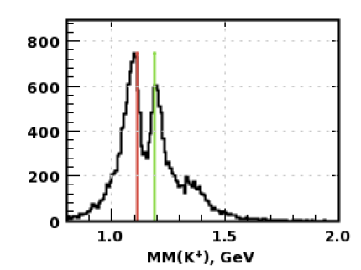
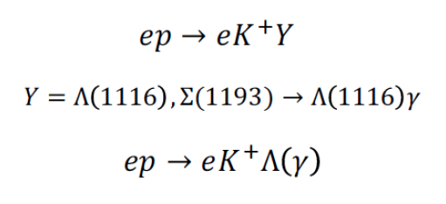
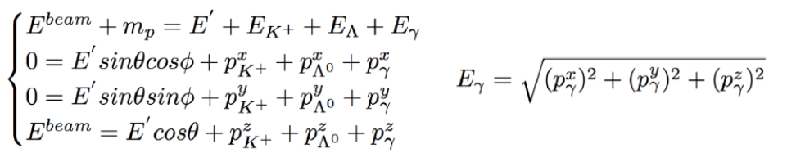
First results: KY electroproduction – e in FT
L. Lanza
Exclusivity cuts

Slide 29
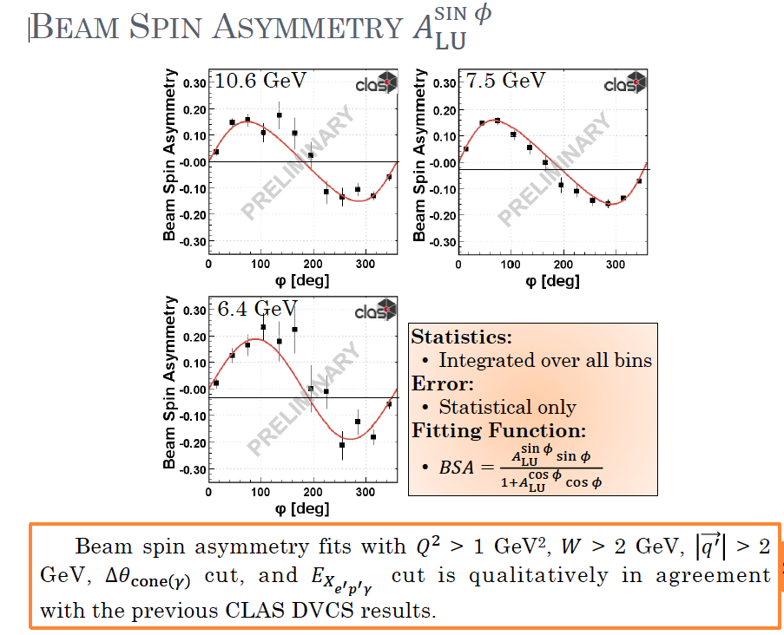
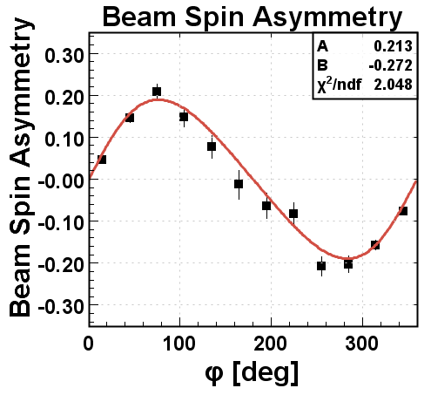
First results: DVCS
7.5 GeV
Josh Tan
FX Girod

Slide 30
Conclusions
Run group K has successfully collected data at 6.5 GeV and 7.5 GeV.
Full luminosity has been reached at 6.5 GeV with FT - OFF
Run conditions are similar to run Group A, but limited to negative outbending torus field and optimized trigger.
Trigger conditions include: 1 electron in CLAS + 1 electron in the FT in coincidence with 1 Forward hadron in CLAS
Manpower of run group A is foreseen to strongly contribute to calibrate and cook the data - working on preparation for PASS1 review
Data quality is very good
7% of total expected charge has been accumulated – 12 ABU days in 18 days of data taking - 15.5 G events collected – 2.7 G events available for data analysis
First results from data analysis are very promising

Slide 31
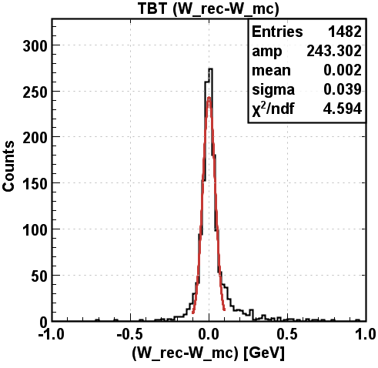
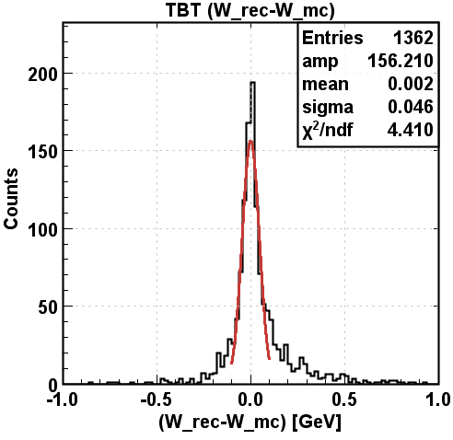
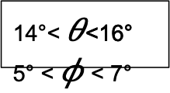
FD tracking efficiency - RG-K Run Low Luminosity Runs
Extensive effort to understand luminosity dependence of event reconstruction efficiency.
μ⁻p -> μ⁻p 6.5 GeV
Use μ’s to avoid radiative tail
0 nA
14°< $θ$<16°
5° < $φ$< 7°
80 nA
Realistic Simulations critical for normalized results

Slide 32

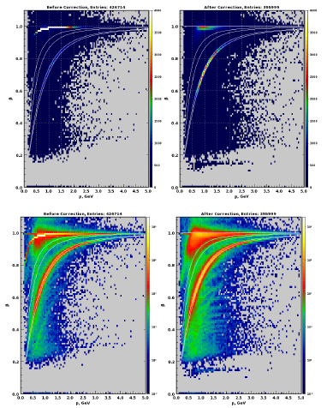
RGK 7.5 GeV Start time correction
electron detected in FT
Event start time should be corrected
using the FT start time
new value for β
better particle ID
k⁺
Implemented in the new Event Builder

Slide 33
Evidence for New N* in KY and other Final States
State N(mass)J^{P} | PDG pre 2010 | PDG 2018 | KΛ | KΣ | Nγ
N(1710)1/2⁺ | *** | **** | ** | * | ****
N(1880)1/2⁺ |  | *** | ** | ** | **
N(2100)1/2⁺ | * | *** | * |  | **
N(1895)1/2⁻ |  | **** | ** | ** | ****
N(1900)3/2⁺ | ** | **** | ** | ** | ****
N(1875)3/2⁻ |  | *** | * | * | **
N(2120)3/2⁻ |  | *** | ** | * | ***
N(2000)5/2⁺ | * | ** | * |  | **
N(2060)5/2⁻ |  | *** | * | * | ***
Study these states in electroproduction and extend to higher masses
Notes:
This slides shows a summary of the results in this analysis. The green column shows the rating by the PDG. The two columns show the importance of the strangeness channel in this results.

Slide 34
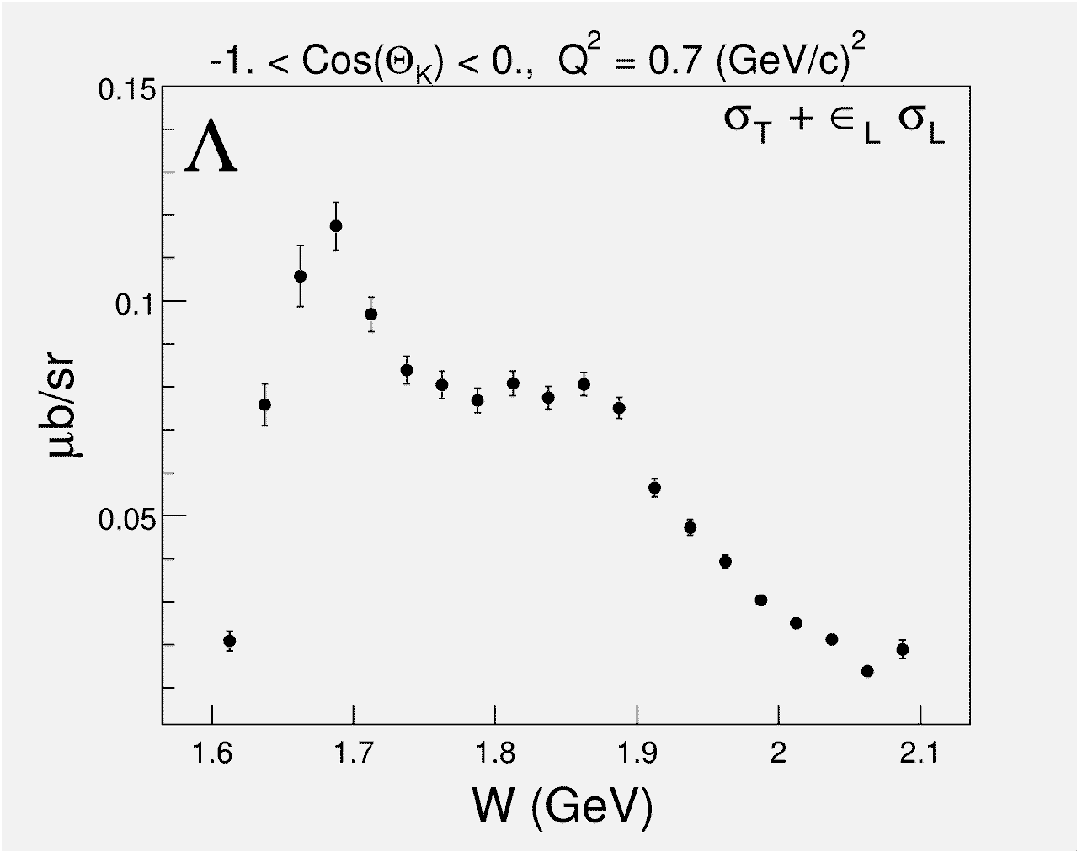
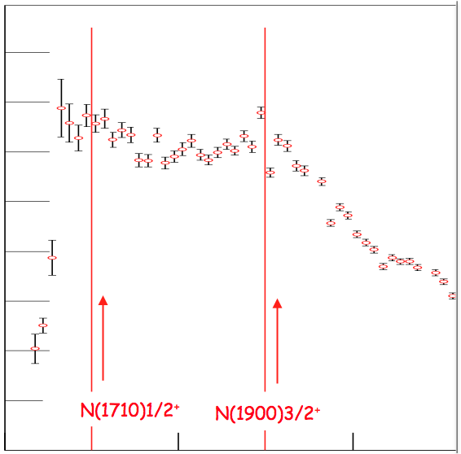
Studying Baryons in γ*p → KΛ/Σ ?
Photoproduction
Electroproduction
1.6
1.4
1.2
1.0
0.8
0.6
0.4
0.2
N(1710)1/2⁺
N(1900)3/2⁺
N(1710)1/2⁺
N(1900)3/2⁺
1.6
1.8
2.0
W (GeV)
Strangeness electroproduction is a fertile ground in studying S=0 baryon states with masses above 1.6 GeV.

Slide 35
Hybrid Baryons: Baryons with Glue as a Structural Component
Hybrid hadrons with dominant gluonic contributions are predicted to exist by QCD.
Experimentally:
Hybrid mesons |qqg> states may have exotic quantum numbers J^{PC} not available to pure |qq> states GlueX, MesonEx, COMPASS, PANDA ….
Hybrid baryons |qqqg> have the same quantum numbers J^{P} as |qqq> exclusive electroproduction with CLAS12 (Hall B).
Theoretical predictions:
        MIT bag model - T. Barnes and F. Close, Phys. Lett. 123B, 89 (1983).
        QCD Sum Rule - L. Kisslinger and Z. Li, Phys. Rev. D 51, R5986 (1995).
        Flux Tube model - S. Capstick and P. R. Page, Phys. Rev. C 66, 065204 (2002).
        LQCD - J.J. Dudek and R.G. Edwards, PRD85, 054016 (2012).
Notes:
… One of the experimental tool we employ is the study of the N* spectrum as a reflection of the underlying degrees of freedom, some of which are shown by these cartoons representing constituent quarks in a bag, held together by gluon strings that my also get excited and generate hybrid baryons, quarks model with di-quark clustering, and states generated dynamically by meson-baryon interaction. These configuration result in variations of the excitation spectrum which we study with hadron or electromagnetic beams. The second line of research is to measure the strength of resonance excitations versus the space-time resolution of the probe to see how the strength of the effective degrees of freedom change with the distance scale. Beyond these mostly experimental aspects, there has been significant progress in the theory sector , e.g. predictions from LQCD of the spectrum, the Dyson-Schwinger equations of QCD, holographic QCD, and others.

Slide 36
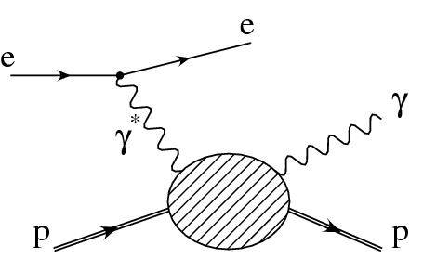
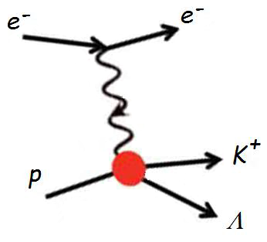
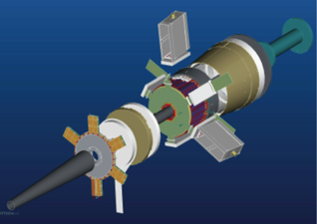
The Experiment
FT
ϑ > 6°
ϑ > 6°
CLAS12
Scattered electrons and photons are detected:
in the Forward Tagger for angles from 2.5° to 4.5°
in the Forward Detector of CLAS12 for scattering angles greater than about 6°
Charged hadrons are measured in the full range from 6° to 130°
FT allows to probe the crucial Q² range where hybrid baryons may be identified due to their fast dropping A_{1/2}(Q²) amplitude and the suppression of the scalar S_{1/2}(Q²) amplitude.
W < 3 GeV Q² range of interest: 0.05 - 6 GeV²

Slide 37
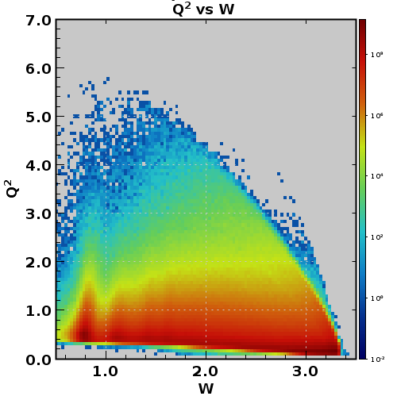
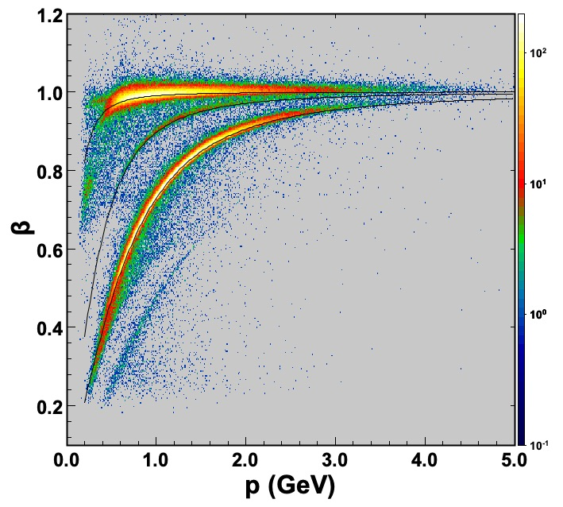
Inclusive and semi-inclusive Electron Scattering
p
6.5 GeV
7.5 GeV
7.5 GeV
p(e,e’)X
p
p(e,e’)X
Q² (GeV²)
Δ⁺(1232)
Δ⁺(1232)
3rd N* Region
3rd N* Region
2nd N* Region
2nd N* Region
W (GeV)
π⁺
p(e,e’π⁺)X
6.5 GeV
7.5 GeV
p(e,e’π⁺)X
K⁺
3rd N* region
neutron
2nd N*region
Δ⁰(1232)
neutron
Δ⁰(1232)
p
positives
M_{x} (GeV)

