Slide 1
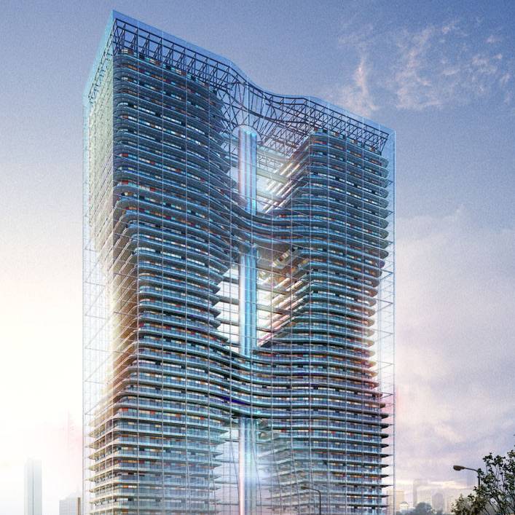
JANA2
David Lawrence, Nathan Brei JLab EPSCI group
May 24, 2020 Streaming Readout VI

Slide 2
Basic Components of an SRO System
Detector
Front End Electronics
Interface
Data Processor
Data Processor
Data Recorder
Software or dedicated hardware connected to FEE via Network
zero suppression
hit filter
data compression
software trigger
JANA2: Multi-threaded Algorithm Deployment - David Lawrence - JLab - Streaming Readout VI May 14, 2020

Slide 3
Detector
Front End Electronics
Interface
Data Processor
Data Processor
Data Recorder
BNL
Jin Huang Talk
https://indico.bnl.gov/event/5807/contributions/26937/attachments/21875/30184/EIC_DAQ_Streaming_Meeting.pdf
JANA2: Multi-threaded Algorithm Deployment - David Lawrence - JLab - Streaming Readout VI May 14, 2020

Slide 4
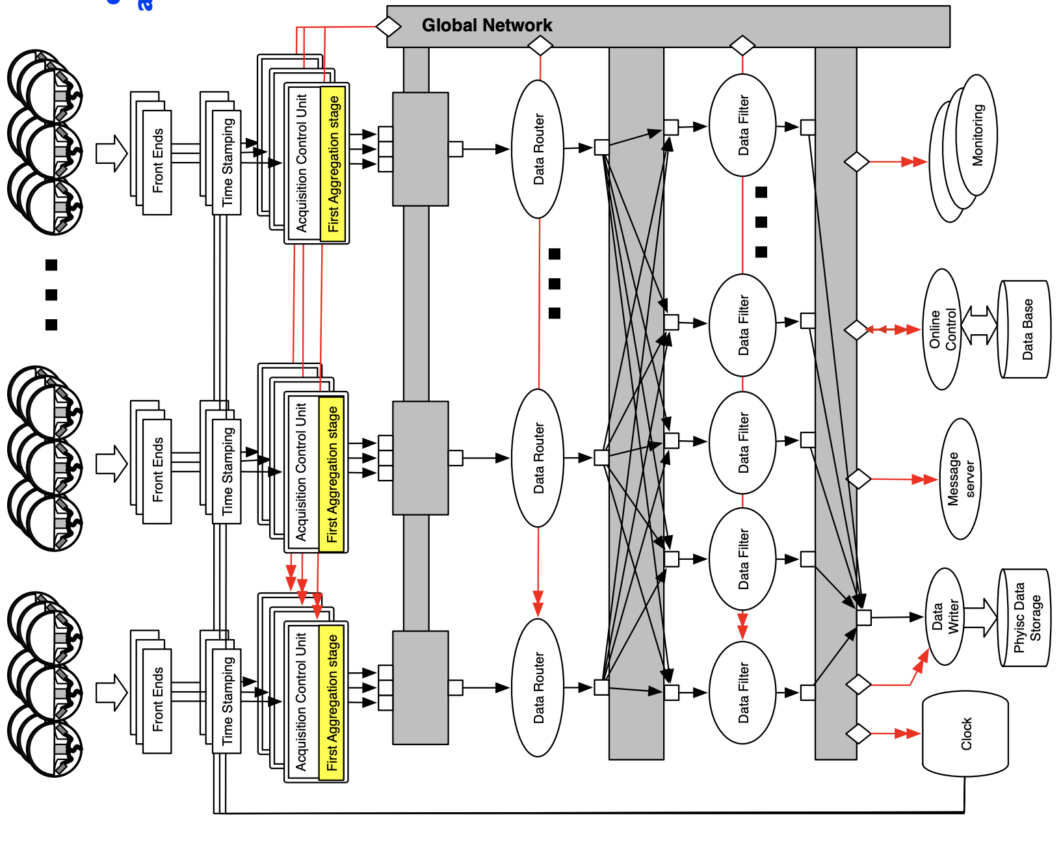
Detector
Front End Electronics
Interface
Data Processor
Data Processor
Data Recorder
TriDAS
Tommaso Chiarusi Talk
https://jeffersonlab.sharepoint.com/sites/SciComp/Shared%20Documents/EPSCI/SRO/Streaming/Tridas/EIC-Stream_Readout-Camogli_20190524_chiarusi.pdf
JANA2: Multi-threaded Algorithm Deployment - David Lawrence - JLab - Streaming Readout VI May 14, 2020

Slide 5
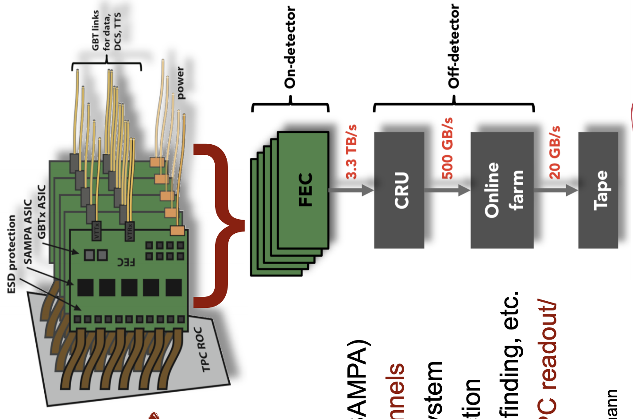
Detector
Front End Electronics
Interface
Data Processor
Data Processor
Data Recorder
ALICE
(Indra-Astra)
Eric Pooser Talk https://www.jlab.org/indico/event/307/session/12/contribution/18/material/slides/0.pdf
JANA2: Multi-threaded Algorithm Deployment - David Lawrence - JLab - Streaming Readout VI May 14, 2020

Slide 6
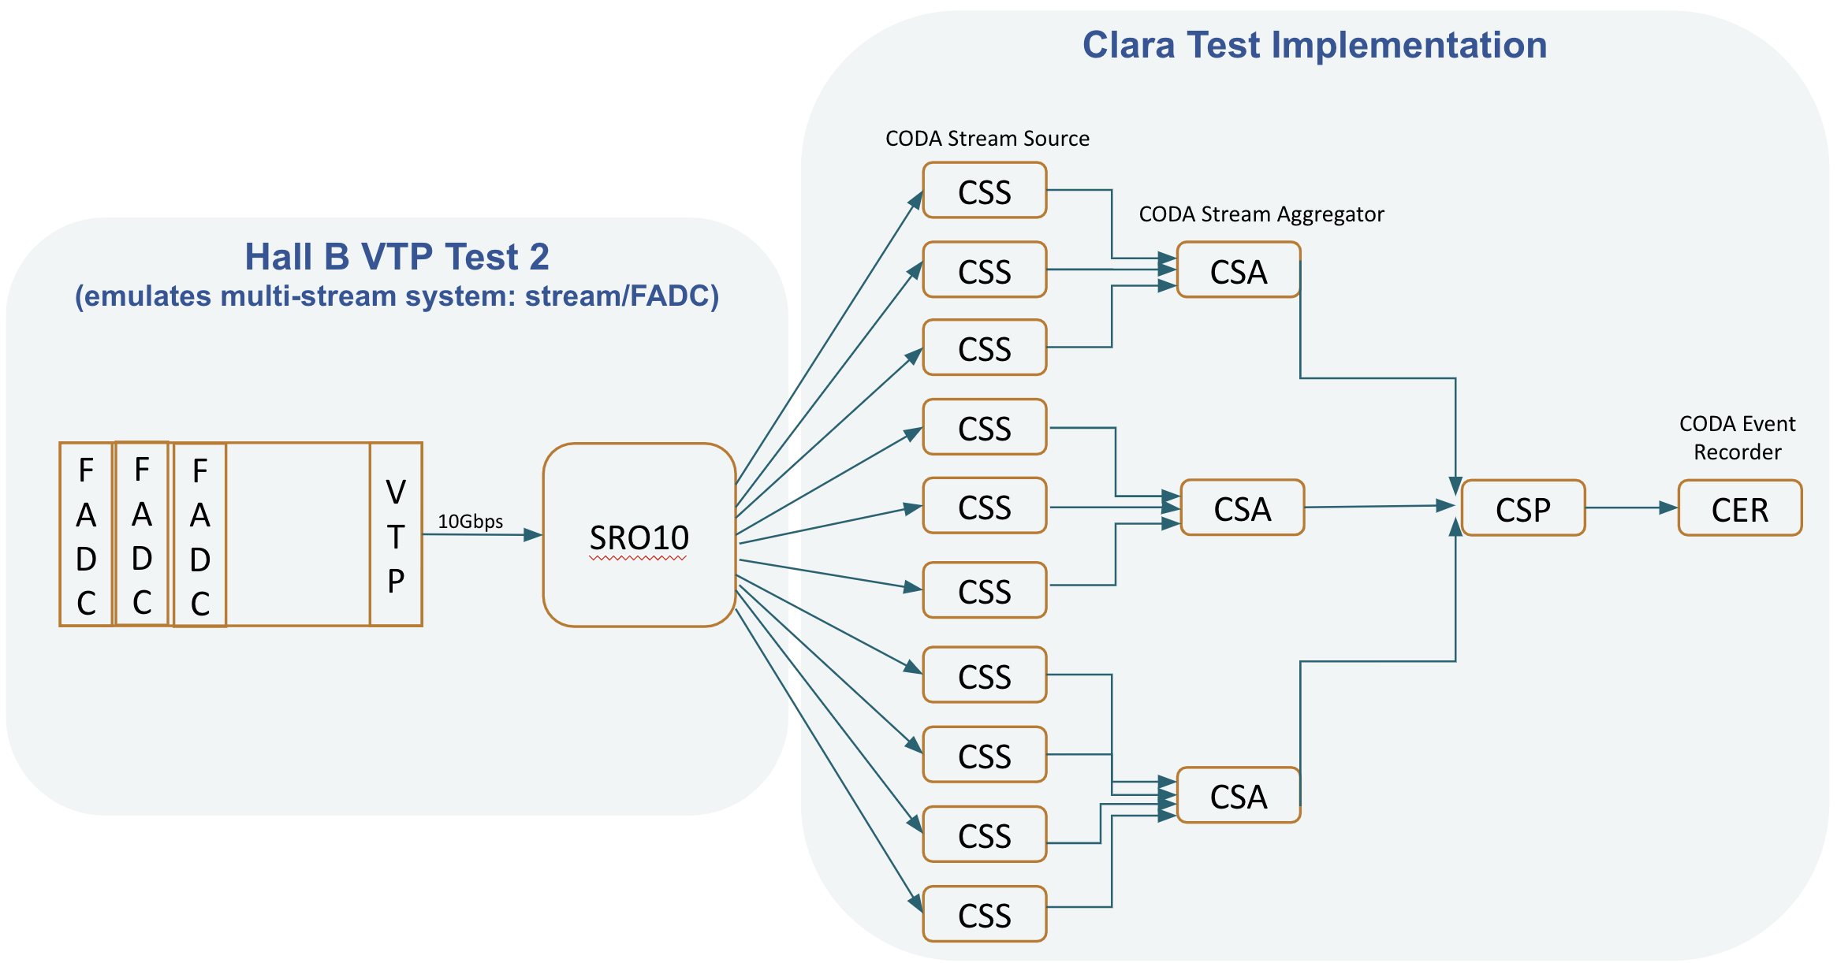
Detector
Front End Electronics
Interface
Data Processor
Data Processor
Data Recorder
CLARA
see Vardan G. talk later this session
JANA2: Multi-threaded Algorithm Deployment - David Lawrence - JLab - Streaming Readout VI May 14, 2020

Slide 7
JANA2’s role in SRO Systems
Detector
Front End Electronics
Interface
Data Processor
Data Processor
Data Recorder
Software or dedicated hardware connected to FEE via Network
zero suppression
hit filter
data compression
software trigger
JANA2: Multi-threaded Algorithm Deployment - David Lawrence - JLab - Streaming Readout VI May 14, 2020

Slide 8
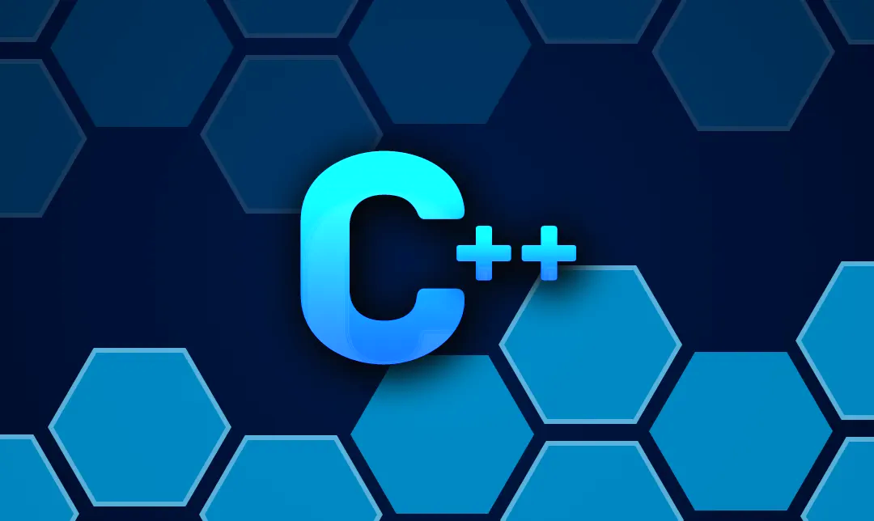
What is JANA2
C++ Multi-threaded event/time slice processing framework
Designed to support
Offline event reconstruction
Online Data Quality Monitoring
Software (aka L3) Trigger
Used in:
GlueX
eJANA (EIC)
BDX
Multiple SRO test stands at JLab
JANA2: Multi-threaded Algorithm Deployment - David Lawrence - JLab - Streaming Readout VI May 14, 2020

Slide 9
Arrow Queue Pattern
CPU intensive event reconstruction will be done as a parallel arrow
Other tasks (e.g. I/O) can be done as a sequential arrow
Fewer locks in user code allows framework to better optimize workflow
queue
queue
...
sequential arrow
parallel arrow
sequential arrow
JANA2: Multi-threaded Algorithm Deployment - David Lawrence - JLab - Streaming Readout VI May 14, 2020

Slide 10
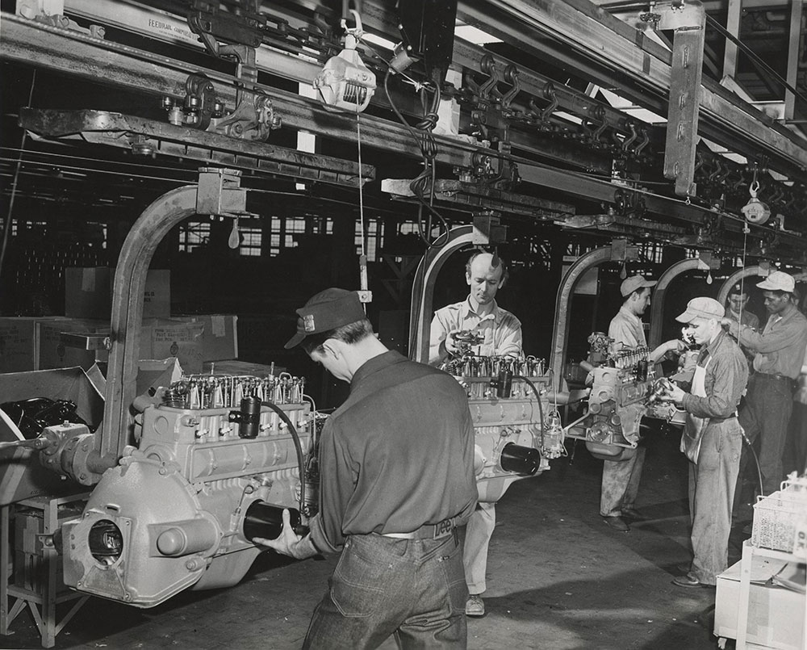
Reactive/Dataflow Programming
Data is presented to arrow in the form of a queue
Arrow transforms data and places it in downstream queue
Minimal synchronization time spent in accessing queues
Course tasks within arrow can eliminate most or all other synchronization points
JANA2: Multi-threaded Algorithm Deployment - David Lawrence - JLab - Streaming Readout VI May 14, 2020

Slide 11
Idea: Structure computation as a dataflow graph.
Idea: For each critical section, replace lock with a sequential arrow. Mediate handover of events between arrows via a queue.
Idea: Structure code identically to the corresponding work-time/work-span analysis
Advantages:
- Generalizable, which enables support for event blocks, subevents, software triggers, event building, etc
- Trivial parallel bottleneck/efficiency analysis
- Control of memory use via backpressure
- Control of memory locality
- Control of parallelism granularity
Simplest possible impl:
Legend
A: event_source.get() [SEQ]
B: event_processor.process_parallel() [PAR]
C: event_processor.process_sequential() [SEQ]
A, B, C
JANA1 impl:
A
B, C
JANA2 impl:
A
B
C
JANA2: Multi-threaded Algorithm Deployment - David Lawrence - JLab - Streaming Readout VI May 14, 2020

Slide 12
Generalizing: Subevents
Problem: If events are too large, we may run out of memory before we run out of cores.
Problem: If we are using a GPU or TPU, we may prefer to submit work in batches of (e.g.) 256 equally sized tasks.
Solution: Split/merge pattern
Legend
A: event_source.get() [SEQ]
B: subevent_processor.split() [PAR]
C: subevent_processor.process() [PAR]
D: group_by() [SEQ]
E: subevent_processor.merge() [PAR]
F: event_processor.process_parallel() [PAR]
G: event_processor.process_sequential() [SEQ]
subevent_processor.split :: event -> [T]
subevent_processor.process :: T -> U
subevent_processor.merge :: [U], event -> event
A
B
C
D
E, F
G
JANA2: Multi-threaded Algorithm Deployment - David Lawrence - JLab - Streaming Readout VI May 14, 2020

Slide 13
Factory Model Embedded in Arrow
FACTORY
(algorithm)
FACTORY
in stock?
NO
ORDER
NO
MANUFACTURE
in stock?
YES
STOCK
MANUFACTURE
YES
FACTORY
in stock?
NO
PRODUCT
STOCK
MANUFACTURE
YES
STOCK
Data on demand = Don’t do it unless you need it
Stock = Don’t do it twice
Conservation of CPU cycles!
JANA2: Multi-threaded Algorithm Deployment - David Lawrence - JLab - Streaming Readout VI May 14, 2020

Slide 14
Data on Demand => Software Trigger
Event by event decision on whether to activate a factory:
Software triggers may have multiple “keep” or “discard” conditions that may be probed in order of CPU cost
// Getting hit objects is cheap so we check that first
auto NcaloHits = jevent->Get<CaloHit>().size();
if( NcaloHits>minCaloHits ){
keep_event = true;
// Tracks factory only activated if not already keeping event
}else if( jevent->Get<Tracks>().size() > minTrackHits ) {
keep_event = true;
}
JANA2: Multi-threaded Algorithm Deployment - David Lawrence - JLab - Streaming Readout VI May 14, 2020

Slide 15
Streaming to JANA, with event building and software trigger
HitFactory:
JFactory
ClusterFactory:
JFactory
"Fast" ZMQ
JTriggeredEventSource<ReadoutMessage>
: JEventSource
TrackFactory:
JFactory
ZmqSource
<FastReadout>
JANA
queue
HistProcessor:
JEventProcessor
Histogram
JANA2: Multi-threaded Algorithm Deployment - David Lawrence - JLab - Streaming Readout VI May 14, 2020

Slide 16
Streaming to JANA, with event building and software trigger
HitFactory:
JFactory
ClusterFactory:
JFactory
"Fast" ZMQ
"Slow" ZMQ
JTriggeredEventSource<ReadoutMessage>
: JEventSource
TrackFactory:
JFactory
ZmqSource
<FastReadout>
ZmqSource
<SlowReadout>
JANA
queue
HistProcessor:
JEventProcessor
Histogram
JANA2: Multi-threaded Algorithm Deployment - David Lawrence - JLab - Streaming Readout VI May 14, 2020

Slide 17
Streaming to JANA, with event building and software trigger
HitFactory:
JFactory
ClusterFactory:
JFactory
"Fast" ZMQ
"Slow" ZMQ
JTriggeredEventSource<ReadoutMessage>
: JEventSource
TrackFactory:
JFactory
ZmqSource
<FastReadout>
ZmqSource
<SlowReadout>
JANA
queue
SessionWindow
FixedWindow
HistProcessor:
JEventProcessor
Histogram
EventTrigger
JANA2: Multi-threaded Algorithm Deployment - David Lawrence - JLab - Streaming Readout VI May 14, 2020

Slide 18
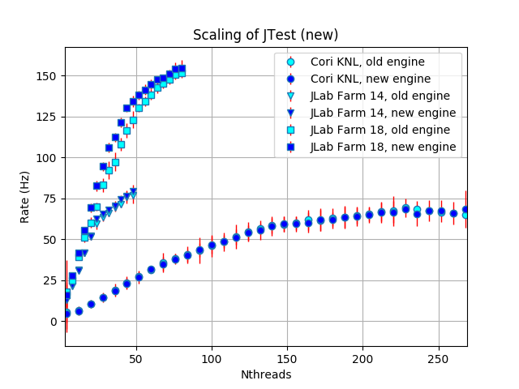
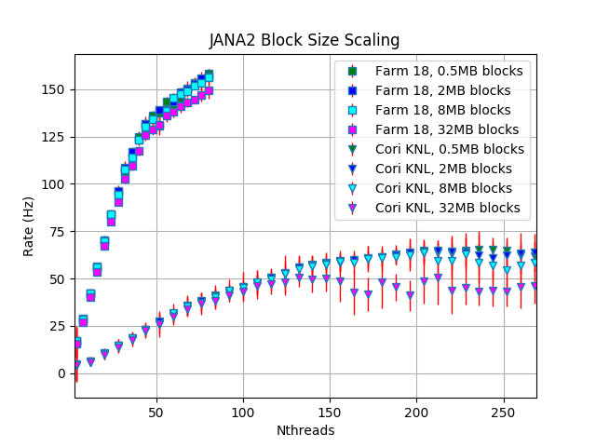
JANA2 Scaling Tests (JLab + NERSC)
40 thr.
24 thr.
136 thr.
204 thr.
68 thr.
kinks indicate hardware boundaries
JANA2: Multi-threaded Algorithm Deployment - David Lawrence - JLab - Streaming Readout VI May 14, 2020

Slide 19
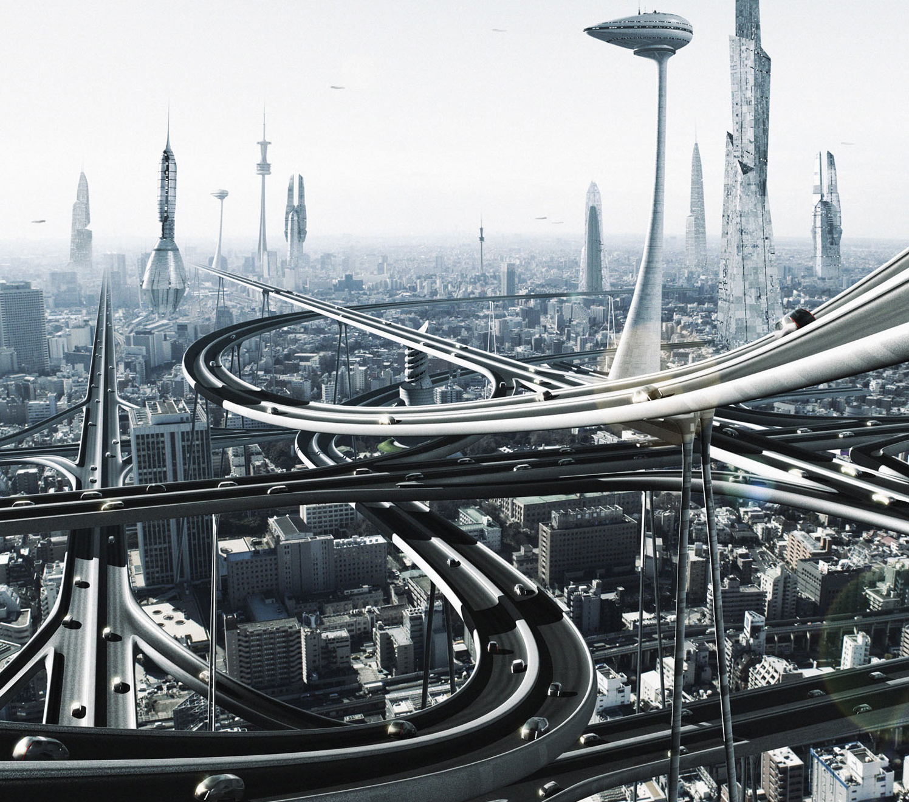
Summary - JANA2
Multi-threaded C++ Framework
Offline event reconstruction
Online Monitoring
Software (L3) trigger
Used for multiple projects
GlueX
eJANA
BDX
Indra-Astra
CLAS12 SRO R&D
Well suited for SRO applications
Bridges Offline/Online
Data on demand
Heterogeneous hardware support
https://github.com/JeffersonLab/JANA2
JANA2: Multi-threaded Algorithm Deployment - David Lawrence - JLab - Streaming Readout VI May 14, 2020

Slide 20
Backups

Slide 21
Projects Driving JLab SRO
Experiment | Conditions | Event Rate | Data Rate | Comments
Moller | Production/ integrated mode | 1920Hz | 130MB/s | Can be handled with the traditional DAQ.
EIC | L=10³⁴ cm⁻²s⁻¹ | 450-550kHz (not including background noise rates) | 20-25GB/s not included vertex tracker that will generate ~240GB/s | ~10kHz/μb, track multiplicity = ~5 JLAB EIC detector design will have millions of channels. Only non-vertex detectors combined will have ~1M channels plus vertex detector: estimated 20-50M channels. In total ~1000 ROC’s. Control nightmare (starting stopping a run). Streaming readout has less control requirements.
TIDIS |  | rTPC hit rates enormous (~800KHz/pad) | 4GB/s | How to match up super Bigbyte detected electrons with rTPC detected spectator protons is a big question. Conventional triggered DAQ will be challenged.
SoLID | 30 sector GEM |  | 30GB/s | 30 separate DAQ’s each 1GB/s? How to combine GEM readout with other detectors? Handling GEM hits sharing adjacent sectors.
CLAS12 | Phase 2 | 100KHz | 5-7GB/s
Notes:
EIC low estimate of 20-25GB/s slightly higher than Jin’s 100Gbps, but only by a factor of a few, not an order of magnitude.
Jin’s talk: (10GB/s) / (5E5 events/s) = 20kB/event which seems small. (Only 30% larger than GlueX for x50 more channels?)

Slide 22
TriDAS Testing
see: https://agenda.infn.it/event/18179/contributions/89843/attachments/63451/76396/EIC-Stream_Readout-Camogli_20190524_chiarusi.pdf
TriDAS system testing in Experimental Halls B and D at JLab
Existing Flash-ADC systems using VTP module with high speed VXS interconnects
Multiple testbeds currently available (Sergey B.)
Supports multi-node, multi-process and multi-threaded scaling options
integrated JANA2 for triggering
Only preliminary testing done so far at JLab
expect more stress testing over coming months
Open issues
System designed for deep sea neutrino experiments (how well does it scale?)
Overall process management
10 components
10 components
HM
TCPU
HM
TCPU
HM
TCPU
VTP (left)
coda_sro
HM
VTP (right)
TCPU
HM
TCPU
HM
TCPU
HM
TCPU

Slide 23
INDRA-ASTRA: Seamless integration of DAQ and analysis using AI
LDRD
goal
prototype components of streaming readout at NP experiments
→ integrated start to end system from detector read out through analysis
→ comprehensive view: no problems pushed into the interfaces
prototype (near) real-time analysis of NP data
→ inform design of new NP experiments
Front End data
Near real-time processor of streamed data in JANA2
Ongoing work
automated data quality monitoring
self-calibration of GEM detector
Near real-time, interactive analysis in JupyterLab
fADCs
Front End data
Analysis data
GEM detector
Front End data
Custom MC Simulated ADC and TDC output
ZeroMQ messages via ethernet

Slide 24
GlueX Computing Needs
 | 2017 (low intensity GlueX) | 2018 (low intensity GlueX) | 2019 (PrimEx) | 2019 (high intensity GlueX)
Real Data | 1.2PB | 6.3PB | 1.3PB | 3.1PB
MC Data | 0.1PB | 0.38PB | 0.16PB | 0.3PB
Total Data | 1.3PB | 6.6PB | 1.4PB | 3.4PB
Real Data CPU | 21.3Mhr | 67.2Mhr | 6.4Mhr | 39.6Mhr
MC CPU | 3.0Mhr | 11.3MHr | 1.2Mhr | 8.0Mhr
Total CPU | 24.3PB | 78.4Mhr | 7.6Mhr | 47.5Mhr
 | Out - years (high intensity GlueX)
Real Data | 16.2PB
MC Data | 1.4PB
Total Data | 17.6PB
Real Data CPU | 125.6Mhr
MC CPU | 36.5Mhr
Total CPU | 162.1Mhr
Anticipate 2018 data will be processed by end of summer 2019
Event size: 12-13kB
Projection for out-years of GlueX High Intensity running at 32 weeks/year

Slide 25
Complete Event Reconstruction in JANA
Framework has a layer that directs object requests to the factory that completes it
HDDM File
EVIO File
ET system
Event Source
Web Service
Multiple algorithms (factories) may exist in the same program that produce the same type of data objects
JANA
Event Processor
This allows the framework to easily redirect requests to alternate algorithms specified by the user at run time
User supplied code
Fill histograms
Write DST
L3 trigger

Slide 26
Multi-threading
A complete set of factories is assigned to an event giving it exclusive use while that event is processed
thread
Event Source
thread
Factories only work with other factories in the same thread eliminating the need for expensive mutex locking within the factories
Event Processor
All events are seen by all Event Processors (multiple processors can exist in a program)
thread
thread

Slide 27
What the user needs to know:
auto tracks = jevent->Get<DTrack>(); for(auto t : tracks){
// ... do something with const DTrack* t
}
vector<const *DTrack> tracks
JANA2: Multi-threaded Event Reconstruction - David Lawrence - JLab - HSF Framework WG Apr. 1, 2020

Slide 28
If an alternate factory is desired:
(i.e. algorithm)
auto tracks = jevent->Get<DTrack>(“MyTest”); or, even better
set configuration parameter: DTrack:DEFTAG=MyTest
Configuration parameters are set at run time
NAME:DEFTAG is special and tells JANA to re-route ALL requests for objects of type NAME to the specified factory.
JANA2: Multi-threaded Event Reconstruction - David Lawrence - JLab - HSF Framework WG Apr. 1, 2020

Slide 29
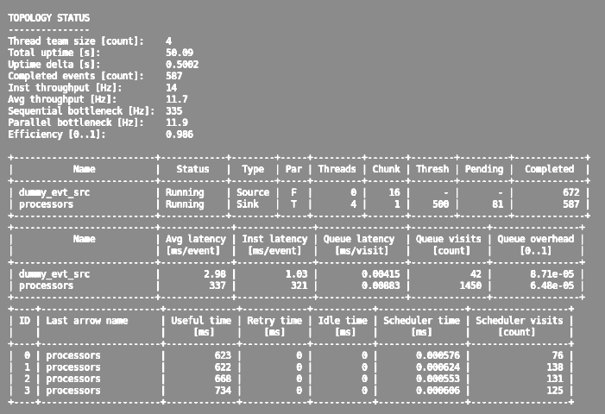
JANA2 now has much better built-in diagnostics compared to the original JANA. This helps pinpoint bottlenecks, especially in more complex systems
JANA2: Multi-threaded Event Reconstruction - David Lawrence - JLab - HSF Framework WG Apr. 1, 2020

