Slide 1
CLARA: Data-Stream Processing Framework
Framework for streaming readout
V. Gyurjyan for JLAB EPSCI Group

Slide 2
Outline
Problem statement and possible solutions
Hardware diversification
Parallelization
Streaming
Micro-services architecture
Micro-service vs monolith
Flow based programming paradigm
Reactive communication
CLARA: reactive data-stream processing framework that implements micro-services architecture and FBP
Summary

Slide 3
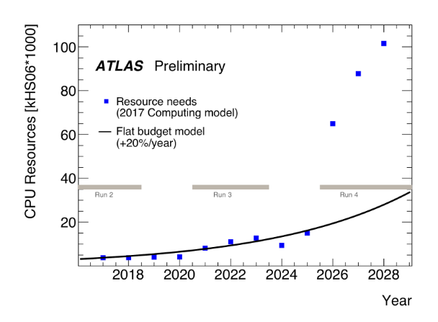
Problem we face
Experiment | Conditions | Event Rate | Data Rate | Comments
Moller | Production/ integrated mode | 1920Hz | 130MB/s | Can be handled with the traditional DAQ.
EIC | L=10³⁴ cm⁻²s⁻¹ | 450-550Hz Not included background noise rates. | 20-25GB/s not included vertex tracker that will generate ~240GB/s | ~10Kz/μb, track multiplicity = ~5 JLAB EIC detector design will have millions of channels. Only non-vertex detectors combined will have ~1M channels plus vertex detector: estimated 20-50M channels. In total ~1000 ROC’s. Control nightmare (starting stopping a run). Streaming readout has less control requirements.
TIDIS |  | rTPC hit rates enormous (~800KHz/pad) | 4GB/s | How to match up super Bigbyte detected electrons with rTPC detected spectator protons is a big question. Conventional triggered DAQ will be challenged.
SoLID | 30 sector GEM |  | 30GB/s | 30 separate DAQ’s each 1GB/s? How to combine GEM readout with other detectors? Handling GEM hits sharing adjacent sectors.
CLAS12 | Phase 2 | 100KHz | 5-7GB/s

Slide 4
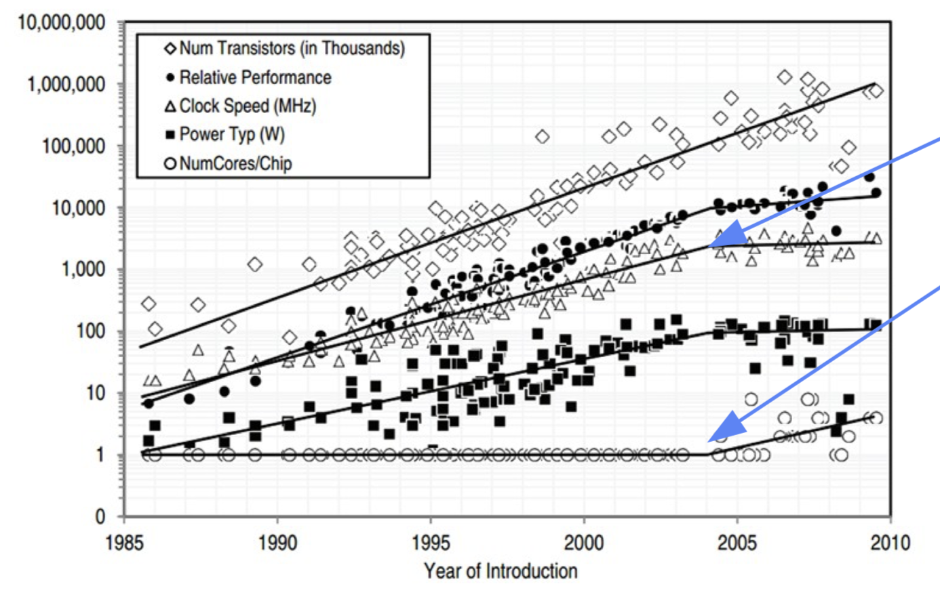
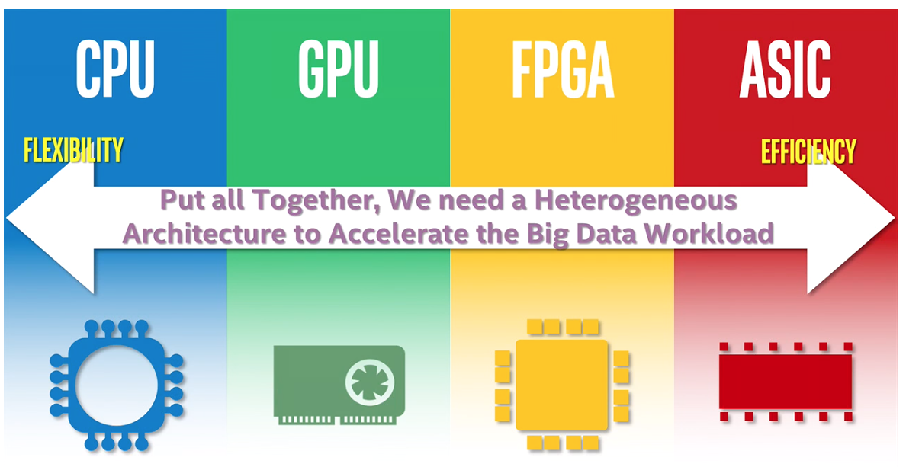
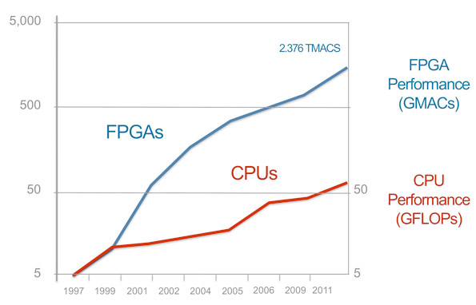
CPU based architecture limitations
A Roadmap for HEP Software and Computing R&D for the 2020s. HEP Software Foundation, Feb. 2018
MIPS/clock speed plateau
“Frameworks face the challenge of handling the massive parallelism and heterogeneity that will be present in future computing facilities, including multi-core and many-core systems, GPUs, Tensor Processing Units (TPUs), and tiered memory systems, each integrated with storage and high-speed network interconnections.”
Squeezing more cores per
chip becomes difficult

Slide 5
The Scale-Cube
Scale by splitting similar things , Y-axis
such as events. Multi-threading
Vertical scaling or multi-treading
Scale by splitting independent things, Z-axis
Functional decomposition
Micro-services
Horizontal scaling
Scale by cloning things. X-axis
Multi-processing
The Art of Scalability. by Martin L. Abbott and Michael T. Fisher. ISBN-13: 978-0134032801

Slide 6
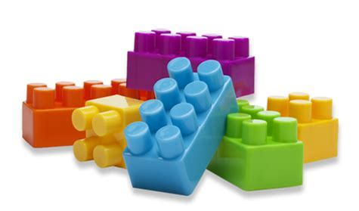
Why decomposition into independent modules
Smaller and independent code bases. Reinforce a maximum independence and isolation of functional components.
Fault tolerant
Overall micro-services based application evolves much faster
No other dependencies other than data (loose coupling) can run on heterogeneous hardware and software infrastructures.
Relatively easy evolution, due to
Requirement changes
Environment changes
Errors or security breaches
New equipment added or removed
Improvements to the system
Encourages contribution and inclusion of new technologies

Slide 7
Micro-services vs Monolithic architecture
Presentation
Logic
Data
Pros
Strong coupling, network independent
Full control of your application
Cons
No agility for isolating, compartmentalizing and decoupling data processing functionalities, suitable to run on diverse hardware/software infrastructures
No agility for rapid development or scalability
Pros
Technology independent
Fast iterations
Small teams
Fault isolation
Scalable
Cons
Complexity networking (distributed system)
Requires administration and real-time orchestration

Slide 8
FBP paradigm and reactive programming
Flow based programming paradigm assumes reactive programming
S1: Proactive, responsible for change in S2
S2: Passive, unaware of the dependency
Passive programming
S1
S2
S1: Broadcasts it’s own result
S2: Subscribes S1 change events and changes itself
S1
S2
Publisher/Producer
Subscriber/Consumer
Reactive programming
Enables event driven stream processing
t2
t1
t0
Feedback to control backpressure
Notes:
express a problem in terms of transforms on streams of data

Slide 9
CLARA Framework
Reactive, data-stream processing framework that implements micro-services architecture and FBP
Provides service abstraction (data processing station) to present user algorithm (engine) as an independent service.
Defines service communication channel (data-stream pipe) outside of the user engine.
Stream-unit level workflow management system and API
Defines streaming transient-data structure
Supports C++, JAVA, Python languages
Authors and chronology
V. Gyurjyan, S. Mancilla, R. Oyarzun, S. Paul, A. Rodrigues
Design: 2009
Betta release and first application: 2010
3 master theses
Publications
Rewards
Research Opportunities in Space and Earth Sciences (ROSES) 2015
Funding for 3 years by the NASA's Earth Science Technology Office (ESTO) and the Advanced Information Systems Technology (AIST) Program.
NAIADS Project ID: AIST-14-0014.
SRB Project ID:LARC-14-0014-2
CLARA: A Contemporary Approach to Physics Data Processing, 2011, J. Phys.: Conf. Ser. 331 032013 doi:10.1088/1742-6596/331/3/032013
Development of A Clara Service for Neutron Reconstruction, 2011, APS: 2011APS..DNP.EA024C
Component Based Dataflow Processing Framework, 2015, IEEE DOI: 10.1109/BigData.2015.7363971, ISBN: 978 1-4799-9926-2
Earth Science Data Fusion with Event Building Approach, 2015, IEEE DOI: 10.1109/BigData.2015.7363972, ISBN: 978 1-4799-9926-2
CLARA: The CLAS12 Reconstruction and Analysis framework, 2016, J. Phys.: Conf. Ser. 762 012009 doi:10.1088/1742-6596/762/1/012009
Users
Documentation
http://claraweb.jlab.org

Slide 10
Basic components and a user code interface
Data Processing Station
Data-Stream Pipe
Orchestrator
Single Interface
Data processing Engine
Data Processing Station
Data Processing Micro-Service
https://claraweb.jlab.org/clara/docs/quickstart/java.html
Engine Tutorials
https://claraweb.jlab.org/clara/docs/quickstart/cpp.html
https://claraweb.jlab.org/clara/docs/quickstart/python.html

Slide 11
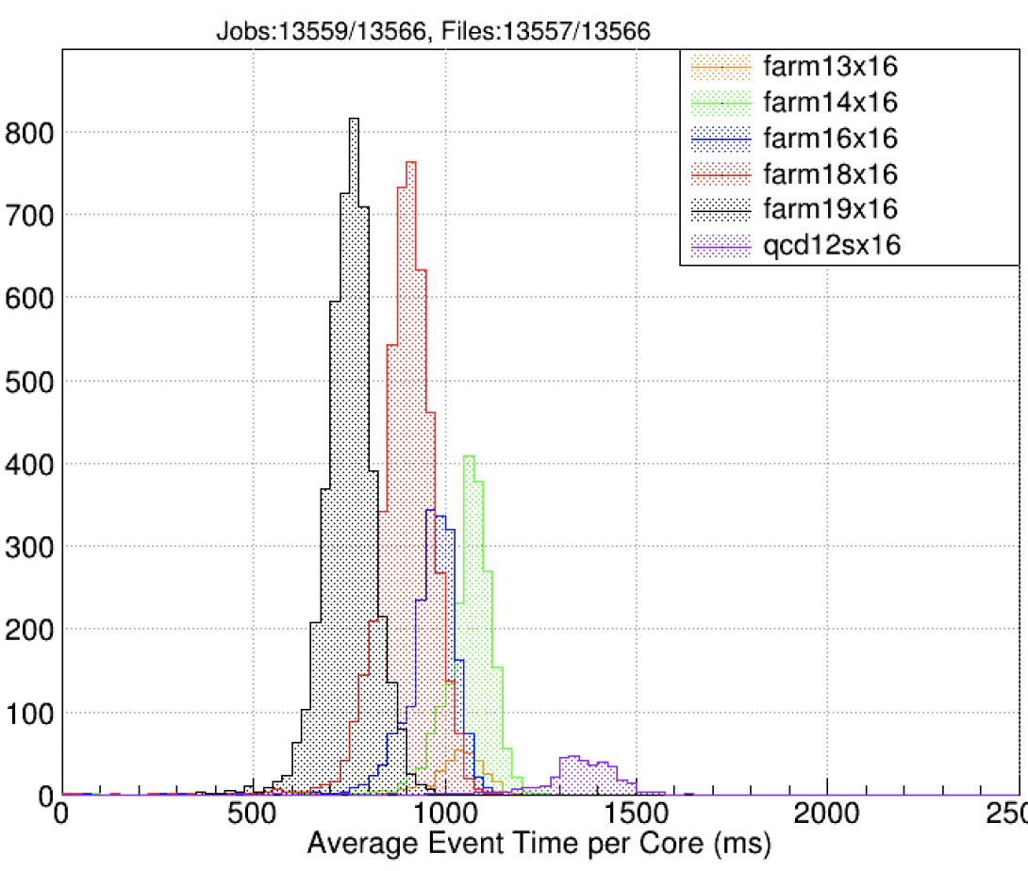
Data Processing Station
Runtime Environment
C++
JAVA
Python
Configuration
configuration:
io-services:
writer:
compression: 2
services:
MAGFIELDS:
magfieldSolenoidMap: Symm_solenoid_r601_phi1_z1201_13June2018.dat
magfieldTorusMap: Full_torus_r251_phi181_z251_08May2018.dat
variation: rga_fall2018
DCHB:
variation: rga_fall2018
dcGeometryVariation: rga_fall2018
dcT2DFunc: "Polynomial"
DCTB:
variation: rga_fall2018
dcGeometryVariation: rga_fall2018
EC:
variation: rga_fall2018
mime-types: - binary/data-hipo
Multi-threading
2020-05-08 11:48:30.940: Benchmark results:2020-05-08 11:48:30.941:
average event time = 0.14 ms2020-05-08 11:48:30.943: MAGFIELDS 2000 events total time = 0.02 s average event time = 0.01 ms2020-05-08 11:48:30.945: FTCAL 2000 events total time = 0.26 s average event time = 0.13 ms2020-05-08 11:48:30.946: FTHODO 2000 events total time = 0.29 s average event time = 0.15 ms2020-05-08 11:48:30.948: FTEB 2000 events total time = 0.13 s average event time = 0.06 ms2020-05-08 11:48:30.949: DCHB 2000 events total time = 1126.76 s average event time = 563.38 ms2020-05-08 11:48:30.951: FTOFHB 2000 events total time = 3.93 s average event time = 1.96 ms2020-05-08 11:48:30.952: EC 2000 events total time = 1.87 s average event time = 0.94 ms2020-05-08 11:48:30.953: CVT 2000 events total time = 150.14 s average event time = 75.07 ms2020-05-08 11:48:30.955: CTOF 2000 events total time = 4.75 s average event time = 2.37 ms2020-05-08 11:48:30.956: CND 2000 events total time = 1.49 s average event time = 0.74 ms2020-05-08 11:48:30.957: BAND 2000 events total time = 0.02 s average event time = 0.01 ms2020-05-08 11:48:30.959: HTCC 2000 events total time = 0.11 s average event time = 0.05 ms2020-05-08 11:48:30.960: LTCC 2000 events total time = 0.05 s average event time = 0.03 ms2020-05-08 11:48:30.961: EBHB 2000 events total time = 1.60 s average event time = 0.80 ms2020-05-08 11:48:30.963: DCTB 2000 events total time = 988.61 s average event time = 494.30 ms2020-05-08 11:48:30.964: FTOFTB 2000 events total time = 3.98 s average event time = 1.99 ms2020-05-08 11:48:30.965: EBTB 2000 events total time = 2.86 s average event time = 1.43 ms2020-05-08 11:48:30.966: RICH 2000 events total time = 2.15 s average event time = 1.07 ms2020-05-08 11:48:30.967: WRITER 2000 events total time = 7.09 s average event time = 3.55 ms2020-05-08 11:48:30.968: TOTAL 2000 events total time = 2296.38 s average event time = 1148.19 ms
Communication
0MQ
POSIX-SHM
In-memory Data Grid (IDG)
https://github.com/JeffersonLab/clara-java.git
Language Bindings
https://github.com/JeffersonLab/clara-cpp.git
https://github.com/JeffersonLab/clara-python.git

Slide 12
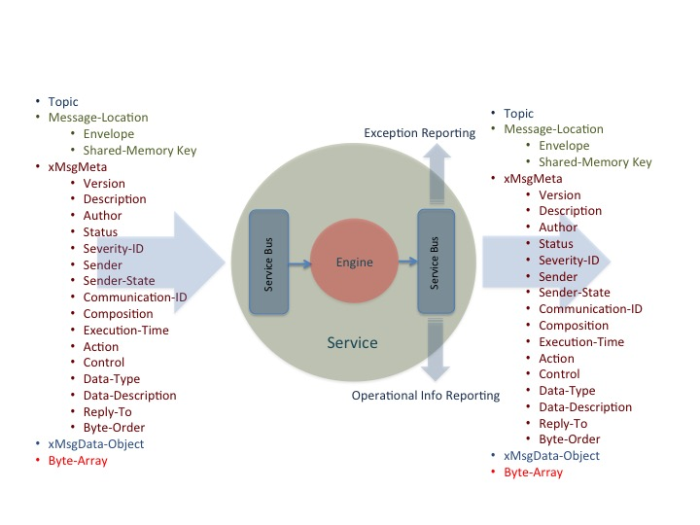
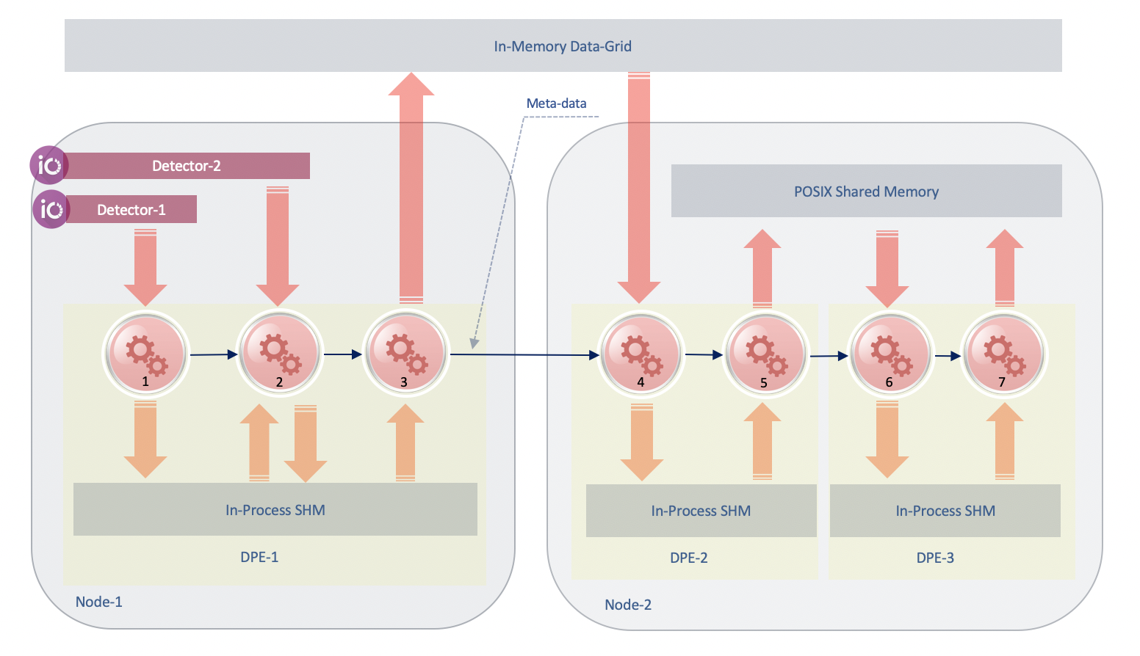
Data Stream Pipe
Transient Stream Unit
Google ProtoBuf
Meta-data
Serialization
Encryption
req
rep
OMQ / POSIX_SHM / IDG
https://github.com/JeffersonLab/xmsg-java.git
Language Bindings
https://github.com/JeffersonLab/xmsg-cpp.git
https://github.com/JeffersonLab/xmsg-python.git

Slide 13
Workflow orchestrator
Application Monitoring,
Real-time Benchmarking
Command-Line Interface
Hardware Optimizations
Application Deployment
and Execution
Service Registration/Discovery
Orchestrator
Exception Logging and Reporting
Data-Set Handling
and Distribution
Farm (batch or cloud) Interface

Slide 14
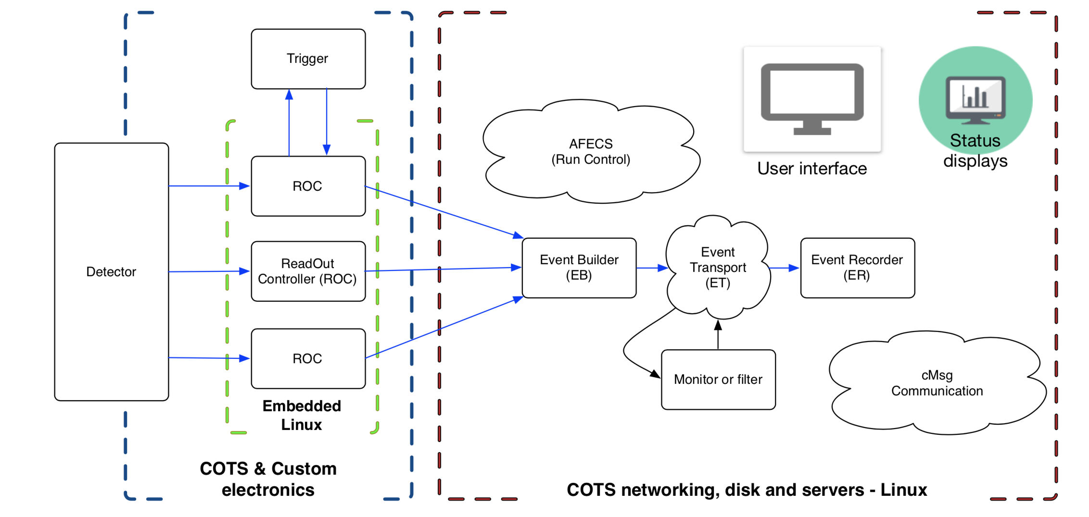
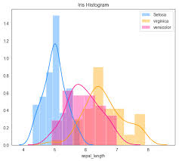
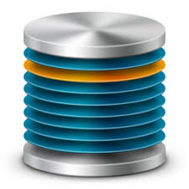
CLAS12 Data Processing Applications
Event Reconstruction Application
MAGF
FCAL
FTHODO
FTEB
DCHB
FTOFHB
EC
CVT
EBTB
FTOFTB
DCTB
EBHB
LTCC
HTCC
BAND
CND
Data Acquisition System
CDG
Data Quality Assurance
Data Provisioning
Physics Analysis Application
J/$ψ/TCS$
$$π0 , e−γγ$$
$$Inclusive Hadron$$
$MesonX/VS$
$$e−π+N$$
$$e−P$$
$$ppX$$

Slide 15
Heterogeneous data-stream processing (LDRD-2018)
VXI Crate
Flash ADCs/TDCs
Detector reconstruction services (DRS)
Full detector reconstruction
Calibration, alignment
Kalman filter
Note: some DRS services might run on GPGPU/TPU
VTP
Detector reconstruction services (DRS)
Cluster, segment finder
Road finder
SIS
Analysis services
Detector 1
Sector 1
Some detectors might need
other detector’s data to
complete their reconstruction.
DRS
ANAS 1
VXS
Sector reconstruction services (SRS)
Geometry matching
Partial software trigger
SIS
Stream interface services (SIS)
Runs on FPGA
0 suppression
Electronic noise removal
SRS
EBS
ERS 1
DRS X
ERS N
ANAS 2
SSP
SIS
Event reconstruction services
DSTP
ANAS N
EP
EB service (GT) or CODA (triggered)
Detector N
Sector N
DST persistency
Reconstructed data
DRS
Event persistency
Raw data
SIS
Note: FPGA based CLARA service’s code base (C++) will be deployed in CPU first for
verification and quality control, and only after will be deployed into FPGAs.
To use existing hardware in a streaming mode data must be reduced while streaming.

Slide 16
Hall-B VTP Test-setup 2
Clara Test Implementation
Stream Source
CSS
Hall B VTP Test 2
(emulates multi-stream system: stream/FADC)
Stream Aggregator
CSS
CSA
CSS
CSS
Stream Processor
FADC
FADC
FADC
VTP
SRO10
Event Recorder
10Gb/sec
CSS
CSA
CSP
CER
CSS
CSS
CSS
CSA
CSS
CSS

Slide 17
Summary
To address scientific data 3V expansion we need to design frameworks capable of leveraging data streams, as well as massive parallelism and heterogeneity of feature computing facilities.
CLARA is a mature data stream processing framework that utilizes micro-services architecture and flow-based programming paradigm, currently in production-use at JLAB and NASA Langley.
CLARA together with JANA are being tested on the Hall-B SRO test-setup 2 for evaluation, and setting up a foundation for an integrated data processing framework for future experiments at home and elsewhere.
Thank you

Slide 18
Backups

Slide 19
Structure
Orchestration Layer
Local Registration
Local Registration
DPE
DPE
SC
SC
SC
SC
FE
Registration
gateway
security
Local Registration
Local Registration
DPE
DPE
SC
SC
SC
SC
Service Layer
Meta-Data
Data
ZeroMQ(xMsg)
POSIX Shared Memory (FIPC)
in-Memory Data-Grid

Slide 20
Event Reconstruction Application (sub-event level parallelization)
FCAL
FTHODO
FTEB
CVT
CND
EBHB
DCTB
RICH
EBTB
CTOFTB
MAGF
DCHB
FTOFHB
FTOFTB
EC
LTCC
HTCC

Slide 21
Heterogeneous deployment algorithm
C++-DPE
DCHBg
$$\sum_{1}^{ti}{CRDCHB−GPU(ti)}$$
P_{g}=$\frac{\sum_{1}^{ti}{CRFTOF(ti)} }{\sum_{1}^{ti}{CRDCHB−GPU(ti)} }$
P_{c}=$\frac{\sum_{1}^{ti}{CRFTOF(ti)} }{\sum_{1}^{ti}{CRDCHB−CPU(ti)} }$
In-Memory Data-Grid
DCHBc
EC
FTOF
$$if Pg<Pc \\ \text{route} \text{data}\text{−}\text{stream} \text{through} \text{DCHBg}$$
$$\sum_{1}^{ti}{CRDCHB−CPU(ti)}$$
In-Process SHM
$$\sum_{1}^{ti}{CRFTOF(ti)}$$
Java-DPE
Farm Node
CLARA micro-service
Can be deployed as a separate process or
a thread within a process. Multi-threaded
CLARA micro-service
Can be deployed as a separate process or
a thread within a process. Multi-threaded
CLARA micro-service
Can be deployed as a separate process or
a thread within a process. Multi-threaded
CLARA micro-service
Can be deployed as a separate process or
a thread within a process. Multi-threaded
CLARA transient data-stream
Message passing through pub-sub middleware. No dependencies between micro-services.
CLARA transient data-stream
Message passing through pub-sub middleware. No dependencies between micro-services.
CLARA transient data-stream
Message passing through pub-sub middleware. No dependencies between micro-services.
CLARA transient data-stream
Message passing through pub-sub middleware. No dependencies between micro-services.
FCAL 0.08ms
FTEB 0.05ms
FHOD 0.05ms
DCHB 34.05ms
DCTB 63.7ms
FTOF 1.16ms
FCAL 0.08ms
FTEB 0.05ms
FHOD 0.05ms
DCHB 34.05ms
DCTB 63.7ms
FTOF 1.16ms
FCAL 0.08ms
FTEB 0.05ms
FHOD 0.05ms
DCHB 34.05ms
DCTB 63.7ms
FTOF 1.16ms
FCAL 0.08ms
FTEB 0.05ms
FHOD 0.05ms
DCHB 34.05ms
DCTB 63.7ms
FTOF 1.16ms
Processing Node/DPE
RS
0.07ms
EBTB 0.38ms
EC 0.75ms
EBHB 0.37ms
LTCC 0.05ms
HTCC 0.14ms
CTOF 0.19ms
Processing Node/DPE
RS
0.07ms
EBTB 0.38ms
EC 0.75ms
EBHB 0.37ms
LTCC 0.05ms
HTCC 0.14ms
CTOF 0.19ms
Processing Node/DPE
RS
0.07ms
EBTB 0.38ms
EC 0.75ms
EBHB 0.37ms
LTCC 0.05ms
HTCC 0.14ms
CTOF 0.19ms
Processing Node/DPE
RS
0.07ms
EBTB 0.38ms
EC 0.75ms
EBHB 0.37ms
LTCC 0.05ms
HTCC 0.14ms
CTOF 0.19ms
Monitor Node/DPE
WS
0.25ms
Monitor Node/DPE
WS
0.25ms
Monitor Node/DPE
WS
0.25ms
Monitor Node/DPE
WS
0.25ms
FCAL HS/TLS
FHOD HS/TLS
FTEB HS/TLS
DC HS/TLS
CTOF HS/TLS
EC HS/TLS
HTCC HS/TLS
LTCC HS/TLS
EB HS/TLS
FCAL HS/TLS
FHOD HS/TLS
FTEB HS/TLS
DC HS/TLS
CTOF HS/TLS
EC HS/TLS
HTCC HS/TLS
LTCC HS/TLS
EB HS/TLS
FCAL HS/TLS
FHOD HS/TLS
FTEB HS/TLS
DC HS/TLS
CTOF HS/TLS
EC HS/TLS
HTCC HS/TLS
LTCC HS/TLS
EB HS/TLS
FCAL HS/TLS
FHOD HS/TLS
FTEB HS/TLS
DC HS/TLS
CTOF HS/TLS
EC HS/TLS
HTCC HS/TLS
LTCC HS/TLS
EB HS/TLS
Filter
TLS
DST
Data
DST
WS
Filter
TLS
DST
Data
DST
WS
claraweb.jlab.org
Filter
TLS
DST
Data
DST
WS
claraweb.jlab.org
Filter
TLS
DST
Data
DST
WS
Clara
Monitor
Server
InfluxDB
service
claraweb.jlab.org
Grafana
InfluxDB
service
claraweb.jlab.org
Grafana
Clara
Monitor
Server
DB
Clara
Monitor
Server
InfluxDB
service
DB
Grafana
Clara
Monitor
Server
InfluxDB
service
DB
Grafana
DB
Binary/HIPO
JSON data-format
Binary/HIPO
Binary/HIPO
Histogram
Analyzer
JSON data-format
Archiver
DB
DST
Remote
Client
Binary/HIPO
Histogram
Analyzer
DST Node/DPE/process
JSON data-format
Archiver
DB
DST
Remote
Client
Histogram
Analyzer
DST Node/DPE/process
JSON data-format
Archiver
DB
DST
Remote
Client
Histogram
Analyzer
DST Node/DPE/process
Archiver
DB
DST
Remote
Client
DST Node/DPE/process

Slide 22
Data-quantum size and GPU occupancy
C++-DPE
DCHBg
In-Memory Data-Grid
set data-quantum size
FTOF
EC
In-Process SHM
Java-DPE
Farm Node
CLARA micro-service
Can be deployed as a separate process or
a thread within a process. Multi-threaded
CLARA micro-service
Can be deployed as a separate process or
a thread within a process. Multi-threaded
CLARA micro-service
Can be deployed as a separate process or
a thread within a process. Multi-threaded
CLARA micro-service
Can be deployed as a separate process or
a thread within a process. Multi-threaded
CLARA transient data-stream
Message passing through pub-sub middleware. No dependencies between micro-services.
CLARA transient data-stream
Message passing through pub-sub middleware. No dependencies between micro-services.
CLARA transient data-stream
Message passing through pub-sub middleware. No dependencies between micro-services.
CLARA transient data-stream
Message passing through pub-sub middleware. No dependencies between micro-services.
FCAL 0.08ms
FTEB 0.05ms
FHOD 0.05ms
DCHB 34.05ms
DCTB 63.7ms
FTOF 1.16ms
FCAL 0.08ms
FTEB 0.05ms
FHOD 0.05ms
DCHB 34.05ms
DCTB 63.7ms
FTOF 1.16ms
FCAL 0.08ms
FTEB 0.05ms
FHOD 0.05ms
DCHB 34.05ms
DCTB 63.7ms
FTOF 1.16ms
FCAL 0.08ms
FTEB 0.05ms
FHOD 0.05ms
DCHB 34.05ms
DCTB 63.7ms
FTOF 1.16ms
Processing Node/DPE
RS
0.07ms
EBTB 0.38ms
EC 0.75ms
EBHB 0.37ms
LTCC 0.05ms
HTCC 0.14ms
CTOF 0.19ms
Processing Node/DPE
RS
0.07ms
EBTB 0.38ms
EC 0.75ms
EBHB 0.37ms
LTCC 0.05ms
HTCC 0.14ms
CTOF 0.19ms
Processing Node/DPE
RS
0.07ms
EBTB 0.38ms
EC 0.75ms
EBHB 0.37ms
LTCC 0.05ms
HTCC 0.14ms
CTOF 0.19ms
Processing Node/DPE
RS
0.07ms
EBTB 0.38ms
EC 0.75ms
EBHB 0.37ms
LTCC 0.05ms
HTCC 0.14ms
CTOF 0.19ms
Monitor Node/DPE
WS
0.25ms
Monitor Node/DPE
WS
0.25ms
Monitor Node/DPE
WS
0.25ms
Monitor Node/DPE
WS
0.25ms
FCAL HS/TLS
FHOD HS/TLS
FTEB HS/TLS
DC HS/TLS
CTOF HS/TLS
EC HS/TLS
HTCC HS/TLS
LTCC HS/TLS
EB HS/TLS
FCAL HS/TLS
FHOD HS/TLS
FTEB HS/TLS
DC HS/TLS
CTOF HS/TLS
EC HS/TLS
HTCC HS/TLS
LTCC HS/TLS
EB HS/TLS
FCAL HS/TLS
FHOD HS/TLS
FTEB HS/TLS
DC HS/TLS
CTOF HS/TLS
EC HS/TLS
HTCC HS/TLS
LTCC HS/TLS
EB HS/TLS
FCAL HS/TLS
FHOD HS/TLS
FTEB HS/TLS
DC HS/TLS
CTOF HS/TLS
EC HS/TLS
HTCC HS/TLS
LTCC HS/TLS
EB HS/TLS
Filter
TLS
DST
Data
DST
WS
Filter
TLS
DST
Data
DST
WS
claraweb.jlab.org
Filter
TLS
DST
Data
DST
WS
claraweb.jlab.org
Filter
TLS
DST
Data
DST
WS
Clara
Monitor
Server
InfluxDB
service
claraweb.jlab.org
Grafana
InfluxDB
service
claraweb.jlab.org
Grafana
Clara
Monitor
Server
DB
Clara
Monitor
Server
InfluxDB
service
DB
Grafana
Clara
Monitor
Server
InfluxDB
service
DB
Grafana
DB
Binary/HIPO
JSON data-format
Binary/HIPO
Binary/HIPO
Histogram
Analyzer
JSON data-format
Archiver
DB
DST
Remote
Client
Binary/HIPO
Histogram
Analyzer
DST Node/DPE/process
JSON data-format
Archiver
DB
DST
Remote
Client
Histogram
Analyzer
DST Node/DPE/process
JSON data-format
Archiver
DB
DST
Remote
Client
Histogram
Analyzer
DST Node/DPE/process
Archiver
DB
DST
Remote
Client
DST Node/DPE/process

Slide 23
Data-processing chain per NUMA
Start DPE pined to a NUMA socket.
Java-DPE
In-Process SHM
Back pressure control
NUMA 0
Java-DPE
In-Process SHM
NUMA 1
Farm Node
CLARA micro-service
Can be deployed as a separate process or
a thread within a process. Multi-threaded
CLARA micro-service
Can be deployed as a separate process or
a thread within a process. Multi-threaded
CLARA micro-service
Can be deployed as a separate process or
a thread within a process. Multi-threaded
CLARA micro-service
Can be deployed as a separate process or
a thread within a process. Multi-threaded
CLARA transient data-stream
Message passing through pub-sub middleware. No dependencies between micro-services.
CLARA transient data-stream
Message passing through pub-sub middleware. No dependencies between micro-services.
CLARA transient data-stream
Message passing through pub-sub middleware. No dependencies between micro-services.
CLARA transient data-stream
Message passing through pub-sub middleware. No dependencies between micro-services.
FCAL 0.08ms
FTEB 0.05ms
FHOD 0.05ms
DCHB 34.05ms
DCTB 63.7ms
FTOF 1.16ms
FCAL 0.08ms
FTEB 0.05ms
FHOD 0.05ms
DCHB 34.05ms
DCTB 63.7ms
FTOF 1.16ms
FCAL 0.08ms
FTEB 0.05ms
FHOD 0.05ms
DCHB 34.05ms
DCTB 63.7ms
FTOF 1.16ms
FCAL 0.08ms
FTEB 0.05ms
FHOD 0.05ms
DCHB 34.05ms
DCTB 63.7ms
FTOF 1.16ms
Processing Node/DPE
RS
0.07ms
EBTB 0.38ms
EC 0.75ms
EBHB 0.37ms
LTCC 0.05ms
HTCC 0.14ms
CTOF 0.19ms
Processing Node/DPE
RS
0.07ms
EBTB 0.38ms
EC 0.75ms
EBHB 0.37ms
LTCC 0.05ms
HTCC 0.14ms
CTOF 0.19ms
Processing Node/DPE
RS
0.07ms
EBTB 0.38ms
EC 0.75ms
EBHB 0.37ms
LTCC 0.05ms
HTCC 0.14ms
CTOF 0.19ms
Processing Node/DPE
RS
0.07ms
EBTB 0.38ms
EC 0.75ms
EBHB 0.37ms
LTCC 0.05ms
HTCC 0.14ms
CTOF 0.19ms
Monitor Node/DPE
WS
0.25ms
Monitor Node/DPE
WS
0.25ms
Monitor Node/DPE
WS
0.25ms
Monitor Node/DPE
WS
0.25ms
FCAL HS/TLS
FHOD HS/TLS
FTEB HS/TLS
DC HS/TLS
CTOF HS/TLS
EC HS/TLS
HTCC HS/TLS
LTCC HS/TLS
EB HS/TLS
FCAL HS/TLS
FHOD HS/TLS
FTEB HS/TLS
DC HS/TLS
CTOF HS/TLS
EC HS/TLS
HTCC HS/TLS
LTCC HS/TLS
EB HS/TLS
FCAL HS/TLS
FHOD HS/TLS
FTEB HS/TLS
DC HS/TLS
CTOF HS/TLS
EC HS/TLS
HTCC HS/TLS
LTCC HS/TLS
EB HS/TLS
FCAL HS/TLS
FHOD HS/TLS
FTEB HS/TLS
DC HS/TLS
CTOF HS/TLS
EC HS/TLS
HTCC HS/TLS
LTCC HS/TLS
EB HS/TLS
Filter
TLS
DST
Data
DST
WS
Filter
TLS
DST
Data
DST
WS
claraweb.jlab.org
Filter
TLS
DST
Data
DST
WS
claraweb.jlab.org
Filter
TLS
DST
Data
DST
WS
Clara
Monitor
Server
InfluxDB
service
claraweb.jlab.org
Grafana
InfluxDB
service
claraweb.jlab.org
Grafana
Clara
Monitor
Server
DB
Clara
Monitor
Server
InfluxDB
service
DB
Grafana
Clara
Monitor
Server
InfluxDB
service
DB
Grafana
DB
Binary/HIPO
JSON data-format
Binary/HIPO
Binary/HIPO
Histogram
Analyzer
JSON data-format
Archiver
DB
DST
Remote
Client
Binary/HIPO
Histogram
Analyzer
DST Node/DPE/process
JSON data-format
Archiver
DB
DST
Remote
Client
Histogram
Analyzer
DST Node/DPE/process
JSON data-format
Archiver
DB
DST
Remote
Client
Histogram
Analyzer
DST Node/DPE/process
Archiver
DB
DST
Remote
Client
DST Node/DPE/process

Slide 24
Results
AMD EPYC 7502 : 1.5MHz, 128/128, NUMA-2
Xeon E-2687A: 2.6GHz, 32/32, NUMA-2
Xeon Gold 6148: 2.4GHz, 40/40, NUMA-4
NUMA socket physical core limit for each node
99.5% parallel efficiency over physical cores

