Slide 1
Clock/Control for Streaming Readout
1. Clock Control requirement
2. JLAB Trg/Clk/Sync/Busy overview
3. Existing studies
4. Proposed Clock/Control system
5. Feasibility studies
6. Summary
William Gu & Ben Raydo
Streaming Readout VI
May 2020, CNU_virtual

Slide 2
1. Clock Control Requirement
Clock jitter: ~ps for ADC measurement;
Clock Time Interval Error : ~ps for TDC measurement, hit coincidence between different parts of the detector;
Phase aligned slower clocks derived from the fast system clock;
Correct (synchronized) time_zero for streaming data time stamp;
Calibration ‘events’ (detector, electronics, and timestamp etc.)
……
TDC: TIE, absolute time measurement;
jitter, if a reference exists (the width measurement)
ADC: jitter, neighboring clocks

Slide 3
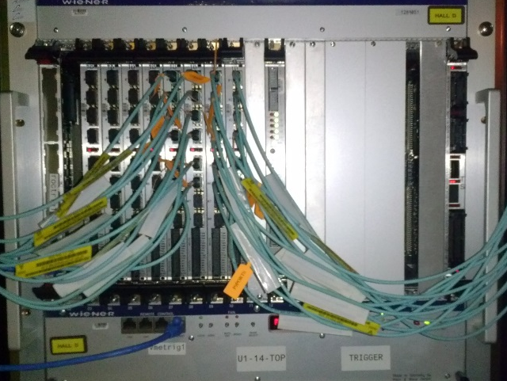
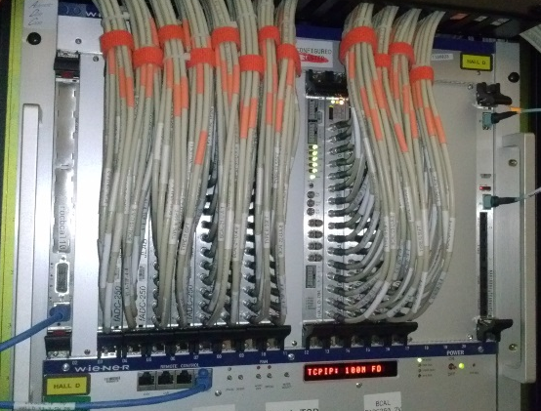
2. JLAB 12GeV Trg/Clk/Sync/Busy overview
TS
QSFP optic transceiver
MTP Fiber assignment (8/12):
SD
(TS) Trigger
Supervisor
TD (up to 16)
Trigger etc. (16-bit @62.5MHz)
Signal Distribution
VXS backplane
Clock (250MHz)
Sync (Manchester Encoded)
(TD) Trigger
Distribution
FiberMeas(Manchester Encoded)
TI (front end)
TS/TD/TI_master
FiberMeas
Not_used
MTP fibers
~60
Not_used
Acknowledgements/Busy
Same clock for the system;
Frontend electronics is Synced to one clock period (4 ns);
Delay adjustment on TI to compensate for the fiber delays;
Clock jitter: several ps;
Clock TIE: source dependent only;
Board setup/control: VME
(TI) Trigger
Interface
Signal Distribution
VXS backplane
TI
Front End
TDC/ADC
FronEnd Readout electronics

Slide 4
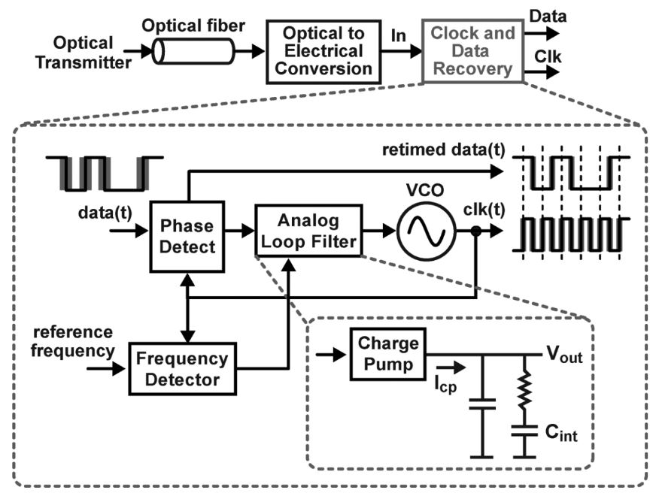
3. Existing Studies
3.1 Clock recovery from SerDes
Xilinx MGT recovered clock: jitter ~ps, but TIE ~ 100ps.
Good enough for ADC, but not for TDC
A typical clock recovery circuit
3.2 White Rabbit Network
Based on Etherment PTP, and Sync Ethernet (1 Gbe)
Jitter ~ps, but TIE is sub_ns
Clock is limited to 10MHz, and 125 MHz
3.3 CERN lpGBT
Radiation tolerant (TID and SEU)
But it is optimized for 40 MHz clock, and TIE ~10s ps

Slide 5
4. Proposed Clock/Control system:
Status
CCM
4.1 Dedicated CLOCK distribution tree using QSFP connectors
Control
Clock
CCM: Clock_Control_Master
-- control encoding, status decoding.
The interface for machine clock source, Data acquisition, detector control and monitor, Front end electronics. The CCM may be a PCIe card sitting in the DAQ computer, or it may be built in on the CCD with an Ethernet connection to the DAQ computer
CCD: Clock_Control_Distribution
The clock/control fanout, and status/busy accumulation. Each CCD may have some CCM functions for the subsystem test; The CCD can be chained for expandability.
CCN: Clock_Control_Node
-- control decoding, status encoding.
The clock/control interface to the front end electronics.
It will be a mezz. card with the decoded control, clock, data, monitoring, and the required power to/from the carrier board (or it can be built-in on the carrier board, where a standard QSFP connector is required)
Data Acquisition
CCD
CCD
CCD
CCN
CCN
CCN
CCN
CCN

Slide 6
4.2 QSFP signal assignment
It is not expensive (Commercial !) and relatively compact:
QSFP multimode optic transceiver $40 (~100 meters),
Single-mode optic transceiver: $200 (~km),
short Copper cables <$50 (~meters)
QSFP signal assignment:
QSFP, 4 Rx 4 Tx
Tx1
Gigabit Ethernet for CCD/CCN (slow control)
Rx1
Tx2
Clock
Rx2
Tx3
Sync FiberMeas (fast control)
DataLink
Rx3
Tx4
Up stream
Computer / CCM / CCD_output
Rx4
Down stream
Detector / CCN / CCD_input
Rx4
DataLink
Tx4
Rx3
FiberMeas / FrontEnd Status (fast control)
Tx3
Rx2
DataLink or Frontend status
Tx2
Gigabit Ethernet for CCD/CCN (slow control)
Tx1
Rx1
Gigabit Ethernet (Slow control)
Clock/Status etc.
Sync etc. (Fast control)
DataLink

Slide 7
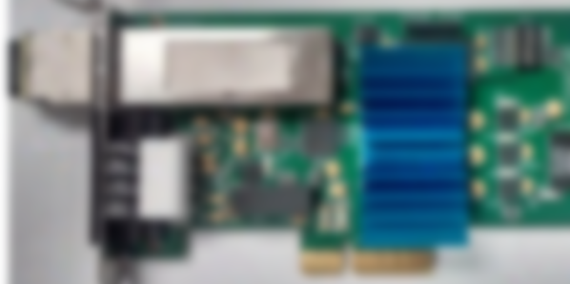
4.3 PCB diagrams
CCM
CCN
Photoshopped PCB
Photoshopped PCB
Osc. Clock
FPGA
Zynq
Clock mux/fanOut
+3V_in
Sync.
Reset status Data clock etc.
Ext. Clock
QSFP
QSFP
FPGA
Clock synth.
GBE
QSFP
Gigabit Ethernet/Slow control
Clock/Status etc.
PCI express
FPGA
Sync etc./Fast control
Ext.
controls
External IO
DataLink
On-board

Slide 8
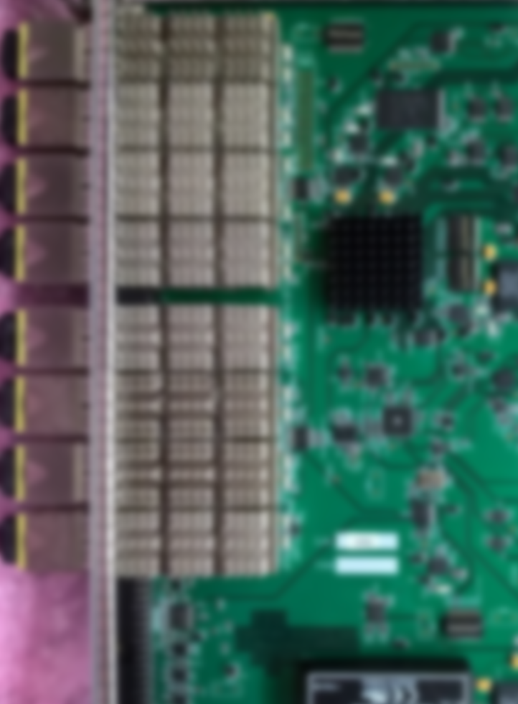
4.3 PCB diagram
CCD
Clock mux/fanOut
QSFP_’out’
Osc. Clock
QSFP_’out’
FPGA
QSFP_’in’
Control
Status
Data
QSFP_’out’
1/10 GBE
GBE switch_chip
(or FPGA builtin)
QSFP_’out’
QSFP28
DAQ
Photoshopped PCB
Power supply
Gigabit Ethernet/Slow control
Clock/Status etc.
Sync etc./Fast control
DataLink

Slide 9
4.4 Clock/Control working model
4.4.1 Clock distribution (fan out tree)
LVPEL/LVDS/optic distribution: minimum added jitter (< 1ps)
Super low jitter buffers readily available
Any frequency clock (to match with the accelerator) (> optic transceiver frequency requirement)
Lower frequency clock phase deterministic synthesizers with optional jitter cleaner: SI534x, AD9510, etc
→ ~ps jitter, common clock is easily achievable
4.4.2 Slow control /asynchronous control (GBE)
The slow control is through the GBE network asynchronously. Each CCN and CCD will have a unique (16-bit) setting (MAC, also possible for a local network IP). No other buses (e.g. VME) are needed. The GBE can reprogram the CCN/CCD remotely;
The status can be accessed through the GBE network, and the dedicated links.

Slide 10
4.4 Clock/Control distribution working model
4.4.3 Fast control /Clock synchronous control
The CCN (and the CCD input QSFP) can initiate Fiber delay measurement by signal loopback. The measurement results can be used to compensate the delays of the synchronization commands. The requirement on the fiber latency measurement precision is half of the transmitted clock period.
The fast controls ( e.g. RESET ) are coded at the system clock rate, then Manchester encoded, and the control commands are generated on the minimum multiple of the front end clock periods, and distributed synchronously.
→ The slower clocks on the CCN are phase aligned across the system
CCD
CCN
Fiber latency measurement
CCN#1
CCN#2
CCN#3
Fast control
Delay/decoding
Synchronous fast controls
Time_0
Fast control
commands
Fast control
commands

Slide 11
4.4 Clock/Control distribution working model
4.4.4 How to deal with data overflow
Option#1: using the BUSY feedback
When the computer readout can not catch up with the data input, it can send a PAUSE fast control signal to the front end to stop the data streaming;
Meanwhile, the front end can also send a PAUSE_REQUEST by asserting the BUSY signal indicating that the front end buffer is about to overflow.
Option#2: Automatic data drop
The front end can drop all the data in a certain time interval (for example 100 us) if the front end can not stream the data out promptly.
The daq computer can also drop certain time intervals, if the computer can not process them, or the data is too late.
Because all the front end data has time stamp, and the data should be formatted in certain time buckets (100 us for example). (This also means that the front end will send ‘no data’, or empty bucket, with this time stamp to indicate no data is dropped by front end). The event recorder can keep track the data lost (either dropped by the front end or dropped by the data processor).
Both options will be designed as the option#1 is more efficient if the data loss is frequent, and option#2 is more efficient if the data loss is occasional.

Slide 12
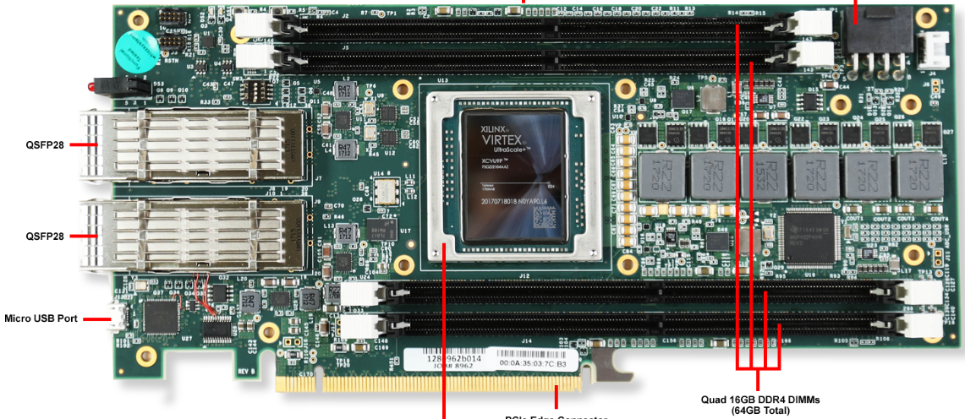
4.5 not just Clock/Control distribution
The CCD can also be served as the data collection board.
The CCN (or its carrier board) serves as a front end data collection board ( >= 10 gbps ). The zero-suppression should be performed, (timestamp and BUSY are needed)
The CCD merge the data and sends them directly to a commercial card inside the DAQ computer (for example: Xilinx VCU1525 (shown here), or Xilinx AI board VCK190 (will be available).
The data can be processed by the online computers, or the commercial FPGA (Acceleration, or AI) boards;
CCD
~100 gbps
CCD
CCD
~10 gbps
CCN
CCN
CCN
CCN
CCN

Slide 13
4.6 Where is the software (CODA)
Sub_system/test
Sub_system/test
CCM
DAQ server
1 GBE / 10GBE switch
VCU1525
DAQ server
CCD
100 GBE
VCU1525
DAQ server
~100 gbps
100 GBE
CCD
CCD
100 GBE switch
VCU1525
DAQ server
100 GBE
CCN
CCN
CCN
CCN
CCN
~10 gbps
VCU1525
DAQ server
100 GBE
QSFP28
100 GBE
1/10 GBE
Clock/Control QSFP

Slide 14
4.6 Where is the software (CODA)
Reset: Run sequence interrupt, it is always available.
reset Configured, Downloaded, Running, Run_ended, and Error
Initialized
CONFIG: define the participating (hardware) components; CCM supplies the stable system clock. Only slow controls in this step
reset Downloaded, Running, and Run_ended; set Configured or Error.
Configured
Download: set up the hardware components, ready for fast controls; set up the software components; ready for data;
reset Running, and Run_ended; set Downloaded or Error.
Downloaded
StartRun: Time_0 set, streaming data flows (either full streaming data, or timestamped data). Only fast controls in this step
reset Run_ended ; set Running or Error.
Running
EndRun: data generation stops, and the downstream finish the data processing
set Run_ended or Error.
Run ended
Error

Slide 15
5. Feasibility studies:
5.1 FADC → VTP
The VTP can ‘be’ a carrier board (hosting the CCN), and generate data at >= 10 gbps
The VTP can also ‘be’ a data concentrator board, collects 16 inputs and pass the data at >= 40 gbps
5.2 VETROC → Xilinx KCU116:
QSFP: VETROC (Streaming TDC) → Xilinx KCU1500: 20 Gbps with 8b/10b encoding,
limited by the Artix-7 capability;
KCU1500 → host PC: > 5 Gbyte/s with PCIe3x8;

Slide 16
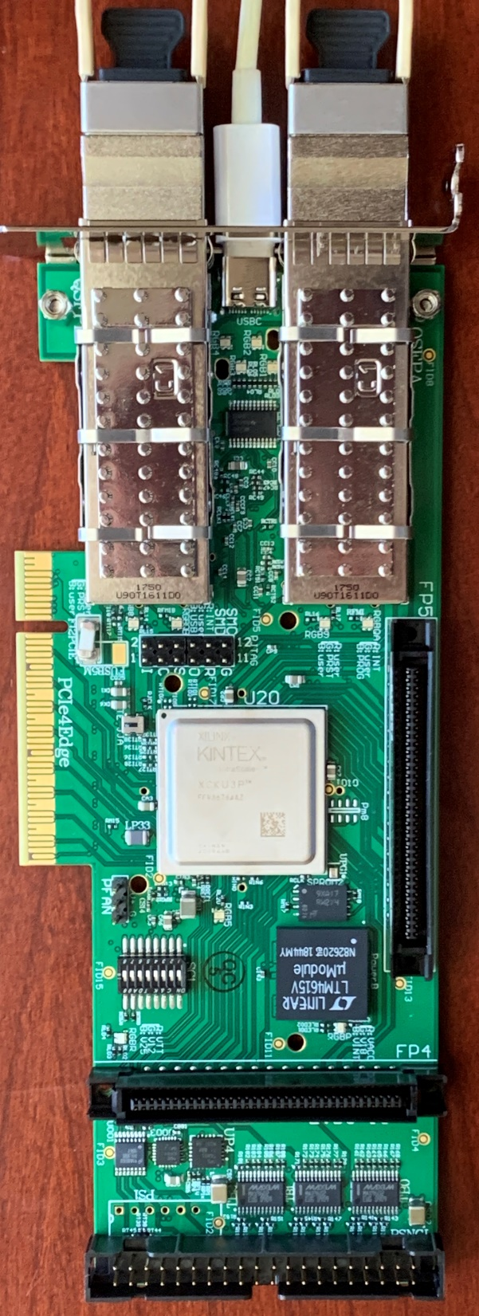
5.3 CC Test board:
A new version of the PCI express Trigger Interface (TIpcie) board is being prototyped. It can be used to test the proposed QSFP fiber assignments, to test the CCM, CCD, and CCN distribution tree, and data readout.
also:
FPGA based high resolution absolute timing measurement (64-channel TDC)

Slide 17
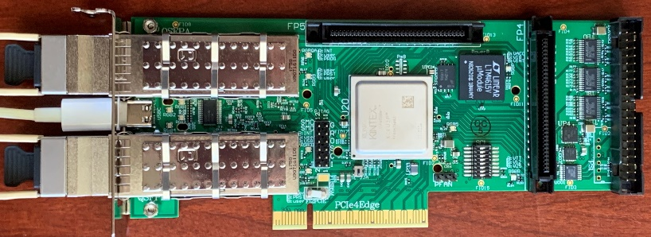
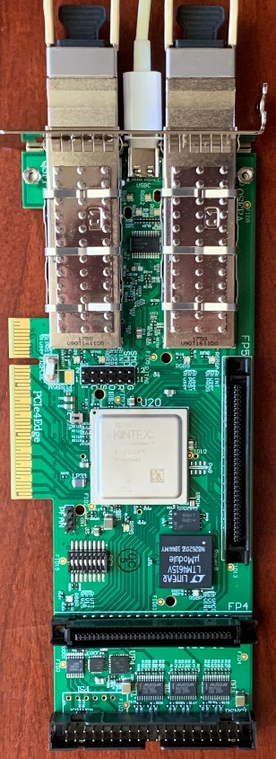
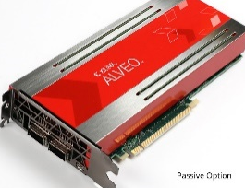
5.3 CC Test board:
CCD: QSFP→QSFP distribution
Test board configurations
CCM: PCIe→QSFP
CCD: DAQ, feeding data to computer
CCD: Data Concentrator (2xQSFP→PCIe)
CCN: QSFP←→CarrierBoard
CCN: Data Acquisition (TDC→QSFP)

Slide 18
6. Summary:
The Clock Control for streaming readout is feasible
The dedicated clock distribution tree is easier, flexible and cost manageable;
The SYNC can be accomplished with the fiber length measurement, and delay compensation;
The distribution system is Ethernet controlled, does not depend on a crate (VME)
The Data acquisition for streaming readout
The Front end FPGAs do the zero suppression
Extra processing in the Xilinx (AI) board, not just the computers
But, depends on the radiation in the EIC, we may have to adapt the lpGBT, or other rad hard components
Thank You

