Slide 1


Backward $ω$ photo/electroproduction
(Daresbury NINA data 1977 / JLab $F_{π}$-2 data 2019)
B.-G. Yu* & K.-J. Kong
Korea Aerospae Univ.
Backward-Angle (u-channel) Physics Workshop
September 23, 2020, JLab

Slide 2
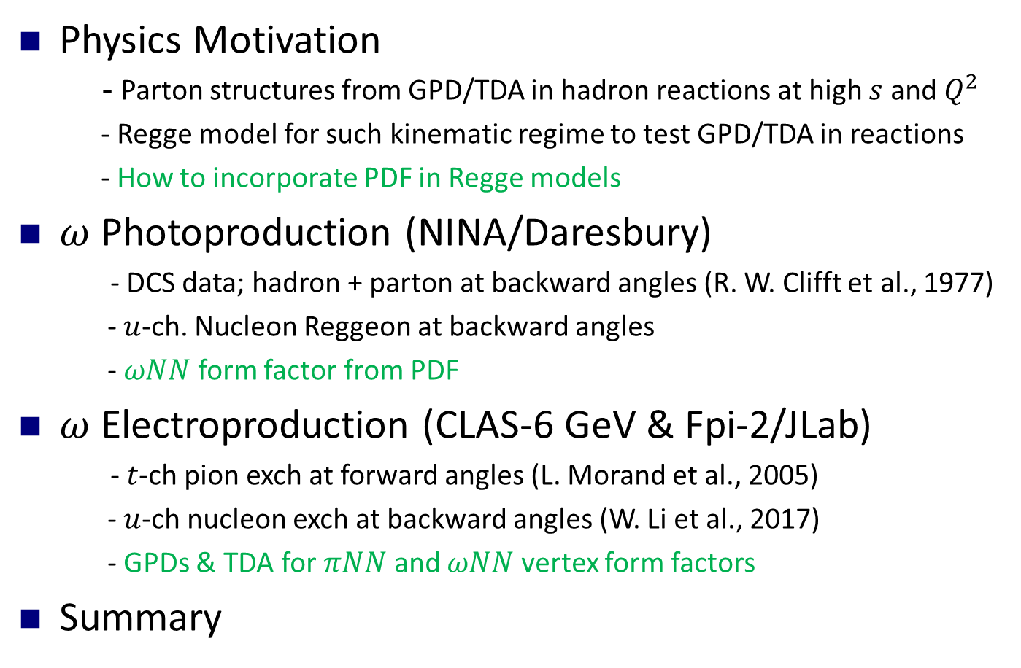
Outline
Physics Motivation
- Parton structures from GPD/TDA in hadron reactions at high $s$ and $Q^{2}$
- Regge model for such kinematic regime to test GPD/TDA in reactions
- How to incorporate PDF in Regge models
$ω$ Photoproduction (NINA/Daresbury)
- DCS data; hadron + parton at backward angles (R. W. Clifft et al., 1977)
- $u$-ch. Nucleon Reggeon at backward angles
- $ωNN$ form factor from PDF
$ω$ Electroproduction (CLAS-6 GeV & Fpi-2/JLab)
- $t$-ch pion exch at forward angles (L. Morand et al., 2005)
- $u$-ch nucleon exch at backward angles (W. Li et al., 2017)
- GPDs & TDA for $πNN$ and $ωNN$ vertex form factors
Summary

Slide 3

Parton dynamics and Regge model
GPD /TDA 3D image of the internal structure of hadrons; Distribution of parton with longitudinal momentum fraction $x$ and transverse position $b$
Universality of PDF for non-pQCD dynamics; a general way to describe/predict hadron reactions at high energies and large angles.
VGL Regge model; poor $σ_{T}$, VGG GPD; limited to $σ_{L}$, JML Regge model; large $u$-ch cuts, TDA by PSS; close to exp. data
Applicability of Reggeon exch with hadron form factors parameterized by PDF at high energies and such wide angles.
Establish hadron models for data reproduction in experiments with GPD/TDA implemented.

Slide 4
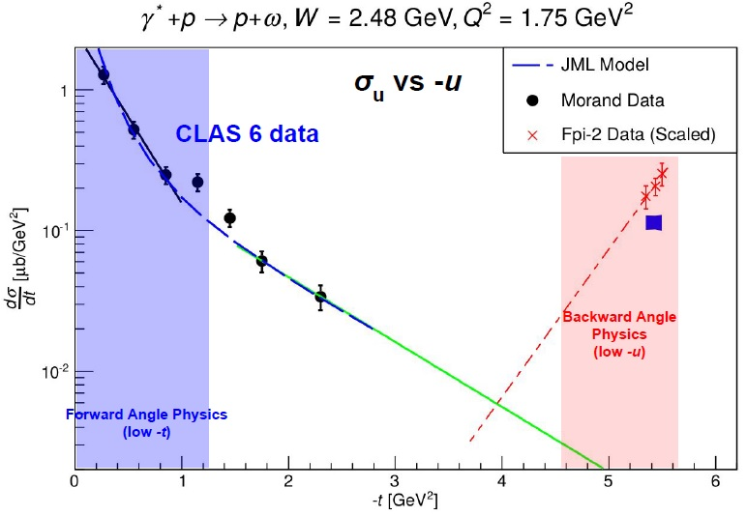
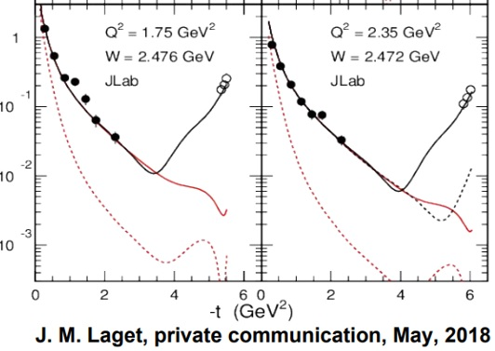
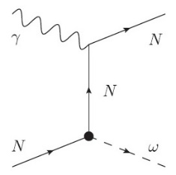
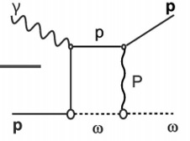
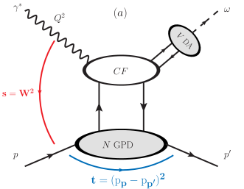
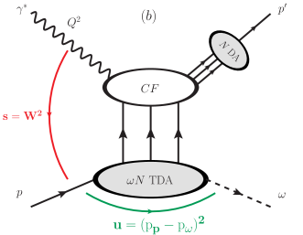

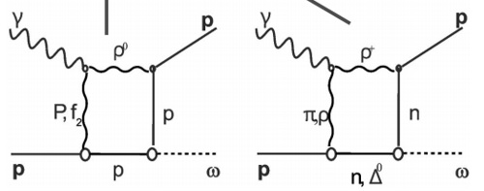





Backward reactions, GPDs/TDA, Reggeons
$$s≫\left|t\right|$$
$${\sim 10}^{2}$$
$$−t\sim large(−u\sim small)$$
$$Q^{2}\sim high$$
Parton structure from non-pQCD
Large $u$-ch cuts in Reggeon exch by Laget
GPD by VGG
TDA by PSS
Meson-baryon form factor

Slide 5
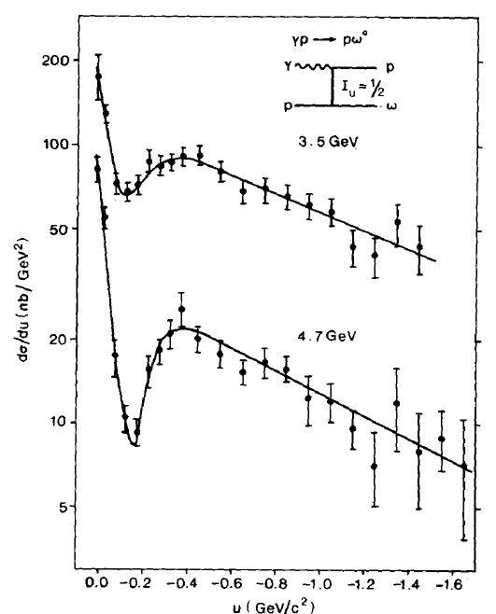
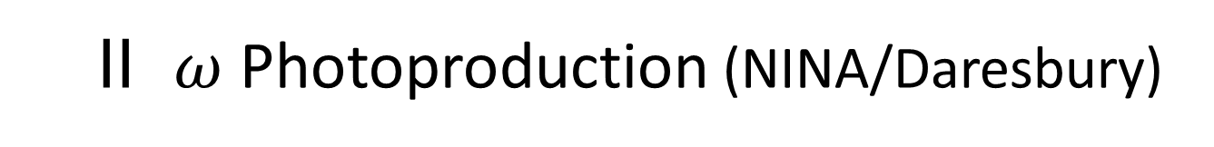
II $ω$ Photoproduction (NINA/Daresbury)
Notes:
Theory and experiments are rare for backward w photoproduction. In experimental side we found that the data available for the analysis of backward process are those from the NINA syncroton at photon energies 3.5 and 4.7 GeV, and CLAS Collaboration between 3 and 4 GeV all of which are over the resonances. In this work we also utilize the SLAC data to compensate for the data at 2.8, 4.7 and 9.3 GeV in the forward direction. As mentioned above due to the large coupling constant omegaNN=15.6 we take here by the universality of vector meson coupling constant with f_w together with the isoscalar nature of omega meson, the u-channel baryon exchange allows only the nucleon which uniquely characterizes the backward production of omega. Moreover the N_a trajectory which includes the nucleon is featured by a sharp dip at u=-0.10 GeV^2. The issue is that there is no dip there which cannot be accounted for by interference of other baryon trajectories because

Slide 6
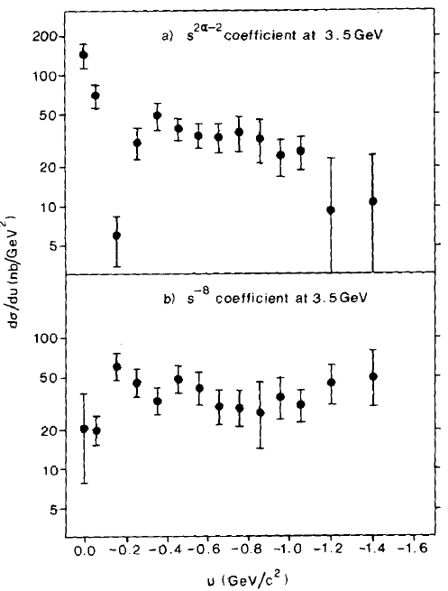
Notes:
Theory and experiments are rare for backward w photoproduction. In experimental side we found that the data available for the analysis of backward process are those from the NINA syncroton at photon energies 3.5 and 4.7 GeV, and CLAS Collaboration between 3 and 4 GeV all of which are over the resonances. In this work we also utilize the SLAC data to compensate for the data at 2.8, 4.7 and 9.3 GeV in the forward direction. As mentioned above due to the large coupling constant omegaNN=15.6 we take here by the universality of vector meson coupling constant with f_w together with the isoscalar nature of omega meson, the u-channel baryon exchange allows only the nucleon which uniquely characterizes the backward production of omega. Moreover the N_a trajectory which includes the nucleon is featured by a sharp dip at u=-0.10 GeV^2. The issue is that there is no dip there which cannot be accounted for by interference of other baryon trajectories because

Slide 7
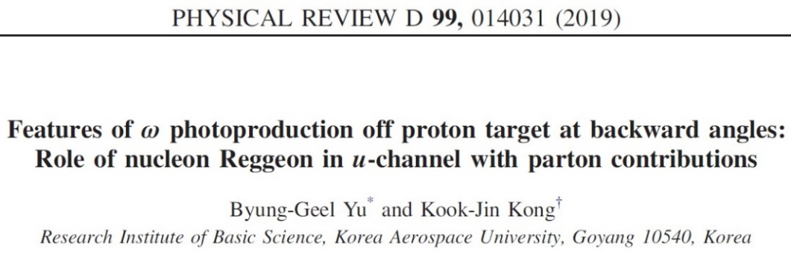
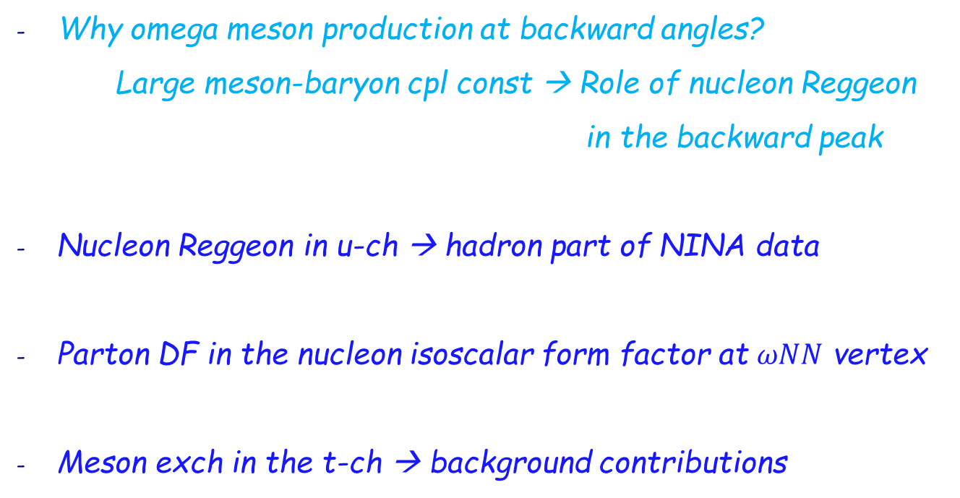
u-ch Regge model for backward $ω$ photoproduction
Why omega meson production at backward angles?
Large meson-baryon cpl const → Role of nucleon Reggeon
in the backward peak
Nucleon Reggeon in u-ch → hadron part of NINA data
Parton DF in the nucleon isoscalar form factor at $ωNN$ vertex
Meson exch in the t-ch → background contributions

Slide 8
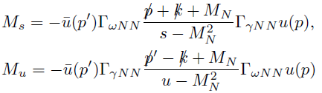
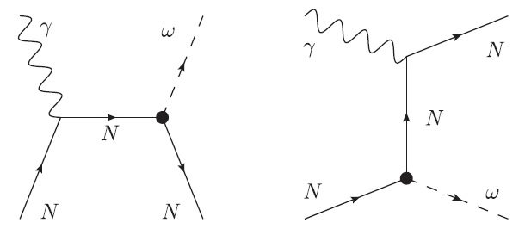
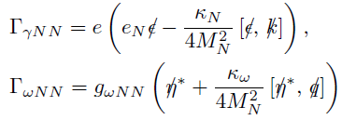


1. Reggeization of nucleon in the u-ch exchange

Slide 9


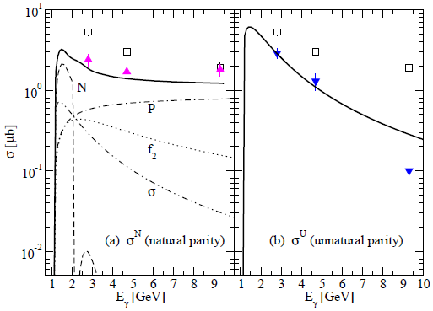
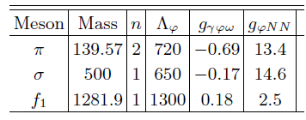

2. Meson exchange in the t-ch
t-ch. simple poles as background contribution
$$π$$
Notes:
The meson exchanges are considered as a background because the u-ch nucleon is in general small in comparison to meson exchanges and therefore cannot reproduce the reaction cross section without meson exchanges. Here to avoid duality with t-ch exch we consider them in the pole model with cutoff functions and model dependent parameters cutoff lambda. Therefore, we construct the photoproduction amplitude as this. Then, in order to construct a reliable base from meson exches to which the nucleon exch is added, it is of importance to determine the cutoff lambda In a less model dependent way. For this we again utilize the natural and unnatural parity cross sections of SLAC as shown in this figure. In doing this the tensor meson f2 exch is highly divergent so that we treat it as the Regge pole as before. Then, the cutoff masses for the pion, sigma, and f1 are fitted to those cross sections. The unnatural parity cross section is reproduced by the pion exch with cutoff lambda=720 MeV, while the natural parity cross section agrees with the sigma with lambda=650 MeV and f2 and pomeron and nucleon Regge pole.

Slide 10






3. Parton contribution
M. Guidal, M.V. Polyakov, A. V. Radyushkin, M. Vanderhaeghen, PRD 72, 054013 (2005)
Notes:
Parton contributions are assumed in the backward angles to cover over the dip with a scaling of s^8. However, the N_a in the pi N scattering shows a deep dip in the backward directions at the same place, though this case should include more of baryon trajectories like the Delta_delta trajectory to compensate for the N_a trajectory. So there are two options in our place; Here, we introduce a substructure to the omega-NN by assuming it to be similar to the virtual photon coupling to NN, and we extend the omega-NN vertex as … to investigate the possibility of parton contributions.

Slide 11
Nucleon Reggeon+ meson poles
Production amplitude
Parton

Slide 12
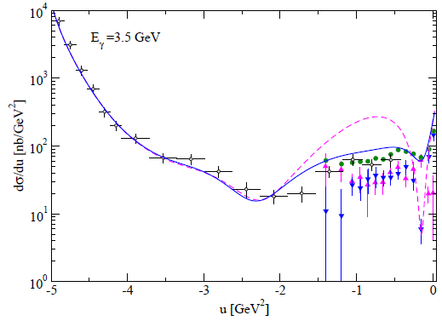


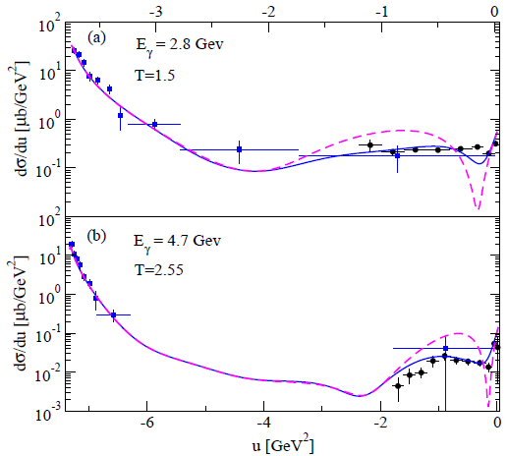
4. Results

Slide 13
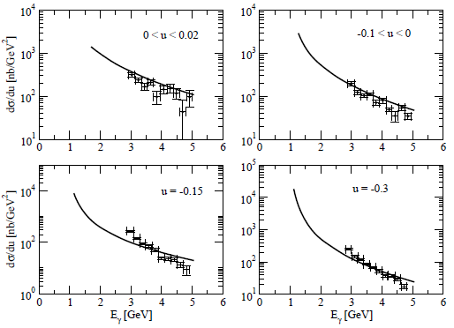
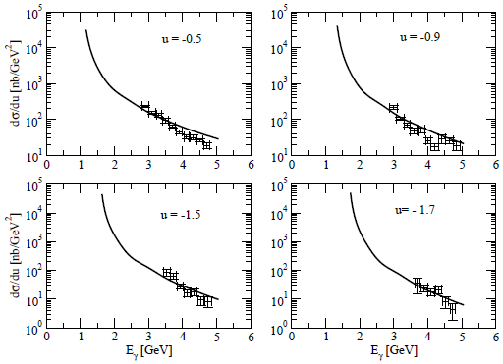
Notes:
Here are the energy dependence of dsigma/du at backward angles where model predictions are made with the parameters chosen as a=100, b=60. Finally we add the figure which shows a support to the parameter a’=0.3 rather than the a’=1.105 of the original GPRV FF. The figure shows the proton Dirac FF extracted from empirical data which agrees with GPRV FF. However, in phenomenological description of the charged pion electroproduction where the proton and pion charge FFs play the important role to reproduce the data we can see that the solid line from the a’=0.3 of the present work is more consistent with the dipole FF of the dotted line which can only agrees with reaction cross sections.

Slide 14
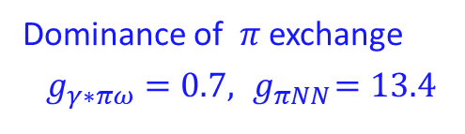
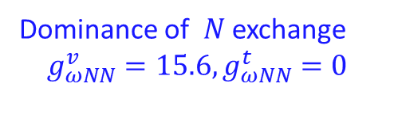

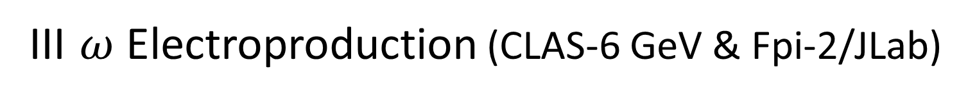
III $ω$ Electroproduction (CLAS-6 GeV & Fpi-2/JLab)
$$γ^{∗}\left(k\right)+p\left(p\right)→ω^{0}\left(q\right)+p(p′)$$
Dominance of $N$ exchange
$$g_{ωNN}^{v}=15.6, g_{ωNN}^{t}=0$$
Dominance of $π$ exchange
$g_{γ∗πω}=0.7,{ g}_{πNN}=13.4$

Slide 15
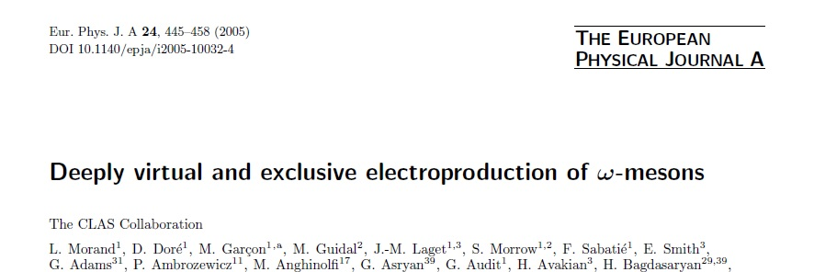
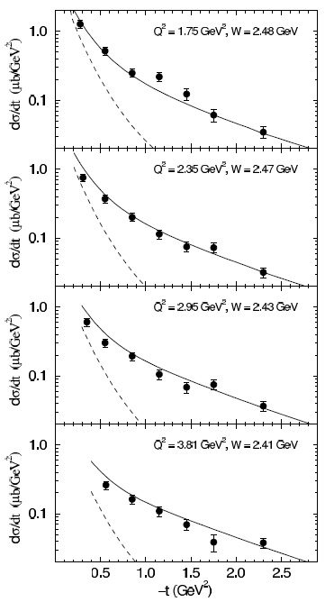
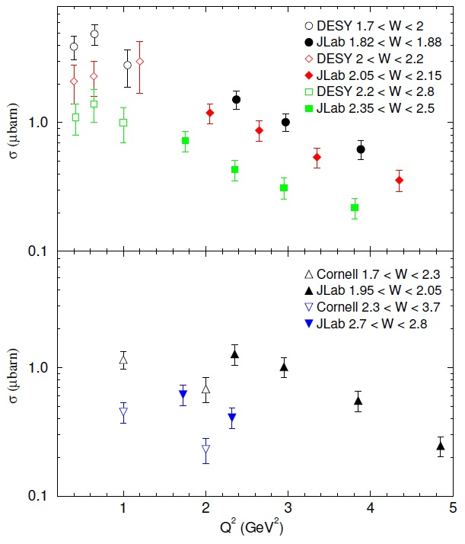

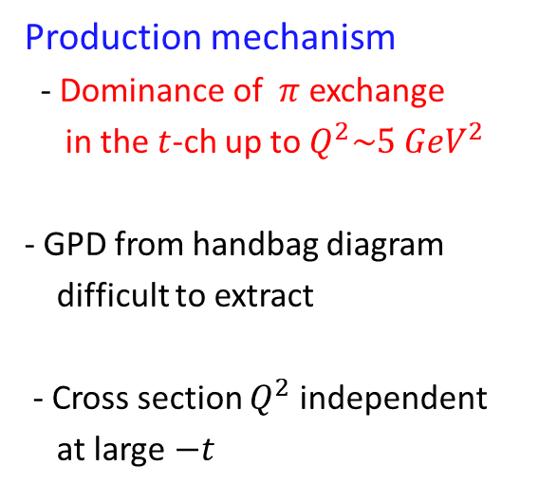
CLAS-6 data on forward $ω$ electroproduction
$1.85<W<2.7 {GeV}^{2}$, $1.7{<Q}^{2}<5 {GeV}^{2}$
Production mechanism
- Dominance of $π$ exchange
in the $t$-ch up to $Q^{2}\sim 5 {GeV}^{2}$
- GPD from handbag diagram
difficult to extract
- Cross section $Q^{2}$ independent
at large$−t$

Slide 16
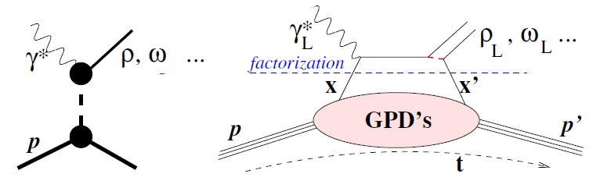



EM form factor for $γ^{∗}φω$ coupling vertex
GPDs for nucleon axial form factor at $πNN$ vertex
1. t-ch. Regge model
B. -G. Yu, T. K. Choi, K.-J. Kong, JPG 46, 075005 (2019)
- $γ^{∗}πω$ transition FF
$$α_{π}(−∞)→−1$$

Slide 17
2. GPDs for nucleon axial form factor at $π^{0}pp$ vertex
D. de Florian, R. Sassot, M. Stratmann, W. Vogelsang, PRD 80, 034030 (2009)

Slide 18
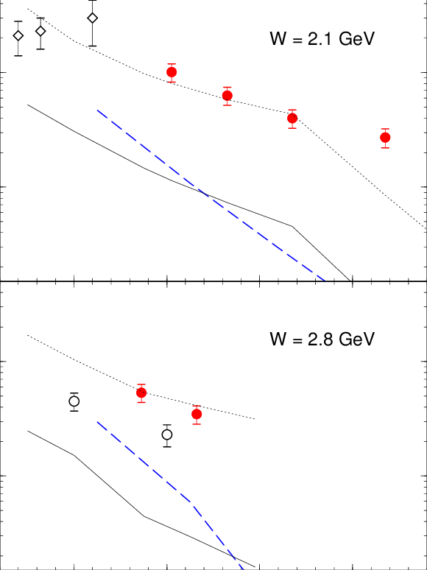


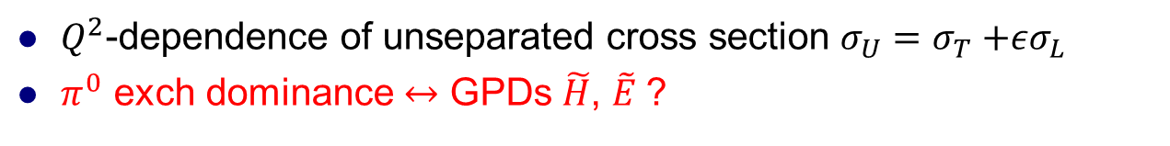
3. Results
$Q^{2}$-dependence of unseparated cross section $σ_{U}=σ_{T}{+εσ}_{L}$
$π^{0}$ exch dominance $↔$ GPDs $\tilde{H}$, $\tilde{E}$?
VGG(L)
JML
VGG $σ_{L}$

Slide 19
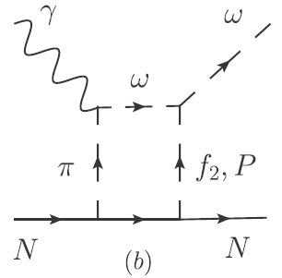
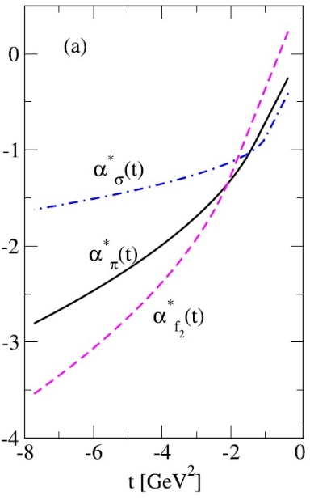




$t$-dependence of unseparated cross section
4 aspects of DCS at forward angles
No cut
Elastic cuts
$$Λ_{π}(0)$$
$(α_{q}^{′}=0.1)$
saturation
GPDs

Slide 20
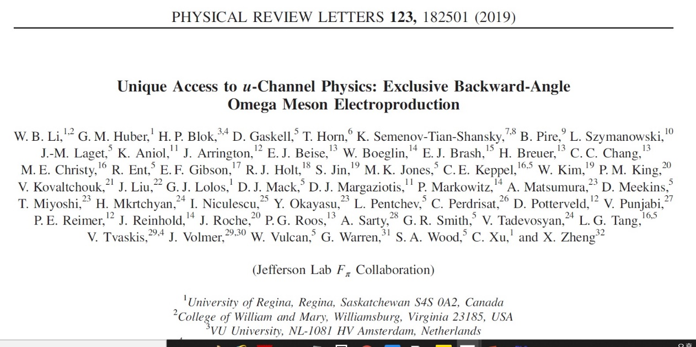
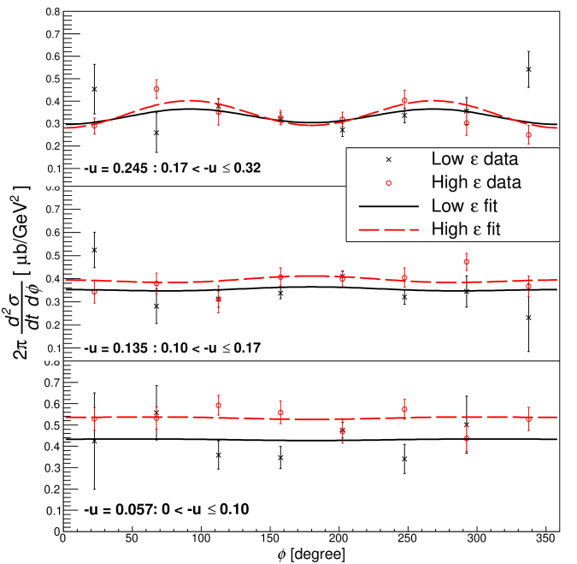
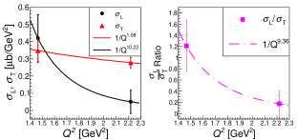






$F_{π}$-2 data on backward $ω$ electroproduction
$W=2.21 GeV$,
$$Q^{2}=1.6, 2.45 {GeV}^{2}$$
$$ε=0.32, 0.59$$
$$u=−u_{min}$$
- $σ_{T}\sim 1/Q$, $σ_{L}\sim 1/Q^{8}$
- Dominance of $σ_{T}$ over $σ_{L}$ ~ TDA ?

Slide 21
Model extension to electroproduction
Based on t-ch meson exch as background contributions
1. Nucleon Born terms for electroproduction
EM FF in $γ^{∗}NN$ and isoscalar FF at $ωNN$ vertices
Gross-Riska prescription for nucleon charge form factor

Slide 22

2. Parton contribution to nucleon Born terms
Nucleon electromagnetic form factors(EMFF’s) at $γ^{∗}NN$ vertex
(1) PDF
Following concept of QCD factorization
(2) Dipole-form factor
$ωNN$ strong coupling form factor
(1) PDF
(2) Bare coupling vertex

Slide 23
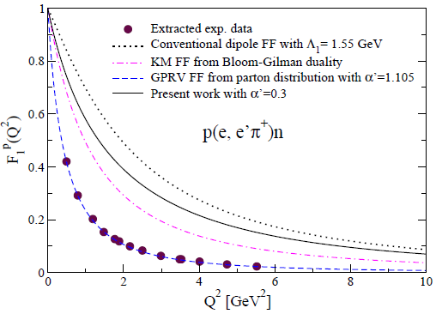
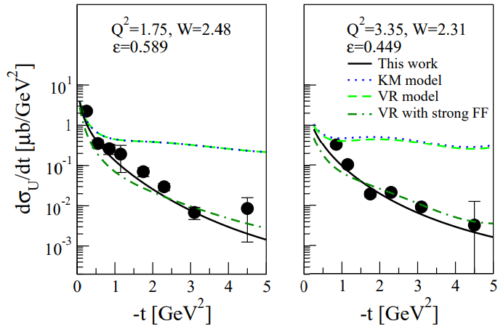
Parameter $α^{′}$ in proton charge form factor
Role of $α^{′}$ in PDF FF for Nucleon EMFF the same as $Λ_{p}$ in Dipole FF
Notes:
Finally I will discuss the significance of the parameter a’ in the R2 ansatz for the parton density. The parton ansatz originally proposed by Guidal et al used a’=1.105 to be consistent with the extracted proton charge FF from experiment as can be seen here, whereas our calculation uses a’=0.3 which is a quite reduced value. Then to see the effect of this difference we calculate the charge form factor F_1p and its application to electroproduction of charged pion. The dotted curve in F_1p is from the conventional dipole FF with cutoff lambda=1.55 Gev which reproduces the electroproduction data to a good degree whereas the dashed curve of Guidal et al which agrees with F_1p is not fitted to the reaction cross section. Our value 0.3 is closer to the dipole FF and thus expected to be more consistent with experiment. From this phenomenological arguements our parameter a’ is further supported by the Regge description of pi+ electroproduction as we compare various types of proton FF and their roles in the reaction cross sections. With these I will give a summary and perspective of the present work.

Slide 24
3. Scheme of parton contribution in meson-baryon form factors
(1) Conventional Regge model for electroproduction
Either parton structure in the overall $ωNN$ form factor
or for conventional approach.
(2) photo-extension to hadron part + partonic phase for $ωNN$ vertex

Slide 25
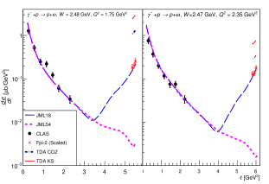
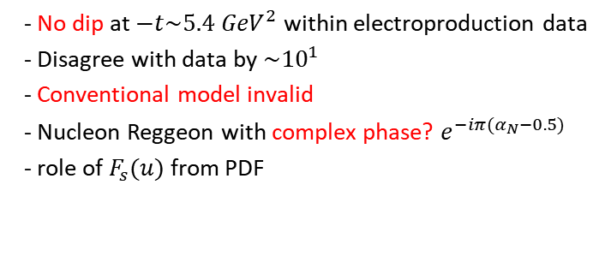
4. Result: Conventional, or overall form factor for Model I
- No dip at $−t\sim 5.4 {GeV}^{2}$ within electroproduction data
- Disagree with data by $\sim {10}^{1}$
- Conventional model invalid
- Nucleon Reggeon with complex phase? $e^{−iπ(α_{N}−0.5)}$
- role of $F_{s}(u)$ from PDF

Slide 26
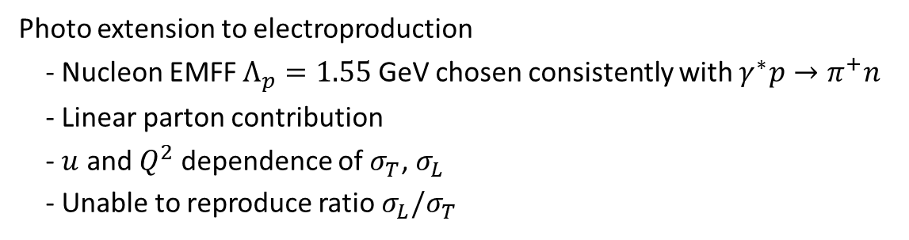
4. Result: Model II-1
Photo extension to electroproduction
- Nucleon EMFF $Λ_{p}=1.55$ GeV chosen consistently with $γ^{∗}p→π^{+}n$
- Linear parton contribution
- $u$ and $Q^{2}$ dependence of $σ_{T}$, $σ_{L}$
- Unable to reproduce ratio $σ_{L}/σ_{T}$

Slide 27
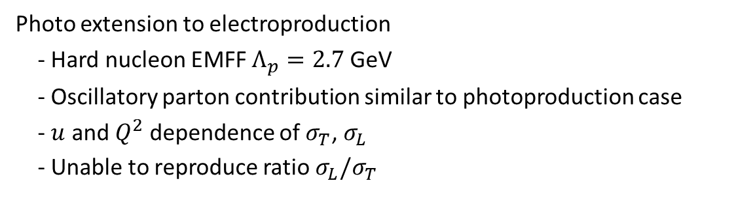
4. Result: Model II-2
Photo extension to electroproduction
- Hard nucleon EMFF $Λ_{p}=2.7$ GeV
- Oscillatory parton contribution similar to photoproduction case
- $u$ and $Q^{2}$ dependence of $σ_{T}$, $σ_{L}$
- Unable to reproduce ratio $σ_{L}/σ_{T}$

Slide 28
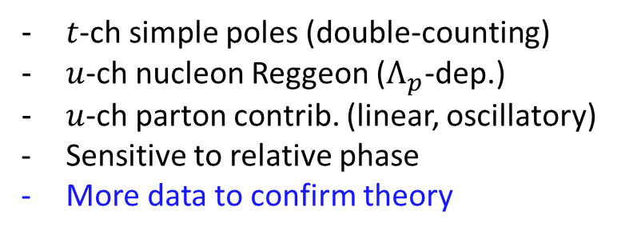
Photoproduction vs Electroproduction
$t$-ch simple poles (double-counting)
$u$-ch nucleon Reggeon ($Λ_{p}$-dep.)
$u$-ch parton contrib. (linear, oscillatory)
Sensitive to relative phase
More data to confirm theory
Model II-1
Model II-2

Slide 29

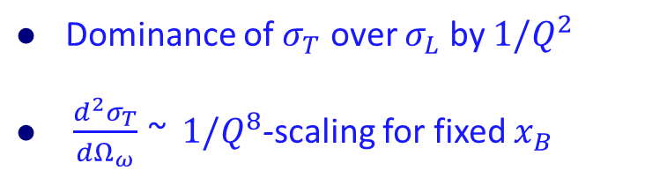
Nucleon transition distribution amplitude (TDA)
B. Pire, Kirill M. Semenov-Tian-Shansky, L. Szymanowski
Phys. Rev. D 91, 094006 (2015)
TDA predicts;
Dominance of $σ_{T}$ over $σ_{L}$ by $1/Q^{2}$
$\frac{d^{2}σ_{T}}{dΩ_{ω}}$ ~ $1/Q^{8}$-scaling for fixed $x_{B}$
TDA and Regge model coincide at high $Q^{2}\sim 6 {GeV}^{2}$

Slide 30
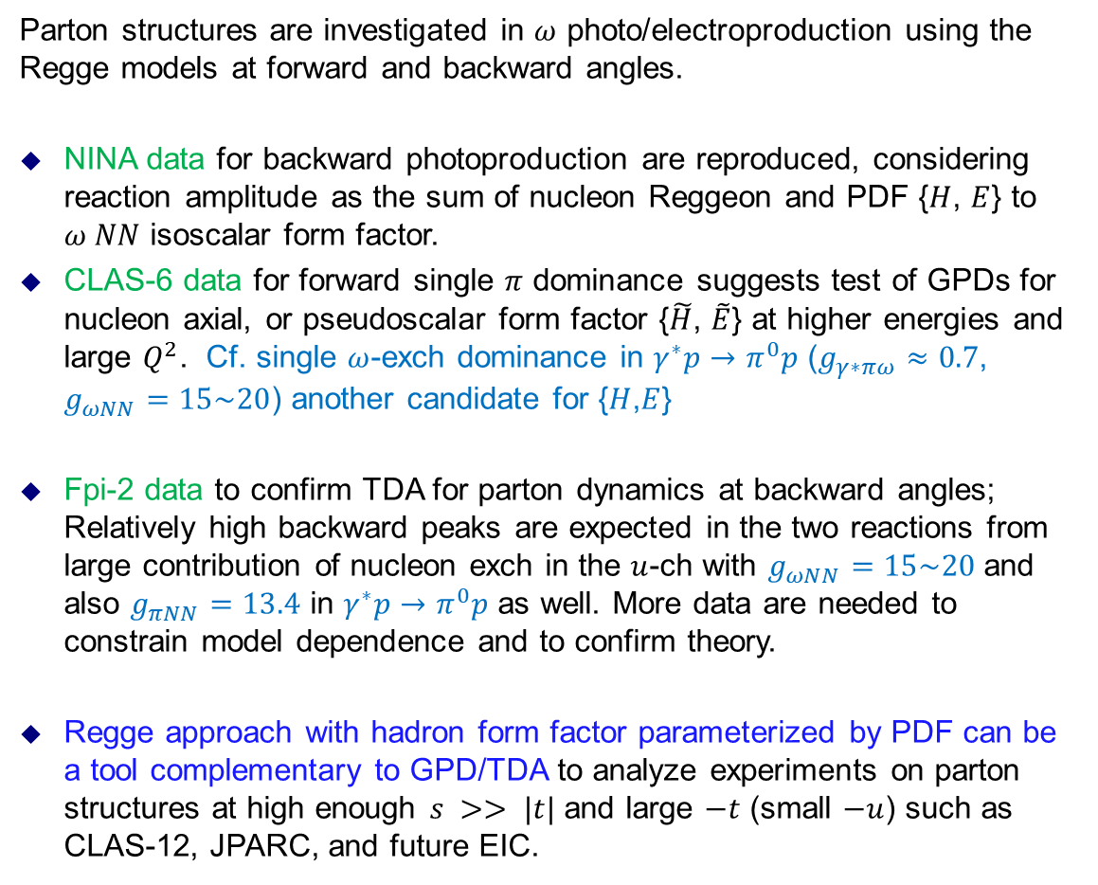
Summary
Parton structures are investigated in $ω$ photo/electroproduction using the Regge models at forward and backward angles.
NINA data for backward photoproduction are reproduced, considering reaction amplitude as the sum of nucleon Reggeon and PDF {$H$, $E$} to $ω NN$ isoscalar form factor.
CLAS-6 data for forward single $π$ dominance suggests test of GPDs for nucleon axial, or pseudoscalar form factor {$\tilde{H}$, $\tilde{E}$} at higher energies and large $Q^{2}$. Cf. single $ω$-exch dominance in $γ^{∗}p→π^{0}p$ ($g_{γ∗πω}≈0.7$, $g_{ωNN}=15\sim 20$) another candidate for {$H$,$E$}
Fpi-2 data to confirm TDA for parton dynamics at backward angles; Relatively high backward peaks are expected in the two reactions from large contribution of nucleon exch in the $u$-ch with $g_{ωNN}=15\sim 20$ and also $g_{πNN}=13.4$ in $γ^{∗}p→π^{0}p$ as well. More data are needed to constrain model dependence and to confirm theory.
Regge approach with hadron form factor parameterized by PDF can be a tool complementary to GPD/TDA to analyze experiments on parton structures at high enough $s >> |t|$and large $−t$ (small $−u$) such as CLAS-12, JPARC, and future EIC.

Slide 31
Backup

Slide 32


Electromagnetic production of $ω$
FORWARD
BACKWARD
-------------------- QCD factorization ----------------------
Nucleon GPD: VGG model
Nucleon TDA: PSS
Phys. Rev. D 56 (1997) 2982
Phys. Rev. D 91, 094006 (2015)
Indep heli.amp.
→ 8
GPDs
→$24$
Meson-baryon form factor

Slide 33
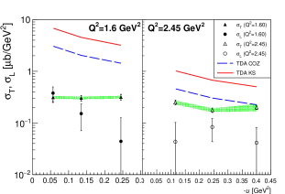

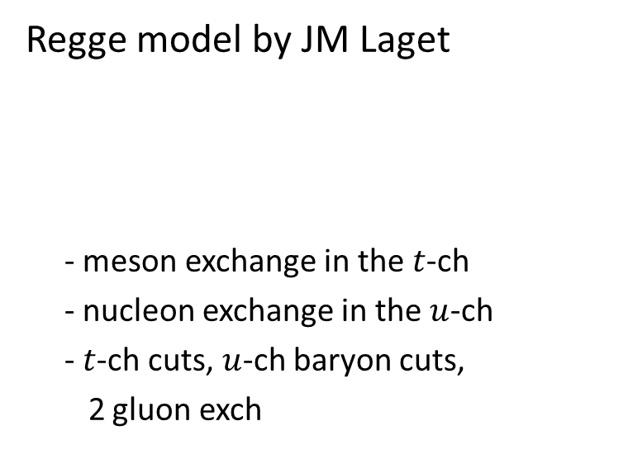

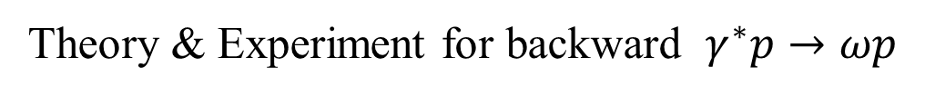

Theory & Experiment for backward $γ^{∗}p→ωp$
Regge model by JM Laget
- meson exchange in the $t$-ch
- nucleon exchange in the $u$-ch
- $t$-ch cuts, $u$-ch baryon cuts,
2 gluon exch
J. M. Laget, PRD 70, 054023 (2004)
J. M. Laget, Prog. Part. Nucl. 111, 103737 (2020)
TDA by Pire, Semenov, Szymanovski
- $σ_{T}$ consistency with TDA at $Q^{2}$=2.45 ${GeV}^{2}$
Phys. Rev. D 91, 094006 (2015)
$$σ_{T}$$
$$σ_{L}$$

Slide 34

4. Result: Conventional, or overall form factor for Model I
- No dip in the electroproduction data
- Nucleon Reggeon with complex phase
$e^{−iπ(α_{N}−0.5)}$
- role of $F_{s}(u)$ from PDF
- Conventional model invalid

