Slide 1
Update of Proposal PR-12-12-008 for parallel running with CLAS12 experiment Run Group A
Photoproduction of the Very Strangest Baryons on a Proton Target in CLAS12
Spokespersons: M. Dugger, J. Goetz, L. Guo*, E. Pasyuk, I. Strakovsky, D. Watts, V. Ziegler
^{*)} Contact

Slide 2

The Status of Excited (PDG12) Ω/Ξ Baryons
(half a century later)
State | J^{P} | M (MeV) | Γ (MeV)
Ω(2250) | ? ? | 2252 | 55
Ξ(1530) | 3/2⁺ | 1531 | 9.1
Ξ(1690) | 1/2? | 1690 | <30
Ξ(1820) | 3/2⁻ | 1823 | 24
Ξ(1950) | ?? | 1950 | 60
Ξ(2030) | ≥5/2? | 2025 | 20
• Very few Ω/Ξ baryons have been identified in the last 50 years.
· Even fewer have their quantum numbers determined.
· Kaon beam was the primary source for these states discoveries.
· Photon beam could be a powerful alternative.

Slide 3

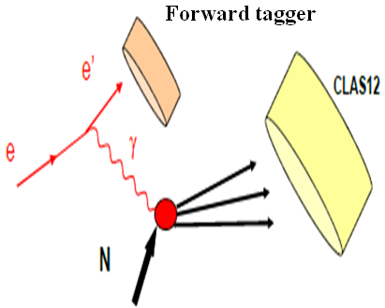
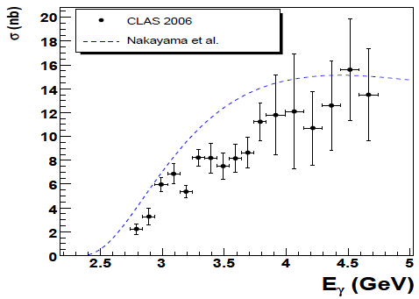

PR12-12-008: Motivation
• Cross section for γp→Ω⁻K⁺K⁺K⁰ is still unknown.
· Study of a mechanism of the Ω⁻ photoproduction which
should be quite specific, since it is the first baryon with
constituents none of which could come from the target
proton.
    Excited cascade resonances (Spin-Parity).
    Polarization measurement of Ξ.
    Mass Splitting measurements for Ξs.
    Expected statistics are several orders of magnitudes
    higher than existing data
Further Physics Goals
γp→Ξ⁻KK

Slide 4
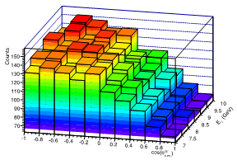
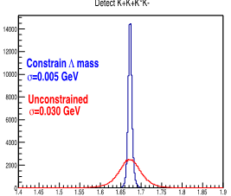
Expected Results
• Ω⁻ Measurement:
  When four kaons detected,
  the spectrum is expected to be background FREE
·Expected Ξ⁻(1820) double moments (L=3)
M(ΛK⁻)
MM(K⁺K⁺K⁰)
Im(H(113M))
(statistical uncertainty only)
• Constraining the Λ mass improves the resolution.
Further improvement expected with kinematic fitting.

Slide 5
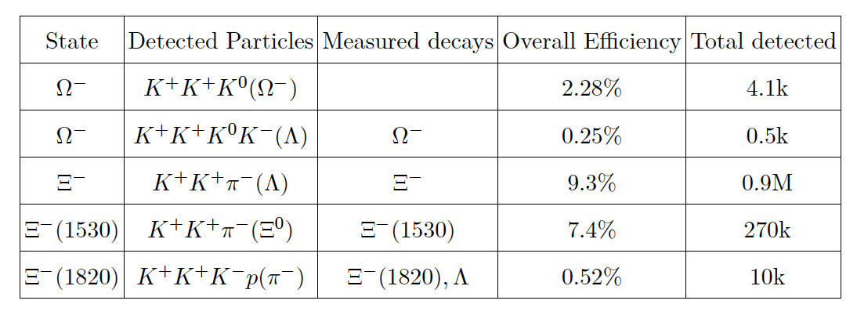

Beam Time & Expected Particle Rate
Approved beam time for CLAS12 Run Group A
(80 full field days + 30 reversed field days)
is sufficient for us to achieve most of goals.

Slide 6
PAC39 recommendation and issues
Recommendation: C2:
The motivation of the proposed measurement is sound and it fits very
well within the physics interest of the 12 GeV run. The PAC39
recommends C2 approval, contingent on the achievement of more
detailed simulations and a more realistic background evaluation.
Issues:
This proposal does not require additional time or equipment with respect to
the already approved CLAS12 meson spectroscopy experiment. However
the simulations carried out to support the proposal are of insufficient detail
to judge its feasibility. In particular the background estimation is based on
overly optimistic assumptions about pion and kaon identification.
Progress:
Additional simulations with much higher statistics and more realistic PID
and background consideration have been conducted. The updated proposal
has been reviewed by a CLAS proposal committee (M. Battaglieri and F. Sabatié) and recommended for approval to run parallel in Run Group A. Subsequently, the CLAS collaboration has endorsed the committee recommendation.

Slide 7
Hall B CLAS12 experiments – run groups
Proposal | Physics | Contact | Rating | Days | Group | New equipment | Energy | Run Group | Target
E12-06-108 | Hard exclusive electro-production of π⁰, η | Stoler | B | 80 | 139 | RICH (1 sector) Forward tagger | 11 | A F. Sabatié | liquid H₂
E12-06-112 | Proton’s quark dynamics in SIDIS pion production | Avakian | A | 60
E12-06-119 | Deeply Virtual Compton Scattering | Sabatie | A | 80
E12-09-003 | Excitation of nucleon resonances at high Q² | Gothe | B+ | 40
E12-11-005 | Hadron spectroscopy with forward tagger | Battaglieri | A- | 119
E12-12-001 | Timelike Compton Scatt. & J/ψ production in e+e- | Nadel-Turonski | A- | 120
E12-12-007 | Exclusive φ meson electroproduction with CLAS12 | Stoler, Weiss | B+ | 60
PR12-12-008 | Photoproduction of the very strangest baryon | Guo
E12-07-104 | Neutron magnetic form factor | Gilfoyle | A- | 30 | 90 | Neutron detector RICH (1 sector) Forward tagger | 11 | B K. Hafidi | liquid D₂ target
PR12-11-109 (a) | Dihadron DIS production | Avakian
E12-09-007a | Study of partonic distributions in SIDIS kaon production | Hafidi | A- | 56
E12-09-008 | Boer-Mulders asymmetry in K SIDIS w/ H and D targets | Contalbrigo | A- | TBA
E12-11-003 | DVCS on neutron target | Niccolai | A | 90
E12-06-109 | Longitudinal Spin Structure of the Nucleon | Kuhn | A | 80 | 170 | Polarized target RICH (1 sector) Forward tagger | 11 | C S. Kuhn | NH₃ ND₃
E12-06- 119(b) | DVCS on longitudinally polarized proton target | Sabatie | A | 120
E12-07-107 | Spin-Orbit Correl. with Longitudinally polarized target | Avakian | A- | 103
PR12-11-109 (b) | Dihadron studies on long. polarized target | Avakian
E12-09-007(b) | Study of partonic distributions using SIDIS K production | Hafidi | A- | 110
E12-09-009 | Spin-Orbit correlations in K production w/ pol. targets | Avakian | B+ | 103
E12-06-106 | Color transparency in exclusive vector meson production | Hafidi | B+ | 60 | 60 |  | 11 | D | Nuclear
E12-06-117 | Quark propagation and hadron formation | Brooks | A- | 60 | 60 |  | 11 | E | Nuclear
E12-10-102 | Free Neutron structure at large x | Bueltman | A | 40 | 40 | Radial TPC | 11 | F | Gas D₂
TOTAL run time |  |  |  | 1411 | 559

Slide 8
C1 approved proposals & non-CLAS12
Proposal | Physics | Contact | Rating | Days | Group | Equipment | Energy |  | Group | Target
C12-11-111 | SIDIS on transverse polarized target | Contalbrigo | A | 110 | 110 | Transverse target | 11 |  | G | HD
C12-12-009 | Transversity w/ di-hadron on transvere target | Avakian | A | 110
C12-12-010 | DVCS with transverse polarized target in CLAS12 | Elouadrhriri | A | 110
All transverse target proposals |  |  |  | 330 | 110
C12-11-006 | Heavy Photon Search at Jefferson Lab (HPS) | Jaros | A | 180 | 180 | New setup in alcove |  | 2.2, 6.6 | H | Nuclear
E12-11-106 | High Precision Measurement of the Proton Charge Radius | Gasparian | A | 15 | 15 | Primex |  | 1.1, 2.2 | I | H2 gas
TOTAL PAC39 beam time request |  |  |  | 525 | 305
One of the approved experiments (PCR) and one C1 conditionally approved experiment (HPS) do not require upgrade equipment. They could run prior to the completion of CLAS12 in Hall B.
1) HPS experiment requires beam energies up to 6 GeV and equipment that is not part of the 12 GeV upgrade project.
2) PCR experiment needs 1.1 and 2.2 GeV beam energy and does not require CLAS12.

Slide 9
Additional Slides

Slide 10
Expected Results (2)
Ξ⁻ polarization measurement:
(should be E_{γ} dependent)
Ξ⁻(1820):
Expected P_{Ξ−} VS E_{γ}
Expected Ω⁻ Cross section Measurements

Slide 11
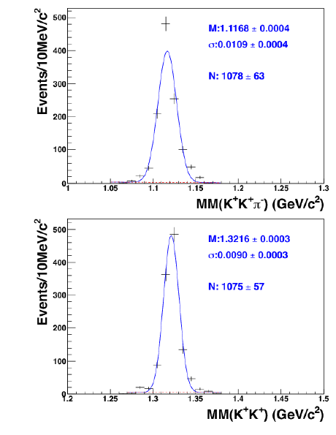
Kinematic Fitting
Examples of kinematic fitting from CLAS g11:
Top: The missing mass spectra of the K⁺K⁺π⁻ system for a proton target. Events corresponding to the Ξ⁻ signal are selected.
Bottom: The missing mass spectra of the K⁺K⁺ system for a proton target. Events corresponding to the Λ signal are selected.
The graphs show the nearly background free signal obtained from the kinematic fit.

