Slide 1

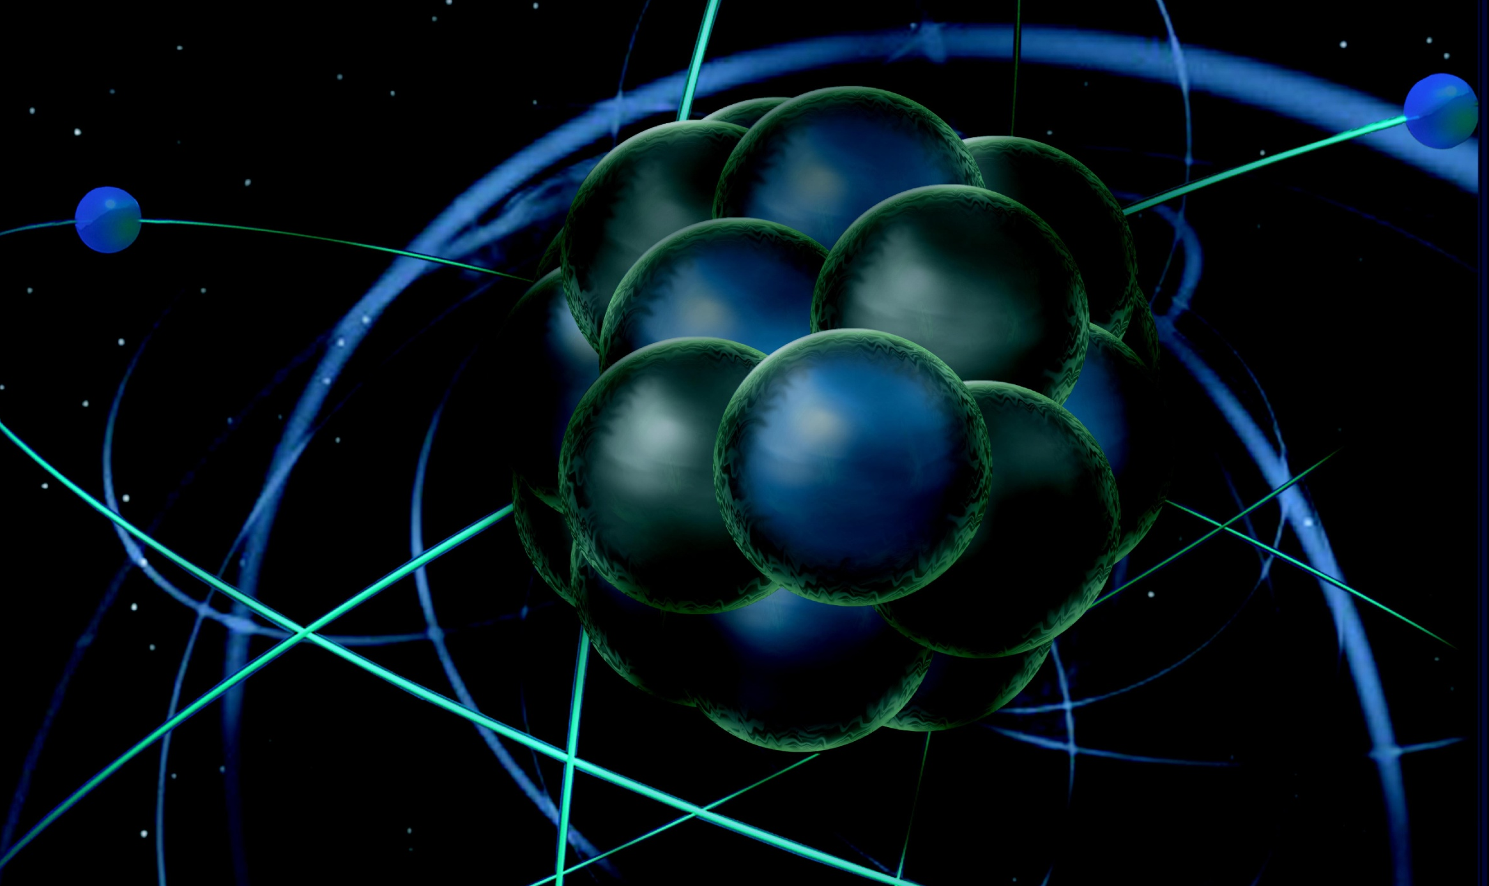
6 GeV Program
12 GeV Program and Preparations
  Status of the Halls
  Early Hall Running
  12-GeV Ancillary Apparatus
  4-Hall running
Rolf Ent
JLab PAC40 Meeting
June 17, 2013

Slide 2
PAC40 Additional Information
In follow-up of an earlier document that was submitted to PAC38 outlining the efforts across Halls A, B and C related to the SIDIS program, we requested documents on two multi-hall programs:
1) deep exclusive scattering
(Girod, Guidal, Horn, Munoz Camacho, Pennington),
with sign-on of most of the spokespersons involved in this program
completed end of May, see
http://wwwold.jlab.org/exp_prog/PACpage/PAC40/secure/Additional%20Information/
2) SRC & hadrons in the nuclear medium
(Arrington, Sargsyan, Solvignon, Weinstein),
bounced off the various spokespersons for
feedback and concurrence
Given that this second document was completed relatively late and has a different structure, there has not been sufficient time to make sure all spokespersons sign off. See also
http://wwwold.jlab.org/exp_prog/PACpage/PAC40/secure/Additional%20Information/
SIDIS working group starts meetings to discuss possible overall data structure for global analysis

Slide 3
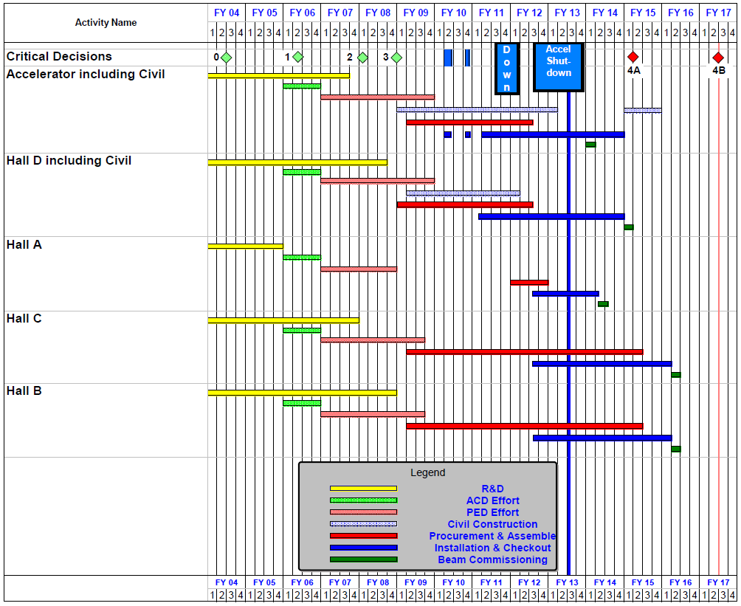
12 GeV Upgrade Project Schedule
FY12: reduction of $16M
FY13: Pres Request – no restoration
    Present expectation (subject to rebaseline approval in August):
    16-month installation
    May 2012 - Sept 2013
    Accelerator commissioning start Oct 2013
    Hall A commissioning start Feb 2014
    Hall D commissioning start
    Oct 2014
    Halls B & C commissioning start Jan/Feb 2016
    Project Completion March 2017
Information based on
DOE Project Review
May 7-9, 2013

Slide 4
Experiment Scheduling Process
Accelerator commissioning under Accelerator Operations Directive (Arne Freyberger).
Plan to have 1 scheduling request per year, starting with a draft scheduling request for Hall A only (January 2014?). Likely output: fixed schedule for 6 months, tentative schedule for 12 more months.
Likely will replace “Fall Cycle” for beam time requests with process to release next 6 months as fixed schedule.
Experiment scheduling process refresher, see http://www.jlab.org/exp_prog/experiment_schedule/beamreq.html

Slide 5
Ancillary Apparatus – Active User Community
Hall A DVCS (France - Orsay) near-complete
Hall A SBS GEMs (Italy – INFN), Hadron Calorimeter (CMU) ongoing
Hall A Moller – pre-R&D (engineering concept, with MIT) ongoing
Hall A SOLID (China, Temple, Duke, ANL, …) ongoing
Hall A APEX septum magnet (Canada, UCLA) ongoing
Hall B longitudinally polarized target (NSF/MRI) ongoing
Hall B forward tagger (Italy INFN & NSF/MRI) ongoing
Hall B RICH sector(s) (Italy INFN) ongoing
Hall B Micromegas (France - Saclay) ongoing
Hall B Central Neutron Detector (France - Orsay) ongoing
Hall B Heavy Photon Search (HPS) (DOE HEP) DOE review 07/11
Hall B H Gas Target for Proton Charge Radius (NSF/MRI) ongoing
Hall C Kaon Detection System (NSF/MRI) near-complete
Hall C Backward nucleon detection system (Tel Aviv/ODU) ongoing
Hall C neutral-particle spectrometer (US/France) planning
Hall D PID systems (US) planning
Hall D Discussions with China on calorimeter upgrades planning

Slide 6
Hall A Status
Have taken a critical look at all experiments in Hall A since last Summer
Found that equipment plans from proposals were not always clear &
that due to cost & manpower demands it was impossible to move them all forward at the pace requested
Have revisited:
  SBS pre-R&D and hadronic calorimeter
  PREX needs (& ongoing: SC Moller Polarimeter)
  APEX
  GMp & DVCS
  3H work
  Polarized 3He planning (have now global plan of Hall A & C)
  A1n Cherenkov
Have a plan that is achievable now folding in the preliminary plans for early beam in Hall A. It allows limited work on future needs for large-scale installations.
Hall A will be the first experiment to face the revised experimental readiness review procedures with GMp & DVCS

Slide 7
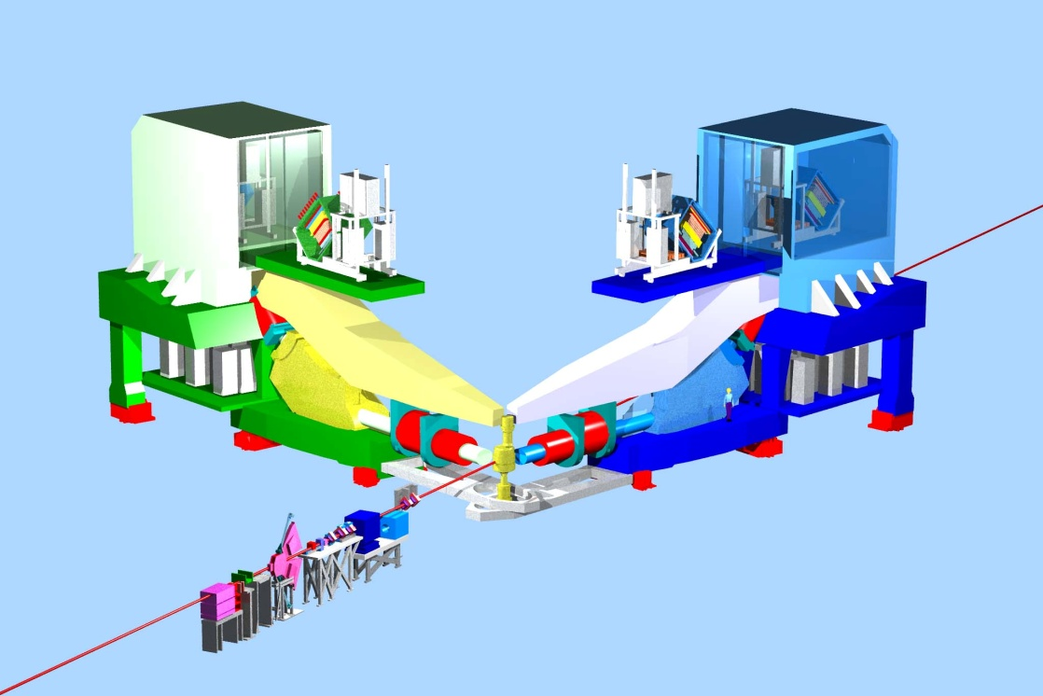
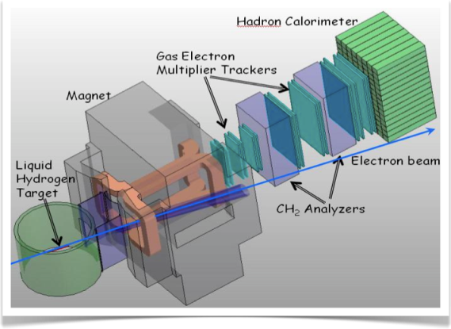
Preliminary Plans for
Early Beam in Hall A
3 A-rated experiments in first years of running
G_{M}^{p} (HRS-R) and DVCS (HRS-L + calo) run is combined
Some flexibility incorporated
16 mo. Shutdown
12 GeV Commissioning
Early Experiments
DVCS-I/ G_{M}^{p}
³H/³He PREX (A1n, APEX)
EM Form Factor
Access to GPDs
d/u at High x
Neutron skin
Neutron spin structure
12 GeV Projects: 1. Moller polarimeter
2. Compton polarimeter
3. Energy Meas. upgrade
SBS Experiments
EM Form Factors
at high Q²
SBS Project
SuperBigbite
11 GeV
Beam 1st to Hall A
FY 2013
FY 2014
FY 2015
FY 2016
FY 2017

Slide 8
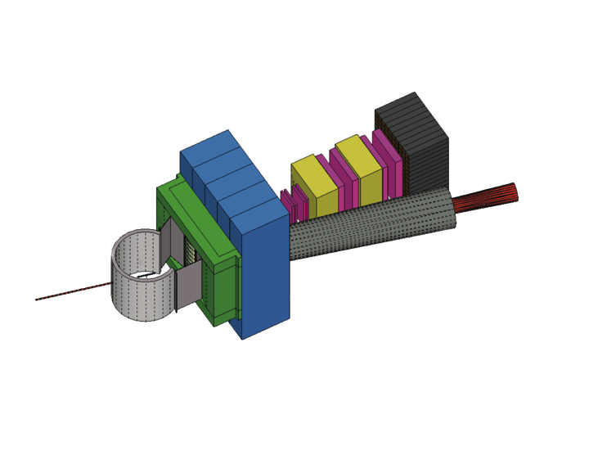
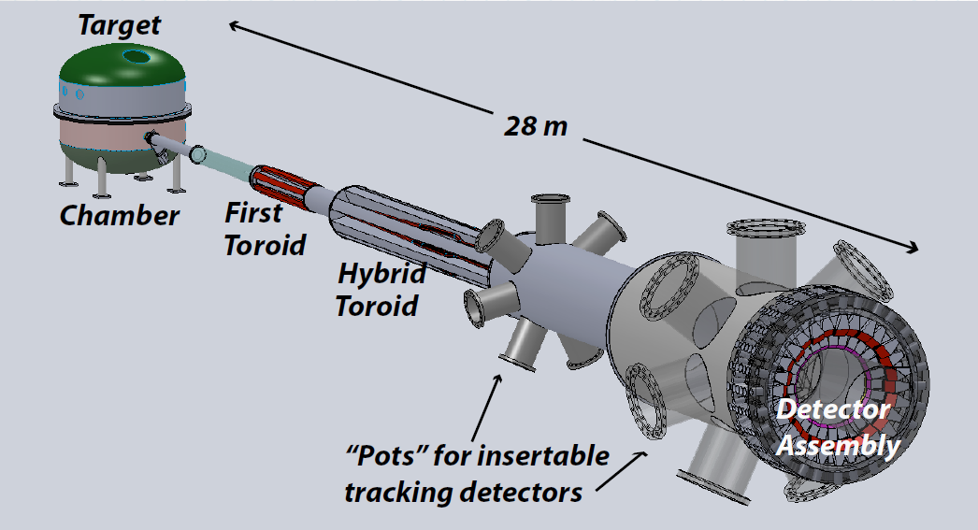
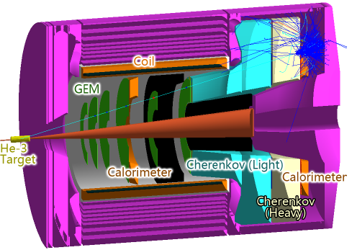
Hall A Large Installations Beyond 12 GeV Upgrade
Super BigBite Spectrometer
(Approved for FY13-16 construction)
- high Q² form factors
- SIDIS
- Project formally started 10/01/2012
MOLLER experiment (MIE – FY14-18?)
  - Standard Model Test
  - Recent Collaboration Meeting
  - Collaboration Structure
  - Magnet pre-engineering tasks with MIT/Bates
SoLID
- Chinese collaboration
- CLEO Solenoid?

Slide 9
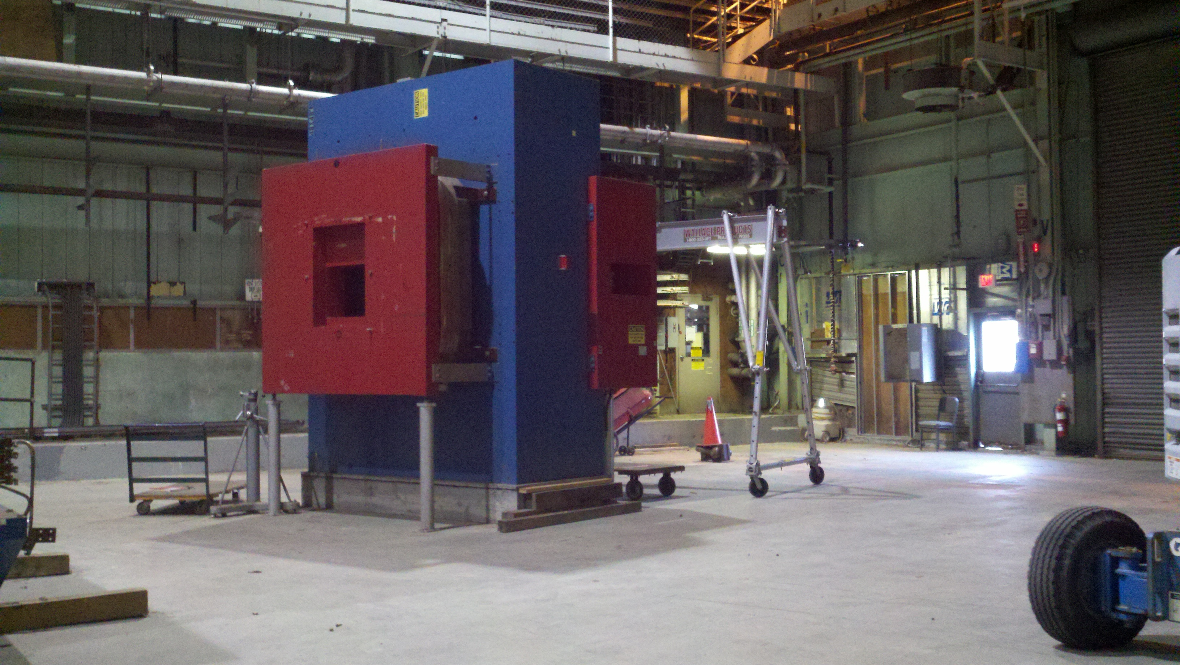
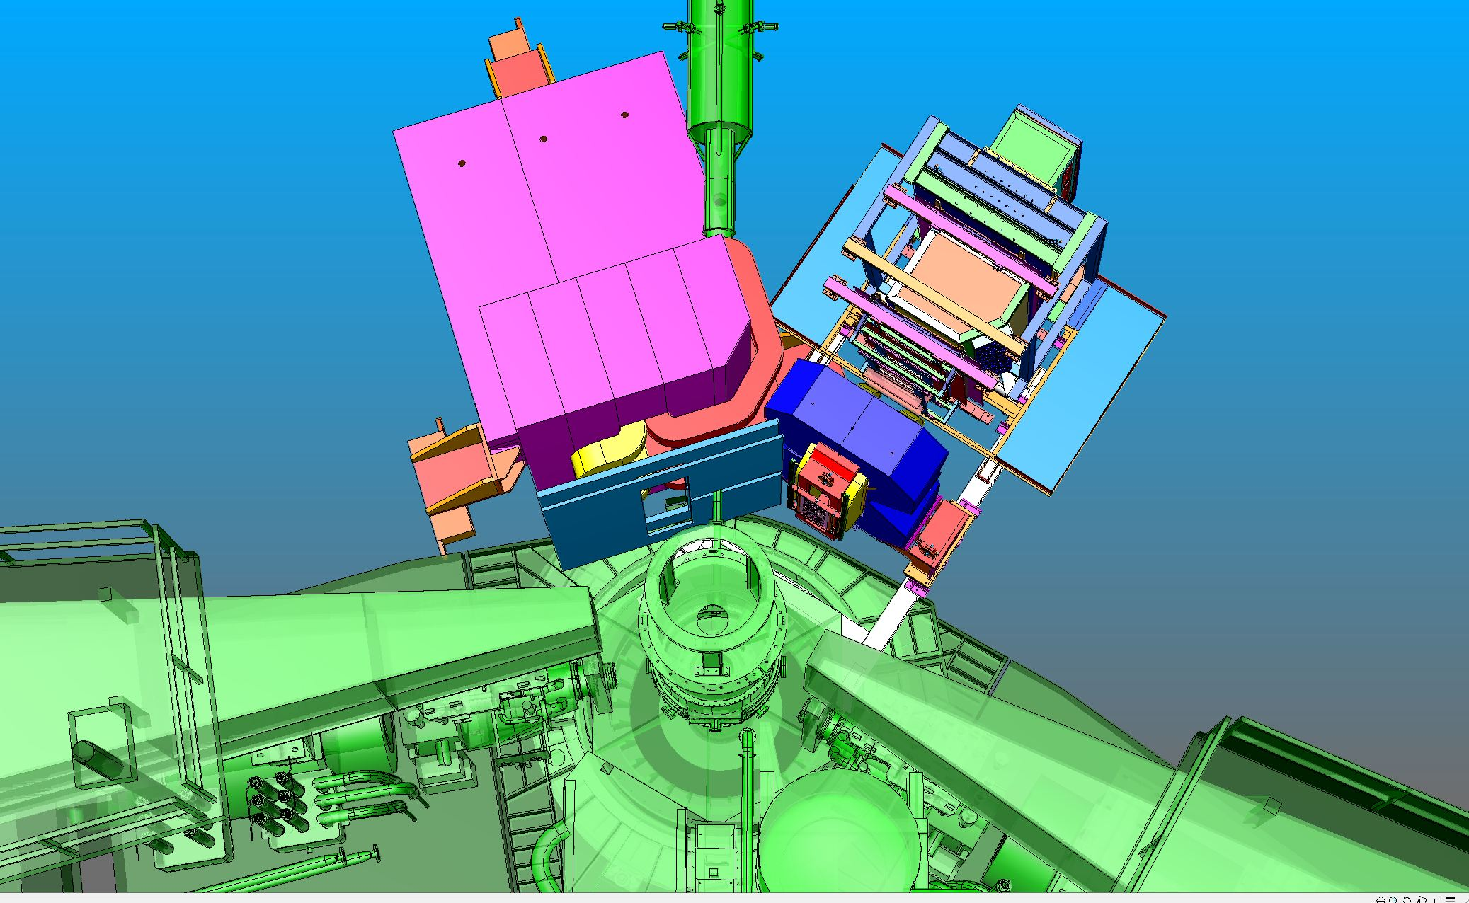
SBS Status
Project formally started 10/01/12
Engineering design for magnet modifications completed, awaiting approval for transfer from BNL.
Magnet power supply ordered
SBS floor plan for GMn
SBS (GEM) pre-R&D last (FY13) phase agreed with UVa, work near-final
Hadronic Calorimeter plans discussed with CMU, first phase started in FY13

Slide 10
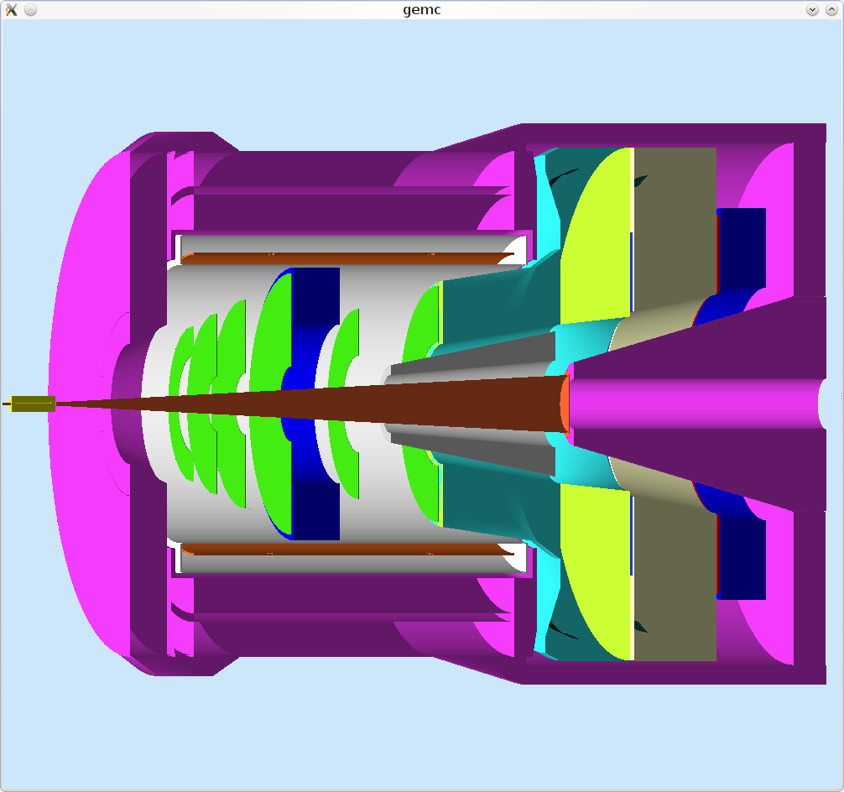
SoLID Status Update
SoLID: large acceptance, capable of handling high luminosity
(up to~10³⁹ with baffle, up to ~10³⁷ without baffle)
  Five Experiments Approved: 1 PVDIS, 3 SIDIS, 1 J/Psi
  Two LOIs this PAC
  Rough cost estimate performed by Division and compared to Collaboration
Magnet: Progress/work done on fit CLEO magnet to Hall A
  Engineering study BaBar magnet option and comparison
  Position paper imminent on CLEO magnet choice
  including requirements to move magnet from CESR to JLab
Simulations: detector and baffle design, background, tracking
GEMs: Chinese collaboration, R&D funded for 4 groups, 2 large NSFC grants awarded; Preparing funding application for full amount
US side: tests/pre-R&D working together with SBS
Cherenkov’s, EM Calorimeter, MRPC, DAQ:
    much work on finalizing conceptual design
Draft of conceptual design report in progress and nearing completion.
Collaboration has requested Director’s Review

Slide 11
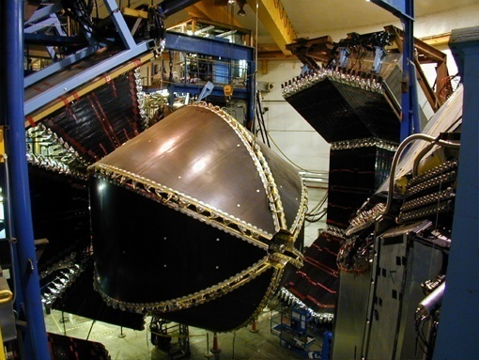
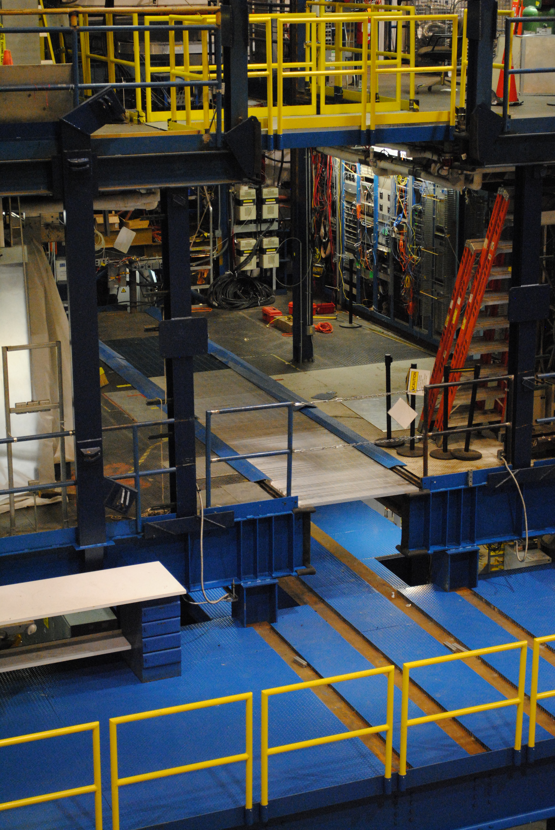
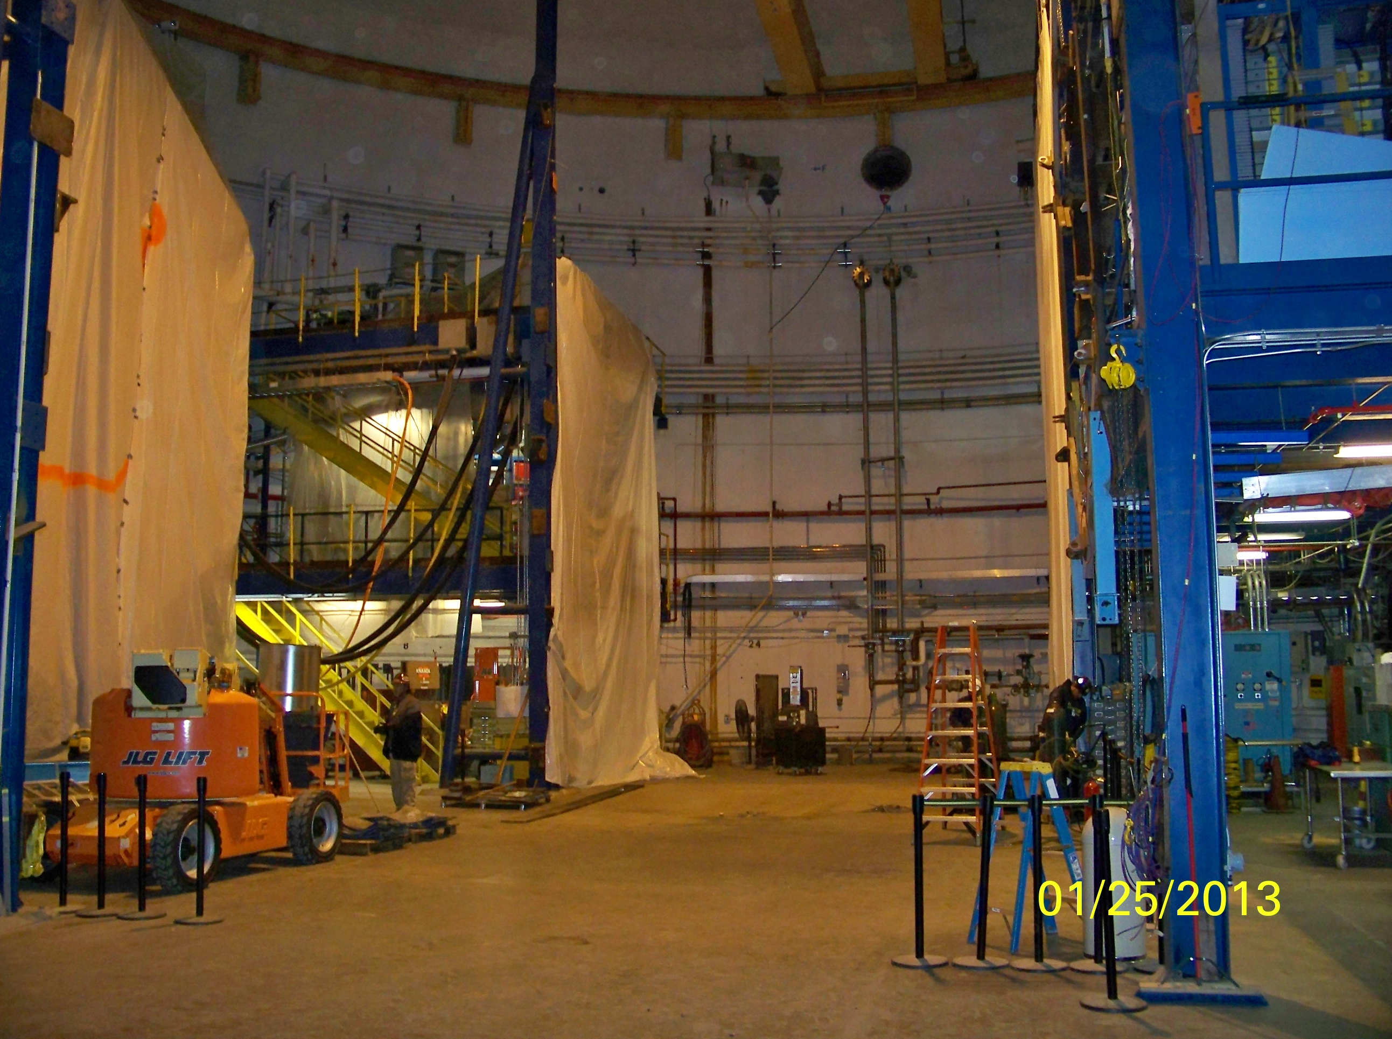
Hall B Status
1997-2012
May 2012
June 2013
Jan. 2013
Jan. 2013

Slide 12
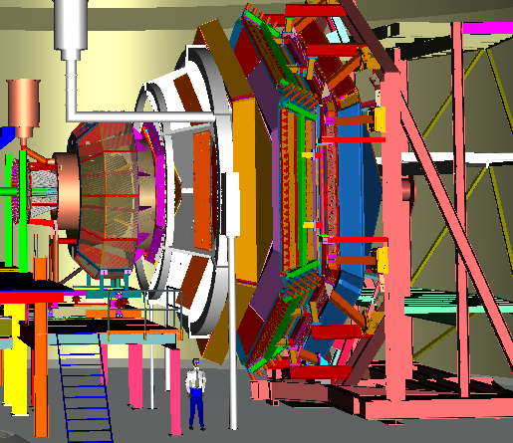
Preliminary Plans for
First Years of Beam in Hall B
6 A rated experiments in first 3 years of running
PCR, HPS, pDVCS, nDVCS, pSIDIS, g₁^{p}/g₁^{n}
High discovery potential during first year
CLAS12
Construction
Installation
Early 11 GeV Experiments
< 6 GeV beam
pDVCS
& GPDs
pSIDIS &
TMDs
nDVCS
& GPDs
nSIDIS
& TMDs
g₁^{p} , g₁^{n}
large x
spin str.
Proton TMDs Transverse spin structure
Installation
Proton
Charge Radius
Dark
Photon
Search
1st beam to Hall B
First 11 GeV
FY 2014
FY 2015
FY 2016
FY 2017
FY 2018

Slide 13


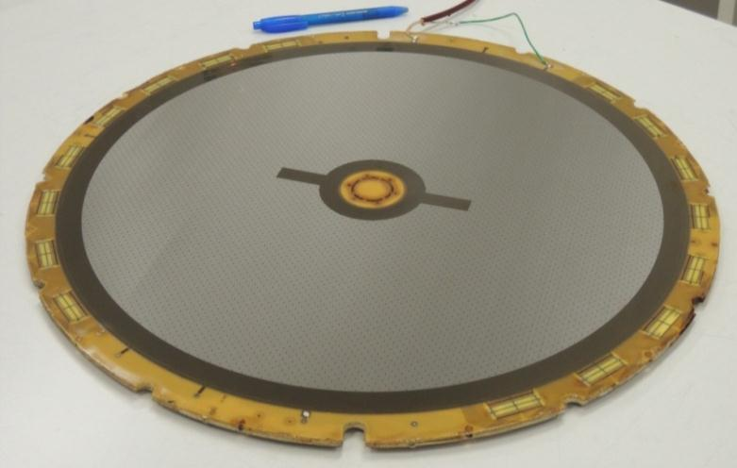
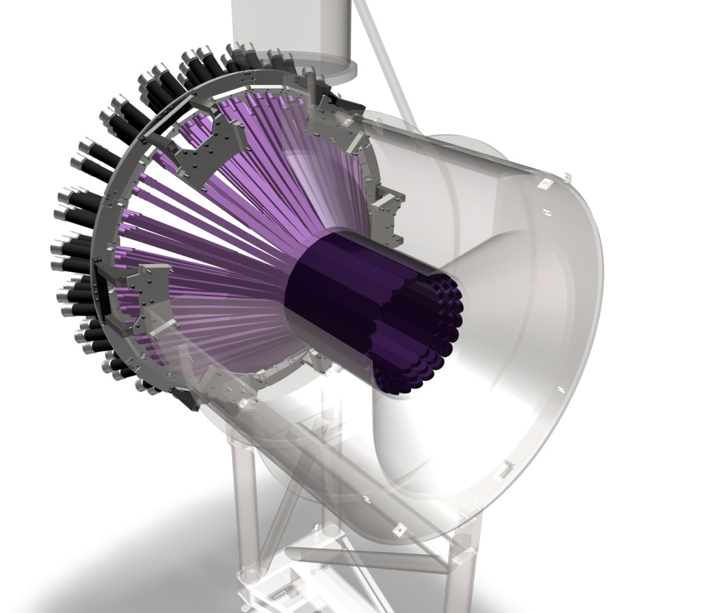

Hall B – Forward Tagger, Central NDET, MVT
  The MVT combined with the SVT will optimize resolution for exclusive reactions.
Status: Tests started on first forward resistive disk, received 2/13. Mechanics design (Barrel + Fwd) and gas distribution system to be sent to JLab 07/13. DREAM ASIC pre-series OK, ordering of the final chips in two sets, 13&14. FE electronics boards pre-series to be tested at the end of 2013. Production of detectors will start in 2014.
INFN Genova
  PbWO4 calorimeter to detect electrons
  Status: FT-Cal procurements started, FT-Trck design is being finalized. An FT prototype, including a calorimeter and a hodoscope, was tested at JLab and BTF at LNF (Italy). The FT mechanical design is in the final phase and the first parts have been machined. We are preparing the benchmark test bed in Genova for full FT functionality tests by Fall 2015.
  The CND provides detection of a 0.2-1.0 GeV/c recoil neutron in electron-deuteron reactions.
  Status: Most components are purchased. Light guides are expected to arrive in June 2013. Prototyping of the mechanical support structure ongoing. Construction of the 24 blocks composing the CND to begin 9/13, shipping foreseen for 9/14.

Slide 14
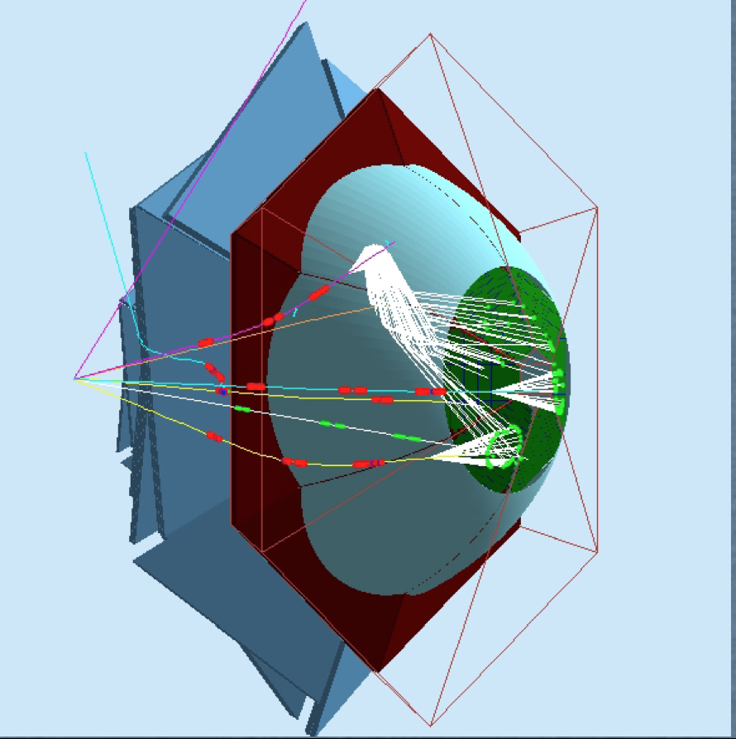
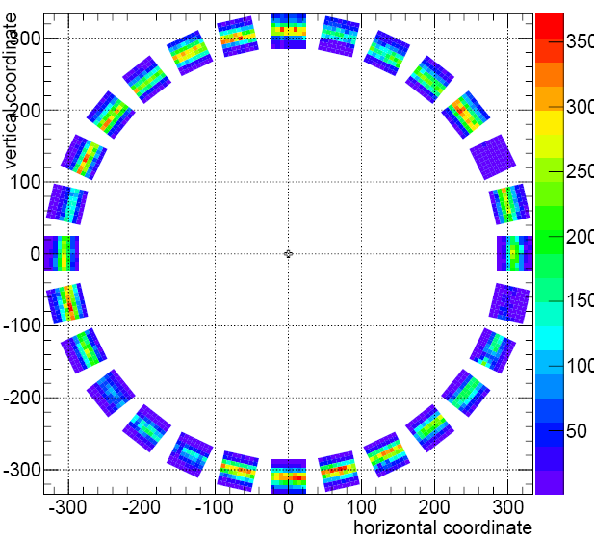
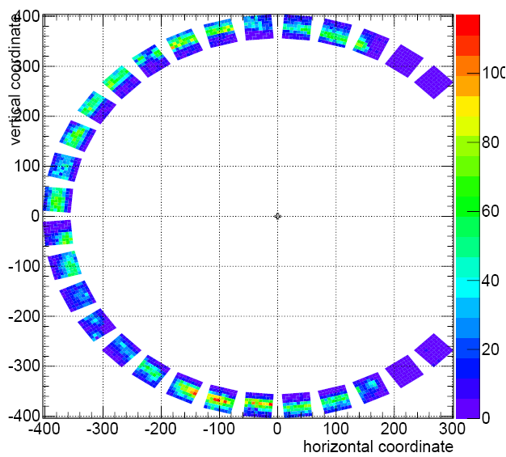
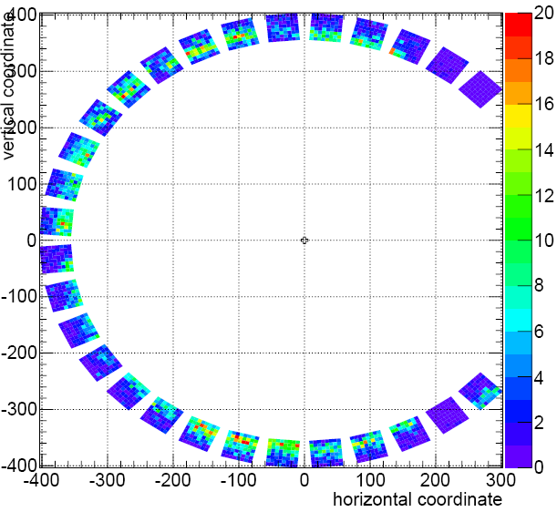
The RICH detector for CLAS12
GOAL:
identification of K in the 2-8 GeV/c momentum region
π/K separation with rejection factor ~1000
CURRENT DESIGN
replace the LTCC (one sector)
aerogel radiator & multi-anode PMT
mirrors to focalize the photons in a smaller area
STATUS OF THE PROJECT
on-beam test at CERN of a simplified detector
  test of MAPMT as single photon detectors
  pion ring reconstruction
Monte Carlo simulations
  simulations calibrated with CERN data
  first realistic estimate of resolution and efficiency
on-beam test at LNF-BTF (July 2012)
  test of DAQ system
on-beam test at CERN of a new prototype
  direct and reflected light setup
  π/K separation
  Multiple crossing through aerogel
on-beam test at LNF (July 2013)
  Test of electronics readout
Done
CERN test results
Aug 2012
Done
direct light
Done
Done
reflected light
Planned
pion trigger
kaon trigger
Review on September 5 + 6, 2013

Slide 15
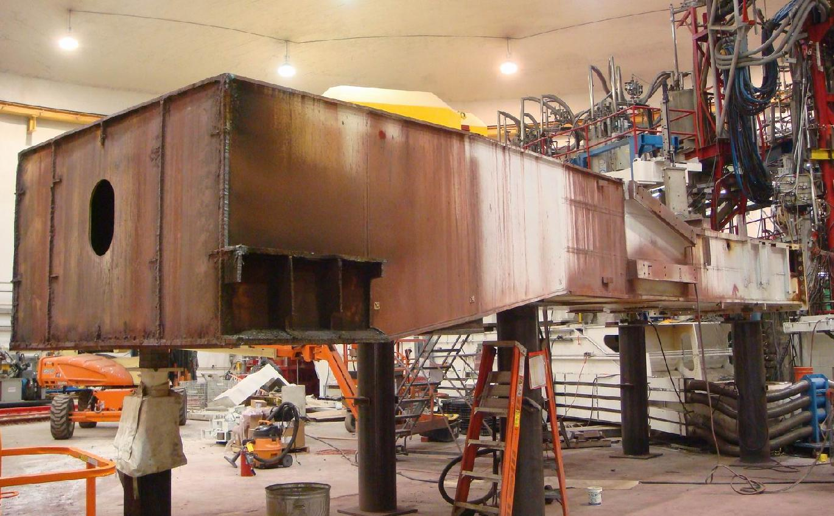
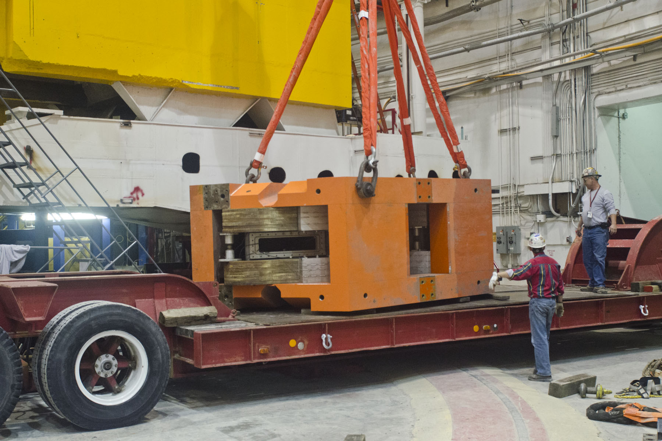
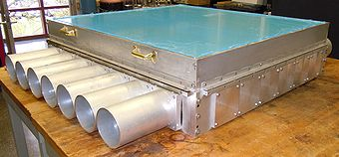
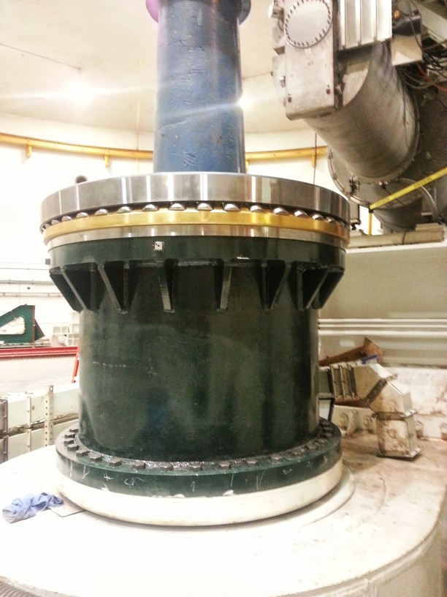
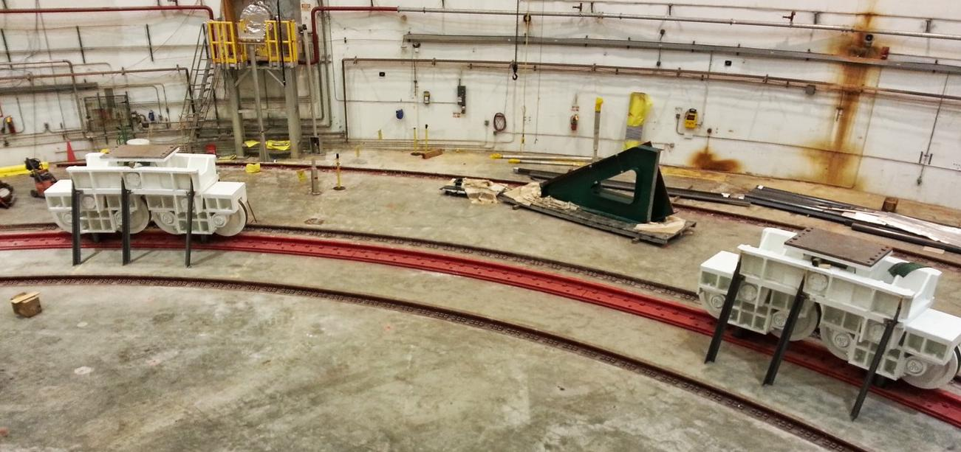
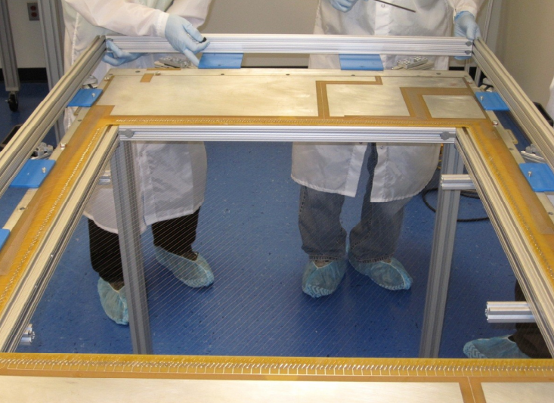
Hall C Status – SHMS Structure Assembly
Qweak & SOS Removed
SHMS Carriage assembly started
Detectors near-complete
NSF/MRI aerogel (CUA)
SHMS Pivot
Bogies on SHMS Rail
SHMS chambers (Hampton)

Slide 16
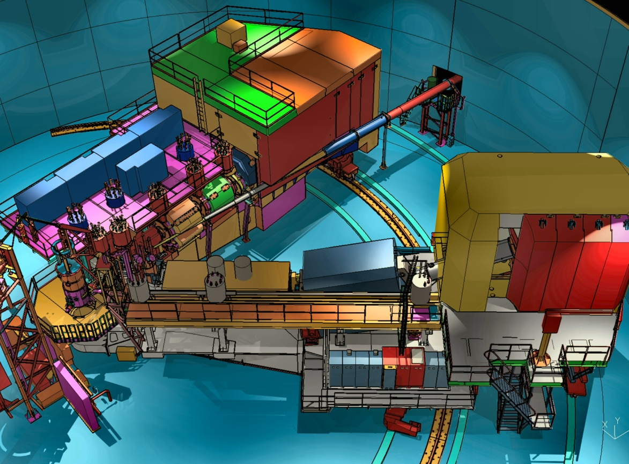
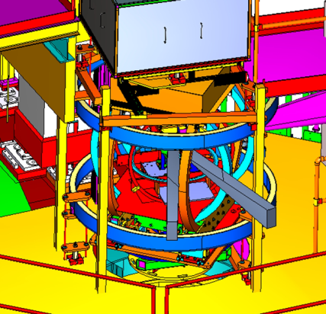
Preliminary plans for Early Beam in Hall C
Straightforward “commissioning experiments”
Basic SIDIS and easiest L/T separation
Base equipment in early years
SHMS Installation
12 GeV Commissioning
Early Experiments
p, d,A(e,e’), A(e,e’p), d(e,e’p)
d2n, A1n
High x nucleon structure
Short Range nuclear structure
Neutron Spin Structure
Pt, CSV, (e,e’K)
Polarized ³He Experiments
First 11 GeV Beam
Basic SIDIS
Charge Symm. Violation
Deep Exclusive Kaon Prod.
FY 2015
FY 2016
FY 2017
FY 2018
FY 2018

Slide 17
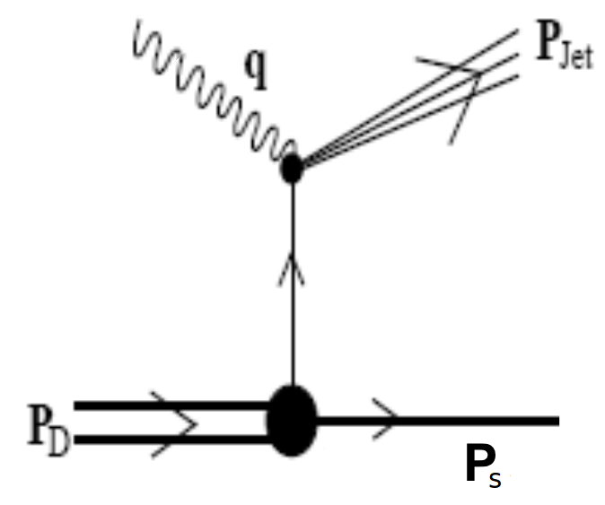
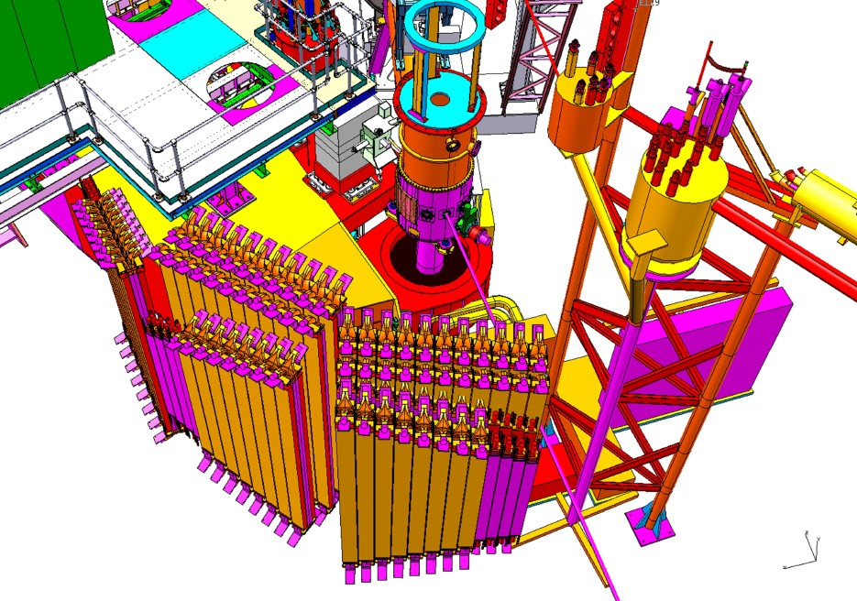
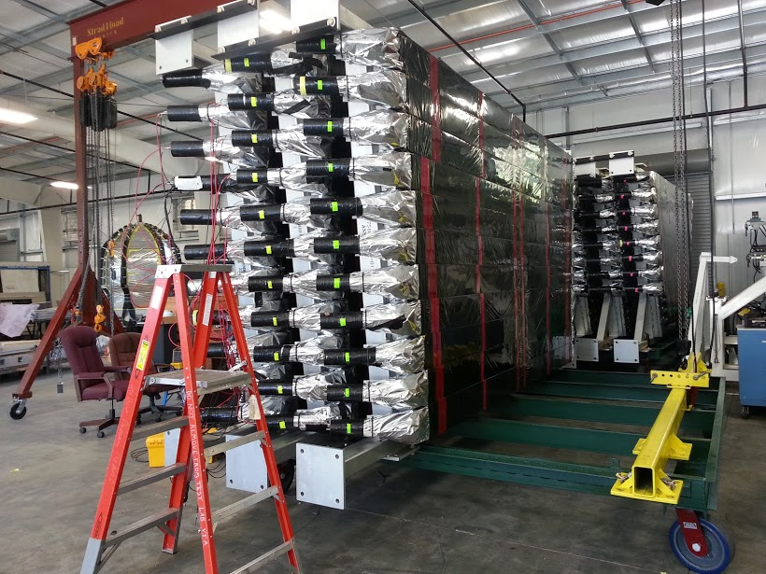
Backward nucleon detector – EMC effect
Hall C/Tel Aviv/ODU
d(e, e′N_{backward})
Detect spectator proton or neutron to tag in-medium structure function on off-shell nucleon.
User labor (& some JLab resources) applied to preserve Hall B detectors.
Recycled CLAS6 (Hall B) TOF detectors

Slide 18
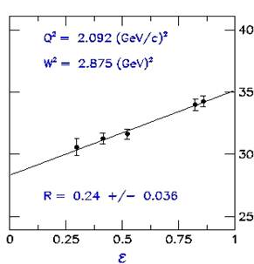
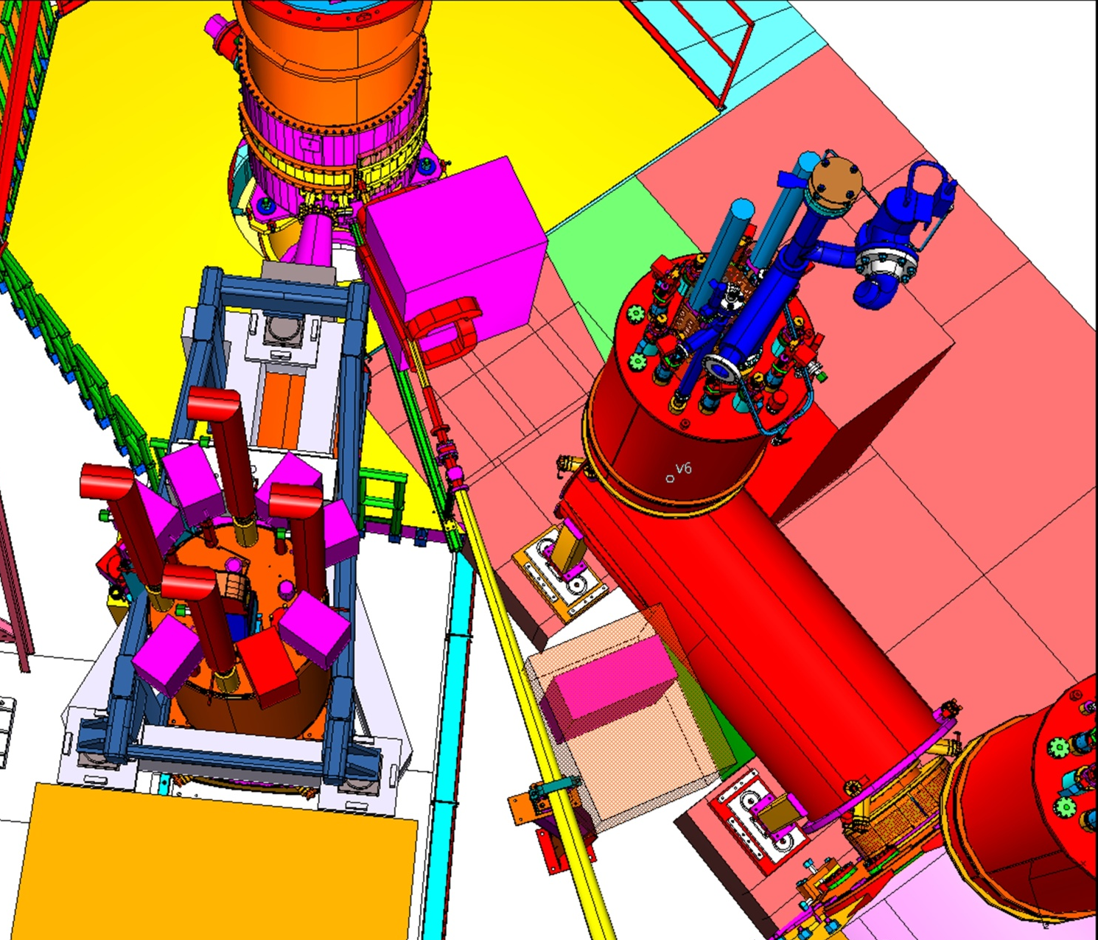
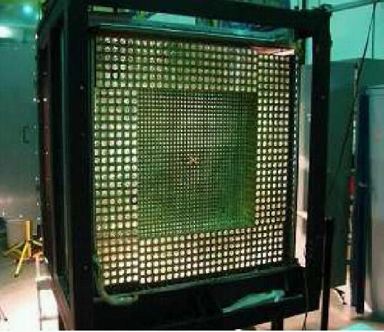
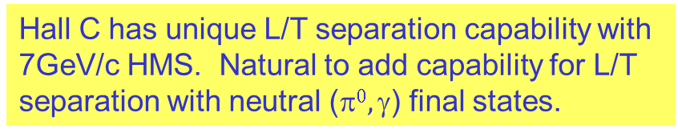
Proposed neutrals ( e.g. π⁰/γ ) detector facility in Hall C
Hall C has unique L/T separation capability with 7GeV/c HMS. Natural to add capability for L/T separation with neutral ($0, $) final states.
Beam direction
target
Concept: Place ~1000 block PbWO₄ detector on SHMS carriage (currently under construction) with conventional sweeping magnet replacing SHMS horizontal bend.
Organizational meetings with Halls A, C & users to propose facility for program of DVCS, WACS, & (e,e’π⁰).
HMS
Notes:
Hall C: Established capability for L/T separation for (e,e’) and (e,e’X)
Requires SHMS superstructure, now under construction

Slide 19
Hall D Status
Included in Allison’s presentation

Slide 20
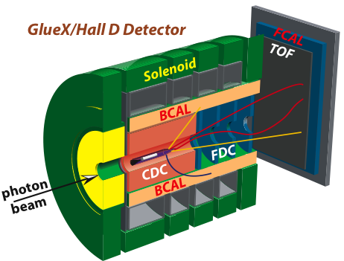
Preliminary Plans for
First Beam in Hall D
Search for Gluonic Excitations (GlueX)
η, η’ couplings, rare decays using Primakoff reaction
12 GeV Commissioning
Primakoff
η→γγ
GlueX
Hardware
Polarized Beam
10⁷γ/s
Light quark mass ratio
η and η’ mixing angle
E = 12 GeV
polarized
10⁸γ/s preparations
E < 12 GeV
unpolarized
FY 2014
FY 2015
FY 2016
FY 2017

Slide 21
New: Proposed 4 Hall Operation (R. Kazimi)
The existing extraction design allows the simultaneous operation of Hall D, plus two other halls (D+2).
We propose a design that allows the simultaneous operation of all four halls (D+3).
Capability | Planned Design (D+2) | New Design (D+3)
Maximum number of halls receiving beam simultaneously | 3 Halls | 4 Halls
How?
Use a different frequency for the horizontal 5th pass separator (750 MHz instead of 500 MHz).
No changes to lower passes (Hall D wants only 5th pass beam).
Cut the beam bunch repetition rate for the halls taking 5th pass beam in half (to 250 MHz).
  Total current to each hall can remain the same.

Slide 22
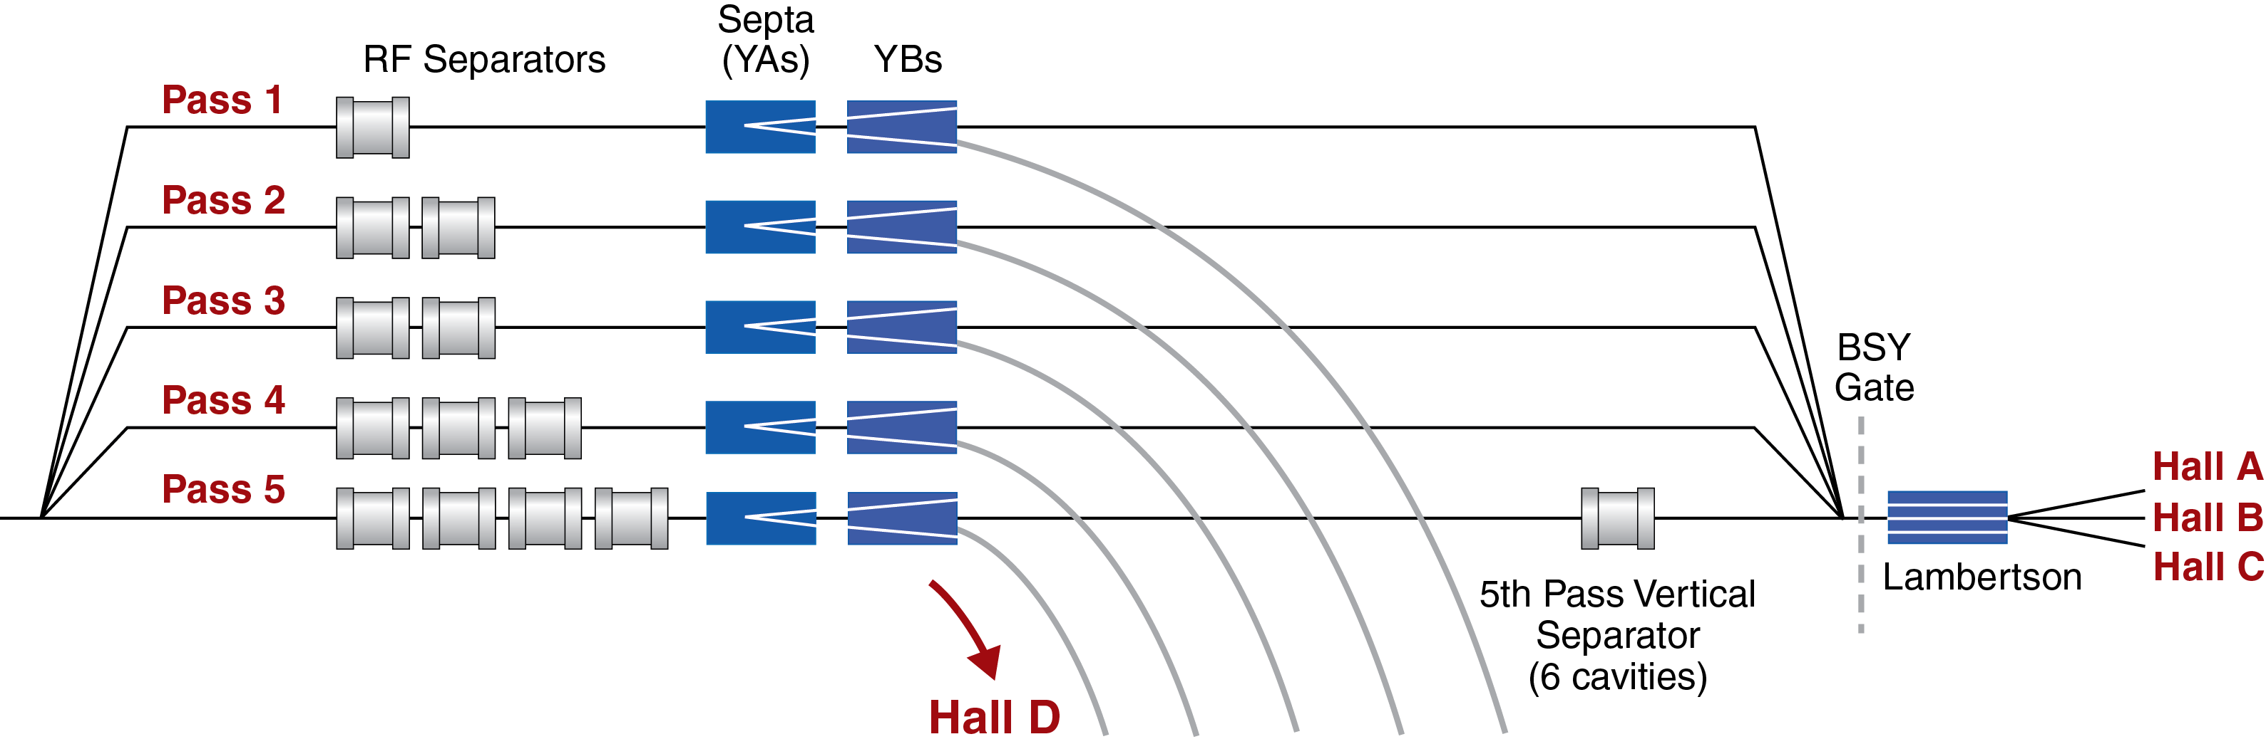
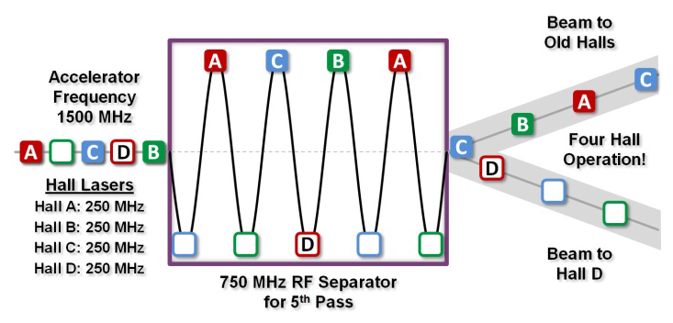
5th Pass RF Separation Hardware
Horizontal 5th Pass Separator
(kicks out Hall D)
D+2: 500 MHz
Vertical 5th Pass Separator (Halls A,B,C)
D+3: 750 MHz

Slide 23
Comparing D+2 and D+3
 | Planned (D+2) | Proposed (D+3)
Maximum number of halls receiving beam | 3 halls | 4 halls
Beam @ 5th pass (Hall D on) | 500 MHz | 250 MHz
Beam @ 5th pass (Hall D off) | 500 MHz | 500 MHz
Beam @ lower passes | 500 MHz | 500 MHz
The D+3 Tradeoff:
  On 5th pass, all halls must run at 250 MHz (half the rep rate), unless Hall D is off.
  When Hall D is on, at least one hall must be configured for the 5th pass.
In exchange we can run Hall D at 12 GeV and Halls A/B/C at 11 GeV

Slide 24
Summary
Halls B and C have been cleared for construction of CLAS12 and SHMS. Hall A preparing for DVCS/GMp experiments. Hall D testing Solenoid before BCal installation.
Started process of initial equipment commissioning and preparations for early experiment readiness review process
The Halls presented their commissioning and early physics plans to PAC-39. Hall A’s plan has been revisited. Impacts of re-baseline need to be further integrated.
Many ancillary 12-GeV projects in motion, led by Jefferson Lab user community
Since last year, a novel idea for a 4-way split has been developed that in principle would allow beam to all 4 Halls.

