Slide 1
PAC40 12 GeV Program Status and Charge
R. D. McKeown

Slide 2
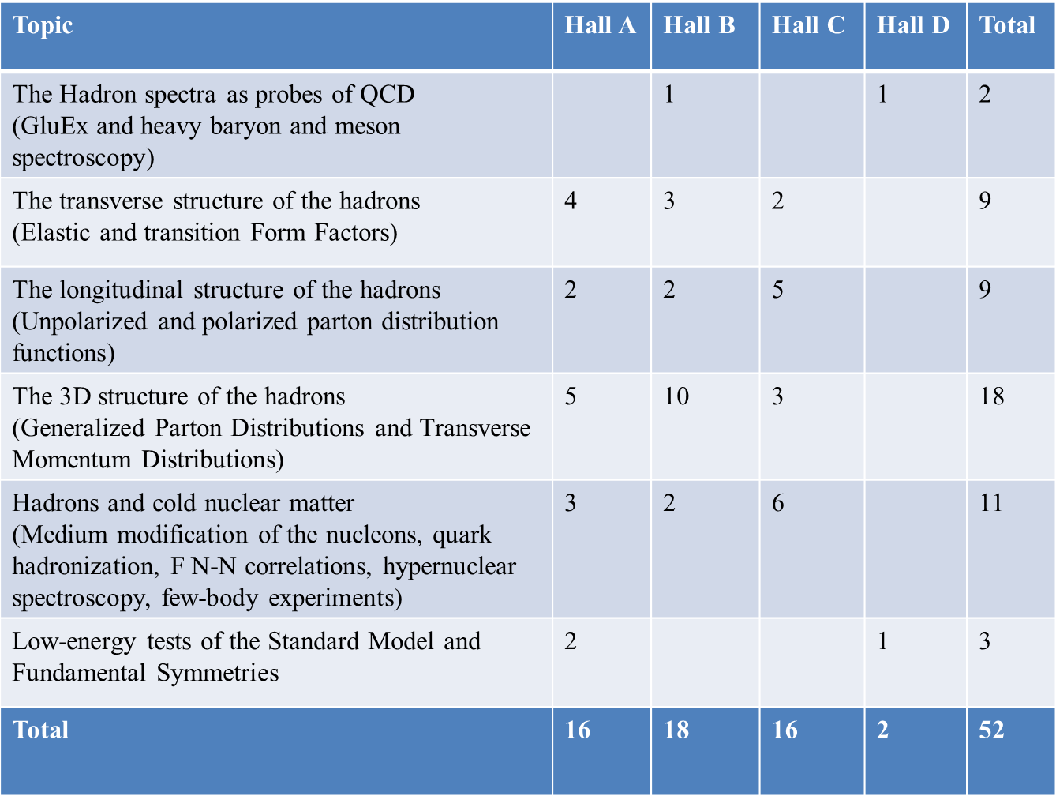
12 GeV Approved Experiments by Physics Topics
E12-11-105 has not been counted with the experiments since it is considered a test

Slide 3
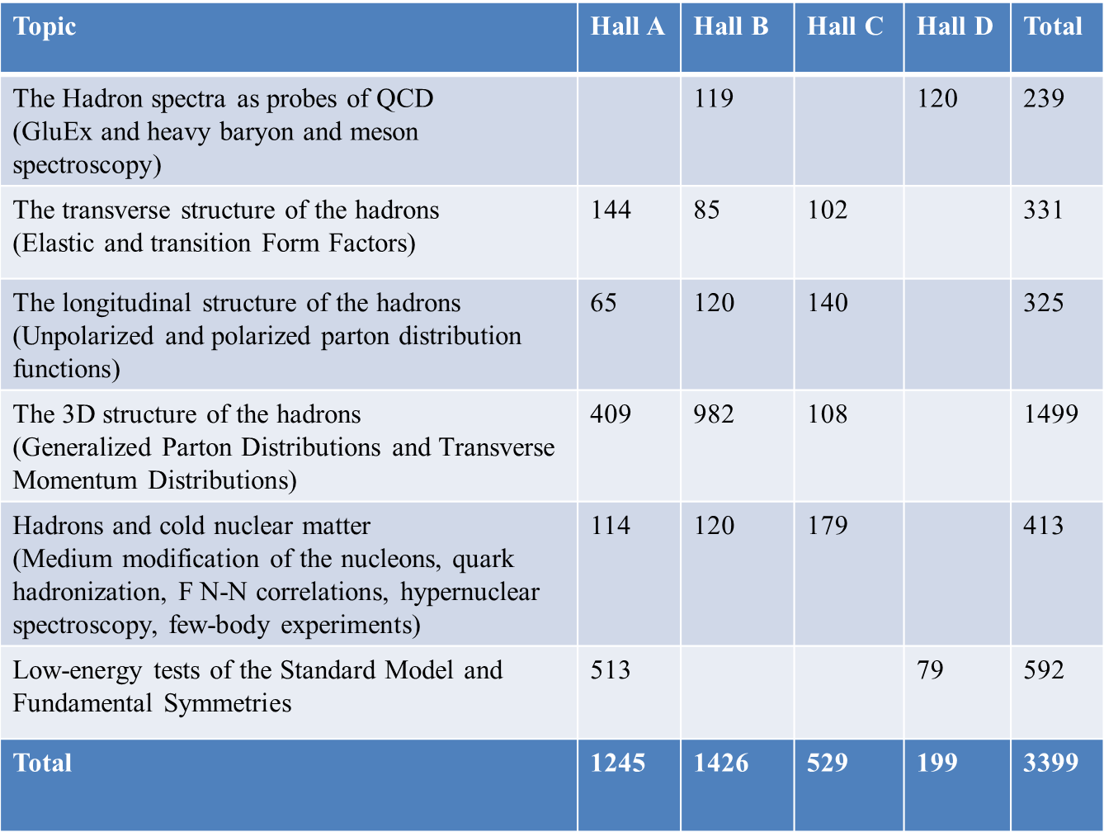
12 GeV Approved Experiments by PAC Days
More than 7 years of approved experiments

Slide 4
PAC40 Charge
1.) Review new proposals, previously conditionally approved proposals, and letters of intent†
for experiments that will utilize the 12 GeV upgrade of CEBAF and provide advice on their
scientific merit, technical feasibility and resource requirements.
Identify proposals with high-quality physics that, represent high quality physics
within the range of scientific importance represented by the previously approved
12 GeV proposals and recommend for approval.
Also provide a recommendation on scientific rating and beamtime allocation for
proposals newly recommended for approval.
Identify other proposals with physics that have the potential for falling into this
category pending clarification of scientific and/or technical issues and recommend for
conditional approval. Provide comments on technical and scientific issues that should be
addressed by the proponents prior to review at a future PAC.
† Letters of intent will be given the same “rights” to their scientific ideas as are
currently afforded to deferred experiments

Slide 5
Conditional Approval
Two types:
C1 – approval pending technical review,
no need to return to PAC
C2 - approval pending further review by
future PAC

Slide 6
Proposals with Parallel Running
New parallel running procedure
-Intent is to encourage proposal of “run groups”
-Summary only of additions to existing run group (PAC to comment)

Slide 7
New Policy on Equipment Availability
New categories for resource availability:
- Stage I: resources need to be identified/obtained
- Stage II: resources are essentially available
This will be considered a Laboratory issue (not for PAC).

Slide 8
Returning C2 Proposals
C12-12-004 | Seamus Riordan | C-REX: A Parity-Violating Measurement of the Weak Charge Distribution of 48Ca to 0.03 fm Accuracy | A

Slide 9
New Proposals
PR12-13-001 | C | Precision Measurements and Studies of a Possible Nuclear Dependence of R | Simona Malace
PR12-13-002 | A | A Study with High Precision on the Electro-production of the Lambda and Lambda-Hypernuclei in the Full Mass Range | John LeRose
PR12-13-003 | D | An initial study of hadron decays to strange final states with GlueX in Hall D | Curtis A. Meyer
PR12-13-004 | D | Symmetry Tests of Rare Eta Decays to All-Neutral Final States: The Jlab Eta Factory (JEF) Experiment | Liping Gan
PR12-13-005 | Inj | Measurement of 16O(³,±)12C with a bubble chamber and a bremsstrahlung beam | Claudio Ugalde
PR12-13-007 | C | Measurement of Semi-Inclusive Àæ Production as Validation of Factorization | R. Ent
PR12-13-008 | D | Measuring the Charged Pion Polarizability in the $\gamma \gamma \rightarrow \pi^+ \pi^-$ Reaction | Rory Miskimen
PR12-13-009 | C | Wide-angle Compton scattering at 8 and 10 GeV photon energies | Bogdan Wojtsekhowski
PR12-13-010 | C | Exclusive Deeply Virtual Compton and Neutral Pion Cross-Section Measurements in Hall C | Carlos Munoz Camacho
PR12-13-011 | C | The Deuteron Tensor Structure Function b1 | Karl Slifer
PR12-13-012 | A | Nucleon Momentum Distributions in Asymmetric Nuclei A Comparison of 3He(e, e2p) and 3H(e, e2p) | Lawrence Weinstein

Slide 10
Parallel Running
Hall B will present an overview of their parallel running and a
a new addition to an existing run group
 PAC to comment on new addition
Hall C has 2 new proposals that involve parallel running
PR12-13-007 requests 25 days in parallel with
PR12-13-010 (65 days total)
PAC should try to consider these together

Slide 11
Letters of Intent
LOI12-13-001 | A | Letter of Intent for Jefferson Lab PAC 40: Timelike Compton Scattering in e+e pair production on the proton with SoLID at 11 GeV | Pawel Nadel-Turonski
LOI12-13-002 | A | Dihadron Electroproduction in DIS with Transversely Polarized ^{3}He Target at 11 and 8.8 GeV | Jixie Zhang
LOI12-13-003 | C | Large Center-of-Mass Angle, Exclusive Photoproduction of pi0 Mesons at Photon Energies of 5 - 11 GeV | Dipangkar Dutta
LOI12-13-004 | A | LOI: Measurementsof the charge and magnetic form factors of the triton at large momentum transfers | G. Petratos

Slide 12
PAC40 Charge (cont’d)
2.) Given the current (and growing) backlog of approved experiments, we anticipate that it will be necessary to readdress priorities for scheduling the program at the beginning of the 12 GeV running period. The PAC should continue the discussion of implementation of the reprioritization (Wed. afternoon)
in order to establish the highest impact program possible with the 12 GeV facilities. We request that the PAC provide comments on the proposed procedure to be followed.

