Slide 1
PR12-13-001 : Precision Measurements and Studies of a Possible Nuclear Dependence of R = σ_{L}/σ_{T}
Simona Malace - contact (JLab)
Eric Christy (Hampton U.), Dave Gaskell (JLab), Thia Keppel (JLab), Patricia Solvignon (JLab & NHU)
and the PR12-13-001 Collaboration
1

Slide 2
Collaboration
Instituion | Collaborators
JLab | Covrig, Ent, Fenker, Gaskell, Higinbotham, Keppel, Malace (contact), Solvignon, Sawatzky, Wood
Hampton U. | Accardi, Albayrak, Christy, Diefenbach, Gueye, Han, Kalantarians, Kohl, Monaghan, Zhu
Carnegie Melon U. | Mamyan
Florida International U. | Boeglin, Markowitz, Reinhold
James Madison U. | Niculescu, Niculescu
LANL | Huang, Jiang
Regina | Huber
MIT | Sulkosky
Mississippi State U. | Dunne, Dutta
Huston U. | Daniel
Rochester U. | Bodek
UVa | Day, Keller, Rondon, Ye, Yurov
Yerevan | Asaturyan, Mkrtchyan, Mkrtchyan, Tadevosyan, Zhamkochyan
Kurchatov Institute | Guzey
NC A&T | Amidouch, Danagoulian
XUL | Wasselmann
ODU | Weinstein
Zagreb U. | Androic
2

Slide 3
Outline
→ Nuclear dependence of R: experimental status
→ Implications of a possible nuclear dependence of R
the antishadowing region
the EMC effect region
→ PR12-13-001: experimental details
kinematic coverage
backgrounds and corrections to the measured cross section
charge-symmetric background
pion background
radiative corrections
Coulomb corrections
→ Projections: R_{proton}, R_{A} - R_{D}
→ Beam time request
3

Slide 4
Formalism: the Rosenbluth Technique
The L & T contributions are separated by performing a fit of the reduced cross section dependence with ε at fixed x and Q²
slope
intercept
Γ = transverse flux
ε = relative longitudinal flux
Requirements for precise L/T extractions:
As many ε points as possible spanning a large interval from 0 to 1 →
as many (E, E’, θ) settings as possible
Very good control of point-to-point systematics → 1-2 % on the reduced cross section translates into 10-15 % on F_{L}
L/Ts needed in order to access F_{L}, F₁, F₂
4

Slide 5
Formalism: R_{A} – R_{D} Extraction
R_{A} – R_{D} and σ_{A}^{T}/σ_{D}^{T} are extracted by performing a fit of the cross section ratio dependence with ε’ at fixed x and Q²
Example: extraction from SLAC E140
R: small quantity (< 1)
Even a small R_{A} – R_{D} in absolute value could imply non-negligible nuclear medium modifications of R
R = 0.2
x = 0.175, Q² = 4 GeV²
ΔR = 0.04 → 20% effect
Phys. Rev. D 86 054009 (2012)
5

Slide 6
Nuclear Dependence of R: Experimental Status
Model-dependent extractions:
NMC: Phys. Lett. B 294, 120 (1992)
Conclusion: ΔR consistent with zero
NMC: Nucl. Phys. B 481, 23 (1996)
Model-independent extractions:
ΔR: positive shift?
SLAC (E140): Phys. Lett. D 49 (1993)
HERMES: Phys. Lett. B 567, 339 (2003)
ΔR consistent with zero?
6

Slide 7
Nuclear Dependence of R: Experimental Status
Coulomb effects have not been accounted for in the SLAC E140 analysis (correction is non-negligible at SLAC and JLab kinematics)
Re-analysis of combined data sets from E140 (Fe), E139 (Fe) and Hall C (Cu) at x = 0.5 and Q² = 4 - 5 GeV² arXiv:0906:0512
Coulomb corrections calculated within the Effective Momentum Approximation framework
the ε’ dependence of the cross section ratios σ_{A}/σ_{D} has been fitted to extract R_{A} - R_{D}
ΔR consistent with zero
ΔR 2σ from zero
No Coulomb Corrections
With Coulomb Corrections
7

Slide 8
Nuclear Dependence of R: Experimental Status
Published/Preliminary extractions from JLab
L/T separations on proton and deuteron at low Q²
E99-118 (Hall C): PRL 98 142301 (2007)
E00-002 (Hall C): preliminary, publ. drafted
ΔR: negative shift
Conclusion: ~20% effect in deuterium
ΔR: negative shift
L/T separations on D and Al, C, Cu, Fe in the resonance region
E04-001/E06-109 (Hall C): under analysis
Preliminary: R_{Al,Cu,C} – R_{D} negative shift
8

Slide 9
Implications of a Possible Nuclear Dependence of R
Not enough experimental evidence to support the often made assumption of ΔR = 0 when transitioning from cross section ratio to structure function ratio
Why we see antishadowing in DIS but not in Drell-Yan?
A very well measured behaviour like the EMC effect still offers surprises – the tension between low ε JLab and high ε SLAC data on heavy targets
EMC effect
Is there gluonic (spin-0) contribution to the antishadowing and/or to the EMC effect?
antishadowing
9

Slide 10
Implications of a Possible Nuclear Dependence of R
V. Guzey et al., PRC 86 045201 (2012)
The impact of a non-zero ΔR for the antishadowing region has been analyzed
“Since the nuclear dependence of R has not as yet been systematically measured, we shall test two assumptions for ∆R…”
1) (Absolute) R_{A} – R_{D} = 0.04
2) (Relative) (R_{A} – R_{D})/R_{N} = 30%
Both assumptions based on NMC R_{Sn} – R_{C}
Two data sets have been analyzed:
EMC, BCDMS, NMC: ε ~ 1
SLAC: ε < 1
10

Slide 11
Implications of a Possible Nuclear Dependence of R
V. Guzey et al., PRC 86 045201 (2012)
The impact of a non-zero ΔR for the antishadowing region
F₂^{A/}F₂^{D}
F₁^{A/}F₁^{D}
Antishadowing disappears for F₁ ratio,
remains for F₂
Antishadowing from longitudinal photons?
11

Slide 12
Implications of a Possible Nuclear Dependence of R
Recent comparison between the size of the EMC effect, -dR_{EMC}/dx, and the relative number of short-range correlations, SRC scale factor Phys. Rev. Lett. 106 052301 (2010)
Robust correlation between the two observable
They measure the same relative effect for Be: small average density but EMC effect comparable to heavier nuclei
Possible Conclusions:
The SRC and EMC effect: a common (as yet unknown) origin
SRC: measure of some quantity like local density experienced by a nucleon in a correlated pair which gives rise to the EMC effect
However:
If R is A-dependent this interpretation needs revision
Does the correlation between -dR_{EMC}/dx and SRC apply the same to F₂, F₁, F_{L}?
12

Slide 13
PR12-13-001: Central Kinematics
We propose to extract R_{p},
R_{A} – R_{D}, for Be, C, Cu, Ag, Au, F₁, F_{L}, F₂ in a model-independent fashion in a x range from 0.1 to 0.6 and Q² from 1 to 5 GeV²
For each L/T extraction (black stars) we would use:
→ both Hall C spectrometers, SHMS and HMS
→ up to 6 beam energies: 4 standard (4.4, 6.6, 8.8, 11 GeV) and 2 non-standard (5.5 and 7.7 GeV)
→ D, Be, C, Cu targets; for most L/Ts we will also use H, Ag and Au targets
(E, E’, θ)
Statistical goal: 0.2 – 0.5% (depending on the target) in a W² bin of 0.1 GeV²
13

Slide 14
PR12-13-001 Kinematics
SHMS has a large momentum “bite”: we will collect a wealth of data within the spectrometers acceptance
Besides the model-independent L/T separations at the central kinematics, we can perform minimally model-dependent L/Ts within the spectrometers acceptance
14

Slide 15
PR12-13-001: Backgrounds and Corrections
Charge-Symmetric Background
Largest contribution 20% (less at most kinematics); the background will be measured with same spectrometer as the signal
Pion Background
Upper limits on π/e ratio:
200:1 for H → < 2% contamination
100:1 for D → < 1% contamination
Be, C, Cu, Ag, Au → << 1% contamination
Much smaller at most settings
Radiative Corrections
Elastic/quasielstic radiative effects: < 20%
Total radiative effects within 40%
To test our understanding of external radiative corrections we will take measurements on a 6% r.l. Cu target at x = 0.1, 0.275 and 0.4
15

Slide 16
PR12-13-001: Backgrounds and Corrections
Coulomb Corrections
Electrons scattering from nuclei can be accelerated/decelerated in the Coulomb field of the nucleus
E_{e} → E_{e} + V₀
E_{e’} → E_{e’} – V₀
change in kinematics
V₀ = 3α(Z-1)/2R
electrostatic potential at center of nucleus
At our kinematics correction no larger than 5% for Au (estimation within the Effective Momentum Approximation)
→ We will take additional measurements to constrain/verify Coulomb corrections procedure
At fixed ε we expect σ_{Au}/σ_{D} to scale with Q², any measured variation would be mostly due to Coulomb corrections
16

Slide 17
PR12-13-001: Projections
Poin-to-point syst.: we assumed 1.8 % for individual cross sections and 1.1 % for the cross section ratios (mostly based on the 6 GeV performance)
model
model
◊ Reduced cross section randomized using 1.8% syst.
◊ Cross section ratio randomized using 1.1% syst.
◊ Randomized reduced cross section fitted to extract R and its uncertainty
Randomized cross section ratio fitted to extract
R_{A}-R_{D} and its uncertainty
17

Slide 18
PR12-13-001: Q² Coverage for R_{A} - R_{D}
DIS world data on model-independent R_{A} - R_{D} extraction: E140 (Fe, Au)
sporadic coverage in x
We would map in detail both the x and Q² dependence of R_{A} – R_{D} for nuclear targets: Be, C, Cu, Ag, Au
We would set the most precise constraint to date on possible nuclear modifications of R
18

Slide 19
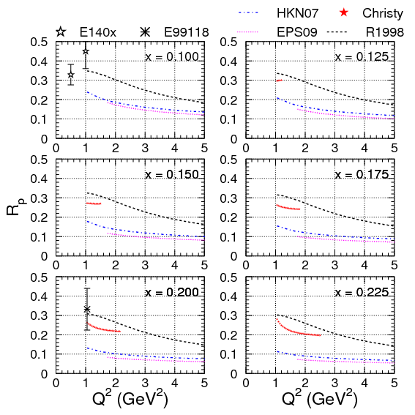
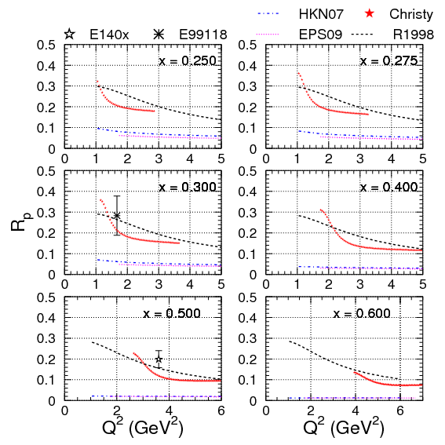
PR12-13-001: Q² Coverage for R_{p}
DIS world data on proton model-independent, dedicated L/Ts experiments: E140x (3) and E99-118 (2)
sporadic coverage in x; NO Q² coverage at fixed x
We would map both the x and Q² dependence of R_{p}
Systematic study of R_{D} - R_{p}
Provide constraints for PDF fits (gluon included): CTEQ-JLab Collaboration
19

Slide 20
PR12-13-001: x Coverage for R_{p} and R_{A} - R_{D}
We would map in detail the antishadowing and most of the EMC effect region to answer the fundamental question if and to what extent R is modified in nuclear medium
Offer experimental constraints on the interpretation of nuclear modifications observed in σ_{A}/σ_{D} in DIS
The wealth of high-precision data would/could also provide experimental constraints on PDFs (and nuclear modifications of PDFs)
F_{L}^{p :} ~50% contribution from gluon distributions at x = 0.1
Be, C, Cu, Ag, Au
20

Slide 21
Beam Time Request
We ask for a total of 34 PAC days
Only 9 PAC days will be spent at non-standard beam energies
21

Slide 22
Summary
We ask for a total of 34 PAC days to map in detail (both in x and Q²) the antishadowing and most of the EMC effect region with measurements of R to answer the fundamental question if and to what extent R = σ_{L}/σ_{T} is modified in nuclear medium
We will perform model-independent L/Ts on H, D, Be, C, Cu, Ag, Au and minimally model-dependent L/Ts (due to the large acceptance of Hall C spectrometers)
We will provide one of the most comprehensive, precise L/T data set on H and nuclear targets
Quote from Theory TAC for PR12-13-001:
“The L/T ratio of the nuclear DIS cross section is an essential input in the extraction of nuclear structure functions and the study of the nuclear modification of the quark-gluon structure of the free nucleon. The proposed experiment would cover both the antishadowing region … and the region of the EMC effect.
Understanding the physical mechanisms acting in both these regions represents a major challenge and is a central objective of the 12 GeV nuclear physics program.”
22

Slide 23
Backup
Structure functions
Nuclear dependence of R, experimental status: NMC, HERMES
Backup
R1990
Coulomb corrections
Why as many beam energies as possible?
Backgrounds and corrections
Systematics

Slide 24
Spin-Averaged Structure Functions
e
QED + QCD
W
Observables – cross sections:
p
e
M
Virtual photon:
longitudinally /transversely polarized
Model Parameters – Structure Functions:
purely transverse
purely longitudinal
F_{L} directly connected to gluons

Slide 25
ΔR: Model-Dependent Extractions
NMC: R_{Sn} - R_{C}
Nucl. Phys. B 481, 23 (1996)
3 muon beam energies but ΔR extracted using Q² dependent fit at fixed x
From published paper

Slide 26
ΔR: Model-Dependent Extractions
NMC: R_{Sn} - R_{C}
Nucl. Phys. B 481, 23 (1996)
From published paper
Fit results at fixed x (and running Q²)

Slide 27
ΔR: Model-Dependent Extractions
HERMES: ³He/D, N/D, Kr/D
Phys. Lett. B 567, 339 (2003)
1 beam energy
R_{A}/R_{D} extracted at fixed x by fitting the cross section ratio as a function of ε with R_{A}/R_{D} and F₂^{A}/F₂^{D} as free parameters under the assumption that:
Cross section ratio at fixed x, running Q² and ε
R_{A}/R_{D} and F₂^{A}/F₂^{D} are constant over the Q² range covered by the data

Slide 28
R1990: Model-Dependent Extraction
SLAC: Whitlow et al.
Phys. Lett. B 250 (1990)
Combined re-analysis of 8 SLAC experiments to extract R_{p}, R_{D} and R_{D} - R_{p}
The data from the other 7 experiments were normalized to E140 by fitting cross sections to a model with normalization factors as free parameters
The only L/T experiment (on D, Fe, Au)
The normalized cross sections were binned in intervals of x and Q² and a bin-centering corrections was applied (probably to extract R at FIXED x and Q²)
Note: R1998 included more data → E140x, NMC, CCFR, CDHSW

Slide 29
Coulomb Corrections
Slide from D. Gaskell

Slide 30
Coulomb Corrections
Slide from D. Gaskell

Slide 31
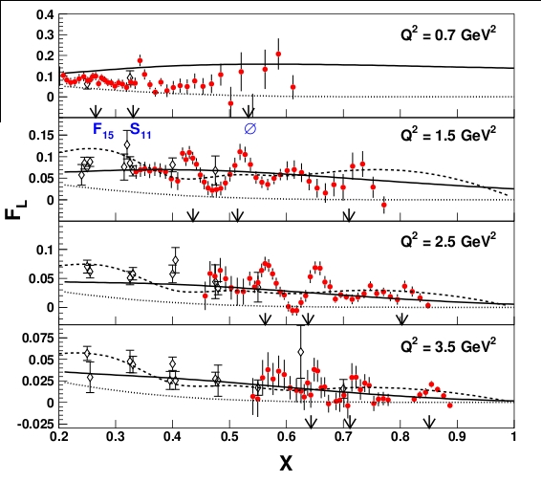
Why as Many Beam Energies as Possible?
E94-110 (Hall C)
Y. Liang, Ph.D. Thesis, Hampton 2002
MRST2004+TM
MRST2004
~ 200 individual L/T separations
one of the most precise L/T ever performed: it became a benchmark for this type of experiments
data have been since included in global fits of F₁, F_{L}, R, F₂ and used for F_{L} moments calculations
7 beam energies

Slide 32
Why as Many Beam Energies as Possible?
E94-110 (Hall C)
Y. Liang, Ph.D. Thesis, American University 2002
0 < ε < 0.34
sigma = 1.4869
err = 0.2789
7 (many) beam energies
many ε points
0.34 < ε < 0.67
sigma = 1.7281
err = 0.0829
It could be checked that the average deviation of the data used to perform the Rosenbluth L/Ts from the linear fit was consistent with the estimated point-to-point uncertainty of 1.6 %
0.67 < ε < 1
sigma = 1.5654
err = 0.0629
(σ_{data} – σ_{fit})*100/σ_{data} (%)

Slide 33
Why as Many Beam Energies as Possible?
PR12-13-001
Example:
Without non-standard beam energies: uncertainty on R extraction larger
Out of 27 central L/Ts, 10 have the lowest ε point provided by a 5.5 GeV beam energy

Slide 34
PR12-13-001: Backgrounds and Corrections
Radiative Corrections
the correction to the inelastic contribution is not as model sensitive as for the elastic and the Q-E case; the inelastic model can be improved via iterations

Slide 35
PR12-13-001: Backgrounds and Corrections
Charge-Symmetric Background
Where non-negligible it will be measured at the same kinematics and with the same spectrometer as the signal

Slide 36
PR12-13-001: Backgrounds and Corrections
Pion Background
Example: Hydrogen – largest π/e ratio of all targets
For very few kinematics p/e → (100:1 -- 200:1)
For most kinematics π/e < 10:1
With a 10⁻⁴ rejection factor → For most kinematics π contamination < 0.1 %

Slide 37
PR12-13-001: Backgrounds and Corrections
Coulomb Corrections

Slide 38
PR12-13-001: Rates
We adjusted the current to keep the detector rates below 600 kHz

Slide 39
PR12-13-001: Running Times per Target

Slide 40
PR12-13-001: Systematics
Table adapted from V. Tvaskis thesis (Hall C – E99-118, L/T experiment)

Slide 41
Systematics
Elastic data provide constraints on possible offsets in beam energy, scattered electron momentum and scattered electron angle
proton mass
Y. Liang, Ph.D. Thesis, American University 2002

Slide 42
Systematics: 2γ effects?
Two-photon exchange effects are investigated by looking for ε dependent non-linearities in existing Rosenbluth L/Ts
Rosenbluth L/Ts from SLAC E140

Slide 43
Systematics: 2γ effects?
Two-photon exchange effects are investigated by looking for ε dependent non-linearities in existing Rosenbluth L/Ts
(data – fit)/fit
No evidence of ε-dependent TPE is found

