Slide 1
Preliminary Application of Bayesian Inference in Accelerator Commissioning
Yue Hao
FRIB/NSCL

Slide 2
FRIB accelerator
FRIB is expected to deliver the largest ion beam power.
200 MeV Uranium
400 KW beam
High availability
Our efforts to achieve the goal:
Build reliable hardware and precise installation
Better model to describe and predict the machine
Effective Machine and personnel protection

Slide 3
How to control accelerator
Measurement, refinement
Machine
Model
Optimization, tuning
Measured data
Beam position, intensity, energy and loss count
Readback of settings
Environment data (temp, pressure, vacuum, etc)
Physics Model
Parameters in Model:
Beam parameters
Element locations
Machine settings
E-/B- Field Profiles
Data based Model

Slide 4
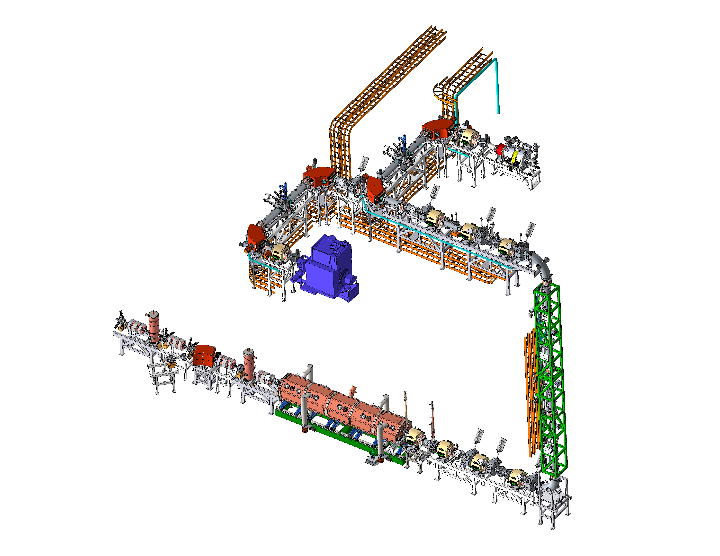
Test of Applying Bayesian Inference
Motivation:
  Some parameters in accelerator can not be measured directly
  These parameter can be used in accelerator model to predict the machine
  This can be done with fitting the model to the measurement data using optimizers.
    Only results are given, how reliable?
    Prone to be have local minimum problem
    Hard to scale to high dimensional problem
    Depend on the definition of the penalty function
Expectations from Bayesian method
  Provide statistics information on reliability
  Better scaling to high dimensional problem
  Less local minimum problem
  Suggest the future experiment
FRIB Front-End

Slide 5
The Problem to Solve
The accelerator model starts at the exit of the ion source. The description of initial beam is hard to measure directly.
The linear accelerator model need the following matrix to describe the beam property in (x, x’, y, y’) phase space, which contains 10 free parameters.
In common accelerator language, we rewrite as:

Slide 6

The Problem to Solve, cont’d
We have to determine these 10 parameters using sets of measurements.
The machine settings V=(v₁, v₂, …, v_{n}) are varied in the measurement and the beam profile (second order moments) are recorded by the profile monitor. In each machine setting, three observables are recorded:
Model
Machine
Bayesian Theorem

Slide 7
The Problem to Solve, cont’d
The likelihood
The prior
Uniform / Gaussian / beta prime distributions
We implement the Metropolis-Hasting method in Python to sample the posterior distribution.
The in-house linear model, FLAME, as the accelerator model. The linear model is fast enough to get converge result in ~10³ seconds on laptop.
Challenge: The quality of data mixed with the quality of the model.

Slide 8
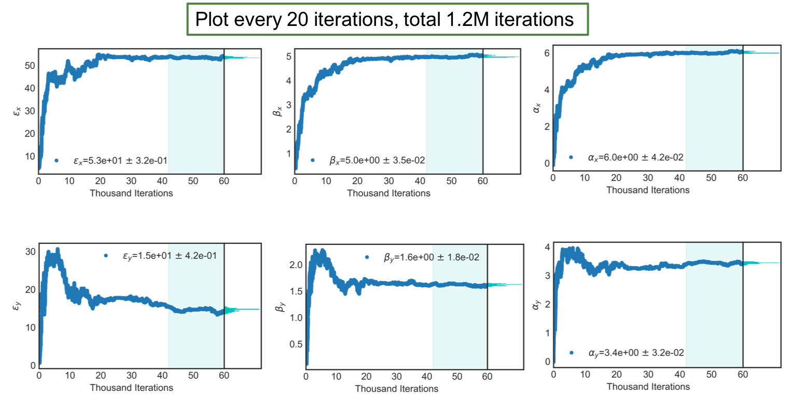
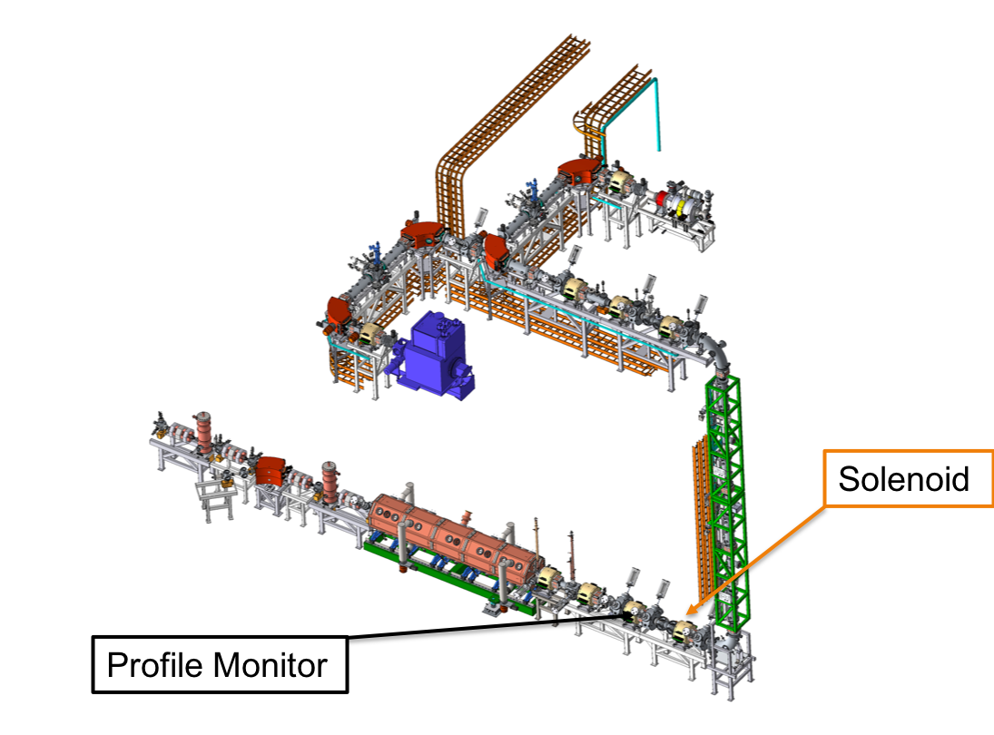
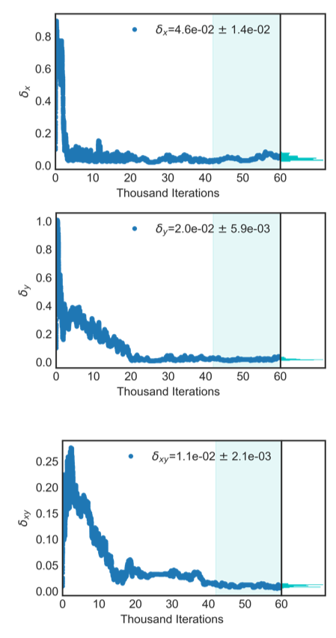
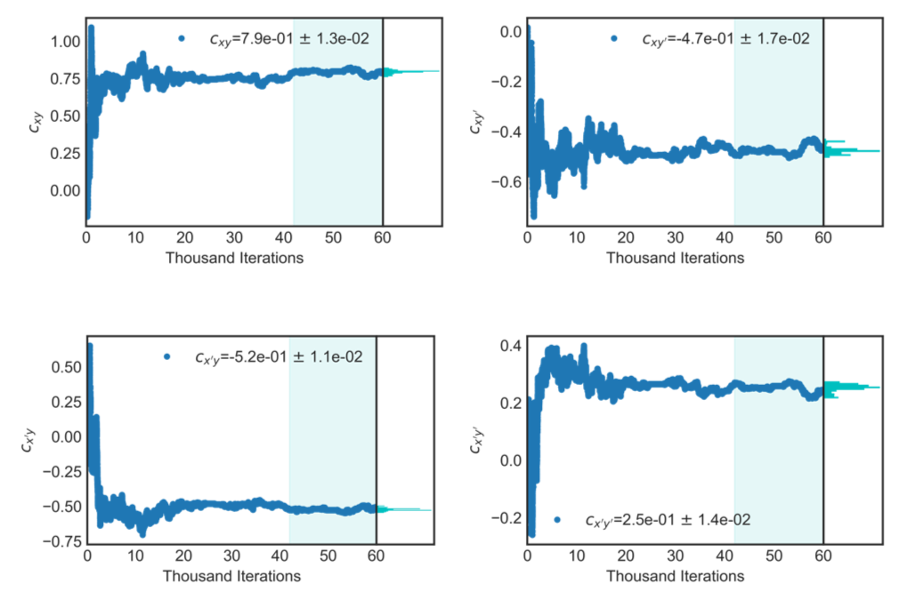
Solenoid Scan Example

Slide 9
Results
 | emit_x [mm-mrad] | β_{x} [m] | ⍺_{x} | emit_y [mm-mrad] | β_{y} [m] | ⍺_{y} | C_{xy} | C_{xy’} | C_{x’y} | C_{x’y’}
Bayesian | 0.27 | 4.99 | 6.01 | 0.074 | 1.62 | 3.44 | 0.79 | -0.47 | -0.52 | 0.25

Slide 10
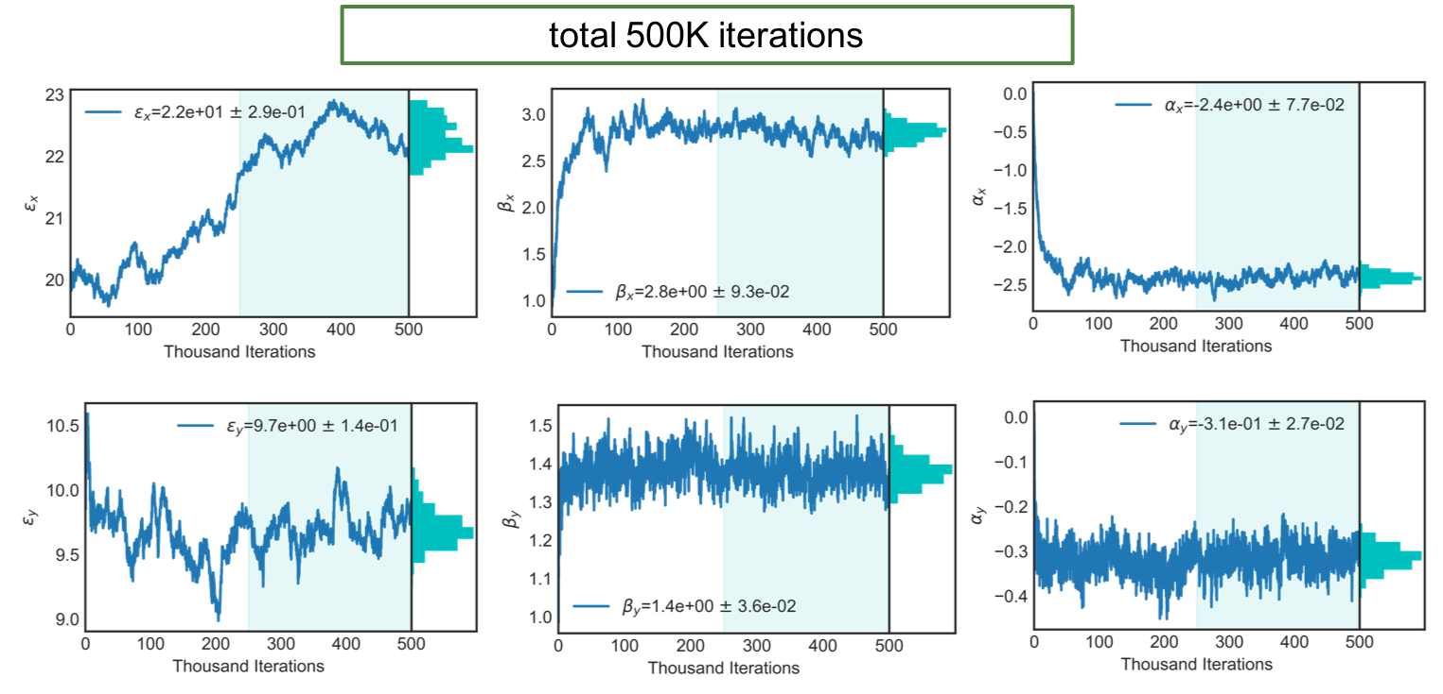
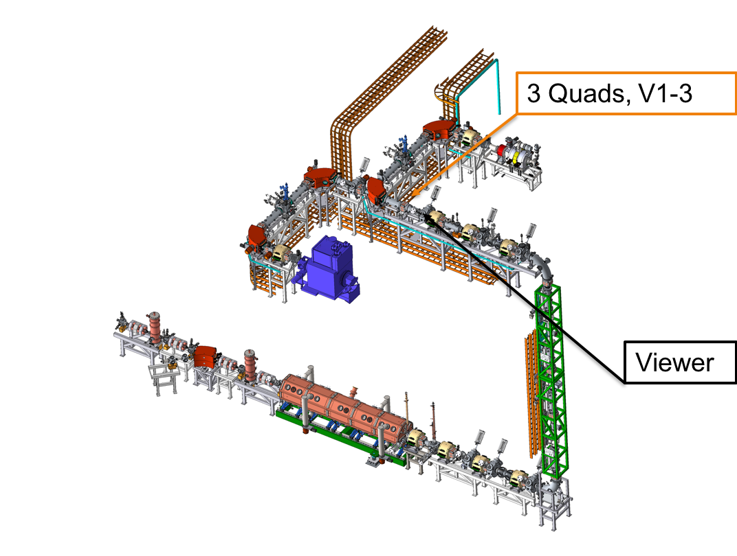
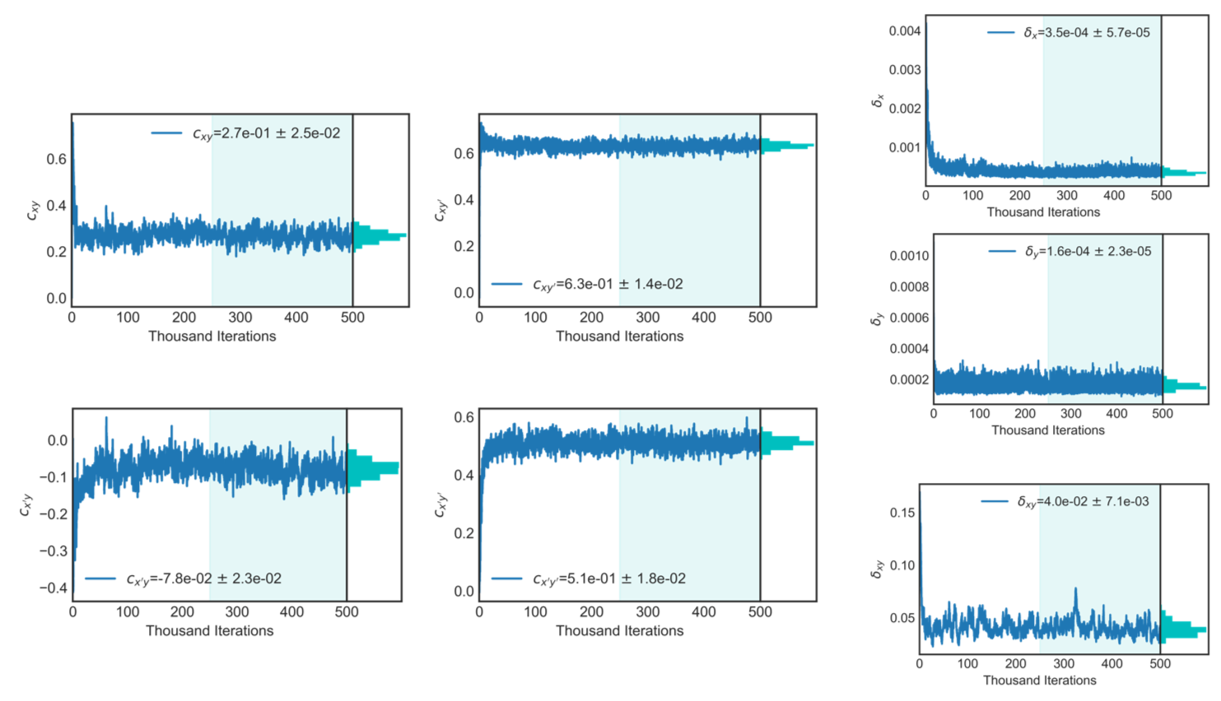
Quadrupole Scan Example

Slide 11
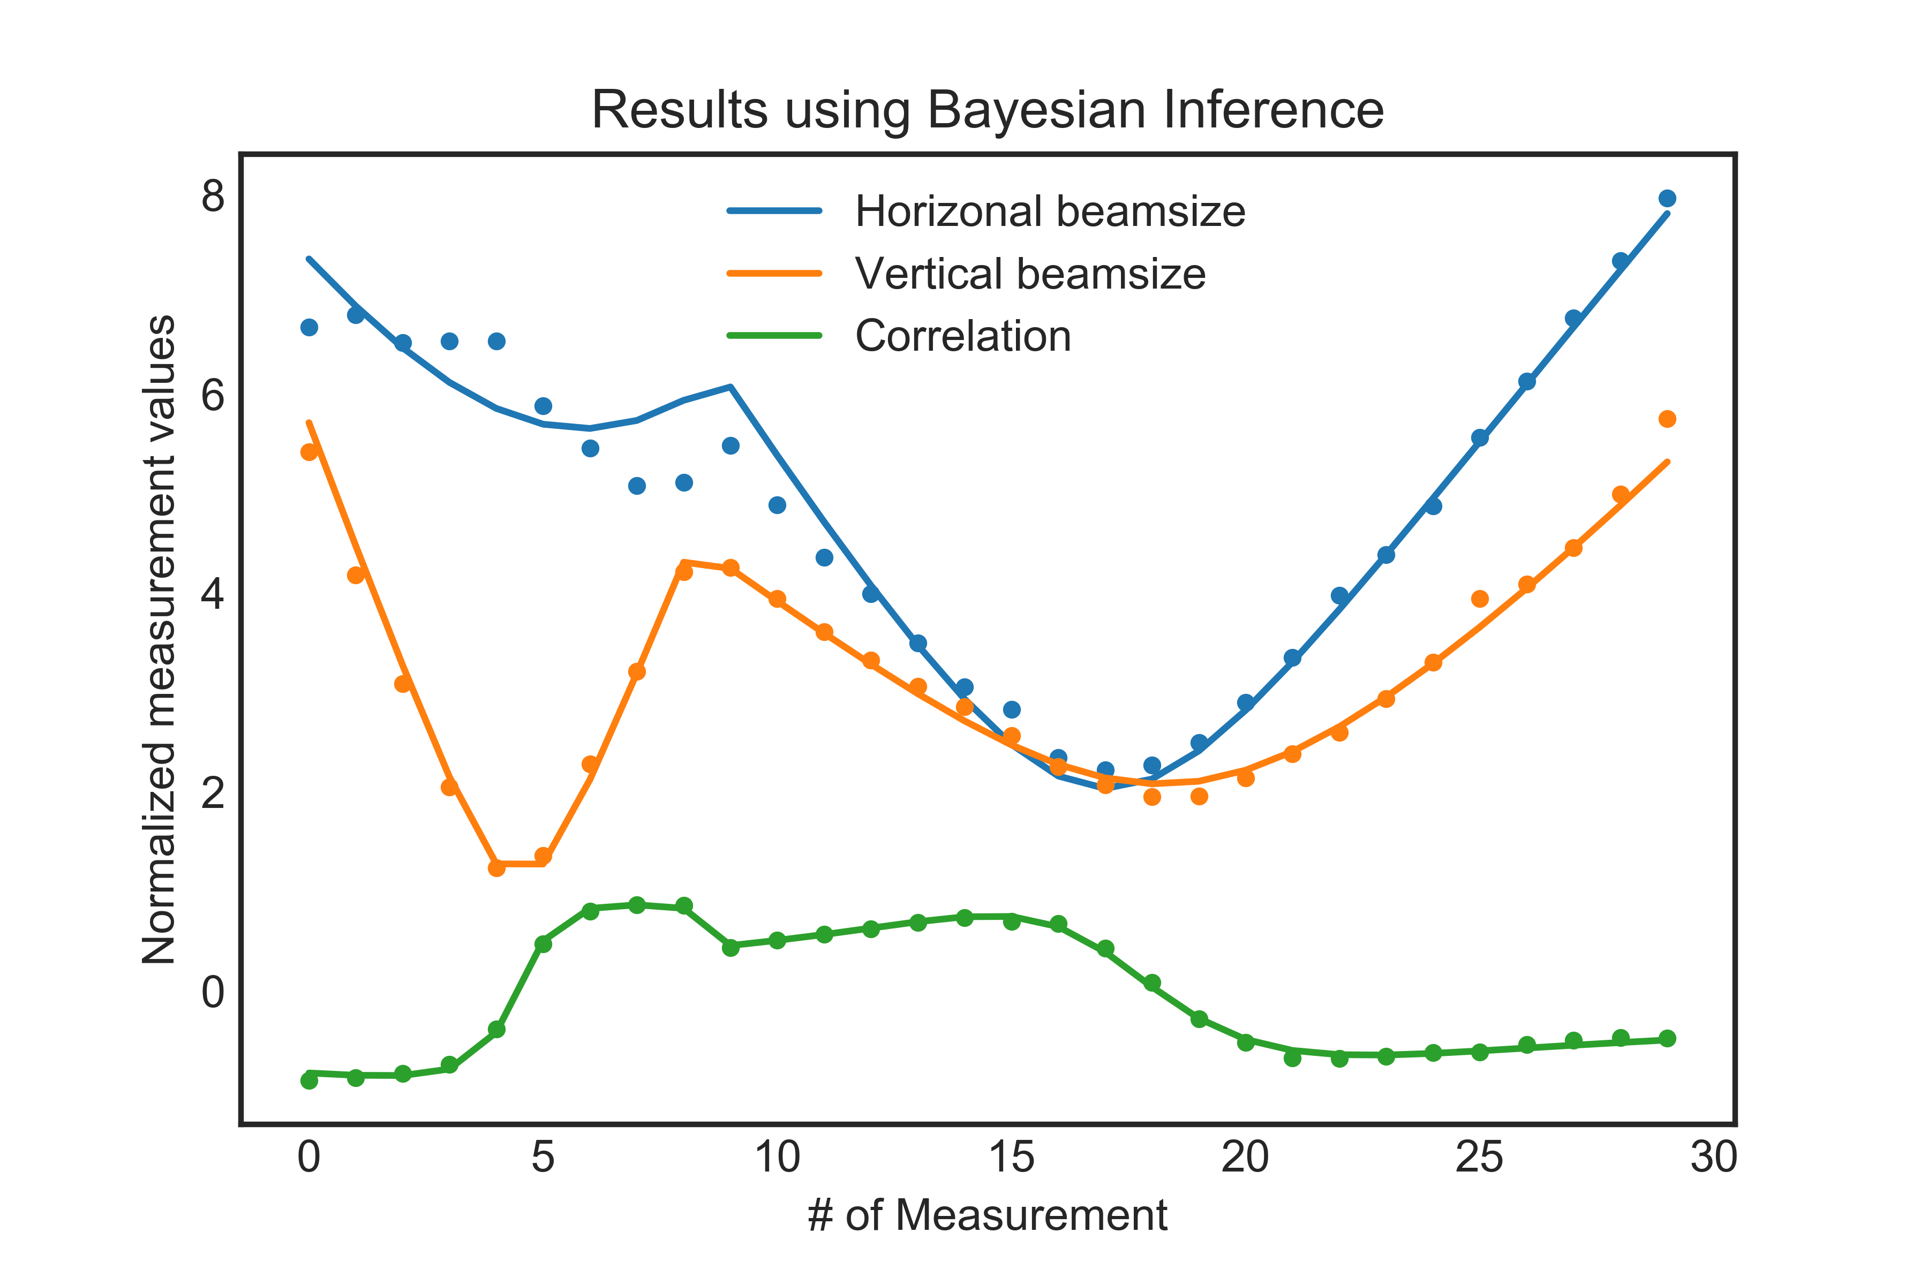
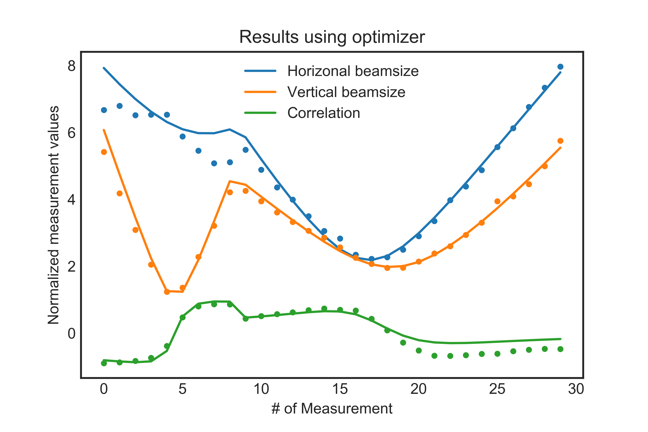
Quad Scan, Result Comparison
 | emit_x [mm-mrad] | β_{x} [m] | ⍺_{x} | emit_y [mm-mrad] | β_{y} [m] | ⍺_{y} | C_{xy} | C_{xy’} | C_{x’y} | C_{x’y’}
Bayesian | 0.104 | 2.76 | -2.38 | 0.049 | 1.37 | -0.31 | 0.26 | 0.63 | -0.08 | 0.51
Optimizer | 0.119 | 2.76 | -2.26 | 0.05 | 1.51 | -0.42 | 0.34 | 0.26 | -0.06 | 0.01

Slide 12
95% Confidence Interval
@ Olivier Coudray, Clément Mantoux

Slide 13
Future Work based on Model Inference
We have to go far beyond the simple examples to make it useful in FRIB.
Involving larger amount of data and higher dimension.
  If we take more measurement at different location, the result solenoid scan can be very different and does not have the suspicious behavior.
  Can we get the indication of ‘more measurement needed’ from inference procedure?
  It seems that the convergence is harder to achieve in this example. An indicator?
Deal with the difference between the model and machine
  We infer the best parameter of the linear model
  Model can not handle all situations by simply adjusting parameter.
  The difference will be modeled by Gaussian Process.
  Comparison of ‘Gaussian Process only’ and ‘Model + Gaussian Process’

Slide 14
Data Driven Models
Beyond the particle motion, described by Maxwell Equation, we don’t have very precise/quick models to predict the data.
Modern accelerators with high speed interlink/network usually store gigantic amount of data of very high number of dimensions.
The performance of the accelerator, on the contrary, are evaluated with small amount of parameters
  Beam energy and its stability
  Beam power and its stability
  Radiation and beam loss control
  Machine availability
We plan to study the data driven model to predict the machine behavior and increase the performance.

Slide 15
Acknowledgements
We thank Dr. Léo Neufcourt for his kind help in Bayesian Inference and Olivier Coudray, Clément Mantoux for independent check of the examples during their summer program at MSU.
We also would like to thank Dr. Tomofumi Maruta and Dr. Takashi Yoshimoto in Accelerator Physics Department of FRIB/NSCL for their measurement data and fitting results.

