Slide 1

A.I. for Nuclear Physics
Accelerator Science and Operations

Slide 2
Welcome!
Introductions
Goals and tasks of the working group
Outline of the next 2 days
Present templates

Slide 3
Goals and tasks
“Report that reflects the status of A.I. applications to key NP scientific research challenges and outlining steps towards a future. To the extent possible, the report should outline priority research directions (PRD) for the future—and those PRDs may well require cross disciplinary teams to achieve.”
Challenge Areas include:
  Data management and curation considerations.
  Collaboration with Industry, Academia
  Statistical techniques
  Common A.I. Frameworks in use
  Computing/storage resources
  Workforce development
Can we identify grand challenges?
Can we identify cross-cutting areas?

Slide 4
Wednesday, 4 March
14:10 - 15:45 Accelerator Science
15:45 - 16:00 Break
16:00 - 17:15 Algorithms
17:15 - 17:30 Recap

Slide 5
Thursday, 5 March
14:00 - 15:30 Accelerator systems operations
15:30 - 15:45 Break
15:45 - 16:30 Data handling and hardware implementations

Slide 7
Wednesday, Accelerator Science
Accelerator Science and discovery
  "Experiments on Improving Cooling Results in the LEReC system using Machine Learning Techniques”, Yuan Gao (BNL)
  Symmetries and correlated parameters
Optics and lattice design, optimization
  “Bayes analysis of beamline optimization” (Hao, MSU)
  Linac, ring specific issues; instabilities, damping, cooling
  Injectors
  Surrogate models (digital twins)
  Virtual beam diagnostics in design
Beam instrumentation design and optimization
  “EM structure optimization”, Mustapha (ANL)
  BPM geometric response function
Reinforcement Learning for Controls
  “Deep reinforcement learning for accelerator control, etc.”, Schram (PNNL)
  RL workflow and considerations
  ASCR ExaLearn efforts for scaling RL

Slide 8
Wednesday, Algorithms
Algorithm discussion
  What are people using and what issues are they having? What successes?
  Supervised and unsupervised learning tools
    Autoencoder, GANs,
    Classification, clustering, PCA
    UQ, Gaussian processes
  Deep reinforcement learning for design and control
  Physics Informed ML
  Areas of application
  Tradeoffs and complementarity

Slide 9
Thursday, Operations
Linac, ring specific issues
  "Online Optimization Strategies at the Argonne Wakefield Accelerator", Ryan Roussel (ANL)
  ALS example
  Transport lines - frag sep, final focus
  Incorporation of ML training with on-line FB/FF
Injectors
Virtual diagnostics in operations
Beam losses and machine protection
  “PCA analysis for beam losses”, Lidia (MSU)
LLRF
  “LLRF monitoring”, Tennant (JLAB)
Target, charge stripper, collimation systems
  SNS example
Anomaly detection
Other operational aspects
  Cryoplant - helium monitoring

Slide 10
Thursday, Data
Data streams, interaction with controls and operations, online learning systems
Data volume, samples, and frequency
Design of archive data structures for efficient ML and data mining
Hardware implementations for AI/ML

Slide 12
ESS Activities (from A. Jansson)
Harmonize the data structure for collected data to facilitate data analysis
Proposal in process to apply ML in FPGA hardware

Slide 13
AI/ML Activities at SNS (W. Blokland)
In progress/done
Machine Learning Workshop at SNS (Program development 2018)
Errant beam (since 2013). (https://www.sciencedirect.com/science/article/pii/S0168900219315189)
Electron scanner image analysis
Target Analysis
Smart control of sampling in high dimensional scans
Beam-based prediction of errant beam pulse and identification of failing equipment
Planned/Proposed
Non-beam-based health monitoring and failure prediction of critical hardware - HVCM, magnet power supply
Model-independent beam loss reduction methods
Interpolation of high dimensional beam phase space data
SNS Target Damage
ML control of for real-time beam impedance compensation of RF cavities
ML assisted analysis of cryogenic moderator system

Slide 14
SNS Target (W. Blokland)
1) to see what is going inside the target (Use any measurements even ones that seem unrelated but nearby)
2) improve the simulation (including to predict cavitation damage)
3) improve the cooling system feedback and/or diagnostics (we had problems with loosing cooling capability)
The target group is focusing on using ML and HPC to improve the target simulation so that one will go ahead and hopefully also drive the target strain measurements study.

Slide 15
Artificial intelligence (AI)-based monitoring of helium inventories in particle accelerators for early leak detection
Systematic segregation and continuous monitoring of the helium inventories in an accelerator facility can be used for inventory data collection and is extremely useful in detecting operational leaks [2].
It is important to quickly detect the leak so that measures can be taken to stop, or at least mitigate the leak. Presently, this requires persistent and regular involvement with careful analyses from skilled human operators to properly access these helium inventories and identify potential leaks. Not only are the systems physically large and complex, but the ambient environment and the process-operating conditions are continuously changing, which must be accounted for in assessing the helium inventory.
An online helium inventory monitoring system trained with a supervised machine learning technique can help to timely identify the leakage in the inventory.
It could be trained to distinguish between intended and unintended consumption, such as liquid filling at a user load vs venting to atmosphere through a pressure relief devices.
It could also be trained to account for the changes in the environment and process-operating conditions and provide early warning to operators to initiate the detection and mitigation.
Moreover, it can be trained to monitor the long-term operational inventory data to forecast operational expenses and to detect the major areas responsible for helium loss so that operators can make plans that require downtime and modifications.
Early leak detection using an AI-based monitoring system has the potential to reduce the annum helium leak by at least 50% and save substantial operating cost, which is a major portion of the operating cost of present accelerator facilities.
[1] Hamak, J. E., 2015, "Minerals Handbook," United States Geological Survey.
[2] Hasan, N., Knudsen, P., and Wright, M., 2017, "Online helium inventory monitoring of JLab cryogenic systems," IOP Conference Series: Materials Science and Engineering, 278, p. 012113.
(P. Knudsen, MSU)

Slide 16
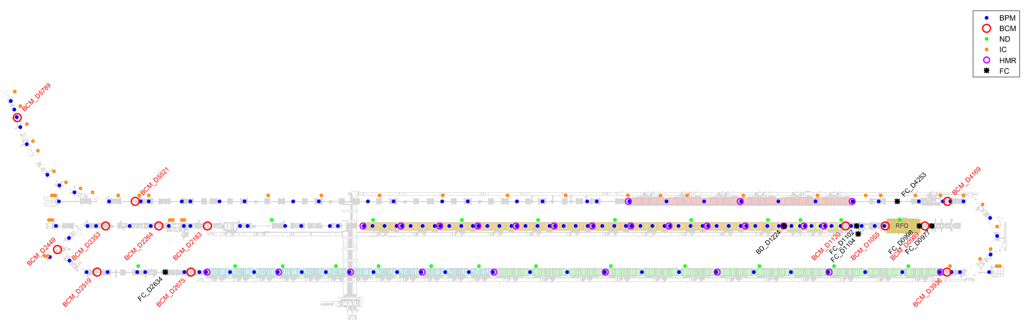
Identifying Sources of Beam Loss
Beam Loss Monitors form a network to monitor beamlines for particle interception
The BLM network has functions: fault detection and fault diagnosis
Fault detection requires BLMs:
  Fast response for acute losses
  Location near sensitive components
  Located at ‘critical positions’ to trigger Machine Protection response
Fault diagnosis requires BLMs:
  Sensitive to diagnose chronic losses and beam tuning errors
  Ability to differentiate between controlled and uncontrolled losses
  Located at ‘discrimination points’ to differentiate spatial loss patterns
We look to answer two questions:
Do we have sufficient detectors in the correct places to catch all events?
Can we use pattern recognition with loss distribution to identify specific failures?
Schematic of FRIB linac with loss sensitive monitors indicated

Slide 17
Determining Critical Positions (CPs)
Study correlations
  Define critical positions by quantifying BLM positions against specific fault modes resulting in losses
IMPACT simulations were generated in each case
  332 cavity faults generate 241 loss distributions
  69 solenoids each generate losses
  Each accelerator element is a loss monitor (as far as IMPACT is concerned) – 572 elements
(Z. Liu, et al., IPAC 2015, TUAC3, p.1356)

Slide 18
Use correlations to identify points of high sensitivity
Reduces required number of BLMs
Calculate correlation. Filter for abs(R) > 0.45
Single-cavity failure
We can identify localized loss areas (outlined regions) that reduce required number of monitors (for this failure mode).
Analyze events to determine if Critical Position network observes all events.
→ Network completeness with ~7 monitors!

Slide 19
Use PCA to find Discrimination Points
Maximizes variation between patterns
PCA finds linear combinations of elements to diagonalize the space, remove degeneracies
Use PCA on single-cavity failure loss matrix, X_{572x241}
  Dramatic reduction in dimensionality! 572 -> 1,2 !
Pattern recognition problem
  Finds ‘significant features’ for each fault mode
  Differentiates ‘distinctive features’ between fault modes

Slide 21
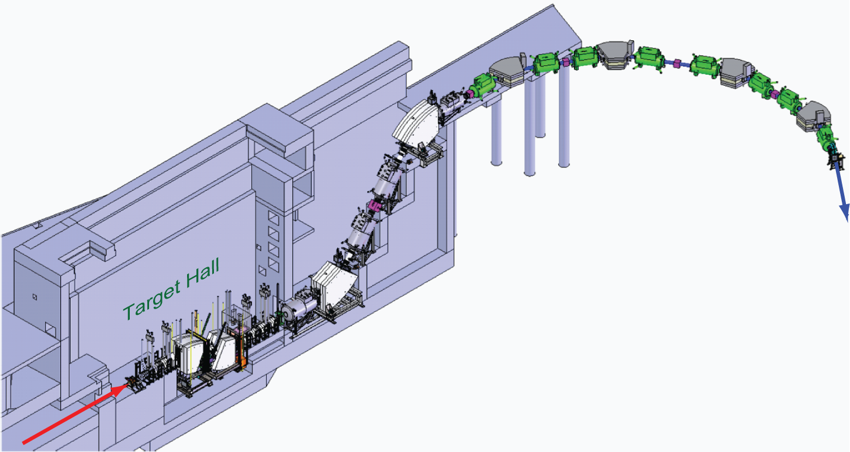
Overview of FRIB Fragment Separator
Second and Third Stage
Preseparator
Beam to
experiments
Wedge/degrader #1
Beam dump
Production target
Beam from driver linac

Slide 22
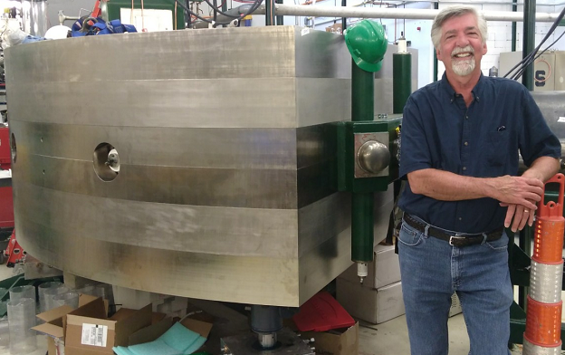
Fragment Separator Dipoles
A1900 Dipoles:
Up to 6.5 Tm
Bend radius ~3.1 m
Bend angle 45 °
Made from steel slabs
Magnetic fields settle slowly; hysteresis has to be carefully managed.
Field matching alone is not sufficient to control beam position --
the error is large enough to degrade transmission or even select wrong isotope.
Mitigation: Always approach from high field.

Slide 23
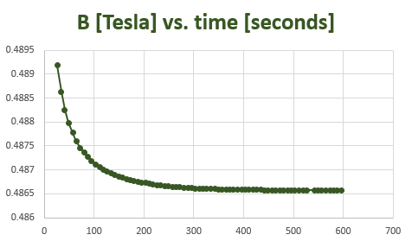
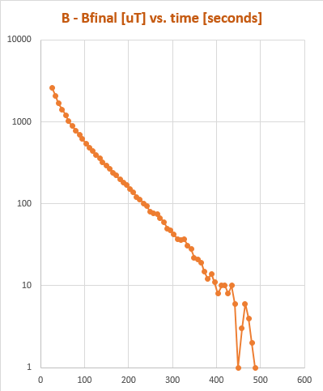
A1900 Dipoles take long time to ramp and a long time to settle.
Rigidity: 1.5 Tm

Slide 24
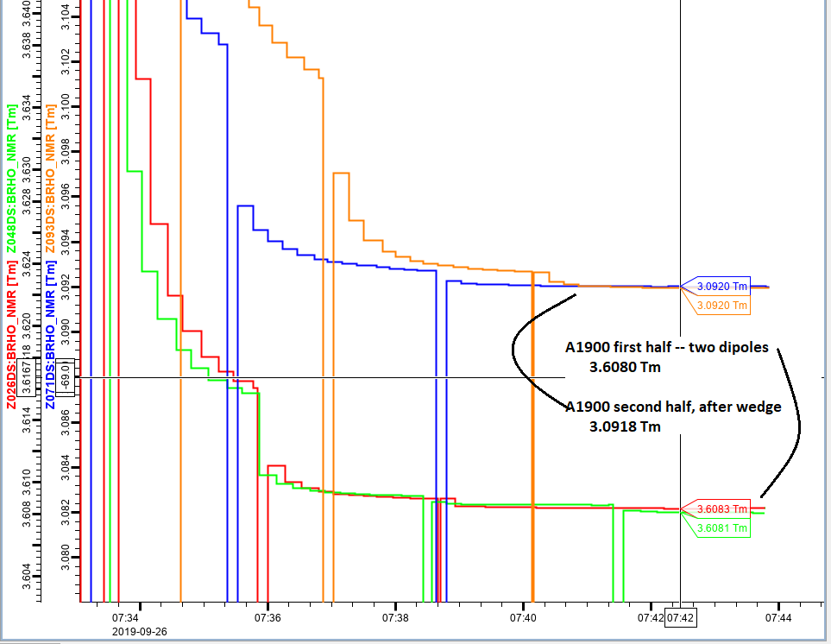
Dialing in Br-85 (35+) 75.3 MeV/nucleon
Observing the behavior of B(t) and predicting
the outcome by fitting lets us save time when setting up the separator.
At low fields, this simple method breaks down, as the B(t) is no longer a simple exponential. Machine Learning could provide the solution.

Slide 25
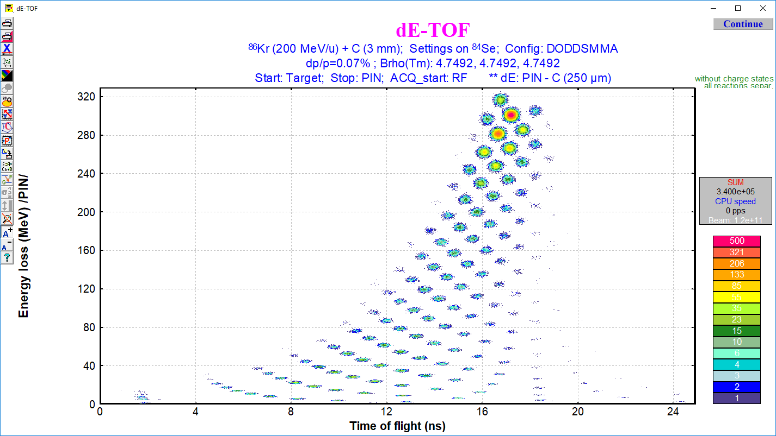
Particle ID, Idealized Situation
Simulated particle-ID spectrum: pattern gives unambiguous ID
  This simulation with (1) zero bunch length, (2) very good TOF resolution, (3) no charge states,
  (4) 0.5% energy resolution in detectors
⁸³Se
⁸⁵Se
Simulations with LISE⁺⁺
(lise.nscl.msu.edu)
⁸⁴Se
N=Z+16
A/Q = 2
A/Q = 7/3
Z=21
N=Z+7

Slide 26

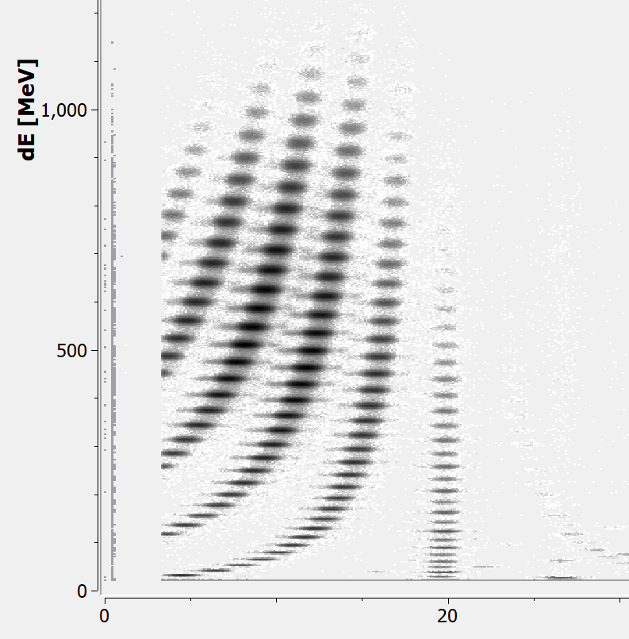
Computer-aided particle ID for the NSCL/FRIB fragment separator
For illustration: actual data time-of-flight / energy loss data. (RF: time info, Si-det: dE)
⁹²Mo → ⁷⁵Sr
Problem: where is the particle of interest, here ⁷⁵Sr?
Currently: use known features:
E.g. Z=const line, a*N=b*Z + c lines
Work out (Z,A) from spacing between isotopes and
E-loss formula (E. Kwan)
Count your way to the region of interest …
And there it is. Sometimes tedious, but it works.
N=Z
N=Z+1
This is an easy case for illustration …
In many cases correct ID can take time:
Less statistics, more exotic species, ambiguities
from charge states and experimental conditions
Significance?
Every beam to user at NSCL/FRIB runs through the
fragment separator - correct ID is essential and
fast ID will give more beam time to users
Z=const
TOF [us]

Slide 27
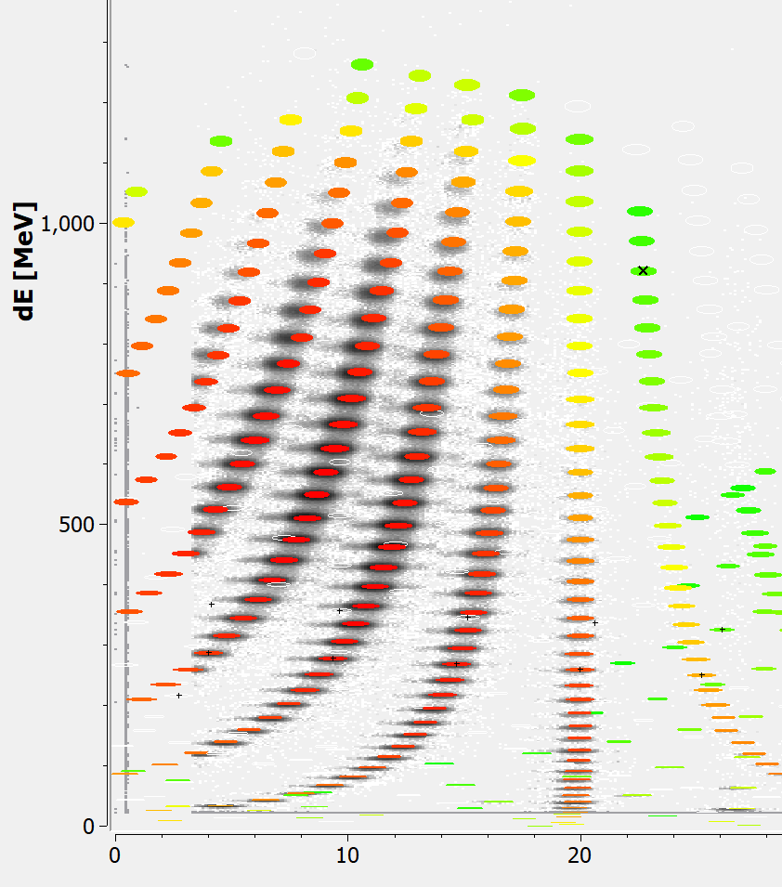
Computer-aided particle ID for the NSCL/FRIB fragment separator
How to simplify and speed up the process?
1 Overlay calculated spectra onto data,
here LISE++ output, but could also use dE formula directly
- Shift pattern around to account for offsets in
dE-dt calibration, apply dE-scaling.
At this moment: visual tool to complement traditional method
2 Automate process
Fit calculated global pattern to data, use to predict
sparsely populated areas
Conceptually not different from image-matching?
Validation:
Match experimental data!
Status:
Starting – gathering information on our end!
Collaborators: Thanks to the NSCL beam physics group,
in particular M. Steiner, C. Sumithrarachchi, E. Kwan, T. Ginter
TOF [us]

Slide 29
Grand Challenges and Opportunities
Optimized design of linacs, synchrotrons, transport lines
  ML techniques applied to 6D phase space evolution and equilibria (higher dimensional frequency maps, beam-beam)
  Development and validation of virtual diagnostics (eg. long. phase space)
  Optimized diagnostic deployment
Improving facility performance and user experience
  Data driven beam generation, transport, delivery optimization
    Automated learning for operator support
  Beam loss correlation studies
  Anomaly detection and mitigation (eg. LLRF, beam diagnostics)
  System health monitoring (eg. targets, cryoplant)
Create/deploy data standards for integration to ML workflows (big, small)
Benchmark techniques on standard models; dedicated accelerator studies
  Dedicated machines, diagnostics?

