Slide 1
Nuclear Physics and AI
AI for Nuclear Physics Workshop, March 4-6, 2020

Slide 2
Office of Science FY 2021 Continuing Research Initiatives
  Machine Learning/Artificial Intelligence
  Bio (security, materials, manufacturing)
  Quantum Information Science - includes quantum sensing, computing, networking, and isotope production
  Exascale Computing
  Microelectronics Innovation
  National Isotopes Strategy
  U.S. Fusion Program Acceleration
AI for Nuclear Physics
March 4-6, 2019
2
Notes:
N8F POM-10 ISPP
2

Slide 3
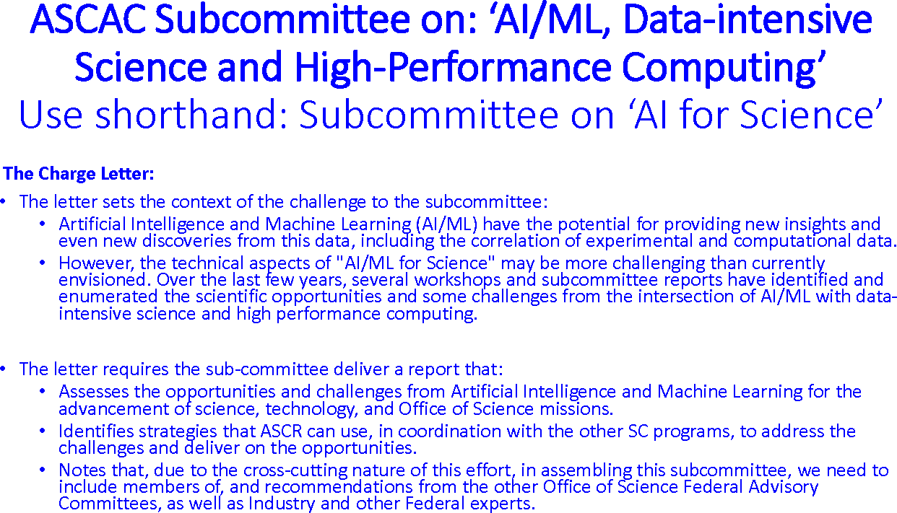
Action to Address AI/ML Priority Initiative

Slide 4
Action to Address AI/ML Priority Initiative

Slide 6
AI for Nuclear Physics
March 4-6, 2019

Slide 7
Office of Science - FY 2021 Research Initiatives
Dollars in Thousands
A cross-program FOA (Lab call) for AI/ML proposals is being developed now.
AI for Nuclear Physics
March 4-6, 2019
Notes:
N8F POM-10 ISPP
7

Slide 8

The 2015 Long Range Plan for Nuclear Science
Recommendations:
Capitalize on investments made to maintain U.S. leadership in nuclear science.
Develop and deploy a U.S.-led ton-scale neutrino-less double beta decay experiment.
Construct a high-energy high-luminosity polarized electron-ion collider (EIC) as the highest priority for new construction following the completion of FRIB.
Increase investment in small-scale and mid-scale projects and initiatives that enable forefront research at universities and laboratories.
All Top Priorities of the 2015 Long Range Plan Can Benefit from AI/ML
AI for Nuclear Physics
March 4-6, 2019

Slide 9
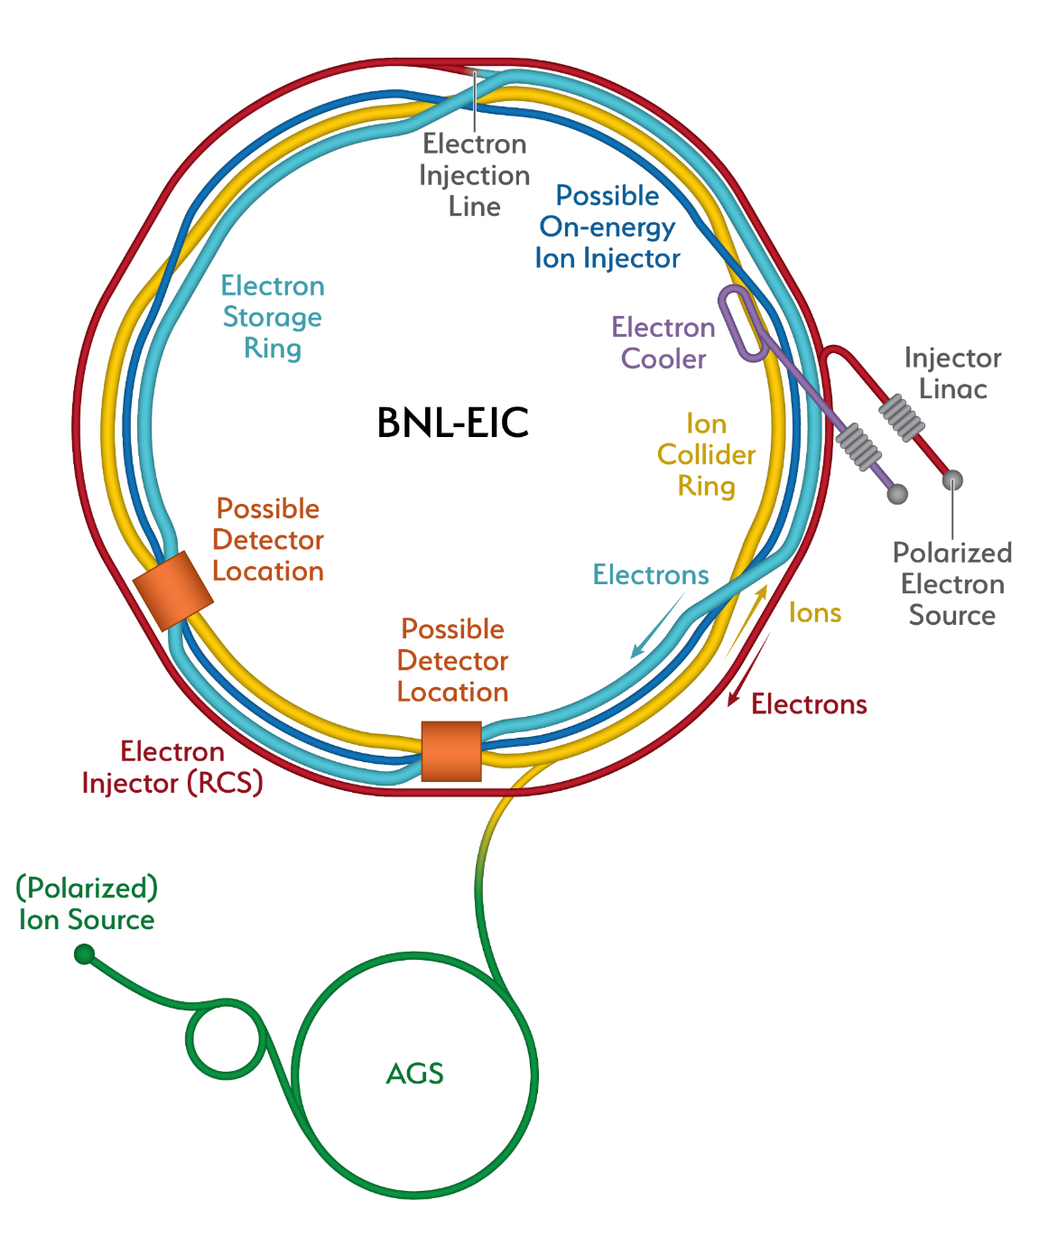
EIC Receives CD0
An SC Prime Directive: The Project will be carried out as a full intellectual partnership between the BNL and JLAB teams (and other collaborators) with major participation by all
TPC range of EIC is $1.6B – $2.6B; complete early next decade
TPC and completion of project dependent upon congressional appropriation and final agreed upon scope when baselined
Magnitude of reprioritized funds ranges from ~$0.6B – $1.2B over the lifetime of the project.
Reprioritization of activities towards the EIC also decreases the amount of new funding required
The EIC could be implemented with caps on amount of new funds needed on an annual basis and still be implemented successfully and in a timely manner.
EIC
AI for Nuclear Physics
March 4-6, 2019

Slide 10
A primary focus for developing the enormous potential of AI/ML in Nuclear Physics is optimizing the control and operation of complex accelerators
-- Work already being pioneered on CEBAF !

Slide 11
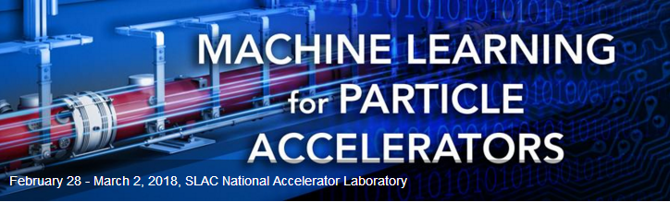
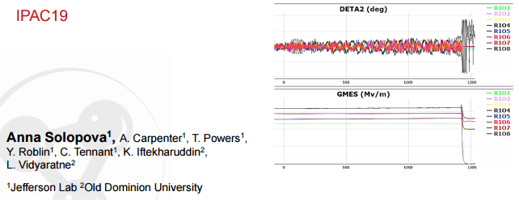
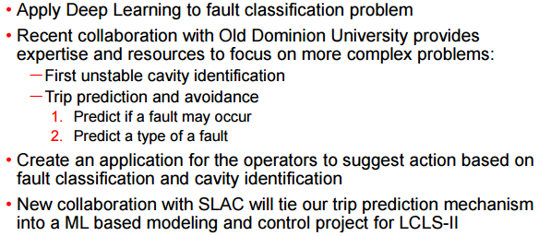
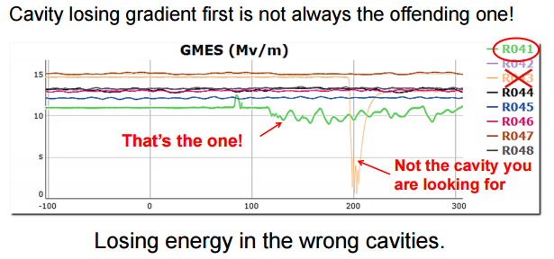
Machine Learning for Particle Accelerators
Intersections between real-time machine learning, control and optimization of complex systems
ML-based solutions to challenges encountered in particle accelerators are now under development and yielding promising results.
Anomaly detection and machine protection:
https://conf.slac.stanford.edu/icfa-ml-2018
SRF Cavity Fault Classification Using Machine Learning at CEBAF at Jefferson Laboratory
10th International Particle Accelerator Conference (IPAC19)
https://ipac19.org
AI for Nuclear Physics
March 4-6, 2019

Slide 12
Office of Science FY 2021 New Research Initiatives
Integrated Computational and Data Infrastructure for Scientific Discovery: Design and deploy a flexible multi-tiers data and computational management architecture that enables a diverse array of on-demand scientific workflows and simulations for SC mission research.
Next Generation Biology Initiative: Support research in areas of neuromorphic computing, programmable biomaterials and biocatalysts, and next-generation tools for characterization of biological, biomaterials, and biohybrid systems.
Rare Earth/Separation Science Initiative: Understanding the fundamentals of rare earth properties; enhancing separations and chemical processing for rare earths.
Revolutionizing Polymer Upcycling: Elucidating the chemical and biological pathways for transforming polymers and synthesizing high-value chemicals or new polymers.
Strategic Accelerator Technology Initiative: Support investments in accelerator technologies, advanced magnet Revolutionary Light Sources. AI for controls ?
Data and Computational Collaboration with NIH: Support DOE laboratories in partnership with NIH to expand the capabilities of DOE’s tools and address NIH’s rapidly growing data and computational challenges.
AI for Nuclear Physics
March 4-6, 2019

Slide 13
The Use of AI to Detect Complex Signatures in Discovery Science
AI for Nuclear Physics
March 4-6, 2019

Slide 14
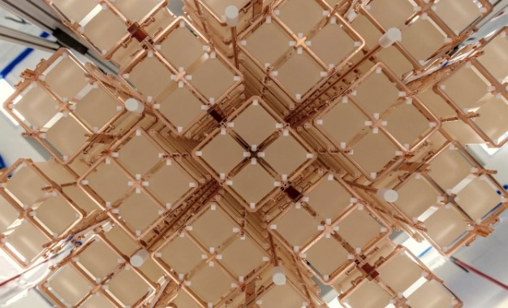
The Campaign to Determine the Fundamental Nature of the Neutrino
How can it be determined whether the neutrino is a Majorana Particle?
Search for Neutrino-less Double Beta Decay (0νββ ): in a selected nucleus, two neutrons decay into two protons and two electrons, with no neutrinos being emitted.
Scientists have been eagerly working to demonstrate the necessary sensitivity
TeO₂ Crystals from CUORE
TeO₂ from CUORE and CUOREcino
1.5 × 10²⁵ years, 90% CL
Ge⁷⁶ from Majorana Demonstrator
1.9 × 10²⁵ years, 90% CL
Ge⁷⁶ from GERDA
8.0 × 10²⁵ years, 90% CL
Xe¹³⁶ from EXO-200
1.8 × 10²⁵ years, 90% CL
Xe¹³⁶ from Kamland-Zen
1.1 × 10²⁶ years, 90% CL
It can only happen if the two neutrinos from the two W⁻ particles annihilate internally because the neutrino is its own anti-particle
FY 2020 Enacted: $1M
FY 2021 Request: $1.44M
AI for Nuclear Physics
March 4-6, 2019

Slide 15
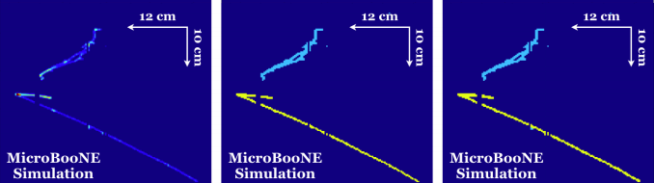
Convolutional Neural Networks (CNNs) search for neutrino events
Micro Booster Neutrino Experiment (MicroBooNE) is the first large liquid-argon time projection chamber (LArTPC) located at the Fermi National Accelerator Facility to acquire a high statistics sample of neutrino beam interactions. Among its science objectives, researchers can measure the elastic scattering cross section ratio σ(ν_{μ}p→ν_{μ}p)/σ(ν_{μ}n→μ–p). When combined with polarized electron-proton/deuterium cross section measurements, this ratio allows a determination of Δs, the fraction of the nucleon spin carried by strange quarks. Dark matter searches also require better knowledge of Δs, with the current uncertainty on this quantity limiting the sensitivity of many such searches.
Nuclear physicist Samantha Sword-Fehlberg at New Mexico State University is developing one of the most sophisticated processing programs for neutrino experiments using CNNs capable of semantic segmentation (3D-Mask R-CNN) . She is teaching the computer to sift through the thousands of interactions that occur every day and create 3-D images of the most interesting ones.
Event displays of νµ interactions. The left column images are inputs to the network. The middle column shows labeled images based on simulation information. Track pixels are masked in yellow and shower pixels are in cyan. The right column shows the output of the network.
https://arxiv.org/pdf/1808.07269.pdf
AI for Nuclear Physics
March 4-6, 2019
Notes:
CNN is a multi-layered neural network with a unique architecture designed to extract increasingly complex features of the data. CNN's are well suited for perceptual tasks.

Slide 16
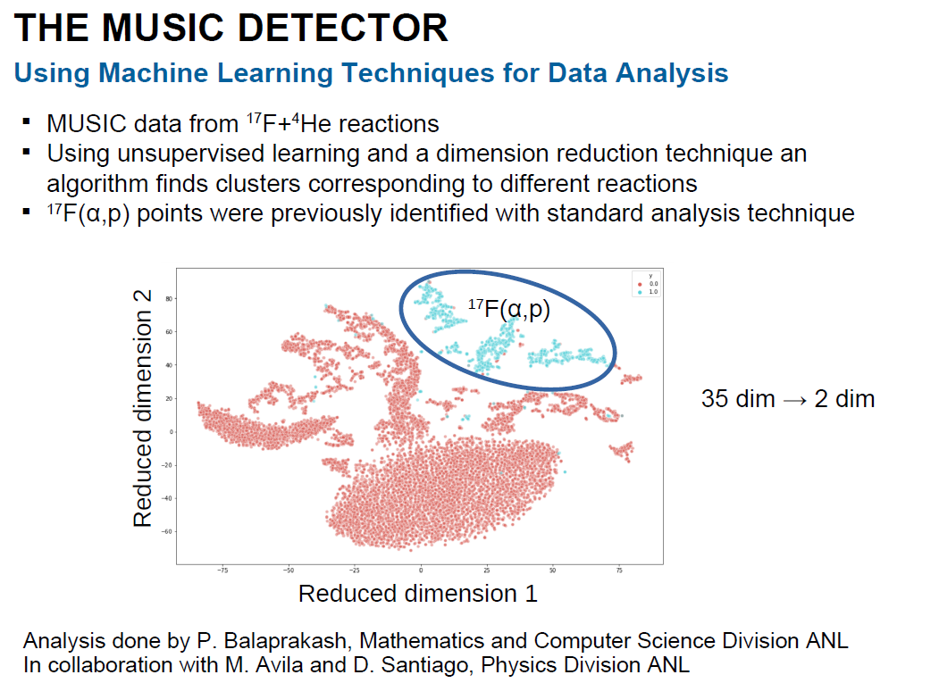
Unsupervised Machine Learning finds Astrophysical Reactions
AI for Nuclear Physics
March 4-6, 2019

Slide 17
AI at Work in Nuclear Data
AI for Nuclear Physics
March 4-6, 2019

Slide 18
AI at Work in Nuclear Data
AI for Nuclear Physics
March 4-6, 2019

Slide 19
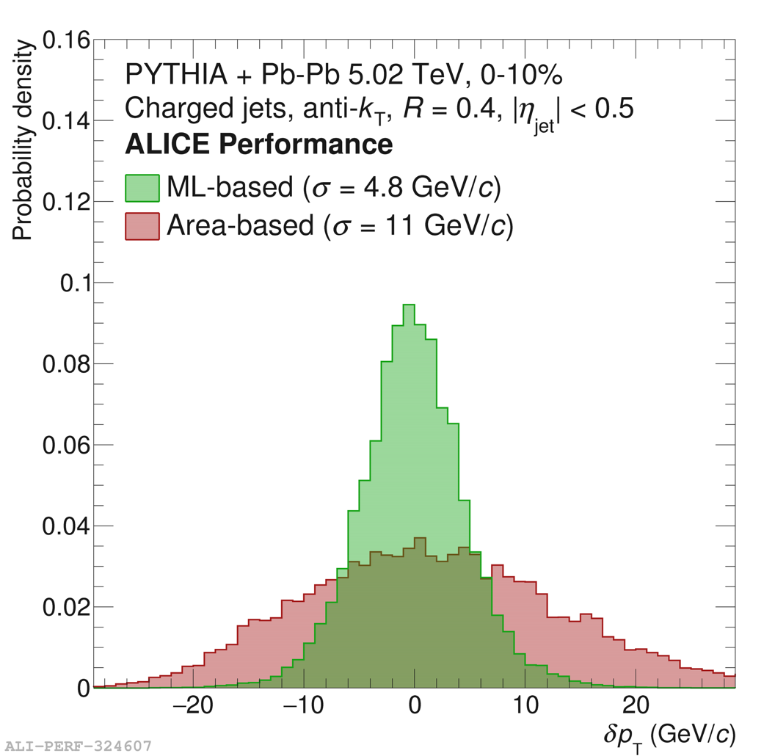
AI at Work in Heavy Ion Jet Measurements
ML significantly improves Jet Resolution in Pb-Pb.
Published: JHEP 10 (2018) 139
AI for Nuclear Physics
March 4-6, 2019

Slide 20
Use of AI/ML to detect and unfold complex detector signatures of rare events is also being pioneered at CEBAF

Slide 21
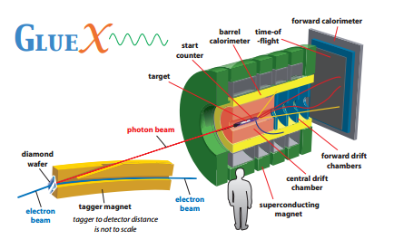
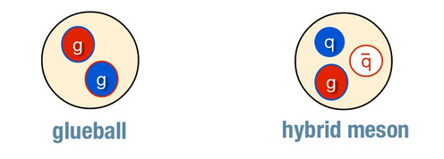
Boosted Decision Trees used to Search for Exotic Mesons in GlueX
Exotic hybrid mesons manifest gluonic degrees of freedom and their detailed spectroscopy in GlueX will provide the precision data necessary to test assumptions in lattice QCD.
One of the primary challenges in GlueX data analysis is isolating events of interest from a disproportionately large background. GlueX has recently begun approaching this selection problem using machine learning algorithms, specifically boosted decision trees¹. Preliminary studies show that these algorithms have the potential to offer vast improvements in both signal selection efficiency and purity over more traditional techniques.
A schematic of the GlueX detector and beamline
LQCD predicts the existence of these “exotic” particles
¹Classification and Regression Trees (Wadsworth Statistics/Probability) by Leo Breiman, Jerome Friedman, Charles J. Stone , R.A. Olshen
AI for Nuclear Physics
March 4-6, 2019
Notes:
A BDT is a multivariate classifier which utilizes machine learning with samples of known
signal or background simulation events to “train" a classifier, which can be used to select a particular
final state topology from experimental data.
The BDT in this case is examining the number of tracks, quality of the kinematic fit to the missing neutron mass, the transverse momentum of the missing neutron, the extra energy detected in the calorimeters, and several other variables. When correlations amongst these variables for signal and background are exploited one can develop a classifier that is a strong discriminator of signal and background. The BDT algorithm takes as inputs the quantities noted above and produces a single number that tends toward one for signal and zero for background

Slide 22
Similar Thrust in CLAS12
AI for Nuclear Physics
March 4-6, 2019

Slide 23
Opportunity for NP Research to Benefit from AI/NL Across the Board
AI for Nuclear Physics
March 4-6, 2019

Slide 24
Outlook
The areas where NP supported research can benefit from AI/ML are ubiquitous
NP researchers already have the talent and many of the tools required for this revolution
This topical area is currently a national priority similar to QIS/QC
MP researchers have much to contribute and to gain from AI/ML research
Effort on AI/ML within NP is fully in line with the goals of the 2015 LRP
AI for Nuclear Physics
March 4-6, 2019

