Slide 1
Enabling AI for Science with Data Standards
Ryan Ly
Data Analytics and Visualization Group
Lawrence Berkeley National Lab
March 5, 2020

Slide 2
Enabling AI for Science with Data Standards
Ryan Ly
Computational Research Division
Lawrence Berkeley National Lab
March 5, 2020
Notes:
Good morning, everyone. My name is Ryan, and I am a data engineer and neuroscientist at Berkeley Lab. My teammates and I develop data standards for neuroscience. You might be asking yourself, why am *I* up here giving this talk to you all about data standards and neuroscience.

Slide 3

Data is getting bigger and more complex!
Problem: How do we efficiently handle such big data and effectively use AI to glean new insights into these data?
A case study:
Notes:
Well, in almost every scientific field, data is getting bigger and more complex, and it has become increasingly important for scientists to address the problems of working with big, complex datasets and to make effective use of the latest, greatest methods in AI to glean new insights into these rich data. [click]
Today I will tell you about some of our work developing a modern data standard for neuroscience, called Neurodata Without Borders. And I will share the lessons that we have learned, in particular how having data standards and a robust data infrastructure can help enable AI for science.
Let’s start with one of the biggest problems in scientific communities.

Slide 4
Community science…
Data
Blue-rectangle format
Red-triangle format
Scientists
Notes:
Here, we have two scientists [click]: Dr. Blue and Dr. Red.
Dr. Blue stores data in the blue-rectangle format
Dr. Red stores data in the red-triangle format
They’ve both been using their respective formats for 20 years, so all of their analysis tools are dependent on blue-rectangles and red-triangles.

Slide 5
Community science…
My models can’t read this data!
It will take 6 months to convert this!
exchange data
Notes:
Now, when they want to collaborate or use each other’s data… they get very upset
<HIT KEY>
They can’t read each others’ data. They can’t run their analysis tools and models on each others’ data either.

Slide 6
Community science…
Standardized data
Notes:
But, if they both store their data in green circles… [click] a standard format agreed upon in the community
And then exchange data

Slide 7
Community science…
My AI models generated a new prediction!
This supports my hypothesis H!
exchange data
Notes:
They’re happy. [click] They can test their hypotheses with other datasets. They can use their same analysis tools and AI models on other datasets without extra work. And science can advance much faster.

Slide 8
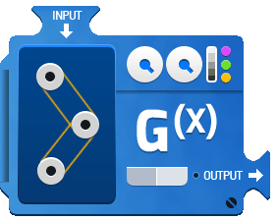
Data standardization enables community tools
Standardized data
Machine learning models,
analysis and visualization tools
Notes:
And if the community builds AI models, analysis software, and visualization tools that all accept data in that standard, then everyone can use these tools, and everyone is happy.

Slide 9
Community science needs data standards
Data standards: rules to organize experimental data and metadata so that people or machines familiar with the rules can understand the data
Major benefits for community science and large-scale collaborations:
Facilitates sharing and reuse of data, maximizes ROI
Improves reproducibility
Enables development of analysis tools that target single format
Notes:
What I am demonstrating here is the need for data standardization. What do I mean by data standards? Data standards are simply rules to organize experimental data and metadata, such that any person or AI familiar with the standard can easily and unambiguously understand the data.
Data standardization has major benefits for community science and large-scale collaborations. It… [read]

Slide 10
Community science needs data standards
Data standards: rules to organize experimental data and metadata so that people or machines familiar with the rules can understand the data
Major benefits for community science and large-scale collaborations:
Facilitates sharing and reuse of data, maximizes ROI
Improves reproducibility
Enables development of analysis tools that target single format
Notes:
I will focus on this last point later in this talk.

Slide 11
How do we build a common data standard?
A case study:
Notes:
So data standards are important, but how do we build a common data standard? [click]
I’ll tell you about our work building Neurodata Without Borders and I’ll try to generalize the lessons learned to other fields.

Slide 12
Requirements change based on use case
Different requirements:
Language (machine and human-readable)
Schema (lab-specific data?)
Storage (optimized for HPC vs cloud?)
Access (which programming language?)
Goal: Build a flexible data standards framework that supports all of these different requirements
Data API
Data Standard Schema
Specification Language
Data Storage
Notes:
When we were first tasked to build this data standard, we found a lot of disagreement among the neuroscience community over what they wanted. And at the heart of the matter was that they all needed to specify data in different ways, store data in different ways, or access data in different ways, depending on their different use cases.
So we needed to build a flexible framework that supports these different requirements yet still adheres to the standard.
I’ll tell you briefly about how we solved each of these issues.

Slide 13
Specification Language
Data API
Standard Schema
Spec. Language
Data Storage
Goal: Enable the formal definition of data standards that is both machine and human-readable
Definitions use object primitives (group, dataset, link, attribute)
Supports reuse of common data types (object-oriented)
Supports validation
Supports custom extensions
Notes:
First, in order to define the data standard, we needed a formal specification language, one that is both machine and human readable
This language uses object primitives based on HDF5, a common format for big scientific data, and supports the reuse of common data types in an object-oriented manner.

Slide 14
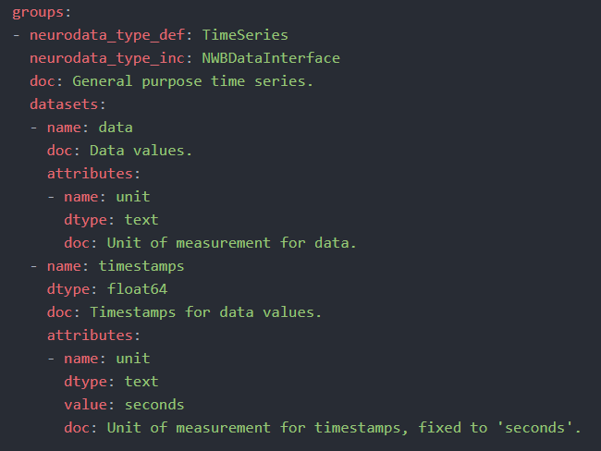
Standard Schema
Data API
Standard Schema
Spec. Language
Data Storage
Uses the language to define core types for the scientific field
TimeSeries
unit
text
data
unit
text
timestamps
float64
Notes:
We can use this language to define core data types for neuroscience. Here is a simplified example where we define a data type that represents time series data, values that change over time. This time series type consists of datasets called “data” and “timestamps”, which are arrays that represent the data and timestamps of a time series. Each of these datasets has an attribute called “unit” which stores the unit of measurement, for example, seconds or meters. In this way, any machine or human reading this time series data will know what unit the data are stored in, and they know what the variables are called, so they have a standard map to get to any particular dataset or metadata.
From my very loose understanding, the nuclear and high energy physics communities already have a flexible language for writing specifications called ROOT. But what I think is missing is a community-wide standard definition of common data types.

Slide 15
Standard Schema
Data API
Standard Schema
Spec. Language
Data Storage
Uses the language to build new data types from existing types
TimeSeries
ElectricalSeries
ImageSeries
extension
extension
extension
Notes:
Using the specification language, we can build off of existing data types to create more specialized types, such as for representing voltage traces from an electrode or images taken from a microscope. [click]
[Defining the initial standard data types is a difficult social and technical problem. It requires the scientific community to work together to decide on which fields are important to store, what they should be named, in which format should they be stored. This can take years, and indeed, for neuroscience, this has taken several years. But this is just to get the ball rolling. ]
Scientific methods are constantly evolving, and data standards need a way to keep up and represent data that falls outside of the standard. And also certain devices or groups want to store data specific to that device or group. To cover those data, the community can define custom extensions to the standard using the same formal specification language. This is a powerful ability for the standard to support virtually any kind of data.
If a researcher has data or metadata that falls outside of the standard, they can create extensions of existing data types to represent their data within the standard using the same spec language. This is a powerful ability for the standard to support virtually any kind of data, as long as it is specified in the formal specification language.

Slide 16
Data Storage
Data API
Standard Schema
Spec. Language
Data Storage
Goal: Map object primitives to storage
Can swap out a different storage backend:
  HDF5: Optimized for high-performance computing and scientific data
  Zarr: Optimized for distributed computing and selective data access in cloud
  Relational database: Optimized for queries over metadata and small data

Slide 17
Data API
Data API
Standard Schema
Spec. Language
Data Storage
Goal: Provide user-friendly functions to read/write/interact with data
Can swap out a different programming language
Other pyramid components are abstracted away

Slide 18
Requirements change based on use case
Different requirements:
Language (machine and human-readable)
Schema (lab-specific data?)
Storage (optimized for HPC vs cloud?)
Access (which programming language?)
Goal: Build a flexible data standards framework that supports all of these different requirements
Data API
Data Standard Schema
Specification Language
Data Storage

Slide 19
HDMF: Modern data standards framework
Machine and human-readable data
Domain-specific common data types and support for custom extensions
Interchangeable data storage
User-friendly data access in multiple languages
Data API
Data Standard Schema
Specification Language
Data Storage
Tritt, Rübel et al. (2019) IEEE Big Data

Slide 20
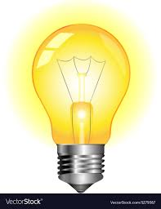
Lessons learned
Community agreement over standards is difficult – start somewhere, then support extensions

Slide 21
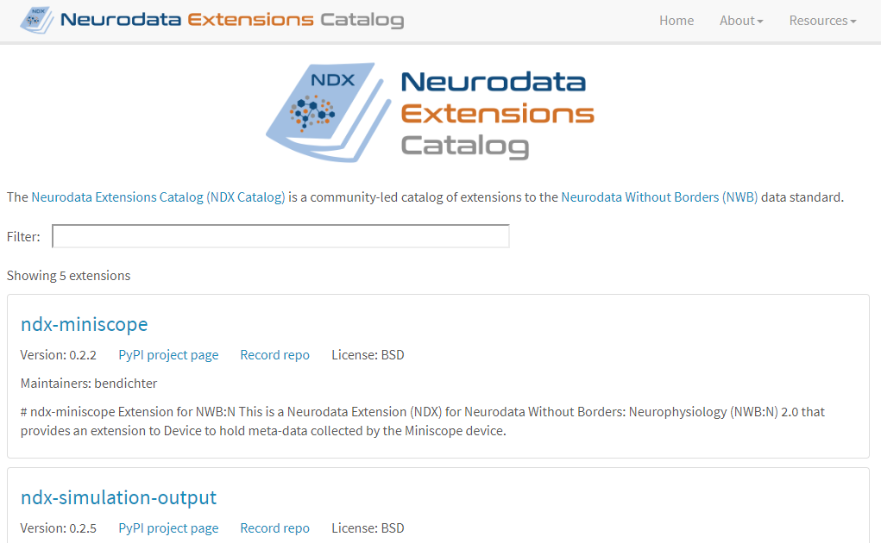
Grow standards from bottom up (by community) instead of from top down (by committee)

Slide 22
Lessons learned
Community agreement over standards is difficult – start somewhere, then support extensions
The same data can have different storage and access requirements depending on the use case
Interacting with data must be easy despite all the layers

Slide 23
Data standardization enables community tools
Standardized data
Machine learning models,
analysis and visualization tools
Notes:
If the community rallies around standardized data, then analysis tools can easily read the data. These might include machine learning models and software that implement domain-specific AI algorithms. In neuroscience, a growing number of tools are using the Neurodata Without Borders data standard.

Slide 24
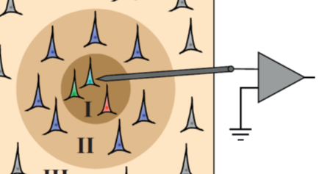
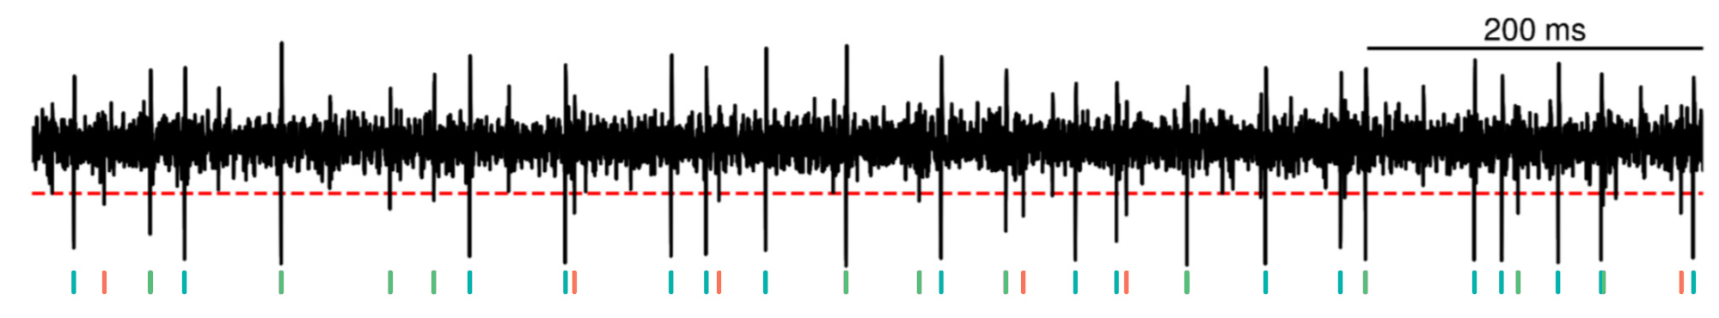
Example AI / ML application: Spike sorting
Sukiban et al., 2019
Notes:
The problem of spike sorting has been a major challenge for neuroscience over the past 30 years. In experiments, neuroscientists use electrodes to *listen* to the electrical activity of nearby neurons. As output, we get a continuous voltage trace, like this [click]. Individual neurons generate these discrete, sharp events called spikes [point to spikes], and all of these spikes get mixed together. The problem is: how do we figure out which neuron [point to neurons] generated which spike? [click] In other words, how can we demix this continuous signal into a series of discrete, labeled events? As an analogy, this is like if I close my eyes and now everyone in the room says the word “Hi” at a random time. How do I, figure out who said hi, at what times? [pause] It’s a hard problem.

Slide 25
Standards enable evaluation of different solutions
Sukiban et al., 2019
Notes:
And there have been 20-30 papers per year over the last 20 years trying to solve the problem with varying success. At its core, this is a machine learning problem that involves event detection, feature selection, and unsupervised or semi-supervised clustering across many feature dimensions.
But returning to the main point of this talk, what do data standards provide?
And another major big advantage is that any group that generates standardized data has access to a wide variety of solutions to this problem which may have
If each group that develops a solution to this problem accepts raw data in a standard format, then it becomes almost trivial to evaluate each solution on a variety of datasets.
Filtering raw data, detecting spikes
Feature selection
Unsupervised or semi-supervised clustering in several dimensions
Many different algorithms
Data are noisy
Can easily compare algorithms when they all take input data in the same format and output data in the same format

Slide 26
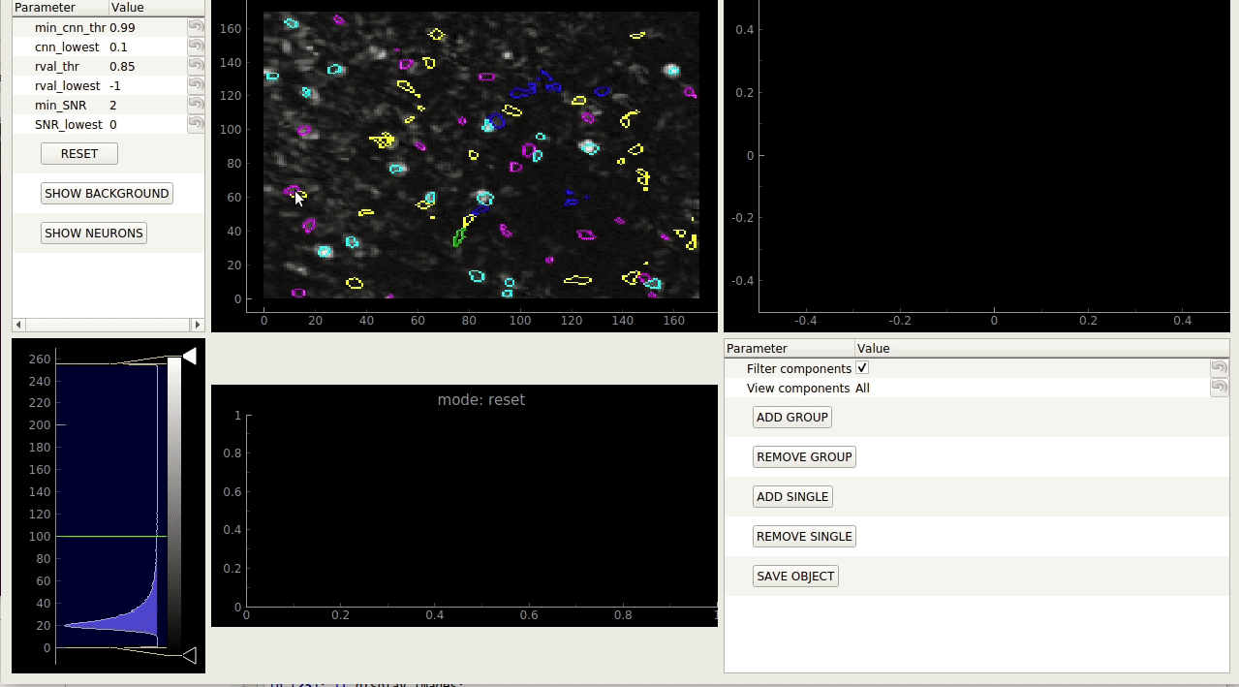
Example AI / ML application: Image processing
Giovanucci et al., 2018
Notes:
This provides scientists who have data in NWB access to cutting-edge AI tools for processing raw microscopy data and segmenting signal from background.
We are now building tools that let you run a variety of different image processing and segmentation algorithms and compare the results on the same standardized data set, which is only possible if there is a single data standard that each of these tools can accept.

Slide 27
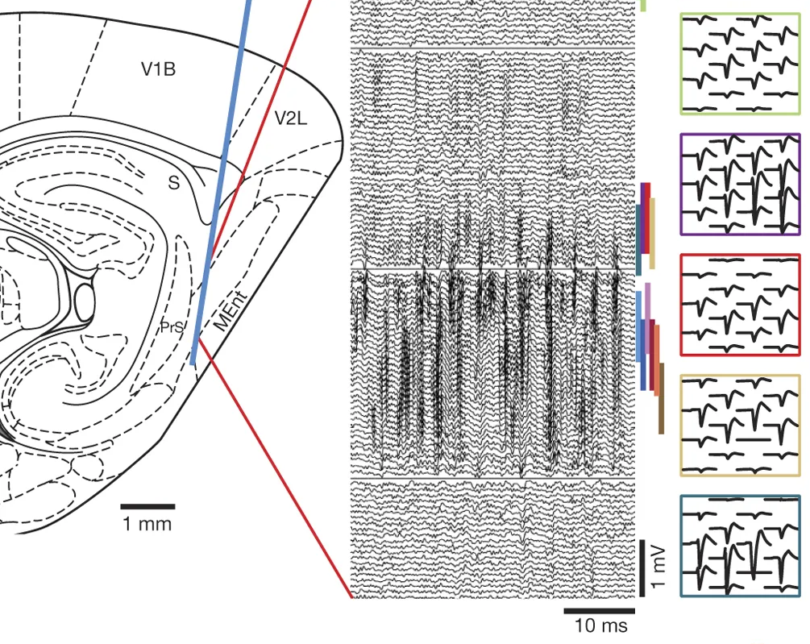

Rich data annotations and metadata can yield more powerful AI solutions
Electrode Location
Probe Geometry
Electrode Properties
Neuropixels Probe
384 channels
20 µm spacing
Link Neural Signal with Behavior
Jun et al., 2017
Notes:
Newer electrodes, newer microscopes. More parameters and metadata to store. More values that an AI model to consider.
Accelerators can store calibration data alongside the raw data. With enough data in the same format, machine learning algorithms may be able to pick out patterns of how particular accelerator parameters may bias particular measurements.

Slide 28
Lessons learned
Community agreement over standards is difficult – start somewhere, then support extensions
The same data can have different storage and access requirements depending on the use case
Interacting with data must be easy despite all the layers
.

Slide 29
Lessons learned
Community agreement over standards is difficult – start somewhere, then support extensions
The same data can have different storage and access requirements depending on the use case
Interacting with data must be easy despite all the layers
Standards enable shared tools for improving productivity
Many solutions for same problem. Standards allow direct comparison and evaluation
Rich data annotations, metadata can yield better solutions
The earlier that standards are integrated, the better

Slide 30

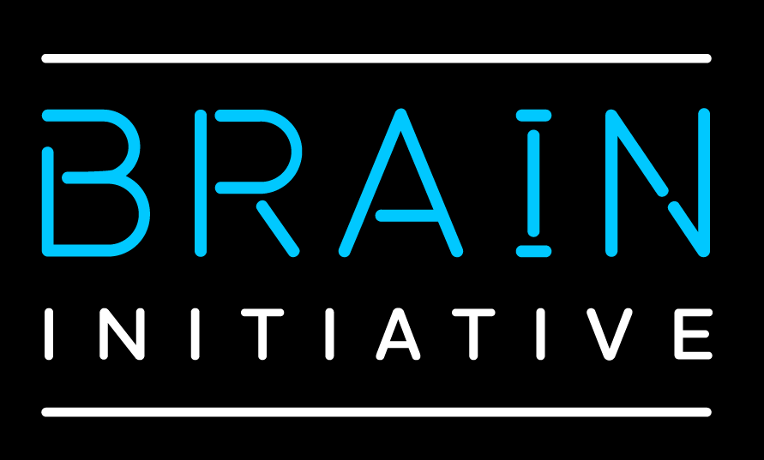
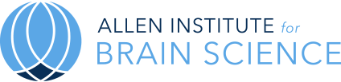


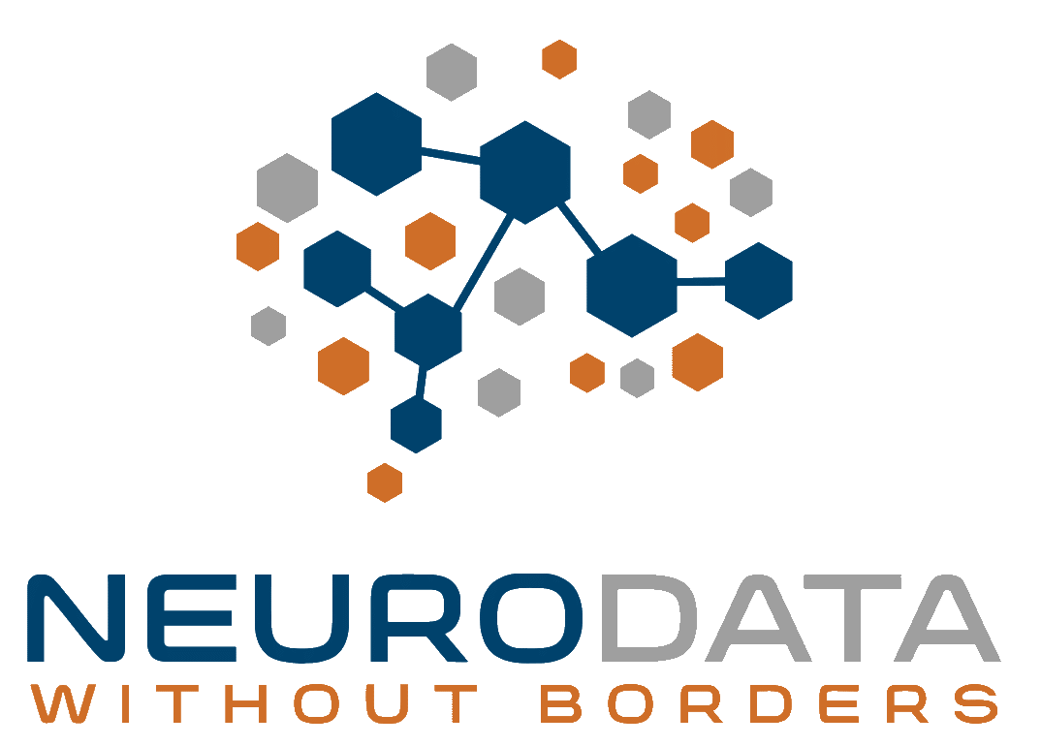
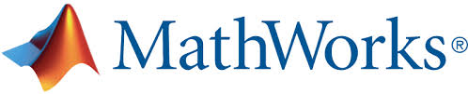

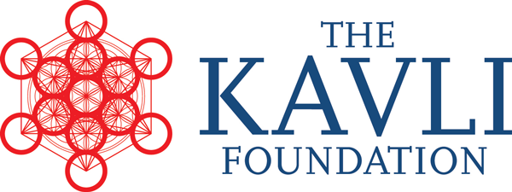
Thanks to:
Oliver Ruebel (LBNL)
Andrew Tritt (LBNL)
Ben Dichter (LBNL)
Neurodata Without Borders community

Slide 32
The cultural energy barrier in data standardization
Sticks
Funding ultimatives
Carrots
No standardization
Analysis and visualization tools
Guidance
Outreach and support
Standardization
Notes:
Data standardization is not just a technical challenge but also a cultural challenge.

Slide 33
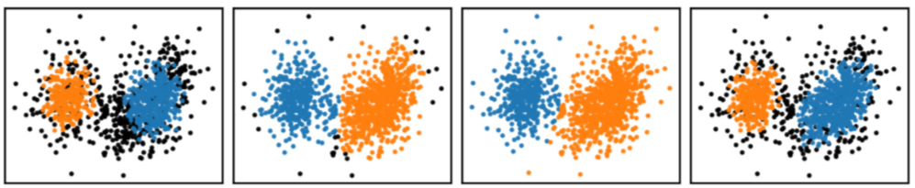
HDMF provides a modern data standards infrastructure
  Machine and human-readable data
  Common data types and custom extensions
  Interchangeable data storage
  User-friendly data access
Data standards enable AI-ready data
  Provide target for tools and AI models
  Facilitate comparison of models and algorithms
  Rich annotations → more information for AI
Data API
Standard Schema
Spec. Language
Data Storage

Slide 34
Data standards reduce work for AI / ML experts
The 80/20 rule:
“80% of a data scientist’s valuable time is spent simply finding, cleansing, and organizing data, leaving only 20% to actually perform analysis.”
- IBM

Slide 35
Scientific data standards enable AI-ready data
Comprehensive metadata, including provenance
Consistent data, with defined way to handle missing data
Richer machine-learning models
Supports complex queries
Less work for AI / ML experts
  The 80/20 rule: “80% of a data scientist’s valuable time is spent simply finding, cleansing, and organizing data, leaving only 20% to actually perform analysis” - IBM
Notes:
https://www.ibm.com/cloud/blog/ibm-data-catalog-data-scientists-productivity
Mars Climate Orbiter - $125 million – JPL used metric system but Lockheed Martin, which built the spacecraft, provided data in imperial units. This in part resulted in the spacecraft propelling too close to the Martian atmosphere, where it burned and disintegrated.
Standardized data are only one piece of building useful AI and ML models, but a necessary piece if the model is to be usable by the broader scientific community.
Units of measurement. Dimensions. Machine learning models that run on experimental data work only as long as the input data is of a format that the model code expects.

Slide 36
Scientific data standards enable AI-ready data
Comprehensive metadata, including provenance
Consistent data, with defined way to handle missing data
Rich annotations and metadata can yield more powerful AI solutions
Notes:
https://www.ibm.com/cloud/blog/ibm-data-catalog-data-scientists-productivity
Mars Climate Orbiter - $125 million – JPL used metric system but Lockheed Martin, which built the spacecraft, provided data in imperial units. This in part resulted in the spacecraft propelling too close to the Martian atmosphere, where it burned and disintegrated.
Standardized data are only one piece of building useful AI and ML models, but a necessary piece if the model is to be usable by the broader scientific community.
Units of measurement. Dimensions. Machine learning models that run on experimental data work only as long as the input data is of a format that the model code expects.

Slide 37
Standard Schema
Data API
Standard Schema
Spec. Language
Data Storage
Uses the language to define core types for the scientific field
NWB standard defines 68 different data types for neuroscience
Growing public catalog of NWB extensions

Slide 38
Standards enable evaluation of different solutions
Sukiban et al., 2019

Slide 39
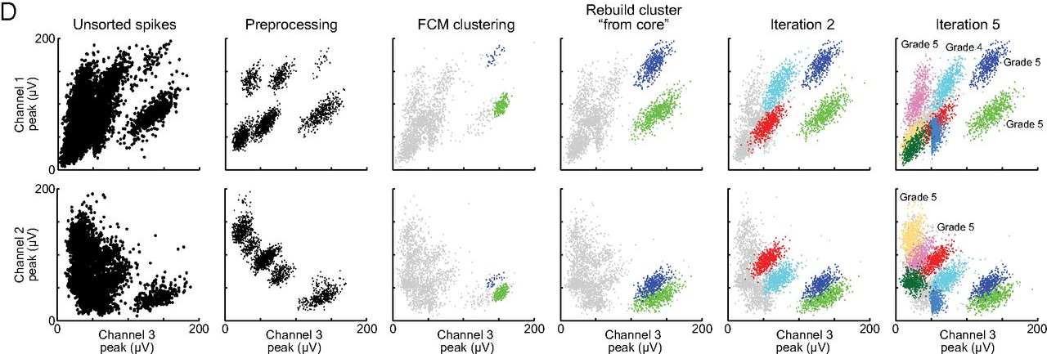
Friedman et al., 2015

Slide 40
Buccino et al., 2019. bioRxiv
Notes:
Standardized data facilitates algorithm comparison

