Slide 1
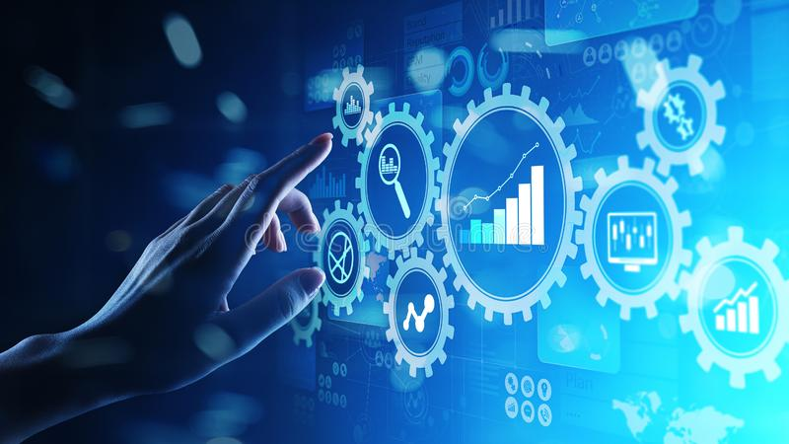
Computing activities at JLab
2020 in review

Slide 2
Scientific Department and CST
Year started with a new department head – me, and a reorganization.
Two groups were formed in Scientific Computing.
  Experimental Physics Scientific Computing Infrastructure (EPSCI)
    Focus on aspects of computing related to the experimental program.
  Performant Cluster Scientific Computing Infrastructure (PCSCI)
  Infrastructure
    Focus on aspects of computing related to theory and compute clusters.
Sci. Comp. Ops. was moved to CNI in 2019
    Focus on operation, hardware technologies, and reliability
Computational Science and Technologies (CST) Division formed in June 2020
  Emphasis on the increasing importance of computation to the scientific mission of the laboratory.
  Ongoing projects are organized around a set of Advanced Computing Initiatives
Direction changes:
  Increased investment to improve reliability and performance.
  Tuning of system parameters to suit program need rather than “one size fits all”.
  Increased investment to dramatically improve access to off site resources.
  Focus on coordination of computing projects across the lab.
CDT
Division
Amber Boehnlein
Sci Comp
Graham Heyes
CNI
Andy Kowalski
MIS
Kari Heffner
EPSCI
David Lawrence
PCSCI
Jie Chen
Sci Ops
Bryan Hess

Slide 3
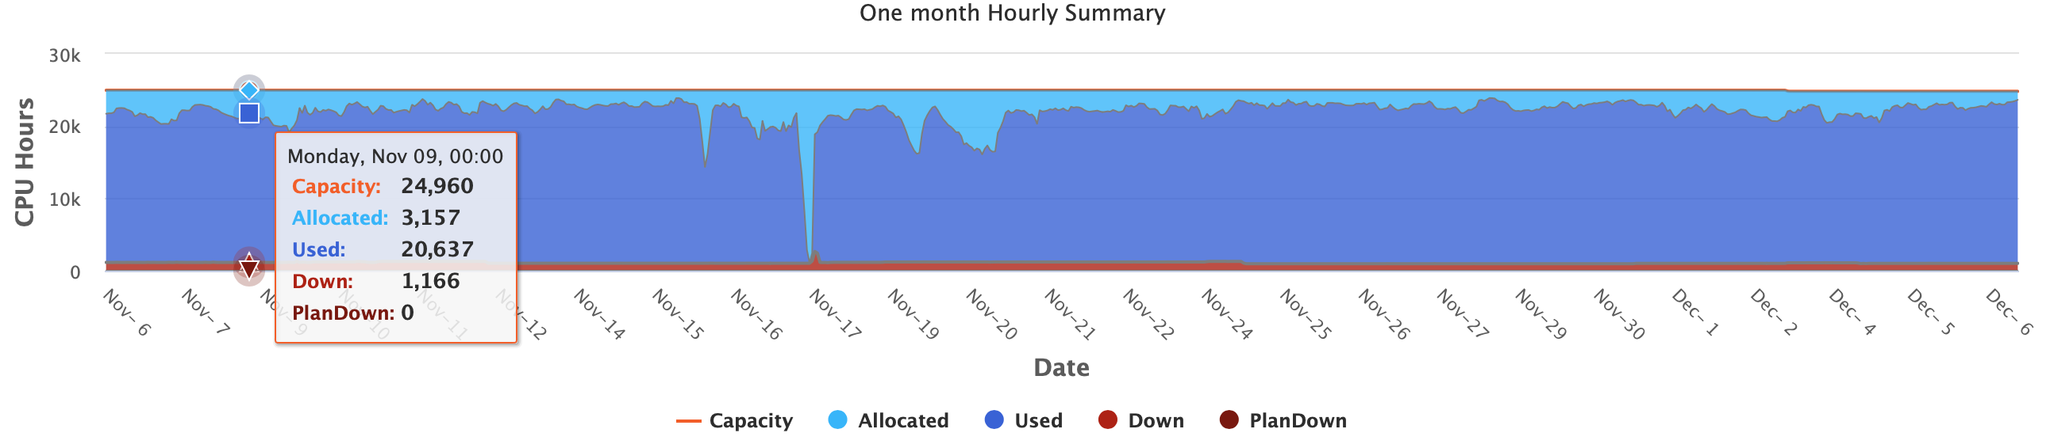
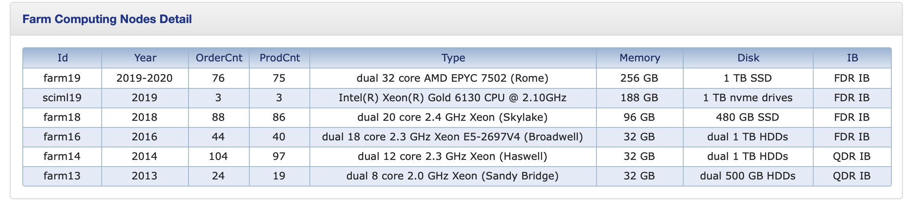
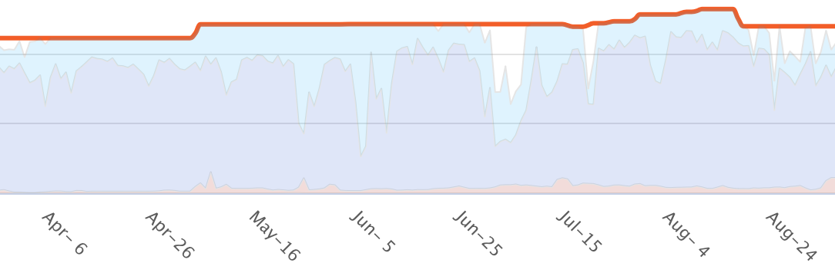
Facilities status: ENP and LQCD Hardware
Focus on reliability and performance
  Improved reporting
  Improve User Experience
ENP Cluster
  Capacity growth to AMD cluster.
  Changes to improve utilization.
    Recently utilization ~ uptime at 95.6%.
  Added small GPU component
LQCD clusters
  Currently two clusters KNL and GPU
    A third cluster was retired in 2020.
    New GPU cluster coming in 2021.
  USQCD Allocated
Storage
  Added Solid State Cache disk.
  LUSTRE Storage system has been rearchitected.
    3.9PB ENP + 1.3PB LQCD
  Rebuilt Tape Library
    Added additional tape drives to increase bandwidth by 25%
ENP
Notes:
Jlab clusters transitioned to SLURM.
Now the users can make sense of the allocations
Added memory to order machines.
Now averaging ~20K of ~21K job slots in use,).
Scheduling is effective and manageable

Slide 4
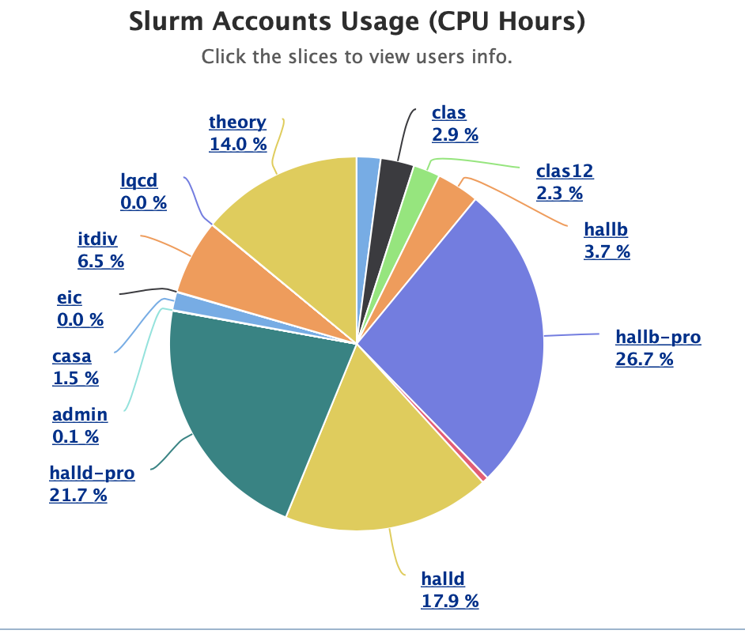
Facility status: Cluster operation updates in 2020
We already had separate Slurm controllers for HPC and ENP.
  Moved them both to virtual machines to increase robustness and improve up time.
  New instances upgraded through a couple of major versions and tuned considerably.
  Retired the old PBS based batch system.
Implemented Nagios for monitoring and Puppet for configuration control.
Implemented CGROUP kernel segmentation for ENP clusters.
  Slight performance hit is made up for by improved up time – badly behaved jobs no longer take down nodes.
The cluster are all on Omnipath, the infrastructure (Data Movers, Lustre, admin nodes) are on Infiniband.
  We've been upgrading those switches to be managed/modern switches that the networking group monitors for errors and failures.
  We are in the process of updating the gatewaying between the network internal to the clusters and the infrastructure servers that provide services such as OSG, XROOTD etc.

Slide 5
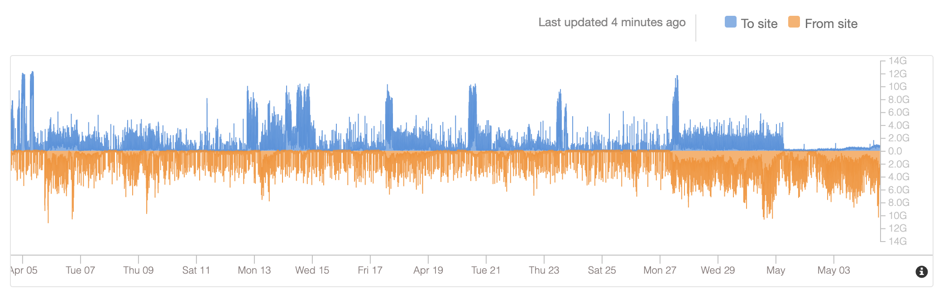
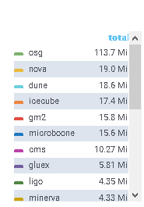
Facility status: Distributed Computing
In 2019, exceeded Wide Area Network capacity - ESnet doubled the connectivity
Jlab now runs an OSG job submission server.
  We now routinely move thousands of jobs per day to the Open Science Grid.
MCWrapper- web form that automatically produces and monitors a workflow to fulfill the request.
  To Date: 13 Billion simulated events in 2.1 Million jobs and over 4 million core hours.
GLUEX is running opportunistically on OSG and has a NERSC allocation.
  Making use of Big Red at Indiana University.
CLAS12 is running via OSG and dedicated CLAS12 collaborating sites.
  GRIDPP at Glasgow, UK.
  INFN (500 cores).
  Orsay.
Gluex on OSG

Slide 6
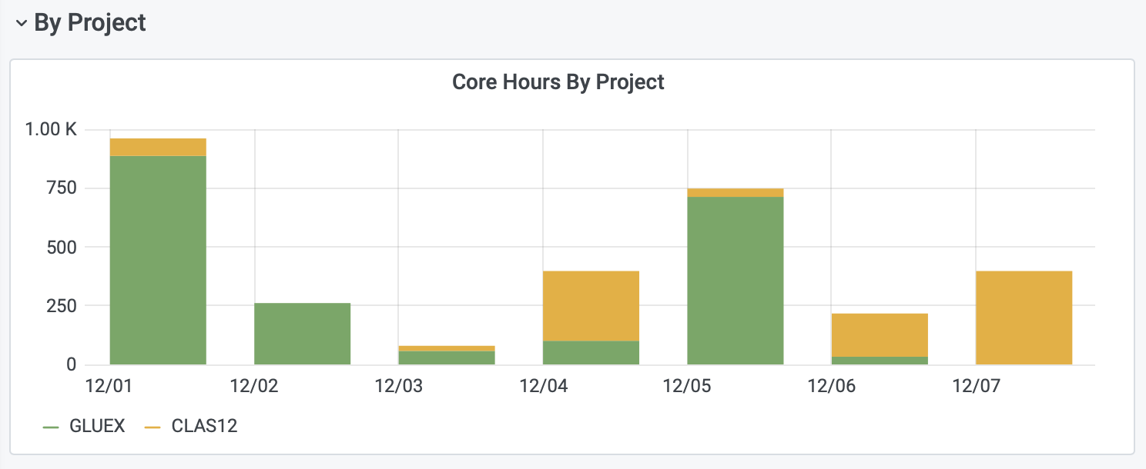
Facility status: OSG Computing
Jlab now has the infrastructure in place to run OSG jobs on the local cluster.
Jobs submitted in the CLAS12, GLUEX, or EIC VOs will land on local nodes if they are free.
  Much more powerful accounting and job control.
  Jobs that run locally run using local authentication.
    We made three osg users: osg-gluex, osg-clas12, and osg-eic.
    Each of those accounts participates in the fair share for the respective account.
    So, it's a jlab account per VO at this point and since it all runs in a container, it works.
  Jobs count against local SLURM Fairshare settings – not a back door.
Allows EIC users at BNL to submit a job and use Jlab resources allocated to EIC.
Eventual goal is to have:
  One way to submit jobs.
  Where a job runs become less visible.
  One way to package up a job for submission
    Containerized with code on CVMFS.
Still need to work out how we want to use this.
  Big step forward though!

Slide 7
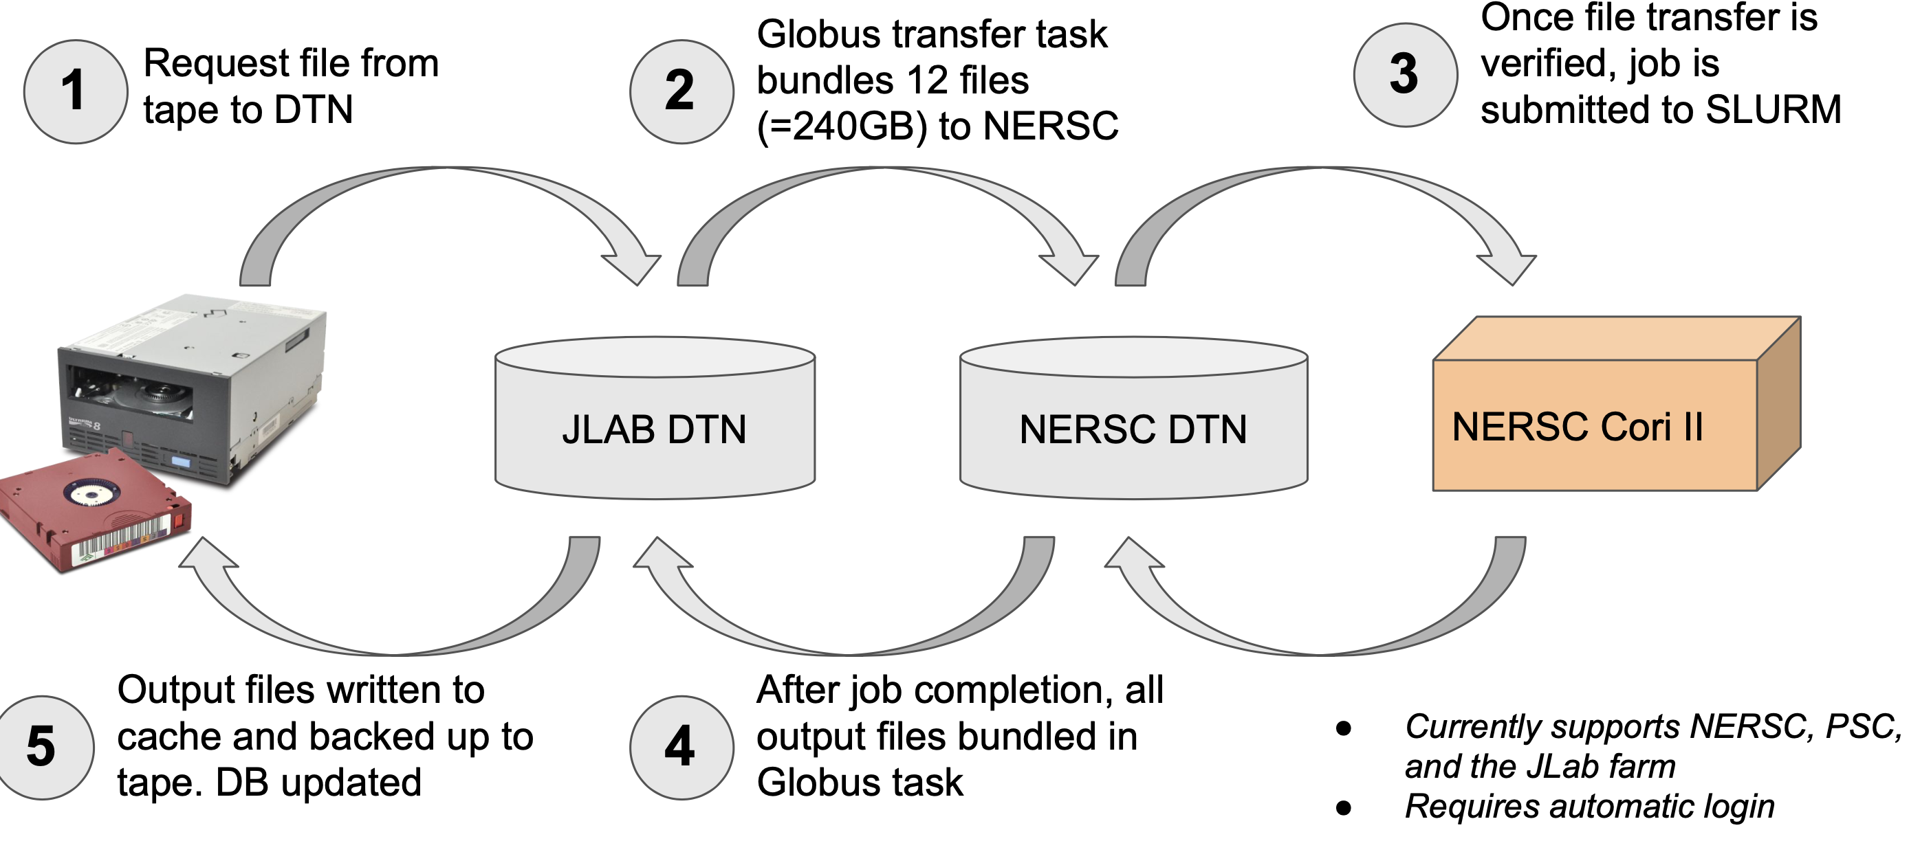
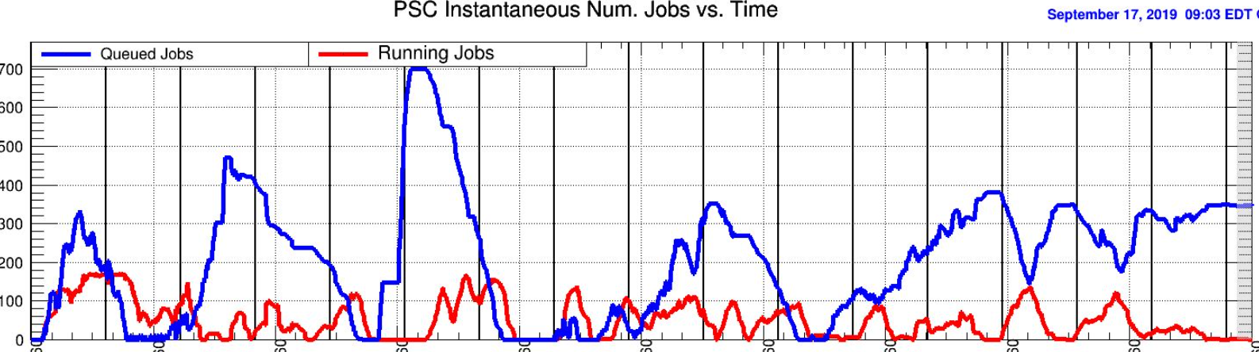
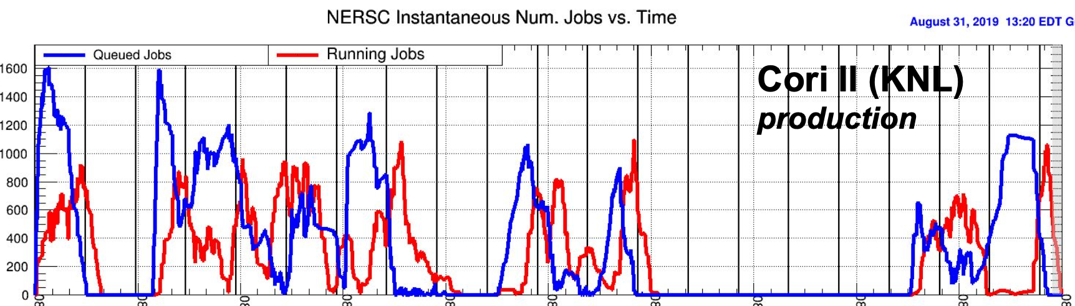
PCSCI: SWIF Workflow manager
Manages file transfer and job submission for nontrivial workflows.
Was around before this year but now seeing major production use by CLAS12 and GLUEX.
User defines a workflow:
  Inputs.
  Code.
  Output destination.
  Retry handling.
In use by both CLAS12 and GlueX.
  GlueX successfully running at supercomputer centers.
  CLAS12 used SWIF to improve reconstruction by retrying failed jobs.
GlueX at Pittsburgh (XSEDE)
GlueX at NERSC Cori II

Slide 8
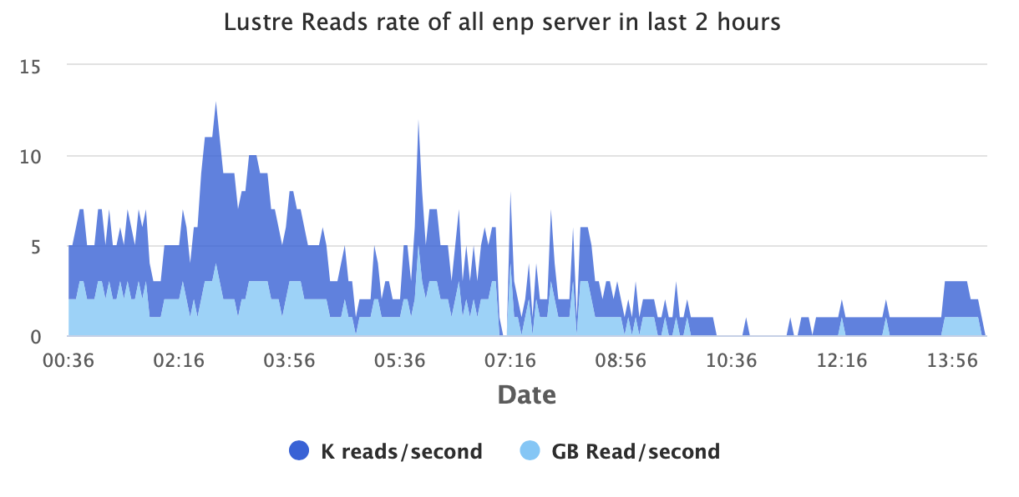
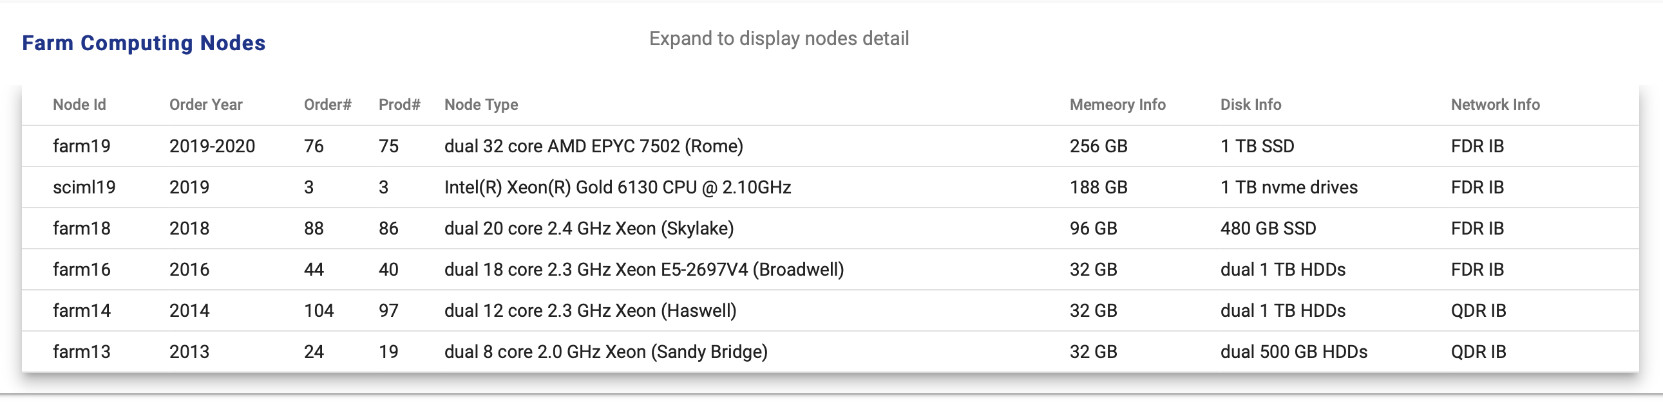
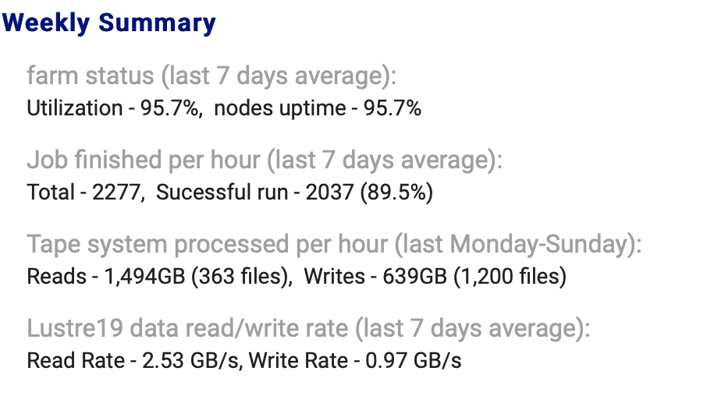
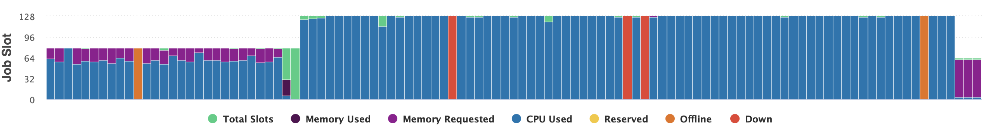
PCSCI: Scientific Computing WebApp development
Updating SciComp web portal to use the Angular javascript framework from Google.
  Improved reporting of system status.
  Periodic reports of metrics for tracking system performance.
  Auto generation of information on cluster composition.

Slide 9

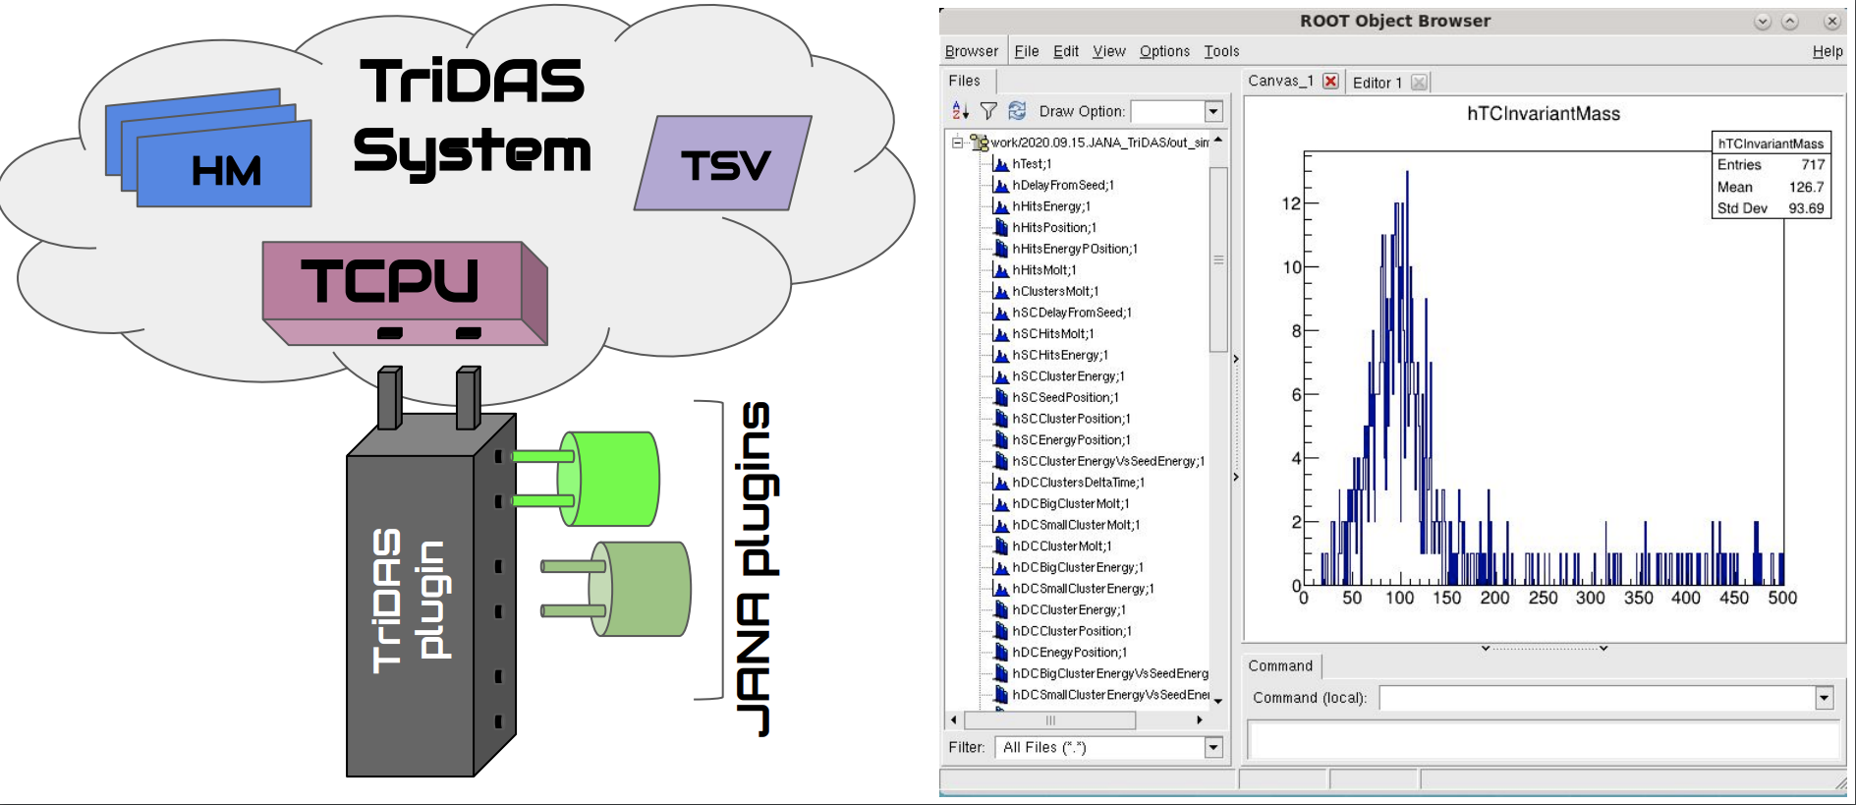
EPSCI: Group Activities
Streaming Readout
  Developing ERSAP system (Environment for Real-time Streaming And Processing)
    Reactive Microservices architecture
    Data Lake buffering
    Beam test with CLAS12 Forward Tagger in Summer 2020
  Evaluation of 3rd party software.
  JANA2
    TriDAS
      JANA2 online streaming filter for single and
      double cluster events in CLAS FT beam test
    INDRA-ASTRA Lab
      0MQ transport
Experimental Physics Software and Computing Infrastructure

Slide 10
EPSCI: Group Activities
Experimental Physics Software and Computing Infrastructure
CODA DAQ system
  Support of backend software for deployed systems
  EVIO-6
Analysis/Reconstruction
  Support of CLAS12 via CLARA
  Support of GlueX via JANA -> JANA2
  EIC eJANA + ACTS
Offsite Computing
  Open Science Grid (OSG) support
    Jobs running at JLab submitted via OSG
    xrootd/stashcache
  GlueX production at NERSC, IU’s Big Red III, and Pittsburgh Supercomputer Center
Scientific software management/support
  Working to replace JLabCE* with SPACK early next year
*thanks Maurizio!

Slide 11
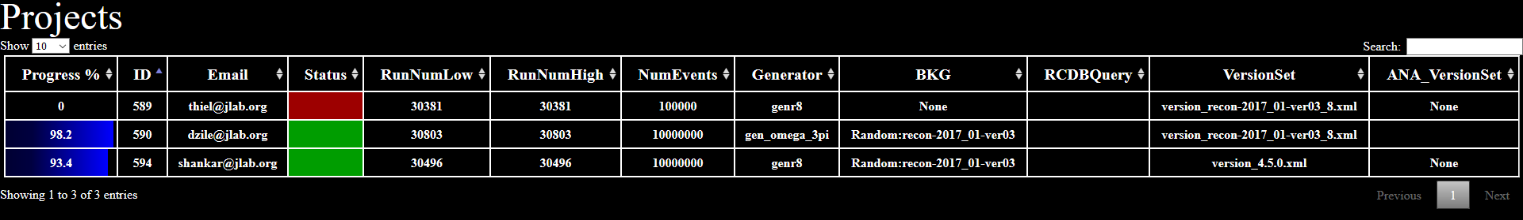
EPSCI/GLUEX: MCWrapper
MCwrapper manages Monte Carlo production for GlueX
  Widely used in the collaboration and works at a variety of institutions
MCwrapper takes requests via a web form and automatically produces and monitors a workflow to fulfill the request.
  Primarily runs on the Open Science Grid (OSG)
To date MCwrapper has autonomously produced more than 13 Billion simulated events in 2.1 Million jobs and over 4 million core hours. Totaling 52TB of simulations.
Author is now part of the EPSCI group in Scientific Computing.
  Working with PCSCI to update using latest WebApp technology and generalize for non-simulation workflows.

Slide 12
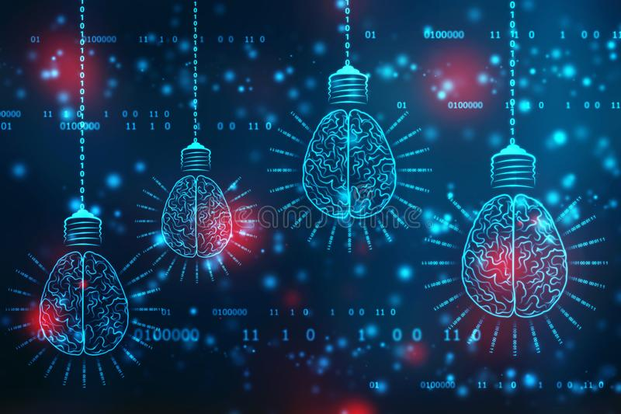
Artificial Intelligence and Machine Learning
AI For Nuclear Physics Workshop
Mar. 4-6, 2020 hosted by Jefferson Lab
  13 plenary talks/presentations
  6 parallel working group sessions
  Final report: https://arxiv.org/abs/2006.05422
Hackathon
  Day before workshop: Mar 3, 2020
  One day event to get people in same room
  working on problem in small groups
  Competitive with prizes
  https://www.jlab.org/news/releases/calling-all-college-and-junior-scientists-ai-hack-thon-now-planned-jefferson-lab
Joint GlueX-EIC-PANDA ML Workshop Sep. 21-25, 2020
  16 Lectures with lots of discussion time
    Some beginner level lectures for those new to AI/ML
  Hands-on examples
  Videos of all talks archived on website https://indico.gsi.de/event/10576/

Slide 13
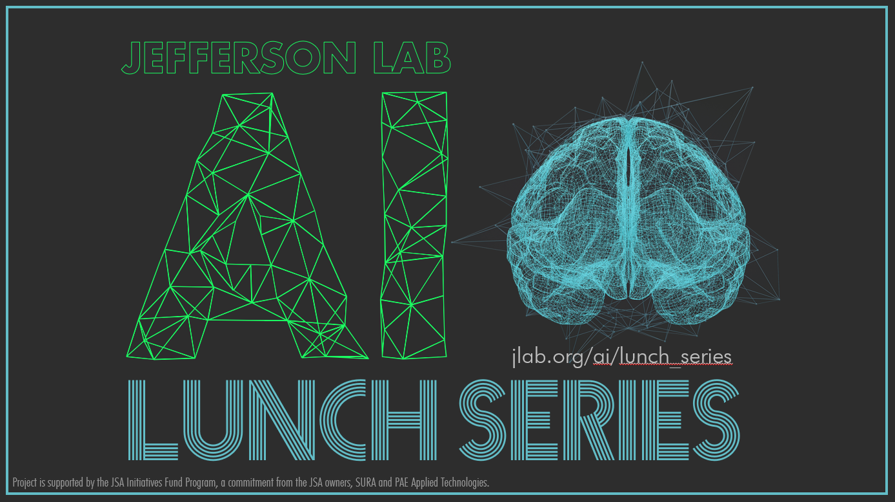
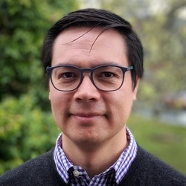
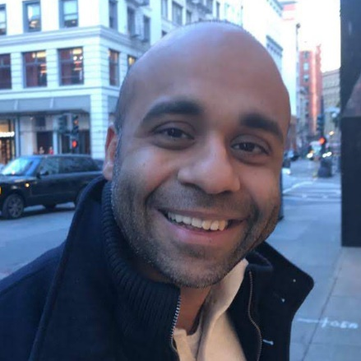
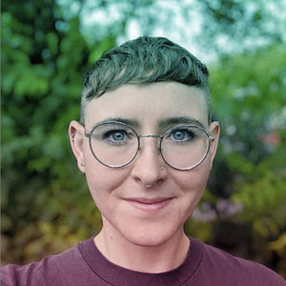

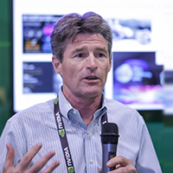
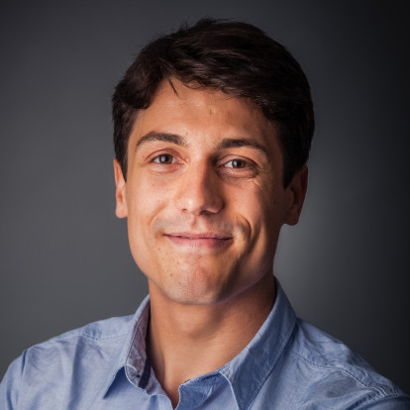
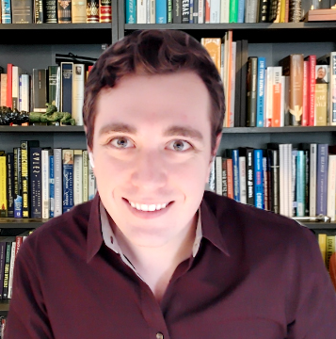
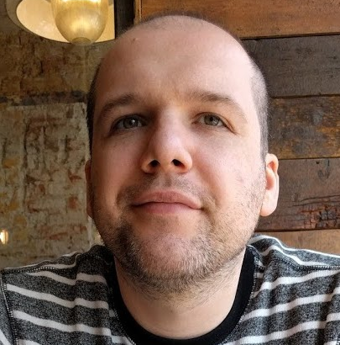
AI Growth and Outreach at Jefferson Lab
Weekly, informal meeting
  Every Wednesday at noon: https://www.jlab.org/AI/lunch_series/2020
Foster community growth
Quarterly physics-inspired ML problems.
  https://www.jlab.org/AI/quarterly_problem
  (with prizes!)
Host external speakers

Slide 14
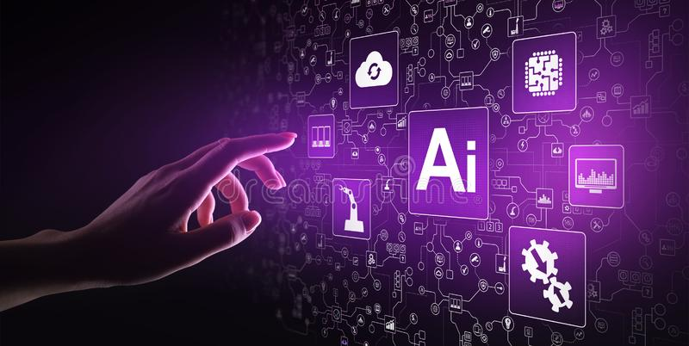
EPSCI: Artificial Intelligence and Machine Learning Coordination
AI Town Hall for JLab ENP+CST on Aug. 8, 2020
  24 projects presented:
      https://docs.google.com/spreadsheets/d/1bAsHq4Zp4pTUMqwUn3600jT3fUrFGIhN5EdCJqn2fr8/edit?usp=sharing
  Most are current projects, a few recent, and a few planned
  Broad categories:
    Detector Design
    Monitoring
    Triggering
    Charged Particle Tracking
    PID
    Simulation
    plus a few more ...

Slide 15
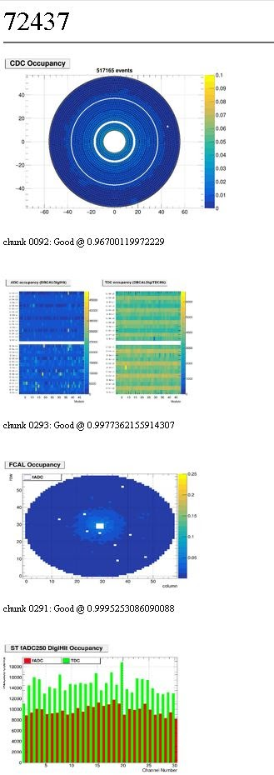
EPSCI: AI/ML Projects
Two EPSCI group members already work on AI/ML Projects. We have hired an AI/ML expert to join the group.
Hydra was a GLUEX project, now supported by EPSCI, that has been successful in 2020.
  Designed to tap into the monitoring stream already in place in GlueX and look at plots periodically.
  Utilizes all the advances in A.I. image processing
  Between 93 and 99% accurate.
    Has found mislabeling by human experts.
  Processes can “listen” to hydra and take action.
    Alarm, produce high-level reports etc.
  This year HYDRA detected an issue with GLUEX that was unnoticed by shift takers and would have seriously impacted data quality.
    This has made management sit up and take notice!
GlueX and CLAS12 are both interested in ML for tracking and particle ID.
Theory are investigating ML based event generation.
A portion of the real-time web dashboard of Hydra inference

Slide 16
LDRD: INDRA-ASTRA
  LDRD
  goal
prototype components of streaming readout at NP experiments
→ integrated start to end system from detector read out through analysis
→ comprehensive view: no problems pushed into the interfaces
prototype near real-time analysis of NP data
→ inform design of new NP experiments
Front End data
Near real-time processor of streamed data in JANA2
Near real-time, interactive analysis in JupyterLab: automated data-quality monitoring and calibrations
fADCs
Front End data
Analysis data
GEM detector
Front End data
Custom MC Simulated ADC and TDC output
ZeroMQ messages via ethernet

Slide 17
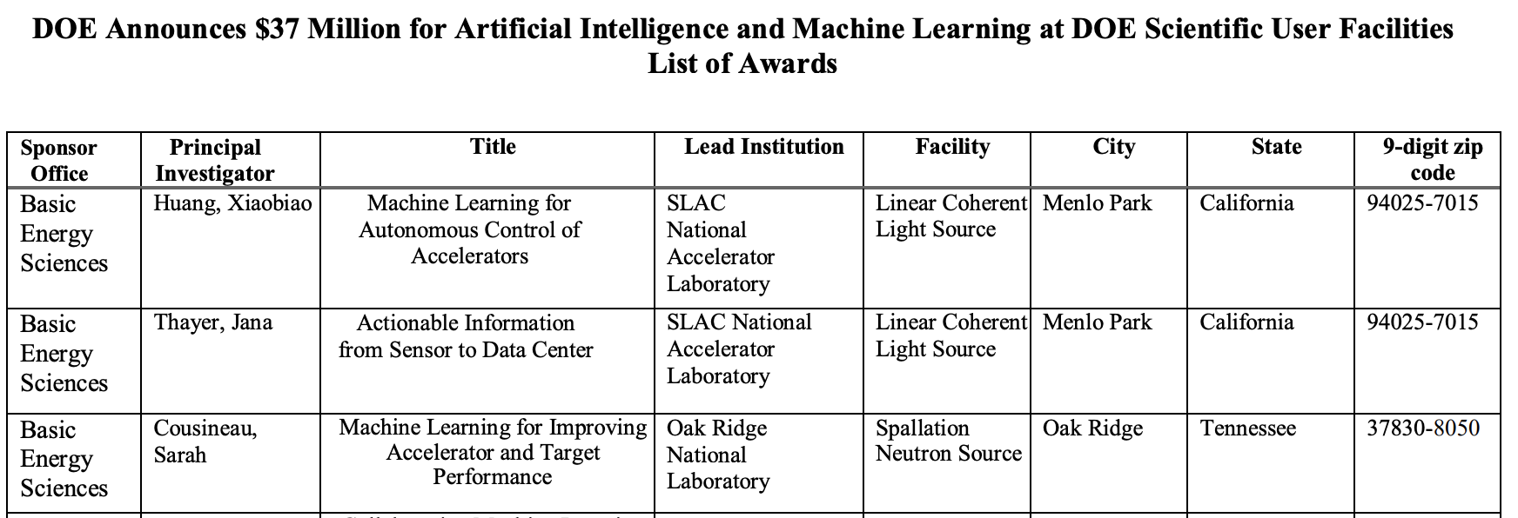
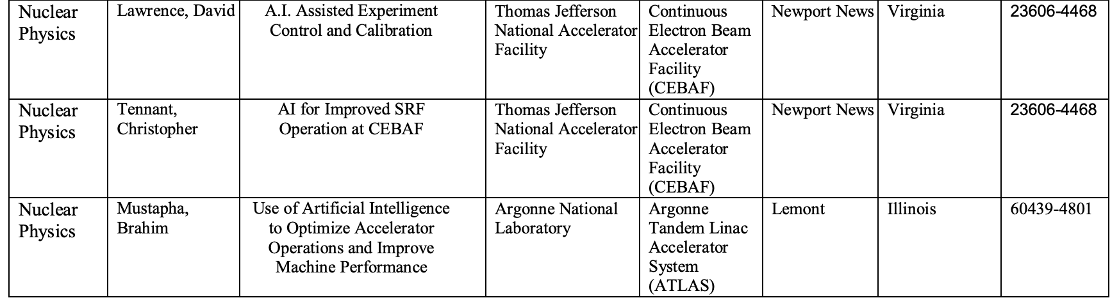
DOE AI/ML funding awards
$0.81M
$1.35M

Slide 18
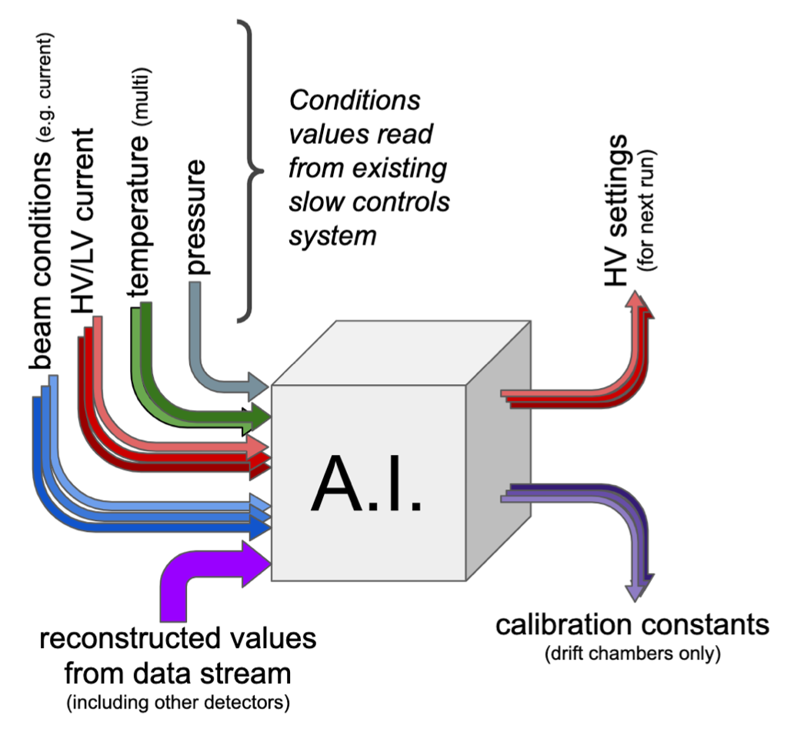
EPSCI: Experimental Detector Control/Calibration with A.I.
Project Goals
Adjust detector controls in near-real time to reduce or eliminate need for offline calibration
Stabilize the GlueX CDC gain to within 5% over a 2 week period with no measurable degradation of the timing resolution.
Reduce time to process data and therefore to publication by 3-6 months
David Lawrence - JLab EPSCI - PI
Thomas Britton - JLab EPSCI - Co-PI
Naomi Jarvis - CMU - Co-PI
New hires: 1 Post-doc and 1 Computer Scientist

Slide 19
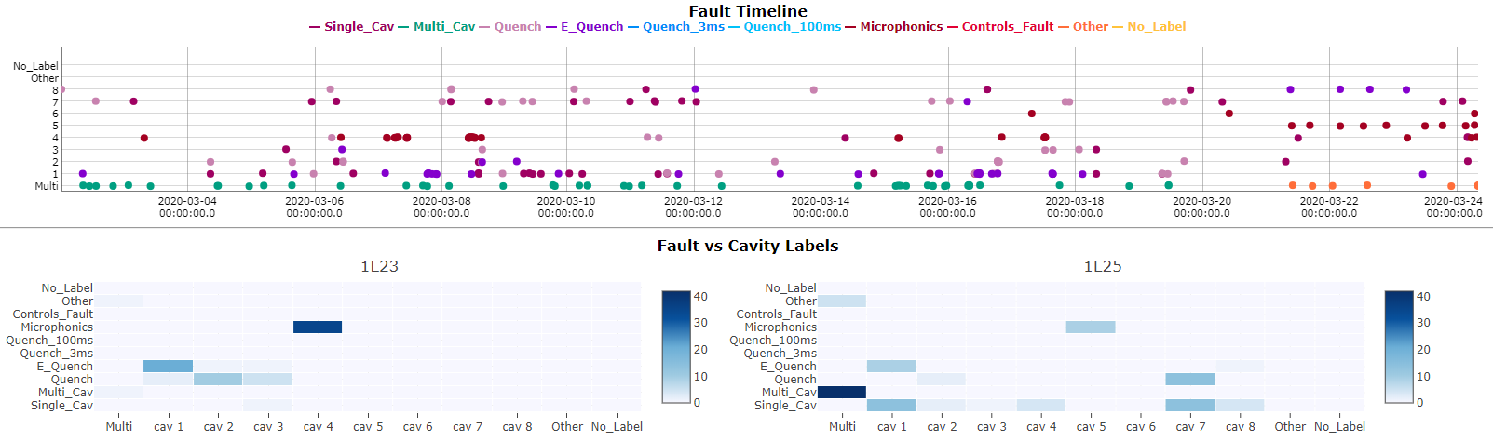
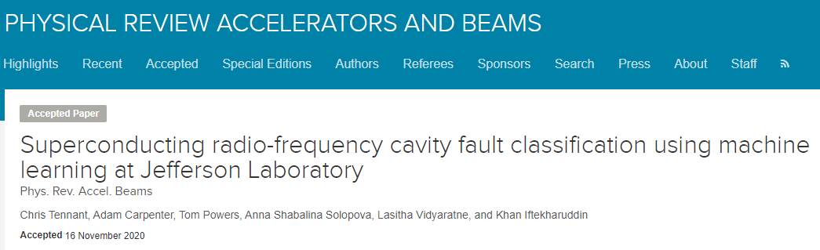
Accelerator AI: ML-based Superconducting RF Cavity Fault Classification
Developed and deployed an online machine learning system in CEBAF to automatically classify C100 cavity faults
Avoids time-intensive labeling from subject matter experts.
Results are useful for:
  Post-Run Analysis
  use aggregate statistics for data-driven guidance for maintenance and/or upgrade activities.
  Post-Fault Analysis
  provides critical feedback to control room operators.
System provided feedback to subject matter experts (SME) in the summer 2020 physics run.
Online visualization tools communicate ML results clearly and concisely to operators and SMEs

Slide 20
Accelerator AI: FOA “AI for Optimized SRF Performance of CEBAF Operations”
A recently awarded 3-year FOA builds on the work of the previous slide and extends the work to optimizing SRF operations more broadly.
  Take advantage of continuous RF data stream from C100 cryomodules to develop online machine learning models to provide real-time predictions for impending faults.
    This represents a critical step towards developing systems that could anticipate and then apply corrective actions to avoid the fault altogether.
  Minimize harmful field emission in the CEBAF linacs by re-distributing SRF cavity gradients while maintaining constant energy.
    This will reduce personnel radiation doses and prevent radiation damage to beamline components while increasing CEBAF reliability and maintainability.
  Develop a data acquisition system to record high-fidelity RF signals from legacy C20 and C50 cryomodules and leverage machine learning’s ability for pattern recognition to develop models to automatically detect SRF cavity instabilities.
    This will result in more efficient operation of the machine.

Slide 21
Accelerator non-AI Electron Cooling and IBS Calculations
JLab Simulation Package for Electron Cooling (JSPEC)
  Calculates the Intrabeam Scattering (IBS) rate and electron cooling rate.
  Simulates the ion beam evolution under the IBS effect and/or electron cooling effect.
  Provides various models for the ion beam and electron beam.
  Provides various formulas for magnetized and non-magnetized friction force and IBS rate.
  Calculate the instant luminosity during the cooling process.
  Benchmarked with other codes and experimental data.
  Written by C++ for high efficiency.
  A Python wrapper has been developed.
  Parallelized using OPENMP for shared memory structure.
  Open source, codes and documents are available on GitHub:
          https://github.com/JeffersonLab/ElectronCooling
  Used in electron cooling and IBS simulations for the EIC design.
  Online version available through SIREPO (cloud service) by Radiasoft.

Slide 22
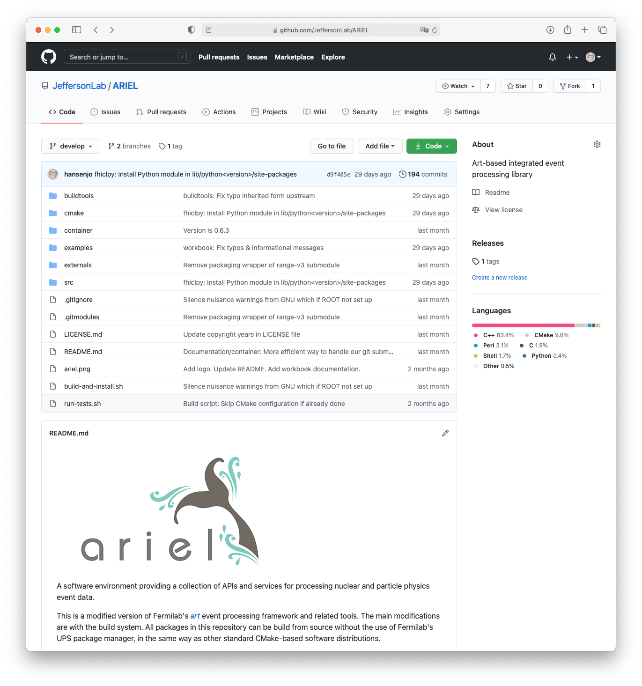
Hall A
General
Multi-threaded version of Hall A analyzer (“Podd”) under development.
  Will benefit SBS and Hall C.
Current Experiments
Analysis of parity experiments PREX/CREX completed/ongoing.
13.5 TB of raw data.
SuperBigBite Spectrometer (SBS)
Preparing for first data taking in Fall 2021.
  Anticipating DAQ rates of up to 1 GB/s and ultimately several PB of raw data.
Running extensive simulations, using in-house g4sbs package.
  Offline reconstruction code, based on Hall A analyzer, under development: https://github.com/JeffersonLab/SBS-offline
SoLID
Preparing for upcoming science review. Simulations ongoing, using Hall B’s GEMC framework.
Prototype reconstruction framework: ARIEL (based on art)
  https://github.com/JeffersonLab/ARIEL
Experimenting with DD4hep and track reconstruction libraries.
Hall A Analyzer

Slide 23
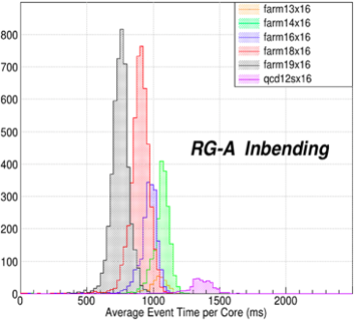
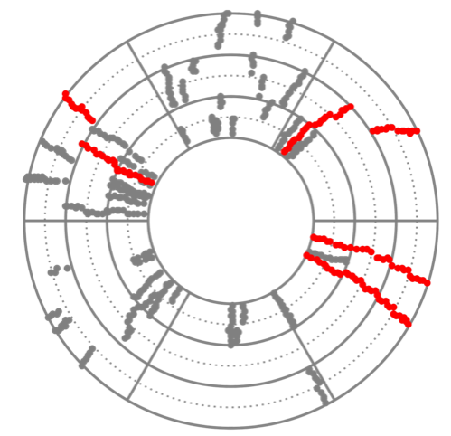
Hall B
First full-scale data processing of CLAS12 2018-2020 experimental runs on JLab farm with very good success
  Workflows developed and throughput benchmarked in advance, performing as expected, 50 million CPU hours this year
  Selected resulting physics analysis in pipeline for collaboration approval and publications (SIDIS, TCS, DVCS)
  Many related presentations at DNP 2020 conference
Started mid-year using JLab's OSG VO for supporting CLAS12 simulations
  With dedicated web portal, priority system, and multiple collaboration institutions providing dedicated resources
  Averaging few-100K CPU hours per week, 12.5 million in the past year
  Using CVMFS for software distribution and XRootD for common data distribution, e.g., background files
Machine-Learning developments
  CLAS12 track-finding for speed improvement implemented and being incorporated into standard workflow
  Cylindrical tracker noise-reduction, magnetic field, and RICH/ECAL actively being explored
One tracker event, with good tracks found by AI in red, and noise/background in grey

Slide 24
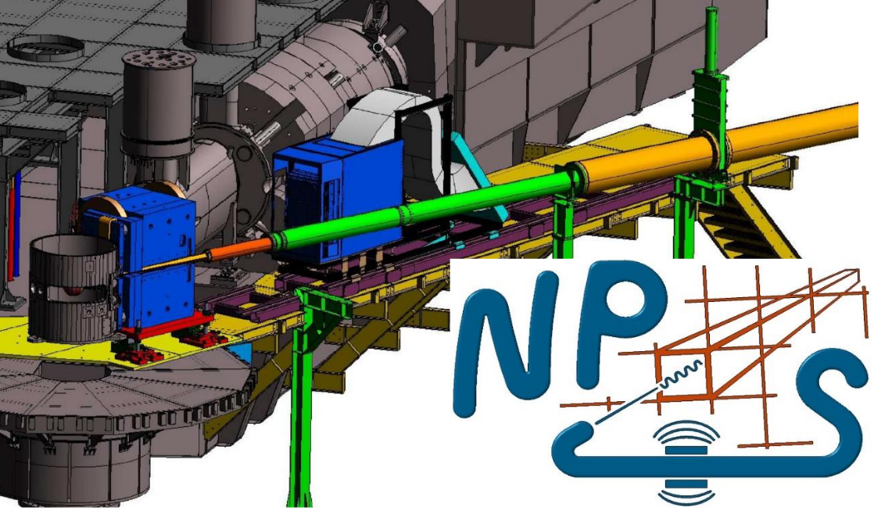
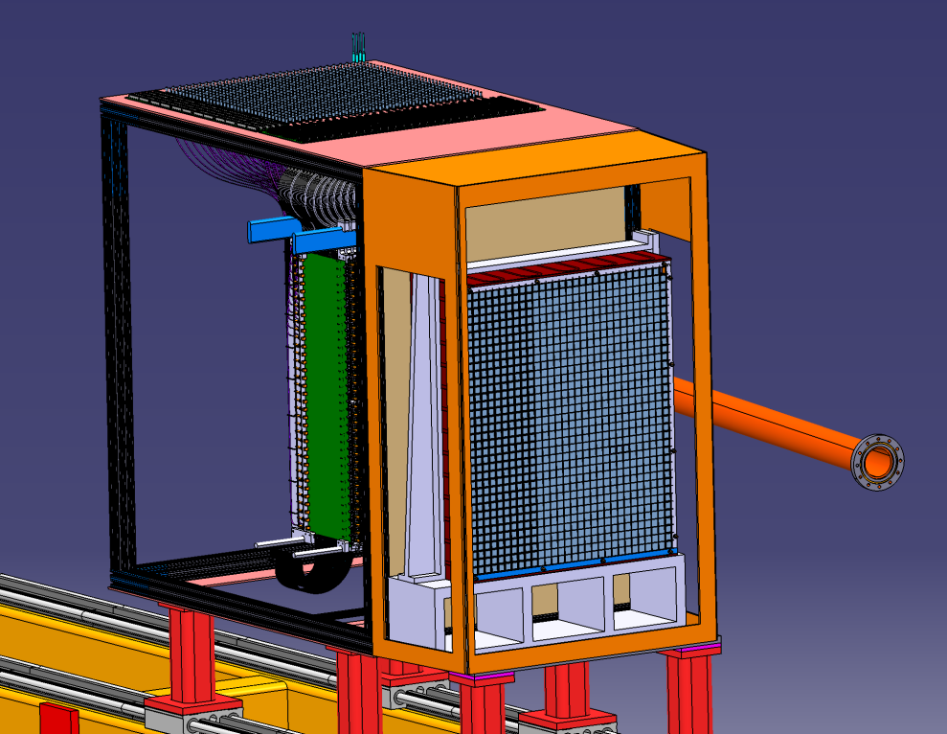
Hall C
General
No major upgrades needed to satisfy current program
  System is very reliable, no issues
Hall C “Remote Counting House” prototype developed during the Fall 2020 run. (Used to supplement standard on-site shift crew in this phase – worked well.)
  This will be a 'production' option for selected external collaborators for upcoming slate of experiments beginning in Fall 2021
Neutral Particle Spectrometer (NPS)
Future experiment that will put pressure on current Hall C DAQ/network systems (Earliest run period: 2022/23?)
  O(100 MB/sec) data rates driven by waveform readout on 1080 crystal calorimeter array
  Modest network/compute infrastructure upgrades are in progress to increase bandwidth and allow greater overhead
  FE/DAQ group developing VTP + FADC firmware to sparsify readout based on updated clustering algorithm
  Updates to Hall C Analyzer (based off Hall A Podd) to support new detector and data analysis requirements also in progress
NPS in Hall C

Slide 25


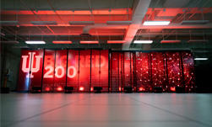


Hall D
Order of magnitude boost in calibration database performance
  Obviated need for extra servers from JLab Computer Center
Off-Site data processing expansion
  Sites:
    NERSC
    Pittsburgh Supercomputing Center
    Big Red at Indiana University
    Compute Canada
    Open Science Grid
  Raw data reconstruction as well as simulation
Multi-threaded Geant4-based simulation (HDGeant4) arrived
Containerization progress
  OSG’s Oasis (CVMFS) as a software distribution mechanism
  Routine use of Singularity for infrastructure development on future platforms
Python 2 to Python 3 conversion done
  Inter-operability with a common software base
Hall D Data Model (HDDM) instrumented with option for HDF5 formatting and I/O
Hall D Online Skim System (HOSS)
  DAQ (CODA) system writes raw data to a large RAM disk on a buffer server
  HOSS distributes raw data from buffer to one of several RAID servers
  HOSS sends copy of raw data to one of several farm nodes to produce skim files
Indiana

Slide 26

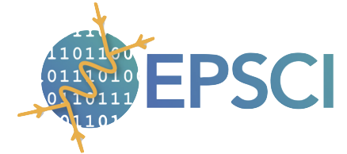
EIC: Jefferson Lab’s role in Software & Computing for the EIC
EIC Computing coordinated by Graham Heyes (JLAB) and Jerome Lauret (BNL)
EIC Software
Emphasizes the close connection of EIC Science to 12 GeV CEBAF science program
Coordinating role for EIC Software in close collaboration with BNL
EIC Software Consortium (ESC), NAS study, EICUG Software Working Group (SWG)
Strong involvement in Yellow Report Initiative: ESCalate with g4e, modern MCEGs
Experimental Physics Software and Computing Infrastructure
led by David Lawrence
JANA 2 framework development
C++ event processing framework
factory model on demand interface, user-centered design
multi-threaded with > 10 years experience
plugin support provide mechanism for many physicists to contribute, multi-threading external to contributed code (parallelizer)
Streaming Readout
Environment for Real-time Streaming Acquisition and Processing (ERSAP)
hardware/software system that will process unbounded streams of continuous data at scale over distributed heterogeneous resources in (near) real-time
currently tested at CLAS12
Artificial Intelligence
dynamic control/calibration of experimental detector systems
automated data quality monitoring
automated calibrations
heterogenous hardware support in reconstruction

Slide 27
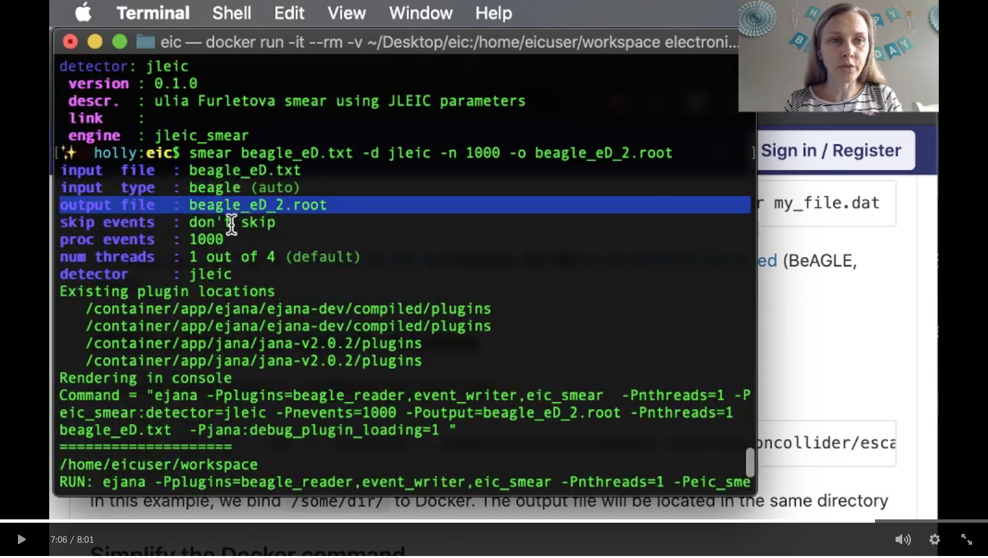
EIC: Making software easier to use
Fast simulations on the command line
smear beagle-eD.txt # smears MC input file (BeAGLE format) with handbook detector
smear pythia-ep.hepmc2 -o myfile.root # smears MC input file (now HepMC format)and sets output file name
smear -d beast -n 10000 beagle-eD.txt # uses beast detector and smears only 10k events
Instructions (and linked files), based on modular ESCalate framework
Works on local system (using Docker), BNL and JLAB systems (using singularity), and cloud (using JupyterHub)
Video tutorial by Holly Szumila-Vance (8:01 minutes)

Slide 28
EIC: EOI for Software: Workplan for Software Working Group
Common Projects
Software Tools for Simulations and Reconstruction
  Monte Carlo Event Generators
  Detector Simulations
  Reconstruction
Middleware and Preservation
  Workflows
  Data and Analysis Preservation
Interaction with the Software Tools
  Explore User-Centered Design
  Discoverable Software
  Data Model
Future Technologies
Artificial Intelligence
Heterogeneous computing
New languages and tools
Collaborative software
29 institutions
https://indico.bnl.gov/event/8552/contributions/43221/

Slide 29
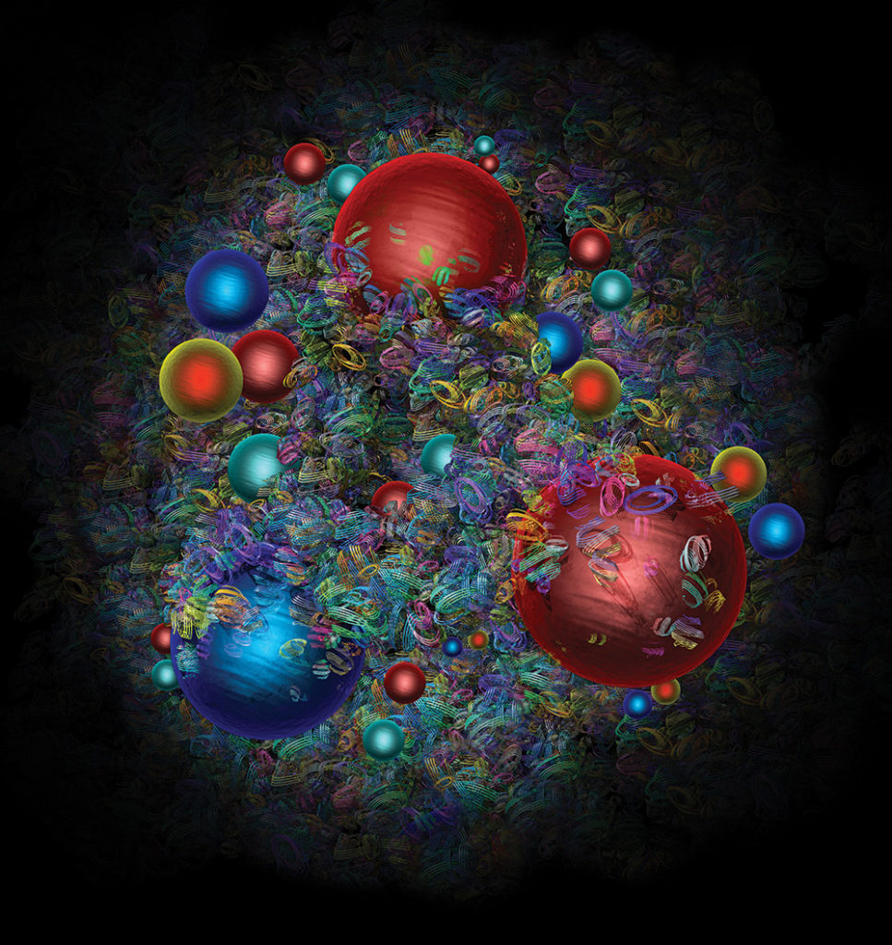



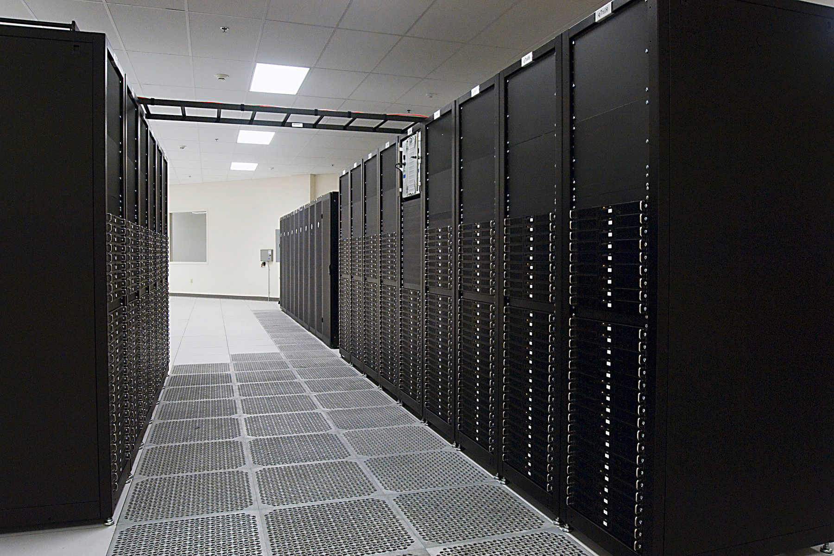


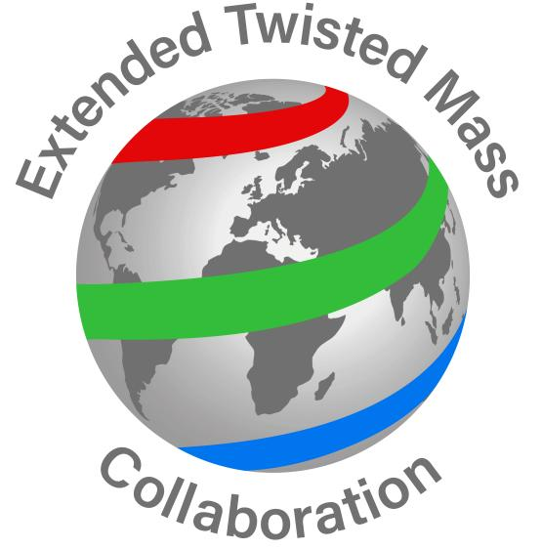
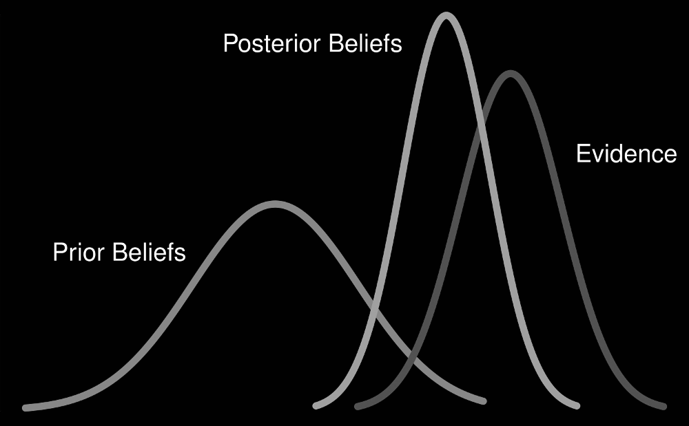
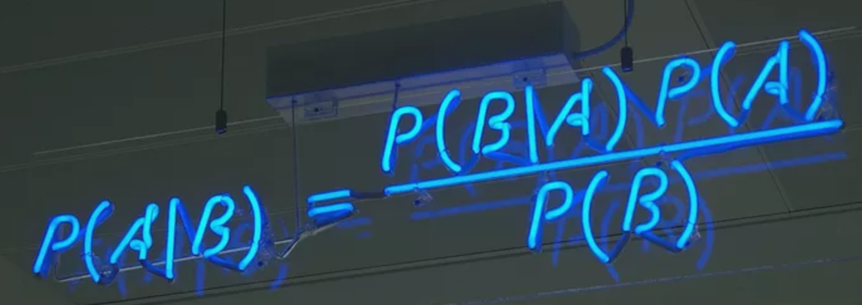
Theory: QCD global analysis paradigm at JLab
Experimental data
Femtoscale structures
Bayesian inference
Theory
Lattice QCD data

Slide 30
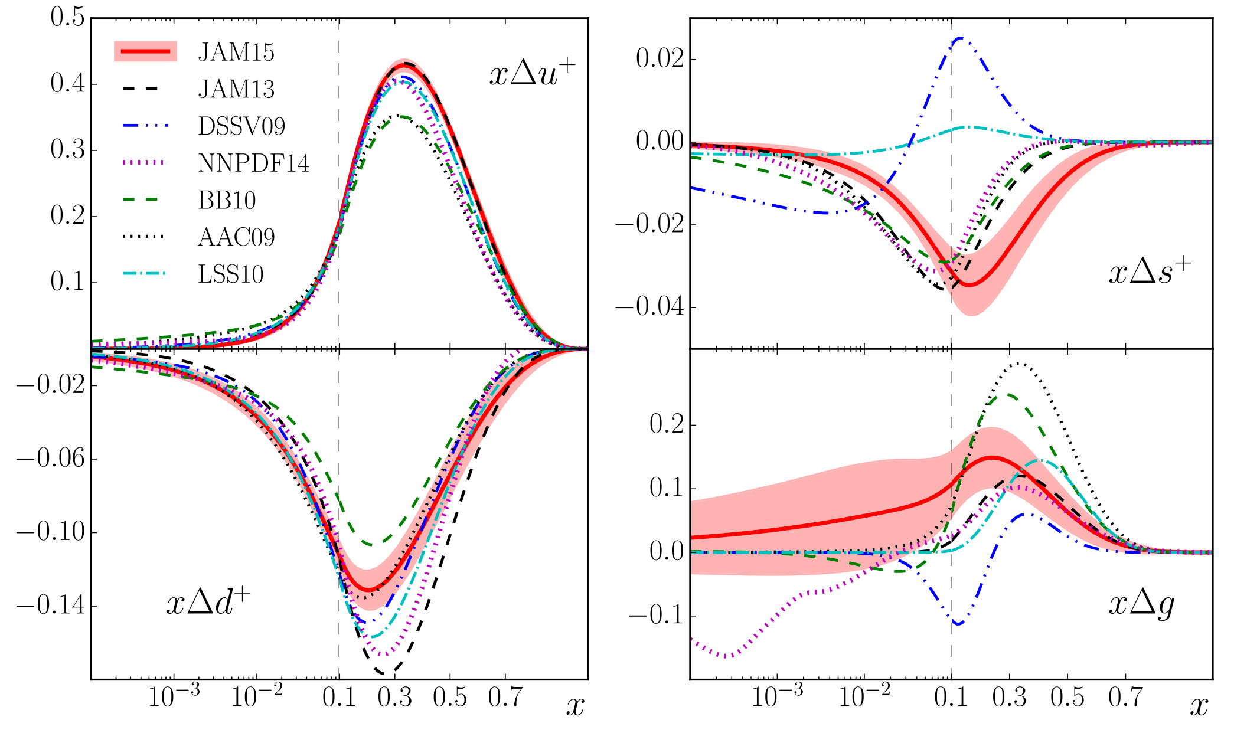
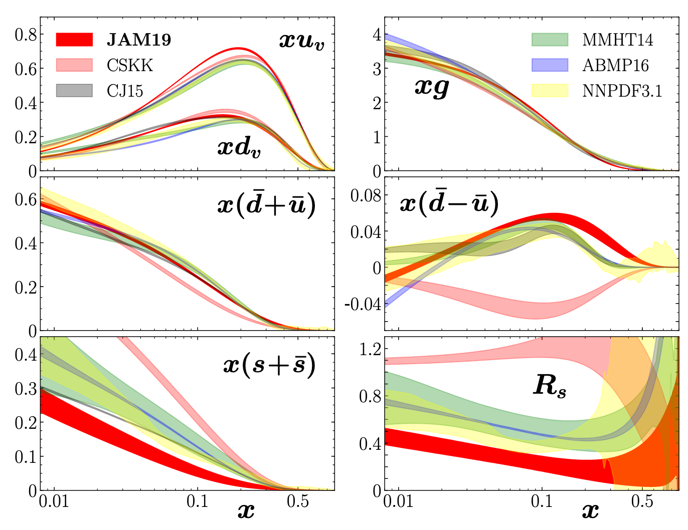
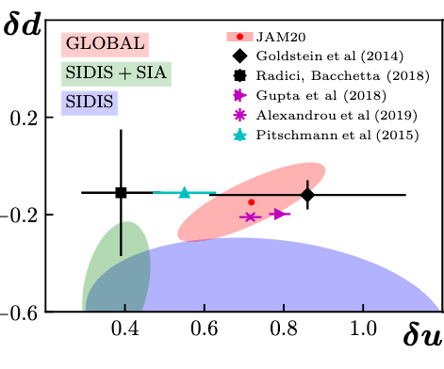
Theory: Understanding the inner structure of hadrons
More anti-downs than anti-ups
Polarized nucleon strangeness is still an open question
Origin of nucleon spin
Nonzero gluon polarization
Strange content of the proton is still not well understood
Nucleon tensor charges compatible with lattice QCD
PRD.93.074005
PRD.94.114004
PRL.119.132001
PRD.101.074020
PRD.102.054002
PRL.120.152502

Slide 31
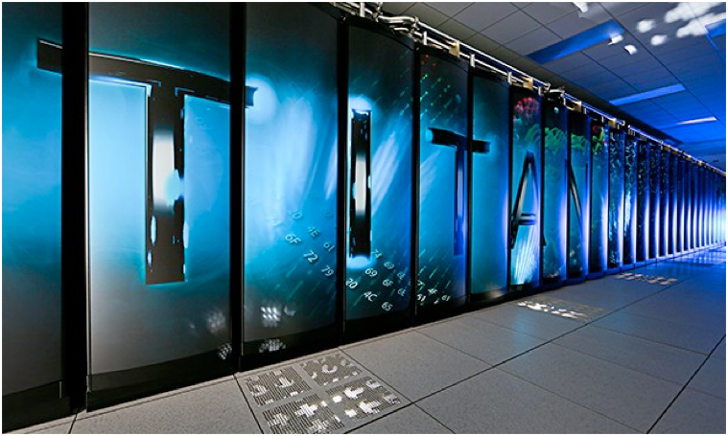


QCD: USQCD & Lattice QCD software development
US Lattice QCD coordinated effort involving JLab, BNL & FNAL : ~150 scientists
Software efforts: efficiently utilize national resources leveraged with local/commodity resources
DOE Office of Science - software development grants:
Partners:
  ASCR: Advanced Scientific Computing Research
  HEP: High Energy Physics
  NP: Nuclear Physics
Architecture
Algorithms
Applications
JLAB

Slide 32

QCD: Quark distribution functions
Significant progress - determine quark/gluon distributions directly from Euclidean space
Current activity - polarized and transversely PDFS
Quark Generalized parton distributions
Isovector valence (unpolarized) quark distribution within nucleon
Hadron Structure: PRL 125
LQCD & pheno each have different
limitations at small-x

Slide 33








QCD: First prediction for $π_{1}$ full width from LQCD
Finite-volume energy levels
Scattering formalism relates finite-volume
energies to scattering amplitudes
8 channel scattering matrix
solutions, En, of
HadSpec: arXiv 2009.10034
phase-space
scattering matrix
finite-volume function
$π_{1}$ branching fractions ~500MeV width
$b_{1}π$ much larger than
models suggest
First determination of full branching fractions for an exotic
GlueX searching here

Slide 34


QCD: State of the art
Finite-volume energy levels
Progress in theory+algorithms+software+hardware: USQCD, SciDAC & Exascale Computing Project
Focusing on a rigorous approach to study QCD
  Often at the wrong light quark mass, but still QCD!
Emphasis so far on meson resonances in coupled-channel meson-meson scattering.
  Very first forays into baryon resonances
To study higher energy, and go to lighter quark masses, need three-body decays.
  More complicated formalism.
First calculation of a 3-body amplitude
Hadron Spectrum: to be published in PRL
3-body amplitudes

Slide 35





Working towards next generation experiment-theory integration
MCWRAPPER
SWIF2
OSG, NERSC
Monitoring
Experiment
ML - HYDRA
Streaming
Readout
Simulation
Calibration
LQCD gauge config.
JANA, CLARA, CODA
ML (CLAS12)
SWIF2
Reconstruction
ML tracking
SWIF2
JANA, CLARA
OSG, NERSC
Physics amplitudes
Analysis
CLAS12 trains
SWIF2
Theory
Spatial and momentum Distributions
Visualization
and
global analysis

Slide 36
Last words
There is clearly a lot going on.
  I think our reorganization and growth in scientific computing has great potential.
  It is very impressive to think that all the hard work this year was achieved despite the non optimal working conditions.
  Thanks to all the groups who provided slides for this talk!
  I look forward to seeing what 2021 will bring.
  I hope everyone enjoys a well-earned holiday.

