Slide 1
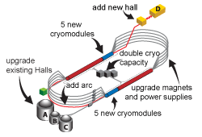
Accelerator Operations Overview
Camille M Ginsburg
Director of Accelerator Operations
CPP Project Director
Hall A Collaboration Meeting
January 30, 2020

Slide 2
Outline
CEBAF operational experience/plans
CEBAF performance and planned improvements
Shutdown achievements/plans: Fall 2019 SAD, Winter 2019 “soft” shutdown, and upcoming May-Dec 2020 SAD
Other considerations for accelerator operations: collaboration and test accelerators

Slide 3
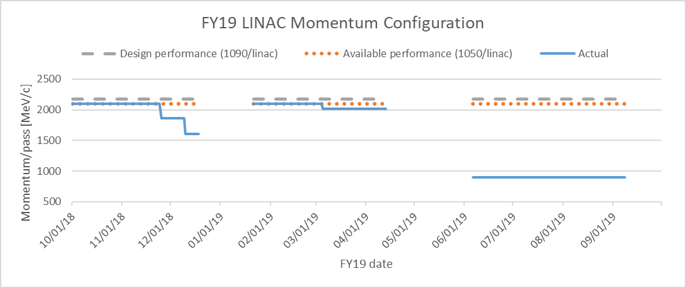
CEBAF operations FY19: Configuration overview
CEBAF delivered beam to all four halls in high-energy running, and 2-3 halls in low-energy running
FY19 schedule was extended to regain some of the lost weeks in Aug/Sep 2018
High-energy running
Low-energy running

Slide 4
CEBAF FY19 operations experience for experimenters
Main FY19 issues from the experimenters
  Recovering stable accelerator operations after a shutdown took too long
  Accelerator performance problems led to lost beam time
  Inability to run stably at high energy due to poor energy margin required schedule modifications
    Some planned Hall B experiments were no longer viable at lower energy
    GlueX at Hall D was finished
  Providing beam suitable for parity measurements at Hall A required a lot of tuning at Hall B
Main FY19 positives from the experimenters
  The lower energy run was more stable and able to operate at higher currents with a much reduced number of trips
    Accomplished more than expected in terms of beam on target
    Accomplished several high-impact (by PAC definition) experiments as requested by PAC and DOE-NP

Slide 5
CEBAF Configuration FY20-FY21
Run with high-energy configuration from Nov. 25, 2019 until May 6, 2020
Long shutdown May 6 through the end of FY21Q1 including helium liquefier upgrade
Long run ~Jan–Sept FY21 to achieve 30+ weeks of running (TBC!)
Three different high-energy runs: (2100, 1960, 1820 GeV/c/pass) for Hall C || – ┴ pion cross sections
a1n/d2n

Slide 6
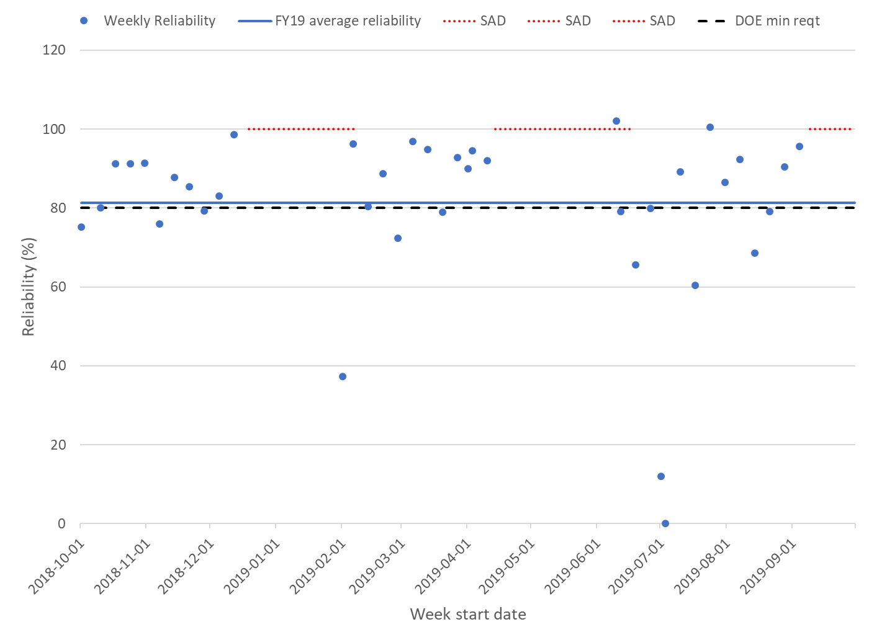
CEBAF performance FY19: exceeded DOE >80% reliability requirement
Average reliability for FY19 is 81.3%
Reliability is most variable at re-start after shutdowns
  Reduce the frequency of shutdowns
Reliability is defined as hours delivered divided by hours scheduled
FY19 reliability: 4621.9/5685 = 81.3%
380 more delivered hours would bring us up to planned 88% reliability
A normal week has 164 scheduled hours; 144/164=88% by plan negotiated with experimenters
FY19 deliv wks of ops = 4621.9/164=28
FY19 sched wks of ops = 5685/164=35
High-energy runs
Low-energy run

Slide 7
CEBAF FY19 performance summary
CEBAF delivered beam to all four halls in high-energy running, and 2-3 halls in low-energy running
Average reliability for FY19 is 81.3%, exceeding our requirement
Reducing the frequency of shutdowns reduces the start-up variability, improving average reliability
In the low-energy configuration, more gradient overhead put less stress on RF and more on tuning due to the unfamiliar machine configuration
Component downtime was dominated by CM zones*, with significant impact from individual RF cavity systems†, cryo system and RF separators; several other components played a smaller but still significant role
Machine trips were dominated by C20 zones by frequency, C100 zones by recovery time, with several other significant contributors
*CM zone includes a vertical slice of SRF, RF, vacuum
†RF cavity system includes the SRF cavity and its associated systems with smaller impact than a whole CM zone

Slide 8
Ongoing run momentum choice
Our primary goal is to provide stable, high-energy running with the same or lower trip rate through continual improvement
  Current capability estimate to keep trip rates < 8/hour and cryo load not choked (Nov 2019):
    North Linac: 1042 MeV/c
    South Linac: 1095 MeV/c
  Conservative estimate to account for potential degradation during the run AND to ensure parity quality beam to Halls A, B and C led to a choice of 1031 MeV/c in each linac, or 2062 MeV/c total per pass
    Three halls have greater than 98% of cathode polarization
  More gradient overhead will reduce trip rate, as problematic cavities can be turned down and others turned up

Slide 9
CEBAF operational priorities/plans
Reach 12 GeV (5.5 pass) in normal operation – steady progress expected in 2020
New (to me): revisit limitations on total current which constrain Halls A and C experiments
Even when we make high gradient with high accelerator reliability, it’s not good enough because of trip rates and heat loads to the cryogenic system
  These are both directly related to field emission in cryomodules
  Physics prefers steady running to short-term gradient reach with high trip rate
Primary issues to be addressed for high quality physics output
  Mitigate field emission in cryomodules
  Reduce trip rates
  Reduce downtimes
Follow the CEBAF Performance Plan, already in place
  Critical spares, obsolescence, energy reach
  Update CPP in FY20 with recent data and accomplishments
  CPP is not aggressive enough – will step up our effort, funding permitting
Improve cryomodule performance
  Install better cryomodules, reduce particulates in warm sections, monitor field emission induced radiation to understand impact of improvements, assorted development work
Make shutdown/problem recovery faster and more reproducible through work processes, procedures, and planning
Target low hanging fruit and most troublesome components using data

Slide 10
CEBAF Performance Plan (CPP)
JLAB-TN-17-022
Multi-year strategy to improve and maintain CEBAF performance
Reach full energy gain in FY22, >80% reliability in FY19, then continual reliability improvement
Strategy in brief:
Identify and purchase Critical Spares to mitigate the impact of single-point failures
Replenish consumed hardware spares, e.g., klystrons
Increase Energy Reach to support the design energy with robust energy margin to address
  Historical CM degradation ~17 MeV/linac/year
  Gradient below spec
  Field emission and particulates
Upgrade original CEBAF systems to mitigate obsolescence issues in a timely manner, i.e., before reliability degrades
Procure equipment to minimize future maintenance duration, to support up to 34 weeks per year of CEBAF operation
NB: CPP assumes <15 trips/hr overall; <10 trips/hr RF
We achieved this in FY19 but it was too high for expt’ers
34

Slide 11
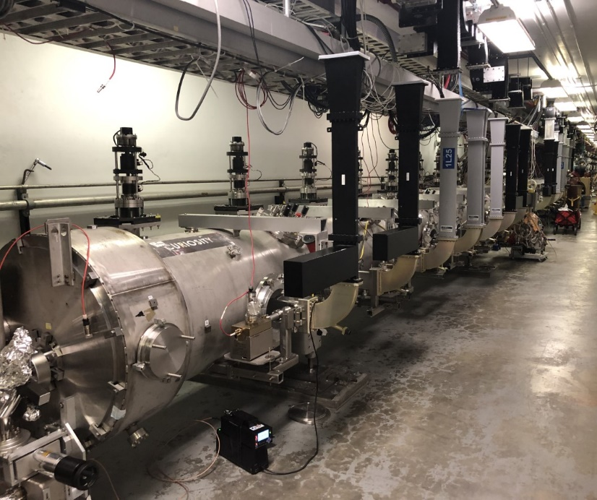
CEBAF Operations – Energy Reach
Energy reach to be improved yearly through the CEBAF Performance Plan
  Improvements via new C75 and refurbished C100 cryomodules
  Steady progress expected in 2020
  Full 12 GeV (5.5 pass) operations, with margin, expected ahead of the FY2024 run periods
First refurbished C100 installed met energy gain expectations – best CM in CEBAF
  Provides further confidence in the plan
Other improvements from the CEBAF Performance Plan already in place
  Procurement of critical spares, replacement of obsolescent components
  Example: increased klystron inventory allows accelerating cavities to be run at full gradient through klystron replacement, instead of degraded in case of klystron weakness or failure
  Example: procured magnet spares reduces unscheduled downtime risk
Energy reach optimizations with existing system for high quality physics
  Mitigate field emission in cryomodules
    RF process cryomodules, reduce particulates in warm sections, monitor field emission induced radiation to understand impact of improvements
  Continually monitor and maintain components to reduce trip rates and reduce unscheduled downtimes

Slide 12
CEBAF shutdown accomplishments FY19
Main goals
  Improve machine performance
    Increase machine energy from Summer Run
  Improve machine reliability – goal >80%
    System upgrades and improvements
  Improve machine set-up and tuning
    Beam transport improvements
Main tasks
  Injector in situ studies for 2020 Injector Upgrade to 200kV
  SRF/Cryogenic/Vacuum Gyrations: 3 cryomodules and >80 U-tubes
  CHL1 major maintenance
    Preparation for CHL1 Subatmospheric Cold Box replacement in 2020
  RF zone conversion (analog to digital) – needed for Energy Reach program
  Electrical Substation major maintenance
    10 year cycle to improve electrical distribution & reliability
  Low Conductivity Water System improvements
  Service Building Air Conditioning improvements
    Greater heat discharge to improve system performance and reliability
  CAMAC to VME upgrade
    Ongoing work to remove obsolete equipment
  PSS Certification: a step in the path toward annual certification

Slide 13
CEBAF FY19 Shutdown Activities for Cryomodules – All in North Linac
98MeV*
25 MeV**
Out for future rebuild
C100-6R
Out for future rebuild
(becomes C75-02)
C20 “Stubby”
10 MeV
~OFF
72MeV
54MeV
82MeV
1L07
(P1)
1L20
(C20)
1L23
(P2)
1L25
(C100)
1L26
(C100)
Courtesy of A. Seryi
FY19 Summer Cryomodule Moves:
Install C100-06R into zone 1L25
Move and install C100 from 1L25 to zone 1L07
Remove cryomodule P1 from zone 1L07 for potential future rebuild
Install older C20 (not refurbished) into zone 1L20
Remove C20 from zone 1L20 for future rebuild
*Expected based on cavities tests results
**Expected based on recent cryomodule test results

Slide 14
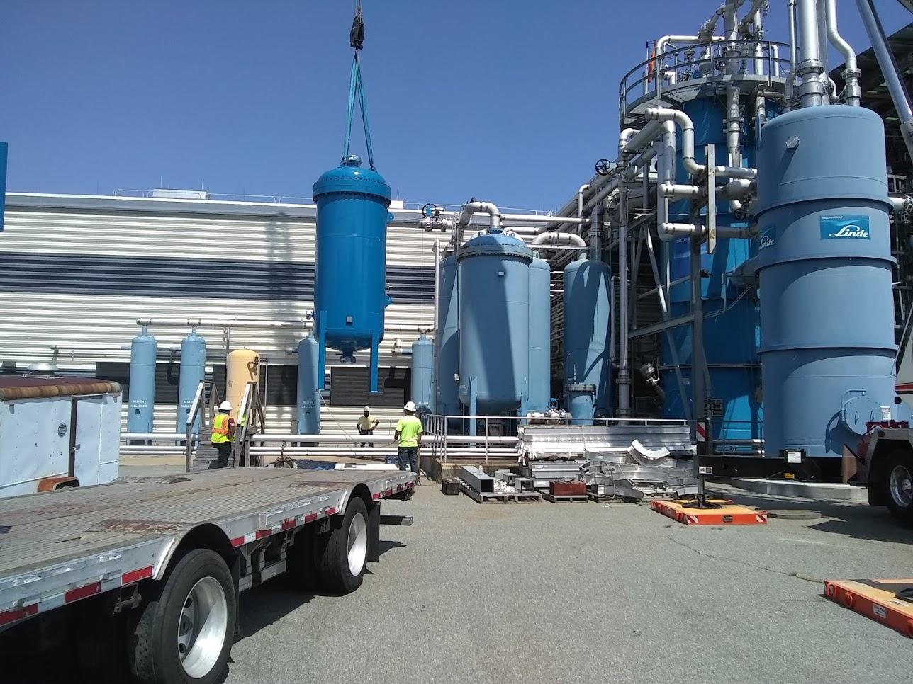
CEBAF accomplishments SAD FY19: Cryogenic system CHL1&CHL2
During low-energy running (and LERF testing)
  CHL1 shutdown and warmed to 300K
    Completed maintenance and repairs: Warm compressors, Cold compressor mag bearing and VFD’s, Vacuum systems, Carbon beds and piping clean up, repairing leaks
  CHL2 supported 2.1K on North & South linacs and LERF
During shutdown
  Restarted 2.1K and split LINACS
  Mapping cold compressor performance and modifying train pressure ratios to lower CC4 speed at given LINAC pressure
Improvements in progress
  Every 6-7 years carbon in primary oil removal adsorber is replaced
    Requires 4 months, with majority of time for drying carbon
  Added secondary carbon absorbers
    New vessels for CHL1 and CHL2
    Will allow offline carbon replacement and conditioning on one bed while plant operating on the other bed
    Shortens required shutdown duration from 4 months to few weeks to swap
    Piping and valve design underway, planning piping fabrication/installation
New carbon absorber vessel installation

Slide 15
“Soft” holiday shutdown (Dec 2019 – Jan 2020)
​Goal: Balance operational needs towards accelerator reliability and energy gradient maintenance with weeks of physics operations towards our nuclear physics mission
Addressing accelerator start-up difficulties after a long holiday shutdown
New approach to put the accelerator in a "hot standby" mode
  enclosure to remain locked-up, systems ON, and the control room staffed throughout the holiday period.
    In addition to the standard holiday coverage provided by the Cryogenics Department and Facilities, extra staff were put on 24/7 "on-call" duty while others were asked to provide control room coverage throughout the period
  Keeping the temperature ~constant in the tunnel minimizes variations to orbits
  Avoiding power cycles preserves delicate equipment
Re-start of beam operations showed that the Physics program was able to resume earlier than scheduled and a smooth start-up with ‘free beam’ delivery was realized
This has been a great success, and a lesson for future short shutdowns

Slide 16
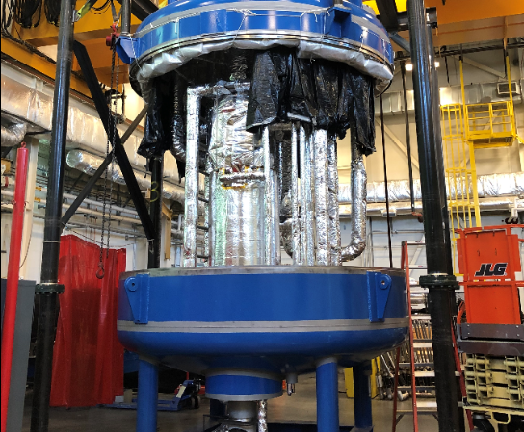
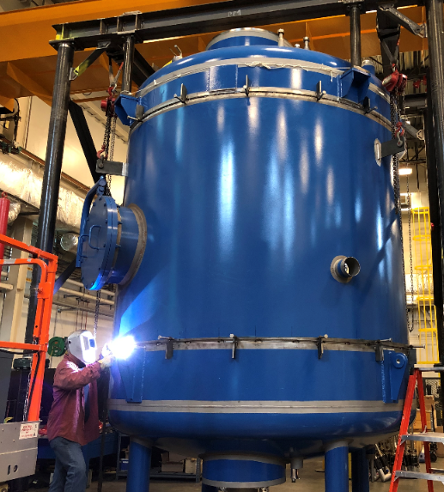
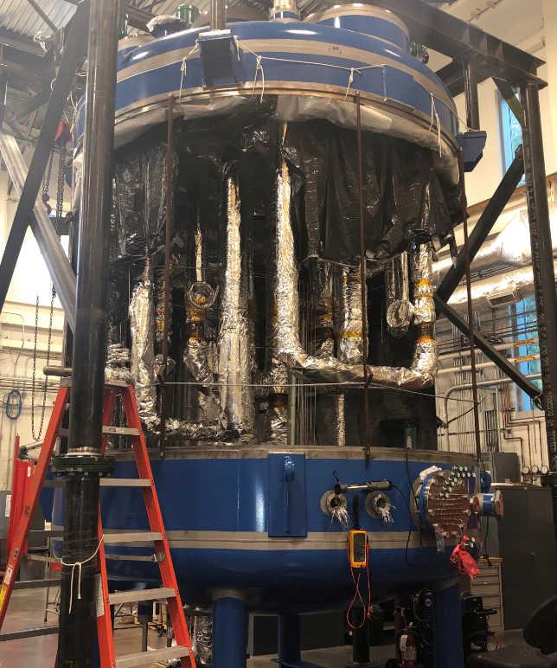
Long CY2020 shutdown (May-Dec 2020) – selection of planned activities
Replace CHL1 cold box
  Existing SC1 2K cold box no longer considered reliable due to two cold compressor problems within the last several years and that the replacement parts are no longer available due to obsolescence.
  A new sub-atmospheric cold box, SC1R, which hosts five technologically superior, water-cooled compressors and one similar 4K-2K refrigeration recovery heat exchanger, will replace the SC1 cold box.
  Engineering and design were completed in November 2018. The fabrication started in the early January 2019 at Lab’s cryogenic fabrication shop. The fabrication will be completed by the end of December 2019.
  The demolition and removal of the existing SC1 2K cold box will start in May 2020. The new 2K cold box will be commissioned by the end of December 2020.
Part 1 of 2 of the injector upgrade for Moller
Cryomodule dance
  Three cryomodules are slated to be replaced, details TBD
  Goal: ability to run stably at 2100 MeV/pass in CY2021
    Need to add 40 MeV plus margin in the North Linac

Slide 17
Operations in the test accelerators: UITF and LERF
Jefferson Lab has two test accelerators which can be used for small R&D experiments
Both have a long list of experiments which we’d like to pursue
  HDIce target development Experiment Readiness Review Nov.19, 2019
  Experimental runs expected during the long down (after May 6, 2020)
Improved responsiveness and more predictable outcomes highly desirable
  Unify components and operations as much as reasonable and safe
  Ownership of systems (e.g., RF, instrumentation) common among all accelerators
Accelerator operations group
  Supplies core accelerator operations staff
  Writes and maintains key operations documentation
  Leads experimental readiness reviews (ERR’s) for accelerator experiments

Slide 18
Tighter coordination of CEBAF operations with experimenters
Nuclear Physics Experiment Scheduling Committee
  Committee: CMG (co-chair), R. Ent (co-chair), V. Burkert (M. Battaglieri), E. Chudakov, J. Gomez, C. Keppel, R. McKeown, M. Poelker, P. Rossi, M. Spata
  Overall schedule and run configuration – experiments input from PAC approvals
    https://www.jlab.org/physics/experiments/schedule
  Allocation of scheduled beam studies, maintenance and RF recovery hours/week
  Proposed schedule and run configuration must be approved by Lab Director
  Prioritization to address any conflicts among experiments provided by Ent/Gomez if needed
Coordination venues
  Accelerator Physicist Experimental Liaisons (APEL’s) coordinate all topics related to beam delivery with the experimental halls
    Have recently revisited the beam parameters with the experimenters to ensure matched expectations for upcoming run
    https://jlabdoc.jlab.org/docushare/dsweb/Get/Document-154003/18-022.pdf
  Plans and expectations for the SRF configuration being revisited in light of shutdown modifications
  Geographic Integrators: members of ops staff serve as “owners” of the areas to ensure consistency between installed hardware and software representations for ops – refreshed this activity
  Daily meetings during operations to discuss immediate issues – small group and larger one
  Weekly ops meetings to discuss ongoing issues, upcoming issues & plans
  Weekly machine physics meetings – beam tuning problems, potential tests with or w/o beam
Tighter integration of accelerator and experiment is desirable and necessary to reach higher accelerator reliability and optimize nuclear physics output

Slide 19
Summary
CEBAF performance in FY19 exceeded requirements
Good strategy in place for improving CEBAF performance in FY20
  Take advantage of existing tools to set priorities
  Many excellent CEBAF technical accomplishments in FY19 will improve our machine capability for FY20
Optimized operations in the test accelerators, UITF and LERF, will make JLab more agile in our ability to organize and run small R&D experiments
Excellent communication with experimental leadership maintained and strengthened to ensure concerns are addressed and interferences negotiated
  Tighter integration of accelerator and experiment is desirable and necessary to reach higher accelerator reliability and optimize nuclear physics output; framework is in place; gaps being addressed
I look forward to working with you to maximize physics output of CEBAF

Slide 20
Acknowledgements
I greatly appreciate slides and content from:
K. Baggett, J. Benesch, S. Benson, M. Bickley, J. Creel, A. DiPette, R. Ent, A. Freyberger, J. Gomez, J. Grames, C. Hovater, R. Kazimi, A. Kimber, R. Michaud, S. Philip,
M. Poelker, T. Powers, C. Reece, T. Reilly, P. Rossi, T. Satogata, A. Shabalina,
S. Suhring, M. Tiefenback, P. Vasilauskis, M. Wissman

