Slide 1
Hall A Meeting Jan 31/2020
GMn Status
Overview
Scheduling
Run Plan
Hardware Status

Slide 2
Overview
E12-09-019 (GMn) Precision Measurement of the Neutron Magnetic Form Factor up to Q²=13.5 (GeV/c)² by the Ratio Method
B. Quinn, J. Annand, R. Gilman, B. Wojtsekhowski
Hall A collab
Approved by PAC 34
PAC 35 allocated 25 of requested 31 days.

Slide 3
What we learn from neutron form factors
Isovector form factor insensitive to disconnected
quark loops. Ideal test case for lattice-QCD
Model-independent extraction of individual u/d flavor contributions.
(assuming s-quark contributions are negligible)
.
Separated quark form factors (extracted using all
four nucleon form factors) constrain GPDs

Slide 4
Technique
e’
e’
e
e
n
p
Many systematic effects (experimental and theory) cancel in ratio.
Expect very small correction for Electric because small
form factor and large kinematic weighting of Magnetic

Slide 5
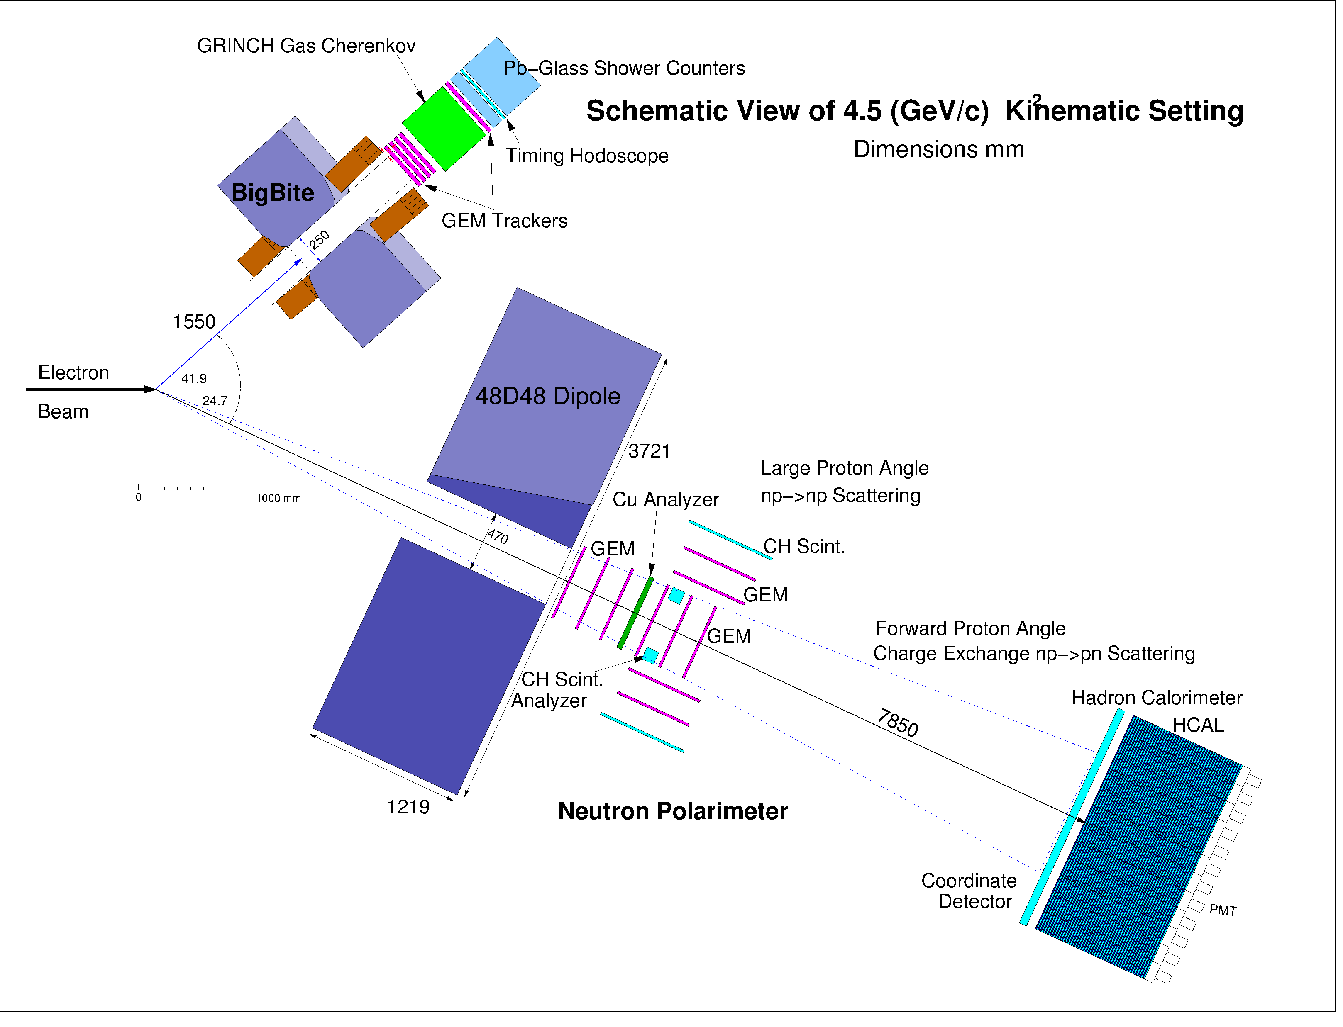
Schematic Experiment Layout
BigBite as electron arm (Beam left)
Identifies q-vector
Fiducial cut in BigBite selects high,
matched acceptance for n and p.
48D48 (SBS spectrometer magnet)
Deflects protons vertically on HCal-J
to distinguish from neutrons
HCAL flight path 6.2 - 17m
HCal-J as hadron detector with CDet in front (Beam right)

Slide 6
Scheduling
ERR passed July 2017
Plans for Hall A running:
Spring 2020 Complete CREX
2020 SBS installation
2021 GMn/GEnRP running

Slide 7
Run Plan
proposed
configuration |  | Q² | E_{Beam} | θ_{BB} | θ_{SBS} | d_{BB} | d_{48D48} | 48D48 field |  | Luminosity |  | dHCal
 |  | (GeV/c)² | (GeV) | (deg.) | (deg.) | (m) | (m) | integral (T-m) |  | (10³⁸/A/cm²/s) |  | (m)
1 |  | 3.5 | 4.4 | 32.5 | 31.1 | 1.80 | 2.00 | 1.40 |  | 0.7 |  | 6.2
2 |  | 4.5 | 4.4 | 41.9 | 24.7 | 1.55 | 2.25 | 1.70 |  | 1.4 |  | 6.2
3 |  | 6.0 | 4.4 | 64.3 | 15.6 | 1.55 | 2.25 | 0.70 |  | 2.8 |  | 11
4 |  | 8.5 | 6.6 | 46.5 | 16.2 | 1.55 | 2.25 | 1.20 |  | 2.8 |  | 11
5 |  | 10.0 | 8.8 | 33.3 | 17.9 | 1.75 | 2.25 | 1.30 |  | 1.4 |  | 13
6 |  | 12.0 | 8.8 | 44.2 | 13.3 | 1.55 | 2.25 | 1.20 |  | 2.8 |  | 14
7 |  | 13.5 | 8.8 | 58.5 | 9.8 | 1.55 | 3.10 | 0.70 |  | 2.8 |  | 17
8 & 9 |  | 3.5/6.0
calibration of HCal using L-HMS at kinematics of config. 1 &3
modified
configuration |  | Q² | E_{Beam} | θ_{BB} | θ_{SBS} | d_{BB} | d_{48D48} | 48D48 field |  | Luminostiy |  | dHCal
 |  | (GeV/c)² | (GeV) | (deg.) | (deg.) | (m) | (m) | integral (T-m) |  | (10³⁸/A/cm²/s) |  | (m)
1 |  | 3.5 | 4.4 | 32.5 | 31.1 | 1.80 | 2.00 | 1.71 |  | 0.7 |  | 7.2
2 |  | 4.5 | 4.4 | 41.9 | 24.7 | 1.55 | 2.25 | 1.71 |  | 1.4 |  | 8.5
3 |  | 5.7 | 4.4 | 58.4 | 17.5 | 1.55 | 2.25 | 1.71 |  | 2.8 |  | 11
4 |  | 8.1 | 6.6 | 43.0 | 17.5 | 1.55 | 2.25 | 1.65 |  | 2.8 |  | 11
5 |  | 10.2 | 8.8 | 34.0 | 17.5 | 1.75 | 2.25 | 1.60 |  | 1.4 |  | 11
6 |  | 12.0 | 8.8 | 44.2 | 13.3 | 1.55 | 2.25 | 1.50 |  | 2.8 |  | 14
7 |  | 13.5 | 11.0 | 33.0 | 14.8 | 1.55 | 3.10 | 0.97 |  | 2.8 |  | 17
GEnRP
 |  |  |  | θ_{L-HRS}
8 |  | 6.06 | 4.4 | 61.1,64.3 | 14.8 |  | 3.10 | 1.71 |  | 0.93 |  | 17
 |  |  |  | 67.5,70.7
9 |  | 4.4 | 4.4 | 39.,42. | 25.5 |  | 3.10 | 1.71 |  | 0.93 |  | 17

Slide 8
Schematic Experiment Layout with GEnRP
4.5 (GeV/c)² Kinematic Setting
HCAL flight path 6.2 - 17m
Analyzer and GEM trackers for G_{en}/G_{mn}
Remove analyzer blocks for GMn
In-acceptance GEM may be removed if not useful for GMn

Slide 9
Run Plan
Present plan to optimize GEnRP/GMn changeover (removal of downstream SBS field clamp)
configuration |  | Q² | E_{Beam} | θ_{BB} | θ_{SBS} | d_{BB} | d_{48D48} | 48D48 field |  | Luminostiy |  | dHCal
 |  | (GeV/c)² | (GeV) | (deg.) | (deg.) | (m) | (m) | integral (T-m) |  | (10³⁸/A/cm²/s) |  | (m)
2 |  | 4.5 | 4.4 | 41.9 | 24.7 | 1.55 | 2.25 | 1.71 |  | 1.4 |  | 8.5
1 |  | 3.5 | 4.4 | 32.5 | 31.1 | 1.80 | 2.00 | 1.71 |  | 0.7 |  | 7.2
3 |  | 5.7 | 4.4 | 58.4 | 17.5 | 1.55 | 2.25 | 1.71 |  | 2.8 |  | 11
4 |  | 8.1 | 6.6 | 43.0 | 17.5 | 1.55 | 2.25 | 1.65 |  | 2.8 |  | 11
5 |  | 10.2 | 8.8 | 34.0 | 17.5 | 1.75 | 2.25 | 1.60 |  | 1.4 |  | 11
6 |  | 12.0 | 8.8 | 44.2 | 13.3 | 1.55 | 2.25 | 1.50 |  | 2.8 |  | 14
7 |  | 13.5 | 11.0 | 33.0 | 14.8 | 1.55 | 3.10 | 0.97 |  | 2.8 |  | 17
GEnRP
 |  |  |  | θ_{L-HRS}
8 |  | 6.06 | 4.4 | 61.1,64.3 | 14.8 |  | 3.10 | 1.71 |  | 0.93 |  | 17
 |  |  |  | 67.5,70.7
9 |  | 4.4 | 4.4 | 39.,42. | 25.5 |  | 3.10 | 1.71 |  | 0.93 |  | 17
Calibration: Elastic p(e,e’p) (SBS magnet on/off)
p(γ,π⁺n) near Bremsstrahlung endpoint

Slide 10
 | config |  | Changes required
 | 2 |  | Remove downstream SBS field clamp/ remove GEn analyzer. Remove GEMs in acceptance????
 |  |  | reposition 48D48, HCal, BigBite
 | 1
 |  |  | reposition 48D48, HCal, BigBite
 | 3
 |  |  | Energy change, reposition BigBite
 | 4
 |  |  | Energy change, reposition BigBite
 | 5
 |  |  | reposition 48D48, HCal, BigBite
 | 6
 |  |  | reposition 48D48, HCal, HRS , BigBite change beam pipe Energy change
 | 7
 |  |  | Energy change/rig out BigBite
 | 8 |  | 3 HRS moves (3 degrees each)
 |  |  | reposition 48D48, HCal, HRS
 | 9 |  | one HRS move (3 degrees)
Total
1 Beam set-up
4 Energy changes
5 SBS 48D48/HCal moves
7 BigBite moves
1 Change of beamline
1 Rig out BigBite
6 lHRS moves

Slide 11
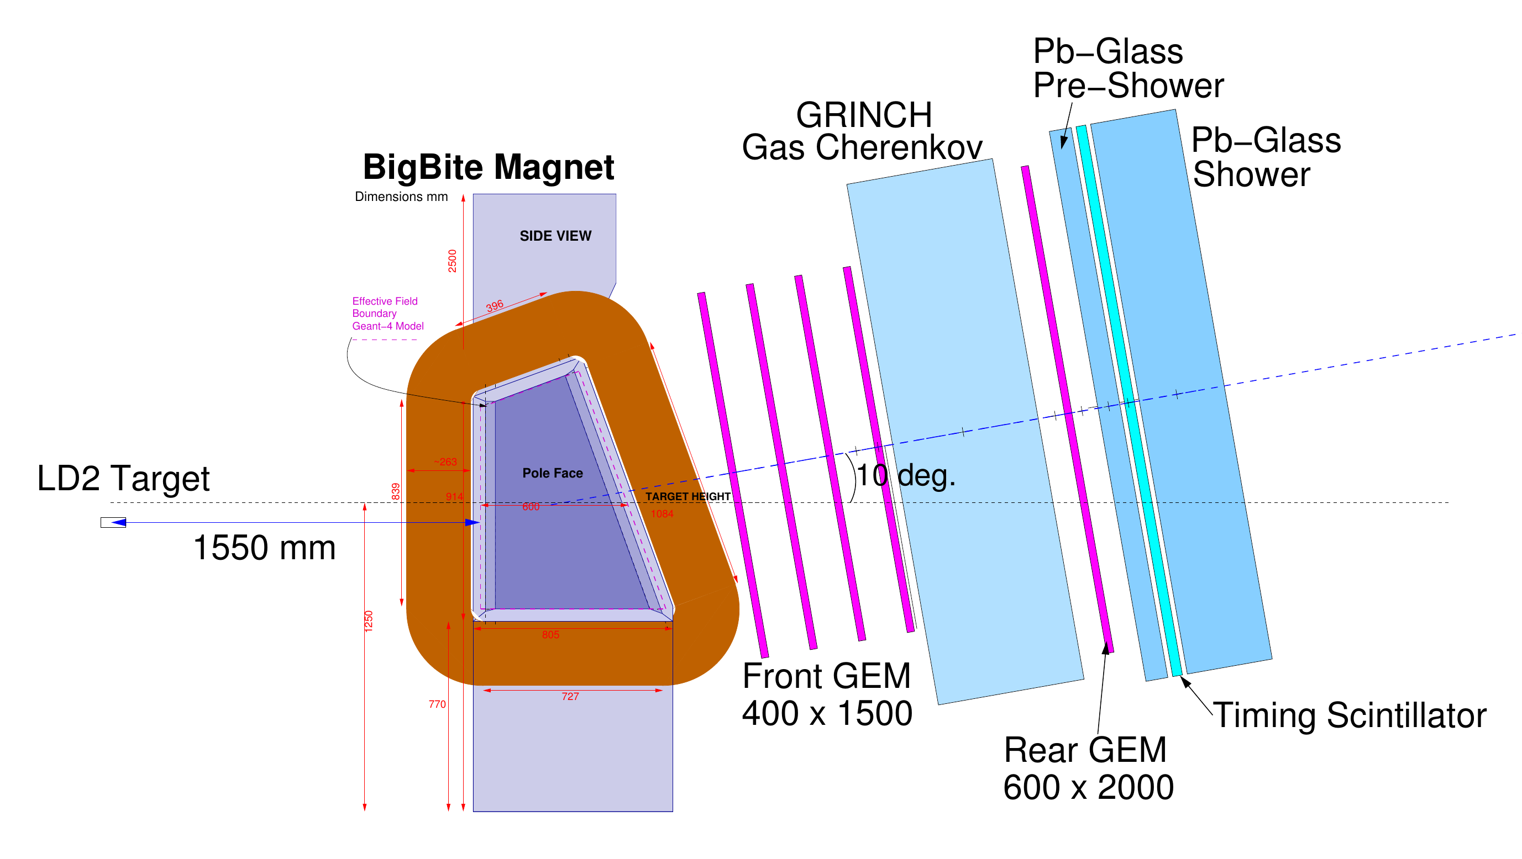
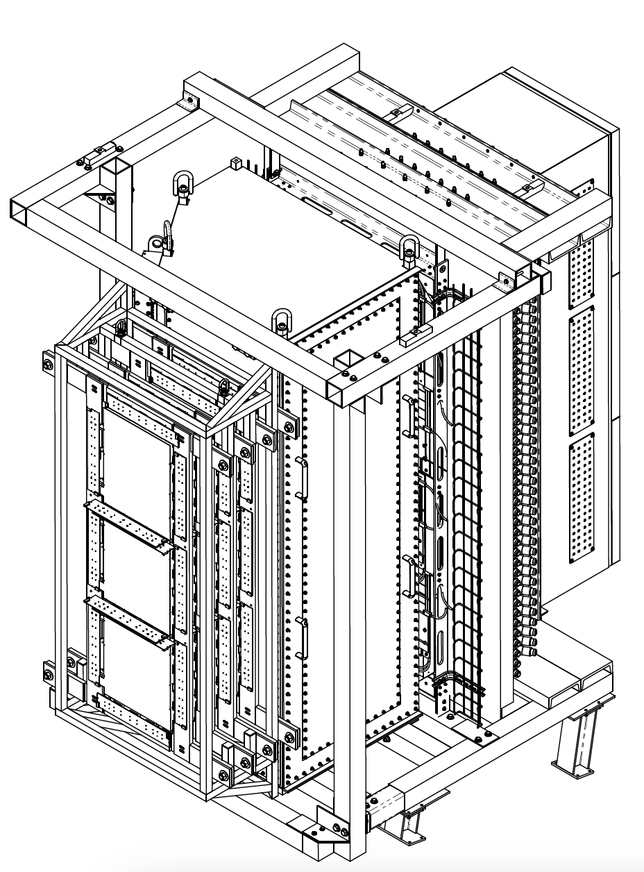
Hardware Status
BigBite as electron arm (Beam left)
DAQ/cabling being installed for shower/GRINCH
Instrumented for high luminosity (GEMs)
30uA on 15cm LD2 (or 45uA on 10 cm) 1.4X10³⁸ /cm²/s
Front frame can hold INFN X-Y planes or new UVa U-V planes
Good electron ID (preshower/shower & GRINCH)
Identifies q-vector ( )
~10 mrad resolution needed
Single-arm trigger efficiency NOT critical
Count event only if BOTH n and p would be in high-acceptance region of HCal-J
GEM frames installed (front)/being built (rear)
W ~ 55 msr
dp/p ~ 0.5%
dθ ~ 1 mr
dz ~ 2 mm @ target
dt ~ 150 ps

Slide 12
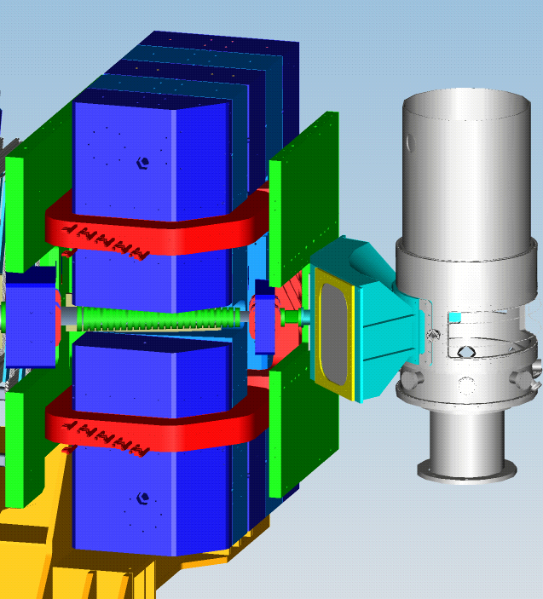
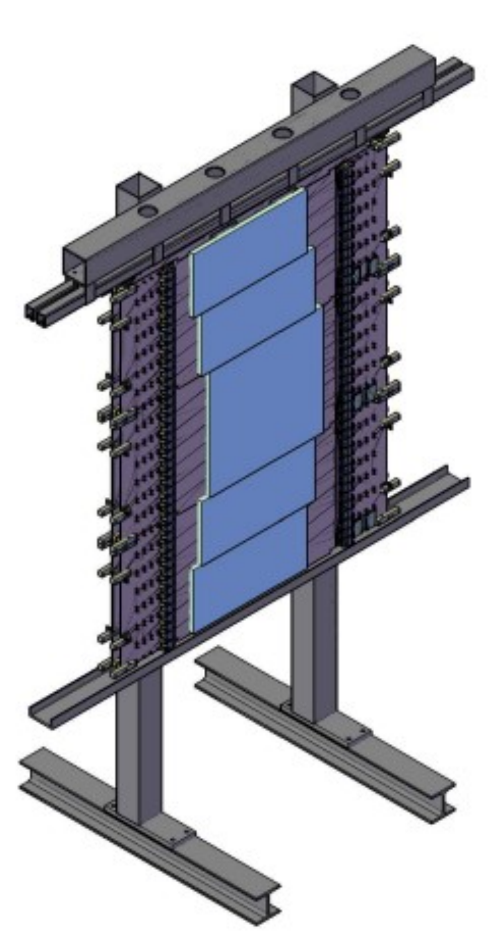
48D48 (SBS spectrometer magnet)
Up to 1.71 T-m ‘kick’ to separate protons from neutrons
Field uniformity, accurate map not critical
– Not used as spectrometer
Ready for installation
CDET (De-scoped for GMn)
In front of HCal, hanging from HCal frame
Positive ID of proton (useful check for proton
efficiency calibrations).
Vertical hit position, useful for calibrating HCal-J position resolution
(not included in original proposal)
Construction, testing of submodules in progress.

Slide 13
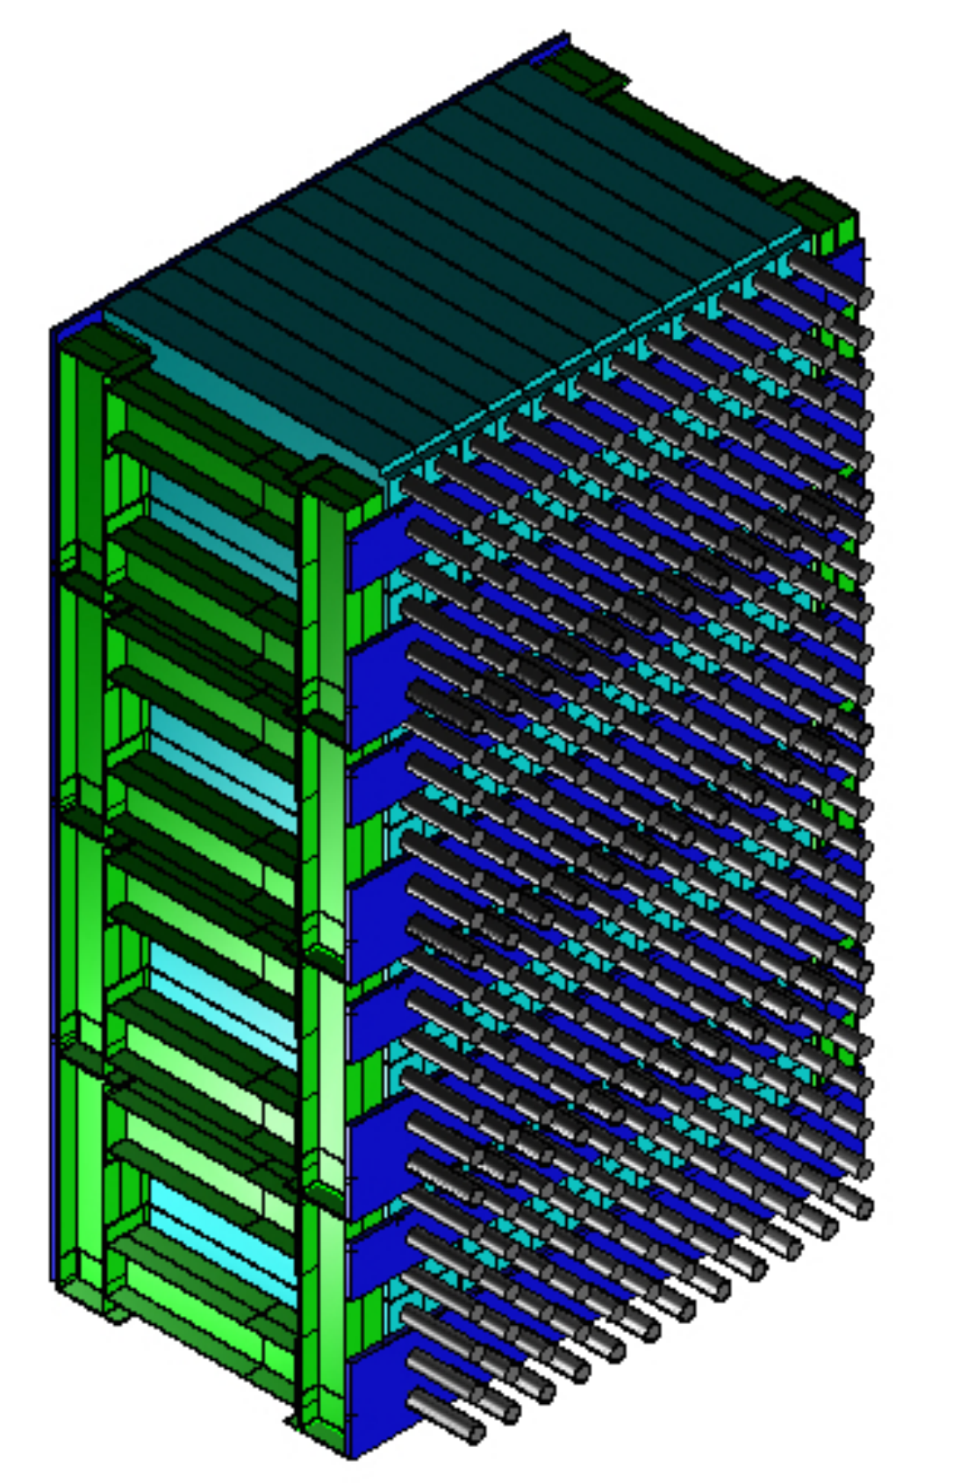
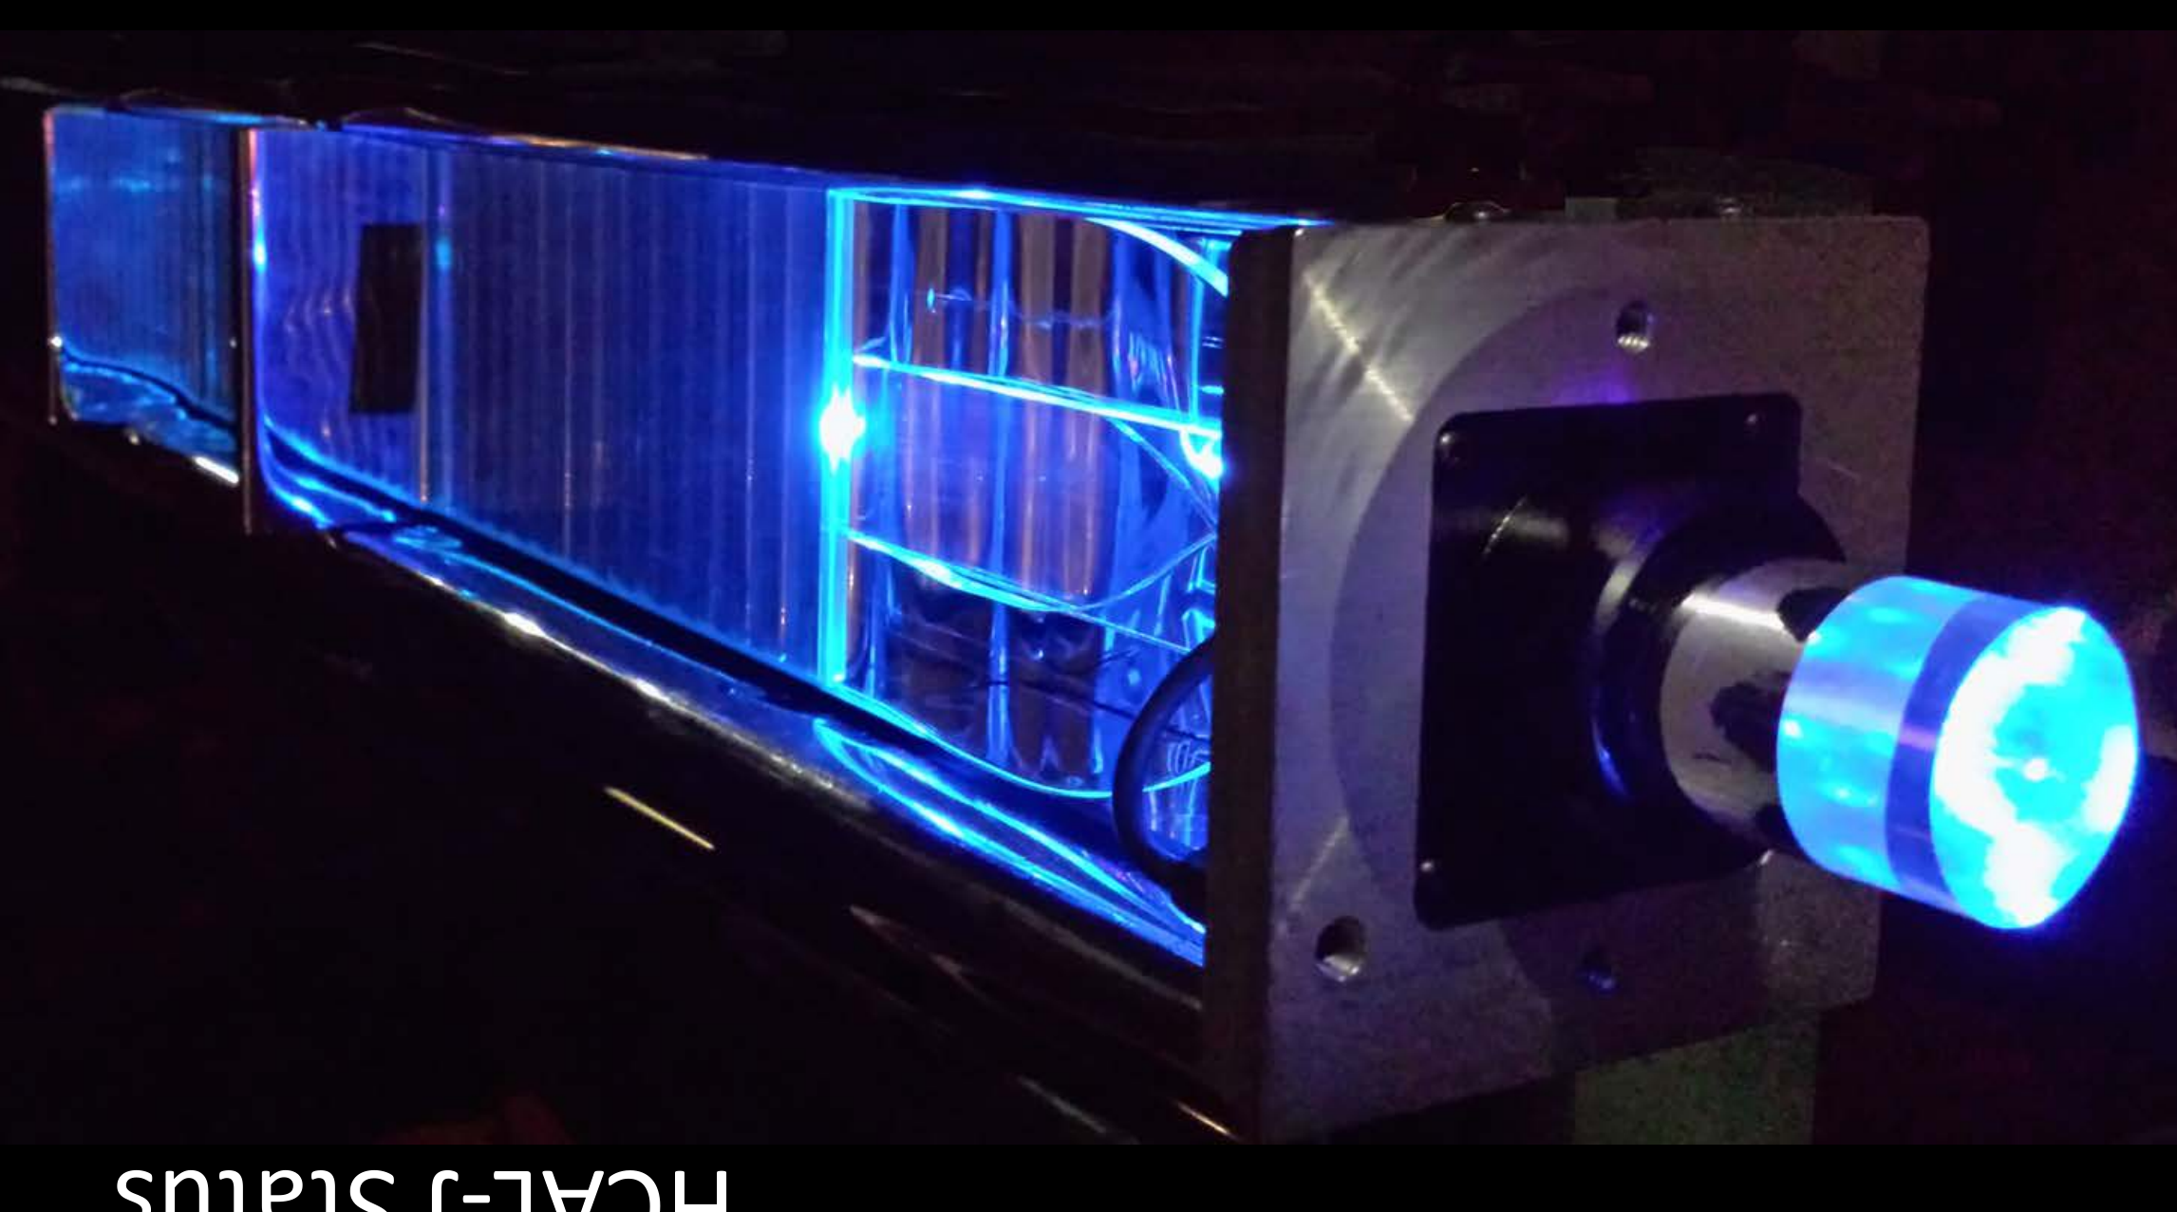
HCal-J as hadron detector (Beam right)
Similar (high) efficiency for neutrons and protons
Good position resolution to test whether hit is associated with known q-vector
Cuts inelastics. Fermi-motion sets resolution limit.
No tracking detectors needed in hadron arm
TOF information will improve inelastic rejection (not included in proposal)
All modules built; all 4 sub-assemblies stacked.
Pulser system & PMTs installed.
Electronics gantry/HCal support being procured.
DAQ installed/cabled
>93% efficiency for
multi-GeV p and n
Effective suppression
Of soft background
~0.5 ns timing
resolution
13

Slide 14
Conclusions
All detectors complete
Assembling all readout electronics
/ cables
Preparing DAQ & analysis for each system
Will test all systems from detector to DAQ
to analysis
New collaborators welcome

