Slide 1
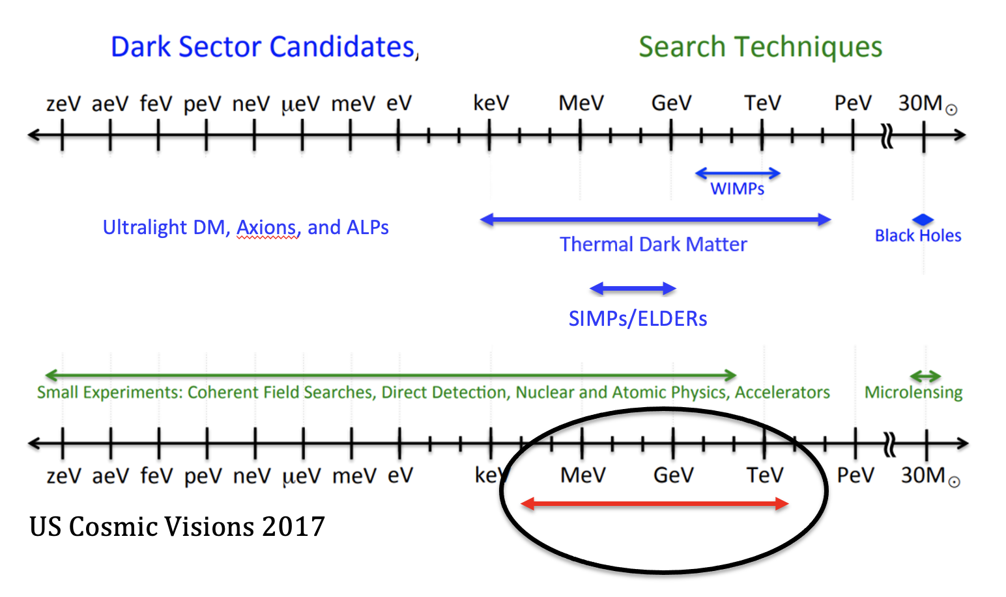
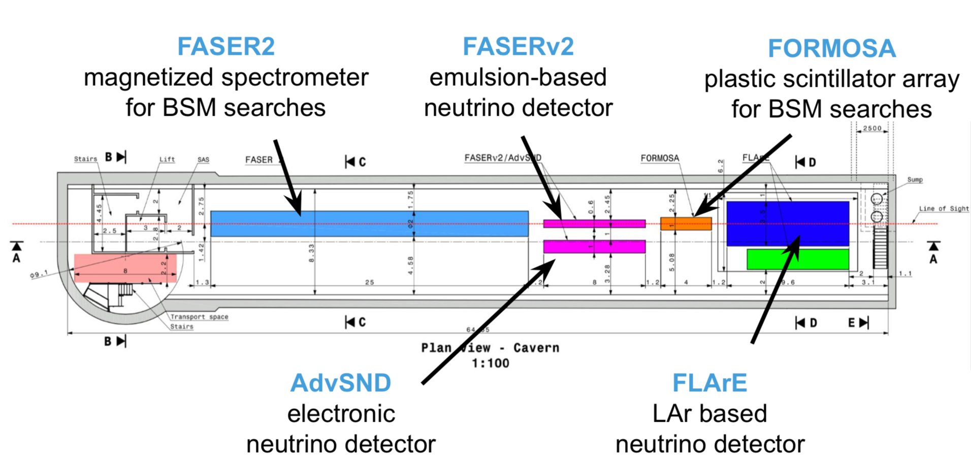
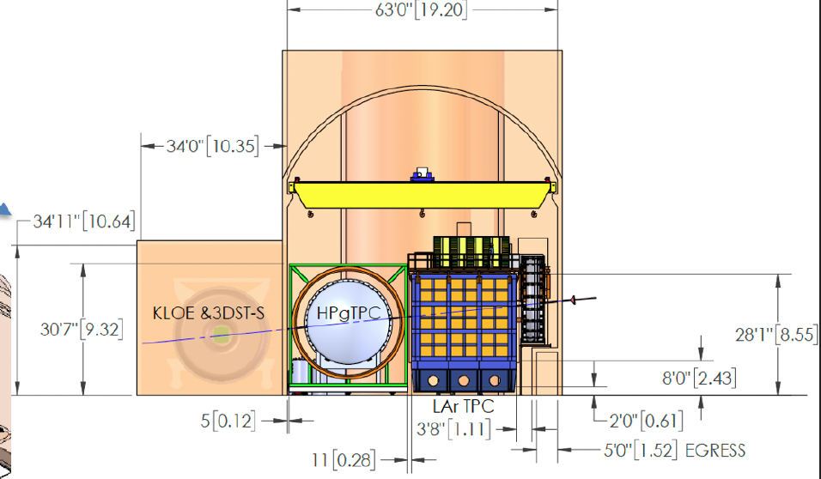
FPF
DUNE
arXiv:2002.02967,
DUNE TDR V - I
Dark Sector in High-Intensity Experiments
Dr. Yu-Dai Tsai, University California, Irvine Contact: yudait1@uci.edu ; yt444@cornell.edu
arXiv: https://arxiv.org/a/tsai_y_1.html

Slide 2
The relevant literatures are growing fast. Let me know if I have not included your important works. I will include them to the slides
Contact: yudait1@uci.edu ; yt444@cornell.edu

Slide 3
Outline
Why study “dark sector” theories? Why sub-MeV to GeV+ region? Why accelerator (intensity) probes?
Intro to dark sector “portals”, dark matter, and anomaly motivated models
Search overview: accelerator experiments
Search overview: large (neutrino) observatories

Slide 4
Exploration of Dark Matter & Dark Sector
Ultralight DM, Axions, and ALPs
SIMPs/ELDERs
US Cosmic Visions 2017
Astrophysical/cosmological observations are important to reveal the actual story of dark matter (DM).
Why accelerator experiments? And why Sub-MeV – GeV+?

Slide 5
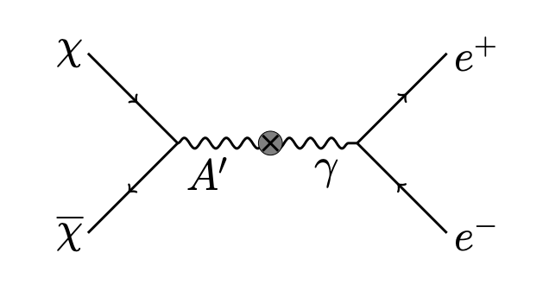
Thermal Dark Matter & The Rise of Dark Sector
From Krnjaic
The Lee-Weinberg bound (1977’): below ~ 2 GeV, DM freeze-out through weak-Interaction (e.g. through Z-boson) would overclose the Universe (not strong enough!!).
Could consider ways to get around this but generally light DM needs light mediators to freeze-out to proper relic abundance.
Mediator is needed for a proper freeze-out: the rise of “dark sector” (DM + mediators + stuffs).
Neutrino experiments can probe both mediators & dark matter

Slide 6
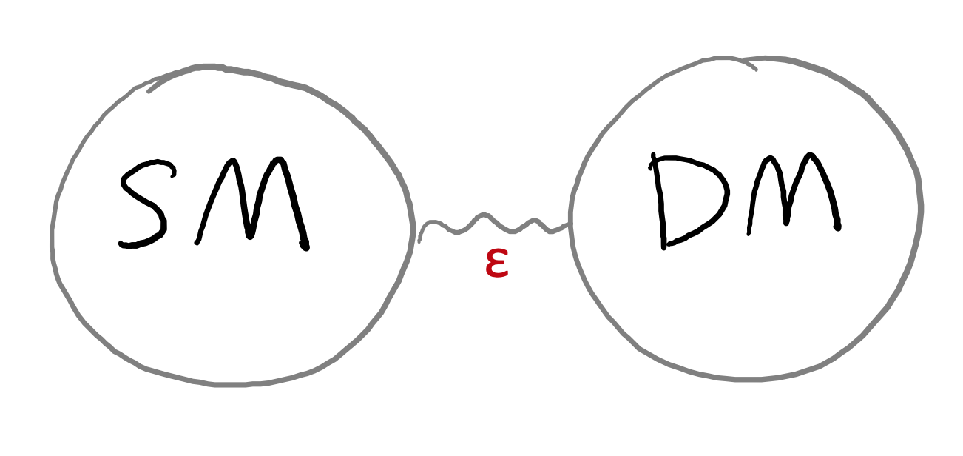
“Portal” Particles
Renormalizable interactions.
High-Dim. axion portal is also popular

Slide 7
Why study sub-MeV – GeV+ region?
Signals of discoveries grow from anomalies Maybe nature is telling us something so we don’t have to search in the dark? (or probably systematics?)
Yu-Dai Tsai, UC Irvine, 2022

Slide 8
Some anomalies involving sub-MeV - GeV+ Explanations
︙
Muon g-2 anomaly
LSND & MiniBooNE anomaly
EDGES result
KOTO anomaly
Beryllium anomaly
︙
Below ~ MeV there are also strong astrophysical/cosmological bounds that are hard to avoid even with very relaxed assumptions

Slide 9
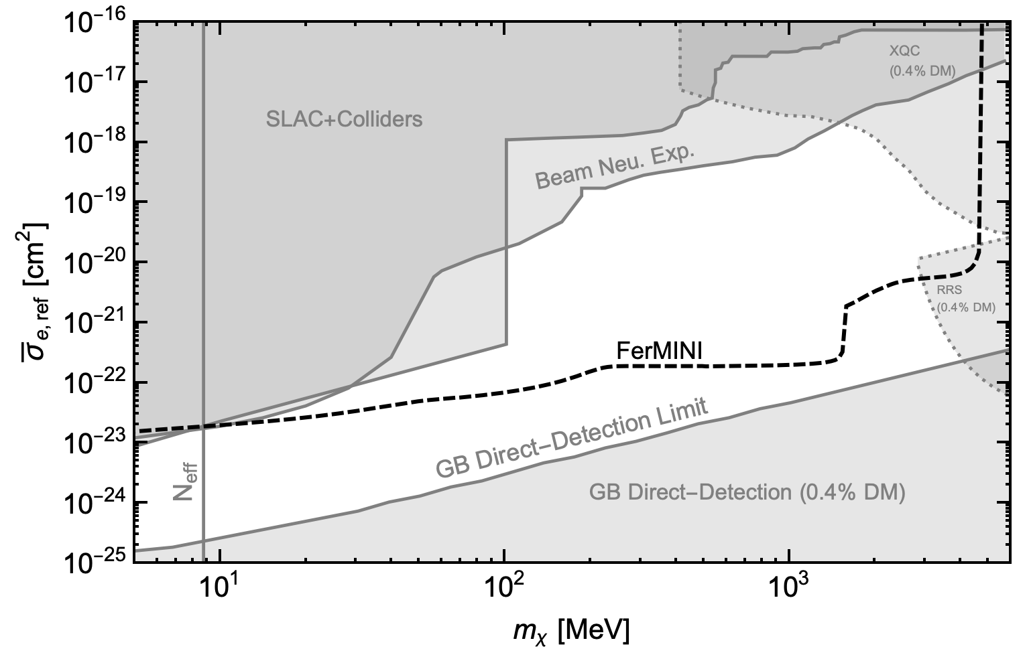
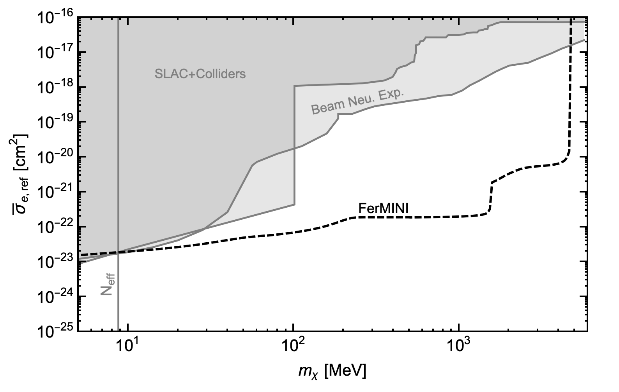
Advantage of Accelerator (Intensity) Searches: Robust Probes & Constraints
Accelerator
Accelerator
Direct-Det.
1812.03998 + 2002.11732
1812.03998 + 2002.11732 with just fixed-target probes
Also consider ambient dark matter
Produce dark particles in collisions
Same mass and interaction strength.
Different assumptions
Some details of these figures will be explained later
Same mass and interaction strength.
Different assumptions
Yu-Dai Tsai, UC Irvine, 2022

Slide 10
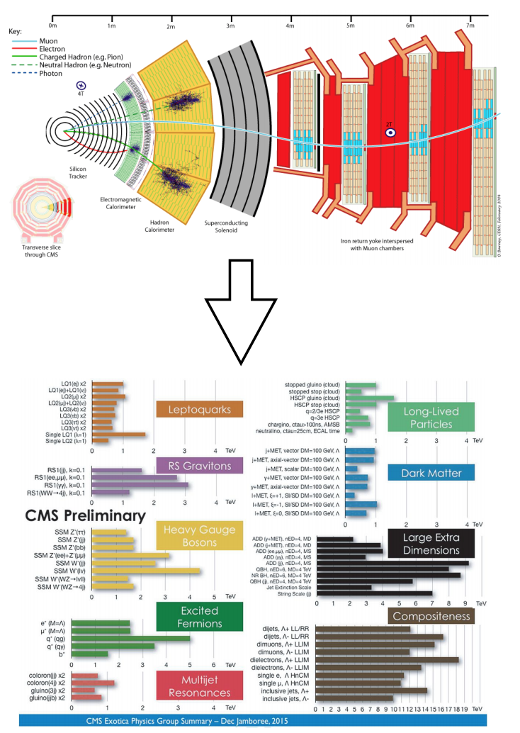
Energy vs Intensity Frontier
High energy frontier
Intensity frontier
arXiv:2002.02967
https://indico.fnal.gov/event/18430/session/8/contribution/17 redesigned from Roni Harnik’s slide
Yu-Dai Tsai, UC Irvine

Slide 11
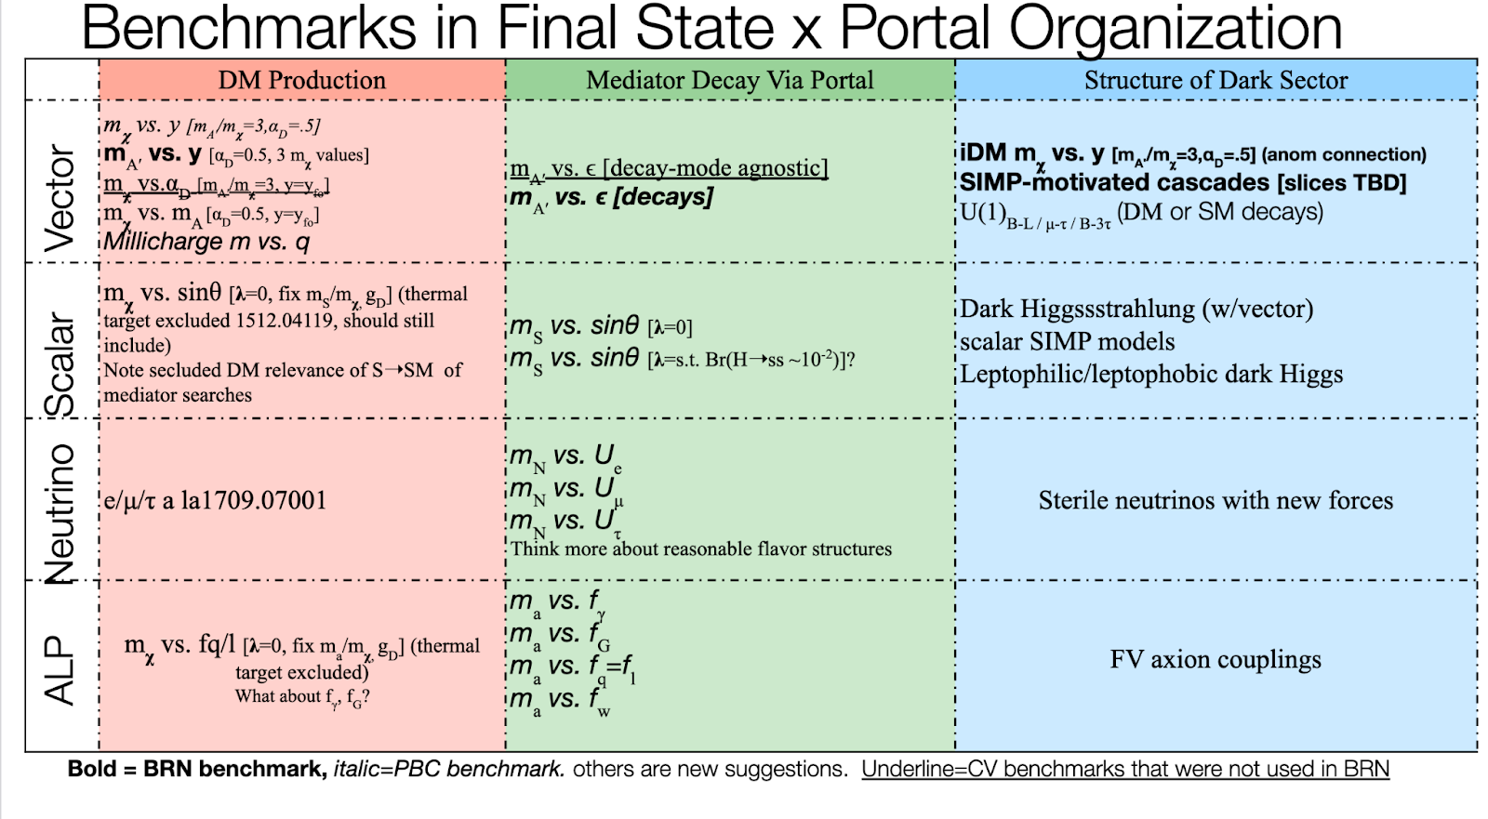
Snowmass RF06 Classification
Benchmark Models for Dark-Sector Searches
PBC: The Physics Beyond Colliders initiative at CERN
Krnjaic, Toro, ... Tsai, arXiv:2207.00597

Slide 12
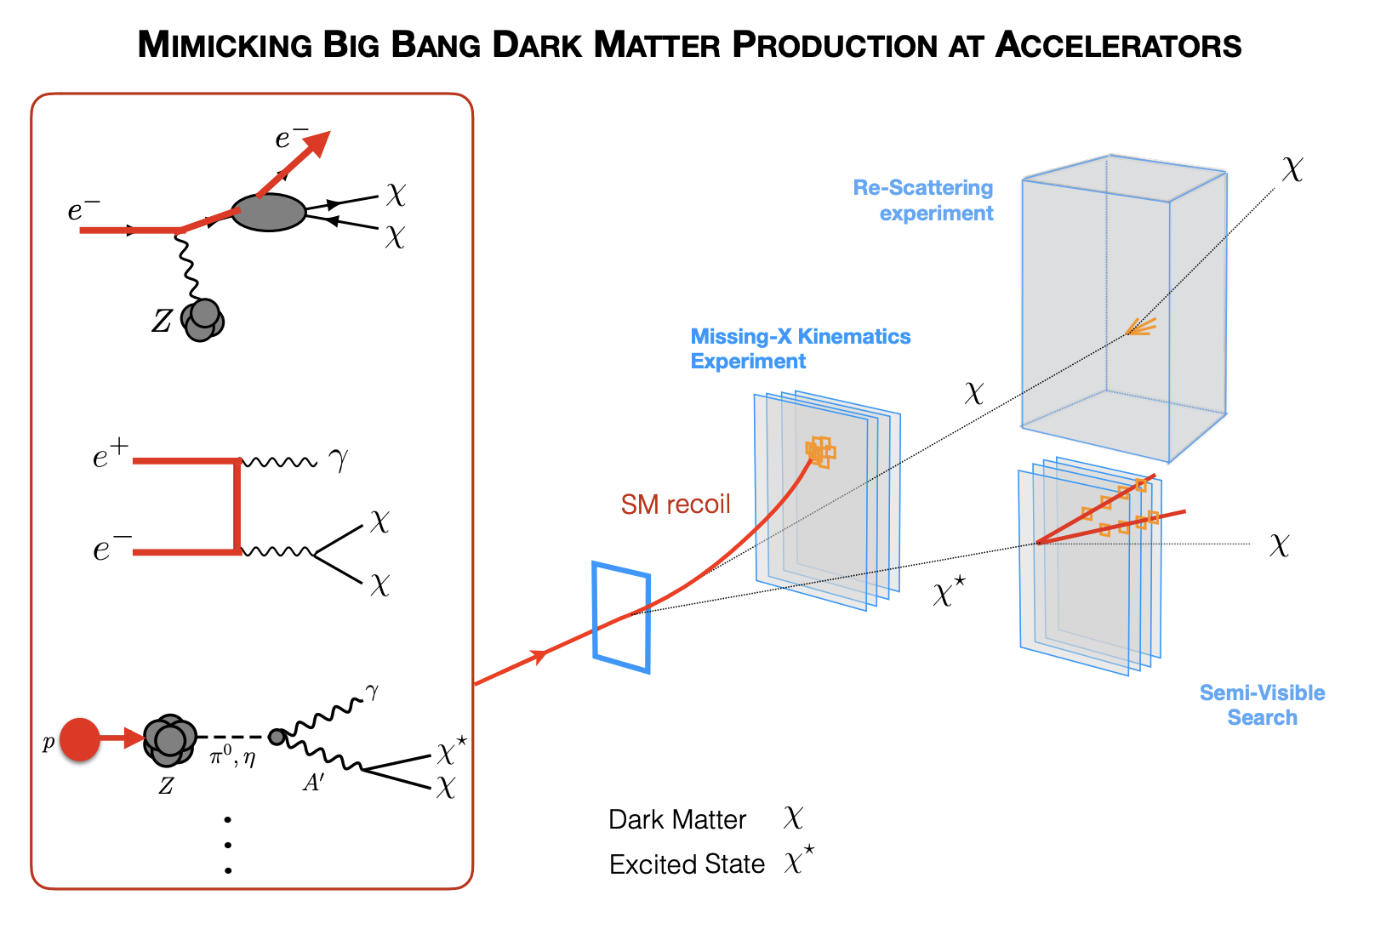
Krnjaic, Toro, et al, arXiv:2207.00597 YT is charge of the millicharged section, if you have any questions/suggestions regarding that section, (e.g., BDX, see Smith’ talk tomorrow)

Slide 13
Overview of benchmark models
Interesting models include:
Deep Theoretical Motivations
Thermal Dark Matter
Explain Anomalies
Connect to Cosmological or Astrophysical Measurements

Slide 14
Portal Particles, Dark Matter, & Anomalies
Massless dark photon can lead to millicharged particles
Other neutrino coupling to new particles interesting for anomalies
I will discuss cosmogenic ALP in large neutrino observatories

Slide 15
Vector Portal
Yu-Dai Tsai, UC Irvine, 22

Slide 16
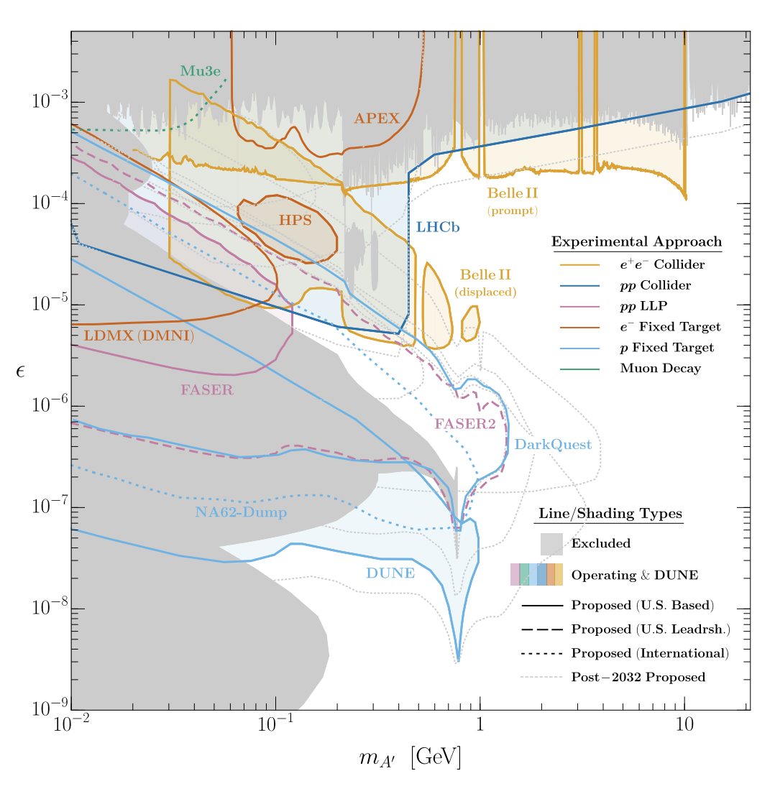
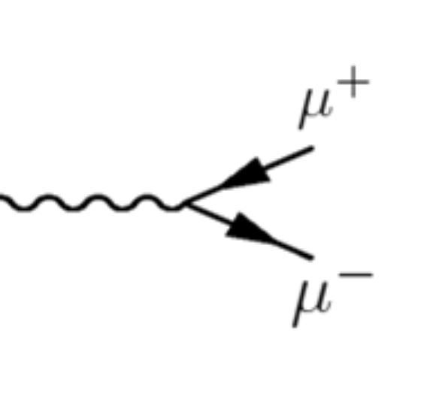
Vector Portal: Dark Photon
$$ε$$
A’
Dark photon A’:
mass basis
Batell, Blinov, Hearty, McGehee, 2207.06905
See also Tsai, deNiverville, Liu, 1908.07525, PRL 21, for the LongQuest projections & CHARM / NuCal Updates

Slide 17
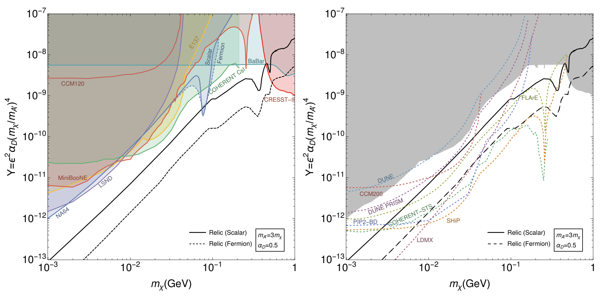
Vector Portal Dark Matter
Batell et al, arXiv:2207.06898
From Krnjaic

Slide 18
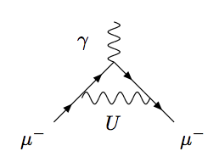
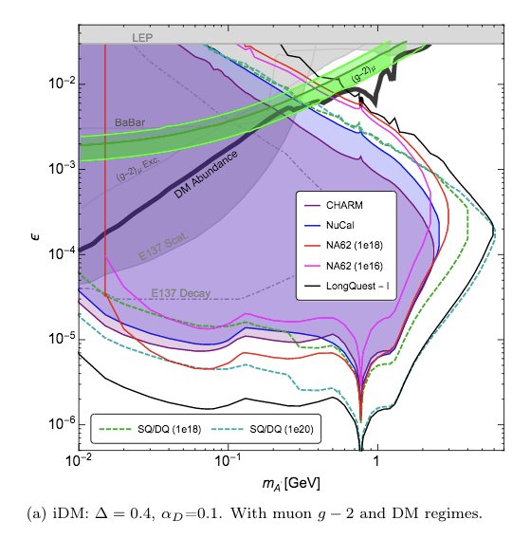
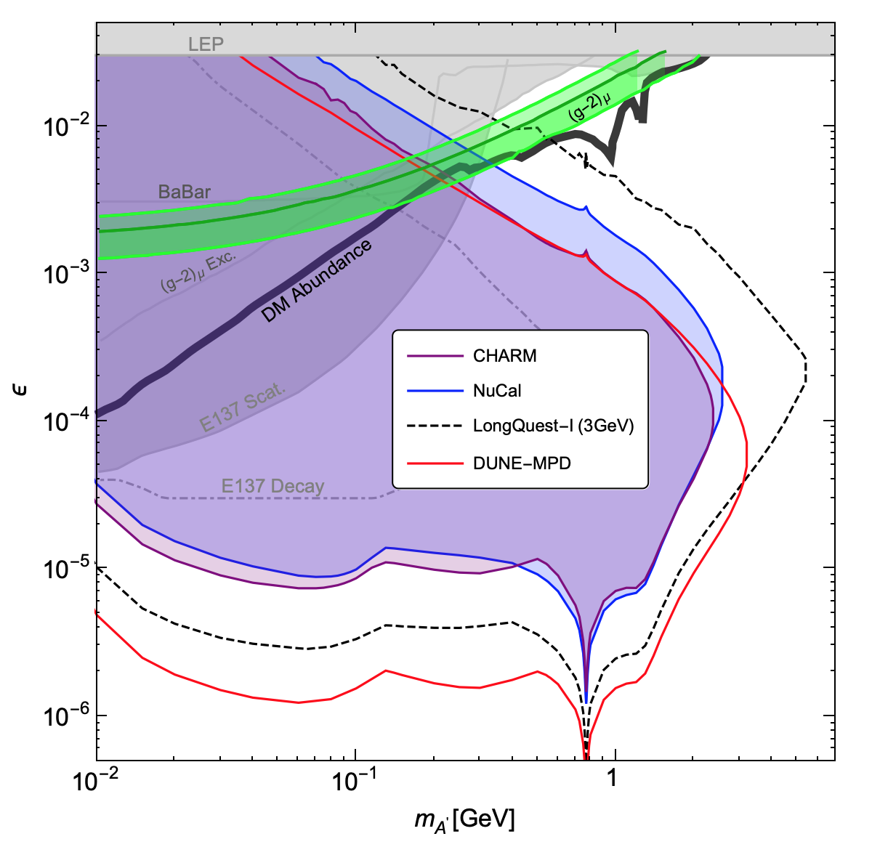
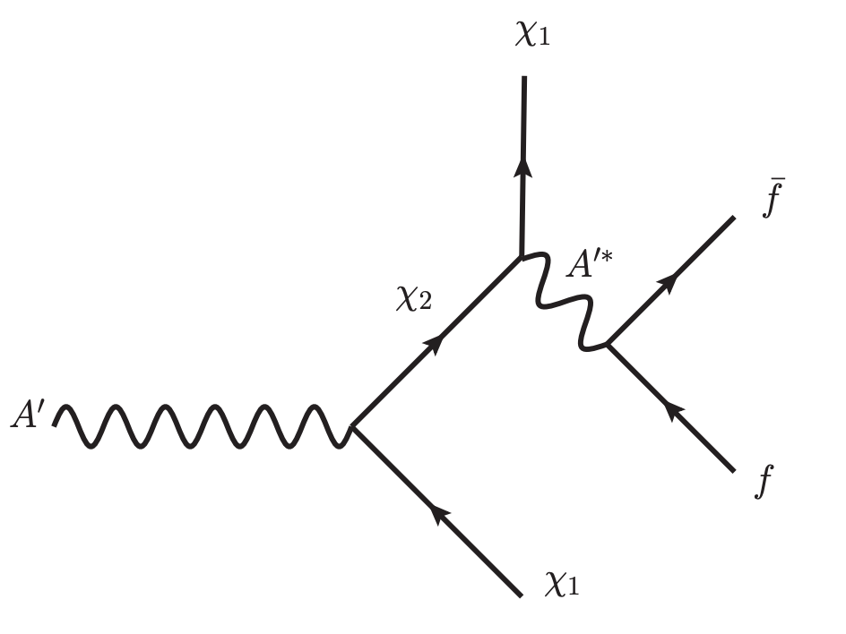
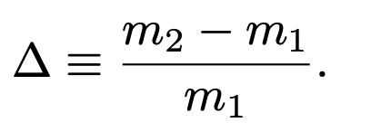
Inelastic Dark Matter & Muon g-2 explainer
A’
See, e.g., Fayet, 2007 (hep-ph/0702176)
1908.07525
See also Mohlabeng PRD 20, arXiv:1902.05075
$m_{A′}/m_{x1}$ = 3, with preliminary DUNE results

Slide 19
Millicharged Dark Sector
Yu-Dai Tsai, UC Irvine, 22

Slide 20
Motivations of Millicharged Particle & Dark Matter
Is electric charge quantized and why? A long-standing question!
SM U(1) allows arbitrarily small (any real number) charges. Why don’t we see them? Motivates Dirac quantization, Grand Unified Theory (GUT), to explain such quantization (anomaly cancellations fix some SM ${U(1)}_{Y}$ charge assignments)
MCP (not confined) is predicted by some Superstring theories: Wen, Witten, Nucl. Phys. B 261 (1985) 651-677 https://www.youtube.com/watch?v=AmUI2qf9uyo (watch 15:50 to 17:28)
Link to string compactification and quantum gravity (Shiu, Soler, Ye, PRL ’13)
Yu-Dai Tsai, UC Irvine, 22

Slide 21
Kinetic Mixing and Millicharge Phase
heavy exotic
Coupled to new dark fermion χ
(SM: Standard Model)
See, Holdom, 1985
New fermion χ charged under new gauge boson B’.
Millicharged particle (MCP) can be a low-energy consequence of massless dark photon (a new U(1) gauge boson) coupled to a new fermion (become MCP in a convenient basis.)
Yu-Dai Tsai, UC Irvine, 22

Slide 22
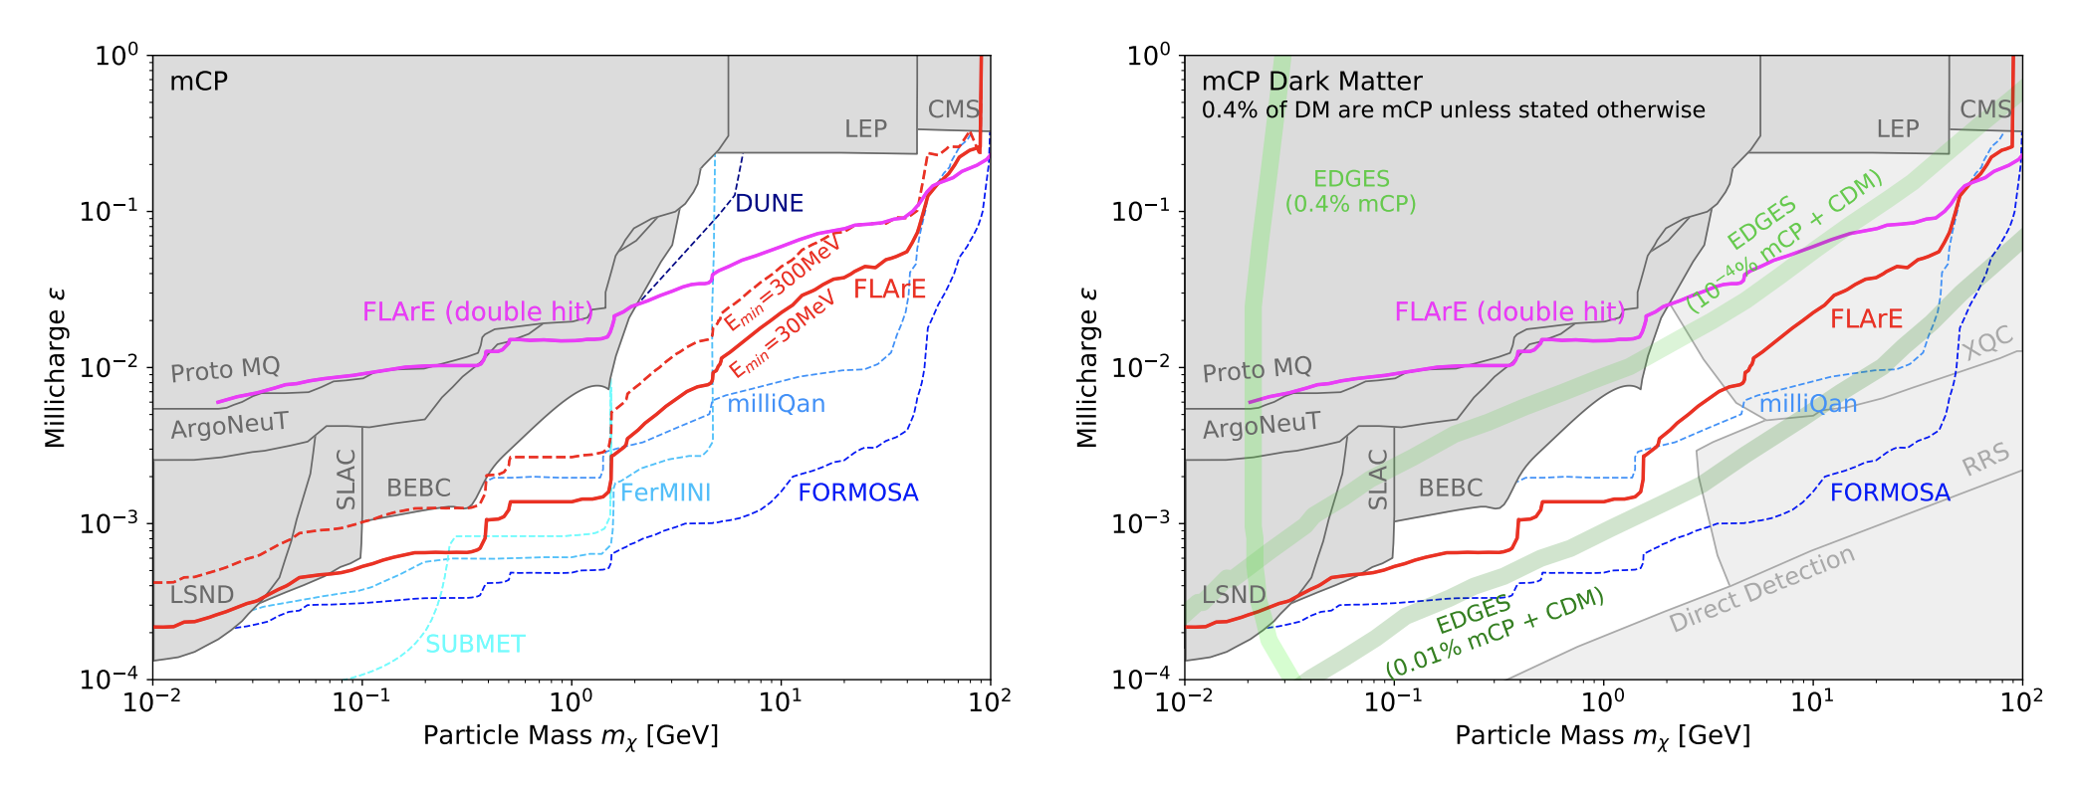
Millicharge Particles & Dark Matter
Probes include our works on Neutrino Experiments: Magill, Plestid, Pospelov, Tsai, arXiv:1806.03310, PRL19; Neutrino Observatories: Plestid, Takhistov, Tsai, et al, arXiv:2002.11732, PRD20; FORMOSA: Foroughi-Abari, Kling, Tsai, arXiv:2010.07941, PRD 21; FLArE: Kling, Kuo, Trojanowski, Tsai: arXiv:2205.09137

Slide 23
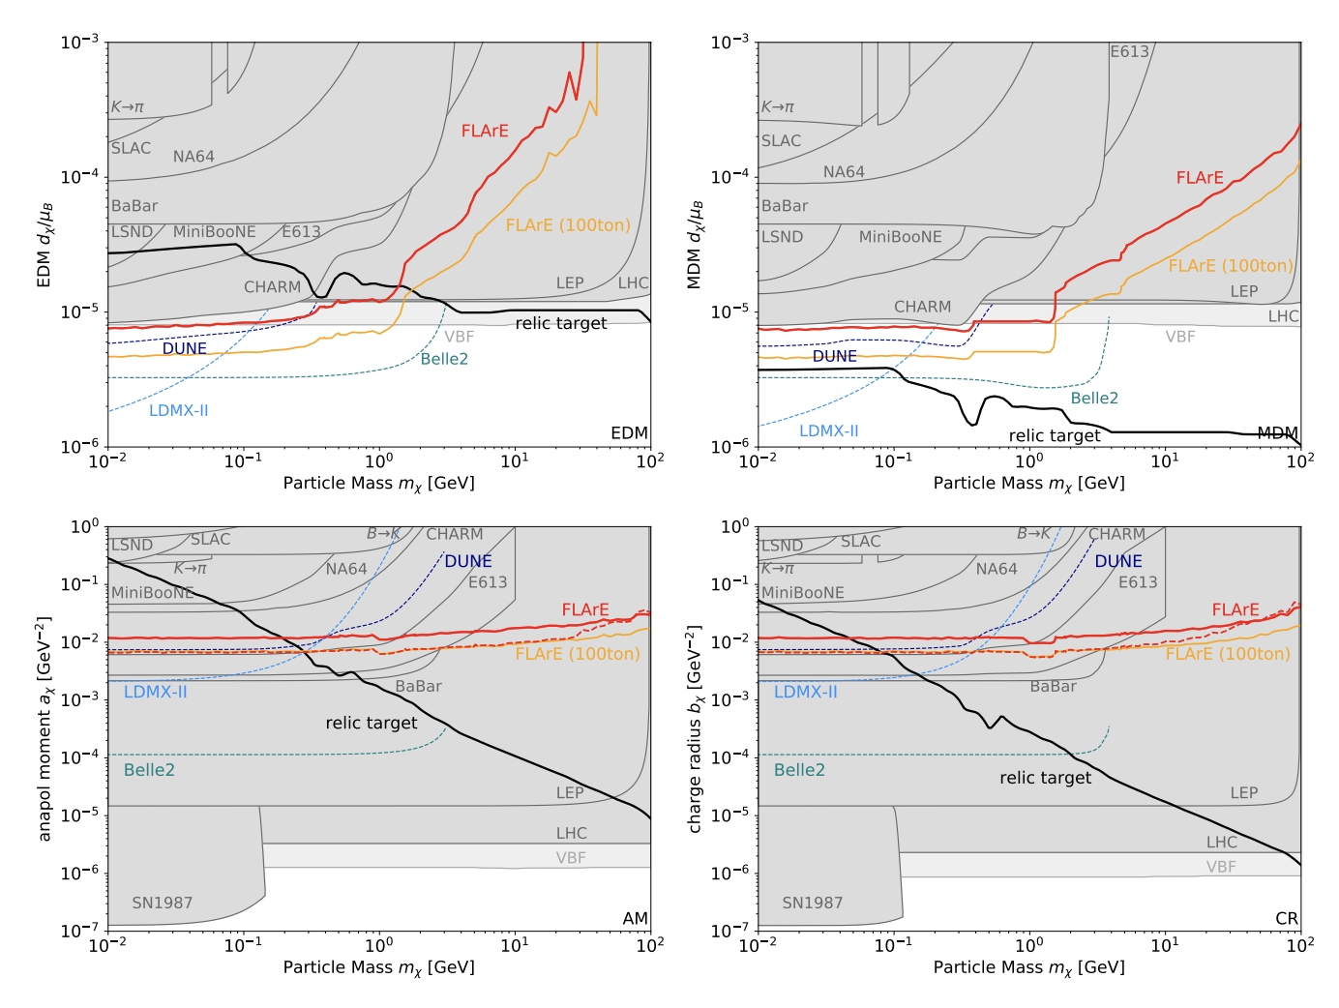
Dark Sector with other EM Form Factors
Kling, Kuo, Trojanowski, and Tsai, arXiv:2205.09137

Slide 24
Neutrino Portal
Yu-Dai Tsai, UC Irvine, 22

Slide 25
Heavy Neutral Lepton
After EW symmetry breaking, the HNLs mix with the SM neutrinos
Follow the convention of considering a single HNL that dominantly mixes with a specific neutrino flavor, i.e., dominant electron-, muon-, or tau- flavor mixing.
Phenomenology characterized by the HNL mass, $m_{N}$ , and mixing angle: |$U_{eN}$|^2 , | $U_{\text{µ}N}$|^2 , | $U_{\text{τ}N}$|^2 See, e.g., Snowmass Whitepaper, Batell et al, arXIv:2207.06905

Slide 26
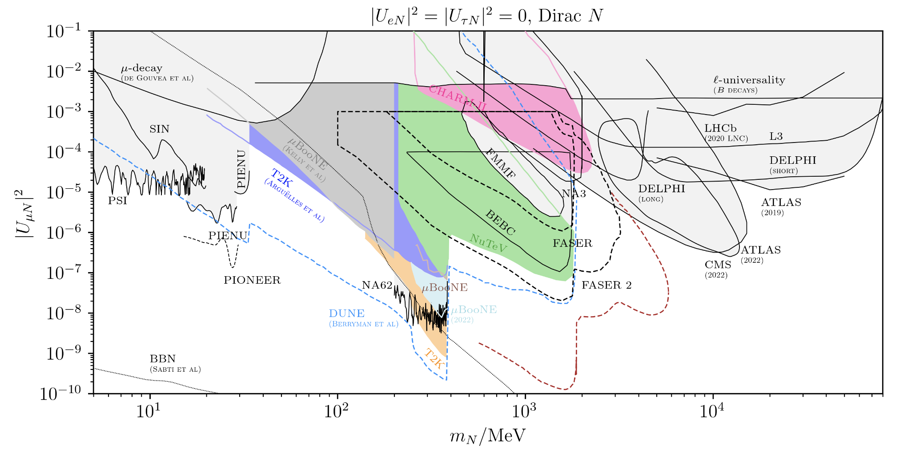
Heavy Neutral Lepton
Batell et al, arXiv:2207.06898

Slide 27
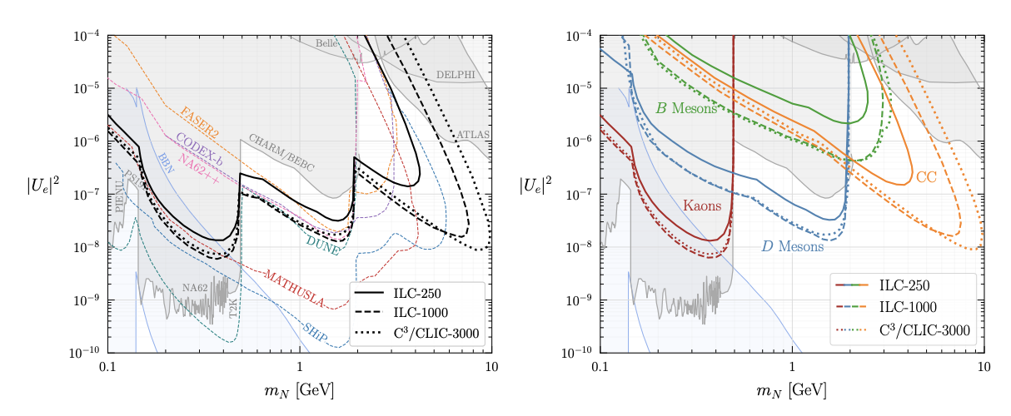
Electron Collider Beam-Dump Searches for HNL
Can be designed for other e +e − colliders as ILC, C3 , CLIC, FCC-ee, and CEPC.
Giffin, Gori, Tsai, Tuckler, arXiv:2206.13745
Nojiri, Sakaki, Tobioka, Ueda, arXiv:2206.13523

Slide 28
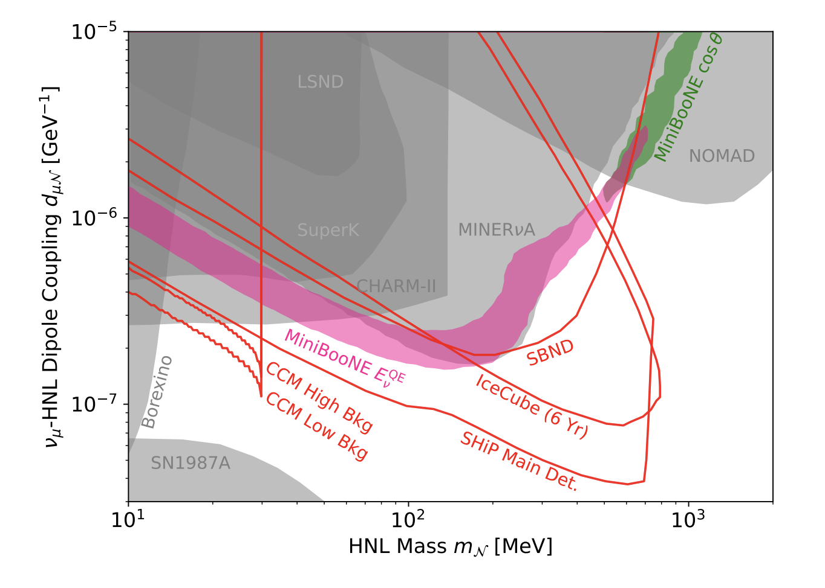
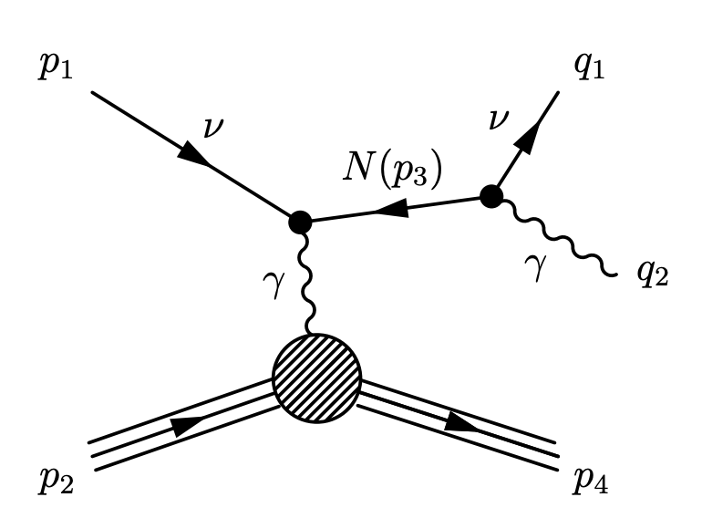
Dipole Portal Heavy Neutral Lepton
Magill, Plestid, Pospelov, Tsai,
PRD 18, arXiv:1803.03262
New Fig from Kamp; Ref: Batell, …, Tsai, arXiv:2207.06898;

Slide 29
Searches in Large Neutrino Observatories
Yu-Dai Tsai, UC Irvine, 22

Slide 30
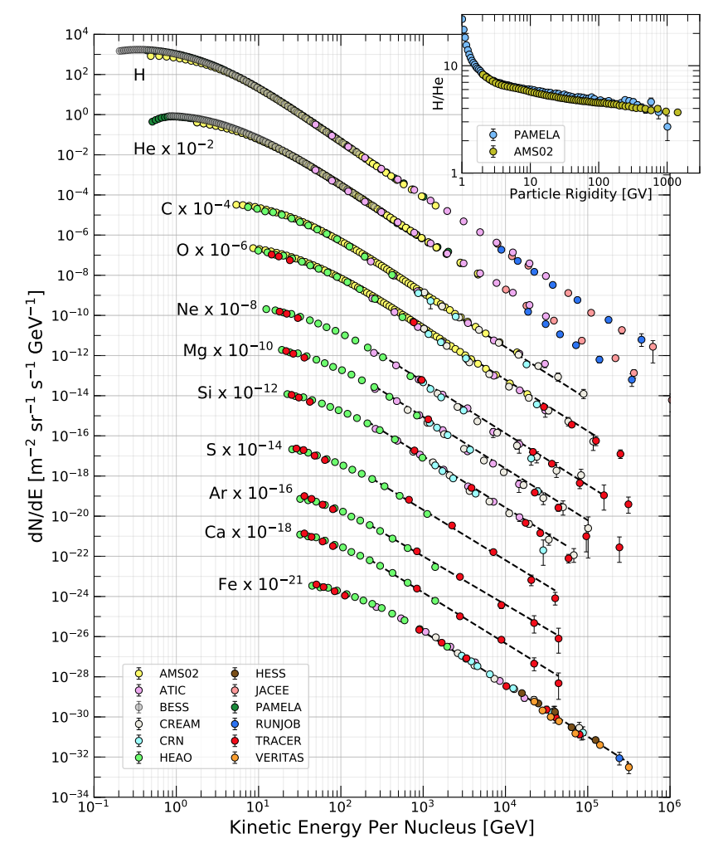
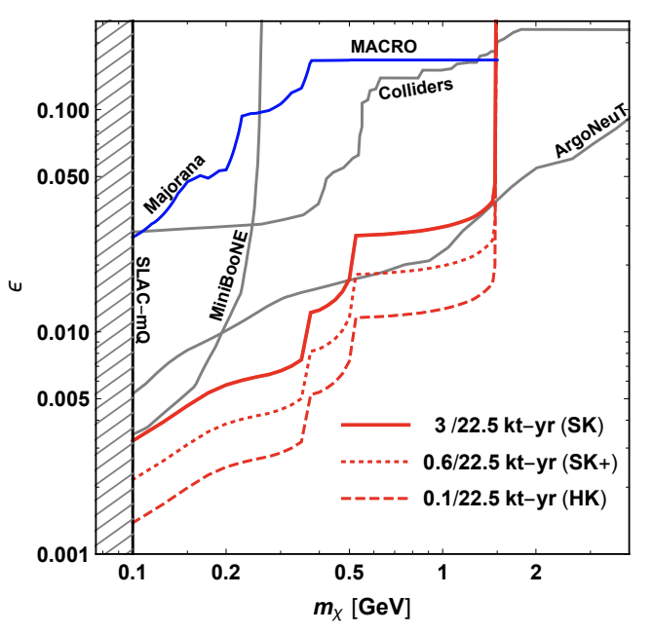
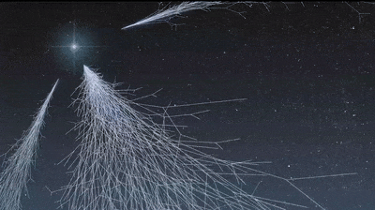
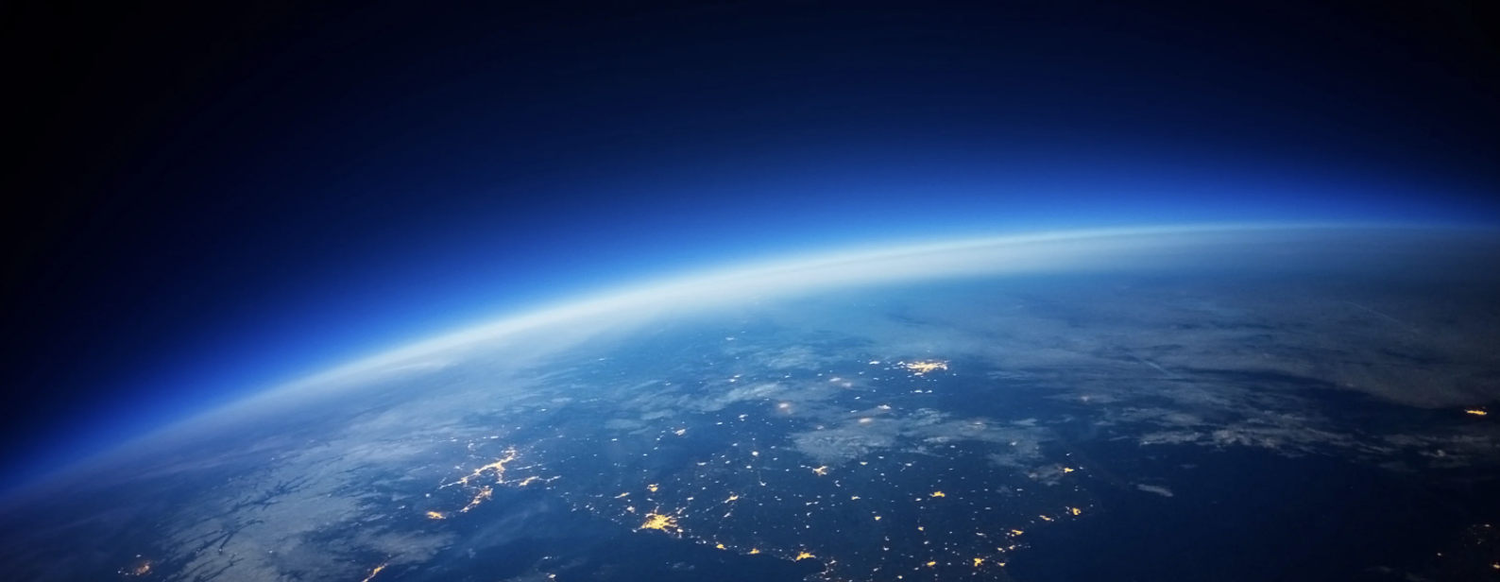
Millicharge Searches at Neutrino Observatories
by Chantelauze, Staffi, and Bret
https://www.futurelearn.com/info/courses/learn-about-weather/0/steps/39415
PDG, RPP, 2019
arXiv:2002.11732
(Plestid, Takhistov, Tsai, Bringmann, Kusenko, Pospelov, PRD 20)
Super-K,
http://www-sk.icrr.u-tokyo.ac.jp/sk/index-e.html
1111.5031, Super-K Collaboration, PRD12
Supernova Relic Neutrino Search at Super-K

Slide 31
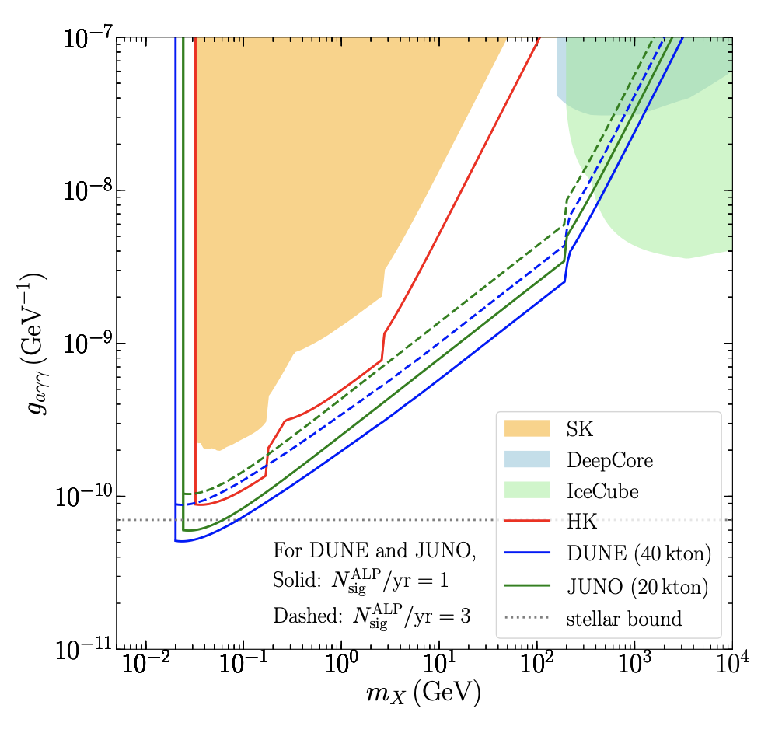
Cosmogenic Axion-Like Particles (ALP) at Neutrino Observatories
Cui, Kuo, Pradler, and Tsai, arXiv:2207.13107

Slide 32
Interesting models include
Deep Theoretical Motivations
Thermal Dark Matter
Explain Anomalies
Connect to Cosmological or Astrophysical Measurements
Yu-Dai Tsai, UC Irvine, 22

Slide 33
Summary & Outlook
Intensity searches provide strong probes of rich dark sector motivated by dark matter and experimental anomalies
One of the main efforts for our community in the next 5 to 10 years.
Explore other models with other theory motivations & beyond the simplified models: connecting to string theory, grand unification theory, etc.
Models with also signatures in cosmological measurements, direct detection, and astrophysical observations, are prime targets for the future
Yu-Dai Tsai, UC Irvine, 22

Slide 34
Higgs & ALP Portal: Both have very interesting dark matter phenomenology; only show minimal models here
Yu-Dai Tsai, UC Irvine, 22

Slide 35
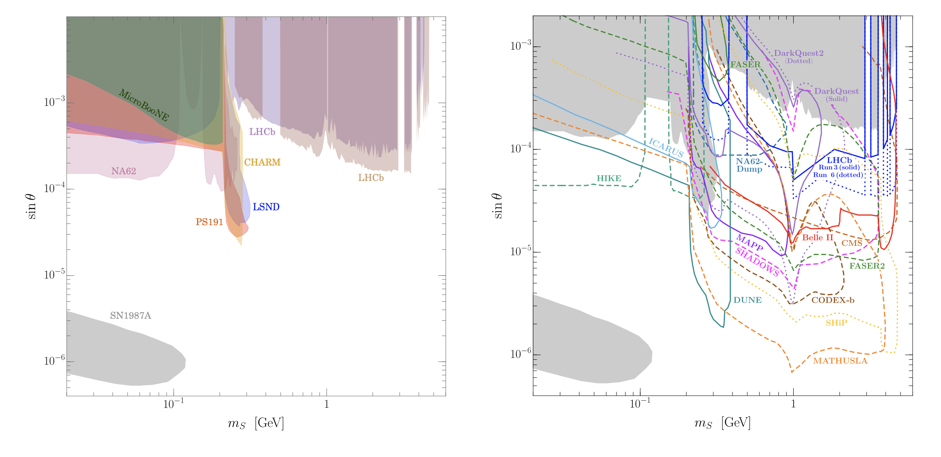
Higgs Portal
Batell et al, arXiv:2207.06898

Slide 36
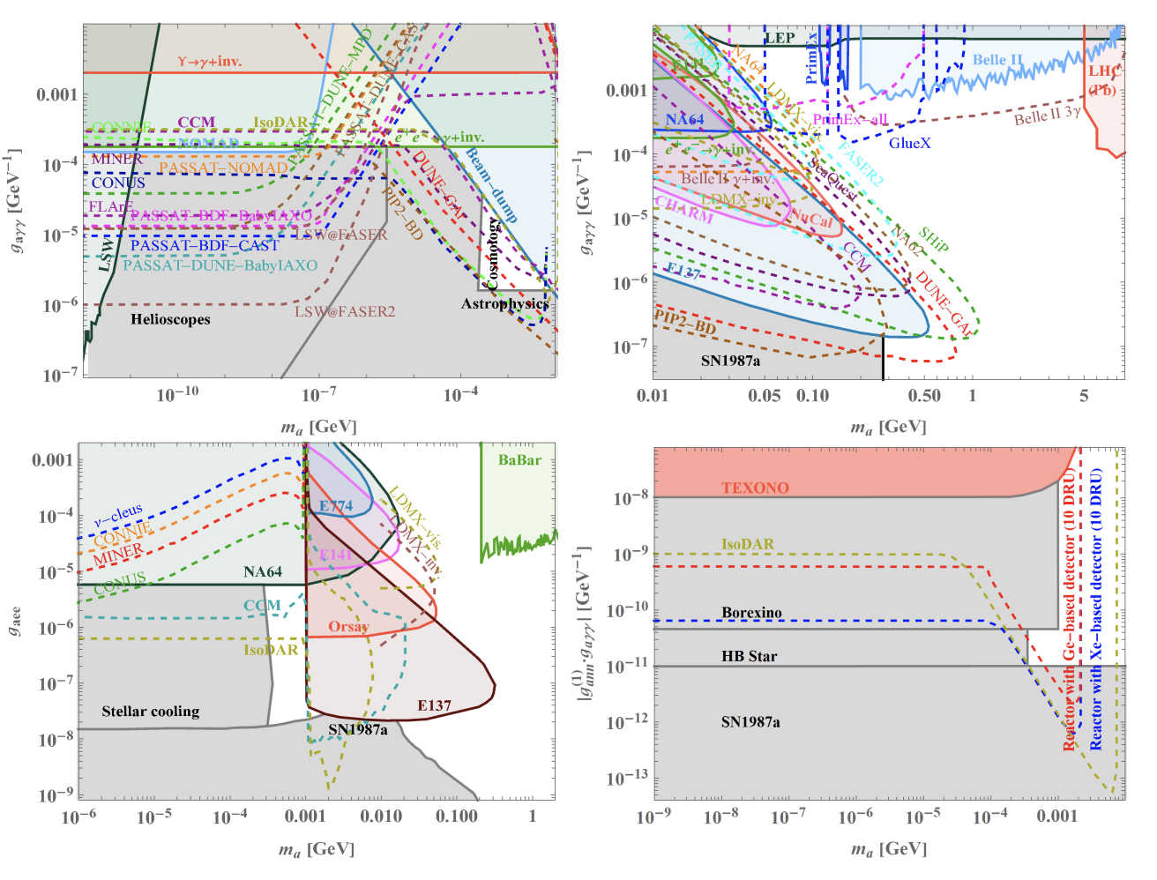
ALP Portal
Batell et al, arXiv:2207.06898
+ …

Slide 37
Thank you!
Yu-Dai Tsai, UC Irvine, 22

