Slide 1
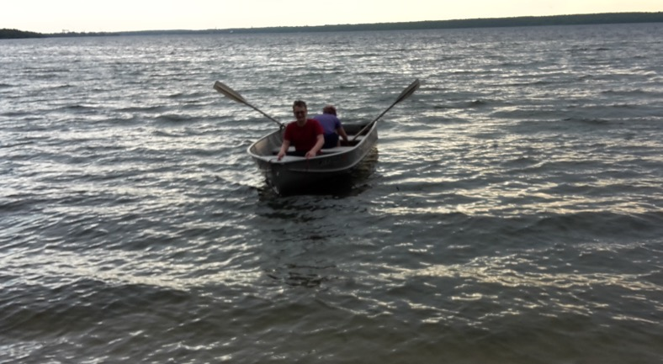
An Asymmetry in the Anti-Matter of the Proton: Exploring the Sea
erhtjhtyhy
Paul E Reimer
Argonne National Laboratory
8 Sept 2022

Slide 2
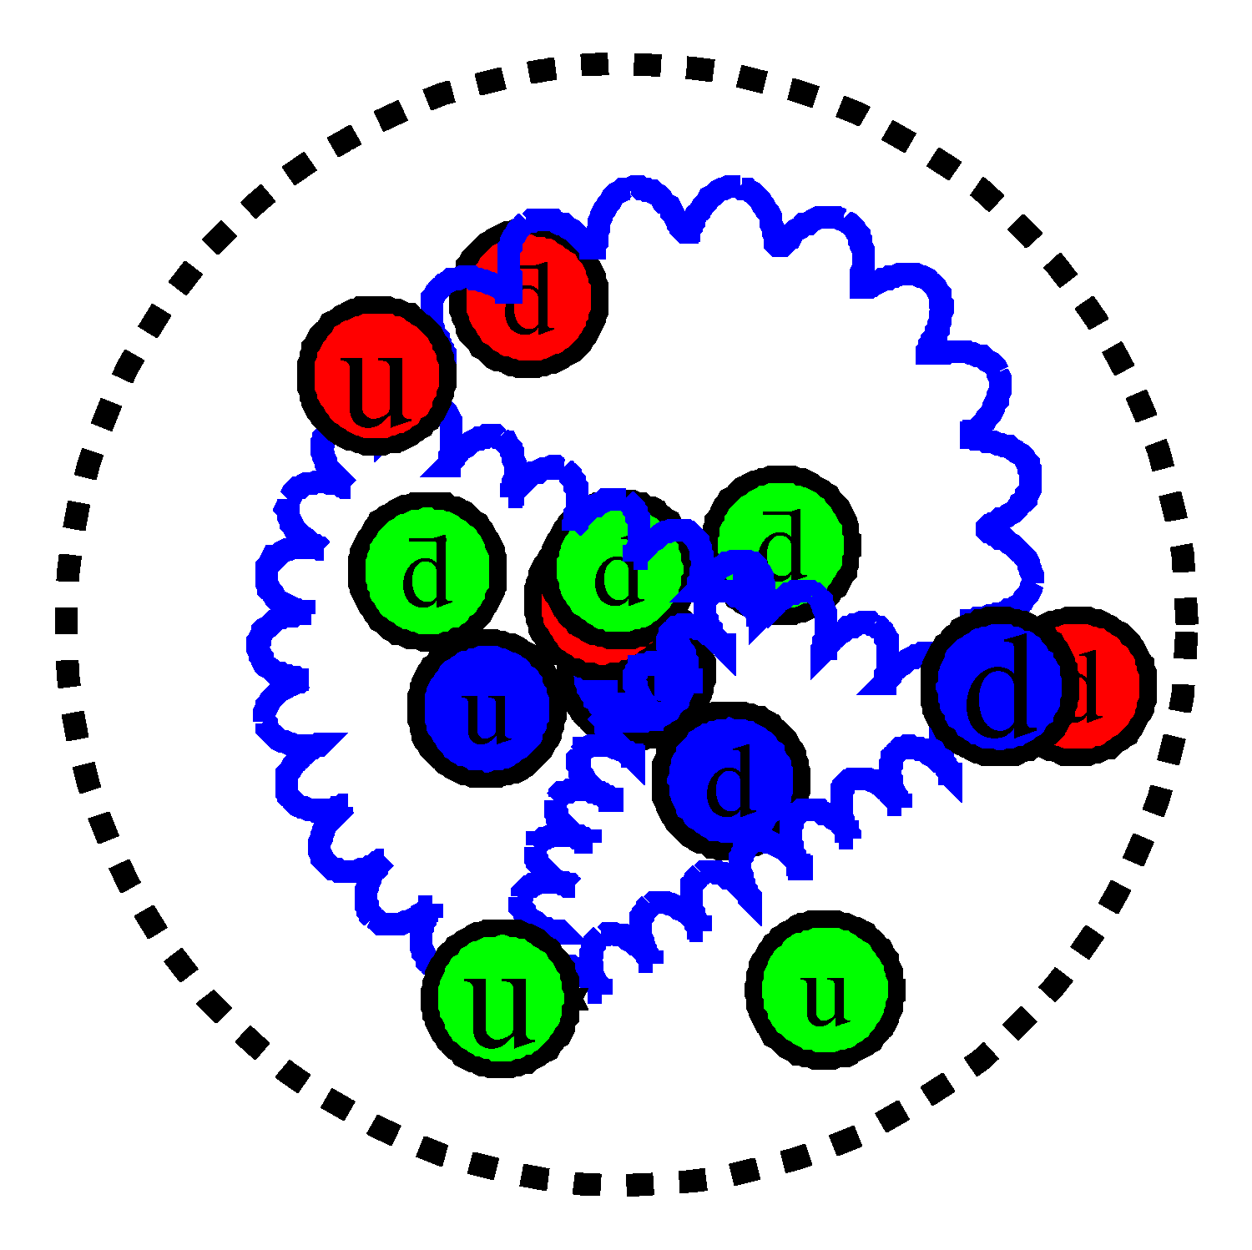
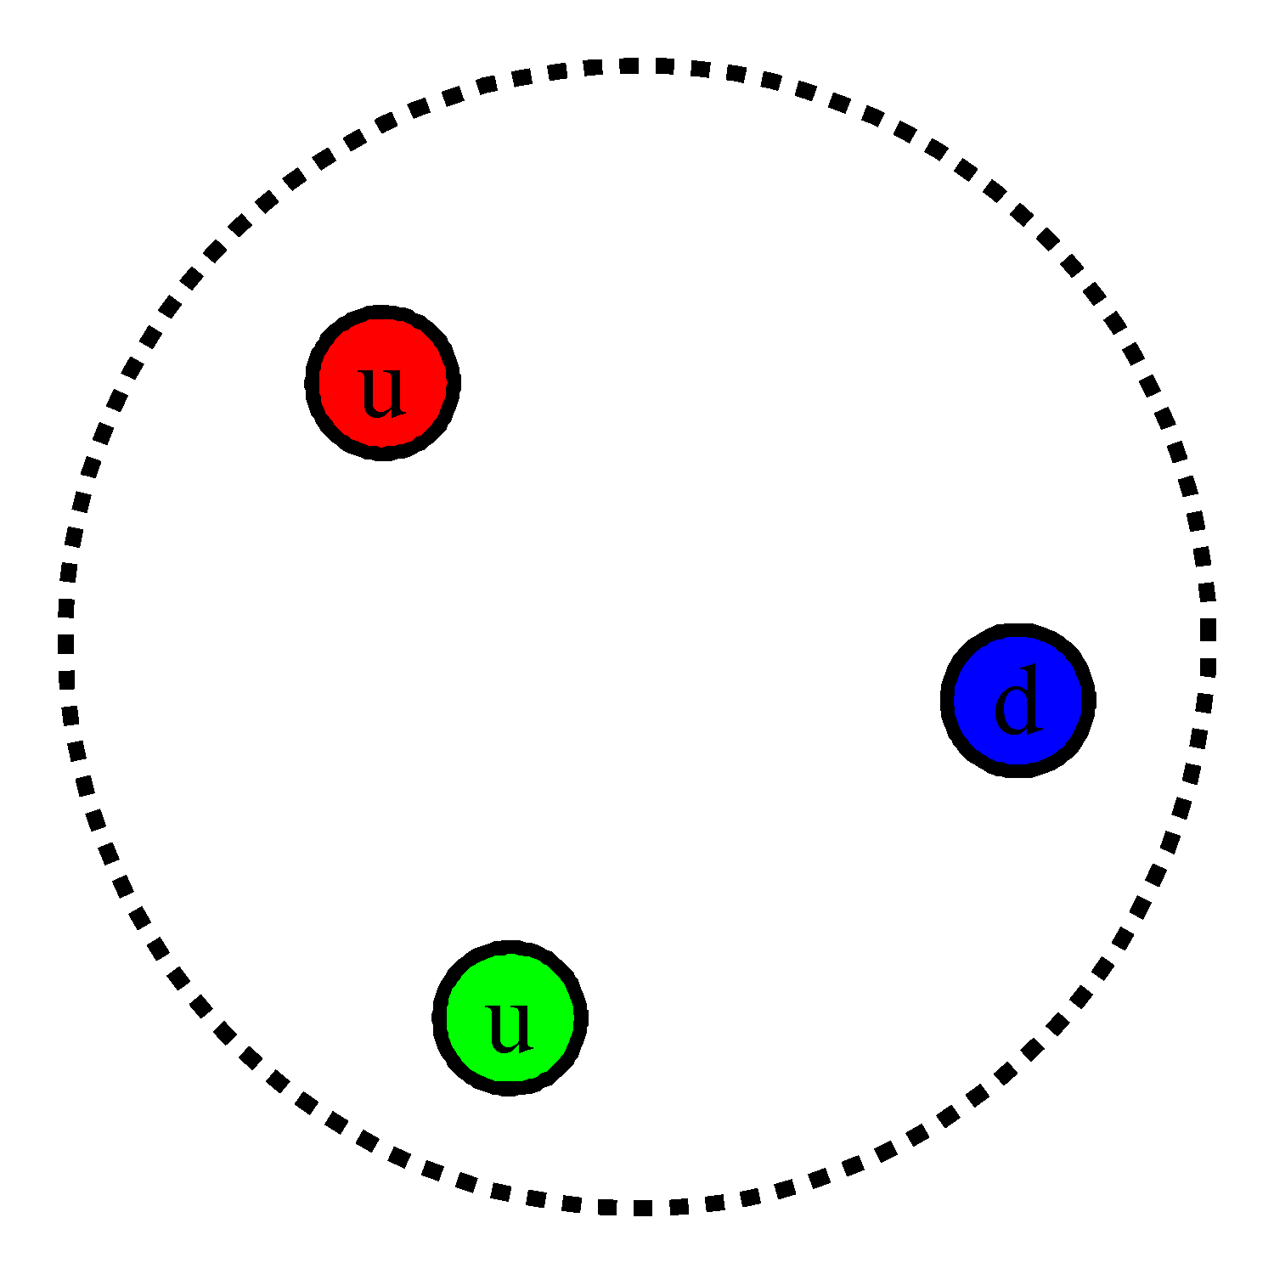
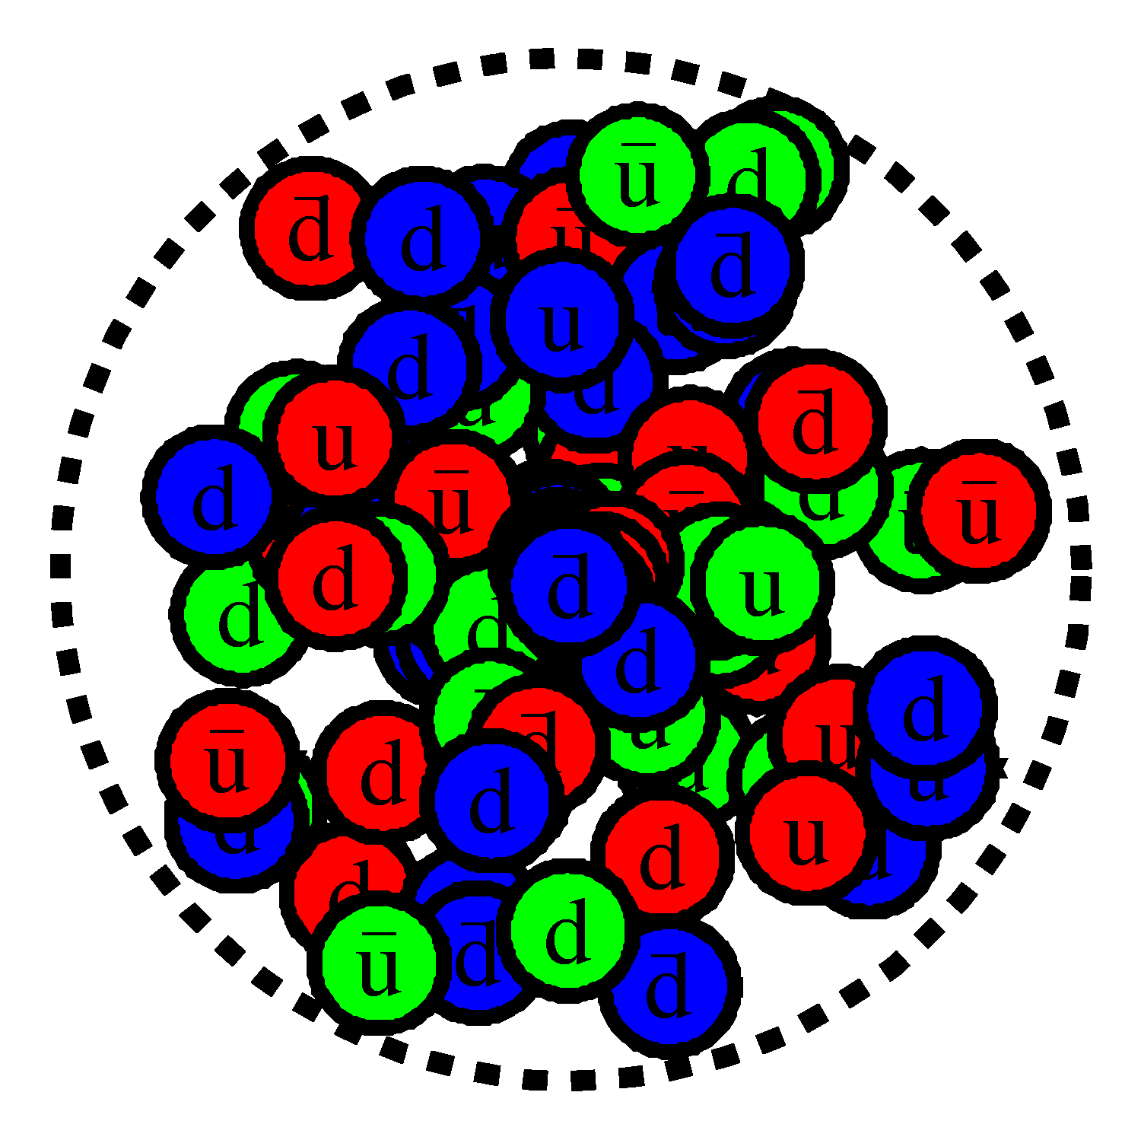
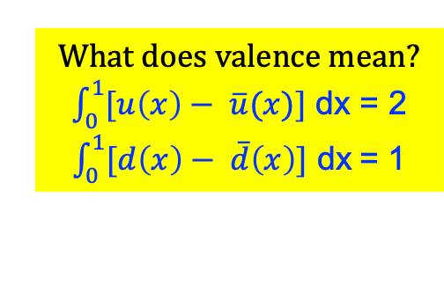
From Constituent Quarks to Partonic Quarks
Constituent Quark/Bag Model motivated valence approach
What does valence mean?
$\int_{0}^{1}{[u\left(x\right)− \overline{u}(x)\text{]} \text{dx}}$ = 2
$\int_{0}^{1}{[d\left(x\right)− \overline{d}\left(x\right)] \text{dx}}$= 1
Static quarks
Interacting quarks
Pair production

Slide 3
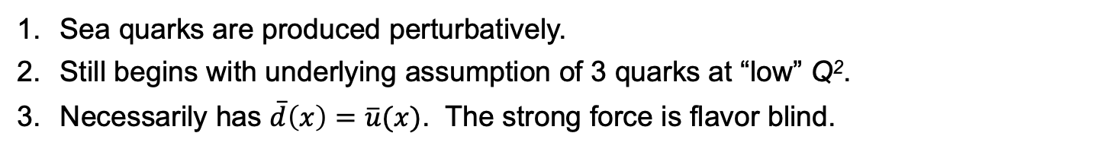
From Constituent Quarks to Partonic Quarks
Constituent Quark/Bag Model motivated valence approach
Sea quarks are produced perturbatively.
Still begins with underlying assumption of 3 quarks at “low” Q².
Necessarily has $\overline{d}\left(x\right)=\overline{u}(x)$. The strong force is flavor blind.

Slide 4
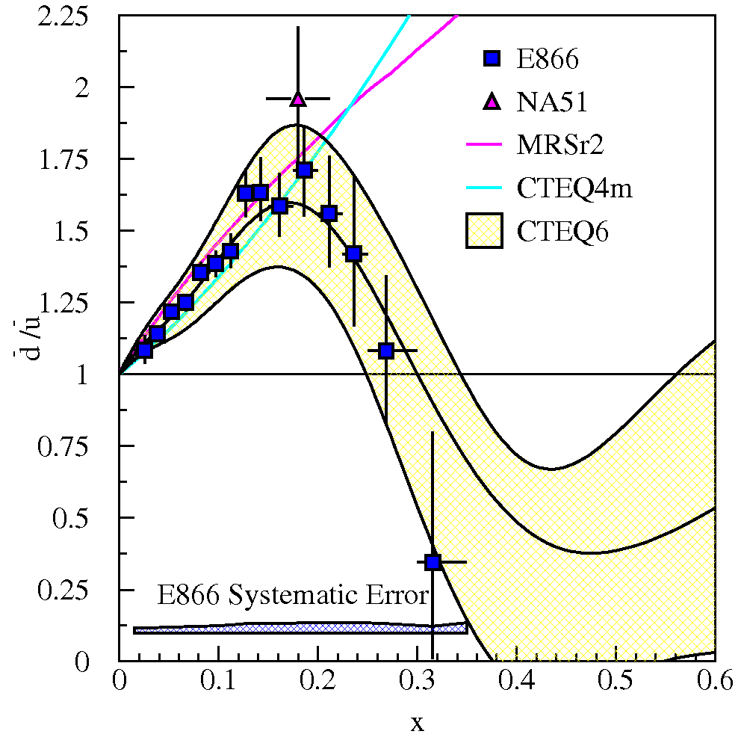
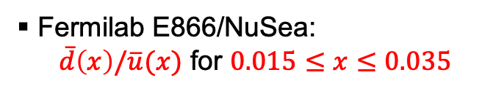
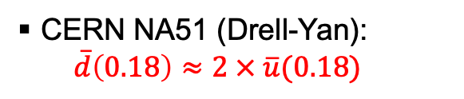
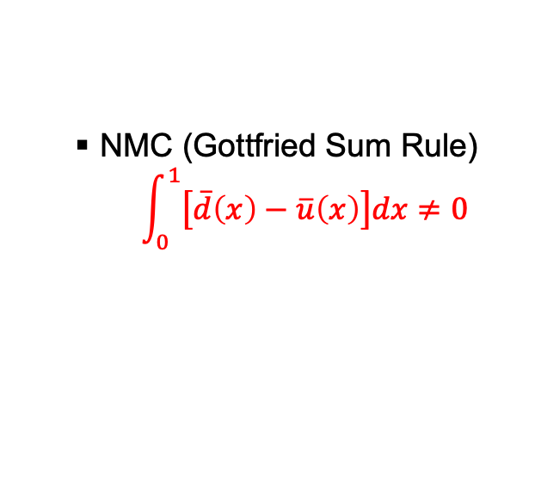
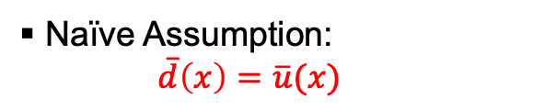
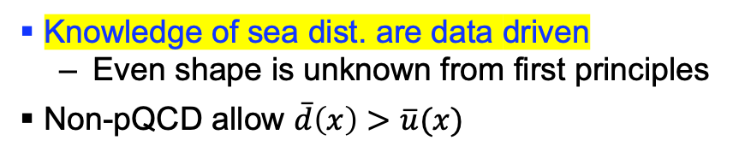
Light Antiquark Flavor Asymmetry: Brief History
Naïve Assumption:
  $$\overline{d}\left(x\right)=\overline{u}(x)$$
NMC (Gottfried Sum Rule)
$$\int_{0}^{1}{\left.\left[\overline{d}\left(x\right)−\overline{u}\left(x\right)\right.\right]dx≠0}$$
CERN NA51 (Drell-Yan):
  $$\overline{d}\left(0.18\right)≈2 × \overline{u}(0.18)$$
Fermilab E866/NuSea:
  $\overline{d}\left(x\right)/\overline{u}(x)$ for $0.015≤x≤0.035$
Knowledge of sea dist. are data driven
  Even shape is unknown from first principles
Non-pQCD allow $\overline{d}\left(x\right)>\overline{u}(x)$

Slide 5
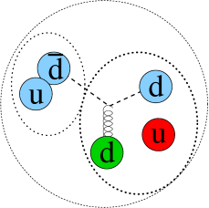
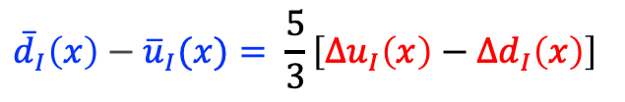
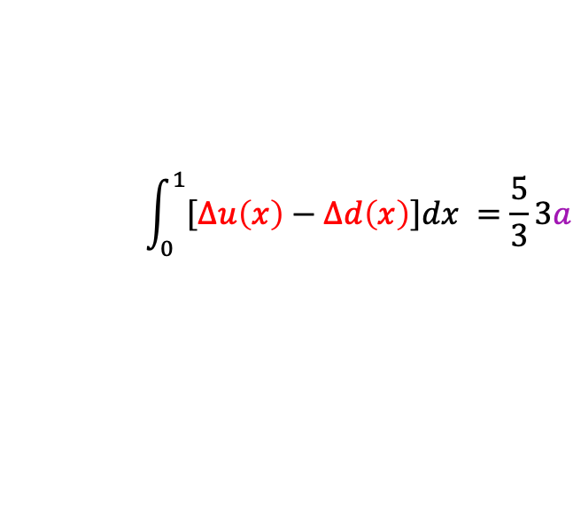
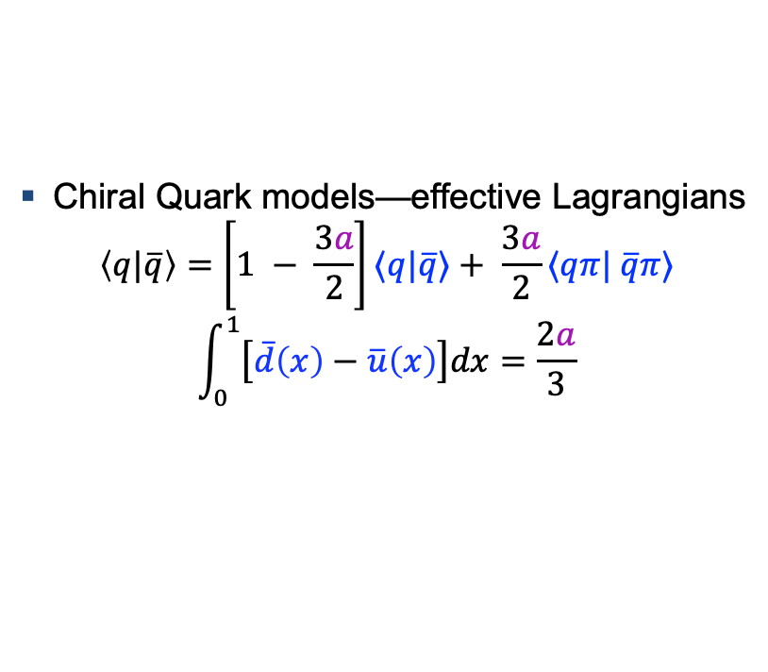
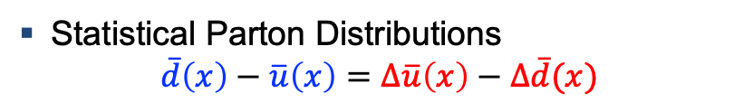

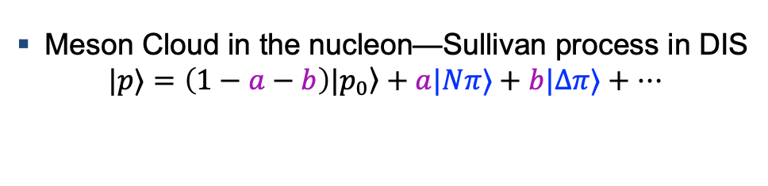
Models Relate Antiquark Flavor Asymmetry and Spin
Meson Cloud in the nucleon—Sullivan process in DIS
$$|p⟩=\left.\left(1−a−b\right)|p_{0}\right\rangle +a|Nπ⟩+b|Δπ⟩+⋯$$
Antiquarks in spin 0 object → No net spin
Chiral Quark models—effective Lagrangians
$$\left\langle q|\overline{q}\right\rangle =\left.\left[1 − \frac{3a}{2}\right.\right]⟨q|\overline{q}⟩+ \frac{3a}{2}⟨qπ| \overline{q}π⟩$$
$$\int_{0}^{1}{\left.\left[\overline{d}\left(x\right)−\overline{u}\left(x\right)\right.\right]dx=\frac{2a}{3}}$$
$$\int_{0}^{1}{\left.\left[Δu\left(x\right)−Δd\left(x\right)\right.\right]dx }=\frac{5}{3}3a$$
Instantons
$$ℒ∝{\overline{u}}_{R}u_{L}{\overline{d}}_{R}d_{L}+{\overline{u}}_{L}u_{R}{\overline{d}}_{L}d_{R}$$
$${\overline{d}}_{I}\left(x\right)−{\overline{u}}_{I}(x)= \frac{5}{3}\left[Δu_{I}\left(x\right)−Δd_{I}\left(x\right)\right]$$
Statistical Parton Distributions
$$\overline{d}\left(x\right)−\overline{u}\left(x\right)=Δ\overline{u}\left(x\right)−Δ\overline{d}(x)$$
For model details, see references in Rep. Prog. Phys. 82 (2019) 046301

Slide 6
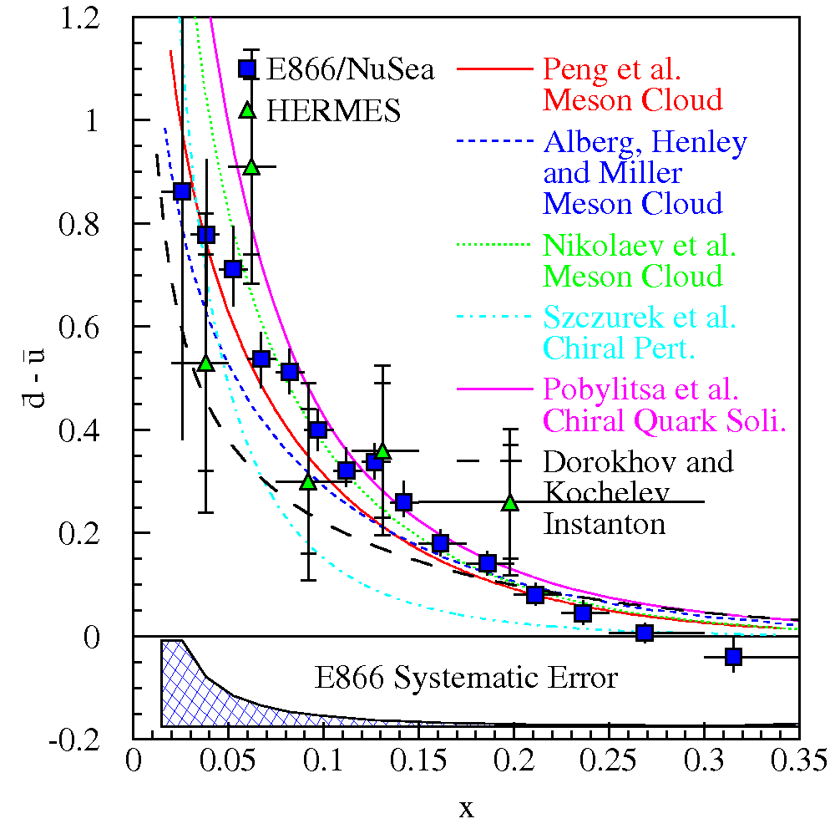
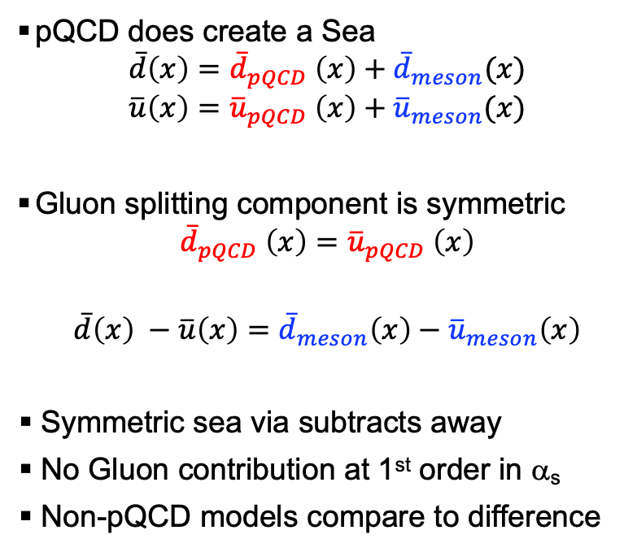
Non pQCD Sea Components
pQCD does create a Sea
$$\overline{d}\left(x\right)={\overline{d}}_{pQCD} \left(x\right)+{\overline{d}}_{meson}(x)$$
$$\overline{u}\left(x\right)={\overline{u}}_{pQCD} \left(x\right)+{\overline{u}}_{meson}(x)$$
Gluon splitting component is symmetric
$${\overline{d}}_{pQCD} \left(x\right)={\overline{u}}_{pQCD} \left(x\right)$$
$\overline{d}\left(x\right) −\overline{u}\left(x\right)=$ ${\overline{d}}_{meson}\left(x\right)−{\overline{u}}_{meson}\left(x\right)$
Symmetric sea via subtracts away
No Gluon contribution at 1st order in α_{s}
Non-pQCD models compare to difference
For model details, see references in Rep. Prog. Phys. 82 (2019) 046301
Notes:
Peng et al.:
Virtual pion cloud coupling to nucleus as a whole. Curve is dependent on dipole cut off factor Lambda, which can be different for pi N N and pi N Delta couplings.
Nikolaev et al.:
Similar to Peng, i.e. virtual pion cloud coupling to the nucleus, but with significantly reduced Delta contributions
Szczurek et al.:
Chiral perturbation theory—Goldstone bosons (pions) couple to valence quark structure u->d pi^+, d->u pi^-. Ad Hoc 11/7 dbar/ubar value, constant as a function of x
Poblylitsa:
Chiral quark soliton model, large N_c limit
Dorokhov and Kochelev:
Instantons coupling to valence structure of proton. Results are already parameterized to fit NMC data.

Slide 7
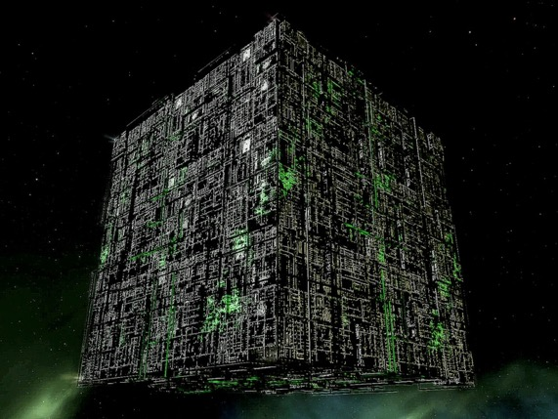
How is the Sea Created?
Lattice weighs in!!
Notes:
Peng et al.:
Virtual pion cloud coupling to nucleus as a whole. Curve is dependent on dipole cut off factor Lambda, which can be different for pi N N and pi N Delta couplings.
Nikolaev et al.:
Similar to Peng, i.e. virtual pion cloud coupling to the nucleus, but with significantly reduced Delta contributions
Szczurek et al.:
Chiral perturbation theory—Goldstone bosons (pions) couple to valence quark structure u->d pi^+, d->u pi^-. Ad Hoc 11/7 dbar/ubar value, constant as a function of x
Poblylitsa:
Chiral quark soliton model, large N_c limit
Dorokhov and Kochelev:
Instantons coupling to valence structure of proton. Results are already parameterized to fit NMC data.

Slide 8
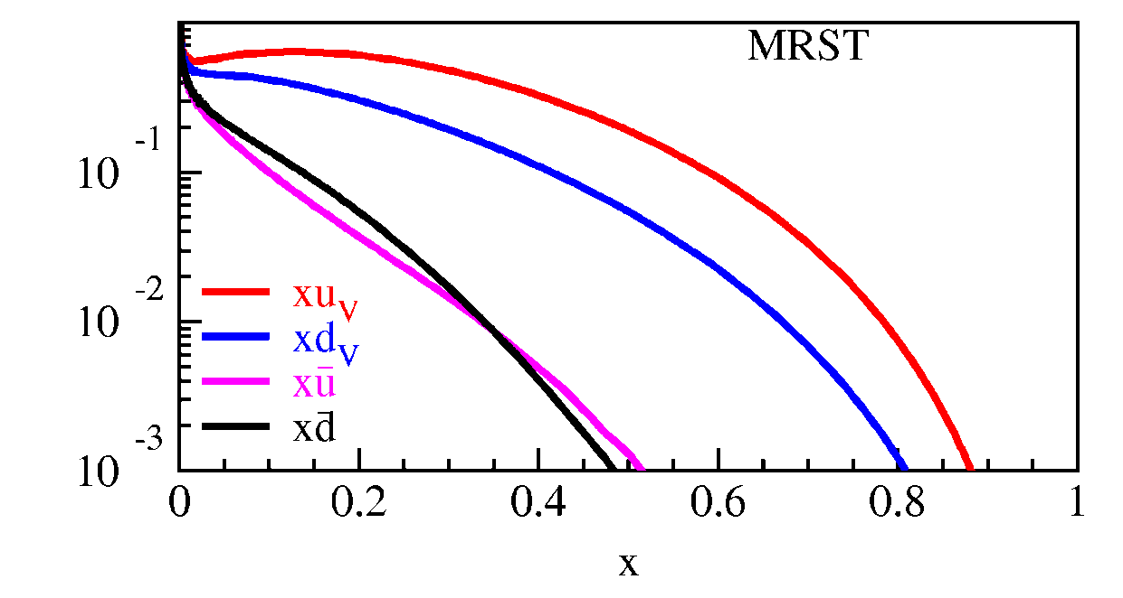
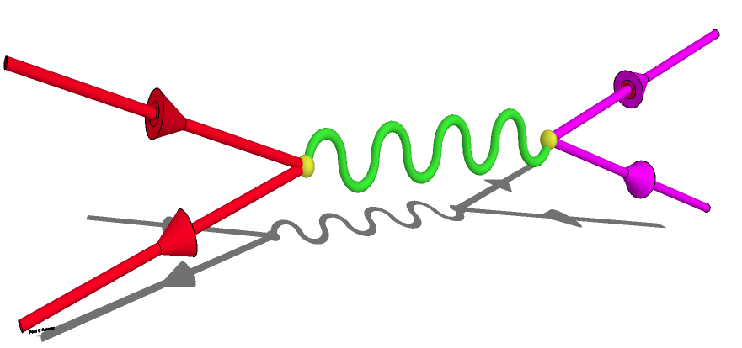
Drell-Yan Cross Section—Sensitivity to Sea Quarks
γ*
q⁺
l⁺
q⁻
l⁻
Cross Section
Point-like scattering of spin-1/2 particles
Convoluted of beam and target parton distributions

Slide 9
Drell-Yan Cross Section—Sensitivity to Sea Quarks
γ*
q⁺
l⁺
q⁻
l⁻
Cross Section
Point-like scattering of spin-1/2 particles
Convoluted of beam and target parton distributions
Acceptance limited
(Fixed Target, Hadron Beam)
u-quark dominance
  (2/3)² vs. (1/3)²

Slide 10
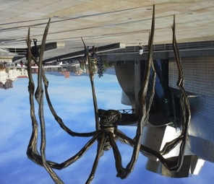
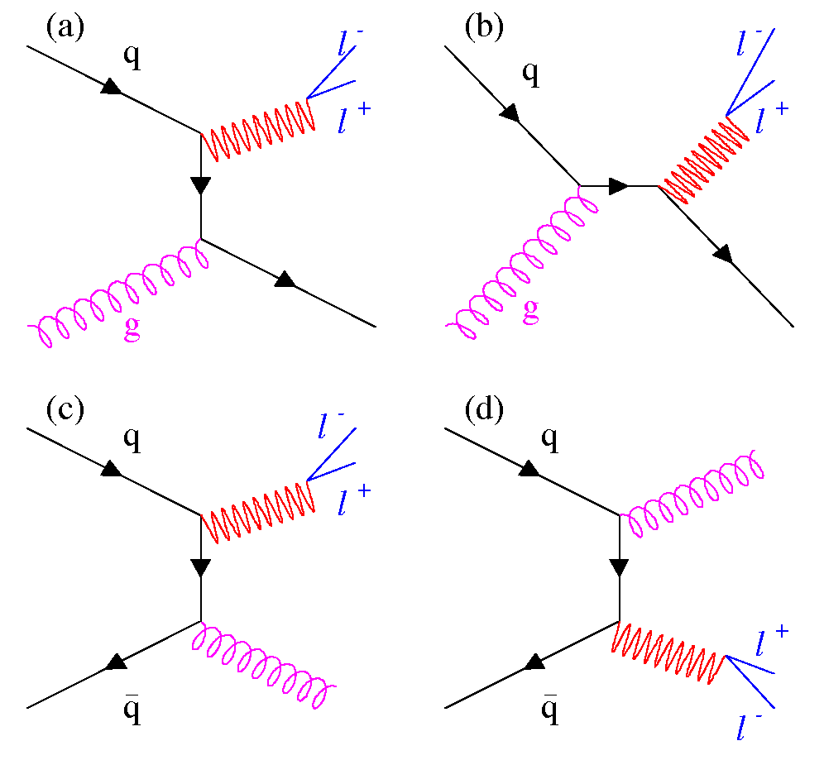
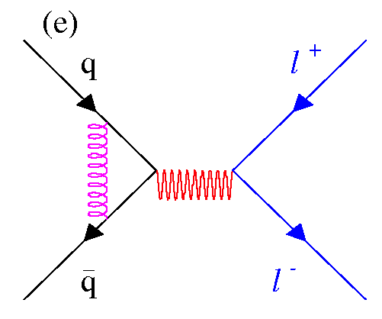
Next-to-Leading Order in α_{s}

Slide 11
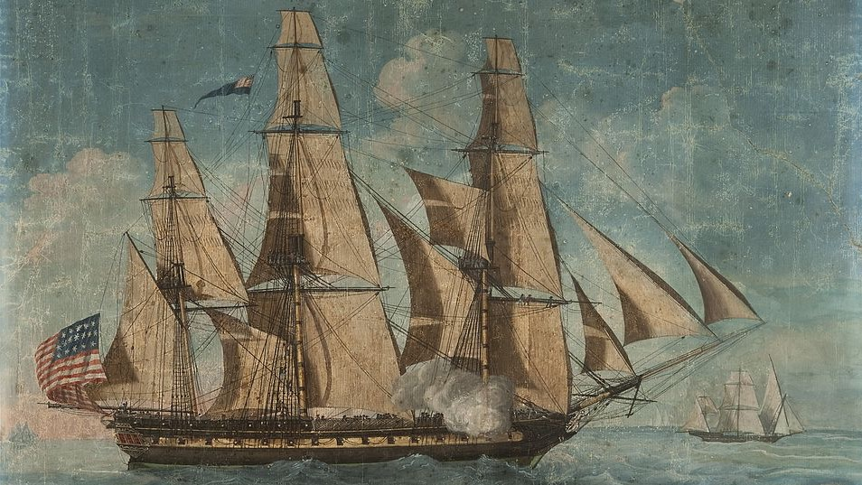
The SeaQuest Detector

Slide 12
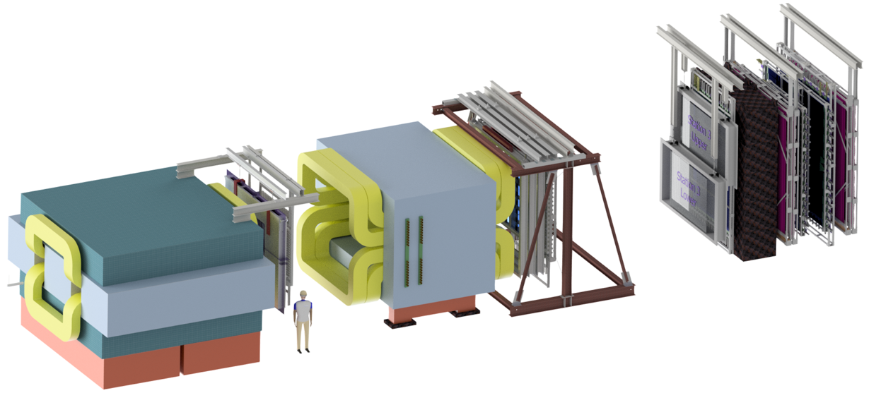
Station 4:
Hodoscope array
Proportional tube tracking
Stations 2 and 3:
Hodoscope array
Drift chamber tracking
Station 1:
Hodoscope array
MWPC tracking
Momentum measuring
magnet (KMag)
Solid iron focusing magnet, hadron absorber and beam dump (FMag)
4.9m
Hadron absorber
(iron wall)
25m
Liquid H₂, D₂, and solid targets

Slide 13
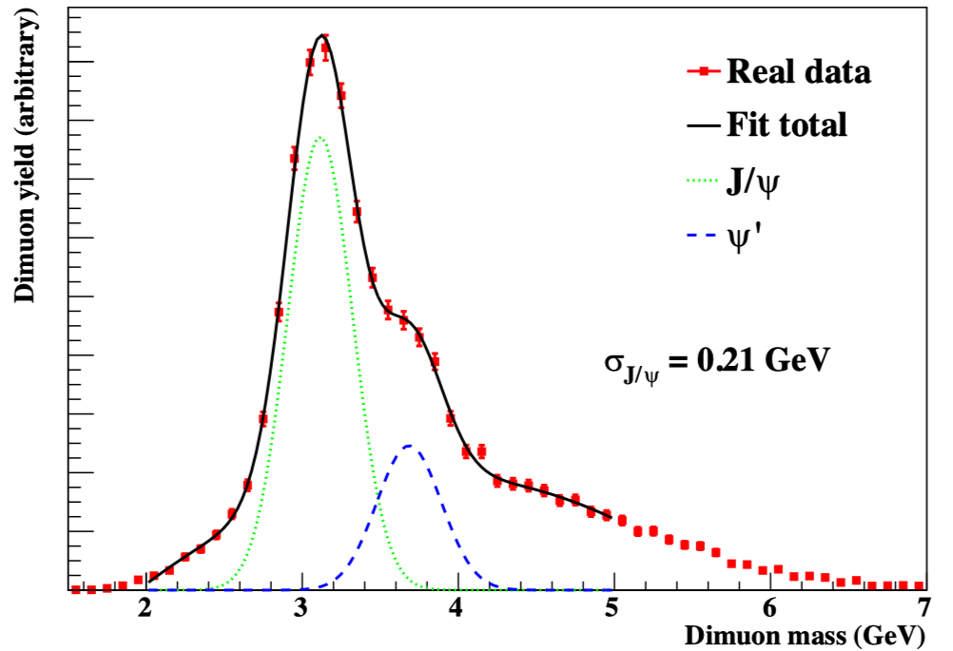
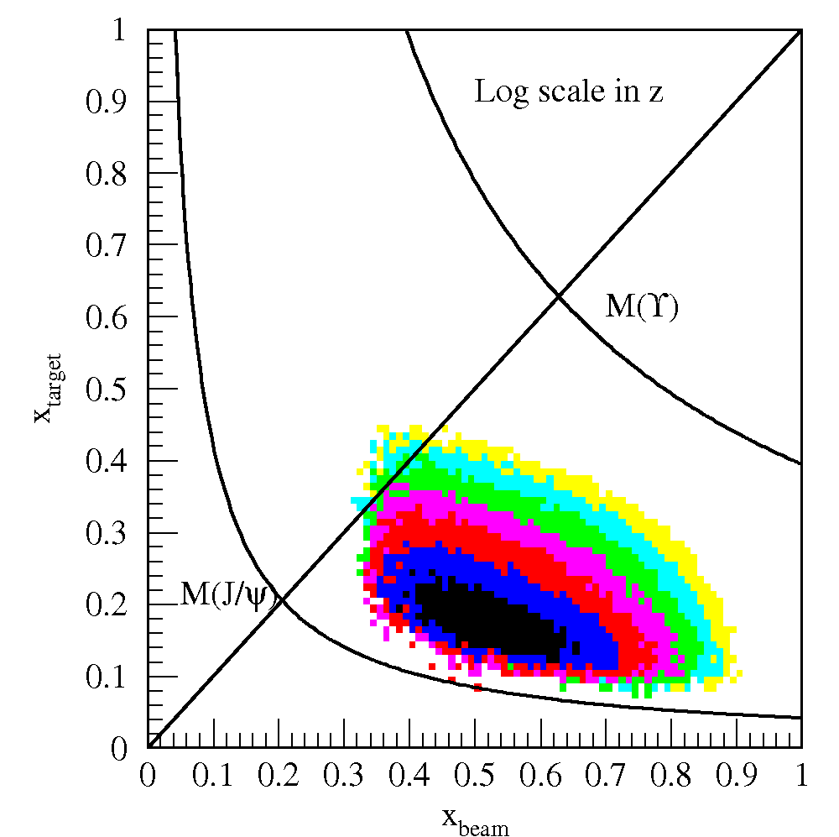
E906 Mass Spectrum
E906 Spect.
Monte Carlo
Drell-Yan

Slide 14
Cross Check of Rate Dependence
Preliminary
Multi-component mass fit
Combinatorial background “mixed” and reconstruction efficiency
Drell-Yan
Drell-Yan

Slide 15
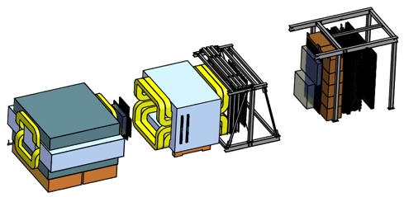
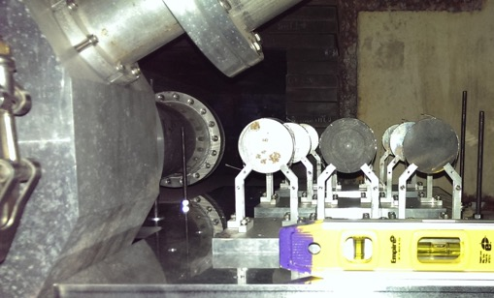
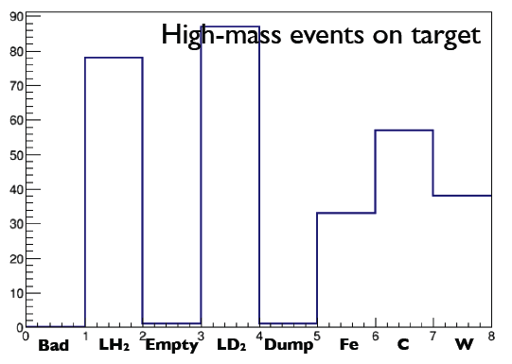
Do We Reconstruct Events When there are Events?
Entire beam interacts upstream of first SeaQuest Spectrometer tracking chamber
Spatial resolution poor along beam axis
Resolve target vs beam dump
Beam Dump
lD₂ None Fe C W
Beam into Page
Off page lH₂ Empty flask

Slide 16
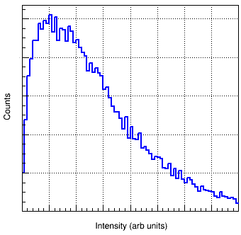
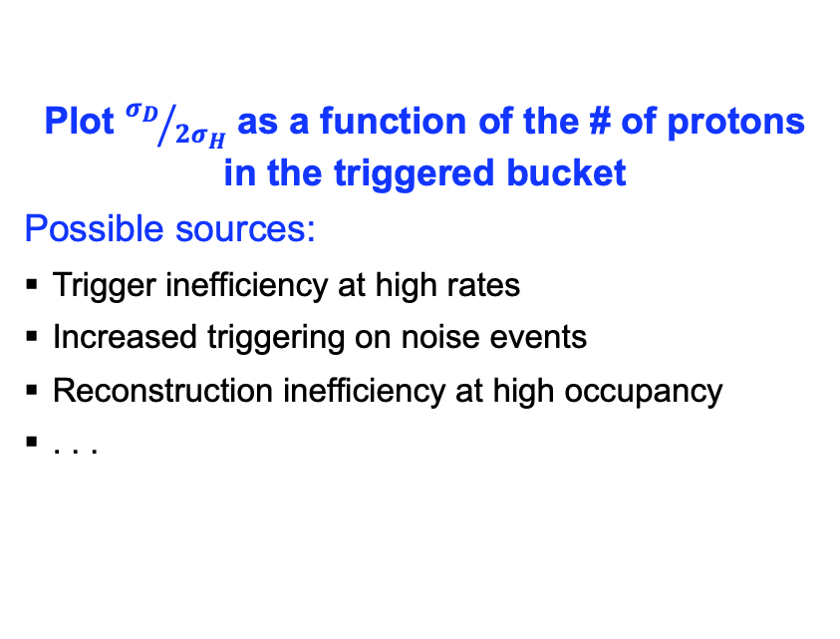
Is There an Intensity Dependence?
Plot ${σ_{D}}/{2σ_{H}}$ as a function of the # of protons in the triggered bucket
Possible sources:
Trigger inefficiency at high rates
Increased triggering on noise events
Reconstruction inefficiency at high occupancy
. . .
1/5 the number of spills, but about 4.5x the protons

Slide 17
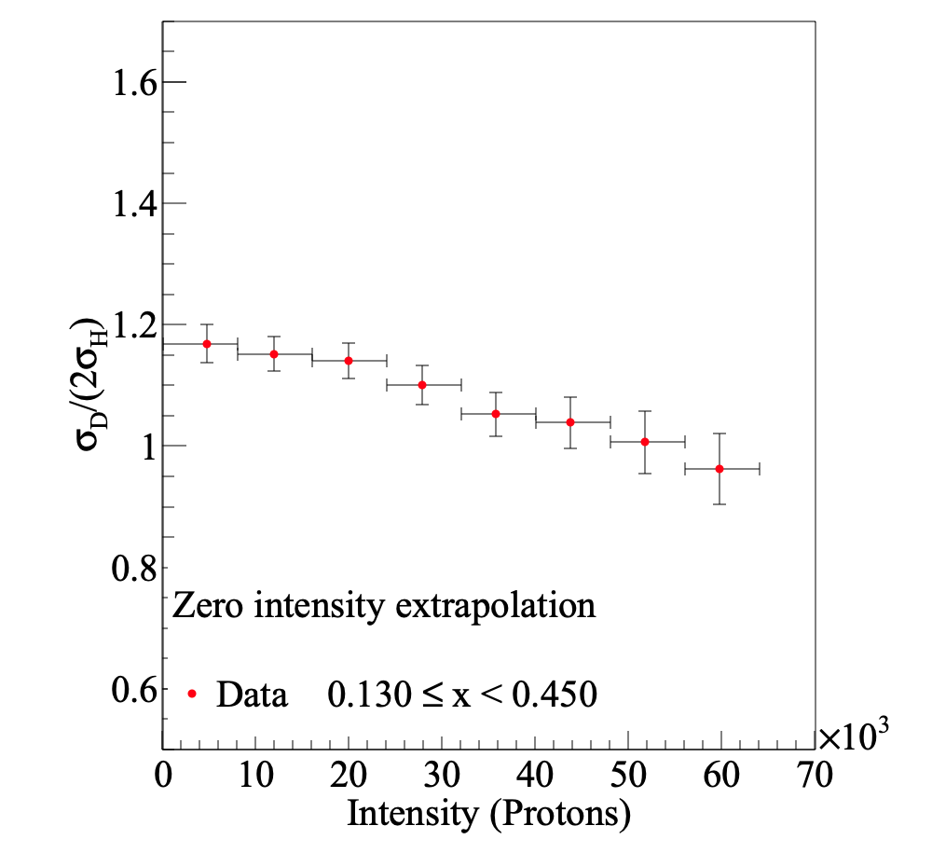
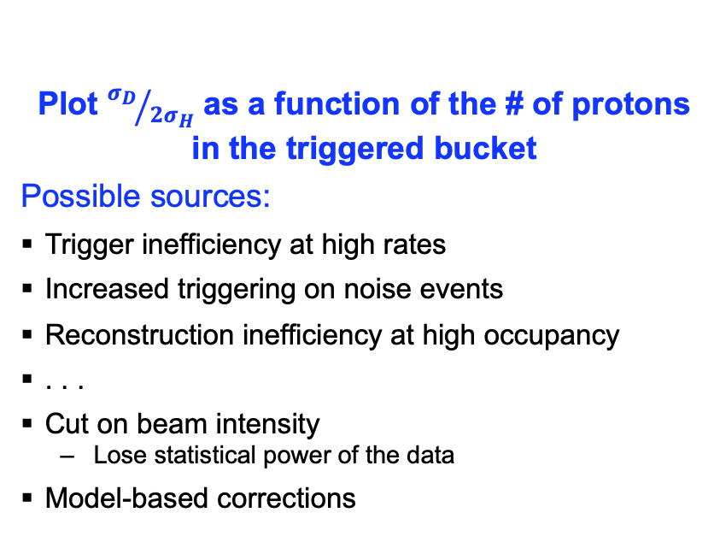
Is There an Intensity Dependence?
Plot ${σ_{D}}/{2σ_{H}}$ as a function of the # of protons in the triggered bucket
Possible sources:
Trigger inefficiency at high rates
Increased triggering on noise events
Reconstruction inefficiency at high occupancy
. . .
Cut on beam intensity
  Lose statistical power of the data
Model-based corrections
  Fit data w/model of source
  Monte Carlo to verify
  Used by E866/NuSea
  Becomes difficult with multiple effects

Slide 18
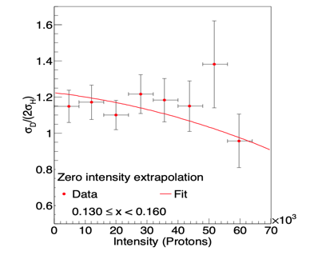
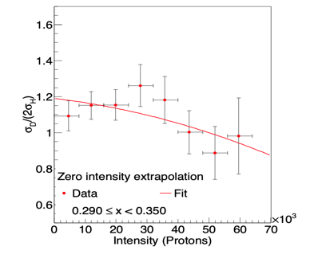
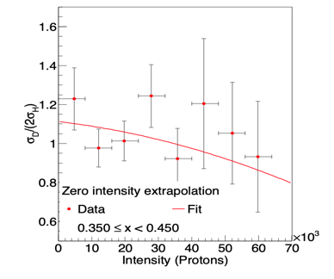
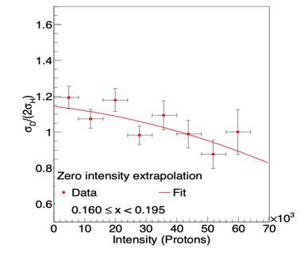
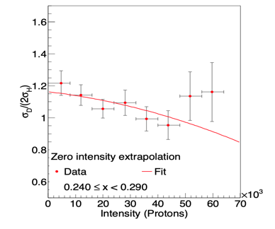
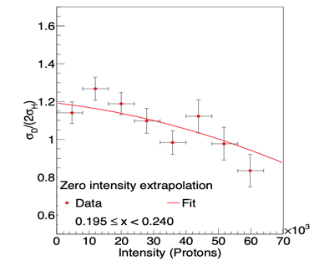
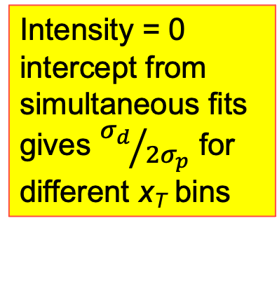
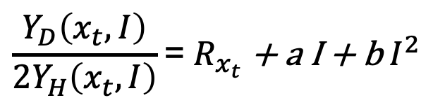
Intensity Extrapolation
$$\frac{Y_{D}\left(x_{t},I\right)}{2Y_{H}\left(x_{t},I\right)}\text{= }R_{x_{t}}\text{ + }\text{a} \text{I}\text{ + }\text{b}{ I}^{2}$$
Intensity = 0 intercept from simultaneous fits gives ${σ_{d}}/{2σ_{p}}$ for different x_{T} bins

Slide 19
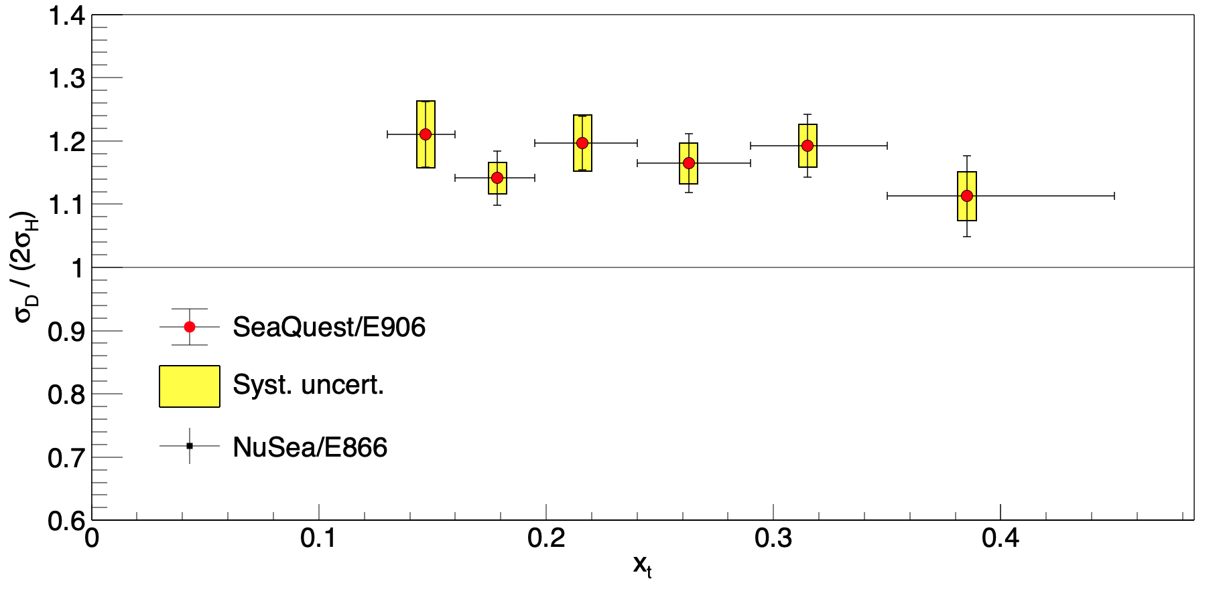

SeaQuest
SeaQuest data,
  $\frac{σpd}{2σ pp}>1$

Slide 20
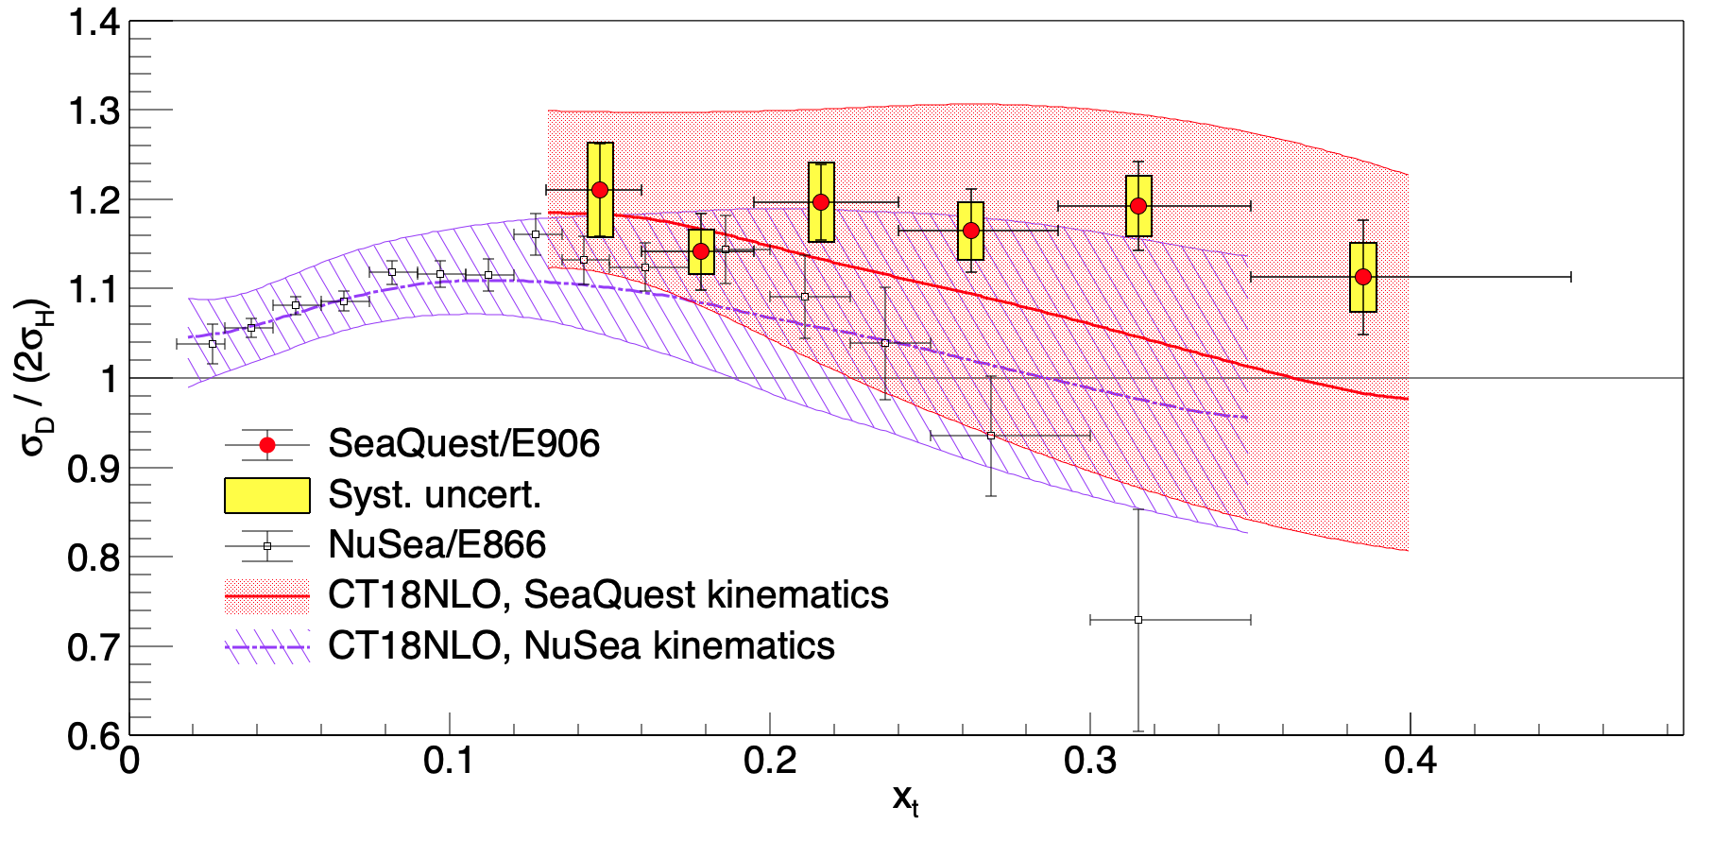
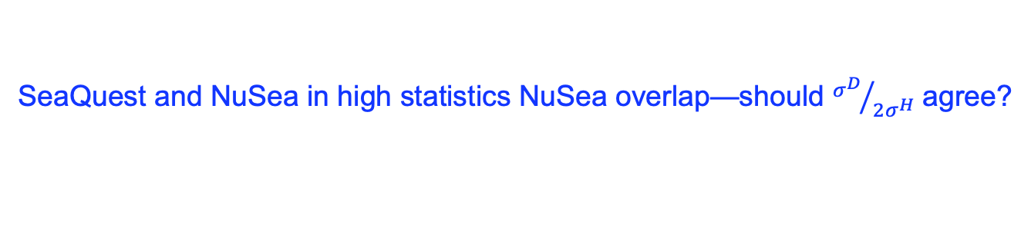
SeaQuest and E866
SeaQuest and NuSea in high statistics NuSea overlap—should ${σ^{D}}/{2σ^{H}}$ agree?

Slide 21
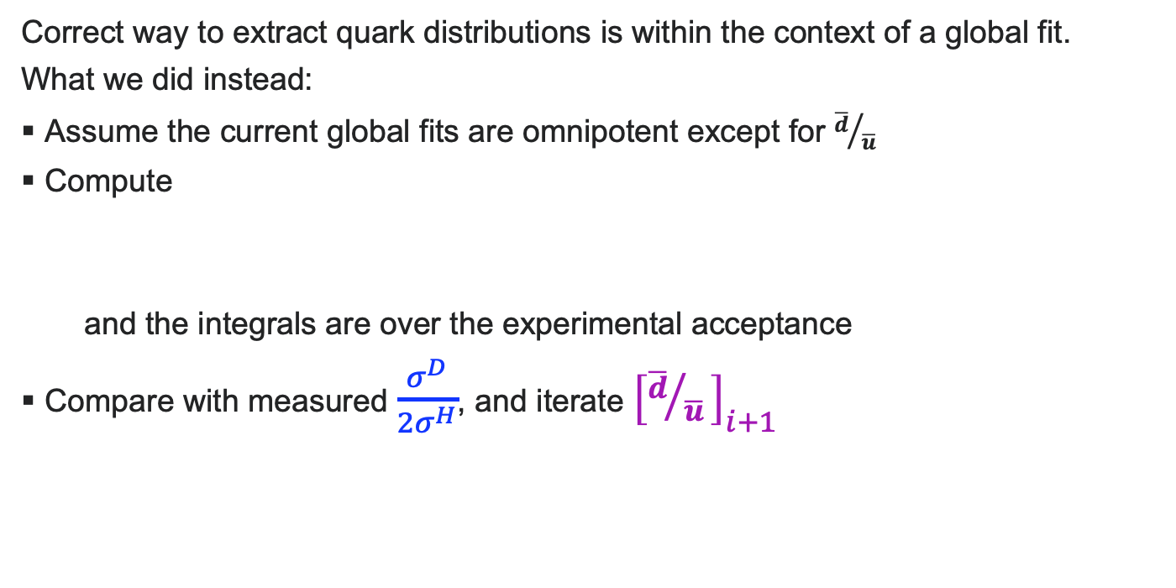



Seaquest’s ${\overline{d}}/{\overline{u} }$ extraction
$$\frac{σ^{D}}{2{ σ}^{H}}= \frac{1}{2}\left[1+\frac{\overline{d}}{\overline{u}}\right]$$
Correct way to extract quark distributions is within the context of a global fit.
What we did instead:
Assume the current global fits are omnipotent except for ${\overline{d}}/{\overline{u} }$
Compute
and the integrals are over the experimental acceptance
Compare with measured $\frac{σ^{D}}{{2σ}^{H}}$, and iterate ${\left[{\overline{d}}/{\overline{u} }\right]}_{i+1}$
$\frac{σ^{D}}{{2σ}^{H}}= \frac{\iint{\frac{dσ_{NLO}^{D}}{dx_{1}dx_{2}}dx_{1} dx_{2} }}{2\iint{\frac{dσ_{NLO}^{H}}{dx_{1}dx_{2}}dx_{1} dx_{2} }}$ with ${\left[{\overline{d}}/{\overline{u} }\right]}_{i}$

Slide 22


SeaQuest and E866
SeaQuest ${\overline{d}\left(x\right)}/{\overline{u}\left(x\right)}>1$ for entire measured range.

Slide 23

SeaQuest compared with Global Fits

Slide 24

SeaQuest compared with Models

Slide 25

Quark Motion in the Sea

Slide 26



How to Measure Orbital Angular Momentum?
q(x)
g_{1T}(x,k_{T})
k_{T} - dependent, “T-even”
Non-zero after k_{T} integration
Δq(x)
h_{1L}⊥(x,k_{T})
h_{1T}(x)
h_{1T}⊥(x,k_{T})
“Naively” T-Odd
k_{T} dependent distributions
  A non-zero Sivers function implies orbital angular momentum
  Not yet a rigorous method to quantitatively extract L_{q} from $F_{1T}^{⊥}$
$$f_{1T}^{⊥}(x,kT)$$
Sivers
$$h_{1}(x,k_{T})$$
Boer-Mulders

Slide 27

SIDIS Sivers Measurements
HERMES, Airapetian et al. Phys. Rev. Lett. 103, 152002
COMPASS, Adloph et al. Phys Lett. B, 717, 383

Slide 28


Pion Cloud and OAM
  Consider a nucleonic pion cloud $|p⟩=\left.\left(1−a−b\right)|p_{0}\right\rangle +a|Nπ⟩+b|Δπ⟩+⋯$
  Pion J^{p}=0⁻ Negative Parity
  Need L=1 to get proton’s J^{p}=½⁺
π
π
p
p₀
N₀
Δ₀

Slide 29


SeaQuest E1039 Status
Expect to start running after Fermilab startup in November 2022.

Slide 30







Epilogue
Drell-Yan provides access to antiquark distribution
x_{Bj} < 0.45, $σpd / σpp≥1$
Non-perturbative QCD is important
SeaQuest has measured the nuclear dependence of the Drell-Yan reaction
$$q$$
γ*
$$l^{+}$$
$$\overline{q}$$
$$l^{+}$$
SpinQuest will measure the Drell-Yan Sivers Function and probe sea quark orbital angular momentum with a polarized target.

