Slide 1
QNP2022 - The 9th International Conference on Quarks and Nuclear Physics
Analysis of Midrapidity p_{t} Distributions of Identified Charged Particles in Xe+Xe collisions at (s_{nn})^{1/2}=5.44 TeV using non-extensive Tsallis Statistics with included Transverse Flow
Khusniddin Olimov
Physical-Technical Institute Of Uzbekistan Academy of Sciences
Tashkent, Uzbekistan

Slide 2
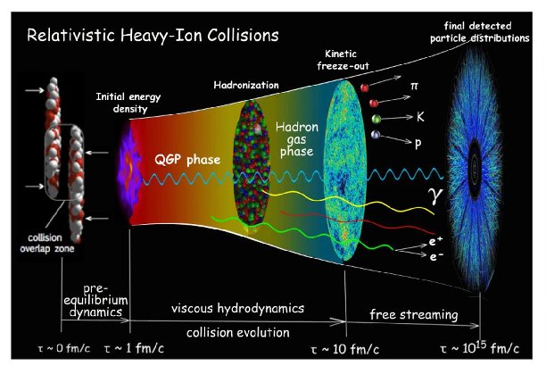
ALICE TRANSVERSE MOMENTUM DATA ON P+P Collisions at 13 TeV (MIDRAPIDITY) CERN PREPRINT CERN-EP-2020-024, 3 March 2020.
Table 1. Mean charged particle multiplicity density in different classes of event multiplicity in p+p collisions at 13 TeV.
V0M mult. class | < dN_{ch}/dη > | σ/σ_{INEL>0} (%)
I | 26.02±0.35 | 0-0.92
II | 20.02±0.27 | 0.92-4.6
III | 16.17±0.22 | 4.6-9.2
IV | 13.77±0.19 | 9.2-13.8
V | 12.04±0.17 | 13.8-18.4
VI | 10.02±0.14 | 18.4-27.6
VII | 7.95±0.11 | 27.6-36.8
VIII | 6.32±0.09 | 36.8-46
IX | 4.50±0.07 | 46.0-64.5
X | 2.55±0.04 | 64.5-100

Slide 3
INTRODUCTION
Investigation of the Properties of Quark-Gluon Plasma (QGP) is of high importance - According to Big Bang Theory – The Matter of the Early Universe was in a State of QGP just a few microseconds after the Big Bang.
The lattice QCD estimations have yielded T_{c} ≈ 150-170 MeV (critical temperature) and ε_{c} ≈ 1 GeV/fm³ (critical energy density) for a transition from a nucleon to QGP state of matter.
Nucleus-Nucleus collisions at High Energies are Key for discovery of new (heavy) particles (resonances), allowing also To Probe the Matter at Record Small Distances about 10⁻¹³ cm and less.

Slide 4
QGP has been discovered in collisions of heavy ions at high energies at the RHIC and LHC. The obtained QGP matter has shown fluid-like behavior with low viscosity.
The parameters of the chemical freeze-out – the chemical freeze-out temperature (T_{ch}) and the baryochemical potential (μ_{b}) are commonly obtained from fitting the particle yields (abundancies) with the statistical hadronization or thermal models.
The parameters of the kinetic freeze-out – the kinetic freeze-out temperature (T₀) and the transverse expansion velocity ($β_{t}$) of particles at the time of decoupling of an expanding fireball are estimated from analysis of transverse momentum distributions of particles with the help of various theoretical and phenomenological models - hydrodynamics based blast-wave models, the blast-wave model with Boltzmann-Gibbs (BGBW model) as well as Tsallis (TBW model) statistics, QCD-inspired Hagedorn (power law) function with embedded transverse flow and others.
Pions, kaons, and (anti)protons account for the predominantly largest part of the final particles produced in high-energy collisions at the RHIC and LHC.

Slide 5
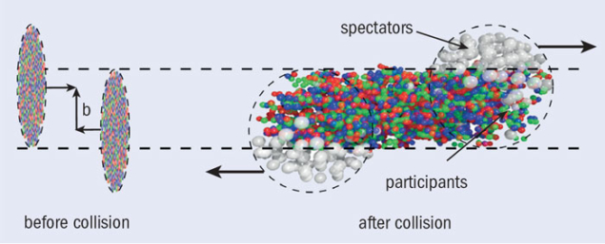

Slide 6
ANALYZED ALICE TRANSVERSE MOMENTUM DATA* ON Pb+Pb Collisions at (s_{nn})^{1/2}=5.02 TeV (MIDRAPIDITY)
The average number of participant nucleons and mean charged-particle multiplicity densities
in the analyzed groups of centralities of Pb+Pb collisions at (s_{nn})^{1/2}=5.02 TeV*.
Centr. | $$〈N_{part}〉$$ | $$〈dN_{ch}/d〉$$
0-5% | 383±11 | 1943±56
5-10% | 331±10 | 1587±47
10-20% | 262±7 | 1180±31
20-30% | 188±5 | 786±20
30-40% | 131±4 | 512±15
40-50% | 87±4 | 318±12
50-60% | 54±3 | 183±8
60-70% | 31±2 | 96±6
70-80% | 16±2 | 45±3
80-90% | 7±1 | 18±2
*ALICE Collaboration, Acharya, S.; et al. Production of charged pions, kaons and
(anti-)protons in Pb-Pb and inelastic pp collisions at (s)^{1/2}=5.02 TeV. Phys. Rev. C 2020, 101, 044907. arXiv: 1910.07678v1 [nucl-ex].

Slide 7
ANALYZED ALICE TRANSVERSE MOMENTUM DATA* ON Xe+Xe Collisions at (s_{nn})^{1/2}=5.44 TeV (MIDRAPIDITY)
The average number of participant nucleons and mean charged particle multiplicity densities
for the analyzed centralities of Xe+Xe collisions at (s_{nn})^{1/2}=5.44 TeV*.
Centr. | $$〈N_{part}〉$$ | $$〈dN_{ch}/d〉$$
0-5% | 236±2 | 1167±26
5-10% | 207±2 | 939±24
10-20% | 165±2 | 706±17
20-30% | 118±3 | 478±11
30-40% | 82±3 | 315±8
40-50% | 55±3 | 198±5
50-60% | 34±2 | 118±3
60-70% | 20±2 | 65±2
70-90% | 8±1 | 24±2
*ALICE Collaboration, S. Acharya et al., Production of pions, kaons, (anti-)protons and φ mesons in Xe–Xe collisions at (s_{nn})^{1/2} = 5.44 TeV, Eur. Phys. J. C 81, 584 (2021), arXiv:2101.03100 [nucl-ex].

Slide 8
TSALLIS DISTRIBUTION FUNCTION
Various types of Tsallis distribution function, based on non-extensive Tsallis statistics, have demonstrated quite high efficiencies, becoming standard for describing the p_{t} spectra of final hadrons in high-energy proton+proton collisions. Tsallis distribution function has the advantage of being connected via the entropy to thermodynamics, which is not the case with other power law distributions.
Simple (thermodynamically non-consistent) Tsallis distribution function (at midrapidity <y> = 0)
$\frac{d^{2}N}{2πN_{ev}p_{t}dp_{t}dy}=C{\left(1+(q−1)\frac{m_{t}}{T}\right)}^{−q/(q−1)}$, (1)
Thermodynamically consistent Tsallis distribution function (at midrapidity <y> = 0)
$\frac{d^{2}N}{2πN_{ev}p_{t}dp_{t}dy}=C_{q}{m_{t}\left(1+(q−1)\frac{m_{t}}{T}\right)}^{−q/(q−1)}$, (2)
$m_{t}=\sqrt{p_{t}^{2}+m_{0}^{2}}$ is the transverse mass (energy), and m₀ - the rest mass of a hadron, T is the effective temperature
q − non-extensivity parameter, which characterizes the deviation of p_{t} distribution from the exponential Boltzmann-Gibbs distribution and is thought to measure the degree of non-equilibrium or non-thermalization.
As q tends to one (1), the Tsallis function approaches the exponential (equilibrated) Boltzmann-Gibbs distribution.
The closer is the parameter q to one, the larger is the thermalization level of a system.

Slide 9
SIMPLE TSALLIS FUNCTION WITH TRANSVERSE FLOW
The values of T, obtained from Tsallis function (Eqs. (1) and (2)) fits are actually the effective temperatures, which include contributions of both the thermal motion and collective expansion (collective flow) effects. То separate these two effects, the transverse flow velocity should be incorporated into the Tsallis distribution function.
For description of midrapidity (mid-y) p_{t} distributions, d²N/(N_{ev}dp_{t}dy), of identified charged particles in different centrality classes of Pb+Pb and Xe+Xe collisions at the LHC, we embed the transverse flow effect into simple Tsallis function in Eq. (1) by substituting (simple Lorentz transformation) $m_{t}→〈γ_{t}〉 (m_{t}−p_{t}〈β_{t}〉)$:
$\frac{d^{2}N}{N_{ev}dp_{t}dy}=2πC p_{t}{\left(1+〈γ_{t}〉\frac{\left(q−1\right)\left(m_{t}−p_{t}〈β_{t}〉\right)}{T_{0} }\right)}^{−q/(q−1)}$ , (4)
which is called simple (or non-consistent) Tsallis function with transverse flow in present work. Here $〈β_{t}〉$ is the average transverse flow velocity in c units.
$<γ_{t}>=1 /\sqrt{1−{<β_{t}^{}>}^{2}}$ is the Lorentz factor.

Slide 10
THERMODYNAMICALLY CONSISTENT TSALLIS FUNCTION WITH TRANSVERSE FLOW
Similarly, we incorporate the transverse flow into Tsallis function with thermodynamical consistence in Eq. (2) by applying simple Lorentz transformation $m_{t}→〈γ_{t}〉 (m_{t}−p_{t}〈β_{t}〉)$ transformation to obtain
$\frac{d^{2}N}{N_{ev}dp_{t}dy}=2π C_{q}p_{t}{〈γ_{t}〉\left(m_{t}−p_{t}〈β_{t}〉\right)\left(1+〈γ_{t}〉\frac{\left(q−1\right)\left(m_{t}−p_{t}〈β_{t}〉\right)}{T_{0} }\right)}^{−q/(q−1)}$ , (5)
which is called thermodynamically consistent Tsallis function with transverse flow in present work.

Slide 11
$\frac{d^{2}N}{N_{ev}dp_{t}dy}=2π C_{q}p_{t}{〈γ_{t}〉\left(m_{t}−p_{t}〈β_{t}〉\right)\left(1+〈γ_{t}〉\frac{\left(q−1\right)\left(m_{t}−p_{t}〈β_{t}〉\right)}{T_{0} }\right)}^{−q/(q−1)}$,
Thermodynamically consistent Tsallis function (for <y>=0) with transverse flow
Fitted p_{t} ranges: [0.5-5.0] GeV/c for $π^{+}$+$π^{−}$; [0.2-5.0] GeV/c for $K^{+}$+$K^{−}$ ;
[0.3-5.0] GeV/c for p+$\overline{p}$.
The results of combined minimum χ2 fits with thermodynamically consistent Tsallis function with transverse flow (Eq.(5)) of p_{t} spectra of particles in Pb+Pb collisions at (s_{nn})^{1/2}=5.02 TeV. n.d.f. denotes the number of degrees of freedom. T₀ and $〈β_{t}〉$ are shared (global) parameters during combined fits.
Centrality | q ($π^{+}$+$π^{−}$) | q ($K^{+}$+$K^{−}$) | q (p+$\overline{p}$) | T₀ (MeV) | $〈β_{t}〉$ | $χ^{2}$/n.d.f.
0-5% | 1.088±0.002 | 1.086±0.002 | 1.088±0.002 | 80±3 | 0.60±0.01 | 296/98
5-10% | 1.093±0.002 | 1.088± 0.002 | 1.090±0.002 | 79±3 | 0.59±0.01 | 301/98
10-20% | 1.096±0.002 | 1.093±0.002 | 1.092±0.002 | 79±3 | 0.58±0.01 | 270/98
20-30% | 1.102±0.002 | 1.098±0.002 | 1.095±0.002 | 77±2 | 0.57±0.01 | 216/98
30-40% | 1.108±0.002 | 1.106±0.002 | 1.098±0.002 | 77±2 | 0.53±0.01 | 167/98
40-50% | 1.117±0.002 | 1.114±0.002 | 1.100±0.001 | 76±2 | 0.49±0.01 | 116/98
50-60% | 1.124±0.001 | 1.121±0.001 | 1.107±0.001 | 78±2 | 0.43±0.01 | 72/98
60-70% | 1.131±0.001 | 1.131±0.001 | 1.112±0.001 | 82±2 | 0.33±0.01 | 31/98
70-80% | 1.136±0.001 | 1.139±0.001 | 1.116±0.001 | 87±2 | 0.22±0.01 | 20/98
80-90% | 1.142±0.001 | 1.146±0.001 | 1.118±0.001 | 86±3 | 0.14±0.02 | 21/98

Slide 12
$\frac{d^{2}N}{N_{ev}dp_{t}dy}=2π C_{q}p_{t}{〈γ_{t}〉\left(m_{t}−p_{t}〈β_{t}〉\right)\left(1+〈γ_{t}〉\frac{\left(q−1\right)\left(m_{t}−p_{t}〈β_{t}〉\right)}{T_{0} }\right)}^{−q/(q−1)}$,
Thermodynamically consistent Tsallis function (for <y>=0) with transverse flow
Fitted p_{t} ranges: [0.5-5.0] GeV/c for $π^{+}$+$π^{−}$; [0.2-5.0] GeV/c for $K^{+}$+$K^{−}$ ;
[0.3-5.0] GeV/c for p+$\overline{p}$.
The results of combined minimum χ2 fits with thermodynamically consistent Tsallis function with transverse flow (Eq.(5)) of p_{t} spectra of particles in Xe+Xe collisions at (s_{nn})^{1/2}=5.44 TeV.
T₀ and $〈β_{t}〉$ are shared (global) parameters during combined fits. n.d.f. denotes the number of degrees of freedom.
Centr. | q ($π^{+}$+$π^{−}$) | q ($K^{+}$+$K^{−}$) | q (p+$\overline{p}$) | T₀ (MeV) | $〈β_{t}〉$ | $χ^{2}$/n.d.f. (n.d.f.)
0-5% | 1.093±0.004 | 1.087±0.003 | 1.085±0.002 | 76±3 | 0.61±0.01 | 1.69 (98)
5-10% | 1.098±0.004 | 1.093±0.003 | 1.086±0.002 | 74±3 | 0.60±0.01 | 1.71 (98)
10-20% | 1.104±0.004 | 1.099±0.003 | 1.092±0.002 | 75±3 | 0.58±0.01 | 1.49 (98)
20-30% | 1.109±0.003 | 1.104±0.003 | 1.096±0.002 | 75±3 | 0.55±0.01 | 1.14 (98)
30-40% | 1.115±0.003 | 1.109±0.003 | 1.099±0.002 | 76±3 | 0.52±0.01 | 1.03 (98)
40-50% | 1.121±0.003 | 1.114±0.003 | 1.103±0.002 | 75±3 | 0.48±0.01 | 0.86 (98)
50-60% | 1.130±0.003 | 1.124±0.002 | 1.114±0.002 | 77±3 | 0.40±0.01 | 0.71 (98)
60-70% | 1.134±0.002 | 1.130±0.002 | 1.119±0.001 | 81±3 | 0.33±0.02 | 0.45 (97)
70-90% | 1.142±0.002 | 1.138±0.002 | 1.120±0.001 | 82±3 | 0.22±0.02 | 0.38 (97)

Slide 13
The obtained fit curves by the thermodynamically consistent Tsallis function with transverse flow of the experimental midrapidity transverse momentum spectra of the charged pions (●) and kaons (Δ), protons and antiprotons (■) in Pb+Pb collisions at (s_{nn})^{1/2}=5.02 TeV at various centralities: 0-5% (a), 20-30% (b), 50-60% (c), and 80-90% (d).

Slide 14
The resulting combined minimum χ2 fit curves by the thermodynamically consistent Tsallis function with transverse flow of the experimental mid-y p_{t} distributions of the charged pions (●) and kaons (Δ), protons and antiprotons (■) in Xe-Xe collisions at (s_{nn})^{1/2}=5.44 TeV at different collision centralities: 0-5% (a), 10-20% (b), 50-60% (c), and 70-90% (d). The error bars are combined (added in quadrature) statistical and systematic errors, dominated by the systematic ones.

Slide 15
Figure. The $〈N_{part}〉$ dependencies of the obtained T₀ (a) and $〈β_{t}〉$ (b) parameters (●) of consistent Tsallis function with transverse flow in Xe-Xe collisions at (s_{nn})^{1/2}=5.44 TeV; (c) – the same for the obtained q values of consistent Tsallis function with transverse flow for the charged pions (●) and kaons (▲), protons and antiprotons (■). The corresponding results extracted for the respective particles in
Xe-Xe collisions at (s_{nn})^{1/2}=5.44 TeV using non-consistent Tsallis function with transverse flow are shown by the corresponding open symbols.
The significantly different growth rates of $〈β_{t}〉$ in regions $〈N_{part}〉$ < 44±5 and $〈N_{part}〉$ > 44±5, with T₀ becoming practically constant in range
$〈N_{part}〉$ > 44±5, could indicate that $〈N_{part}〉$ ≈ 44±5
($〈dN_{ch}/d〉$ ≈ 158±20) is a threshold border value for a crossover transition from a dense hadronic state to the Quark-Gluon Plasma phase (or mixed phase of QGP and hadrons) in Xe+Xe collisions at (s_{nn})^{1/2}=5.44 TeV. The threshold border value is $〈β_{t}〉$ ≈ 0.44±0.02 (corresponding to $〈N_{part}〉$ ≈ 44±5 and $〈dN_{ch}/d〉$ ≈ 158±20).

Slide 16
Figure. The $〈N_{part}〉$ dependencies of the obtained T₀ (a) and $〈β_{t}〉$ (b) parameters (●) of consistent Tsallis function with transverse flow in Pb+Pb collisions at (s_{nn})^{1/2}=5.02 TeV; (c) – the $〈β_{t}〉$ versus $〈dN_{ch}/d〉$ dependence; (d) – The $〈N_{part}〉$ dependence for the extracted q values of consistent Tsallis function with transverse flow for the charged pions (●) and kaons (▲), protons and antiprotons (■). The results extracted for the respective particles in Pb+Pb collisions at (s_{nn})^{1/2}=5.02 TeV using non-consistent Tsallis function with transverse flow are plotted by the corresponding open symbols.
Significantly differing growth rates of $〈β_{t}〉$ in regions $〈N_{part}〉$ < 71±7 ($〈dN_{ch}/d〉$ < 251±20) and $〈N_{part}〉$ > 71±7 ($〈dN_{ch}/d〉$ > 251±20) with T₀ staying constant within uncertainties in region $〈N_{part}〉$ > 71±7 ($〈dN_{ch}/d〉$> 251±20) probably indicates that $〈N_{part}〉$ ≈ 71±7 ($〈dN_{ch}/d〉$ ≈ 251±20) is a threshold border value for a crossover transition from a dense hadronic state to the QGP phase (or mixed phase of QGP and hadrons) in Pb+Pb collisions at (s_{nn})^{1/2}=5.02 TeV.
The threshold border value $〈β_{t}〉$ ≈ 0.46±0.03 (corresponding to $〈N_{part}〉$ ≈ 71±7 and $〈dN_{ch}/d〉$ ≈ 251±20) in Pb+Pb collisions at (s_{nn})^{1/2}=5.02 TeV has agreed well with the corresponding border value $〈β_{t}〉$ ≈ 0.44±0.02, obtained by us in Xe+Xe collisions at (s_{nn})^{1/2}=5.44 TeV.

Slide 17
The threshold border value $〈β_{t}〉$ ≈ 0.46±0.03 (corresponding to $〈N_{part}〉$ ≈ 71±7 and $〈dN_{ch}/d〉$ ≈ 251±20), estimated in Pb+Pb collisions at (s_{nn})^{1/2}=5.02 TeV in Ref. [1] has agreed well with the corresponding border value $〈β_{t}〉$ ≈ 0.44±0.02, obtained in Xe+Xe collisions at (s_{nn})^{1/2}=5.44 TeV in Ref. [2], and with almost constant $〈β_{t}〉$ values extracted in Ref. [3] in the BES program at the RHIC in central Au+Au collisions in (s_{nn})^{1/2} = 7.7−39 GeV energy range, where the threshold for QGP production has been reached.
[1.] Kh. K Olimov et al., Midrapidity p_{T} Distributions of Identified Charged Particles in Pb + Pb Collisions at (s_{nn})^{1/2}= 5.02 TeV Using Tsallis Distribution with Embedded Transverse Flow, Universe 8, 401 (2022). https://doi.org/10.3390/universe8080401
[2.] Kh. K Olimov et al., Study of midrapidity p_{t} distributions of identified charged particles in Xe+Xe collisions at (s_{nn})^{1/2}=5.44 TeV using non-extensive Tsallis statistics with transverse flow, Modern Physics Letters A 37, 2250095 (2022). https://doi.org/10.1142/S021773232250095X
[3.] STAR Collaboration, Adamczyk, L.; et al. Bulk Properties of the Medium Produced in Relativistic Heavy-Ion Collisions from the Beam Energy Scan Program. Phys. Rev. C 2017, 96, 044904. arXiv:1701.07065 [nucl-ex].

Slide 18
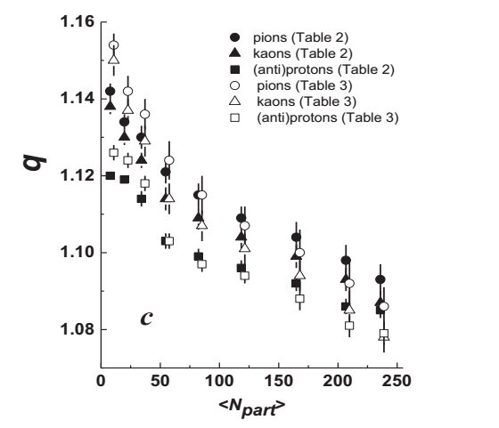
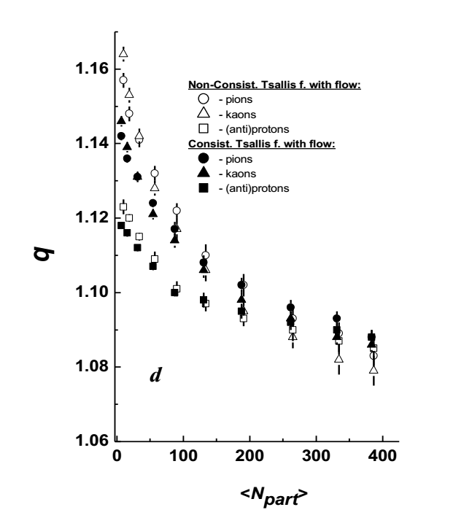
The non-extensivity parameter q demonstrates a systematic decrease with increasing $〈N_{part}〉$ (collision centrality) for all studied particle species in both Xe+Xe (left figure) and Pb+Pb (right figure) collisions at the LHC. This observation is in agreement with the known fact that the degree of thermalization of the system grows with increasing centrality of heavy-ion collisions at high energies.
The gap between q(mesons) and q(baryons) decreases with an increase in collision centrality, and q(mesons) practically coincides within uncertainties with q(baryons) in central Xe+Xe (left figure) and Pb+Pb (right figure) collisions with large $〈N_{part}〉$ values at the LHC. This could indicate quite large degree of equilibrium and thermalization of QGP produced in central Xe+Xe and Pb+Pb collisions with large $〈N_{part}〉$ values at the LHC.

Slide 19
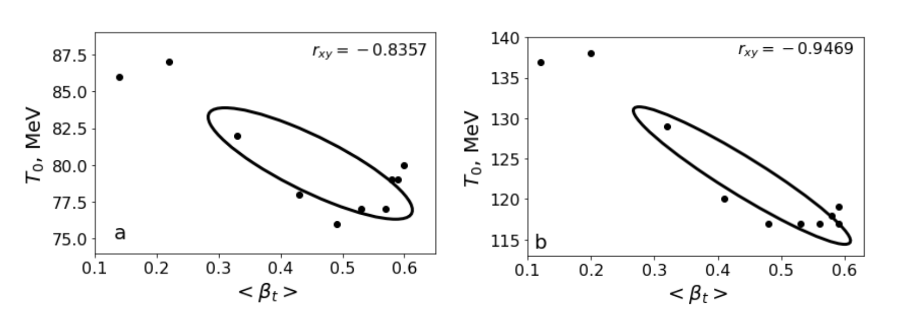
The 1-sigma confidence ellipse (corresponding to 68% confidence interval) of the covariance of the parameters T₀ and $〈β_{t}〉$ and the calculated Pearson correlation coefficient, r_{xy}, between T₀ and $〈β_{t}〉$ in Pb+Pb collisions at (s_{nn})^{1/2}=5.02 TeV are shown in the figures.
The orientations and shapes of the confidence ellipses and values of Pearson correlation coefficient r_{xy} on Left (a) and Right (b) Figures show the high degree of anticorrelation (negative correlation) between parameters T₀ and $〈β_{t}〉$ extracted from fits by both consistent and non-consistent Tsallis functions with transverse flow.

Slide 20
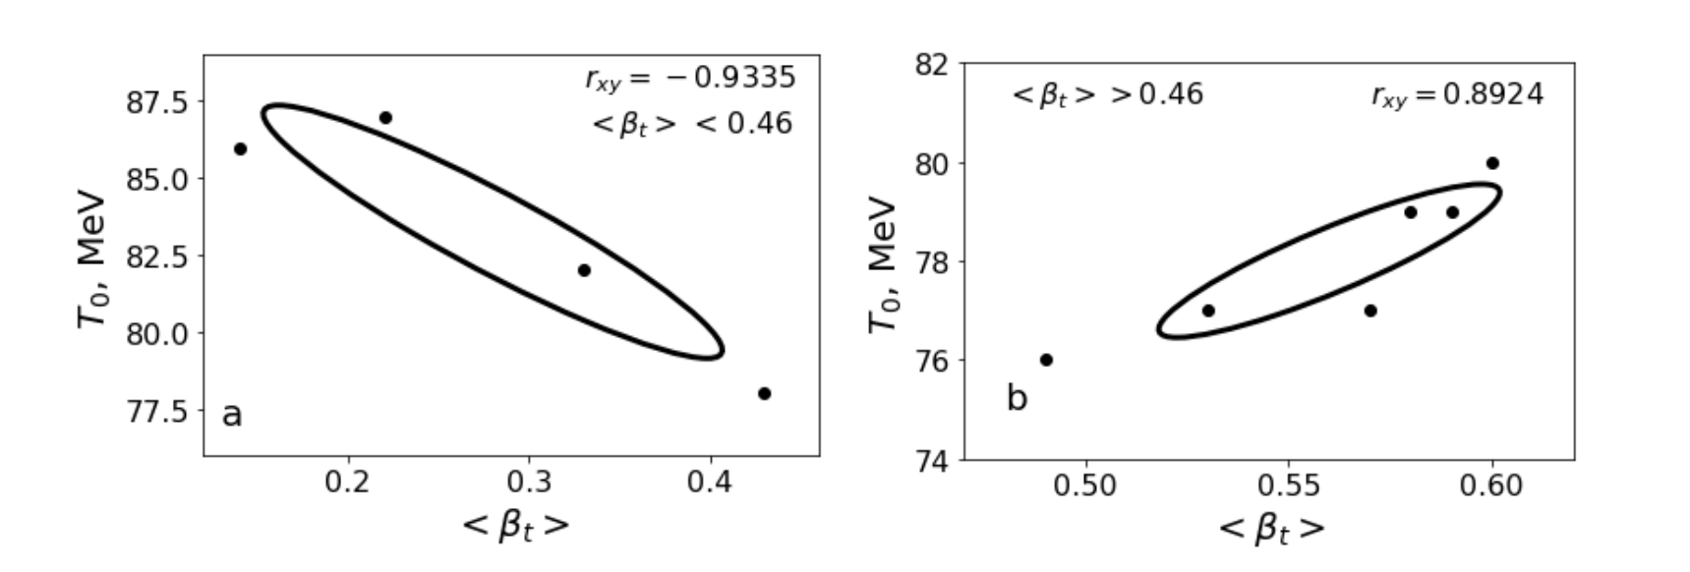
It is observed that not only the parameter $〈β_{t}〉$ shows significantly differing growth rates in regions $〈N_{part}〉$ < 71±7 ($〈dN_{ch}/d〉$ < 251±20) and $〈N_{part}〉$ > 71±7 ($〈dN_{ch}/d〉$ > 251±20), but also the character of correlation between parameters T₀ and $〈β_{t}〉$ differs much in the corresponding intervals $〈β_{t}〉$ < 0.46 and $〈β_{t}〉$ > 0.46 in Pb+Pb collisions at the LHC.
This supports further our conjecture that $〈N_{part}〉$ ≈ 71±7 ($〈dN_{ch}/d〉$≈ 251±20) is probably a threshold border value for a crossover transition from a dense hadronic (nucleon) state to the QGP phase (or mixed phase of QGP and hadrons) in Pb+Pb collisions at (s_{nn})^{1/2}=5.02 TeV.
Also in Xe+Xe collisions at the LHC - the degree of correlation between parameters T₀ and $〈β_{t}〉$ differs much in the corresponding intervals $〈β_{t}〉$ < 0.44 and $〈β_{t}〉$ > 0.44.

Slide 21
The threshold border values of $〈N_{part}〉$ , $〈dN_{ch}/d〉$, and $〈β_{t}〉$ estimated in Pb+Pb collisions at (s_{nn})^{1/2}=5.02 TeV and compared with those extracted in Xe+Xe collisions at (s_{nn})^{1/2}=5.44 TeV. The ratios of the corresponding quantities for two collision types are given in the last column.
Quantity | Xe+Xe collisions at (s_{nn})^{1/2}=5.44 TeV [24] | Pb+Pb collisions at (s_{nn})^{1/2}=5.02 TeV | $$\frac{Pb+Pb}{Xe+Xe}$$
$$〈N_{part}〉$$ | 44±5 | 71±7 | 1.61±0.24
$$〈dN_{ch}/d〉$$ | 158±20 | 251±20 | 1.59±0.24
$$〈β_{t}〉$$ | 0.44±0.02 | 0.46±0.03 | 1.07±0.08
It is interesting to compare these ratios for border values of $〈N_{part}〉$ as well as $〈dN_{ch}/d〉$ with the ratio of the mass numbers of the corresponding ²⁰⁸Pb and ¹³²Xe nuclei
equal to $\frac{A\left({208}_{Pb}\right)}{A\left({132}_{Xe}\right)}≈1.58$.
All three ratios practically coincide with each other satisfying the
relation
$\frac{{〈N_{part}〉}_{Pb+Pb}}{{〈N_{part}〉}_{Xe+Xe}}≈\frac{{〈dN_{ch}/dη〉}_{Pb+Pb}}{{〈dN_{ch}/dη〉}_{Xe+Xe}}≈\frac{A\left({208}_{Pb}\right)}{A\left({132}_{Xe}\right) }≈1.6$

Slide 22
SUMMARY AND CONCLUSIONS
We have analyzed successfully the midrapidity p_{t} distributions of the charged pions and kaons, protons and antiprotons, measured by ALICE Collaboration at various centrality classes of Xe+Xe collisions at (s_{nn})^{1/2}=5.44 TeV and Pb+Pb collisions at (s_{nn})^{1/2}=5.02 TeV, applying combined minimum χ² fits with the thermodynamically non-consistent as well as thermodynamically consistent Tsallis function with transverse flow.
We have estimated the threshold border values of $〈N_{part}〉$, $〈dN_{ch}/d〉$ , and$〈β_{t}〉$ for a crossover transition from a dense hadronic state to the QGP phase (or mixed phase of QGP and hadrons) in Xe+Xe collisions at (s_{nn})^{1/2}=5.44 TeV and Pb+Pb collisions at (s_{nn})^{1/2}=5.02 TeV.
The ratio (1.61±0.24) of the estimated border values of $〈N_{part}〉$ in Pb+Pb collisions at (s_{nn})^{1/2}=5.02 TeV and Xe+Xe collisions at (s_{nn})^{1/2}=5.44 TeV has coincided with the ratio (1.59±0.24) of the corresponding $〈dN_{ch}/d〉$ in these two collision types, and with the ratio of the mass numbers of the corresponding ²⁰⁸Pb and ¹³²Xe nuclei equal to $\frac{A\left({208}_{Pb}\right)}{A\left({132}_{Xe}\right)}≈1.58$.
The non-extensivity parameter q demonstrates a systematic decrease with increasing $〈N_{part}〉$ (collision centrality) for all studied particle species in both Xe+Xe and Pb+Pb collisions at the LHC, implying an increase in system thermalization with increasing centrality of heavy-ion collisions at high energies.
The gap between q(mesons) and q(baryons) decreases with an increase in collision centrality, and q(mesons) practically coincides within uncertainties with q(baryons) in central Xe+Xe and Pb+Pb collisions with large $〈N_{part}〉$ values at the LHC. This could indicate quite large degree of equilibrium and thermalization of QGP produced in central Xe+Xe and Pb+Pb collisions with large $〈N_{part}〉$ values.

Slide 23
QNP2022 - The 9th International Conference on Quarks and Nuclear Physics
THANK YOU VERY MUCH

