Slide 1
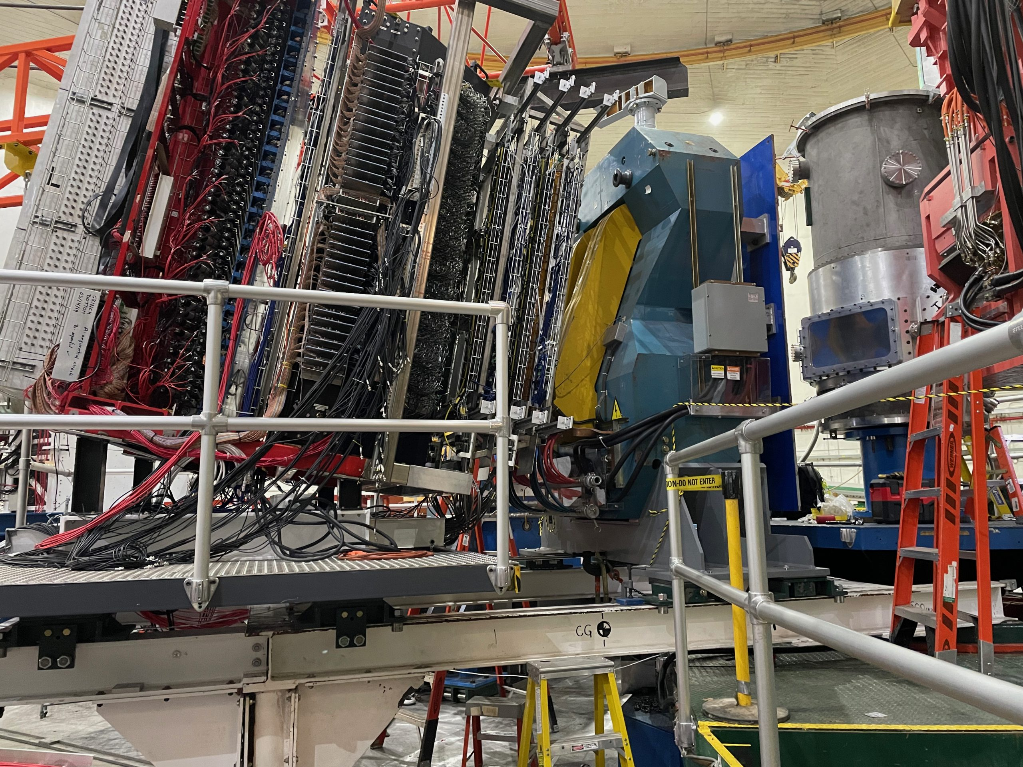
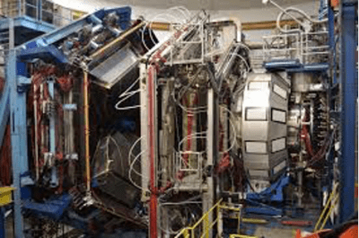
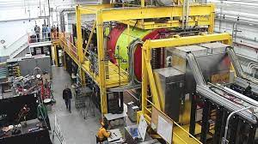
Nucleon Structure Physics from Electron Scattering Experiments
Cynthia Keppel Thomas Jefferson National Accelerator Facility
QNP2022:
9th International Conference
on Quarks and Nuclear Physics
5-9 September 2022

Slide 2
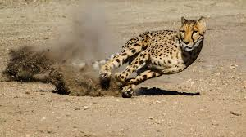
Talk Topics
Nucleon Structure in 25 minutes or less!
Nucleon form factors
Structure functions
Unpolarized
Polarized
“2D” and “3D”
GPDs
TMDs
Will focus on recent and near upcoming results from Jefferson Lab

Slide 3
Elastic Scattering
R. Hofstadter

Slide 4
SBS Physics: Extending Q² Range of Nucleon Form Factors
G^{M}_{p}
G^{M}_{n}
G^{E}_{p}
G^{E}_{n}
high
impact
Map transition to perturbative regime—running of dressed quark mass function
Imaging of the nucleon charge and magnetization densities in impact-parameter space in the infinite momentum frame
Precision high Q² form factors have impact on GPD extractions from DVCS
Combined data allows flavor separation for large range of Q²

Slide 5
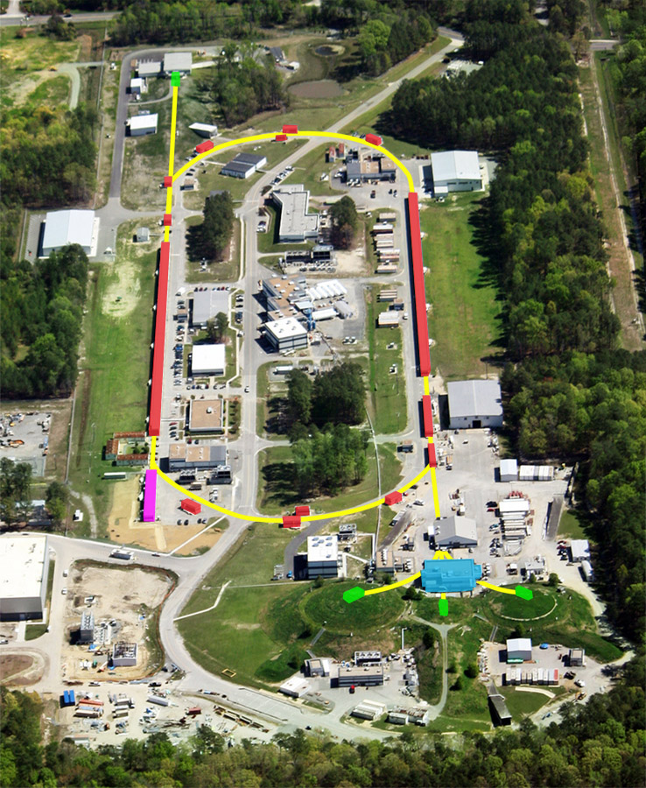
JLab Hall A Super BigBite Spectrometer Program
then
now
Substantial new equipment installation
Dedicated to precision measurements of nucleon form factors to highest Q²
Started taking data in 2021!

Slide 6
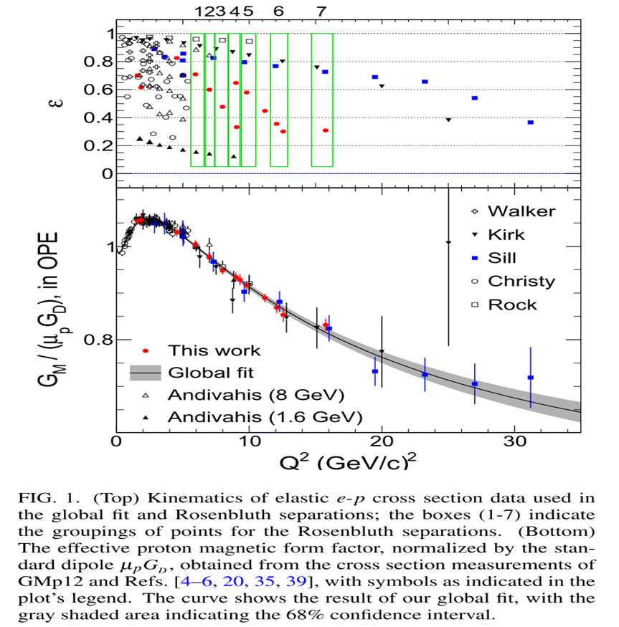
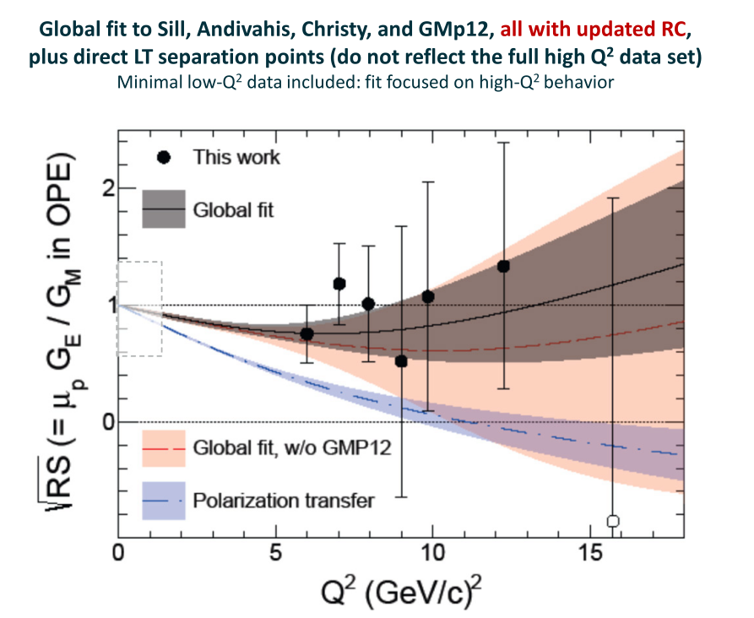
G_{M}^{p} establishes > 95% confidence for two photon effects in elastic electron-proton scattering
Phys. Rev. Lett. 102002 (2022)

Slide 7
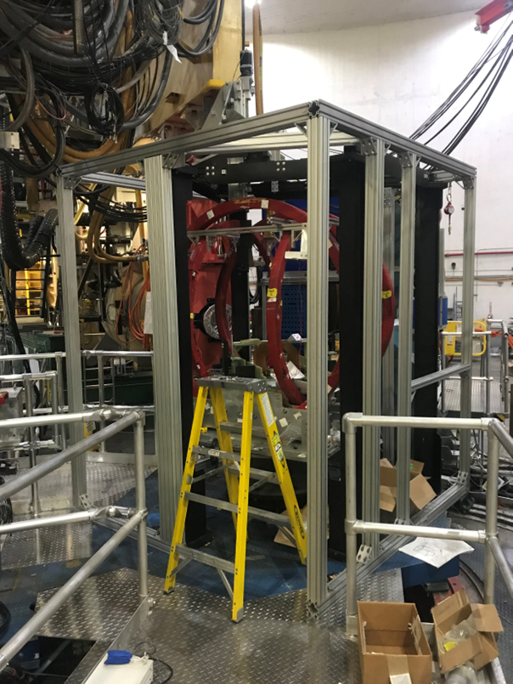
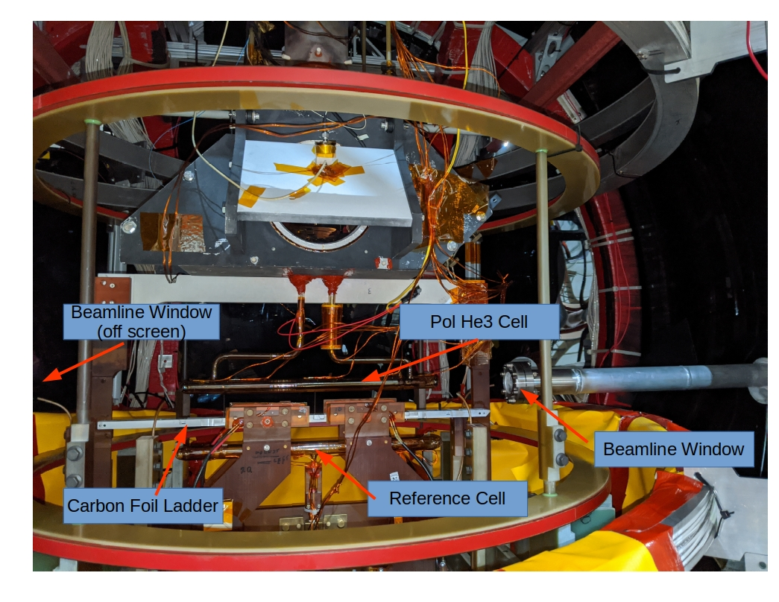
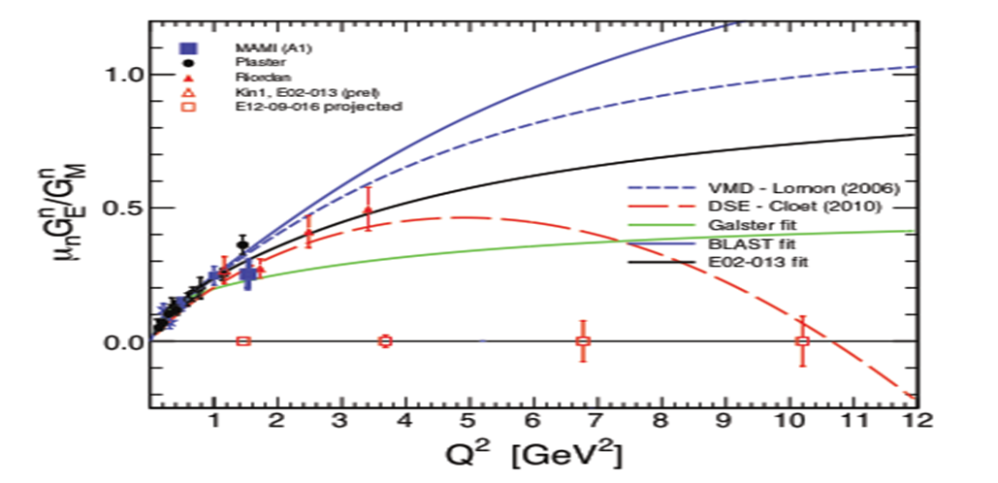
SBS measures Form Factors at Unprecendented Q²
Neutron Electromagnetic Form Factor G_{E}^{n} Installation, G_{M}^{n} just ran
Use the same BigBite and SBS+HCAL setup as GM_{n} to measure quasi-free scattering on polarized ³He
Polarized 3He target – highest L
to date!
60cm long (40cm in Hall C)
55-60% polarization
60μA (30μA in Hall C)

Slide 8
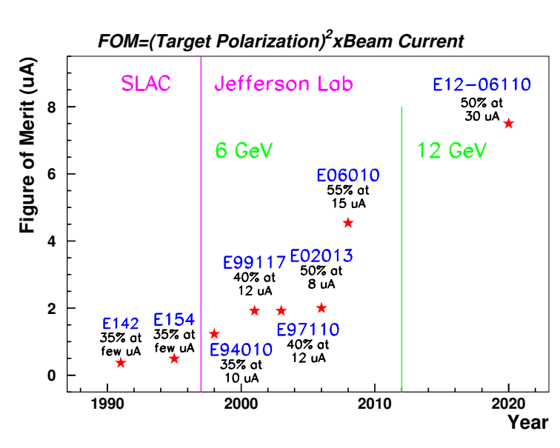
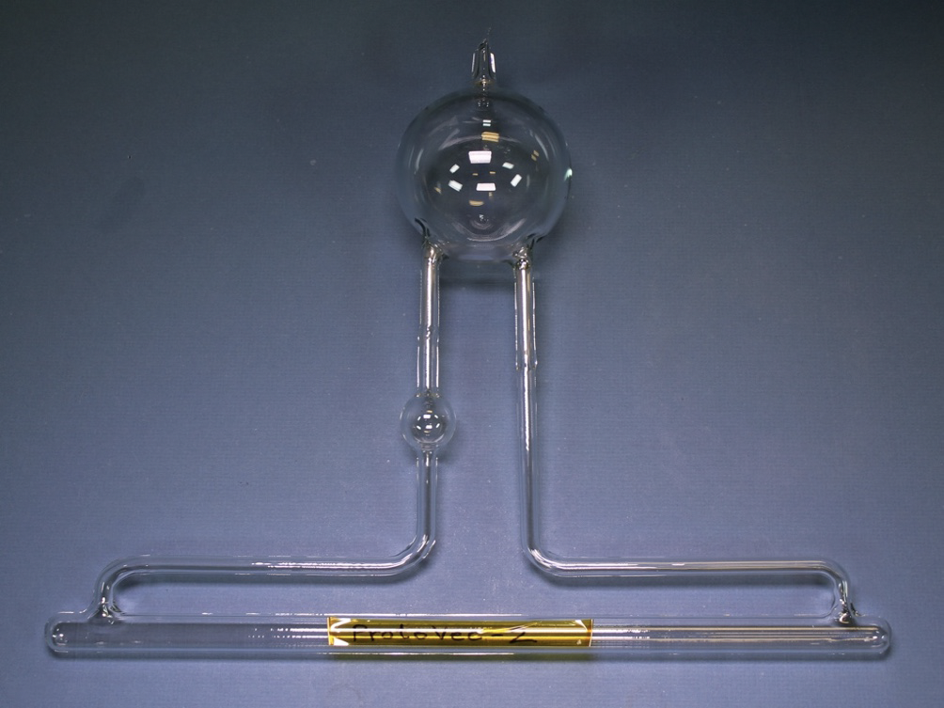
Polarized ³He Target Performance Evolution
Pumping chamber
1-inch sphere
two transfer tubes
Target chamber
12 GeV era Target Cell:
Convection Cell (replacing 6 GeV diffusion cells.)
G_{E}^{n} (E02-013):
Started to use Rb/K hybrid alkali cell.
Transversity
(E06-010):
Started to use narrow band laser.
GEn-II:
Expect another factor 2 increase in FOM (larger pumping chamber)

Slide 9
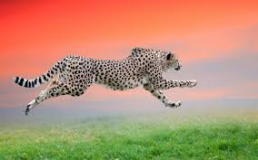
Talk Topics
Nucleon Structure in 25 minutes or less!
Nucleon form factors
Structure functions
Unpolarized
Polarized
“2D” and “3D”
GPDs
TMDs
Will focus on recent and near upcoming results from Jefferson Lab

Slide 10
Talk Topics
Nucleon Structure in 25 minutes or less!
Nucleon form factors
Structure functions – access to the parton distribution functions (PDFs) through deep inelastic scattering
Unpolarized
Polarized
“2D” and “3D”
GPDs
TMDs
Will focus on recent and near upcoming results from Jefferson Lab

Slide 11
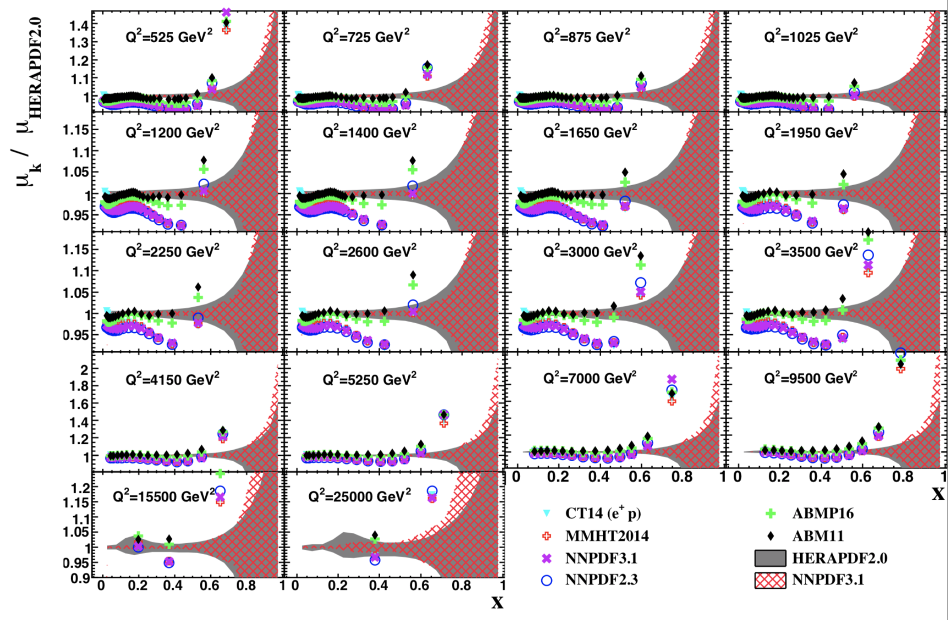
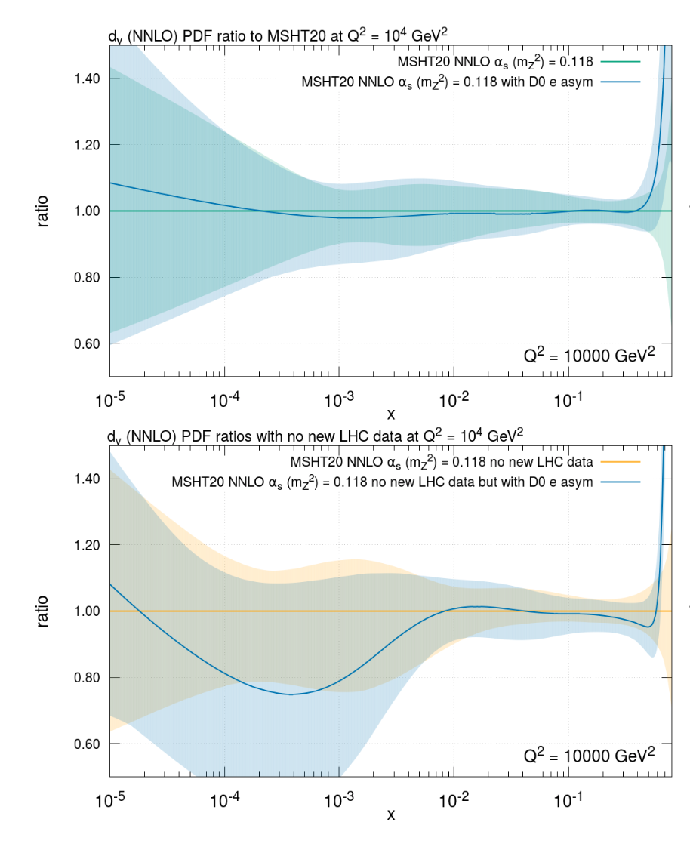
Large uncertainties on PDFs at large x
Sampling of PDF results shown at PDF4LHC meeting 22-23 March 2021

Slide 12
Why is the x > ~0.3 valence regime interesting?
Partonic structure in the valence region defines a hadron
Baryon number, charge, flavor content, total spin, …
Keen discriminator of hadron structure models
Facilitates comparison with lattice QCD
“Valence regime” at large x, low Q² evolves to low x, high Q²
Intersection of nuclear and particle physics
New generation of experiments at JLab focused on high x

Slide 13
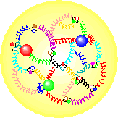
Multiple predictions for d/u at large x
1
1
1
p
↓
=
u
↓
(
ud
)
+
u
↓
(
ud
)
−
u
↓
(
ud
)
2
S
=
0
18
S
=
1
3
S
=
1
1
2
−
d
↓
(
uu
)
−
d
↓
(
uu
)
3
S
=
1
3
S
=
1
Nucleon Model | F₂^{n}/F₂^{p} | d/u
SU(6) | 2/3 | 1/2
Valence Quark | 1/4 | 0
DSE contact interaction | 0.41 | 0.18
DSE realistic interaction | 0.49 | 0.28
pQCD | 3/7 | 1/5
A Longstanding Problem!
Numerous Review Articles:
N. Isgur, PRD 59 (1999)
S Brodsky et al NP B441 (1995)
W. Melnitchouk and A. Thomas PL B377 (1996)
R.J. Holt and C. D. Roberts, Rev. Mod. Phys. 82 (2010)
I. Cloet et al, Few Body Syst. 46 (2009) 1.
A measurement is needed, but the lack of free neutrons has been a major obstacle…

Slide 14
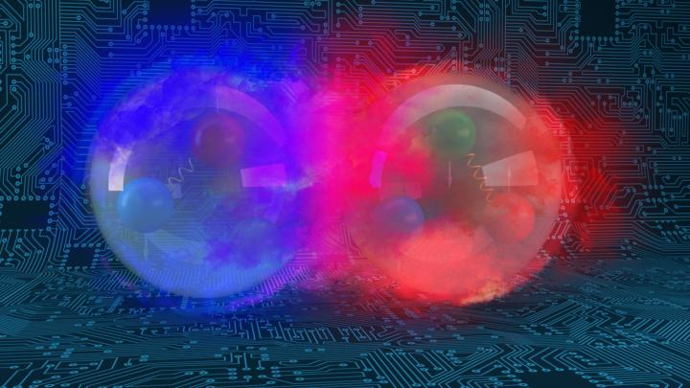
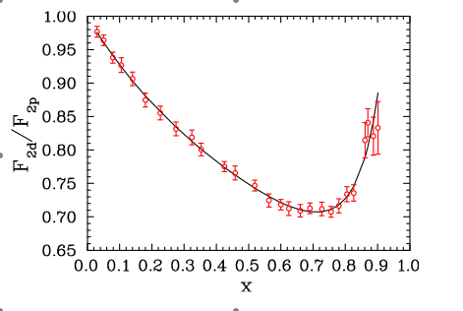
Neutron (and hence d(x,Q) structure is typically derived from deuterium target data by subtracting proton data
…..but…..
The deuteron is a nucleus!
n, p e- scattering different…and…
Large uncertainty in unfolding nuclear effects (Fermi motion, off-shell effects, deuteron wave function, coherent scattering, final state interactions, nucleon structure modification (“EMC”-effect),………..
F₂^{d}/F₂^{p}
SLAC data

Slide 15
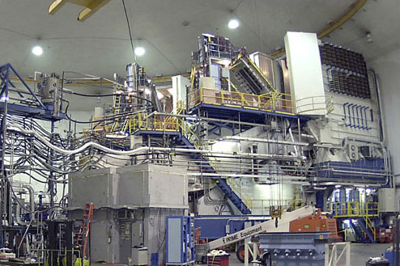
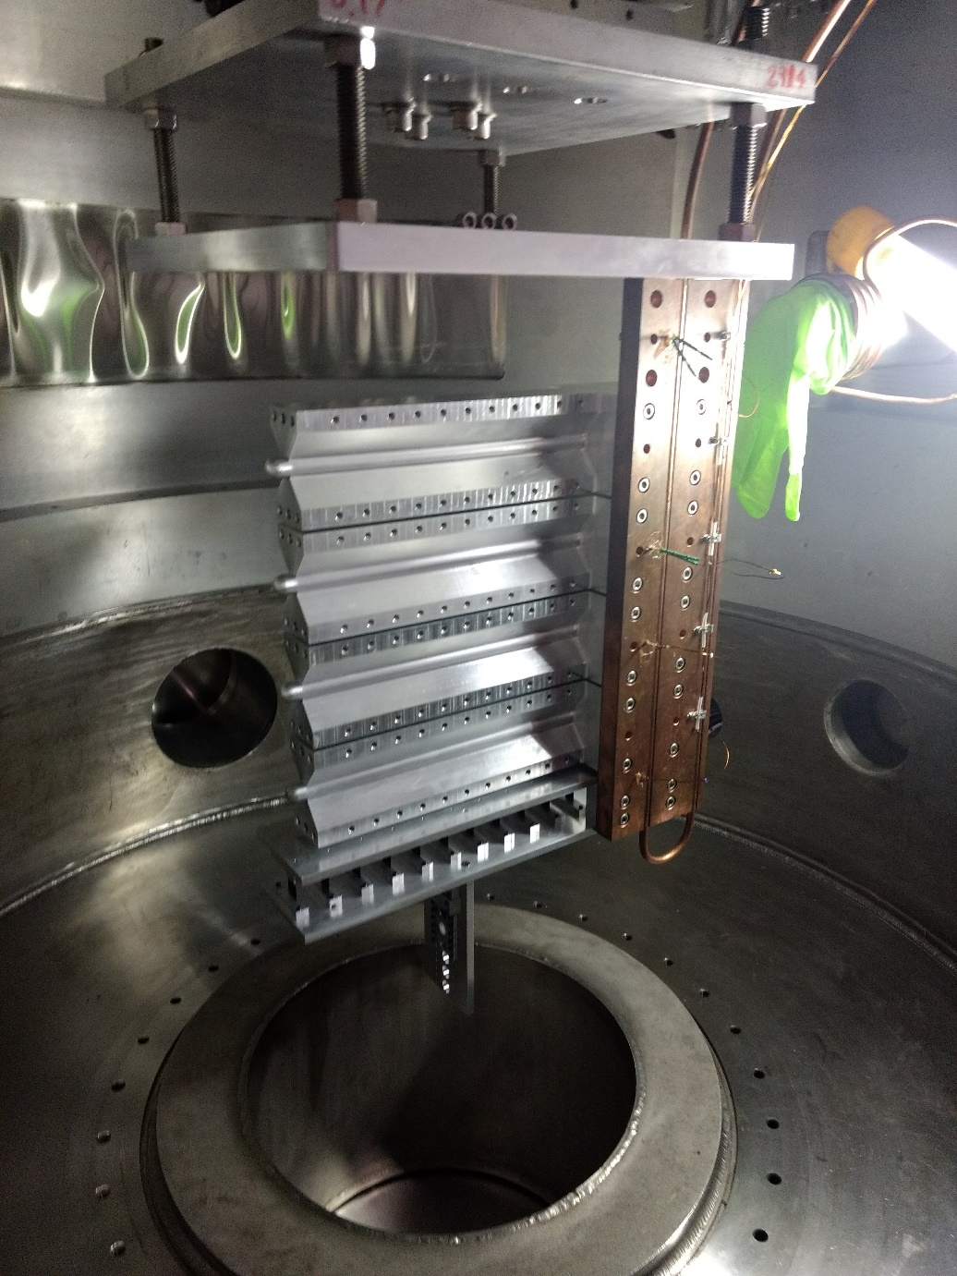
A nuclear physicists approach to the d/u question….
First tritium target in decades!
JLab Hall A HRS Spectrometer
Tritium target cell
Problem:
Deuteron experiments present free nucleon extraction complications.
Solution: Add another nucleon!
³H/³He ratio: minimizes nuclear physics uncertainties

Slide 16
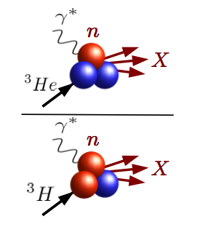
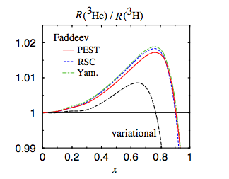
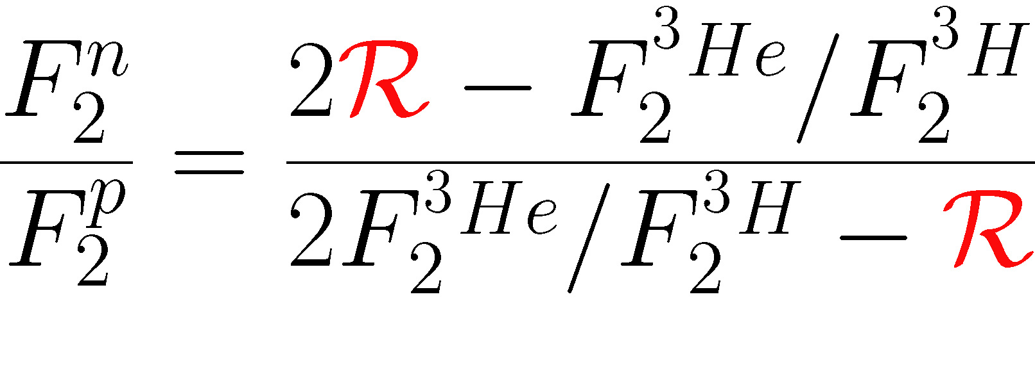
MARATHON: Deep Inelastic Scattering from A=3 Nuclei
Mirror symmetry of A=3 nuclei
Extract F₂^{n}/F₂^{p} from ratio of measured ³He/³H structure functions
R = SUPER ratio of ”EMC ratios” for ³He and ³H
- Relies only on difference in nuclear effects in ³H, ³He
- Calculated to within 1%
- Most systematic and theoretical uncertainties cancel
I. Afnan et al, PRC 68 (2003)

Slide 17
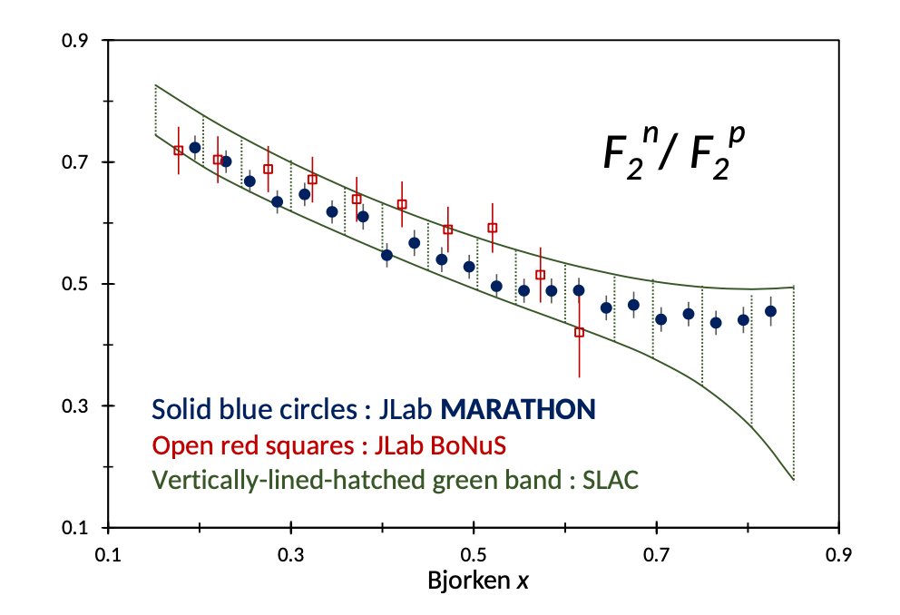
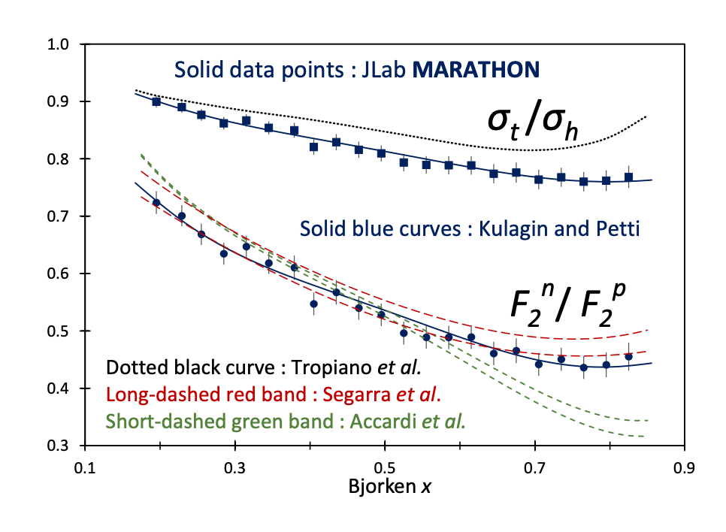
MARATHON Results
SU(6)
Phys. Rev. Lett. 128 (2022) 13, 132003
DSE
Helicity conservation
u quark dominance
High precision data
In agreement with Kulagin-Petti
But…..

Slide 18
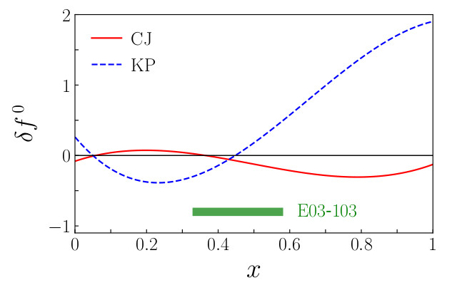
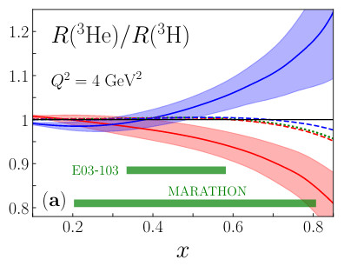
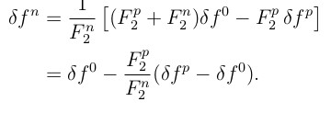
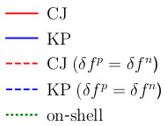
But…. Tropiano et al. considered isospin dependent off-shell modifications
A. J. Tropiano, J. J. Ethier, W. Melnitchouk, and N. Sato Phys. Rev. C 99, 035201 (2019)
→ Consider 2 different isoscalar off-shell corrections:
- CTEQ-JLab (CJ)
- Kulagin-Petti (KG)
→ Fit ³He/D ratios from JLab Hall C E03-103 to extract
proton off-shell function. Then the neutron is
Resulting super ratios have significant
differences @ x>0.6
Such and effect can not be unambiguously disentangled
from F₂^{n} with A=3 inclusive data. (see also C. Cocuzza et al., Phys. Rev. Lett. 128 (2022) 13, 132003)

Slide 19
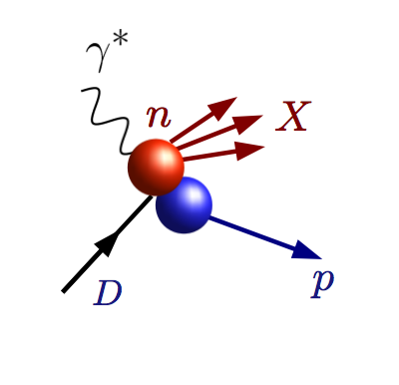
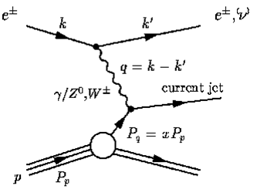
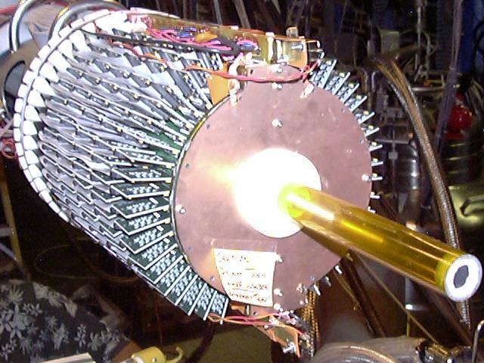
TDIS to access nucleon valence structure ”BONuS” Experiment at Jefferson Lab – use fixed target Tagged DIS to create an effective free neutron target
Measure DIS electron in coincidence with proton tag
n
p
“Hard” scattering inelastic event (high Q, W)
Proton remains intact
Low momentum proton = nucleons barely off shell
Neutron target!
p
Deuteron Target

Slide 20
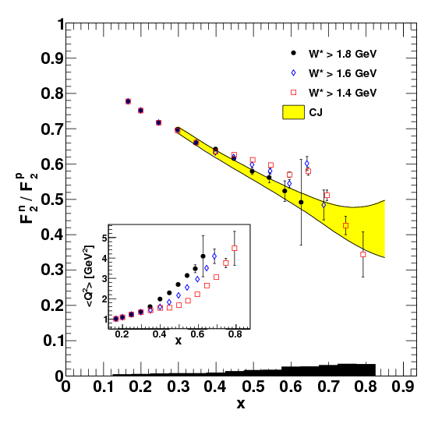
BONuS effective neutron target via TDIS achieved!
Phys.Rev. C92 (2015) no.1, 015211
Phys.Rev. C91 (2015) no.5, 055206
Phys. Rev. C89 (2014) 045206 – editor’s suggestion
Phys. Rev. Lett. 108 (2012) 199902
Nucl. Instrum. Meth. A592 (2008) 273-286
Textbook Physics!
Not quite high enough x, Q² in 6 GeV era
Nonetheless still used as input for global PDF fits…

Slide 21
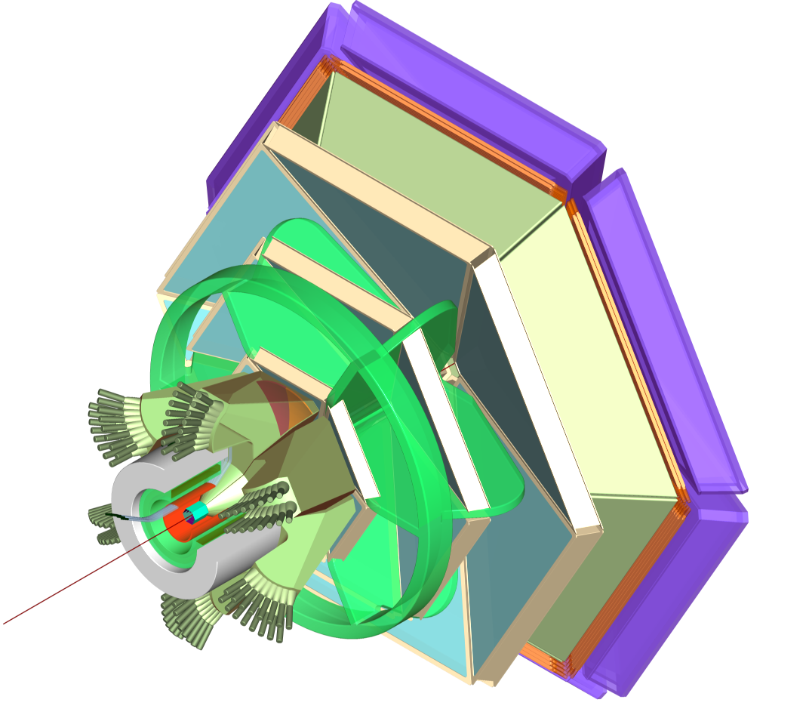
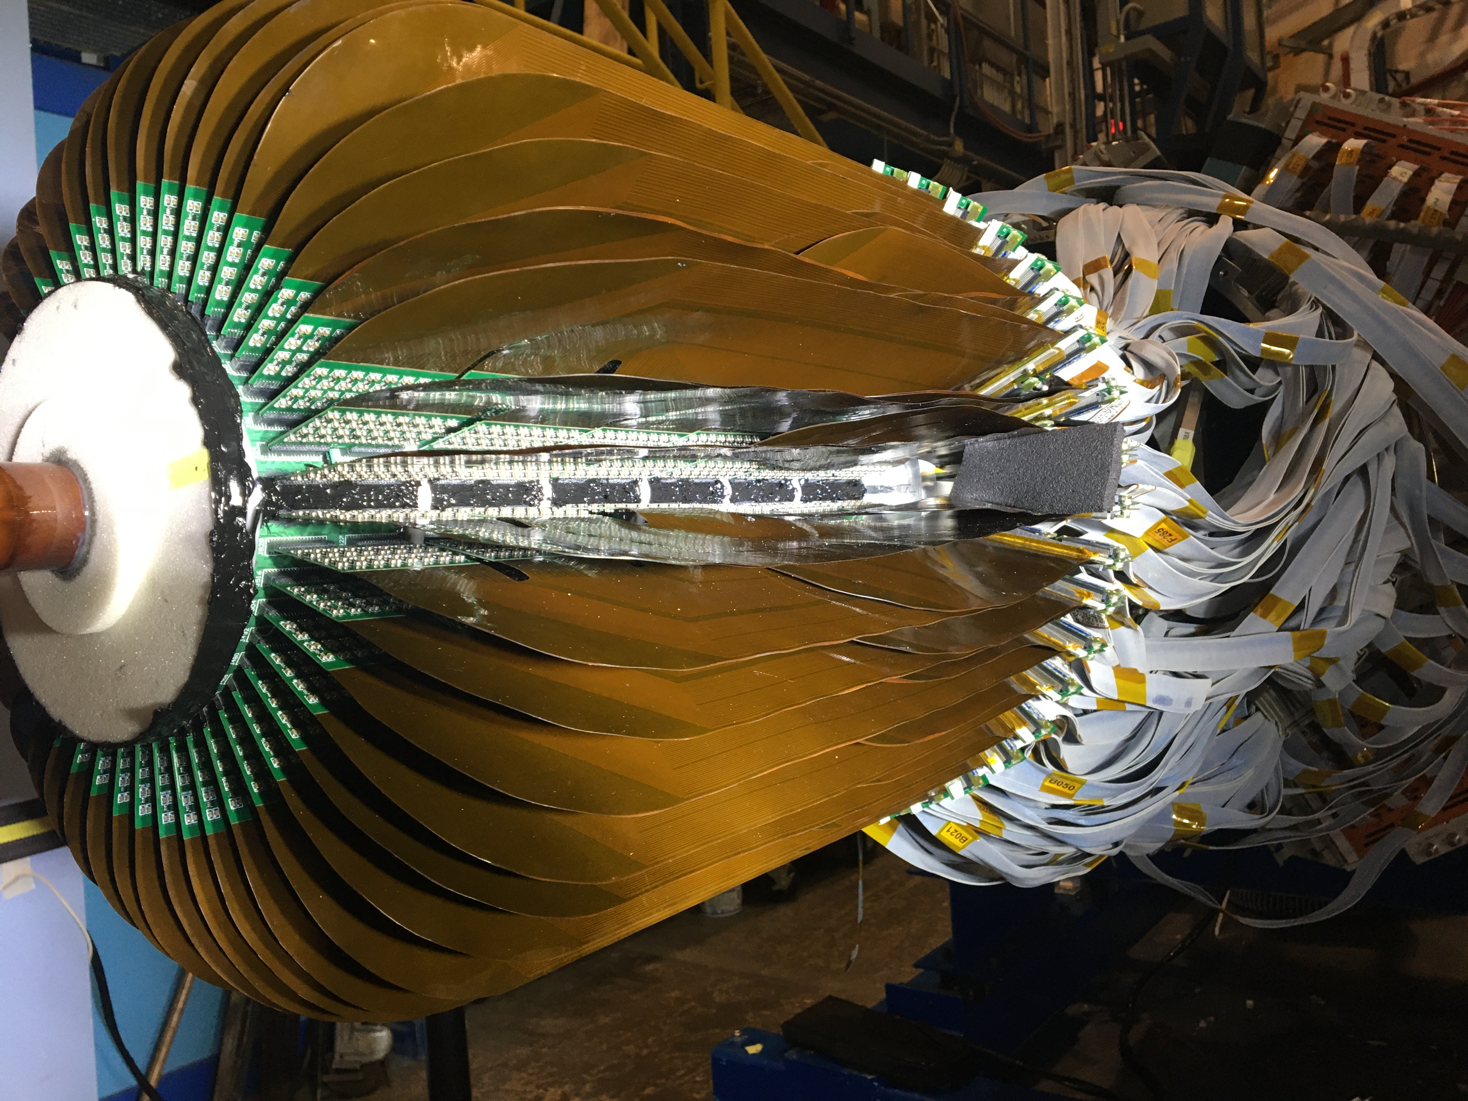
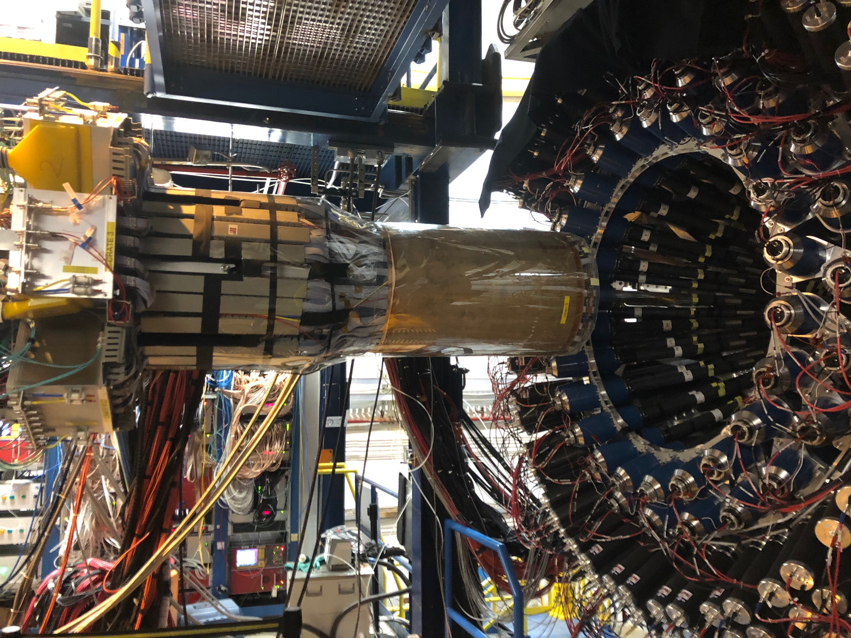
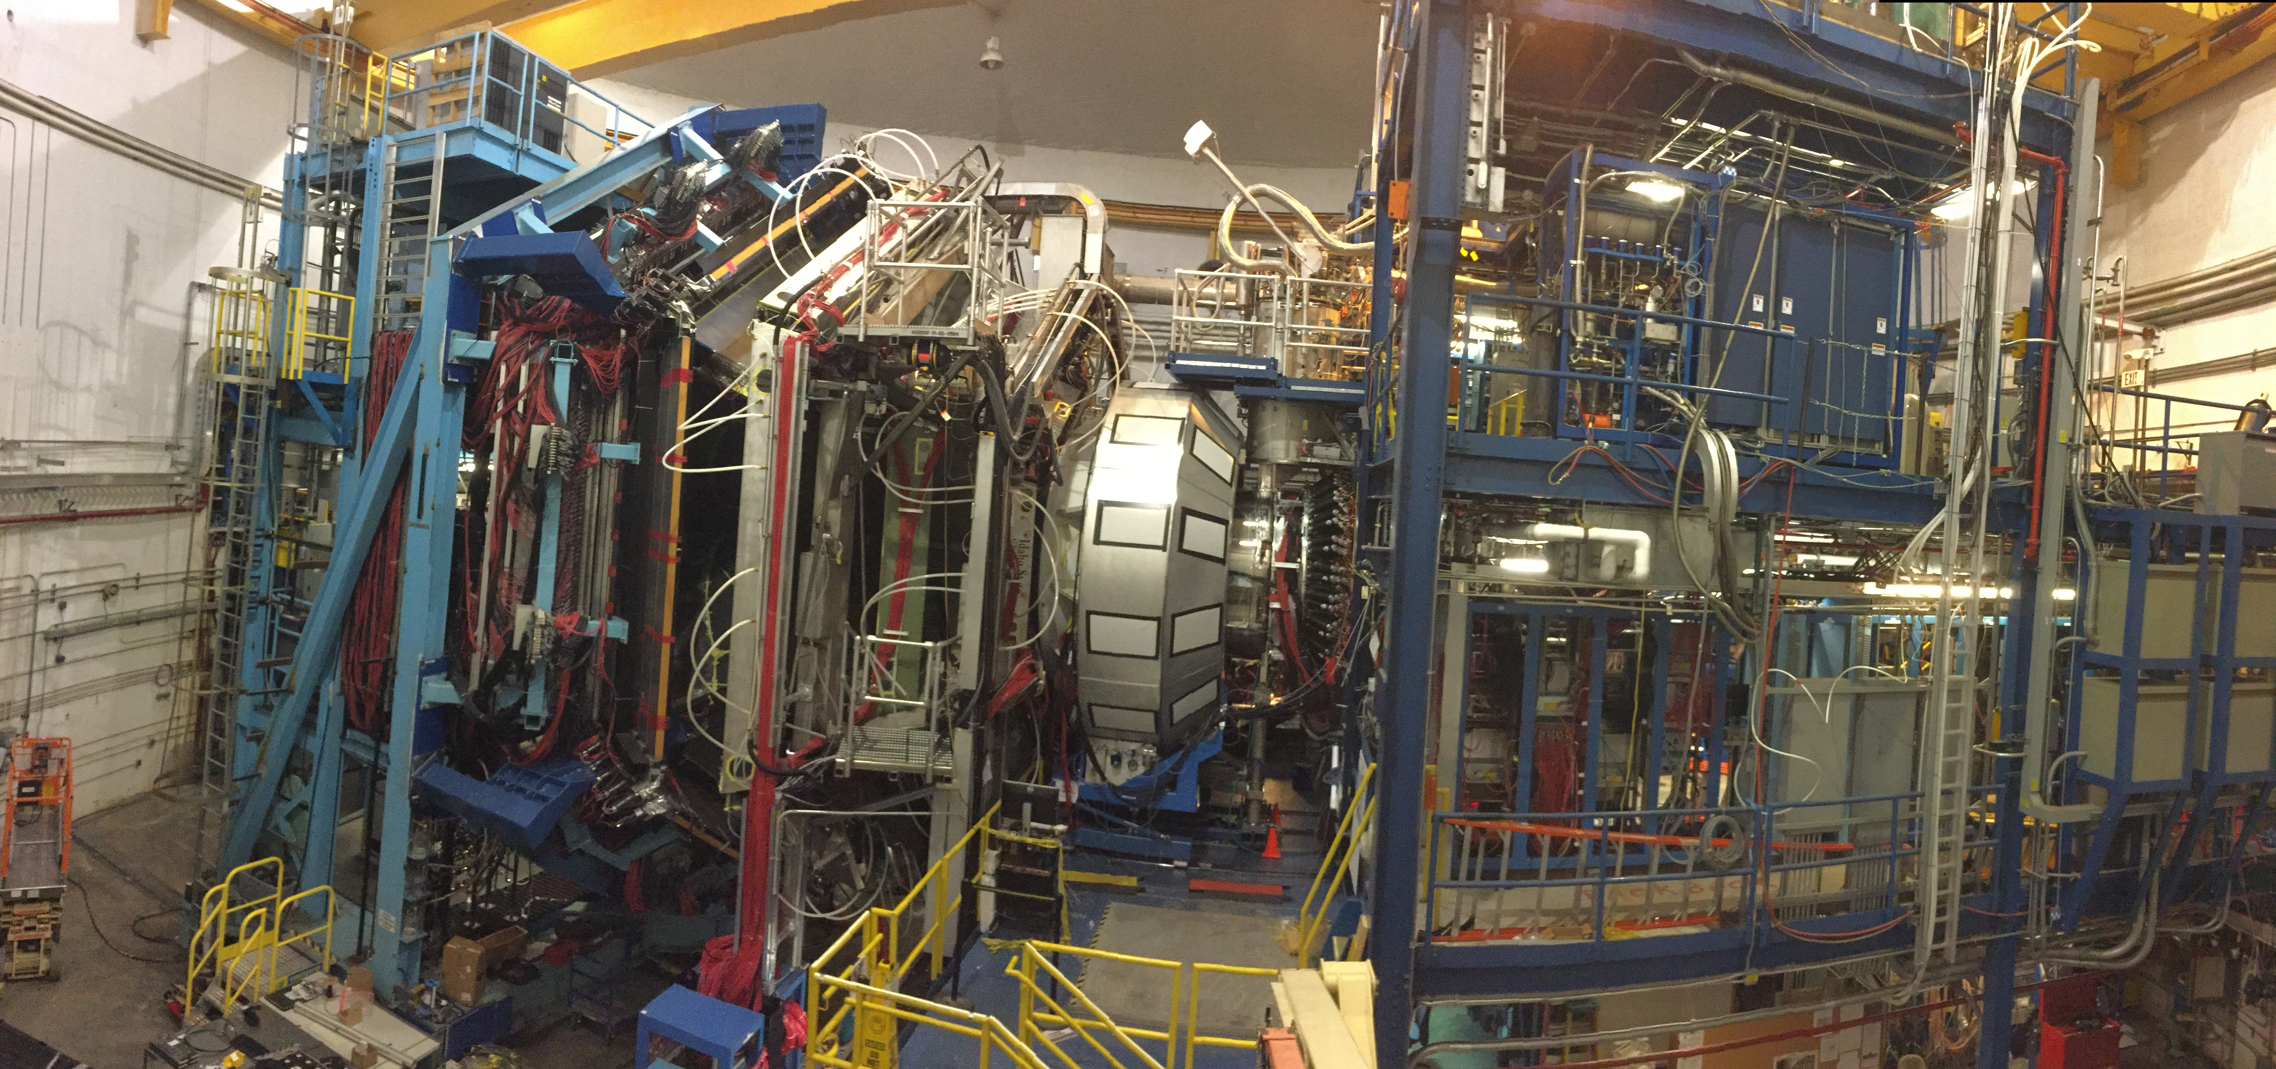
2020 E12-06-113 “BONUS12”: Larger x and higher Q²
CLAS12
Central
Detector
High Impact
New rTPC
Hall B CLAS12 Spectrometer
Notes:
21

Slide 22
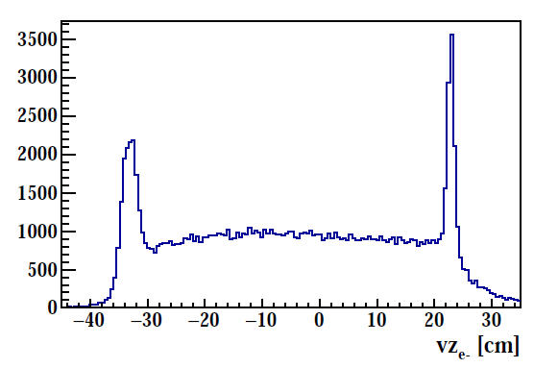
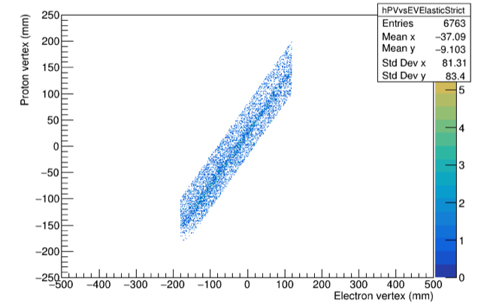
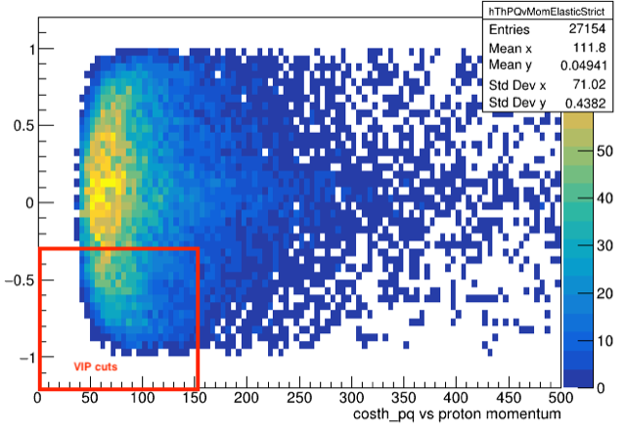
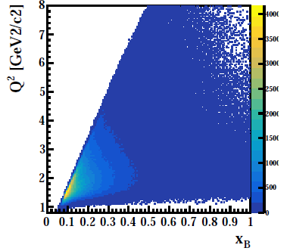
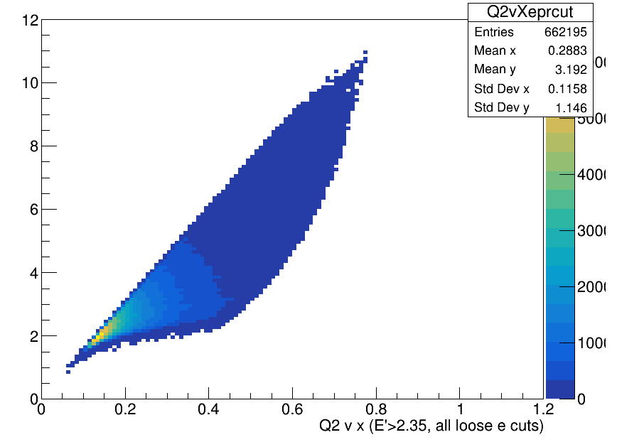
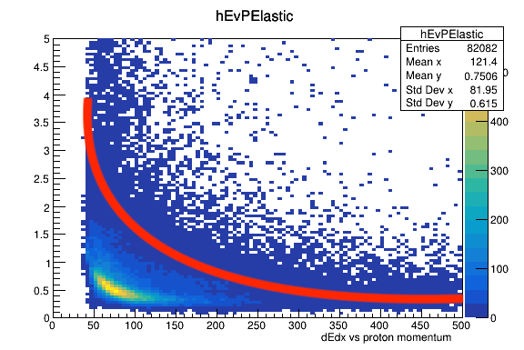
Preliminary Analysis – 5 Pass Data (subset)
e⁻ @10.4 GeV beam on D₂ target
Proton Selection on D₂ target
→ Expect first results on F2n / F2p by end of 2022
BONuS12 completed successfully in Summer 2020 with large fraction of proposed data set
→ New RTPC performed very well, major improvements over previous generations
→ Calibrations going well, much analysis still to do

Slide 23
Also Hall A “TDIS” Experiment RunGroup Approved for F₂^{n}
Same technique for measuring F₂^{n} as BONuS, but:
different detector, different systematics
independent physics normalization
higher luminosity = higher statistics at the largest x, Q²

Slide 24
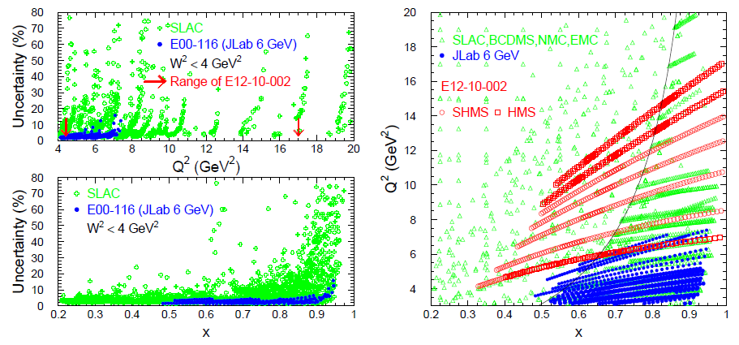
F₂^{p} & F₂^{d} Structure Functions from JLab Hall C
JLab12 Hall C commissioning experiment aimed to reduce uncertainties in F₂^{p} and F₂^{d} structure functions at large x and high Q²
Goal @ 12 GeV: ~2% total precision cross sections, (as achieved previously @ 6 GeV)

Slide 25
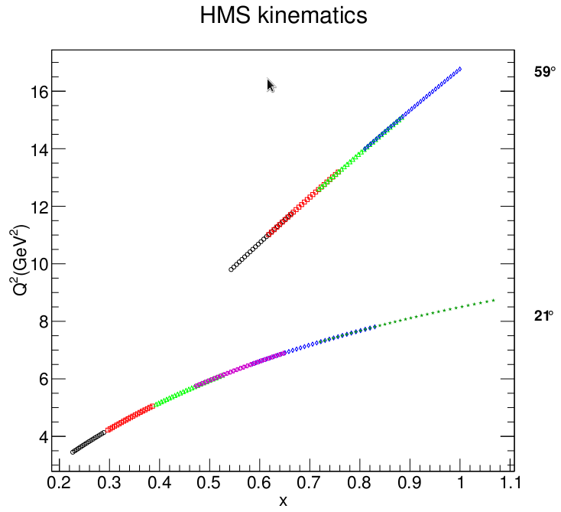
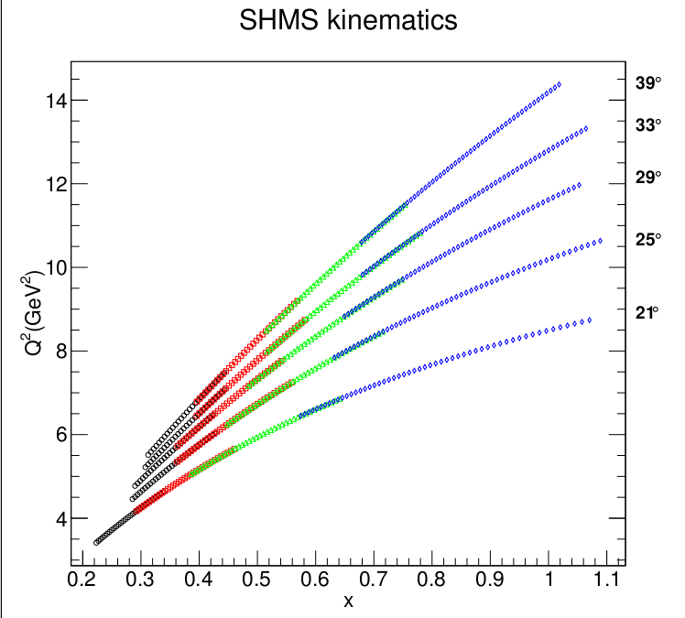
Hall C E12-10-002: High Precision Measurement of the F₂ Structure Function on p,D
10.6 GeV beam
Targets: LH2, LD2, Al
HMS
SHMS
Q²
Fix energy and angle
Scan in momentum
Effective scan in x
Stringent check on spectrometer acceptance
x

Slide 26
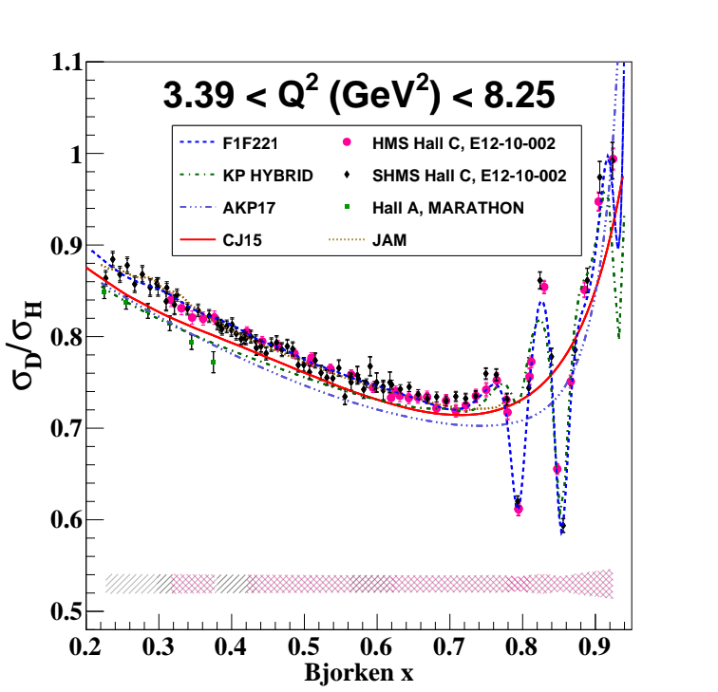
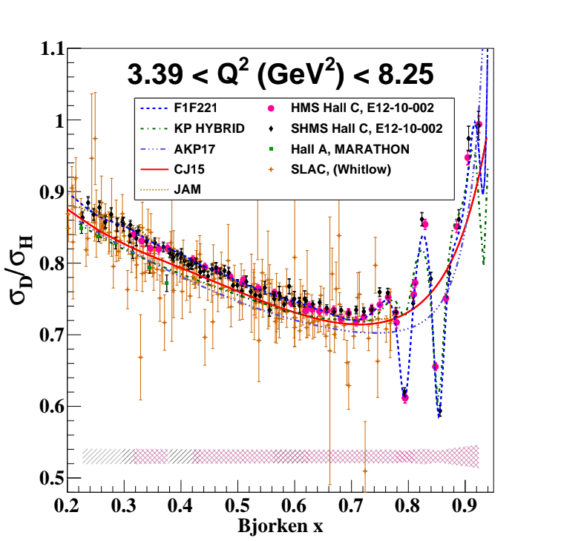
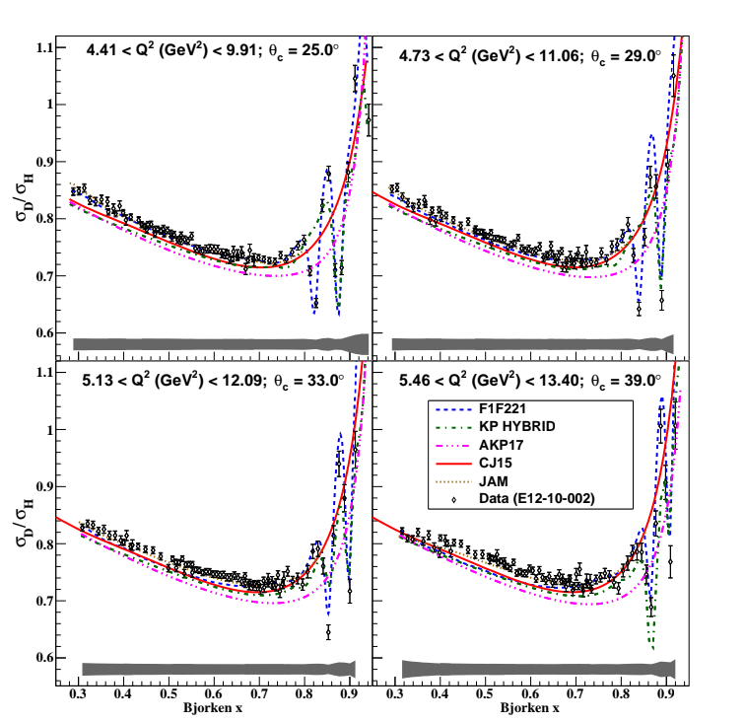
Results from JLab Hall C E12-10-002
preliminary
preliminary
Significant improvement in precision
First publication in preparation

Slide 27
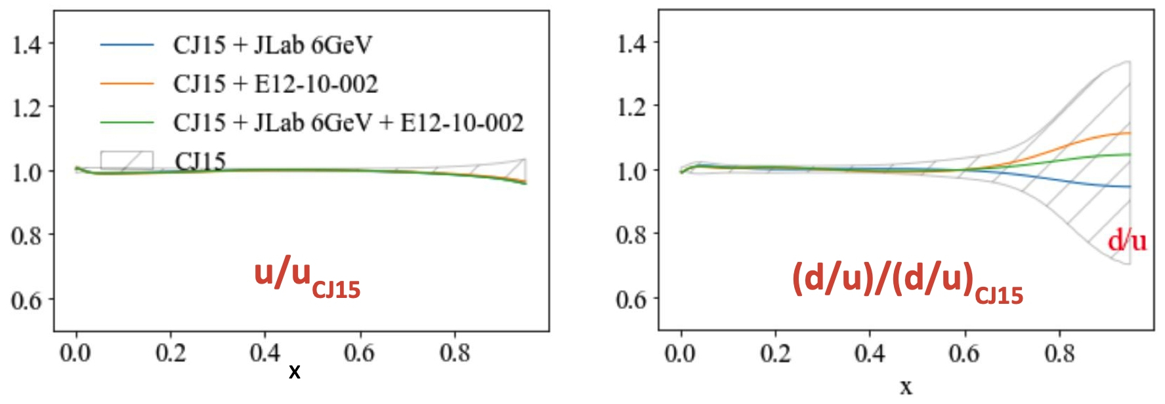
Preliminary CJ pdf Impact Studies
Studies courtesy of A. Accardi, W. Henry and Shujie Li
pdf ratios relative to CJ15
Including E12-10-002 changes
d/u central value
by 15-20%
pdf uncertainty ratios relative to CJ15
Including E12-10-002 reduces
uncertainty ~30%
Courtesy of Alberto Accardi and Shujie Li

Slide 28
d(x) at Large x: Constraints The whole is greater than the sum of the parts.
D0, CDF (RHIC, LHCb) asymmetries
Direct sensitivity to d(x)
High W, Q
Small data set
d(x,Q)
+ nuclear dynamics
“BONuS” tagged neutron target
Nearly model-independent neutron data
Data obtained in 6 GeV JLab era at low W, Q
!2 GeV extends range
Deep inelastic deuterium, 3H, 3He
Large body of data from multiple (deuterium) experiments
Extensive range in x and Q²
Requires nuclear corrections

Slide 29
CTEQ PDF fits: Implications of nuclear corrections for deuteron DIS for LHC EW precision studies (A. Accardi, T. Hobbs, X. Jing, P. Nadolsky, EPJC 81 (2021) 60)
Precision measurements of the weak mixing angle at the LHC are strongly correlated with valence $u,$ $d$ PDFs at $x∼0.03$. In global fits, these PDFs are sensitive via sum rules to nuclear dynamics in high-$x$ deuteron DIS at BCDMS, NMC, JLab, SLAC

Slide 30
Polarized predictions for d/u structure at large x
Proton Wavefunction (Spin and Flavor Symmetric)
1
1
1
p
↓
=
u
↓
(
ud
)
+
u
↓
(
ud
)
−
u
↓
(
ud
)
2
S
=
0
18
S
=
1
3
S
=
1
1
2
−
d
↓
(
uu
)
−
d
↓
(
uu
)
3
S
=
1
3
S
=
1

Slide 31
Existing World Data on Spin Structure at High x:
information drops off
x ~ 0.6
Figure credit: D. Flay
D. Parno et al. Phys.Rev.Lett. 113 (2014) 2, 022002, 1404.4003

Slide 32
JLab 12 GeV A₁^{n} E12-06-110 (Hall C)
First experiment in Hall C’s 12 GeV era to utilize polarized beam
10.4 GeV beam, 85% polarization
HMS and SHMS detecting electrons in the inclusive mode
both at 30 deg to reach high x
First time polarized 3He target is installed in Hall C
achieved 30 uA beam incident on 40-cm long target, with 50-55% in-beam polarization
factor 2 increase in 3He target FOM vs. 6 GeV era
Ran in Hall C from Nov 2019 to March 2020 (run group continued in July-Sept.2020)
Spokespeople: J.P. Chen, G.D. Cates, Z.-E. Meziani, X. Zheng
Grad students:
Mingyu Chen, Melanie Cardona
Postdocs:
A. Tadepalli, W. Henry
M. Nycz, J. Zhang

Slide 33
Preliminary A₁(³He) Results
These are without radiative corrections
statistical uncertainties only
Still to do:
Radiative corrections
Finalize all systematic uncertainties
Nuclear corrections
Preliminary
MUCH extended x range!

Slide 34
Near and Far-Future Projection including JLab 24 GeV
30 days of 22 GeV
Projection using Hall C’s
HMS @ 30 deg, 4.6 GeV
SHMS @ 20 deg, 7.8 GeV
Polarized 3He target
40cm, 50%, 30uA
“F1F221 fit” for ³He → neutron “nuclear correction”
projections (12 and 24 GeV) plotted on pQCD
Figure credit:
Cameron Cotton (UVA)
David Flay (Jlab, JHU)
One part of a broad 12 GeV spin structure program - taking data in Hall B as we talk…!...

Slide 35
Comprehensive program of nucleon spin structure
CLAS12 (~140000 channels).
Few new systems, RICH-II, raster, and polarized target
Off to a good start!
Two sectors of RICH-II
~1 Hz full cycle
Longitudinally polarized NH3 and ND3 target system in the hall
First time target has been polarized in the CLAS12 solenoid field.
Measured high polarization for NH₃ from the elastic scattering data:
$$E_{b}=2.2 GeV$$
$${NH}_{3}$$
$$E_{b}=10.55 GeV$$
$${NH}_{3}$$
$$P_{t}≈P_{b}≈0.85$$
$$P_{t}≈0.8$$
$$ep→e^{′}p^{′}$$
Run Group C: Spin structure of the nucleon, neutron DVCS, SIDIS kaon production,…
PRELIMINARY

Slide 36
Talk Topics
Nucleon Structure in 25 minutes or less!
Nucleon form factors
Structure functions
Unpolarized
Polarized
“2D” and “3D”
GPDs
TMDs
Will focus on recent and near upcoming results from Jefferson Lab

Slide 37
Wigner Distribution Function
Nuclear Femtography
The ultimate (and lofty!) goal is to extract $W(x,k_{⊥},r_{⊥})$ experimentally and compare to theory.
Program of experimentation:
Ongoing measurements of PDFs and Form Factors
A start on determining the Generalized Parton Distributions
Planning for measurements of the Transverse Momentum Distributions
Phenomenology/Theory
Lots of model-building
Fundamental theory calculations are currently underway
Slide from J. Napolitano, JLUO 2022

Slide 38
Deeply Virtual
Compton Scattering
Compton Form Factors (CFF) derived from asymmetries with polarized beam, compared to convolution integrals of GPDs.
The data are well described by calculations based on transversity Generalized Parton Distributions (GPDs) coupled to a helicity ﬂip Distribution Amplitude (DA) of the pion
Suggest the amplitude for transversely polarized virtual photons continues to dominate
Nuclear Femtography
+ Bethe-Heitler
F. Georges et al., Phys. Rev. Lett. 128, 252002 – June 2022

Slide 39
Timelike Compton Scattering
PRL 127 (2021) 262501
First Measurement of Timelike Compton Scattering
Nuclear Femtography
TCS – time-reversal symmetric process to DVCS: incoming photon is real, and the outgoing photon has large time-like virtuality
The beam helicity asymmetry, $A_{⊙U}\sim \sin{φ}$, accesses the imaginary part of the Compton amplitude, the same way as DVCS - probes universality of GPDs
The forward-backward asymmetry, $A_{FB}\sim \cos{φ}$, projects out the real part of the Compton amplitude – direct access to the EM FF $D^{Q}(t)$ (D-term) that relates to mechanical properties of the nucleon (quark pressure distribution inside the nucleon).

Slide 40
Neutral Particle Spectrometer (NPS) preparation
Install Neutral Particle Spectrometer (NPS) during March 2023 to July 2023
Magnet with calorimeter
1080 Lead-Tungstate blocks in Calorimeter to detect γ and π⁰
Remove the SHMS HB magnet
Experiments:
E12-13-010: two concurrent experiments
Exclusive Deeply Virtual Compton on proton
SIDIS p(e,e’,π⁰) cross section. Map the transverse momentum dependence.
E12-06-114: completion of Hall A DVCS experiment
New proposal for Neutron DVCS just approved
Also! Two concurrent experiments with photon beam
E12-14-003 : Wide-angle Compton Scattering at 8 and 10 GeV Photon Energies (18 PAC days)
E12-14-005 :Wide Angle Exclusive Photoproduction of pi-zero Mesons

Slide 41
SoLID@JLab: at the QCD Intensity Frontier
SoLID will maximize the science return of the 12-GeV CEBAF upgrade by combining...
High Luminosity
10³⁷⁻³⁹ /cm²/s
[ >100x CLAS12 ][ >1000x EIC ]
Large Acceptance
Full azimuthal 𝜙 coverage
PAC50 Re-affirmed priority of science program
5 jeopardy experiments re-approved
One experiment raised from A- to A
Two new experiments approved
Research at SoLID will have the unique capability to explore the QCD landscape while complementing the research of other key facilities
Precision lepto-quark couplings at unique mass and sensitivity scales
3D momentum imaging of a relativistic strongly interacting confined system (nucleon spin)
Superior sensitivity to the differential electro- and photo-production cross section of J/𝜓 near threshold (proton mass)
Synergistic with the pillars of EIC science (proton spin and mass) through
high-luminosity valence quark tomography and precision J/𝜓 production near threshold
Notes:
41

Slide 42
Thank You!
…and apologies to everything (a lot!!) that the talk cheetah ran past

