Slide 1


Triangle singularities in hadronic reactions
Feng-Kun Guo
Institute of Theoretical Physics, Chinese Academy of Sciences
07 Sept. 2022
For a review, see FKG, X.-H. Liu, S. Sakai, Prog.Part.Nucl.Phys. 112 (2020) 103757
05-09 Sept. 2022

Slide 2

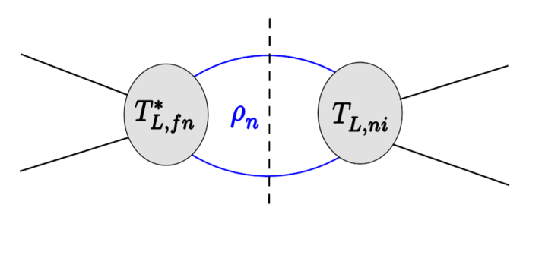
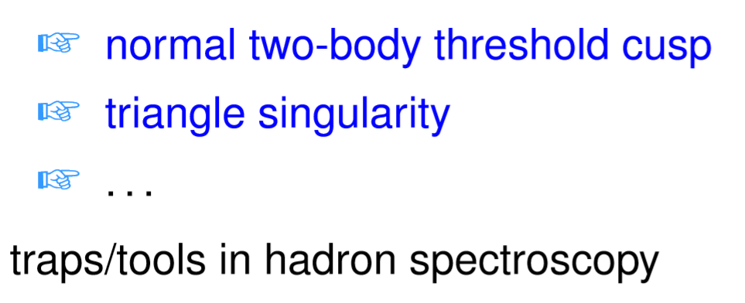
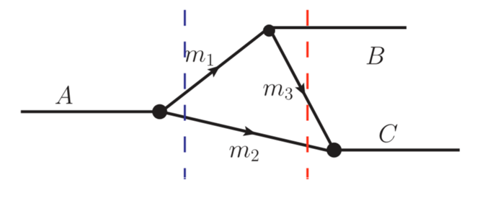
S-matrix singularities
Dynamics: poles, corresponding to hadron resonances, genuine physical states such as the ordinary and exotic mesons, baryons; location fixed by the dynamics
Kinematics: (normally) branch points of the S-matrix, due to on-shell intermediate particles, results of unitarity; location fixed by the involved kinematic variables: masses, energies
Known since long: Landau singularity
L.D.Landau (1959); J.D.Bjorken (1959); J.Mathews (1959); N.Nakanishi (1959)

Slide 3
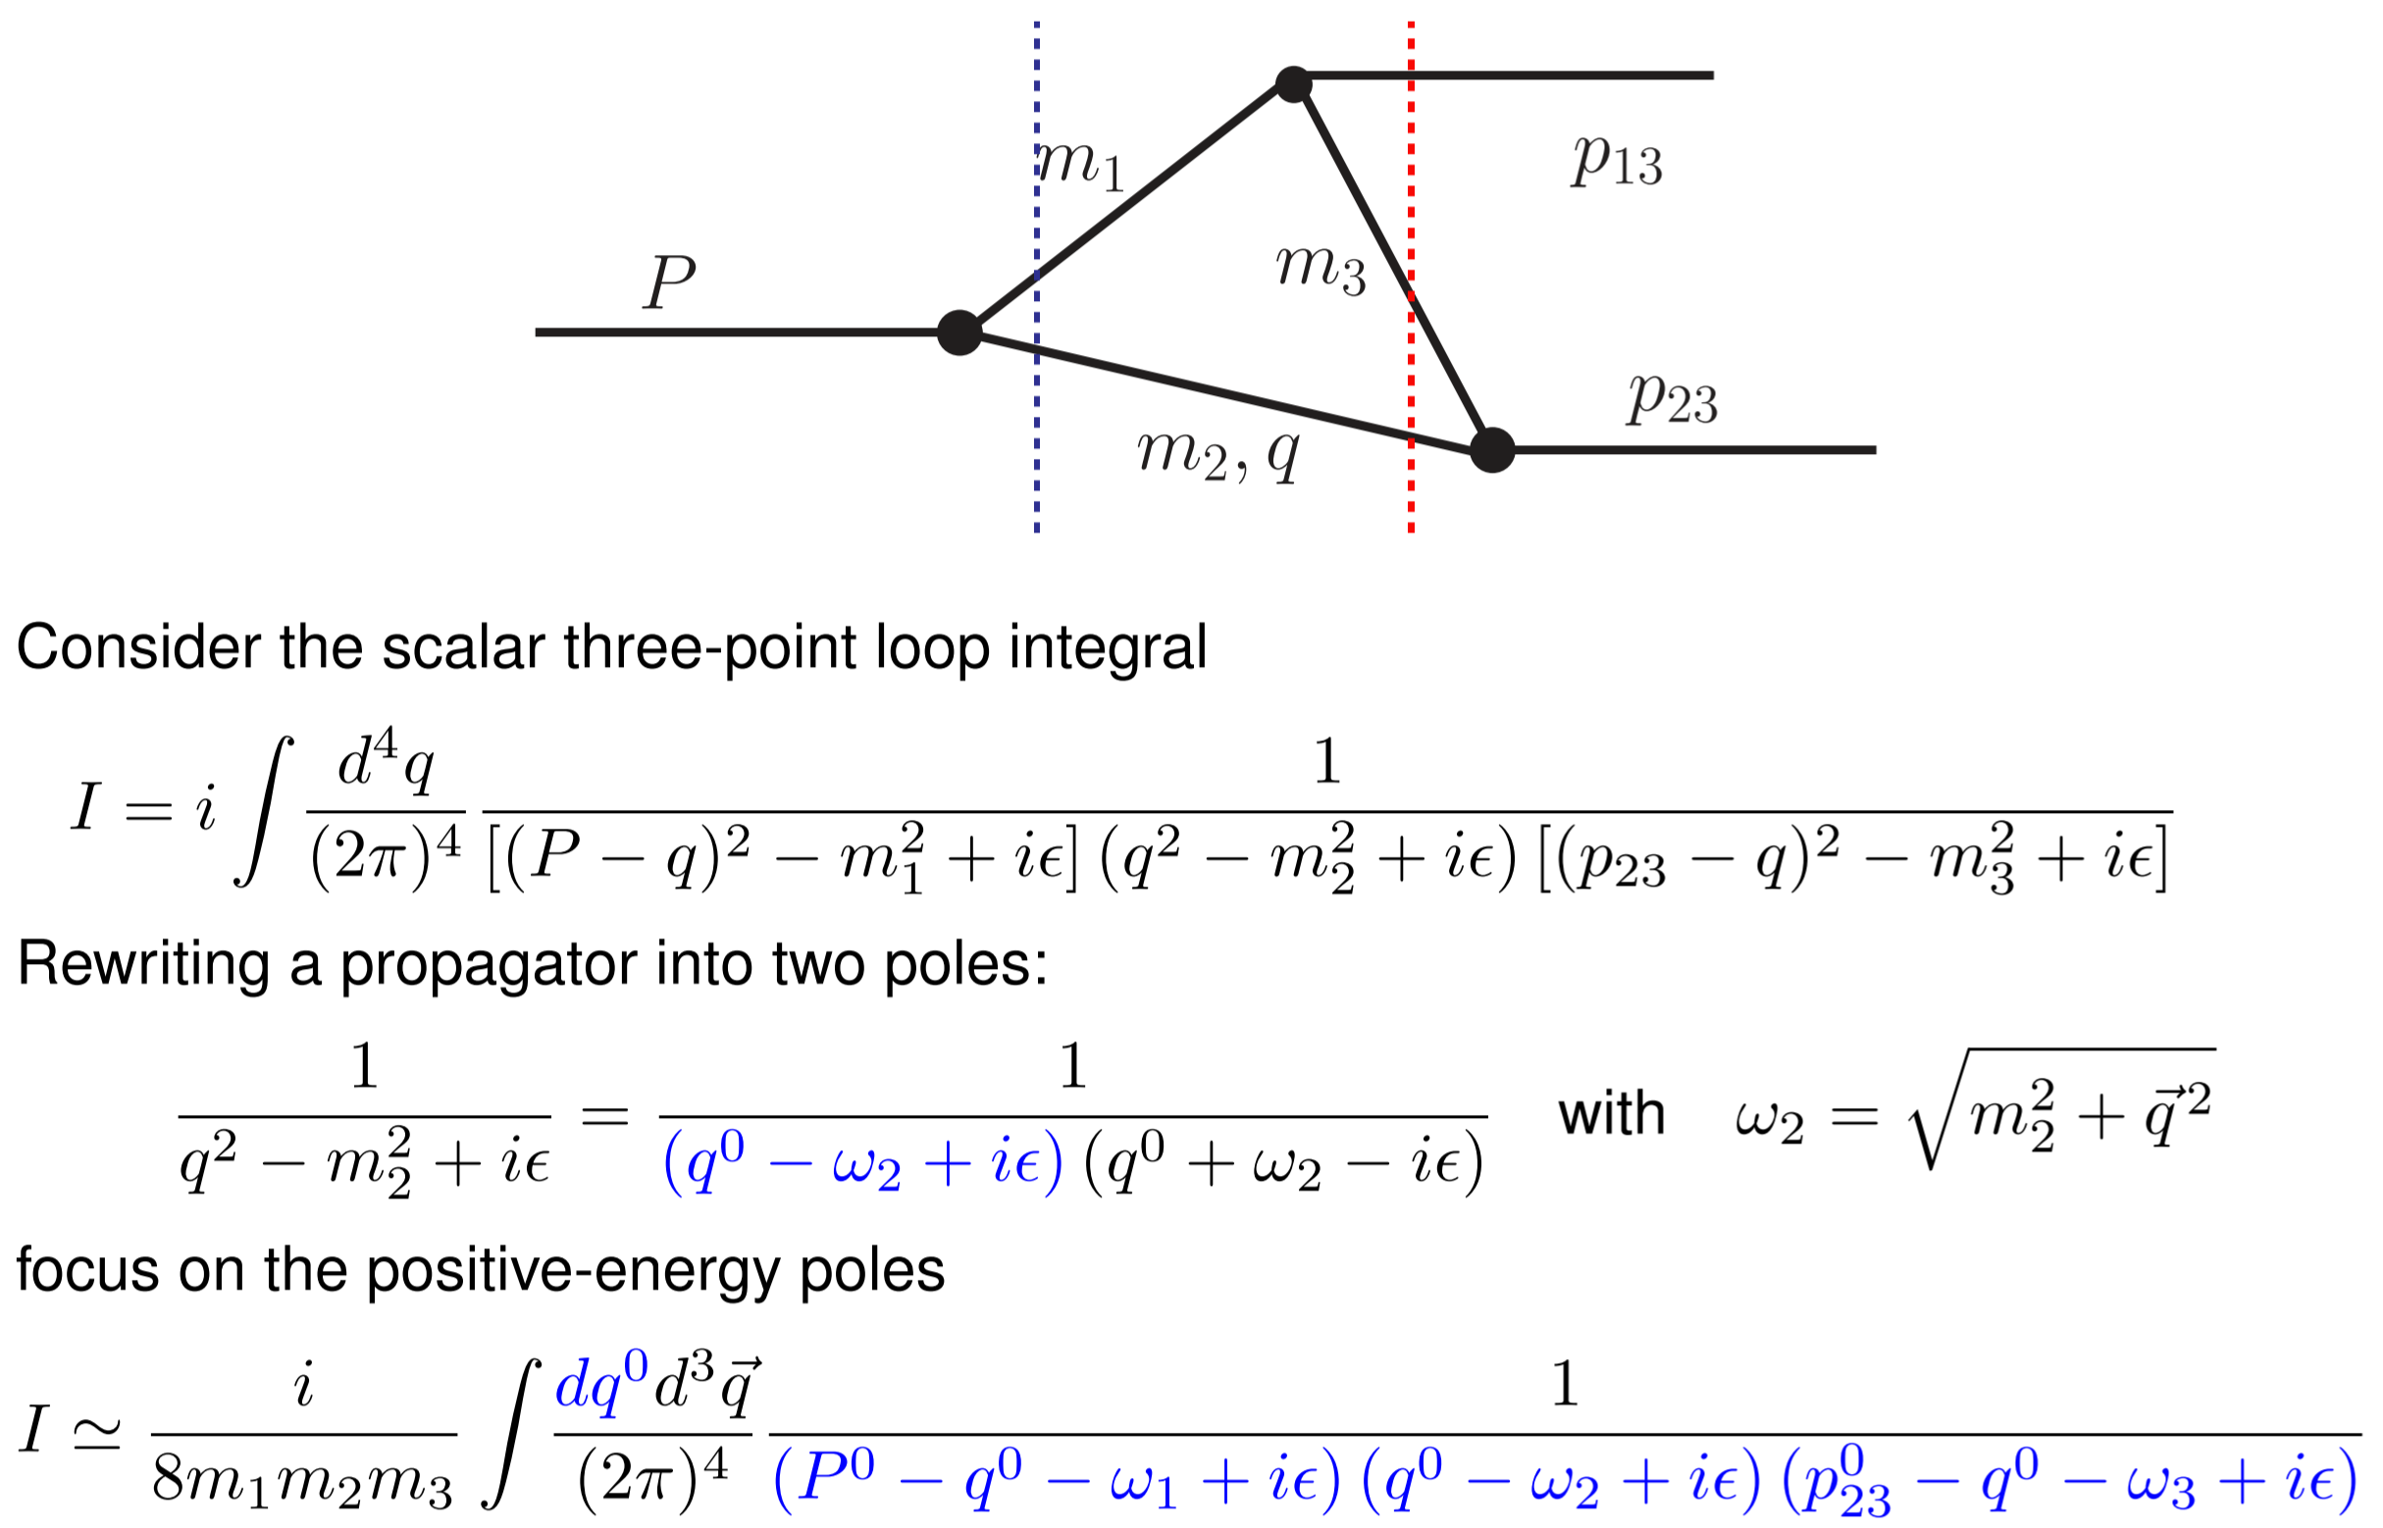
Derivation of the TS equation
Bayar, Aceti, FKG, Oset, PRD94(2016)074039
TS: Leading Landau singularity for a triangle diagram

Slide 4
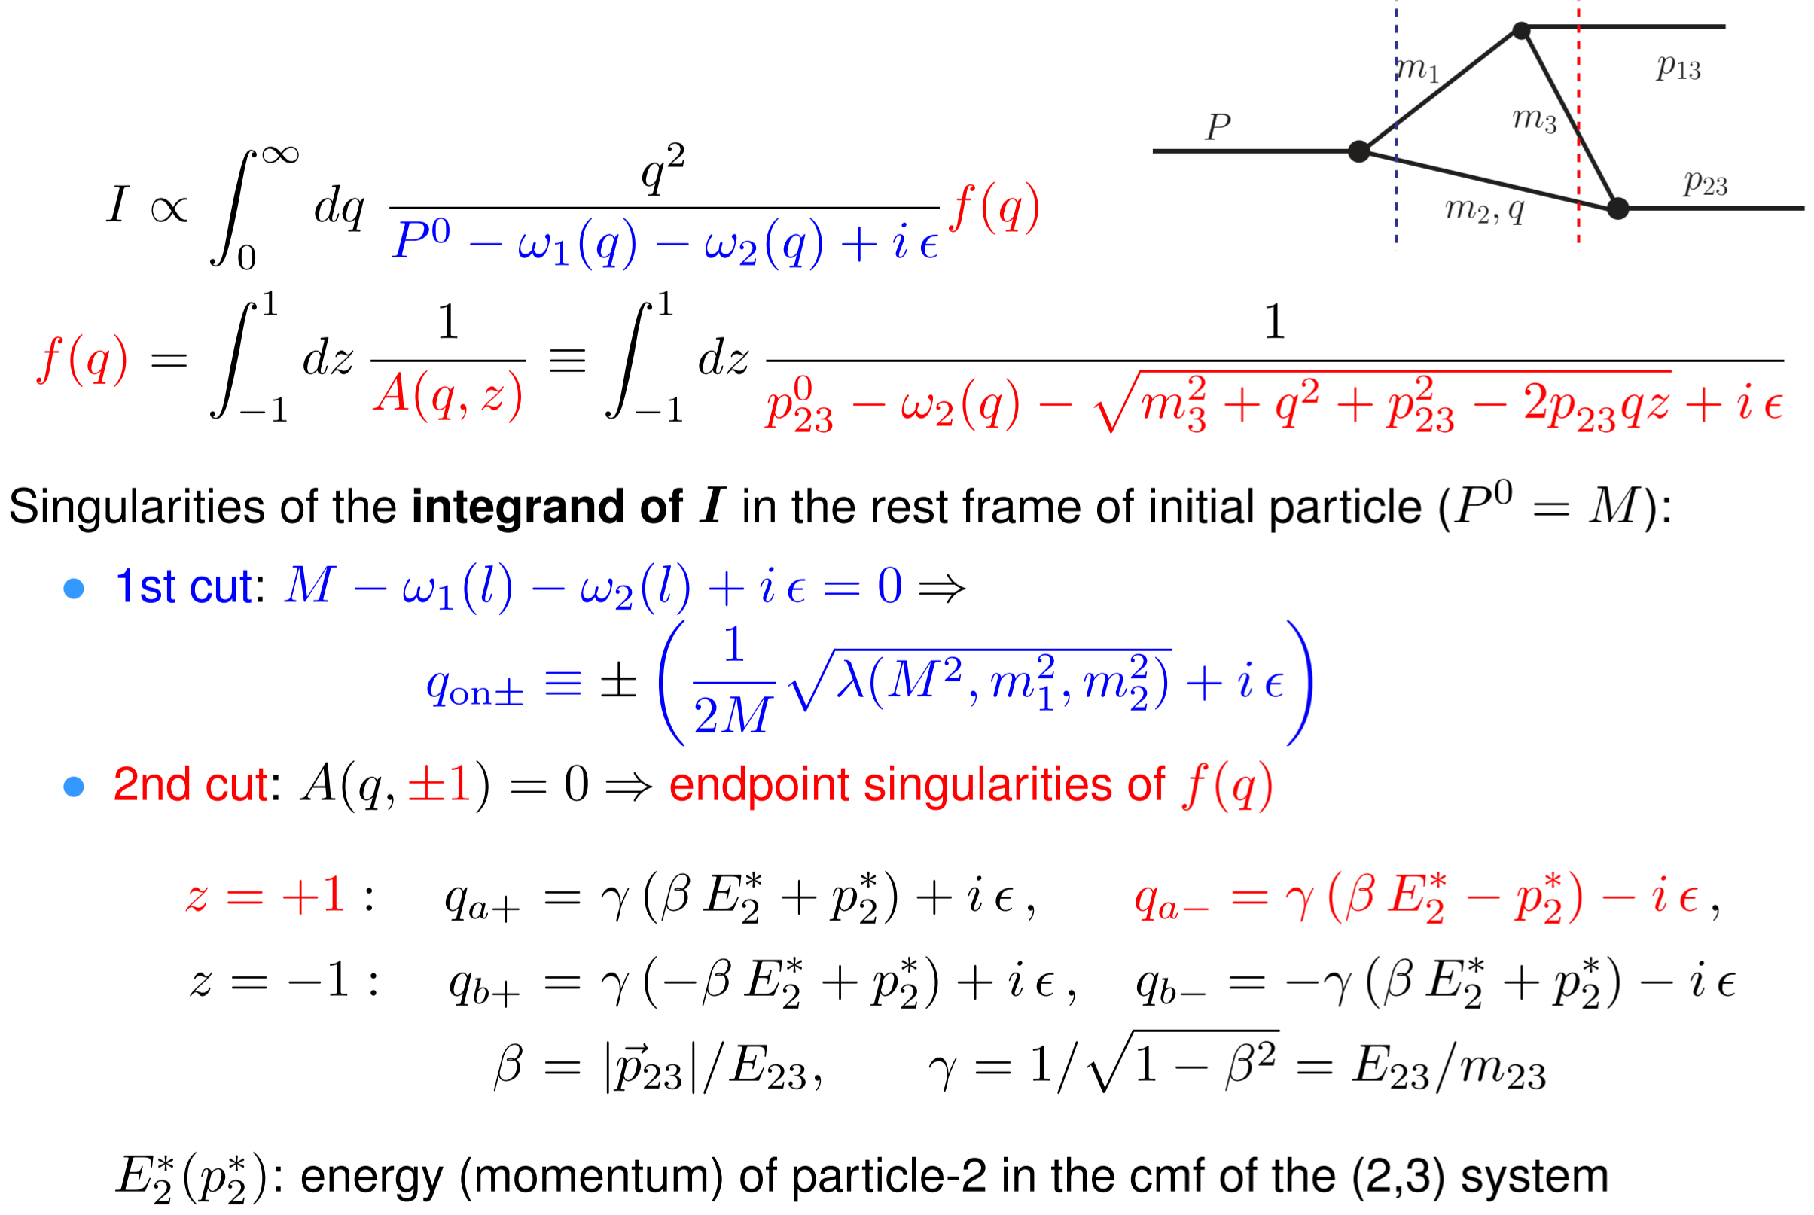
Derivation of the TS equation

Slide 5
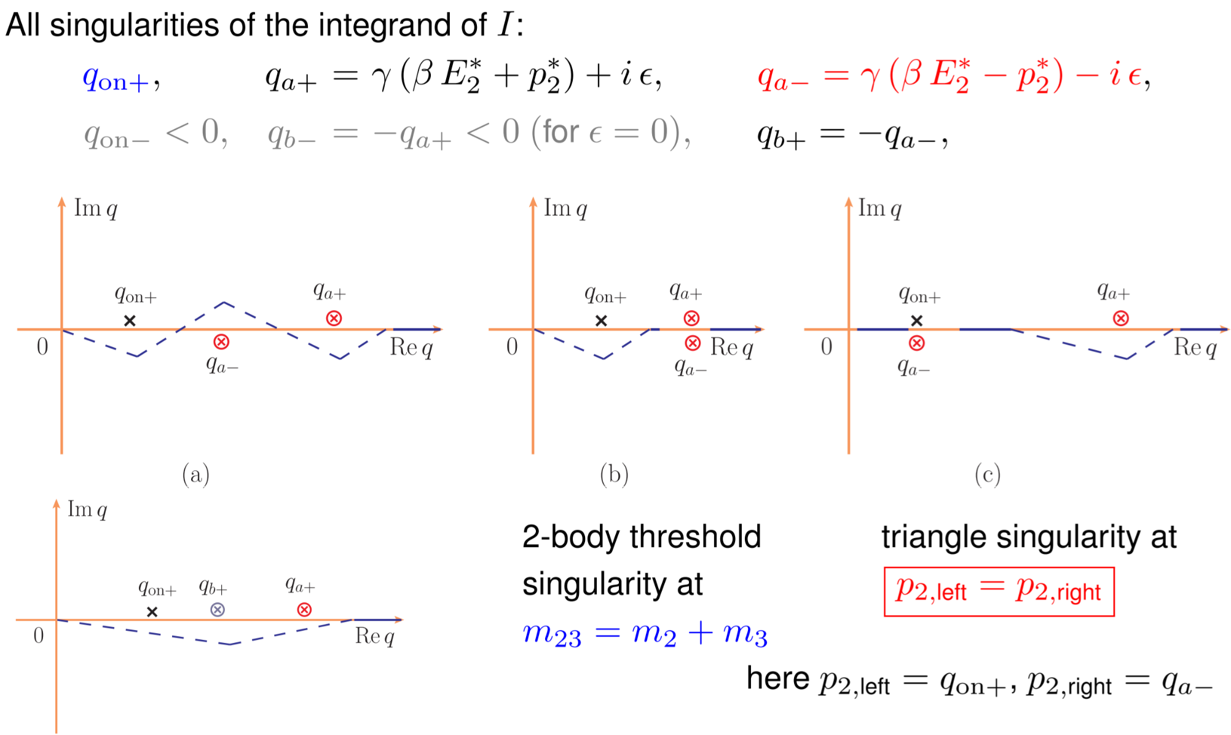
Derivation of the TS equation

Slide 6
Triangle singularity (TS)
Logarithmic singularity
Bayar, Aceti, FKG, Oset, PRD94(2016)074039
Coleman, Norton (1965); Bronzan (1964)

Slide 7
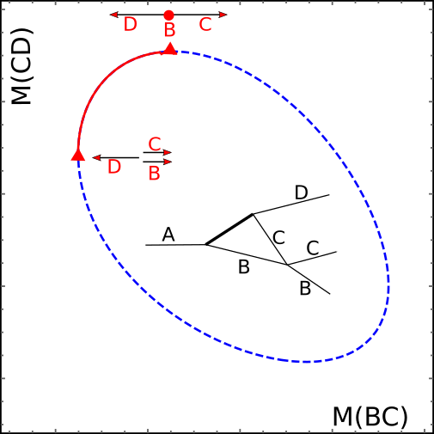
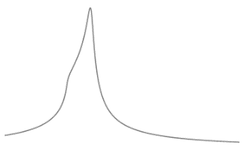
Triangle singularity (TS)
R
R

Slide 8
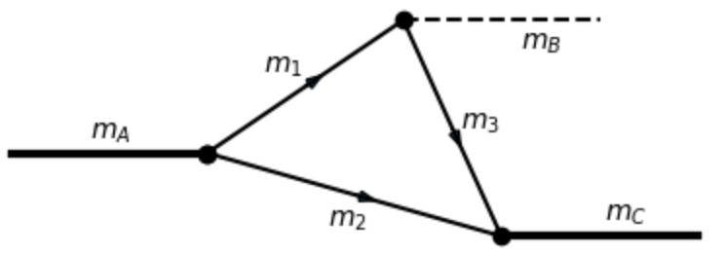
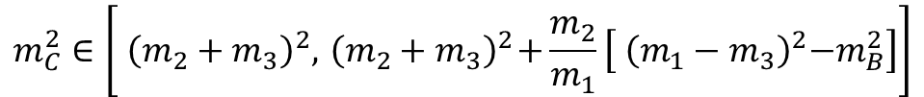
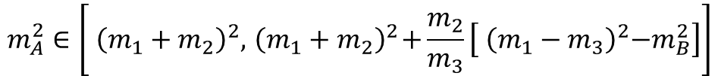
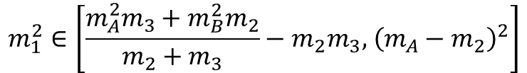
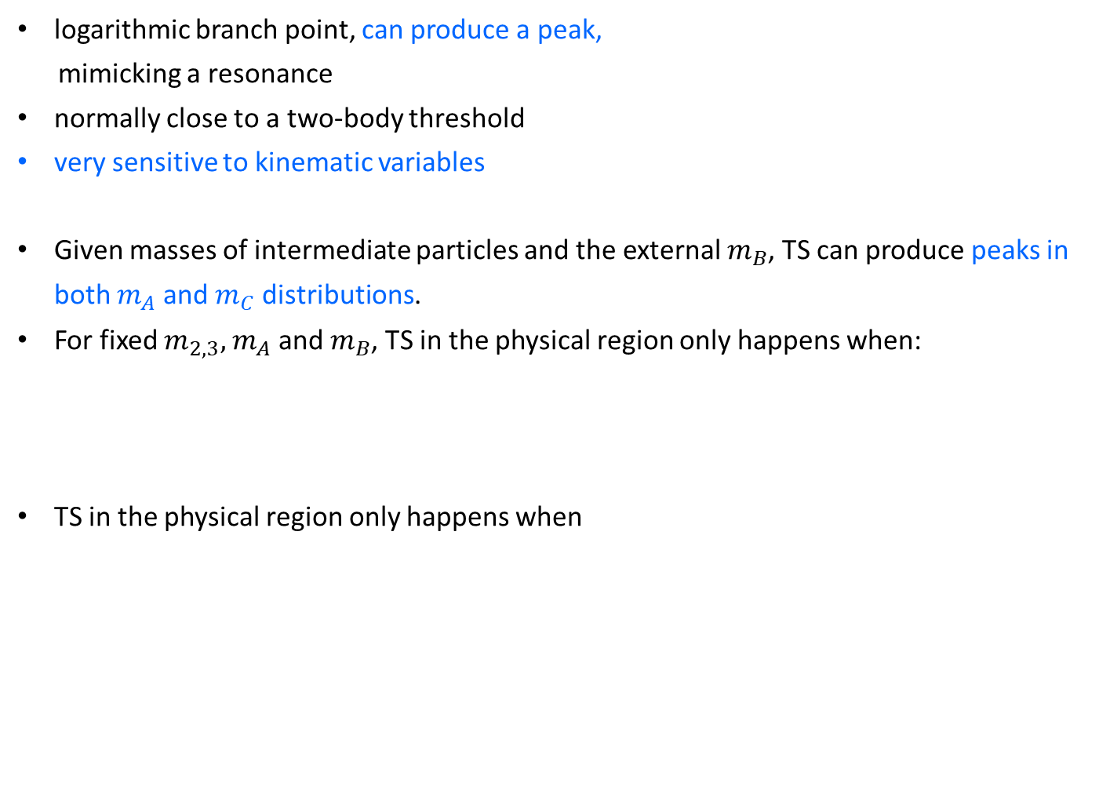
Features of TS
logarithmic branch point, can produce a peak,
mimicking a resonance
normally close to a two-body threshold
very sensitive to kinematic variables
Given masses of intermediate particles and the external $m_{B}$, TS can produce peaks in both $m_{A}$ and $m_{C}$ distributions.
For fixed $m_{2,3},$ $m_{A}$ and $m_{B}$, TS in the physical region only happens when:
TS in the physical region only happens when
$$m_{1}^{2}∈\left[\frac{m_{A}^{2}m_{3}+m_{B}^{2}m_{2}}{m_{2}+m_{3}}−m_{2}m_{3},{ \left({m_{A}−m}_{2}\right)}^{2}\right]$$
$$m_{A}^{2}∈\left[{ \left({m_{1}+m}_{2}\right)}^{2},{ \left({m_{1}+m}_{2}\right)}^{2}+\frac{m_{2}}{m_{3}}\left[{ \left({m_{1}−m}_{3}\right)}^{2}−m_{B}^{2}\right]\right]$$
$$m_{C}^{2}∈\left[{ \left({m_{2}+m}_{3}\right)}^{2},{ \left({m_{2}+m}_{3}\right)}^{2}+\frac{m_{2}}{m_{1}}\left[{ \left({m_{1}−m}_{3}\right)}^{2}−m_{B}^{2}\right]\right]$$

Slide 9
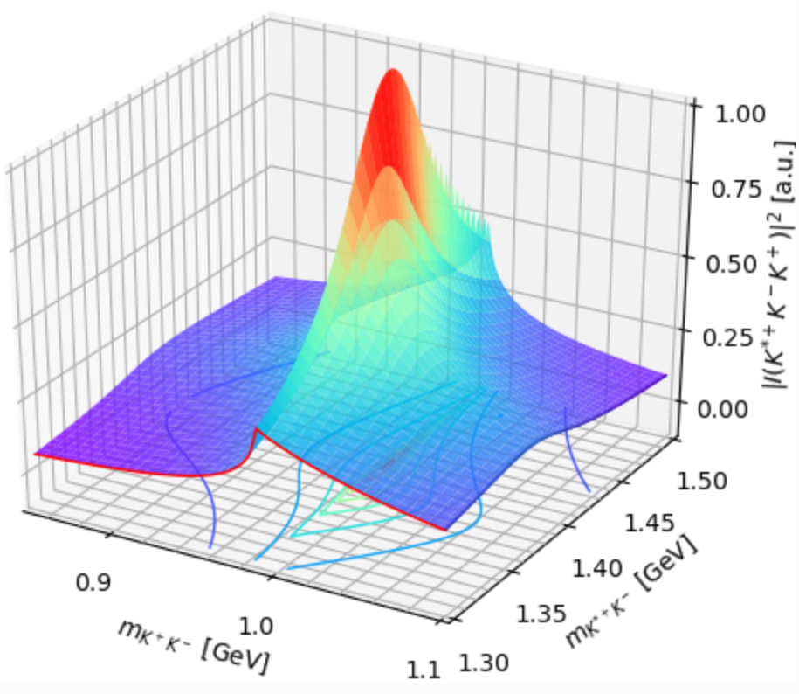
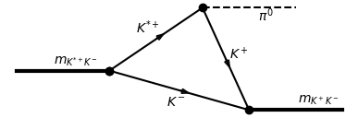
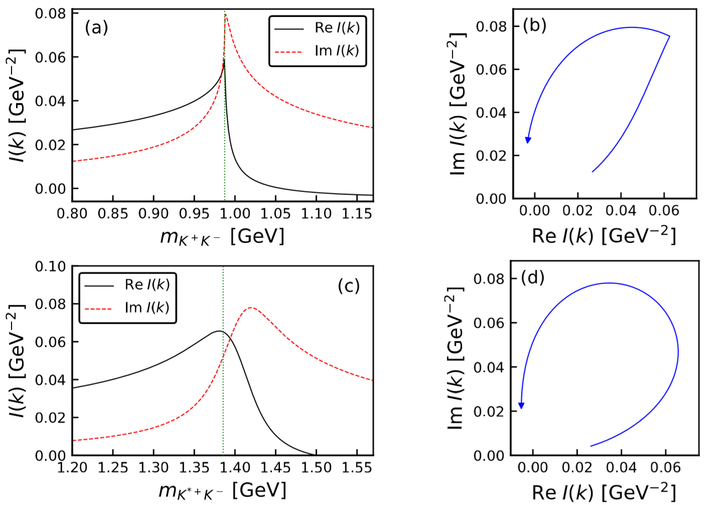






Features of TS
Phase motion of triangle diagram in the presence of a TS
$K\overline{K}$ threshold
$m_{K^{∗}\overline{K}}=1.42$ GeV
$m_{K\overline{K}}=0.99$ GeV
The argand plot is counterclockwise, resembling that of a resonance

Slide 10
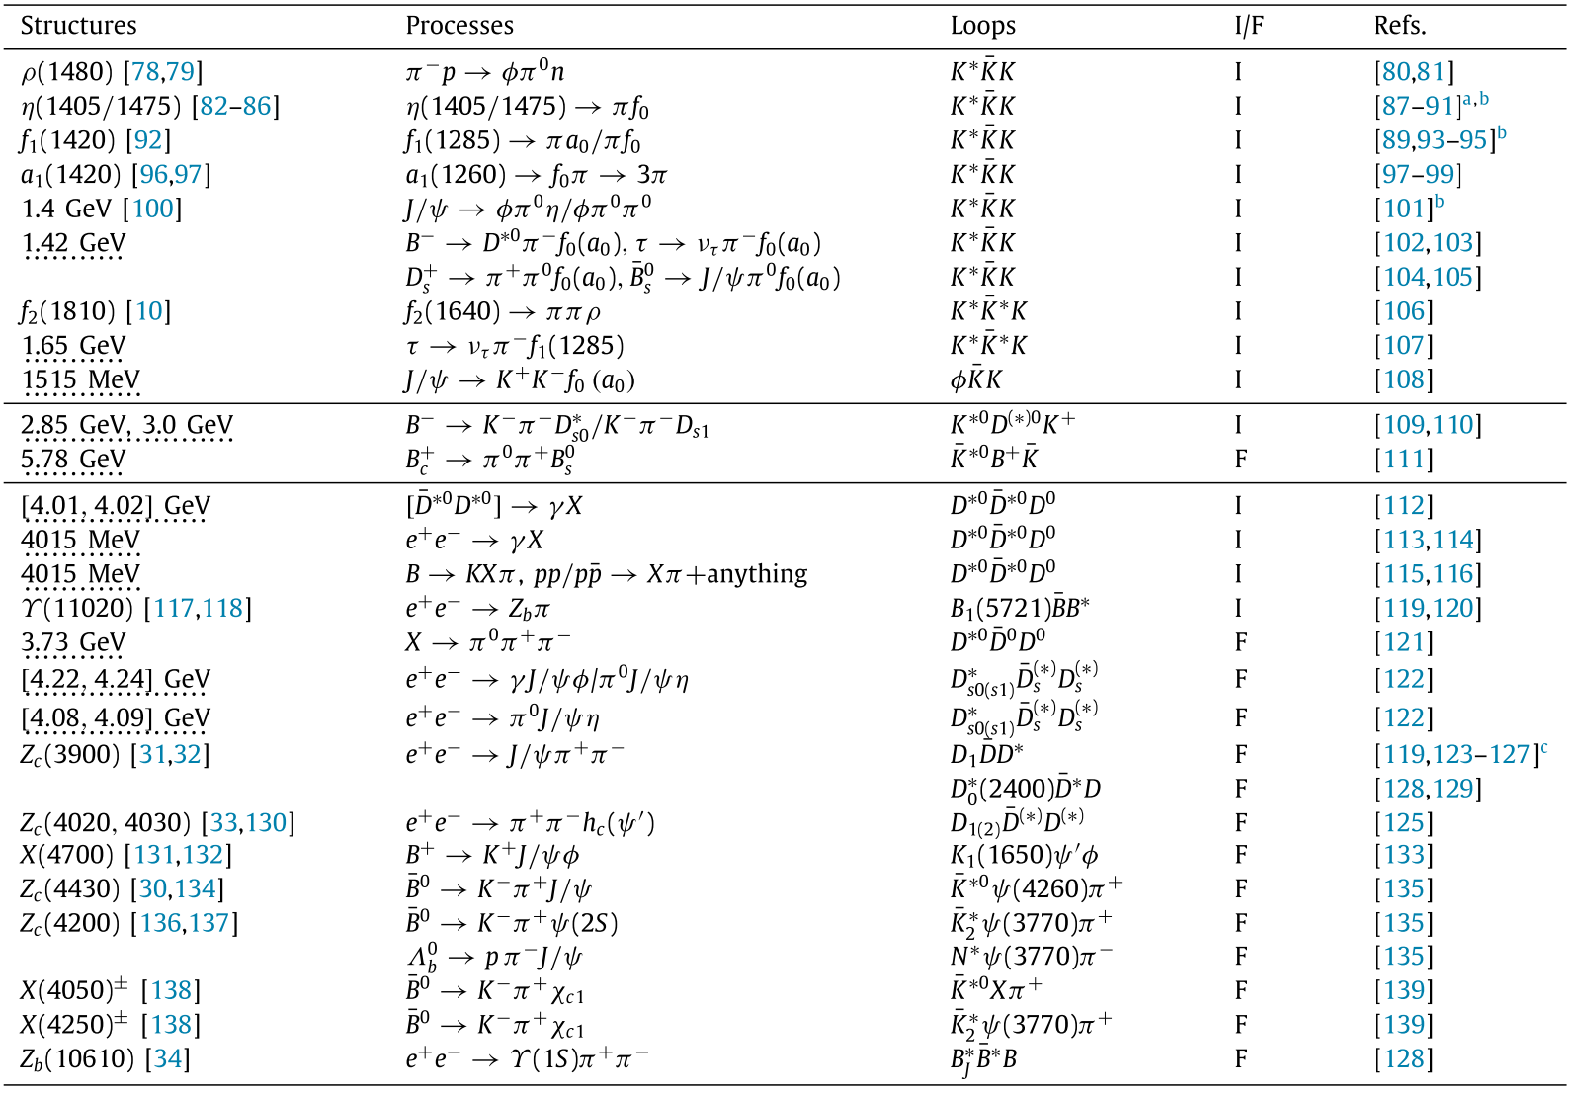
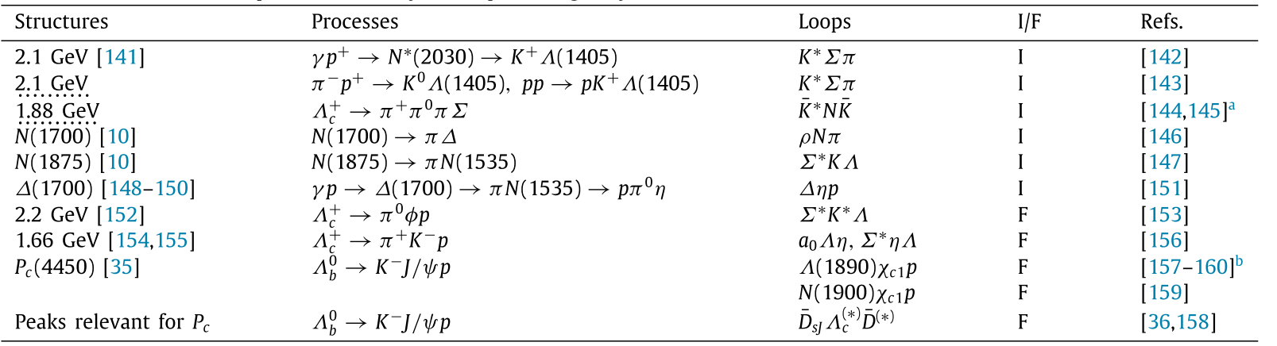
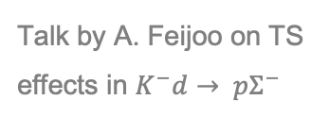
Reactions with TS
Talk by A. Feijoo on TS effects in $K^{−}d→ pΣ^{−}$
Reviewed in FKG, X.-H. Liu, S. Sakai, PPNP 112 (2020) 103757

Slide 11
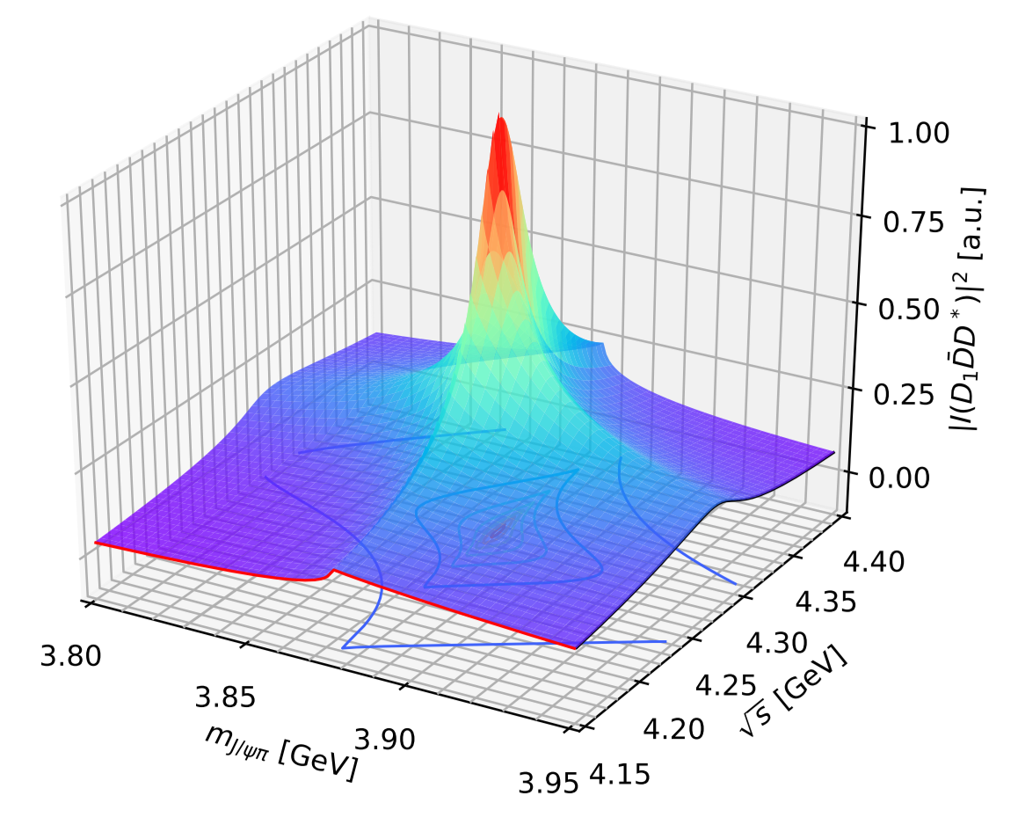
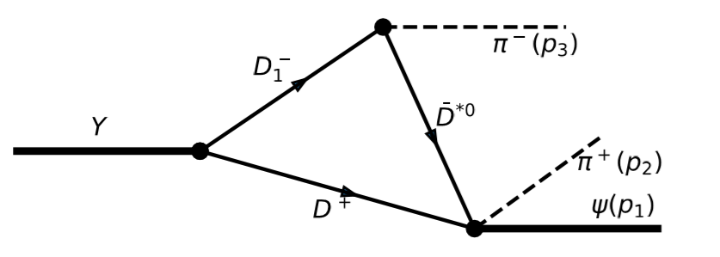
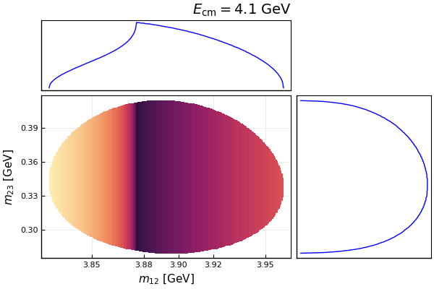
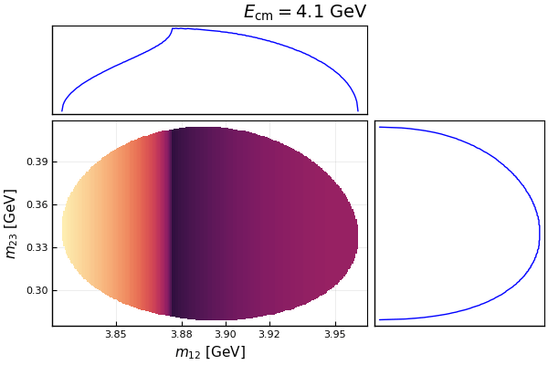
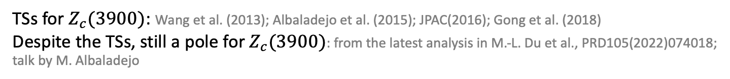
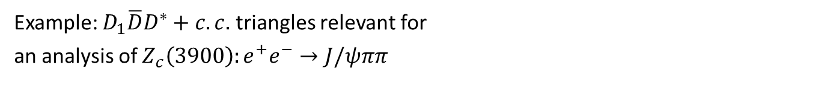



Example: $Z_{c}\left(3900\right)$
Example: $D_{1}\overline{D}D^{∗}+c.c.$ triangles relevant for
an analysis of $Z_{c}\left(3900\right):e^{+}e^{−}→J/ψππ$
Very sensitive to energy!
Scalar 3-point $D_{1}\overline{D}D^{∗}$ loop
Sum of $D_{1}\overline{D}D^{∗},D_{1}{\overline{D}}^{∗}D^{∗},D_{2}{\overline{D}}^{∗}D^{∗}$loops
TSs for $Z_{c}(3900)$: Wang et al. (2013); Albaladejo et al. (2015); JPAC(2016); Gong et al. (2018)
Despite the TSs, still a pole for $Z_{c}(3900)$: from the latest analysis in M.-L. Du et al., PRD105(2022)074018; talk by M. Albaladejo

Slide 12
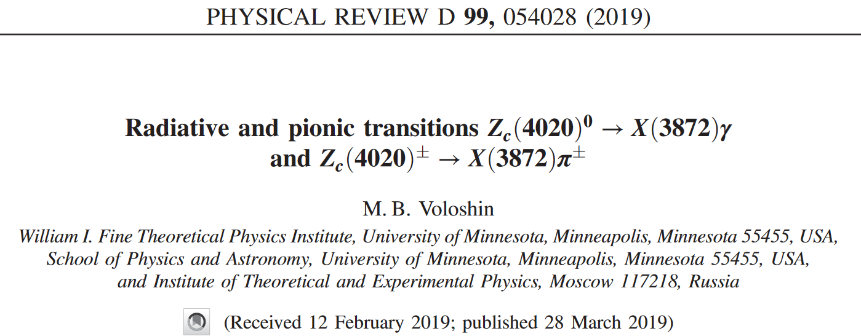
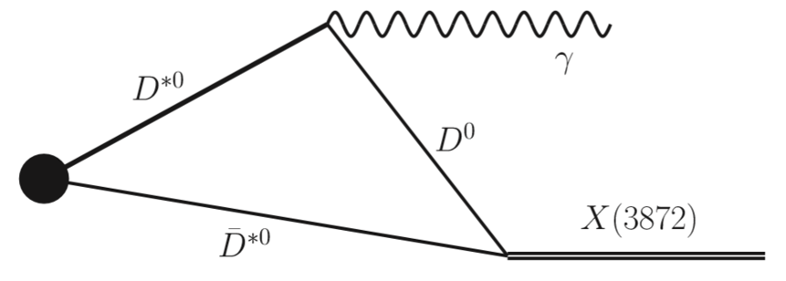
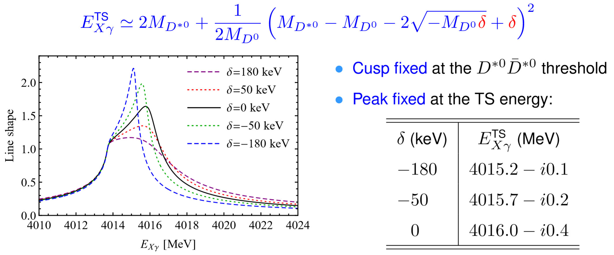
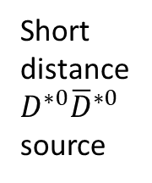
TS as a tool: precise binding energy measurement
FKG, PRL122 (2019) 202002
Short distance
$D^{∗0}{\overline{D}}^{∗0}$ source

Slide 13
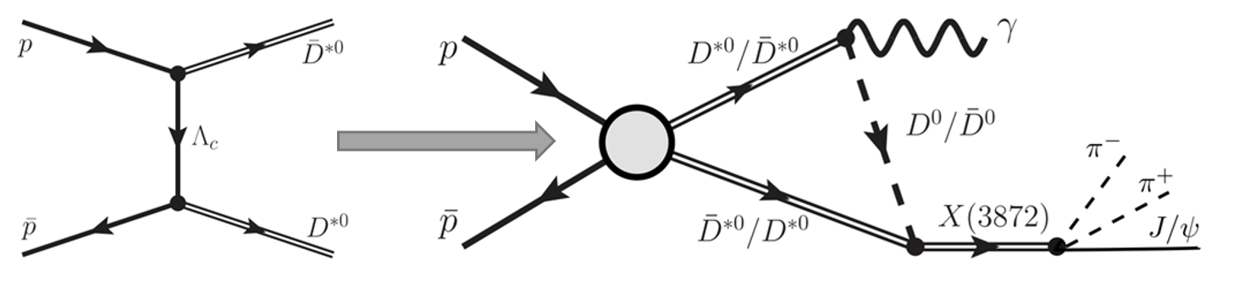
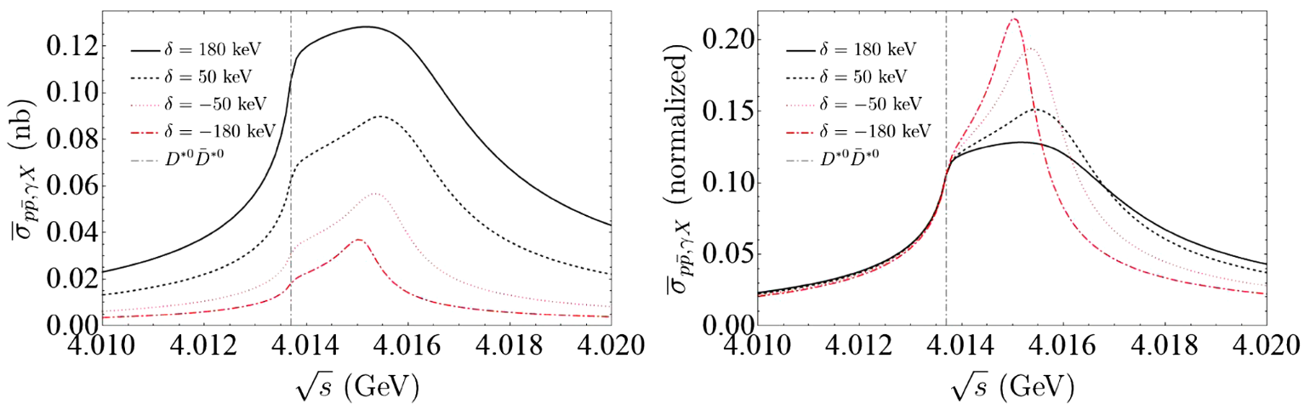

TS as a tool: precise measurement of X(3872)
Cross section estimate: $p\overline{p}→γX(3872)$
S. Sakai, H.-J. Jing, FKG, PRD 102 (2020) 114041
$σ\left(p\overline{p}→γX\right)×ℬ\left(X→J/ψπ^{+}π^{−}\right)=𝒪(10 pb)$
$𝒪(2×{10}^{3})$ events taking into account $ℬ\left(J/ψ→ℓ^{+}ℓ^{−}\right)≃12\%$ for an integrated luminosity of 2 ${fb}^{−1}$ at PANDA
PANDA, EPJA55(2019)42

Slide 14
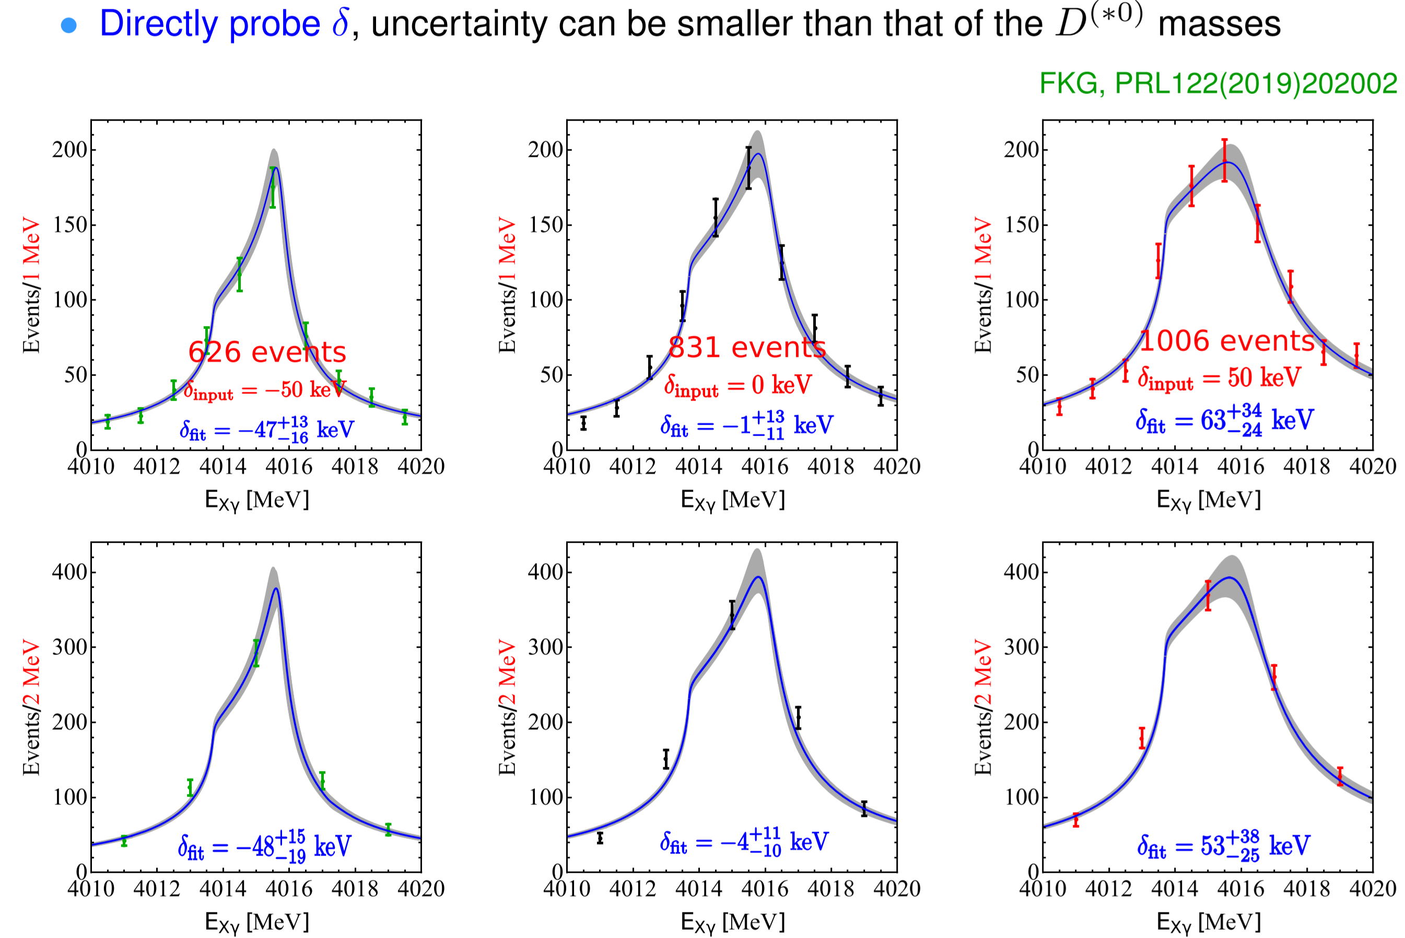
TS as a tool: precise measurement of X(3872)
Monte Carlo simulation of the sensitivity:
Effects of energy resolution studied in P. G. Ortega, E. Ruiz Arriola, PRD 103 (2021) 114029

Slide 15
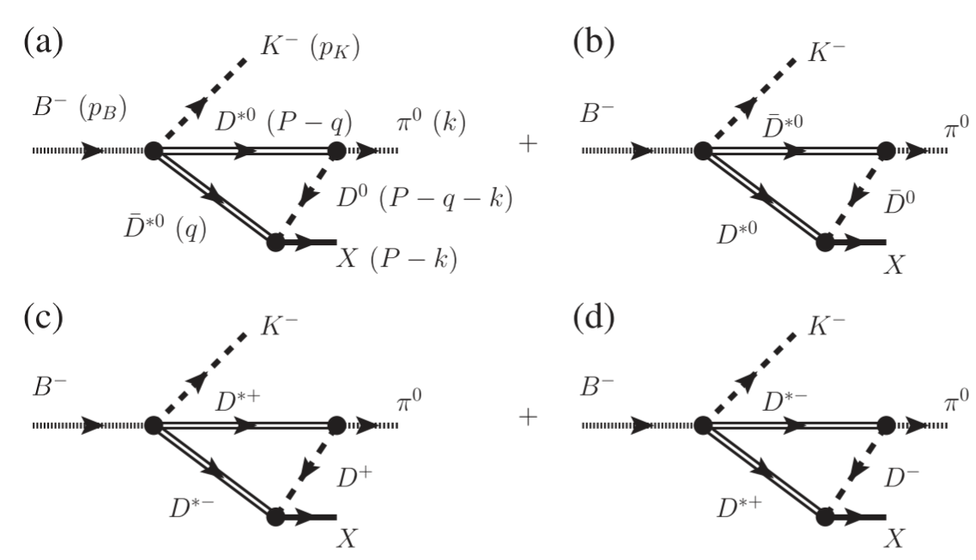
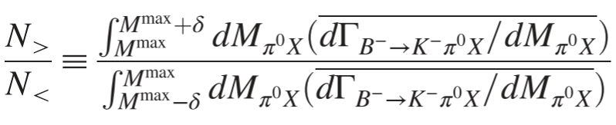
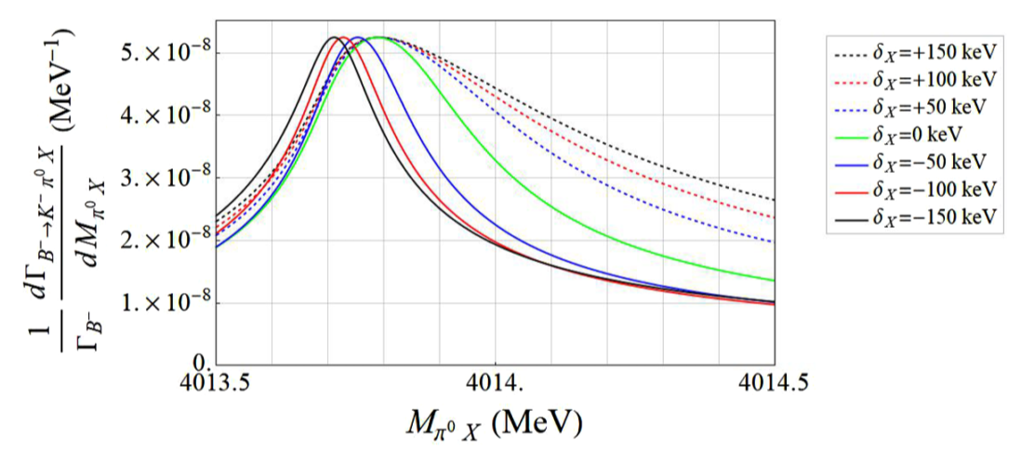
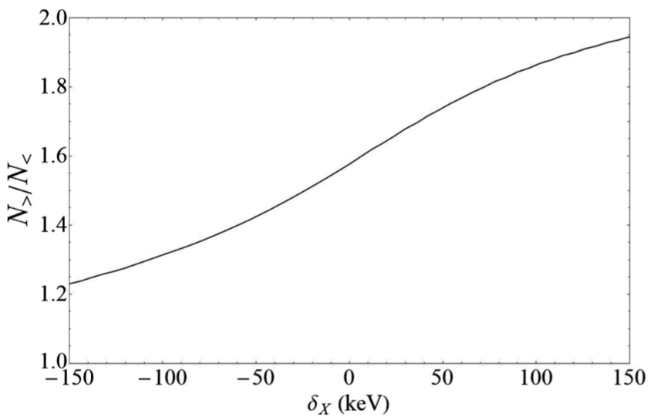

Line shape asymmetry in $B→KπX(3872)$
S. Sakai, E. Oset, FKG, Phys.Rev.D101(2020)054030
Asymmetric line shape

Slide 16
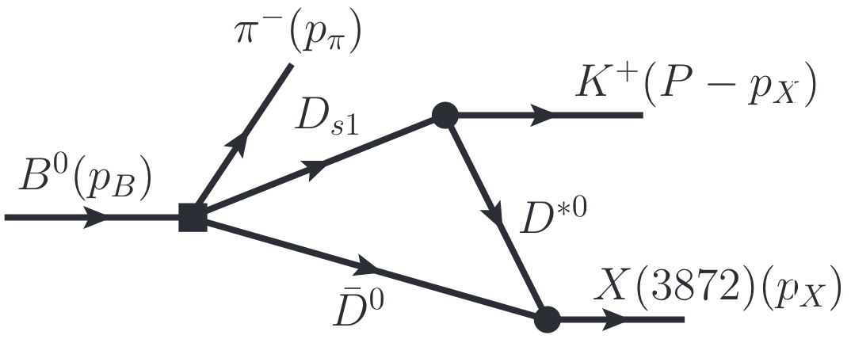
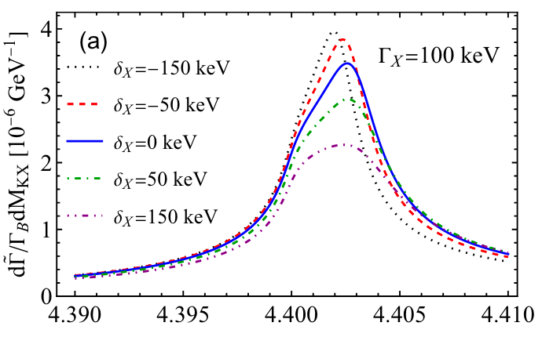
$$B→KπX(3872)$$
M.-J. Yan, Y.-H. Ge, X.-H. Liu, arXiv:2208.03943
Sensitivity to the binding energy of the $X(3872)$ in $B→KπX(3872)$ in the $XK$ line shape

Slide 17
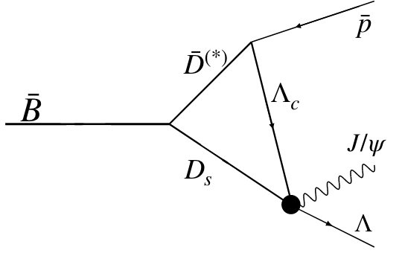
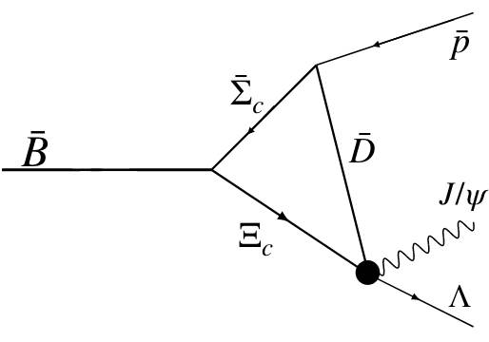
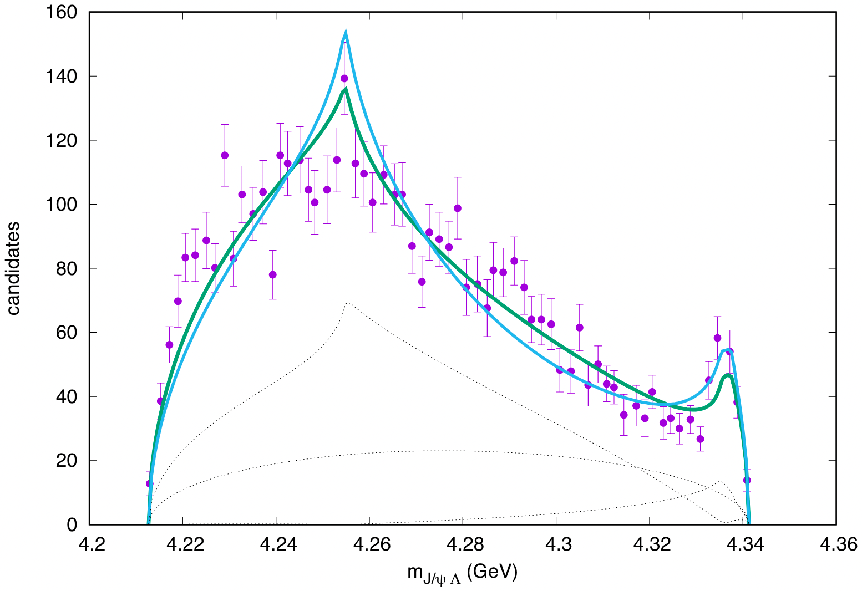






Some other recent works on TS effects
$$B→KπX(3872)$$
E. Braaten, L.-P. He, K. Ingles, PRD100 (2019) 074028;
S. Nakamura, PRD 102 (2020) 074004
Production of $X(3872)$ at hadron collider
E. Braaten, L.-P. He, K. Ingles, PRD 100 (2019) 094006
$e^{+}e^{−}→γD^{0}{\overline{D}}^{∗0}$
$$e^{+}e^{−}→γX\left(3872\right),$$
E. Braaten, L.-P. He, K. Ingles, PRD 101 (2020) 014021
E. Braaten, L.-P. He, K. Ingles, PRD 101 (2020) 096020
$Z_{cs}$ related
Z. Yang et al., PRD 103 (2021) 074029;
V. Baru et al., PRD 105 (2022) 034014;
M.-L. Du et al., PRD 105 (2022) 074018; talk by M. Albaladejo
$T_{cc}$ related
N.N. Achasov, G.N. Shestakov, PRD 105 (2022) 096038;
E. Braaten, L.-P. He, K. Ingles, J. Jiang, PRD 106 (2022) 034033
$P_{c}$, $P_{cs}$ related
FKG, U.-G. Meißner, W. Wang, Z. Yang, PRD 92 (2015) 071502;
M. Mikhasenko, arXiv:1507.06552; LHCb, PRL 122 (2019) 222001;
S. Nakamura, PRD 103 (2021) L111503
P. Burns, E. Swanson, arXiv:2208.05106
And many more $……$

Slide 18
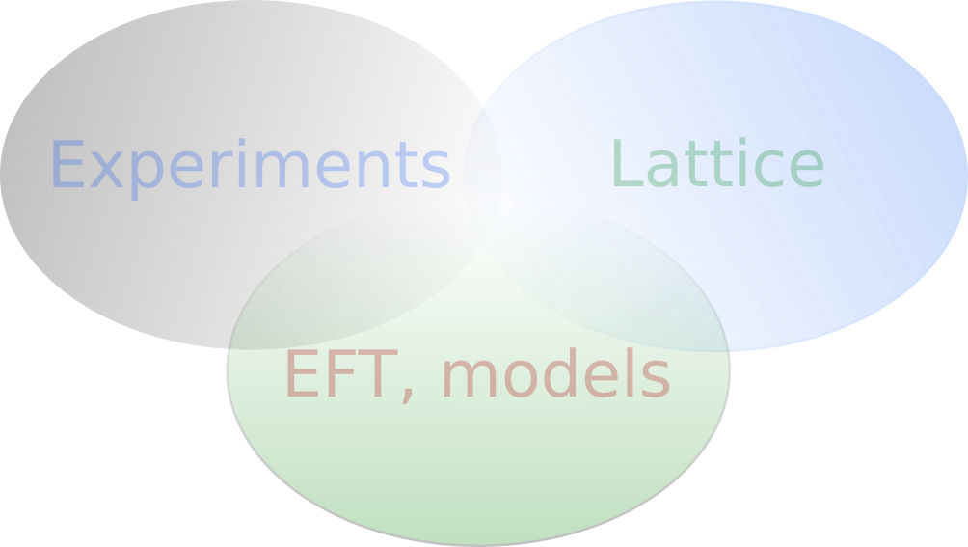
Thank you for your attention!
Conclusion
Triangle singularity effects
  May mimic resonance signals:
  TS-induced peak for the initial-state (final-state) energy distribution may be checked by varying the invariant mass of final (initial) states
  Tool for precise measurement of the binding energy of near-threshold particles:
  possible use in nuclear physics?

