Slide 1

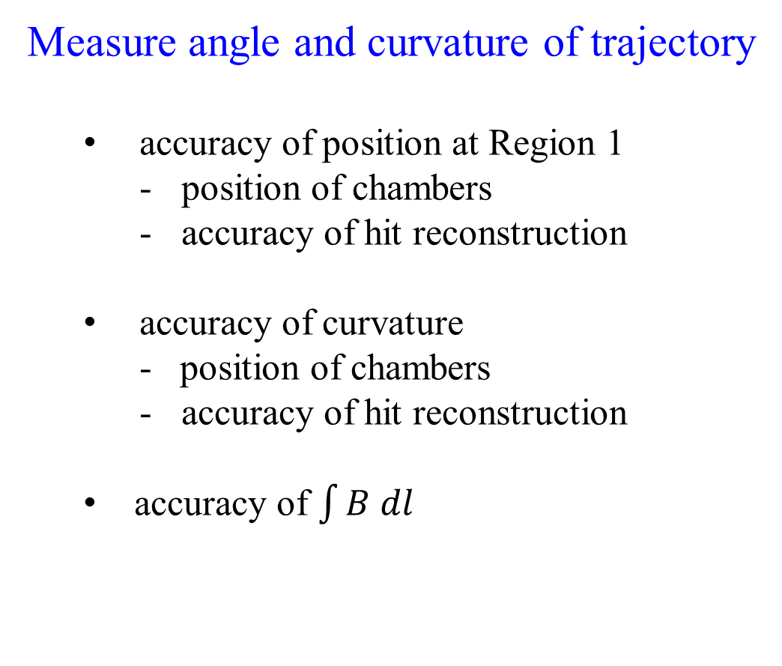
Charged Particle Tracking Resolution
Measure angle and curvature of trajectory
  accuracy of position at Region 1
    position of chambers
    accuracy of hit reconstruction
  accuracy of curvature
    - position of chambers
    accuracy of hit reconstruction
  accuracy of $\int{B dl}$
Projects
Alignment
Time → Dist. Calibration
Modelling of B-field
dΘ
$$\frac{dp}{p}$$

Slide 2
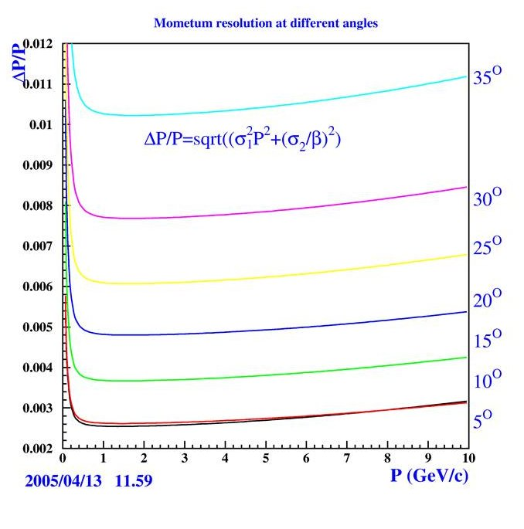
Charged Particle Tracking: Resolution Goals
Momentum Resolution:
Ideal B-Field
DC resolution ~ 250 μm
Ideal DC alignment
Best at small theta
  highest B-field
dp/p Goal: ~ 0.3%
the best we can do
Most important part of phase-space for missing-mass resolution

Slide 3
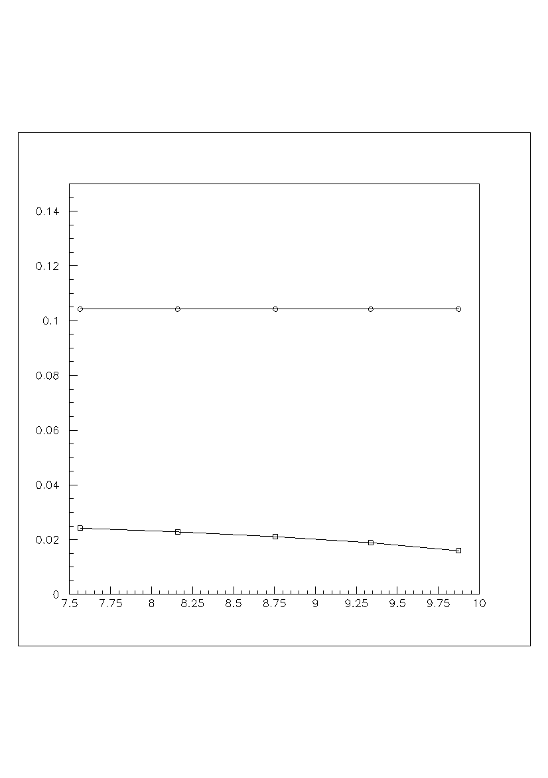
What is our Momentum Resolution Now?
Size of W-Shift
Width of elastic peak → resolution
δp/p = 1% → 100 MeV shift
δθ = 0.001 → 20 MeV shift
70 MeV width of elastic peak (σ)*
    σp/p ~ 0.7% or
    σθ ~ 3.5 mrad
    or some combination
*Fits of elastic peak (Fall 2018, inbending)
done by Stefan Diehl, Apr. 2019.
δp/p = 1%
ΔW (GeV)
0.1
0.05
δθ = 1 mrad
7.5
10.0
P_{electron}

Slide 4
What is Needed to Achieve 0.3% Accuracy?
3 cm
sagitta
10 GeV electron at 7⁰
2 Tesla field X 2m
17 m radius of curvature
3 cm sagitta
measure sagitta to 0.3%
measure sagitta to 90 μm
3 measurements of 75 μm
B-field accuracy <0.2%
1 m
1 m
17 m
Hit resolution < 200 μm
Alignment < 50 μm
tight constraints !

Slide 5
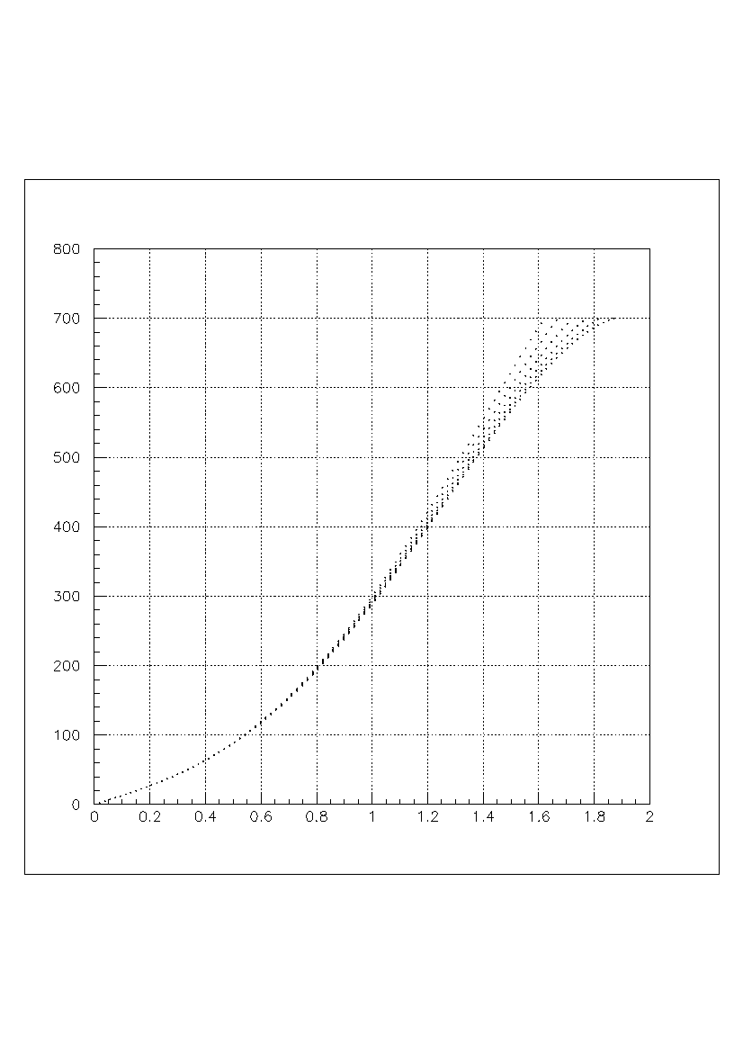
Distance → Time Function: Polynomial Form
T(x) = a x + b x² + c x³ + d x⁴
800
Time (ns)
0
0
2
Distance (cm)

Slide 6
Distance → Time Function: Polynomial Form
Dmax
0⁰ 30⁰
T(x) = a x + b x² + c x³ + d x⁴
Simple calculus:
(a,b,c,d) → (V₀, V_{mid}, R, T_{max})
Physically meaningful* parameters
Published data for V₀, V_{mid}
→Reality checks on fits
* “Electron Drift Velocity …” NIM A340 (1994) 485
Tmax
Minimum velocity = V_{mid}
inflection point =“R”
2
Distance (cm)
Saturated velocity = V₀

Slide 7
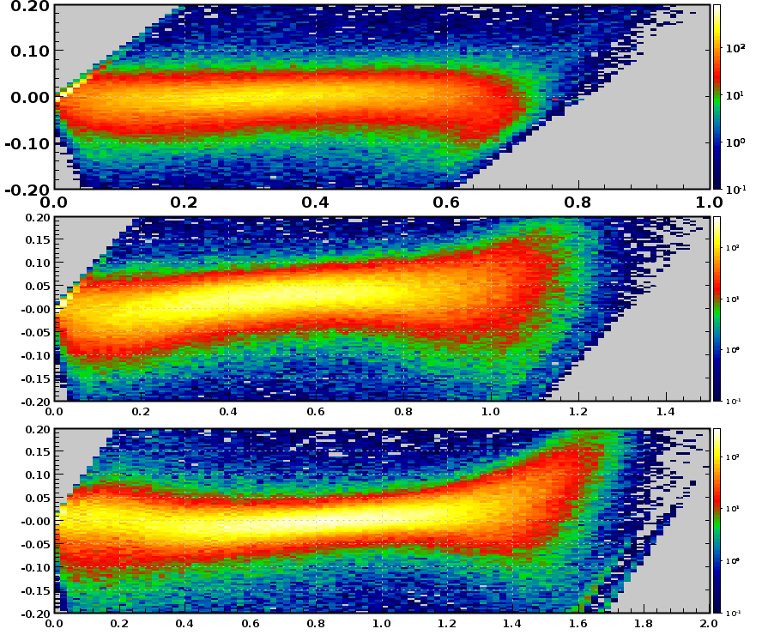
DC Hit Resolution
Run 5419*
low lum., fall 2018 run
R1 → flat distribution
R2 → not flat
fit with B-field parameters
R3 → not flat
re-fit with different values of Tmax
Reg. 1
Residual (cm)
Reg. 2
Not flat;
let’s take a closer look
Reg. 3
DOCA (cm)
* Cooked with Taya Chetry’s default parameters

Slide 8
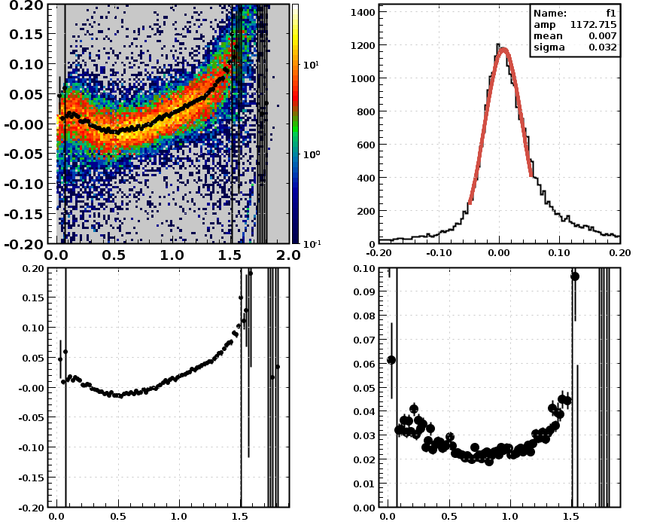
Residual (cm)
σ = 320 μm
Not flat
room for improvement
DOCA (cm)
σ from slice fit
400 μm
mean from slice fit
300 μm
200 μm
Intrinsic Resolution
~ 200 μm

Slide 9
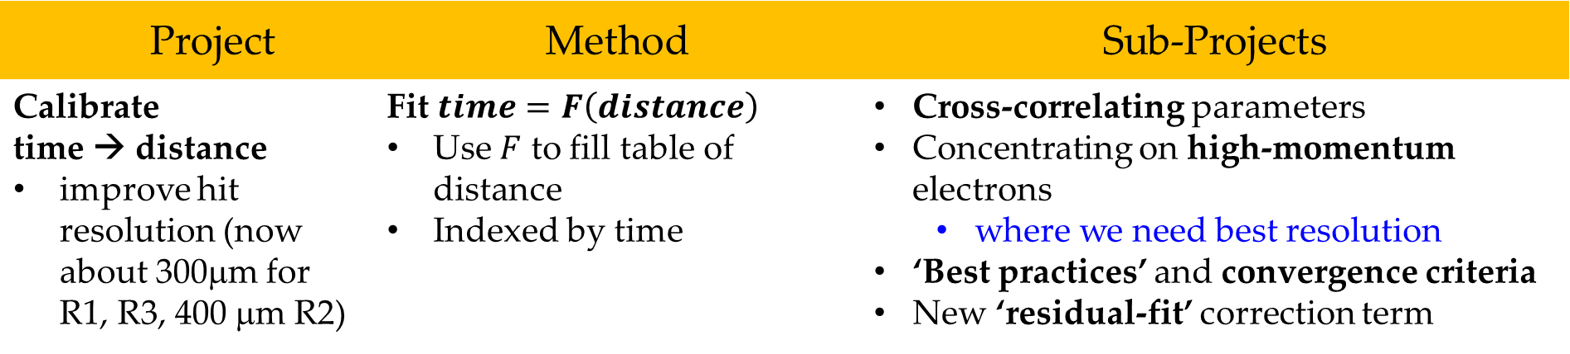
Forward Track Resolution: Status
Project | Method | Sub-Projects
Calibrate time → distance improve hit resolution (now about 300μm for R1, R3, 400 μm R2) | Fit $time=F\left(distance\right)$ Use $F$ to fill table of distance Indexed by time | Cross-correlating parameters Concentrating on high-momentum electrons where we need best resolution ‘Best practices’ and convergence criteria New ‘residual-fit’ correction term
→ Expect significant improvement in R2, R3 resolutions
  better fits, use of residual fits as fn. of time
→ Re-calibration criteria based on atm. pressure
  strong correlations seen
better resolution
more consistent

Slide 10
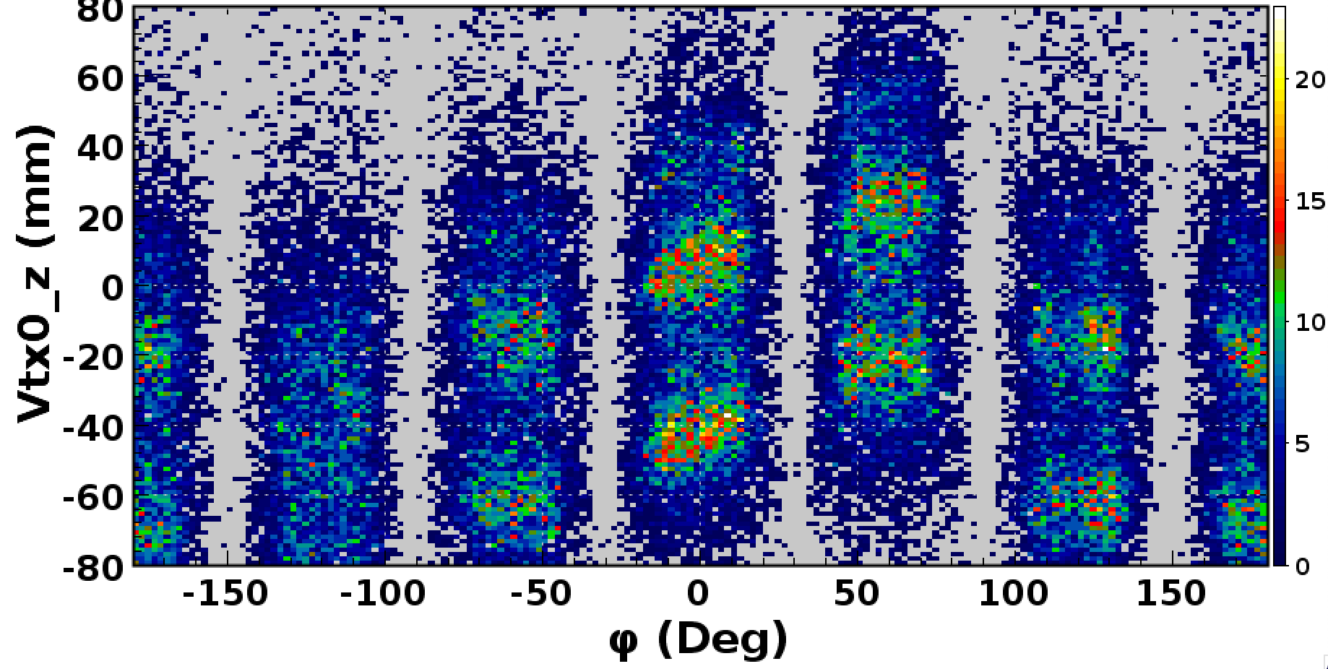
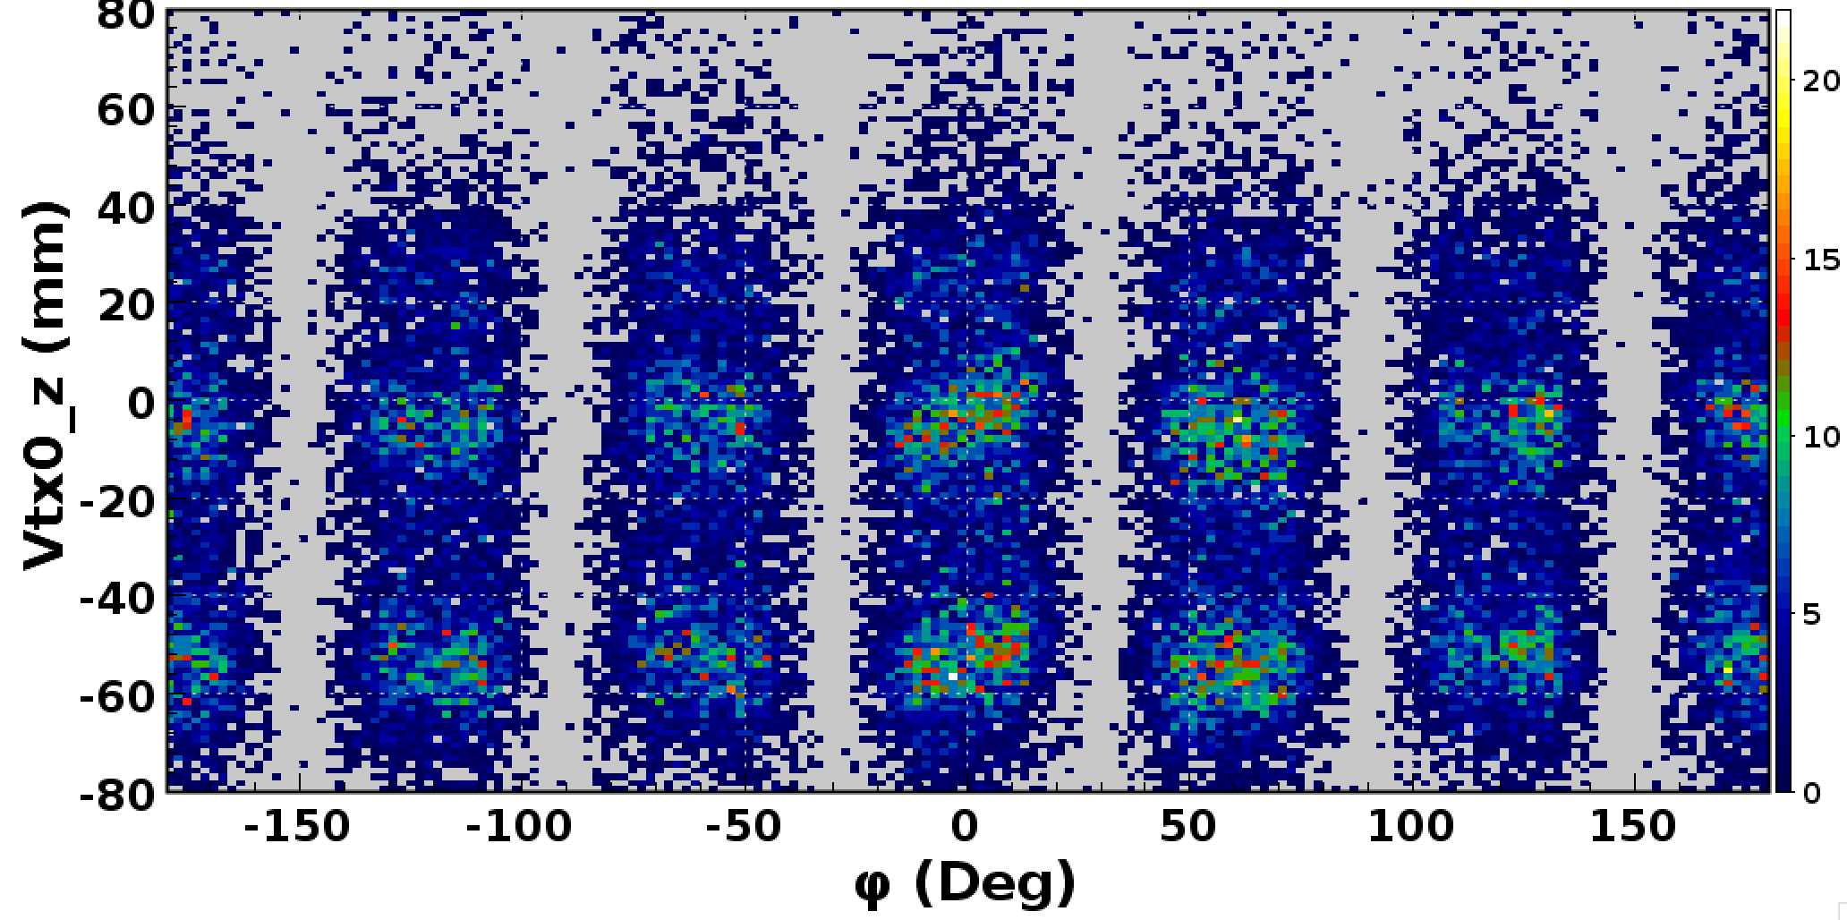
run 5297, Fall Alignment Vertices *
Vertices same for all sectors
Unaligned
Aligned
* Timothy Hayward’s slides from Spring ‘19 Collaboration Meeting

Slide 11
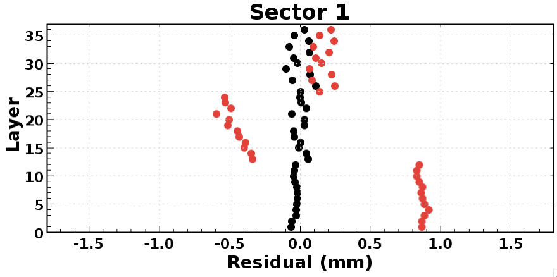
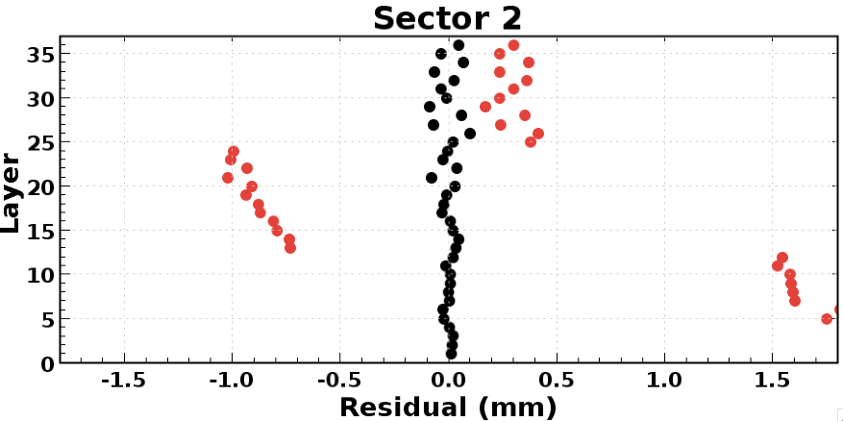
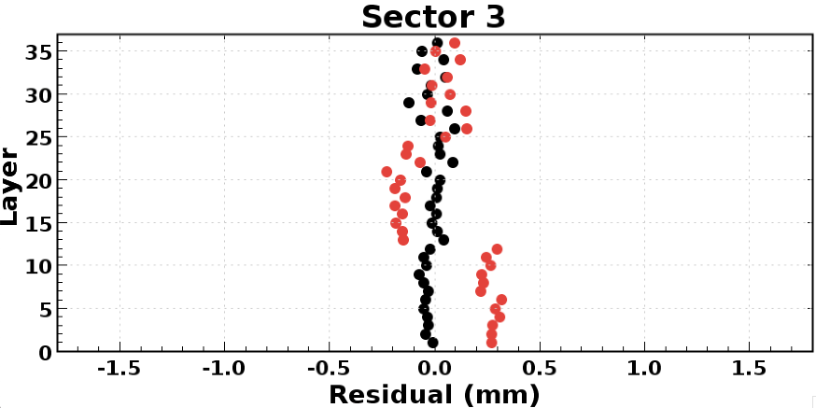
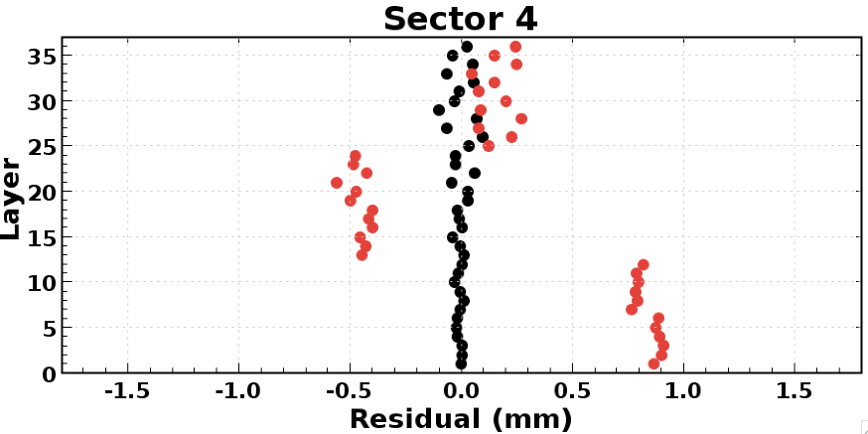
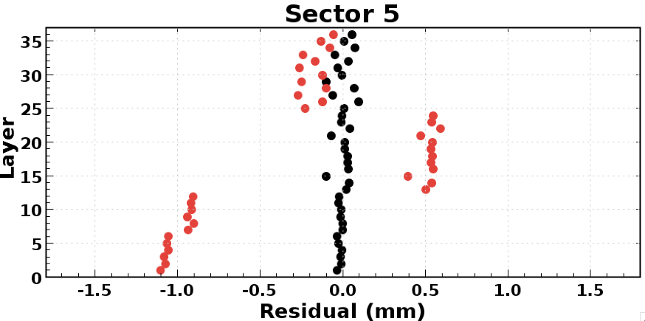
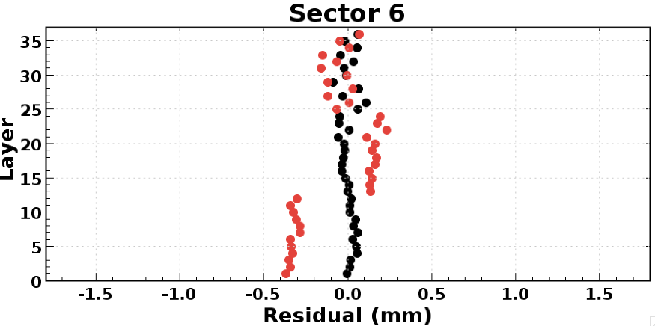
run 5297, Fall Alignment Residuals
Chambers aligned to < 50 μm on average
aligned to < 100 μm in all angular bins
BEFORE
AFTER
Mean RMS: 47 μm
Mean RMS: 41 μm
Mean RMS: 48 μm
Mean RMS: 39 μm
Mean RMS: 44 μm
Mean RMS: 44 μm

Slide 12
Fall Alignment Numbers
Rotations less than 1 mrad
Shifts of a few mm

Slide 13
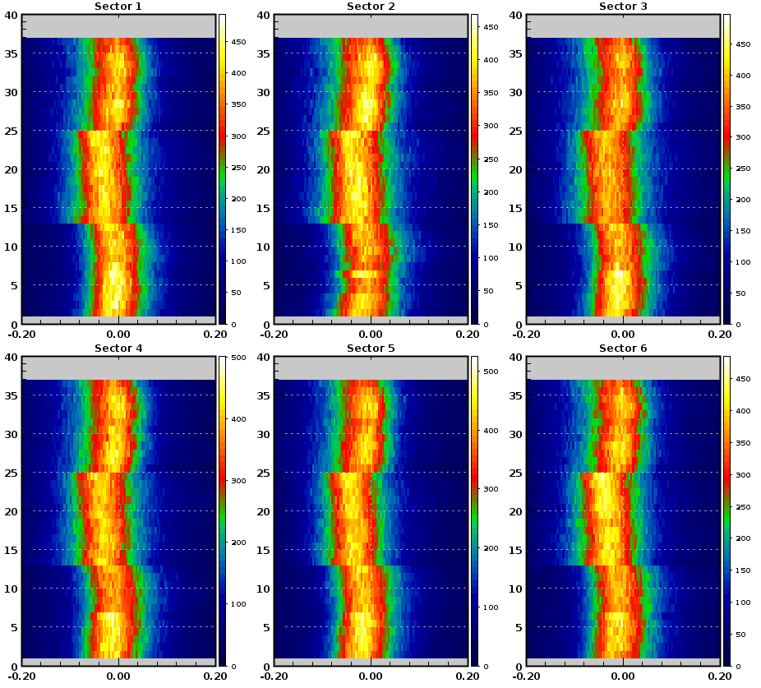
New, improved Kalman Fitter
approx. equal residuals for R1, R2, R3
(R3 previously was pulling fits)
But, this means that the alignment solution will change
Probably, R3 misalignment will increase and R1, R2 decrease
All alignment procedures are in place
→ New, improved alignment soon
Layer (1 – 36)
Fit Residual
Run 5038
- cooked with new code

Slide 14
Drift Chamber Alignment: Status
Project | Method | Sub-Projects
Re-align Drift Chambers improve tracking ( original misplacements of ~2mm) | Fit residual mean offset patterns from “straight-track” data to a weighted sum of pre-calculated offset patterns caused by “unit displacements” of chambers | produce “unit distortion” tables of residual mean offsets vs. layer fit weighted sum to data calibrate ‘mini-stagger’ concentrate on small angles
expect ‘re-alignments’ of > 100 μm
expect RMS of residual means < 65 μm in all angular bins
will concentrate on small-angle range

Slide 15
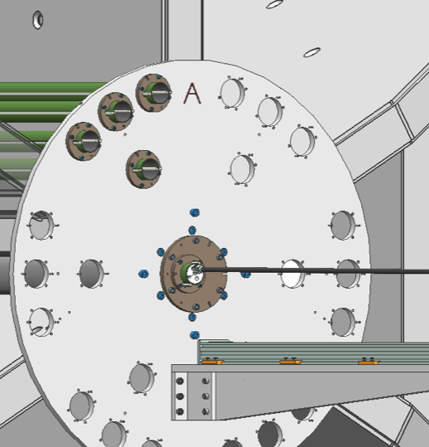
Location Of Measurement Points*
Inner Holes (A): 30 cm From the Center
Outer Holes (B, C, and D): 46.5 cm From the Center
* Joseph Newton’s slides from Summer ‘18 Collaboration Meeting

Slide 16
Sector 1 Hole B
Sector 1 Hole A
Black: Asymmetric (Current) Map
Red: Symmetric Map
Green: Old Map
agreement good at 46.5 cm
Sector 1 Hole D
Sector 1 Hole C
Notes:
Radius Curvature Change 1.5 mm

Slide 17
Sector 1 Hole B
Sector 1 Hole A
New (symmetric) map → ~ 0.7% high
Black: Asymmetric (Current) Map
Red: Symmetric Map
Green: Old Map
Old map → ~ 3% low
Sector-dependent map → ~ 0.2 – 0.7% high
Sector 1 Hole D
Sector 1 Hole C
Notes:
Radius Curvature Change 1.5 mm

Slide 18

Present work
adding an ‘s-wave’ to corner of
coil stack
$$≈4 mm$$

Slide 19
Forward Track Resolution: Status
Project Status | Near-term goal | Who*
Calibrate time → distance now about 300μm(σ) for fit to +/- 0.5mm | 200 μm resolution (fit to +/- 0.5mm) 250 μm (average) ? | TC
Align Drift Chambers now < 100 μm at all angles reconstruction changes → re-align | chambers aligned to <50 μm for small angles ? | TH
Model torus B-field → now ~ 0.5 % accurate | → B-field accuracy of 0.2% ? | JN, Engineers
Credit to Joseph Newton and Timothy Hayward and Taya Chetry for great work

