Slide 1
RadCon Overview for LERF Isotope Test
Keith Welch
RadCon Manager
September 26, 2019

Slide 2
Outline
Controls for prompt radiation
Shielding
Monitoring
Controls for residual dose rates
General requirements
Target access/retrieval
Estimated dose rates
Packaging and Shipping
Transfer/packaging
Package dose rates and classification

Slide 3
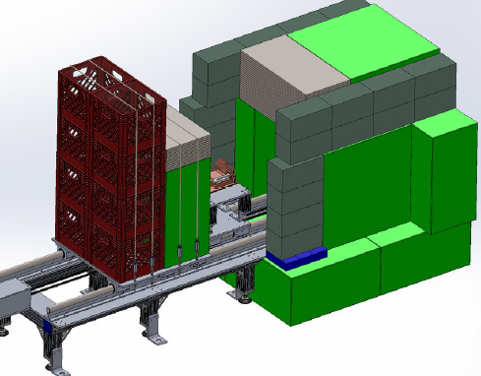
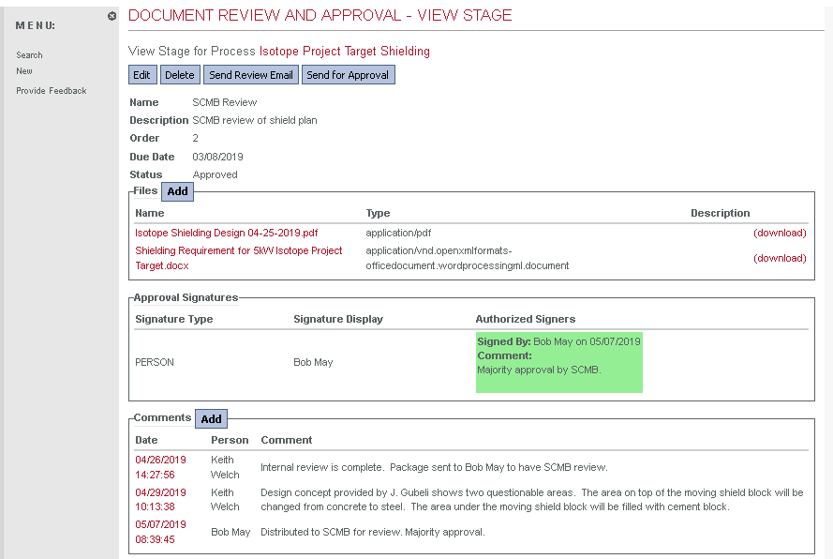
Controls for Prompt Radiation
Shielding
Shield design goals
Maintain dose rates outside structural shielding at levels below RCA (0.05 mrem/h)
Minimize damage/activation to components in vault
Allow for relatively quick access to target
Shielding designated “medium” project
Reviewed by RadCon/SCMB
Shield is not Credited Control

Slide 4
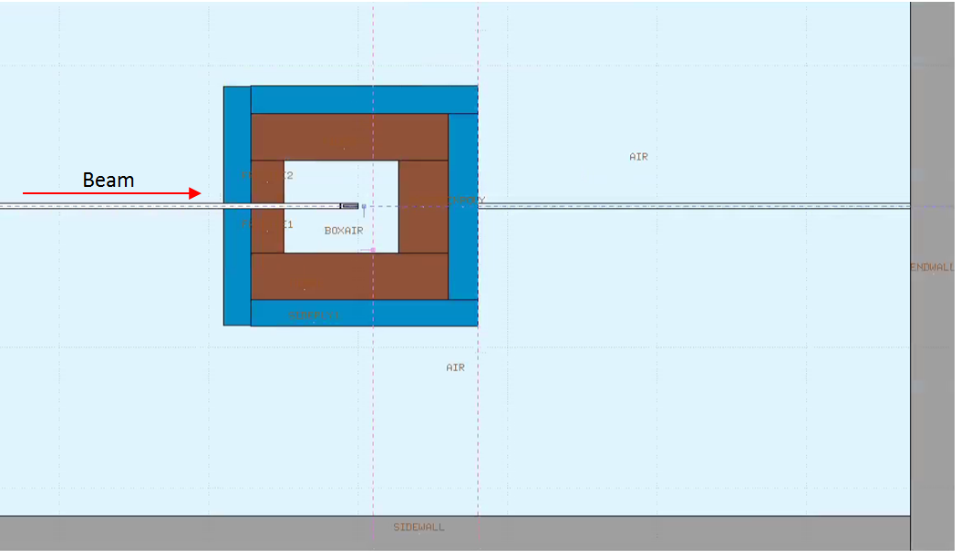
Controls for Prompt Radiation
Shielding
Shielding modeled with FLUKA
Simplified geometry with 13” steel and 8” water
Dimensionally accurate with respect to gallery above

Slide 5
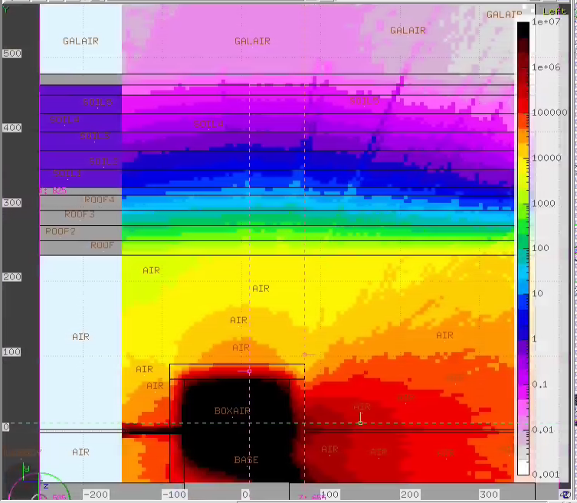
Controls for Prompt Radiation
Shielding
Dose rate at 5 kW 40 MeV
Gallery dose rate: ~ 0.02 mrem/h
Agrees well with semi-empirical calculations
Dose rate in vault at 1 meter:
~ 250 rem/h
Good for several hundred hours operation with negligible impact
Gallery floor
Vault ceiling
Side View

Slide 6
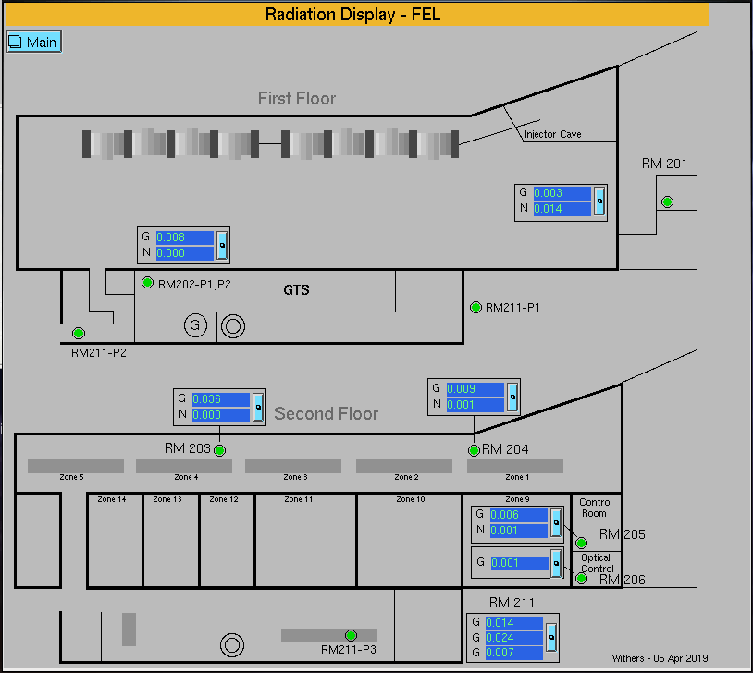
Controls for Prompt Radiation
Monitoring
RF Gallery
LERF CARMs
Part of certified PSS
Probes positioned appropriate for source
Surveys during run
RSAD specifies RCD presence required to commence production run
RF gallery to be conservatively posted as RCA in target region

Slide 7
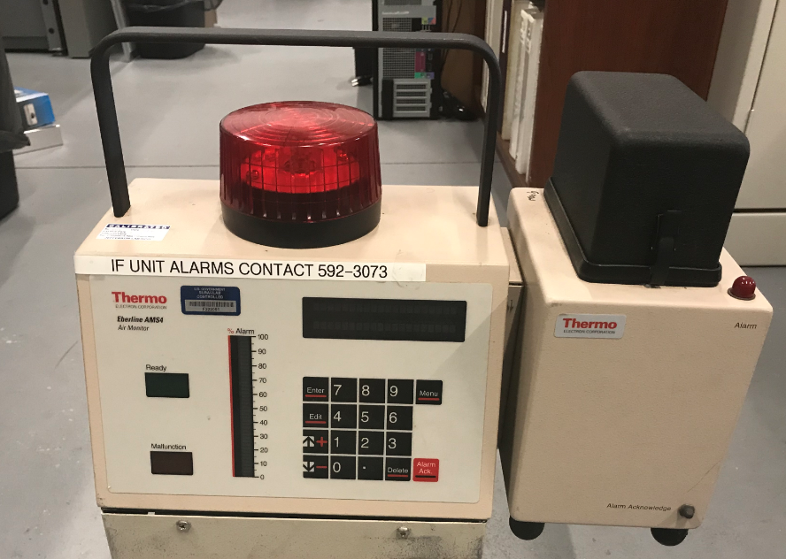
Controls for Prompt Radiation
Monitoring
Air Monitoring
Continuous sampling from vault using AMS-4
Standard monitoring system used in CEBAF
EPICS archiving
RSAD threshold for operations hold point (standard practice)
Significant activity not expected, but measurement will validate

Slide 8
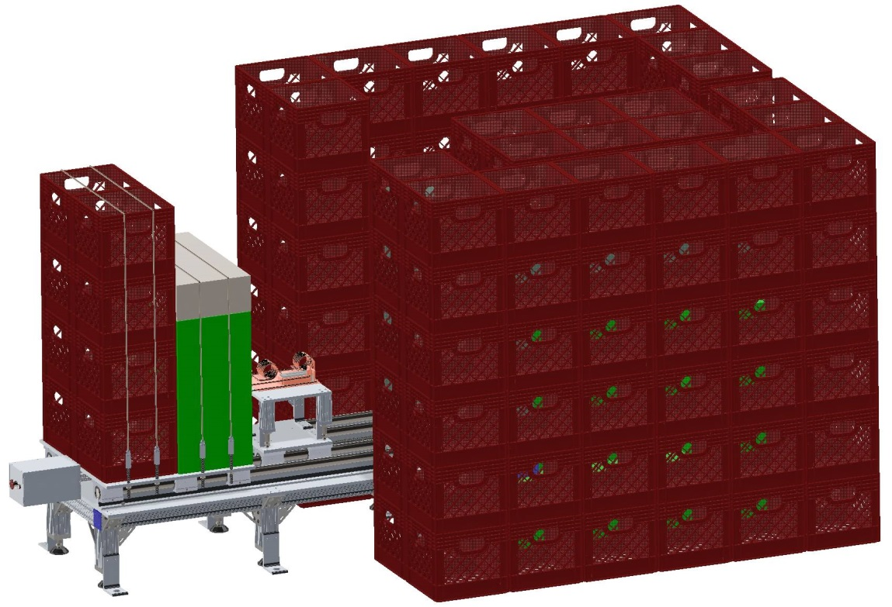
Controls for Residual Radiation
Target Access/Retrieval
Rear shield block retracts to provide access to target
Radiator remains in place upstream within hutch
Extended tool for retrieving target
Moveable shadow shield planned
Extraction procedure to be captured in RWP, rehearsed
Target placed immediately in transport pig, hutch closed
Pig moved to low-background area
Gamma spec performed
Packaging for shipment

Slide 9
Controls for Residual Radiation
General Requirements
RWP will guide all activities
All entries to the vault after the run has started require RCT survey/escort
At least 8 hours decay required prior to opening shield
Radiation levels outside shield expected < 2 mrem/h after decay
All surfaces internal to shield will be considered contaminated
All steps for target removal, transfer, counting and packaging to be rehearsed in full detail, procedure included in RWP

Slide 10
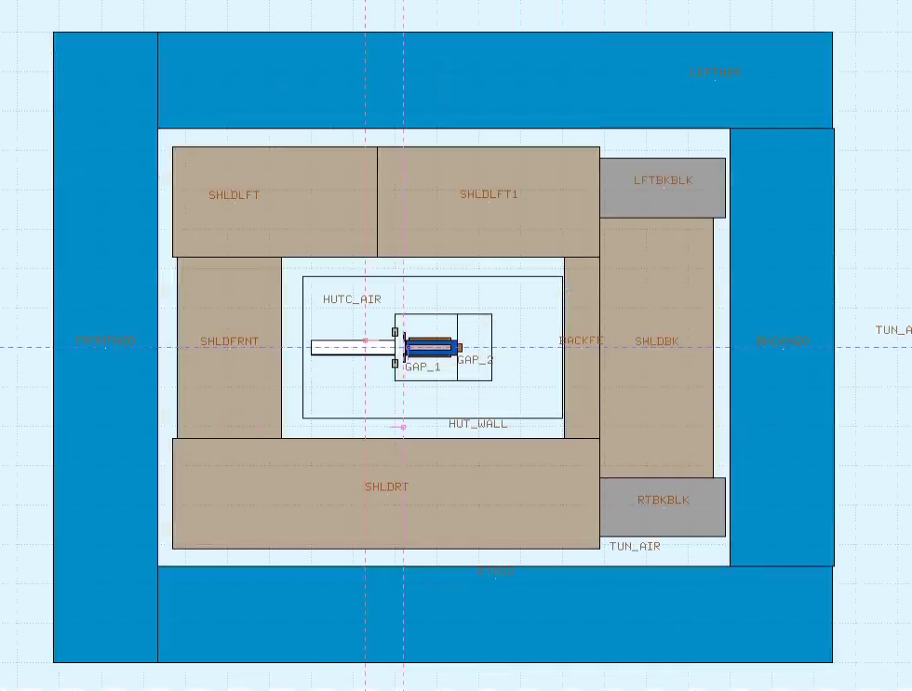
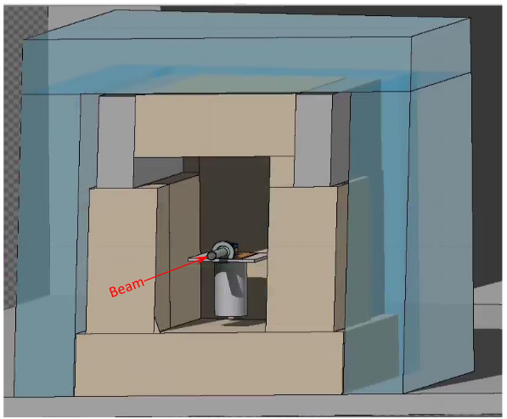
Controls for Residual Radiation
Estimating Residual Dose Rates
Beam
FLUKA model used for assessing activation and residual dose rate

Slide 11
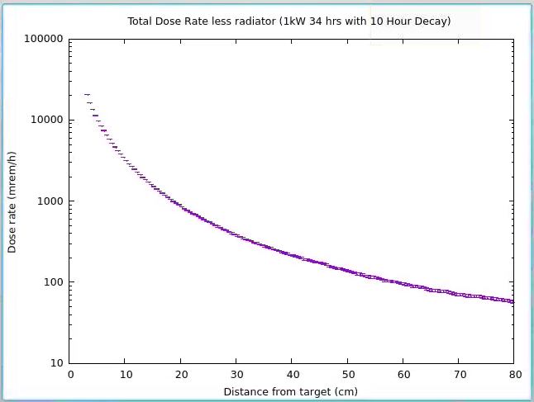
Controls for Residual Radiation
Estimating Residual Dose Rates
Beam
30 cm dose rate at target ~ 400 mrem/h
Actual work area dose rate ~ 100 mrem/h

Slide 12
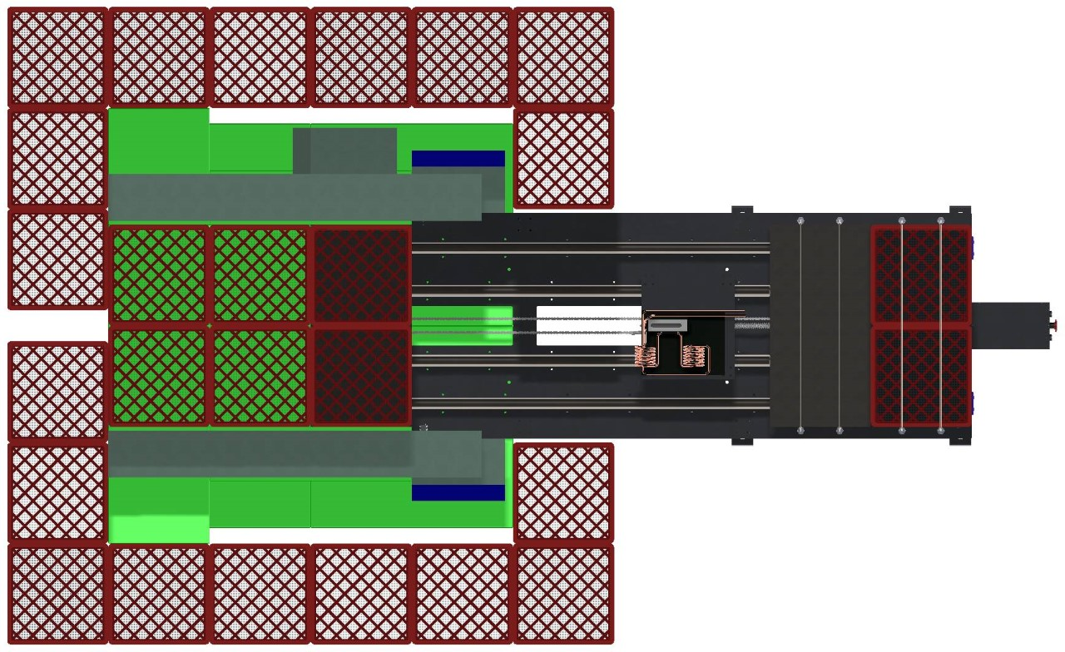
Controls for Residual Radiation
ALARA practices for target extraction
RWP development underway
Detailed rehearsals to occur when installation complete
Preliminary estimate for dose during removal < 50 person-mrem
Portable shadow shield
Pig on cart
Shield design gives clear access to target
Target removal should take less than 2 minutes
Shadow shield to be evaluated during 1 kW run
Target

Slide 13
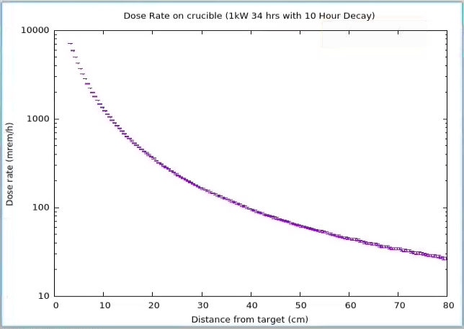
Packaging and Shipping
Dose rate from target/crucible
Once removed from hutch, crucible has 30 cm dose rate ~ 180 mrem/h
Crucible moved to southwest vault for counting/packaging
Counting configuration for unshielded count will require about 3 meter distance
Canberra ISOCS system used for analysis
Contamination control protocols invoked for all handling of crucible
May be able to count in pig

Slide 14
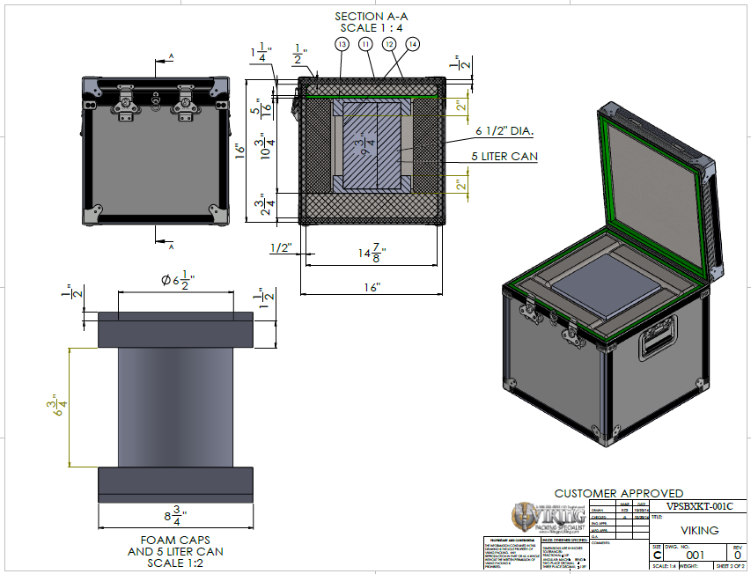
Packaging and Shipping
Package Details
DOT Spec 7A Type A
Certified for liquids
Acceptable for quantities expected for 5 kW runs
Loading sequence is video recorded for reference
Will be shipped exclusive use
Excl. use not required for 1 kW, but speeds up delivery
JLab maintains DOT hazardous materials shipping registration
Registered for FedEx Custom Critical

Slide 15
Packaging and Shipping
Activity Estimates and dose rate on package
Nuclide | Quantity (mCi) | DR @ Crucible surf | DR @ Pig surf | DR @ Can surf | DR @ Box surf
Cu 64 | 55 | 4400 | 165 | 75 | 16
Cu 67 | 10 | 250 | 0.05 | - | -
Ga 67 | 350 | 17500 | 70 | 25 | 6
Ga 72 | 4 | 4000 | 680 | 240 | 50
Zn 69m | 4 | 520 | 15 | 6 | 1.5
Totals | 423 | 26670 | 930 | 346 | 75
Values above for 5 kW exposure and 24-hour decay
Dose rate expected to be no more than about half the values above for 1 kW and 10 hour decay
“Transport Index” expected ~1-2
Requires “Yellow III” label
Exclusive use not required
Box
Crucible
Pig
Ga-72 dose rate per mCi

Slide 16
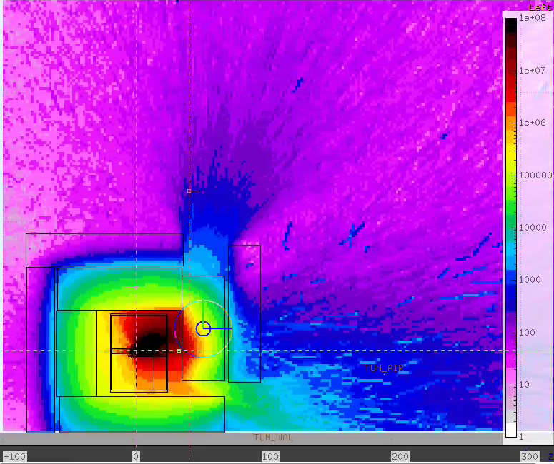
Extra Slides

Slide 17
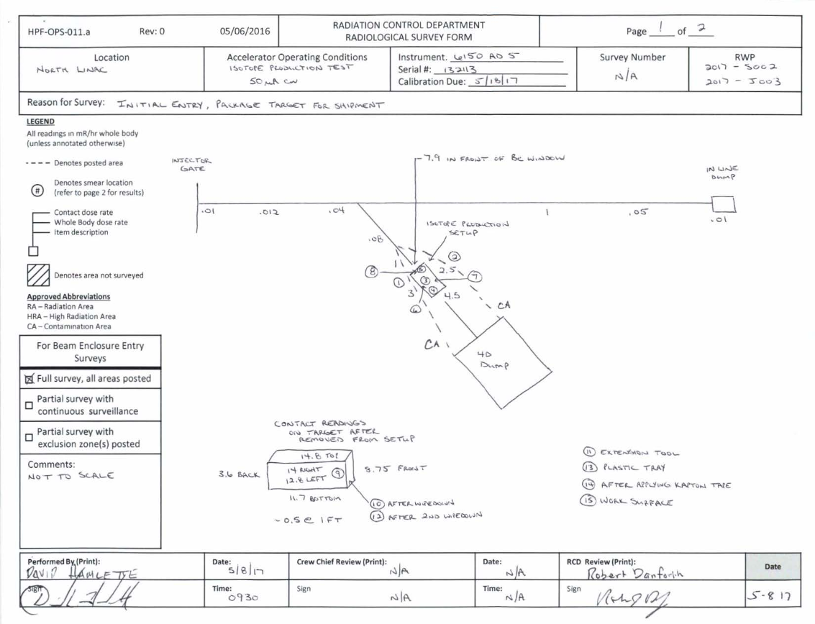
Extra Slides
2017 irradiation post-run survey

Slide 18
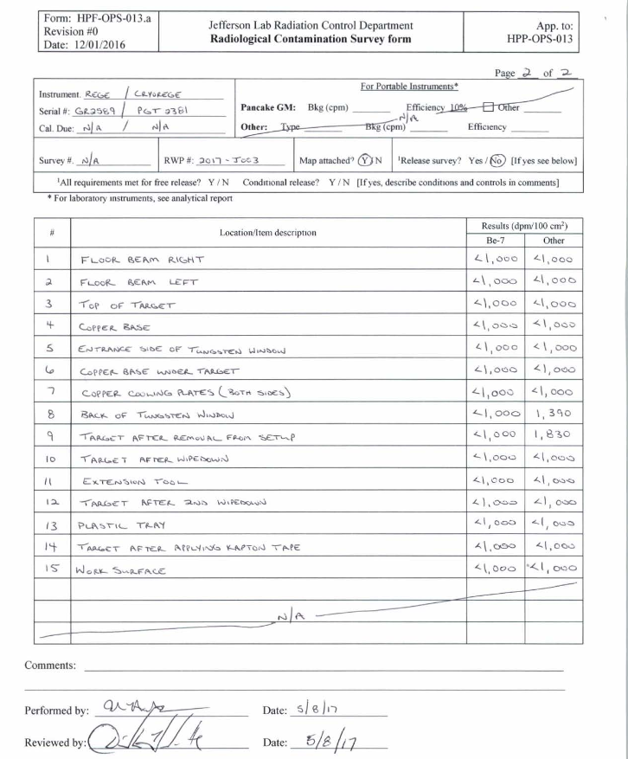
Extra Slides
2017 irradiation post-run survey

