Slide 1
Isotope Readiness Review
Run Plans
Stephen Benson
For the Isotope Team

Slide 2
Outline
Electron beam requirements
Status of LERF Accelerator
Remaining commissioning of beam to the 1G dump
Target Commissioning
Accelerator run plan for target irradiation

Slide 3
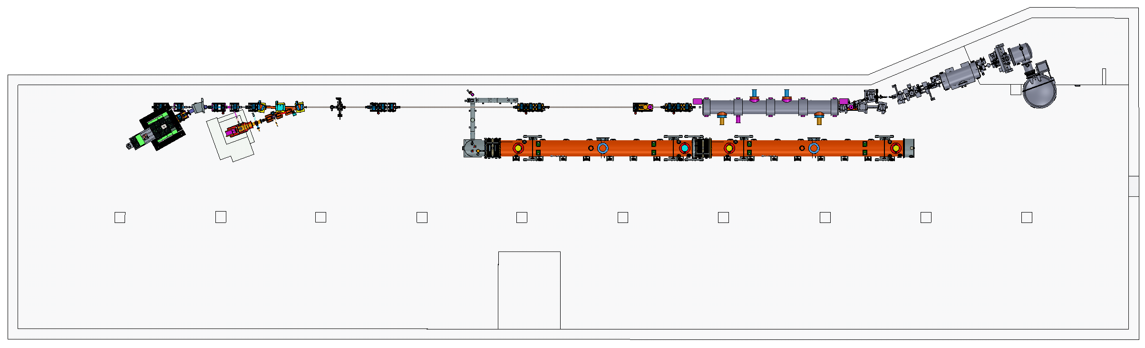
LERF 1F & 2F MODIFICATIONS
ADDED THREE SETS OF QUAD TRIPLETS
ADDED DIPOLE AND 1X LINE
ADDED VIEWER & “HARP” CHAMBER
ADDED DP AND FAST VALVE GIRDER
Notes:
Blue Interior Page Design 1

Slide 4
Electron Beam Requirements
Energy 25 MeV
Beam current < 40 µA
Spot size > 1 mm rms
Energy spread < 0.1% rms (ηδ∼1mm)
Bunch repetition rate 4.678 MHz
Bunch charge 8.6 pC

Slide 5
Electron Beam Match

Slide 6
LERF Accelerator Status
As of July 17, delivered clean pulsed beam to the 1G dump.
  Energy is 12 MeV with two cavities powered in zone 2
  Cavities phased. Beam well matched in the beam transport
  No beam losses on beam loss monitors with HV at max.
  Did not have time to turn on and calibrate cavities 1,2, and 6.
  Cavities 3, 4, and 5 have frozen tuners.
  MPS for CW operation had not yet been certified so we were restricted to pulsed beam.
  Zone 2 commissioning indicates that 25 MeV beam should be possible with available gradient in cavities 1,2,6, 7, and 8.
Remaining work to commission linac
  Certify MPS for CW operation with beam.
  Run 40 µA CW beam to 1G dump.
  Calibrate gradients on zone 2 cavities.

Slide 7
1X Line Commissioning
Replace target crucible with aluminum block and replace tungsten radiator with viewer flag with fiducials.
Install camera looking at the target flag.
Run beam to 1G dump at 12 MeV and calibrate injector BCM for 40 µA beam.
Turn on and transient phase cavities 1,2, and 6 and set to drive highs.
Set quads to 25 MeV settings.
Turn off the 1G dump magnet and thread beam to the 1X viewer.
Phase zone 2 cavities and match to the 1X viewer. Minimize energy spread at 1X.
Center in 2F and 1X quads and on the target viewer. Record BPM positions.
Verify that beam loss is negligible (<<1 µA) and ramp up CW beam to 40 µA.
AllSave configuration.

Slide 8
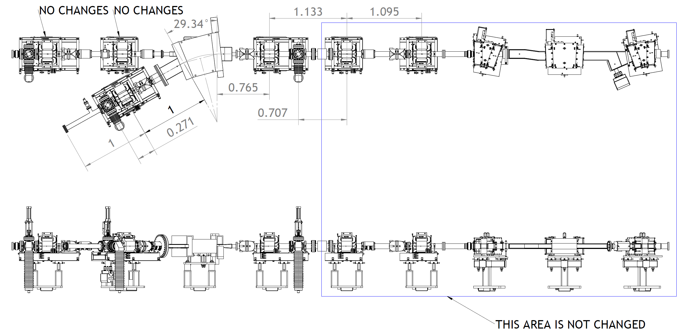
2F & 1X REGION
DQ DIPOLE
QUAD & YAG VIEWER GIRDER
QUAD, YAG VIEWER, BPM & CORRECTOR PAIR GIRDER
Be WINDOW
Notes:
Blue Interior Page Design 1

Slide 9
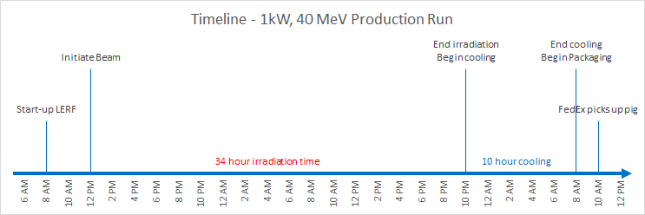
Target Irradiation
Install crucible and tungsten radiator.
Record all vacuums and temperatures.
Restore commissioning setup and put all magnets on hysteresis.
Turn on 40 µA pulsed beam to the 1X line and verify that zone 2 is phase and the beam trajectory is recovered. Verify that transport is lossless.
Set up strip charts of vacuum and temperatures near the target.
Turn on CW beam. Run timeline as follows:

Slide 10
Post Irradiation
Once irradiation is done, turn off the electron beam and continue to monitor vacuum and temperatures.
RadCon will monitor the radiation levels during cooldown. Vault must be in at least Controlled Access.
RadCon to supervise transfer of crucible to pig and packing of the shipping container.

Slide 11
Questions?

