Slide 1
Isotope Readiness Review Lessons Learned from Previous Test
Andrew Hutton
For the Isotope Team

Slide 2
Introduction
There was an opportunity in May 2017 to conduct a test to produce ⁶⁷Cu using a gallium target in the CEBAF Injector
The successful set up of the CEBAF Injector at 4K made the test possible
Beam line modifications were modest , and new diagnostics (BPM and Harp) in front of the isotope target were calibrated against existing diagnostics in the beam line
The existing diagnostics were downstream of the target which intercepted all of the beam
Goals of the Run
The run had two goals
Produce ~ 0.5 mCi of Cu-67 using 18.65 MeV, 50 μA (~1kW) electron beam irradiating 100 g of gallium encased in a Boron Nitride crucible
Chemically separate Cu-67 from the gallium target at VCU
Two implied and essential conditions were to ensure personnel safety and machine safety in the CEBAF injector where this test was done

Slide 3
Experiment Layout

Slide 4
Results of the Experiment
Produced ~70 μCuries of ⁶⁷Cu
No chemical separation could be done at VCU
The problems that were encountered can be divided into three areas:
Irradiation
Transfer to VCU
Opening the transport container at VCU
Problems with the irradiation were the subject of an internal review
Our responses are presented here and in the background documentation
Problems with the transfer were the subject of a DOE ORPS Report and a Jefferson Lab Lessons Learned report
We have arranged a FedEx point-to-point transfer, which avoids the possibility of the same problem re-occurring
Problems with opening the transport container at VCU
We have carried out two dry runs in close collaboration with the VCU RSO to practice all of the steps

Slide 5
Lessons Learned from Irradiation
The two implied and essential conditions to ensure personnel safety and machine safety were successful with the exception that two pieces of equipment in that area were damaged, which were replaced
There was a subsequent “Lessons Learned” document produced focusing on seven different categories
Planning
Review Process
Risk Assessment
Skills mix (technical, procedural, operational, . . )
Safety
Documentation
Communications
All the recommendations were put into an Excel Spreadsheet with responses and placed in the Background Documents file
The Lessons Learned document is also in the Background Documents file
The following pages provide an overview of the responses

Slide 6
Planning
Planning started with a detailed GanttProject Gantt Chart of tasks to accomplish
GanttProject is open source and can be imported into Microsoft Project
Task list contained 51 entries, including 20 Milestones
The Milestones were transmitted to DOE in November 2018, and we are being tracked against them
Meetings were held semi-regularly in the LERF Breakroom to discuss detailed schedules
Comments:
Planning was difficult given the low priority of the Isotope Project
This is the first time an ERR has been held for a “small” experiment
Required rewriting EHS&Q Manual Chapter 3130 which defines the process to be followed
We are currently ~1-2 months behind schedule
Isotope Kick-Off Meeting August 3, 2018

Slide 7
Isotope Project Plan

Slide 8
Review Process
In August 2018, I proposed the following review process
I suggest two different kinds of Review; Detailed Reviews and the Beam Authorization Review (now called the Experiment Readiness Review ERR)
The Detailed Reviews should cover the new technologies in a project. The TRP (Technical Review Process) Chair (now ERR Chair) and the Project PI should identify these areas early on in the project
For the Isotope Project, I would propose the target design, including the simulations and instrumentation; and the radiation shielding, including target removal and handling
For the Detailed Reviews, one or (not more than) two reviewers should spend time going over the details of the solutions proposed; no presentations but an in-depth evaluation
The reviewers should be members of the ERR team
The ERR itself should cover all of the aspects of the project and a positive review would result in authorization to start installation of the experiment
Beam would be authorized by the Director of Operations when the ERR Chair certifies that the installation has met criteria defined in the ERR
If the criteria cannot be met, a second review would be needed
This is the Review Process we have been following
Copied from email to Andrei Seryi, Will Oren, Arne Freyberger and Mike Spata on August 6, 2018
Items in blue were edited for enhanced clarity

Slide 9
Review Process (cont.)
March 8, 2019 and April 25, 2019 Tim Whitlatch reviewed the target and shielding design
Here are Tim’s comments (items in red were colored by Tim)
Charge: Review the engineering assumptions and calculations for the Isotope Shielding enclosure, including the mechanism for withdrawing and inserting the target and the radiator.
The Thompson rail system provides a good base for the movement of the target and movable shielding. We discussed the alignment of the 4 rails and accuracy needed. Joe will verify the requirements to see if he can reduce to using 1 set of rails instead of 2 sets. The 80/20 supports for the target and movable shielding should be adequate. Joe will look at the lateral stability using a 10% lateral load and add stiffeners where required. It looks like you are staying with the 2 sets of rails which is ok. Just ensure alignment is good. Looks like adequate lateral stability has been added.
The overall support structure (1/2" steel plate) was analyzed using Solidworks FEA module. The entire static shielding weighs 7500 lbs. All the stresses and deflections are very low with large safety factors. Joe will perform some simple hand calculations to corroborate the FEA results. Joe will come up with a method of securing the shielding (straps or plates). The 1/2" steel plate is now gone from the design. The 1/2" aluminum plate spans the pillow block bushings. Hand calculations performed and straps added. You show the deflection of the aluminum plate is .24 inches. This is based on the total load at the center which is very conservative. If it actually deflected 1/4 inch there may be problems. Since the concrete blocks span the rails this will be no problem.
The chain drive system and crank handle appears adequate as the coefficient of friction for the Thompson rails system is very low. 3000 lb total weight with a COF of .004 yields 12 lbs. The chain is rated for 195 lbs. Stops will be put in place to ensure the target is in correct position when installed. Details of the attachment to the chain are to be worked out. The chosen motor provides 200 in-lb torque. The stated require torque with this low COF is 29.7 in-lbs. This is based on a 1.8 inch diam, gear for the chain. Looks like the Details have been worked out.
The neutron shielding consists of water jugs placed in stack-able crates. This appears to be adequate for system. Discussions of using poly beads in containers was discussed and will be looked at. Supports for the bags would be required. Joe is sticking with the water bottles and RADCON ok with it.
Cable managers of some sort will be added for instrumentation (temp sensors) wiring. Joe is also looking at using an insertable camera to look at things remotely. Not sure if this was implemented. Not subject to my review
The installation work will be done by the Engineering Installation group which has much experience with this sort of thing. They will use a forklift to place the shielding blocks. Ok
It is assumed that the shielding requirements have been ordained by RadCon. Yes
The cooling of the tungsten radiator is verified elsewhere. Ok
“From my standpoint, the design assumptions and calculations are good”

Slide 10
Other Reviews
Tom Renzo reviewed the original design of the hutch which had two SEG blocks vertically on top of each other and recommended strapping for earthquake restraint
Joe Gubeli modified the design to only have a single layer of SEG blocks and this did not require strapping
Matt Marchlik reviewed the pressure vessel requirements of the target cooling system and recommended changing the brass fittings for stainless steel
This change was incorporated
The RadCon Group reviewed the radiation calculations carried out by Keith Welch
There were no recommendations
We had two target brainstorming sessions: March 18, 2019 and May 31, 2018
Dave Meekins participated in both sessions providing expert input on thermal management

Slide 11
Risk Assessment
Risks are formally addressed in these documents:
Experiment Safety Assessment Document, ESAD
Radiation Safety Assessment Document, RSAD
Risks have been mitigated during the design
In some cases, the procedures have been tested, e.g. we have carried out two mock transfers of the crucible to VCU to verify all of the details
Keith Welch will address this in his presentation
Calculations of areas which are not standard at Jefferson Lab have received independent checks
In my opinion, the major risk is missed deadlines due to the low priority assigned to the Isotope Project
I do not know how to mitigate this

Slide 12
Skills Mix
An agreement was reached with Arne that the resuscitation of LERF would be the responsibility of the Operations Department
Since the LCLS II cryogenic line was installed at the location of the second triplet, this required moving this triplet and installing another
This work was overseen by Anthony DiPette following an optics deck from Chris Tennant and a detailed mechanical engineering layout by Joe Gubeli
I would have preferred that the Mechanical Engineering Department take ownership of the layout
The electrical hookup was fully owned by the Electrical Engineering Department
Software checkout was fully owned by the Accelerator Controls Group
A dipole was required in the target line; the IR Demo had 8 suitable dipoles but they had been improperly stored so the coils had rotted through. The magnet measurement group found two coils that worked and rebuilt one dipole
Excellent work, unfortunate that it was necessary!
The radiation calculations were handled by Keith Welch, who also did the RSAD
Keith also brought other RadCon staff up to speed to ensure that the knowledge was spread
The target handling and the movable shielding hutch were engineered, designed, parts were procured, installed and tested personally by Joe Gubeli
Unfortunately, no-one from the Mechanical Engineering Department was involved in the design, a lost opportunity

Slide 13
Skills Mix (cont.)
The target was designed and built by Kevin Jordan
The radiation calculations were originally done by George Kharashvili and were repeated by Keith Welch, and also by Geno Santisteven and Robert Bentley at NMT (under George’s supervision)
Geno and Robert are also simulating the cooling of the crucible at higher powers
The ESAD was written by Steve Benson
Operators were involved in all the resuscitation runs and will be heavily involved in the target irradiations
Example; during the resuscitation run on June 27, 2019, Mike McCaughan brought pulsed beam to the dump on Swing Shift without the Isotope Team beam experts

Slide 14
Safety
Radiation Safety
The hutch shielding has been designed to reduce radiation to levels that will not affect instrumentation in the LERF vault
This is more stringent than is required at the ANL Isotope Irradiation Facility, which members of the Isotope Team visited to learn about their isotope program
The radiator will remain in place inside the hutch until the radiation levels are sufficiently low
The target assembly will be retracted with the rear wall of the hutch, which will provide shielding for the person who will remove the crucible
The crucible will be removed using long-handled tongs and immediately placed in the “pig”
Once the lid is on the “pig” the radiation levels are low enough to allow handling
The hutch will then be closed up and the target raft will not be accessed again before the radiation levels are sufficiently low
Personnel Safety
The PSS in the LERF will undergo the standard twice-yearly audit
The PSS access controls are in the MCC and operated by the ARM
Machine Protection System
The MPS has been reconfigured to match the present machine layout
The protection is the same as CEBAF and the previous FEL

Slide 15
Documentation
Isotope_Production_at_Jefferson_Lab_Proposal.docx | Original Proposal with details on JLab and partner activities | 0
Initial Packet for DOE | Initial Packet with deliverables and timelines | 0
FY19Q1 Quarterly Report | FY19Q1 Quarterly Report to the DOE | 0
FY19Q2 Quarterly Report | FY19Q2 Quarterly Report to the DOE | 0
FY19Q3 Quarterly Report | FY19Q3 Quarterly Report to the DOE | 0
Tech Note TN-18-050 | Technical Note describing the Beam Optics of the 1F Region of LERF | 0
Isotope_Beamline_Commissioning.docx | Isotope beamline commissioning | 0, 1
Isotope_Beamline_Run_plan.docx | Isotope Beamline run plan | 1
ERG | Isotope Emergency Response Guidelines | 1, 5
Layout Coordinates 1F | Layout Coordinates of the 1F Line | 2
Layout Drawings 1F | Detailed layout drawings of the 1F Region of LERF | 2
Tech Note TN-18-054 | Technical Note describing the Beam Optics of the Isotope Target Beamline of LERF | 2
Design of 2F line | Design of 2F Line
Shielding Design | Shielding design of the Isotope Target as Reviewed by Tim Whitlach | 2
Whitlach Email | Email from Tim Whitlatch documenting review of target shielding | 2
Email Renzo | Email documenting that Tom Renzo Approves Target Shielding Seismic Safety | 2
Isotope Risk Registry | Risk Registry | 2, 3
Isotope RSAD | Isotope Radiation Safety Assessment Document | 2, 5
Dose rates during crucible removal | Dose rates from activated hardware | 2
Lessons Learned Isotope 2017 Run | Lessons learned from 2017 run | 3
Response to lessons learned | Response to lessons Learned | 3
Lessons learned Transport | Notable Event Report for transport mistakes | 3
FedEx quote | Quote from FedEx for point-to-point transfer to VCU | 3
Dose rate estimates for package | Dose Rate estimates for package | 4
Transport Container | Details of the Class A Transport Container | 4
Opening instructions | Opening instructions for transport container | 4
ESAD | Experiment Safety Approval Form | 5
Isotope COO | Isotope Production Conduct of Operations | 6
OSP LT&T | OSP for LT&T of Equipment without an Operational Voltage Verification Unit (VVU) | 7
OSP Energized Power Supplies | OSP for Testing and Adjusting Power Supplies while Energized | 7
OSP Gun HV Conditioning | OSP for LERF Gun High Voltage Conditioning | 7
LOSP Drive Laser | LOSP for the Drive Laser Enclosure | 7
LOSP Laser Alignment | LOSP for Drive Laser Alignment in the LERF Vault | 7
OSP for CPS and HPA Lockout | OSP for Lockout of LERF LINAC CPS and HPA | 7

Slide 16
Communications – Kick-Off Meeting
There was an Isotope Kick-Off Meeting on August 3, 2018: here is the Agenda
Introduction of Scope and Budget – Andrew Hutton (JLab PI) 20 min
Overview of what has been accomplished so far – Hari Areti 10 min
Organizational structure going forward – Andrei Seryi 10 min
Isotope production mechanism – Pavel Degtiarenko 10 min
Target development – Kevin Jordan 10 min
Example of beamline optics – Chris Tennant 10 min
JLab Approval process – Arne Freyberger 10 min
VCU Plans – Jamal Zweit (VCU PI) via Bluejeans 10 min
New Mexico Tech Plans – Doug Wells (NMT PI) via Bluejeans 10 min
The invitees from JLab were:
Andrei Seryi, Mary Logue, Will Oren, Mike Spata, Rusty Sprouse, Mike Aiken, Hari Areti, Steve Benson, Matt Bickley, James Coleman, Pavel Degtiarenko, Anthony DiPette, Harry Fanning, Arne Freyberger, Omar Garza, Joe Grames, Joe Gubeli, Carlos Hernandez-Garcia, Kevin Jordan, George Kharashvili, Andrew Kimber, Jerry Kowal, Geoff Krafft, Tim Michalski, George Neil, Matt Poelker, Steve Suhring, Chris Tennant, Keith Welch, Shukui Zhang

Slide 17
Communication – Target Shielding Meeting
There was a meeting on May 20, 2019 to plan the target shielding installation
Agenda:
Discuss the steps needed to install the shielding for isotope production
Load test a crate
Remove vacuum tube
Mark floor points
Install partial shielding ~ 6 blocks
Install and align base plate and rails
Wire and test motor, switches, lights and estop
Re-install vacuum tube with window
Install & align the radiator and target
Install utilities - dump water, camera tube, light tube,....
Install remaining shielding
. . . . . .
JLab staff invited:
Steve Benson, Anthony DiPette, Chris Gould, Kevin Jordan, Andrew Hutton, Bern Johnson, Gregory Marble, Steve Suhring, Ricky Taylor, Keith Welch, Neil Wilson

Slide 18
Hardware Changes
Two items were affected by radiation
We have designed and built a radiation shielding hutch to avoid deterioration of the diagnostics and damage to beamline equipment
Radiation also damaged the remote air valves that controlled positive pressure on the cooling plates
Result was that cooling was lost and the run was aborted
We have changed the design to use springs to provide the positive pressure

Slide 19
Additional Concern – Ozone Production
The beam goes through a 150 mm gap between the beam exit window and the radiator
Ozone production is a problem
We will use nitrogen blowing into a shroud to mitigate this risk
Nitrogen will be provided via an “air knife”
Nitrogen flow is 22.5 cfm
The nitrogen line is equipped with instrumentation to measure flow and an orifice to limit the maximum nitrogen flow
At this flow level, ODH in the vault will not be a problem

Slide 20
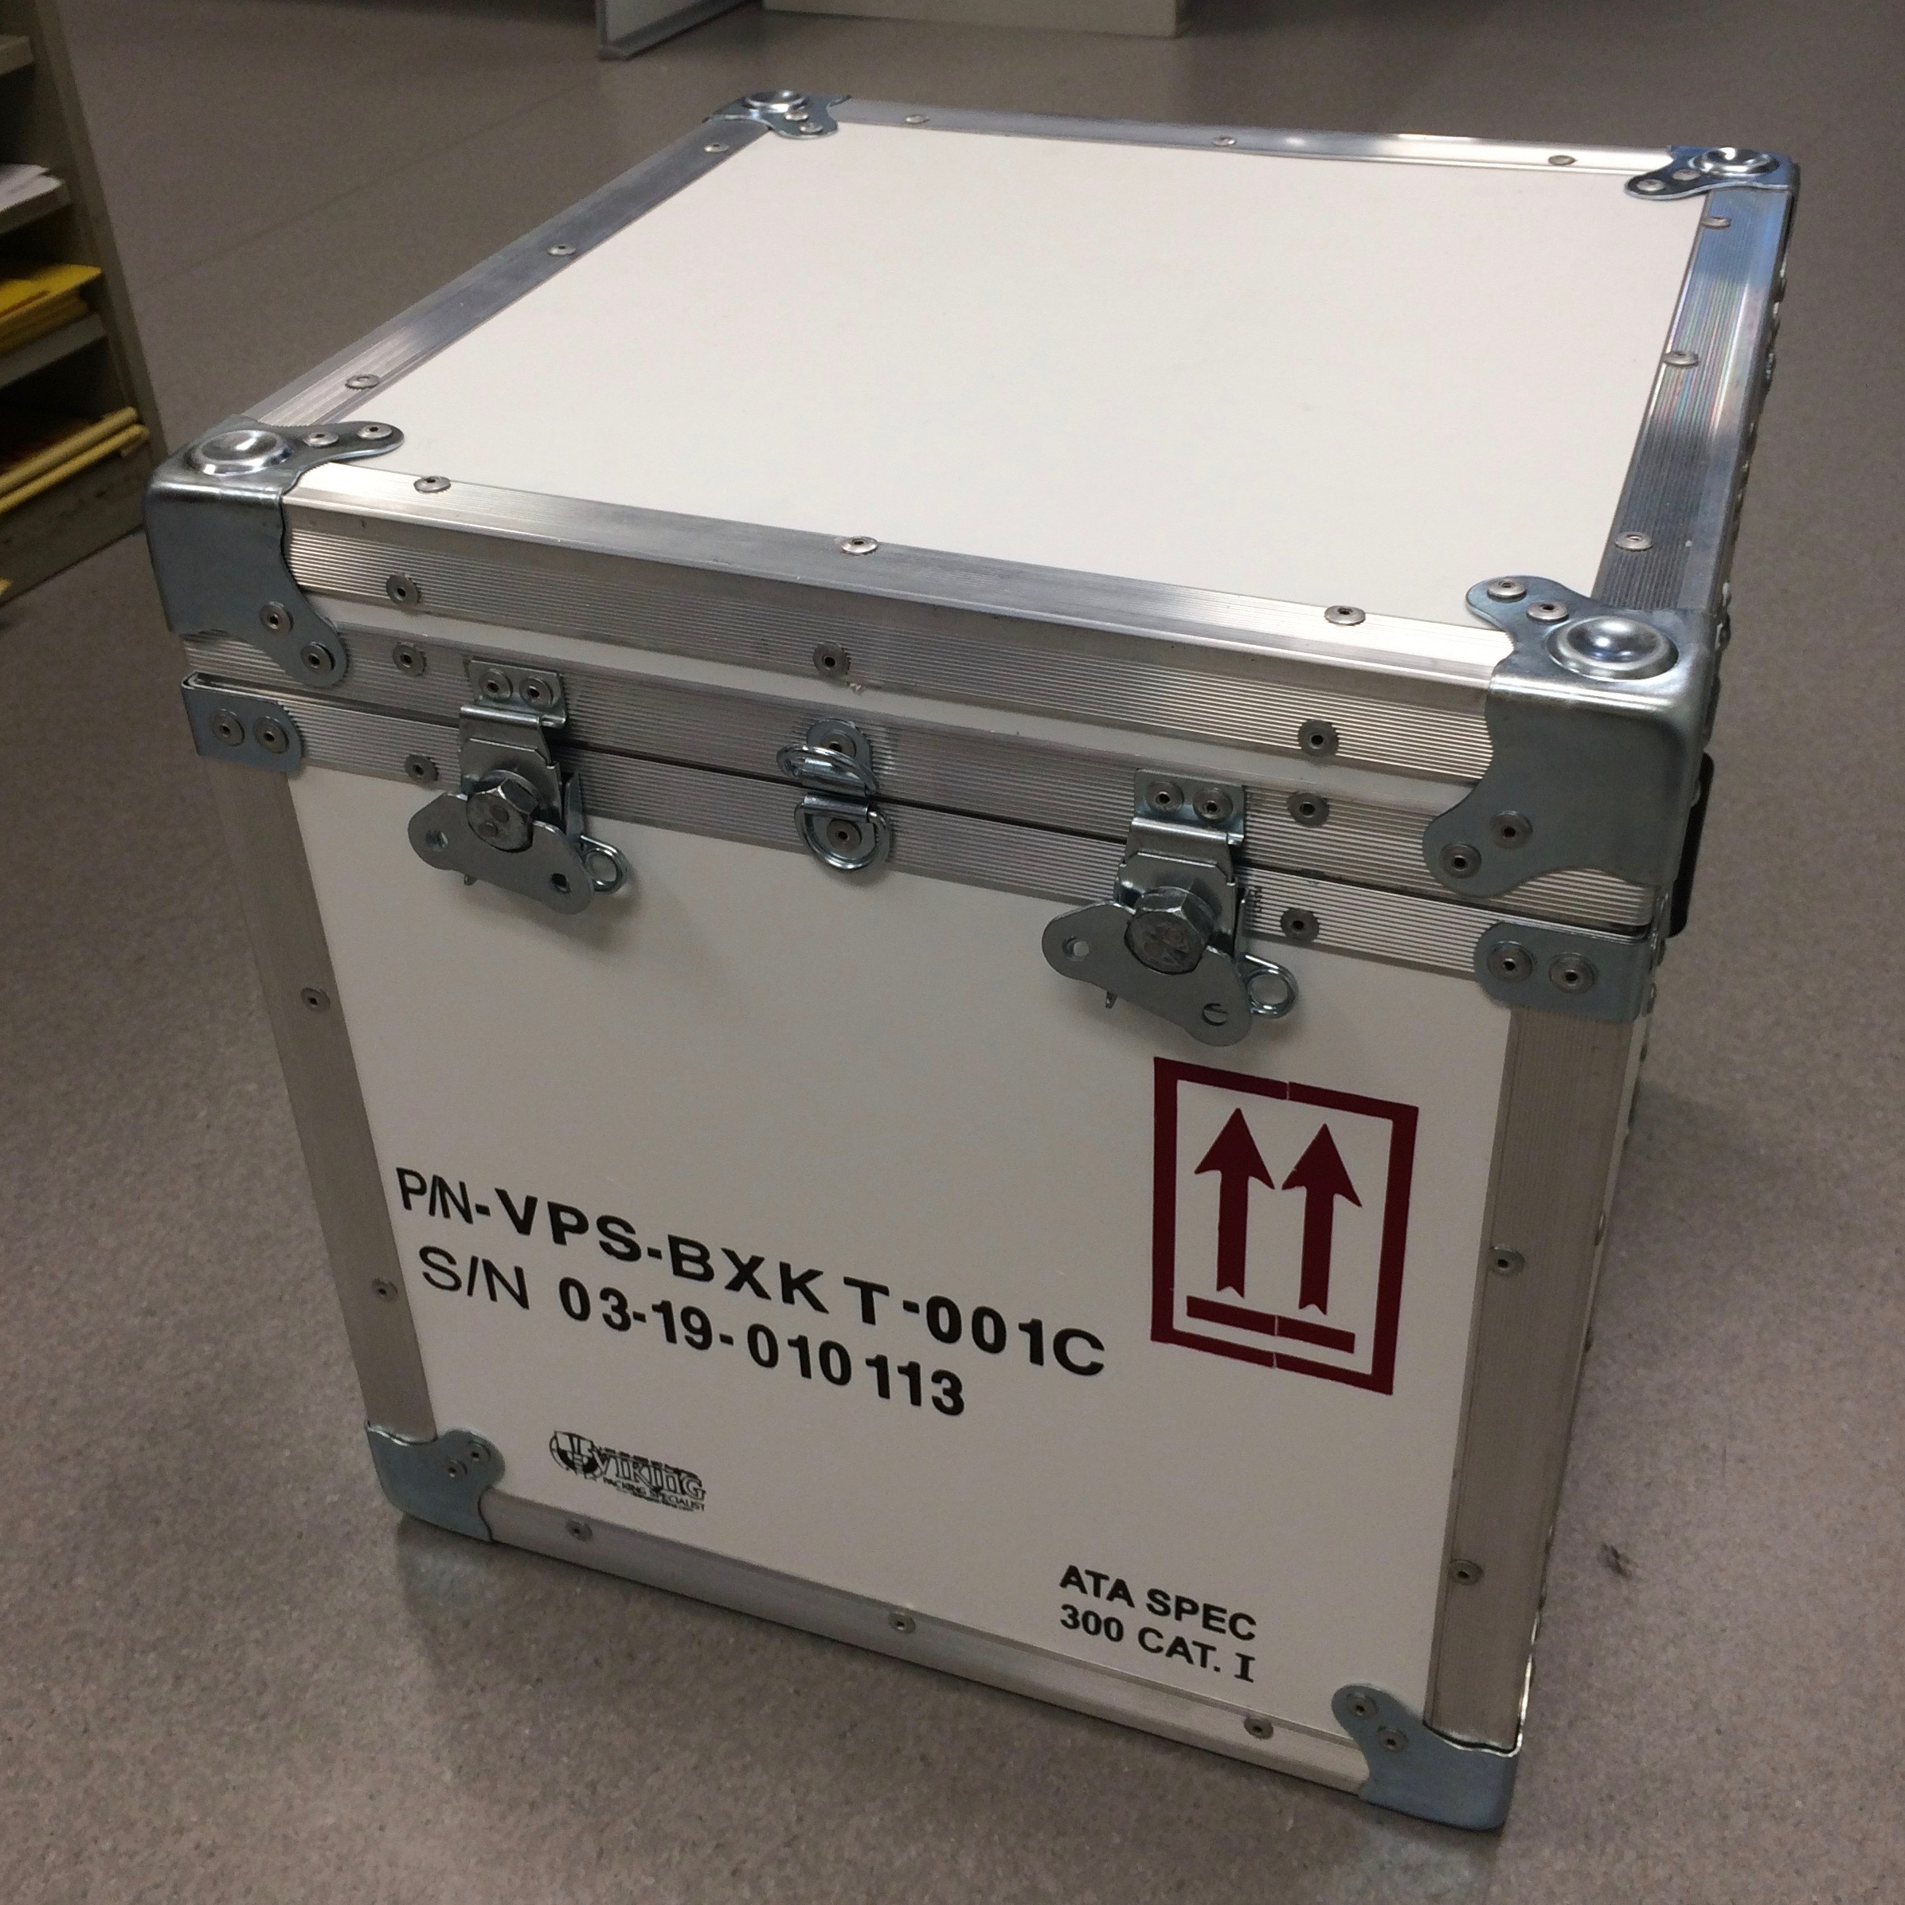
Transport Lessons Learned
We have purchased a commercial Type A Transport Container
We have designed and had made two lead “pigs” that:
Fit in the shipping container
Provide sufficient shielding
The crucible fits inside

Slide 21
Transport Lessons Learned
We have adopted a point-to-point delivery
Pickup will be directly from the EH&S Building at Jefferson Lab
We will follow the FedEx truck for the first transfers to monitor the transport
Dropoff is at the loading dock under Sanger Hall at VCU
VCU RSO has offices adjacent to the loading dock
The VCU RSO, Holly Dean, has been included in the transport dry runs

Slide 22
Problems with Opening the Transport Container at VCU
Instructions for opening the transport container had been provided to VCU
There were no instructions in the container
The person who opened the container had not seen the instructions
Instructions for opening the transport container have been provided to VCU
The VCU RSO and staff have participated in the dry runs
They have made suggestions and comments that have been implemented
Instructions will be placed in the container
The instructions were placed in the container for the dry runs
The most critical element, the pig, has clear markings that it must be delivered to the laboratory of Jamal Zweit and only be opened in a hot cell
We will accompany the initial shipments to ensure that the steps are followed correctly

Slide 23
Risk Registry
Risk | Consequence level | Probability | Unmitigated Risk | Mitigation | Mitigated Risk
Water cooling stops | EL | M | 1 | Flow and temperature measurements on each circuit | N
Thermocouples change calibration due to radiation | EL | M | 1 | Reduntant thermal measurement on two circuits | N
Instrumentation is damaged by radiation | L | M | 2 | Radiation shielding surrounds radiator and target No instrumentation inside the shielding hutch | N
Ozone production in the air gap | L | H | 3 | Nitrogen flowing through the air gap Ozone monitoring on the exit air plenum No entry to the vault during cool down period would allow ozone to be removed from vault | N
Crucible cracks | EL | L | ! | High surface tension of Gallium would keep it contained in the crucible | N
Crucible breaks apart so Gallium can leave the crucible (1) | L | L | 1 | Gallium is kept on copper baseplate by secondary containment | N
Crucible breaks apart so Gallium can leave the crucible (2) | L | L | 1 | Gamma ray absorption by rear push plate would increase temperature of the cooling water Excess temperature is interlocked to prevent LERF beam operation. | N
Crucible is dropped during removal | L | M | 2 | Practice with empty crucible | 1
Transfer to VCU goes wrong | EL | M | 1 | Use point-to-point transfer JLab staff follow truck to ensure correct delivery | N
Transport container is opened incorrectly | L | M | 2 | Carry out dry runs with VCU RSO participation JLab staff will be present for initial deliveries | N

