Slide 1

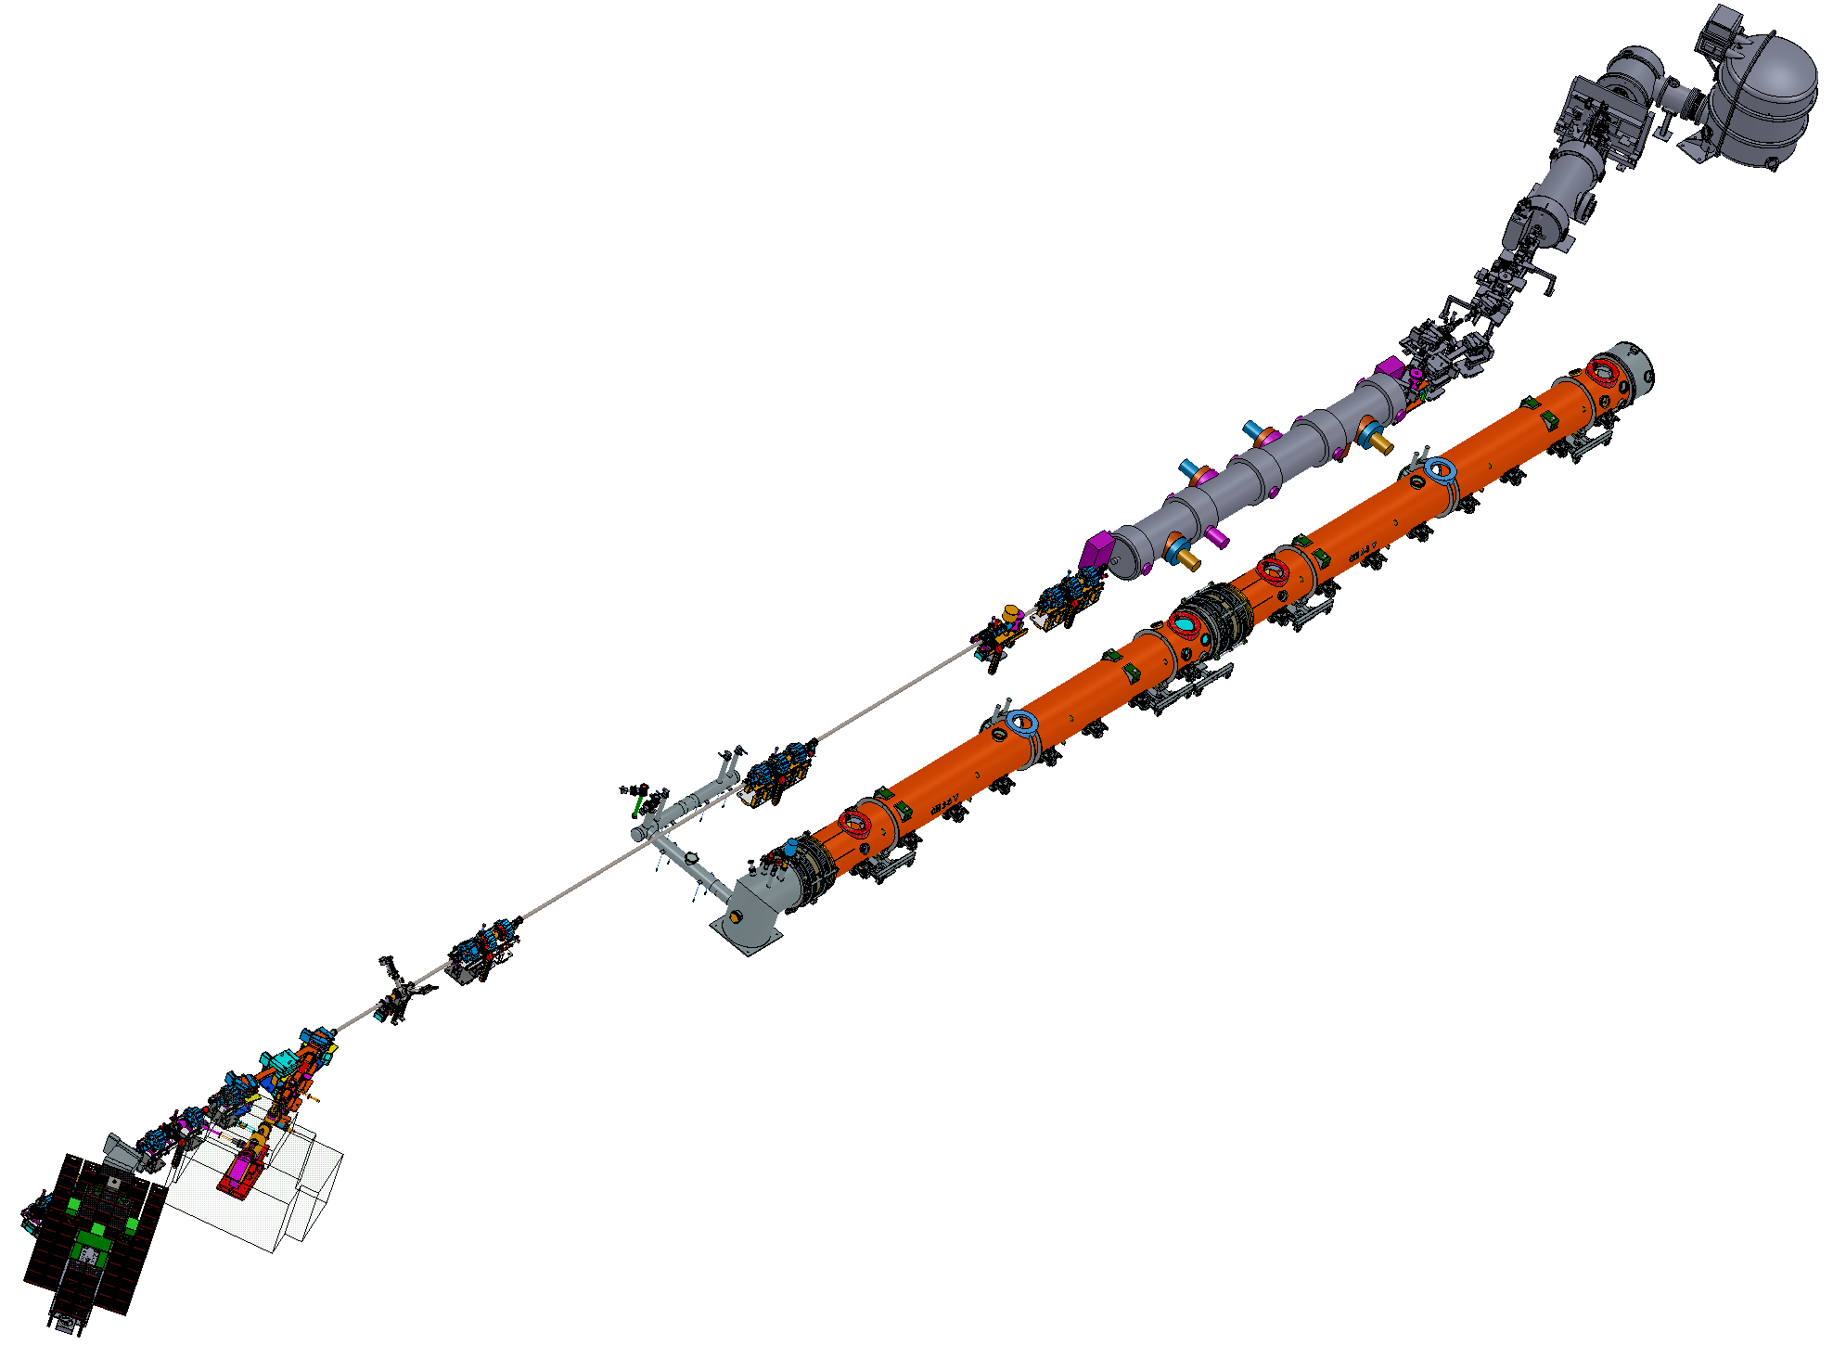
ISOTOPE REVIEW:
DESIGN, LAYOUT AND INSTALLATION
09-26-2019 JFG
Notes:
Blue Interior Page Design 1

Slide 2
TOPICS
LERF 1F & 2F REGION MODIFICATIONS
EXPERIMENT SHIELDING HUTCH
RADIATOR/TARGET
WINDOW THERMAL ANALYSIS
RADIATOR/TARGET ANALYSIS
Notes:
Blue Interior Page Design 1

Slide 3
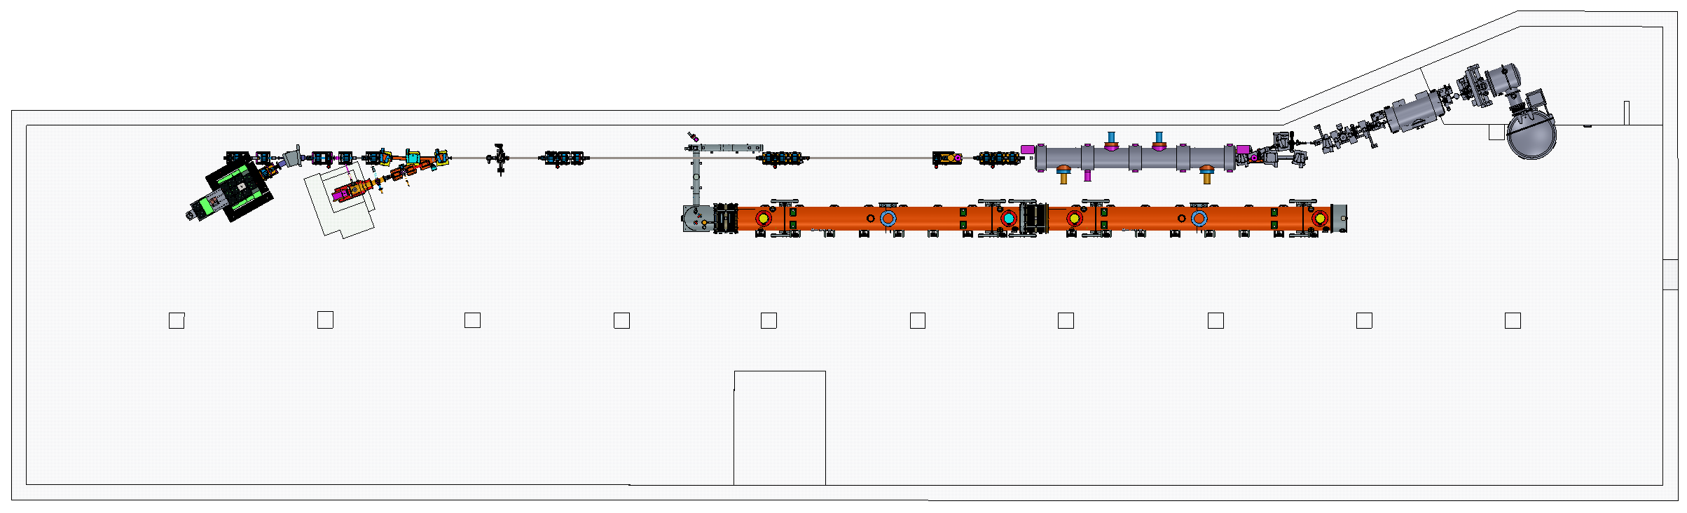
LERF 1F & 2F MODIFICATIONS
ADDED THREE SETS OF QUAD TRIPLETS
ADDED DIPOLE AND 1X LINE
ADDED VIEWER & “HARP” CHAMBER
ADDED DP AND FAST VALVE GIRDER
Notes:
Blue Interior Page Design 1

Slide 4
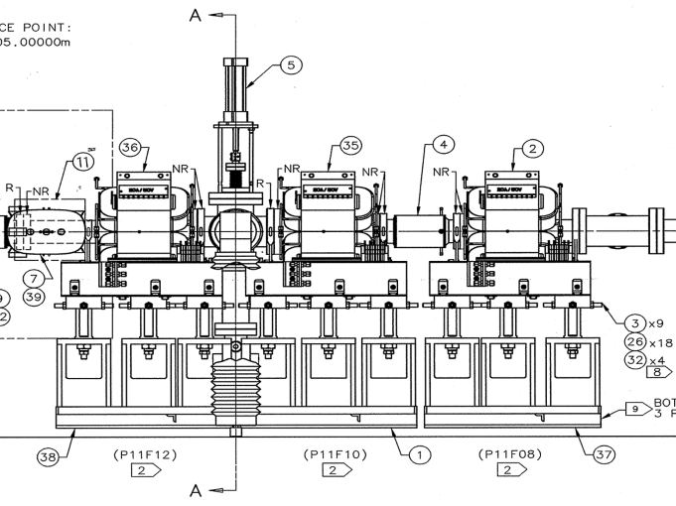
1F TRIPLETS
H&V CORRECTORS
YAG VIEWER & ION PUMP
BPM
QUADS
Notes:
Blue Interior Page Design 1

Slide 5
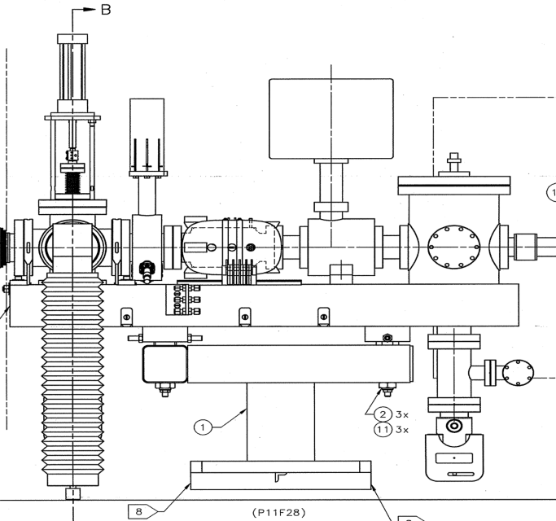
1F DP & FAST VALVE
YAG VIEWER
CURRENT CAVITY
FAST VALVE
DP STATION
Notes:
Blue Interior Page Design 1

Slide 6
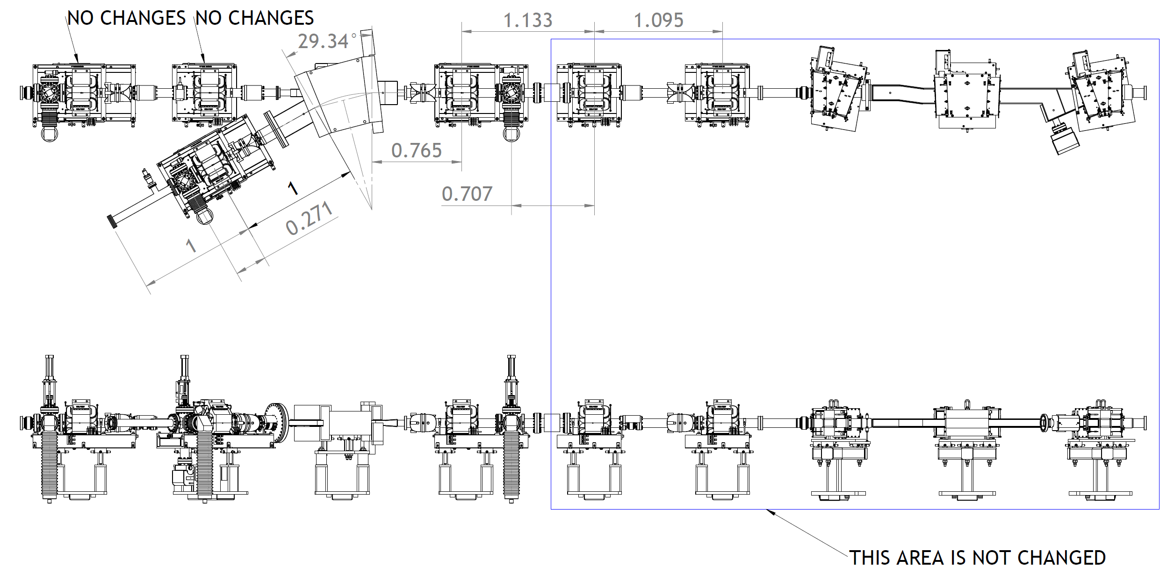
2F & 1X REGION
DQ DIPOLE
QUAD & YAG VIEWER GIRDER
QUAD, YAG VIEWER, BPM & CORRECTOR PAIR GIRDER
Be WINDOW
Notes:
Blue Interior Page Design 1

Slide 7
5kW @ 40 MeV RADIATION SHIELDING REQUIREMENTS
13” OF STEEL - INTERIOR
8” OF WATER - EXTERIOR
RELATIVE QUICK ACCESS TO TARGET
MAINTAIN RADIATOR BEHIND AS MUCH SHIELDING AS POSSIBLE
Notes:
Blue Interior Page Design 1

Slide 8

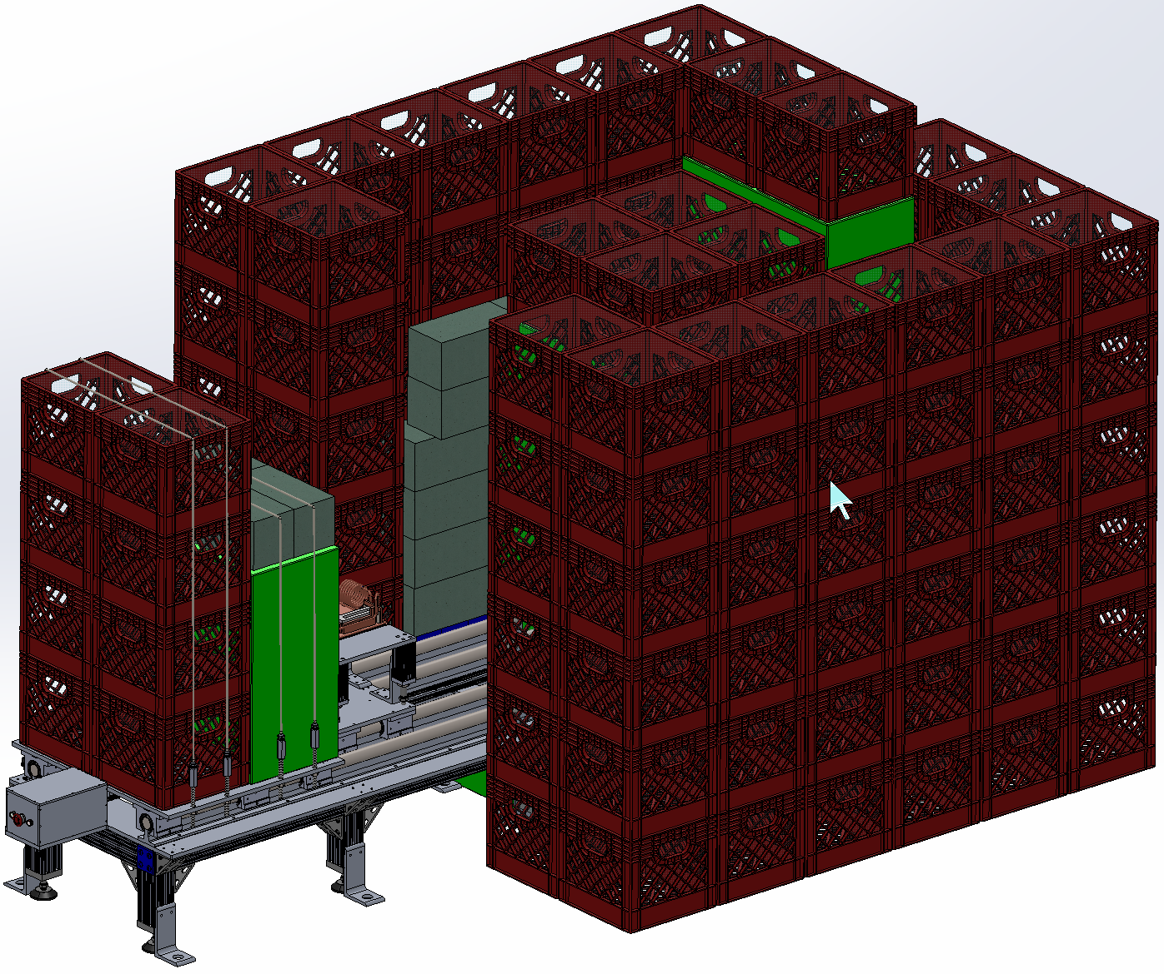
DESIGN
USED (11) S4 SHIELDING BLOCKS, STEEL PLATES, CONCRETE BLOCKS AND WATER FILLED MILK CRATES TO CREATE ≥13” OF STEEL AND 12” OF WATER.
BACK WALL, TARGET AND RADIATOR ON LINEAR RAILS
Notes:
Blue Interior Page Design 2

Slide 9
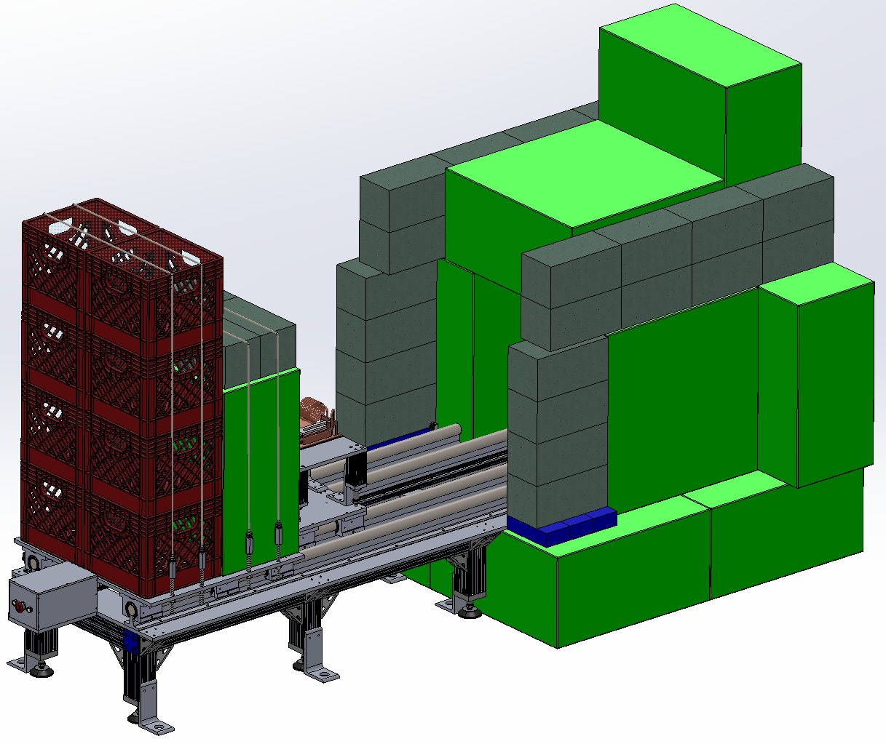
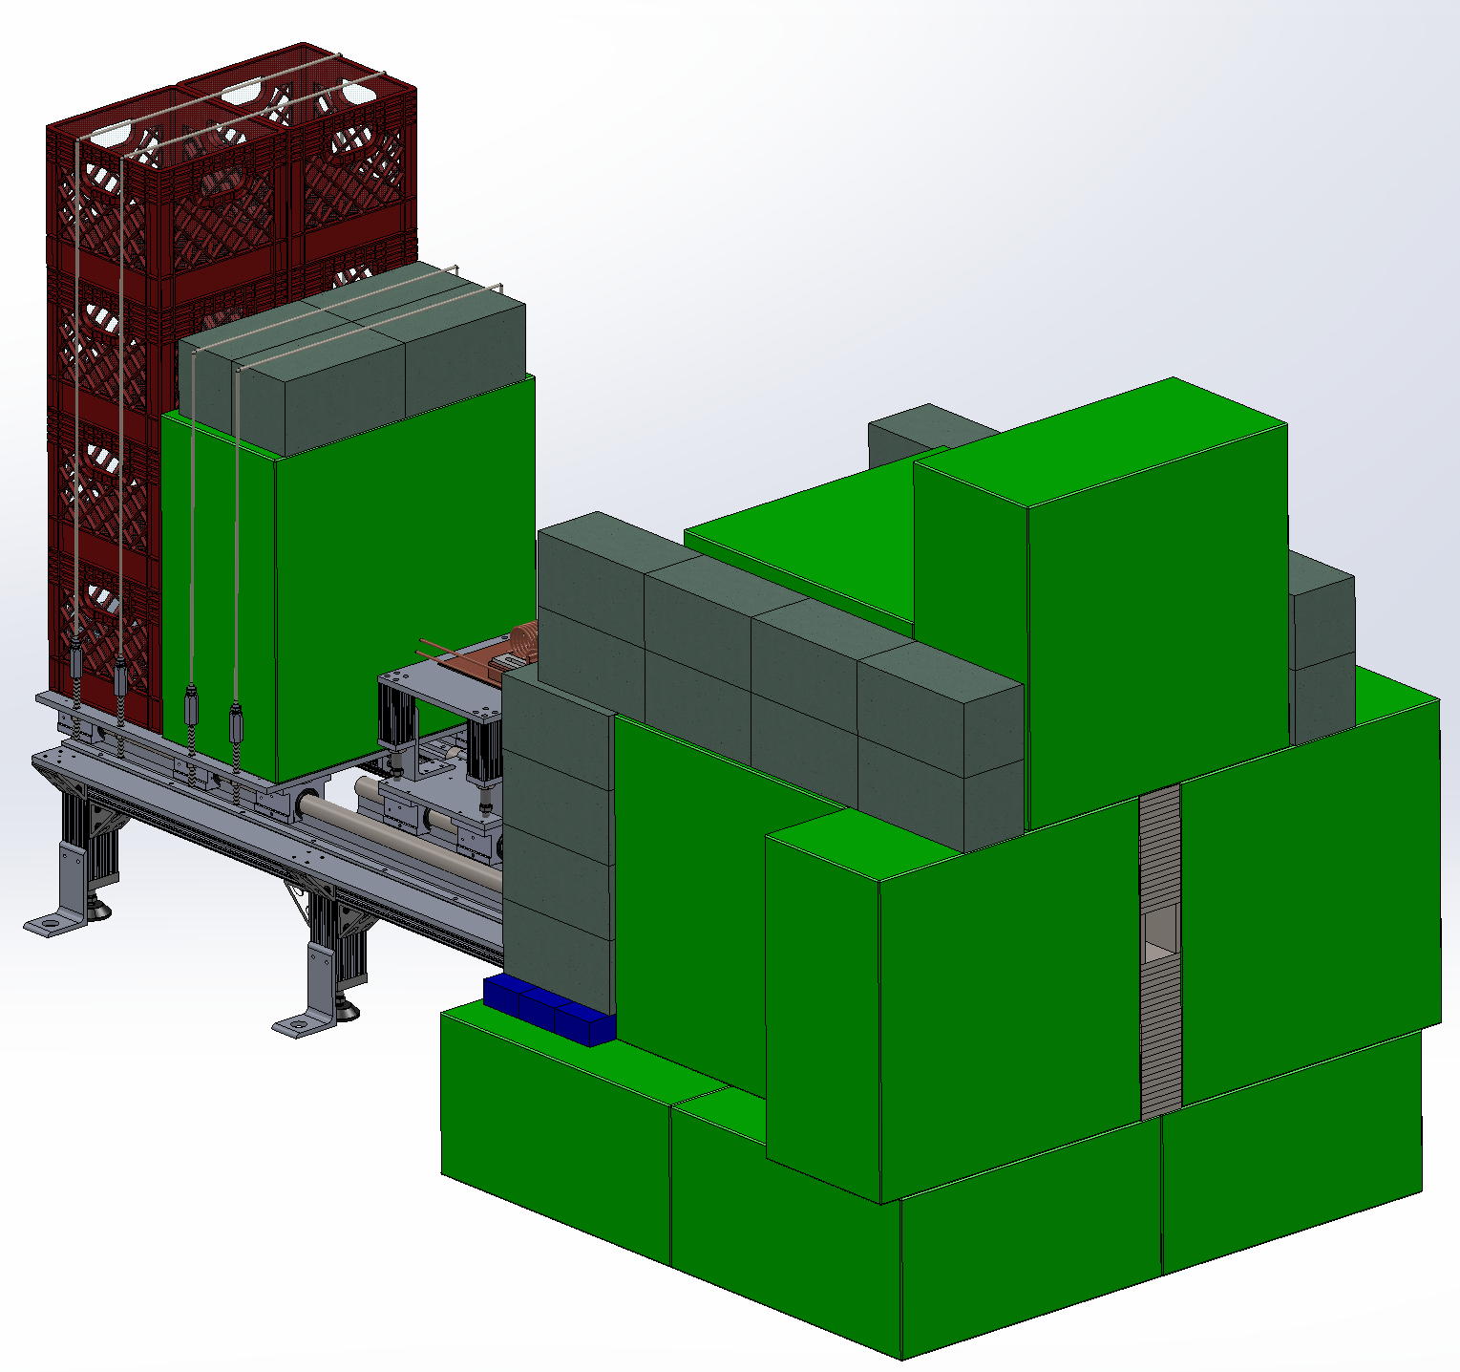
DESIGN CONT.
UPDATED DESIGN REPLACES S4 BLOCK WITH STEEL PLATES
LIGHT GREEN – S4 STEEL BLOCK
DARK GREEN – CONCRETE BLOCK
TAN – STEEL PLATE
GREY – ALUMINUM
RED – WATER FILLED PLASTIC CRATE
Notes:
Blue Interior Page Design 2

Slide 10
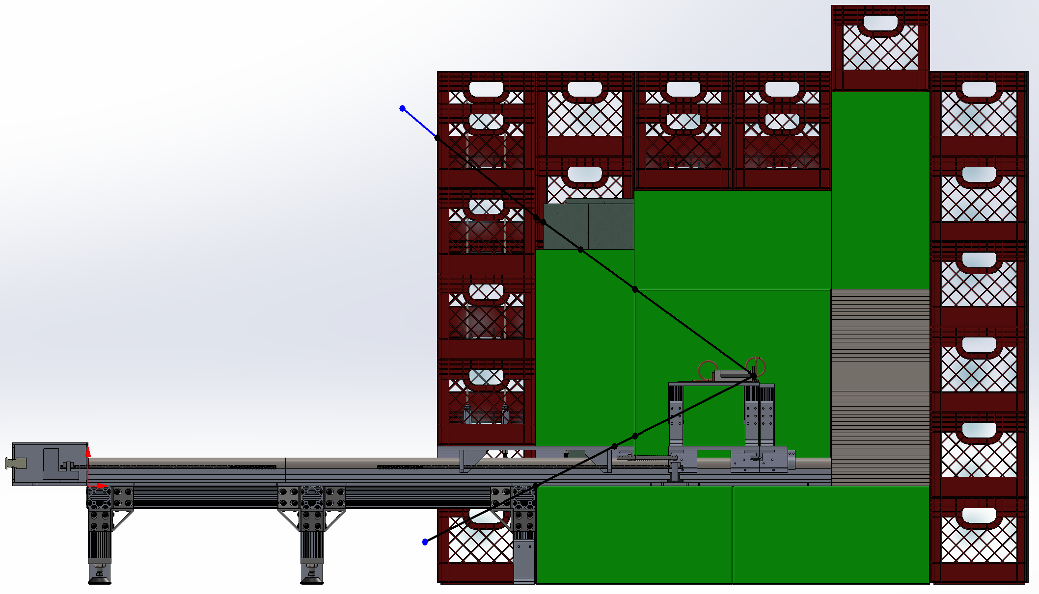
SHIELDING CONCERNS
  A - 8.9” STEEL
  6.1” CONCRETE
  16.7” WATER
  SHIELDING OK
A
  B – 3.1” STEEL
  0” CONCRETE
  0” WATER
B
Notes:
Blue Interior Page Design 2

Slide 11
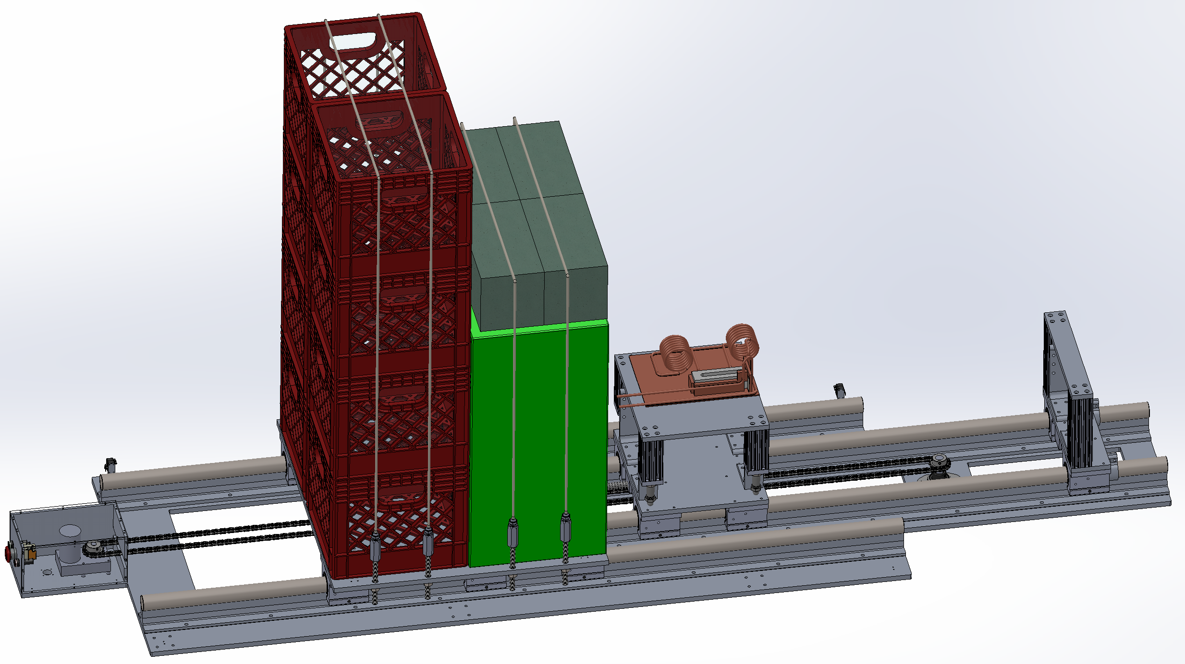
SLIDE ASSEMBLY
DOUBLED IN/OUT LIMIT SWITCHES
RADIATOR SLIDE
MOTOR DRIVE
TARGET SLIDE
SHIELDING SLIDE
E-STOP + IN/OUT LIGHTS
SHIELDING TIE DOWN
¼” WIRE ROPE W/ TENSIONER
Notes:
Blue Interior Page Design 2

Slide 12
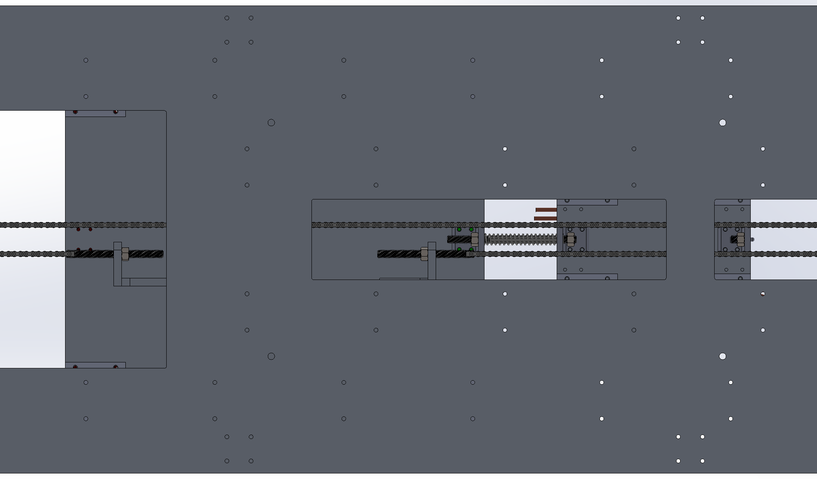
SLIDE ASSEMBLY
SPRING/SHAFT
ALLOWS TARGET ASSEMBLY TO RETRACT W/ SHIELDING
AND PRESSES TARGET ASSEMBLY TO RADIATOR ASSEMBLY WHEN INSERTED
CHAIN TENSIONER
SPRING PLUNGER
KEEPS RADIATOR ASSEMBLY FROM RETRACTING WITH TARGET ASSEMBLY
Notes:
Blue Interior Page Design 2

Slide 13
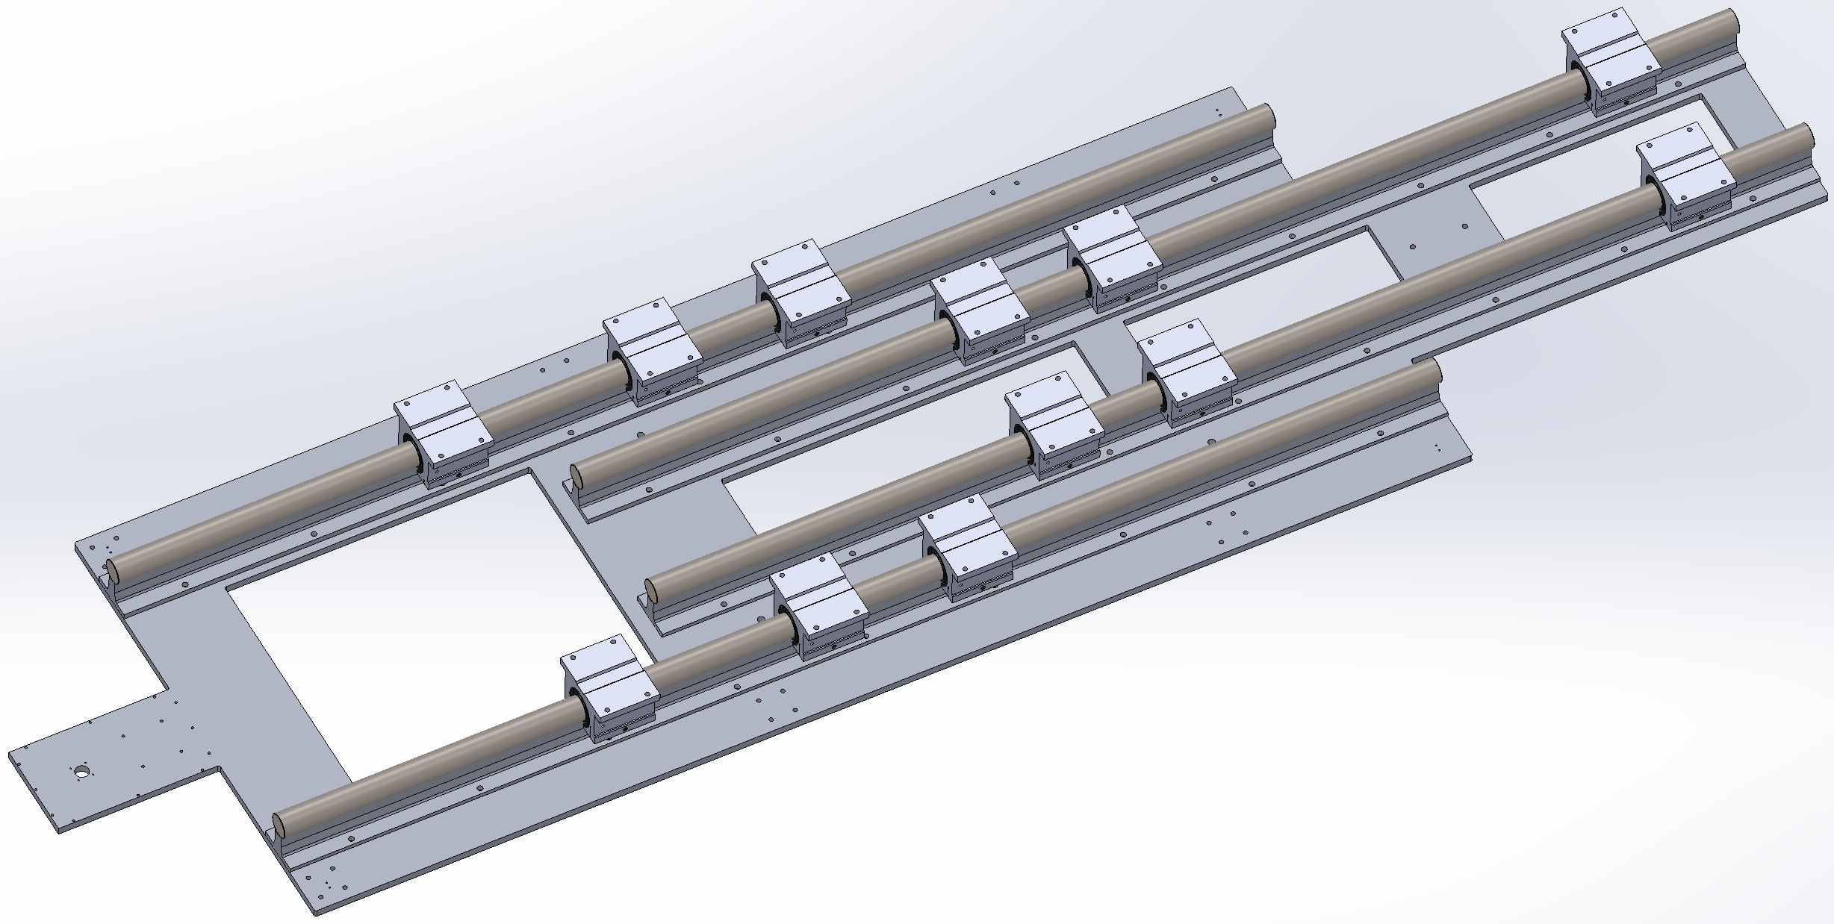
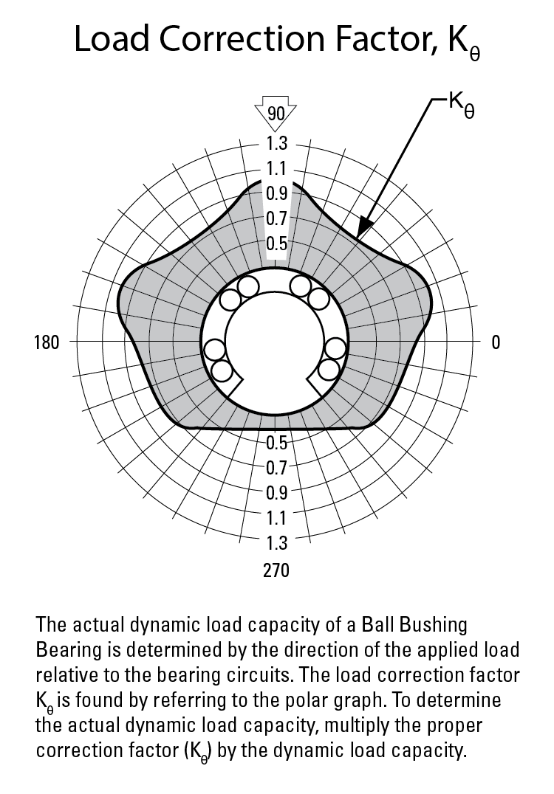
LINEAR SLIDE ASSEMBLY
1.5” RAILS
SSUPBO-24
BEARING DYNAMIC LOAD CAPACITY – 3880 lbs.
COEFF. STATIC FRICTION - 0.001 to 0.004
SHIELDING LOAD ~ 3000 lbs.
FORCE TO MOVE SHIELDING (0.004) ~ 12 lbs.
~LOAD PER BEARING (6 BEARINGS) – 500 lbs. EA.
Notes:
Blue Interior Page Design 2

Slide 14
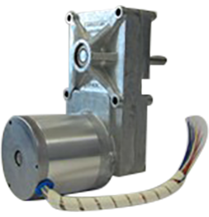
Slide GEARED motor
MOTOR LOAD WHILE MOVING
SHIELDING SLIDE (~3000 lbs.) – 12 lbs.
TARGET SLIDE (~30 lbs.) – 0.12 lbs.
~12 lbs. TOTAL OR 10.8 in-lbs.
MOTOR LOAD AT FULL INSERTION
SHIELDING SLIDE (~3000 lbs.) – 12 lbs.
TARGET SLIDE (~30 lbs.) – 0.12 lbs.
SPRING (24.31 lbs./in)@1/2 in – 12 lbs.
SPRING PLUNGER – 9 lbs.
~33 lbs. TOTAL or 29.7 in-lbs.
MOTOR RATED AT 200 in-lbs.
Notes:
Blue Interior Page Design 2

Slide 15
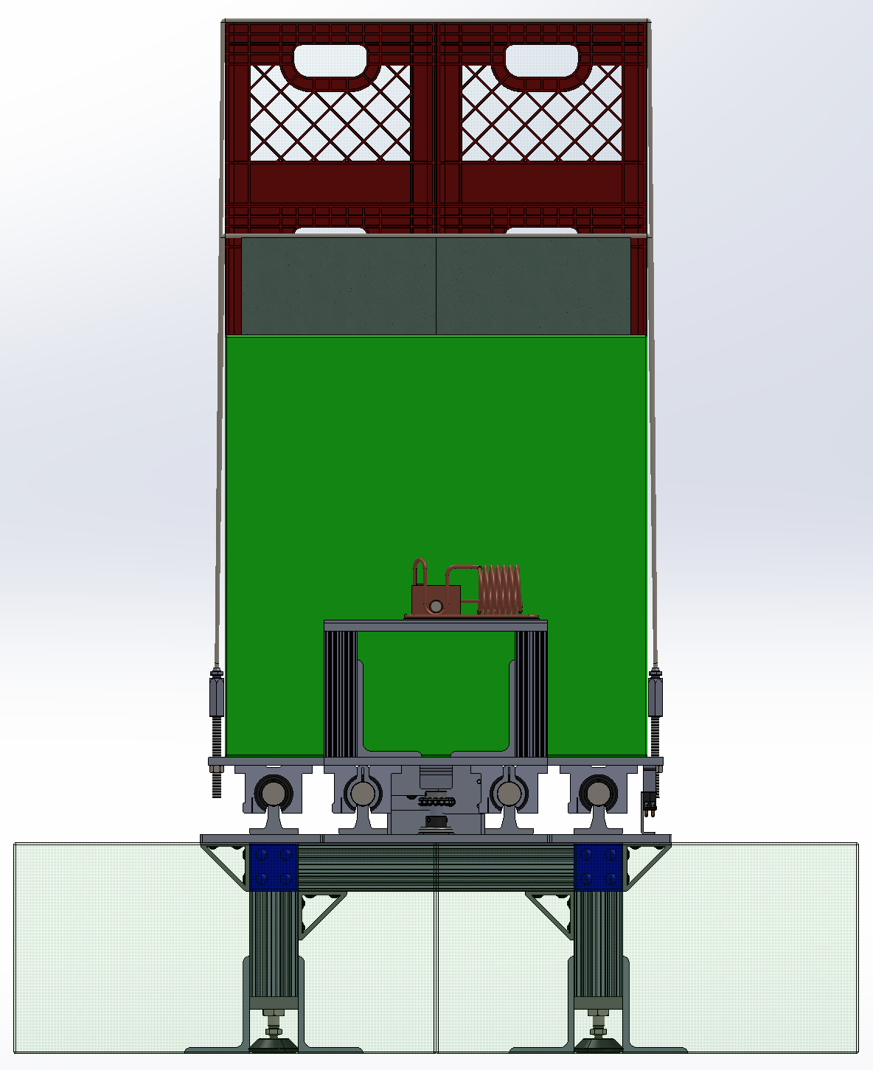
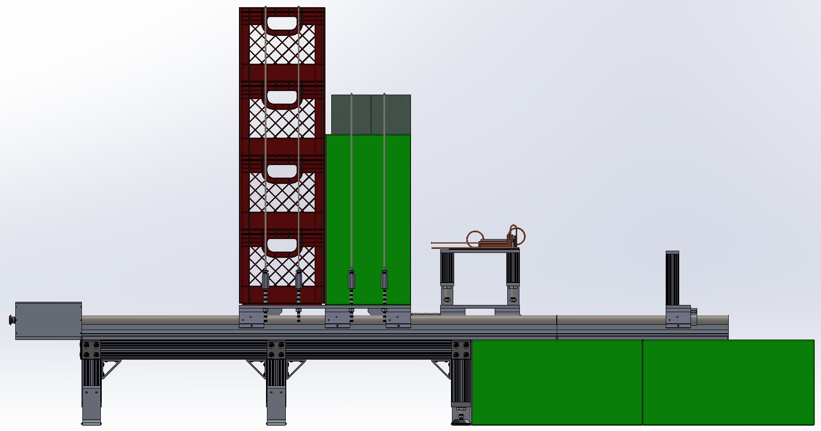
ALUMINUM TOP PLATE ANALYSIS
PLACING THE SHIELDING LOAD CENTERED ON THE PLATE
Maximum Stress
 |  | ½” THICK Aluminum plate
y(in) | DISTANCE FROM AXIS | .25
F(lbs.) | LOAD | 3000
L(in) | SPAN LENGTH | 20
I(in^4) | MOMENT OF INERTIA | .208
E(psi) | MODULUS OF ELASTICITY | 10000000
Y(psi) | YIELD STRENGTH | 40000
Maximum Deflection
Maximum Stress = 18029 psi
Maximum Deflection = 0.24 in
Safety Factor = 2.2
IN REALITY THE S4 BLOCK (& SOME OF THE WATER) SPANS THE PLATE SUPPORTS AND HAS LITTLE CONTRIBUTION TO THE ANALYSIS DECREASING THE STRESS BY 10x
Notes:
Blue Interior Page Design 2

Slide 16
SUPPORT STAND ANALYSIS
PLACING HALF SHIELDING LOAD CENTERED 0N THE 8020 25” SPAN
Maximum Stress
 |  | 8020 – 3030 PROFILE
y(in) | DISTANCE FROM AXIS | 1.5
F(lbs.) | LOAD | 1500
L(in) | SPAN LENGTH | 25
I(in^4) | MOMENT OF INERTIA | 3.4133
E(psi) | MODULUS OF ELASTICITY | 10200000
Y(psi) | YIELD STRENGTH | 35000
Maximum Deflection
Maximum Stress = 4120 psi
Maximum Deflection = 0.014 in
Safety Factor = 8.5
300 lbs. Lateral load on vertical post
Maximum Stress = 659/6 psi
Safety Factor = 53*6
Notes:
Blue Interior Page Design 2

Slide 17
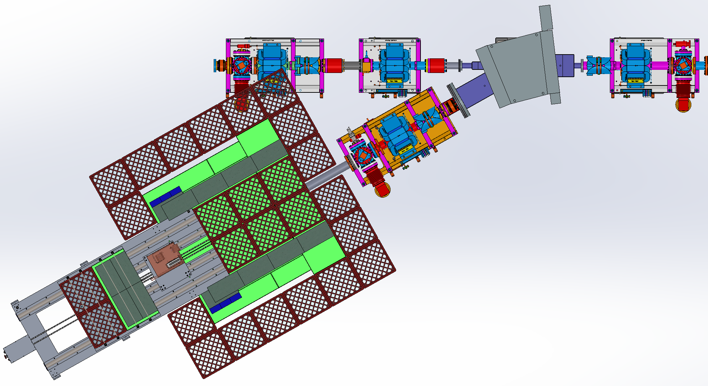
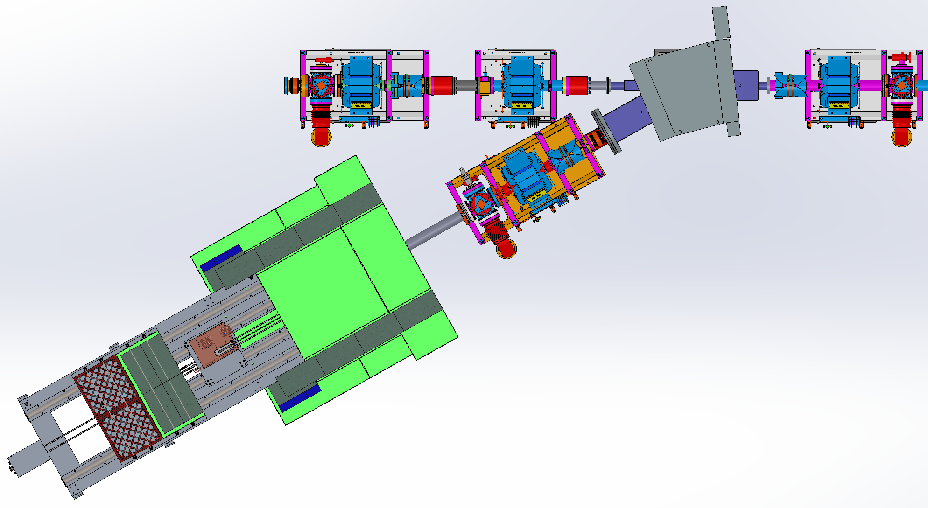
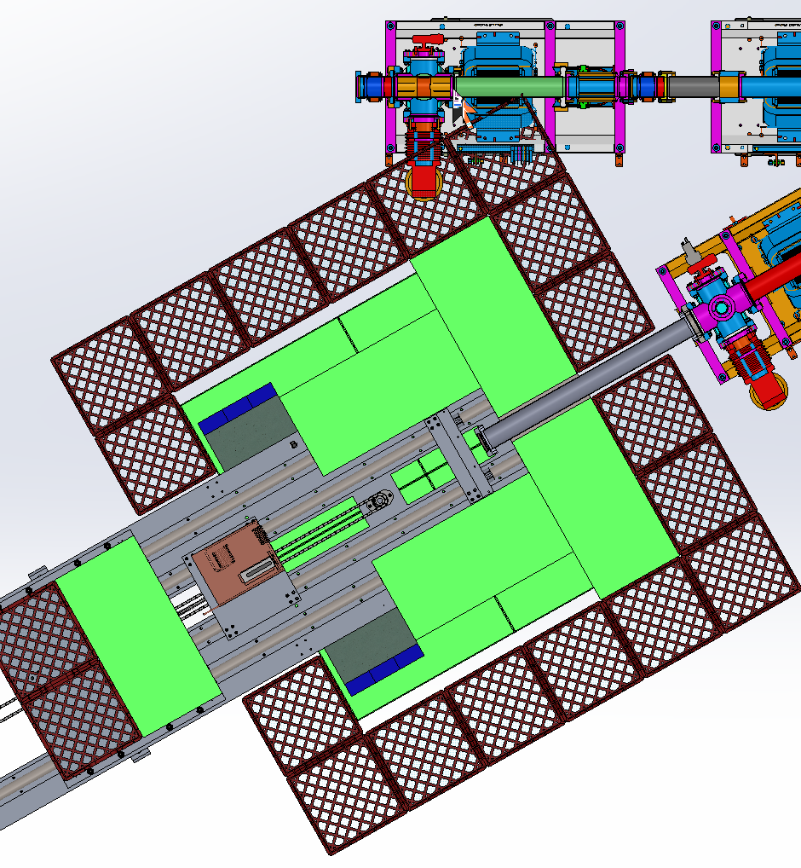
2F
THESE SETS OF WATER CRATES WILL NEED TO BE REPLACED
INSIDE FLANGE FACE IS 2-1/2” FROM S4 BLOCK
Notes:
Blue Interior Page Design 2

Slide 18
SHIELDING DESIGN REVIEWED
MECHANICAL DESIGN REVIEWED BY TIM WHITLATCH 04/30/2019
SEISMIC CONCERNS REVIEWED BY THOMAS RENZO 09/05/2019
Hi Joe,
I looked over the slides.
Based on the previous review and findings, my comments are in red:
Charge: Review the engineering assumptions and calculations for the Isotope Shielding enclosure, including the mechanism for withdrawing and inserting the target and the radiator.
The Thompson rail system provides a good base for the movement of the target and movable shielding. We discussed the alignment of the 4 rails and accuracy needed. Joe will verify the requirements to see if he can reduce to using 1 set of rails instead of 2 sets. The 80/20 supports for the target and movable shielding should be adequate. Joe will look at the lateral stability using a 10% lateral load and add stiffeners where required. It looks like you are staying with the 2 sets of rails which is ok. Just ensure alignment is good. Looks like adequate lateral stability has been added.
The overall support structure (1/2" steel plate) was analyzed using Solidworks FEA module. The entire static shielding weighs 7500 lbs. All the stresses and deflections are very low with large safety factors. Joe will perform some simple hand calculations to corroborate the FEA results. Joe will come up with a method of securing the shielding (straps or plates). The 1/2" steel plate is now gone from the design. The 1/2" aluminum plate spans the pillow block bushings. Hand calculations performed and straps added. You show the deflection of the aluminum plate is .24 inches. This is based on the total load at the center which is very conservative. If it actually deflected 1/4 inch there may be problems. Since the concrete blocks span the rails this will be no problem.
The chain drive system and crank handle appears adequate as the coefficient of friction for the Thompson rails system is very low. 3000 lb total weight with a COF of .004 yields 12 lbs. The chain is rated for 195 lbs. Stops will be put in place to ensure the target is in correct position when installed. Details of the attachment to the chain are to be worked out. The chosen motor provides 200 in-lb torque. The stated require torque with this low COF is 29.7 in-lbs. This is based on a 1.8 inch diam, gear for the chain. Looks like the Details have been worked out.
The neutron shielding consists of water jugs placed in stack-able crates. This appears to be adequate for system. Discussions of using poly beads in containers was discussed and will be looked at. Supports for the bags would be required. Joe is sticking with the water bottles and RADCON ok with it.
Cable managers of some sort will be added for instrumentation (temp sensors) wiring. Joe is also looking at using an insertable camera to look at things remotely. Not sure if this was implemented. Not subject to my review
The installation work will be done by the Engineering Installation group which has much experience with this sort of thing. They will use a forklift to place the shielding blocks. Ok
It is assumed that the shielding requirements have been ordained by RadCon. Yes
The cooling of the tungsten radiator is verified elsewhere. Ok
From my standpoint, the design assumptions and calculations are good.
Cheers,
Tim
Joe,
Looks good to me. No frame needed.
Tom
Notes:
Blue Interior Page Design 1

Slide 19
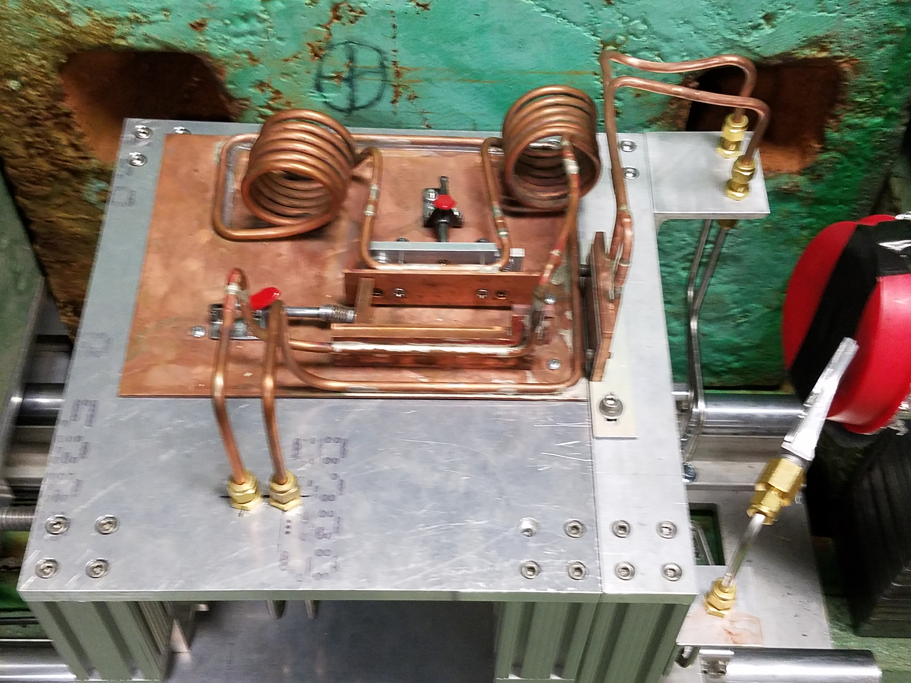
TARGET/RADIATOR
LATCH
TARGET LOCATION
RADIATOR
RADIATOR COOLING
TARGET COOLING
AIR KNIFE – OZONE PRODUCTION MITIGATION AND SUPPLEMENTAL WINDOW COOLING
Notes:
Blue Interior Page Design 1

Slide 20
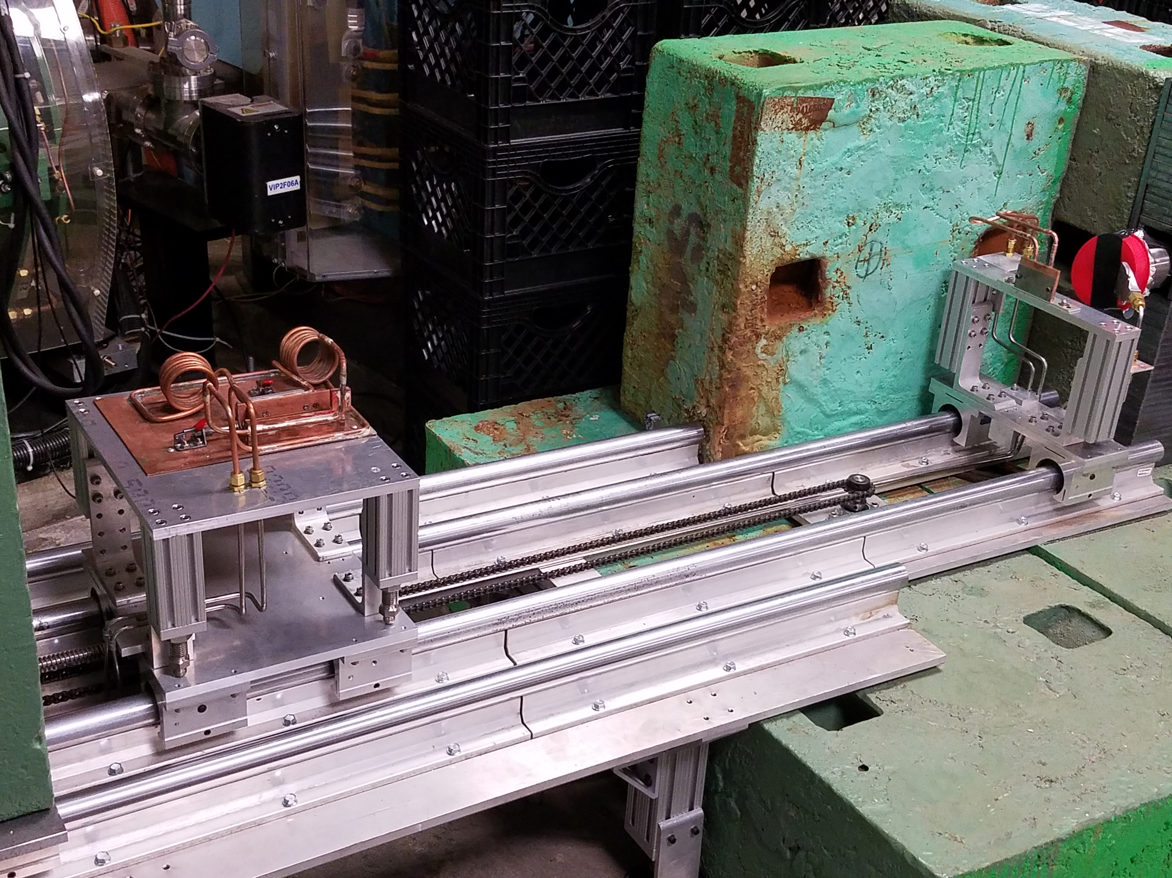
TARGET/RADIATOR ALARA
TARGET RETRACTS FOR RETRIEVAL
RADIATOR STAYS WITH SHIELDING
Notes:
Blue Interior Page Design 1

Slide 21
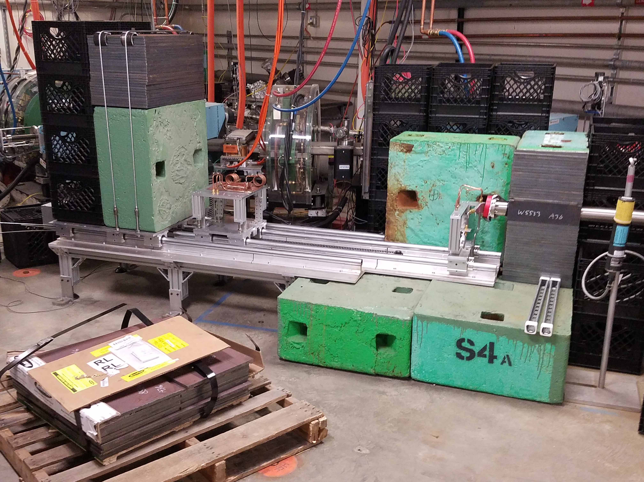
SHIELDING - CURRENT STATE (09/24/2019)
HALF OF THE S4 BLOCK IN PLACE
AIR @ COOLING LINES RAN TO OUTSIDE OF SHIELDING
SLIDE, TARGET & RADIATOR ALIGNED
HAVE ALL THE MATERIALS NEEDED TO COMPLETE THE SHIELDING
Notes:
Blue Interior Page Design 1

Slide 22
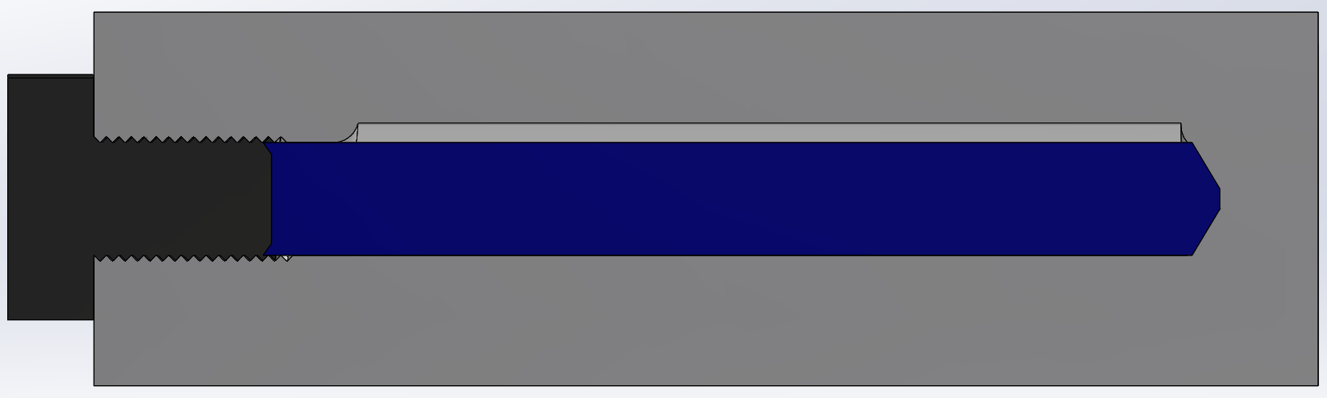
TARGET
GRAPHITE PLUG
AIR GAP
GALLIUM
HBN
Notes:
Blue Interior Page Design 1

Slide 23
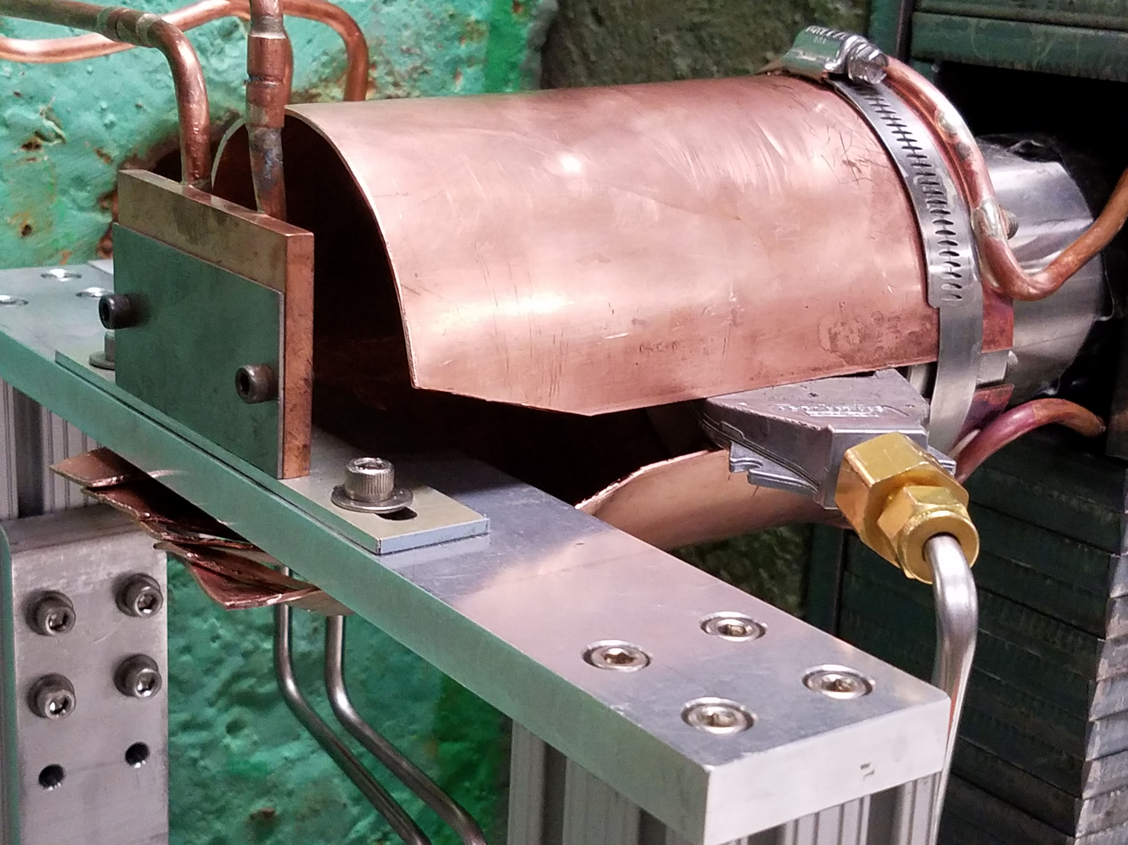
OZONE MITIGATION
RADIATOR
WINDOW FLANGE COOLING
NITROGEN “AIR KNIFE”
SHROUD
“AIR KNIFE” USED TO FLOW 22.5 CFM OF NITROGEN GAS IN THE VOLUME BETWEEN THE EXIT WINDOW AND THE RADIATOR PLATE
ORIFICE PLATES INSTALLED IN VAULT TO PREVENT ODH WITH ALL NITROGEN LINES OPEN
OZONE LEVELS CAN BE MONITORED IN THE RETURN AIR PLENUM LOCATED OUTSIDE THE VAULT
Notes:
Blue Interior Page Design 1

Slide 24
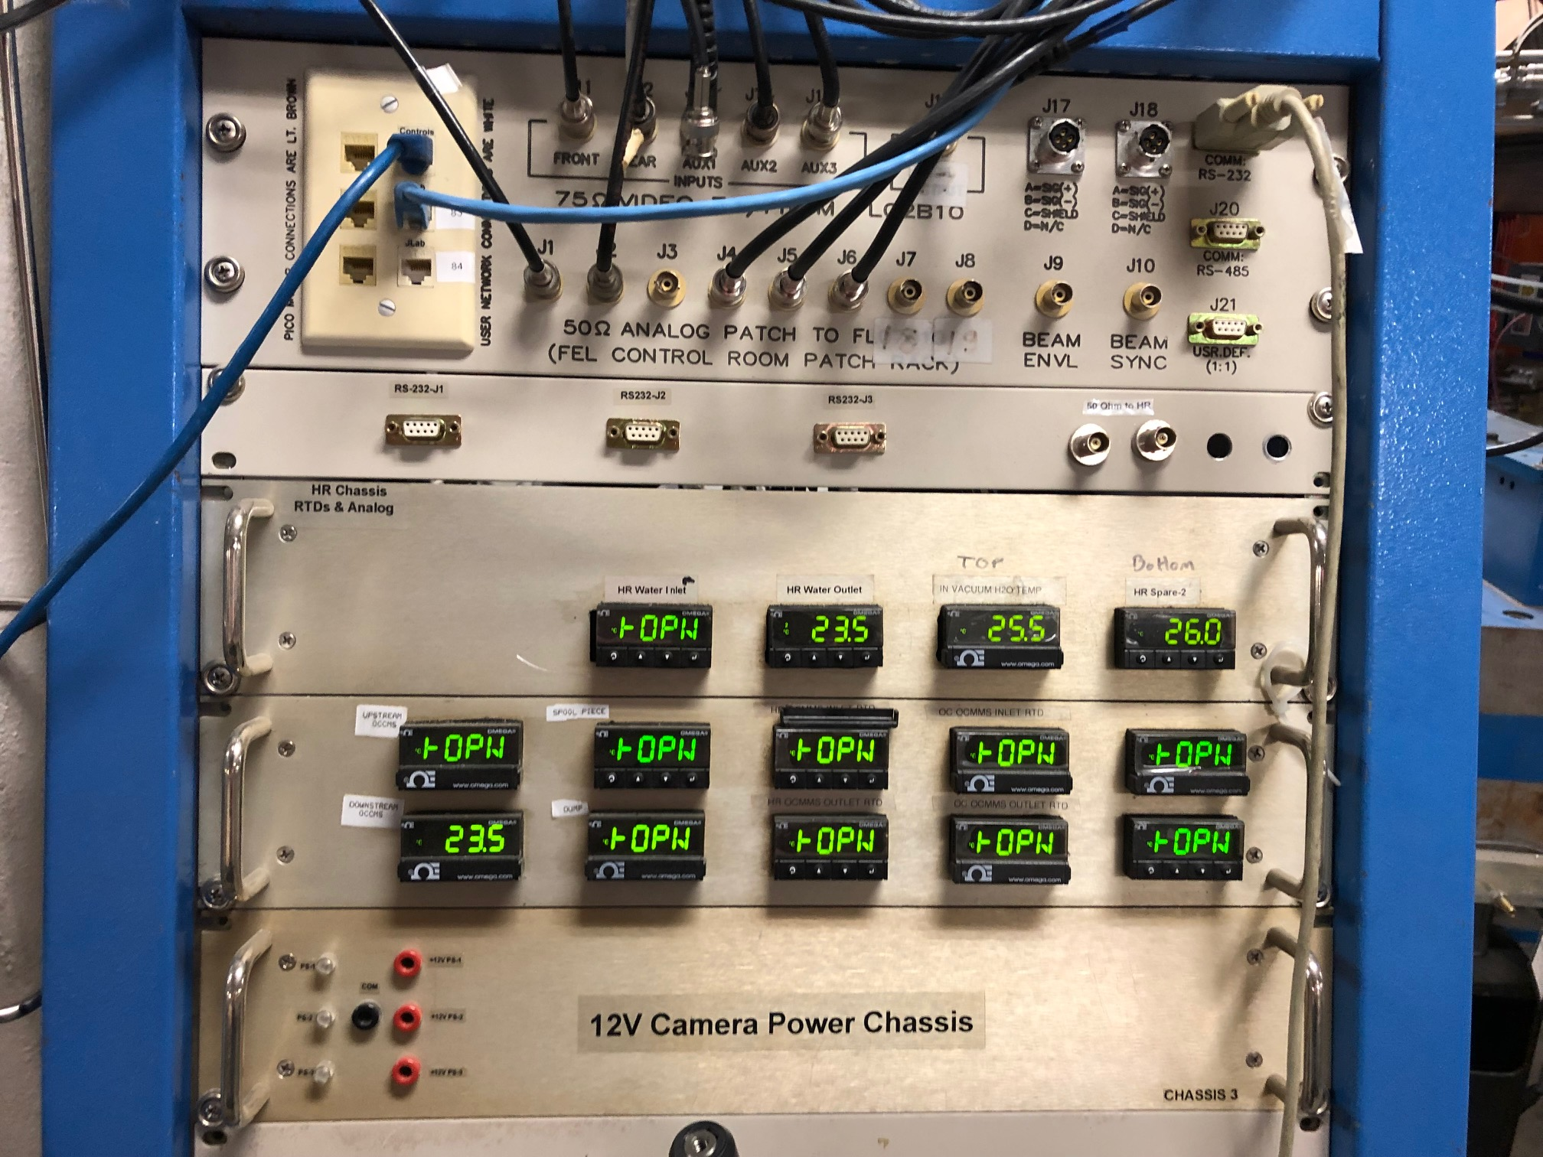
instrumentation
INSTRUMENTATION
TYPE | LOCATION
TC | COMMON COOLING INLET
TC | RADIATOR COOLING OUTLET
TC | TARGET COOLING OUTLET
TC | WINDOW COOLING OUTLET
TC | HBN BACK
TC | HBN SIDE
TC | RADIATOR PLATE
RTD | HBN BACK
RTD | HBN SIDE
PADDLE WHEEL | RADIATOR COOLING OUTLET
PADDLE WHEEL | TARGET COOLING OUTLET
PADDLE WHEEL | WINDOW COOLING OUTLET
FLOW SWITCH | NITROGEN FLOW
SOLENOID | NITROGEN FLOW
EXISTING 14 CHANNEL TC/RTD CONTROLLERS
Notes:
Blue Interior Page Design 1

Slide 25
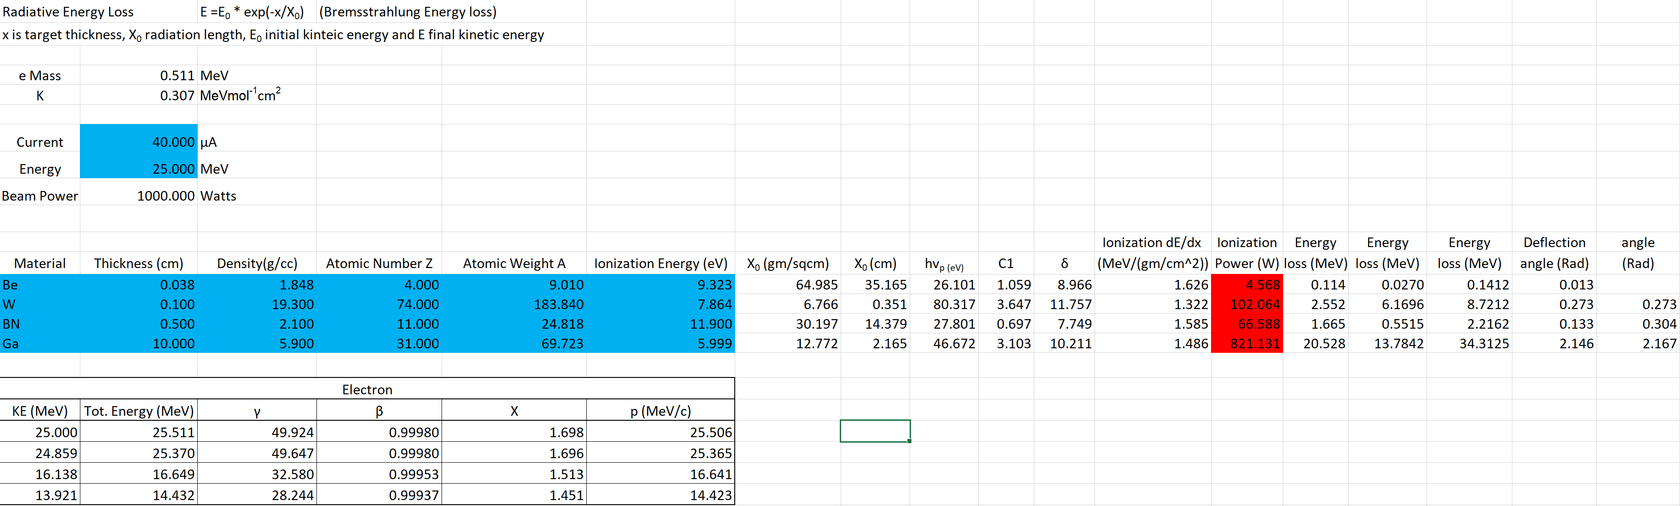
BEAM ENERGY LOSS @ 25MEV-40μA
NOT ALL BEAM ENERGY LOSS CONTRIBUTES TO THERMAL HEATING
BERYLLIUM – 4.6 W
TUNGSTEN – 102.1 W
BORON NITRITE – 66.6 W
GALLIUM – 821.1 W
Notes:
Blue Interior Page Design 1

Slide 26
BERYLLIUM WINDOW SPECIFICATIONS
PS-200 Materion (materion.com)
304L 4-1/2 CF Flange
Electron beam welded Beryllium window
Window has a 2.5” aperture and is 0.015” thick
Pressure tested to 19 psi
Beryllium max stress: 75,000 psi
Beryllium melting point 1287 ºC
Notes:
Blue Interior Page Design 1

Slide 27
ANALYSIS INPUTS
OD constrained and temperature fixed at 25ºC
14.7 PSI load applied to the back of the window
2.5 mm RADIUS BEAM CENTERED ON WINDOW @ 4.6 W
Notes:
Blue Interior Page Design 1

Slide 28
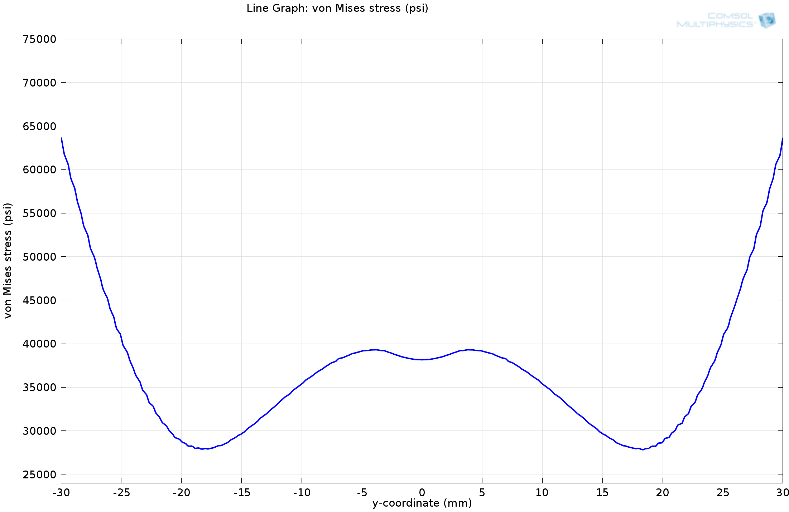
WINDOW STRESS
Notes:
Blue Interior Page Design 1

Slide 29
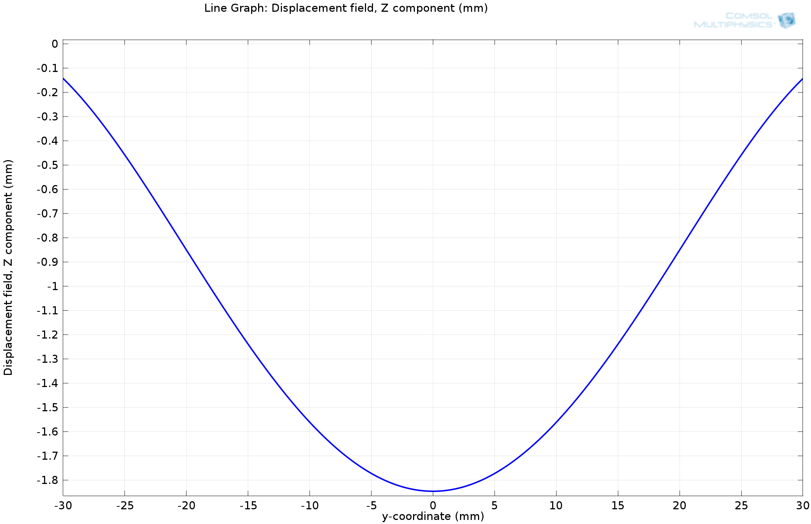
WINDOW DEFLECTION
Notes:
Blue Interior Page Design 1

Slide 30
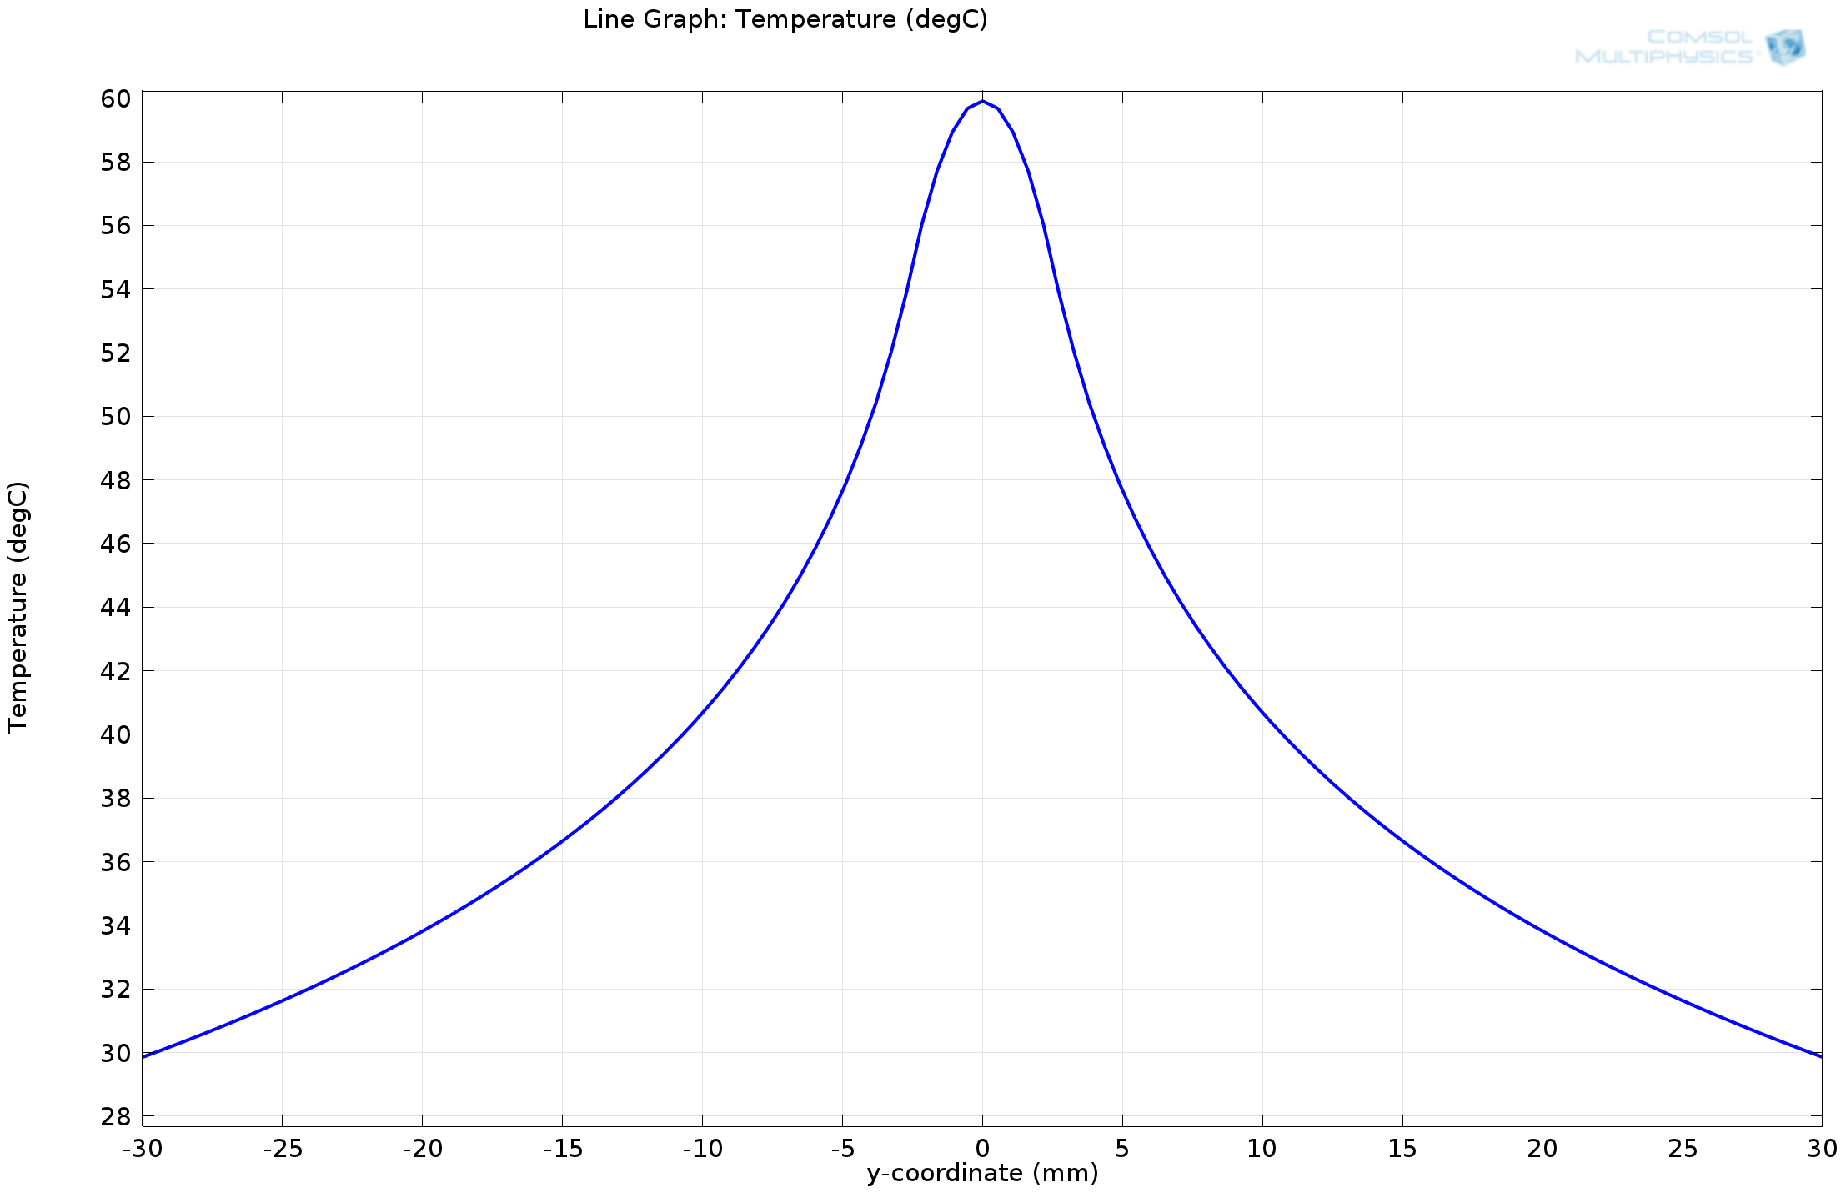
WINDOW TEMPERATURE
Notes:
Blue Interior Page Design 1

Slide 31
SIMPLIFIED EXPERIMENTAL MODEL
FRONT COOLING PLATE
HBN HOLDER FILLED WITH GALLIUM
BASE PLATE
ALUMINUM SUPPORTS
OUTLET
TUNGSTEN
INLET
SIDE COOLING PLATE
Notes:
Blue Interior Page Design 1

Slide 32
SIMPLIFIED EXPERIMENTAL MODEL
[2015 ANALYSIS]
CONVECTION AND RADIATIVE COOLING TERMS SUPPRESSED
INLET: 1 GPM @ 31.85ºC
NO THERMAL RESISTANCE APPLIED AT BOUNDARIES
500W APPLIED TO ENTIRE TUNGSTEN VOLUME [102 W]
500W APPLIED TO ENTIRE GALLIUM VOLUME [821 W]
Notes:
Blue Interior Page Design 1

Slide 33
THERMAL RESULTS
Notes:
Blue Interior Page Design 1

Slide 34
THERMAL RESULTS
Notes:
Blue Interior Page Design 1

Slide 35
THERMAL RESULTS
Notes:
Blue Interior Page Design 1

