Slide 1
Use of Fun4All for GEANT4 simulation needs

Slide 2
G4 program flow within Fun4All
Modular: Each detector is its own entity providing the flexibility needed for complex setups
Fun4AllServer
Geant4
Event generator (input file, single particle, pythia8)
PHG4Reco
Initializes Geant4 before detectors are added
Node tree
The processing is done by chaining up modules. At every step the state of the Node Tree can be saved
Interface Detector 1
Construct() → Geometry
Stepping Action (Hit extraction)
Generic detectors like boxes, cylinders, cones exist and can be configured on a macro level
Interface Detector 2
Construct() → Geometry
Stepping Action (Hit extraction)
Hit Converter
File
Setup
calls
Reconstruction code
dataflow

Slide 3
Hit Converter
Fun4All Module with access to all available input needed for reconstruction (hits, geometry, parameters,…)
Needs to be maintained by Fun4All side
Fun4All is capable of snapshots – input can be file or memory content of G4 simulation
Output determined by needs of subsequent reconstruction code/framework
Needs to be implemented and maintained by that framework
Frameworks need the freedom to change their data model if needed but converters provide the long term interface since they can be adjusted

Slide 4
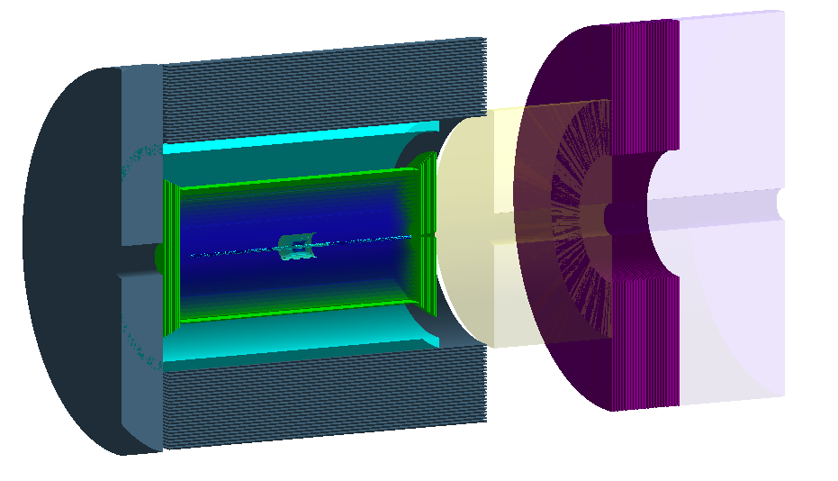
JLEIC in Fun4All
Reverse engineered from g4e
https://gitlab.com/jlab-eic/g4e/
(as of 2 months ago)
Porting JLEIC looks straightforward
Implemented some changes for GEANT4 handling
Hierarchical volumes now supported
Color setting for generic detectors
Code kept in separate area so far use of generic detectors is mostly sufficient to build jleic:
https://github.com/pinkenburg/coresoftware/tree/add-jleic
simulation/g4simulation/g4jleic

Slide 5
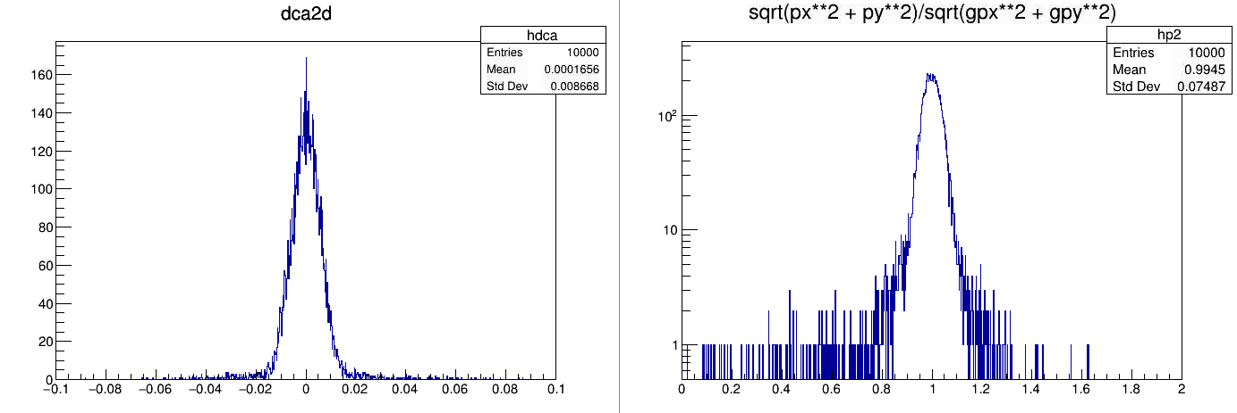
Additional Benefit: Fast Momentum Resolution Estimate of JLEIC inner tracking
Quick test of a 6 layer silicon pixel detector, 50um thick followed by 12 layers of 10μm silicon with 20μm granularity using 10 GeV/c electrons and a 1.5T field

Slide 6
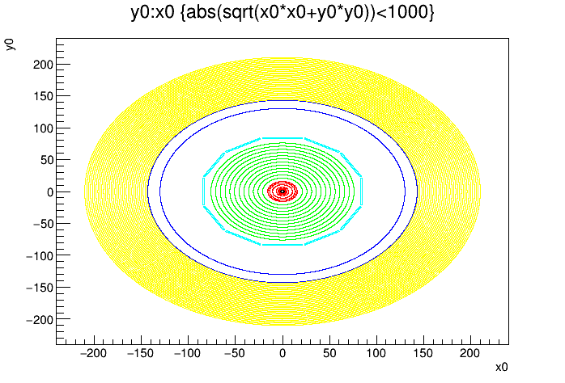
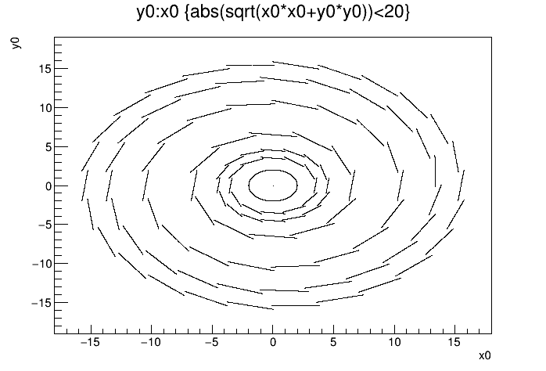
Additional Benefit: Geantino Scans to verify Geometry
Barrel HCal
Beam Pipe
Magnet
DIRC
CTD
VTX
Geantinos are propagated to the hits and can be used to verify geometries by simply plotting the entrance/exit hit

Slide 7
Additional Benefit: Truth information propagation and leakage detection
BLACKHOLE (PHCompositeNode)/
G4HIT_BLACKHOLE (IO,PHG4HitContainer) ← terminates tracks and integrates energy
G4TruthInfo (IO,PHG4TruthInfoContainer) ← Truth tree going back to primaries

Slide 8
Summary
Fun4All + G4 provides a modular implementation of detectors
No code shared among detectors → no need for coordination
Only detector construction and stepping action need to be implemented
Command line by cling and root macros which are more powerful than the GEANT4 commands
Painless adding of new detectors into existing setups (with overlap check)
Large collection of reusable detectors, including EIC specific ones
Interface to ROOT for use of histograms, ntuples, TF’s,… if needed
Hit Converter would be needed to interface to other reconstruction frameworks
Singularity container allows easy remote setups without rcf account
continuous integration exists
Diversity helps
The NSRL introduced the capability to use ions
Adding JLEIC lead already to some improvements in the Fun4All GEANT4 implementation

